Slide 1
Framework evolution: status and outlook
SuperB Computing R&D Workshop
9-12 March 2010, IUSS, Ferrara, Italy
P. Mato /CERN

Slide 2
Outline
About myself
Introduction
Software components
Programming languages
Software interoperability levels
Level-1 to Level-3
Data Processing Software Frameworks
Possible evolution of Frameworks
Summary

Slide 3
About myself
Former LHCb core software coordination
Architect of the GAUDI framework
Applications Area manager of the Worldwide LHC Computing Grid (WLCG)
Develops and maintains that part of the physics applications software and associated infrastructure that is common among the LHC experiments
Leader of the Software Development for Experiments (SFT) support group in the Physics (PH) Department at CERN
Projects: Geant4, ROOT, GENSER, SPI, CernVM, etc.
Giving support to LHC experiments (+LC Detector studies)

Slide 4
Simplified Software Structure
Applications
Applications are built on top of frameworks and implementing the required algorithms (e.g. simulation, reconstruction, analysis, trigger)
Event
Det Desc.
Calib.
Every experiment has a framework for basic services and various specialized frameworks: event model, detector description, visualization, persistency, interactivity, simulation, calibrarion
Experiment Framework
Simulation
Data Mngmt.
Distrib.
Analysis
Specialized domains that are common among the experiments (e.g. Geant4, COOL, Generators, etc.)
Core Libraries
Core libraries and services that are widely used and provide basic functionality
(e.g. ROOT, HepMC,…)
non-HEP specific
software packages
Many non-HEP libraries widely used (e.g. Xerces, GSL, Boost, etc.)

Slide 5
Software Components
One or more implementations of each component exists for LHC
Foundation Libraries
Basic types
Utility libraries
System isolation libraries
Mathematical Libraries
Special functions
Minimization, Random Numbers
Data Organization
Event Data
Event Metadata (Event collections)
Detector Description
Detector Conditions Data
Data Management Tools
Object Persistency
Data Distribution and Replication
Simulation Toolkits
Event generators
Detector simulation
Statistical Analysis Tools
Histograms, N-tuples
Fitting
Interactivity and User Interfaces
GUI
Scripting
Interactive analysis
Data Visualization and Graphics
Event and Geometry displays
Distributed Applications
Parallel processing
Grid computing

Slide 6
Programming Languages
C++ used almost exclusively by all LHC Experiments
LHC experiments with an initial FORTRAN code base have completed the migration to C++ long time ago
Large common software projects in C++ are in production for many years
ROOT, Geant4, …
FORTRAN still in use mainly by the MC generators
Large developments efforts are being put for the migration to C++ (Pythia8, Herwig++, Sherpa,…)
Java is almost inexistent for LHC
Exception is the ATLAS event display ATLANTIS

Slide 7
Scripting Languages
Scripting has been an essential component in the HEP analysis software for the last decades
PAW macros (kumac) in the FORTRAN era
C++ interpreter (CINT) in the C++ era
Python is widely used by 3 out of 4 LHC experiments
Most of the statistical data analysis and final presentation is done with scripts
Interactive analysis
Rapid prototyping to test new ideas
Scripts are also used to “configure” complex C++ programs developed and used by the experiments
“Simulation” and “Reconstruction” programs with hundreds or thousands of options to configure

Slide 8
Role of Python
Python language is really interesting for two main reasons:
High level programming language
Simple, elegant, easy to learn language
Ideal for rapid prototyping
Used for scientific programming (www.scipy.org)
Framework to “glue” different functionalities
Any two pieces of software can be glued at runtime if they offer a “Python interface”
In principle with PyROOT any C++ class can be easy used from Python

Slide 9
Interoperability an Reuse
The software system of an experiment should allow for interoperability, reuse and enabling independent developments
Level 1 - Application Interfaces/Formats
Level 2 - Software Integrating Elements
Level 3 – Common frameworks

Slide 10
Interoperability Level-1
Application Interfaces and Common Formats

Slide 11
Application Interfaces
Agreement on ‘standard formats’ for input and output data is essential for independent development of different detector concepts
Detector description, configuration data, MC generator data, raw data, reconstructed data, statistical data, etc.
This has been the direction for the ILC software so far (e.g. lcdd, lcio, stdhep, gear,…)
Very successful
Interoperability with different languages (C++, Java)
Unfortunately LHC has been standardizing on other formats/interfaces (e.g. HepMC, GDML, ROOT files, etc.)
Effort has started to increase convergence in this area

Slide 12
Standard Data Formats
It is not sufficient to say that is ‘ROOT’ format or ‘ASCII’ format
You need to agreed on what is the actual data contents
It implies common or standard ‘Event Data Models’
Common Event Data models
Obviously within an experiment the Event model is common
Algorithms can be easily re-used between reconstruction, high-level trigger, etc.
Sharing of Event Data models in LHC has not happen
On the contrary, LCIO is a very successful Event Model (and I/O system) for the ILC community
It allows to interoperate between detector concepts

Slide 13
HepMC Event Record
Event record written in C++ for HEP MC Generators.
Many extensions from HEPEVT (the Fortran HEP standard common block)
Agreed interface between MC authors and clients (LHC experiments, Geant4, …)
I/O support
Read and Write ASCII files. Handy but not very efficient.
HepMC events can also be stored with ROOT I/O

Slide 14
GDML Exchange Format
Geometry Description Markup Language (XML)
Low level (materials, shapes, volumes and placements)
Quite verbose to edit directly
Directly understood by Geant4 and ROOT
Long term commitment
Has been extended by lcdd with sensitive volumes, regions, visualization attributes, etc.

Slide 15
Interoperability Level-2
Dictionaries, Scripting Languages and Components Models

Slide 16
Software Integrating Elements
To facilitate the integration of independently developed components to build a coherent [single] program
Dictionaries
Dictionaries provide meta data information (reflection) to allow introspection and interaction of objects in a generic manner
The LHC strategy has been a single reflection system (Reflex)
Scripting languages
Interpreted languages are ideal for rapid prototyping
They allow integration of independently developed software modules (software bus)
Standardized on CINT and Python scripting languages
Component model and plug-in management
Modeling the application as a set of components with well defined interfaces
Loading the required functionality at runtime

Slide 17
Strategic Role of C++ Reflexion
Python (PyROOT)
CINT
Object I/O
Scripting (CINT, Python)
Plug-in management
etc.
ROOT meta C++
ROOT
Reflex
Reflex
data
rootcint
XDict.so
X.h
genreflex
dictionaries

Slide 18
ROOT I/O
Highly optimized (speed & size) platform independent I/O system developed for more than 10 years
Able to write/read any C++ object (event model independent)
Almost no restrictions (default constructor needed)
Make use of ‘dictionaries’
Self-describing files
Support for automatic and complex ‘schema evolution’
Usable without ‘user libraries’
All the LHC experiments rely on ROOT I/O for the next many years

Slide 19
Interoperability Level-3
Software Frameworks

Slide 20
Definition: Software Framework
A software framework is an abstraction in which common code providing generic functionality can be selectively overridden or specialized by user code providing specific functionality.
A software framework is similar to software libraries in that they are reusable abstractions of code wrapped in a well-defined API
Typically the framework “calls” the user provided adaptations for specific functionality
Is the realization of a software architecture and facilitates software re-use

Slide 21
Architectural Design
Capture major interfaces between subsystems and packages early
Be able to visualize and reason about the design in a common notation
Common vocabulary, running scenarios
Be able to break the work into smaller pieces that can be developed concurrently by different teams
Acquire an understanding of non-functional constrains
Programming languages, concurrency, database, GUI, component re-use

Slide 22
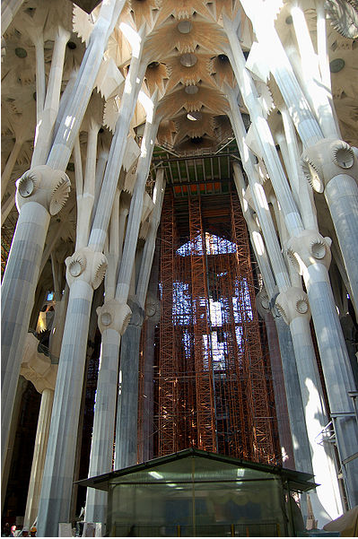
Architectural Design Qualities
A well designed architecture has certain qualities:
layered subsystems
low inter-subsystem coupling
robust, resilient and scalable
high degree of reusable components
clear interfaces
driven by most important and risky use cases
easy to understand

Slide 23
Data Processing Frameworks
Experiments have developed Software Frameworks
General architecture of any event processing applications (simulation, trigger, reconstruction, analysis, etc.)
To achieve coherency and to facilitate software re-use
Hide technical details to the end-user Physicists
Help the Physicists to focus on their physics algorithms
Applications are developed by customizing the Framework
By the “composition” of elemental Algorithms to form complete applications
Using third-party components wherever possible and configuring them
ALICE: AliROOT; ATLAS+LHCb: Athena/Gaudi; CMS: CMSSW

Slide 24
Features of an ideal Framework
Predefined component ‘vocabulary’
E.g. ‘Algorithm’, ‘Tool’, ‘Service’, ‘Auditor’, ‘DataObject’, ‘Property’, ‘DetectorCondition’, etc
Separation from interfaces & implementation
Allowing for evolution of implementations
Plug-in based (dynamic loading)
Homogenous configuration, logging and error reporting
Built-in profiler, monitoring, utilities, etc.
Interoperable with other languages (e.g. Java, Python, etc.)

Slide 25
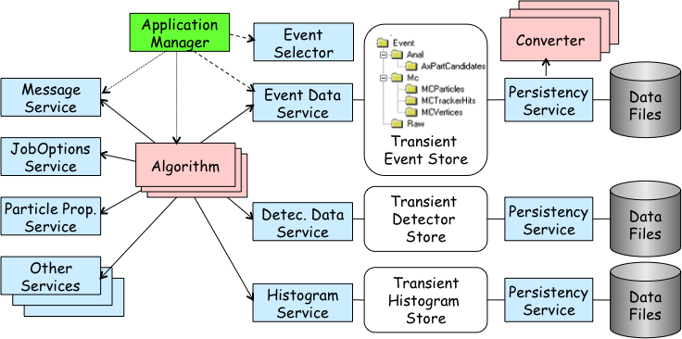
Example: GAUDI Framework
GAUDI is a mature software framework for event data processing used by several HEP experiments
ATLAS, LHCb, HARP, GLAST, Daya Bay, Minerva, BES III,…
The same framework is used for all applications
All applications behave the same way (configuration, logging, control, etc.)
Re-use of ‘Services’ (e.g. Det. description)
Re-use of ‘Algorithms’ (e.g. Recons -> HTL)

Slide 26
Gaudi: Principal Design Choices
Separation between “data” and “algorithms”
Three basic categories of “data”
event data, detector data, statistical data
Separation between “transient” and “persistent” representations of data
Data store-centered (“black-board”) architectural style
“User code” encapsulated in few specific places
Well defined component “interfaces” with plug-in capabilities

Slide 27
Gaudi: Algorithms & Transient Store
Data T1
Data T1
Transient Event
Data Store
Data T1
Algorithm
A
Data T2, T3
Data T2
Algorithm
B
Data T4
Data T3, T4
Algorithm
C
Data T5
Apparent dataflow
Real dataflow
Data T5
Notes:
Algorithm & Transient Store
In order to minimize the coupling between algorithms, the transient data store acts a “black-board” between algorithms. An Algorithm does not need to know from where the data has been produced, it only knows what data it requires and what data will be producing.
As in shown in the viewgraph, we can create “data-flows” using a number of Algorithms known only, their inputs and outputs, by scheduling them in the adequate order.

Slide 28
Gaudi: Control Sequences
Concept of sequences of Algorithms to allow processing based on physics signature
Avoid re-calling same algorithm on same event
Different instances of the same algorithm possible
Event filtering
Avoid passing all the events through all the processing chain
Event
Input/Output
Algorithm
Filter
Decision
Single
Instances

Slide 29
Gaudi: Data On Demand
Typically the execution of Algorithms are explicitly specified by the initial sequence and and sub-sequences
Avoid too-late loading of components (HTL)
Easier to debug
For some use-cases it is necessary to trigger the execution of a given Algorithm by accessing an Object in the Transient Store
The DataOnDemand Service is can be configured to provide this functionality

Slide 30
Other Gaudi Services
JobOptions Service
Message Service
Particle Properties Service
Event Data Service
Histogram Service
N-tuple Service
Detector Data Service
Magnetic Field Service
Tracking Material Service
Random Number Generator
Chrono Service
(Persistency Services)
(User Interface & Visualization Services)
(Geant4 Services)
Notes:
Gaudi Services
Open ended list of available services in Gaudi. The services in the top of the list will be the ones that will be used and exercised during the tutorial. Many of the existing services are not really used directly by the Algorithms implementing a physics algorithm but they are used by the Framework itself in implementing some of the functionalities (persistency, visualization, interactivity, etc.)

Slide 31
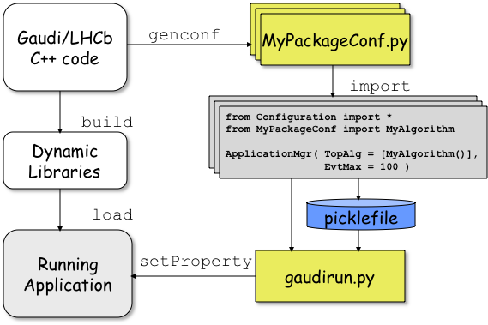
Gaudi: Configuring the Application
Each Framework component can be configured by a set of ‘properties’ (name/ value pairs)
In total thousands of parameters need to be specified to fully configure a complex HEP application
Using Python to facilitate the task
Python ”configurables” generated from C++
Build-in type checking

Slide 32
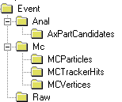
Gaudi Parallel
Input Event Data
Configuration
Reader
Worker
Writer
Transient Event Store
Transient Event Store
Transient Event Store
Event Input
Queue
Event Output
Queue
Algorithm
Algorithm
OutputStream
Algorithm
output
gaudirun –-parallel=N optionfile.py

Slide 33
Python as the ‘Framework’
The high-level steering of applications could be done in Python
Configuration, plugin (module) loading, event loop, algorithm scheduling, etc.
The low Python execution performance shouldn’t be a problem at this level
The real number-crunching could be done in a proper compiled language (e.g. C or C++)
Essential to define ‘interfaces’ and ‘concepts’ for the framework components
As it is the case for a C++ framework

Slide 34
Python Application Steering
Could simply a number of functionalities
Plug-in declaration, definition and loading
Interactivity/scripting will be more natural and better integrated
Already a positive experience with Gaudi Parallel
The setup and steering is done in from Python using standard module (e.g. Processing)

Slide 35
Summary
I have been focusing on the reasons why a Framework is needed rather than recommending a concrete one
When deciding on the framework (and languages) not only the technical advantages should be considered
Interoperate with existing codes from the community (e.g. ROOT, Geant4, etc.)
People training should not be underestimated
Common interfaces/formats is good but adopting a common framework is even better
It would enable one level up in re-use
Single framework to cover all applications is desirable
Super-B could profit from existing structures and support for the common LHC software

