Slide 1
Measurement of fusion excitation function for ⁷Li+⁶⁴Ni at near the V_{B}
Md. Moin Shaikh
E-mail: moin.shaikh@saha.ac.in
Nuclear Physics Division,
Saha Institute of Nuclear Physics,
Kolkata, India

Slide 2
Fusion with weakly bound nuclei
Weakly bound nuclei have dominant cluster structure, low breakup threshold
From presentation of P. R. S. Gomes
DCF
CN
Additional channels open up : breakup and transfer breakup
SCF
CN
Breakup
ICF
CN
ICF
CF = DCF + SCF
CN
TF = CF + ICF
NCBU
General interest:
Energy dependence of TF and CF, if separated.

Slide 3
Observations of Fusion with weakly bound nuclei
In above barrier region ,
CF is suppressed compared to1DBPM prediction.
TF matches with1DBPM prediction.
i.e. flux from CF went to ICF.
In below barrier region ,
Both CF & TF are enhanced compared to1DBPM.
CF have been tried to be explained by channel coupling.
TF very large compared to the theoretical predictions.

Slide 4
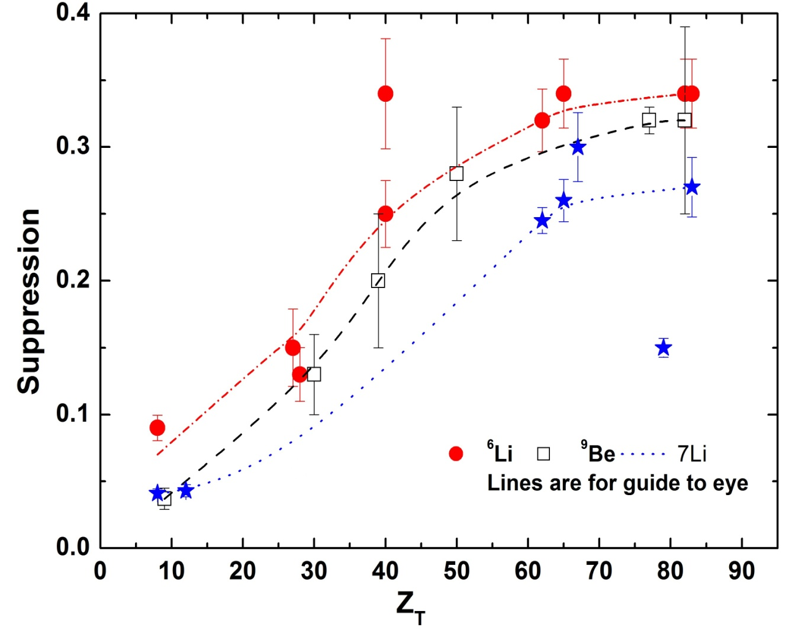
Motivation of present study
How BU like processes affect TF and CF with energy and target mass or charge?
Weakly bound stable projectiles ⁶Li, ⁹Be show change in suppression factor with target .
Data for ⁷Li is insufficient, specially at lower-medium mass.
Also …….

Slide 5
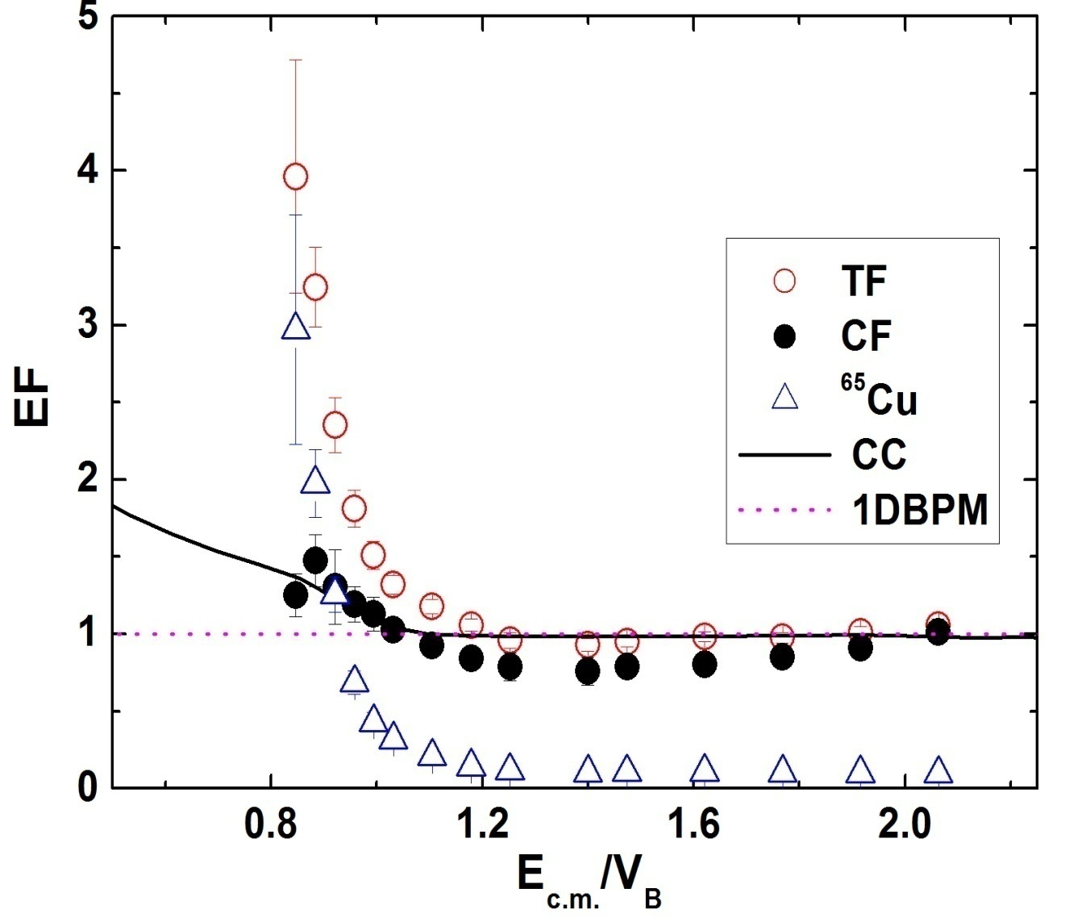
Motivation of present study
Observation from ⁶Li+⁶⁴Ni:
In E >V_{B,} CF suppressed by 13% but TF is unaffected.
In E <V_{B} TF & CF enhanced.
Enhancement of CF can be explained by channel coupling.
TF cannot be explained by it.
TF = CF+ ICF + DCT/+ 1p- stripping
Same study extended to ⁷Li+⁶⁴Ni system

Slide 6
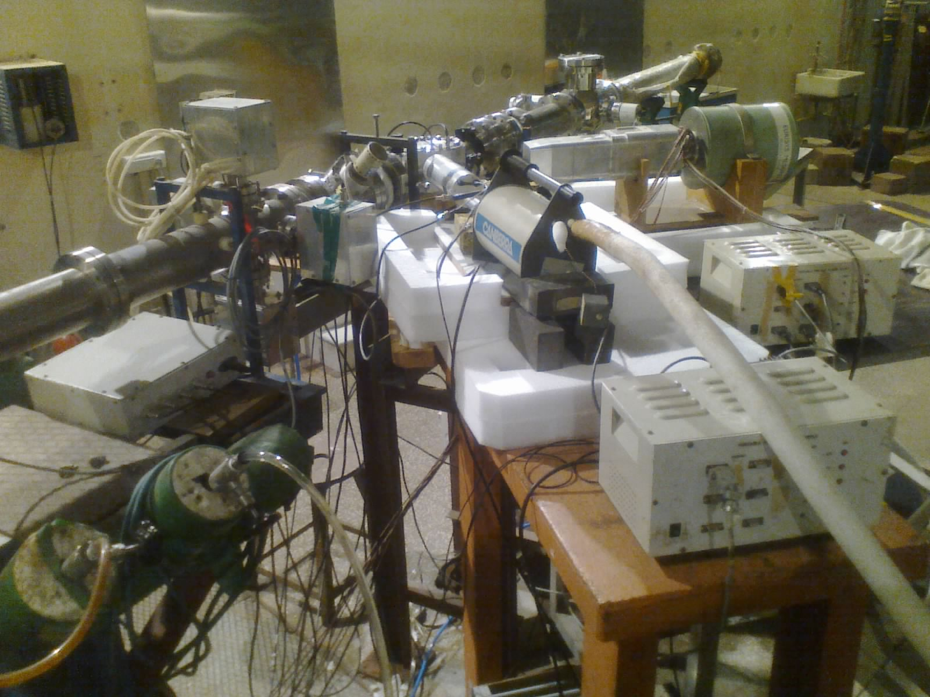
Experimental Setup
Fusion excitation function (12-28 MeV).
Beam: ⁷Li (Breakup threshold = 2.47 MeV)
Current: 1.5-6 pnA.
Target thickness : 500 μg/cm² ⁶⁴Ni.
Detection procedure: online characteristic γ-rays from the residues.
beam
45º clover
125º HPGe
The experiment carried out at Pelletron Facility in Mumbai, India.
Data recorded and analyzed using the acquisition software LAMPS.

Slide 7
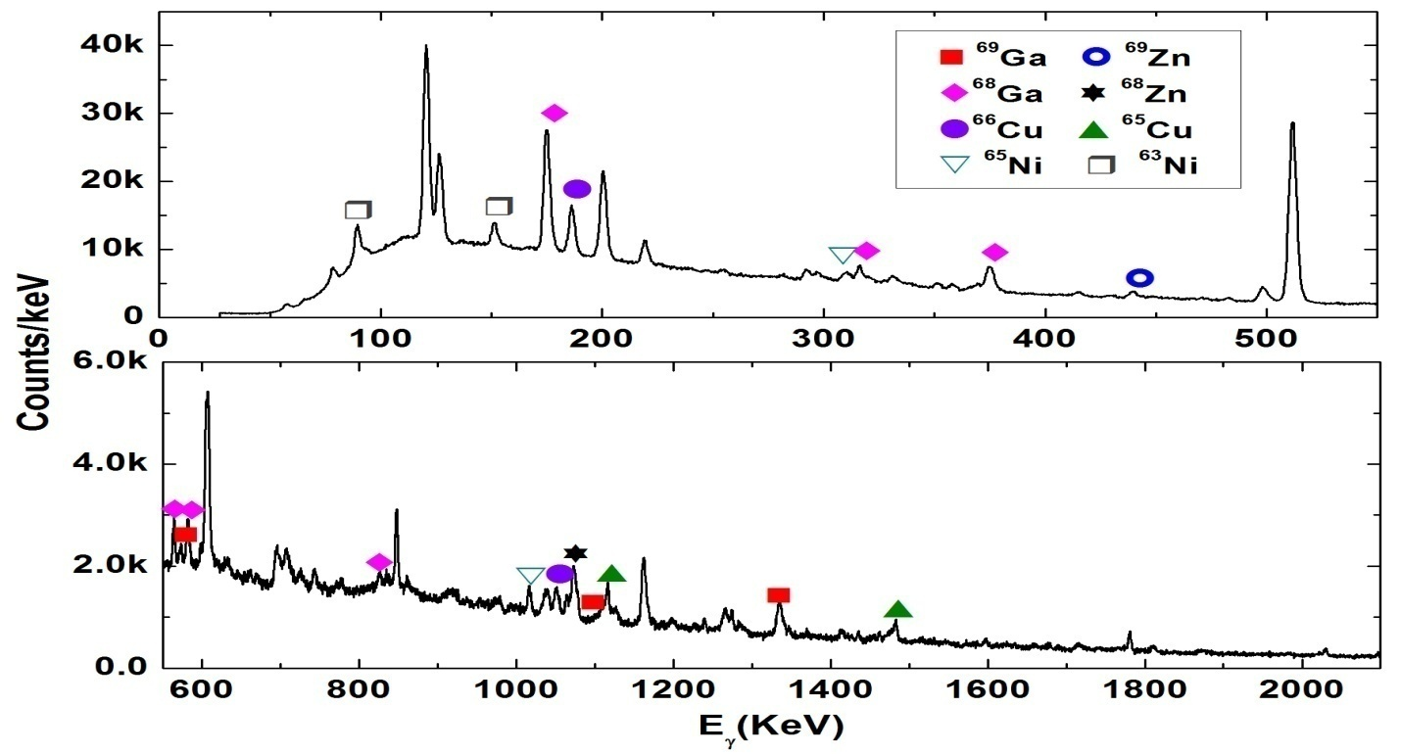
Representative spectra of ⁷Li+⁶⁴Ni at E_{lab} = 26 MeV

Slide 8
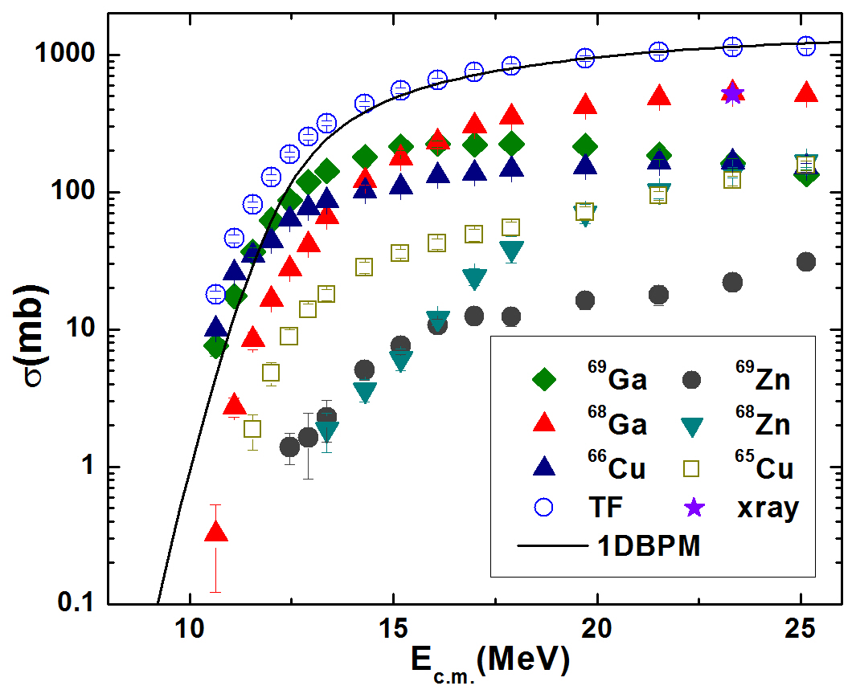
⁷Li+⁶⁴Ni excitation function
Observed channels:
Pure CF channels: ⁶⁹Ga (2n) , ⁶⁸Ga (3n), ⁶⁹Zn (pn), ⁶⁸Zn( p2n) Mixed CF+ICF channels: ⁶⁶Cu (αn) and ⁶⁵Cu (α2n)
γ-yield
γ-efficiency
No. incident beam particle
No. Target particle/area

Slide 9
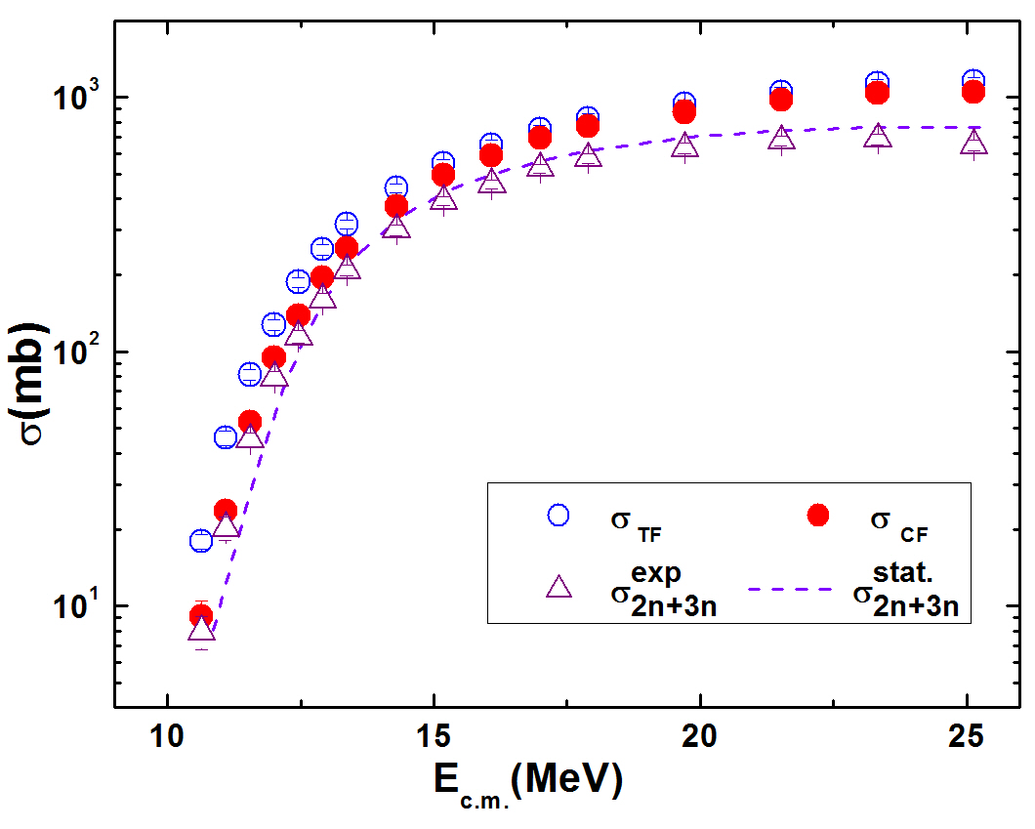
Extraction of complete fusion cross section
Extracted from two Ga channels 2n and 3n
Used statistical model: PACE4
% of 2n+3n within CF is 66-87%
Notes:
A parameter values

Slide 10
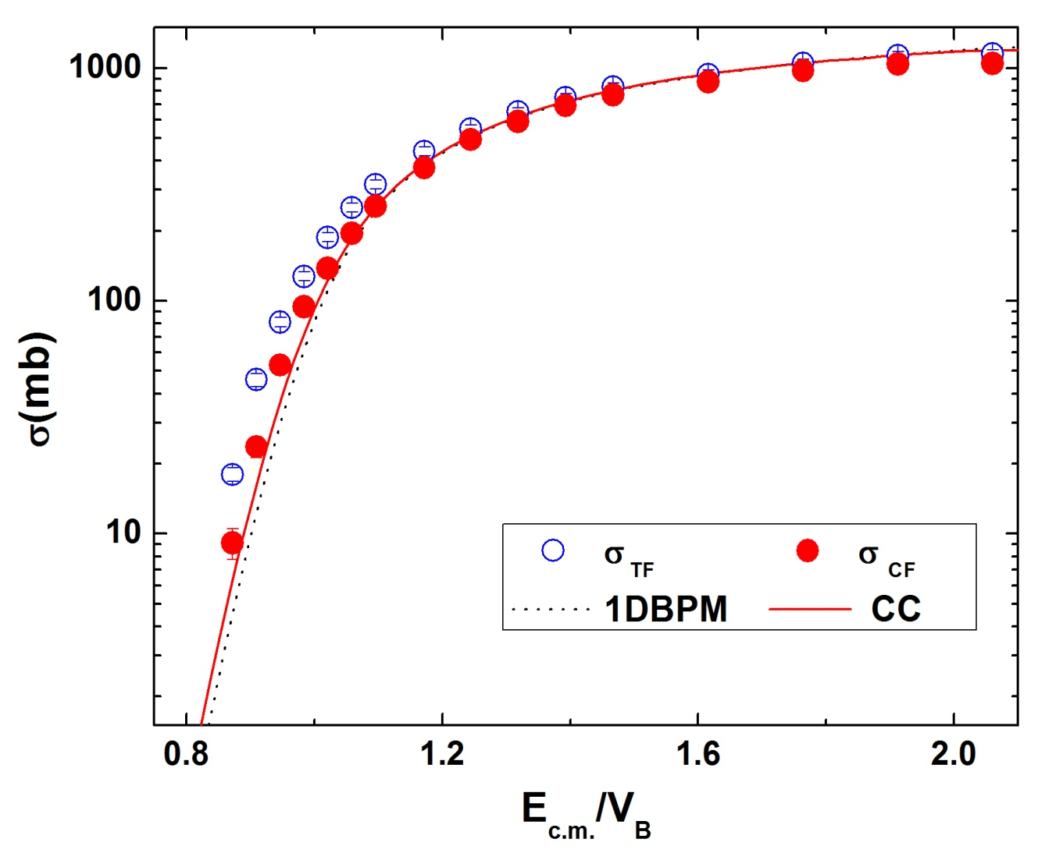
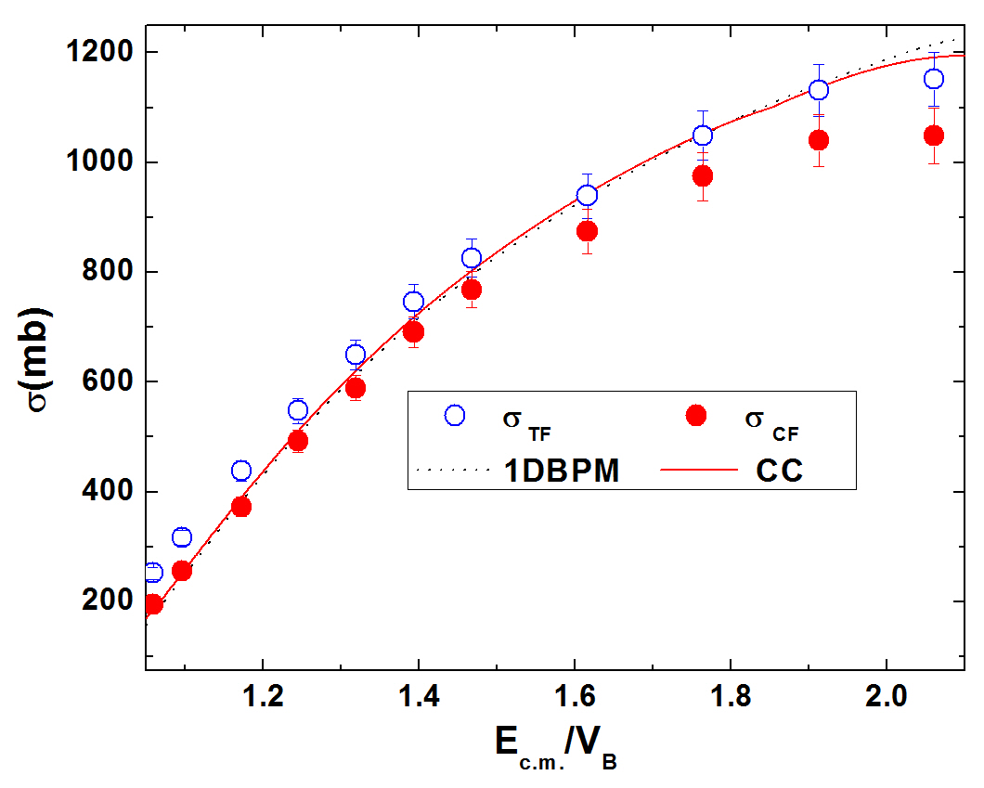
Model predictions of fusion cross sectios
CC scheme in CCFULL
1.34 MeV
0.48 MeV
0.0 MeV
⁷Li + ⁶⁴Ni
1DBPM calculation using CCFULL in no coupling mode
Used Akyuz-Winter potential:
V₀(MeV) | r₀(fm) | a₀(fm)
42.09 | 1.17 | 0.6
Resultant barrier parameters:
V_{b} (MeV) | R_{b} (fm) | ħω (MeV)
12.20 | 9.25 | 3.56
K. Hagino, N. Rowley, A.T. Krupp, Comput. Phys. Commun. 123, 143 (1999).

Slide 11
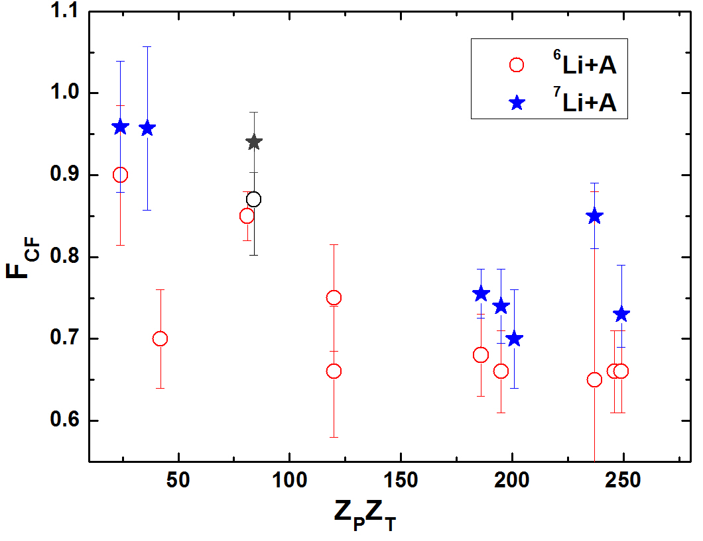
Above barrier: Suppression for CF for ^{6, 7}Li
Suppression factor,
⁷Li +⁶⁴Ni, present
⁶Li +⁶⁴Ni
F_{CF} (⁷Li) ~ 0.94±0.04
< F_{CF} (⁶Li) = 0.87±0.07
How F_{CF} changes with Z_{P}Z_{T} for ^{6,7}Li?
M. Dasgupta et al.,
PRC 66, 041602(R) (2002),
C. Palshetkar et al.,
PRC 89, 024607 (2014), V. Tripathi et al.,
PRL 88, 172701 (2002),
A. Mukherjee et al.,
PLB 636, 91 (2006),
P. Rath et al.,
PRC 88, 044617 ( 2013),
H. Kumawat
PRC 86, 024607 (2012),
M. Ray et al.,
PRC 78, 064617 (2008),
A. Mukherjee et al., NPA 645, 13 (1996) and M. M. Shaikh et al., PRC 90, 024615 (2014).
Notes:
Error bar

Slide 12
Above barrier Suppression: ⁷Li
Still more data point required for the projectile ⁷Li to draw any conclusion

Slide 13
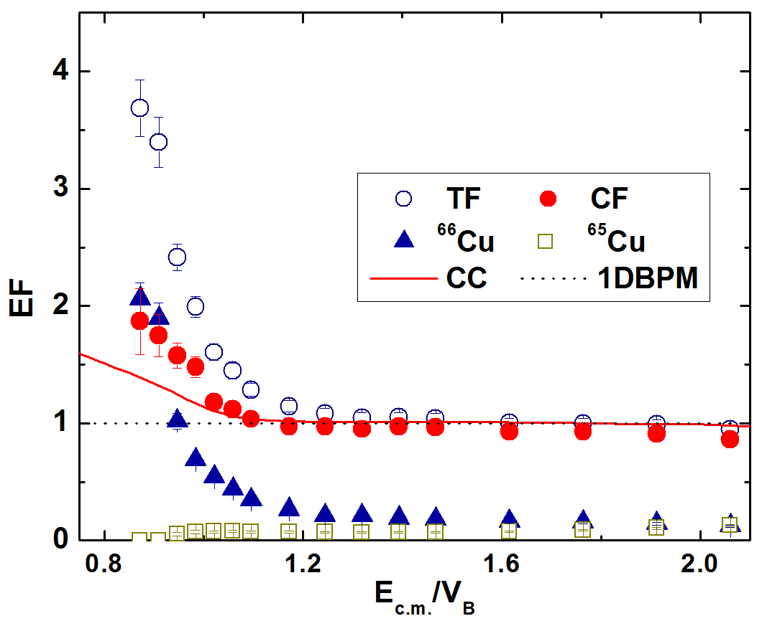
Below barrier region: Enhancement factor for ⁷Li
The enhancement of CF is larger than CC. But TF is way too large.
Reason?
TF + transfer ??
In E<V_{B} mixed channel ⁶⁶Cu is a dominant contributor in TF.
Origin of ⁶⁶Cu & ⁶⁵Cu:
CF b. ICF
+
High probability of coming from transfer
For ⁶⁵Cu,
c. 1p- stripping
with Q-value= -2.52 MeV.
For ⁶⁶Cu,
c. 1d- stripping, Q-value=2.83 MeV.
d. 1t- stripping to the unbound state of ⁶⁷Cu, Q-value = 12.7 MeV.

Slide 14
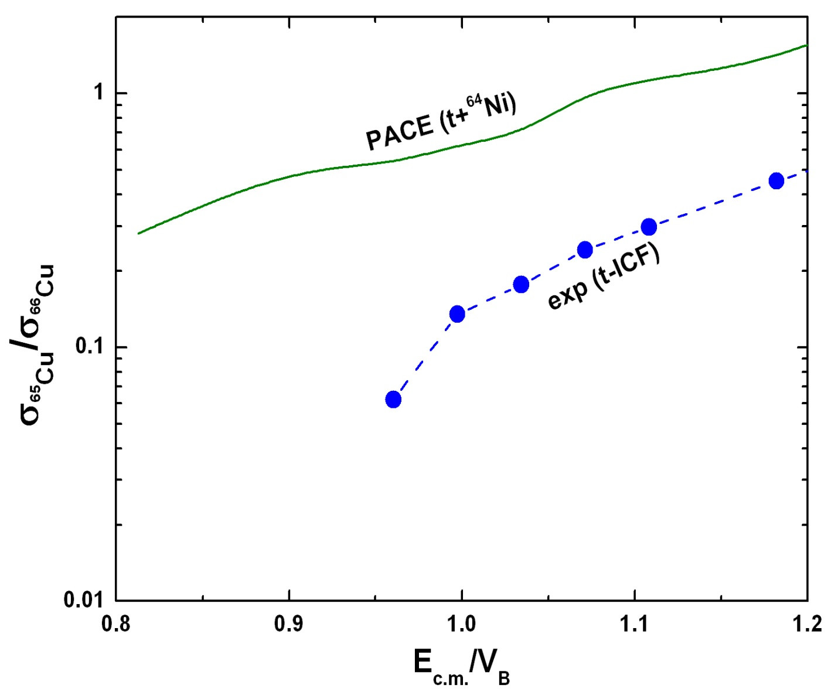
Channels in TF other than CF
For dominance of ICF or 1p-stripping comparable σ_{65Cu} with σ_{66Cu} expected
σ_{65Cu} ~0 for E_{lab}< 13 MeV, no ICF or 1p- stripping is observed.
⁶Li
In E<V_{B}
TF = CF+ ICF + DCT/+ 1p- stripping
X
1p-transfer ⁶⁵Cu not observed
⁷Li
√
1t and/or d-transfer ⁶⁶Cu observed
TF = CF+ DCT
Cluster transfer dominates over single particle transfer.

Slide 15
Conclusion
σ_{TF} is reproduced in E > V_{B} though enhancement in E < V_{B} with respect to theoretical prediction, which may because of admixture with transfer cross section.
Unlike CF enhancement of ⁶Li, The enhancements of ⁷Li can’t be reproduced by channel coupling to only inelastic excitations.
σ_{CF} is suppressed by 6% for ⁷Li projectile with ⁶⁴Ni target at above V_{B,} compared to 13% for ⁶Li on the same target.
The admixture in σ_{TF} for ⁷Li is dominated by cluster transfer over single particle transfer in the below barrier region.
More work needs to be done with the projectile ⁷Li with different targets to understand reaction mechanism clearly.

Slide 16
I am really thankful to my collaborators
Acknowledgment
Subinit Roy, SINP (Supervisor) V. Nanal, TIFR
Subhedu Rajbanshi, SINP Sanjoy Pal, TIFR
Mukesh Pradhan, SINP S. Saha, TIFR
Anjali Mukherjee, SINP R.G. Pillay, TIFR
Padmanava Basu, SINP A. Srivastava, BARC.
Special thanks to K. Divekar and S. Ghosh of TIFR.
We are thankful to the pelletron staff for providing us stable and uninterrupted beams.
I thank CSIR for their financial support.

Slide 17
Thank You

