Slide 1
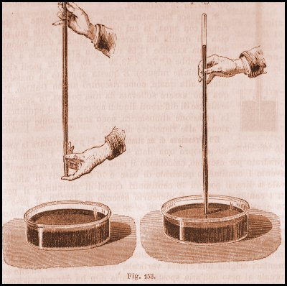
Vacuum laboratory
D. Alesini, S. Bini, F. Cioeta

Slide 2
Index
INTRODUCTION
Vacuum Definition and Applications
Pressure measurements and Vacuum classification
Vacuum in particle accelerators
BASIC CONCEPTS
Mean free path and Gas Flow Regimes ( Transition, Molecular and Viscous)
Gas flow rate and pumping speed
Desorption, Outgassing and Degassing
Leaks
Throughput Q=p*S
Pumping Speed
Residual Gas Composition
Vacuum Conductance, Series and Parallel
Electrical Analogy and Examples
PUMPING TECHNOLOGY
Primary pumping systems: Scroll Pump, Turbomolecular Pump,
UHV pumping system: Ion Pump, Getter Pump,
Vacuum Gauge
Leak Detectors
VACUUM SYSTEM DESIGN
Materials
Clean Process
Laboratory experience description

Slide 3
INTRODUCTION
Vacuum Definition and Applications
Pressure measurements and Vacuum classification
Vacuum in particle accelerators

Slide 4
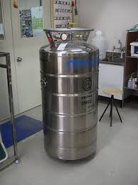
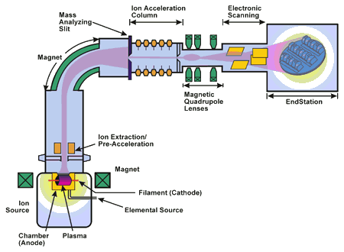
Vacuum Definition and Applications
Vacuum science studies behavior of rarefied gases, interactions between gas and solid surfaces (adsorption and desorption), etc.
Vacuum technology covers wide range of vacuum pumping, instrumentations, materials engineering, and surface engineering,…
A vacuum is the state of a gas where the pressure is lower than atmospheric pressure at the Earth's surface.
APPLICATIONS
a) To Avoid chemical and physical processes caused by atmospheric gases (e.g: during the fusion of particular reactive metals, like Ti,…);
b) To increase the mean free path of molecules, atoms and ions avoid the impacts with residual gas molecules (e.g: Metalization processes under vacuum, particles accelerators, ion implantation,…)
c) To increase thermal insulation ( e.g: in the Dewars, criogenics systems)
d) To simulate some particulars physical situations (e.g. chamber of space simulation for test on satellites or space stations)
e) Food and packaging, brazing in furnaces, sputtering processes,…

Slide 5
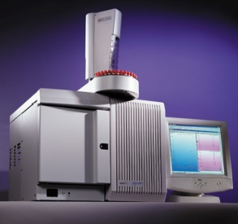
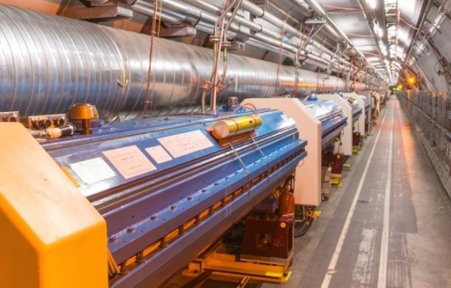
Pressure measurements and Vacuum Classification
Extreme UltraHigh Vacuum (XHV)
~10⁻¹² mbar
Low Vacuum
(LV)
30 to 10³ mbar
Medium Vacuum (MV)
10⁻³ to 30 mbar
Very High Vacuum (VHV)
10⁻⁶ to 10⁻⁹ mbar
Ultra High Vacuum (UHV)
10⁻⁹ to 10⁻¹² mbar
Industrials Scope
High Vacuum (HV)
10⁻³ to 10⁻⁶ mbar
Particles Accelerator -P~10⁻⁸-10⁻¹⁰ mbar
NB: P=10⁻¹⁰ mbar
∼ 10⁶ molecules/cm³ !!!

Slide 6
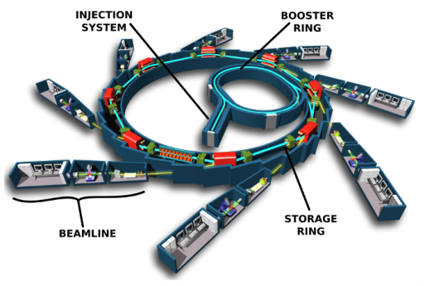
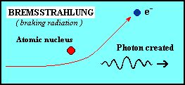
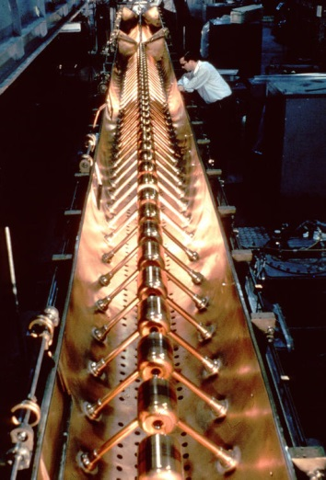
Vacuum in Particle Accelerators
1) Circular machines like synchrotrons (multi-passage, high current)
The interaction between the residual gas and the particles beam can have several effetcs:
⇒ reduction of beam lifetime (because of scattering and energy lost by bremsstrahlung). The lifetime is proportional to 1/P where the P is the residual gas pressure.
⇒ instability of the stored particles beam (ion trapping, fast ion instability)
⇒ betatron tune variation
⇒ Increase in beam emittance
Typical vacuum pressures in synchrotons are 10⁻⁸-10⁻¹¹ mbar
2) Linear accelerators (single-passage, low current)
In LINAC the vacuum requirements are less demanding because of the single passage (no cumulative effects) and less average current. The vacuum can still have impact on:
⇒ Increase in beam emittance
⇒ discharges in high gradient (10-100 MV/m) accelerating structures
⇒ Contaminations of targets, …
Typical vacuum Pressures are 10⁻⁸-10⁻⁹ mbar

Slide 7
BASIC CONCEPTS
Mean free path and Gas Flow Regimes ( Transition, Molecular and Viscous)
Gas flow rate and pumping speed
Desorption, Outgassing and Degassing
Leaks
Throughput Q=p*S
Pumping Speed
Exercise
Residual Gas Composition
Vacuum Conductance, Series and Parallel
Electrical Analogy and Examples

Slide 8
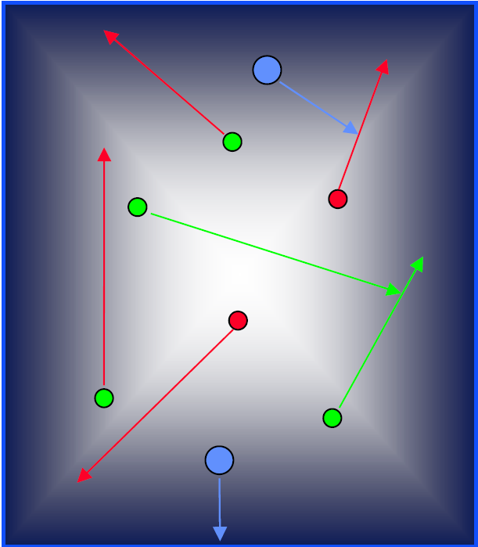
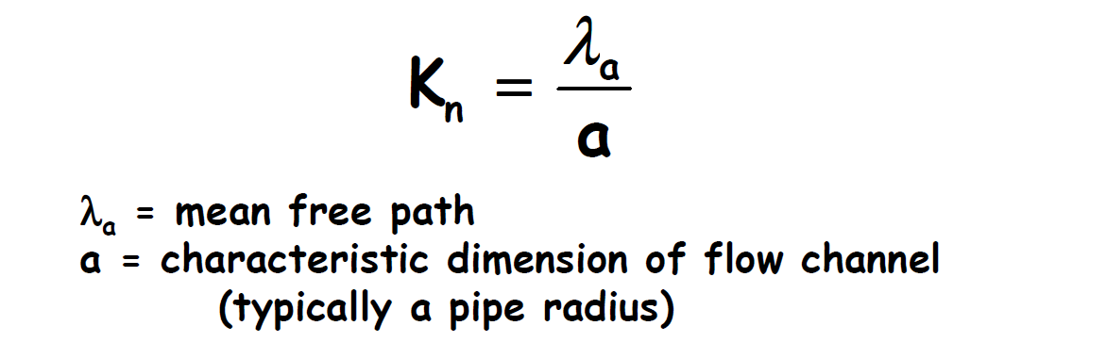
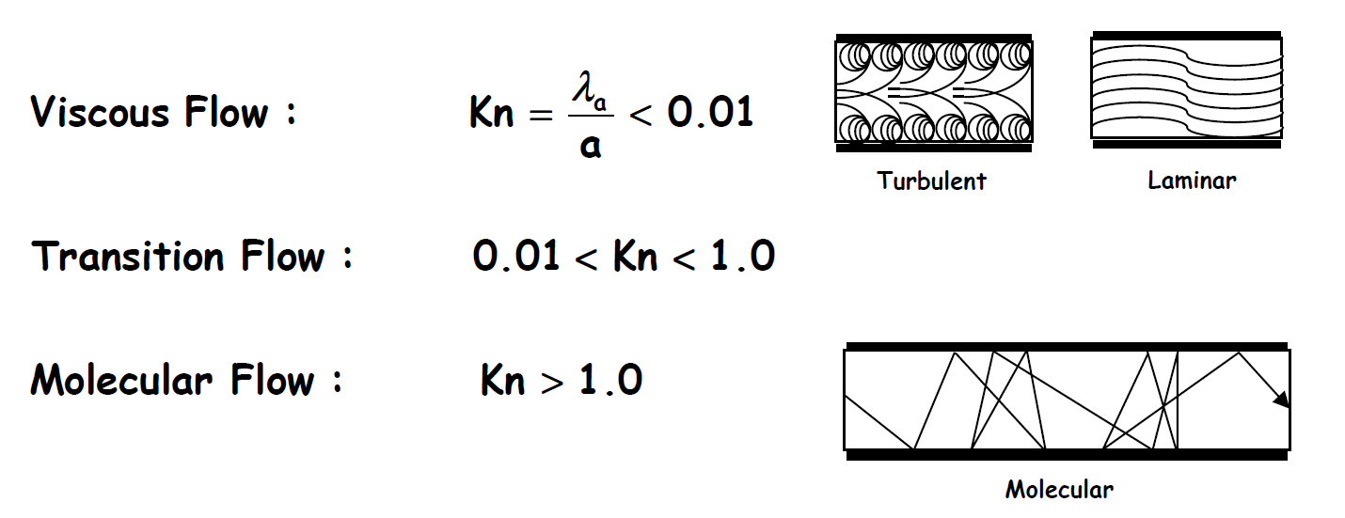
Gas Flow Regimes
The mean free path is the average distance that a gas molecule can travel before colliding with another molecule and is determined by:
- Size of molecule (2r)
- Pressure (p)
- Temperature (T)
K
.
T
λ_{a} =
(2r)² p
π 2
The gas in a vacuum system can be in a viscous state, in a molecular state (or in a transition state) depending on the dimension-less parameter know as the Knudsen number (K_{n}) that is the ratio between the mean free path and the characteristic dimension of the flow channel.
Viscous Flow
(momentum transfer
between molecules)
Molecular Flow
(molecules move
independently)
P> 1 mbar
P<10⁻³ mbar
Typical pressure values
Notes:
Flusso molecolare:Per gas rarefatti la probabilita’ di urto fra
le molecole del gas e’ << della proba8
bilità di collisione con le pareti del
condotto. E’ il regime normalmente
valido in vuoto

Slide 9
Gas flow rate and pumping speed
In a vacuum system (to the 1° order) the total gas load is the sum of several contributions.
The main important (for our typical applications) are:
Desorption or outgassing ( Q_{des});
Leaks (Real or Virtual , Q_{L})
Desorption or Outgassing (Q_{des})
SYSTEM
Leaks (Q_{L})
P(t)
Q_{pV}
Q_{tot} = Q_{des}+ Q_{L}
Pumping speed (S)
PUMP
The final pressure in the system is given by the equilibrium between the total gas load (Q_{tot}) and the gas flowing into the pump (pS).
The pressure p(t) can be obtained solving this equation:

Slide 10
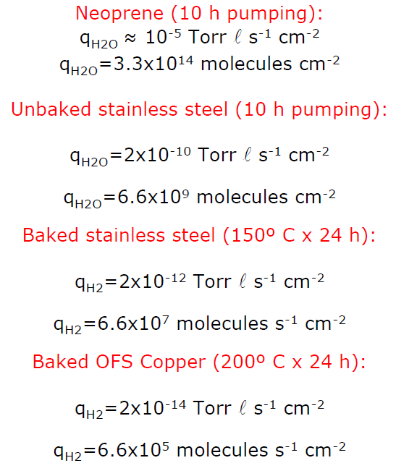
Desorption, outgassing, degassing
Gas molecules, (primarily water) are bound to the interior surfaces of the vacuum chamber and gradually desorb again under vacuum. The desorption rate of the metal and glass surfaces in the vacuum system produces a gas yield that decreases over time.
mbar
s⁻¹cm⁻²
mbar
s⁻¹cm⁻²
mbar
Q_{des}(t)=A*q_{des}(t)
mbar
Q_{des} | Desorption rate | [mbar l s⁻¹]
q_{des} | Desorption rate density or specific desorption rate | [mbar l s⁻¹ m⁻²]
A | Area | [m²]
Q_{des}
t

Slide 11
Leaks
Q_{L} describes the leak rate, i.e. a gas flow, which enters the vacuum system through leaks.
The leakage rate is defined as the pressure rise over time in a given volume:
Q_{L} | Leak rate | [mbar l s⁻¹]
Δp | Pressure change during measurement period | [mbar]
V | Volume of the system | [l]
Δt | Measurement period | [s]

Slide 12
Gas flow rate and throughput of a vacuum pump
Gas flow rate is the volume of gas, at a known pressure, that passes through a plane per unit time
The throughput of a vacuum pump is the gas flow rate that a pump is able to absorb and is related to the pressure at the pump inlet as:
$\frac{dn}{dt}=\frac{pdV}{RTdt}⇒Q=\frac{PdV}{dt}$ = P⋅S
This equation is directly obtained from the main ideal gas equation.
PV=nRT
Q is define as the quantity of gas that leaves the pipe in the unit time.
S is called pumping speed
[mbar*l/s]
dV
P = Pressure of gas
V = Volume
n= number of molecules
R= Boltzman Constant (8,314472 J/mol K)
T= Temperature
P
PUMP
dt
Pump Inlet
The lower the pressure, the «Better» or «Higher» the vacuum
Notes:
Q rappresenta la quantità di materia che deve essere portata via dal condotto nell'unità di tempo se si vuole mantenere la pressione bassa. Tale grandezza ha le dimensioni di una pressione per un volume diviso un tempo.
Con maggiore rigore la quantità di materia da portare via nell'unità di tempo dovrebbe essere il numero di molecole trascinate diviso il tempo in cui avviene il fenomeno. Quindi dall'equazione dei gas perfetti, dovrebbe essere pari alla derivata rispetto al tempo di pV/T. Se però le temperature del sistema da vuoto sono costanti nel tempo come spesso accade, risulta più semplice definire nella maniera anzidetta.
La grandezza dV, è la derivata temporale del volume che nel linguaggio del vuoto viene spesso denominata velocità di aspirazione, viene spesso indicata con il simbolo (dall'inglese speed).

Slide 13
Pumping Speed
Is the volume of gas flowing through the cross section of the inlet port of a vacuum pump.
The pump’s maximum achievable pumping speed is always referred to as its rate pumping speed. Determination of the pumping speed is described in base standard ISO 21360-1.
$s=\frac{dV}{dt}$ [l/s]
Nitrogen
The pumping speed depends on the system pressure and gas type
Argon
All pumps have both high
and low applicable
pressure limit

Slide 14
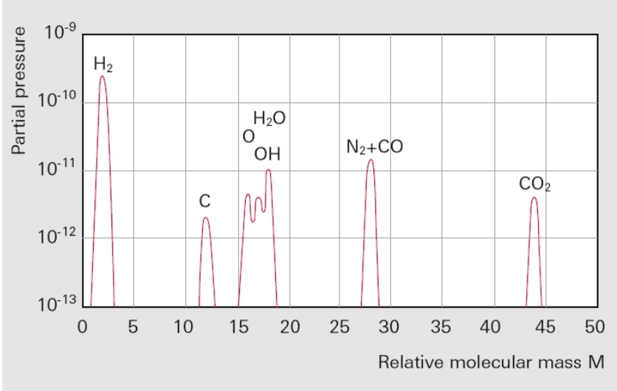
Residual Gas Composition
When working in ultra-high vacuum, it can be important to know the composition of the residual gas.
A residual gas analyzer (RGA) is a small and usually rugged mass spectrometer^{(*)}, typically designed for process control and contamination monitoring in vacuum systems.
As example the percentages of water (m/e = 18) and its fragment OH (m/e = 17) will be large in the case of vacuum chambers that are not clean or well baked.
Leaks can be identified by the peaks of nitrogen (m/e = 28) and oxygen (m/e = 32) in the ratio N₂/O₂ of approx. 4 to 1. Hydrogen (m/e = 2), water (m/e = 17 and 18), carbon monoxide (m/e = 28) and carbon dioxide (m/e = 44) will be found in well-baked chambers.
No hydrocarbons have to be present in well cleaned chambers.
Typical residual gas spectrum of a vessel evacuated by a turbomolecular pump

Slide 15
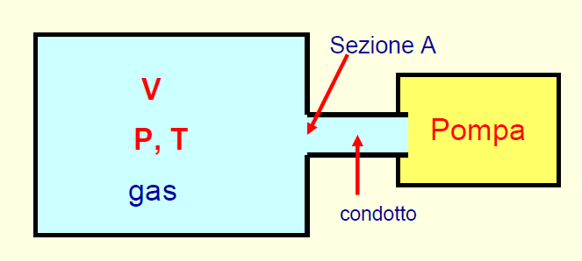
Vacuum Conductance
Gases moving through elements (pipes, tubes, vessels, and orifices) in a vacuum system encounter resistance to their motion. We can define the impedance of a tube as:
Section A
P₁
P₂
Pump
Pipe
Impedance
Z=( P₁-P₂ )/ Q
C= 1/Z=Q/P₁-P₂
Defines the pressure
drop in a pipe
Conductance is an abstract concept used to describe the behavior of gas in a vacuum system.
• Conductance is specific to a particular geometrical configuration.
• Conductance is specific to the actual gas species and temperature.
The Condutance is the capability to let through a particular gas volume in a known time
Notes:
Prima di introdurla dare un esempio semplice. Manca la definizione di conduttanza o impedenza.
Consideriamo un recipiente ideale a pareti rigide di volume V
contenente N molecole di gas alla temperatura T ed alla pressione P
􀂄 Il recipiente è collegato ad una pompa da vuoto tramite un condotto di
sezione A (A è la sezione del foro che collega il recipiente al condotto).
􀂄 All’istante t nel recipiente ci sono N molecole alla pressione P
􀂄 All’istante t+dt nel recipiente ci sono N′ molecole alla pressione P′
La conduttanza è la capacità di un’apertura di lasciar fluire un determinato volume di gas in un’unità di tempo

Slide 16
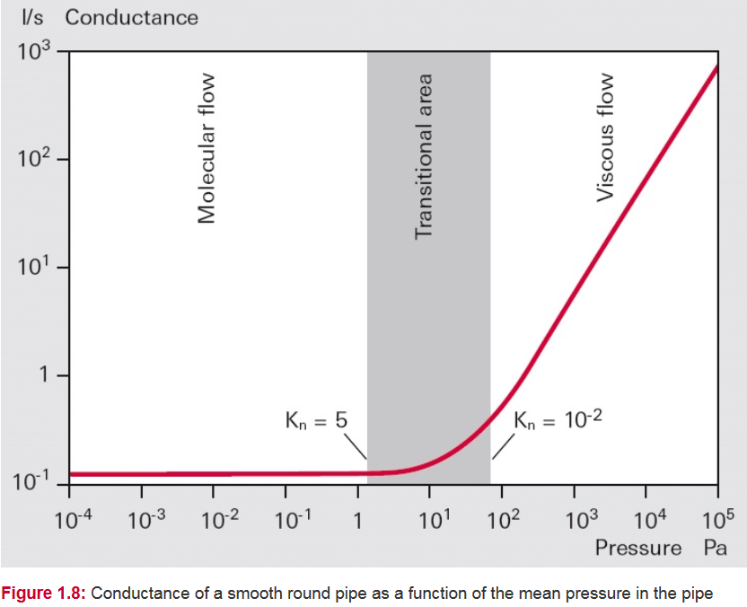
Conductance Properties
The conductance of pipes and pipe bends will differ in the various flow regimes.
In viscous flow they are proportional to the mean pressure p and in molecular flow they are independent of pressure. Knudsen flow represents a transition between the two types of flow, and the conductivities vary with the Knudsen number.
10⁻² mbar
1 mbar

Slide 17
Example:
Conductance in Molecular Flow of a Long Round Tube
Under molecular flow conditions doubling the pipe diameter increases the conductance eight times. The conductance is INVERSELY related to the pipe length.

Slide 18
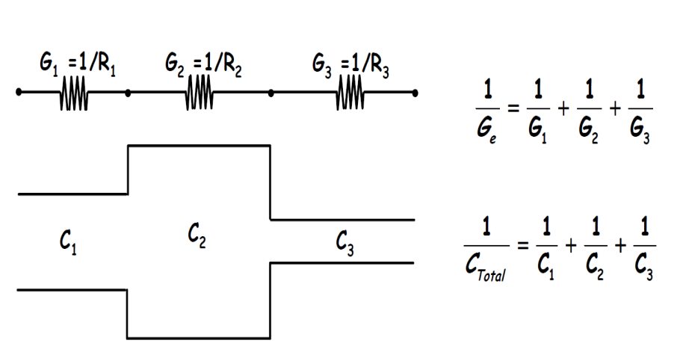
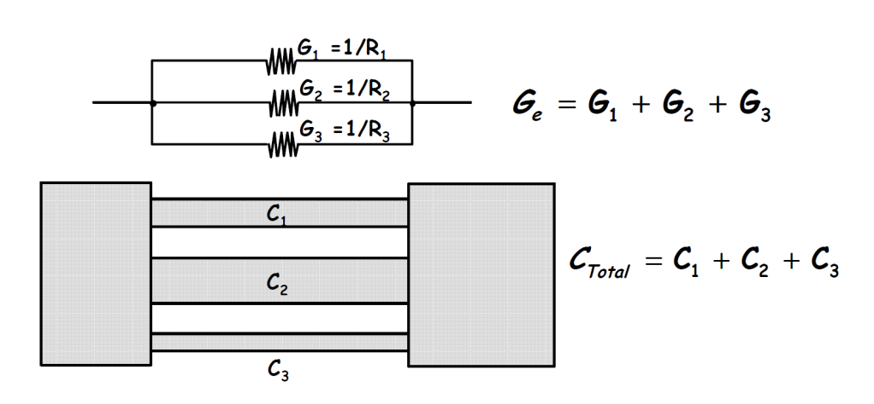
Electrical Analogy of a Vacuum System (1/2)
A vacuum system can be analized/designed using an equivalent electrical model.
In this model:
1-pressures at a given point is the voltage
2-gas flow rate Q is the current
3-the conductances are electrical resistors
4-the pumping system are voltage generator
5- leacks as resistors that connect a given point to the mass.
I=ΔV/R= I=ΔV*G ⇒ Q=ΔP*C
Conductances
in Series
Conductances
in Parallel

Slide 19
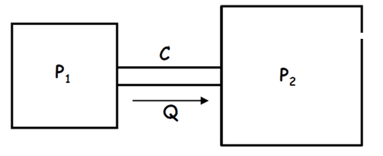
Electrical Analogy of a Vacuum System (2/2)
leaks
f.e.m = electromotive force pump
Z = Pipe Impedance
Z_{c} = Leaks Impedance
Z_{p} , Z_{s} = Pump’s Impedance
C = Volume of Vacuum Chamber
= 1/Z
Pump
Vacuum Chamber (V)
Z
C
f.e.m
Z_{c}
Z_{p}
Z_{s}

Slide 20
Pumping Technology
Primary pumping systems: Scroll Pump, Turbomolecular Pump,
UHV pumping system: Ion Pump, Getter Pump, Titanium Sublimation Pump
Vacuum Gauge and Leak Diagnostic

Slide 21
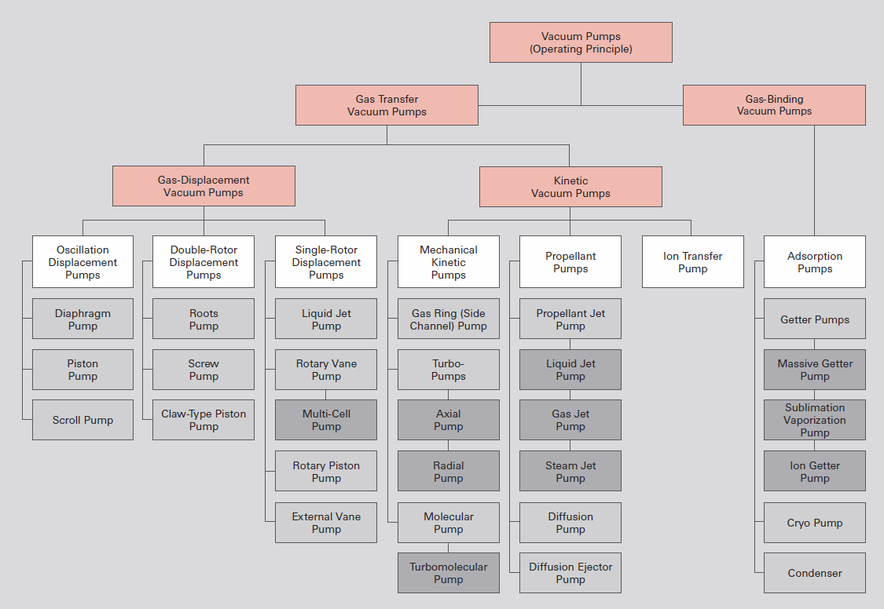
Pumping Technology
Overview of vacuum pumps

Slide 22
Pumping Technology
Primary pumping systems are mechanical pumps that work to decrease the pressure from atmospheric pressure to the pressure (10⁻⁶-10⁻⁸) to start the ion pump or other UHV pumping systems. We have:
Scroll Pump ( atmospheric pressure to about 10⁻³ mbar)
Turbomolecular Pump ( from 10⁻² mbar to about 10⁻⁸ mbar )
UHV pumping system are the pumps that work at low pressure or in ultra high vacuum. The tipical pumps are :
Ion Pump (from 10⁻⁶ mbar to 10⁻¹¹ mbar)
Getter Pump
Titanium Sublimation Pump
⇒In particles accelerator ion, Ti Sublimation and NEG pumps are in general used.
⇒Different pumps are more effective for different chemical species.
⇒In a vacuum system we find these typical gases:
Nitrogen N2, CO, CO2, methane , Argon , Oxygen , Hydrogen, Helium, Water ..

Slide 23
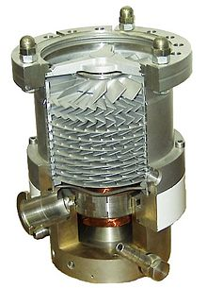
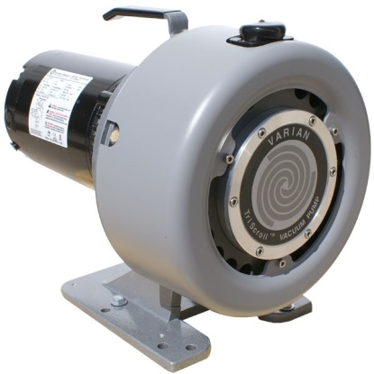
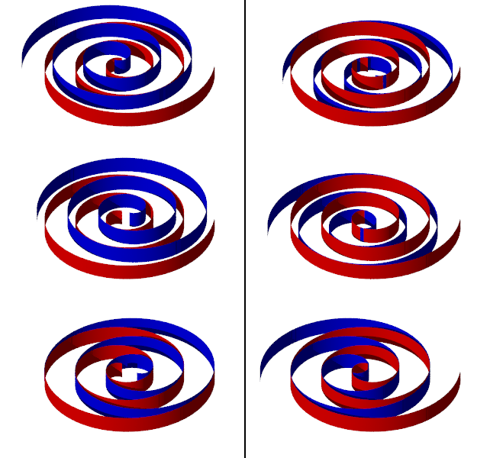
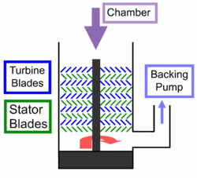
Scroll Pump
Turbomolecular Pump
A scroll compressor (also called spiral compressor, scroll pump and scroll vacuum pump) is a device for compressing air or refrigerant. It is used in air conditioning equipment, as an automobile supercharger (where it is known as a scroll-type supercharger) and as a vacuum pump.
A turbomolecular pump is a type of vacuum pump, used to obtain and maintain high vacuum.
These pumps work on the principle that gas molecules can be given momentum in a desired direction by repeated collision with a moving solid surface.
In a turbomolecular pump, a rapidly spinning fan rotor (50000-100000 rpm) 'hits' gas molecules from the inlet of the pump towards the exhaust in order to create or maintain a vacuum.
Interior view of a turbomolecular
pump
A scroll compressor uses two interleaving spirals that allow to physically remove the gas from The system. It allows to reach pressure of the order 10⁻²-10⁻³ mbar .
These pumps can be a very versatile pump. It can operate from intermediate vacuum (~10⁻² mbar) up to ultra-high vacuum levels (~10⁻⁸ mbar).
Schematic of a turbomolecular pump.
These devices are known for operating more smoothly, quietly, and reliably than conventional compressors in some applications
Their design is similar to that of a turbine. A multi-stage, turbine-like rotor with bladed disks rotates in a housing.
Notes:
Most turbomolecular pumps employ multiple stages consisting of Rotor turbine / stator pairs mounted in series. Gas captured by the upper stages is pushed into the lower stages and successively compressed to the level of the fore-vacuum (backing pump) pressure. As the gas molecules enter through the inlet, the rotor, which has a number of angled blades, hits the molecules. Thus the mechanical energy of the blades is transferred to the gas molecules. With this newly acquired momentum, the gas molecules enter into the gas transfer holes in the stator. This leads them to the next stage where they again collide with the rotor surface, and this process is continued, finally leading them outwards through the exhaust.

Slide 24
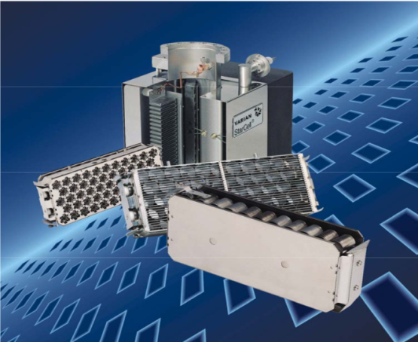
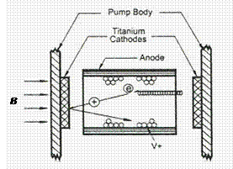
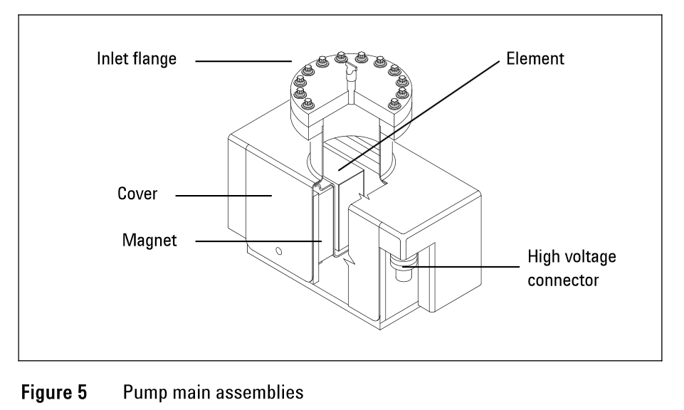
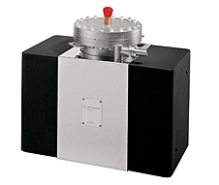
Ion Pump
An ion pump (also referred to as a sputter ion pump) is a type of vacuum pump capable of reaching pressures as low as 10⁻¹¹ mbar under ideal conditions. An ion pump ionizes gas within the vessel appling a strong electrical voltage, typically 3–7 kV, which allows the ions to accelerate and be captured by a solid electrode.
Ion pumps and are available in four types:
StarCell
Triode
Noble Diode
Diode

Slide 25
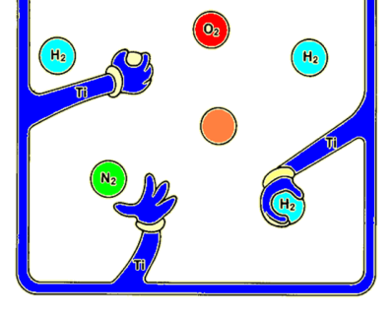
Getter Pump
Evaporable Getters
Non-Evaporable Getters - NEG
The active Ti surface is obtained under vacuum with subsequent depositions of a metal film of Ti in the system
Also in this case, a particular material alloy (NEG coating) has the property to absorb the molecules of gas. To activate the surface it is necessary to simply heat it at 250-300 C.
TSP
The titanium is heated to the sublimation temperature (about 1100 ° C).
The gas particles which collide on the layer of titanium are linked via chemi-absorption.
Main Getter Elements are:
Barium, zirconium, tantalum, molybdenum, vanadium, titanium, niobium
NEG Coating : i.e. 84% Zr; 16% Al or Zr, Fe, V
About 0,07 mm
Support: plated iron or nickel, tickeness 0,2 mm

Slide 26
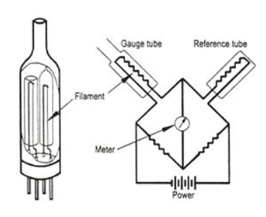
Thermal Conductivity VacuumGauge
(Pirani)
This measurement principle utilizes the thermal conductivity of gases for the purpose of pressure measure in the range from 10⁻⁴mbar to atmospheric pressure.
Two platinum filaments are used as two arms of a Wheatstone bridge:
The filament in the reference tube is immersed in a gas at a fixed pressure in the high vacuum regime;
⇒ The measurement filament is exposed to the vacuum system environment.
Both filaments are heated to a constant temperature by the current through the bridge.
Advantages:
Stable measurements within a wide temperature range
Highly resistant to overpressure
The resistance change define the vacuum pressure
When gas molecules in the vacuum system hit the filament, thermal energy is conducted away. This loss in thermal energy is detected and replaced by the feedback circuit to the power supply. The amount of electrical current needed to restore the temperature of the filament is then converted to a pressure readout.
Pirani gauges have inherent errors because the thermal conductivity and viscosity for each specific gas is different and varies non-linearly with pressure. They are therefore not used for measuring absolute pressures.
Notes:
Scelta del vacuometro
Campo di pressione
Precisione necessaria
Condizioni dell’ambiente circostante
Compatibilita’ con altri strumenti
Integrazione/automazione richiesta
il Pirani misura la resistenza del filamento riscaldato per indicarne la temperatura, talvolta attraverso l’uso di un ponte Wheatstone calibrato.
Campo: da 1000 mbar a 10⁻³ mbar
Tempo di risposta: lento - 100 msec
Applicazioni: qualsiasi camera per basso vuoto
Precisione: +/- 10% a 10⁻³ mbar

Slide 27
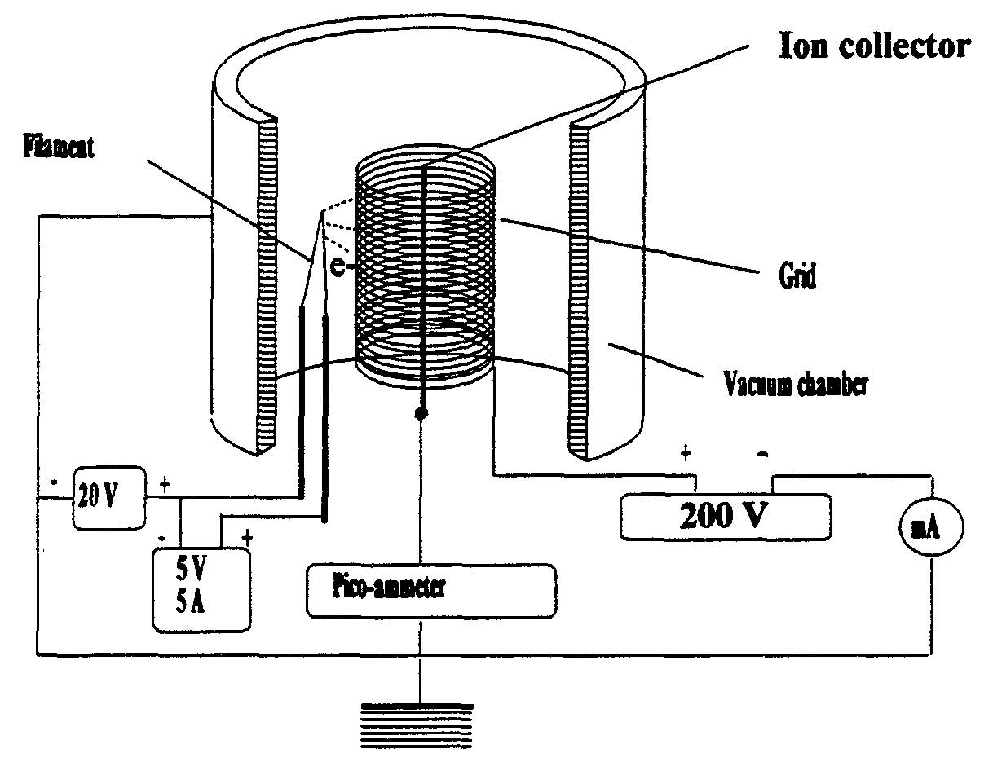
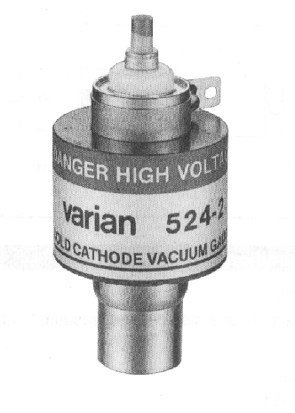
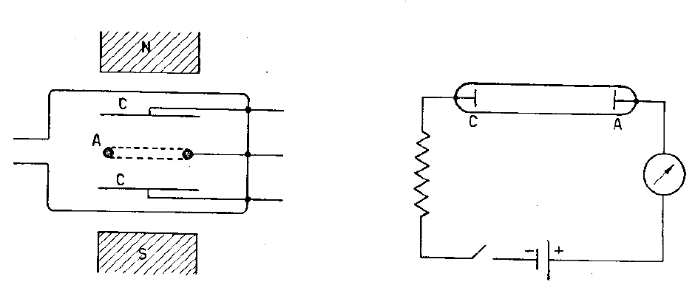
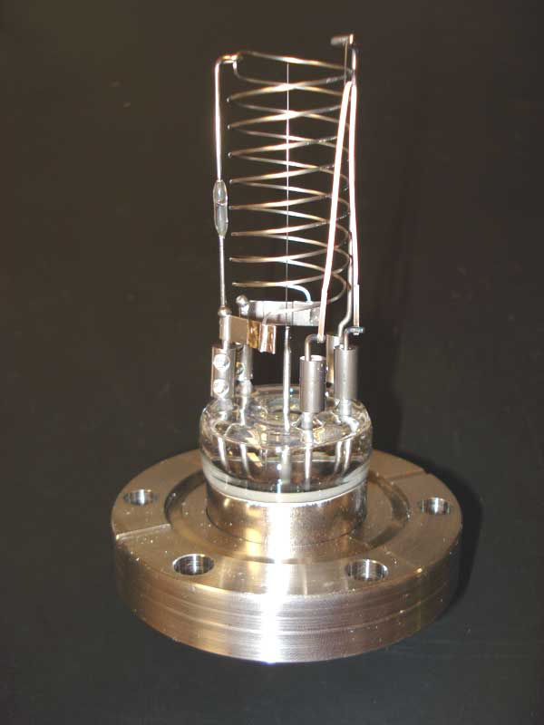
Vacuum Gauge based on Ionization Probability
Penning gauge: more stable, less precise
cold-cathode gauge
2 electrodes: anode, cathode+ permanent magnetic field
invented 1937 by Penning
precursor of sputter-ion pump
nonlinear dependence
Bayard-Alpert gauge: less stable, more precise
hot-cathode gauge,
3 electrodes: filament, collector, grid
invented 1950, revolution in vacuum technology linear dependence
Here the pressure is measured through a gas discharge in the gauge head where the gas discharge is obtained by applying a high voltage.
The pressure range from 10⁻⁴ to 1 x 10⁻⁹ mbar.
Molecules are ionized and collected.
Pressure reading is determined by the electronics from the collector current.
Advantages:
The sensitivity of the device is more different for each gas;
is necessary to degas the head of measure to avoid outgassing
Advantages:
is rugged enough
is resistant to sudden variations of pressure.
Low tendency for contamination (also during argon operation) due to high voltage reduction after ignition of the plasma and due to the titanium cathodes

Slide 28
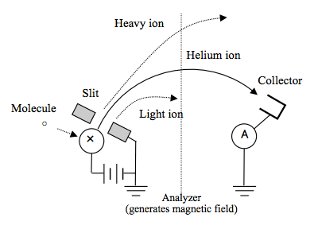
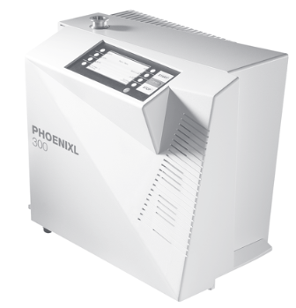
Helium Leak Detectors
What is a Helium Mass Spectrometer Leak Detector?
It is a Helium-specific partial pressure analyzer
It detects Helium applied as a tracer or probe gas
It consists of:
the mass spectrometer tube tuned on He
it’s own vacuum system capable of 10⁻⁵ mbar in the spectrometer tube
a sensitive and stable amplifier valves, and auxiliary pumps for interfacing to vacuum system
a display for monitoring leak rate
Sensitivity is 10⁻¹⁰ mbar or better
⇒A helium leak detector permits the localization of leaks and the quantitative determination of the leak rate, i.e. the gas flow through the leak. Such a leak detector is therefore a helium flow meter.
In practice the leak detector performs this task by firstly evacuating the part which is to be tested, so that gas from the outside may enter through an existing leak due to the pressure difference present. If there is a leak, helium can enter in the system from the leak (for example by using a spray gun). This helium flows into the leak detector and is detected.
System
He
Notes:
Principle of Detection
The leaked helium gas is ionized by the electron beam from the filament within the ion chamber of the analyzing tube. The ions are accelerated and move out through a slit and then pass through the magnetic field generated by the analyzer. Since the circular trajectories of the ions depend on their mass, the collector can catch only the helium ions and detect helium.

Slide 29
VACUUM SYSTEM DESIGN
Vacuum Materials
Clean Process
Laboratory Experience

Slide 30
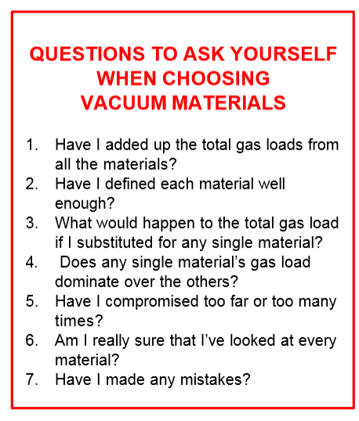
Vacuum Materials

Slide 31
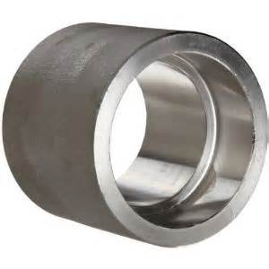
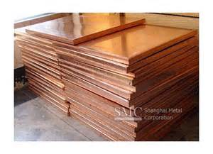
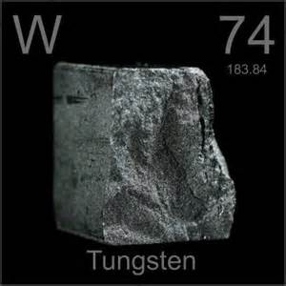
Materials to use: Metals
STAINLESS STEEL
Most common choice in HV and UHV systems
304 – common,
304L – Low carbon variant of 304 especially in UHV systems
321 – for when low magnetic permeability is required
BUT…. Avoid 303 grade – contains sulphur and tends to outgas
COPPER (Oxygen-free) C10100 & C10200
‘Oxygen-free’ type is widely used
Easy to machine
Impermeable to hydrogen and helium
Low sensitivity to water vapour
TUNGSTEN
Can be used at high temperatures
Can be used for filaments
BUT…Becomes brittle when work-hardened
ALUMINIUM & AL ALLOYS
Low outgassing
Easy to machine
Low weight and lower cost
BUT…Some alloys contain a high proportion of Zinc ; Must NOT be anodised; Poor strength at high temperatures ;
Not easy to weld

Slide 32
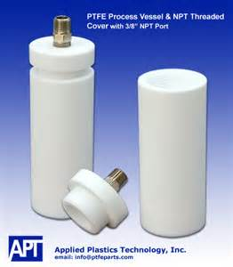
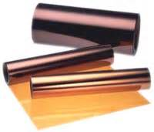
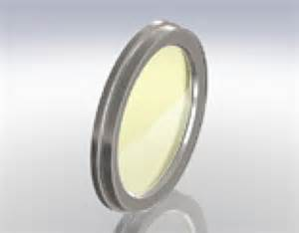
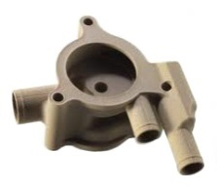
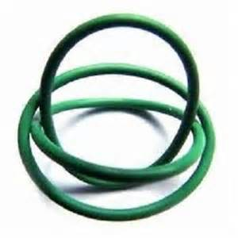
Materials to use: Ceramics
Materials to use: Polymers
PORCELAIN AND ALUMINA
Excellent electrical insulation
Non-porous if fully vitrified
Low coefficient of thermal expansion – usable to 1500ºC
BOROSILICATE GLASS
Used for viewports
Can be machined and joined with metals
Low coefficient of thermal expansion – resistant to thermal shock
PTFE-TEFLON
Good electrical insulator
Tolerant to high temperatures
Low outgassing
BUT…Cannot be used as a barrier between vacuum and atmosphere as it is permeable to gases
KAPTON
Good electrical insulator
Tolerant to high temperatures
Very low outgassing
Available in tape and film form
PEEK – Polyether ether ketone
Excellent mechanical & chemical resistance
Suitable for UHV applications
Very low outgassing
BUT…Has a melting point of 343ºC
VITON
Used for demountable seals (‘O’ rings etc.)
Can also be used as a seating face in valves
Good electrical insulator
Good chemical resistance
Bakeable to 200ºC

Slide 33
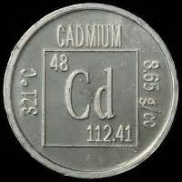
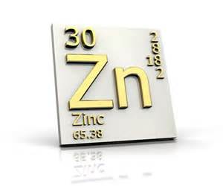
Materials To Avoid
because of the high vapor pressure
CADMIUM
Often present in the form of plating (fasteners etc.) or in some brazing alloys
ZINC
Is a problem in high vacuum and high temperatures. Present in some alloys like brass (some electrical fittings)
MAGNESIUM
Low melting point (650ºC at atmosphere). Contains free hydrogen gas
PVC
Often found in wire insulation, dust caps etc.
POLYMERS
Many have an affinity to water
Especially plastic tapes. Mould release residue can be an issue too. Polymers may generate a static charge attracting dust
Nylon has a high outgassing rate

Slide 34
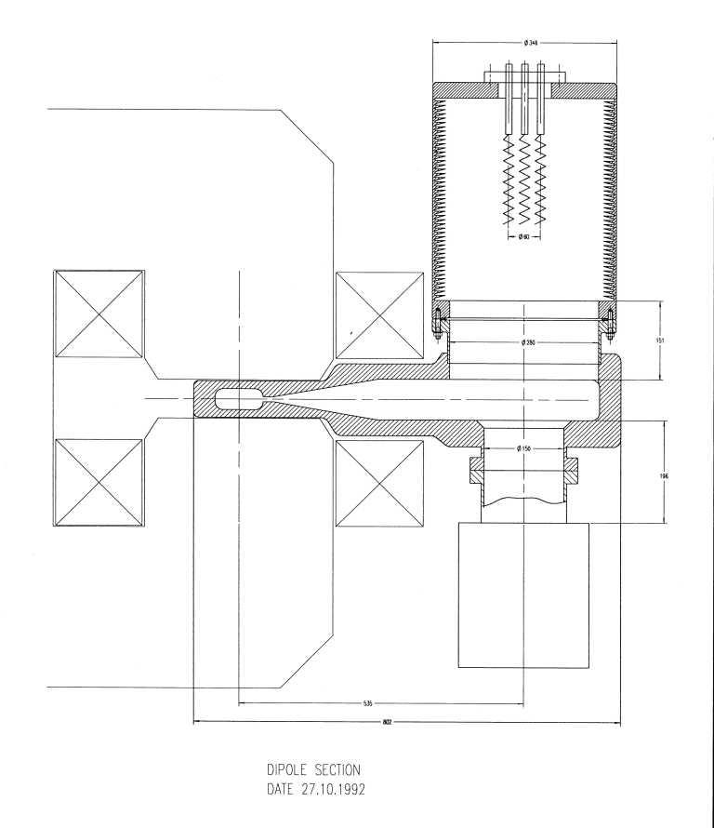
Synchrotron Radiation
When work with a circular machine we have a important radiation due at the synchrotron light .
Two main parameters assist to select the vacuum chamber material:
the synchrotron radiation power density;
the secondary electron yield coefficient.
The material that fulfills these requirements is Aluminum. Moreover, a suitable water cooling must be adopted
The main process of gas desorption in beam operation is photodesorption i.e. desorption caused by SR.
In order to evacuate the beam pipes we can use:
A distribuited pumping scheme using a stryp-type nonevaporable getter (NEG) and we can use these
pumps irrespective of the presence of magnetic fields.(The maximum Pumping Speed is 160l/s )
Lumped NEGs can be used for the straight section as necessary.
Coating: NEG (Ti-Zr-V), TiN, Graphite

Slide 35
Bake-out
To achieve pressures in the ultra-high vacuum range (<10⁻⁸ hPa) the following conditions must be met:
The base pressure of the vacuum pump should be a factor of 10 lower than the required ultimate pressure.
The materials used for the vacuum chamber and components must be optimized for minimum outgassing and have an appropriate surface finish grade.
Metallic seals (e. g. CF flange connections or Helicoflex seals for ISO flange standards) should be used.
Clean work is a must for ultra-high vacuum, i. e. all parts must be thoroughly cleaned before installation and must be installed with grease-free gloves.
The equipment and high vacuum pump must be baked out.
Leaks must be avoided and eliminated prior to activating the heater.
A helium leak detectors or mass spectrometer must be used for this purpose.
Bake-out significantly increases desorption and diffusion rates, and this produces significantly shorter pumping times. As one of the last steps in the manufacturing process, chambers for UHV use can be annealed at temperatures of up to 900 °C.
N.B: If stainless steel vessels with an appropriate surface finish grade and metal seals are used, bake-out temperatures of 120°C and heating times of approximately 48 hours are sufficient for advancing into the pressure range of 10⁻¹⁰ mbar.

Slide 36
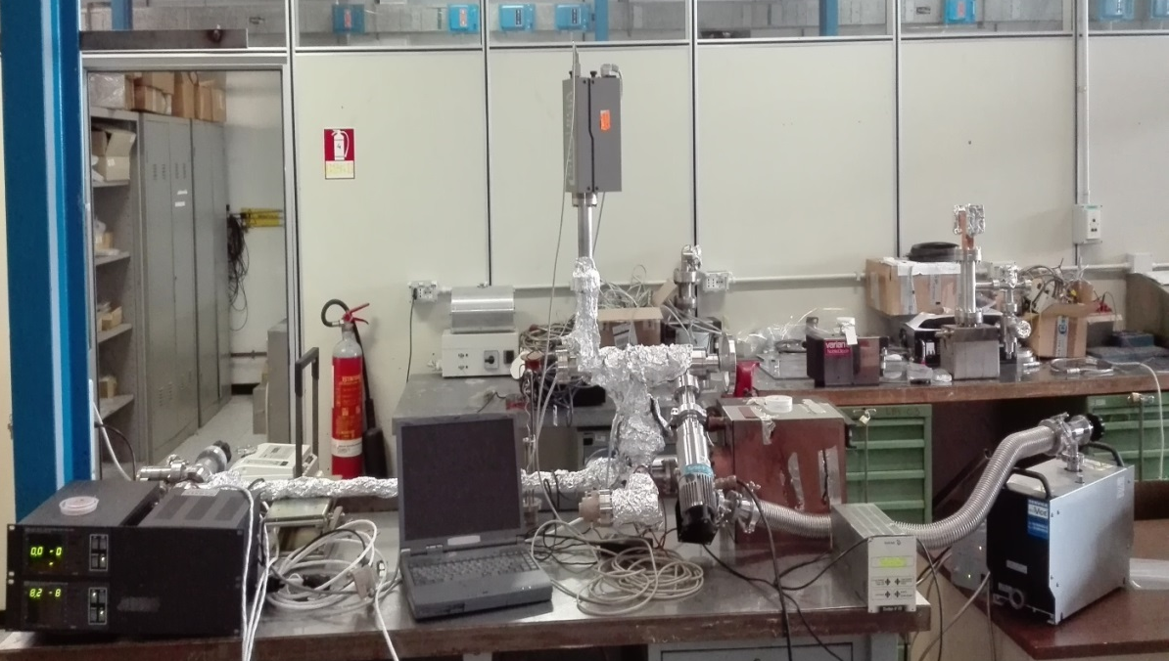
LABORATORY EXPERIENCE

