Slide 1
Photo Reflectivity and Photo Electron Yield
of technical surfaces
A.Liedl¹, E. La Francesca^{1,2}, M. Angelucci¹, and R. Cimino¹
¹INFN – Laboratori Nazionali di Frascati
²Università “Sapienza “ di Roma
In collaboration with F. Schäfers and F. Siewert
Helmholtz-Zentrum, Berlin

Slide 2
Synchrotron Radiation
Vacuum Chamber Wall
Absorbed Radiation
Italy, La Biodola Bay, Isola d'Elba 3-7June ‘18
Photo Stimulated Desorption
Heat Load
PhotoYield
Single bunch Instability
Seeds E-Cloud
Heat Load
Beam Instabilities
Vacuum Instability
Liedl A. et al. -Photo reflectivity and PEY of technical surfaces
Photon Tracing (hence Reflectivity) is essential to understand where these detrimental phenomena occur
It is important to measure such quantities in condition as close as possible to operation

Slide 3
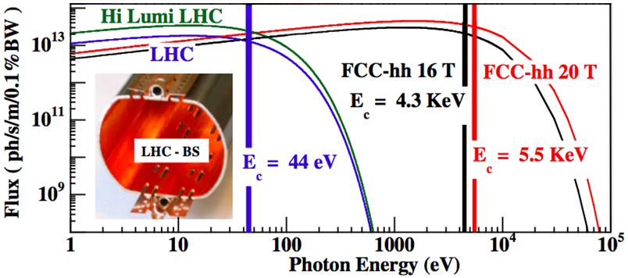
Synchrotron Radiation on High Energy Accelerator Walls
Italy, La Biodola Bay, Isola d'Elba 3-7June ‘18
Grazing angles: e.g LHC 0.28° FCC-hh 0.07°
Radiation Energy Spectrum: from eV to several keV
Liedl A. et al. -Photo reflectivity and PEY of technical surfaces
R. Cimino, V. Baglin and F. Schäfers, PRL. 115 (2015) 264804

Slide 4
For such conditions, there are few experimental setups that could work close to the required geometry
A.A.Sokolov,et al,Proc.of SPIE92060J-1-13(2014)
BESSYII “Optics” beamline
Italy, La Biodola Bay, Isola d'Elba 3-7June ‘18
Experimental Parameters
Phot. Energy range 35$÷$1800 eV
Beam height h=0.3 mm
Incident Beam measurement
GaAsP Photodiodes (4x4mm) (0.1*4mm)
Incidence angle 0.1, 0.25, 0.5, 1 deg
Liedl A. et al. -Photo reflectivity and PEY of technical surfaces
REFLECTOMETER

Slide 5
θ_{r}
Φ
i
θ/2θ geometry allows to detect the specular reflected signal.
Two possible way
Contemporary, the current generated on the insulated sample is detected for PY
Fixed energy and incident angle.
The detector moves around the sample mapping the angular distribution of the Reflected and Scattered signal.
Liedl A. et al. -Photo reflectivity and PEY of technical surfaces
Fixed θ/2θ
Beam Energy Scan
Fixed Beam Energy
θ/2θ Scan
$$R=\frac{I}{I_{0}}$$
$$PY=\frac{N_{e}}{N_{γ}}$$

Slide 6
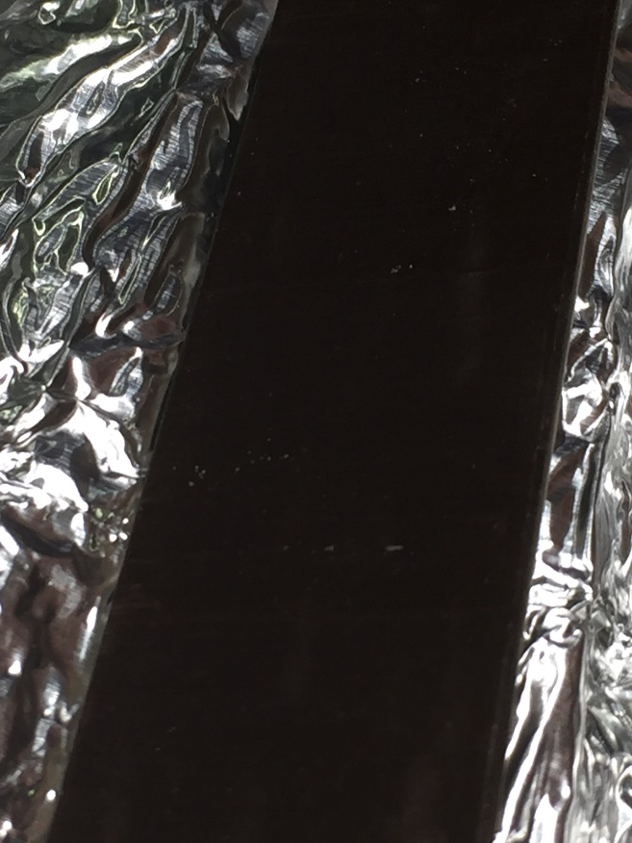
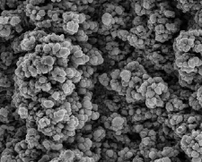
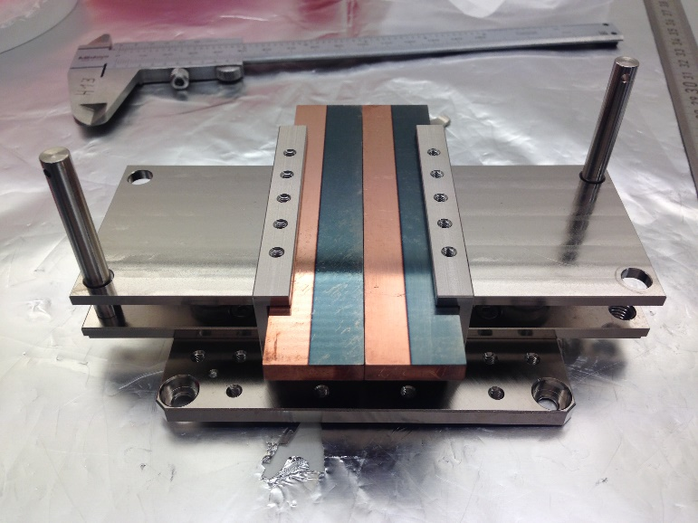
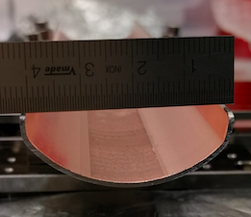
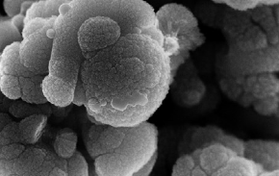
Investigated Samples
Italy, La Biodola Bay, Isola d'Elba 3-7June ‘18
50 μm
5 μm
LHC Saw Tooth
Cu (different Roughness)
Cu+ amorphous Carbon Thin Film
LASE Cu
Liedl A. et al. -Photo reflectivity and PEY of technical surfaces
LHC Cu
And: NEG, Stainless Steel, ...

Slide 7
Investigated Samples
Italy, La Biodola Bay, Isola d'Elba 3-7June ‘18
50 μm
5 μm
LHC Saw Tooth
Cu (different Roughness)
Cu+ amorphous Carbon Thin Film
LASE Cu
Liedl A. et al. -Photo reflectivity and PEY of technical surfaces
LHC Cu
And: NEG, Stainless Steel, ...

Slide 8
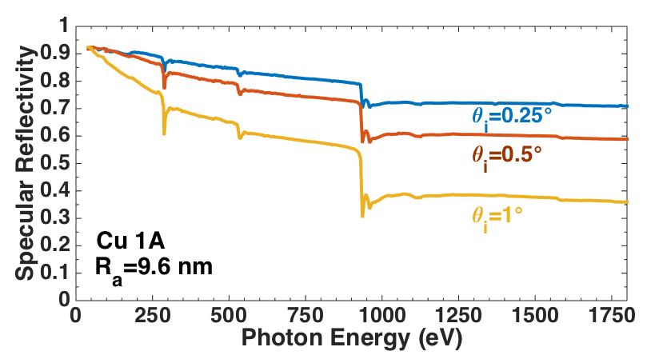
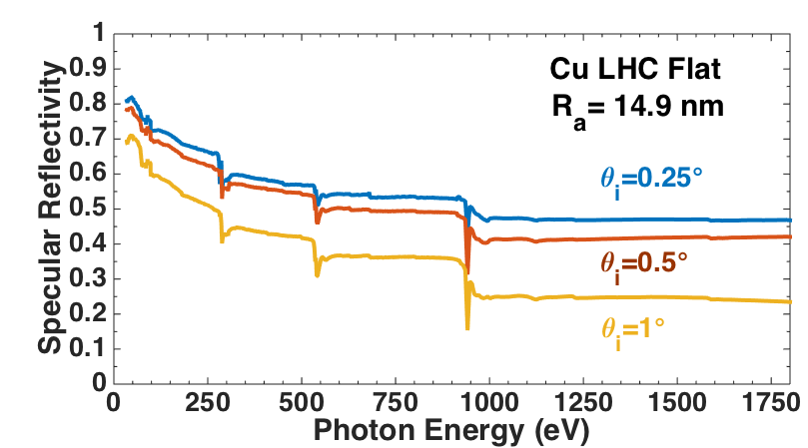
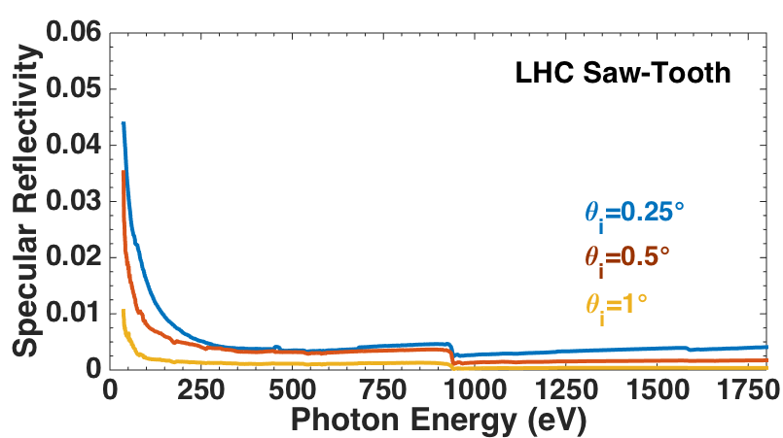
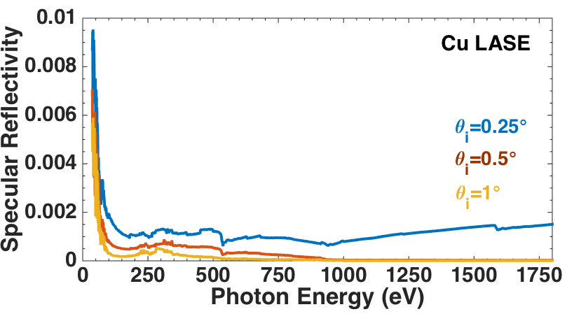
Specular Reflectivity
Italy, La Biodola Bay, Isola d'Elba 3-7June ‘18
Liedl A. et al. -Photo reflectivity and PEY of technical surfaces

Slide 9
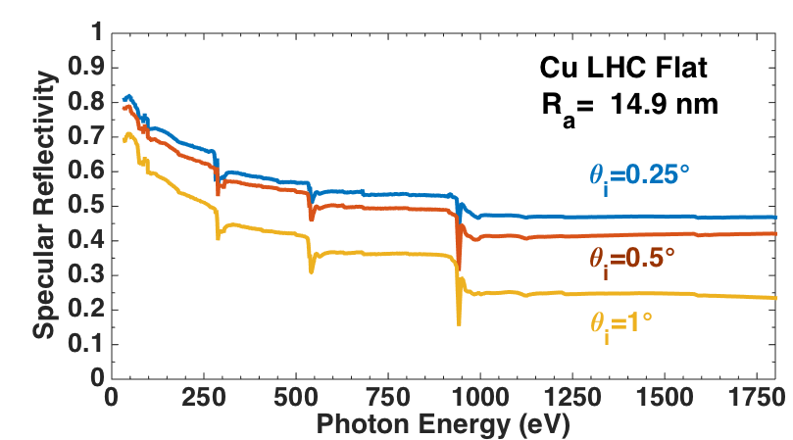
Specular Reflectivity
Italy, La Biodola Bay, Isola d'Elba 3-7June ‘18
Liedl A. et al. -Photo reflectivity and PEY of technical surfaces

Slide 10
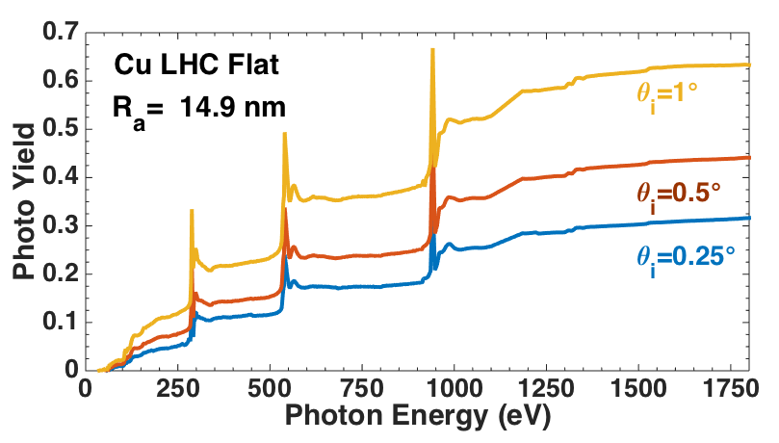
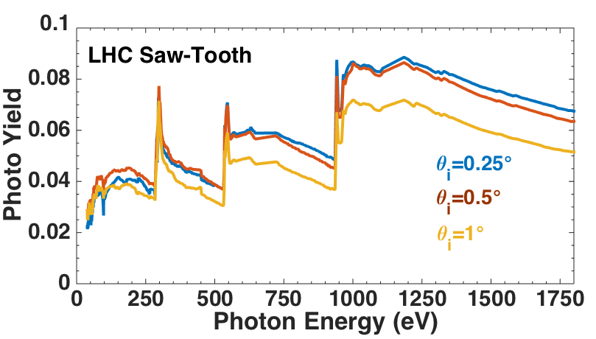
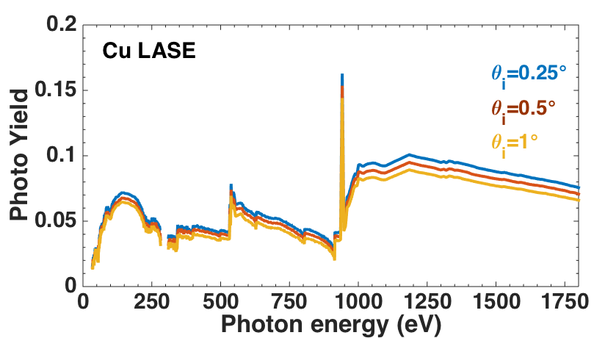
Photon Yield
Italy, La Biodola Bay, Isola d'Elba 3-7June ‘18
Liedl A. et al. -Photo reflectivity and PEY of technical surfaces

Slide 11
Photon Yield
Italy, La Biodola Bay, Isola d'Elba 3-7June ‘18
Liedl A. et al. -Photo reflectivity and PEY of technical surfaces

Slide 12
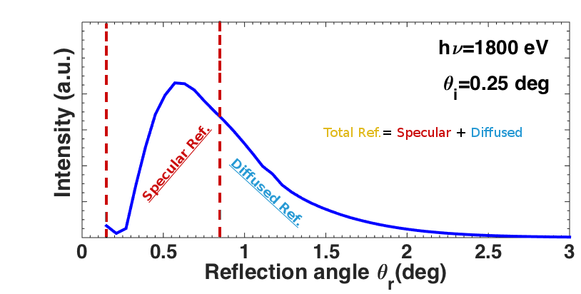
Experimental Observation
Angular Distribution of Reflectivity
Italy, La Biodola Bay, Isola d'Elba 3-7June ‘18
Angular Distribution of Reflectivity is measured keeping the incidence angle and the photon Energy fixed and mapping Reflected and Scattered radiation with the detector over the reachable Solid Angle Φ[0;7.4] θ_{r}[0;5]
Detector
Acceptance angle
θ_{r}
Φ
Liedl A. et al. -Photo reflectivity and PEY of technical surfaces
Integrating the angular distribution we calculate the Total Reflectivity

Slide 13
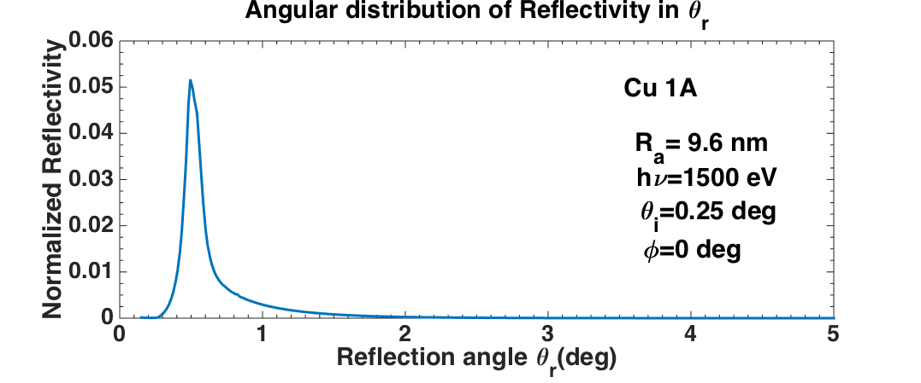
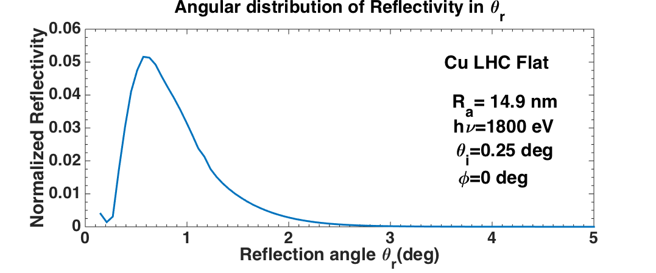
Experimental Observation
Angular Distribution of Reflectivity
Italy, La Biodola Bay, Isola d'Elba 3-7June ‘18
Angular Distribution of Reflectivity is measured keeping the incidence angle and the photon Energy fixed and mapping Reflected and Scattered radiation with the detector over the reachable Solid Angle Φ[0;7.4] θ_{r}[0;5]
Detector
Acceptance angle
θ_{r}
Φ
Liedl A. et al. -Photo reflectivity and PEY of technical surfaces
Integrating the angular distribution we calculate the Total Reflectivity

Slide 14
Monochromatic values
Sample | hν (eV) | q_{i} (deg) | Specular Reflect. (E) ($±$ 10%) | Total Reflect. (E) (±10%) | PY (E) (±2%)
Cu + Carbon | 1500 | 0.25° | 0.77 | 0.92 | 0.09
 |  | 0.5° | 0.70 | 0.90 | 0.14
Cu Ra=9.6 nm | 1500 | 0.25° | 0.61 | 0.74 | 0.18
 |  | 0.5° | 0.57 | 0.67 | 0.30
LHC-Flat Ra=14.9 nm | 1800 | 0.25° | 0.468 | 0.722 | 0.32
 |  | 0.5° | 0.421 | 0.627 | 0.44
LHC-ST | 1800 | 0.25° | 0.0040 | 0.054 | 0.07
 |  | 0.5° | 0.0017 | 0.006 | 0.06
LASE | 1800 | 0.25° | 0.0015 | 0.007 | 0.08
 |  | 0.5° | 2.50E-05 | 0.0003 | 0.07
Italy, La Biodola Bay, Isola d'Elba 3-7June ‘18
Liedl A. et al. -Photo reflectivity and PEY of technical surfaces

Slide 15
Monochromatic values
Sample | hν (eV) | q_{i} (deg) | Specular Reflect. (E) ($±$ 10%) | Total Reflect. (E) (±10%) | PY (E) (±2%)
Cu + Carbon | 1500 | 0.25° | 0.77 | 0.92 | 0.09
 |  | 0.5° | 0.70 | 0.90 | 0.14
Cu Ra=9.6 nm | 1500 | 0.25° | 0.61 | 0.74 | 0.18
 |  | 0.5° | 0.57 | 0.67 | 0.30
LHC-Flat Ra=14.9 nm | 1800 | 0.25° | 0.468 | 0.722 | 0.32
 |  | 0.5° | 0.421 | 0.627 | 0.44
LHC-ST | 1800 | 0.25° | 0.0040 | 0.054 | 0.07
 |  | 0.5° | 0.0017 | 0.006 | 0.06
LASE | 1800 | 0.25° | 0.0015 | 0.007 | 0.08
 |  | 0.5° | 2.50E-05 | 0.0003 | 0.07
Italy, La Biodola Bay, Isola d'Elba 3-7June ‘18
Decreasing Reflectivity
Liedl A. et al. -Photo reflectivity and PEY of technical surfaces

Slide 16
Monochromatic values
Sample | hν (eV) | q_{i} (deg) | Specular Reflect. (E) ($±$ 10%) | Total Reflect. (E) (±10%) | PY (E) (±2%)
Cu + Carbon | 1500 | 0.25° | 0.77 | 0.92 | 0.09
 |  | 0.5° | 0.70 | 0.90 | 0.14
Cu Ra=9.6 nm | 1500 | 0.25° | 0.61 | 0.74 | 0.18
 |  | 0.5° | 0.57 | 0.67 | 0.30
LHC-Flat Ra=14.9 nm | 1800 | 0.25° | 0.468 | 0.722 | 0.32
 |  | 0.5° | 0.421 | 0.627 | 0.44
LHC-ST | 1800 | 0.25° | 0.0040 | 0.054 | 0.07
 |  | 0.5° | 0.0017 | 0.006 | 0.06
LASE | 1800 | 0.25° | 0.0015 | 0.007 | 0.08
 |  | 0.5° | 2.50E-05 | 0.0003 | 0.07
Italy, La Biodola Bay, Isola d'Elba 3-7June ‘18
Decreasing Total Reflectivity
Liedl A. et al. -Photo reflectivity and PEY of technical surfaces

Slide 17
Monochromatic values
Sample | hν (eV) | q_{i} (deg) | Specular Reflect. (E) ($±$ 10%) | Total Reflect. (E) (±10%) | PY (E) (±2%)
Cu + Carbon | 1500 | 0.25° | 0.77 | 0.92 | 0.09
 |  | 0.5° | 0.70 | 0.90 | 0.14
Cu Ra=9.6 nm | 1500 | 0.25° | 0.61 | 0.74 | 0.18
 |  | 0.5° | 0.57 | 0.67 | 0.30
LHC-Flat Ra=14.9 nm | 1800 | 0.25° | 0.468 | 0.722 | 0.32
 |  | 0.5° | 0.421 | 0.627 | 0.44
LHC-ST | 1800 | 0.25° | 0.0040 | 0.054 | 0.07
 |  | 0.5° | 0.0017 | 0.006 | 0.06
LASE | 1800 | 0.25° | 0.0015 | 0.007 | 0.08
 |  | 0.5° | 2.50E-05 | 0.0003 | 0.07
Italy, La Biodola Bay, Isola d'Elba 3-7June ‘18
82%
$$\frac{Specular R.}{Total R.}$$
65%
Liedl A. et al. -Photo reflectivity and PEY of technical surfaces

Slide 18
Monochromatic values
Sample | hν (eV) | q_{i} (deg) | Specular Reflect. (E) ($±$ 10%) | Total Reflect. (E) (±10%) | PY (E) (±2%)
Cu + Carbon | 1500 | 0.25° | 0.77 | 0.92 | 0.09
 |  | 0.5° | 0.70 | 0.90 | 0.14
Cu Ra=9.6 nm | 1500 | 0.25° | 0.61 | 0.74 | 0.18
 |  | 0.5° | 0.57 | 0.67 | 0.30
LHC-Flat Ra=14.9 nm | 1800 | 0.25° | 0.468 | 0.722 | 0.32
 |  | 0.5° | 0.421 | 0.627 | 0.44
LHC-ST | 1800 | 0.25° | 0.0040 | 0.054 | 0.07
 |  | 0.5° | 0.0017 | 0.006 | 0.06
LASE | 1800 | 0.25° | 0.0015 | 0.007 | 0.08
 |  | 0.5° | 2.50E-05 | 0.0003 | 0.07
Italy, La Biodola Bay, Isola d'Elba 3-7June ‘18
TOP
Liedl A. et al. -Photo reflectivity and PEY of technical surfaces

Slide 19
Monochromatic values
Sample | hν (eV) | q_{i} (deg) | Specular Reflect. (E) ($±$ 10%) | Total Reflect. (E) (±10%) | PY (E) (±2%)
Cu + Carbon | 1500 | 0.25° | 0.77 | 0.92 | 0.09
 |  | 0.5° | 0.70 | 0.90 | 0.14
Cu Ra=9.6 nm | 1500 | 0.25° | 0.61 | 0.74 | 0.18
 |  | 0.5° | 0.57 | 0.67 | 0.30
LHC-Flat Ra=14.9 nm | 1800 | 0.25° | 0.468 | 0.722 | 0.32
 |  | 0.5° | 0.421 | 0.627 | 0.44
LHC-ST | 1800 | 0.25° | 0.0040 | 0.054 | 0.07
 |  | 0.5° | 0.0017 | 0.006 | 0.06
LASE | 1800 | 0.25° | 0.0015 | 0.007 | 0.08
 |  | 0.5° | 2.50E-05 | 0.0003 | 0.07
PY
(absorbed pht.)
Italy, La Biodola Bay, Isola d'Elba 3-7June ‘18
1.125
0,69
1,14
0,07
Liedl A. et al. -Photo reflectivity and PEY of technical surfaces
0,08

Slide 20
Investigated Samples
Cu & LHC Cu
VS
Roughness
Italy, La Biodola Bay, Isola d'Elba 3-7June ‘18
Side A
Sample | RMS Roughness (R_{a})
Cu 1A | 9.6 nm
Cu 2A | 27 nm
Cu 1B | 25 nm
Cu 2B | 643 nm
LHC | 14.9 nm
Polished
Lapped
Side B
Liedl A. et al. -Photo reflectivity and PEY of technical surfaces

Slide 21
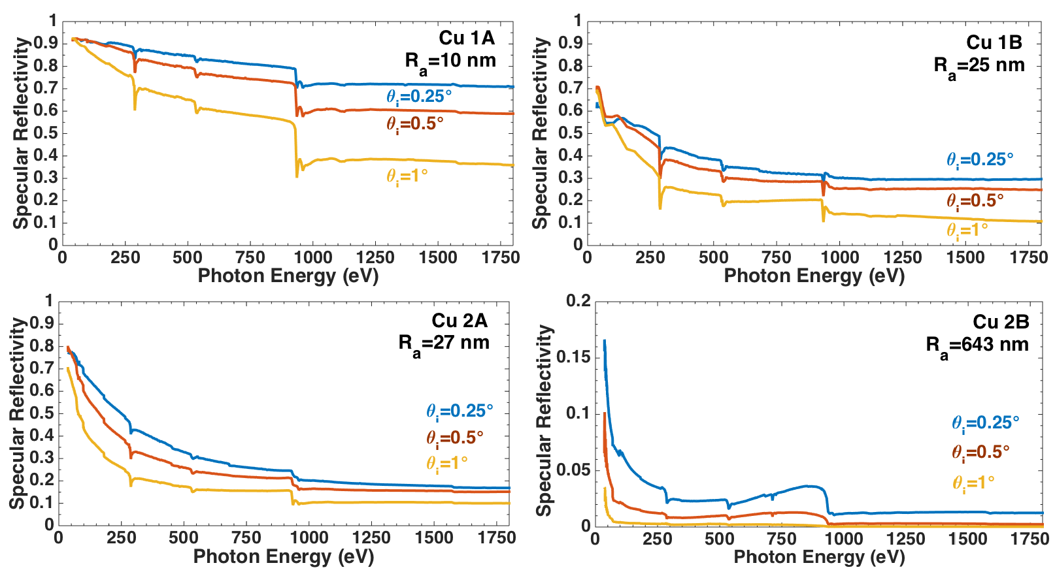
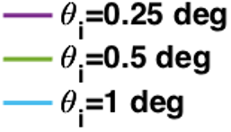
Specular Reflectivity VS Roughness
Italy, La Biodola Bay, Isola d'Elba 3-7June ‘18
Liedl A. et al. -Photo reflectivity and PEY of technical surfaces

Slide 22
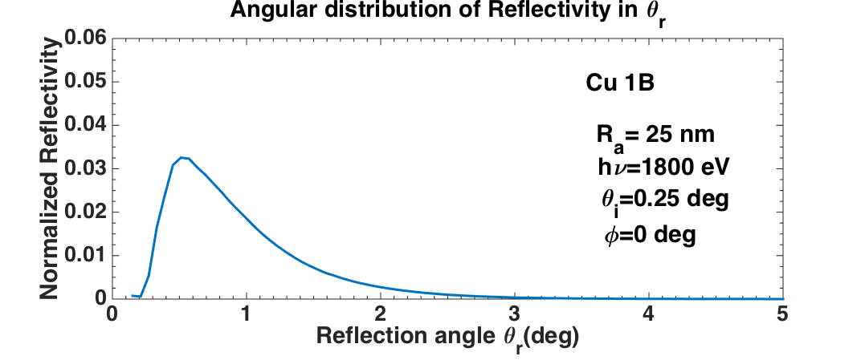
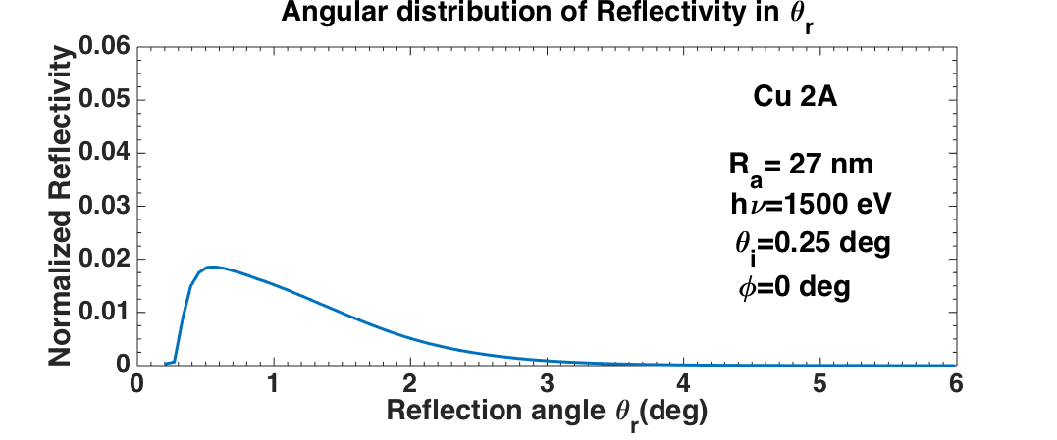
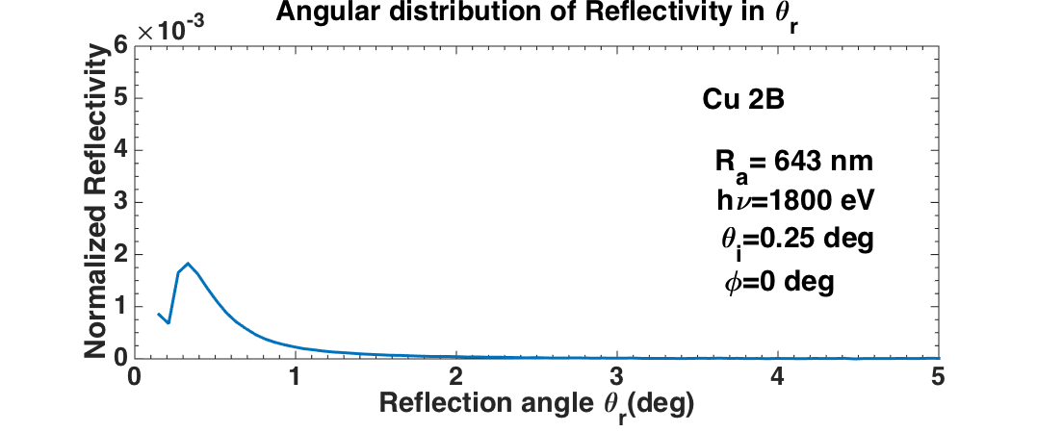
Angular Distribution VS Roughness
Italy, La Biodola Bay, Isola d'Elba 3-7June ‘18
Liedl A. et al. -Photo reflectivity and PEY of technical surfaces

Slide 23
Conclusion
Italy, La Biodola Bay, Isola d'Elba 3-7June ‘18
R and PY strongly depend on :
Material, angle of incidence and photon energy
Surface Contaminants at grazing angles
Thin film Coverage
Surface finish
Surface Treatments
There are setup which allow us to study these features,
providing useful data for the simulations
Liedl A. et al. -Photo reflectivity and PEY of technical surfaces

Slide 24
Italy, La Biodola Bay, Isola d'Elba 3-7June ‘18
Thank you for the attention!
Liedl A. et al. -Photo reflectivity and PEY of technical surfaces

