Slide 1
Time-dependent analyses at D⁰-D⁰ threshold
M. Rama, N. Neri, M. Giorgi, F. Martínez-Vidal, A. Oyanguren
XVII SuperB Workshop and Kick Off Meeting, Elba, 2011

Slide 2
Outline
Introduction
Time-dependence of correlated decays with CP violation
Sensitivity studies: preliminary results
Ideas for further studies

Slide 3
Some preliminary considerations
Different situation from B⁰-B⁰ system:
Flavor tagged D⁰ through D^{*+}→D⁰π⁺ decay allow time-dependent (TD) measurement at Υ(4S) with a flavor mistag of about 0.1% and relatively high purity due to Δm=m(D^{*+})-m(D⁰) cut.
Proper time resolution is about τ(D⁰)/2 ≈ 0.2 ps at Υ(4S) which is adequate for TD measurement.
In principle TD measurement can be done at Υ(4S) and it is not necessary to have coherent D⁰-D⁰ production…

Slide 4
Pro and cons for running at charm threshold
Pros:
Very clean environment, background extremely low;
Exploit quantum coherence: mixing, CPT, T, CPT analyses;
Produce CP-tagged events;
Access to D⁰-D⁰ relative phases;
Systematic errors reduction -and different wrt ϒ(4S)- due to background and Dalitz model uncertainties.
Cons:
Time-dependent measurements (might) require larger CM boost compared to the B⁰-B⁰case to achieve adequate time resolution;
Reconstruction efficiency decreases with large CM boost. Need to determine the optimal boost value.

Slide 5
Time-dependence at D⁰-D⁰ threshold and at Υ(4S)
At Psi(3770):
Identical time-dependence wrt ϒ(4S) when using flavor tag!
z = CPT violation parameter
q, p = indirect CP violation parameters
At ϒ(4S) using D^{*+} tagged events:

Slide 6
Some numbers for comparison of D⁰ flavor tagged modes
D⁰→K⁺π⁻ (WS) as an example:
Extrapolating from BaBar analysis (PRL 98, 211802, 2007) 4030 WS events (384 fb⁻¹) we expect 787K WS events at ϒ(4S) with 75fb⁻¹. Purity is about 60% and mistag fraction is about 0.1%.
About 15K WS events (with semileptonic flavor tag) at Ψ(3770) (500 fb⁻¹) with very high purity. Mistag level?
It looks like there is no advantage in running at Psi(3770) for reducing the statistical error for flavor tagged modes.

Slide 7
Decays considered for running at Psi(3770) - I
Expected about 50 events with 500 fb⁻¹ of Psi(3770) data in both cases. Time-integrated measurement is probably more appropriate.

Slide 8
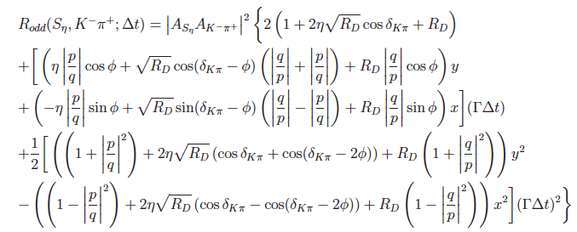
Decays considered for running at Psi(3770) - II
Expected about 100K events with 500 fb⁻¹ of Psi(3770) data.
Time-dependence exclusive at Psi(3770).
See preliminary results in the following slides.

Slide 9
Ideas for further studies
Time-dependent Dalitz plot analyses
CPT/CP, CP/T studies
Combined analysis of double-tags

Slide 10
Time-dependent Dalitz plot analyses
Self-conjugate modes allow to extract mixing and CP violation parameters without D⁰-D⁰ relative phase ambiguity when assuming CP is conserved in the decay.
In SM we expect CPV in the D⁰ decay due to CPV in KS mixing at the level of 3x10⁻³.
Is the above assumption still valid for the precision that we aim at SuperB?
Dalitz model uncertainty can be reduced using Psi(3770) data. Is it possible to perform a TDDP analysis in a model independent way for extracting mixing and CPV parameters? Can we relax the assumption of CP conservation in decays?

Slide 11
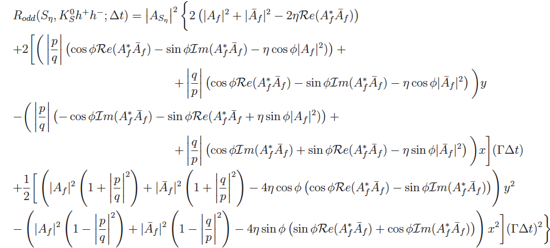
tag
We are currently trying to understand if there is the possibility to extract mixing and CPV observables in a model independent way and without assuming CP conservation in the decay.

Slide 12
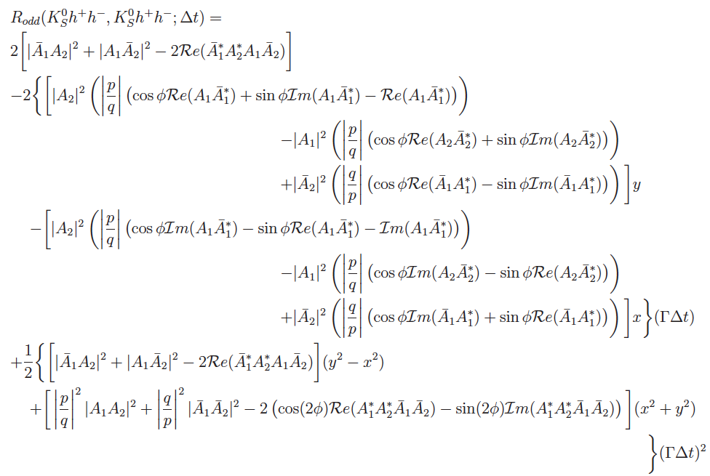
for double 3-body decays
We are currently trying to understand if there is the possibility to extract mixing and CPV observables in a model independent way and without assuming CP conservation in the decay.

Slide 13
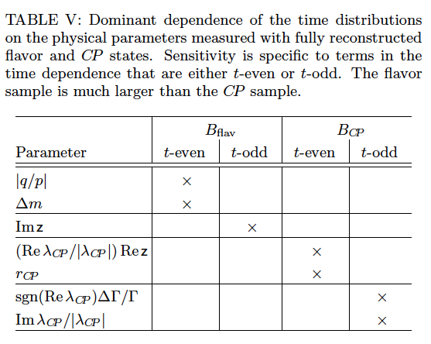
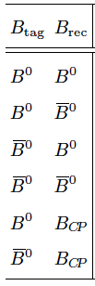
CPT/CP and CP/T studies
Exploit quantum coherence as in B⁰-B⁰bar case where we use combination of BCP, BFLAV for Breco, BTAG modes.
This approach might potentially be applied to D⁰-D⁰
Important to have Δt <0 and Δt>0

Slide 14
Combining all doble tags
Ultimately, exploit quantum coherence of the D⁰-D⁰ system and different dependences for all possible combination of double-tags to extract mixing and CPV (in interference, mixing and decay), as well as CPTV
 | CP | Kpi | Semilep | 3-body
CP
Kpi
Semilep
3-body

Slide 15
Sensitivity studies: preliminary results

Slide 16
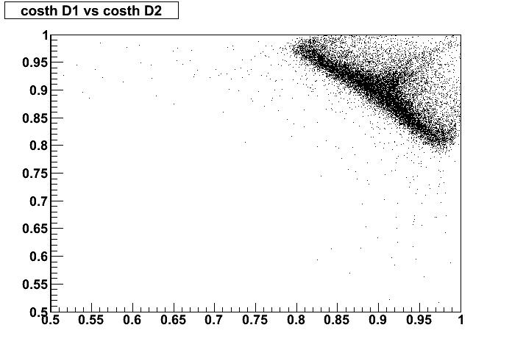
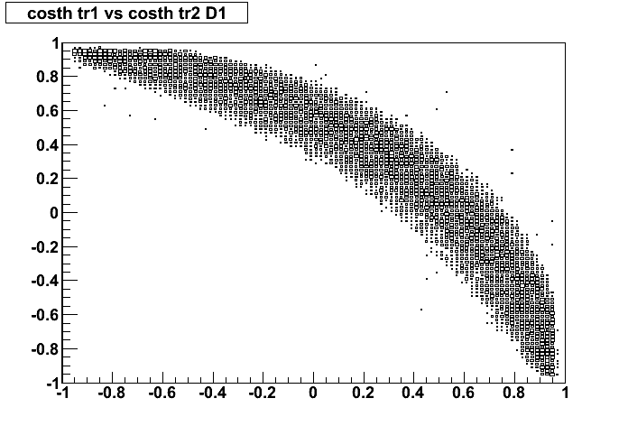
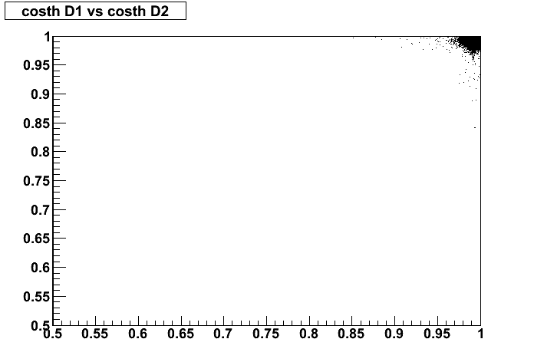
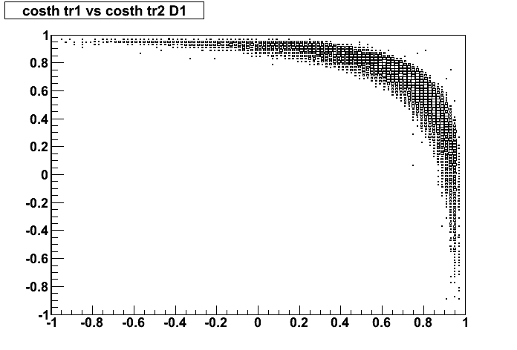
D kinematics: cosTheta distributions
cosTheta D1 vs cosTheta D2
cosTheta K vs cosTheta π in D→Kπ
βγ=0.30
D mesons decay inside the beam-pipe
βγ=0.90

Slide 17
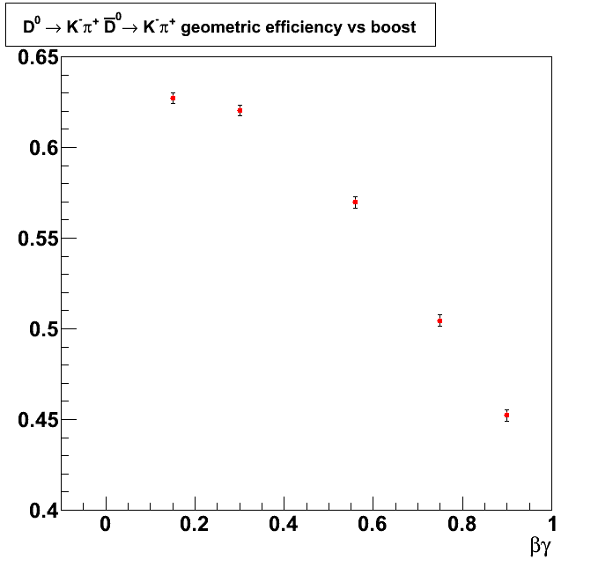
Geometric efficiency as a function of the CM boost

Slide 18
Δt reconstruction
The flight lengths of the two Ds are reconstructed through a combined beam spot constrained vertex fit
Proper times are computed from the flight lengths and the D momenta
D reco vertex
beam spot (z-x plane, not in scale)
D reco vertex

Slide 19
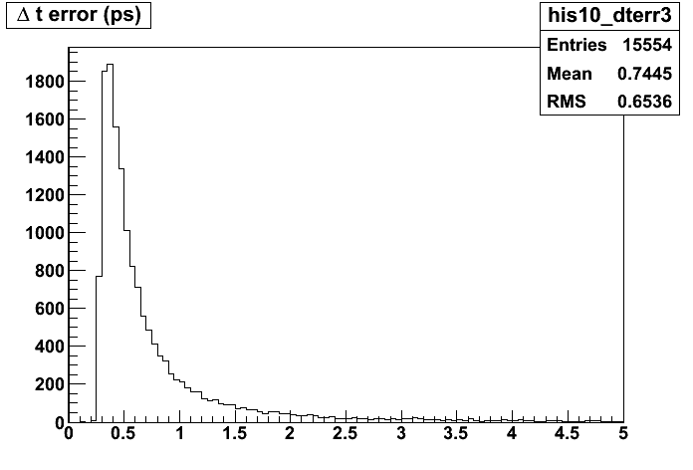
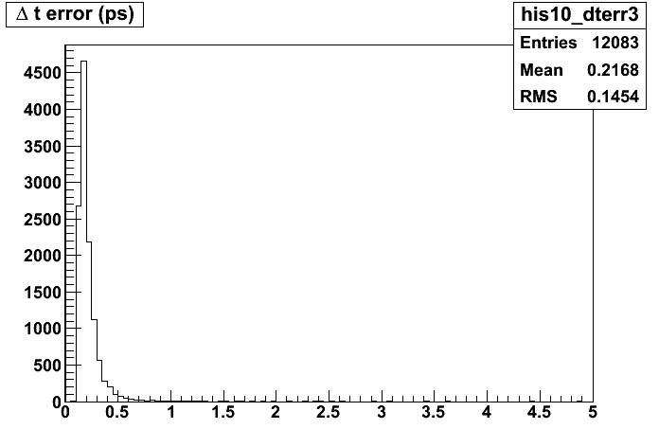
Δt error distribution
βγ=0.30
βγ=0.90
<error> = 0.745 ps
<error> = 0.217 ps

Slide 20
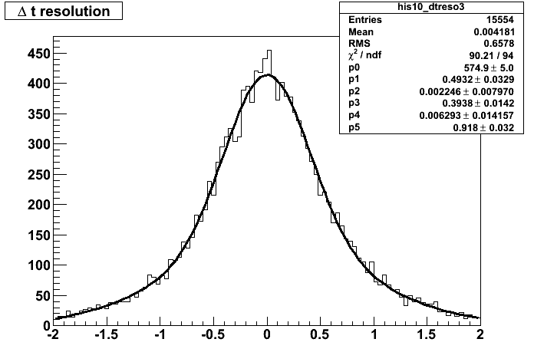
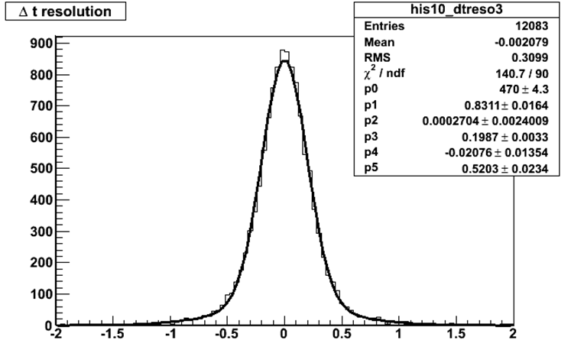
Δt resolutions
βγ=0.30
βγ=0.90
RMS = 0.658 ps
Res. fnc. is unbiased
RMS = 0.310 ps
Res. fnc. is unbiased

Slide 21
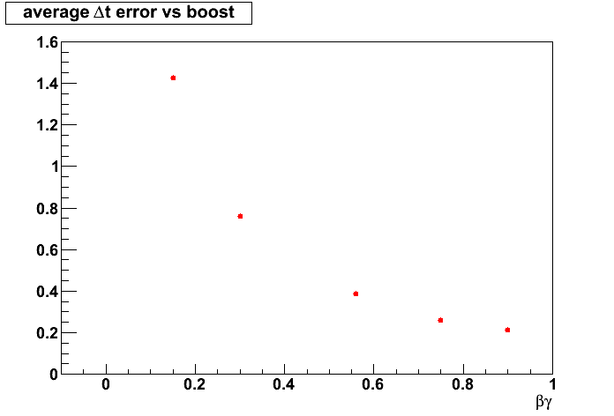
Δt average error as a function of the boost
average error (ps)
D lifetime

Slide 22
Impact on physics
Next step will be to use FastSim resolutions and geometrical efficiencies as a function of CM boost to evaluate effect on physics parameters
Use CLEOc reconstruction efficiencies corrected by geometrical acceptance
Kernel of Toy MC generator and fitting code in place, starting to obtain first results for some combinations of double-tags (e.g. CP vs Kpi)
But results not in time for today…

Slide 23
Summary
Flavor tag at D⁰-D⁰ threshold provides identical time-dependence than at ϒ(4S) using D* tagging, and less events, although in a different environment (different systematic uncertainties);
D⁰-D⁰ threshold is unique to provide CP tag, giving access to D⁰-D⁰ relative phases;
Ultimately, exploit quantum coherence with all possible combination of double-tags to extract mixing and CPV (in interference, mixing and decay), as well as CPTV
Variation of Δt resolution and geometrical acceptance as a function of CM boost evaluated
Now:
Assessing the impact on physics
Evaluating the possibility to extract mixing and CPV observables in a model independent way and without assuming CP conservation in the decay using 3-body decays (CP/flavor tags vs 3-body, double 3-body)
Feed back from theorists very welcome !

