Slide 1
ATF2 International Test Facility @ KEK for Nano-Scale Beam Generation and Measurements
Glen White, SLAC

Slide 2
Overview
The ATF2 test facility
Overview of ATF & ATF2
International collaboration
Project Goals
Generation, control & measurement of nano-scale beams
Education of young accelerator physicists
International operations
Technical Achievements
~40nm beam sizes @ low-charge
Ongoing work to understand and mitigate wakefields

Slide 3
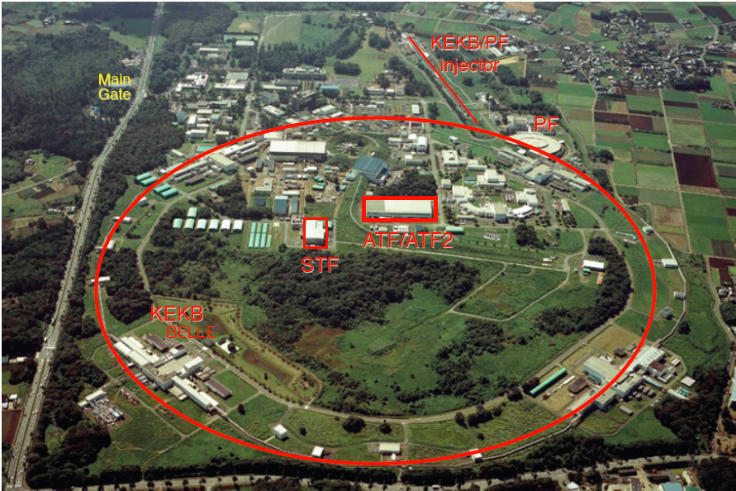
ATF2 @ KEK

Slide 4
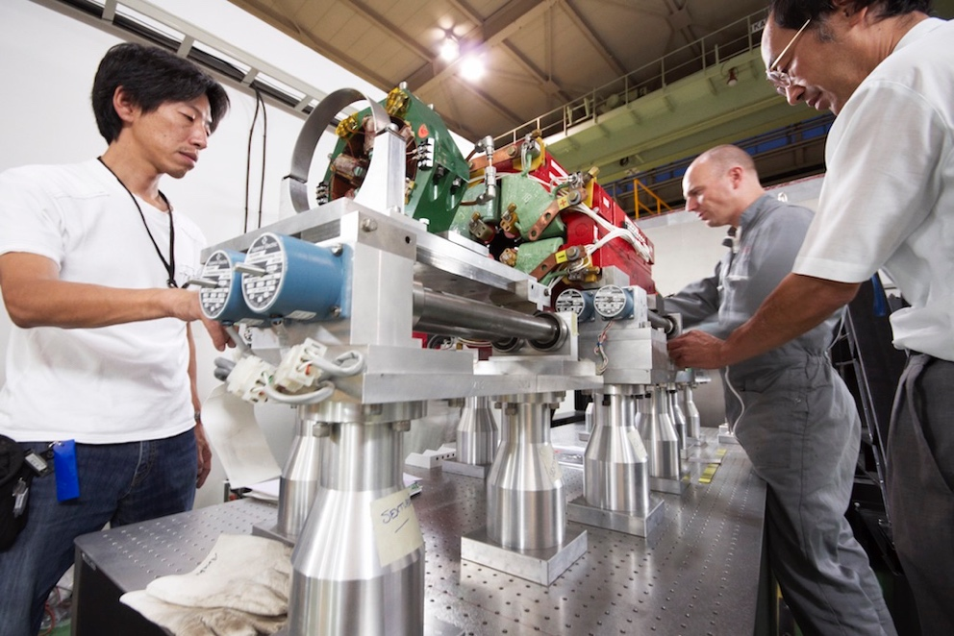
International Collaboration

Slide 5
International Collaboration
21 Institutes
11 countries

Slide 6
Construction Timeline
Construction started 2007
First Commissioning of beam 2009-2010
Operations continue today

Slide 7
ATF2 Project Goals
Experimental verification of the ILC FFS scheme
Development of beam tuning procedures and demonstration of operability of “local” chromaticity correction optics
Learn to measure and control nm-scale beams
Understand limits of focusing capabilities of this optics design
Development of ILC instrumentation
BPMs, movers, MHz feedback, 1-um Laserwire, straightness-monitor, OTRs, wirescanners, HA-PS, fast pulser, beam tilt-meter …
Education of young generation for future linear colliders
Active participation of graduate students and post-docs
Operation of complex accelerator in an international setting with in-kind hardware contributions and joint efforts on commissioning & operation

Slide 8
Organization
MOU
- 17 organizations initially
ICB 1 mtg / year
TCB 2 mtgs / year
Operations:
~21 wks/year
International collaboration assisted commissioning
KEK staff + experimenters
Usually Mon-Fri
Some multi-week continueous runs
Daily ops mtg + weekly conference mtg

Slide 9
ATF2 Facility Layout

Slide 10
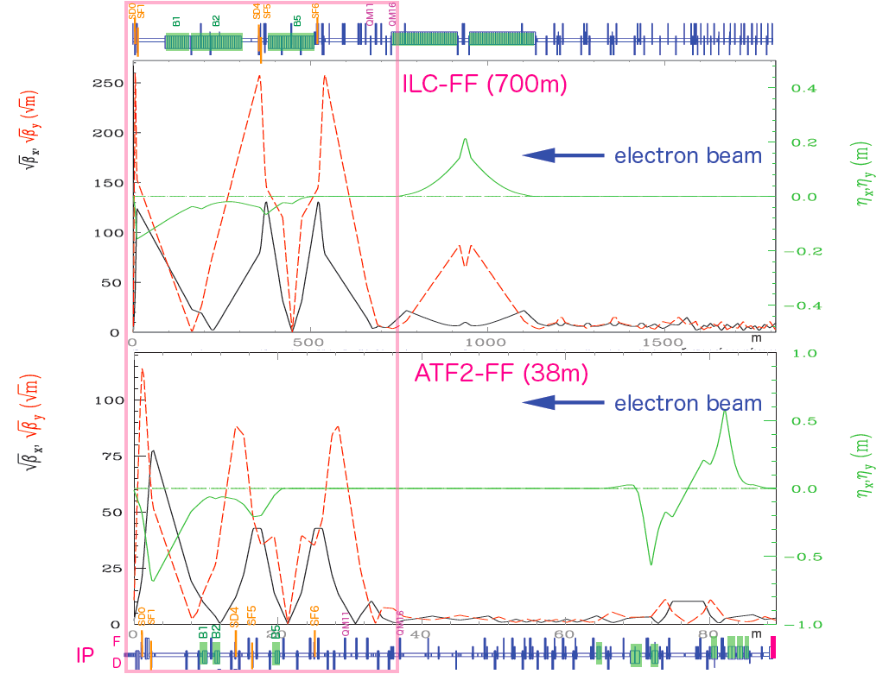
Test of ILC FFS Optics – ATF2 Parameters
 | ILC | ATF2
L* / m | 4.1 | 1.0
ξ_{y} (~ L* / β*_{y}) | 4100 / 0.41 | 1000 / 0.1
E_{beam} / GeV | 125 | 1.3
Q / nC | 3.2 | 0.16 – 1.6
β*_{x,y} / mm | 13, 0.41 | 40, 0.1*
γε_{x,y} / μm-rad | 5.0, 0.035 | 3.5-4.8, 0.025-0.037
σ_{x,y} / nm | 365, 7.7 | 7500 – 8700 , 37 (41 measured)
δ_{E} / E (%) | 0.15-0.19 | 0.06-0.08
f_{rep} / Hz | 5 | 3.2
Scale test of ILC FFS Optics (“Local” Chromaticity Correction)
* beta_y scales down to 0.025 mm ~ CLIC ξ_{y}

Slide 11
ATF2 Facility Layout
Final Focus System (FFS)
Scale test of ILC FFS optics
Extraction Line (EXT)
Extract beam from DR
Correct for coupling and dispersion errors
Correctly match beam into final focus system.

Slide 12
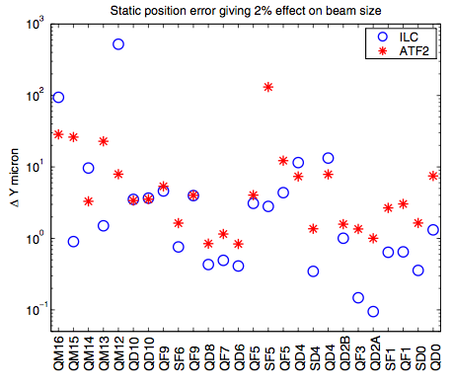
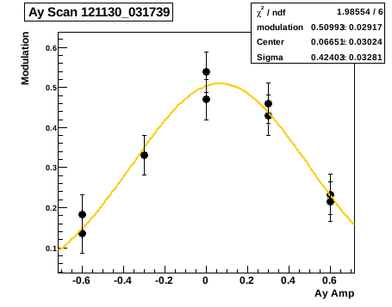
Beam Tuning – Overcoming V. Tight Tolerances
Optics setup:
BPM Calibration
Steering
BBA
Global Dispersion correction
Extracted emittance measurement
Extracted coupling correction
Beta matching
Model and optics verification
Vertical Tolerances similar to ILC – below achievable by survey techniques
Overcome using “sextuple mover knobs”
- e.g. here scan y waist
Aberration tuning:
Linear tuning knobs using pre-computed orthogonalised horizontal/vertical moves of 5 FFS Sextupole magnets.
alpha_x, eta_x, alpha_y, eta_y, <x’y>
Non-linear tuning knobs using strength changes of 5 FFS Sextupoles & 4 skew-Sextupoles
Y22, Y26, Y44, Y46

Slide 13
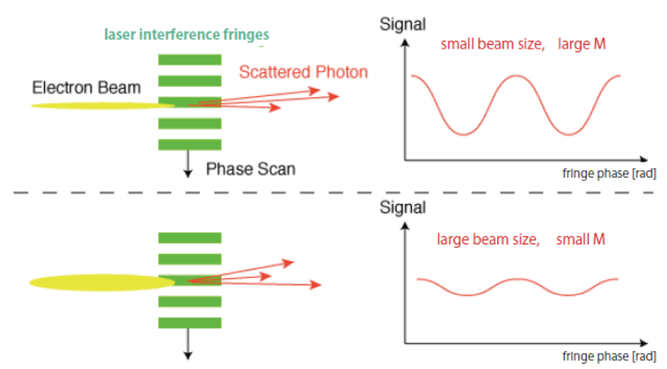
Key Hardware – International Contributions
Magnets
22 Quadrupoles – IHEP, China
5 Sextuples – SLAC
3 Bends – SLAC, IHEP
23 Magnet movers (SLAC, from FFTB, um-accuracy)
“High-availability” power supplies (SLAC, ILC test)
Final doublet vibration isolated table – LAPP, France
BPMs
All quads & sexts have cavity-type BPM (<100nm res)
c-band: PAL, S.Korea, SLAC & UK
Stripline BPMs (few um res)
KEK & SLAC
Ring button BPM high-bandwidth readout system - Fermilab
Profile Measurement
IPBSM – KEK & Tokyo (~35 nm measurements)
Laserwire – UK (1 um measurements)
OTR/ODR (high res ~um) – KEK, UK
Diamond sensor Halo measurements – France
Multi-OTR emittance measurement (SLAC & IFIC, Spain)
High-bandwidth feedback
2-bunch nm-scale position feedback, <300ns latency – S.Korea (IP nm-BPMs), UK
IPBSM “Shintake Monitor”
Magnet Movers & BPMs

Slide 14
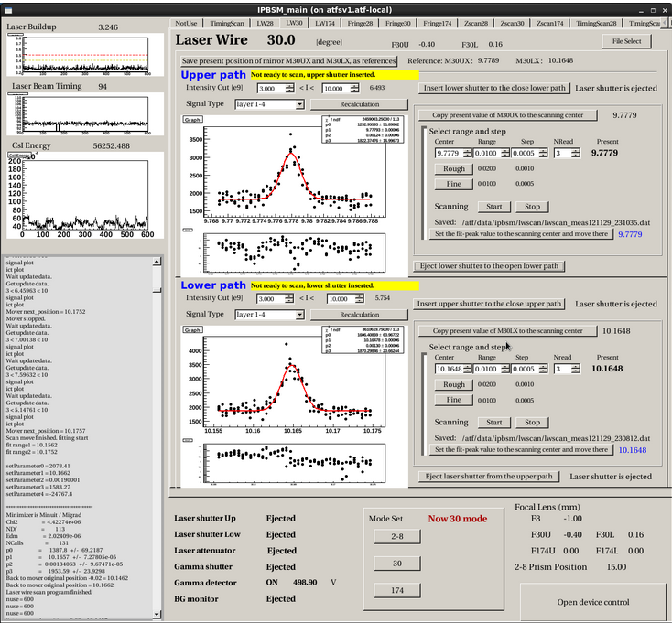
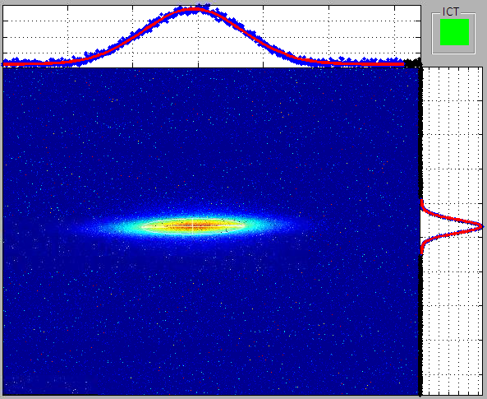
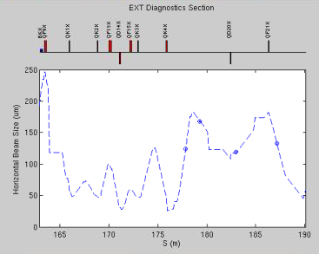
Software & Beam Tuning “Apps”
Core accelerator tuning software developed by KEK staff & international community
“Flight simulator” concept developed as a way to develop & test apps remotely and easily implement @ KEK
User-friendly IPBSM controls
“Flight Simulator” Concept
Multi-OTR Emittance Measurement

Slide 15
IP Beam Size Achievements
Great East Japan Earthquake, March 2011
Beam size reduced over time as experience gained, hardware problems found and resolved, techniques improved etc

Slide 16
Intensity Dependence & Wakefields
Wakefield effects became dominant for σ_{y} < 100 nm
c-band cavity BPMs & bellows @ high-beta locations
Smallest beam sizes only achieved at N < 1E9
Static component 10-> 5 nm/1e9
Some BPMs removed, bellows shielded, active compensation used
Dynamic component 10 nm/1e9
Demonstrated mitigation possible with 2-bunch feedback
Effects understood through detailed wakefield simulation work
Scaled to ILC parameters, expected NOT a problem
Measurements

Slide 17
Beam Stabilization
2 bunch feedback (Δt = 280 ns)
Stabilize second bunch using detection of first & stripline kicker
Extrapolate IP position from 2 cavity BPMs near IP
Vertical position jitter @ IP: 106 nm -> 41 nm
Performance limited by BPM resolution & inability to get small beams @ high Q

Slide 18
Education

Slide 19
Education

Slide 20
Summary and Thanks
Content and slides courtesy of ATF2 collaboration and experimental contributors
ATF2 has been, and continues to be, a very productive proving ground for LC technology and for training accelerator physicists who will hopefully go on to be responsible for the real thing…
Main goal of ATF2 achieved: the local-chromaticity correction FFS optics works!
Work continues to increase beam charge and reduce beta function @ IP to test CLIC-level correction scheme
20-nm beams, Octopole correction devices…

