Slide 1
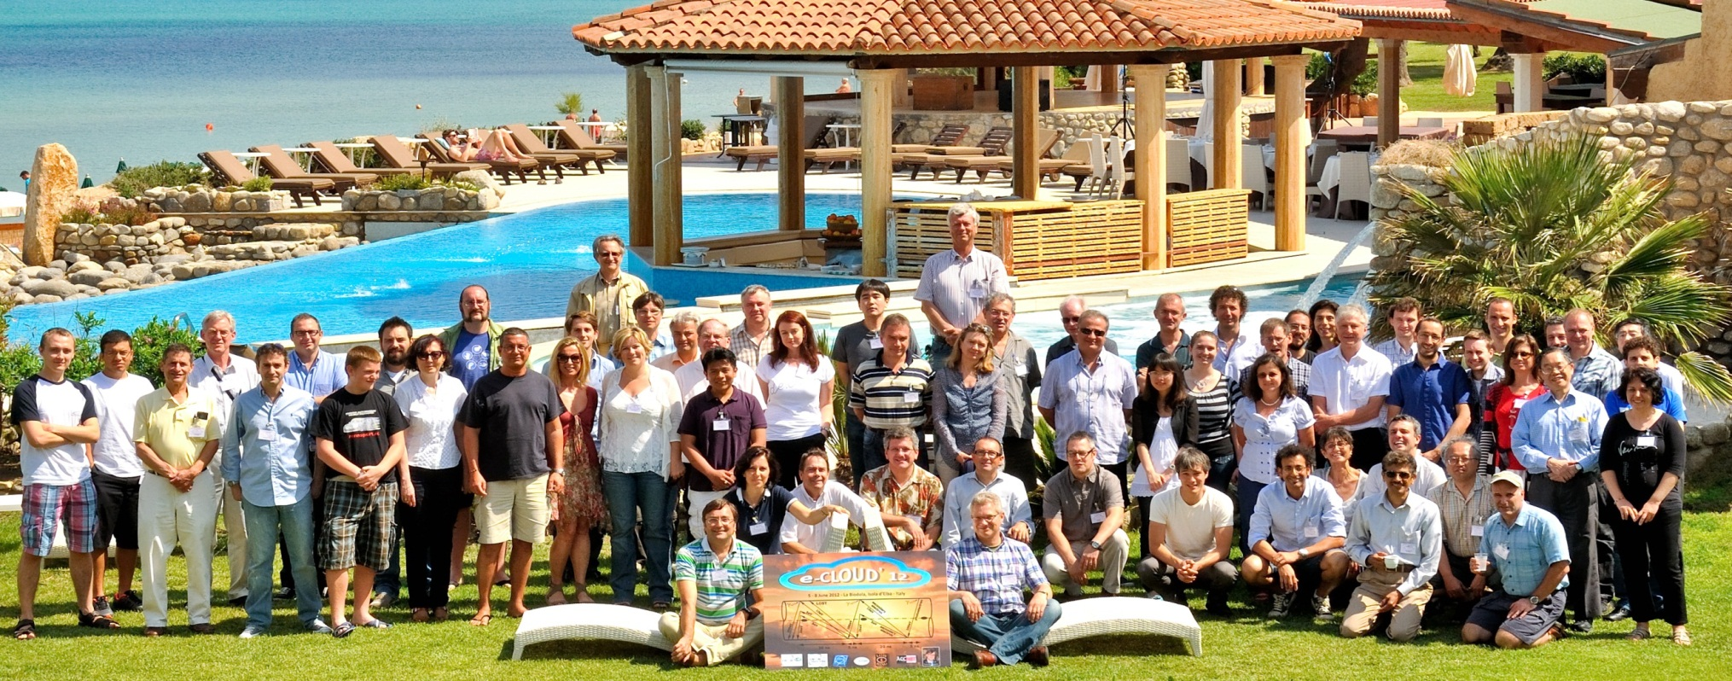
ECLOUD12 conclusions
Roberto Cimino & Frank Zimmermann
8 June 2012

Slide 2
62 participants
United States: 15
Switzerland: 15
Italy: 10
Germany: 7
Japan: 4
Spain: 3
United Kingdom: 3
France: 2
Mexico: 1
Portugal: 1
Russia: 1

Slide 3
statistics
50 presentations
including one remote talk
(recalling results from the 1960’s)
1 soccer match
1 social dinner
working discussions until late in the night

Slide 4
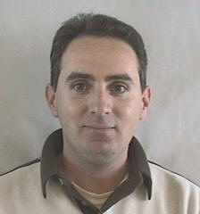
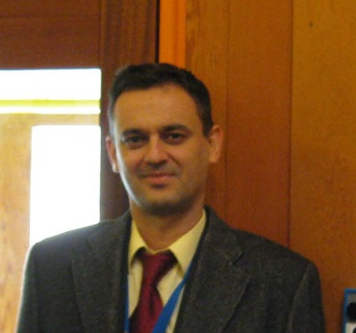
two key people had to cancel their participation
Jose Miguel Jimenez
Leader of the CERN TE-VSC Vacuum Group
”unforeseen complications for the preparation of the LS1”
David Raboso
High Power RF laboratory manager, TEC-ETM European Space Agency
“related to recent anomalies detected in one of our satellites, I have been requested to travel to The Netherlands during week 23”
thanks to Benito Gimeno and Pedro Costa Pinto for giving these talks

Slide 5
great progress everywhere
electron cloud at LHC, CesrTA, PETRA-3 & DAPHNE – many signatures, lots of data, test beds for simulations of build up / instabilities, heat load, new diagnostics,…
mixing all accelerators & spacecraft communities
understanding the physics of surface conditioning
e-cloud mitigation important for upcoming projects:
HL-LHC, LIU, RHIC upgrade, Project-X, ISIS upgrade, J-PARC, RHIC upgrade, SuperKEKB, SuperB, ILC
new diagnostics: synchronous phase shift, cryo measurements, microwaves, coded aperture, t-resolv. shielded pick ups; new lab model: Gabor lenses

Slide 6
quotation
“impressive resemblance (between simulation and measurement) suggests that our electron cloud model correctly describes the phenomenon and the rationale for the data analysis is promising”
G. Rumolo et al, cited by J. Crittenden

Slide 7
powerful new codes
SYNRAD3D – photon tracking including surface
properties & 3D geometries
OSMOSEE – secondary emission yield including
at low primary energies
PyECLOUD – build up simulations
faster, better convergent
WARP-POSINST – combined simulations
build up, instability, emittance growth
over 100s of turns
BI-RME/ECLOUD – microwave/e-cloud interaction

Slide 8
new codes also mean more work
e.g. redoing all ECLOUD changes for PyECLOUD?
(Cornell, EPFL,…)

Slide 9
synergies with spacecraft community
modelling surface parameters: SE, PE
(“Furman formula” widely used for satellites)
mitigation measures – e.g. advanced coatings
simulation codes – BI-RME, FEST3D,…
VALSPACE, ESA/ESTEC, ONERA, MIT, EPFL,
ICMM-CSIC,….

Slide 10
still many puzzles
e.g.
betatron sideband signal at CesrTA
(different from KEKB and PETRA-3)
beam-size growth in PEP-II (unexpected plane)
complex incoherent effects
e-cloud for e- beams (high energy photo-electrons
ε_{max} (δ_{max}) & R for LHC Cu still open
stainless steel conditioning vs Cu conditioning
the same or different?
if the same why coat the SPS (w/o LHC)?

Slide 11
and open questions
e.g.
can SEY change over time scale of second during
the accelerator cycle?
can we speed up surface conditioning by controlled
CO gas injection?

Slide 12
can we conclude on the “e-cloud safety” of the new machines?
ILC – OK
LHC – OK if scrubbing progresses as expected
Project-X
RHIC upgrade
J-PARC
SuperKEKB – OK
SuperB

Slide 13
ECLOUD12: a lot of positive feedback
workshop pen “made in Italy”
thanks to SuperB!
why only 3.5 days?
choice of place
“I would strongly encourage you and the organizers to look for more convenient places … for future workshops.”
a few suggestions for improvements

Slide 14
workshops organized by EuCARD WP4.2 AccNet-EuroLumi
(successor of CARE-HHH; & to be followed by EuCARD2-XBEAM)
16-18 September 2009 EuCARD-ACCNET Workshop on LHC Crab Cavities "LHC-CC09", organized jointly with CERN, US-LARP, DL/CI, and KEK, at CERN
12-13 October 2009 AccNet EuroLumi Workshop on Anti E-Cloud Coatings that Require No Activation "AEC'09", CERN
9-10 November 2009 EuCARD-AccNet-EuroLumi mini-Workshop on Crystal Collimation, at CERN
17-18 December 2009 Working meeting on proton driven plasma acceleration PPA09 at CERN
11-12 March 2010 Workshop on Proton Driven Plasma Wake Field Acceleration, CERN
14-16 October 2010 HE-LHC'10, Mini-Workshop on High-Energy LHC, Malta MCST
25-26 October 2010 Annual Workshop on Crystal Collimation, CERN
15-17 December 2010 LHC-CC10, 4th LHC Crab Cavity Workshop, CERN
7-8 March 2011 CERN-GSI Electron-Cloud Workshop, CERN
20-21 June 2011 Workshop on Optics Measurement, Correction & Modelling "OMCM", CERN
14-15 November 2011 LHC-CC11- 5th LHC Crab Cavity Workshop, CERN
5-9 June 2012 ECLOUD'12, INFN-LNF/INFN-Pisa/LER/EuCARD-AccNet Joint workshop, Elba

Slide 15
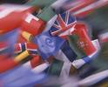
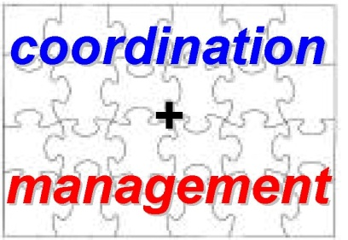
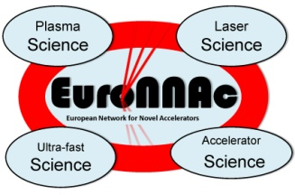
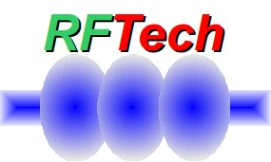
ACCNET Accelerator Science Networks
Coordination & Management
coordinated by Walter Scandale, IN2P3 ; Peter Spiller, GSI ;
Frank Zimmermann, CERN
EURO-
LUMI
RFTECH
EuroNNAc
novel accelerators
coordinated by
Ralph Assmann, CERN
Jens Osterhoff, DESY
Henri Videau, CNRS
accelerators & colliders
performance
coordinated by
Frank Zimmermann &
Ezio Todesco, CERN
sc & nc rf technologies
coordinated by
Jean-Marie de Conto, UJF
Mariusz Grecki, DESY
(Wolfgang Weingarten,
CERN)

Slide 16
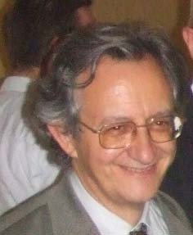
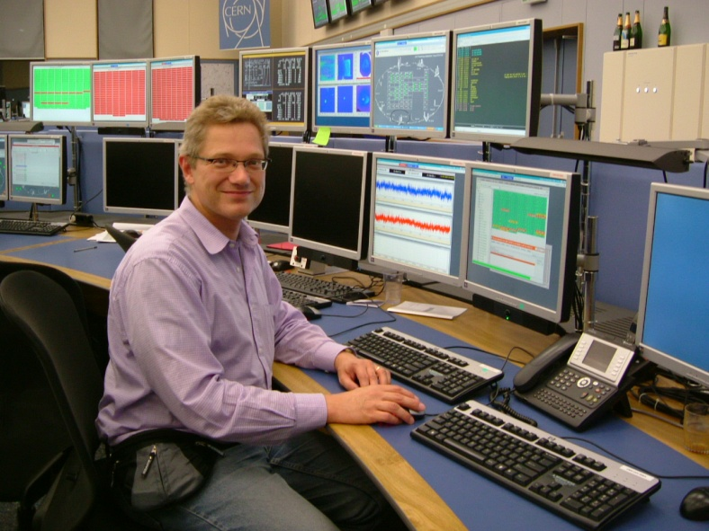
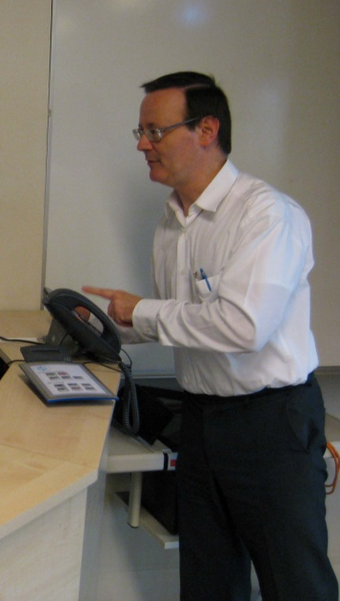
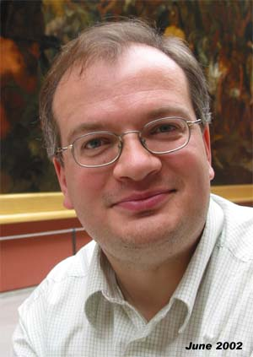
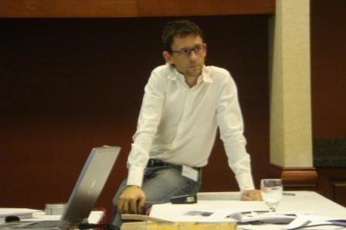
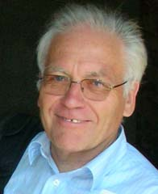
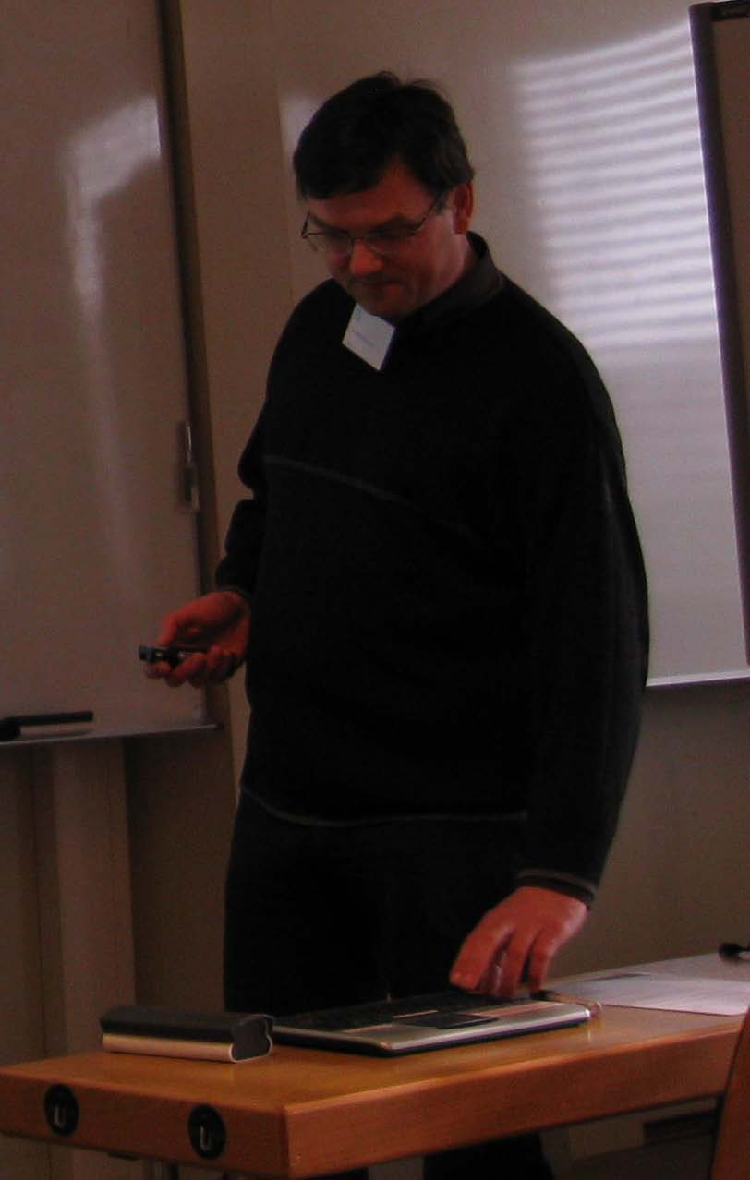
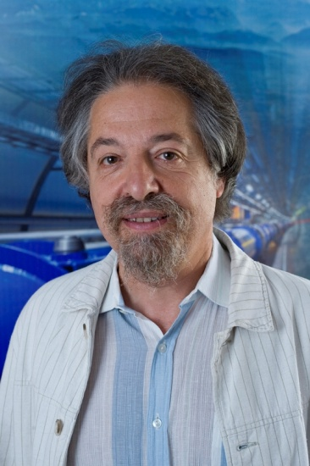
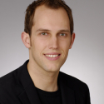
AccNet Coordinators

Slide 17
ECLOUD12 proceedings
proceedings represent a valuable reference
announcement & instructions for workshop proceedings will shortly be sent out by Giovanni Rumolo

Slide 18
many thanks
to the IAC for producing so exciting a programme
to all speakers and chairmen for excellent talks and animated discussions and respecting the schedule
to Maria Rita Ferrazza, Lucia Lilli, Delphine Rivoiron
for wonderful preparation & support
to Octavio Dominguez and Giovanni Rumolo for lots of input and help with the organization
to Roberto Cimino who convinced me of organizing a workshop at La Biodola

Slide 19
see you at ECLOUD15 ?!
50 year anniversary of first e-cloud observation
ECLOUD was held 2x in Europe, 2x in US, 1x in Asia
maybe ECLOUD2015 should be held in Asia
at/near KEK or J-PARC?, chair K. Ohmi?

