Slide 1
Some final consideration on Ecloud’18
General consideration
The “football match”
Special thanks
Notes:
BRAVA

Slide 2
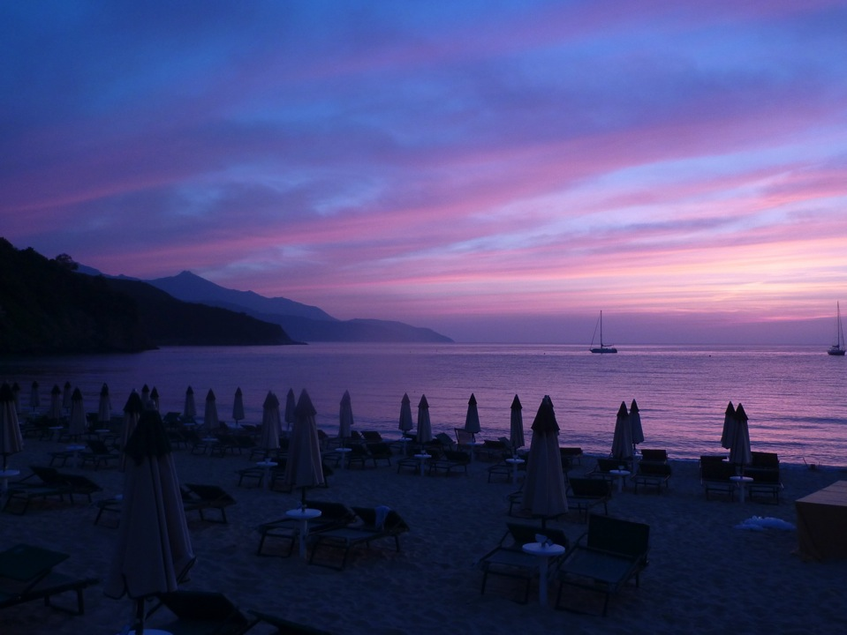
64 participants.
Very successful meeting:

Slide 3
64 participants. (Most of them in the audience all the time, a clear “cloud” effect!)
Very successful meeting:

Slide 4
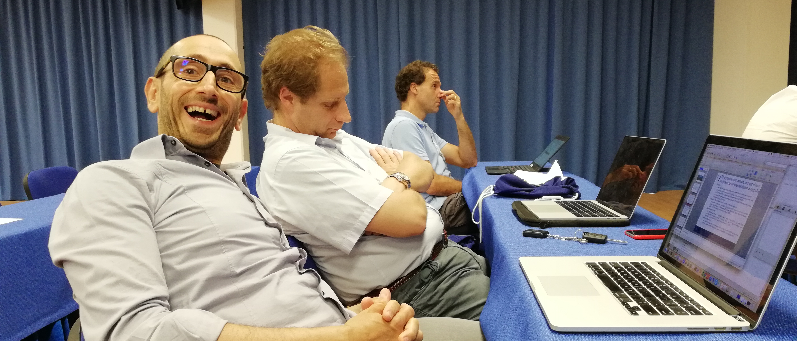
64 participants. (Most of them carefully following.....!)
Very successful meeting:

Slide 5
64 participants. (Most of them in the audience all the time, a clear “cloud” effect!) Interesting discussion in the audience and outside! Some seeds for future collaborations! (EC calls, involving USA and other fields etc.)
Very successful meeting:

Slide 6
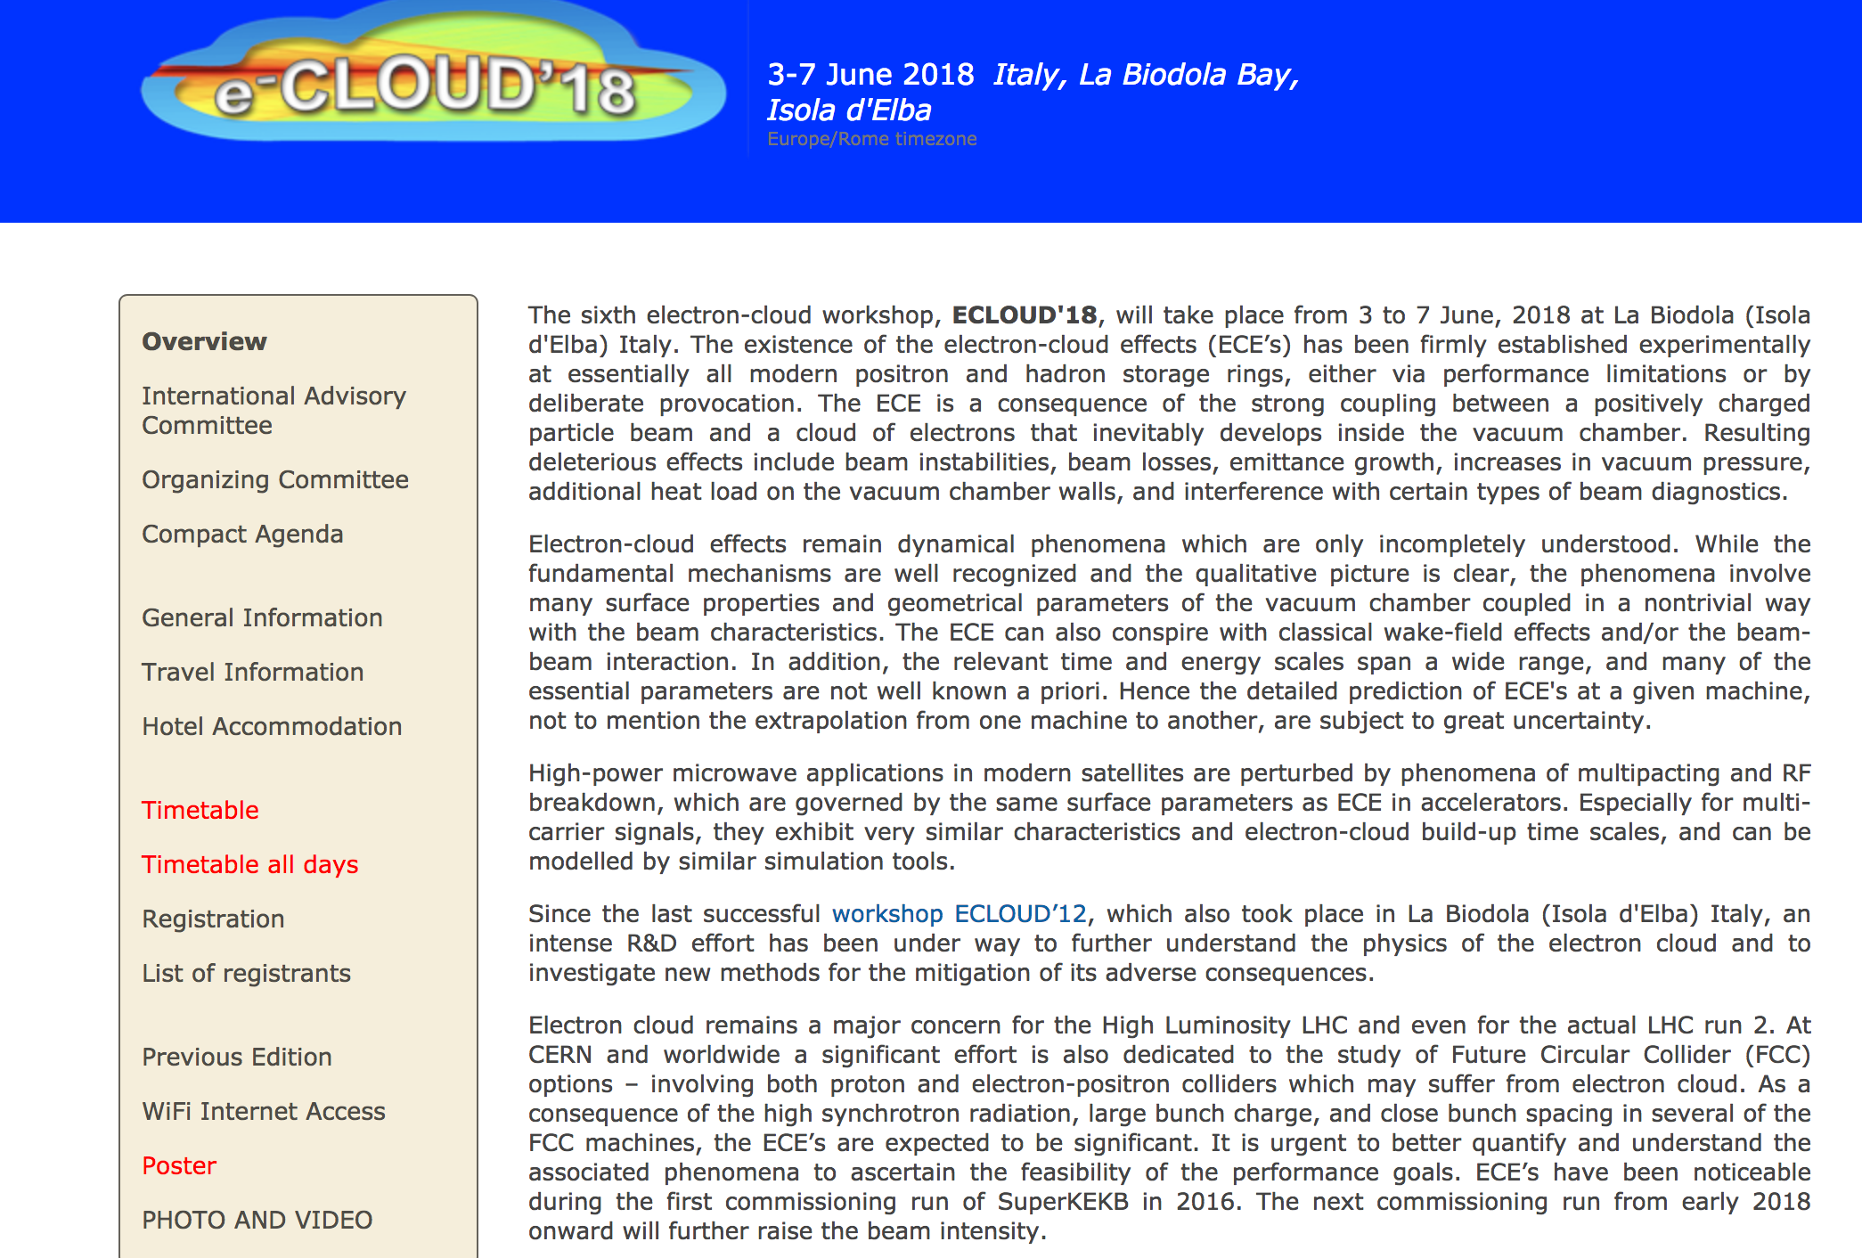
See conference photos

Slide 7
Some final consideration on Ecloud’18
The quality and the improvements in all fields discussed in this Ecloud18 edition in respect to Ecloud12 workshop is indeed enormous!
Maybe too much time passed between the two events.
“ I suggest a two/three year repeatability of this meeting
LOOKING FORWAR TO HAVE A YELLOW BOOK REPORT ALL TOGHETHER!
Notes:
BRAVA

Slide 8
Some final consideration on Ecloud’18
The “Synergy” workshop: not only among different Labs and accelerators, but among different research fields!
“Synergy” also in research: e-cloud mitigation tools has to be compliant with Impedance budget, Vacuum stability and compatibility, etc.
“ Synergy” with test machines to validate codes and Laboratory results.
Notes:
BRAVA

Slide 9
The football game !
All of you want to know the results... But first some important background info:
theory group: proposed some strange last minute changes in speakers
Experimental “Secret service” confirmed that the new speakers were all excellent football players and all would use top quality “tools”

Slide 10
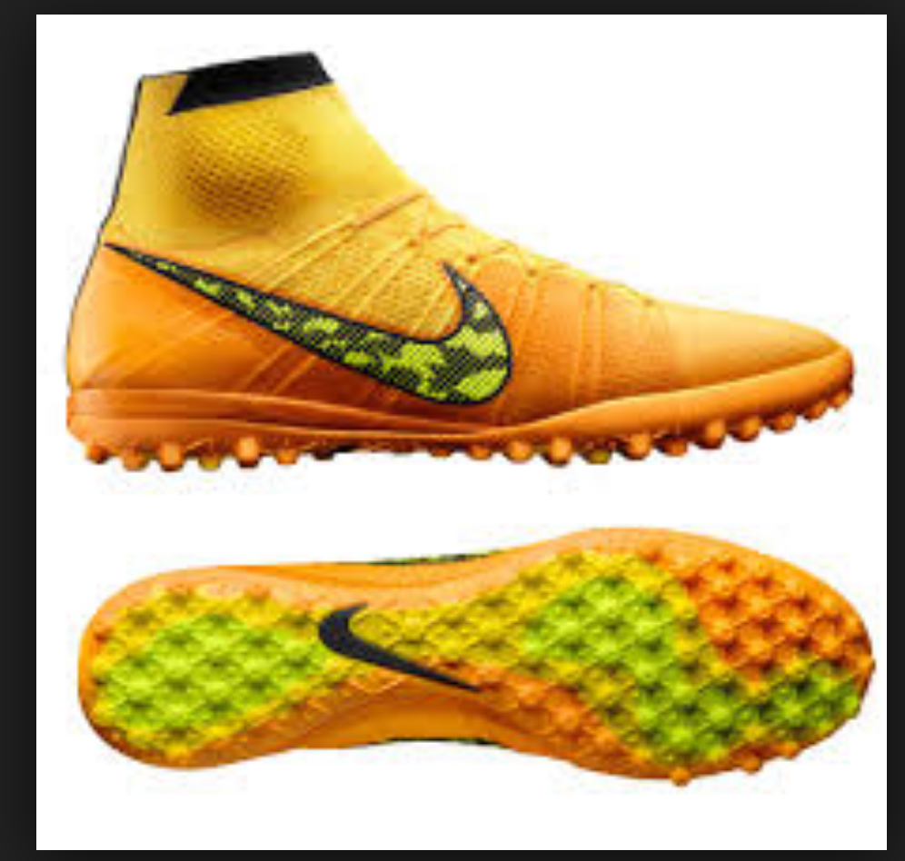
The football game !
All of you want to know the results... But first some important background info:
theory group: proposed some strange last minute changes in speakers
Experimental “Secret service” confirmed that the new speakers were all excellent football players with all the top quality “tools”

Slide 11
The football game !
All of you want to know the results... But first some important background info:
theory group: proposed some strange last minute changes in speakers
Experimental “Secret service” confirmed that the new speakers were all excellent football players with all the top quality “tools”
On the contrary, the experimental tools available for the game were “not state of the art”.

Slide 12
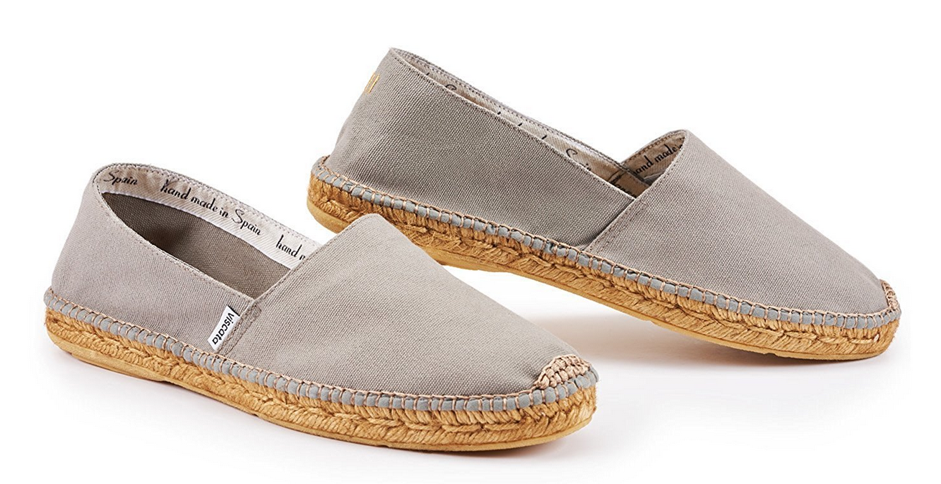
The football game !
All of you want to know the results... But first some important background info:
theory group: proposed some strange last minute changes in speakers
Experimental “Secret service” confirmed that the new speakers were all excellent football players
Also, the experimental tools available were not “state of the art”.

Slide 13
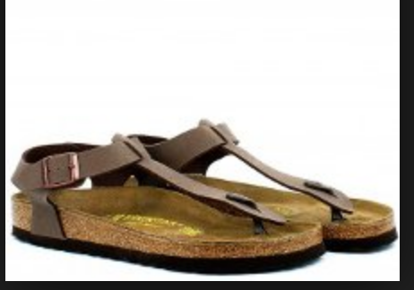
The football game !
All of you want to know the results... But first some important background info:
theory group: proposed some strange last minute changes in speakers
Experimental “Secret service” confirmed that the new speakers were all excellent football players
Also, the experimental tools available were not “state of the art”.

Slide 14
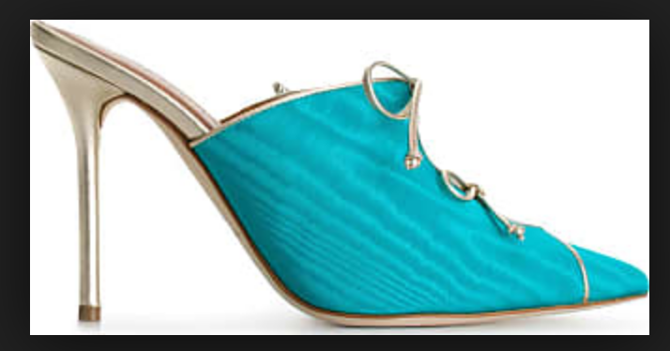
The football game !
All of you want to know the results... But first some important background info:
theory group: proposed some strange last minute changes in speakers
Experimental “Secret service” confirmed that the new speakers were all excellent football players
Also, the experimental tools available were not “state of the art”.

Slide 15
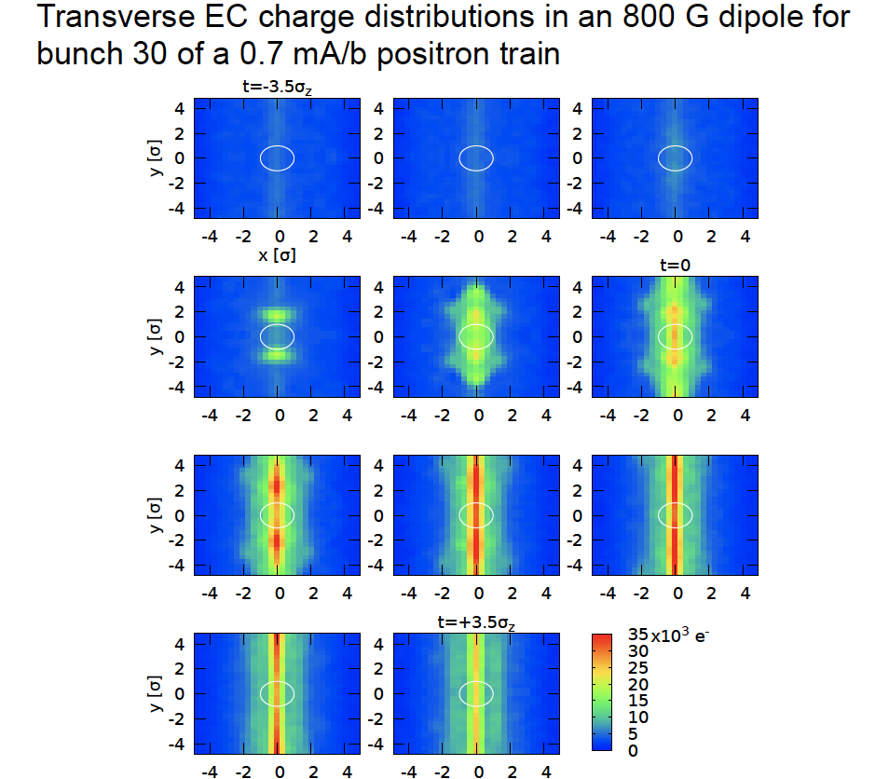
The Experimental strategy!
Stephen Poprocki (Cornell University)

Slide 16
The Experimental strategy!
In reality: we were discussing tactics!!!
Stephen Poprocki (Cornell University)

Slide 17
The Experimental strategy!
Let them play while we cumulate at midfield
Let them Score!!!
.... and score !!!!!
.... and score...!!!!
.... and score...!!!!
Than .. Propose the golden goal to finish!!!
Stephen Poprocki (Cornell University)

Slide 18
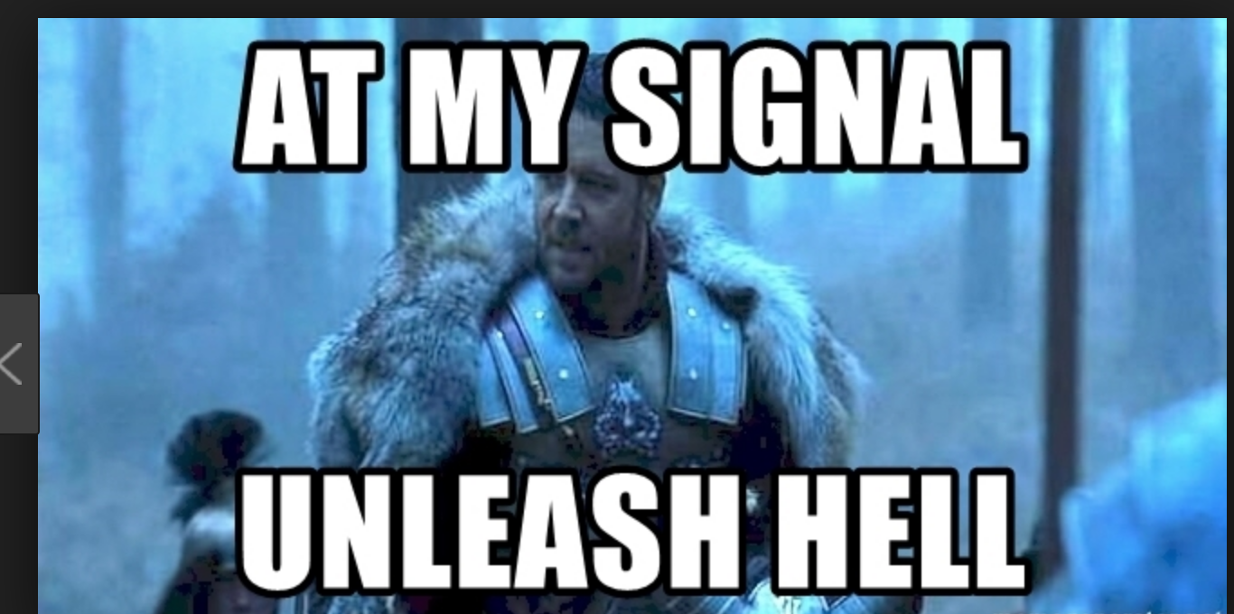
Once Golden goal was accepted:

Slide 19
The football game !
 | Theory | Exp.
(Heavily) injured | 1 +/- 2 | 0 +/- 1
LOST | Some | Many
Partial (and useless) result | 5 | 1
FINAL RESULT | - | Golden GOAL!!!

Slide 20
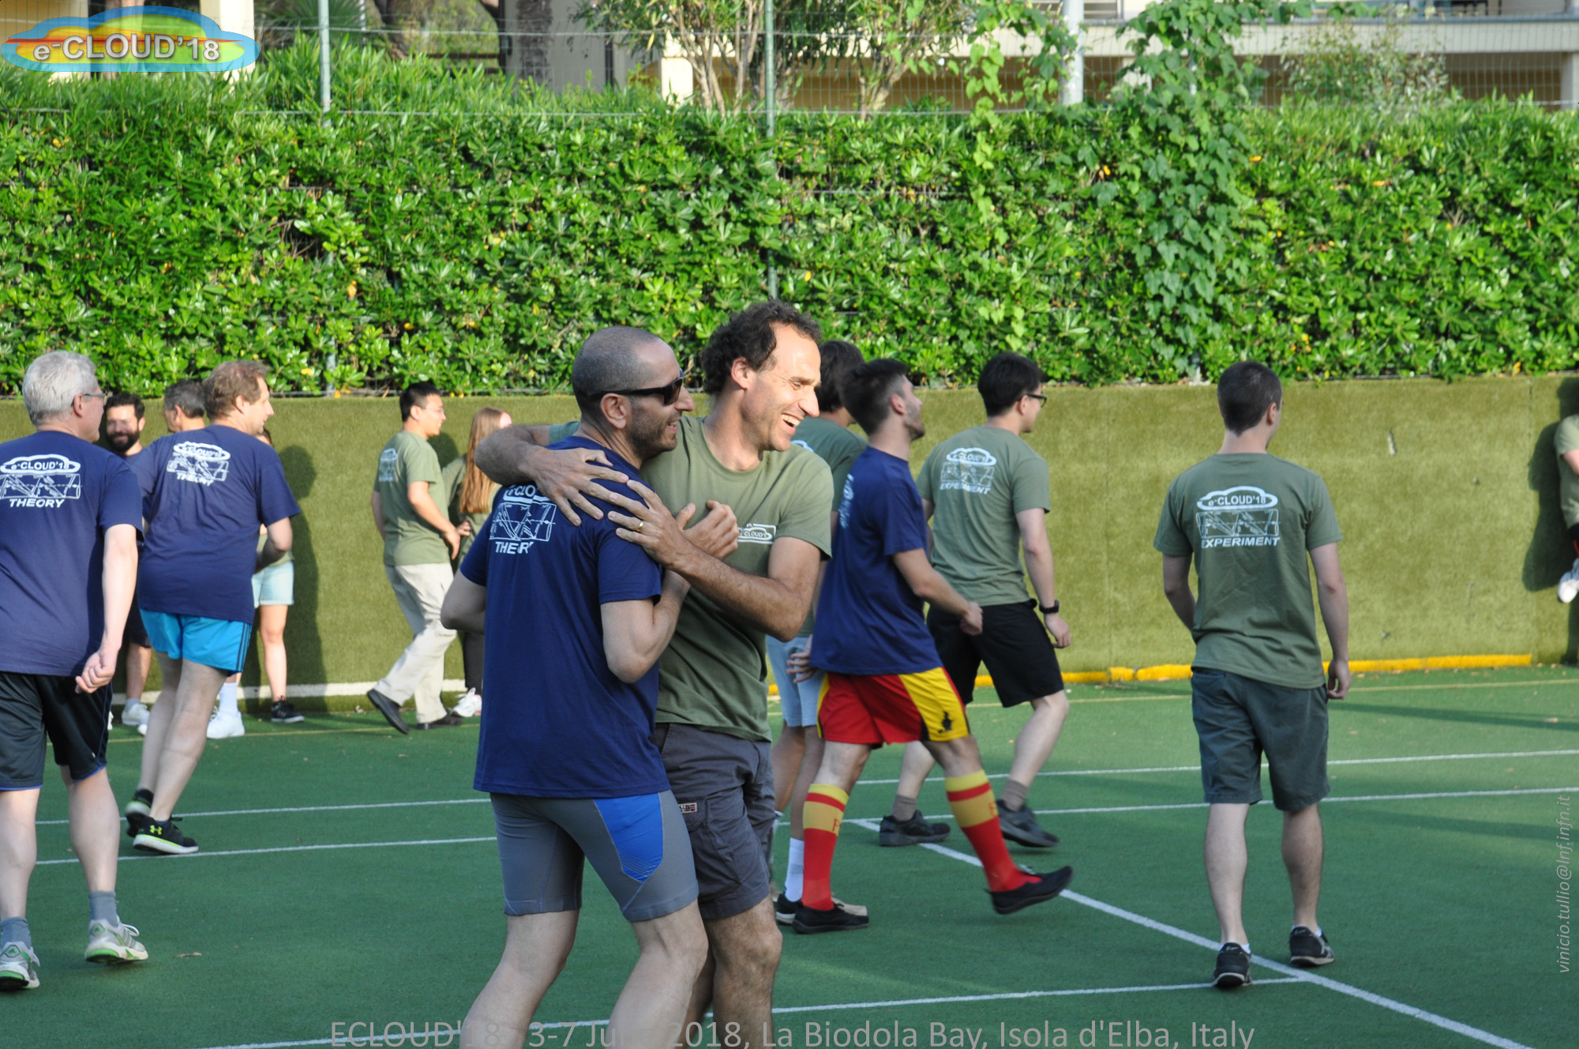
The football game !
Collaborative spirit:

Slide 21
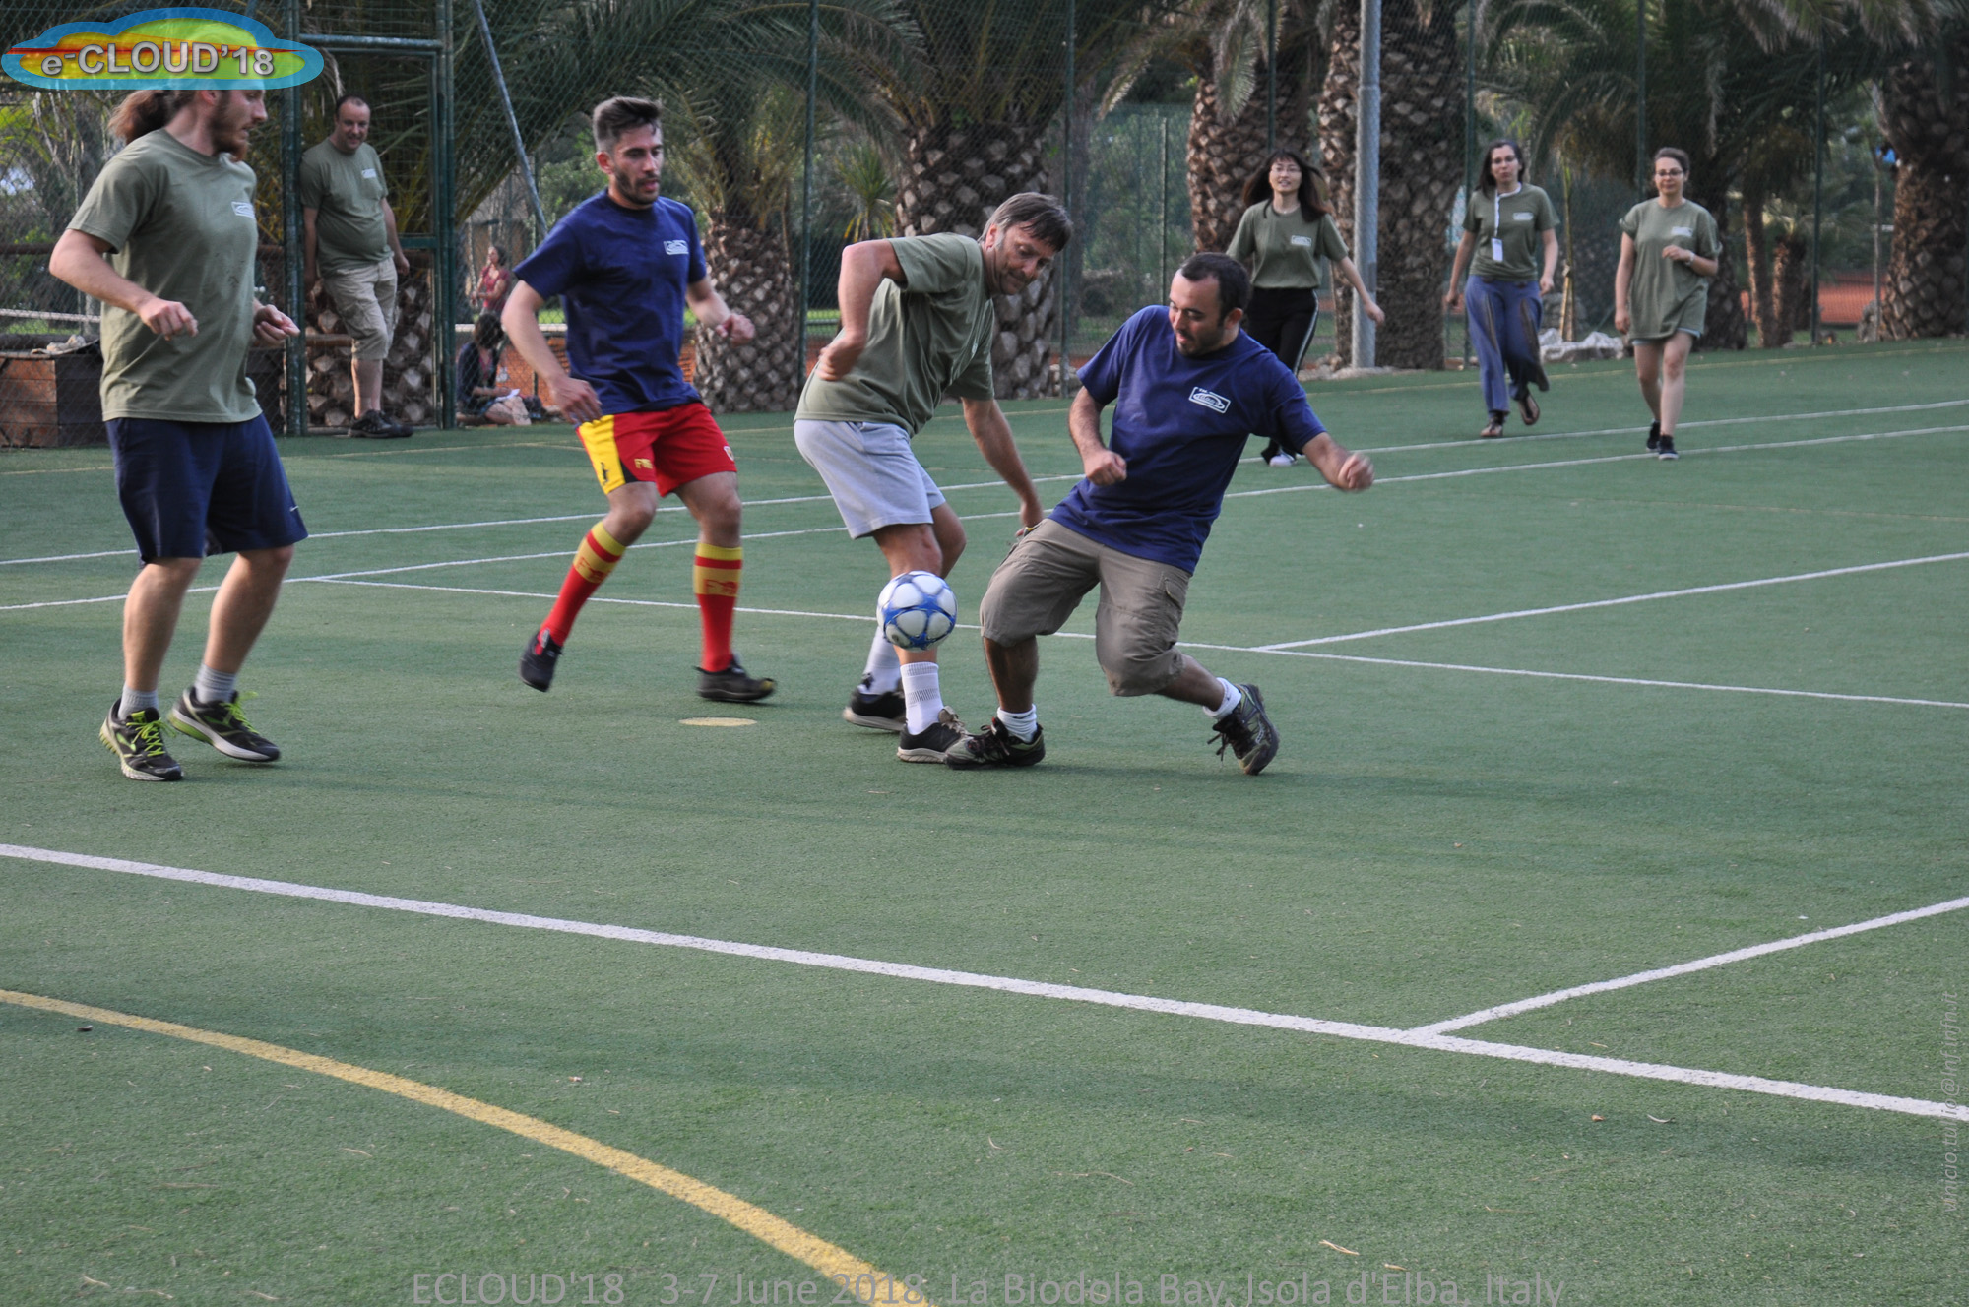
The football game !
But some fair competition:

Slide 22
The football game !
... Not so fair ....

Slide 23
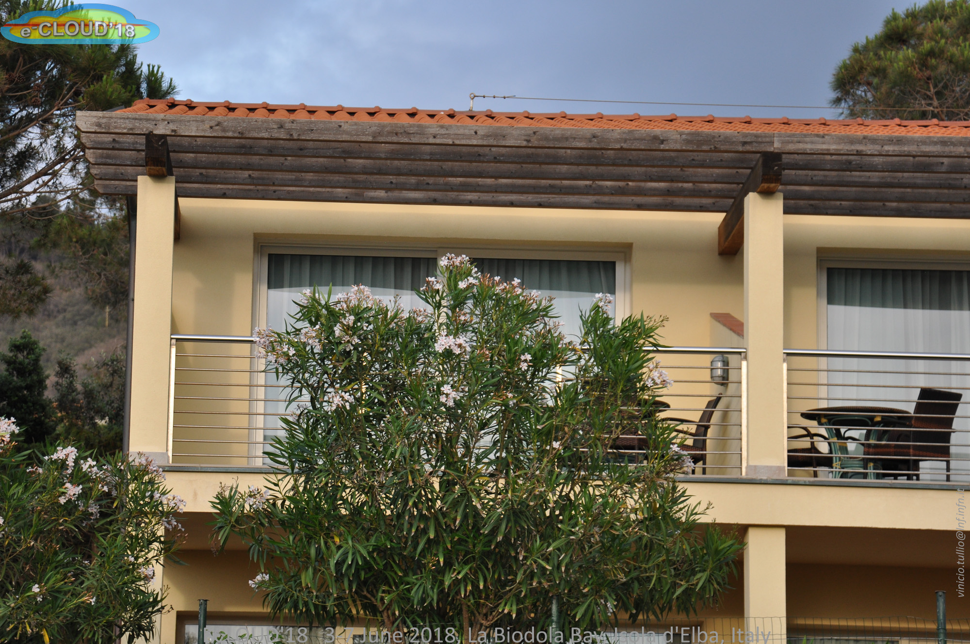
The football game !
New symbol for .. Interval.... And coffe breaks

Slide 24
The football game !
Amazing: theoretician always Simulate!!!!

Slide 25
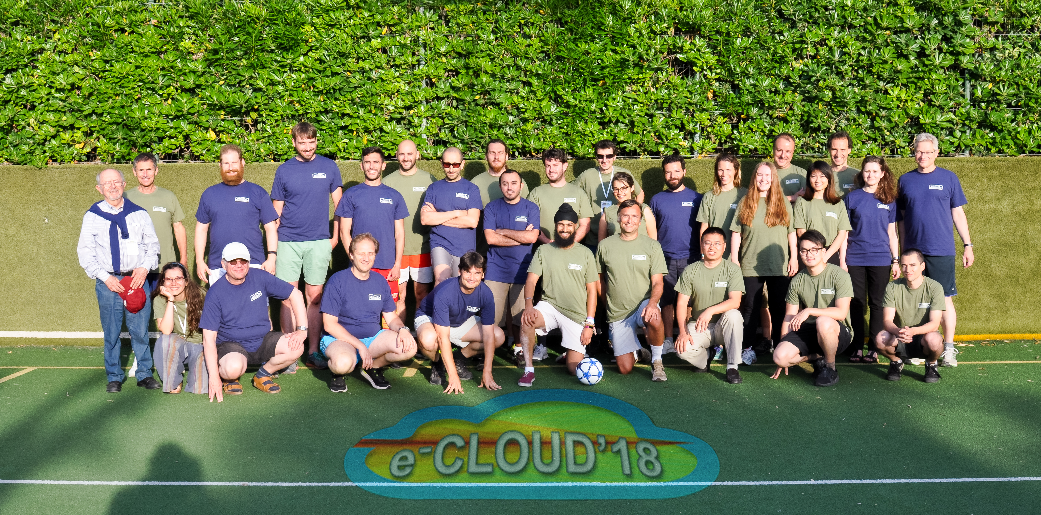
The football game !
Conclusion:
Ideally, theoretician and experimentalists should play in the same team!

Slide 26
LAST PART:
Special thanks
ECLOUD 2018, from June 3rd to 7th - 2018
R. CImino

Slide 27
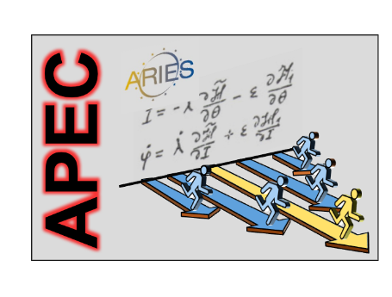
Special thanks to:
INFN- Sezione di Pisa
Laboratori Nazionali di Frascati
And:
ECLOUD 2018, from June 3rd to 7th - 2018
R. CImino

Slide 28
Preparatory part:
Organizing Committee Marco Angelucci, INFN - LNF Maria Giuseppina Bisogni, University of Pisa and INFN Pisa Roberto Cimino, INFN - LNF (chair) Maria Rita Ferrazza, INFN - LNF Lucia Lilli, INFN Pisa Riccardo Paoletti, University of Siena, and INFN Pisa Giovanni Rumolo, CERN
PS: I just checked: 1758 mail in my Ecloud18 mailbox.....
ECLOUD 2018, from June 3rd to 7th - 2018
R. CImino

Slide 29
Preparatory part:
International Advisory Committee
Gianluigi Arduini (CERN) Vincent Baglin (CERN) Riccardo Bartolini (Oxford) Mohamed Belhaj (ONERA) Michael Benedikt (CERN) Oliver Brüning (CERN) Paolo Chiggiato (CERN) Roberto Cimino (INFN) Chair Jim Crittenden (Cornell) Stefano De Santis (LBL) Wolfram Fischer (BNL) Giuliano Franchetti (GSI) John Fox (SLAC & Stanford) Miguel Furman (LBL) Benito Gimeno Martinez (VSC & U Valencia) Susanna Guiducci (INFN) Chen Hesheng (IHEP) Giovanni Iadarola (CERN) Ubaldo Iriso (ALBA/CELLS) José Miguel Jimenez (CERN) Alexander Krasnov (BINP) Rosanna Larciprete (CNR)
Oleg Malishev (ASTEC) Oliver Meusel (U. Frankfurt) Mauro Migliorati (Sapienza) Catia Milardi (INFN) Kazuhito Ohmi (KEK) Katsunobu Oide (KEK) Ioannis Papaphilippou (CERN) Eugene Perevedentsev (BINP) Mauro Pivi (MedAustrom) Qing Qin (IHEP) David Raboso (ESA-ESTECH) Tor Raubenheimer (SLAC) Giovanni Rumolo (CERN) Daniel Schulte (CERN) Elena Shaposhnikova (CERN) Vladimir Shiltsev (FNAL) Yusuke Suetsugu (KEK) Mauro Taborelli (CERN) Jiuqing Wang (IHEP) Rainer Wanzenberg (DESY) Seiya Yamaguchi (KEK) Frank Zimmermann (CERN) Chair

Slide 30
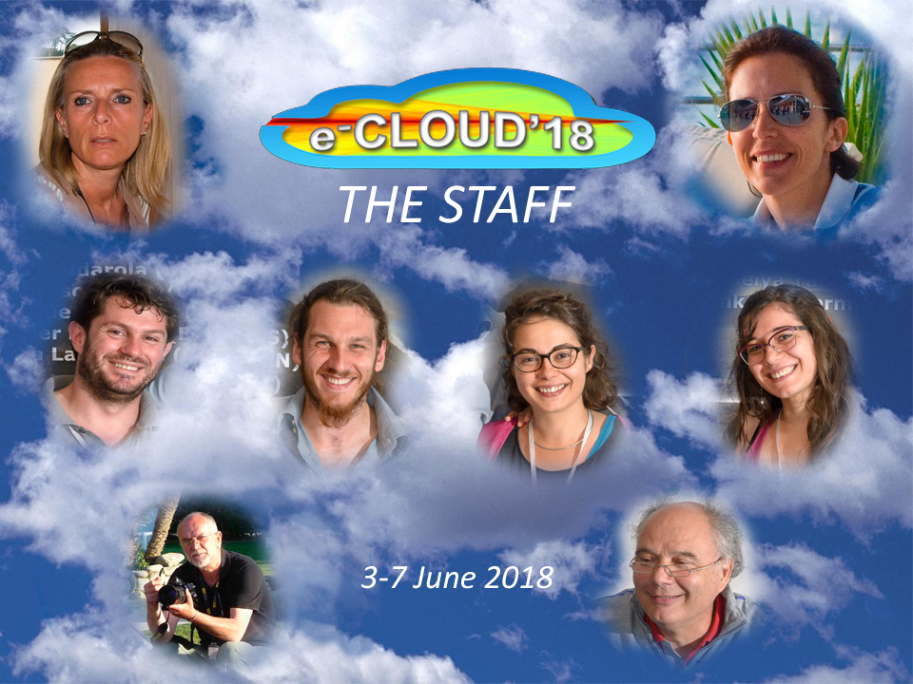
Tanks to “the team”:

Slide 31
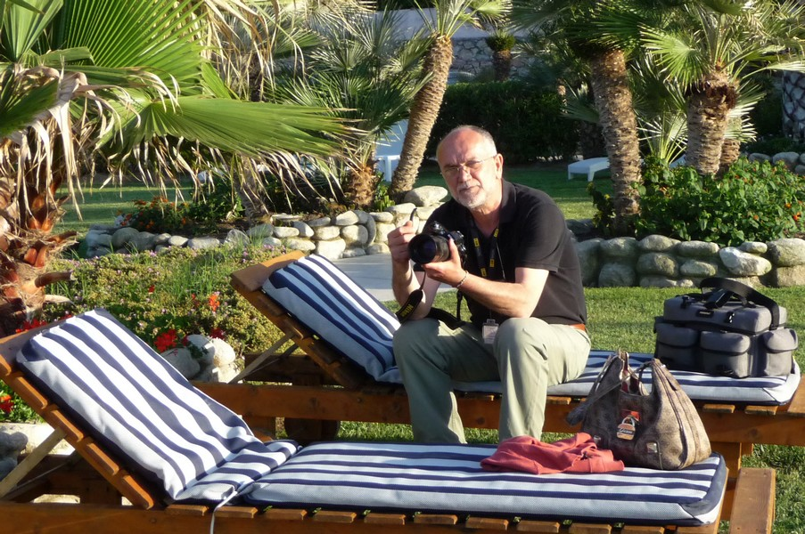
Thanks to: Vinicio, the “paparazzo”!

Slide 32
Thanks to: Vinicio, the “paparazzo”!
Whatever you have done, it can be on the web!

Slide 33
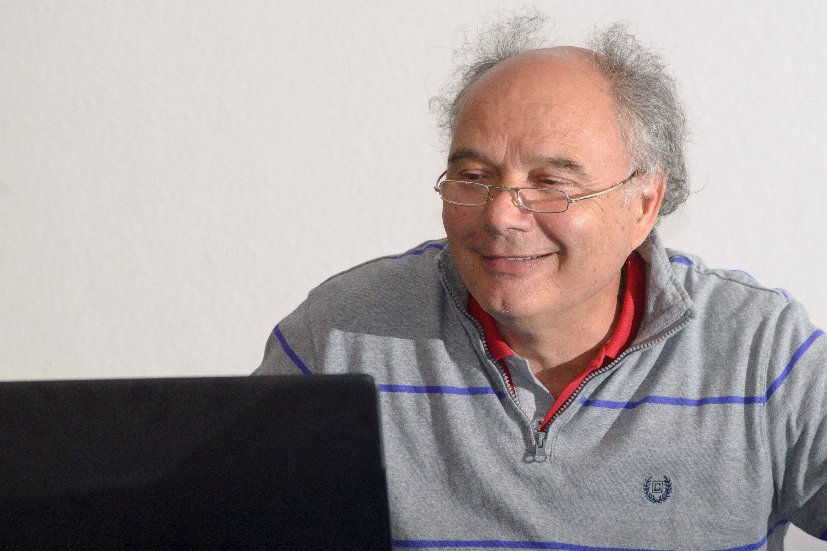
Thanks to: Mauro!

Slide 34
Thanks to: Mauro!
If Wifi, microphones, projector etc. were not an issue was thanks to him!

Slide 35
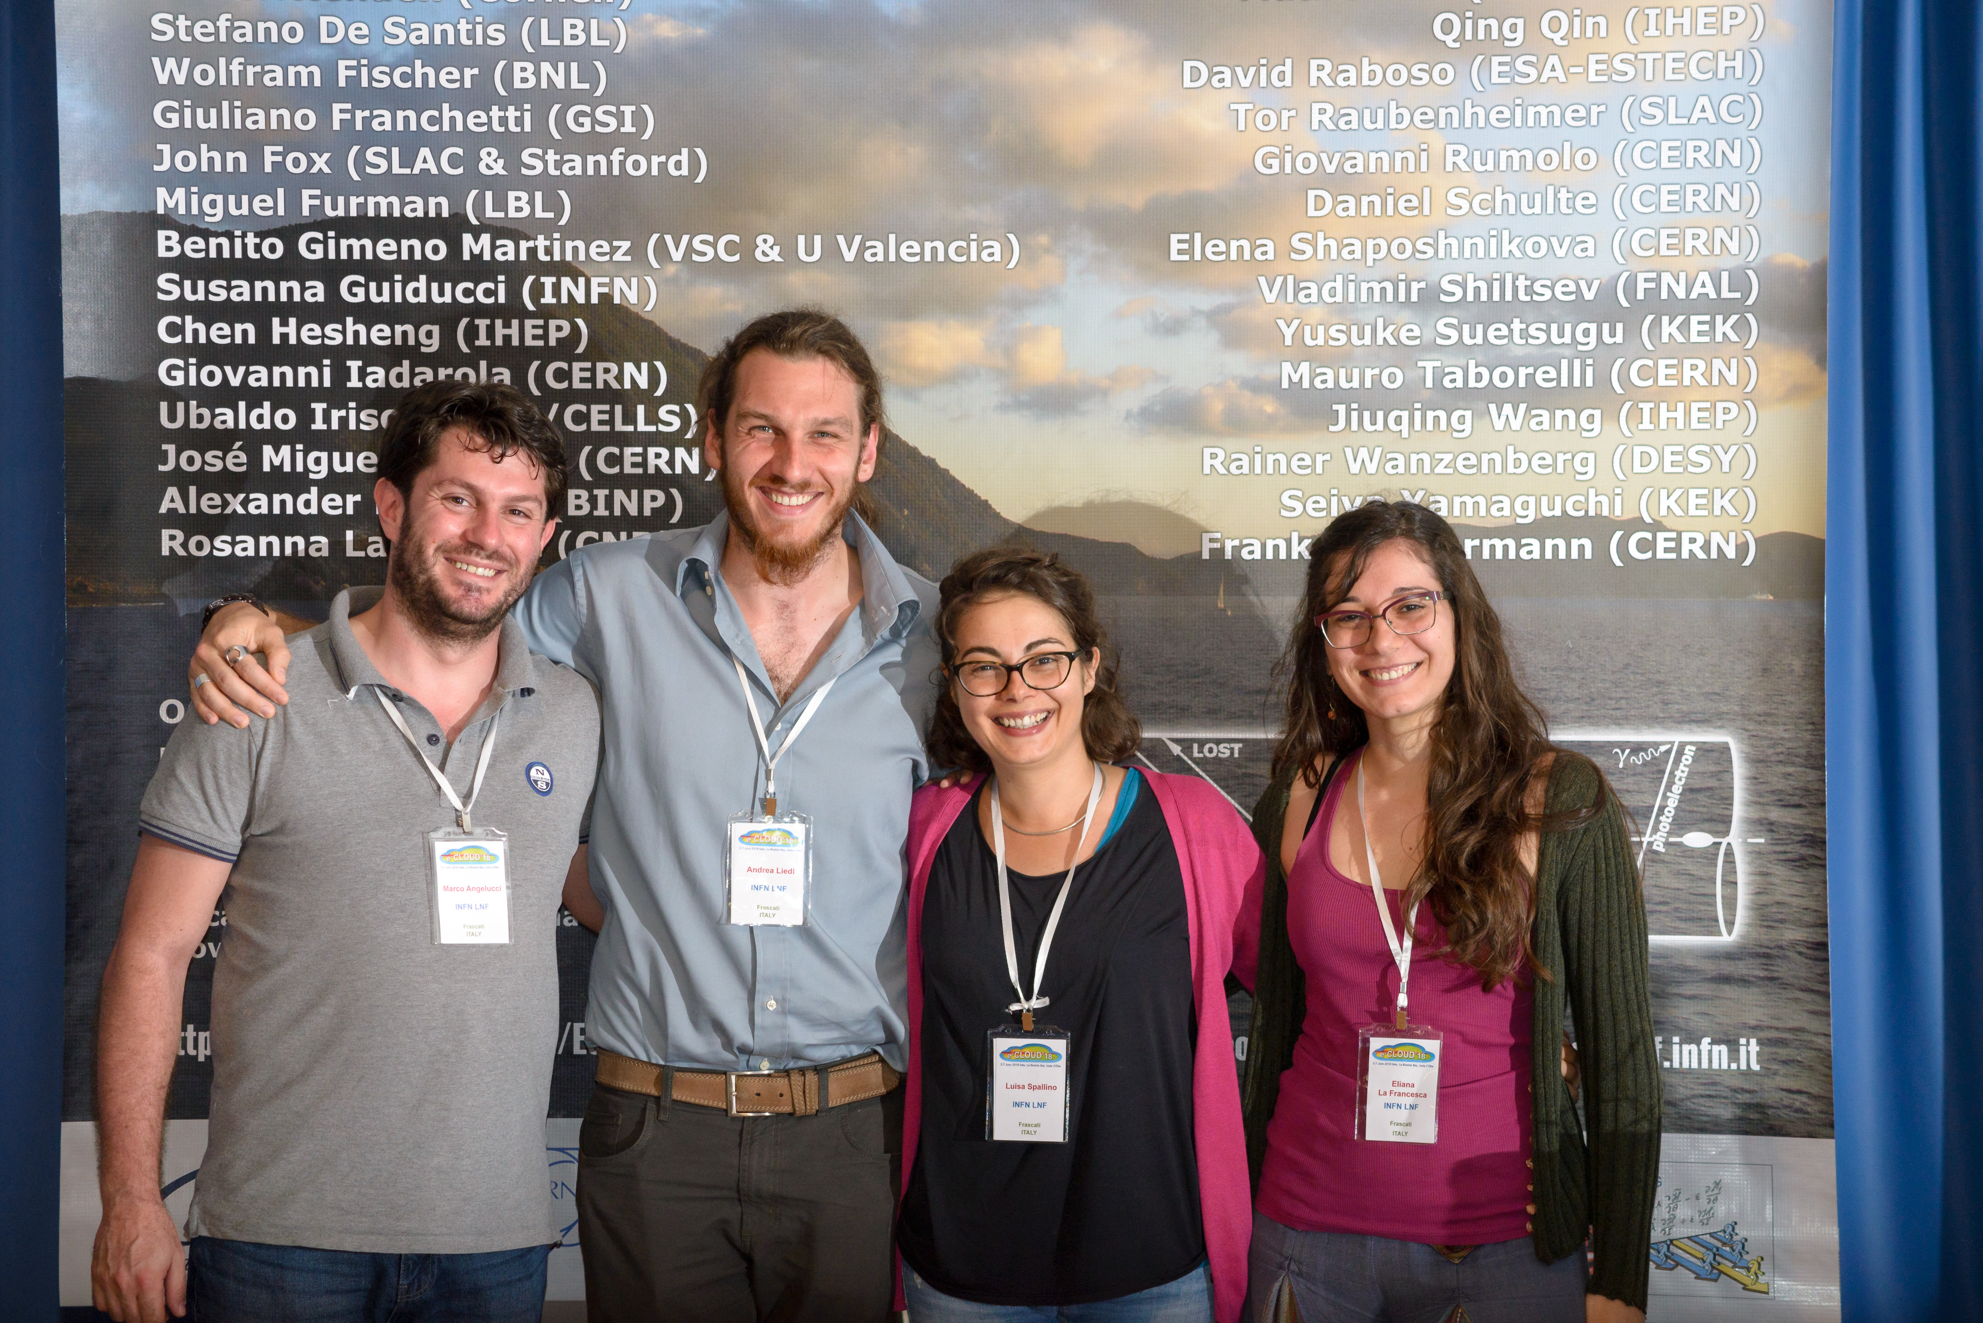
Thanks to: the “conference room” assistants!

Slide 36
Thanks to: the “conference room” assistants!
Marco: “The photon irradiating” one!

Slide 37
Thanks to: the “conference room” assistants!
Marco: “The golden goal” one!

Slide 38
Thanks to: the “conference room” assistants!
Andrea and Eliana: the “Reflecting” ones!

Slide 39
Thanks to: the “conference room” assistants!
Luisa: The “cold one”!

Slide 40
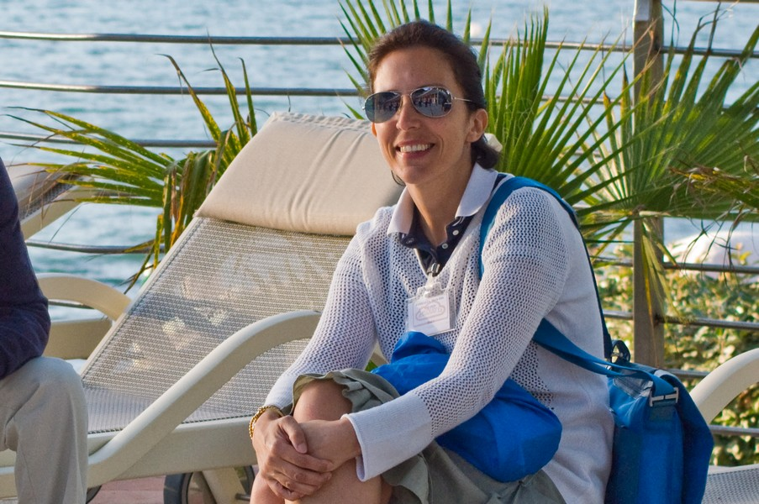
Thanks to: Maria Rita, our Bank!

Slide 41
Thanks to: Maria Rita, our Bank!
No money for the Fee? Be careful she has license to kill for just a discount request!

Slide 42
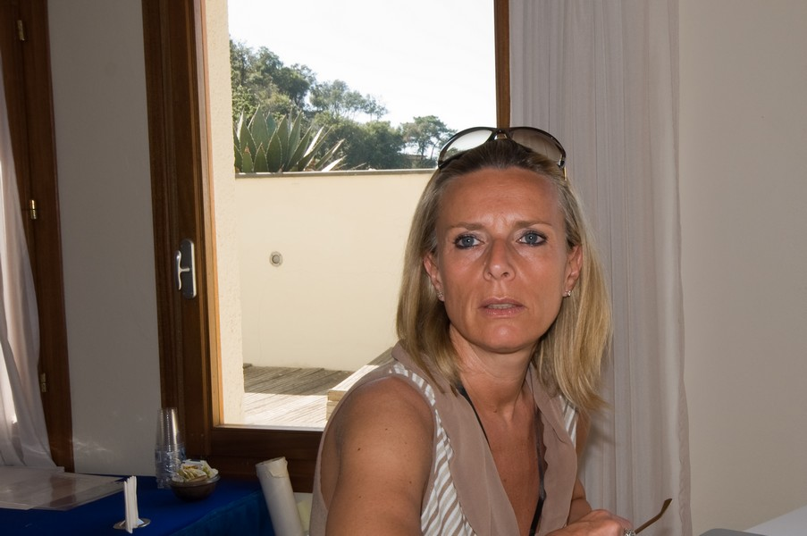
Thanks to: Lucia, The PROBLEM SOLVER!

Slide 43
Thanks to: Lucia, The PROBLEM SOLVER!
A legend says that her gran-gran-gran mother organized Napoleon stay and (especially!) his trip back!

Slide 44
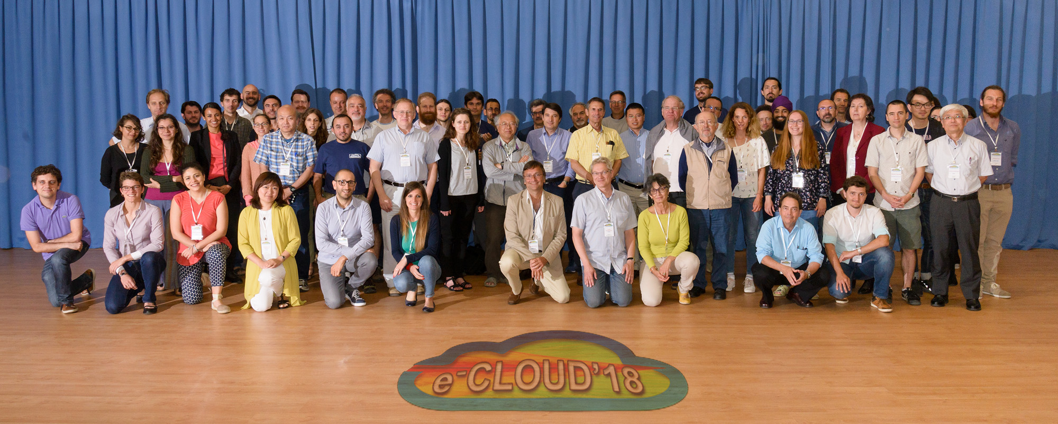
Thanks to all of you!
See you soon!

Slide 45
Thanks to all of you!
In 3 years?

Slide 46
Thanks to all of you!
Maybe in Japan, or in Cancun..... But of course you are very welcome to come back here in Elba!
In 3 years?

Slide 47
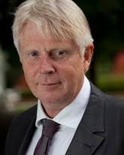
A
.. and if you are not particularly concerned by
what Frank
reported:
“LHC electron cloud is top priority. If e-cloud heat differences between sectors are not understood and HL-LHC not mastered, CERN may be shut down!”
Norbert Holtkamp, Chair CERN MAC, 28 January 2018

Slide 48
Thanks for coming!!!
Than ... Keep studying e-cloud related issues .... At least to hope (if you enjoyed) to come back here in 3 years!!!

