Slide 1
GPGPU Evaluation – Update
Napoli
Silvio Pardi
Notes:
1
1
1

Slide 2
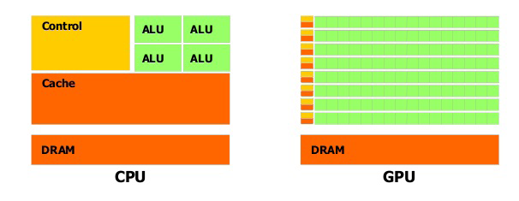
Goal of our preliminary tests
Achieve know-how on the GPGPU architectures in order to test the versatility and investigate the adoption for some specific tasks interesting for SuperB.
Create a list of test which we are interesting for.
multi-core Technology
High speed and complex processing unit
General Purpose
many-core technology
Hundred of simple Processing Units
Designed to macht the SIMD paradigm (Single Instruction Multiple Data)
Notes:
2
2
2
Differiscono dalle cpu, strade diverse multi-core e many-core, grande distribuzione miglior rapporto Gflops/costo

Slide 3
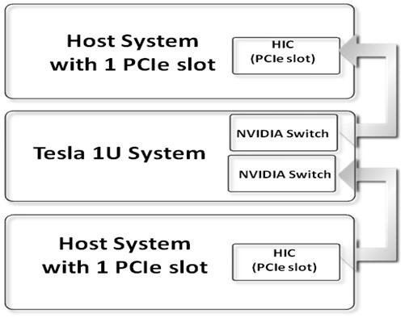
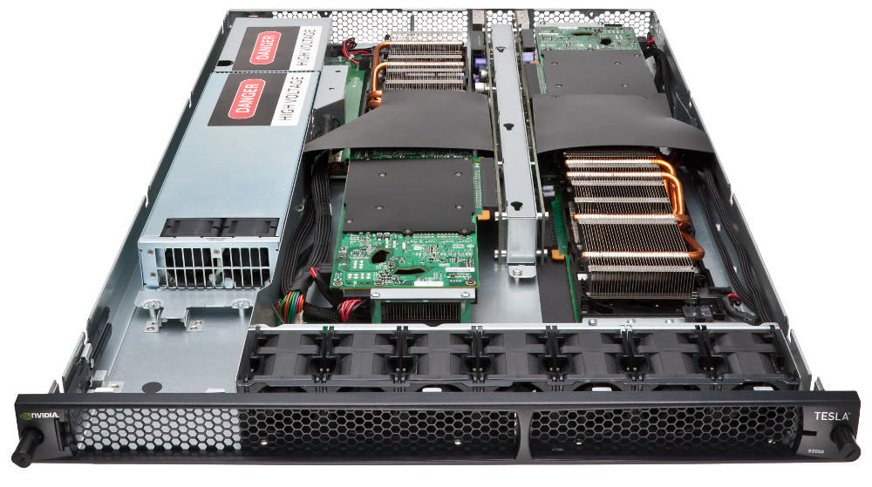
The Hardware Available in Napoli
2U rack Dell PowerEdge R510
Intel Xeon E5506 eight-core @ 2.13 GHz
32.0 GB DDR3
8 hard disk SATA (7200 rpm), 500 GB
1U rack NVIDIA Tesla S2050
4 GPU Fermi
Memory for GPU: 3.0 GB
Core for GPU: 448
Processor core clock: 1.15 GHz
Notes:
3
3
3
1U system rack (sistema a montaggio su rack di un’unità con quattro processori di calcolo NVIDIA Fermi.

Slide 4
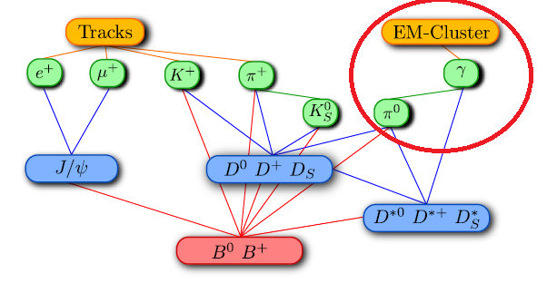
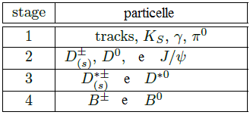
B-meson reconstruction algorithm
Combinatorial problem
Problem Modellization: given N quadrivector (spatial component and energy), combine all the couple without Repetition. Then calculate the mass of the new particle and check if the mass is in a range given by input.
GOAL: Understand the impact, benefits and limits of using the GPGPU architecture for this use case, through the help of a toy-model, in order to isolate part of the computation.
Toy model implemented in CUDA C by 2 undergraduate students.
1
Notes:
4
4
4

Slide 5
B-meson reconstruction algorithm
Combinatorial problem
Problem Modellization: given N quadrivector (spatial component and energy), combine all the couple without Repetition. Then calculate the mass of the new particle and check if the mass is in a range given by input.
GOAL: Understand the impact, benefits and limits of using the GPGPU architecture for this use case, through the help of a toy-model, in order to isolate part of the computation.
Toy model implemented in CUDA C by 2 undergraduate students.
1
2
Notes:
5
5
5

Slide 6
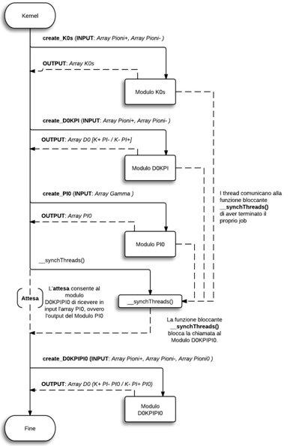
Input:
3 Array:
PI+
PI-
Gamma
Four Modules
K0S
D0KPI
PI0
D0KPIPI0

Slide 7
Start
Parallel implementation
of each module
Sequential code(CPU)
Parallel code (GPU)
Read Input
START MODULE
Thread 0:
Sum of n quadrivector
m²=E²-px²-py²-pz²
Thread 1:
Sum of n quadrivector
m²=E²-px²-py²-pz²
Thread k:
Sum of n quadrivector
m²=E²-px²-py²-pz²
…
m0-Δ<m<m0+Δ
NO
m0-Δ<m<m0+Δ
NO
NO
m0-Δ<m<m0+Δ
SI
SI
SI
Particle found
Particle found
Particle found
END OF THE MODULE
Notes:
7
7
7

Slide 8
Methodology used in the test
Memory in input
CudaMalloc input
CudaMalloc output
Load input array
cudaMemcpy() hostTOdevice
cudaMemset()
Kernel
cudaMemcpy() deviceTOhost
cudaFree()
free()
Total time
A sequential version of the toy algorithm has be implemented to compare the parallel one.
We increment the input in order to found the minimal data set in which the GPU algorithm overcome the sequential code.
In testing the CUDA algorithm we measuring the time spent in any single activities in order to evaluate the overhead.
Notes:
8
8
8

Slide 9
Test Results
Complete Algorithm
Input |  |  | CUDA |  |  |  |  |  |  |  |  |  |  | SEQUENTIAL
PI+ | PI- | Gamma | Memory in input | CudaMalloc input | CudaMalloc output | Caricamento array input host | cudaMemcpy() hostTOdevice | cudaMemset() | Kernel | cudaMemcpy() deviceTOhost | cudaFree() | free() | Total | Moduli | Total
l5 | 5 | 20 | 510 byte | 0,151 ms | 0,225 ms | 0,004 ms | 0,111 ms | 0,056 ms | 0,073 ms | 0,239 ms | 0,832 ms | 0,01 ms | 1,701 ms | 0,014 ms | 0,116 ms
10 | 10 | 40 | 1020 byte | 0,142 ms | 0,329 ms | 0,004 ms | 0,108 ms | 0,05 ms | 0,073 ms | 0,28 ms | 0,959 ms | 0,01 ms | 1,956 ms | 0,047 ms | 0,155 ms
50 | 50 | 200 | 5100 byte | 0,239 ms | 0,226 ms | 0,011 ms | 0,113 ms | 0,051 ms | 0,572 ms | 0,341 ms | 0,918 ms | 0,009 ms | 2,484 ms | 4,177 ms | 4,301 ms
100 | 100 | 400 | 10200 byte | 0,245 ms | 0,332 ms | 0,02 ms | 0,113 ms | 0,055 ms | 5,141 ms | 0,416 ms | 1,055 ms | 0,015 ms | 7,432 ms | 48,857 ms | 48,993 ms
200 | 200 | 800 | 20400 byte | 0,243 ms | 0,458 ms | 0,042 ms | 0,122 ms | 0,05 ms | 69,763 ms | 0,656 ms | 1,291 ms | 0,03 ms | 72,654 ms | 681,151 ms | 681,293 ms
500 | 500 | 2000 | 51000 byte | 0,245 ms | 0,705 ms | 0,11 ms | 0,147 ms | 0,051 ms | 2694,594 ms | 1,976 ms | 2,59 ms | 0,469 ms | 2711,719 ms | 22135,501 ms | 22135,722 ms
1000 | 1000 | 4000 | 102000 byte | 0,262 ms | 24,844 ms | 0,229 ms | 0,229 ms | 0,059 ms | 14818,104 ms | 2,964 ms | 7,219 ms | 0,176 ms | 14854,087 ms | 361505,69 ms | 361506,06 ms
Notes:
9
9
9

Slide 10
CUDA Configurations
Configurations (dimPIp*dimPIm*numPI0)
Input |  |  | Thread per Block | grid.x | grid.y | PI0 trovate
PI+ | PI- | Gamma
5 | 5 | 20 | 256 | 1 | 1 | 8
10 | 10 | 40 | 1024 | 4 | 1 | 33
50 | 50 | 200 | 1024 | 2063 | 1 | 845
100 | 100 | 400 | 1024 | 182 | 182 | 3390
200 | 200 | 800 | 1024 | 729 | 729 | 13580
500 | 500 | 2000 | 1024 | 4555 | 4555 | 84950
1000 | 1000 | 4000 | 1024 | 10000 | 10000 | 102400
Notes:
10
10
10

Slide 11
Results plot (kernel only)
Notes:
11
11
11

Slide 12
Results plot (kernel + Overhead)
Notes:
12
12
12

Slide 13
Conclusion
In Napoli we started to test the NVIDIA GPGPU architecture and we started to investigate how porting HEP on code in these architectures.
The theme seem very attractive for enthusiastic students and we are seizing the opportunity to test GPU for our purpose within an Academic exercise.
We learn that the CudaFree function is an other expensive function to take in account
After the implementation of the new modules, the kernel algorithm it’s self work faster than the sequential version, also for relative small input, however the main issue is the riduction of the overhead due to the memory management (allocation, transfer and free)
Notes:
13
13
13

Slide 14
RISERVA
Notes:
14
14
14

Slide 15
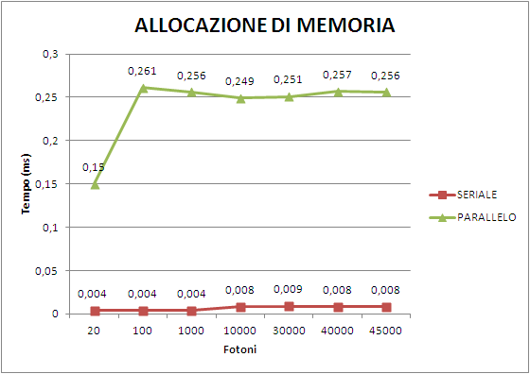
Comparison malloc e cudaMalloc

Slide 16
ENVIRONMENT
Cuda compilation tools, release 4.0, V0.2.1221
NVIDIA-Linux-x86_64-270.41.34.run
cudatoolkit_4.0.17_linux_64_rhel5.5.run
gpucomputingsdk_4.0.17_linux.run

Slide 17
Tuning for lazily modality remotion
The firsts test on the Tesla S2050 GPU with CUDA C show a starting overhead ~2 second due the “context” creation needed by the CUDA toolkit. The context is create on demand (lazily) and de-allocated when is not use.
SOLUTIONS (Suggested by Davide Rossetti):
Before the CUDA 4, Create a dummy process allways active that keep alive the CUDA context “nvidia-smi -l 60 -f /tmp/bu.log”
Since CUDA ver. 4 use the -pm (persistence-mode ) option from the nvidia-smi command to active the GPU contex.

