Slide 1
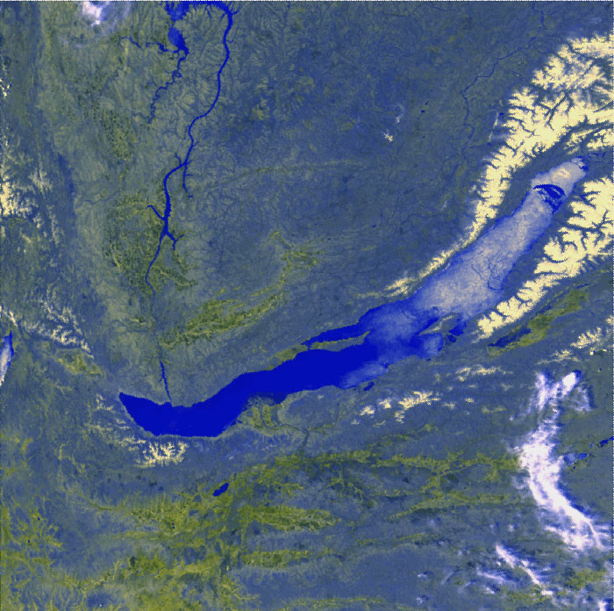
Prototyping Phase of the
BAIKAL-GVD Project
Zh.-A. Dzhilkibaev, INR (Moscow),
for the Baikal Collaboration
Rome, 22-24 May, 2013

Slide 2
GVD-project
Institute for Nuclear Research, Moscow, Russia.
Joint Institute for Nuclear Research, Dubna.
Irkutsk State University, Irkutsk, Russia.
Skobeltsyn Institute of Nuclear Physics MSU, Moscow, Russia.
Nizhny Novgorod State Technical University, Russia.
St.Petersburg State Marine University, Russia.
EvoLogics Gmb., Berlin, Germany.

Slide 3
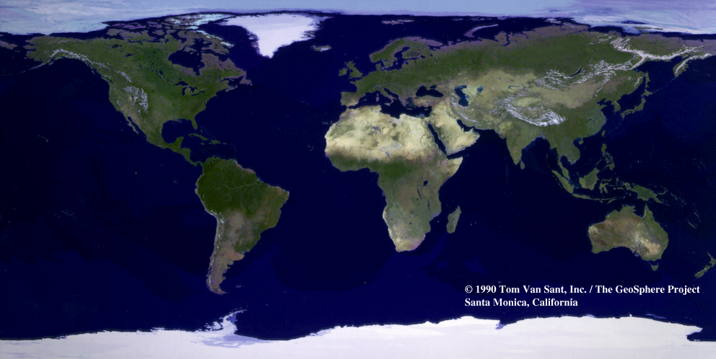
Baikal-GVD
(~2020)
KM3NeT
(~2020)
A
N
N
IceCube
(2011)

Slide 4
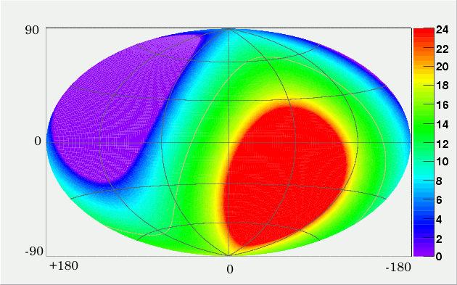
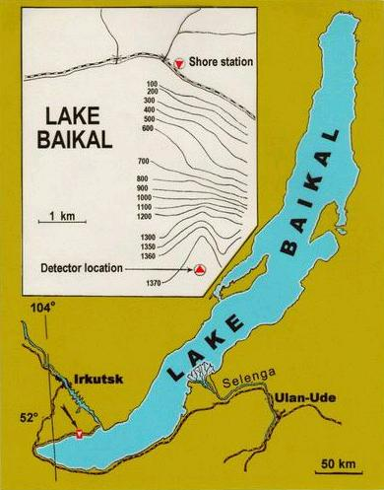
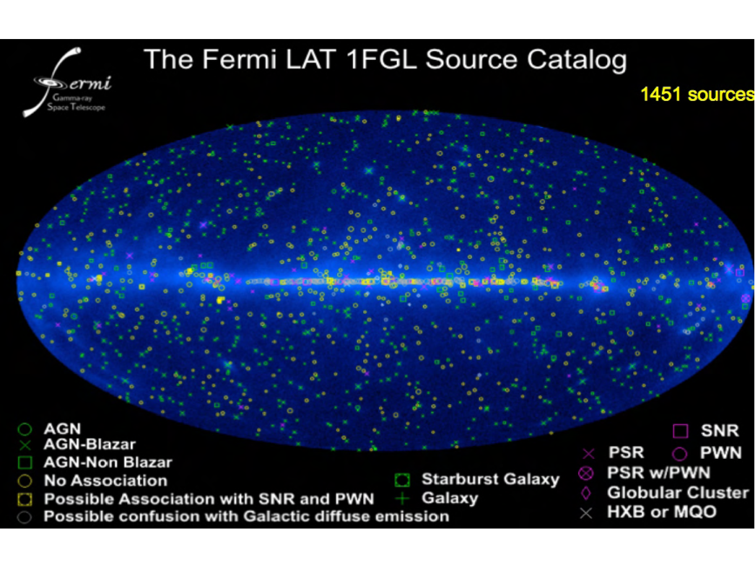
Location: 104º25’ E; 51º46’ N
Northern hemisphere– GC (~18h/day) and Galactic plane survey
The GVD sky view

Slide 5
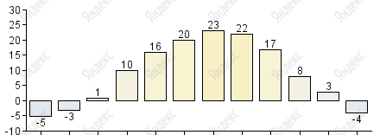
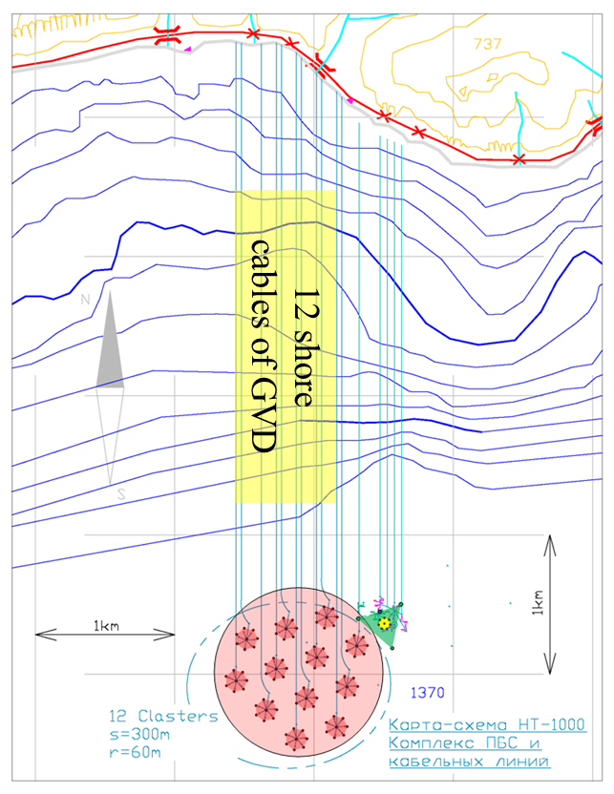
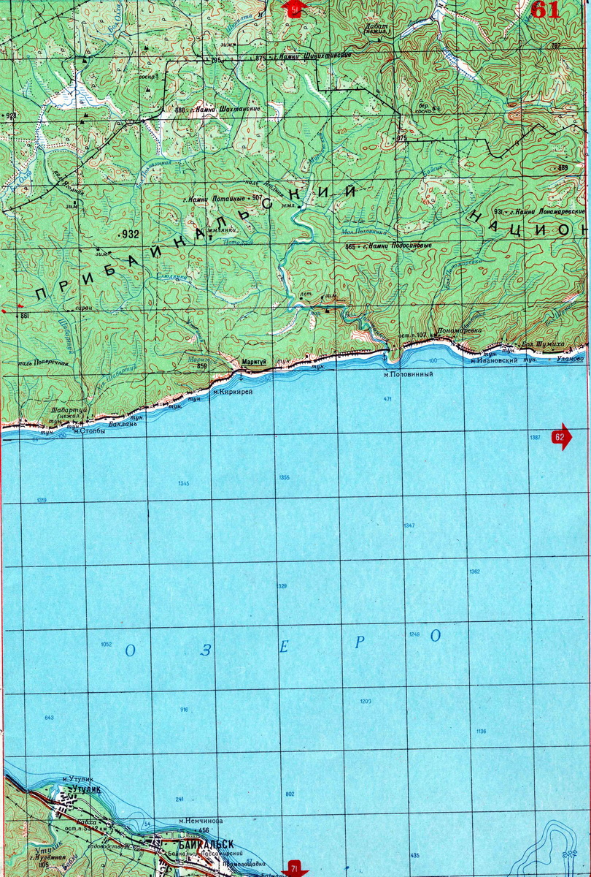
Summer
expedition
Cite properties:
Winter
expedition
Day temperature
>250 km³
Depth – 1360 m; Flat the lake bed at >3 km from the shore – allows > 250 km³ Instrumented Water Volume!

Slide 6
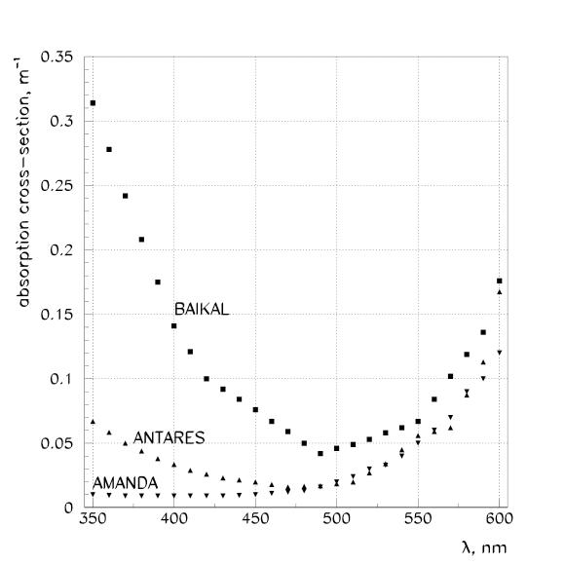
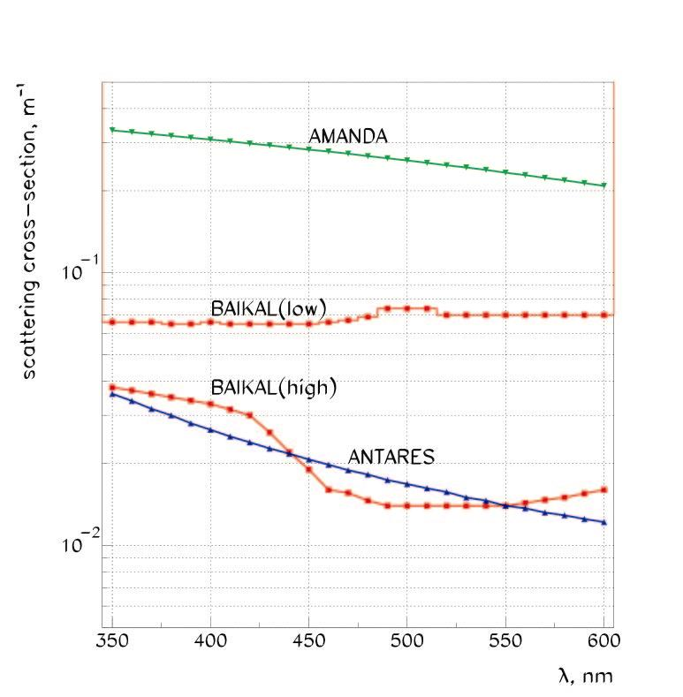
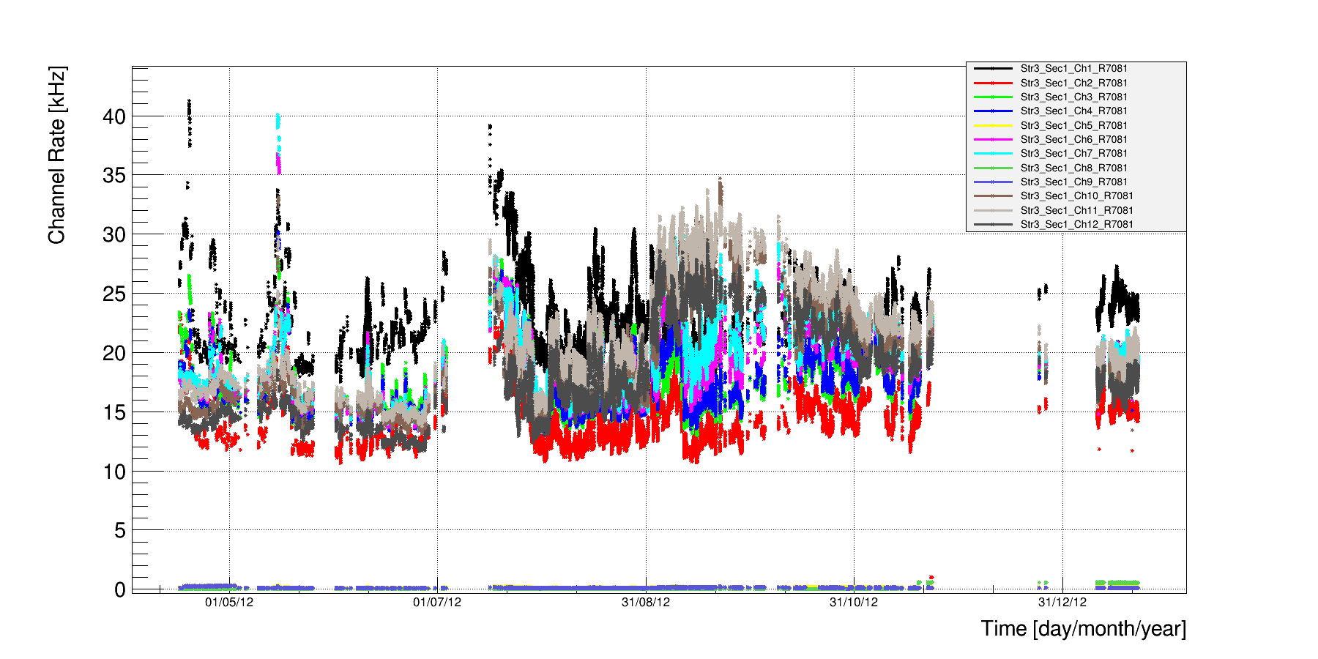
Water properties allow detection of all flavor
neutrinos with high direction-energy resolution!
Absorption length – 22-24 m
Scattering length: 30-50 m
(L_{eff} ~ 300-500 m),
Strongly anisotropic phase
function: <cosθ> ~ 0.9
Baikal
Absorption cross section, m⁻¹
Scattering cross section, m⁻¹
Baikal
λ, nm
λ, nm
PMTs Counting rates
April 2012 – February 2013
Moderately low background in fresh water:
15 – 40 kHz (10’’ R7081HQE)
absence of high luminosity bursts from
biology and K⁴⁰ background.

Slide 7
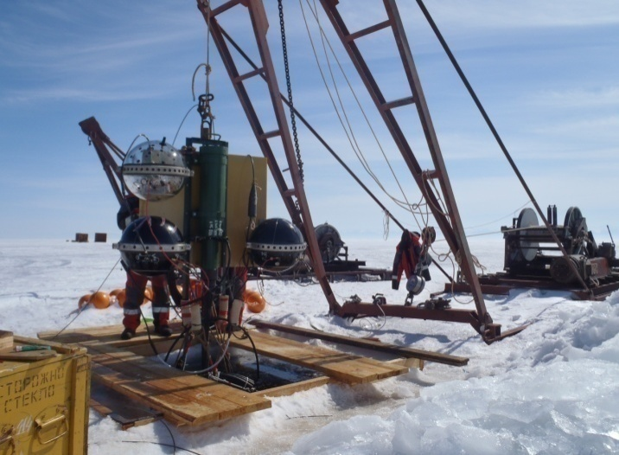
Strong ice cover during ~2 months:
Telescope deployment, maintenance, upgrade and rearrangement
Installation & test of a new equipment
All connections are done on dry
Fast shore cable installation (3-4 days)
Simultaneous deployment of strings
Dry mating
March 2011

Slide 8
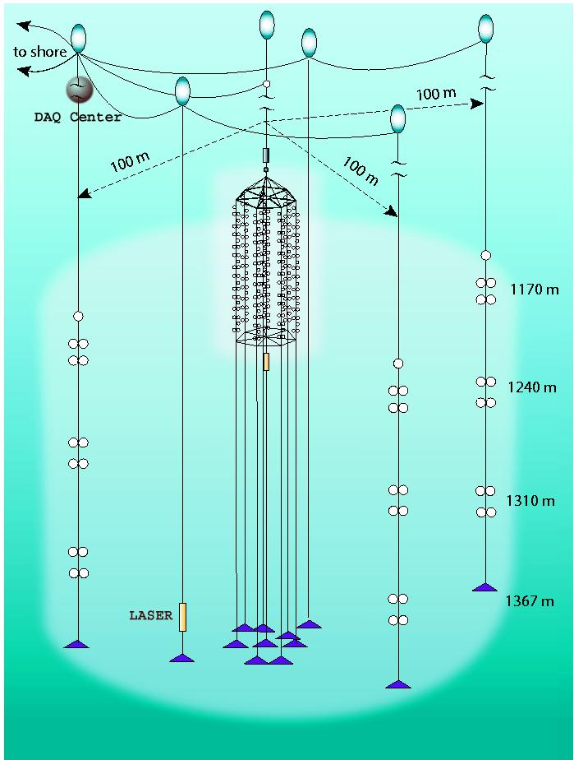
All connections on dry without bed junction boxes

Slide 9
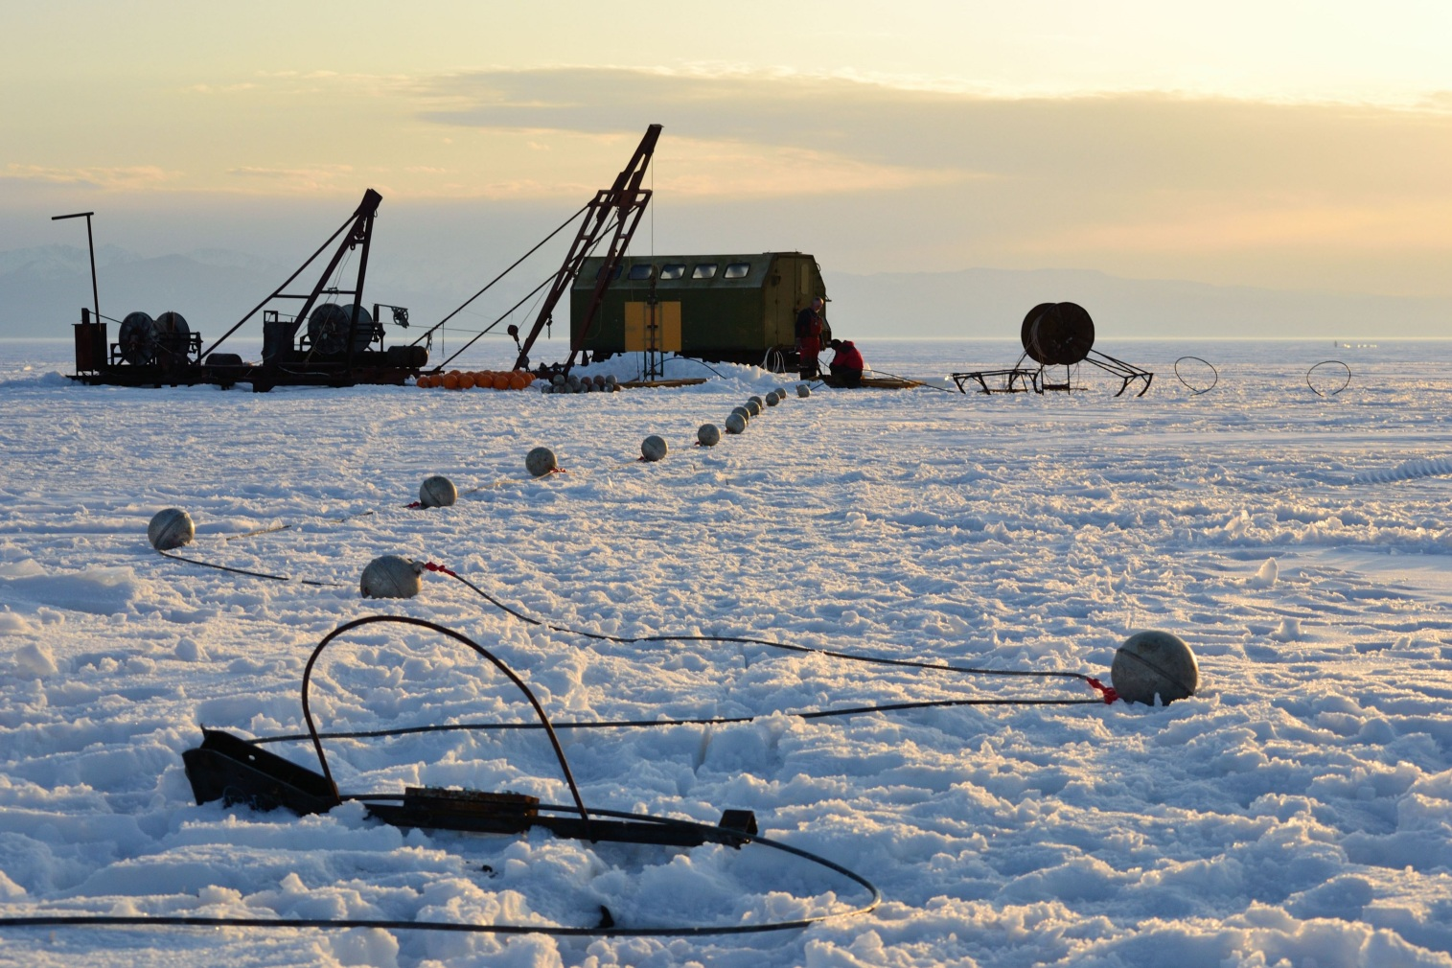
All connections on dry without bed junction boxes

Slide 10
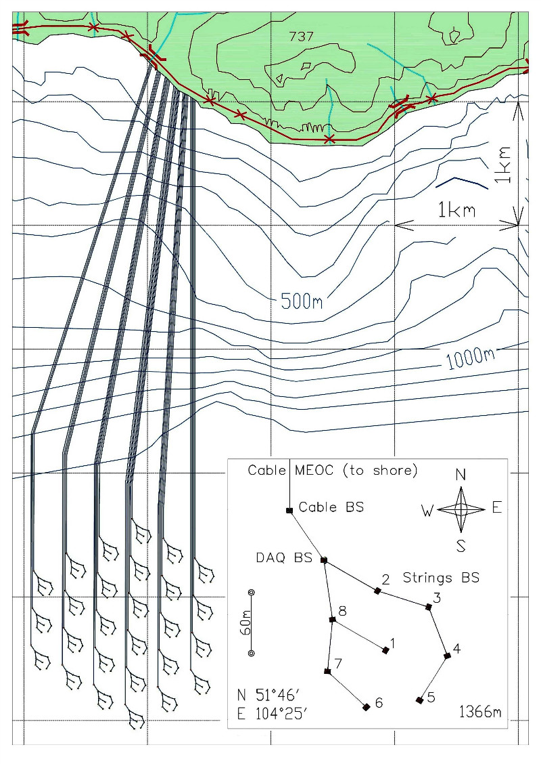
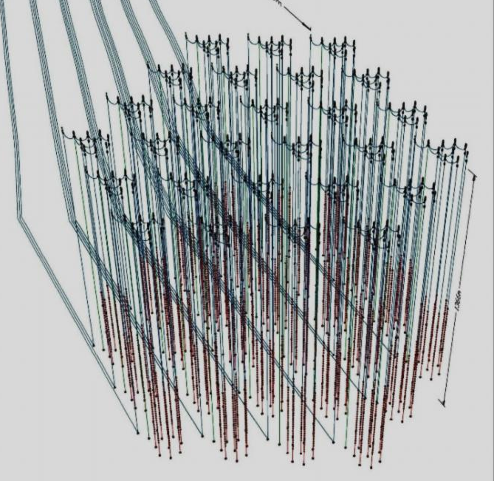
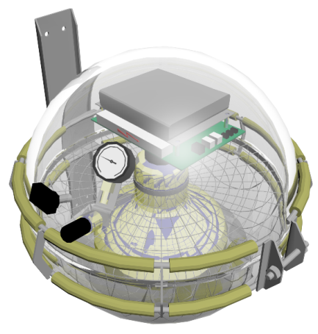
Gigaton Volume Detector (Lake Baikal)
10368 photo-sensors at 216 strings
27 subarrays (clusters with 8 strings)
String: 4 sections, 48 photo-sensors
Active depths: 600 – 1300 m
To Shore: 4 – 6 km
Instrumented water volume
V= 1.5 km³ S = 2 km²
Angular resolution
Muons: 0.25 degree
Showers: 3.5-5.5 degree
Section: basic detection unit
GVD array
1st GVD cluster: 8 strings
- Installed strings and
cable stations
Optical module

Slide 11
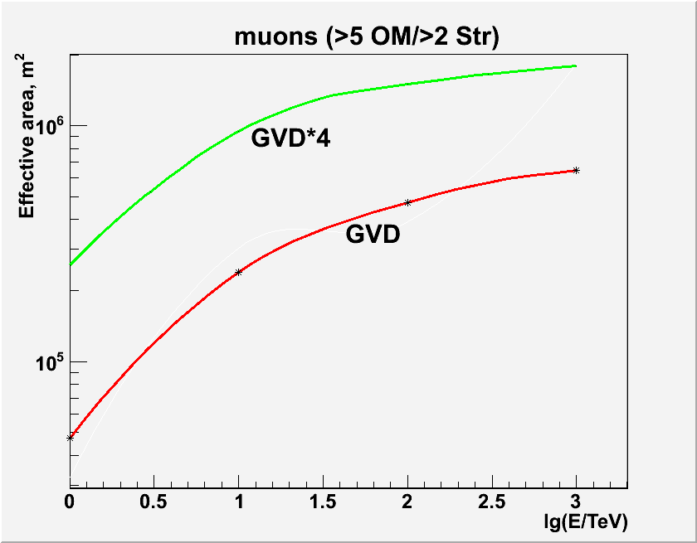
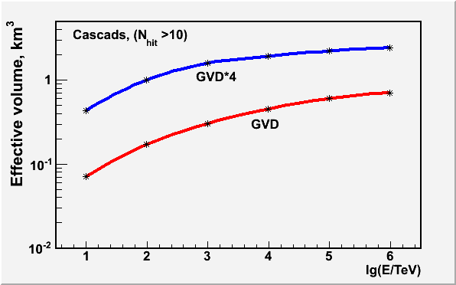
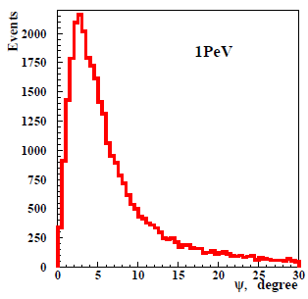
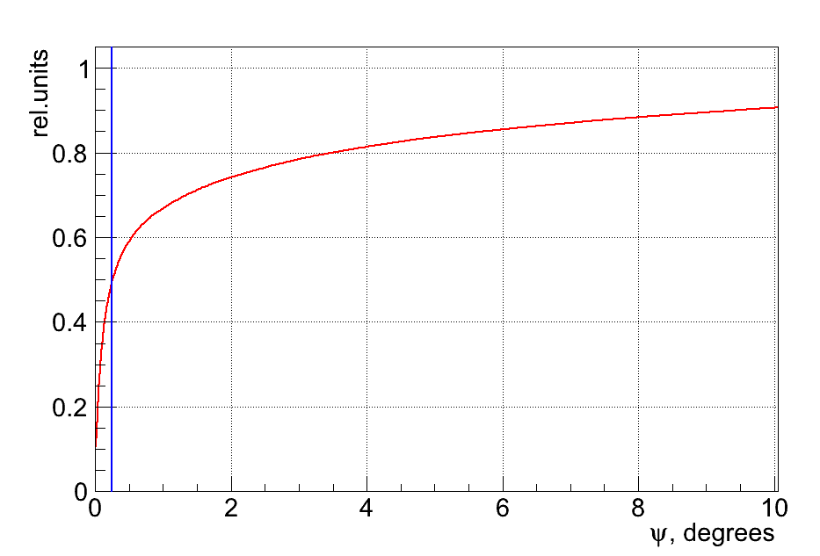
GVD Performance
Cascades: (E>10 TeV):
V_{eff} ~0.4–2.4 km³
Muons: (E>1 TeV):
S_{eff} ~ 0.3–1.8 km²
10368 OMs
10368 OMs
2304 OMs
2304 OMs
Direction resolution: 3.5º - 5.5º
Direction resolution - 0.25º

Slide 12
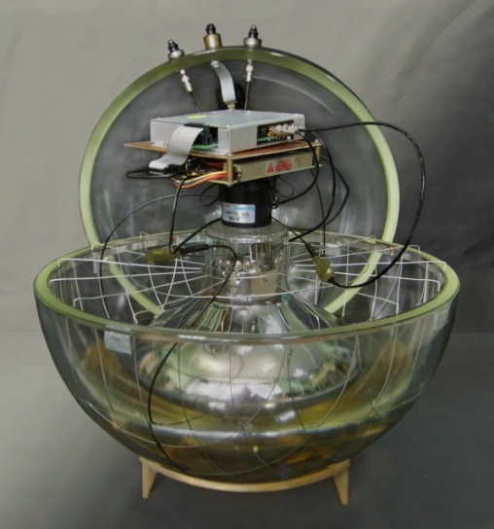
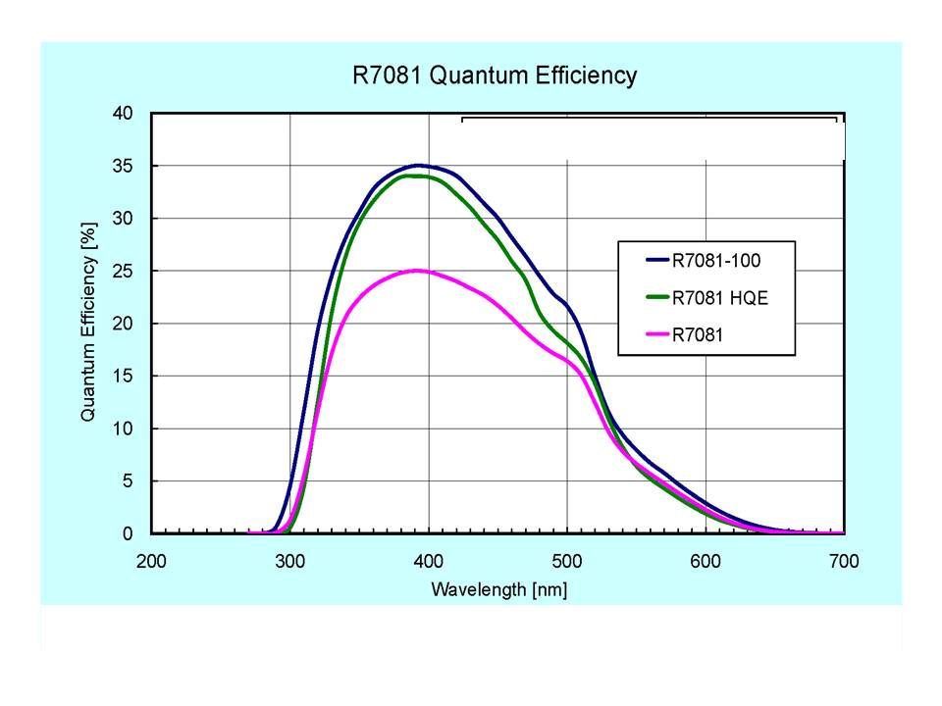
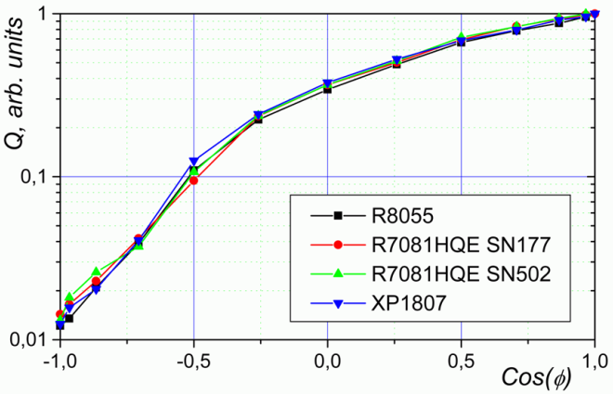
Optical module (OM)
Glass pressure-resistant sphere VITROVEX (17”)
OM electronics: amplifier, HV DC-DC, RS485 controller
2 on-board LED flashers: 1…10⁸ pe., 430 nm, 5 ns
Mu-metal cage
PMT R7081HQE : D=10”, ~0.35QE
Elastic gel
Angular sensitivity
Quantum efficiency

Slide 13
Measuring channel
PMT
Amplifier
90 m coax.cable
FADC
Optical module
Central module
A, mV
Time, 5 ns
Nominal PMT gain 1×10⁷ (PMT voltage 1250 – 1650 V)
Amplifier, k_{amp}=10;
Pulse width ~20 ns
ADC: 12 bit 200 MHz FADC (5 ns time bin);
Waveform information is recorded in a programmable interval (up to 30 mks)
Linearity range: 1 ─ 100 p.e.;

Slide 14
Triggering and Data Transmission
SECTION
CLUSTER

Slide 15
Project time-line
STReport
http://baikalweb.jinr.ru/GVD
Research & Development
Prototyping & Construction
Prototype Strings
Data Taking
2008
2009
2010
2011
2012
2013
2015
2020
Design, production and long-term in-situ tests of key elements and systems of GVD:
Optical Modules
FADC-readout system
Section Trigger Logics
Calibration system
Data Transmission
Cluster Trigger System, DAQ
Data Transport to Shore
Engineering Arrays
Cluster
8 strings
3 full strings
(72 ОМ)
3-strings array (36 ОМs),
1 full-scale string (24 ОМs)
3-strings array (24 ОМ).
Optical-electric cable to shore.
Cluster DAQ-center.
Shore station.

Slide 16
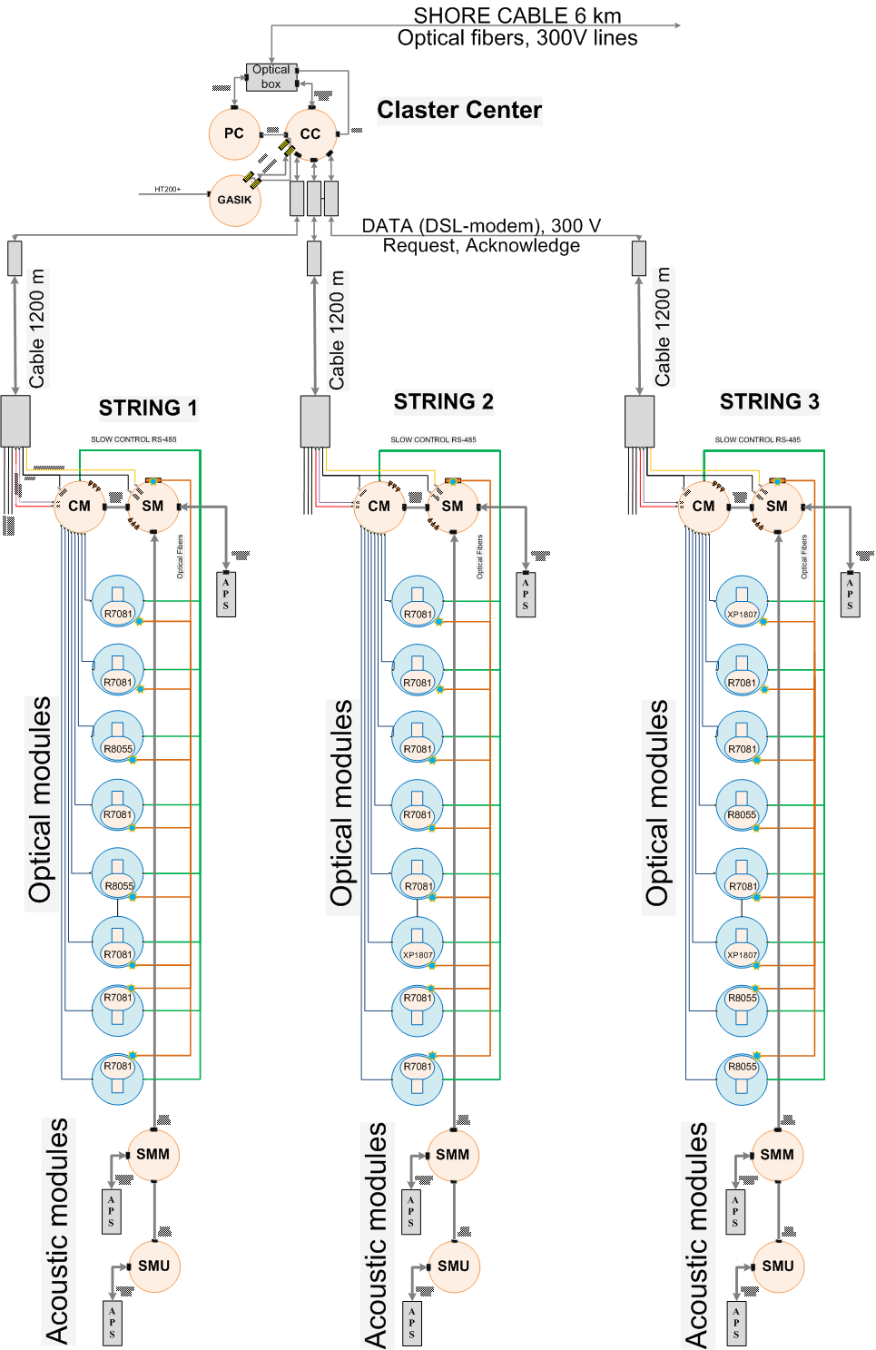
Prototyping Phase
Engineering array 2011 - technical design
24 Optical modules
The OMs house photomultipliers of different types:
16 PMT R7081HQE (Hamamatsu, ∅10 inch)
5 PMT R8055 (Hamamatsu, ∅13 inch)
3 PMT XP1807 (Photonis, ∅12 inch
3 Strings
Size reduced section:8 optical modules, CM and SM.
CM (Central module): 2ADC board (8 chan.), Master .
SM (Service module): Control and connection to the
cluster DAQ center.
Acoustic positioning system, 3 modules on each string.
Cluster DAQ center
Cluster DAQ center provides the string triggering, power supply, and communication to shore.
Communication lines
Connection between the strings and cluster DAQ center: 1.2 km copper cable. Connection to shore – optical cable 6 km.

Slide 17
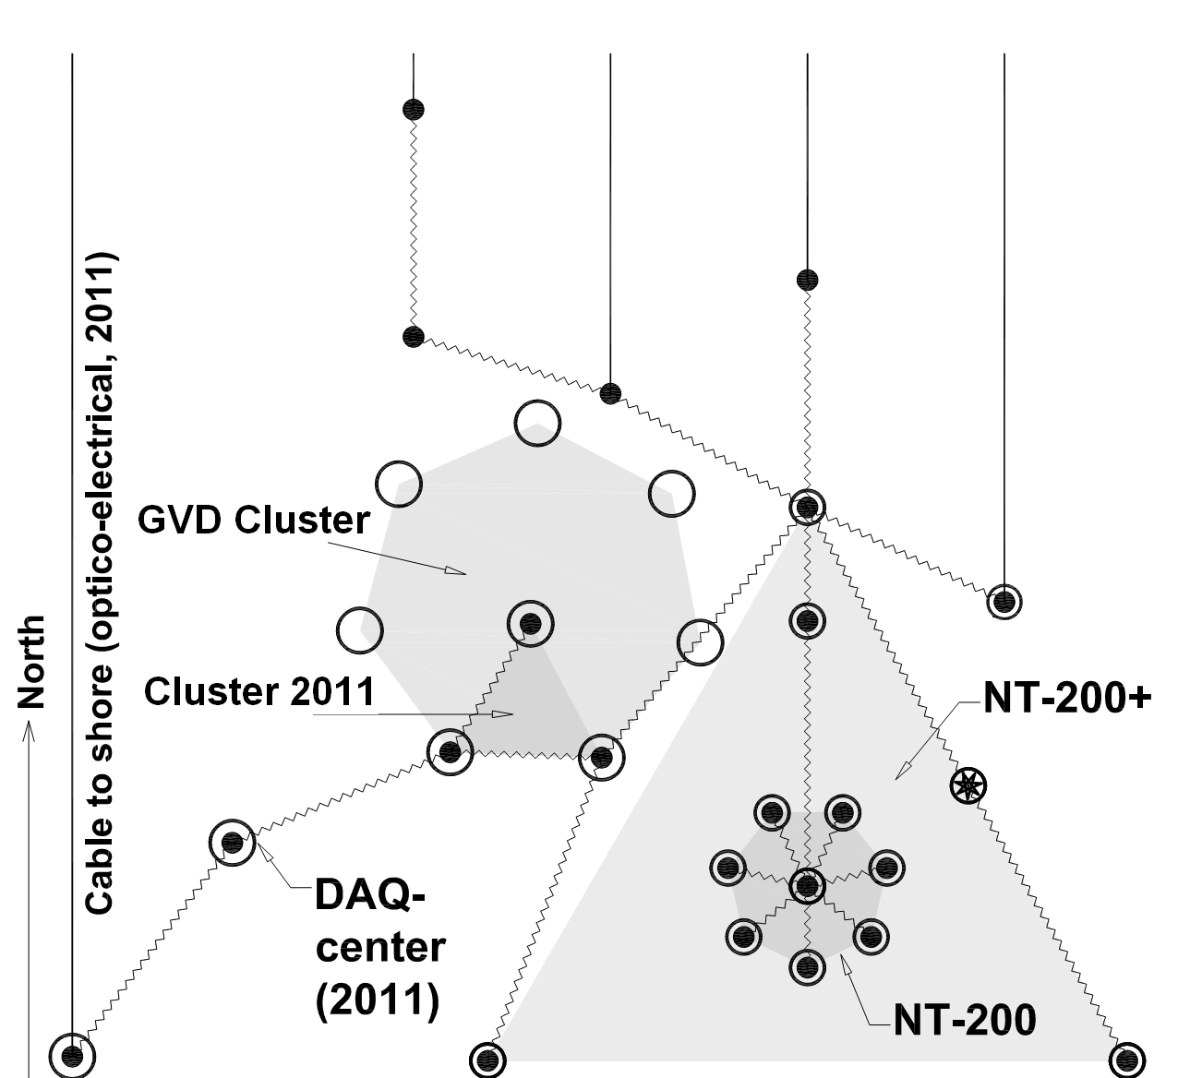
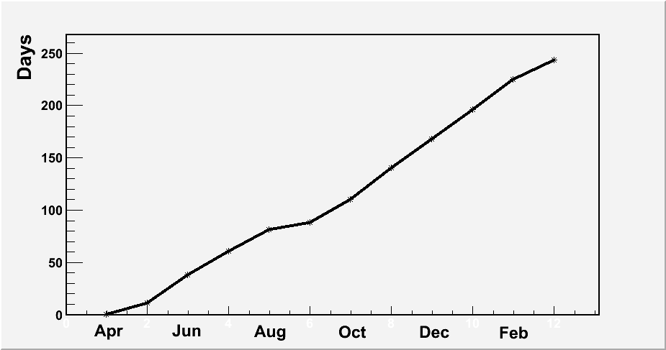
Engineering array 2011
NT200+ communication lines
248 days data
taking
Optical cable 2011
Laser
NT200
Layout of prototype cluster, neutrino telescope NT200+, and communication lines.
In April 2011, a prototype cluster of GVD was installed in Lake Baikal.
3 vertical strings with 8 optical modules each.
Vertical spacing between OMs is 10 m.
Horizontal distance between strings is 40 m.
Depths is 1205 – 1275 m.

Slide 18
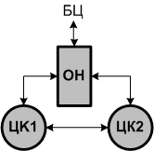
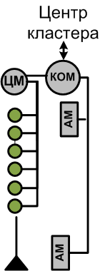
Engineering array 2012
DAQ
Modified three string array comprising full scale GVD string
shore
24 ОМ with Hamamatsu R-7081HQE:
12 ОМ with XP1807 и R8055
10 acoustic modems (AM)
DAQ-Center
Instrumentation string
Cluster DAQ-center
DAQ
DAQ

Slide 19
Engineering array 2012
First full scale GVD string with 24 OMs (2 sections) has been deployed.
String modernizations
1. Optical modules:
One OM connector (SubConn LF, 5 pin) instead of two coax. conn:
- reliability increasing;
- separation power supply and analog pulse lines → decreasing the
channel thresholds (0.5 p.e. to 0.25 p.e.)
2. String central module electronics:
Master boards : new FPGA Xilinx “Spartan 6” instead of “Spartan 3” for on-line data processing (cut out waveform data without pulses).
On-line data processing provides increasing the event transmission
rate with 10 Mbit DSL-modem to factor ~100 (10Hz → 1 kHz)
( )
( )
( )
( )

Slide 20
Engineering array 2013
The first stage of GVD Cluster comprising 3 strings
Instrumentation
string
DAQ
DAQ
DAQ
72 OM (R7081HQE, R7081-100) 3 Strings 6 Sections
Positioning System: 12 - Аcoustic Мodems
Instrumentation string: 8 ОМ (600-900 m depth) 11 Acoustic sensors (50-1220 m depth) 2 Acoustic Modems Laser ( 1215 m depth)

Slide 21
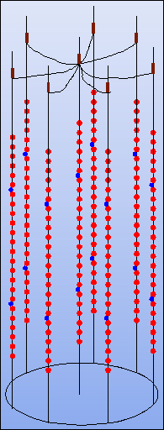
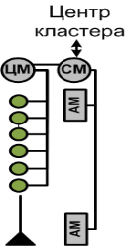
Engineering arrays (2012-2015)
2012
3 strings, first full-scale
GVD string (24 ОМs)
Data taking from
April 2012 yr.
2013
3 full-scale strings (72 OMs),
update of section electronics
Data taking from
April 2013 yr.
2014-2015
First Cluster (8 strings)
(ANTARES-scale array)
DAQ
DAQ
DAQ
DAQ
345 m
DAQ
DAQ
60 m
∼10⁶ м³ instrumented volume
∼4×10⁶ м³

Slide 22
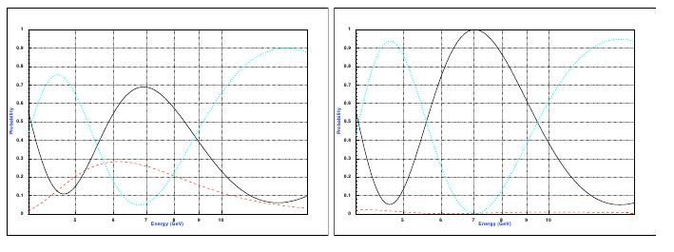
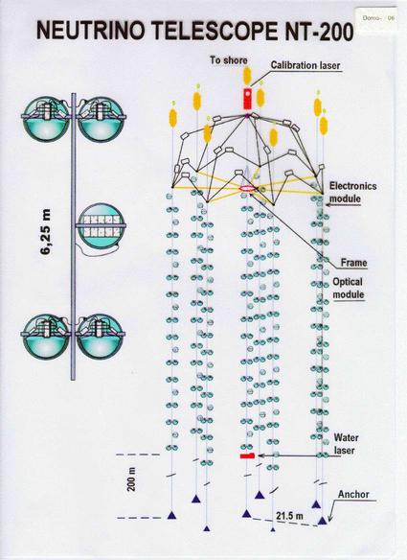
Multi-megaton array with ~1 GeV threshold
(low energy phenomena - neutrino oscillations, dark matter …)
Atm. Neutrinos: energy – zenith angles distributions of muons and cascades
Long Base Line Experiments: CERN-BAIKAL
F.Vissany et al.,arXiv:1301.4577
normal
inverted
μ
τ
μ
τ
Energy 6-8 GeV; distance 6000-8000 km;
N^{NH}/N^{IH} ~ 0.7 (30% difference);
For 10²⁰p.o.t. @ Mton Volume N_{μ} ~ 1000 events
P_{μ→x}
e
Multi-Megaton low threshold array in Lake Baikal:
The same detection system as for GVD!
Configuration – 9 independent subarrays (heptagons)
OMs – 1500 – 3000;
Positioning precision during deployment < 1 m
Heptagon strings deflections due to water currents during
year-exposition < 1m
These allow OM spacing ~ 3 m (vert.); 7-10 m (hor.);
Reconstruction of energy and direction of secondary muons and cascades
allows selection of events induced by neutrinos of all flavors.
ν_{μ}

Slide 23
Time schedule of the BAIKAL-GVD
2013 - 2015 - verification of final versions of the GVD elements
and systems, start of the first phase of construction
with deployment of the first Cluster, data taking
2015 – 2018 – the first phase of construction (12-14 Clusters),
data taking
2018 – 2020 - the final phase of construction (27 Clusters), data
taking

Slide 24
Conclusion:
During 2006-2010 the key elements and systems of the GVD
have been developed, produced and tested in Lake Baikal.
Scientific-Technical Report (STR) has been prepared
Prototyping & Construction Phase of Project is started in 2011
with deployment of the 3-string engineering array – prototype
of the GVD Cluster in Lake Baikal, which comprises all elements
and systems of the future telescope
Prototyping Phase of project will conclude in 2015 with
deployment in Lake Baikal of the ANTARES-scale array – the
first Cluster of BAIKAL-GVD.

Slide 25
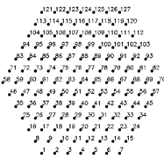
Global Neutrino Observatory
South hemisphere: – 1km³
Northern hemisphere:
KM3NeT (2 x 2.5)km³ + 1.5 km³ GVD

Slide 26
Section – Detection Unit of array
Section: 12 Optical Modules & Central Module
Central Module (CM):
12 FADC - waveform digitizers
Master board - trigger formation and data processing,
Power unit - power control and transmission
Basic trigger: coincidences of nearby OMs (threch. ~0.5&3 p.e.)
Communications:
String ↔ cluster centre: 1.2 km cable, DSL-modem
CM↔ OMs: RS-485 Bus (slow control)
Section center

Slide 27
Cluster DAQ center
Cluster – up to 8 strings
Cluster center: trigger logic, strings power supply, and communication to shore
Trigger system
2 ADC board (8 channels) and Master board
Inputs: 8 string local trigger
Output: global trigger
Networking
- 8 DSL-modems –string data
- Optical Ethernet provides data communication with Shore center.
Power supply
300 VDC commutator, 8 channels

