Slide 1
ORIGIN OF GALACTIC COSMIC RAYS: MODERN ASPECTS OF A 100 YEAR OLD PROBLEM
Pasquale Blasi
INAF/Osservatorio Astrofisico di Arcetri

Slide 2
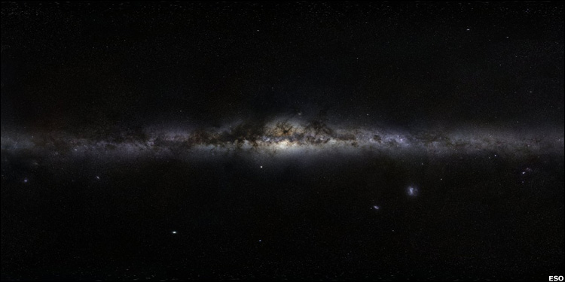
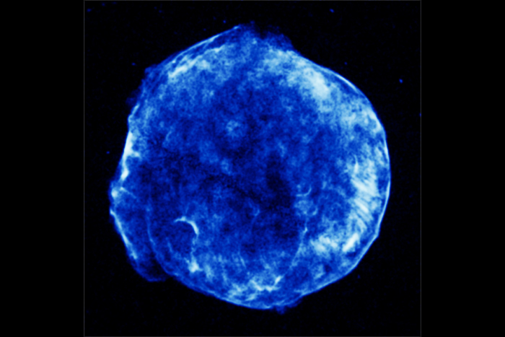
THE SNR PARADIGM
Escape boundary of the Halo
Halo height
2H~4-16 kpc
Galactic
Disc 2h~300 pc
Galactic Disc Radius: R~15 kpc
Escape boundary of the Halo
CRs ARE GENERATED IN SNR WITH AN EFFICIENCY OF ~5-20%
THEY PROPAGATE DIFFUSIVELY IN THE ISM IN AN ENERGY DEPENDENT WAY
THE MECHANISM FOR PARTICLE ACCELERATION IS MOST LIKELY DIFFUSIVE SHOCK ACCELERATION

Slide 3
SUPERNOVA BLAST WAVE
FREE EXPANSION VELOCITY:
THE EXPANSION SPEED DROPS DOWN DURING THE SEDOV-TAYLOR
PHASE, BUT THE MACH NUMBER IS ~100
A STRONG SHOCK WAVE DEVELOPS

Slide 4
Collisionless shocks
While shocks in the terrestrial environment are mediated by particle-particle
collisions, astrophysical shocks are almost always of a different nature. The
pathlength for ionized plasmas is of the order of:
Absurdly large compared with any reasonable length scale. It follows that
astrophysical shocks can hardly form because of particle-particle scattering
But REQUIRE the mediation of magnetic fields. In the downstream gas the
Larmor radius of particles is:
The slowing down of the incoming flow and its isotropization (thermalization)
Is due to the action of magnetic fields in the shock region (COLLISIONLESS
SHOCKS)

Slide 5
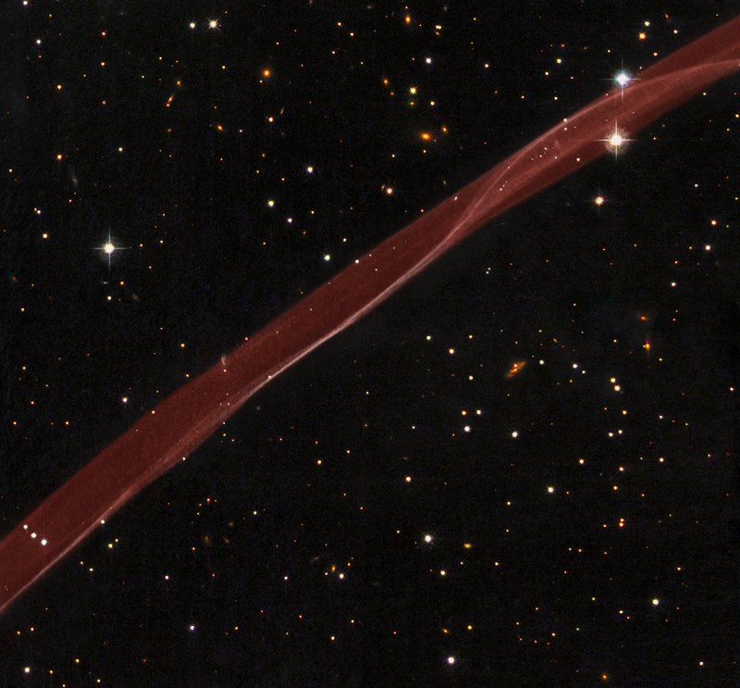
DIFFUSIVE SHOCK ACCELERATION IN SNR TEST PARTICLE APPROACH
DIFFUSION OF CHARGED PARTICLES BACK AND FORTH THROUGH THE SHOCK LEADS TO
U₁
U₂
PARTICLES ARE ACCELERATED TO A
POWER LAW SPECTRUM
THE SLOPE OF THE SPECTRUM ONLY
DEPENDS ON THE COMPRESSION
NOT ON THE DIFFUSION COEFFICIENT
FOR STRONG SHOCKS: E⁻²
THE EFFICIENCY REQUIRED PER SNR VIOLATES THE ASSUMPTION OF TEST PARTICLES →
FIRST NEED FOR A NON-LINEAR THEORY

Slide 6
Maximum Energy
The maximum energy in an accelerator is determined by either the age of
the accelerator compared with the acceleration time or the size of the
system compared with the diffusion length D(E)/u. The hardest condition
is the one that dominates.
Using the diffusion coefficient in the ISM derived from the B/C ratio:
and the velocity of a SNR shock as u=5000 km/s one sees that:
Too long for any useful acceleration → NEED FOR ADDITIONAL TURBULENCE
SECOND NEED FOR NON-LINEAR TREATMENT

Slide 7
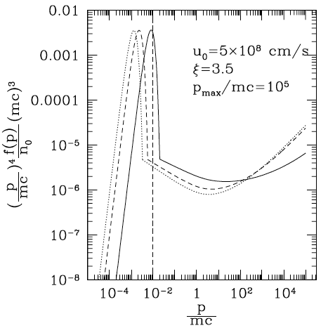
BASIC PREDICTIONS OF THE NON LINEAR THEORY OF DSA
VELOCITY
PROFILE
COMPRESSION FACTOR BECOMES FUNCTION OF ENERGY
SPECTRA ARE NOT PERFECT POWER LAWS (CONCAVE)
GAS BEHIND THE SHOCK IS COOLER FOR EFFICIENT SHOCK ACCELERATION
SYSTEM SELF REGULATED
EFFICIENT GROWTH OF B-FIELD IF ACCELERATION EFFICIENT
0
1
2

Slide 8
MAGNETIC FIELD AMPLIFICATION INDUCED BY CR STREAMING

Slide 9
X-ray rims and B-field amplification
TYPICAL THICKNESS OF FILAMENTS: ~ 10⁻² pc
The synchrotron limited thickness is:
In some cases the strong fields are confirmed by time variability of X-rays
Uchiyama & Aharonian, 2007

Slide 10
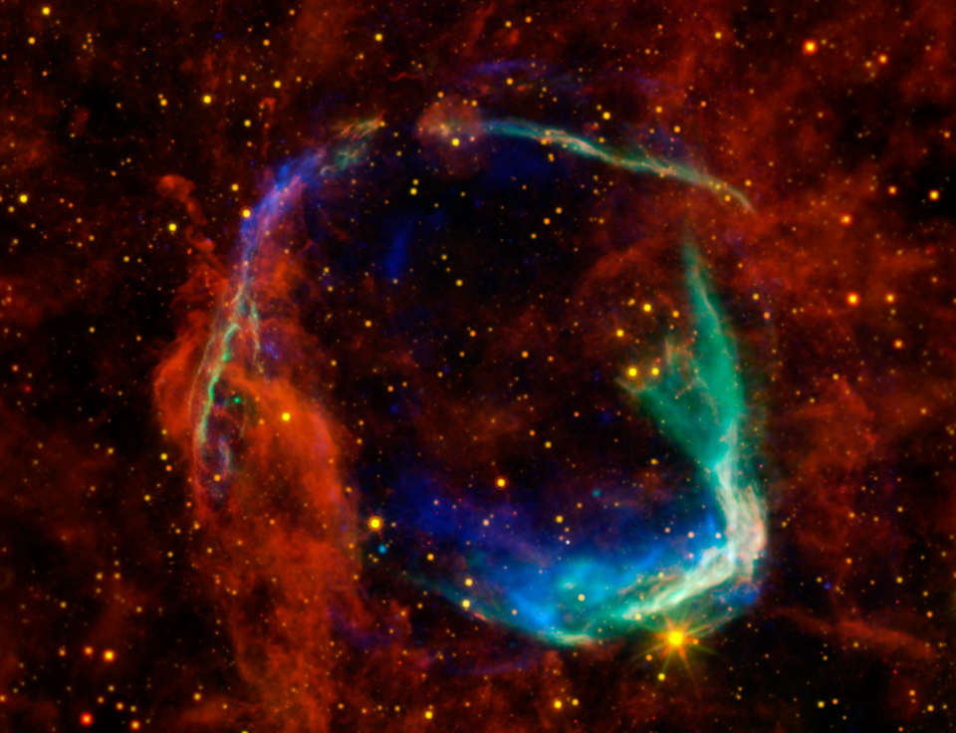
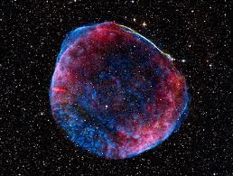
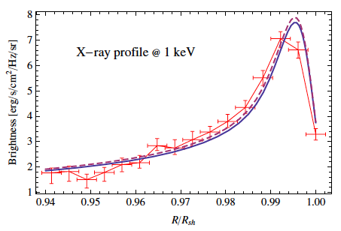
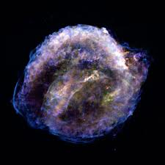
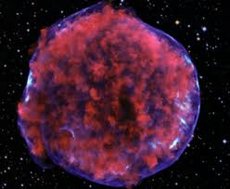
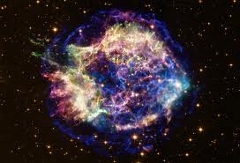
Morlino & Caprioli 2012

Slide 11
CR INDUCED INSTABILITIES
a = thermal protons, thermal electrons, cosmic rays
COSMIC RAY INDUCED STRONG CR MODIFICATION
THE UNSTABLE WAVES ARE ALFVEN WAVES WHOSE AMPLITUDE GROWS WITH A RATE PROPORTIONAL TO THE DENSITY OF RESONANT CR
THE UNSTABLE WAVES PROPAGATE FASTER THAN ALFVEN WAVES. THE GROWTH IS PROPORTIONAL TO N_{CR}^{1/2}

Slide 12
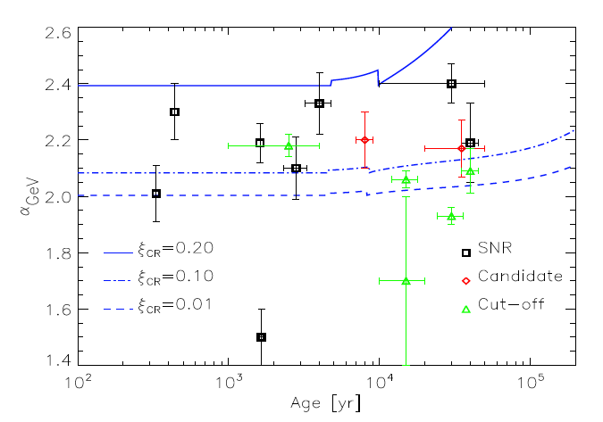
Problematic Aspects I: Spectra
The non linear theory of DSA (as well as the test particle theory) all predict CR spectra close to E⁻² and even harder than E⁻² at E>10 GeV (IN NL THEORY)
This finding does not sit well with:
CR Anisotropy
Gamma Ray Spectra from selected SNRs
Caprioli 2011
THE PROBLEM WITH ANISOTROPY IS CONNECTED WITH THE FACT THAT:
g+d = 2.7 → d=0.6-0.7
WHILE THE ISSUES WITH THE GAMMA RAY SPECTRA IS ILLUSTRATED ON THE SIDE

Slide 13
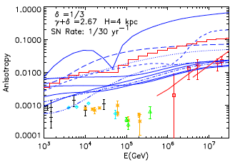
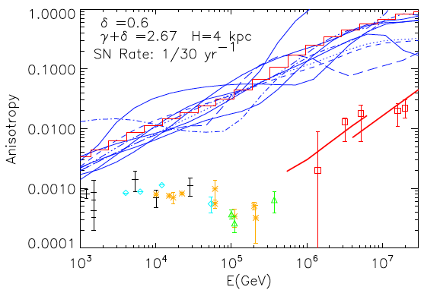
Problematic Aspects II: Large Scale CR Anisotropy
Naïve expectation:
proportional to E^{d}
d=1/3
d=0.6
PB & Amato 2011
(see also Wolfendale, Erlykin)

Slide 14
POSSIBLE REASONS FOR STEEPER SPECTRA IN NLDSA
AMPLIFIED MAGNETIC FIELD DYNAMICAL REACTION (Caprioli +, 2008,2009)
2. SHOCK MODIFICATION INDUCED BY NEUTRALS IN THE SHOCK REGION (PB+, 2012)
THE CHARGE EXCHANGE REACTIONS BETWEEN COLD (FAST) NEUTRALS AND HOT (SLOW)
IONS BEHIND A COLLISIONLESS SHOCK, LEADS TO A RETURN FLUX OF NEUTRALS
UPSTREAM. THESE NEUTRALS DEPOSIT ENERGY UPSTREAM THROUGH CHARGE EXCHANGE
AND IONIZATION. THE MACH NUMBER DECREASES → COMPRESSION FACTOR DECREASES→
SPECTRUM STEEPENS
3. FINITE VELOCITY OF SCATTERING CENTERS (Caprioli+, 2010, Zirakashvili, Ptuskin, Seo 2010)
IF MAGNETIC FIELD AMPLIFICATION LEADS TO FAST MOVING WAVES IN THE PLASMA
FRAME, THEN THE COMPRESSION FACTOR RELEVANT FOR ACCELERATION IS THAT OF THE
SCATTERING CENTER’S VELOCITY. THIS EFFECT MAY LEAD TO STEEPENING AS WELL AS TO
HARDENING DEPENDING ON HELICITY.
CHANGE IN THE EQUATION OF STATE→ LESS
COMPRESSION @ SHOCK → STEEPER SPECTRA

Slide 15
VELOCITY OF WAVES and SPECTRUM OF CR
One should recall that the compression factor that counts in shock acceleration is not that of fluid velocity, but that of the scattering centers velocity
When the magnetic field is amplified EFFECTIVELY by CR, the phase velocity can be
THIS EFFECT LEADS TO STEEPER SPECTRA WHEN ACCELERATION IS EFFICIENT (BUT VERY MODEL DEPENDENT)

Slide 16
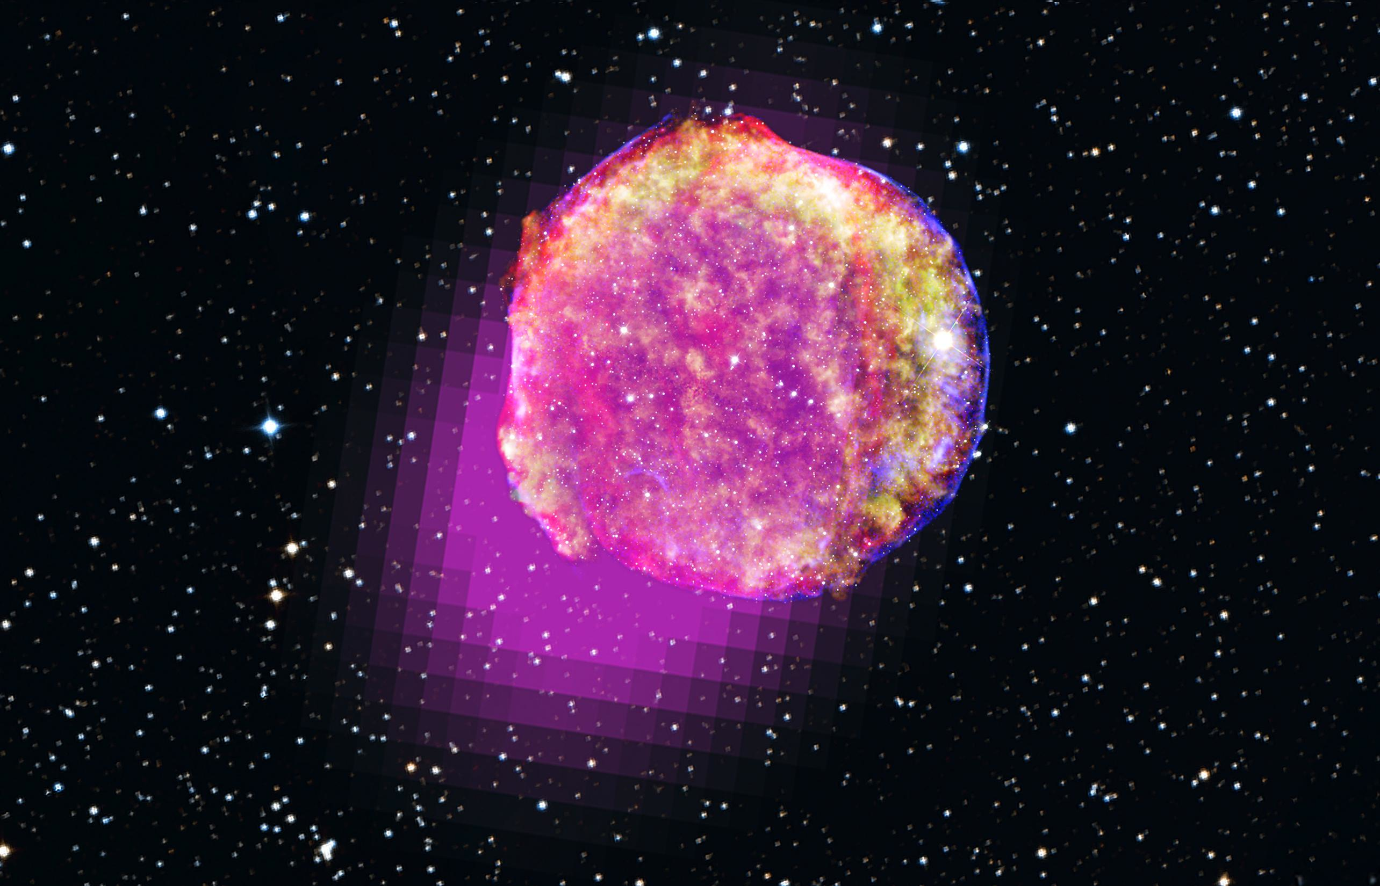
Tycho Supernova Remnant – 1572
SN Type Ia
Distance ~3 kpc

Slide 17
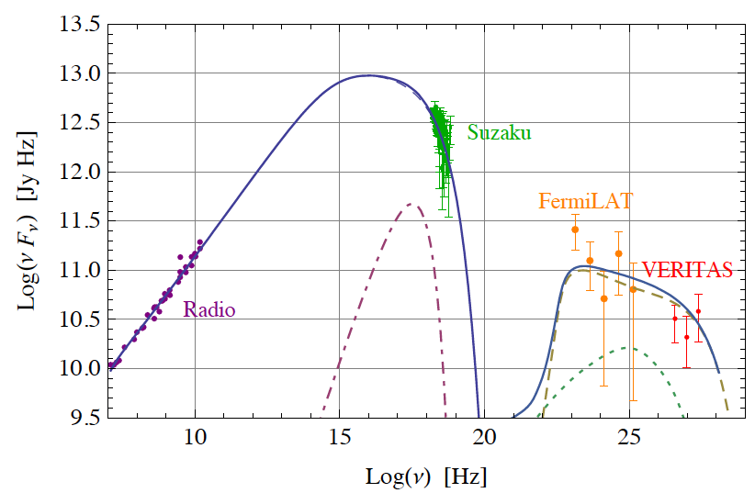
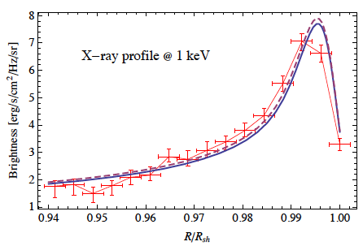
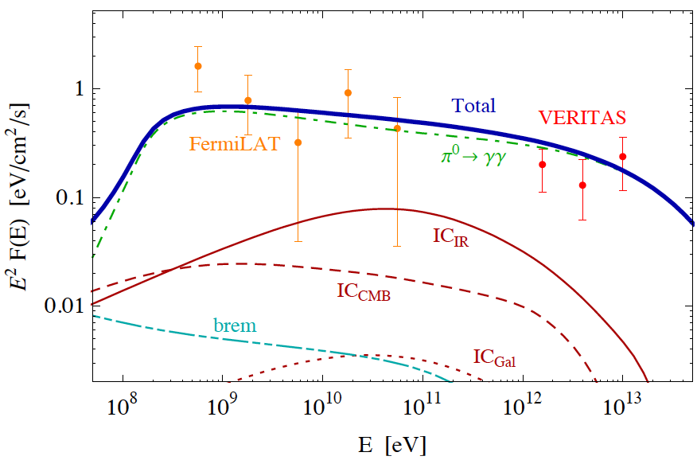
The case of Tycho with V_{wave}
STEEP SPECTRUM
BASICALLY IMPOSSIBLE TO
EXPLAIN WITH LEPTONS
Morlino&Caprioli 2011

Slide 18
SUMMARY OF PROPAGATION MODELS
I DELIBERATELY SUMMARIZE HERE ONLY THE VERY ESSENTIAL POINTS…
PROPAGATION MAINLY MODELED BY USING GALPPROP AND DRAGON
WE ARE STILL STUCK WITH TWO MAIN POSSIBILITIES:
REACCELERATION
IT REQUIRES D(p)~p^{1/3} WITH NO LOW ENERGY BREAKS
IT REQUIRES AN INJECTION SPECTRUM WITH A FLATTENING BELOW ~2 GV
THE INJECTION SPECTRUM IS ~p^{-2.4} STEEPER THAN PREDICTIONS FROM DSA
NO REACCELERATION (Diffusion Models)
IT REQUIRES D(p)~p^{0.6} WITH A LOW ENERGY BREAK BELOW FEW GV
IT REQUIRES A POWER LAW IN INJECTION ~p^{-2.1}
IT HAS SEVERE PROBLEMS WITH ANISOTROPY, EXCEEDED WILDLY
NEITHER REACCELERATION MODELS NOR DIFFUSION MODELS ACCOUNT FOR THE OBSERVED SPECTRAL BREAKS IN PROTONS AND HELIUM (I do not consider adding breaks in injection or D(E) as an explanation)

Slide 19
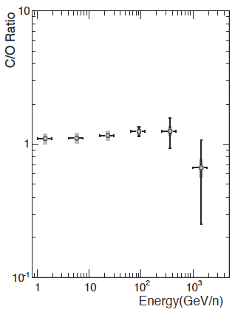
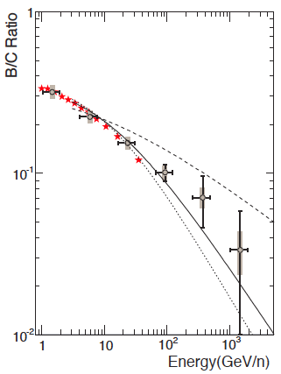
Secondary/Primary ratio
Primary/Primary
CREAM 2008
D(E) ~ 3 10²⁸ (E/3GeV)^{d} d=0.3-0.7
THESE NUMBERS CAN BE USED TO DETERMINE THE GRAMMAGE AND THEREFORE THE ENERGY INPUT FROM SNR → 5-20% EFFICIENCIES ARE REQUIRED (NOT SMALL!!!)

Slide 20
PROBLEMATIC ASPECTS OF PROPAGATION
PHENOMENOLOGICAL ISSUES
LOW RIGIDITY TREND DEPENDS ON ADVECTION, REACCELERATION… IN GENERAL FIT TO THE DATA REQUIRES POORLY JUSTIFIED BREAKS IN INJECTION AND/OR D(E)
USUALLY SOURCE DISTRIBUTION CONTINUOUS… NO POINT SOURCES… ESPECIALLY IMPORTANT FOR ELECTRONS
PROBLEMS OF PRINCIPLE
ORIGIN OF DIFFUSION STILL UNCLEAR (PRE-EXISTING, SELF-GENERATED?)
DIFFUSION USUALLY PARAMETRIZED WITH A SCALAR, BUT UNLIKELY SO
DIFFUSION PARALLEL TO SPIRAL ARMS FASTER THAN PERP, BUT PERP IN GENERAL HAS DIFFERENT ENERGY DEPENDENCE
DIFFUSION IN THE DISC HARDLY OF THE SAME TYPE AS DIFFUSION IN THE HALO
CASCADE OF TURBULENCE DEVELOPS PERPENDICULARLY → NO SCATTERING
SURPRISING THAT DESPITE A VERY SIMPLE PHENOMENOLOGICAL APPROACH, MOST THINGS SEEM TO MAKE SOME SENSE… THOUGH NOT ALL OF THEM DO…

Slide 21
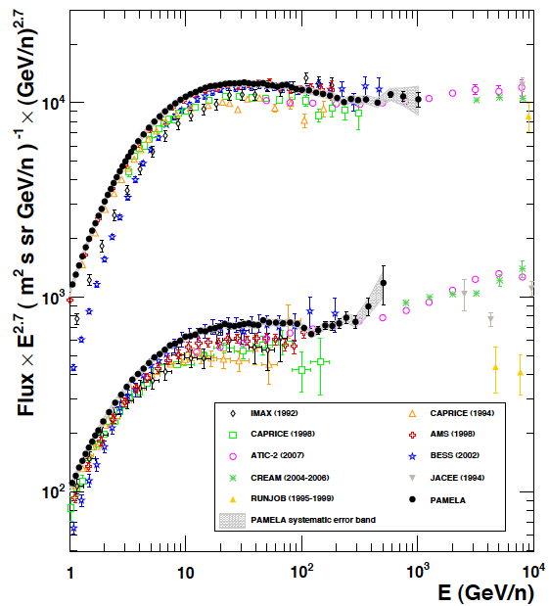
PAMELA
PROTONS
SOMETHING NEW IS TAKING PLACE AT RIGIDITY ~ 200 GV
HELIUM

Slide 22
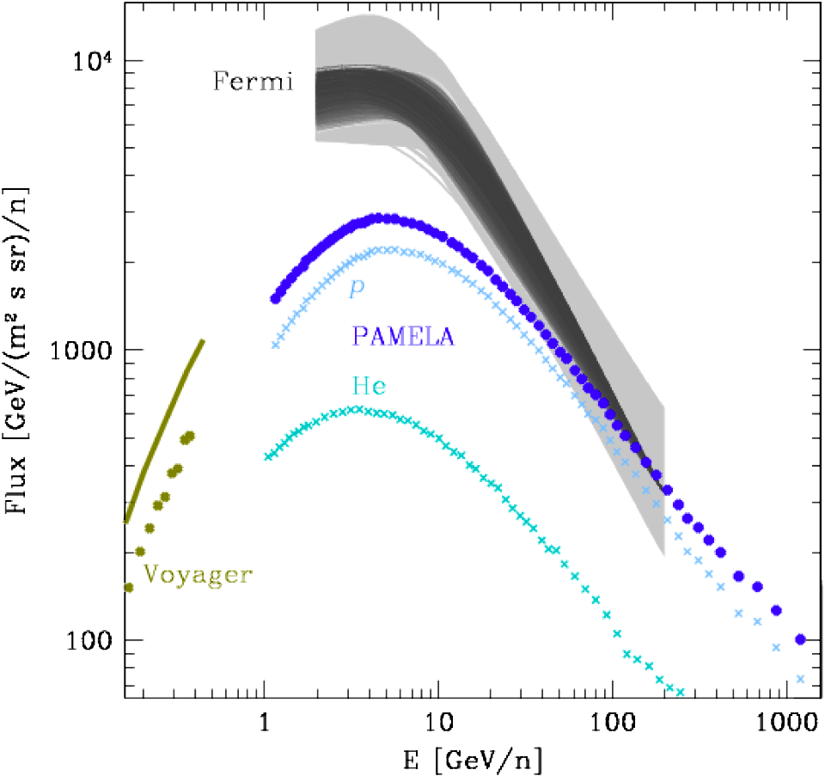
CLOUDS IN THE GOULD BELT
~E^{-2.9}
SOLAR
MODULATION
~E^{-2.6}
Neronov, Semikoz, Taylor 2012, Kachelriess & Ostapchenko 2012

Slide 23
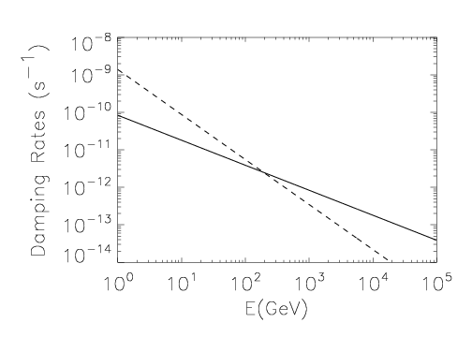
DAMPING vs CR-INDUCED GROWTH
CR-INDUCED
GROWTH
NL Damping
AT ENERGIES BELOW 200 GeV THE WAVES GROW FASTER THAN THEY ARE DAMPED AND THE QUESTION OF THE SELF-GENERATED D(E) IS WELL POSED. NOTICE THAT TO THIS POINT WE USED NO MODEL, JUST OBSERVED QUANTITIES (FLUXES, GRAMMAGE, SLOPES)
Blasi, Amato & Serpico, PRL 2012; Aloisio & Blasi, 2013

Slide 24
NON LINEAR EFFECTS INDUCED BY COSMIC RAYS DURING PROPAGATION
COSMIC RAY GRADIENTS LEAD TO THE EXCITATION OF STREAMING INSTABILITY, WHENEVER THE STREAMING VELOCITY BECOMES >V_{A}. THE GROWTH RATE OF THE INSTABILITY IS:
FOR A SIMPLE INSTANCE OF TRANSPORT EQUATION, THE SOLUTION IS:
USING Quasi-Linear-Theory THE DIFFUSION COEFFICIENT PARALLEL TO THE MAGNETIC FIELD IS:
AND USING THESE EXPRESSIONS IN THE GROWTH RATE:

Slide 25
THE DIFFUSION TIME CAN BE WRITTEN IN TERMS OF THE GRAMMAGE:
AND USING THE OBSERVED INTEGRAL SPECTRUM OF CR:
WHERE THE SLOPE IS FROM PAMELA AT E<200 GEV, ONE GETS:
THIS GROWTH RATE NEED BE COMPARED WITH DAMPING RATES…
-

Slide 26
TRANSPORT IN THE PRESENCE OF GROWTH AND DAMPING OF WAVES
a DENOTES THE TYPE OF NUCLEUS (BOTH PRIMARIES AND SECONDARIES ARE INCLUDED)
Power law in p
THE EQUATION FOR THE WAVES IS:
Damping as diffusion in k-space
SUM OVER ALL NUCLEI OF THE RIGHT MOMENTUM
TO GENERATE A WAVE WITH GIVEN k

Slide 27
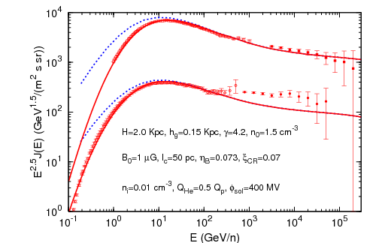
SPECTRA OF H AND He FOR H=2 kpc
Aloisio & PB 2013

Slide 28
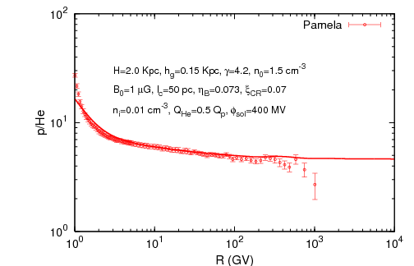
THE p/He RATIO
Aloisio & PB 2013

Slide 29
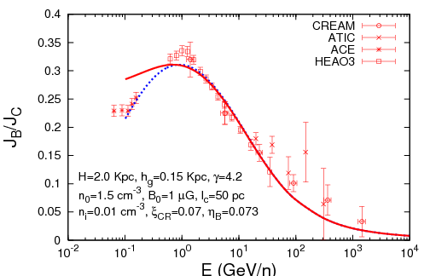
B/C RATIO
Aloisio & PB 2013

Slide 30
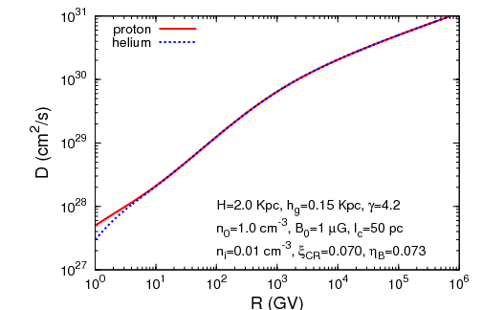
DIFFUSION COEFFICIENT
Slope~1/3
Slope~0.7
Aloisio & PB 2013

Slide 31
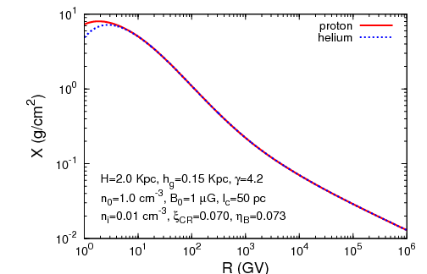
GRAMMAGE
Slope~0
Slope~0.7
Slope~1/3
Aloisio & PB 2013

Slide 32
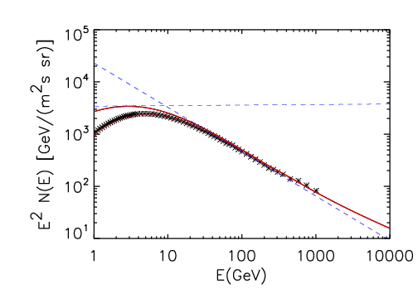
COMPARISON WITH SPECTRUM OF CR IN CLOUDS
Slope 1.9
Slope 2.85
Spectral
Break
Aloisio & PB 2013

Slide 33
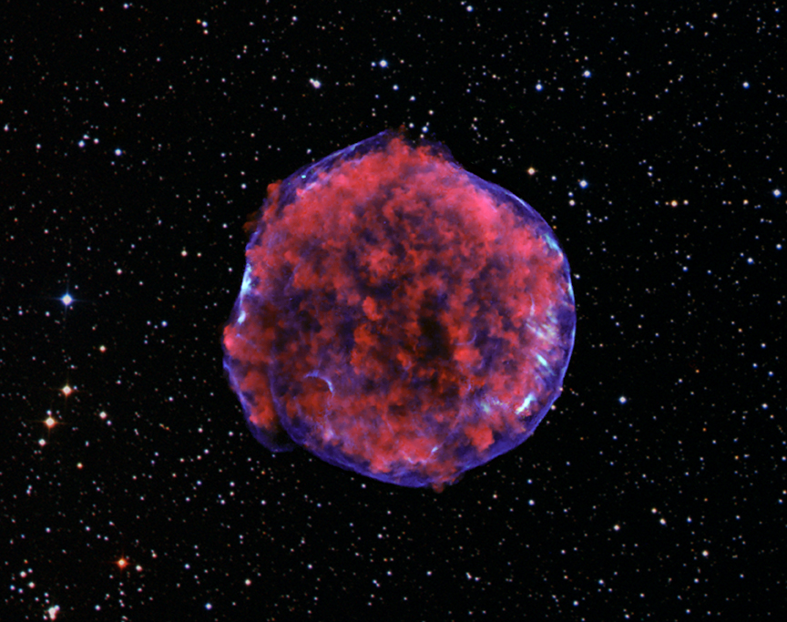
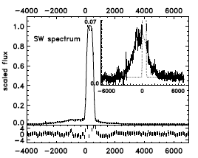
LOOKING FOR COSMIC RAYS
IN THE OPTICAL

Slide 34
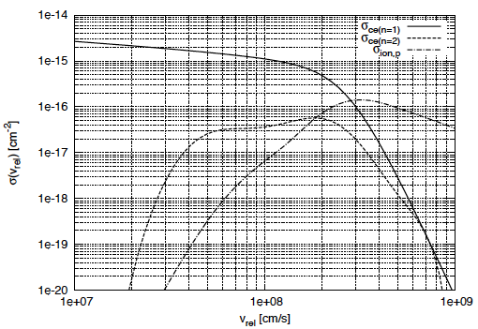
NEUTRALS IN COLLISIONLESS SHOCKS
NEUTRALS
AND IONS
SHOCK VELOCITY
PB+, 2011
+
+
n=1
Hot
ion
Cold
ion
n=2
Cold neutral
hot neutral
CHARGE EXCHANGE
IONIZATION

Slide 35
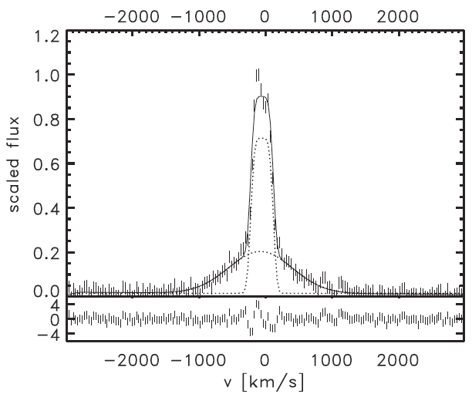
BALMER LINE WIDTH IN RCW86
Helder et al. 2009
THE MUCH LOWER TEMPERATURE DEDUCED FROM THE WIDTH OF THE BROAD BALMER LINE INDICATES THAT THERE MAY BE EFFICIENT CR ACCELERATION IN RCW86

Slide 36
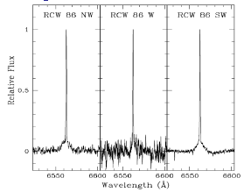
BROADER narrow BALMER LINES
Sollerman et al. 2003
NEUTRALS
IONS
CHARGE EXCHANGE OCCURS
NOW IN THE CR INDUCED
PRECURSOR
NARROW BALMER LINE BROADER
THAN FOR AN UNMODIFIED SHOCK

Slide 37
NEUTRALS INDUCED MODIFICATION OF A SHOCK WAVE WITH AND WITHOUT COSMIC RAY ACCELERATION

Slide 38
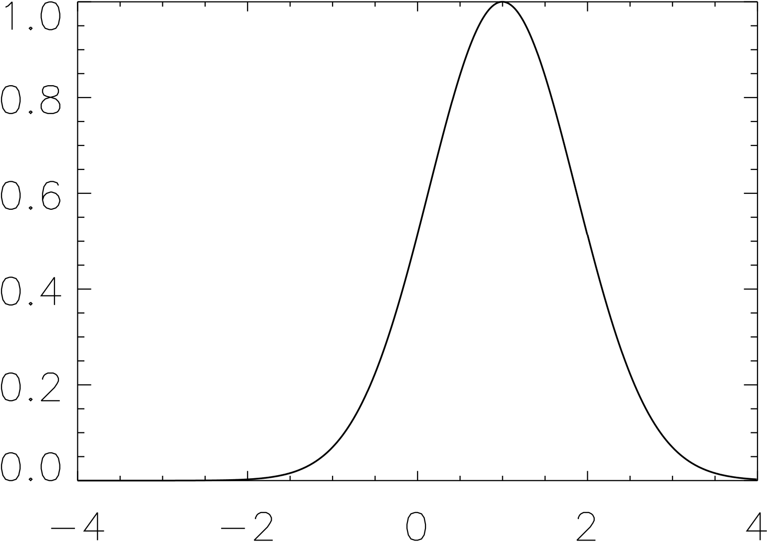
The neutral return flux
PB, Morlino, Bandiera, Amato, Caprioli 2012
NEUTRALS
AND IONS
SHOCK VELOCITY
A NEUTRAL ATOM CAN CHARGE
EXCHANGE WITH AN ION WITH
V<0, THEREBY GIVING RISE TO
A NEUTRAL WHICH IS NOW FREE
TO RETURN UPSTREAM
THIS NEUTRAL RETURN FLUX
LEADS TO ENERGY AND
MOMENTUM DEPOSITION
UPSTREAM OF THE SHOCK!
V_{perp}=0
V<0
v/(Vs/4)
1

Slide 39
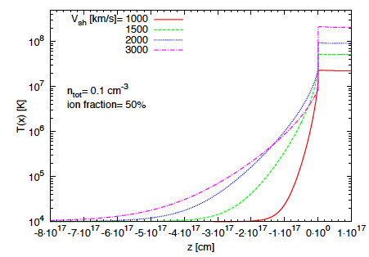
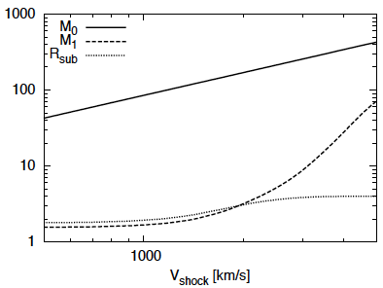
NEUTRAL INDUCED PRECURSOR
PB+ 2012
EVEN FOR A STRONG SHOCK (M>>1) THE EFFECTIVE MACH NUMBER OF
THE PLASMA IS DRAMATICALLY REDUCED DUE TO THE ACTION OF THE
NEUTRAL RETURN FLUX

Slide 40
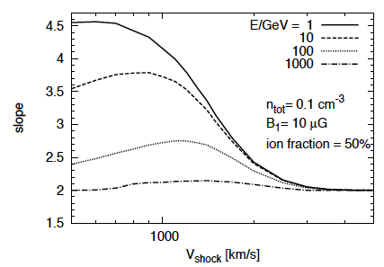
ACCELERATION OF TEST PARTICLES
PB+ 2012

Slide 41
NLDSA IN THE PRESENCE OF NEUTRALS
ACCOUNTS FOR DSA WITH DYNAMICAL REACTION OF CR
MAGNETIC FIELD AMPLIFICATION INDUCED BY CR STREAMING
MAGNETIC DYNAMICAL REACTION AND HEATING BY DISSIPATION
NEUTRAL RETURN FLUX

Slide 42
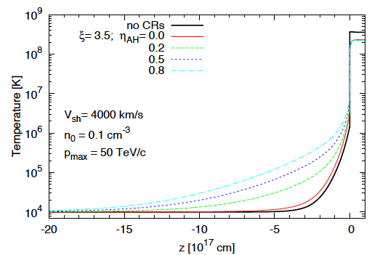
Morlino +, 2012
HEATING
IN THE PRECURSOR
SHAPE OF THE BALMER LINE
FULL LINE NARROW LINE

Slide 43
Width of Balmer LineS
BROAD BALMER LINE
NARROW BALMER LINE
Morlino +, 2012

Slide 44
FINAL REMARKS
100 YEARS AFTER DISCOVERY, THE GENERAL FEATURES OF THE PHENOMENON OF CR APPEAR TO BE UNDERSTOOD
BUT SEVERAL IMPORTANT ELEMENTS ARE NOT IN PLACE:
1- WE KNOW VERY LITTLE ABOUT GALACTIC DIFFUSION
2- DSA PRODUCES SPECTRA THAT ARE NOT COMPATIBLE WITH ANISOTROPY AND EVEN WITH SELECTED GAMMA RAY OBSERVATIONS
GOOD NEWS IS THAT GAMMA RAY OBSERVATIONS ARE PRODUCING IMPORTANT RESULTS
OTHER TECHIQUES ARE BEING STUDIED TO STUDY THE ORIGIN OF CR IN SNR (BALMER LINES)
GALACTIC CR → IMPLICATIONS FOR TRANSITION TO EXTRAGALACTIC AND UHECR
THE STUDY OF THE ORIGIN OF CR IS BENEFITING FROM AN INTERDISCIPLINARY APPROACH IN WHICH PARTICLE PHYSICISTS, PLASMA PHYSICISTS, ASTRONOMERS ARE WORKING TOGETHER, THOUGH OFTEN SPEAKING DIFFERENT LANGUAGES. OBSERVATIONS AT DIFFERENT WAVELENTHS ARE ALSO BEING CRUCIAL!

Slide 45
From “COSMIC RAYS”, by Bruno Rossi, 1964

