Slide 1
2nd European Advanced Accelerator Concepts
Workshop 13-19 September 2015
La Biodola, Isola d'Elba
Attosecond Electron Sheets and Attosecond Light Pulses from Laser Wakefield Acceleration
Feiyu Li
SUPA, Department of Physics, University of Strathclyde,
Glasgow G4 0NG, UK
Wed, Sep 16th, 2015

Slide 2
Acknowledgement
Z. M. Sheng: Strathclyde Univ. & SJTU
M. Chen: SJTU (Shanghai Jiao Tong Univ.), J. Meyer-ter-Vehn: MPQ, H.-C. Wu: Zhejiang Univ., W. B. Mori: UCLA, W. Lu: Tsinghua Univ.
Y. Liu, J.-L. Liu, M. Zeng et al. SJTU, M. Weikum: Strathclyde.

Slide 4
Outline
The flying mirror model based on plasma wave motion
Attosecond (10⁻¹⁸s) sheets in wakefield accelertion
Coherent Thomson backscattering (KeV photon energy)
High-energy (~10mJ), single attosecond (~100as) pulses
Significance/applications
Summary

Slide 5
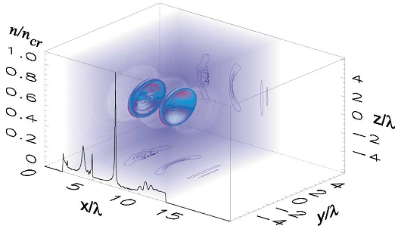
Breaking plasma waves as flying mirrors
Plasma waves excited in underdense plasmas have been responsible for a wide range of phenomena (compact particle acceleration, novel radiation generation, etc), mostly in debt to acceleration
Large plasma density waves created by ultrashort intense laser pulse have the ability to compress plasma electrons into dense ultrashort bunches surfing at relativistic speeds, which may serve as flying mirrors.
Wavebreaking
Quasi-1D
Towards Schwinger limit:
n_{e} ~ 10¹⁷ cm⁻³
ɣ_{ph}~ 100
Driver diameter ~ 800 µm
Probe laser ~ 10¹⁷ W/cm²
Focused X-rays ~ 1.3×10²⁹ W/cm²
Bulanov, et al. KSF 1991, PRL 2003

Slide 6
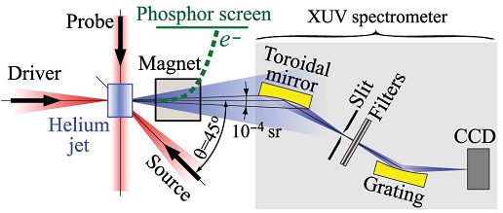
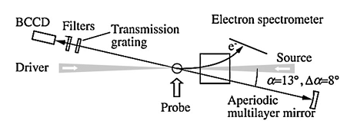
Experimental campaigns
Major features:
- Monitoring collision at fs timescale
- Driver: ~ 10¹⁸ W/cm²
- n_{e} ~ a few 10¹⁹ cm⁻³
- ɣ_{ph}~ 4-8
- Doppler shifts: a few tens
- UV or XUV lights
- Probably Bubble regime
Kando, et al. PRL 2007, 2009

Slide 7
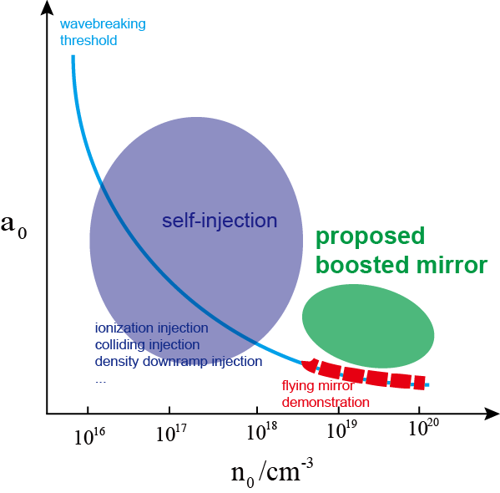
Limitations & Solutions?
X-ray backscattering requires very low density
Low density requires stronger driver and broader diameter, thus extremely high power
Using large diameter can be vulnerable to plasma density non-uniformity
Using low density is even harder to form converging density wave spikes

Slide 8
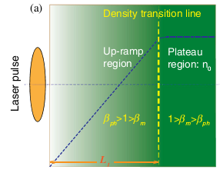
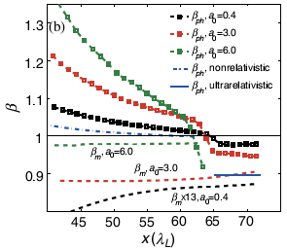
Controlled injection of attosecond electron sheets
The ramping-up density provides the control and makes sure that the density wave crests are stably compressed without premature injection
Superluminal region
Sub-luminal region
Superluminal
Sub-luminal
Li, et al. PRL 2013

Slide 9
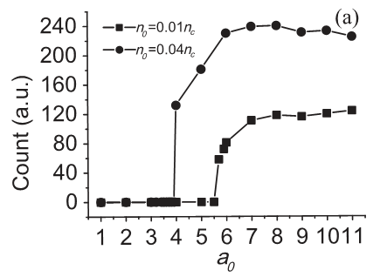
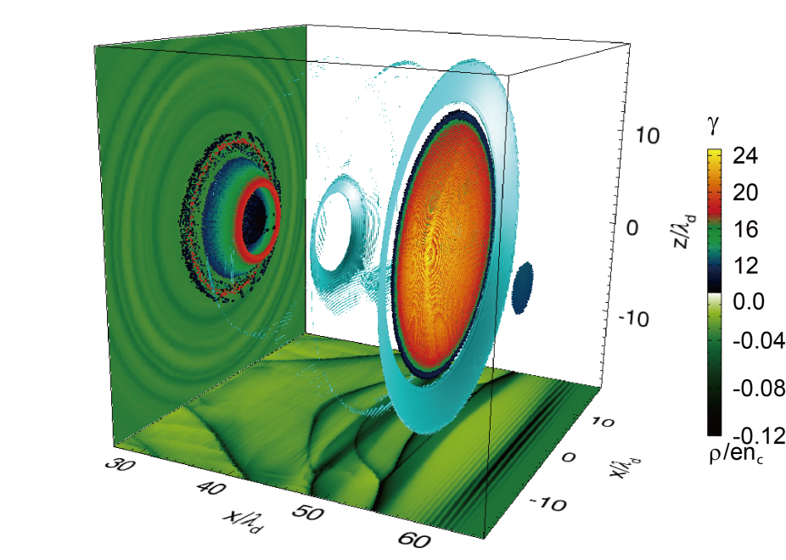
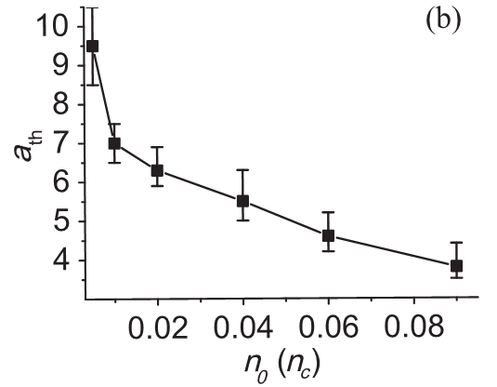
Parameter space & 3D sheets propagation
Onset of injection

Slide 10
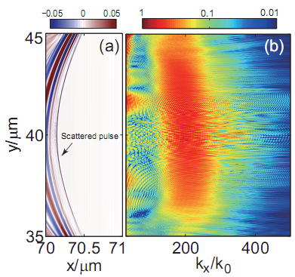
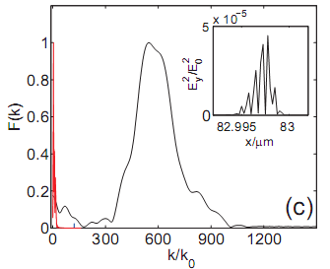
Kiloelectrovolt-level coherent Thomson scattering
Due to non-injected spike
1D linear backscatter
2D nonlinear backscatter
Li, et al. APL 2014

Slide 11
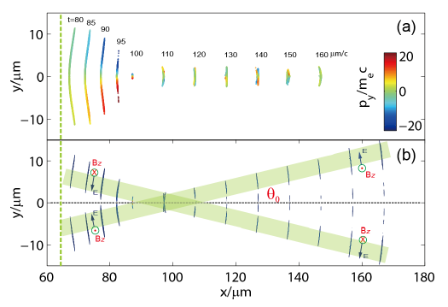
High-energy single attosecond pulses
Electron sheet
Plasma:
n_{e} ~ 7×10¹⁹ cm⁻³
Laser:
~ 7×10¹⁹ W/cm²,
w₀ ~15 µm,
peak power ~300TW,
energy ~5J
Attosecond pulse:
~10mJ,
saturated at ~ 4×10¹⁹ W/cm²,
> 7×10²⁰ W/cm² converging
Radiation
Li, et al. PRE 2014

Slide 12
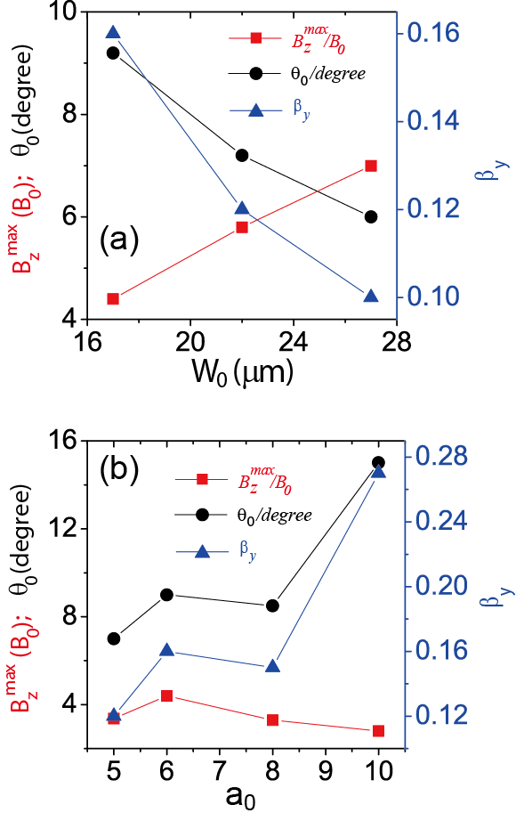
Novel features
Coherent synchrotron radiation
Radiation field
Single attosecond (~100as) pulse, no needs of filtering
High energy (mJ-level), high conversion efficiency (>10⁻³)
Quasi-1D regime; scale up to larger driver spots and higher laser powers

Slide 13
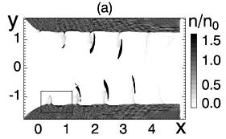
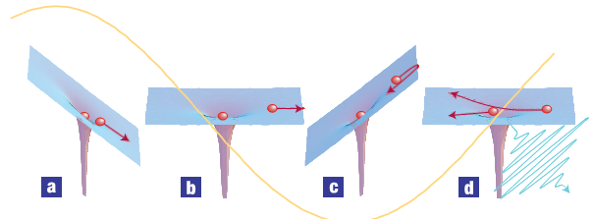
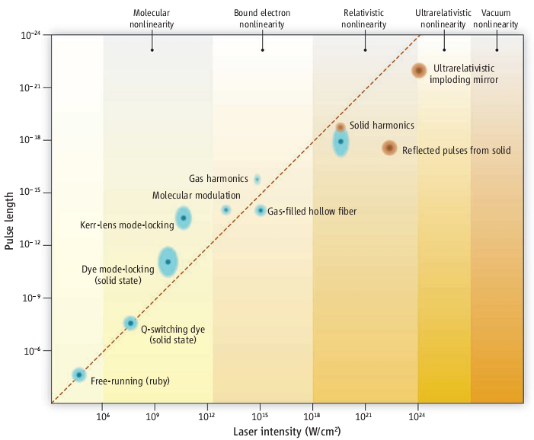
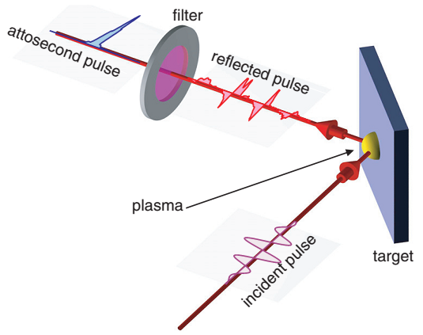
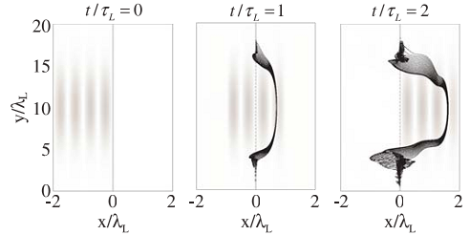
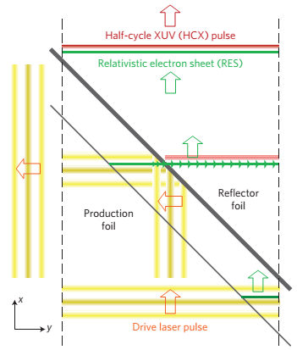
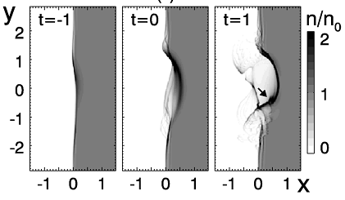
Looking at the bigger picture
Relativistic generation [compared with gas harmonics]
Gas targets
(making use of the nature of plasma wave motions to compress into attoseconds) [compared with nanofoil-based schemes which require harsh laser conditions]
Mourou, Tajima, Science, 2011

Slide 14
Summary
We have explored new possibilities of LWFA, namely the highly nonlinear quasi-1D regime along with controlled injection of dense electron sheets, which allow for bright attosecond bursts of coherent X-ray/XUV pulses;
The new path relies on relativistic generation using gas targets, allows for both high repetition rates and high intensity, whilst requiring affordable laser conditions as well as fitting well into higher powers which are coming up soon.

Slide 15
Thank you for your attention & Questions/Comments

