Slide 1
H1 Squeezing Experiment: the path to an Advanced Squeezer
L. Barsotti (LIGO-MIT)
for the Squeezing Team
(AEI, ANU, CIT, LHO, MIT)

Slide 2
Outlines
Why we are testing squeezing now?
H1 Squeezing Experiment Status
October 2010 (end of S6) – January 2012 (aLIGO H1 installation)
What are we going to do next?

Slide 3
Why Squeezing?
Quantum noise
is everywhere!

Slide 4
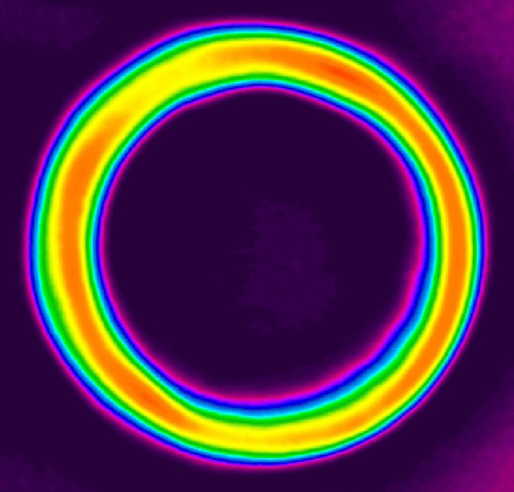
Why Now? You might need a squeezer sooner than you think
Advanced LIGO sensitivity dominated by quantum noise (shot noise and radiation pressure noise)
31 W + 6 dB of Sqz (10 dB of anti-Sqz, Total Losses ~ 20%)
With 6 dB of perfect squeezing:
need 4 time less power!
“RISK MITIGATION”
for high power
What about 60 W power + 3 dB squeezing?
Might be faster…

Slide 5
Advanced Squeezing
Shape the quantum noise
by changing the sqz angle

Slide 6
Even More Advanced
Frequency dependent squeezing:
beat quantum noise everywhere!

Slide 7
H1 Experiment Goal: Design the aLIGO Squeezer
Inject 6 dB of squeezing at the asymmetric port of H1
Improve the sensitivity by 3 dB (due to losses) above 400 Hz
Understand the impact of squeezing at low frequency
Find/fix “technical problems”

Slide 8
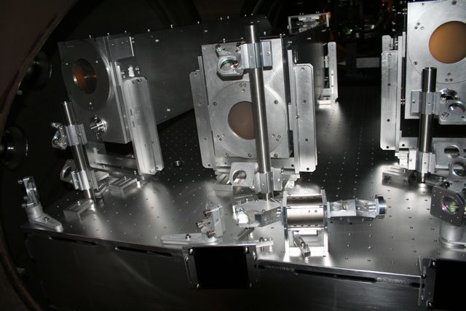
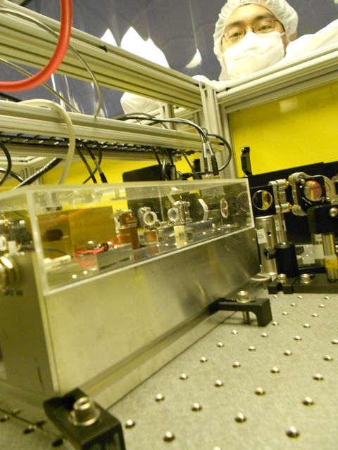
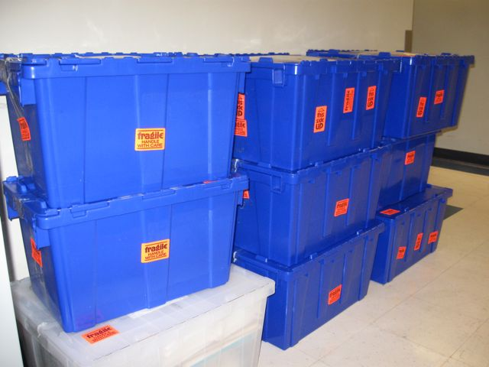
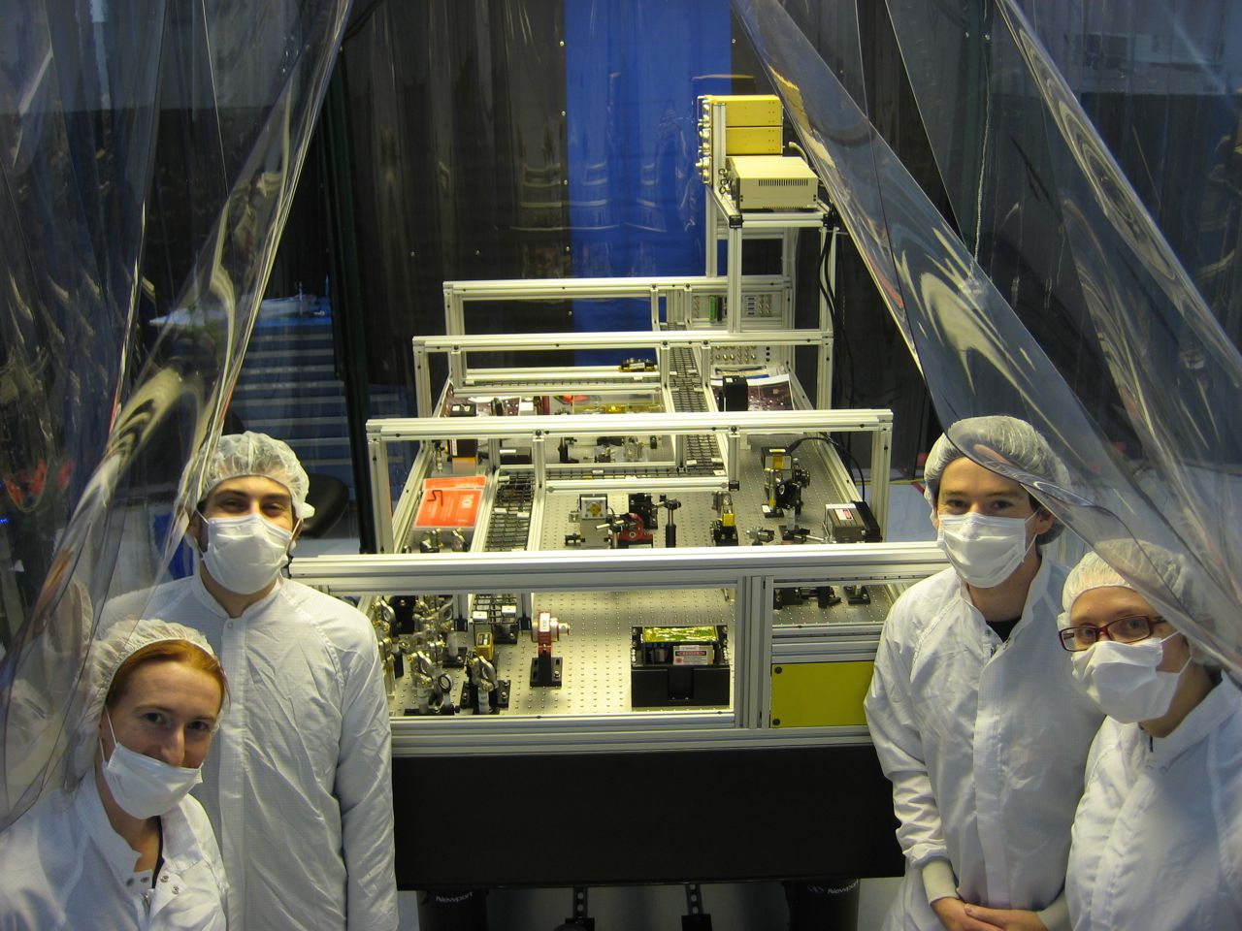
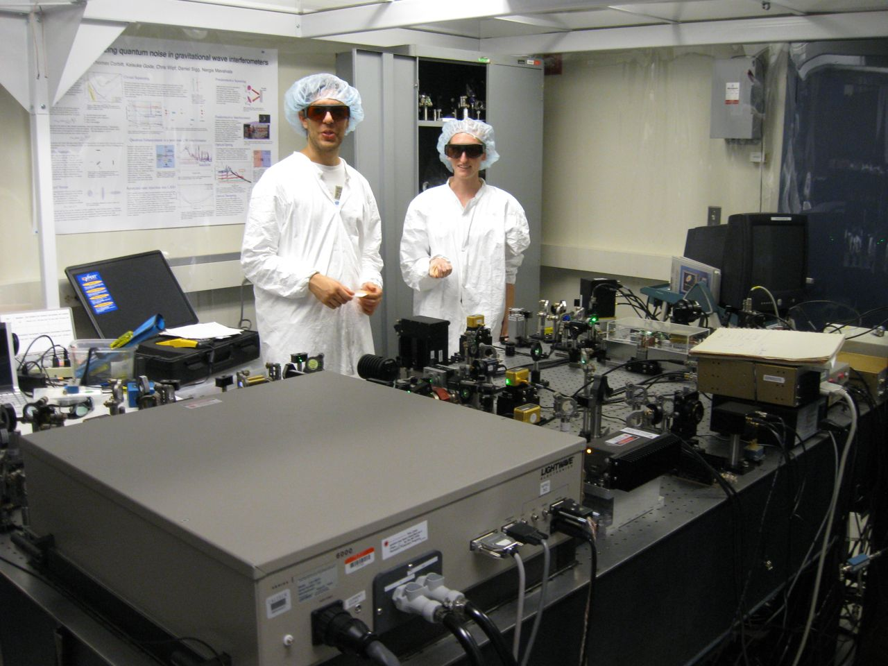
Squeezer Experiment Timeline
October 2010
End of S6
June 2011
August
2011
December 2011
1) OPO Designed at ANU, squeezer assembled at MIT
2) Reassembling of
the squeezer at LHO
3) Sqz installation
4) Sqz injection with short Michelson and full IFO
* Back scattering?
* Losses?
* Anti-Squeezing?
* Control noises?
aLIGO H1 installation starting in January 2012

Slide 9
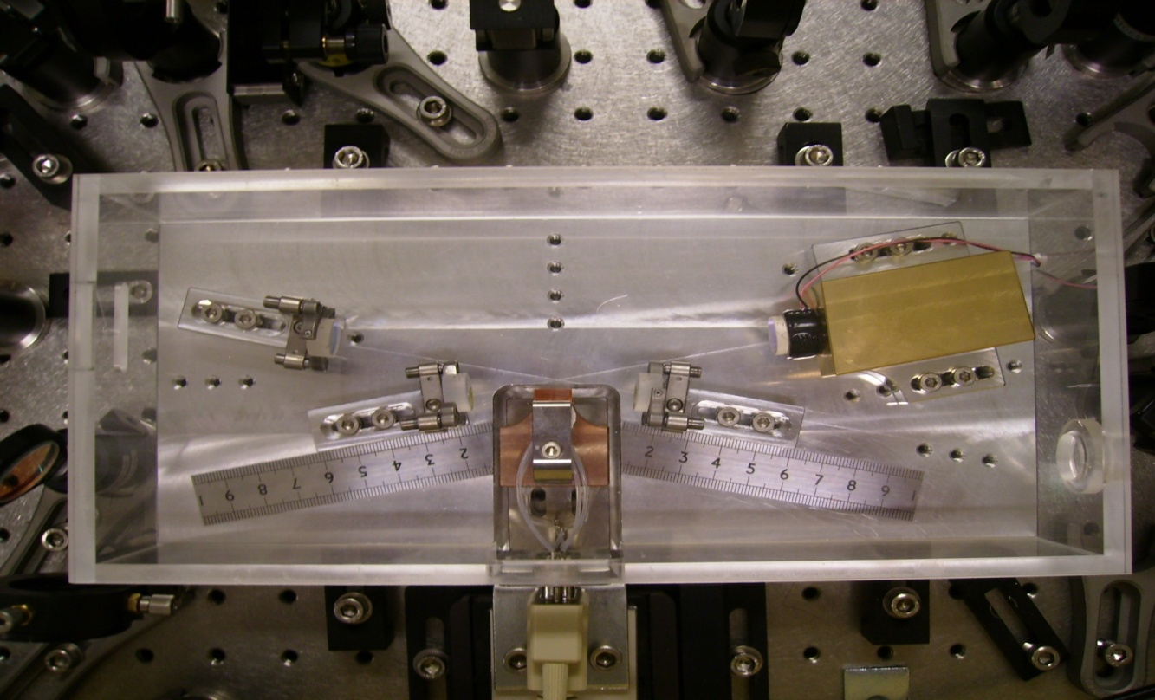
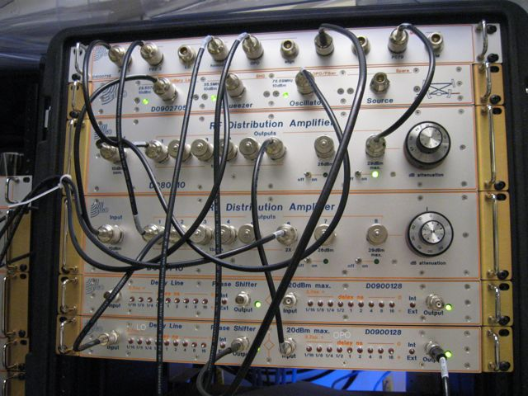
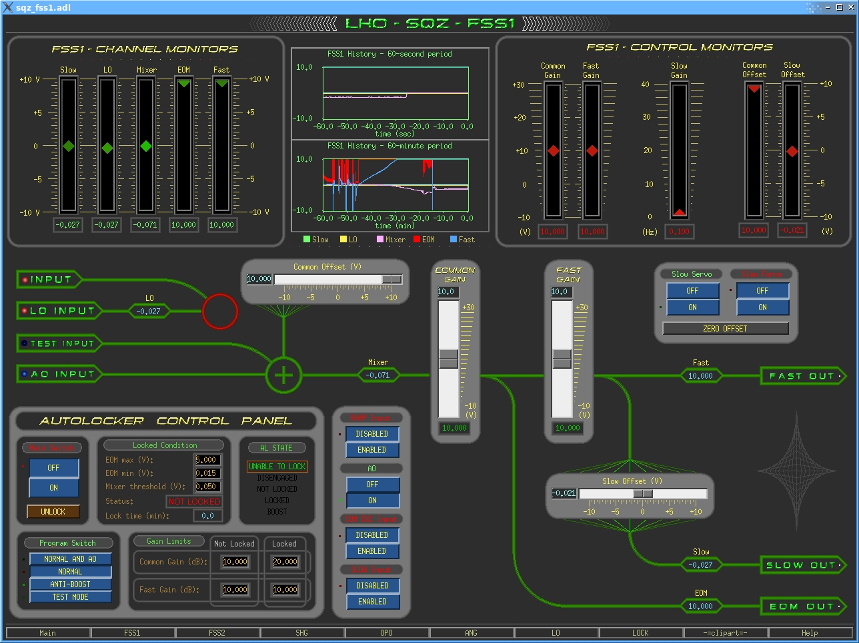
Squeezer Highlights
Squeezing
Out
ANU Design
PZT Actuator
Bow-tie cavity OPO:
less back scattered light than linear cavity
High quality optics:
low scatter, low losses
aLIGO electronics:
low noise, stable,
controllable remotely
Pump light In
Crystal
Oven/
Temperature
Sensor
aLIGO Electronics

Slide 10
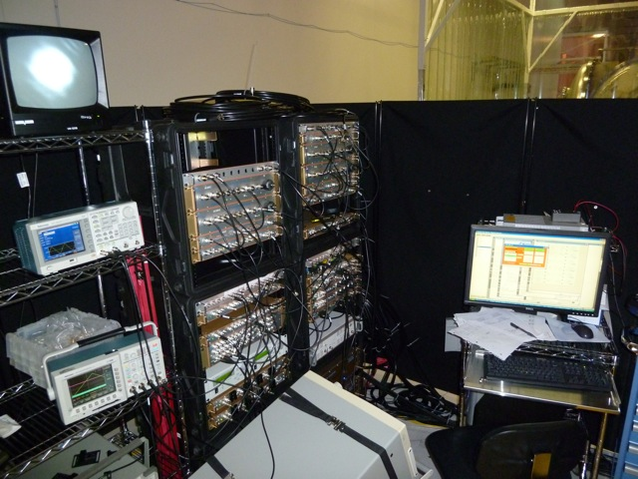
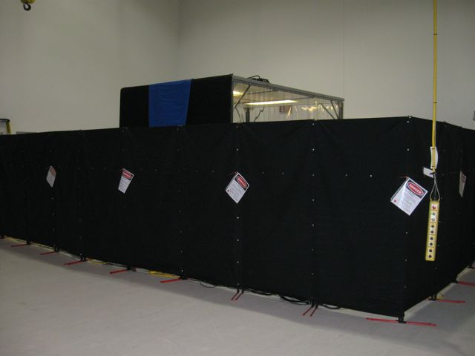
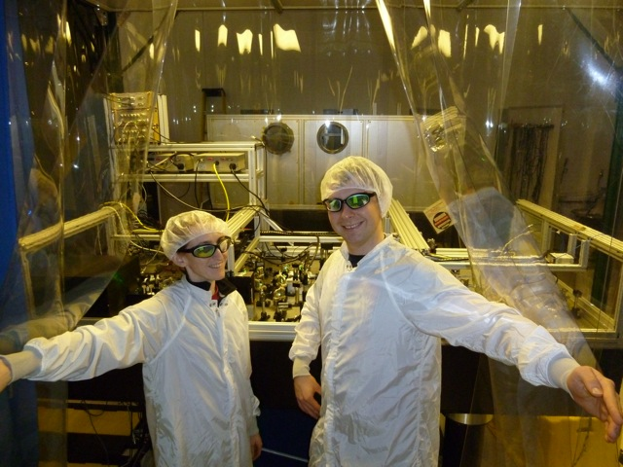
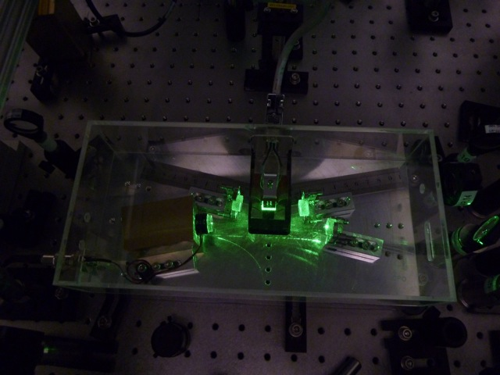
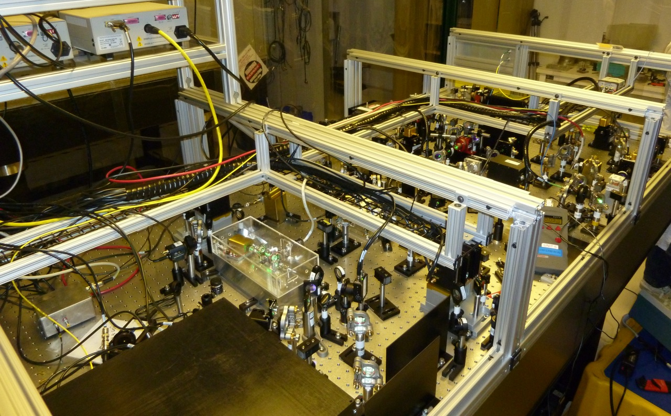
The Squeezer @ LHO
Squeezing Lab in the LVEA
The OPO

Slide 11
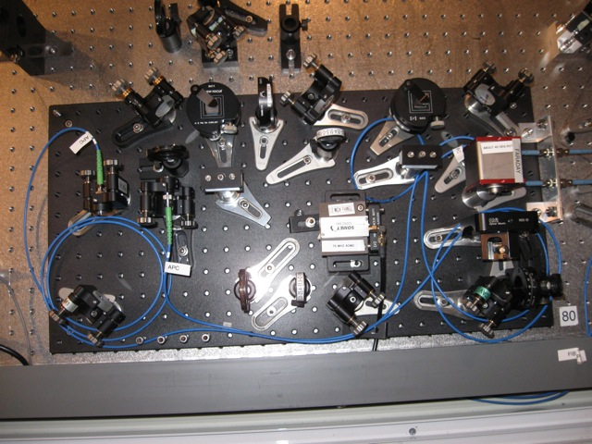
The H1 Squeezer: Ready to Install
Sample of H1 laser light
Squeezer laser locked to the H1 main laser
All loops closed:
needed frequency actuator for the LO loop, not enough range with PZT mirror
1 hour lock last week
Working on making the squeezer fully controllable from the control room

Slide 12
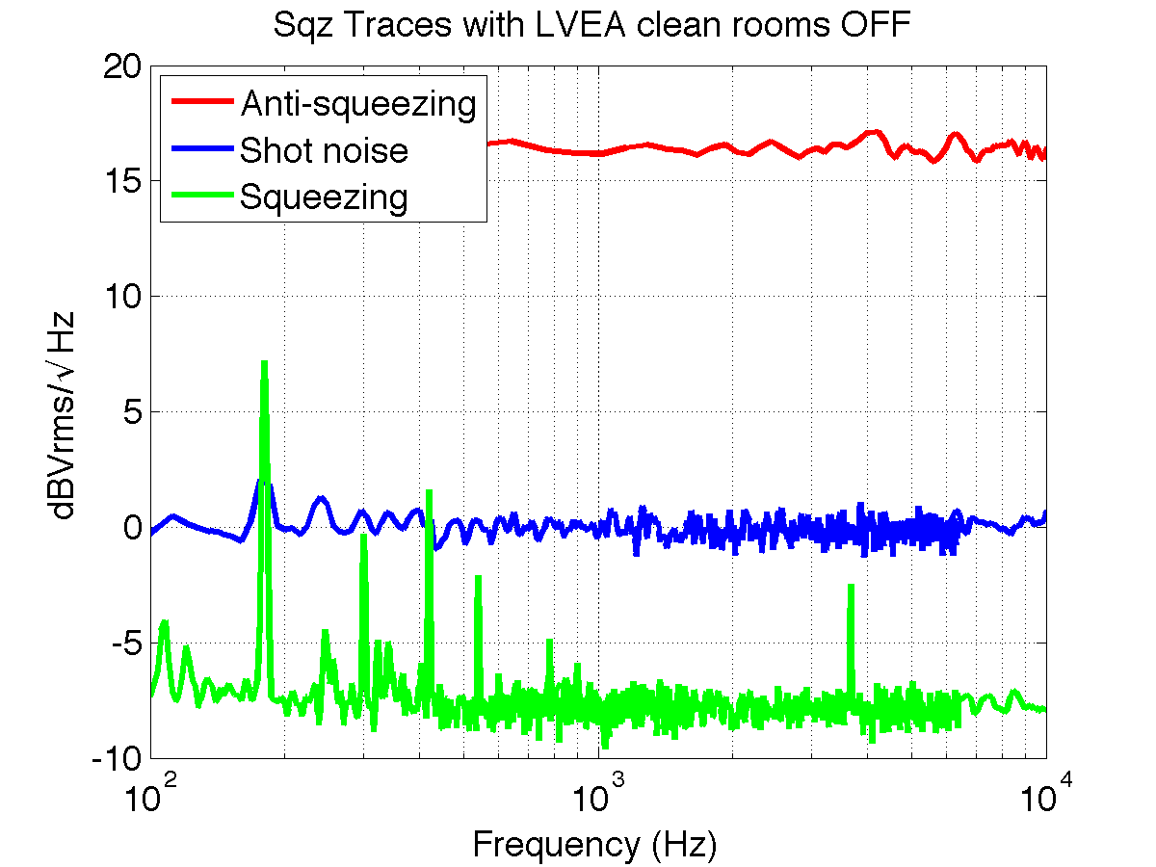
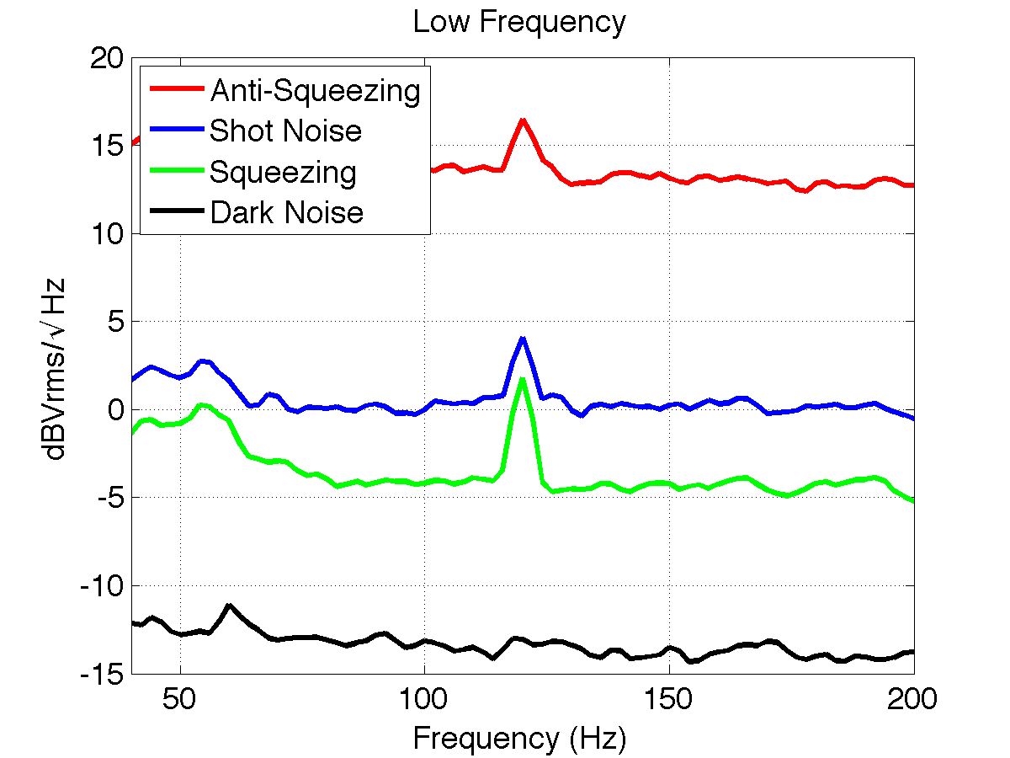
Performance: 6+ db
As measured on the homodyne detector on the squeezer table
Total losses on the squeezer table ~ 20%

Slide 13
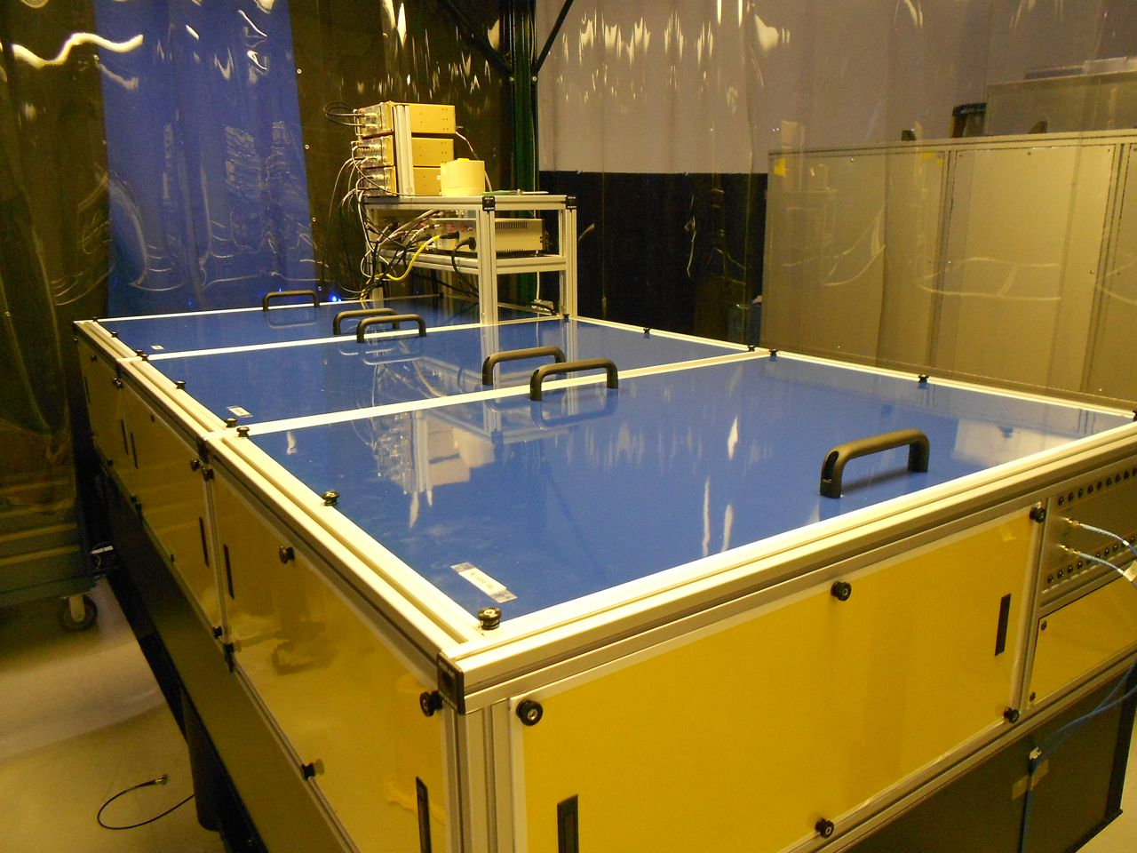
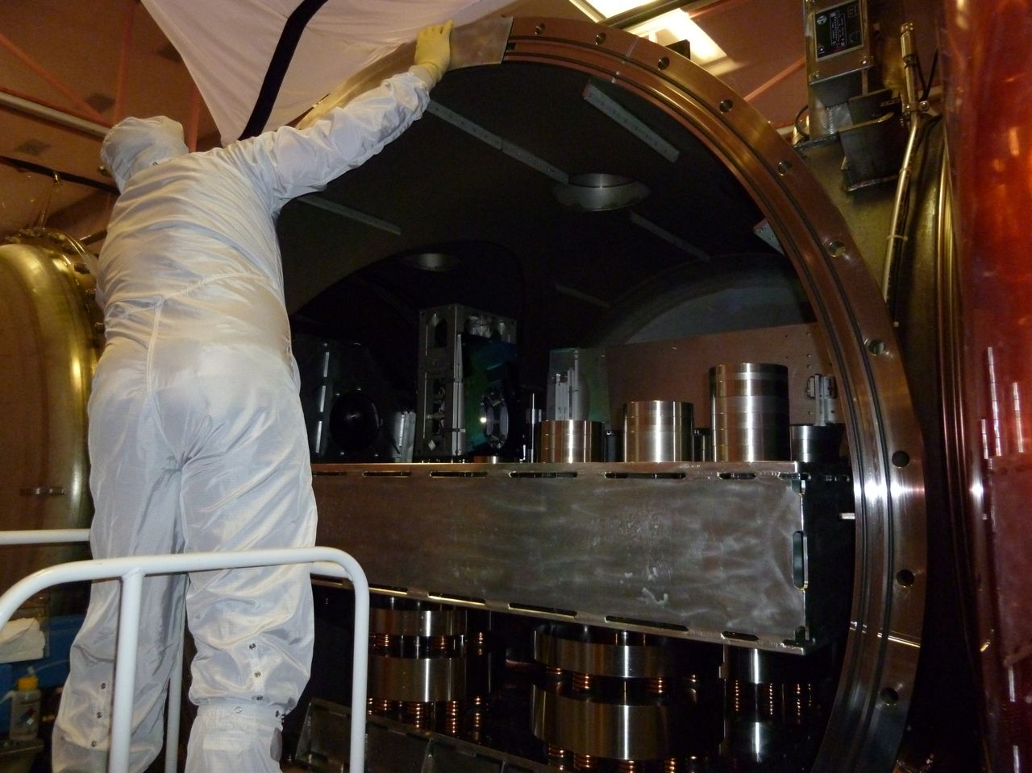
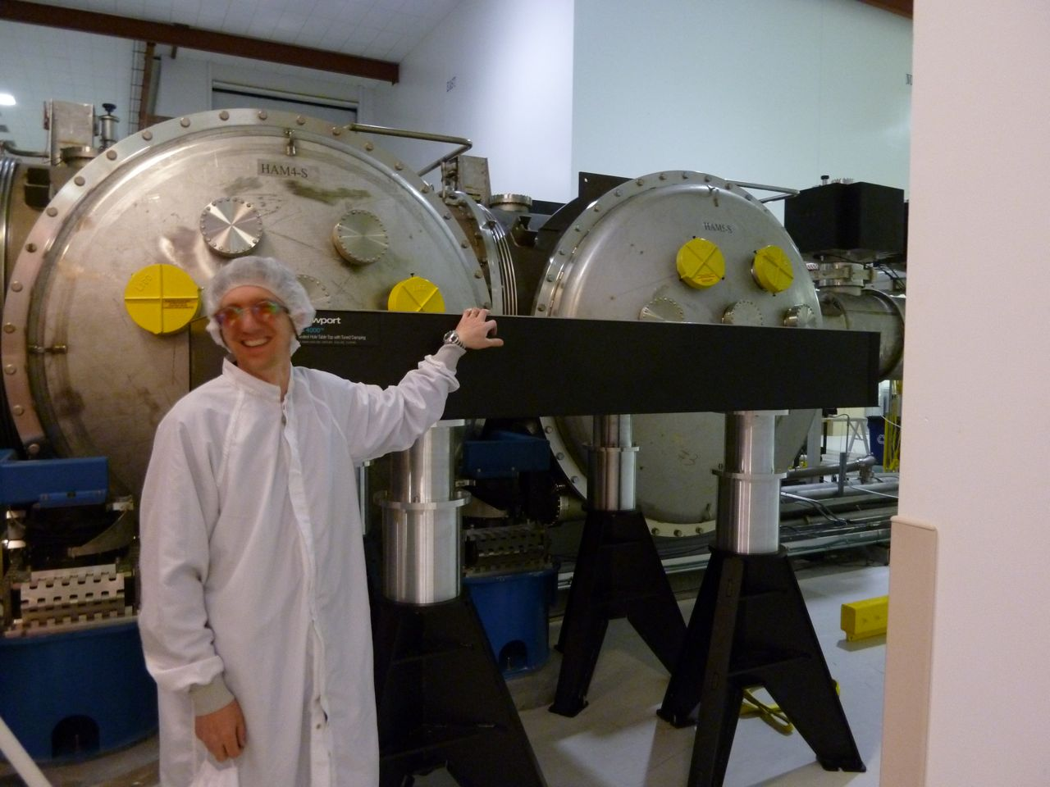
A squeezed H1: By the end of August
We are here
June 2011
August
2011
December 2011
H1 taken apart
Preparing the squeezer
for the move in June
Unlocking of the optics started last week
High legs tested with dummy table

Slide 14
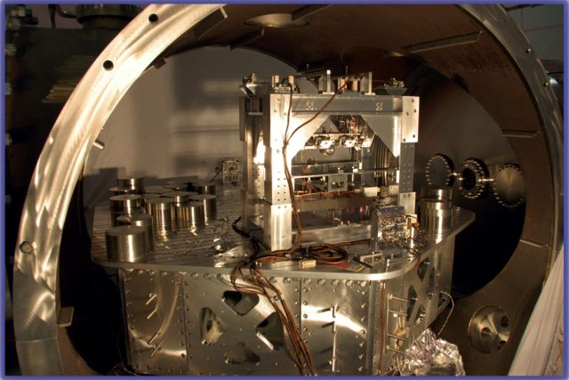
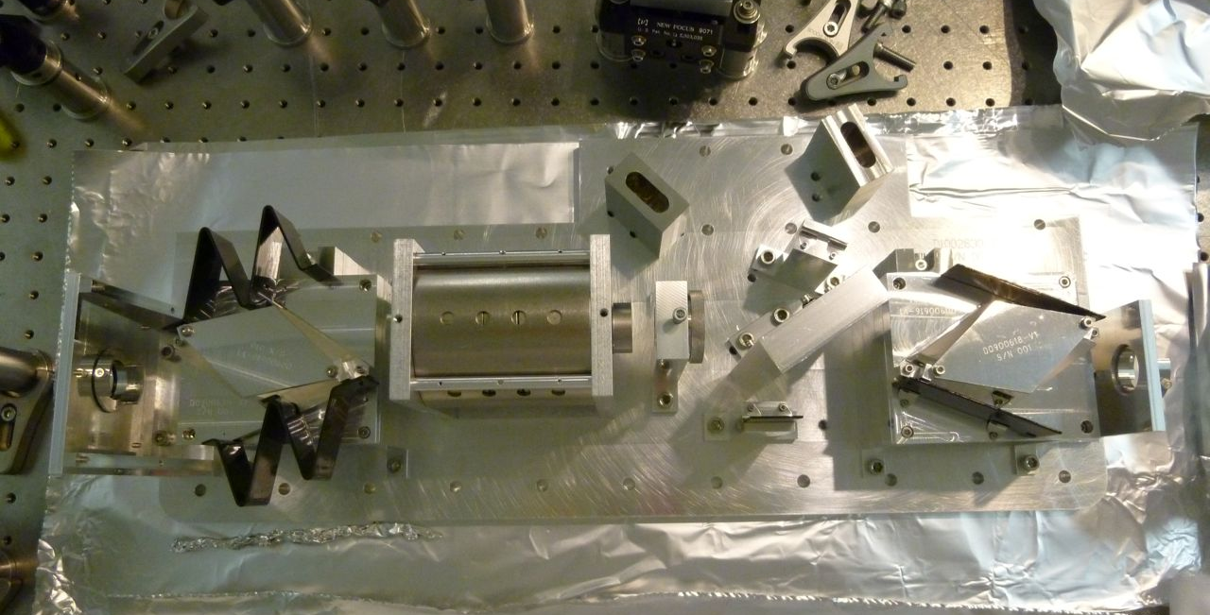
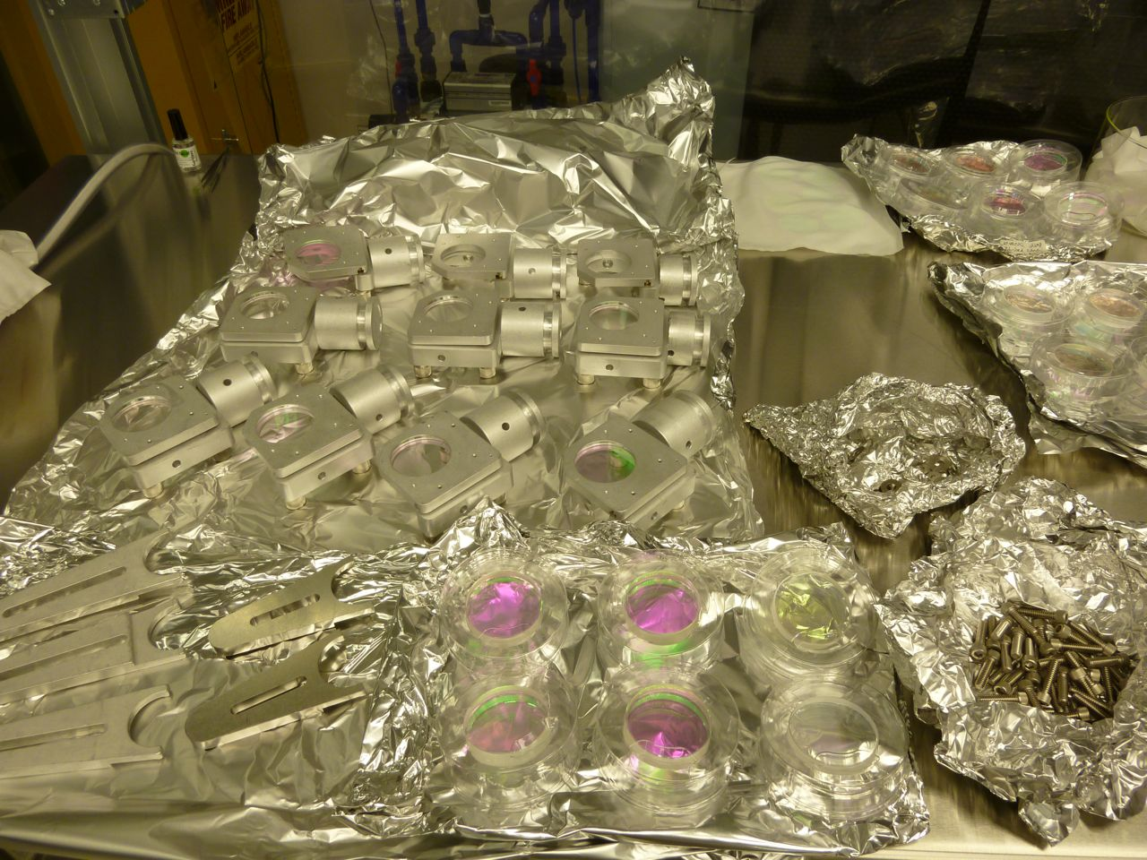
Squeezing Injection
New Output Faraday (first aLIGO unit)
In-vacuum parts

Slide 15
Things to worry about
Back Scattering
Mode Matching
Alignment
IFO Stability
…

Slide 16
Back Scattering
IFO light to the squeezer and back to the IFO
Power reflectivity of the scattering surface
HARD to ESTIMATE
Motion of the scattering surface
Measured at ANU
(Conor’s talk)

Slide 17
Back Scattering Noise
Power reflectivity of the scattering surface
With 100 mW at the AS port and 2 Faradays in the sqz path
Motion of the scattering surface

Slide 18
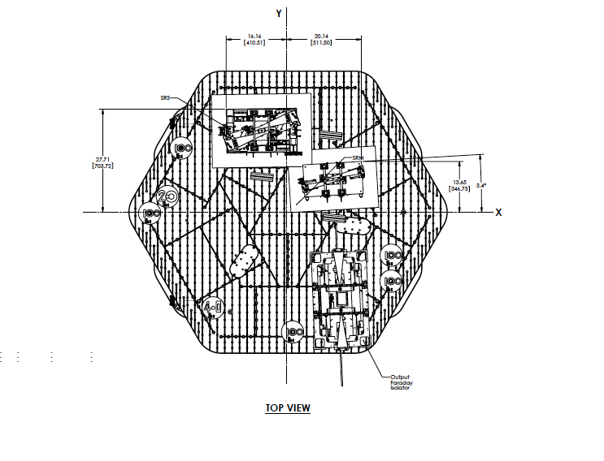
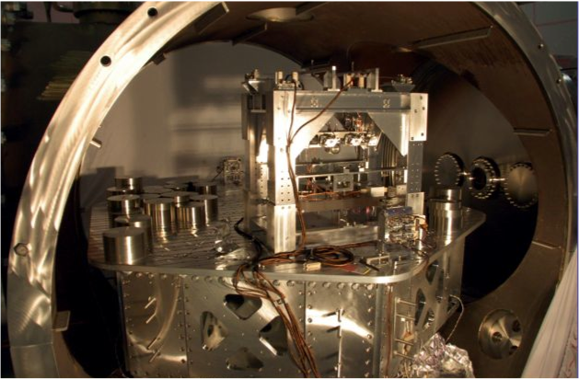
Speculations on the Advanced Squeezer
Two directions:
Reduce the light back to the squeezer
(more Faradays, but Faraday=losses)
Reduce the motion of the scattering surface (OPO)
OPO
Sqz Faraday
Output Faraday
Advanced LIGO HAM5

Slide 19
Back Scattering Noise
Power reflectivity of the scattering surface
With 100 mW at the AS port and 2 Faradays in the sqz path
Motion of the scattering surface

Slide 20
The Message
The H1 squeezer squeezes, and it is ready to be installed
Work with the interferometer:
installation of the squeezer at the end of June
first test with full IFO July/August
short Michelson when conflicts with aLIGO arise
The current setup might be not optimal for aLIGO
and aLIGO+, the H1 experiment will give us an answer
We have a couple of years in front of us to build the aLIGO/aLIGO+ squeezer

Slide 21
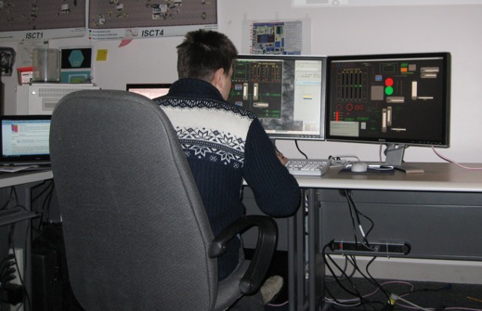
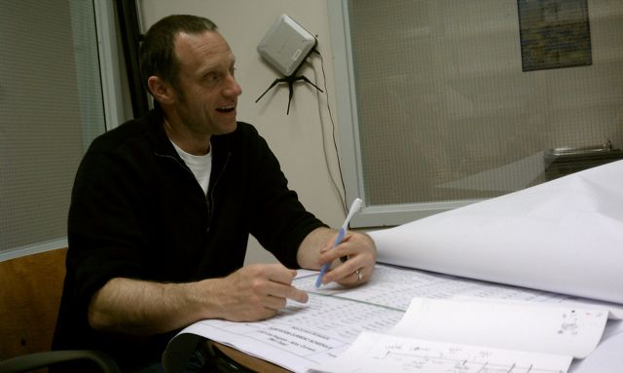
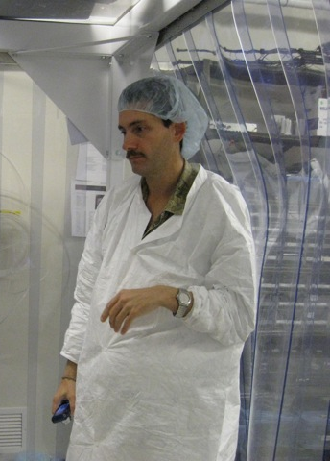
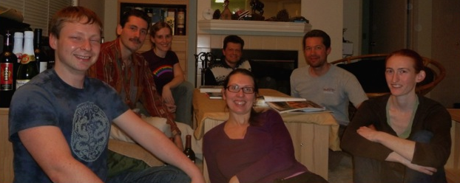
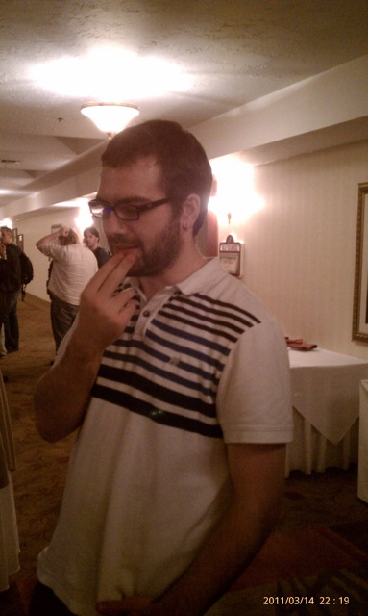
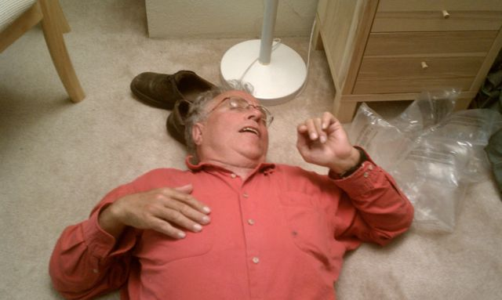
Thanks for your time

Slide 22
Why Squeezing?
0
We better understand shot noise as produced by vacuum fluctuations entering the asymmetric port (AS)
Vacuum fluctuations have equal uncertainty in amplitude and phase
Vacuum fluctuations determine the uncertainty in the interval between photons
The minimal phase variation in the arms which can be measured is:
LASER
AS port
Phase
N number of photons incident on the mirrors in the measurement time
IFO Signal
Amplitude

Slide 23
Why Squeezing?
0
Squeezed fields with less uncertainty in the “phase” quadrature
The minimal phase variation in the arms which can be measured is:
LASER
AS port
with r squeeze factor
Squeeze Angle:
Squeezed Field
Phase
ϑ: squeeze angle
Phase
IFO Signal
IFO Signal
23
Amplitude
Amplitude

Slide 24
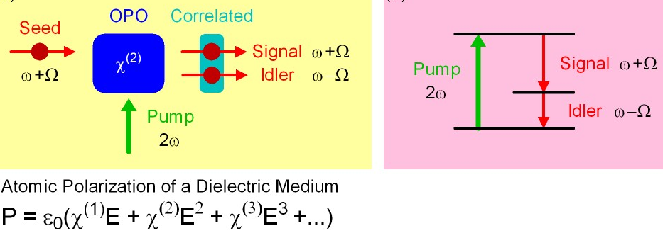
How Can you Make Squeezed Fields?
Non linear medium which correlates upper and lower quantum sidebands
Sum of the correlated sidebands:
the squeezed state
SHG
Squeezing
Out
Optical Parametric Oscillator
(ANU prototype)
PZT Actuator
Pump light In
Crystal
Oven/
Temperature
Sensor

Slide 25
Squeezing Injection
About 20% losses
in the output path (OMC, Faraday)
About 10% losses in the sqz injection path
3 dB of Sqz observed with 6 dB of Sqz produced

Slide 26
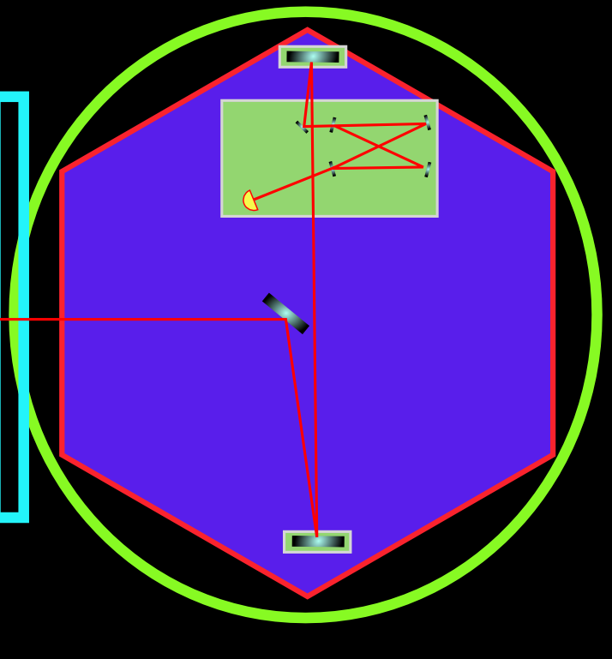
Losses
~20% losses in the IFO output path
IFO
~10% losses in the sqz injection path
HAM 4
Squeezing Table
~ 30% TOTAL LOSSES

