Slide 1
The 12th International Conference on Nucleus-Nucleus Collisions, June 21-26, 2015, Catania, Italy
Time Evolution of Heavy Quark Distribution Function in Quark Gluon Plasma:
Laplace Transform Approach
Sharareh Mehrabi Pari
Department of Physics, Ferdowsi University of Mashhad,91775-1436 Mashhad, Iran
Department of Physics and Technology, University of Bergen, Allegaten 55, 5007 Bergen, Norway

Slide 2
Why Heavy Quarks Probe the QGP?
Their mass is larger than the temperature plasma is formed in, M ≫ Tc
HQ thermalization time in a perturbative QCD is estimated to be at the order of 10 − 15
fm/c for charm and about 25 − 30fm/c for bottom
Heavy quarks are produced in hard processes with a known initial momentum distribution
The heavy quarks are the witness to the entire space-time evolution of the system
If the heavy quarks pass through a QGP they collide and radiate and therefore change
heir momentum
This may allow for studying plasma properties using momentum distribution

Slide 3
Momentum Evolution
The Brownian motion of a patron in a thermal bath, governed by the Fokker- Planck (FPE) equation, while Evolution of the expanding QGP is described by the relativistic Hydrodynamics. We start from the Boltzmann equation for the distribution function $f\left(x,p\right)$ which in the relativistically covariant form can be written as:
$$p^{μ}∂_{μ}f\left(x,p\right)=c\left\{f\right\}$$
the collision term
phase-space density
$$p^{μ}= \left(E_{p} , \overline{p}\right)$$
four-momentum of the test quark
B. Svetitsky, Phys. Rev. D 37, 2484( 1988)
H. van Hees, R. Rapp, Phys. Rev. C,71, 034907 (2005)

Slide 4

If we assume a uniform plasma, the Boltzmann equation becomes
$$\frac{∂f}{∂t}=\frac{C\left\{f\right\}}{E}={\left(\frac{∂f}{∂t}\right)}_{coll}$$
To simplify the Boltzmann equation, employing the Landau approximation and
Neglect the interaction of heavy quarks with each other. Then the evolution of
Momentum distribution of heavy quarks is given by
$$\frac{∂f}{∂t}=\frac{∂}{∂p_{}}\left[A\left(p\right)f+\frac{∂}{∂p_{}}\left[B\left(p\right)f\right]\right]$$
In which, $A_{i}(p)$ and $B_{ji}(p)$ are Drag and Diffusion coefficients
respectively
$$A=\int{d^{3}kω\left(p,k\right)k}$$
$$B=\frac{1}{2}\int{d^{3}}kω\left(p,k\right)k^{2}$$
Here, we considered the elastic scattering of the HQs with gluons, light quarks, and corresponding anti-quarks. All these interactions contribute to determine collision rate:
$ω\left(p,k\right)$=$g_{j}\int{\frac{d^{3}q}{{\left(2π\right)}^{3}}f_{j}\left(q\right)v_{ij}σ_{p,q→p−k,q+k}^{j}}$

Slide 5
By replacing the distribution functions of the collision partners of the test particle by their Fermi-Dirac or Bose-Einstein distributions equation reduces to the Fokker-Planck equation:
$$\frac{∂f}{∂t}=A\frac{∂}{∂P}\left(Pf\right)+D_{F}\frac{∂^{2}f}{{∂P}^{2}}$$
The above Equation describes the evolution of the momentum distribution of a test particle undergoing Brownian motion.

Slide 6
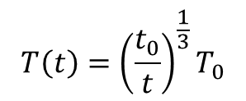
During the propagation through the QGP, the heavy quarks dissipate energy predominantly by two processes:
$$\left(i\right) Collision gQ → gQ, qQ → qQ, \overline{q}Q → \overline{q}Q$$
$$\left(ii\right) Radiative processes, i.e. Q + q → Q + q + g, Q + g → Q + g + g$$
The action of drag on the heavy quark can be defined through the relation
$$〈A\left(p; t\right)〉 = A\left(t\right)={〈−\frac{1}{P}\frac{∂E}{∂L}〉}_{coll}$$
we approximate the drag coefficient by the average value of energy change per unit distance
Diffusion coefficient
(Einstein relation)
$$D= {AT}^{2}$$
initial time
Initial temperature
The time dependence of the temperature
$$T\left(t\right)={\left(\frac{t_{0}}{t}\right)}^{\frac{1}{3}}T_{0}$$
B. Svetitsky, Phys. Rev. D 37 (1988) 2484.

Slide 7
The energy loss for heavy quarks in collisions from pQCD is:
smooth velocity function
$$\frac{−dE}{dL}=\frac{8πα_{s}^{2}T^{2}}{3}\left(1+\frac{n_{f}}{6}\right)\left[\frac{1}{ν}−\frac{1−ν^{2}}{2ν^{2}}ln\left(\frac{1+ν}{1−ν}\right)\right]ln\left[2^{\frac{n_{f}}{6+n_{f}}}B\left(ν\right)\frac{ET}{Mm_{g}}\right] for E≪\frac{M^{2}}{T}$$
gauge coupling
parameter
number of quark flavors
$$m_{g}=\sqrt{\left(1+\frac{n_{f}}{6}\right)\frac{T^{2}}{3}g^{2}}$$
strong coupling constant
thermal gluon mass
$\frac{−dE}{dL}=\frac{8πα_{s}^{2}T^{2}}{3}\left(1+\frac{n_{f}}{6}\right)ln\left[2^{\frac{n_{f}}{12+{2n}_{f}}}0.92\frac{\sqrt{ET}}{m_{g}}\right] for E≫\frac{M^{2}}{T}$
The radiative energy loss for heavy quarks
$$−\frac{{dE}_{rad}}{dL}=\frac{10α_{s}^{2}T^{2}}{3}ln\left(\frac{3E}{8πα_{s}T}\right) \left[ln\left(ξ+\sqrt{1+ξ^{2}}\right)+ξln\left(\frac{1}{ξ}+\sqrt{1+\frac{1}{ξ^{2}}}\right)\right]$$
$$ξ=\frac{9E}{2π^{3}T}$$
J. D. Bjorken, FERMILAB-PUB-82-059-THY
E. Braaten and R.D. Pisarski, Nucl. Phys. B 337 (1990) 569.

Slide 8
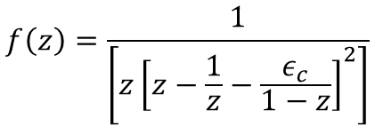

The initial conditions for the distributions of HQs have been taken from Durham HepData Project database ${}^{∗}$
We convolute the solution of the $FP$ equation with the fragmentation functions of the heavy quarks to obtain the $p_{T}$distribution of the heavy mesons $(D and B)$
for charm quark $ε_{c} = 0.05$and for bottom quark $ε_{b}$ ${\text{=(}m_{c}/m_{b}^{})}^{2}ε_{c}$
$$f\left(z\right)=\frac{1}{\left[z{\left[z−\frac{1}{z}−\frac{ε_{c}}{1−z}\right]}^{2}\right]}$$
The Nuclear Suppression factor
The ratio of the $p_{T}$ distribution of the electron from the decays of heavy flavors produced in heavy ion collisions to the corresponding (appropriately scaled by the
number of collisions) quantities from the p-p collisions
is defined as the nuclear suppression factor :
$$R_{AA}\left(P_{T}\right)=\frac{{\frac{{dN}^{e−}}{d^{e}p_{T}}}^{Au+Au}}{\left\langle N_{coll}\right\rangle ×{\frac{{dN}^{e−}}{d^{e}p_{T}}}^{p+p}}$$
${}^{∗}$EKS98, K. J. Eskola, V. J. Kolhinen and C. A. Salgado, Eur. Phys. J. C9 (1999) 61; K. J. Eskola, V. J. Kolhinen and P. V. Ruuskanen, Nucl. Phys. B535 (1998) 351

Slide 9
The Iterative Laplace Transform Method
A new method was proposed by Daftardar-Gejji and Jafari to seek numerical solutions of nonlinear equations. This method is called the Iterative Laplace Transform Method (ILTM), which is combination of two powerful methods, namely, the Laplace transform method and the Iterative method. The method gives numerical solutions in the form of convergent series with easily computable components.
Fokker-Planck ‎equation‎‎ ‎i‎‎n general form ‎is‎
$$D_{t}^{α}f=\left[D_{p}^{β}A\left(p,t,f\right)+D_{p}^{2β}B\left(p,t,f\right)\right]f(p,t)$$
Caputo fractional derivative with respect to 𝑡 and p.
Limei Yan, Hindawi , Volume 2013,
Article ID 465160, 7 pages,

Slide 10
$I$. The Caputo fractional derivative of function (p, 𝑡) is defined as
$$D_{t}^{α}f\left(p,t\right)=\frac{1}{Γ\left(m−α\right)}\int_{0}^{t}{{\left(t−η\right)}^{m−α−1}f^{\left(m\right)}\left(p,η\right)dη }$$
$$m−1<α≤m, m∈N,$$
$II$. The Laplace transform is defined as
$$G\left(s\right)=ℒ\left[g\left(t\right)\right]=\int_{0}^{∞}{e^{−st}g\left(t\right)dt}$$

Slide 11
III. Laplace transform of Caputo derivative is given as
$$\sum_{k=0}^{m−1}{f^{\left(k\right)}\left(p,0\right) } m−1<α≤m$$
$ℒ[D_{t}^{α}f$(p,t)]=$x^{α}ℒ\left[f\left(p,t\right)\right]−{ x}^{α−1−k}$
The general space-time differential equation is:
$$D_{t}^{α}f=𝒜\left(f,D_{p}^{β}f,D_{p}^{2β}f,…\right) m−1<∝≤m$$
$n−1<β≤n, (1)$
$m,n∈N$
A is Linear or non linear operators of
$$f,D_{p}^{β}f,D_{p}^{2β}f,…$$
With initial condition
$$f^{\left(k\right)}\left(p,0\right)=h_{k}\left(p\right), k=0,1,…,m−1 (2)$$

Slide 12
First we take Laplace transfer of both sides of $(1)$
$$s^{α}ℒ\left[f\left(p,t\right)\right]−\sum_{k=0}^{m−1}{s^{α−1−k}}f^{\left(k\right)}(p,0)$$
$=ℒ[𝒜(f,D_{p}^{β}f,D_{p}^{2β}f,…$)].
After simplification, we have
$$ℒ\left[f\left(p,t\right)\right]=\sum_{k=0}^{m−1}{s^{−1−k}f^{\left(k\right)}\left(p,0\right)}$$
$+s^{−α}ℒ[𝒜((f,D_{p}^{β}f,D_{p}^{2β}f,…$)].
Operate Laplace inverse on both sides of above equation
$$f\left(p,t\right)=ℒ^{−1}\left[\sum_{k=0}^{m−1}{s^{−1−k}f^{\left(k\right)}\left(p,0\right)}\right]$$
$+ℒ^{−1}{\left[s^{−α}ℒ[𝒜(f,D_{p}^{β}f,D_{p}^{2β}f,…\text{)]}\right].}^{}$
$$=C(f,D_{p}^{β}f,D_{p}^{2β}f,…\text{)}$$

Slide 13

We set
$$f_{0}=ℒ^{−1}\left[\sum_{k=0}^{m−1}{s^{−1−k}f^{\left(k\right)}\left(p,0\right)}\right]$$
.
.
.
$$f_{1}=C(f,D_{p}^{β}f,D_{p}^{2β}f,…\text{)}\text{,}$$
$$f_{m+1}=C\left(\sum_{k=0}^{m}{f_{k},D_{p}^{β}}\sum_{k=0}^{m}{f_{k},D_{p}^{2β}\sum_{k=0}^{m}{f_{k},… }}\right)$$
$$−C\left(\sum_{k=0}^{m−1}{f_{k},D_{p}^{β}}\sum_{k=0}^{m−1}{f_{k},D_{p}^{2β}\sum_{k=0}^{m−1}{f_{k},… }}\right) m≥1$$
Therefore the 𝑚-term numerical solution of $(1)$ with initial condition of $(2)$ gives numerical solutions in the form of convergent series
$f\left(p,t\right)=f_{0}\left(p,t\right)+f_{1}\left(p,t\right)$+… $m=1,2,…$

Slide 14
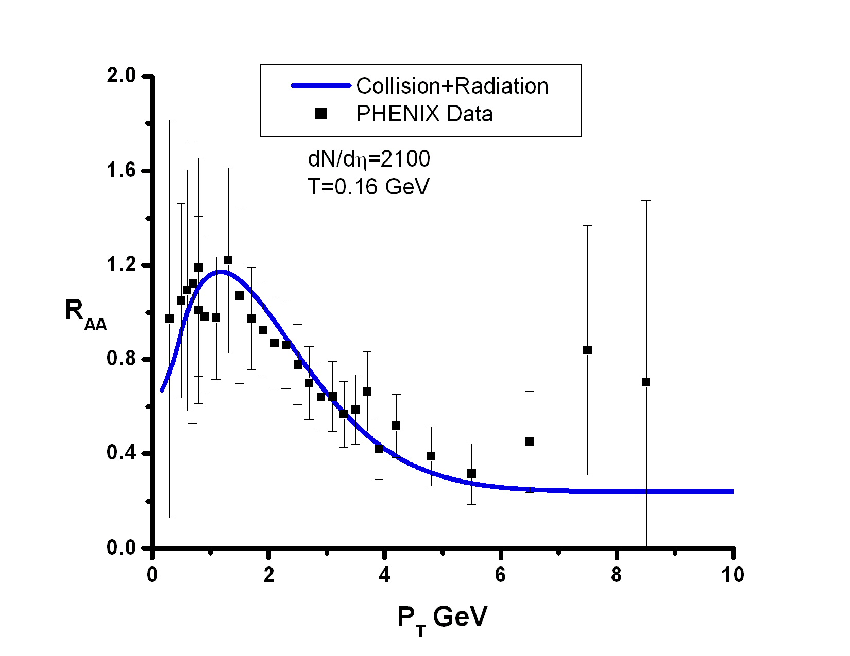
1. Dead cone effect ad LPM effect in radiative energy loss can be considered
$Au−Au collisions at \sqrt{S_{NN}}$=$200GeV T_{0}=0.373GeV$
2. Since the medium is not static and it cools while expands, the strong coupling is not fixed, running with the evolution of the system. temperature dependence of the running coupling constant is considered:
thermal $\left[α_{s}^{\left(th\right)}\right]$
Variation of drag coefficient with $p_{T}$ for Bottom and Charm quarks.
Nuclear modification factor for D and B mesons in Au-Au collision at the RHIC energies.
S. S. Adler et al., (PHENIX Collaboration), Phys. Rev. C 84, 044905 (2011)

Slide 15
Summary and Conclusion
Considering both radiative and elastic loss in effective drag and diffusion enables us to reduce the gap between experiment and theory
The Charm quark suffers more suppression than bottom quark at RHIC energy
The suppression are affected by two factor
different value of coefficients
different initial momentum
At large energy, radiate energy loss becomes much larger than the collisional one; at lower energy, the elastic and radiate processes can contribute equally. For small value of Parton energy, the collisional one can dominate
The use of Iterative Laplace Transform Method for solving the Fokker-Planck describe experimental data with a good approximation

Slide 16
Thank you
for your attention

Slide 17
The strong coupling is not fixed, running with the evolution of the system.
The effects of quark mass in the gluon radiation is taken into account by dead cone effect.
The LPM effects have been taken into account by including a formation-time restriction on the phase
Space of the emitted gluon in which the formation time, $τ_{F}$ , must be smaller than the interaction time.
The sensitivity of the results on the equation of state is also demonstrated. A softer equation of state (lower value of $c_{s}$) makes the expansion of the plasma slower, enabling the propagating heavy quarks to spend more time interacting in the medium and hence lose more energy before exiting from the plasma.
.

Slide 18
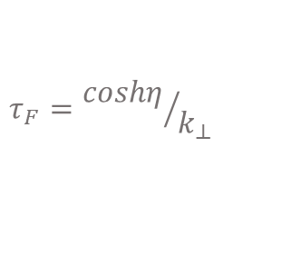
The LPM Effects
Inverse of the interaction time
The radiative energy loss of a heavy quark
$${\left.\frac{dE}{dx}\right|}_{rad}=Λε=τ^{−1}ε$$
The average energy per collision
$$ε=\int{dηd^{2}k_{⊥}\frac{dn_{g}}{dηd^{2}k_{⊥}}k_{0}Θ(τ−τ_{F})F^{2}}$$
formation time
$$τ_{F}={coshη}/{k_{⊥}}$$

Slide 19
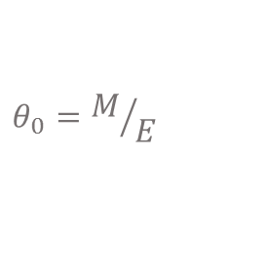
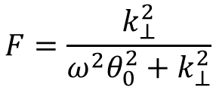
Radiation
The matrix element for the radiative process $( Q +q → Q + q + g)$can be factorized into an elastic process $(Q + q → Q + q)$and a gluon emission $(Q → Q + g).$The emitted gluon distribution can be written as
Casimir invariant of the adjoint representation
strong coupling constant
$$\frac{dn_{g}}{dηd^{2}k_{⊥}}=\frac{C_{A}α_{s}}{π^{2}}\frac{q_{⊥}^{2}}{k_{⊥}^{2}{(k_{⊥}−q_{⊥})}^{2}}F^{2}$$
four-momentum of the emitted gluon
four-momentum of the exchanged gluon
The effects of quark mass in the gluon radiation is taken into account by dead cone effect
$$F=\frac{k_{⊥}^{2}}{ω^{2}θ_{0}^{2}+k_{⊥}^{2}}$$
$$θ_{0}=M/E$$
PHYSICAL REVIEW C 82, 014908 (2010)

