Slide 1
SuperB R&D on going on storage and data access
R&D Storage
Silvio Pardi
spardi@na.infn.it

Slide 2
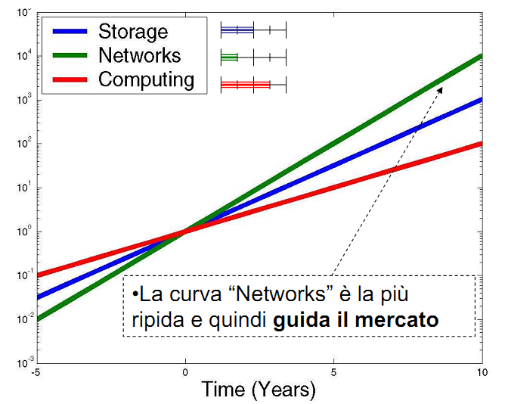
Network vs Storage and CPU
Gilder’s Law
the total bandwidth of communication systems triples every twelve months
The network drive toward a new data-model totally site independent:
In design the Storage and the Data Management strategy SuperB must take in account the novelty provided by the network
The network grows faster
than Storage density and CPU

Slide 3
Background Requirements – LHCONE by Richard Hughes-Jones
There has been a changing of the data models so it is less hierarchical. Data caching is now more widespread with on demand draw down. Implications are for much greater traffic needs intra T2 traffic. Instead of complying with the hierarchical MONARC model, any T2 must be able to exchange traffic with other T2s and T1s. A big increase in traffic was seen in May 2010 as data started flowing. Large traffic flows often made of several different flows but peaks up to 8 -9 Gbps (ie at saturation level of 10 Gbps) on access links.

Slide 4
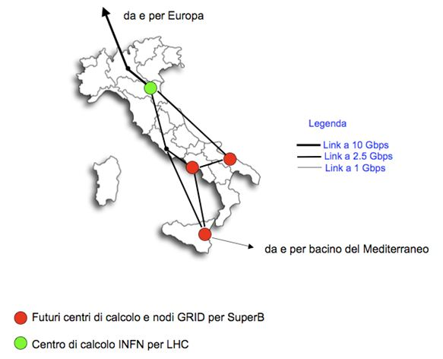
NEXT INSTALLATION
Distributed computer facility -Tier0/Tier1 services will be available in tree years (2013/2014?)
200.000-300.000 core
100PB of disk space
10/40/100 Gbit/s
R&D Storage
The SuperB Computing R&D program

Slide 5
Storage R&D
How setup the storage in the sites and how share and replicate data between them?
Which data access services we want implement?
We want support IPv6 in the next future?
Are the file systems that we plan to use IPv6 compliant? There is roadmap ?

Slide 6
Storage R&D on going
Investigate usage of WN disks for data storage/data caching
Performance of different filesystem
File/Replica location. Investigate on storage systems able to do it natively. Geographic file system
Interactivity + usage of personal resources for personal analysis tasks
Investigating Catalogue and metadata system
How distribute the software.

Slide 7
Work on Storage R&D
Work in progress:
Testing both functionalities and performance
File system under test:
Lustre, Xrootd, HDFS, GlusterFS
Testing new file systems with analysis jobs:
Jobs coming from SuperB itself and CMS
We looking for a more representative code in term of I/O usage.

Slide 8
COMMON STORAGE ARCHITECTURE
CE Computing Element
GridFTP
SRM
DATA INFRASTRUCTURE
SRM-Service
WN
WN
WN
GPFS
EXT3
WN
COMPUTING INFRASTRUCTURE
I/O Serve

Slide 9
TIER2 ATLAS IN NAPLES
108 Nodes for a total of 1.056 cores
Whereof
83 Worker Node for a total of 882 cores
19 Storage Node for a total of 144 cores
6 Services Nodes for a total of 30 core
~ 800 TB Available
~14% of Total Core for the storage infrastructure
+
Complex Network infrastructure to support traffic WN to SE Based on DPM
+
19 Server and Storage System in fiber optic

Slide 10
TIER2 ALICE-CMS IN BARI
135 Nodes for a total of 1350 cores
20 Disk Server => ~700TB of storage
Each server has multiple Gbps connection
1 x 10 Gbps storage server dedicated for tests
The network infrastructure is able to provide 1Gbps to each WN
~12% of Total Core for the storage infrastructure

Slide 12
NEW POSSIBLE SCENARIOUS?
CE Computing Element
GridFTP
We can design a cluster setup to integrate data storage and computing services in the same nodes.
Computer facility as a farm of high density Box in term of core and disk
DATA INFRASTRUCTURE
WN
SRM
WN
WN
WN
COMPUTING INFRASTRUCTURE
To day in a 2 Unit server we can have
more than 10TB of disk and 48 core

Slide 13
HIBRID SOLUTION
CE Computing Element
GridFTP
GridFTP
SRM
DATA CACHE AND COMPUTING INFRASTRUCTURE
DATA INFRASTRUCTURE
SRM-Service
AREA
CACHE
WN
SRM
WN
WN
GPFS
EXT3
WN
I/O Serve

Slide 14
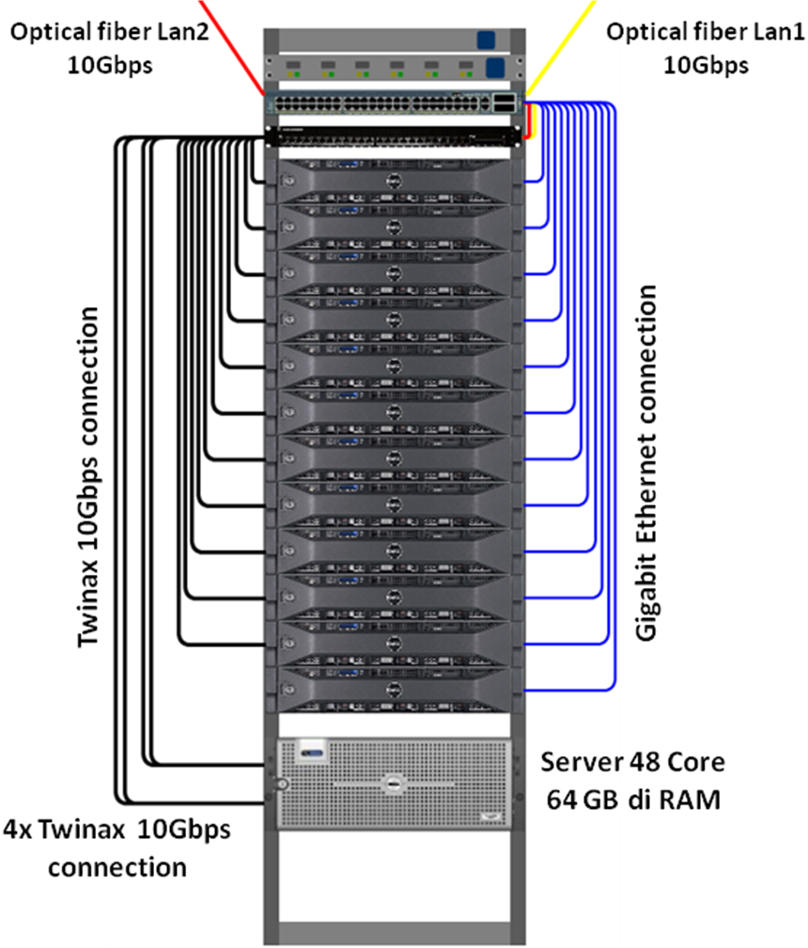
10Gbit/s Farm Setup in Naples
DELL Server PowerEdge R510 biprocessor quadcore Intel(R) Xeon(R)
Memory 32Gbyte RAM, a PERC H200 controller RAID and four local disk of 500GB in Raid0 configuration.
Broadcom NetXtreme I 57711 double port SFP+ 10GbE NIC with ofload TOE e iSCSI, PCIe x8.
OS SL 5.5
PCI Expander with 4 Tesla
Interested Peoples can use the cluster for Test
PCI Expander

Slide 15
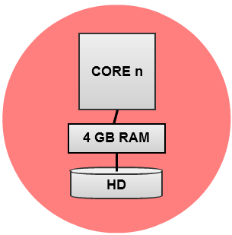
The configuration of each node
2x CPU 2,13GHz 4Core, 4,80GT/s + 4,80GT/s QPI
8x 4GB Dual Rank 1066MHz
8x HDD 500GB 7200rpm SATA Hot-Plug 3,5”
1 Gbps
10 Gbps
10 Gbps
1 Gbps
Twinax
UTP
. . . 8x one node (12 nodes in this test)
96 core (8x 12), 384 GB Ram (32x 12), 48 TB HD (4x 12)

Slide 16
FILE SYSTEM IN EVALUATION
In this infrastructure we have implement two Open source solution currently in investigation.
Hadoop File System
GlusterFS
16

Slide 17
HDSF-HADOOP IMPLEMENTATION
HDSF Name Node
10 GIGABIT SW
1 NAME NODE
8 WORKER NODE / DATANODES that share
the local disk
All the DataNode mount
HDSF Posix Inferface through
Fuse module
HDFS FILE SYSTEM
WN1/DataNode
WN2/DataNode
WN../DataNode
WN8/DataNode
17

Slide 18
GLUSTER IMPLEMENTATION
GLUSTERFS IS A FILE CLUSTER FILE SYSTEM THAT WORK WITHOUT DATA-NODES. IT CAN WORK IN 3 DIFFERENT CONFIGURATION: DISTRBUTED, STRIPED AND REPLICA. IT USE THE POSIX EXENSION TO GUARANTEED THE CONSISTENCE OF FS.
GLUSTER
10 GIGABIT SW
NO NAME NODE
9 WORKER NODE / DATANODES that share
the local disk
All the DataNode are client and server.
The Gluster FS is configured with replica 3
WN1/DataNode
WN2/DataNode
WN../DataNode
WN9/DataNode
18

Slide 19
Job Analysis Benchmark
Performance test executed through a SuperB Analysis job provided by Alejandro Perez.
It executes an analysis test on a set of simulated root files previously replicated in the GlusterFS and Hadoop volumes.
The following compare the execution time and the bandwidth occupation during a set of different job execution setup

Slide 20
GOAL
Understand the main parameters:
Scalability
Global performance and the right setup
Reliability
Network Usage
CPU and Memory load on each Node
File System overhead

Slide 21
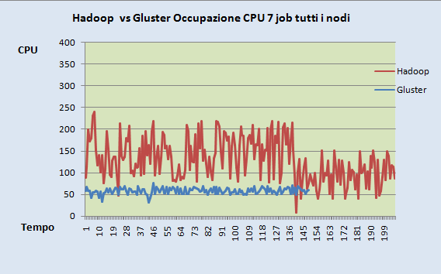
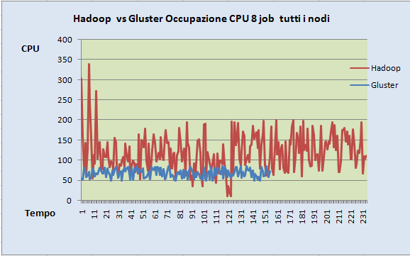
File System | 1 Job | 2 Jobs | 4 Jobs | 8 Jobs
GlusterFS | 115s | 116s | 114s | 135s
HDFS | 141s | 145s | 148s | 198s
ONLY ONE NODE
File System | 7 Jobs | 8 Jobs
GlusterFS | 140s | 155s
HDFS | 205s | 225s
ALL THE NODES WORK TOGETHER
HDSF vs GlusterFS 7 jobs per Node
HDSF vs GlusterFS 8 jobs per Node
TIME
TIME
12% of core dedicate for storage
No core dedicate for storage

Slide 22
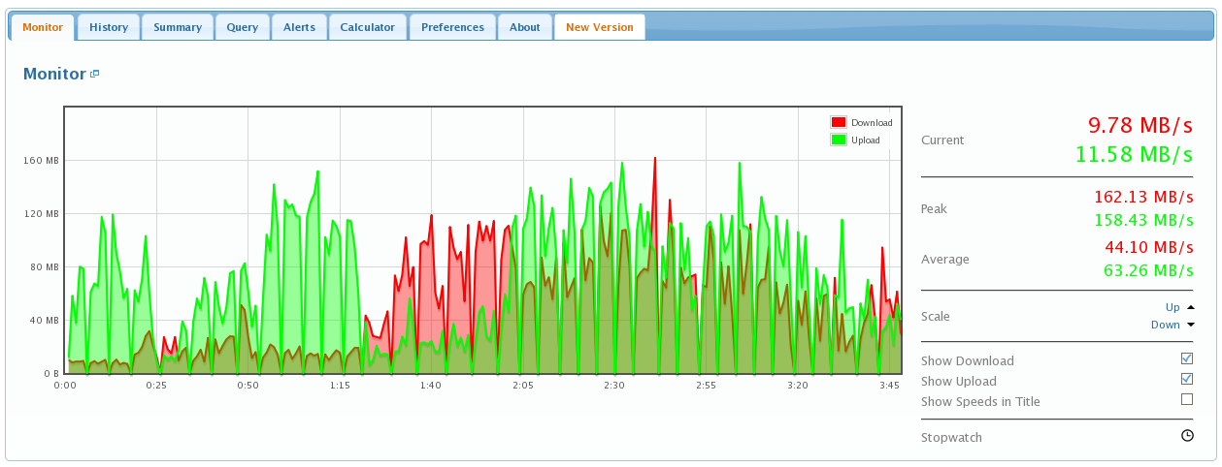
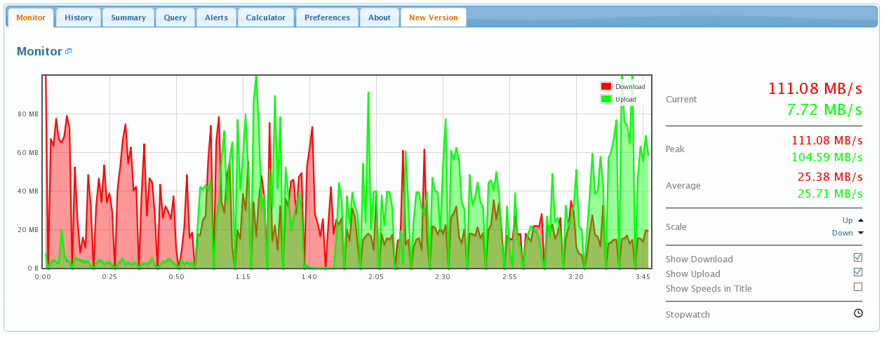
Network Traffic
In this test we sent 8 analysis jobs for node
We achieve an Aggregate
Network occupation of about 10Gbit/s In the Cluster .

Slide 23
Geographic testbed
Geographical distributed Storage Element
Caracterizing HDFS for high throughput data transfer is an issue arised at CHEP2010 by the CMS Group
HDFS

Slide 24
Catalogue
New tests carried on with DIRAC File Catalogue
This will be interesting because we will have both File Catalogue features and Metadata feature
Using the Storage Element already configured in DIRAC instance
Configuring the SE is not at all a trivial task!!
The typical grid file catalogue features are available
copy-and-register, replicate, delete, get, etc…

Slide 25
Catalogue – 2
The DIRAC File Catalogue has a good number of added features:
Checksum
CreationDate
ModificationDate
Owner
OwnerGroup
Size
DIRAC provides both “batch” and “interactive” command line
Web interface still to be tested
The system is able to provide also an index of the Storage Element configured
They can be used with user-friendly names

Slide 26
Conclusion 1/2
A new computer facility will be created in the next 2-3 years, then we must accelerated the R&D Storage program in order support the new Installation.
The network performance and the new features of distributed file-system that implement data replication natively, allow to design a new distributed infrastructure and new data movement strategy
Right now they are a set of interesting on going actives bust also some open issue.

Slide 27
Conclusion 2/2
In order to start complete R&D activities:
What are the other International datacenter involved in the SuperB Data Analysis? We can create a map of all the possible sites?
What are the main point-to-point network flows that we expect to have?
For the R&D Storage programs, would be important found more realistic benchmark in term of I/O usage

Slide 28
Thank you

