Slide 1
EAAC2015 Statistics and Close-OUT
Ralph W. Aßmann (DESY). Massimo Ferrario (INFN)
Coordinator European Network for Novel Accelerators
2nd European Advanced Accelerator Concepts Workshop
Elba, 18.09.2015

Slide 2
Participants and Students

Slide 3
Some Statistics
258 registered participants + about 50 accompanying persons. 45 sponsored students.
Participants from 23 countries in 4 continents (11 EU member states):
EU member states: 188
Other Europe + Russia + Israel: 28
US: 30
Asia: 11
Australia: 1
218 male (84%), 40 female (16%) participants

Slide 4
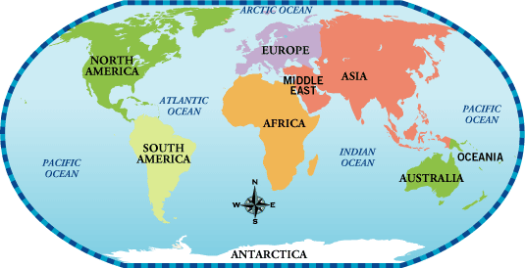
Participants
30
216
11
1

Slide 5
By Country

Slide 6
Scientific Work
Working Groups + Summaries: 7
Invited Talks: 30
Special Science Talk: 1
WG Talks: 138
Posters: 76 Thanks again Alban Mosnier + Program Committee
To come: Proceedings - Special Volume NIM Lead editor: Ulrich Dorda ulrich.dorda@desy.de
Shows how productive and innovative the field is!

Slide 7
Experimental Work Day and Night...
Wakefield generation in the regime of coherent stimulated emission of free bodies...

Slide 8
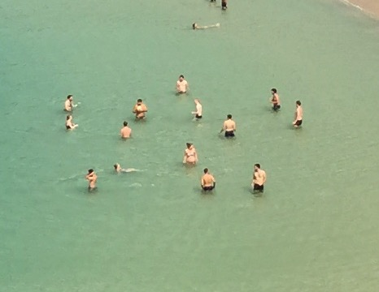
Experimental Work Day and Night...
Wakefield generation in the regime of coherent stimulated emission of free bodies...

Slide 9
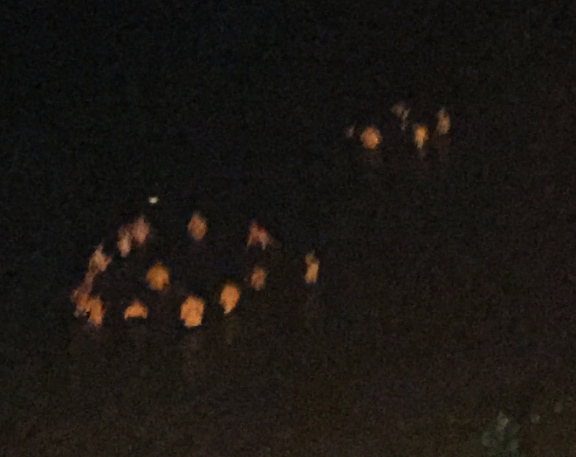
Experimental Work Day and Night...
Wakefield generation in the regime of coherent stimulated emission of free bodies...

Slide 10
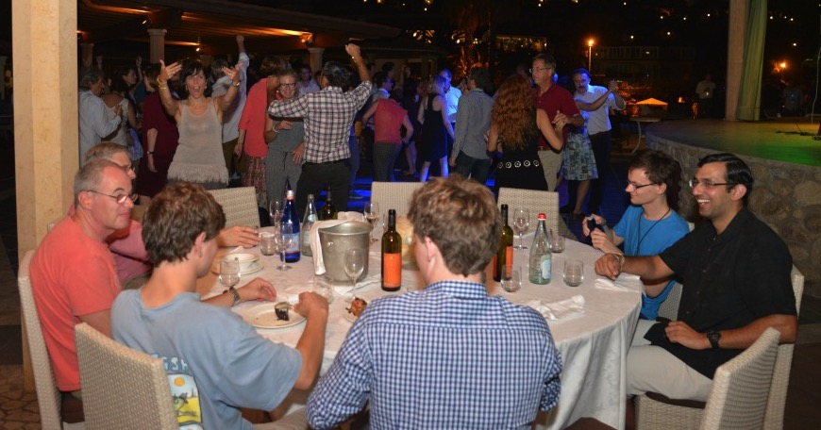
Work Discussions at Dinner

Slide 11
Work Discussions at Dinner
... and partying...

Slide 12
Yesterday we thanked in more detail all the persons helping in organizing and managing this workshop. Thanks again. Tomorrow: Yearly EuroNNAc Meeting. The conference chairmen would like to thank you for your contributions and support for this workshop. ... and (last slide) →

Slide 13
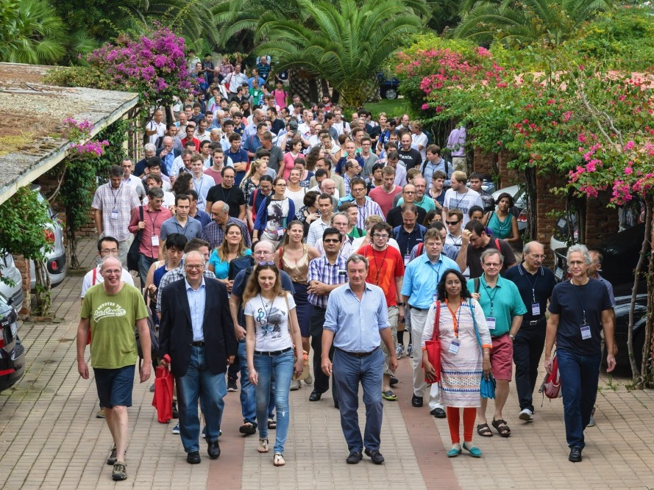
Novel Accelerators are Coming...
EAAC2015: The novel accelerator field is healthy and advancing...
Have a good trip back home.

