Slide 1
Milano, 2015 July 7
POLITECNICO DI MILANO
DEPARTMENT OF ENERGY
New Experimental Labs for Nuclear Engineering R&D and Education
Prof. Stefano Agosteo
Department of Energy

Slide 2
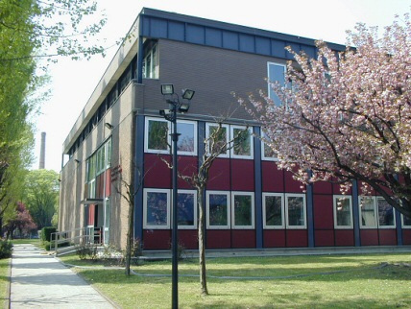
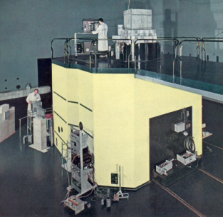
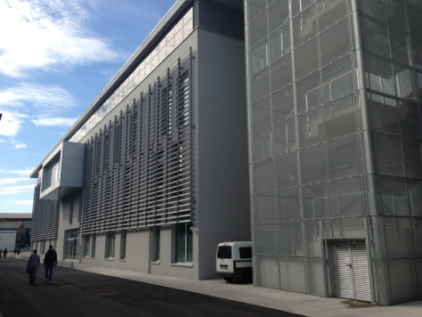
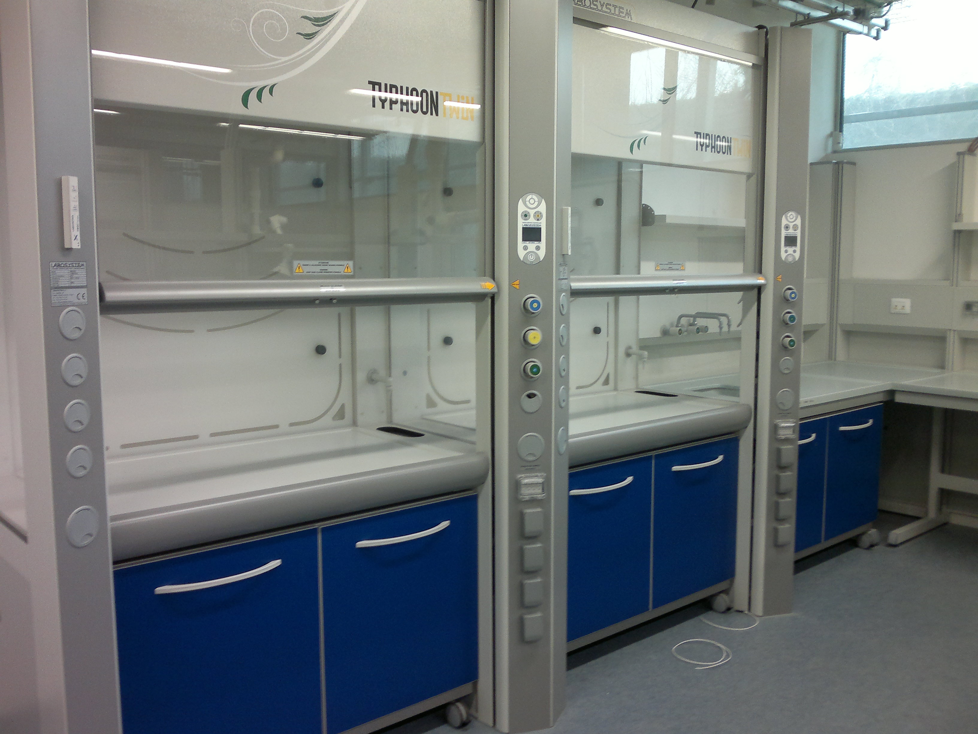
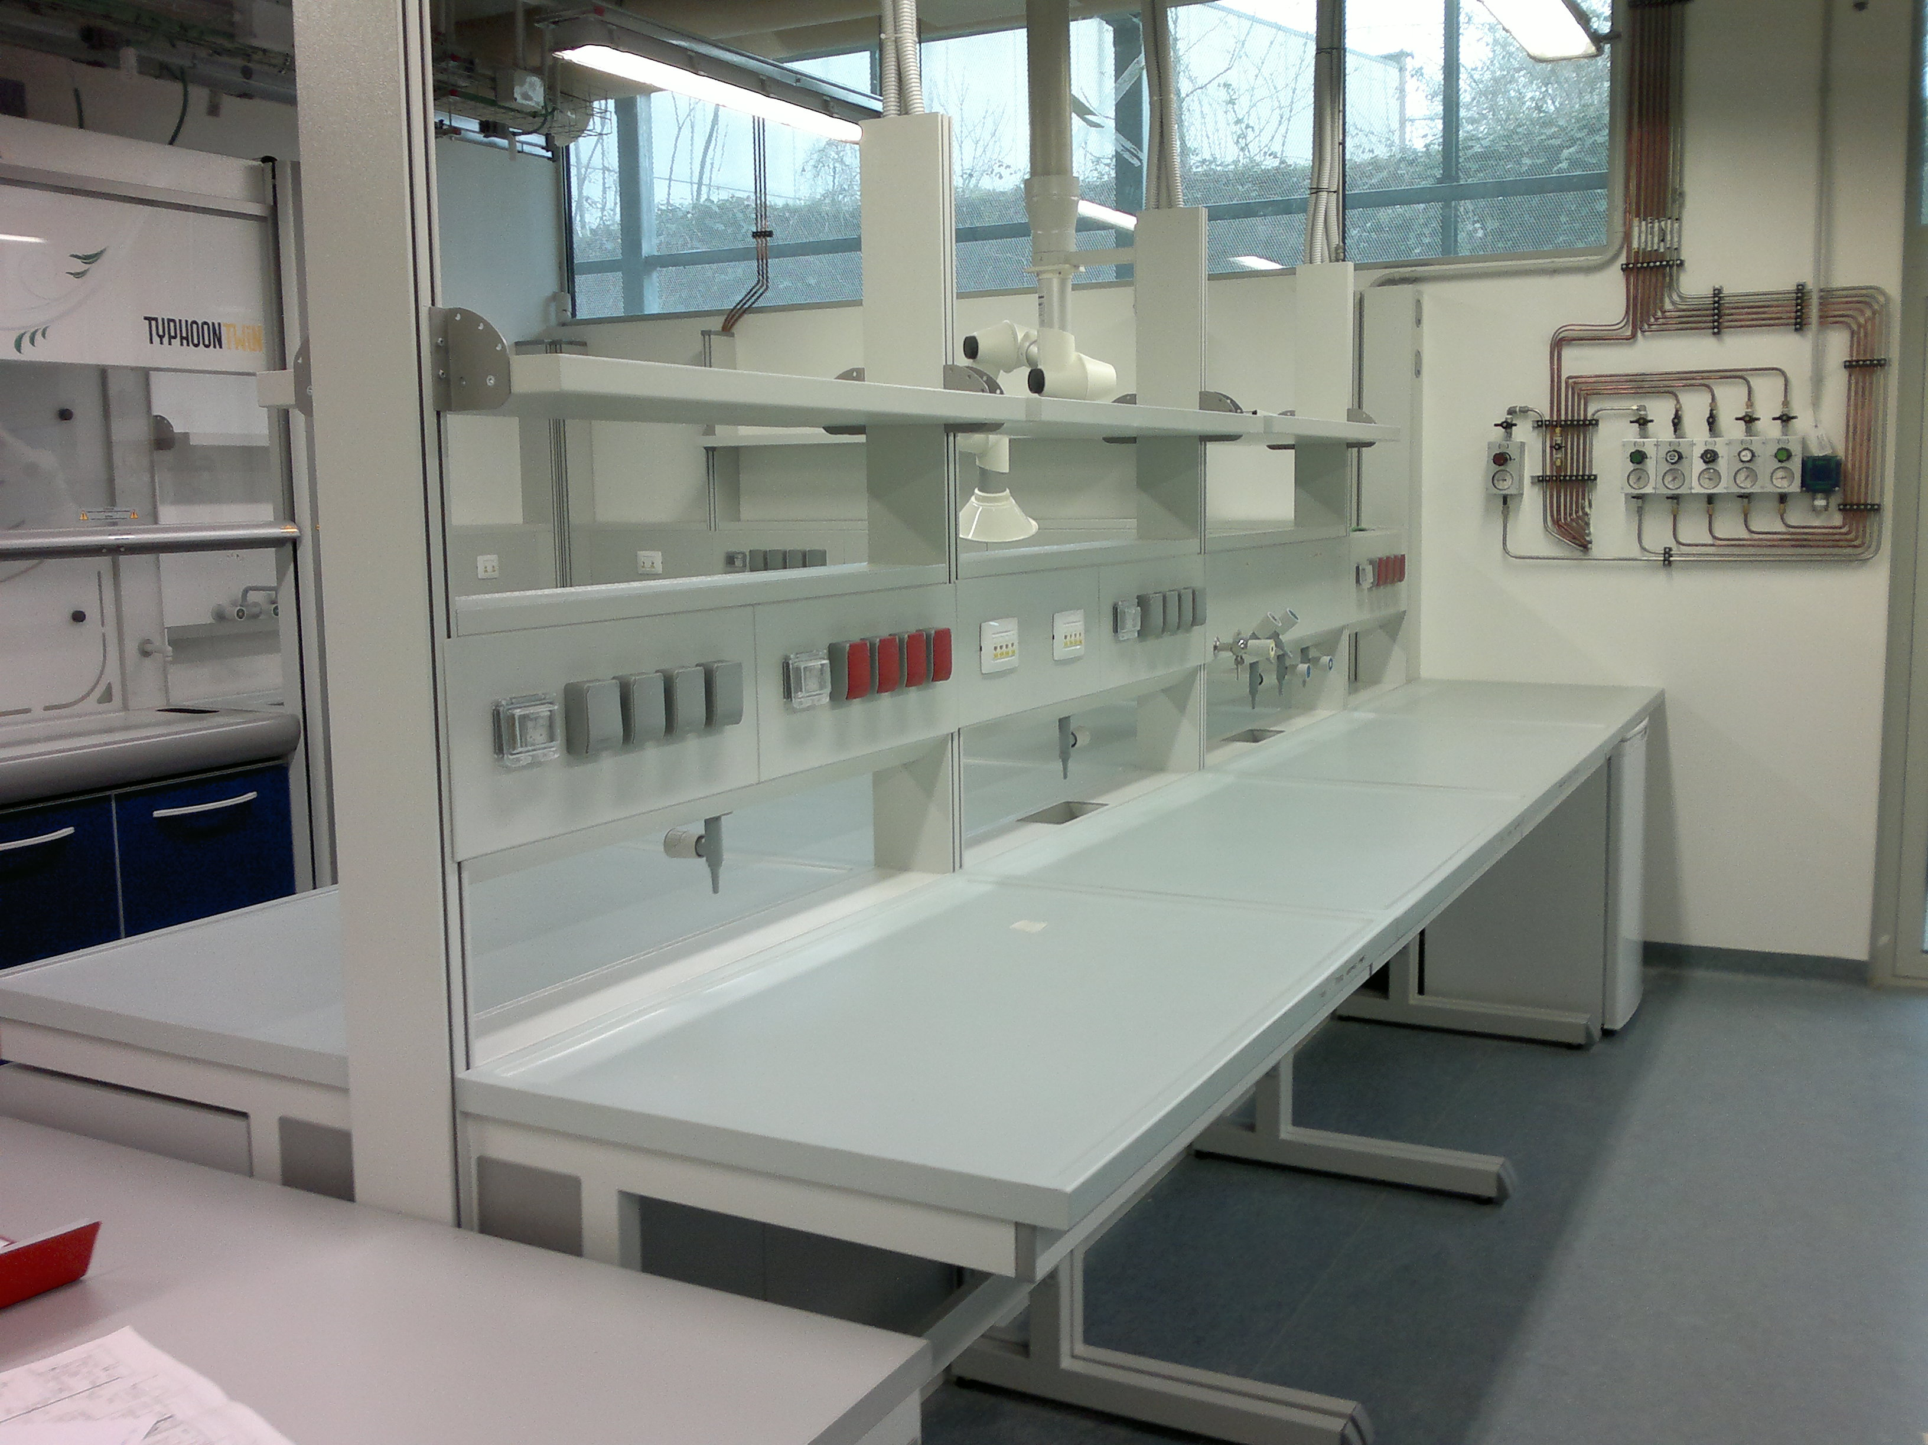
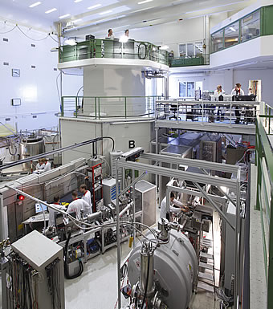
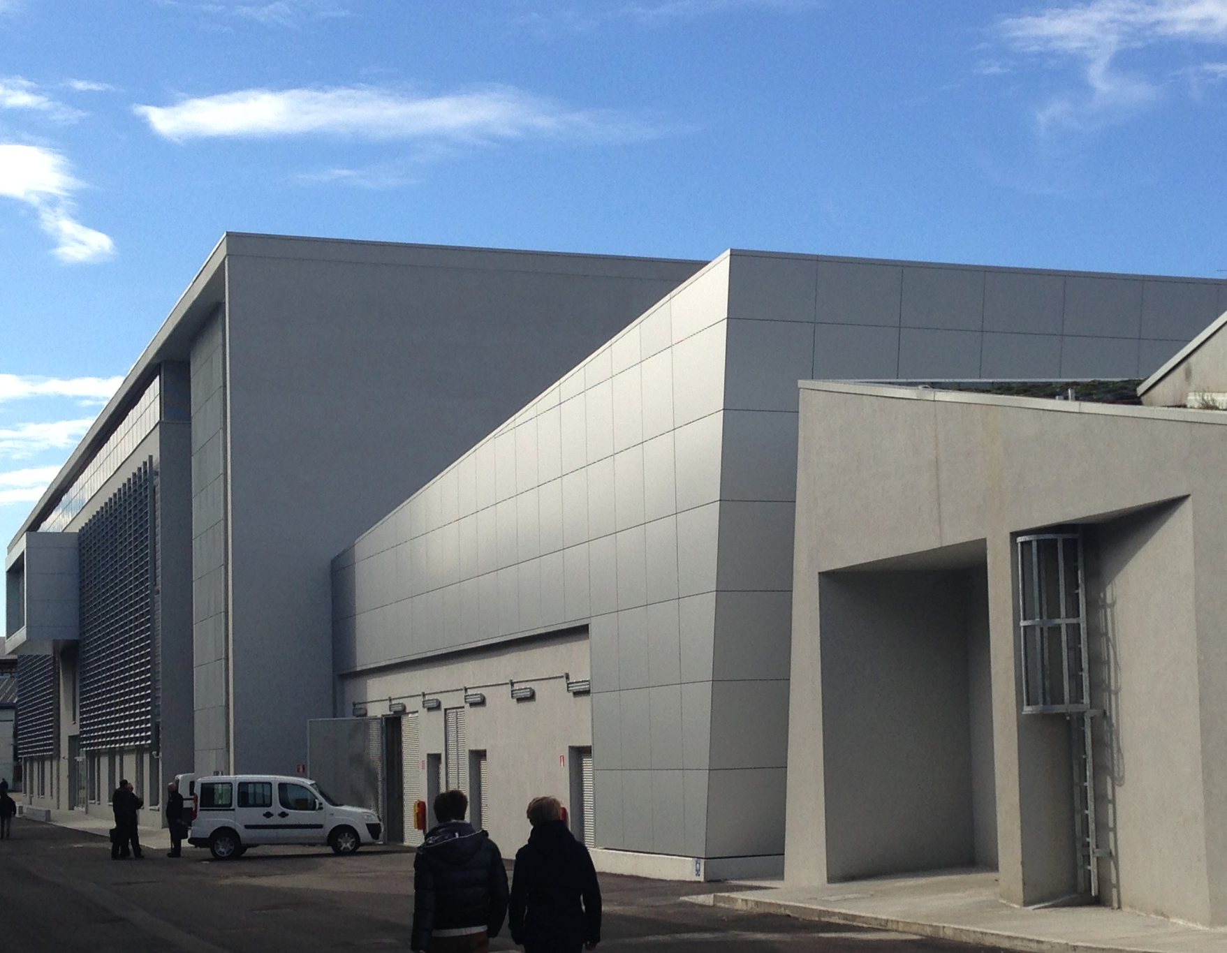
Nuclear Engineering @POLIMI
History
First educational programme in Nuclear Engineering (1956)
First research nuclear reactor in Italian Universities (1959)
Today
Still first MSc in NE in Italy today (>40 new students per year), one of the largest in Europe
English taught MSc in Nuclear Engineering + PhD programme
Brand-new experimental labs
Access to TRIGA research and training reactor (Pavia)

Slide 3
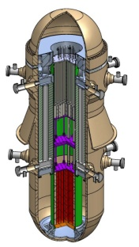
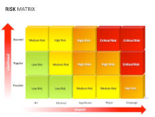
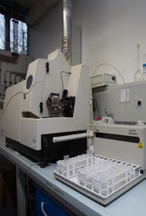
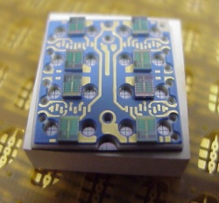
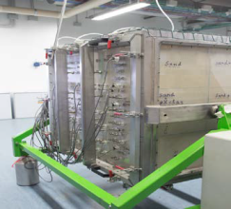
Nuclear Engineering @POLIMI
The largest NE Division in Italian Universities
Nuclear Reactors group
thermal hydraulics (experim. & modelling), thermal mechanics, fuel performance, dynamics & control, safety analysis, economics
RAMS group
soft methods (fuzzy, neural networks,…) for maintenance/ reliability optimization and risk analysis purposes
Radiochemistry group
methods for waste characterisation, confinement in inorganic matrices, wet- and pyro-processes for partitioning
Radiation Protection group
dosimetry, radon, decommissioning processes
Radiation Measurement & Instrumentation group
medical applications, electronics for radiation measurement devices
Reactor Physics and Contaminants group
MCNP methods for neutronics and particle transport, contaminant transport in porous media

Slide 4
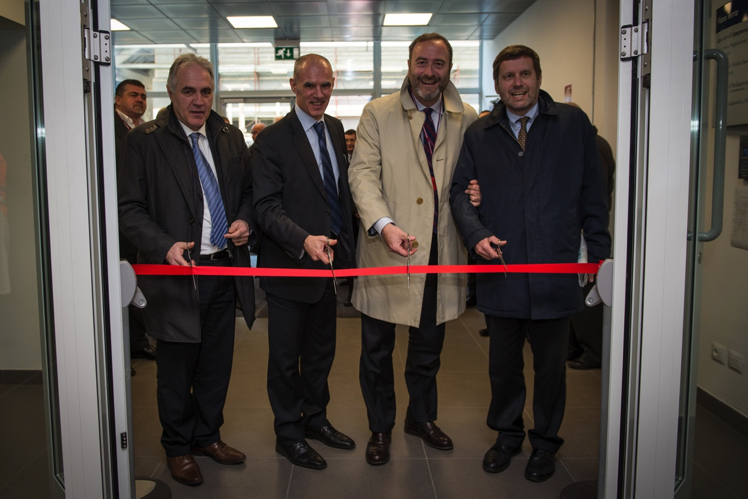
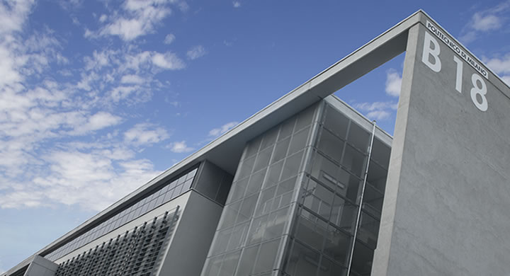
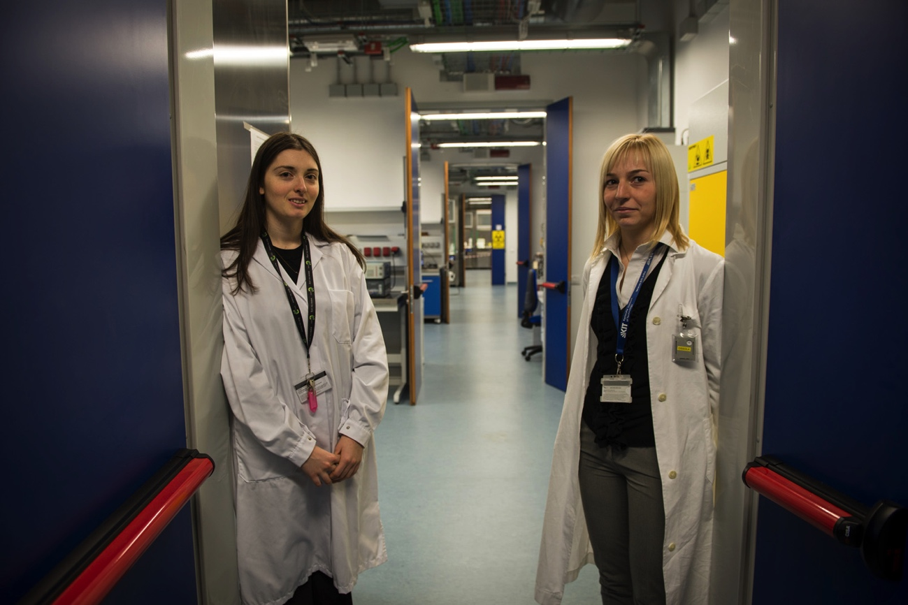
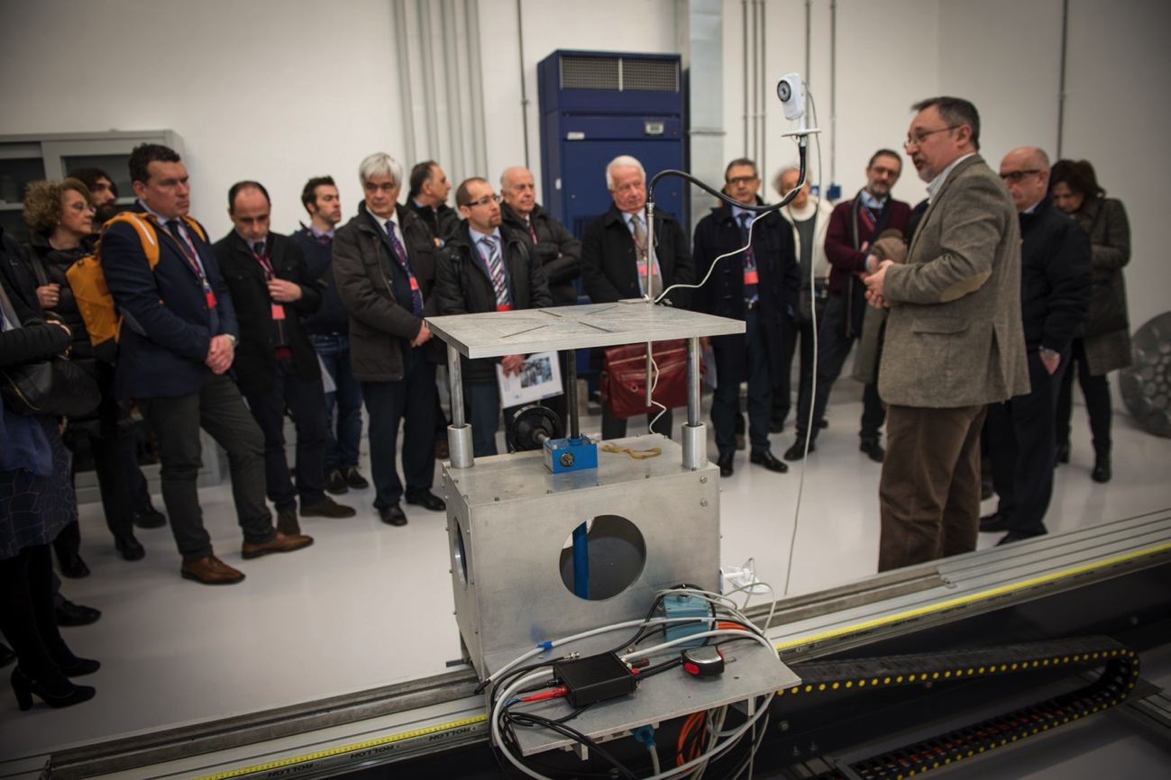
New experimental laboratories Opening Ceremony: 6 March 2015
New, advanced experimental labs for research, training, education
Nuclear sector and chemical-energy sector
More than 6 000 m² brand new areas, more than 15M€ investment

Slide 5
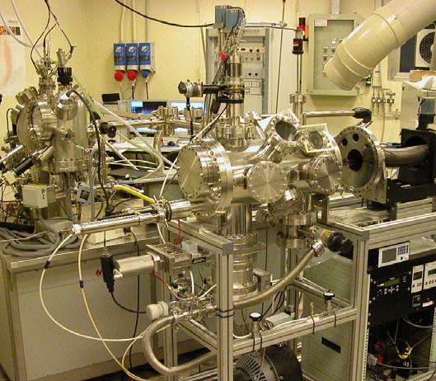
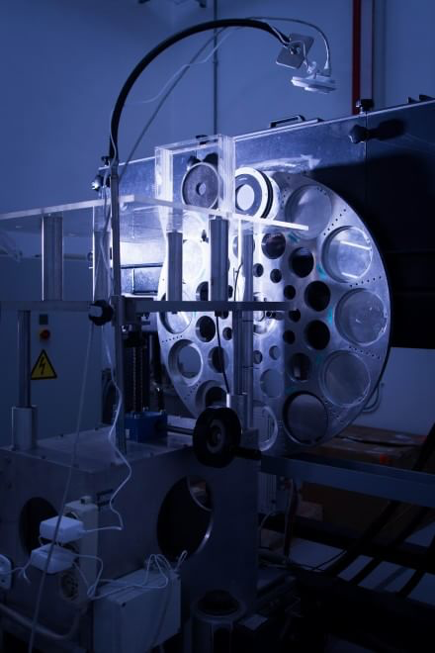
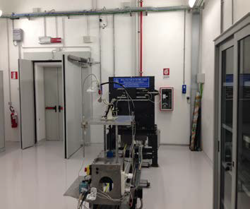
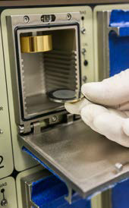
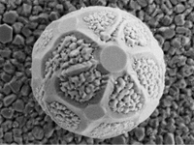
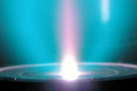
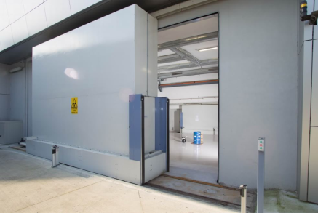
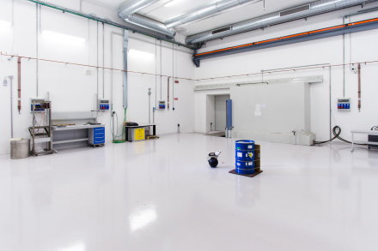
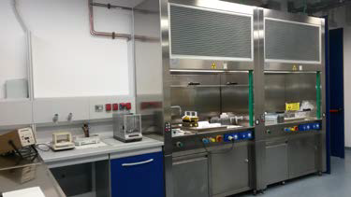
Nuclear Engineering Experimental labs
By means of these brand new facilities, Politecnico di Milano is one of the few institutions in Europe that can boast modern and complete equipment for cutting-edge research in the field of Nuclear Engineering.
The labs allow developing fundamental research on nuclear issues at international level, as well as applied research in industrial, medical and environmental fields. (1500 m² )
Rad Bunker 500 m²
Radiochemistry
Contaminants Migration
Radiation Protection
Health physics
Nuclear Instrum. & Measurements
Nuclear Electronics
Ionizing Radiation Metrology

Slide 6
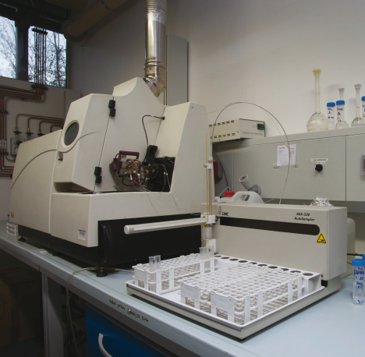
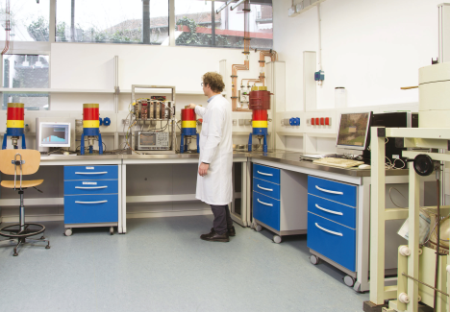
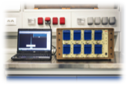
RADIOCHEMISTRY AND RADIATION CHEMISTRY
The Radiochemistry and Radiation Chemistry Laboratory perform chemical-physical and radiometric characterizations on matrices of interest in nuclear, industrial, medical and environmental fields.
The activities include the radiochemical and isotopic analyses of contaminated samples, the study of the effects of radiation on materials and the development of chemical dosimeters for medicine and industry.
Instrumentation & facilities
Fully-equipped Chemical-Radiochemical Labs in Controlled and Supervised Areas,
Chemical-electrochemical-analytical instrumentation,
ICP-Q-MS - Inductively Coupled Quadrupole Mass Spectrometer,
UV-VIS Spectrophotometer, FT-IR Spectrophotometer, HPLC/UV - High Performance Liquid Chromatograph-UV detector,
Beta and Gamma Scintillation Counters, Ultra Low-level Liquid Scintillation Counter, High resolution gamma spectrometers, High resolution alfa spectrometers,
Liquid-Liquid Extraction System by multi-stages Centrifugal Contactor and Mixler-Settler Batteries.

Slide 7
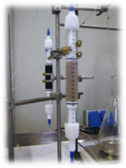
CONTAMINANTS MIGRATION AND SAFEGUARDS
The Laboratory of Contaminants Migration and Safeguards studies the processes of migration of toxic and radioactive contaminants in natural and artificial porous media.
The available equipment reproduces the experimental processes at laboratory scale. In addition, Monte Carlo simulations of radiation fields are performed for Nuclear Safeguards purposes.
Instrumentation & facilities
Columns and a large scale sand box for contaminant migration experiments,
Conductimeters, pH-meters and Potentiometer Equipment, Gamma Spectrometers,
Electronics and plastic scintillator detectors for photons and fast neutrons correlation measurements.

Slide 8
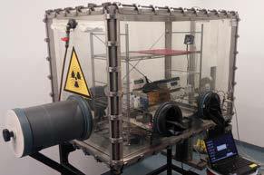
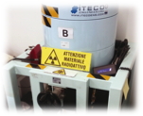
RADIATION PROTECTION
The Laboratory of Radiation Protection develops dosimetry in mixed fields of X-rays, gamma-rays and neutrons, by means of film dosimeters and thermoluminescence dosimeters.
The Lab is capable of providing services to face every radiation protection issues, e.g. analysis in gamma spectrometry, liquid scintillation, smear tests, indoor radon measurements as well as consulting services.
Instrumentation & facilities
Film-badge dosimetry system, Thermo-luminescent dosimeter readers,
Portable neutron and gamma dose rate monitors, portable gamma spectrometers, Smear-Test analyzer,
High Purity Germanium detectors (HPGe) for high resolution gamma-ray spectroscopy,
Quantulus 1220-type machine for alpha and beta-ray spectroscopy by means of liquid scintillation counting,
In-situ high resolution gamma spectrometer (ISOCS),
Radon glove boxes for instruments and detectors characterization with controlled radon air concentration.

Slide 9
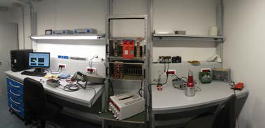
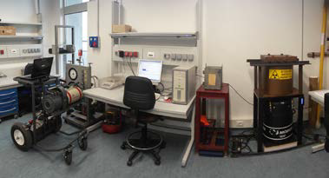
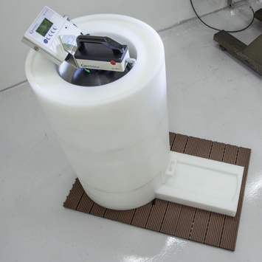
NUCLEAR INSTRUMENTATION AND MEASUREMENTS
In the laboratory of Nuclear Instrumentation and Measurements, methods and techniques for the measurement of ionizing radiation fields are developed, with applications to spectrometry and dosimetry of complex fields of neutrons, photons and charged particles.
Instrumentation & facilities
High resolution gamma spectrometers for in-lab (HPGe) and for in-situ (ISOCS) characterization of radioactive samples,
Spectrometers for complex fields of neutrons, continuously distributed in energy, from thermal up to GeV,
Neutron radiation fields for the characterization of detection systems employed in radiation protection applications: thermal neutrons (30cm×30cm area) and fast neutrons.

Slide 10
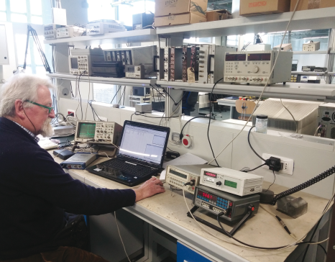
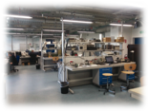
NUCLEAR ELECTRONICS
The Laboratory of Nuclear Electronics, equipped with certified shielded rooms for the measurement of very low noise circuits, conducts experimental activities on electronic instrumentation associated with radiation detection.
The applications relate to dosimetry and radiation protection as well as to diagnostic radiology and radiotherapy.
Instrumentation & facilities
6 experimental benches with electronic instrumentation (waveform generators, stabilized power supplies, oscilloscopes, test probes, etc.),
1 experimental bench for characterization of semiconductor devices,
Custom instrumentation and shielded chamber for low-noise measurements,
Spectrum analyser and RF antennas,
Circuit simulator and printed circuit design.

Slide 11
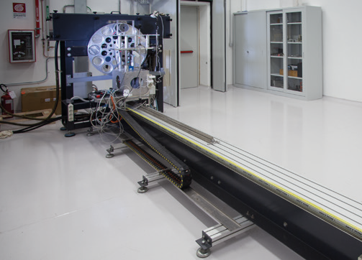
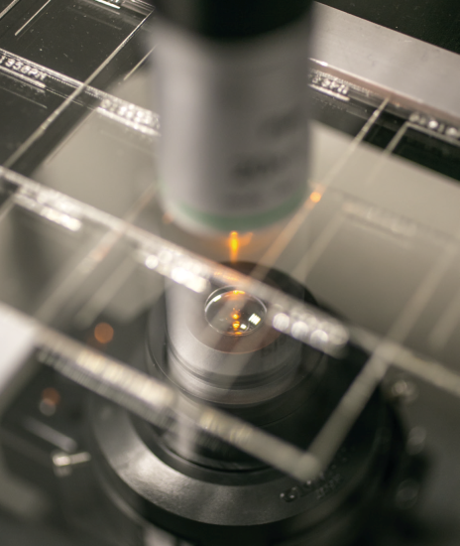
IONIZING RADIATION METROLOGY
The Metrology Laboratory of ionizing radiation is accredited to perform certified calibrations of nuclear instruments. Research institutions, hospitals, national and local health bodies and environmental protection bodies, private companies refer to the laboratory for their calibrated instruments.
The Ionizing Radiation Bunker hosts the irradiation rooms.
Instrumentation & facilities
Gamma irradiation room with self-shielded gamma sources,
X irradiation room with X-rays generator.

Slide 12
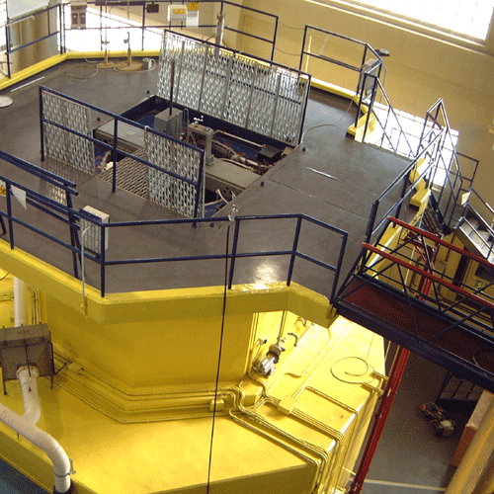
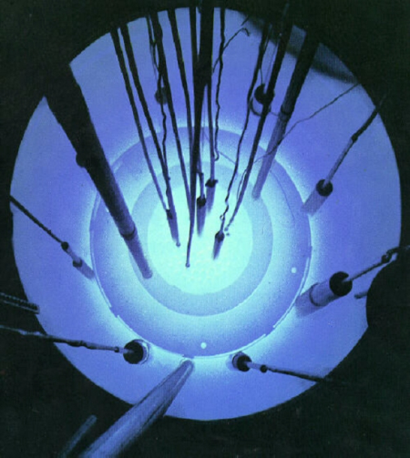
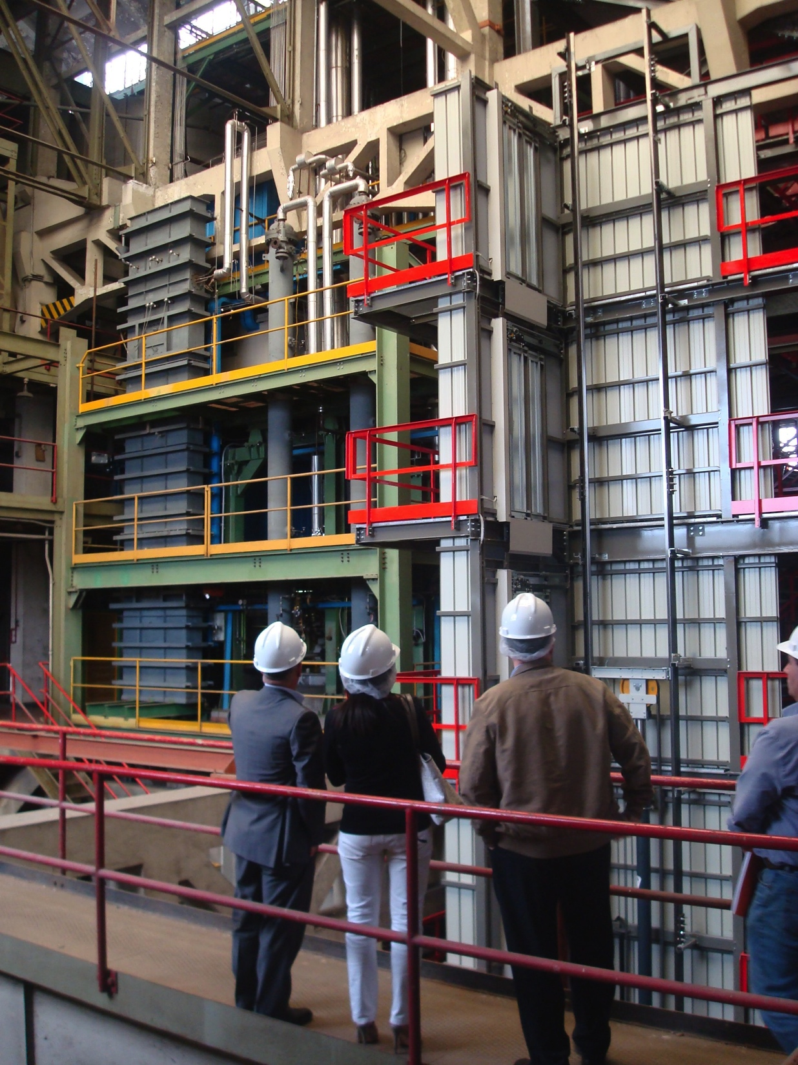
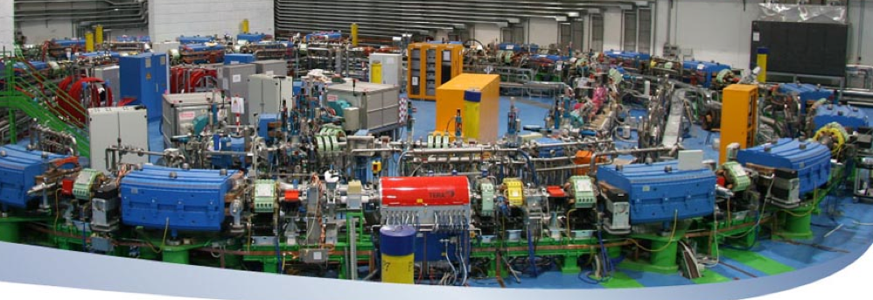
Full access to External laboratories
TRIGA research reactor (at Pavia)
for Training and R&D activities
TRIGA MarkII (250 kW)
SIET labs (at Piacenza)
Large scale exp. labs for safety systems and thermalhydraulic tests, for nuclear reactor components and systems
CNAO (at Pavia)
Sincrotron for adrontherapy, for medical applications of radiation

Slide 13
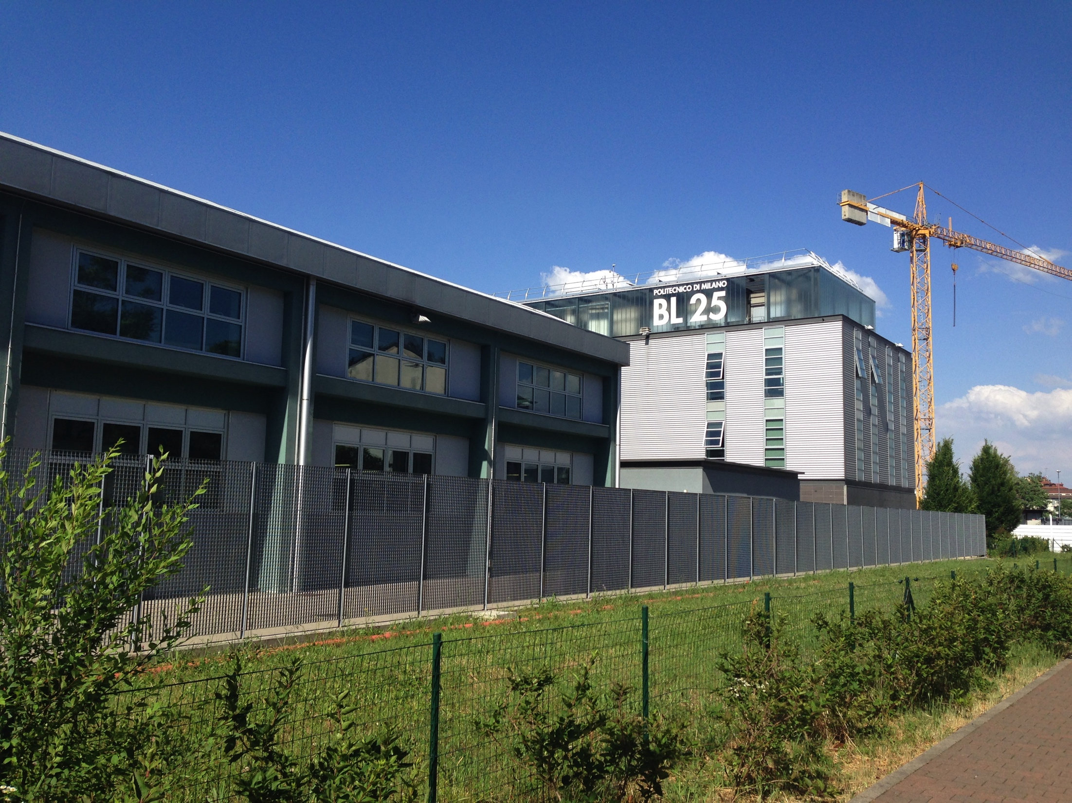
www.energia.polimi.it

