Slide 1
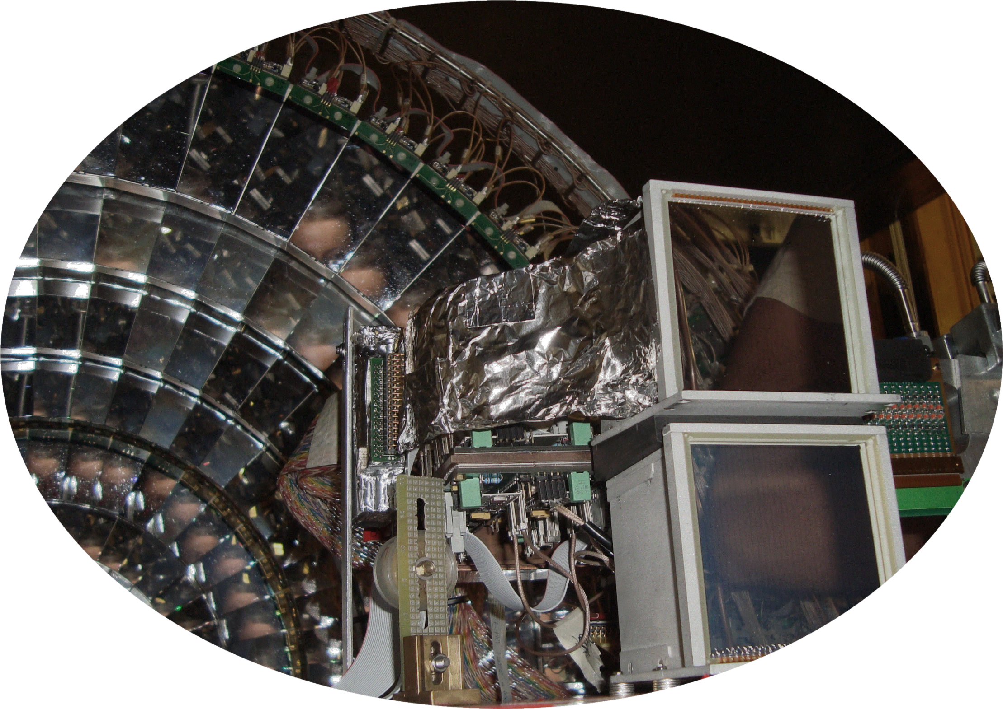
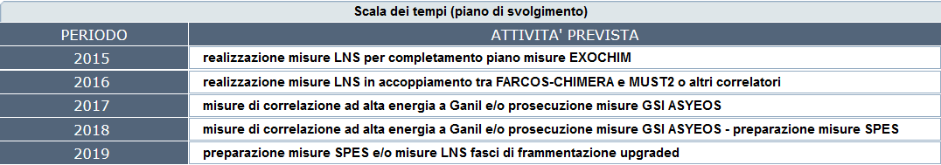
NEWCHIM (2015-2019)
Raccoglie l’esperienza fatta con EXOCHIM e la estende puntando anche a misure di seconda generazione caratterizzate da elevata precisione.
Studio della dipendenza dall’isospin dell’equazione di stato della materia nucleare sia a bassa che ad alta densità nucleare utilizzando sia fasci radioattivi che stabili.
Realizzazione di un correlatore ad elevata risoluzione angolare ed energetica (FARCOS) basato su un array di 20 telescopi per misure di correlazione tra particelle leggere e tra particelle leggere e frammenti di massa intermedia, sia a bassa che ad alta energia.

Slide 2
Outline
Participating Sections and People @ INFN-MI
Physics cases
FARCOS telescopes and the related TDR
FARCOS DSSSD VLSI Front-end Electronics
  Design specs
  Full architecture design
    Topology
    Input transistor sizing
    Layout
  Post Layout Simulation/Qualification:
    Integral-Non-Linearity
    Rise/Fall Time
    Noise Performance

Slide 3

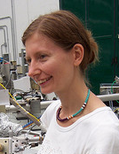
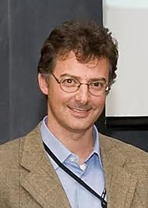

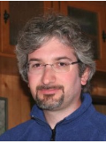

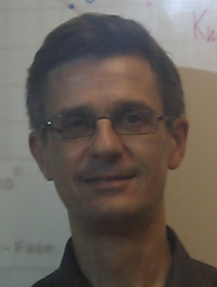
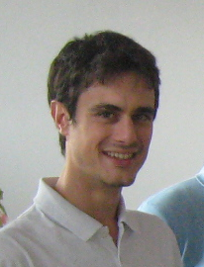
Units and INFN-MI team
Andrea Castoldi
Chiara Guazzoni
Tommaso Parsani
Filippo Riccio
Ciro Boiano
Total FTE @ MI: 3.8 FTE (5 people)
    + 3 man/month Electronic Service
    + 1 man/month Mechanical Workshop
Stefano Maffessanti
Fabio Previdi

Slide 4
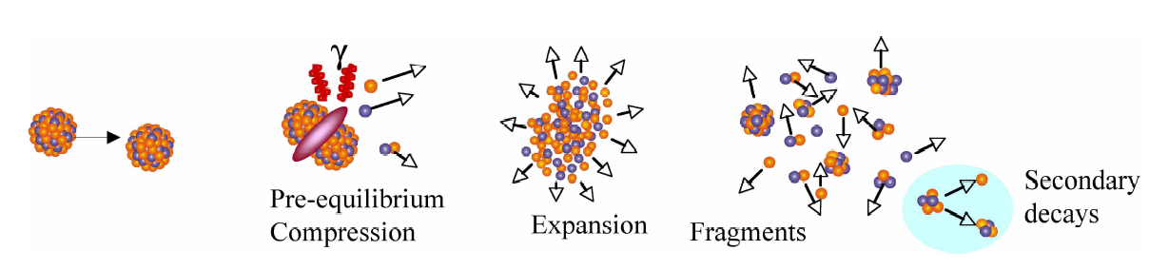
NewChim Physics Cases
Heavy ions collisions complex but rich systems to explore the properties of nuclear matter under extreme conditions.
Need for a clear understanding of the dynamics of heavy-ion collisions. Particles are emitted at different stages that are difficult to isolate.
Important to disentangle particle and fragment emitting sources. Where and when are fragments produced?
tracing-back particle and fragment emitting sources to understand dynamics in heavy-ion collisions

Slide 5
NewChim Physics Cases
Correlation Methods
Advances in dynamics and time scale of particles and cluster emission
Perspectives at GSI/SIS energies: we foresee to continue experiments similar to ASY-EOS, exploring higher densities, i.e increasing the beam energy, and/or exploring larger Isospin asymmetries by using Radioactive Ion Beams (e.g. ¹³²Sn, ¹⁰⁸Sn) expected to be delivered by the forthcoming FAIR facility. In view of that, FARCOS could be a very important instrument.
Extended “limiting” case (reactions between Calcium isotopes at 25 AMeV )
Cluster structure of light nuclei via break-up
Isospin dependence of Compound Nucleus formation and decay - Experiment @SPES: LoI (Italian-French collaboration supported by Lea-Colliga) for experiment, presented and approved in 2014 → explore heavy ion dynamics above interaction barrier, study evolution of reaction dynamics with isospin asymmetry, competition between different reaction and decay modes, relaxation time scales for various degrees of freedom, as well as interplay between nuclear structure and reaction mechanism in emission processes.
C. Guazzoni – NEWCHIM – Consiglio di Sezione INFN – 9 luglio 2015

Slide 6
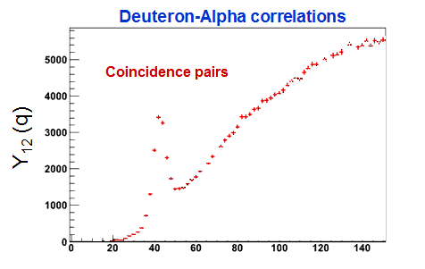
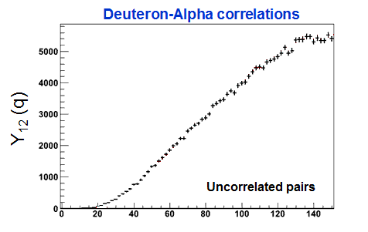
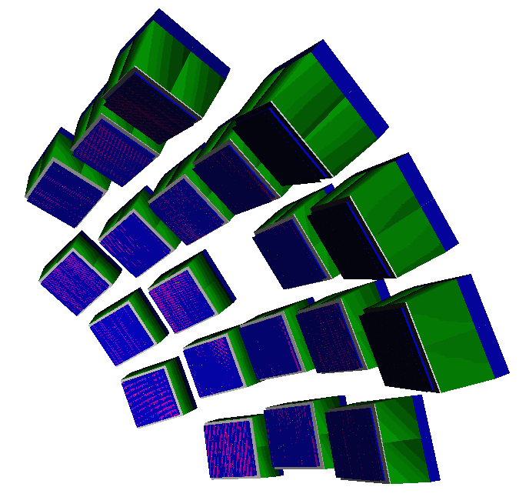
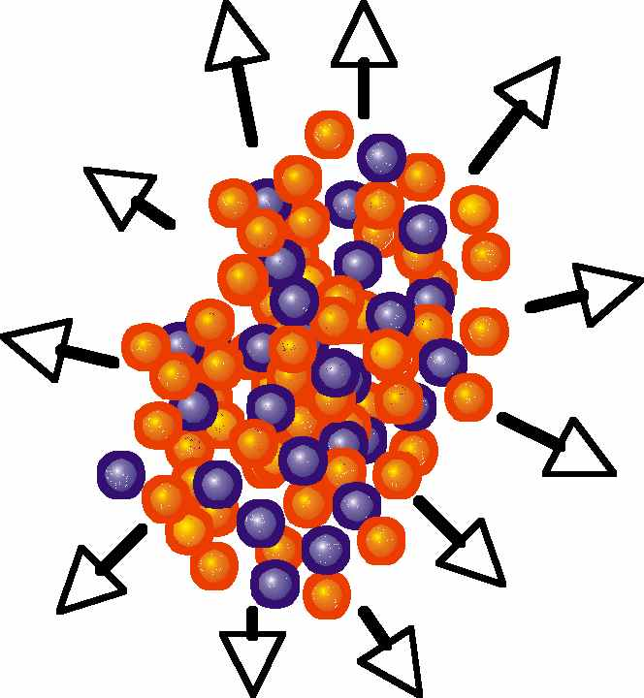
NewChim Physics Cases
Correlations methods allows probing space-time features of nuclear reaction mechanism → detection of light particles abundantly produced during overall dynamical evolution of excited and dilute nuclear systems produced in central and peripheral impacts
Final-state interactions
θ_{rel}
q (MeV/c)
Coulomb FSI
anti-correlation at small q values
Nuclear FSI
correlation at q=42 and 84 MeV/c

Slide 7
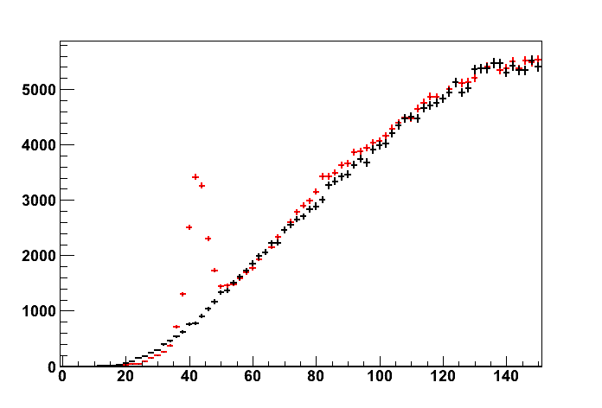
NewChim Physics Cases
Measuring particle-particle correlations to probe the space-time features of nuclear reaction mechanism (→ FEMTOSCOPY)
FSI
Deuteron-Alpha correlations
Coincidence pairs
deuteron-alpha
Y₁₂ (q)
Uncorrelated pairs
q (MeV/c)
Coulomb FSI
anti-correlation at small q values
Nuclear FSI
correlation at
42 and 84 MeV/c
1+R(q)
Correlation function
q (MeV/c)

Slide 8
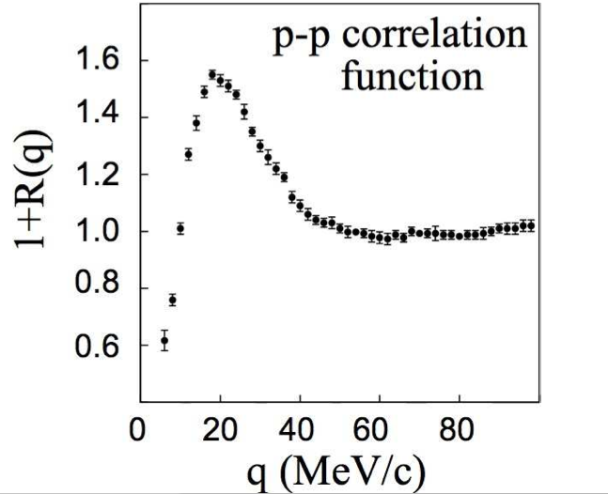
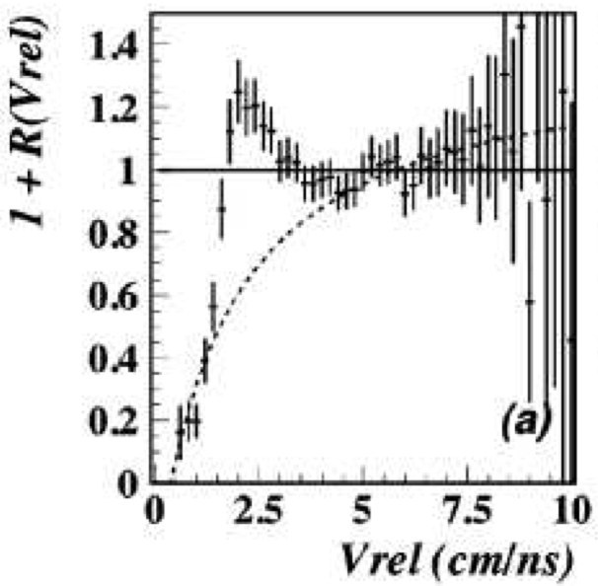
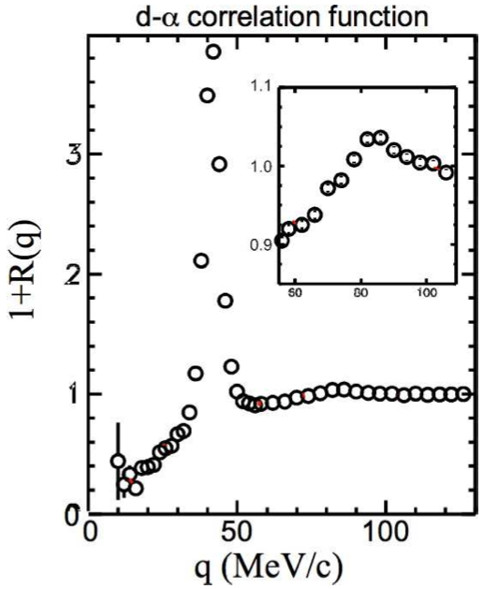
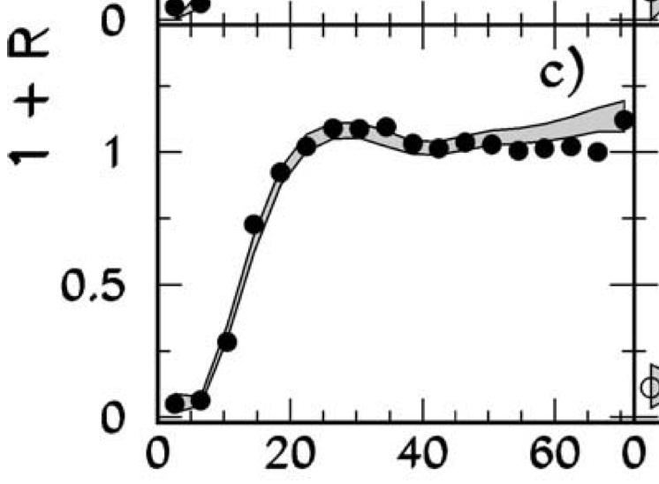
NewChim Physics Cases
Extending particle-particle correlation to a wide range of particles and unlike particle correlations: dynamics and spectroscopy
Multiple correlation analyses have provided unexpected differences in source sizes corresponding to different particle pairs. Differences attributed to possible effects induced by the existence of collective motion, that points to the possibility that different particle species may be originated by different times and from different emitting sources
The effects induced by final state correlations can indeed be used to probe which particle type is emitted first, when studying correlations between unlike particles (such as p-d, p-n, p-a, etc.). Such information and even the effective existence of a reaction chronology is of key importance to probe microscopic reaction models still lacking quantitative information about cluster formation at different stages of the reaction and with different mechanisms.
The study of IMF-IMF correlation functions in a HBT-like fashion → extracting the volume and the time-scales of multifragmenting sources at the late dilute freeze-out stage of heavy-ion collisions at intermediate energies.
p-p
LCP-IMF
IMF-IMF
d-α

Slide 9
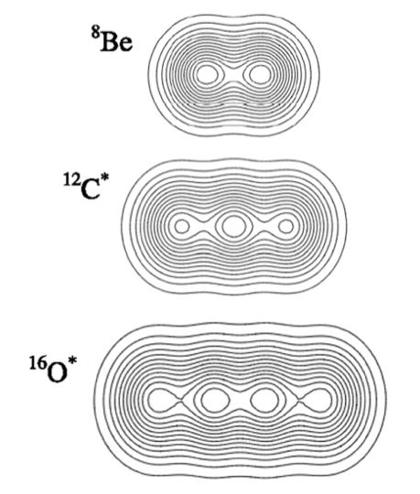
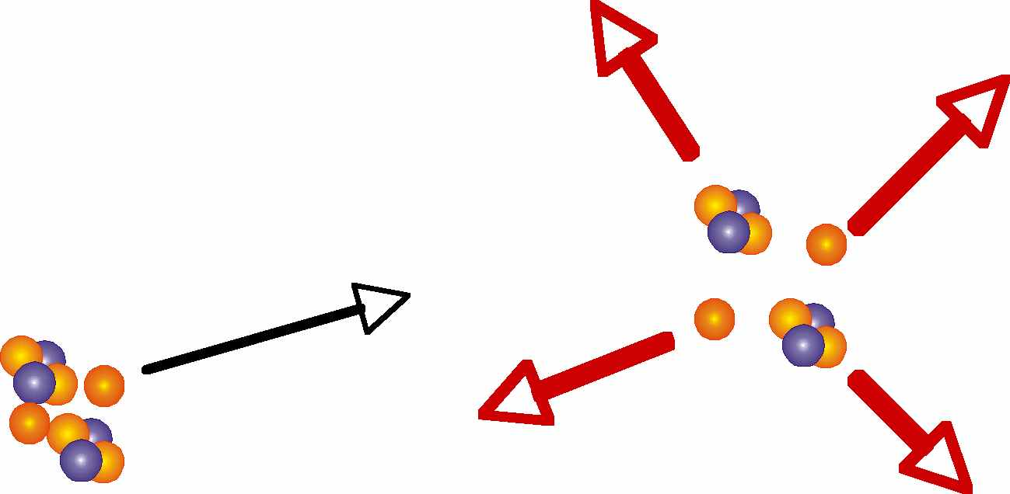
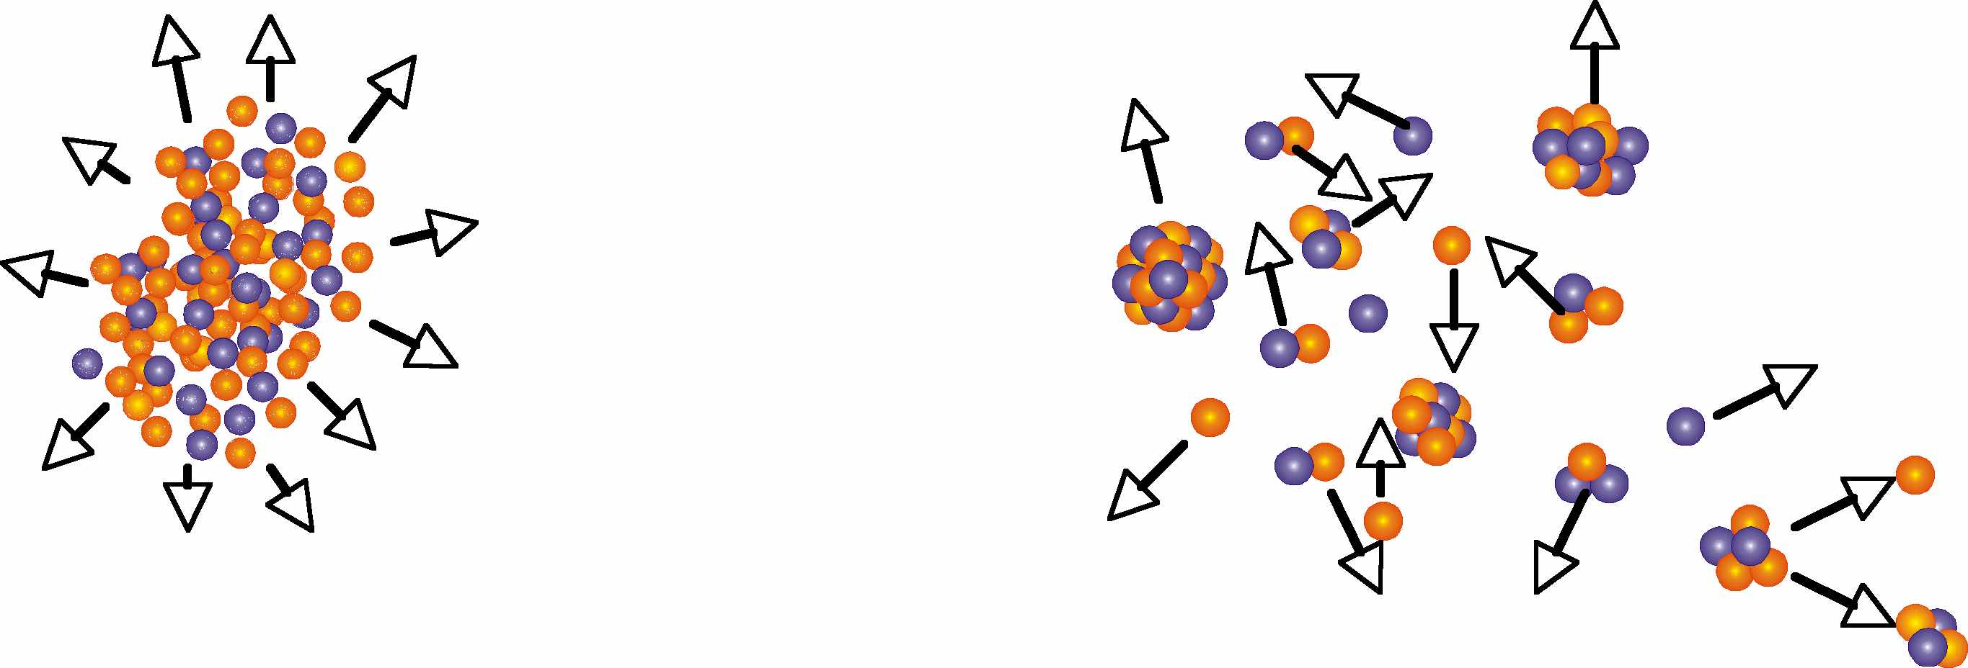
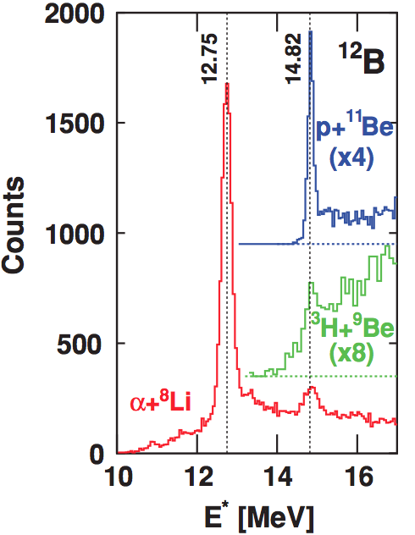
NewChim Physics Cases
Cluster structure of light nuclei via break-up
Decay spectroscopy
¹⁰C*
Hoyle states and Bose Condensation
¹²Be (neutron rich) decay: α-⁸Li
The α-cluster model of nucleus traces back to the very beginning of nuclear physics (Hafstadt and Teller, 1938), and has been subsequently the subject of many investigations during the ’50-’70. Nowadays it probably represents one of the most important aspects of modern nuclear physics, also because of its link to other fields of physics (atomic physics, astrophysics) Partial failure in the description of the structure of light nuclei with shell model (as for the case of the famous Hoyle state in ¹²C, and its rotational and vibrational excitations) triggered new experiments aimed at improving the spectroscopy of such light nuclei, in order to understand how nuclear forces act inside light nuclei, where the surface effects are dominant
¹⁰Be*: α ⁺ …

Slide 10
Instrumentation Requirements
High energy- and angular-resolution, to obtain the momentum vector and its correlation (→ correlation measurements and direct reactions in inverse kinematics with RIB)
Wide solid angular coverage, to gain large statistics in two- or more-particle correlation
Low identification thresholds both for LCPs and IMFs (→ low energy measurements with RIB at SPES and SPIRAL2)
Wide dynamic range to detect both LCPs and IMFs in the same event (→ LCP-IMF correlation functions to ascertain temperature and excitation energy of primary fragments and (p,d) and (d,p) direct reactions in inverse kinematics with RIBs)
High stopping power → high-energy LCPs correlations, ‘space-time’ snapshots of particle and complex fragments emitting sources
Simple, versatile, modular and transportable geometry → ease of coupling with other detectors (4π-arrays, spectrometers, neutron detectors) and temporary installation in different facilities.
C. Guazzoni – NEWCHIM – Consiglio di Sezione INFN – 9 luglio 2015

Slide 11
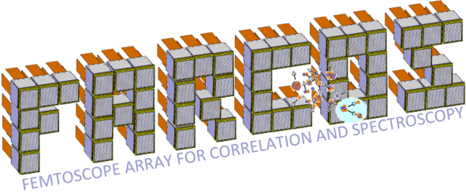
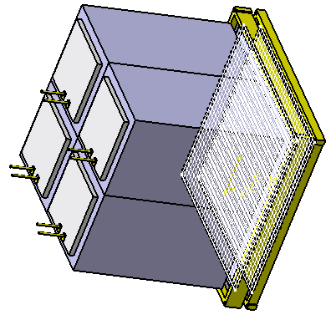

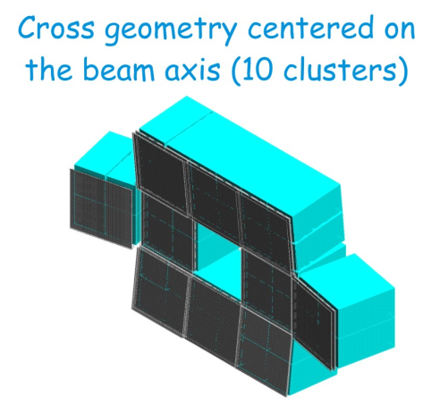
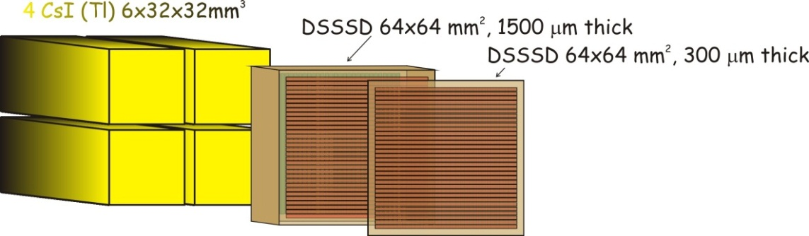
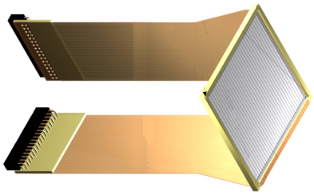
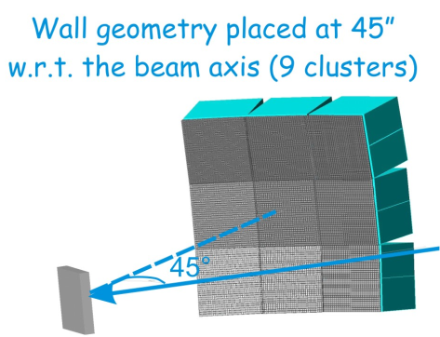
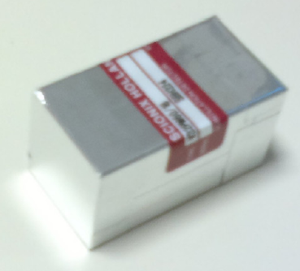
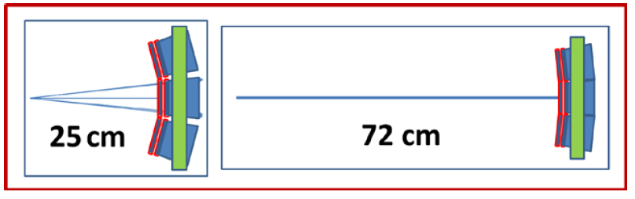
telescopes
Possible geometries
Single cluster
DSSSD, made by MICRON Semiconductor, on a standard design (BB7) with a minimum area PCB frame (4 mm wide)
Front-side gap: 25 μm, back-side gap 40 μm
Kapton cables directly bonded to each side of the welded detector
highly homogeneous CsI(Tl) crystals, made by SCIONIX, with Tl concentration of the order of 1200 to 1500 ppm
each crystal wrapped with 0.12 mm thick white reflector including 50 micron of aluminized Mylar
entrance window composed by 2 μm thick aluminized Mylar with a density of 0.29 g/cm²
output light read out by a Hamamatsu 18x18 mm PIN diode S3204-08, attached to the rear face of each crystal.
geometry of clusters follows the same radius with respect to the center of the target (i.e. each detector tangential
to the imaginary sphere generated by a distance ”target-array” previously fixed)
C. Guazzoni – NEWCHIM – Consiglio di Sezione INFN – 9 luglio 2015

Slide 12
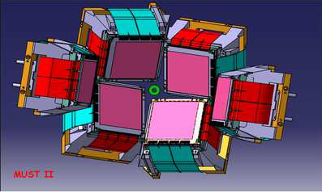
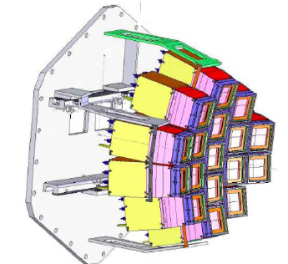
Existing correlators
MUST II - Mur à strip
(@Ganil)
HiRA - High Resolution Array
(@ Michigan State University)
mainly intended for nuclear astrophysics studies (Z=1 and Z=2)
array of 20 telescopes:
  65µm-thick Single-Side Si-strip detector
  1.5mm-thick silicon-strip detector
  four 4cm-thick CsI(Tl) crystals
angular resolution of 0.15° at the nominal distance of 35 cm from the target
70% of the solid angle between scattering angles of 5° and 30°
dedicated to the study of reactions induced by radioactive beams on light particles (up to Z=2)
telescope consists of
  300µm-thick Double-Side Si-strip detector
  two segmented 5mm-thick Si(Li) detector
  3cm-thick CsI(Tl) crystals
large angular coverage (70% up to angles of 45°).
C. Guazzoni – NEWCHIM – Consiglio di Sezione INFN – 9 luglio 2015

Slide 13
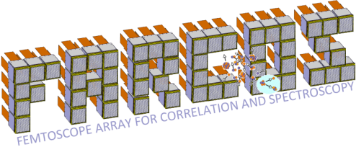
TDR
Physics Cases
  Correlation Methods
  NEWCHIM Physics Cases
FARCOS prototype
Tests of FARCOS Silicon detectors
Test of inter-strips charge sharing with alpha-source
Tests of FARCOS CsI(Tl) crystals
Test of uniformity of light response of FARCOS CsI(Tl) crystals
1st beam test at LNS
FARCOS Microstrip Detector Response Matrix
Characterization of FARCOS Prototype with beam
Detector & Mechanics
Double side silicon strip detectors (DSSSD)
CsI(Tl) stage
Mechanical support
Positioning system of FARCOS telescopes
Electronics
FARCOS Front-End electronics
Get Electronics
Dynamic range evaluation
FARCOS Dual gain module
Power Supply
Data Acquisition
New data acquisition for FARCOS and CHIMERA
FARCOS DAQ with the GET electronics (hardware architecture)
Standard CHIMERA DAQ (hardware architecture)
FARCOS and CHIMERA DAQ (software architecture design)
Data merging and storing
Cost evaluation and construction plan
Milano contribution and/or leadership
C. Guazzoni – NEWCHIM – Consiglio di Sezione INFN – 9 luglio 2015

Slide 14
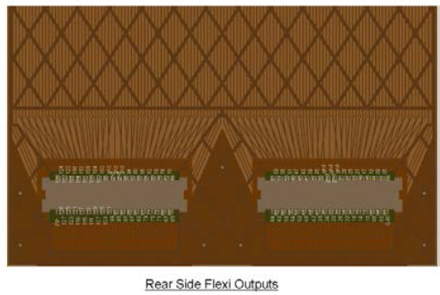
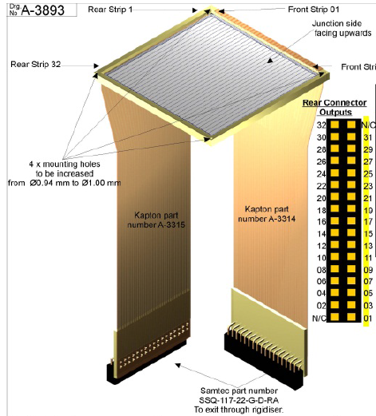
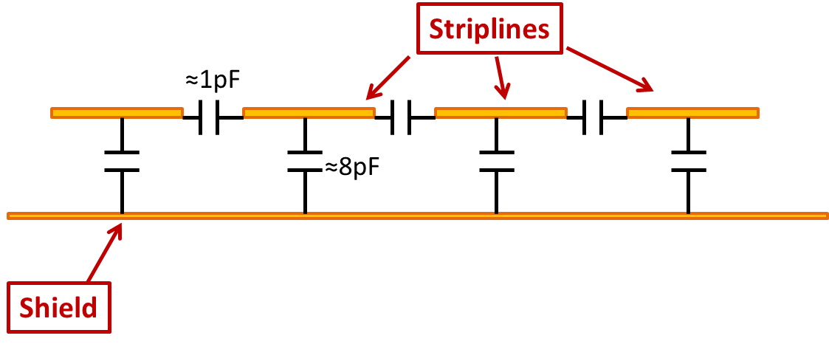
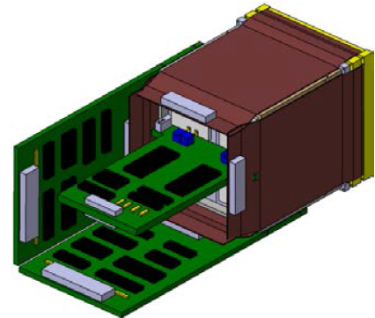

Interconnection issue
Existing Kapton cables
Proposed Kapton cable design and module assembly
C. Guazzoni – NEWCHIM – Consiglio di Sezione INFN – 9 luglio 2015

Slide 15
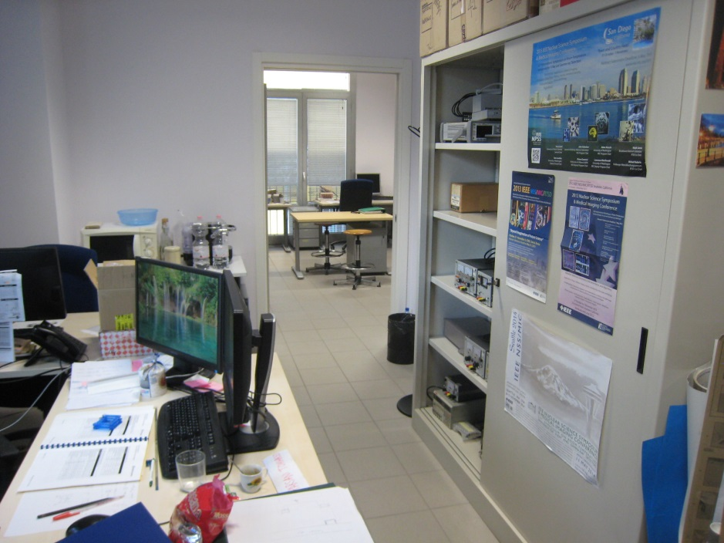
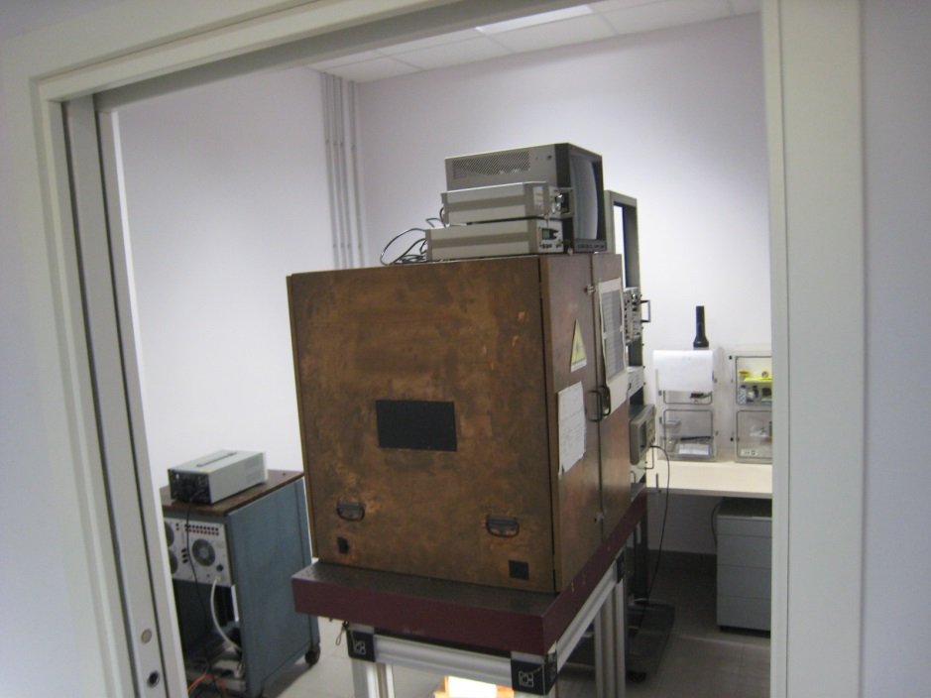
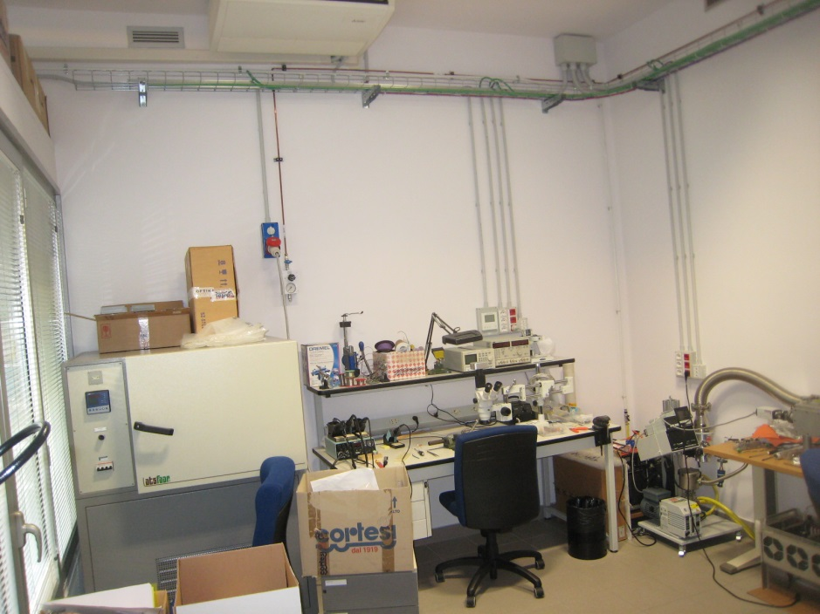
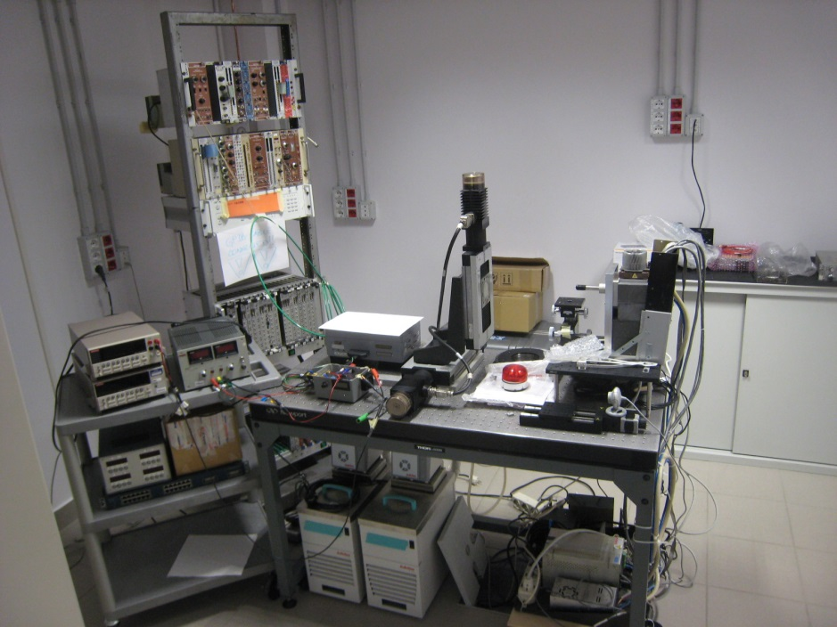
Imaging detector lab relocated
CAD / PhD students/Research Assistants & Lab
Dark room
UHV room
X room
C. Guazzoni – NEWCHIM – Consiglio di Sezione INFN – 9 luglio 2015

Slide 16
DSSSD basic param. qualification
I-V characteristics (junction side) – 300 μm
interstrip impedence (ohmic side) – 300 μm
vacuum
C-V measurement (junction side) – 300 μm
interstrip resistance (ohmic side) – 300 μm
C. Guazzoni – NEWCHIM – Consiglio di Sezione INFN – 9 luglio 2015

Slide 17
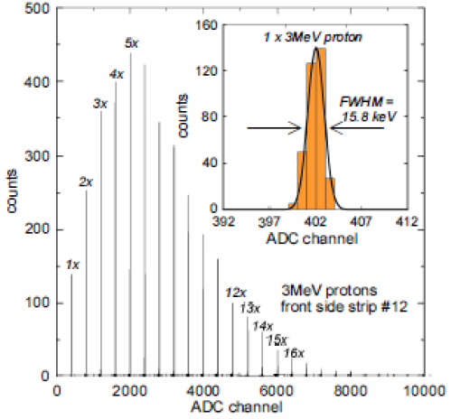
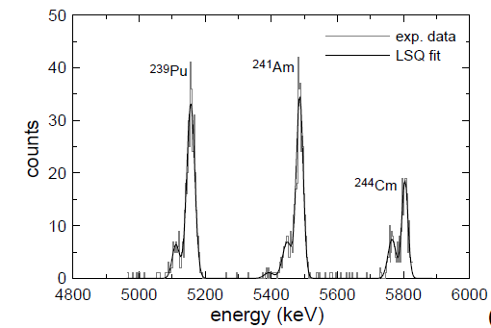
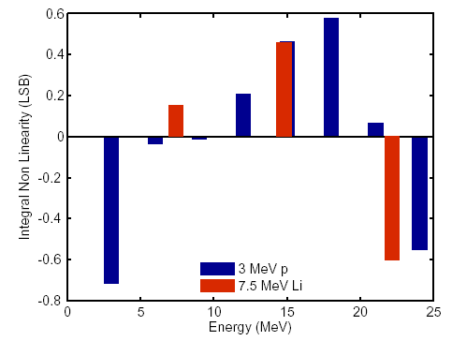
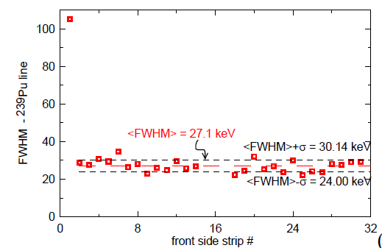
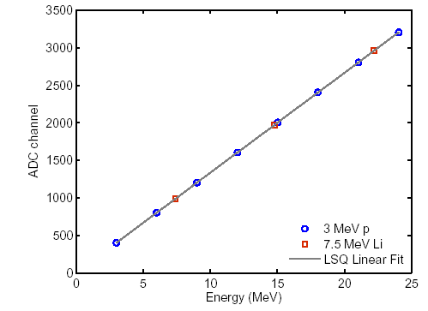
DSSSD response matrix
Integral non linearity and calibration
Energy resolution
3 MeV proton beam @LaBeC
Mixed nuclei α source
C. Guazzoni – NEWCHIM – Consiglio di Sezione INFN – 9 luglio 2015

Slide 18
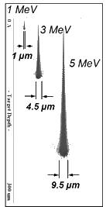
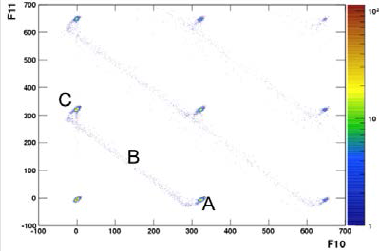
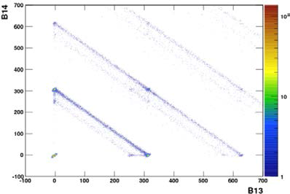

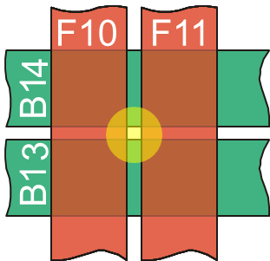
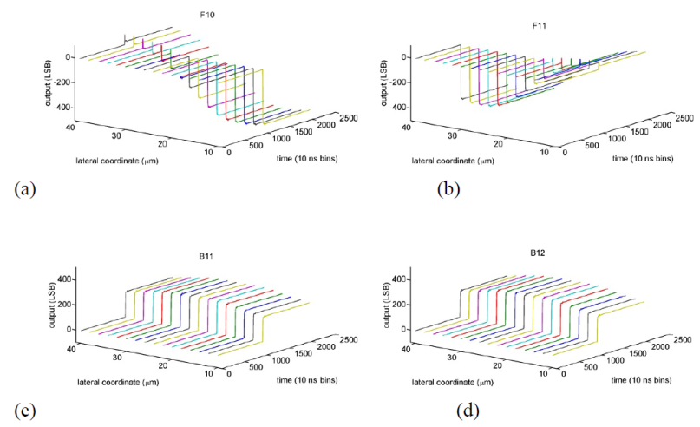
DSSSD response matrix
Position response matrix and interstrip effects
1 MeV protons (range 16.6 μm)
F10
F11
front injection
IR laser (705 nm & 904 nm)
C. Guazzoni – NEWCHIM – Consiglio di Sezione INFN – 9 luglio 2015

Slide 19
A Selectable-Gain CMOS
Charge Preamplifier
for Pulse Shape Analysis
in Double Sided Silicon Microstrip Detectors

Slide 20
DSSSD frontend design specs:
foreseen number of channels of the entire FARCOS system (20 telescopes × 2 detection layers × 32 channels per side × 2 detector sides = 2560 channels) → static power consumption of 10 mW/channel
single design to readout signals from the FARCOS DSSSDs of both thicknesses (300 µm and 1500 µm) and of both polarities.
measured strip capacitance about 65 pF (300 µm) and 35 pF (1500 µm).
strip leakage current of the order of 5 nA (300 µm) and 25 nA (1500 µm) (at RT in vacuum).
suitable for pulse shape technique → front-end amplifies the whole signal waveform without amplitude and shape distortion.
expected charge collection times of several tens of ns – dominated by plasma erosion time – and expected event rate per channel tens of Hz
expected deposited energy imposes a selectable-gain feature → target dynamic ranges: 100 MeV, 200 MeV, 350 MeV and 500 MeV.
chosen technology: 0.35 μm C35B4C3 AMS technology (high resistivity poly and 4 metal layers, 3.3 V supply voltage)
C. Guazzoni – NEWCHIM – Consiglio di Sezione INFN – 9 luglio 2015

Slide 21

Full Architecture Design
strip pitch
2 mm
AC coupled, with an external capacitor
external feedback resistor
external biasing resistor
independent biasing of the first branch
C. Guazzoni – NEWCHIM – Consiglio di Sezione INFN – 9 luglio 2015

Slide 22


Telescopic cascode topology
PMOS cascode located in the same branch of the input transistor → optimal current usage beneficial both for the transconductance of the input MOS and for the transconductance of the cascode.
PMOS source follower with the well contact shorted to the source → no body effect in a single well process.
Input Transistor Sizing
limited power budget → input transistor in moderate-weak inversion
optimization: inversion factor 3.2 and gate capacitance 7 pF.
limited sensitivity of the ENC to the bias current variation due to the large white parallel noise contribution.
C. Guazzoni – NEWCHIM – Consiglio di Sezione INFN – 9 luglio 2015

Slide 23



8-channel layout
730 µm × 4400 µm for the 8-channel
channel-to-channel pitch of 450 µm
C. Guazzoni – NEWCHIM – Consiglio di Sezione INFN – 9 luglio 2015

Slide 24

Post-layout Simulation Results
Rise/Fall Time - 300 µm DSSSD
Junction Side Strips
Ohmic Side Strips
100 MeV
200 MeV
350 MeV
500 MeV
100 MeV
200 MeV
350 MeV
500 MeV
τ = 10 ns
τ = 10 ns
τ = 1 ns
τ = 1 ns
Rise/fall time behaviour set by the signal dependence of the trasconductance of the input transistor.
C. Guazzoni – NEWCHIM – Consiglio di Sezione INFN – 9 luglio 2015

Slide 25


8-channel qualification…in progress
Output waveforms - 300 µm DSSSD – G00 (maximum gain)
Junction Side Strips
Ohmic Side Strips
C. Guazzoni – NEWCHIM – Consiglio di Sezione INFN – 9 luglio 2015

Slide 26


8-channel qualification…in progress
Integral-Non-Linearity - 300 µm DSSSD
Junction Side Strips
Ohmic Side Strips
90 MeV
200 MeV
350 MeV
500 MeV
90 MeV
200 MeV
350 MeV
90 MeV
200 MeV
350 MeV
500 MeV
500 MeV
0.5%
0.5%
0.5%
for every input signal amplitude, the INL is computed as the maximum deviation from the linear LSQ fit up to the considered amplitude.
C. Guazzoni – NEWCHIM – Consiglio di Sezione INFN – 9 luglio 2015

Slide 27


8-channel qualification…in progress
Output pulse rise time (20% - 80%) - 300 µm DSSSD - G00 (maximum gain)
Junction Side Strips
Ohmic Side Strips
C. Guazzoni – NEWCHIM – Consiglio di Sezione INFN – 9 luglio 2015

Slide 28

Post-layout Simulation Results
Noise performance
300 µm DSSSD
white series noise: 1.8 nV/√Hz
white parallel noise: 12.9 fA/√Hz → total parallel noise dominated by leakage current.
no evidence of significant flicker noise contribution.
triangular filter with optimum shaping time
C. Guazzoni – NEWCHIM – Consiglio di Sezione INFN – 9 luglio 2015

Slide 29


Piano delle attivita’ @ INFN-MI
Attivita’ legata allo sviluppo strumentale del correlatore FARCOS (20 telescopi)
Completo sviluppo e qualificazione dell’elettronica di front-end VLSI ad elevata dinamica per riconoscimento in forma anche dei frammenti che si fermano in Silicio. (→ responsabilita’ stesura della sezione dedicata del TDR)
Progetto e realizzazione delle interconnessioni tra rivelatori e front-end per minimizzare parassitismi ed area morta e preservare l’integrita’ del segnale e carrier preamplificatori.
Qualificazione dei rivelatori in Silicio da impiegare prima dei test su fascio
Consulenza e supporto alla sez. di Catania per lo sviluppo degli algoritmi di filtraggio digitale da implementare nella nuova elettronica di back-end GET sia per FARCOS che per l’up-grade dei CsI(Tl) di CHIMERA.
Collaborazione ai beam-time nei diversi lab (GANIL, GSI, LNS, SPES,…) e alla analisi dati

Slide 30
Richieste finanziarie
 | NEWCHIM |  | NEWCHIM
 | Assegnazioni |  | Preventivi
 | 2015 |  | 2016
Missioni (keuro) | 8.5 |  | 9(*)
Apparati (keuro) | 11 |  | 22(*)
Consumo (keuro) | 19 |  | 16(*)
 |  |  | (*) le cifre sono in fase di assestamento finale
Officina (Mesi Uomo) | 1 |  | 1
Elettronica (Mesi Uomo) | 3 |  | 3 (nella persona di Ciro Boiano (che e' disponibile), per la precedente conoscenza dell'intero sistema)
Servizio Elettronica
caratterizzazione preamplificatori VLSI, progetto e realizzazione carrier per PA, schede di alimentazione PA, etc,
Servizio Officina
lavorazioni meccaniche per supporti rivelatori, elettronica di front-end sia per caratterizzazioni in laboratorio che su fascio, supporti meccanici funzionali al montaggio dei telescopi. Non previste richieste per servizio progettazione. Uso saltuario stampante 3D.
C. Guazzoni – NEWCHIM – Consiglio di Sezione INFN – 9 luglio 2015

Slide 31
Pubblicazioni recenti
A. Castoldi, C. Guazzoni, T. Parsani, F. Riccio and P. Zambon, “Detailed mapping of the interstrip response in Double Sided Silicon Strip Detectors in front and back injection by means of IR laser irradiation”, 2014 IEEE Nuclear Science Symposium and Medical Imaging Conference Records
A. Castoldi, C. Guazzoni, T. Parsani, “A Selectable-Gain CMOS Frontend for Pulse Shape Analysis in Double Sided Silicon Microstrip Detectors”, 2014 IEEE Nuclear Science Symposium and Medical Imaging Conference Records
A. Castoldi, C. Guazzoni, T. Parsani, F. Riccio, L. Carraresi, F. Taccetti, L. Acosta, I. Martel, J. A. Dueñas, “Characterization of a NTD Double-Sided Silicon Strip Detector using a Pulsed Ion Beam”, 2014 IEEE Nuclear Science Symposium and Medical Imaging Conference Records
P Russotto, E De Filippo, A Pagano, E Piasecki, L Acosta, F Amorini, A Anzalone, L Auditore, V Baran, I Berceanu, C Boiano, B Borderie, M Bruno, T Cap, G Cardella, A Castoldi, S Cavallaro, M B Chatterjee, A Chbihi, M Colonna, M D'Agostino, M D'Andrea, M Di Toro, F Fichera, L Francalanza, E Geraci, R Gianì, B Gnoffo, A Grimaldi, A Grzeszczuk, C Guazzoni, P Guazzoni, N Giudice, S Kowalski, E La Guidara, G Lanzalone, G Lanzanò, I Lombardo, C Maiolino, G Marquínez-Durán, T Minniti, M Papa, E V Pagano, G Passaro, S Pirrone, R Płaneta, G Politi, F Porto, L Quattrocchi, M F Rivet, E Rosato, F Riccio, F Rizzo, G Saccà, K Schmidt, K Siwek-Wilczyńska, I Skwira-Chalot, A Trifirò, M Trimarchi, G Verde, M Vigilante, J P Wieleczko, J Wilczyński, P Zambon, L Zetta and W Zipper, “Isospin Against Size Effects In Projectile Dynamical Fission For 112,124Sn+58,64Ni and 124Xe+64Zn Reactions At 35 A.MeV”, 2014 J. Phys.: Conf. Ser. 515 012020
A. Castoldi, C. Guazzoni, S. Maffessanti, G. V. Montemurro, L. Carraresi, “High-resolution Commercial CMOS Image Sensors as X-ray Imagers and Low-Intensity Particle Beam Monitors”, 2014 IEEE Nuclear Science Symposium and Medical Imaging Conference Records
L. Quattrocchi, L. Acosta, E. De Filippo, T. Minniti, E. V. Pagano, P. Russotto, A. Trifirò, G. Verde, F. Amorini, A. Anzalone, L. Auditore, C. Boiano, G. Cardella, A. Castoldi, L. Francalanza, R. Gianì, C. Guazzoni, G. Lanzalone, I. Lombardo, E. Morgana, S. Norella, A. Pagano, M. Papa, S. Pirrone, G. Politi, F. Riccio, F. Rizzo, M. Trimarchi, P. Zambon, “The FARCOS project. First characterization of CsI(Tl) crystals of the FARCOS array using charged particle beams at LNS”, EPJ Web of Conferences 66 11001 (2014)
P. Russotto, M. Chartier, M.D. Cozma, E. De Filippo, A. Le Fèvre, S. Gannon, I. Gašparić, M. Kiš, S. Kupny, Y. Leifels, R.C. Lemmon, Q. Li, J. Łukasik, P. Marini, P. Pawłowski, S. Santoro, W. Trautmann, M. Veselsky, L. Acosta, M. Adamczyk, A. Al-Ajlan, M. Al-Garawi, S. Al-Homaidhi, F. Amorini, L. Auditore, T. Aumann, Y. Ayyad, V. Baran, Z. Basrak, R. Bassini, J. Benlliure, C. Boiano, M. Boisjoli, K. Boretzky, J. Brzychczyk, A. Budzanowski, G. Cardella, P. Cammarata, Z. Chajecki, A. Chbihi, M. Colonna, B. Czech, M. Di Toro, M. Famiano, V. Greco, L. Grassi, C. Guazzoni, P. Guazzoni, M. Heil, L. Heilborn, R. Introzzi, T. Isobe, K. Kezzar, A. Krasznahorkay, N. Kurz, E. La Guidara, G. Lanzalone, P. Lasko, I. Lombardo, W.G. Lynch, Z. Matthews, L. May, T. Minniti, M. Mostazo, A. Pagano, M. Papa, S. Pirrone, R. Pleskac, G. Politi, F. Porto, R. Reifarth, W. Reisdorf, F. Riccio, F. Rizzo, E. Rosato, D. Rossi, H. Simon, I. Skwirczynska, Z. Sosin, L. Stuhl, A. Trifirò, M. Trimarchi, M.B. Tsang, G. Verde, M. Vigilante, A. Wieloch, P. Wigg, H.H. Wolter, P. Wu, S. Yennello, P. Zambon, L. Zetta, M. Zoric, “The ASY-EOS experiment at GSI: investigating symmetry energy at supra-saturation densities”, EPJ Web of Conferences 66 03074 (2014),
A. Castoldi, C. Guazzoni, T. Parsani, F. Riccio and P. Zambon, “Laser mapping of the inter-strip response in double sided silicon strip detectors for particle identification”, JINST, Vol. 10, C01017, 2015, doi:10.1088/1748-0221/10/01/C01017
A. Castoldi, C. Guazzoni, S. Maffessanti, G.V. Montemurro and L. Carraresi, “Commercial CMOS image sensors as X-ray imagers and particle beam monitors”, JINST, Vol. 10, C01002, 2015, doi:10.1088/1748-0221/10/01/C01002
C. Guazzoni – NEWCHIM – Consiglio di Sezione INFN – 9 luglio 2015

Slide 32

Thank you for your attention !

Slide 33
Backup slides

Slide 34

Post-layout Simulation Results
Output waveforms - 300 µm DSSSD
dashed lines for fast input signal (τ=1 ns)
solid lines for a slower input signal (τ=10 ns)
choice of the compensation capacitance for phase margin greater than 60°.
positive polarity requires a higher compensation capacitance owing to the higher loop gain caused by the large signal response of the input transistor

Slide 35

Timing Plan
C. Guazzoni – NEWCHIM – Consiglio di Sezione INFN – 9 luglio 2015

Slide 36

Cost Estimation
C. Guazzoni – NEWCHIM – Consiglio di Sezione INFN – 9 luglio 2015

