Slide 1
ATLAS
F. Tartarelli
CdS, 9 Luglio 2015

Slide 2
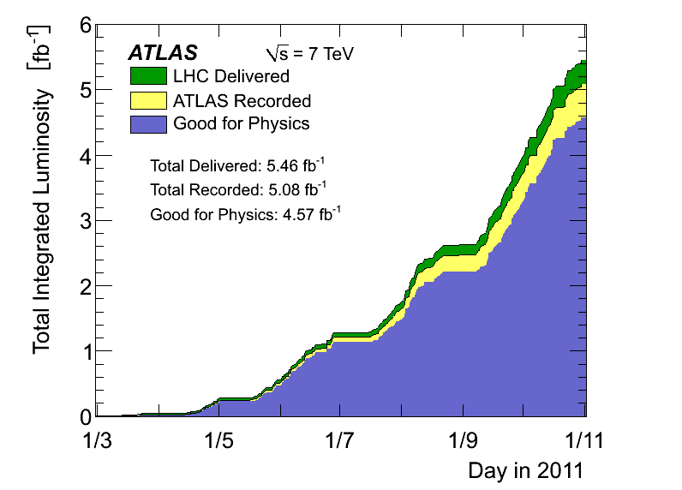
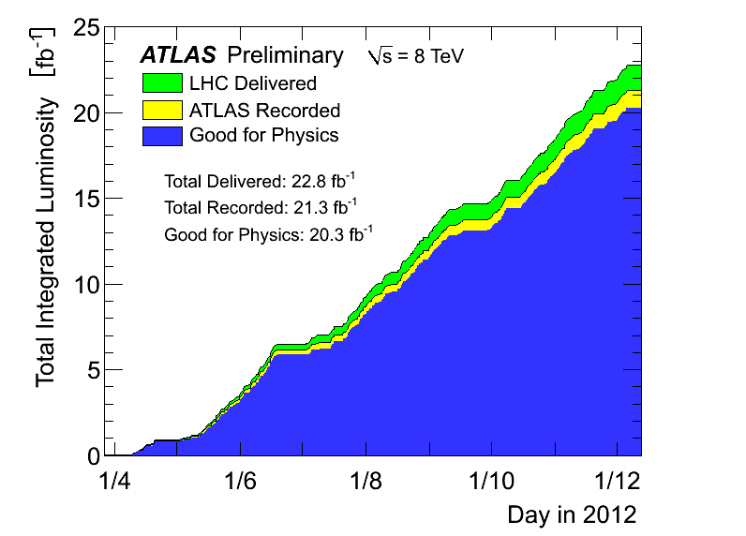
RUN 1
RUN 1 (2010-2012), main pp data samples used for analysis in ATLAS:
  4.57 fb⁻¹ pp collisions at √s = 7 TeV recorded in 2011
  20.3 fb⁻¹ pp collisions at √s = 8 TeV recorded in 2012
424 articoli e 625 “ConfNote” pubblicate a Giugno 2015

Slide 3
Articolo recenti con nostro coinvolgimento
Coinvolgimento da tanti anni nelle ricerche di SUSY e in particolare di stop
Lunga esperienza in misure con fotoni e importante coinvolgimento in misure di precisione dell’Higgs
“ATLAS Run 1 searches for direct pair production of third-generation squarks at the Large Hadron Collider”
  Sottomesso a EPJC il 29/06/2015
  Editor: T. Lari, C. Troncon,…
  L. Mandelli, chair dell’Editorial Board
“Study of the spin and parity of the Higgs boson in diboson decays with the ATLAS detector”
  Sottomesso a EPJC il 18/06/2015
  Contact editor: M. Fanti,…

Slide 4
“Measurement of Higgs boson production in the diphoton decay channel in pp collisions at center-of-mass energies of 7 and 8 TeV with the ATLAS detector”
  Contact editor: Leonardo Carminati,…
  Phys. Rev. D 90, 112015 (2014)
“Electron and photon energy calibration with the ATLAS detector using LHC Run 1 data”
  Contact editor: L. Carminati,…
  Eur. Phys. J. C (2014) 74:3071
“Search for new phenomena in events with a photon and missing transverse momentum in pp collisions at sqrt{s}=8 TeV with the ATLAS detector”
  Contact editor: D. Cavalli,…
  Phys. Rev. D 91, 012008 (2015)

Slide 5
Analisi run I ancora in corso
“Search for a high-mass Higgs boson decaying to W boson pairs in pp collisions at √s=8 TeV with the ATLAS detector”
  L. Mandelli, chair dell’Editorial Board
Standard Model 2γ+jets
  M. Fanti
“Search for a pair produced scalar top decaying in final states with two tau leptons and missing transverse momentum”
  Contact editor: T. Lari

Slide 6
RUN 2
RUN 2 e’ appena iniziato con collisioni pp a √s=13 TeV (Giugno 2015)

Slide 7
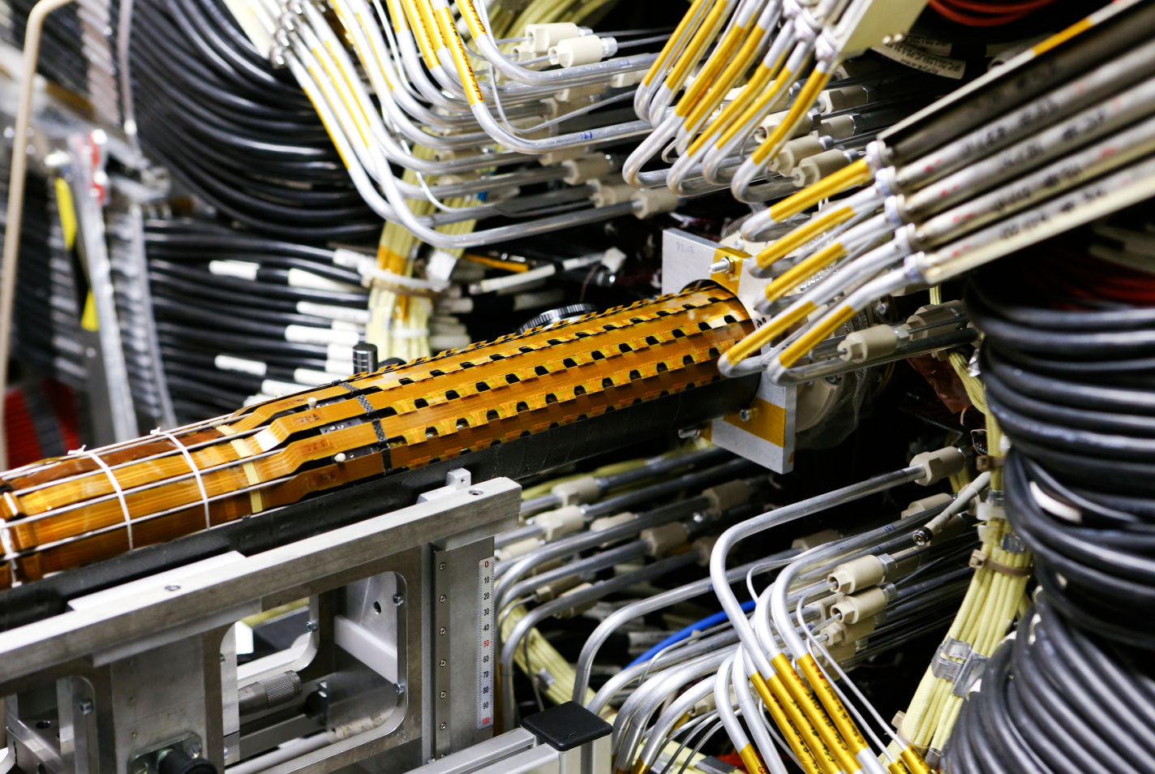
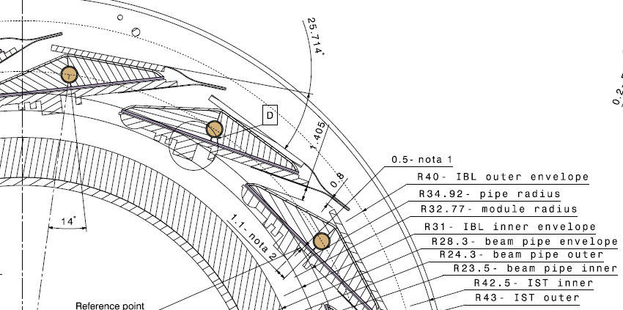
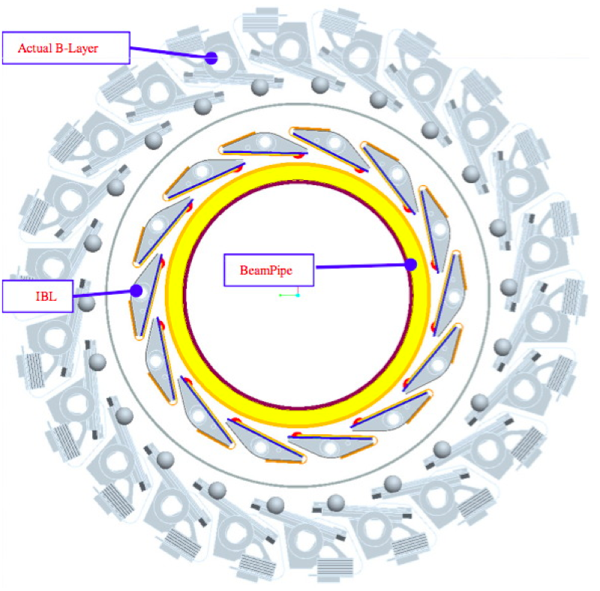
The ATLAS IBL
The ATLAS Insertable B-Layer:
4th Pix. layer (instead of b-layer repl.)
Closer interaction point (5.05 → 3.27cm)
Smaller pixels (50 x 250 μm2)
Better sensors, better R/O chip
Significantly reduced X0/Layer

Slide 8
IBL new technologies
For the IBL we have developed several new technologies to match the requirements for the IBL:
New Sensors at smaller radius:
  Radiation hard 5x10¹⁵ n_{eq}/cm²
  Geometrical acceptance >97%, Efficiency after irradiation >97%
  Developed slim-edge planar and 3D silicon sensors
New Front-end readout ASIC: FEI4 in IBM 130nm process
  Improved data buffering/transfer architecture for higher hit-rate capability and eliminate readout inefficiency at higher luminosity and reduced radius.
  Larger size (~4cm²) for cost reduction and larger active area/physical size (FEI3:74% to FEI4:90%).
  Thinned to 150 μm and solder bump-bonded to sensor
New support structures and cooling
  Reduce X0/Layer from ~3% to 1.9% including all supports
  Cooled with CO₂ at Tcoolant = - 40C
New readout system with higher bandwidth and processing power

Slide 9
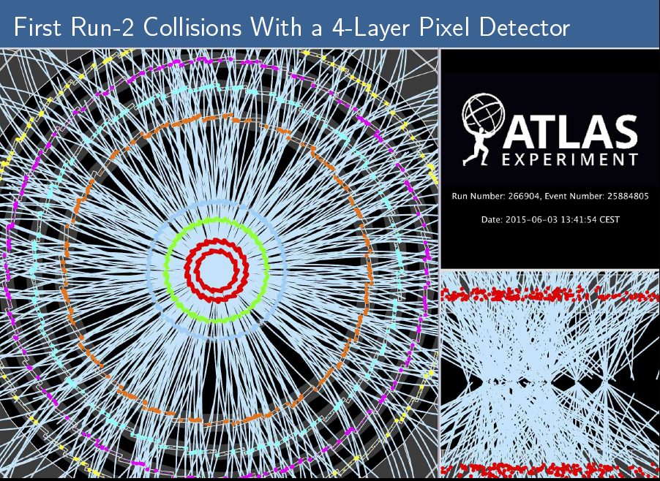

Slide 10
Liquid Argon calorimeter
Gestione sistema DCS HV
Durante lo shutdown:
  Sostituzione PC, passaggio a Linux
  Moduli HV di nuova generazione, meno sensibili ai trip durante la presa dati
  F. Tartarelli, R. Turra
Calibrazione di elettroni e fotoni:
  prerecommendation released in June, based on 2012 reprocessed data and 2012 MC and 2015 MC.
Now focusing on data driven recommendation with Z -> ee
MVA MC calibration, diagonalization of the systematics
implementation and tool maintainance
R. Turra, S. Manzoni

Slide 11
RUN 2 analysis

Slide 12
Scalar top search
Our analysis targets the decay to bWχ⁰₁ via chargino.
In supersymmetry, the scalar top is key to the naturalness of the Higgs mass, and expected to have a mass below the TeV.
run2
Run1 limits. We expect to need a few fb-1 to exceed
the run1 sensitivity at high mass.

Slide 13
Scalar top search
Analysis strategy similar to that of run1
Aiming for a result for winter conferences
Tommaso Lari (supervisor) and Claudia Merlassino (diploma student) working on the estimation of the QCD (multijet) background.
Bern, Lecce, Pavia, Texas and Irvine also involved in the analysis
Electron efficiency as a function of transverse momentum for a sample with fake electrons (QCD sample, left) and good electrons (Z sample, right).
ATLAS work in progress
√s = 13 TeV, 7 pb⁻¹
ATLAS work in progress
√s = 13 TeV, 7 pb⁻¹
+ Luciano Mandelli, EB chair dell’analisi «one lepton» con i primi dati del RUN 2:
Search for top squark pair production in final states with one isolated lepton, jets, and
missing transverse momentum in sqrt(s)=13 TeV pp collisions with the ATLAS detector

Slide 14
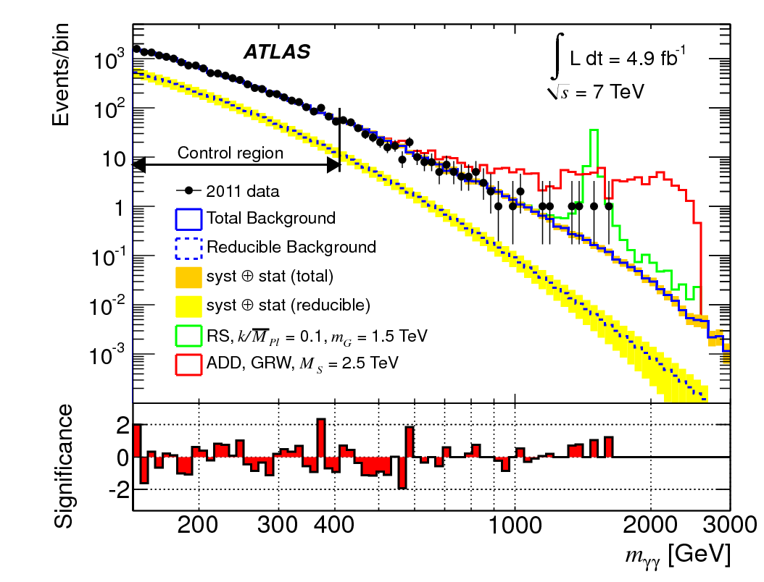
Searches in the di-photon channel
2 photons with P_{T} > 50 GeV and 0<|η|<2.37 (crack 1.37 1.52 excluded)
Tight selection ( quality cuts and cleaning )
Isolation
Dominated by irreducible QCD di-photon background ( known at NNLO )
Reducible background (γ+jet) shape determined from data
Search for extra dimensions
Might want to look at both (broad) resonances (RS) or quasi-continuous excess (ADD)
Nima Arkani-Hamed, Savas Dimopoulos, and Gia Dvali

Slide 15
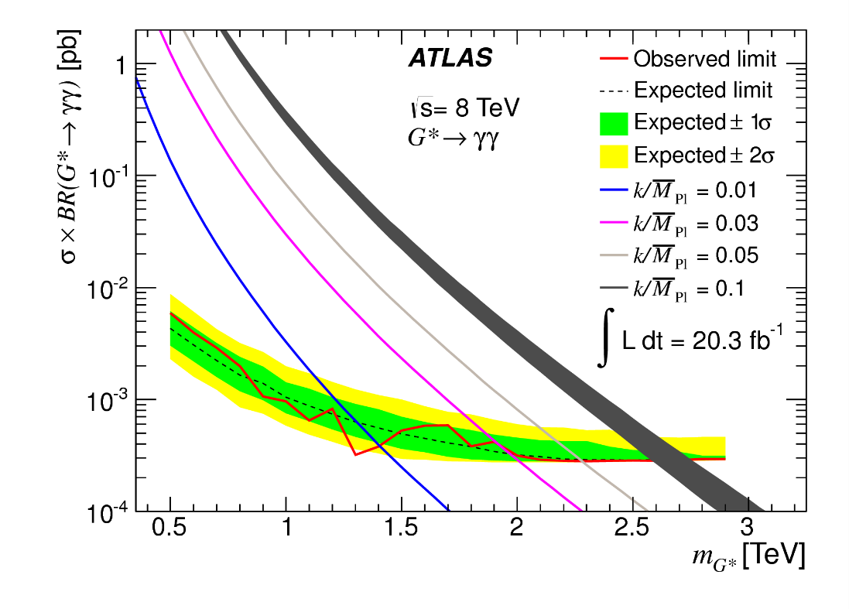
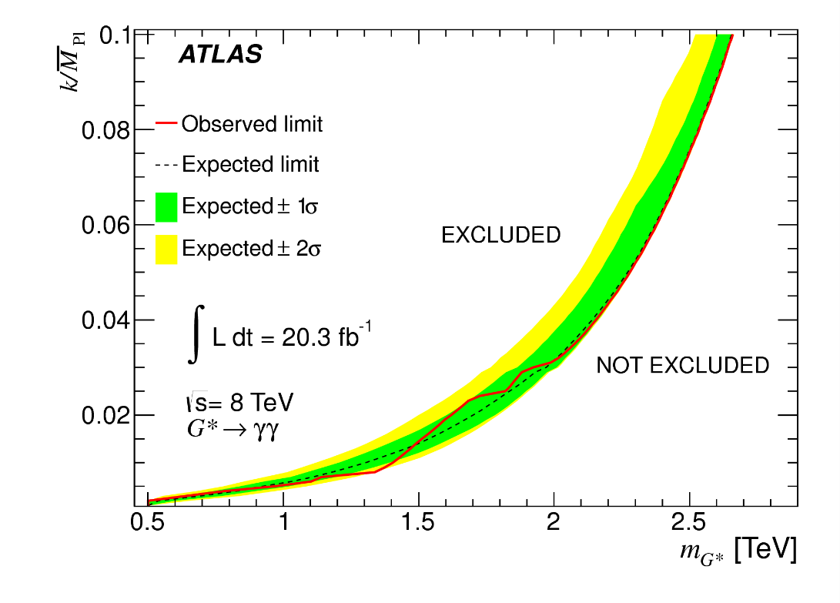
Perspectives in graviton to diphoton
Expected to extend RUN1 limits with > 5 fb⁻¹ of integrated luminosity at 13 TeV (approximately fall 2015). Working in close collaboration with high-low mass Higgs to diphoton searches.
Milano group involved with S. Mazza (analysis contact, PhD student) and L. Carminati

Slide 16
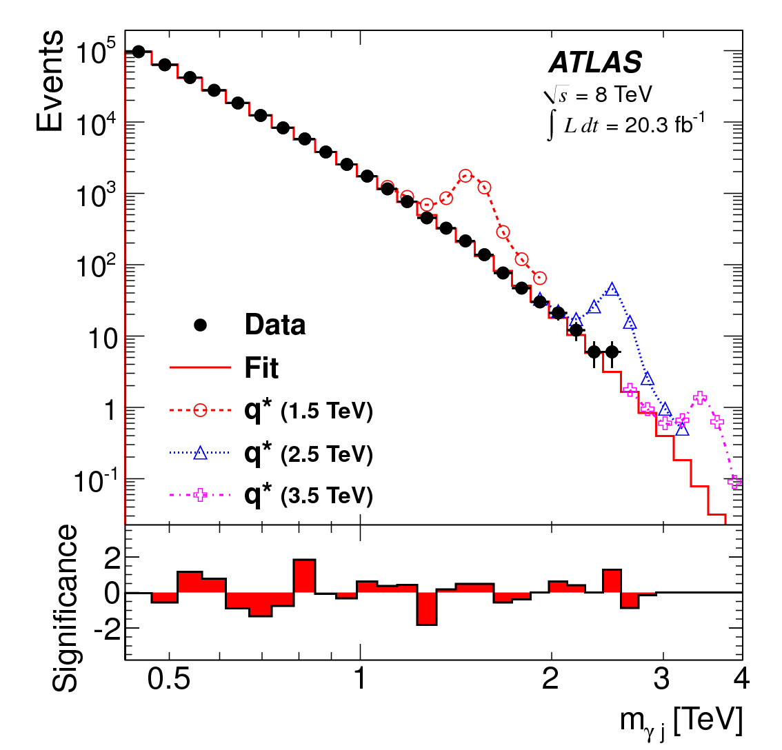
Exotics photon+jets resonances
Exotics (BSM) models predict decays into a photon and a jet ( typically resonant ): excited quarks and quantum black holes.
Select an high E_{T} photon with an energetic jet
Look for (broad) resonances over a continuous falling background
Non-thermal quantum black holes are excluded below masses of 4.6 TeV and excited quarks are excluded below masses of 3.5 TeV from RUN I analysis

Slide 17
Exotics photon+jets resonances
Large increase of the cross sections when moving to 13 TeV : very early analysis, could improve the limits already with 1 fb⁻¹ of integrated luminosity at 13 TeV
Milano group involved with M. Villaplana ( analysis contact, PRIN-STOA post-doc ), R. Turra and L. Carminati
Presently under strong pressure to have a public document already by the end of July (!)

Slide 18
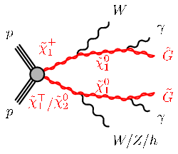
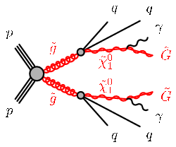
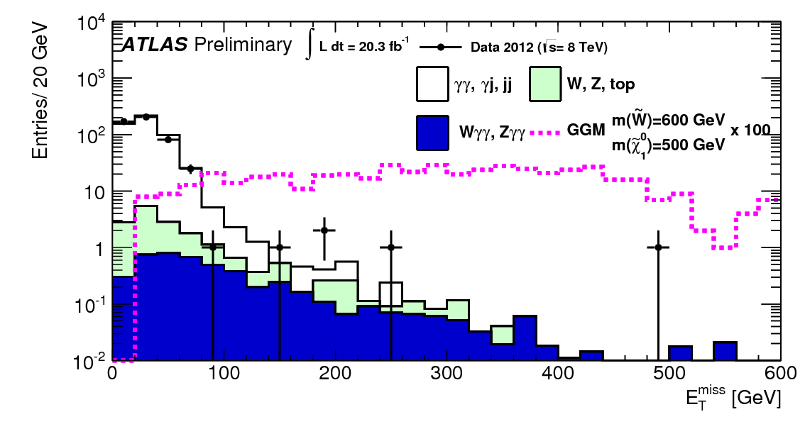
Diphoton + MET
In Gauge Mediated SUSY Breaking the LSP is the Gravitino. In this model the NLSP is a bino-like lightest neutralino : assuming R-parity conservation 2 photons and 2 gravitinos ( MET ) are observed
Look for 2 high E_{T} photons ( > 50 GeV) and typically large MET ( ~ 150 )

Slide 19
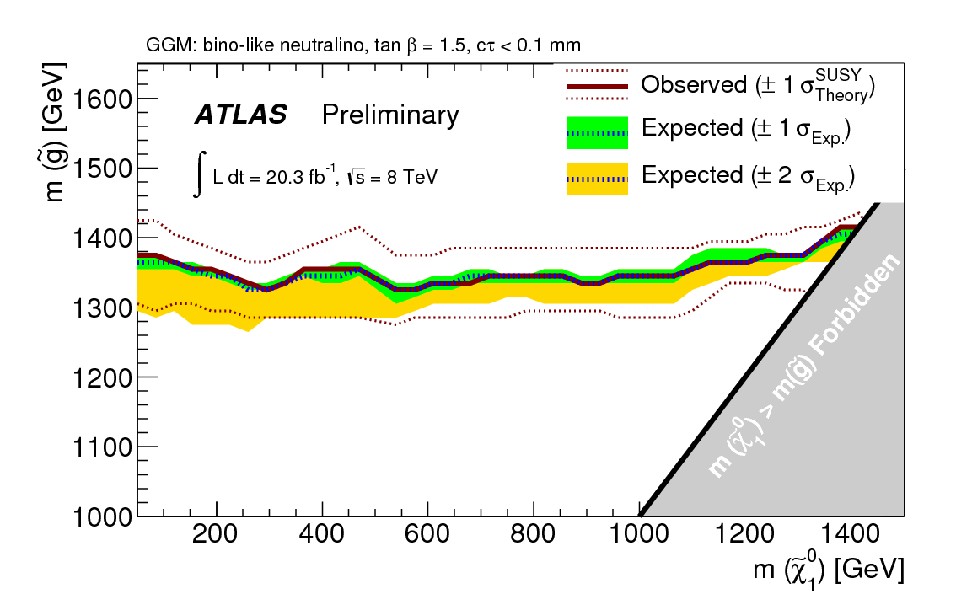
Diphoton + MET
NLSP and NNLSP masses are free parameters in the model. Expect to extend RUN1 sensitivity already with 2 fb⁻¹ of integrated luminosity at 13 TeV.
Milano group involved with L. Carminati, T. Lari, S. Manzoni ( PhD student) and S. Zecchinelli (master student)
Expect public document available in the fall

Slide 22
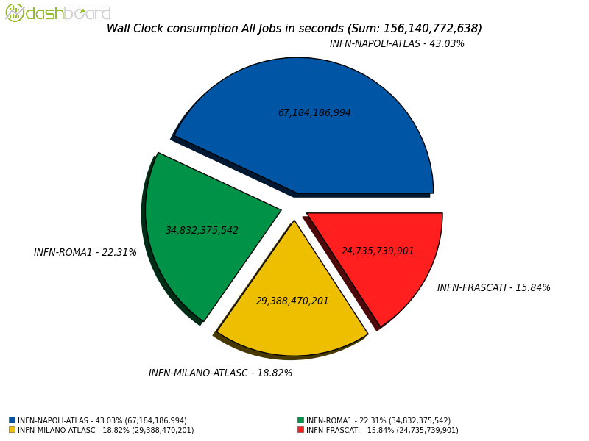
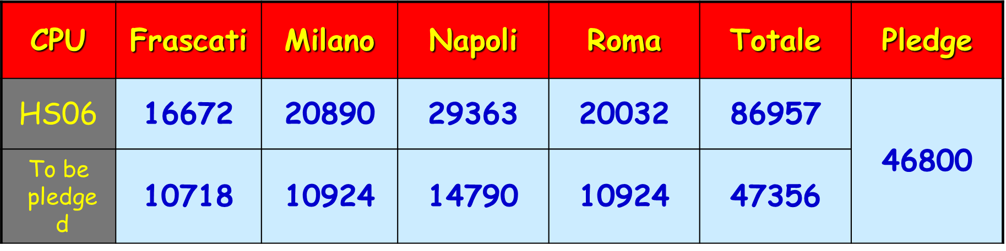
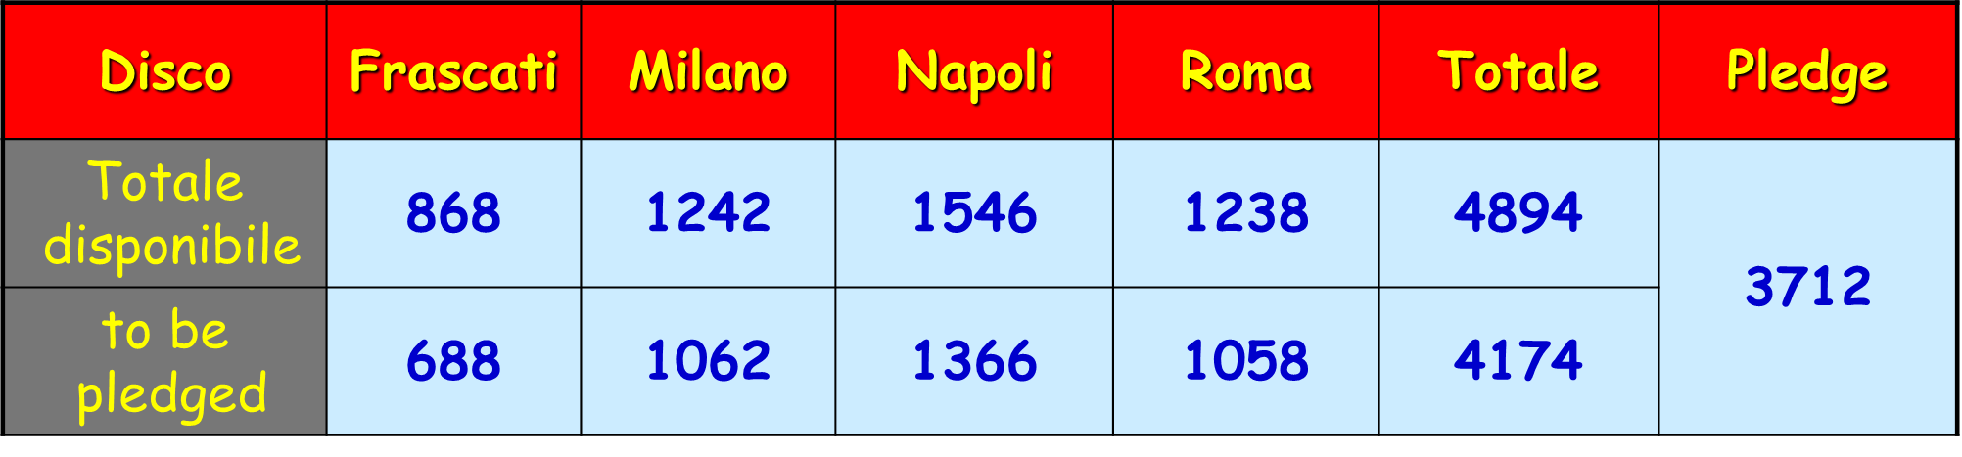
Calcolo
Tier2
Tier3, cluster proof, LOCALGROUP disk per calcolo
locale
L. Carminati, L. Perini, D. Rebatto, L. Vaccarossa

Slide 23
ATLAS Upgrades

Slide 24
Schedule LHC

Slide 25
Fase I

Slide 26
Lar Phase I upgrade
Upgrade del trigger di L1 del Lar
Aumento della granularita’ permette di usare algoritmi piu’ sofisticati, per esempio, per separazione e/jet
Upgrade dell’elettronica, introduce nuove componenti con compatibilita’ all’indietro
Richiede:
  una nuova scheda di trigger
  nuovo baseplane del crate che ospita la scheda di trigger e le schede di front-end

Slide 27
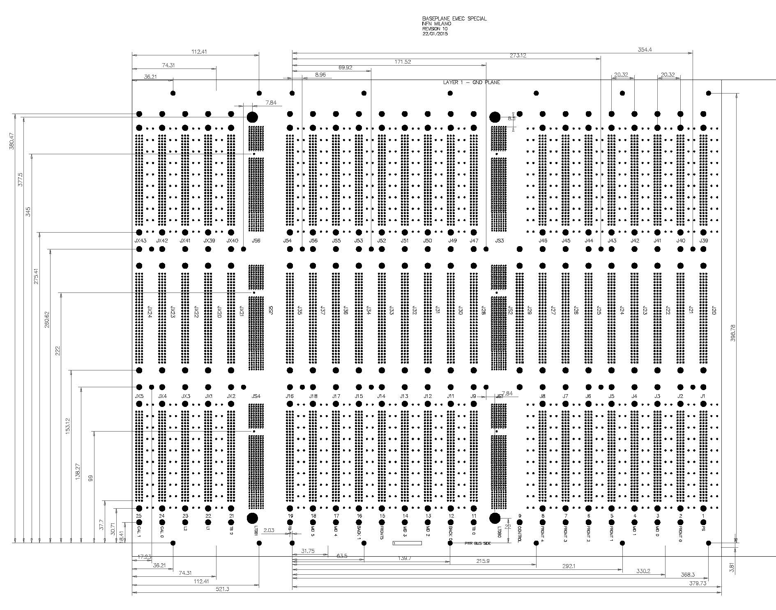
M. Citterio, F. Sabatini
EMEC Special Baseplane layout develop along two LTDBs
The LTDB on the left part of the board will serve 160 supercells
Two TBB boards on the left part
Layout completed:
Debug/cross-check is on-going
The “patch card” used to correct some calorimeter cabling error in the current baseplane cannot be re-used due to a different slot assignments
  the card is being redone
  issue on how to properly hold in place the patch card is under discussion
Not optimal use of fibers
  adjustment will be done after finalizing the new patch card
Signal polarity: assumed POSITIVE
The LTDB on the right part of the boards handles 240 supercells
One TBB board on the right part
Maximum density of traces in the right part of the board
Layout completed
Layout implemented to be compatible with “the generic LTDB pinout”
Connectivity has been checked
Signal polarity: assumed POSITIVE
TB2
TB1
TB0

Slide 28
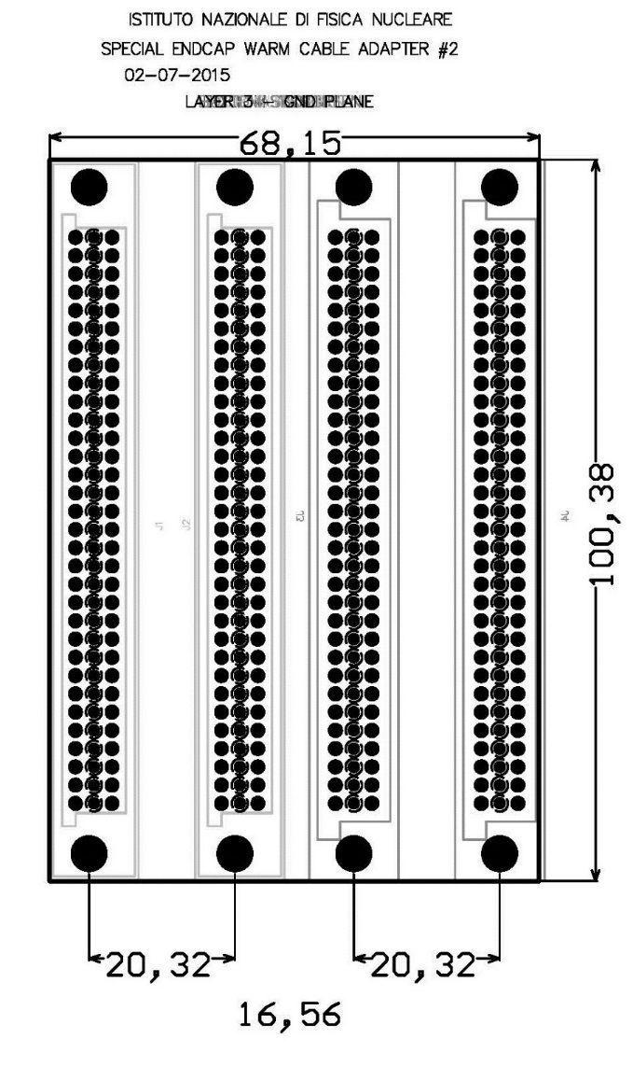
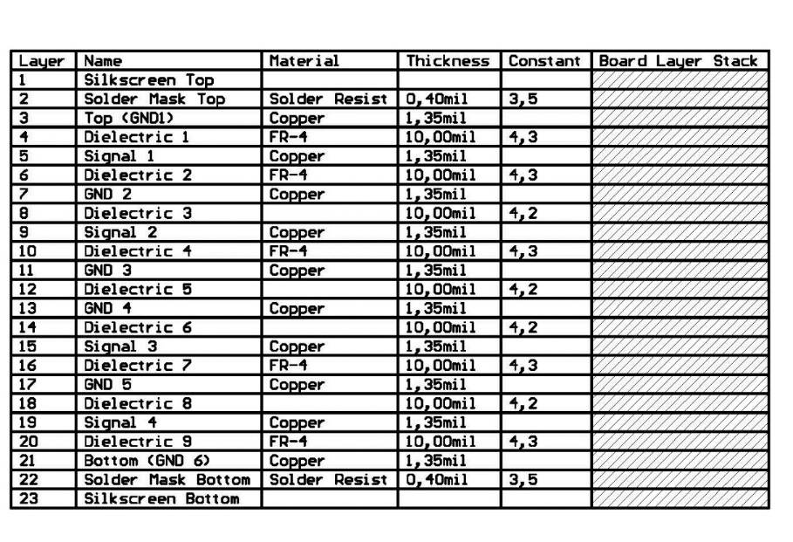
PATCH CARD design
Two different cards to be designed
Having decreased the space between the L1 and L2, that are now two consecutive slots: new placement of the connectors in the match card
  Two connectors on the left (A and B) toward the baseplane
  Two connectors on the right (C and D) to the Warm Cable
A
B
C
D
  No of “signal layers” increased
  GND planes added to
  obtain 50 Ohm impedance

Slide 29
Power section LTDB
Design della parte di powering della nuova scheda di trigger
Step 1:
  Sviluppare una board che possa essere inserita sulla LTDB
  Testare design e componenti (POL FEASTMP del CERN)
Step 2:
  Integrazione complete della parte di powering nella LTDB
M. Citterio, M. Lazzaroni, S. Latorre

Slide 31
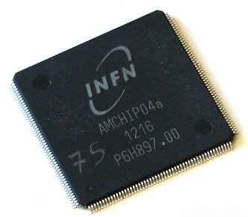
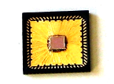
AmchipS SUBMISSIONS
FTK (Fast TracK Trigger)
Since 2010:
AM chip v. 4 designed and characterized 2012 – area: 14 mm² – cost: 50 k€ – 8 kpattens
Since 2011:
AM chip v. 5-mini@sic designed and characterized 2012 – area: 4 mm² – cost: 20 k€ – 256 pattens for cell test
AM chip v. 6 submitted in Jun. 2015 – area: 160 mm² – cost: 550 k€ – 128 kpattens
AM chip v. 5-mpw designed and characterized 2013 – area: 12 mm² – cost: 75 k€ – 5 kpattens
2015-2016
AM chip v.7a submitted in Jun. 2015, AM chip v.7b will be designed in Feb 2016
65 nm
65 nm
28 nm + FPGA
Notes:
Ho detto troppi Noi e non è utile entrare nei dettagli di ogni chip dalla versione 4 alla versione 6

Slide 32
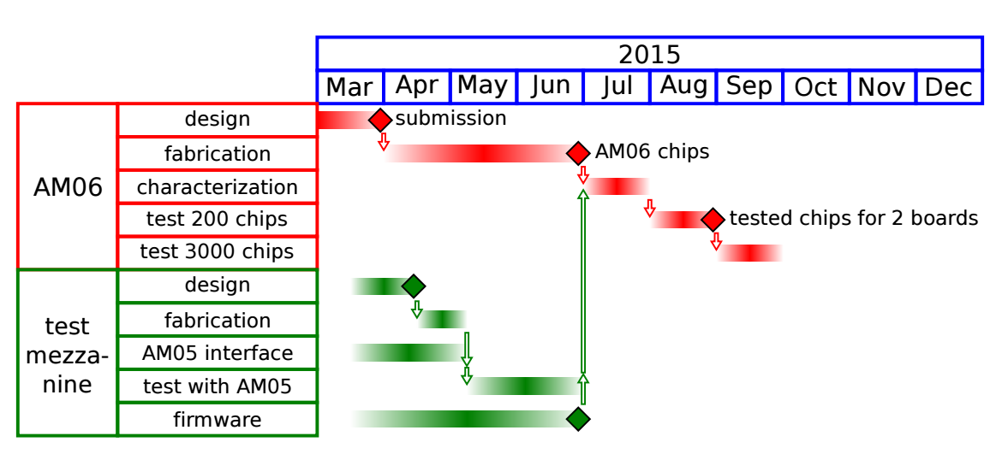
AMCHIP06 testing
2015 |  |  |  |  |  |  | 2016
Jun | Jul | Aug | Sep | Oct | Nov | Dec | Jan | Feb | Ma
V. Liberali, A. Stabile, J. Shojai, A. Andreani

Slide 33
Fase 2

Slide 34
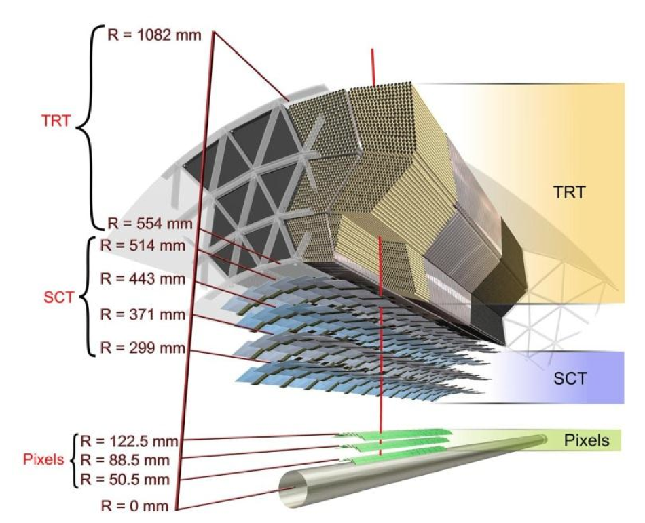
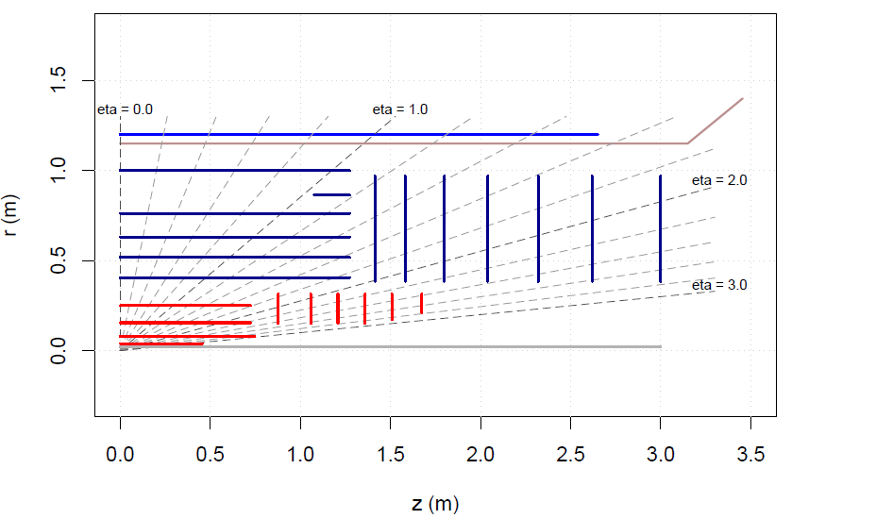
ITK
Long Barrel Strips
Short Barrel Strips
Forward Strips
Cryostat
Barrel pixel
Forward pixel
All Silicon tracker for Phase 2 (TRT would not cope with occupancy)
Baseline layout of the new ATLAS inner tracker for HL-LHC
Aim to have at least 14 silicon hits everywhere (robust tracking)
~Grad & 10¹⁶/cm² 1MeV neutron equivalent NIEL on the innermost layer

Slide 35
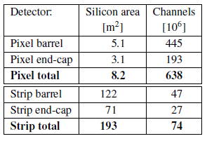
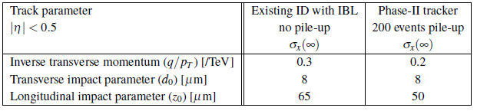
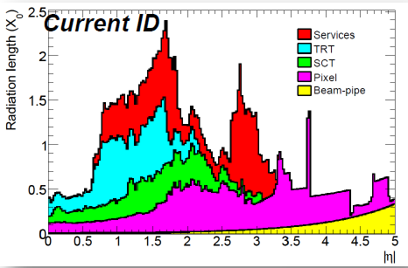
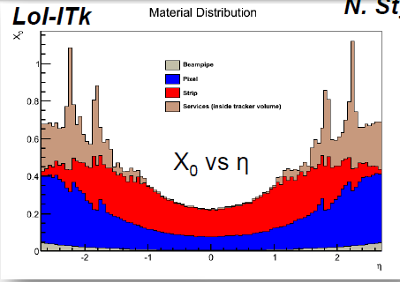
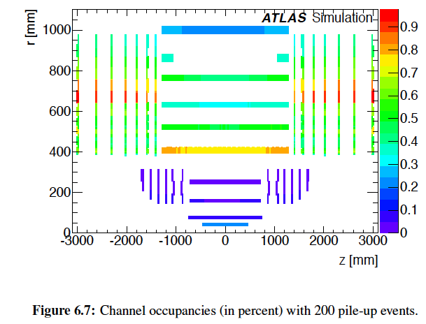
ITK - Tracker performance
Basic numbers of baseline (LoI):
New Inner Detector Improved granularity
  (Smaller pixels and 4.9cm and 9.8cm strips (74.5μm pitch)
  Improved radiation hardness
  Reduced material
  Extended forward coverage
  Robust tracking (14 layers)
  Exact distribution of layers (how many pixel & strips under study, extension to eta <4?))
Tracker - now and then:
Occupancy for <μ>=200 (in %)

Slide 36
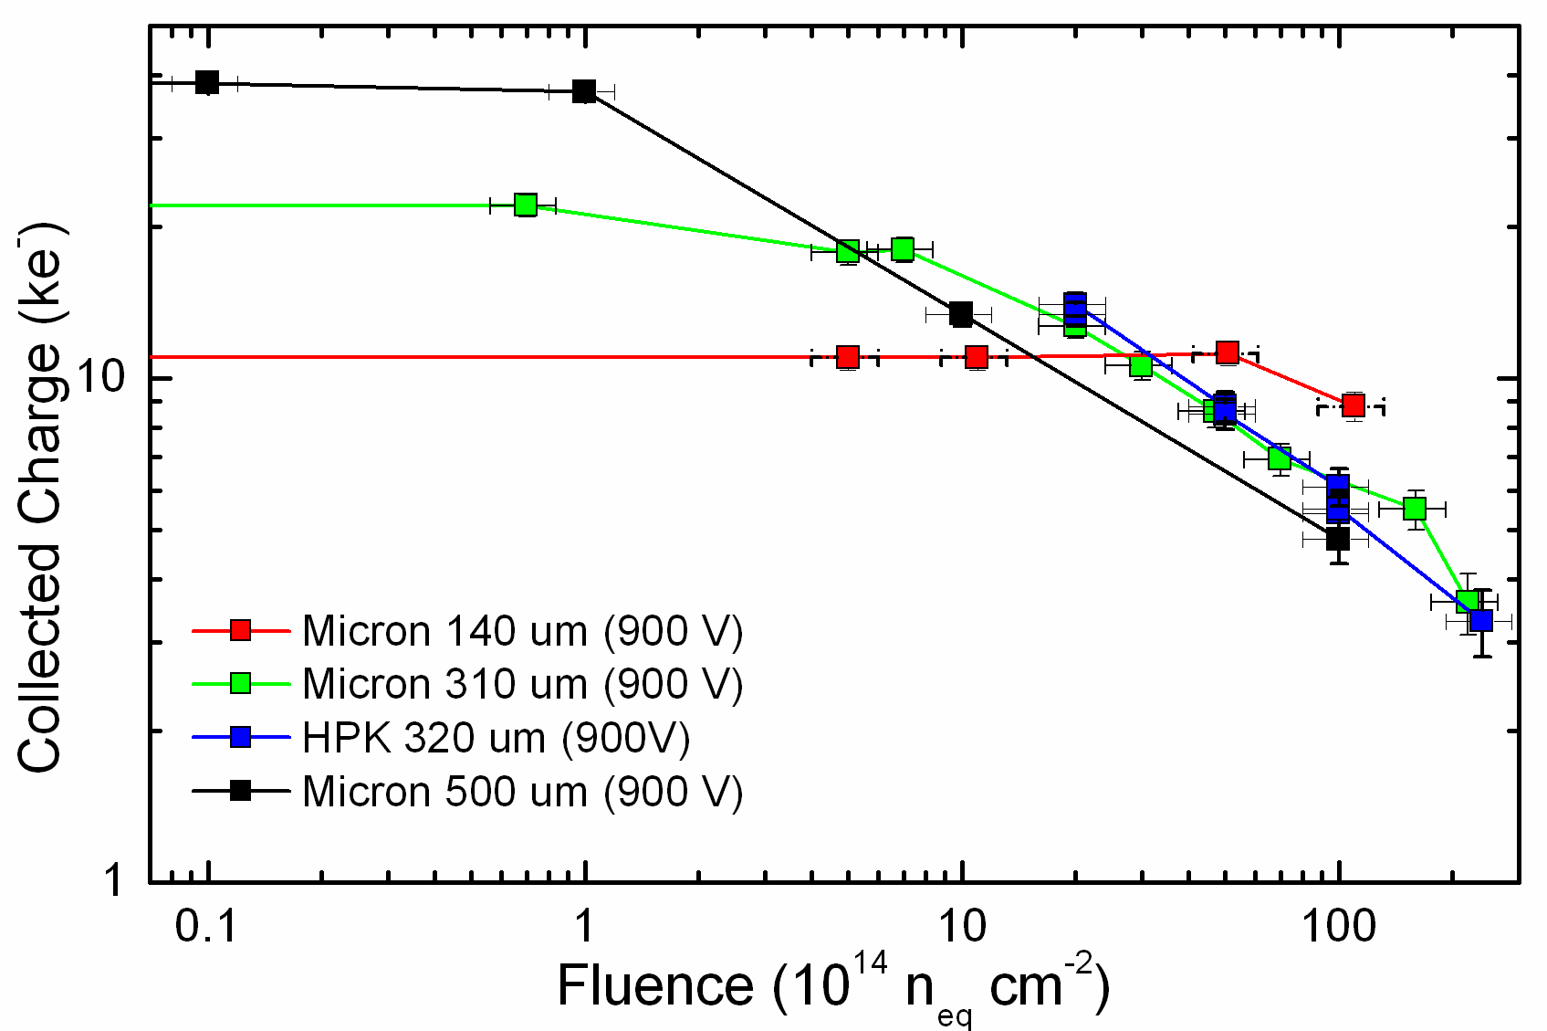
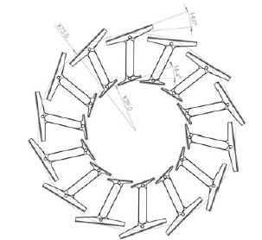
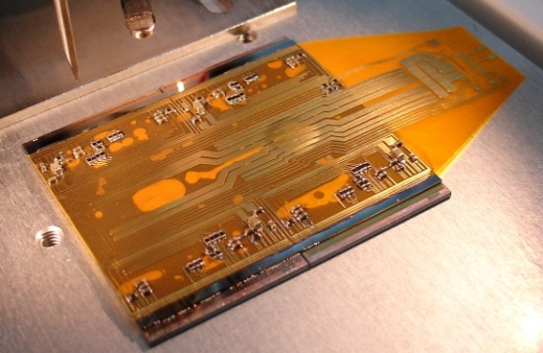
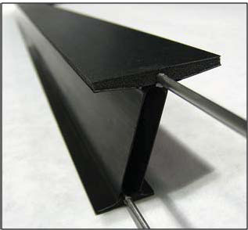
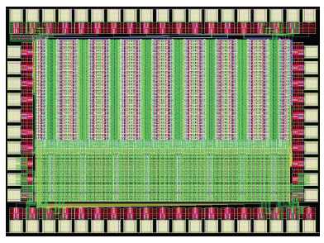
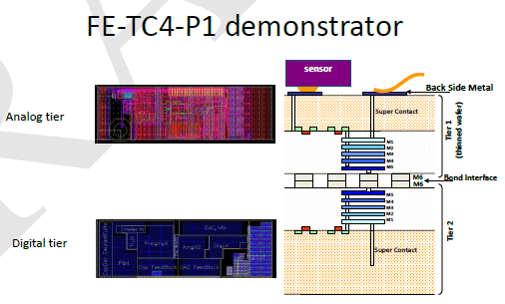
ATLAS ITK pixels
Pixel Detector
Pixel sensors in several technologies proved to high doses
(planar/3D/diamond shown to 2×10¹⁶n_{eq}/cm²)
Next front end chip has to deal with 1Gbps per chip
scheme, go down to 25µm×125µm pixels with 65 nm CMOS
Common effort to develop pixel chip at 65nm (RD-53)
Larger area sensors quads/sextuplets produced on 150mm diameter wafers with several foundries
Quad pixel module produced, being tested and results look promising
Prototyping of local supports for
various concepts has been carried out
A number of support designs and service routings are been studied
Quad module prototype

Slide 37
ITK
Milano interests:
  Local supports and cooling: sviluppo comune con LHCb di un sistema di CO₂ cooling in sezione
  CERN R&D RD53: develop the tools and designs needed to produce the next generation of pixel readout chips needed by ATLAS and CMS at the HL-LHC
  Gruppo V HVR_CCPD: prototype an active CCPD (Capacitive Coupled Pixel Detector) by developing, testing and characterizing an HV/HR-CMOS design and its integration with a pixel detector chip for R/O.
A. Andreazza, S. Coelli, C. Meroni, C. Troncon, V. Liberali, F. Ragusa, G. Alimonti, M. Citterio, S. Shojai

Slide 38
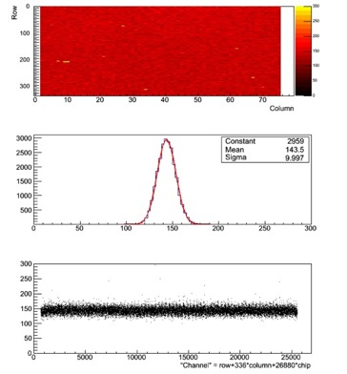
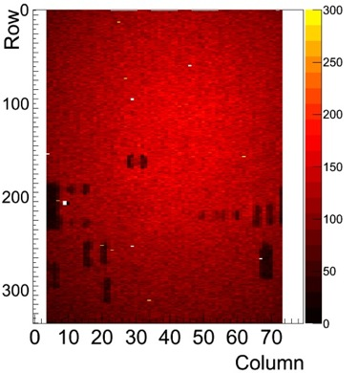
Indium bonding @Selex
G. Alimonti
Same technology used for about half the Atlas Pixel Detector modules but:
For IBL: larger (~19x20 mm² instead of 7x11 mm²) and thinner (100 μm) chips with one order of magnitude more bumps (26880 instead of 2880)
IBL did not use Indium BB; nevertheless modules produced both with planar and 3D sensors have shown that the Selex indium bonding process can be used with large FE-I4 thinned down to 100 μm
Development of Indium bump bonding for the ATLAS Insertable B-Layer (IBL)
G Alimonti et al 2013 JINST 8 P01024 doi:10.1088/1748-0221/8/01/P01024

Slide 39
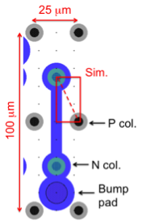
ATLAS upgrade
Higher (x5) density bumps due to a smaller pixel size
FE thickness | ≤ 150 µm
Detector area | 15 m²
BUMP-BONDING SPECS | –––––––––––––––––––
Bump-pitch | 50 µm
No. bumps / FE | 120 ÷ 150 k
BUMP_BONDING COST | –––––––––––––––––––
BB cost total | 6000 k€
  Is it possible any optimization of the bump pads and bump dimensions?
  Any micron gained in the metal would make safer the layout of the 3D sensors
  Would it be possible to place the bump on top of the n-type (or p-type) columns?

Slide 40
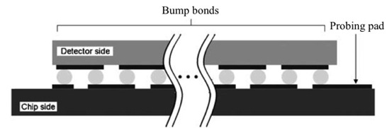
Next steps
Two 6” sensor wafer ready for deposition: planar and 3D modules will soon be assembled to test the new 6” production lines
After testing the two upgraded lines, new developments can be tested:
Test new 3D sensors from FBK: first production by the end of 2015 will also test the “bump on column” solution
Assemble dummy modules with higher density (x5) bumps. Design, produce and measure resistivity bump chains dummies with high density bumps: masks are being designed with different bump and openings size for wafer production at FBK

Slide 41
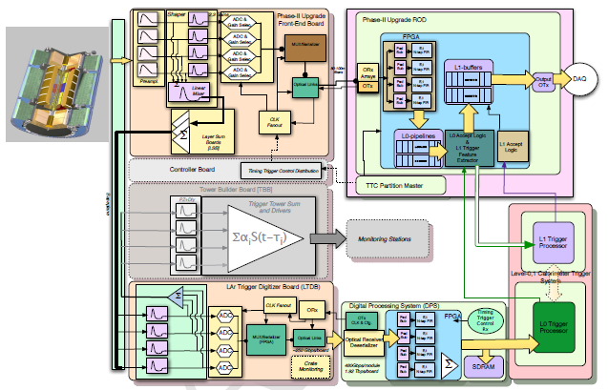
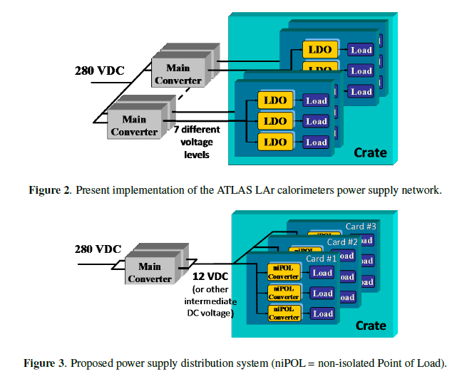
Lar Fase 2
Completazione sostituzione dell’elettronica di Front end del calorimetro Lar:
  Ageing, resistenza alle radiazioni, incompatibilita’ con la nuova architettura di read-out
Interessi di Milano:
  Vogliamo studiare il powering delle nuove schede di front-end
  Nuovi main converter che produrranno una tensione intermedia 12 o 24V da cui creare sulla scheda le altre tensioni necessarie
M. Citterio, M. Lazzaroni, S. Latorre

Slide 42
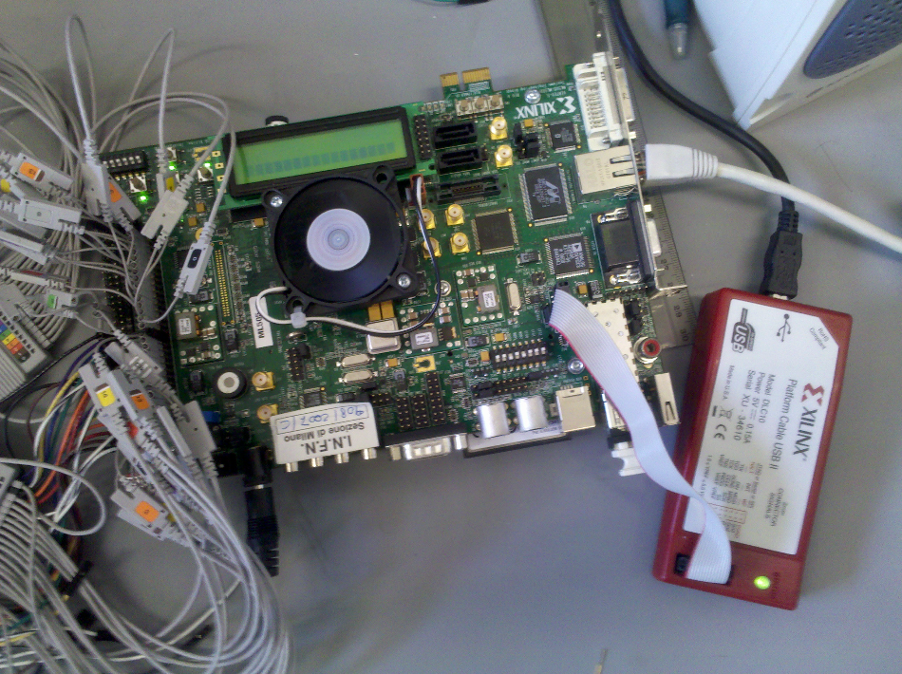
Lar Fase 2
La nuova elettronica di read-out permette di implementare algoritmi di trigger molto sofisticati gia’ a Livello 1 su FPGA
Studiare nuovi algoritmi di trigger per il riconoscimento di e/γ/τ
  Development of the algorithms
  Study of the system architecture: partitions, # FPGA requested,...
Implement this on a mezzanine card that can be used in an ATCA crate
  Make communication tests (data transfer rates,...)
  We are setting up a test system
A. Camplani, M. Citterio,
  F. Tartarelli
  + PRIN 2013 H_TEAM

Slide 43
Amchip07 for phase II
IMPART project
Team leader: A. Stabile
RD_FASE2 TrackTrigger
Team leaders: A. Annovi e F. Palla
Team leader: G. Calderini
ANR FastTrack
Amchip & ATCA
A new little AMchip07a has be designed for the project (in collaboration with Milano Bicocca)
Silicon area: 0.6 mm²
Memory depth: ~48 kbit (i.e., 2688 patterns: 18×1 bits)
Word comparisons in parallel per second: 9,6×10¹²
After this a new prototype AMchip07b will be designed with an mixed approach (std-cell + full-custom): 500 kbit and 6 mm²

Slide 44
Responsabilita’ (ATLAS)
A. Andreazza: Tau CP convenor
  Finisce mandato biennale ad Ottobre 2015
T. Lari: SUSY convener
  Da Ottobre 2014 a Ottobre 2016
C. Troncon: Inner Det. Speaker Comm. Chair
R. Turra: elettroni/gamma calibration convener
  Da Ottobre 2014
F. Tartarelli: Lar HV system DCS
D. Giugni: PIXEL ITK engineer, PIXEL engineer and Design Group

Slide 45
Responsabilita’ (ATLAS Italia)
C. Troncon: coordinatrice PIXEL Italia
V. Liberali: coordinatore FTK Italia
F. Tartarelli: coordinatore LAr Italia

