Slide 1



Recent results in Nuclear Astrophysics @ n_TOF, CERN
Tagliente Giuseppe
Istituto Nazionale Fisica Nucleare, Sez. di Bari
(on behalf of the n_TOF collaboration)
14th International Conference
On Nuclear Reaction Mechanisms

Slide 2
The n_TOF Collaboration
(~100 Researchers from 30 Institutes)
CERN
Technische Universitat Wien Austria
IRMM EC-Joint Research Center, Geel Belgium
Charles Univ. (Prague) Czech Republic
IN2P3-Orsay, CEA-Saclay France
KIT – Karlsruhe, Goethe University, Frankfurt Germany
Univ. of Athens, Ioannina, Demokritos Greece
INFN Bari, Bologna, LNL, LNS, Trieste, ENEA – Bologna Italy
Univ. of Tokio Japan
Univ. of Lodz Poland
ITN Lisbon Portugal
IFIN – Bucarest Rumania
CIEMAT, Univ. of Valencia, Santiago de Compostela,
University of Cataluna, Sevilla Spain
University of Basel, PSI Switzerland
Univ. of Manchester, Univ. of York UK
Notes:
Motivazioni Zr, Mg / Misure precedenti Os (orela ’80) / Proprietà nucleari (average level spacing, average radiative width, average neutron strength) / ISO 2919

Slide 3
n_TOF Scientific Motivations
  Neutron cross sections relevant for Nuclear Astrophysics
  Measurements of neutron cross sections relevant for Nuclear Waste Transmutation and related Nuclear Technologies (ADS)
  Neutrons as probes for fundamental Nuclear Physics

Slide 4
Abundances beyond Fe–ashes of stellar burning
α-nuclei
¹²C,¹⁶O,²⁰Ne,²⁴Mg, …. ⁴⁰Ca
Gap
B,Be,Li
Elements heavier than Fe are the result of neutron capture processes
NEUTRONS
H 30 000
C 10
Fe 1
Au 2 10⁻⁷
r-process peaks (nuclear shell closures)
s-process peaks (nuclear shell closures)
Fe peak
Th, U
Au
Pb

Slide 5
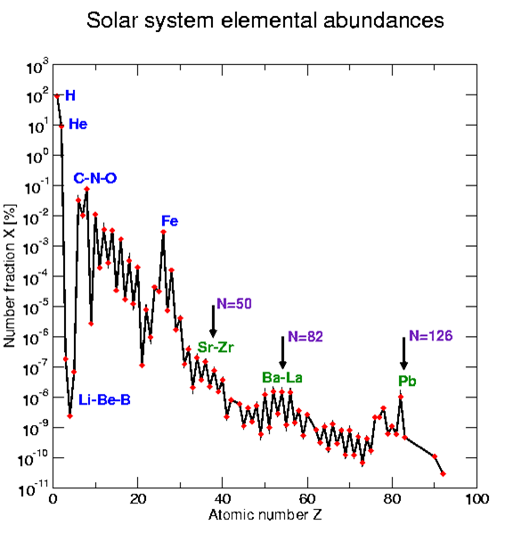
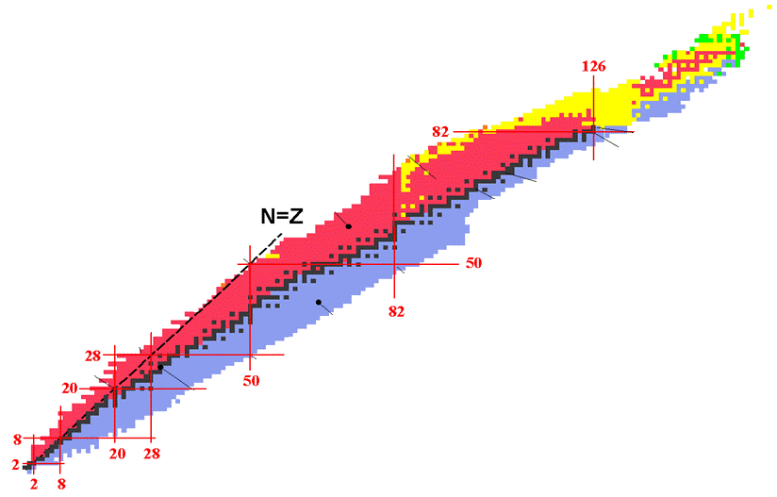
Nucleosynthesis
s-process lifetime 10⁴ years n_{n}≈10⁶-10¹² neutron/cm³
r-process lifetime μs n_{n}≈10²² neutron/cm³
β-decay lifetime: few hours to few years
The canonical s-process
neutrons

Slide 6
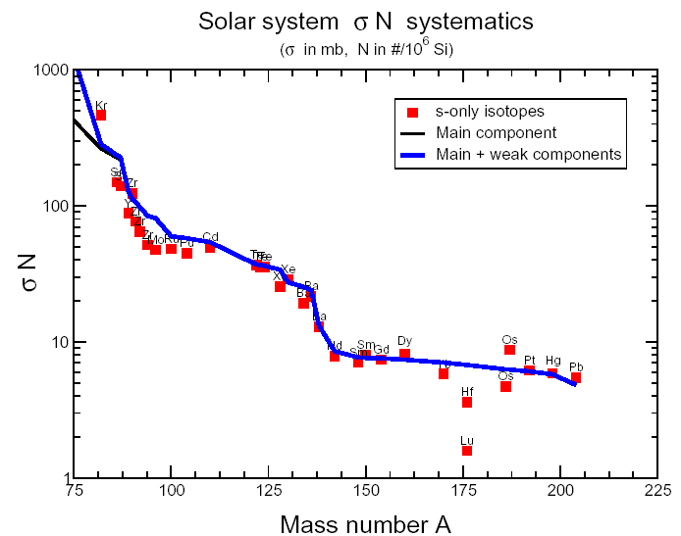
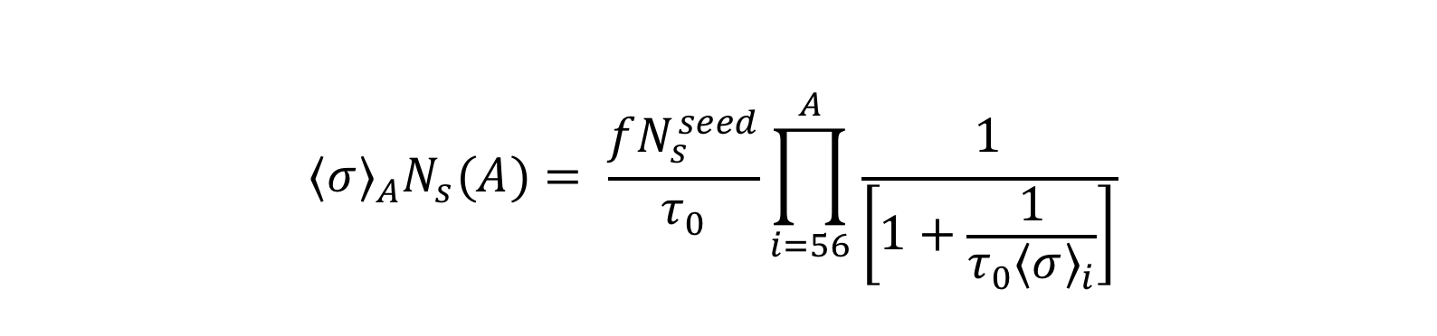
Stellar Models

Slide 7
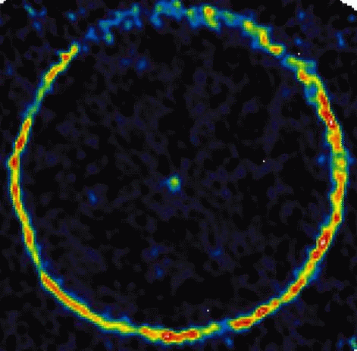
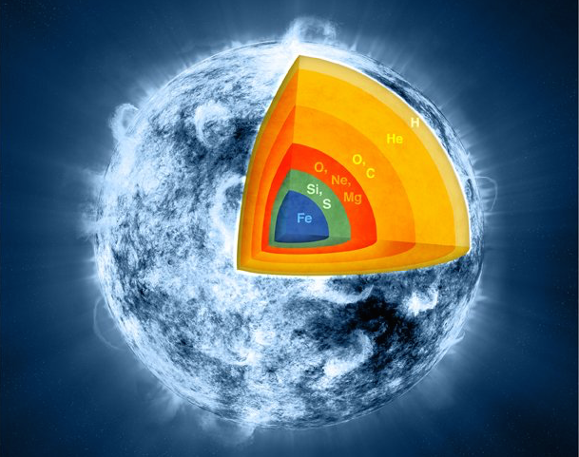
s-process stellar sites
Low mass Asympotic Giant Branch (AGB) M≈1.5 - 3 M
¹³C(α,n)¹⁶O T ~ 8 keV N_{n} < 10⁷ n/cm³
²²Ne(α,n)²⁵Mg T ~ 23 keV N_{n}~10¹⁰-10¹² n/cm³
Massive stars M≈15 - 25 M
²²Ne(α,n)²⁵Mg
In core He-burning T ~ 26 keV N_{n} ~ 10⁶ n/cm³
In core C-burnig T ~ 90 keV N_{n}~10¹¹ n/cm³

Slide 8
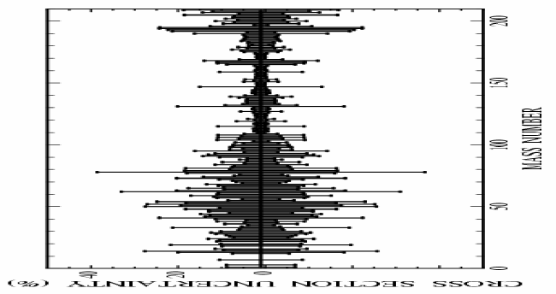
n_TOF Goal
*** cross section uncertainties <5%
*** safe control of systematic uncertainties

Slide 9
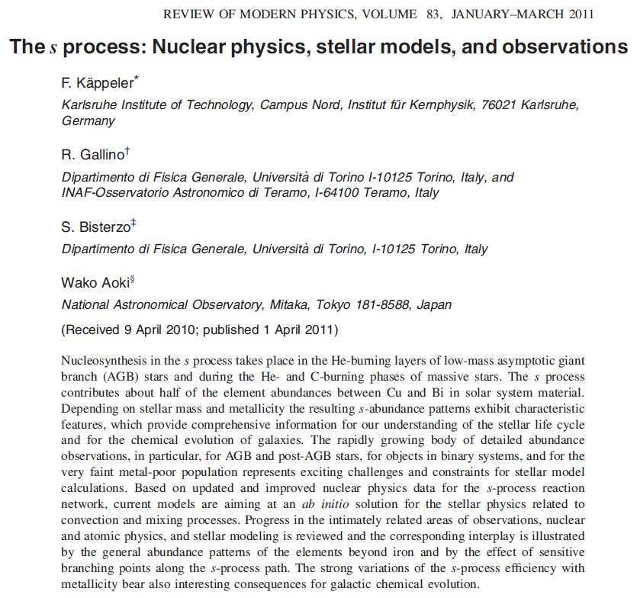
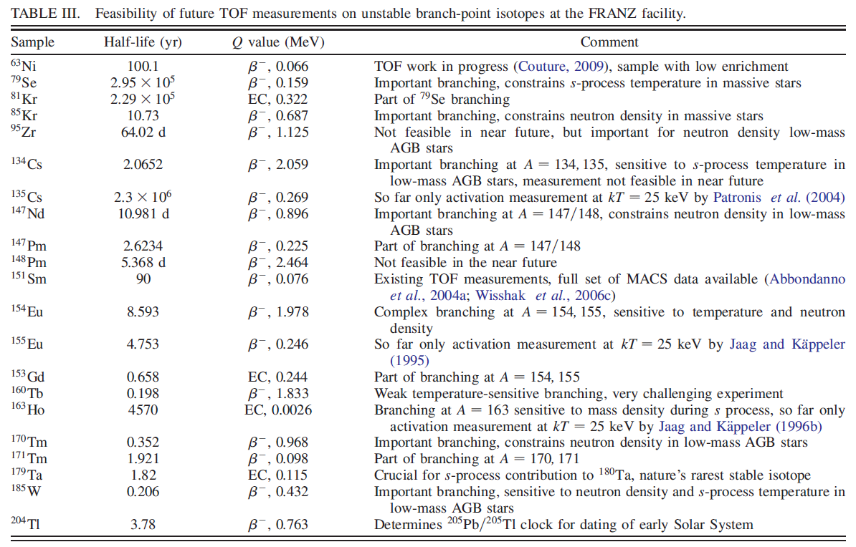
n_TOF Goal

Slide 10
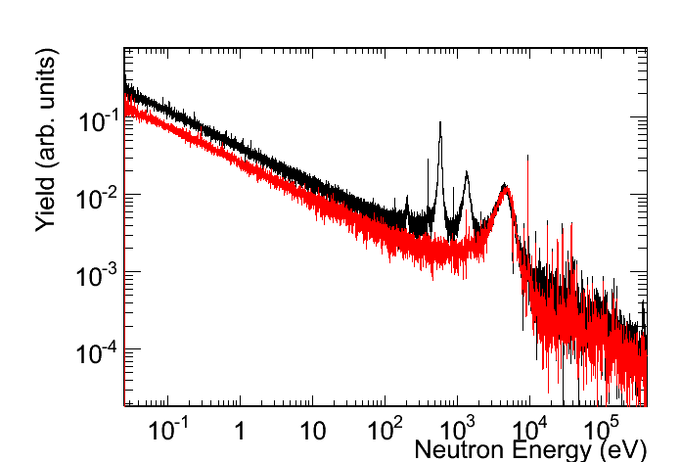
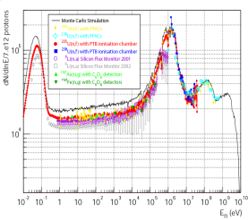
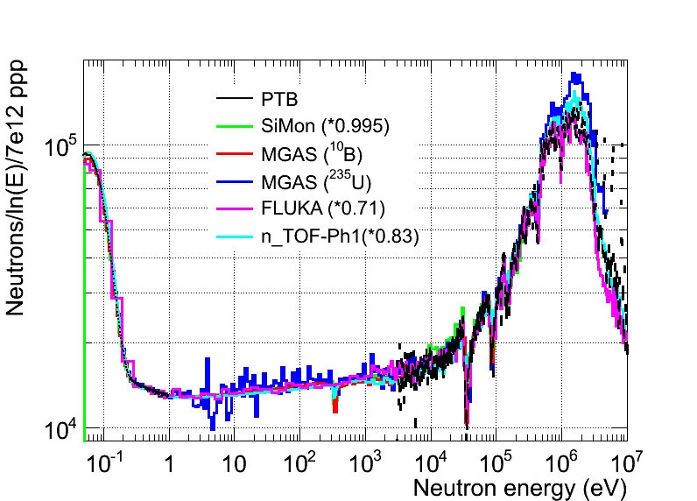
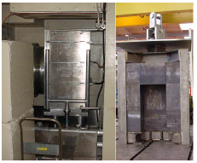
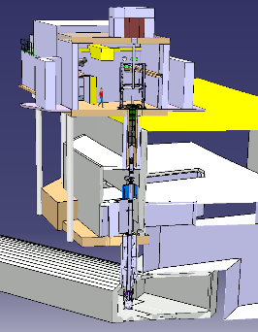
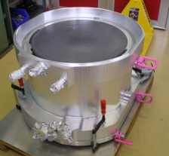
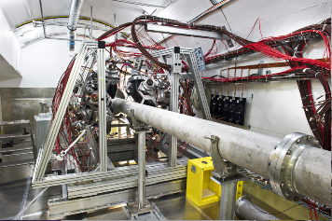
n_TOF Time line
2001-2004
2009-2012
⁶³Ni
⁶²Ni
Commissioning
Commissioning
2000
2009
Phase I
Measurement campaign
Phase II
Measurement campaign
Phase III
1997
2012
2015
Construction
started
2nd Exp. area
1999
New Target
installed
2014
2008
Upgrades
¹⁰B-water
Class-A area
2010
Concept
by C.Rubbia
CERN/ET/Int. Note 97-19
1997

Slide 11
The experimental activity at n_TOF: Ph I
¹⁵¹Sm
^{204,206,207,208}Pb^{,209}Bi
^{24,25,26}Mg
^{90,91,92,94,96}Zr, ⁹³Zr
¹³⁹La
^{186,187,188}Os
Cross sections relevant in
Nuclear Astrophysics
    s-process: branchings
    abundancies in presolar grains
    Magic nuclei
    Isotopes of particular interess
In the period 2002-2004 measured long-needed capture and fission cross-sections for 36 isotopes, 18 of which radioactive.
The unprecedented combination of excellent resolution, unique brightness and low background has allowed to collect high-accuracy data, in some cases for the first time ever.

Slide 12
n_TOF Phase II

Slide 13
The experimental activity @ n_TOF: Ph II
^{54,56,57}Fe
^{58,60,62}Ni,⁶³Ni
²⁵Mg
⁹³Zr
Cross sections relevant in Nuclear Astrophysics
    s-process: seeds isotopes
In the period 2009-2012 measured long-needed capture and fission cross-sections for 22 isotopes, 14 of which radioactive.

Slide 14
n_TOF Phase III

Slide 15
AstroPhysics program EAR I & EAR II
Isot. | R | Comments
^{70,72,73}Ge | (n,γ) | s-process flow
¹⁷¹Tm,²⁰⁴Tl | (n,γ) | Branching points
Isot. | R | Comments
¹⁴⁷Pm | (n,γ) | Branching point
²⁶Al | (n,p/α) | ²⁶Al galactic abundance
⁷Be | (n,α) | n capture in light nuclei

Slide 16
Conclusions
There is need of accurate new data on neutron cross-sections for astrophysics.
Since 2001, n_TOF@CERN has provided an important contribution to the field, with an intense activity on capture measurements.
Several results of interest for stellar nucleosynthesis (Sm, Os, Zr, Ni, Fe, etc…).
To date, high resolution measurements performed in EAR1 in optimal conditions (borated water moderator, Class-A experimental area, etc…).
The EAR2 has opened new perspectives for frontier measurements on short-lived radionuclides.
16

Slide 17
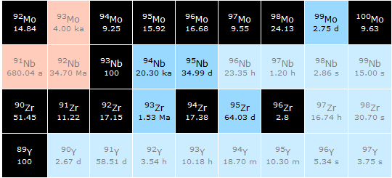

Slide 18
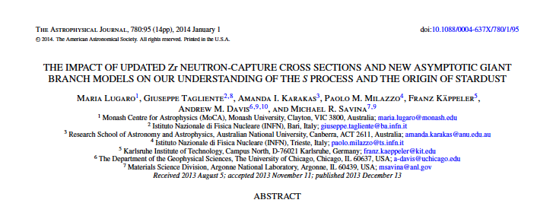
The experimental results: Zr isotopes
Courtesy of R. Gallino and S. Bisterzio
Nucleus | N_{ʘ} Normalized to N(Si)=10⁶ atoms | N_{s}/ N_{ʘ} % Old | N_{s}/ N_{ʘ} % n_TOF
⁹⁰Zr | 5.546 | 0.789 | 0.844
⁹¹Zr | 1.21 | 1.066 | 1.024
⁹²Zr | 1.848 | 1.052 | 0.981
⁹⁴Zr | 1.873 | 1.217 | 1.152
⁹⁶Zr | 0.302 | 0.842 | 0.321
Solar abundances, N, from Lodders 2009, accuracy 10%
The s-abundances, N_{s}, are calculated using the TP stellar model for low mass AGB star (1.5 - 3 M).

Slide 19
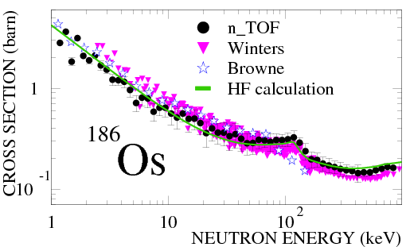
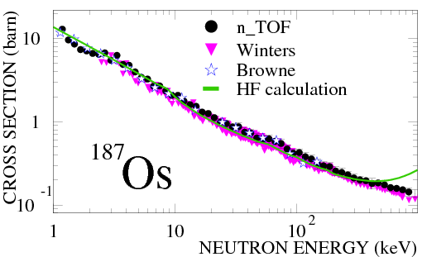
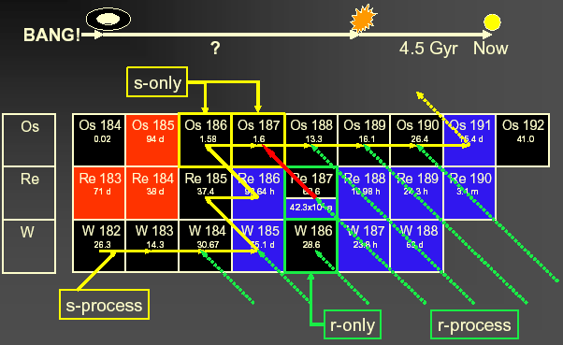
The experimental results: ^{186,187}Os

Slide 20
The experimental results: ^{186,187}Os
Cosmological way
Astronomical way
Nuclear way: Re/Os clock Th/U clock
13.7 ± 0.2 Gyr
14 ± 2 Gyr
14.9 ± 2 Gyr(*)
14.5 ± 2.5 Gyr
(*) 0.4 Gyr uncertainty due to cross-sections

Slide 21




The experimental results: ¹⁵¹Sm
Laboratory t_{1/2} = 93 yr
reduced to t_{1/2} = 3 yr @ s-process site
¹⁵²Gd
¹⁵⁴Gd
¹⁵¹Eu
¹⁵²Eu
¹⁵³Eu
¹⁵⁴Eu
s-Process
¹⁵⁰Sm
¹⁵¹Sm
¹⁵²Sm
¹⁵³Sm
The branching ratio for ¹⁵¹Sm depends on:
  Termodynamical condition of the stellar site (temperature, neutron density, etc…)
  Cross-section of ¹⁵¹Sm(n,γ)
  ¹⁵¹Sm used as stellar thermometer !!

Slide 22
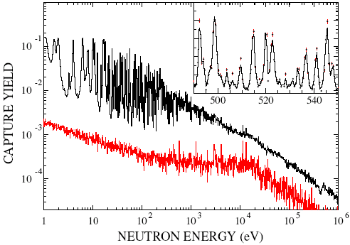
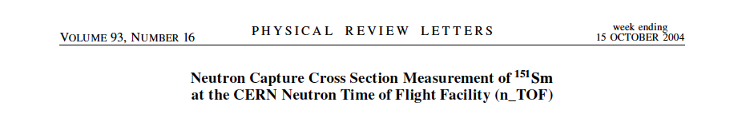
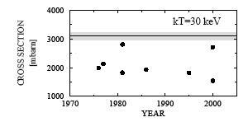
The experimental results: ¹⁵¹Sm
background
Measured for the first time at a time-of-flight facility
Resonance analysis with SAMMY code.
Maxwellian averaged cross-section experimentally determined for the first time
s-process in AGB stars produces 77% of ¹⁵²Gd,
23% from p process
Maxwellian averaged (n,γ) cross section of the ¹⁵¹Sm and previous calculation (symbol)
NO PREVIOUS MEASUREMENTS!

Slide 23
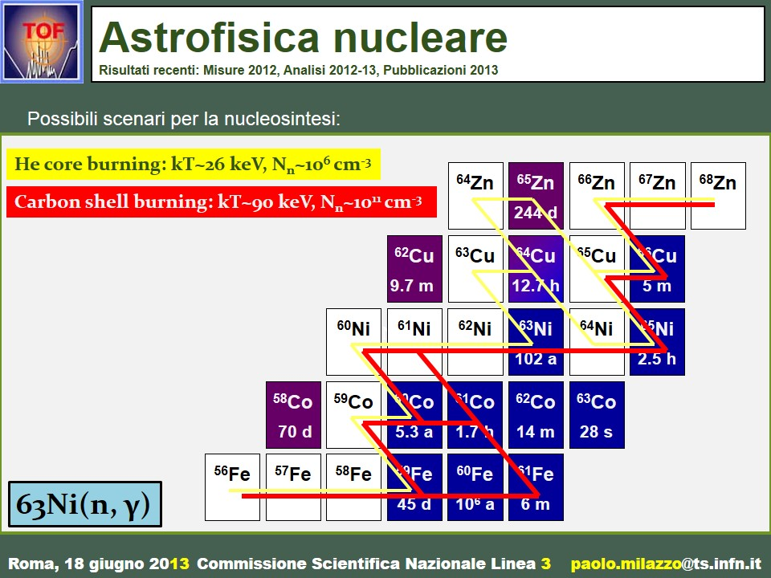
The experimental results: ⁶³Ni
Scenarios
in massive stars

Slide 24
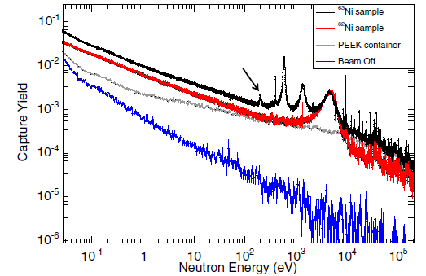
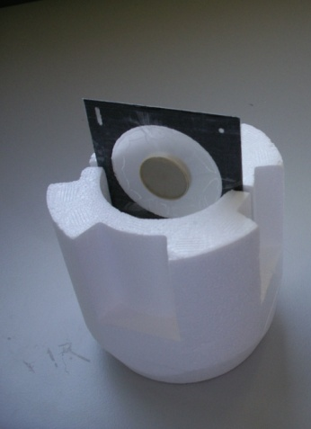
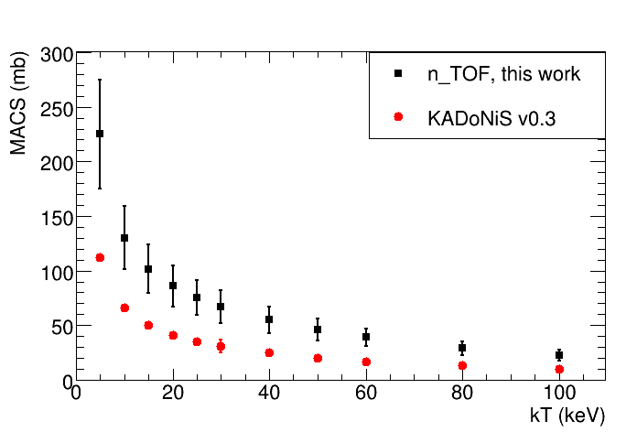
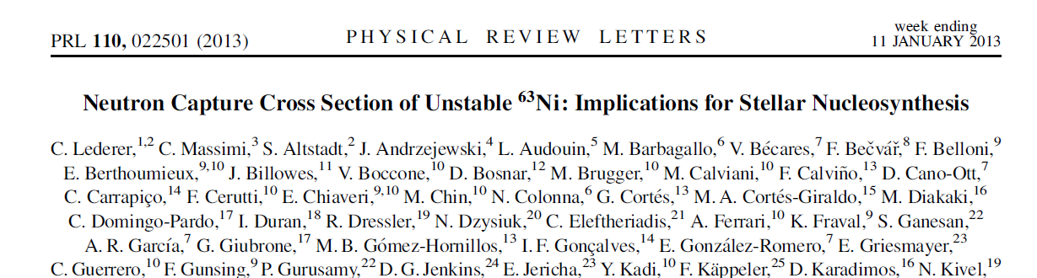
The experimental results: ⁶³Ni
⁶³Ni (t_{1/2}=100 y) represents the first branching point in the s-process, and determines the abundance of ^{63,65}Cu
⁶²Ni sample (1g) irradiated in thermal reactor (1984 and 1992), leading to enrichment in ⁶³Ni of ~13 % (131 mg)
In 2011 ~15.4 mg ⁶³Cu in the sample (from ⁶³Ni decay).
After chemical separation at PSI, ⁶³Cu contamination <0.01 mg
First high-resolution measurement of ⁶³Ni(n,γ) in the astrophysical energy range.

Slide 25
The experimental results: ¹⁷¹Tm(n, γ)
MACS @30 keV (mb)
Isotope production @ILL
¹⁷¹Tm: ¹⁷⁰Er(n, γ)¹⁷¹Er (β⁻, 7.5h)¹⁷¹Tm (enrichment 1.8%)
3.6 mg of ¹⁷¹Tm (1.9 y) [1.3x10¹⁹ atoms]
Chemical separation and sample preparation @PSI
¹⁷¹Tm (97.9%) + ¹⁶⁹Tm (2.1%) + ¹⁷⁰Tm(0.07%)
1400
1332
1200
1000
800
637
600
KADoNiS = 486
400
399
200
309
243
1975
1980
1985
1990
1995
2000
2005
YEAR
¹⁷¹Tm deposit (20 mm diameter)
Aluminum (7 μm) backing
Frame (50 mm diameter)
Mylar (5 μm)

Slide 26
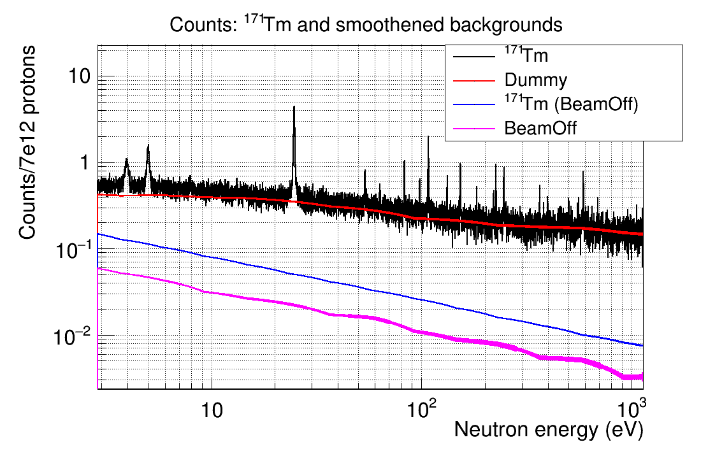
The experimental results: ¹⁷¹Tm(n, γ)
First
experimental measurement
VERY PRELIMINARY RESULTS

Slide 27
The experimental results: Ge(n, γ)
The neutron capture cross section on Ge
affects the abundances
for a number of heavier isotopes
up to a mass number of A = 90.

Slide 28
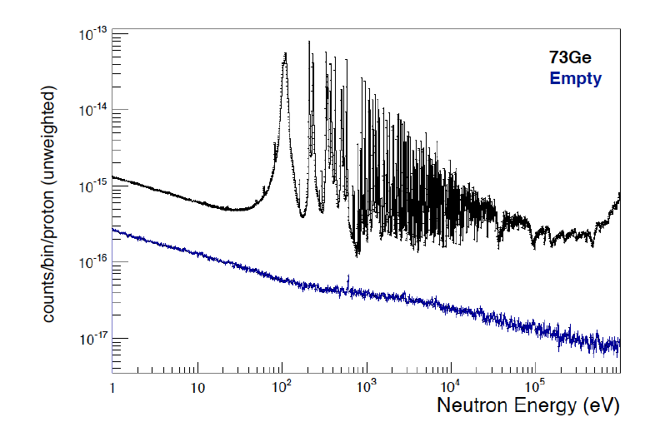

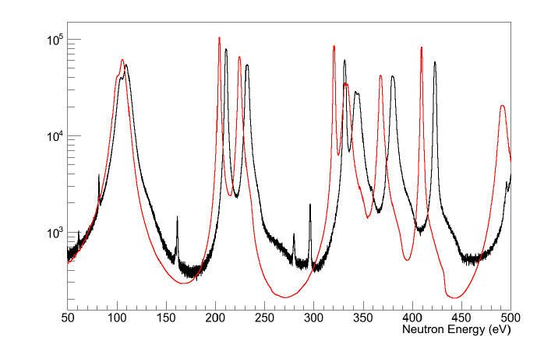
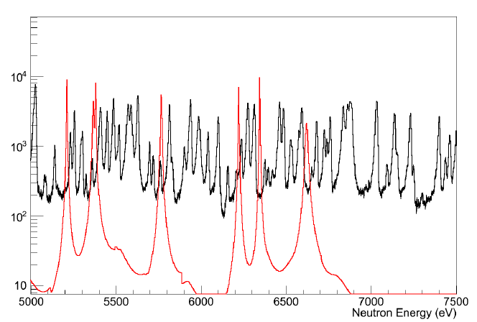
The experimental results: ⁷³Ge(n, γ)
ENDF/B-VII
n_TOF
ENDF/B-VII
n_TOF
VERY PRELIMINARY RESULTS

Slide 29
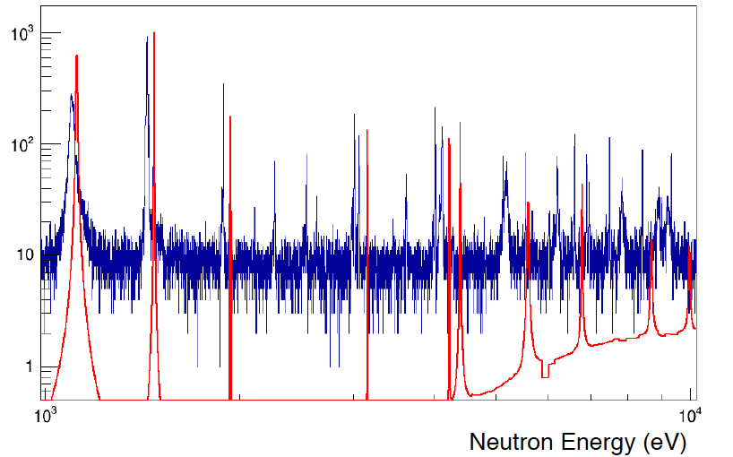

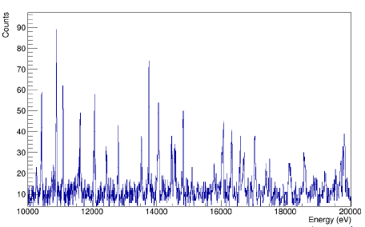
The experimental results: ⁷⁰Ge(n, γ)
Counts
ENDF/B-VII
n_TOF
VERY PRELIMINARY RESULTS

Slide 30
²⁶Al(n, p), (n, α)
Observation of the cosmic ray emitter ²⁶Al is proof that nucleosynthesis is ongoing in our galaxy.
The neutron destruction reactions ²⁶Al(n, p) and ²⁶Al(n, α) are the main uncertainties to predict the galactic ²⁶Al abundance.
There are only few experimental data on these reactions and they exhibit severe discrepancies.

Slide 31
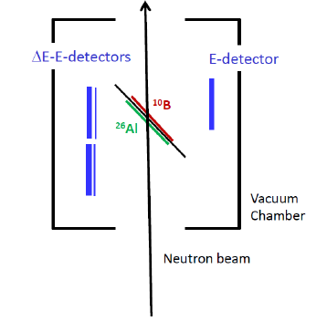
²⁶Al(n, p), (n, α)
The sample was produced by IRMM in collaboration with LANCSE
The p and α will be detected by double sided silicon strip detectors arranged as E –ΔE telescope
The neutron fluence will be monitored by a ¹⁰B sample

Slide 32
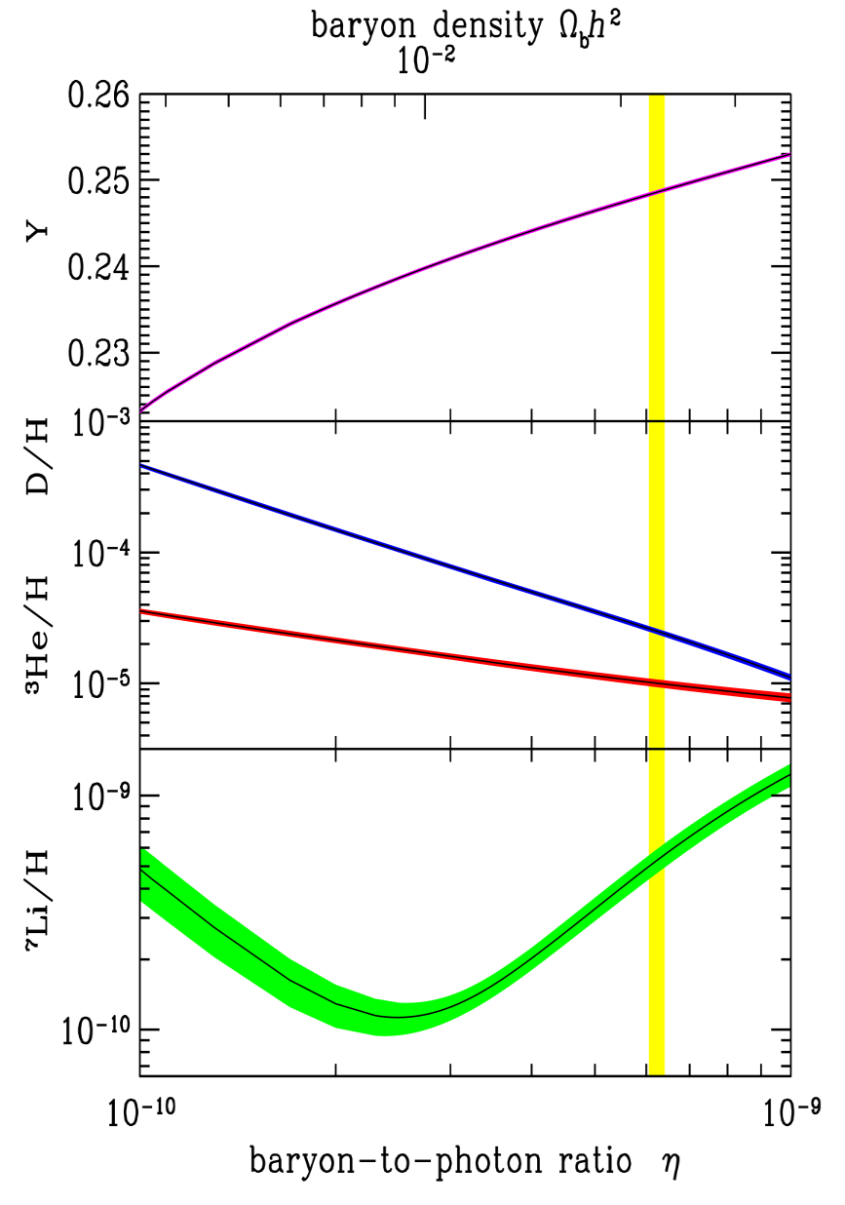
⁷Be(n, p), (n, α)
*
BBN successfully predicts the abundances of primordial elements such as ⁴He, D and ³He
A serious discrepancy (factor 2-4) between the predicted abundance of ⁷Li and the value inferred by measurements
Cosmological Lithium Problem

Slide 33
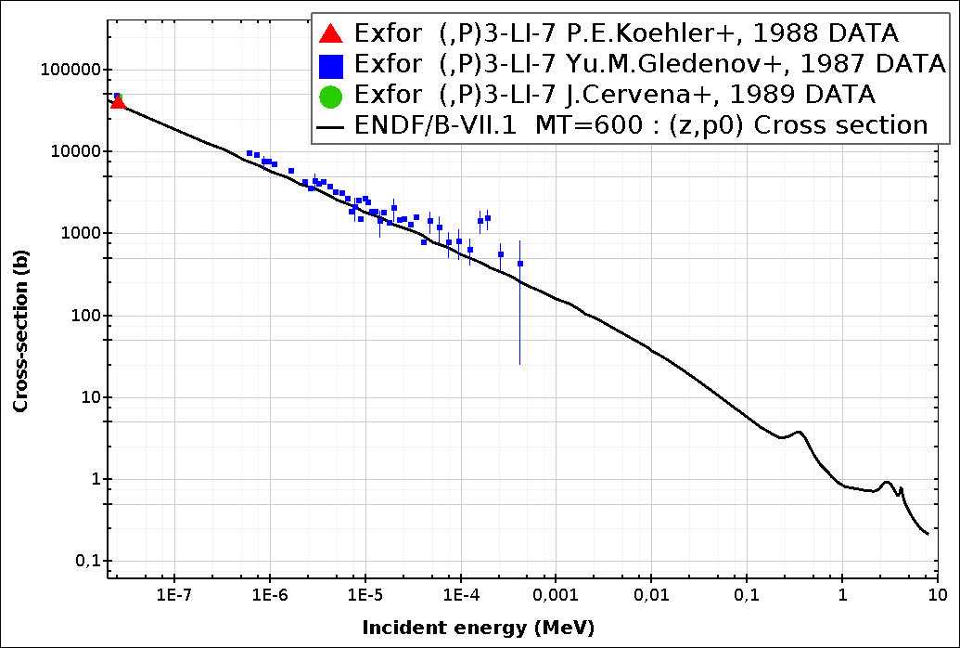
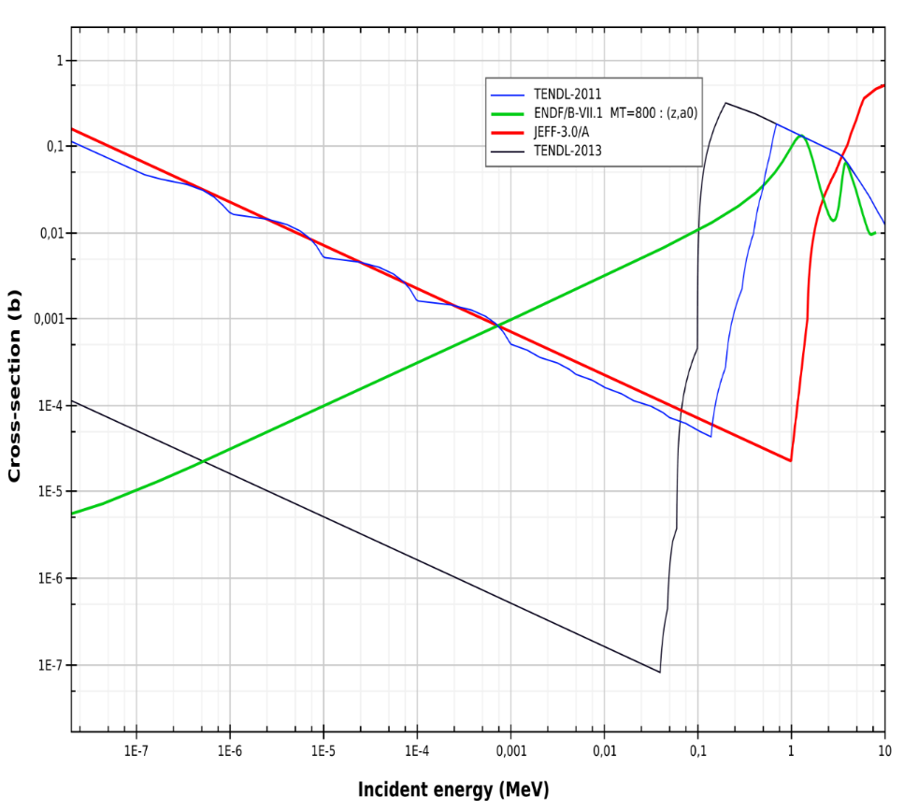
⁷Be(n, p), (n, α)
Approximately 95% of primordial ⁷Li is produced from the electron capture decay of ⁷Be (T_{1/2}=53.2 d)
⁷Be is destroyed via (n,p) (≈97%) and (n, α) (≈2.5%) reactions
A higher destruction rate of ⁷Be can solve or at least partially explain the Cosmological Lithium Problem
Only one direct measurement
(P. Bassi et al., 1963, @ 0.025 eV)
⁷Be(n, p)
⁷Be(n, α)

Slide 34
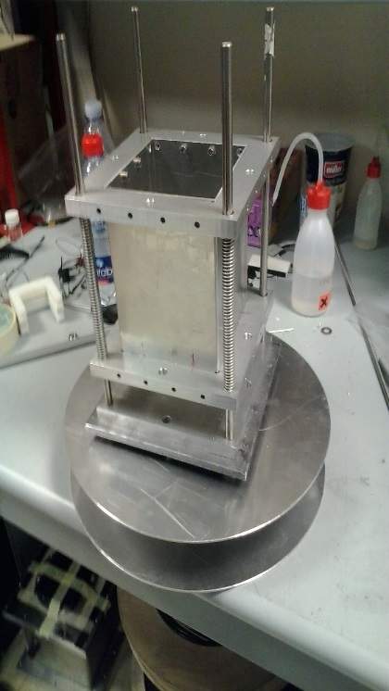
⁷Be(n, p), (n, α)
Sandwich of silicon detectors directly inserted in the beam
Detection of both alpha particles (E≈9 MeV)
Silicon 1
sample
Coincidence technique:
Strong rejection of background
neutrons
Silicon 2
Sample:
1-10 μg of ⁷Be from water cooling of SINQ spallation target.
(activity of 478 keV γ-rays 1 GBq/μg)
Isotopic composition: 1:1 ⁷Be-¹⁰Be 1:5 ⁷Be-⁹Be

Slide 35
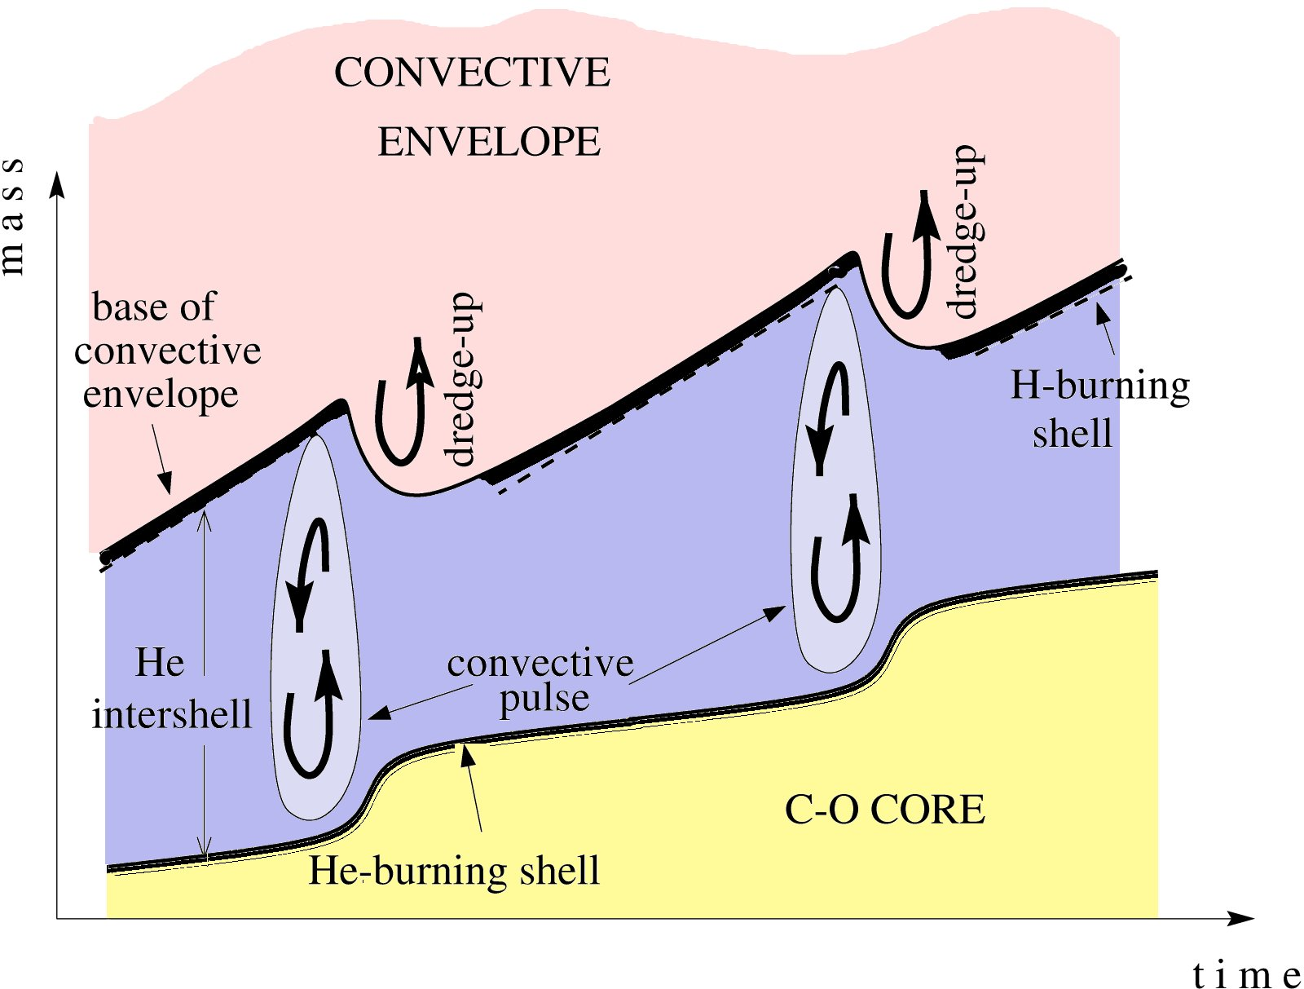
neutron density
neutron density
time
10⁻⁴
time
proton diffusion
¹³C(α,n)¹⁶O
- C
²²Ne(α,n)²⁵Mg
Notes:
Low mass AGBs Intermediate mass AGBs
Lower temperature ~4.5 M Higher temperature
Larger intershell mass Smaller intershell mass

