Slide 1
































AEgIS
(Antimatter Experiment gravity Interferometry Spectroscopy)
A E g I S collaboration
CERN
Czech Technical
University
ETH Zurich
Stefan Meyer Institute
University of
Genova
University of
Milano
University of
Padova
University of
Pavia
Institute of Nuclear
Research of the
Russian Academy
of Science
Max-Planck Institute
Heidelbert
Politecnico di
Milano
University College
London
University of
Bergen
University of
Bern
University of
Brescia
Heidelberg
University
University of
Oslo
University of
Paris Sud
University of
Trento
University of
Lyon 1
INFN sections of:
Genova, Milano,
Padova, Pavia,
Trento
Gemma Testera Consiglio di Sezione Luglio 2015

Slide 2
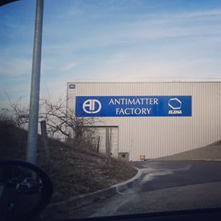
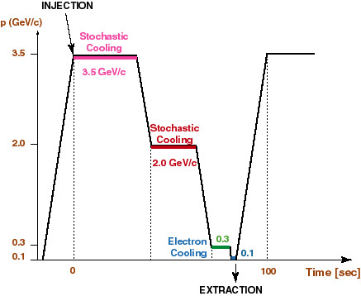
Antiproton Decelerator (and ELENA) at CERN
3.5 10⁷ in 200 ns
AEgIS
From 2017-2018: ELENA:
New ring inside AD
Antiprotons @100 keV
4 bunches
More than a factor 100 increase of the
usable antiprotons
ELENA
Deceleration+ phase space compression
3.5 10⁷ in 200 ns antiprotons
100 sec rep. rate
5 MeV kinetic energy

Slide 3
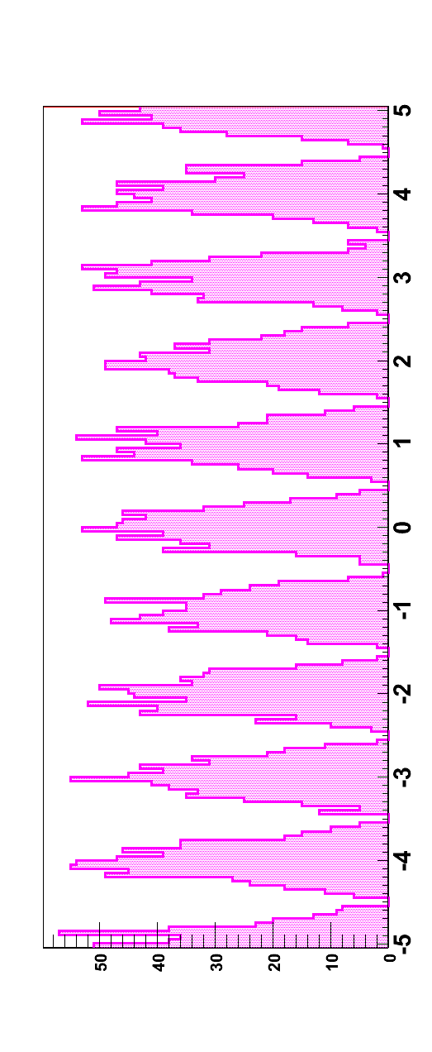
The AEgIS goal
Counts vs vertical coordinate
1)
Direct g measurement (WEP test)
cold Hbar beam (few 100 m/s)
moiré deflectometer
expected accuracy: 1%
higher precision with ultracold
antiprotons and/or large statistics
L=few tens cm
Grating period a : few tens μm
High resolution position detector : few μm
Shift of the periodic pattern due to vertical forces (gravity)
Phase shift
1% (stat. only) with 600 detected vertices and 2-3 micron resolution
achievable with emulsions +silicon detectors
2)
Antihydrogen spectroscopy with cold beam
Accurate CPT tests

Slide 4
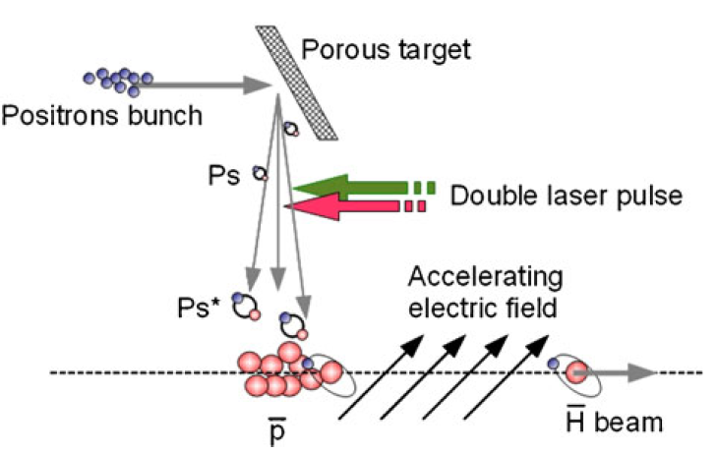
AEgIS summary
1) Catch pbar from 5 MeV AD beam (CERN), cool, store
Pbar ultracooling: 100 mK (10 μeV)
2) Accumulate e+ in a trap
3) Form Ps
Launch e+ toward a e+ to Ps converter (nanoPorous target);
3) Excite Ps to Rydberg states
(2 laser pulses)
4) Produce Rydberg Hbar: pulsed production
5) Form the beam
(electric field gradient)
6) Measure gravity using a moiré
deflectometer and a time-position
sensitive detector

Slide 5
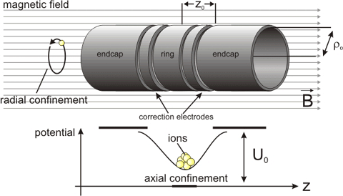
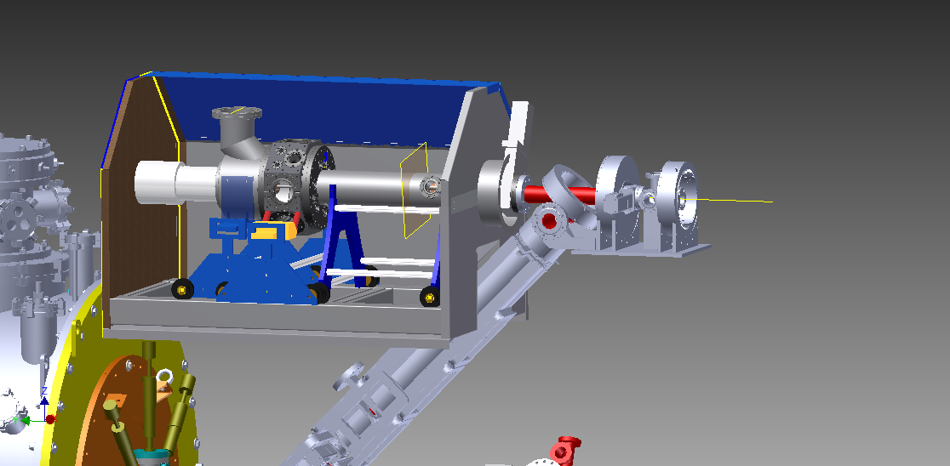
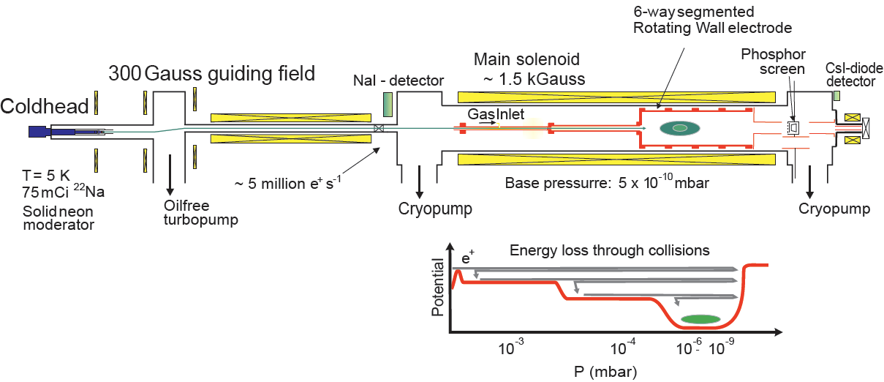
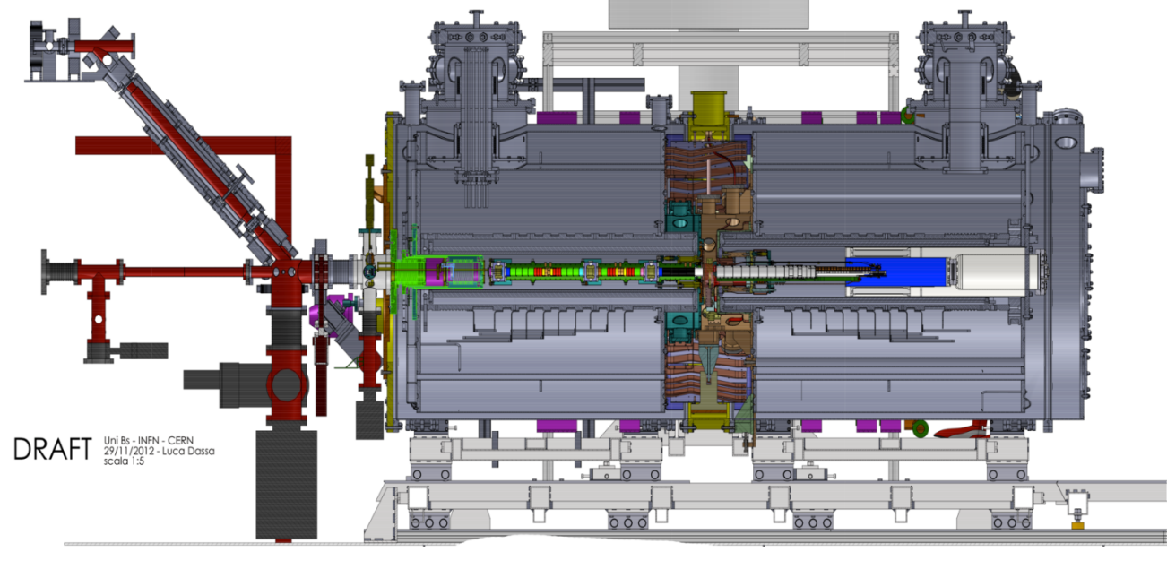
AEgIs setup
TRAP BASIC
e+ measurement setup :
g measurement
Region (not installed)
Buffer gas type e+ accumulator
Magnetic pulsed e+ transfer line
5T
1T
Antiprotons from AD
Accumulator for e+
Magnetic transfer line for e+
Superconducting magnetic fields with cryogenic traps (105 electrodes)
antiH detector
External (scintillators) and internal (MCP+phosp.; Faraday cups in cryo-UHV ) detectors
lasers
POSITRON MEASUREMENT setup

Slide 6
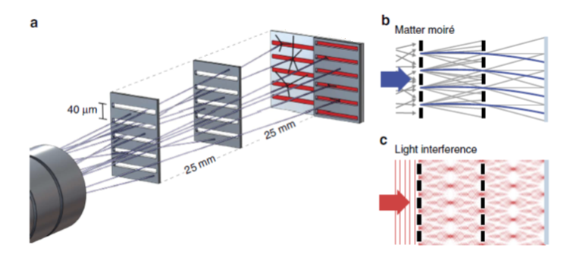
Grating system and position sensitive detector
Measurements during the antiproton beam time
Two identical transmission gratings followed by a nuclear emulsion detector
Absolute Light (Talbot-Lau interferometer) referencing of the observed antimatter pattern
AEgIS collaboration
Light is not shifted
Antiprotons are shifted
Force: residual magnetic field
Amount of the shift: as in the gravity meas. !!!
d= grating period

Slide 7
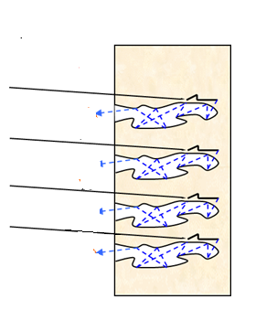
Pulsed Ps formation on nanochannels in AEgIS (in the e+ measurement setup)
e+ converter
Ps signal in Si p-type (111)
10⁷ e+, 3 mm radius, <6 ns length
PRELIMINARY
Positrons
Ps
Positronium
Detector: PbWO₄ + PMT
oPs: 142 ns lifetime
it annihilate on flight
pPs: 128 ps lifetime (no visible)

Slide 8
Ps laser excitation to n=3 in the e+ meas. setup in AEgIS
ionization
Form Ps then switch on the UV laser (excite n=3)
Switch on a second IR laser for ionization
Detect changes in the time profile of the annihilations
IR
n=3
UV
n=1
PRELIMINARY
NOTE:
n=3 never done before
(another group has done n=2)

Slide 9
Ps excitation to n=15-16 in AEgIS starting from n=3
Rydberg
PRELIMINARY
IR
n=3
UV
n=1

Slide 10
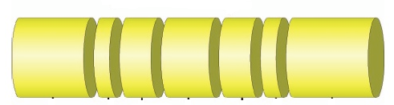
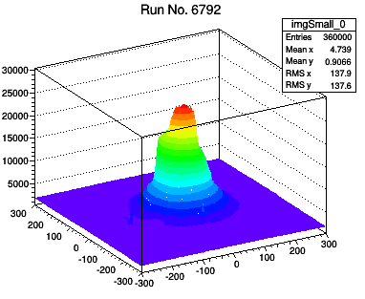
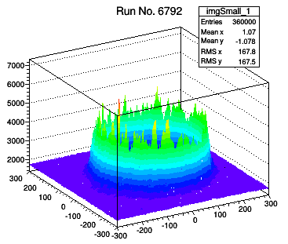
Trapped Cold Antiprotons
TRAP BASIC
Pbar+e-
electrons
MCP+PhosPh
B
Electrons radiate energy (high B)
They reach thermal equilibrium with the 10 K ambient (ideally)
Antiprotons cool by coollisions
Centrifugal separation !!!
expected for pbar and e- in thermal equilibrium
estimation of the plasma temperature
antiprotons
Temperature of the antiprotons:
10-20 K (1-2 meV) consistent with
the trap temperature !!!!
r= 5-8 mm
From 5 MeV to meV

Slide 11
Trapped Cold non Neutral Plasma manipulation: radial compression

Slide 12
Diocotron mode excitation in AEgIS :
coherent plasma shift transverse to magnetic field
B
J.R. Danielson, T.R. Weber, C.M. Surko, Phys. Plasmas 13, 123502 (2006)
C. Canali et al., Eur. Phys. J. D 65 (3) 499-504 (2011)
an essential step toward antihydrogen by charge exchange with Ps formation on target
now performed in AEgIS
RF excitation, non linear oscillator (frequency depends on the amplitude )

Slide 13
Diocotron mode excitation in AEgIS (electrons) :

Slide 14
Tuned circuit & cryo-amplifier
tuned circuit and RF cryoamplifier tested at 4 K
Now is installed in AEgIS

Slide 15
AEgIS a Genova
G. Testera 60 % (resp. Naz & Deputy spokes)
S. Zavatarelli 50 %
F. Sorrentino 50%
V. Lagomarsino 100%
D. Krasnicky 100%
R. Caravita 100%
(R. Vaccarone 50% ?)
+ G. Sobrero 100%
Richieste ai servizi
- Servizio elettronica : 2-3 mesi uomo sparsi durante l'anno per realizzazione prototipi, assistenza montaggio
- Servizio progettazione: 6 mesi/uomo a partire da Ottobre (disegno nuova linea trasferimento positroni)
- Servizio officina meccanica: 4-5 mesi a partire da gennaio 2016+ assistenza per piccoli lavori durante tutto l'anno.
- Uso dell'elio e azoto saltuario.

Slide 16
AEgIS a Genova
Gruppo responsabile della cattura, raffreddamento, manipolazione di elettroni, antiprotoni e positroni
nei magneti superconduttori
Realizzazione trappole
Progetto custom e realizzazione elettronica per tutte le manipolazioni (V. Lagomarsino) e la rivelazione
DAQ e data Analysis (e simulazioni)
Non neutral trapped cold plasma physics
Run&setup laser per eccitazione
Attivita’ prevista nel prossimo anno
Simulazioni comportamento plasmi con GPU
Presa dati & analisi con pbar ( run al CERN dal 6 luglio fino a fine novembre)
Presa dati con positroni (in assenza di pbars)
Modifiche del sistema di trasferimento di positroni dalla zona di accumulazione al target nella zone 1 Tesla
Studio fase 2 di AEgIS (interferometria anti-atomica)

