Slide 1
Towards the South African Underground Physics Laboratory
LNGS (2015)
Collaboration
Shaun Wyngaardt * (Physics Department, Stellenbosch University)
Richard Newman (Physics Department, Stellenbosch University)
Robbie Lindsay (Physics Department, University of the Western Cape)
Andy Buffler (Physics Department, University of Cape Town)
Jacques Bezuidenhout (Saldanha Military Academy, Stellenbosch University)
Rob de Meijer (EARTH Foundation)
Peane Maleka (iThemba LABS National Research Foundation)
Ricky Smit (iThemba LABS National Research Foundation)
Rudolph Nchodu (iThemba LABS National Research Foundation)
Milton van Rooy (Physics, Department, Stellenbosch University)
Zikona Ndlovu (Physics, Department, Stellenbosch University)

Slide 2
Outline
Background
History of Underground Physics in SA
SAUPL (Phase 1 & 2)

Slide 3
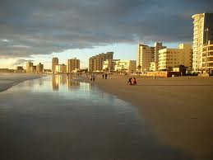
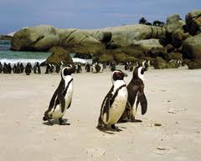
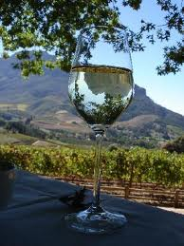
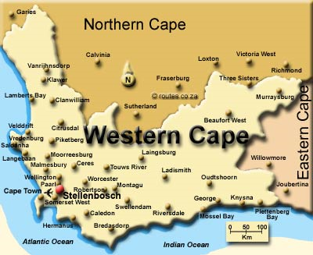
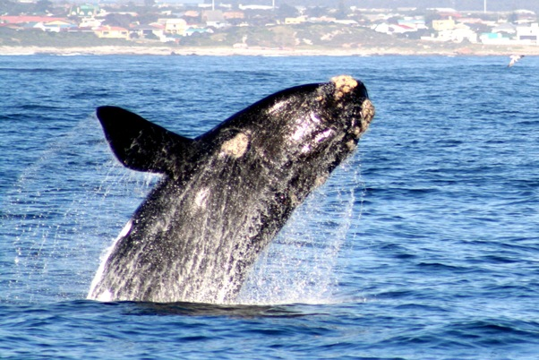
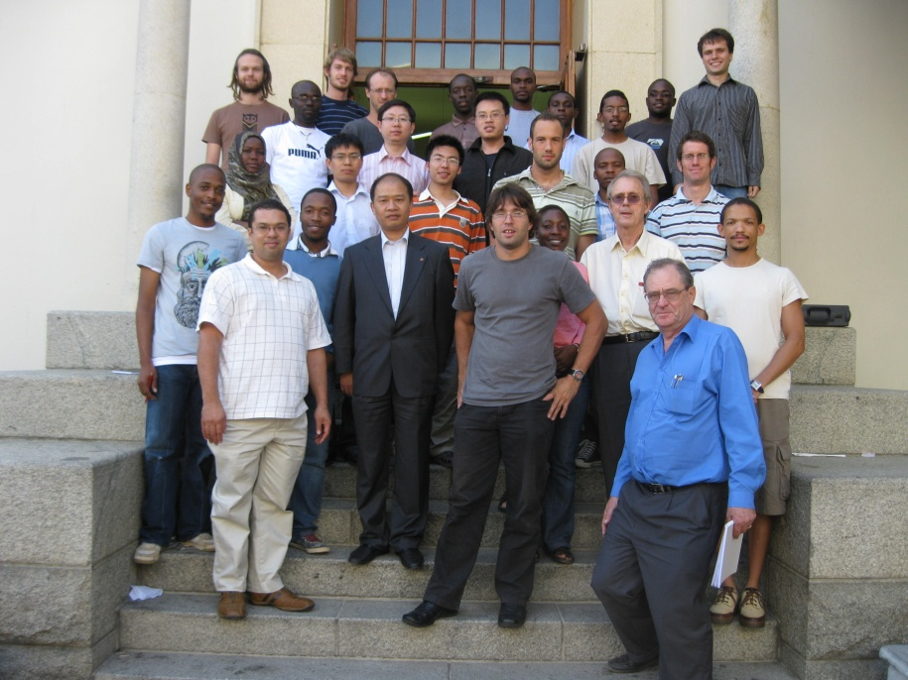
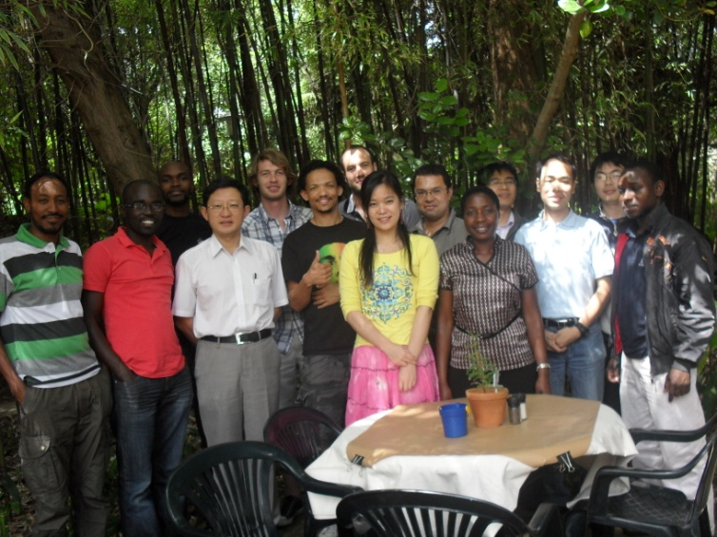

Slide 4
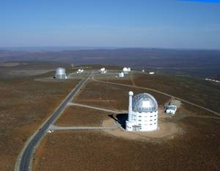
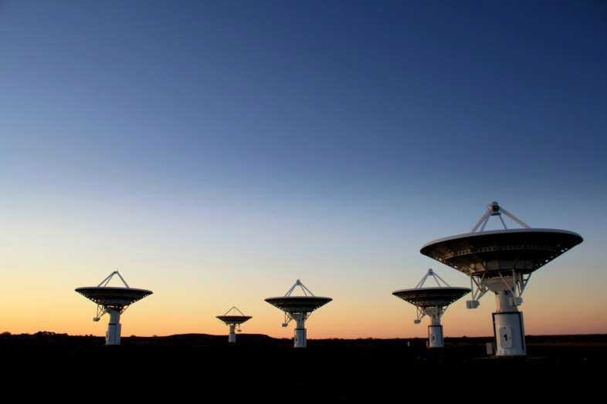
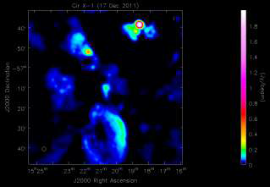
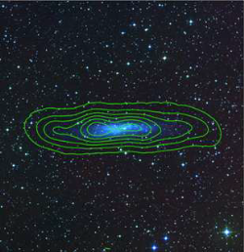
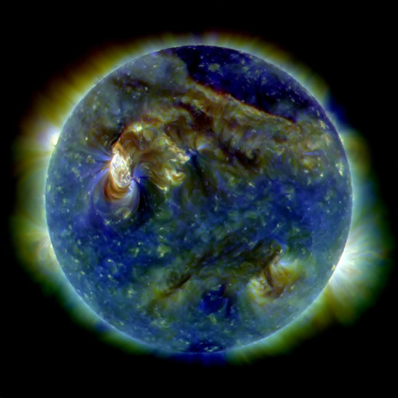
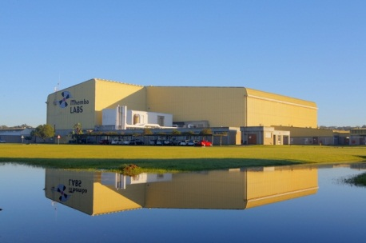
South African Astronomical Observatory
Square Kilometer Array
iThemba LABS

Slide 5
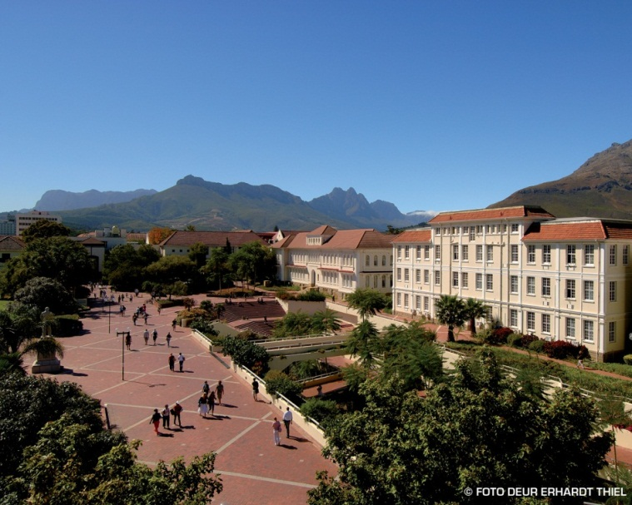
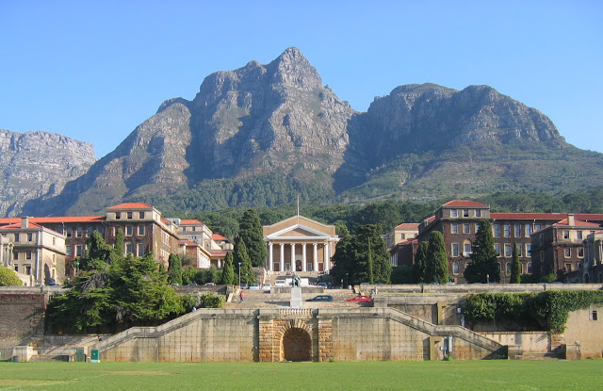
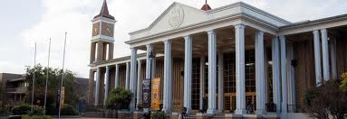
World Class Universities
Stellenbosch University
University of Cape Town
University of the Western Cape

Slide 6
Introduction
Discussions about an underground research facility in SA started in 2011.
South Africa has a number of the worlds deepest gold mines (TauTona Gold Mine ~3.9 km)
Initial focus was on establishing an underground facility in one of South Africa’s deep gold mines.
The alternative is to develop such an underground laboratory inside the Huguenot Tunnel.

Slide 7
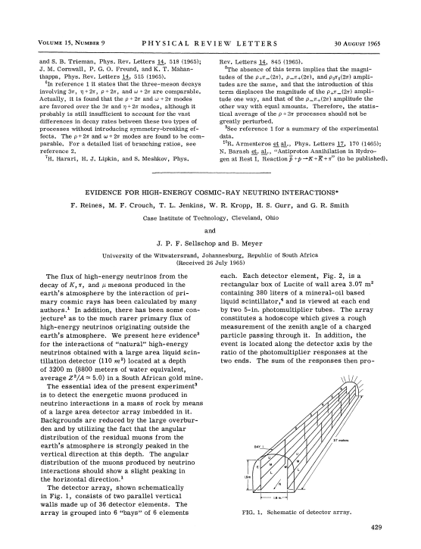
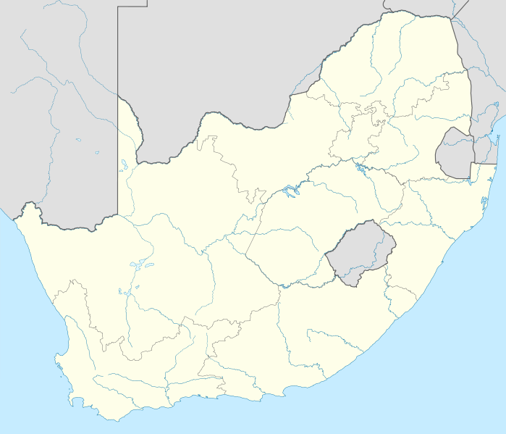
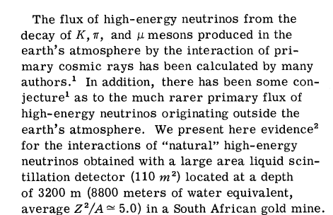
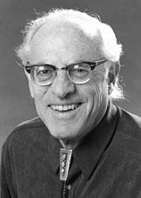
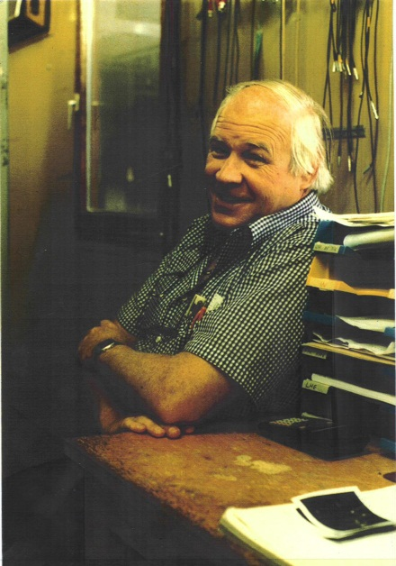
Underground Physics in SA
Phys Rev Lett, 15, 429 (1965)
Phys. Rev. Lett. 15, 429 (1965)
Frederick Reines
Friedel Shellschop

Slide 8
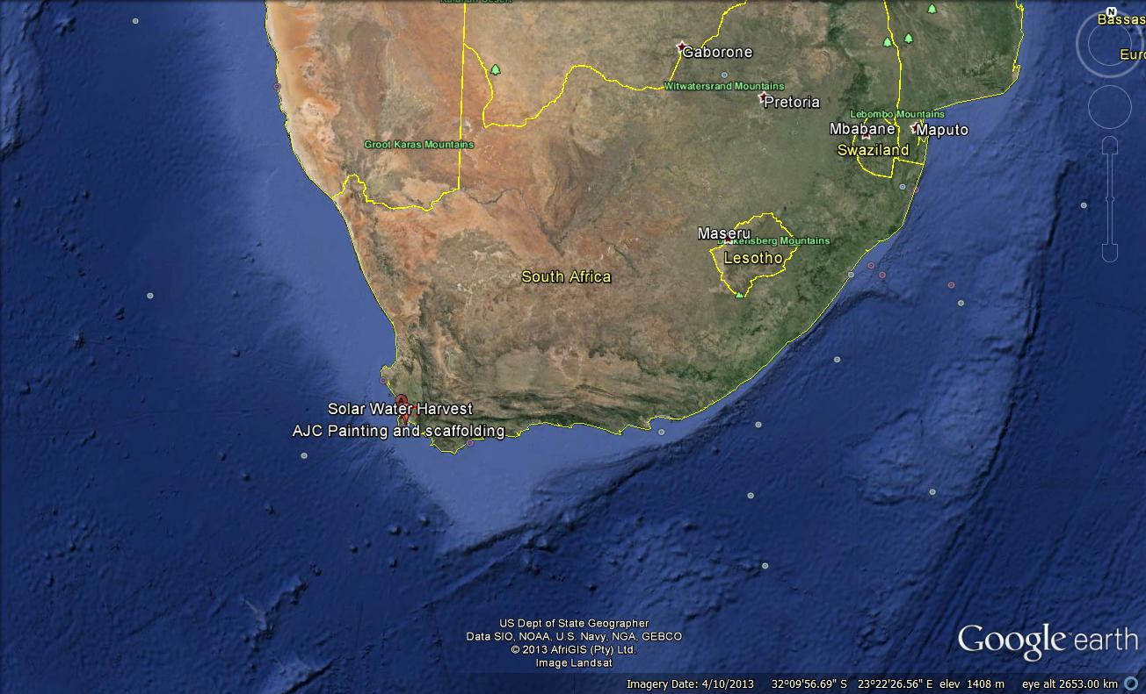
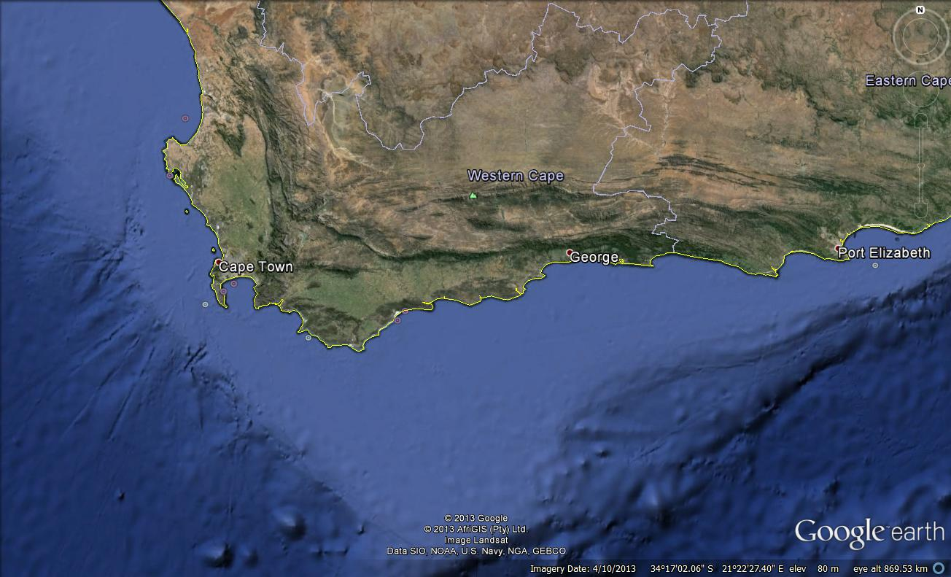
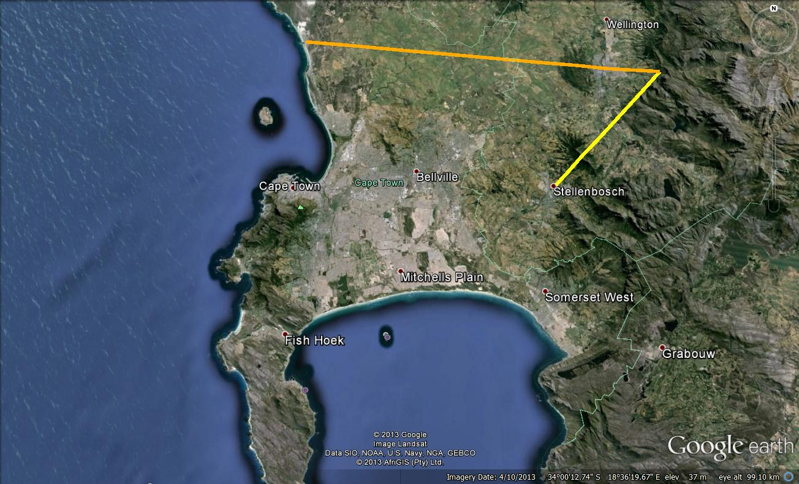
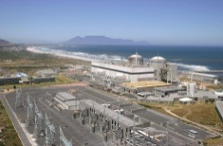
Koeberg Nuclear Power plant
Huguenot Tunnel
60 km
25 km

Slide 9
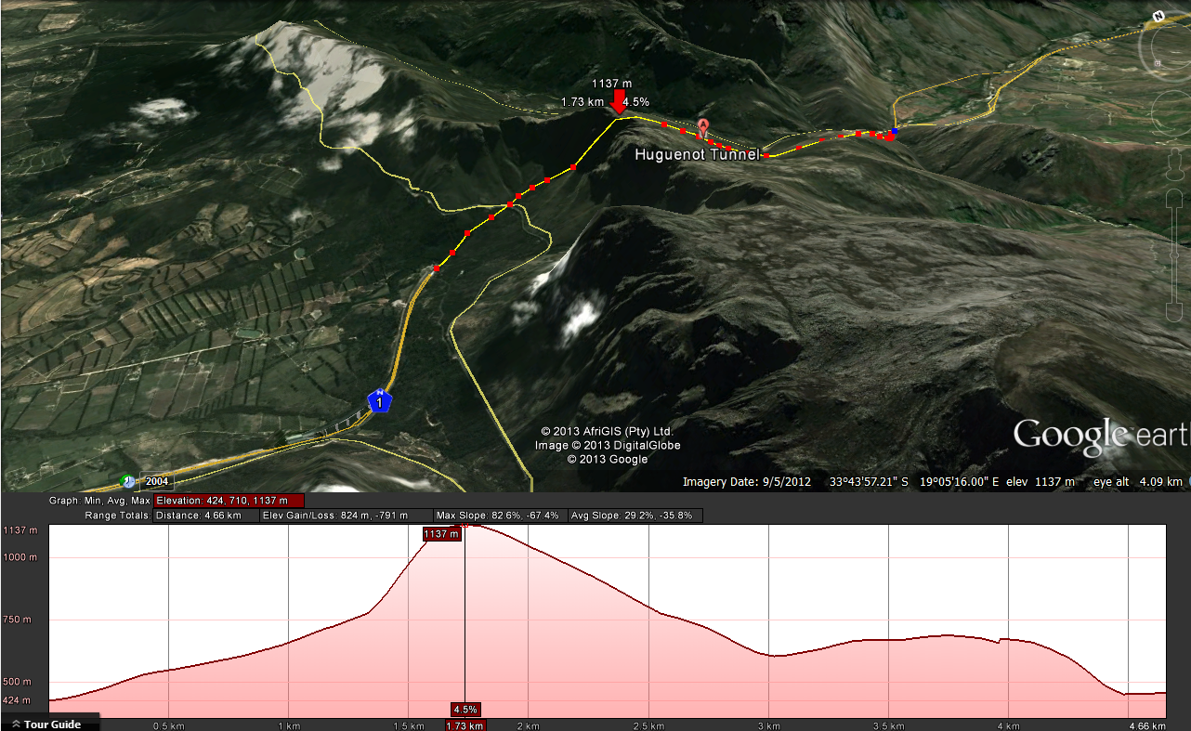
East Entrance
West Entrance
The range mostly consists of Table Mountain sandstone, an erosion-resistant quatzitic sandstone

Slide 10
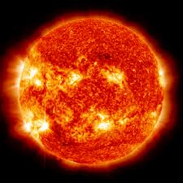
Possibility for developing
a low level radiation
Lab

Slide 11
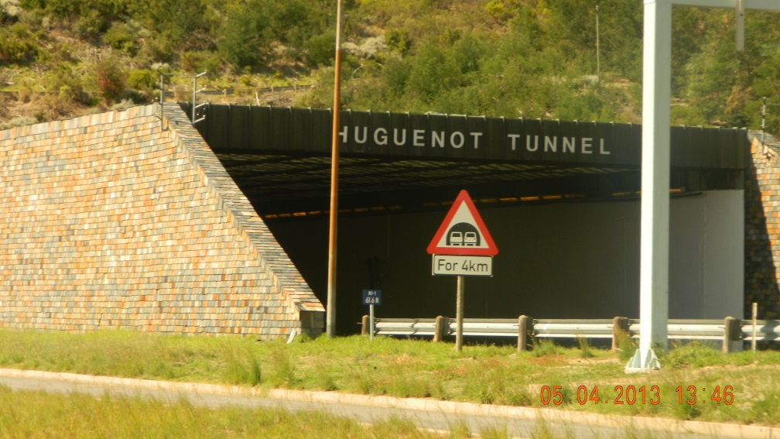
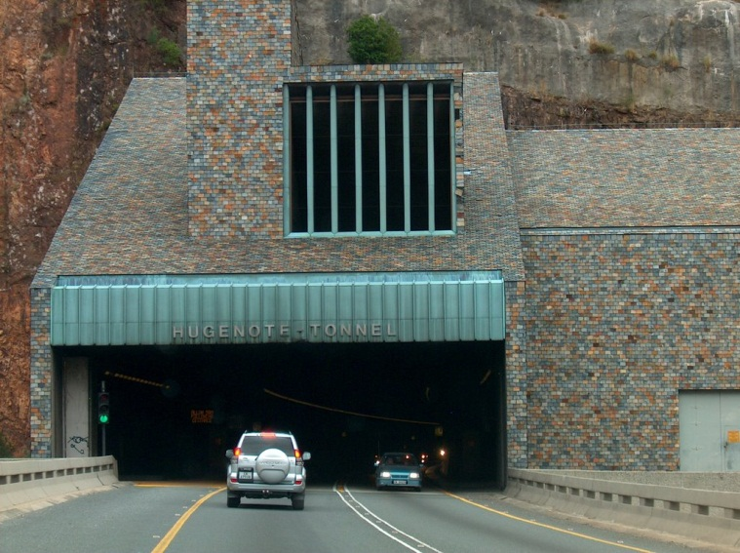
Huguenot Tunnel survey 05 April 2013
PP Maleka¹, NB Ndlovu^{1,2}, RT Newman², S Tshingana¹, M Van Rooy^{1,2}
iThemba LABS
Stellenbosch University

Slide 12
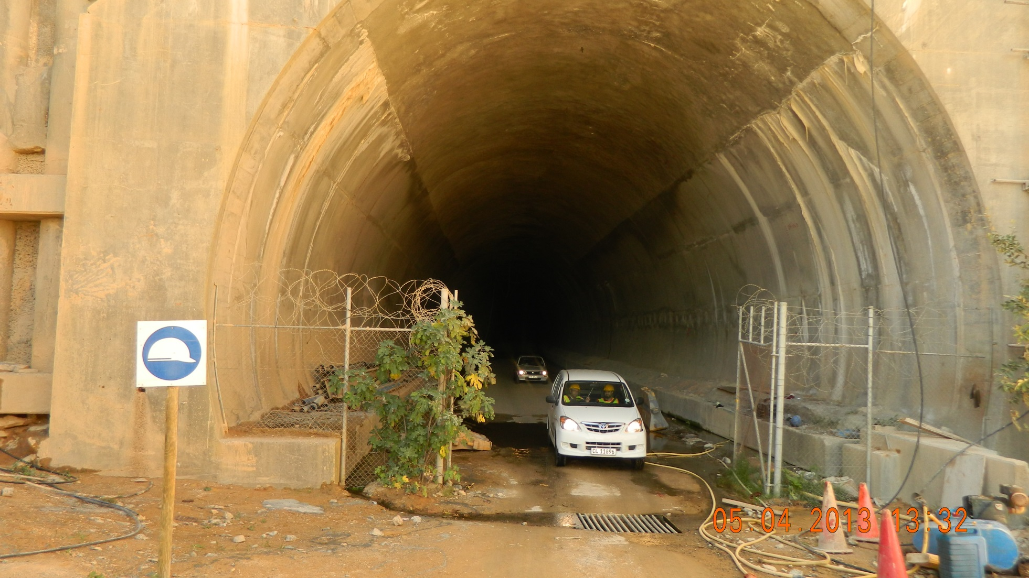
The view from the outside of the tunnel (Cape Town end)

Slide 13
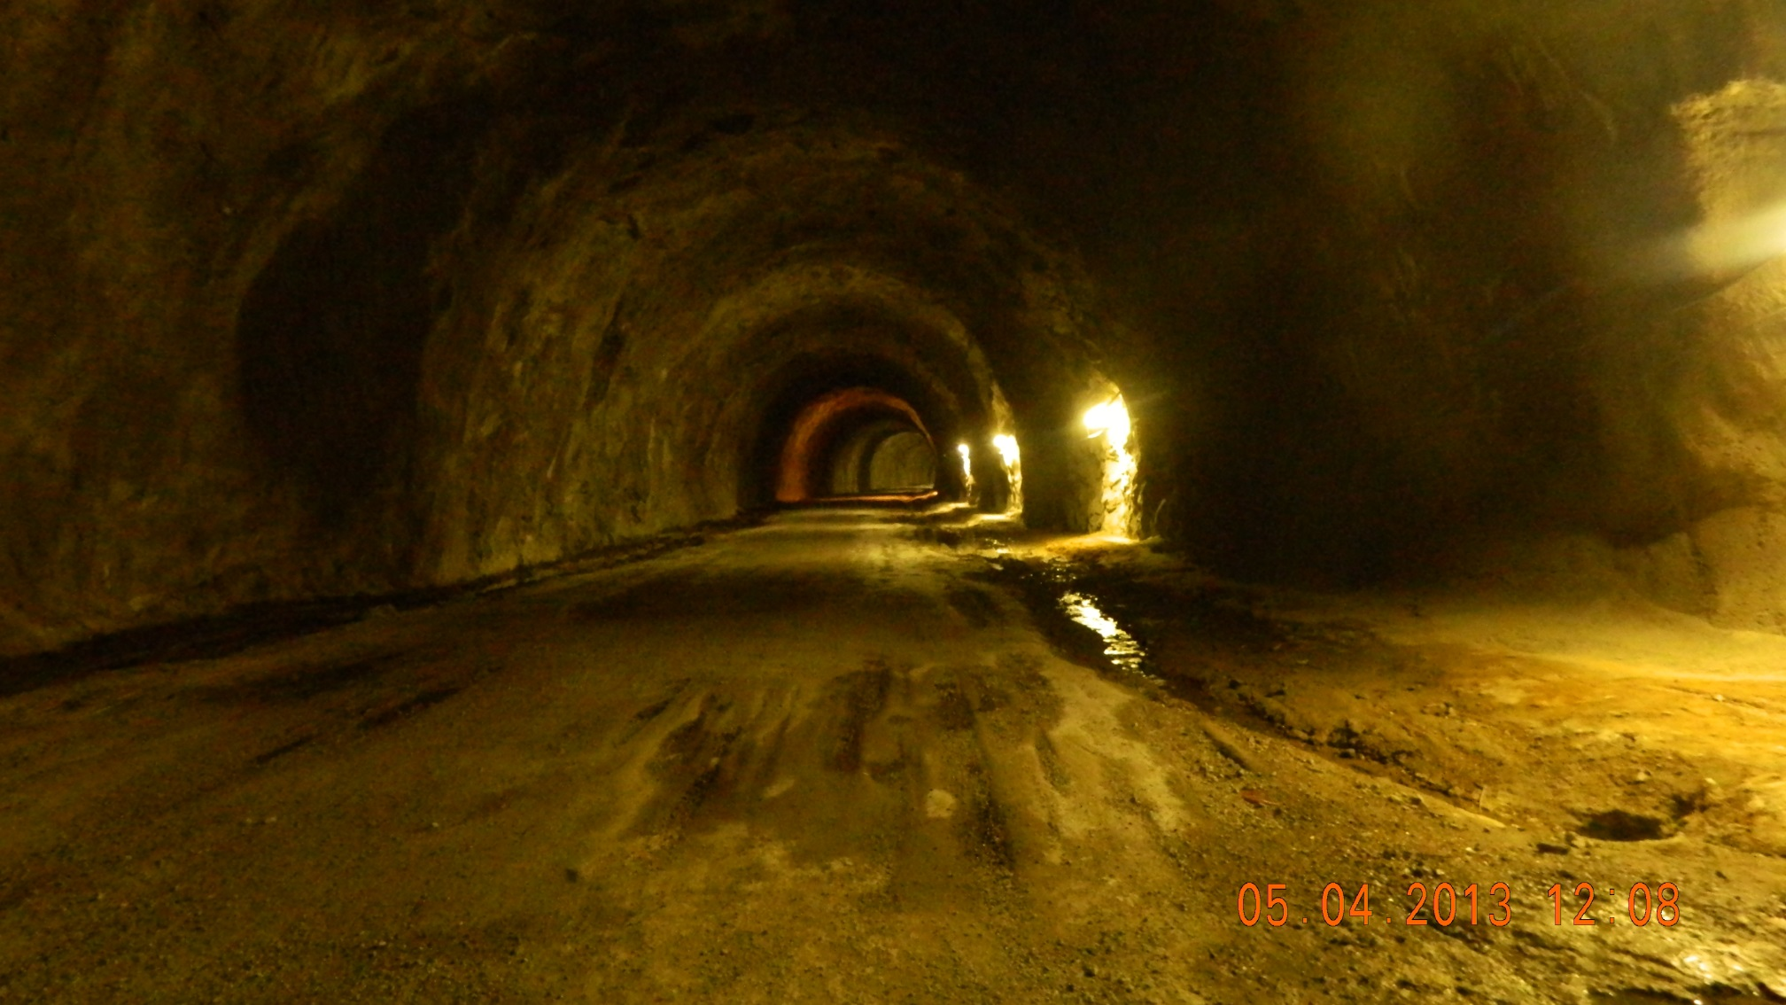
The picture view of the tunnel

Slide 14
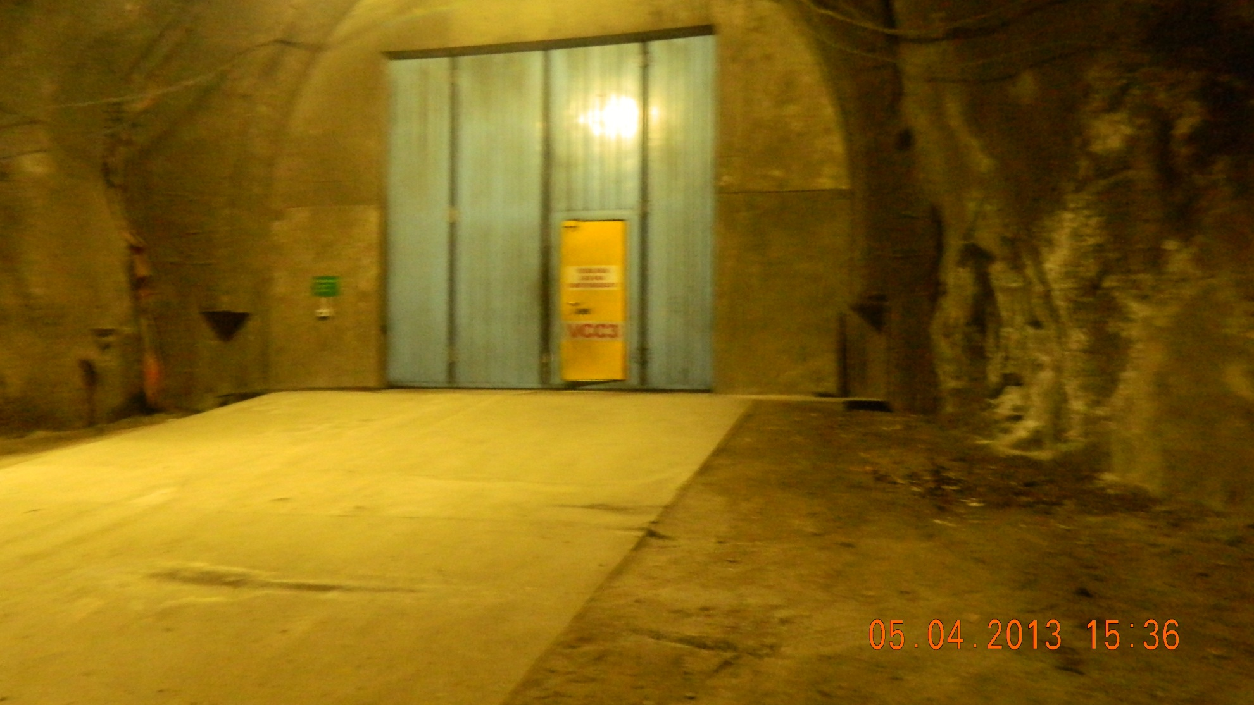
Picture view of one of the VCC (Vehicle Cross-Cut), electret were deployed close by

Slide 15
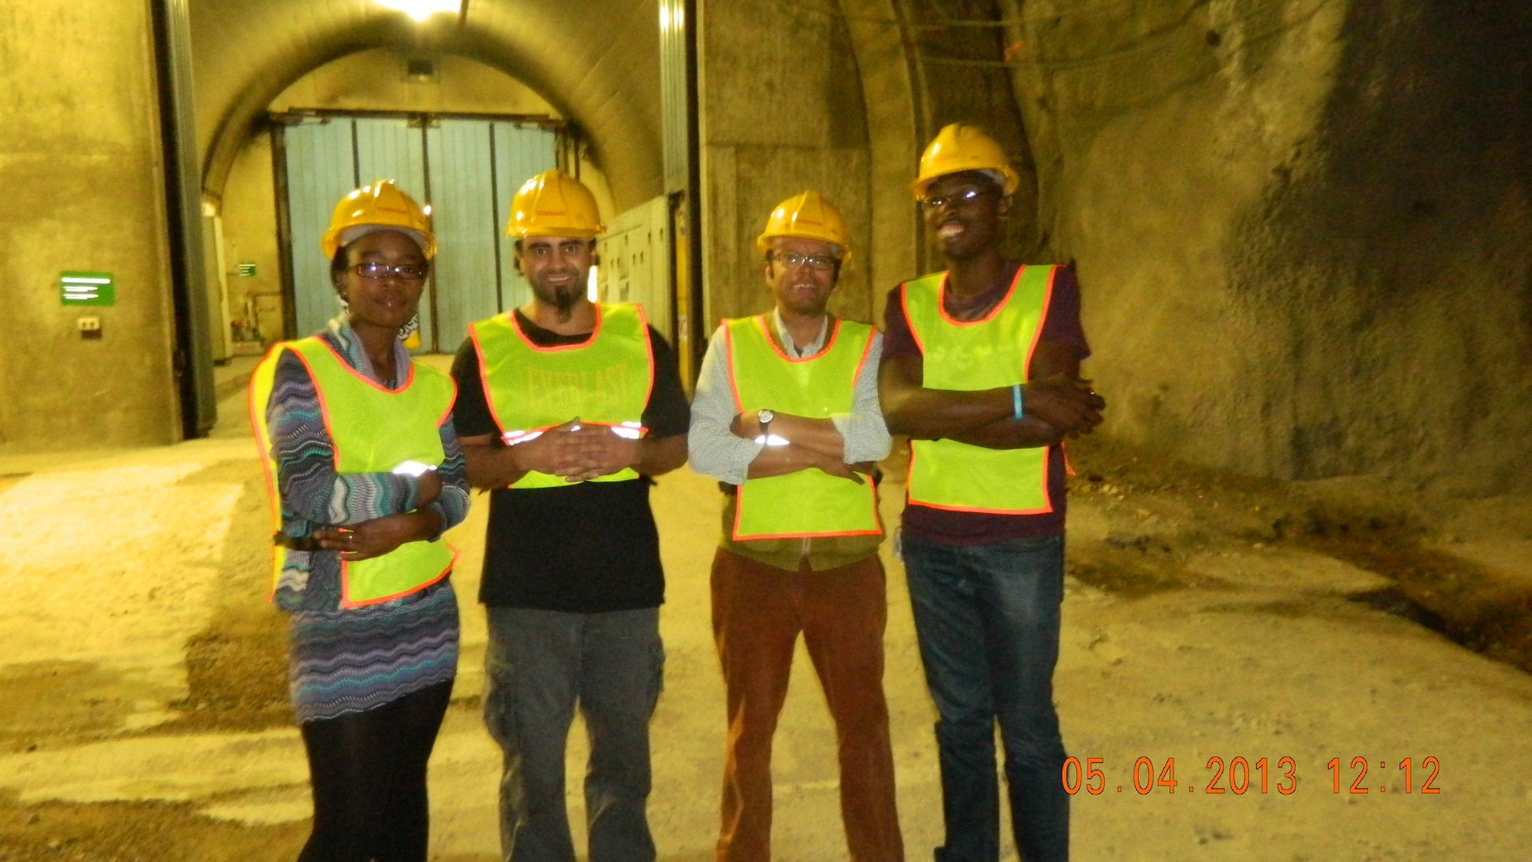
The team; Zina, Milton, Richard and Siya

Slide 16
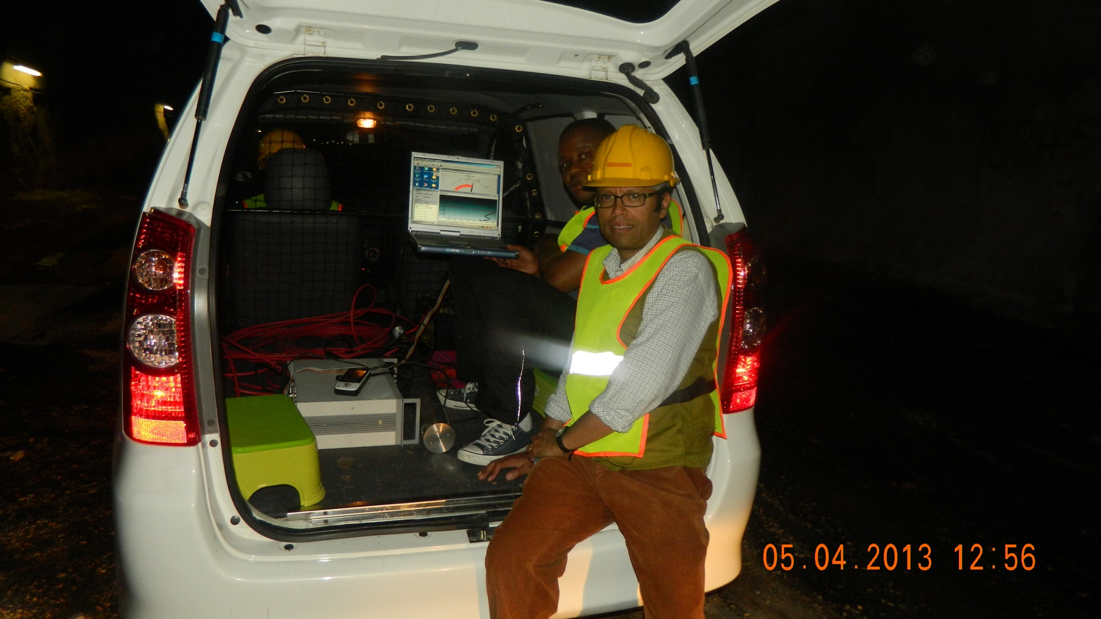
MEDUSA (multi-element detector using a scintillator array) setup for gamma-ray mapping

Slide 17
Phase 1
Perform a survey the tunnel
Identify reasonable science programs/project
Train future researchers in low level radiation physics and develop a dedicated underground physics program

Slide 18
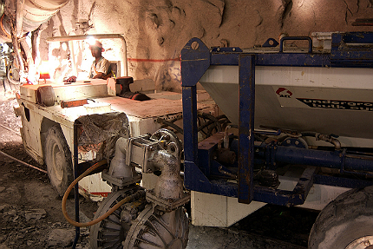
Phase 2
7 deepest mines in the world are located in the RSA
Mponeng gold mine in South Africa is currently the deepest mine in the world.

Slide 19
English: Thank you Afrikaans: Dankie IsiNdebele: Ngiyathokoza Sesotho: Ke a leboha Northern Sotho: Ke a leboga Setswana: Ke a leboga SiSwati: Siyabonga Xitsonga: Inkomu Tshivenda: Ndo livhuwa / Ro livhuwa IsiXhosa: Enkosi IsiZulu: Ngiyabonga
Contact: Shaun Wyngaardt (E-mail. shaunmw@sun.ac.za)

