Slide 1
iThemba LABS and the
SA Underground Physics Laboratory initiative
Rudolph Nchodu

Slide 2
Background
iThemba L(aboratory) for A(ccelerator) B(ased) S(ciences) is a multi disciplinary research centre, operated by the NRF (National Research Foundation). It provides accelerator and ancillary facilities for:
  Research and training in the physical, biomedical and material sciences
  Treatment of cancer patients with energetic neutrons and protons and related research
  Production of radioisotopes and radiopharmaceuticals for use in nuclear medicine, research and industry and related research

Slide 3
Background
Strategic Objectives
Improve quality and quantity of research outputs
Increase training capacity
Strengthen collaboration with Higher Education sector
Forge closer ties with SA, African and International S+T institutions
Scientifically service research groups that want to use International facilities

Slide 4

Z I M B A B W E
M O Ç A M B I Q U E
N A M I B I A
B O T S W A N A
N A M I B I A
N A M I B I A
Johannesburg
SWAZI-
LAND
6 MV EN Tandem
Ion Implanter
(Gauteng)
KIMBERLEY
NORTHERN CAPE
LESOTHO
Durban
NORTHERN CAPE
SOUTH AFRICA
Colesburg
Cape Town
Port Elizabeth
Notes:
SPC: Solid Pole Cyclotron

Slide 5
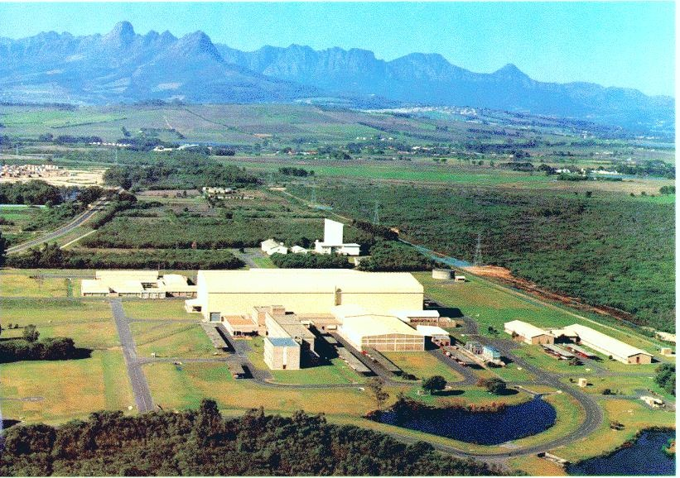
iThemba LABS Cape Town Site

Slide 6
Multi-User Facility
Proton Therapy: 200 MeV p
Neutron Therapy: 66 MeV p, ~ 40mA
Isotope Production: 66 MeV p, up to 350mA
Nuclear Physics: various beams
Notes:
6
This slide shows the layout of our facilities. Beams from the variable separated-sector cylotron, that has a maximum energy of 200 MeV for protons, are directed to vaults for the production of radioisotopes, proton- and neutrontherapy and nuclear physics experiments. Light ions, pre-accelerated in the first solid-pole injector cyclotron with a K-value of 8 are used for therapy and radioisotope production. For radioisotope production and neutrontherapy a 66 MeV proton beam is used and for protontherapy a 200 MeV beam. The second solid-pole injector cyclotron with a K-value of 10 (which you see here) is used for pre-acceleration of heavy ions and polarized protons from these two external sources

Slide 7
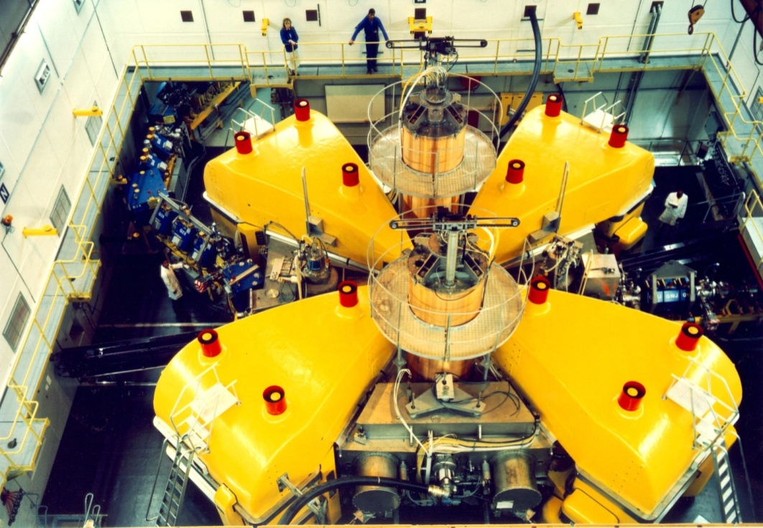
Beams delivered at iThemba LABS
Notes:
This table shows the particle species and beam energies which have been accelerated using the internal PIG (Penning or Philips Ion Gauge) source of the light-ion injector cyclotron and the Minimafios ECR ion source of the heavy-ion injector cyclotron. The ECR source is in use since 1994.

Slide 8
Nuclear Physics on Weekends
Notes:
Beam is delivered to the different users for 24 hours per day and seven days per week. Radionuclide production and neutron therapy run from 16h00 on Mondays until 5h00 on Fridays. Patients are treated during day time and between treatments the beam is switched to the radionuclide production vault and the intensity is increased to 85μA. On Mondays and Fridays a 200 MeV beam is used for proton therapy and over the weekend beams of light and heavy ions as well as polarized protons, pre-accelerated in a second solid-pole injector cyclotron. In spite of this very tight schedule it remains difficult to satisfy the beam requirements of the different users. We are therefore in the process of increasing the beam intensity for the production of radioisotopes as well as installing and planning additional beam lines for the same purpose. It is planned to produce radioisotopes on two different targets simultaneously.

Slide 9
Nuclear Physics Research
Basic research
  AFRODITE
  K600 magnetic spectrometer
  ALICE-CERN
Applied Research
  Neutron physics
  Environmental Radioactivity Laboratory
  Target laboratory

Slide 10
Nuclear Physics Research
Nuclear Structure
  Pairing Isomers
  Pairing Vibrations
  Tetrahedral Shapes
  Hyperdeformation
  Chirality
  Giant Resonances
Nuclear Reactions
  Fusion Barrier Distributions
  Incomplete Fusion
  Astrophysical reactions
  Production of intermediate mass fragments
  Reaction Mechanisms

Slide 11
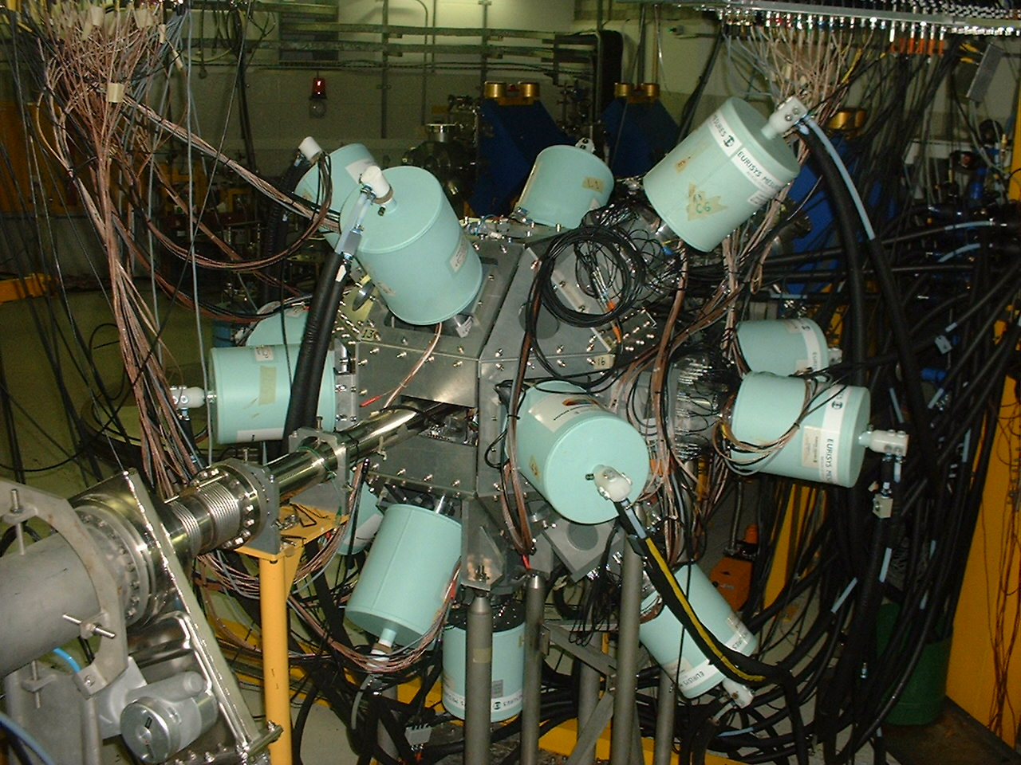
AFRODITE: Gamma Ray Spectroscopy
9 Compton Suppressed Clover detectors
8 LEPS detectors

Slide 12
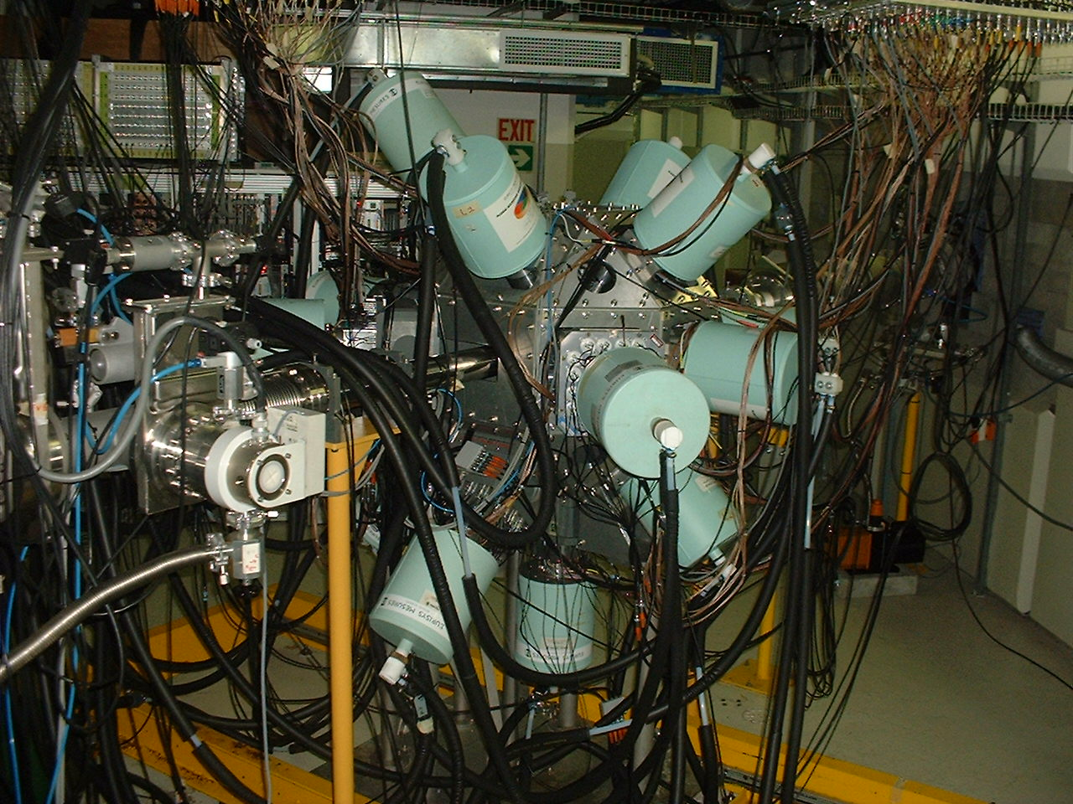
Search for chiral partner bands in many research laboratories, in many nuclei in different mass regions
at iThemba LABS with the AFRODTE gamma-ray array:
→A=80 a new mass region, studies on ^{78,80}Br, by J. Meng et al.
→ A=130 ¹³⁶Pm, studies by P. Datta
→ A=100 ¹⁰⁶Ag, studies by E. Lieder, R. Lieder
→A=190 a new mass region, studies on ¹⁹²⁻¹⁹⁸Tl, by E.A. Lawrie
The new 190 mass region
with AFRODITE:
Postgraduates involved:
P.A. Vymers,
P.L. Masiteng
K. Guthikonda,
J. Easton,
J. Ndayishimiye
O. Shirinda - theory
9 clover detectors
8 LEPS detectors
AFRODITE array

Slide 13
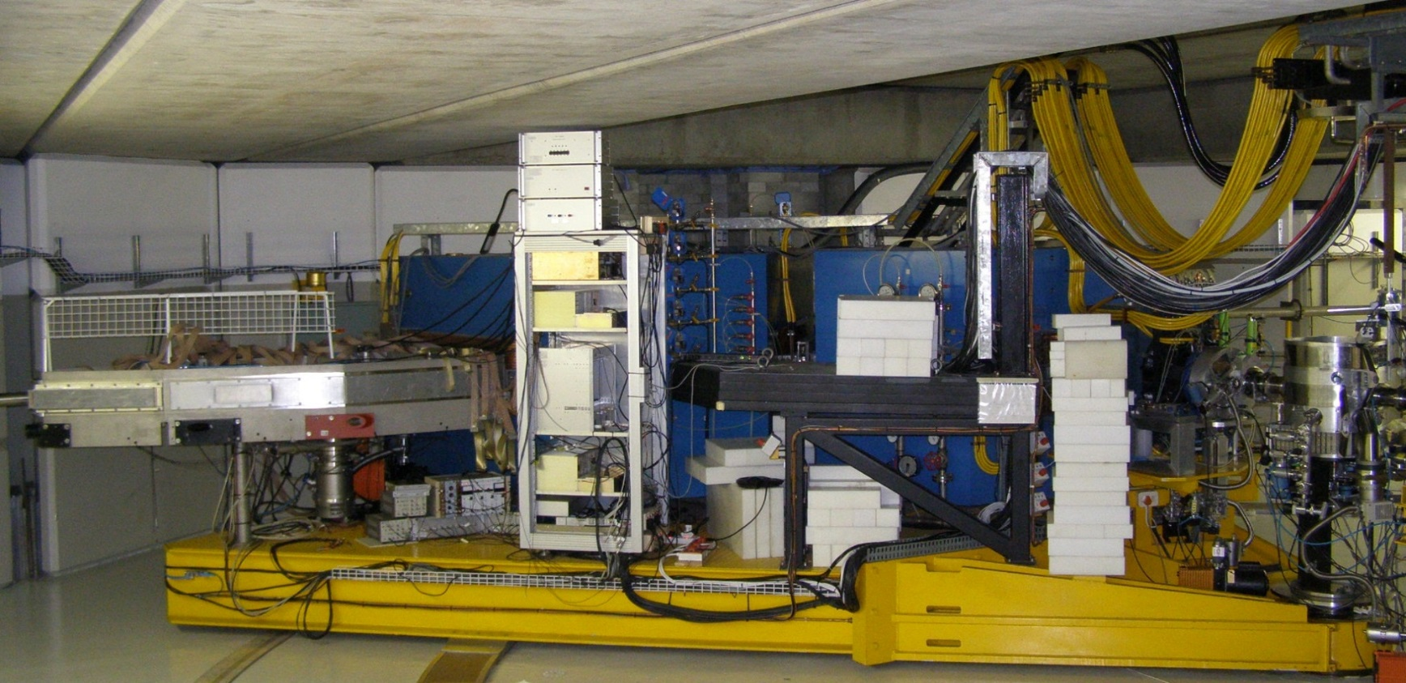
K600 Magnetic Spectrometer

Slide 14
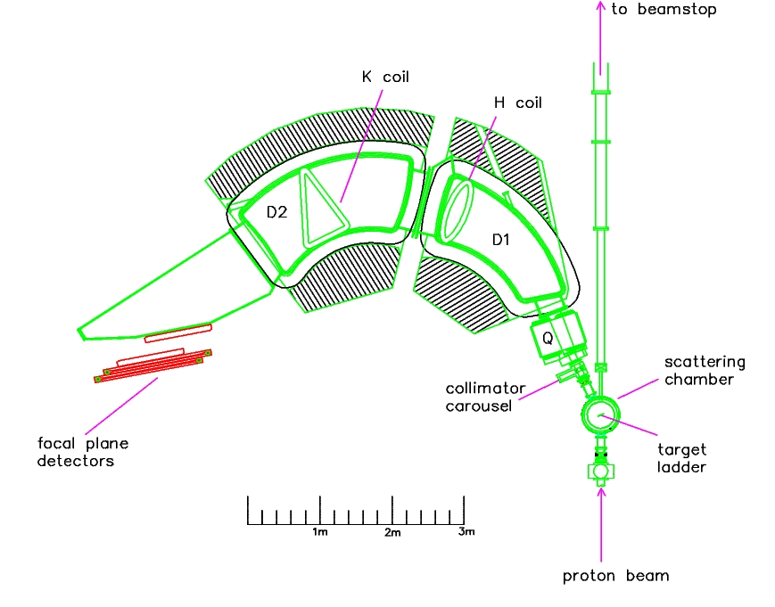
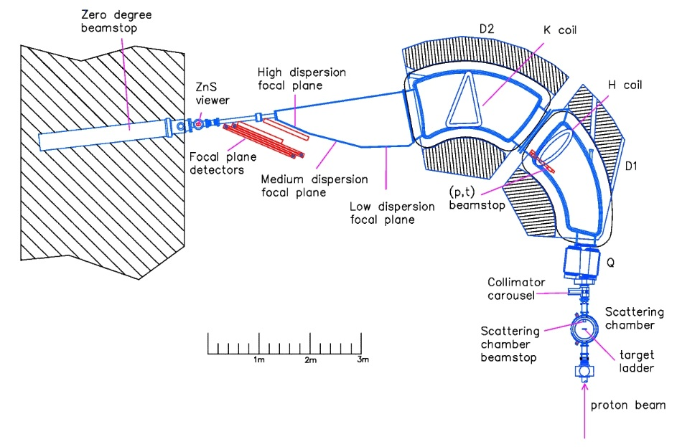
The K600 at iThemba LABS
A kinematically corrected QDD magnetic spectrometer for light ions
3 focal planes (low, medium & high dispersion), nominal bending radius: 2.1m, B_{max}= 1.64 T
Finite angle measurements (θ_{scat}>5°)
Medium dispersion focal plane B(D1)=B(D2)‏
Large momentum range: p_{max}/p_{min}=1.097
Resolving power: ∆p/p = 1/28000
Horizontal magnification M_{x} =-0.52
Vertical magnification M_{y} =-5.5
Dispersion: 8.4 cm/%
Since 1993
Zero degree measurements (θ_{scat}<2°)
High dispersion focal plane B(D1)/B(D2)=1.49‏
Momentum range: p_{max}/p_{min}=1.05
Horizontal magnification M_{x} =-0.74
Vertical magnification M_{y} =-7.05
Dispersion: 10.9 cm/%
Since 2009
Notes:
K600 is used for high resolution singles measurements for nuclear reaction and nuclear structure studies.
e.g. the fine structure studies of the giant quadrupole resonance at finite angles and the finite structure of the giant dipole resonance.
Proton and alpha knockout reactions,
Studies of the Hoyle state and its excitations etc.

Slide 15
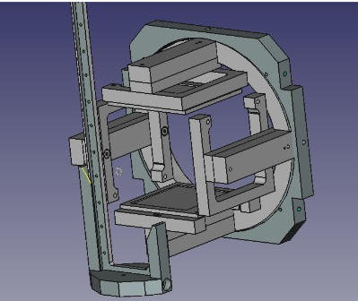
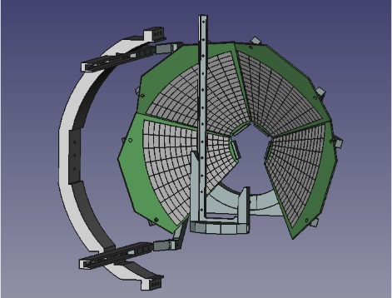
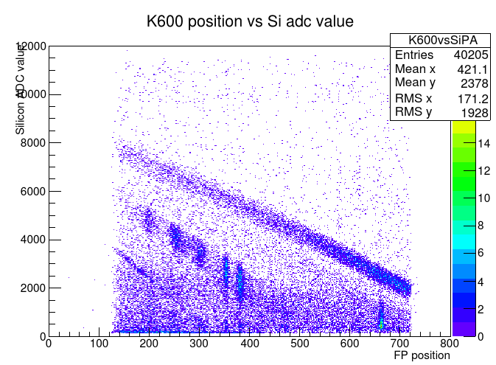
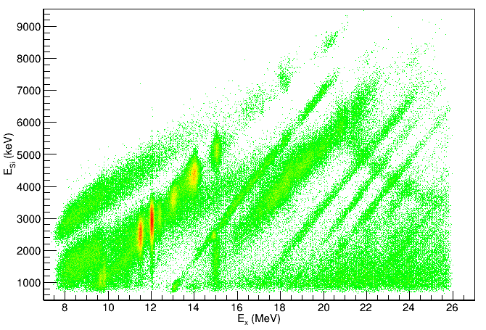
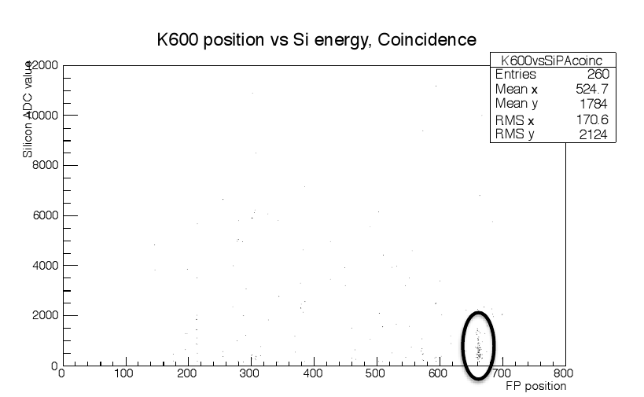
The K600 at 0° and particle decay
Characterize particle decay path: branching ratios, spin assignments
Current interest:
- Search for alpha cluster states (¹⁶O, ²⁰Ne, ²⁴Mg, ²⁸Si, ²⁷Al)
- Clustering and superdeformed states: search for SD states in ²⁸Si,³⁰S
- Pair decay of astrophysically important states (e.g. Hoyle)
W1
Li₂CO₃(α,α') @ 120 MeV
in coincidence with single DSSSD
hit
Li₂CO₃(α,α') @ 200 MeV
in coincidence with single DSSSD
hit
E in Si (keV)
MMM
¹⁶O: α0 p0 α1 p1p2
focal plane position
⁷Li
double DSSSD hit
clearly see only 6.049 MeV state in ¹⁶O; pair decay
E in Si (keV)
focal plane position
Notes:
Coincidence measurements were made possible by the acquisition of equipment through the NEP program
For the bottom left figure:
16O nucleus was excited and particles coming off the nucleus are detected by the double sided silicon detectors
It is clear from the kinetics which particles is which and there is no need for the DE-E detector.
Can extract branching ratios

Slide 16
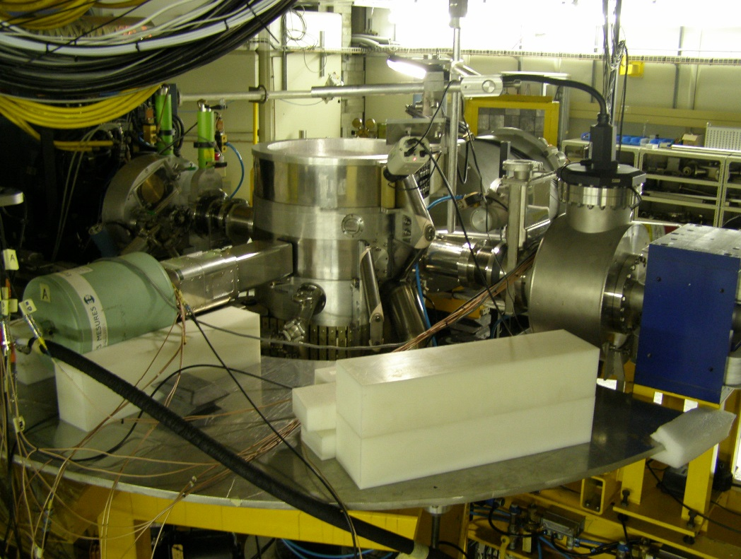
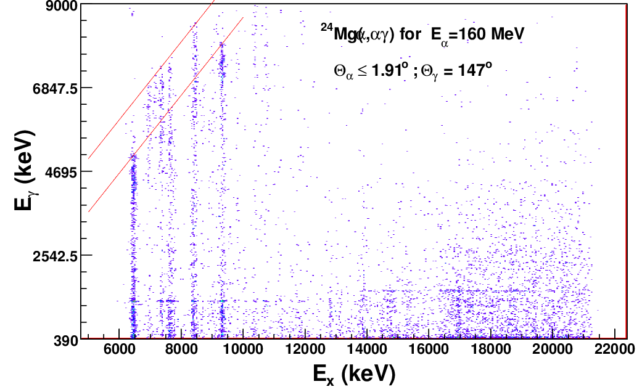
The K600 at 0° and gamma decay
Select excited state with K600, characterize decay through gamma detection
Sensitive to weak gamma branches, e.g. locating SD bandheads in light nuclei
At zero degrees focus on low L transfer states
Study of the low energy part of the E1 response through (p,p’γ) and (α,α’γ)
First tests: December 2012
isovector, volume
isoscaler, surface
Transition to: gs 1368 keV
0⁺ 6.433
²⁴Mg 1368 keV
²⁰Ne 1634 keV

Slide 17


THE ALICE COLLABORATION
History of the ALICE Experiment:
1990-1996 Design
1992-2002 R&D
2000-2010 Construction
2002-2007 Installation
2008 -> Commissioning
4 TP addenda along the way:
  1996 Muon spectrometer
  1999 TRD
  EMCAL
  DCAL
LoI for the Upgrade
2012-2014 R&D
2014-2016 Procurement/Fabrication
2016-2017 Integration, pre-commissioning
2018-2019 Installation, commissioning
2019-2020 Full deployment of DAQ/HLT
7 Collaborators coming from 3 Institutes:
University of Cape Town (UCT), Cape Town
iThemba LABS, Somerset West
University of the Witwatersrand (WITS), Johannesburg
Source: Alice Collaboration Data Base, June 2014

Slide 18
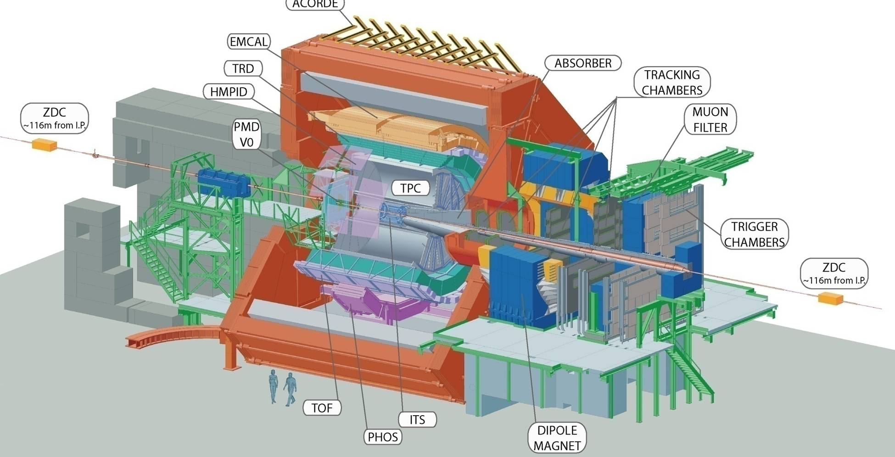

SOUTH AFRICA IN ALICE
Maintenance and Operations
Sub-detectors
  Muons Tracking and Trigger
  TRD
  Muon High Level Trigger (HLT)

Slide 19
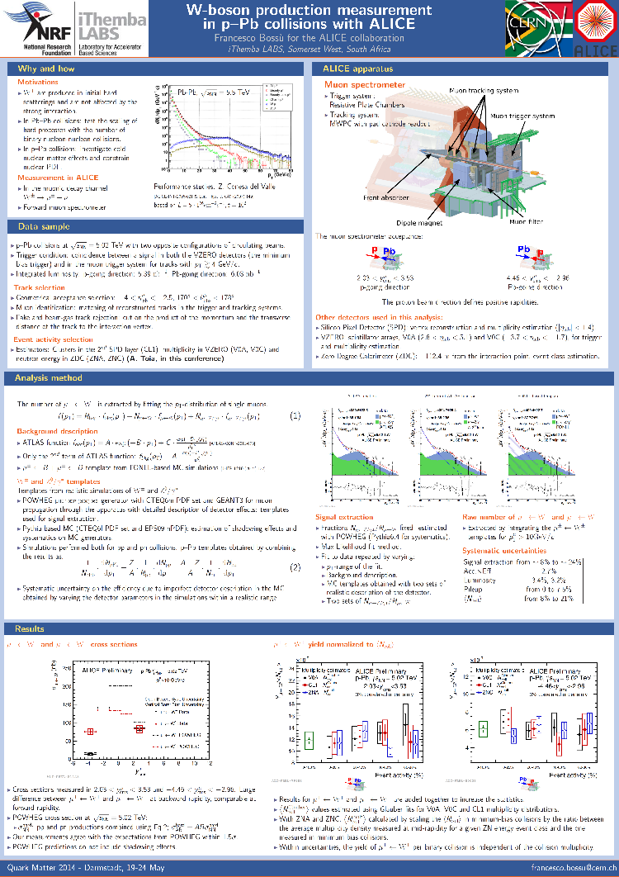
Physics:
Electroweak Bosons:
W boson production measurement in pp and p-Pb collisions
with ALICE
W± are produced in initial hard scatterings and are not affected by the
strong interaction.
In Pb-Pb collisions: test the scaling of hard processes with the number of binary nucleon-nucleon collisions.
In p-Pb collisions: investigate cold nuclear matter effects and constrain nuclear PDF.
In pp collisions: use as a candle to test detector efficiency and performance
Measurement in ALICE
In the muonic decay channel W± →μ± + ν
Forward muon spectrometer
Preliminary results presented at QM2014, Darmstadt, 19-24 May 2014
and at the Bormio 2015 conference, 26-30 January 2015
Yield of W versus event activity → test the dependence of this
hard process with the event activity.
Cross-section → is sensitive to cold nuclear matter effects
(shadowing).
Comparison with theoretical predictions based on pQCD NLO with and without shadowing shown in JHEP 1103 (2011) 071 → Shadowing effects are more pronounced at forward rapidity.

Slide 20

Earth AntineutRino TomograpHy
Final Goal: Tomographic image of distribution of natural radioactivity in Earth
Work has been by :
Stichting Earth – Netherlands , local universities and iThemba LABS
Natural radioactivity and nuclear power reactor emit antineutrinos

Slide 21
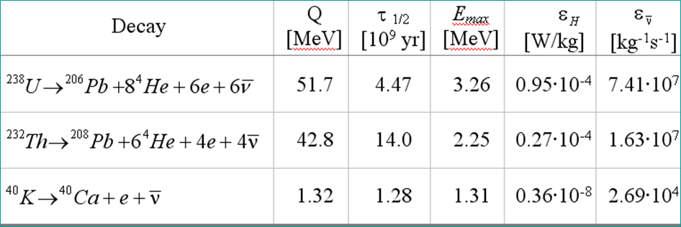
Antineutrinos and detection
Insensitive to large, low energy portion of antineutrino spectrum

Slide 22
Beta decaying Nuclei
Antineutrino capture on a beta-decaying nucleus has NO threshold
Have been examining ²²Na decay at power reactor for several years [ ν_{e} + ²²Na → ²²Ne + e⁺ + ν_{e}+ν_{e}]
M.W. van Rooy - PhD
Cocco et al. http://arxiv.org/pdf/hep-ph/0703075.pdf

Slide 23
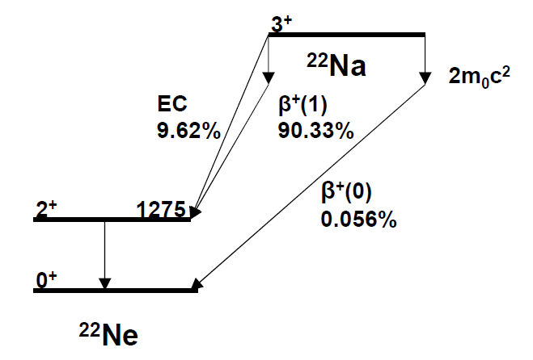
Experiment
²²Na source and 5” NaI well detector
1275 keV – Electron
capture and Beta + decay
1786 keV – Beta + decay only
Look at ratio of two

Slide 24
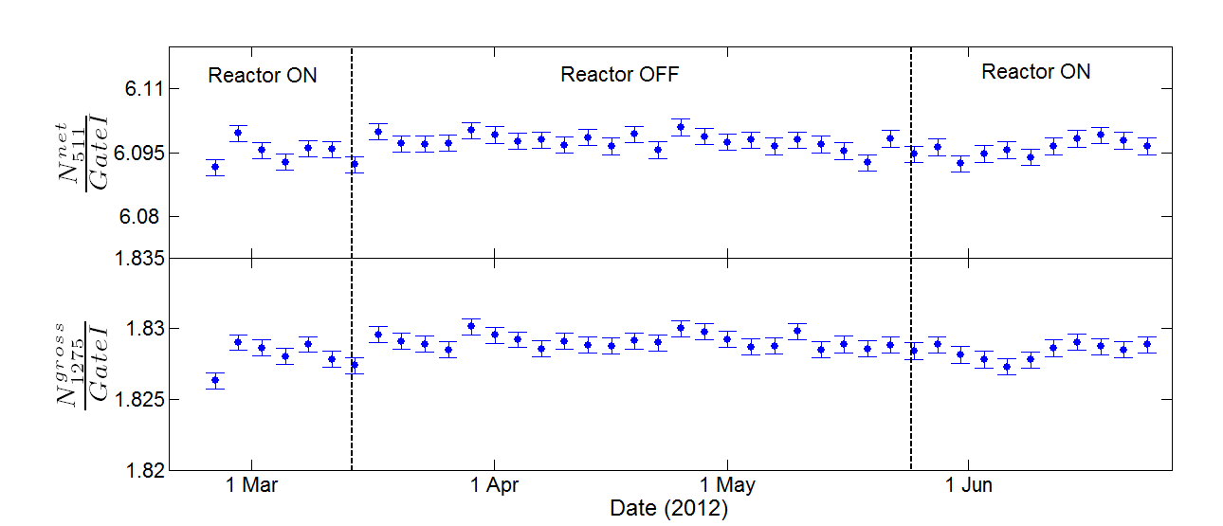
Beta decaying Nuclei
Antineutrino capture on a beta-decaying nucleus has NO threshold
Have been examining ²²Na decay at power reactor for several years [ ν_{e} + ²²Na → ²²Ne + e⁺ + ν_{e}+ν_{e}]
Down to present sensitivity (four orders less than Jenkins and Fischbach), observed no variation in decay rate. M.W. van Rooy - PhD
Cocco et al. http://arxiv.org/pdf/hep-ph/0703075.pdf

Slide 25
Thank you

Slide 26
Environmental Radiation Lab
Measurement of low level radiation
Measurement of Radon in air and water
Monitoring air pollution

Slide 27
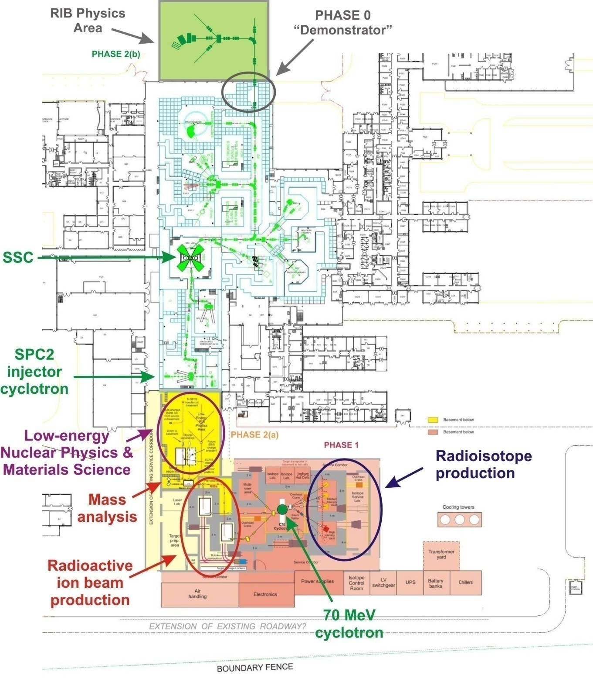
Additions to the existing facility

Slide 28
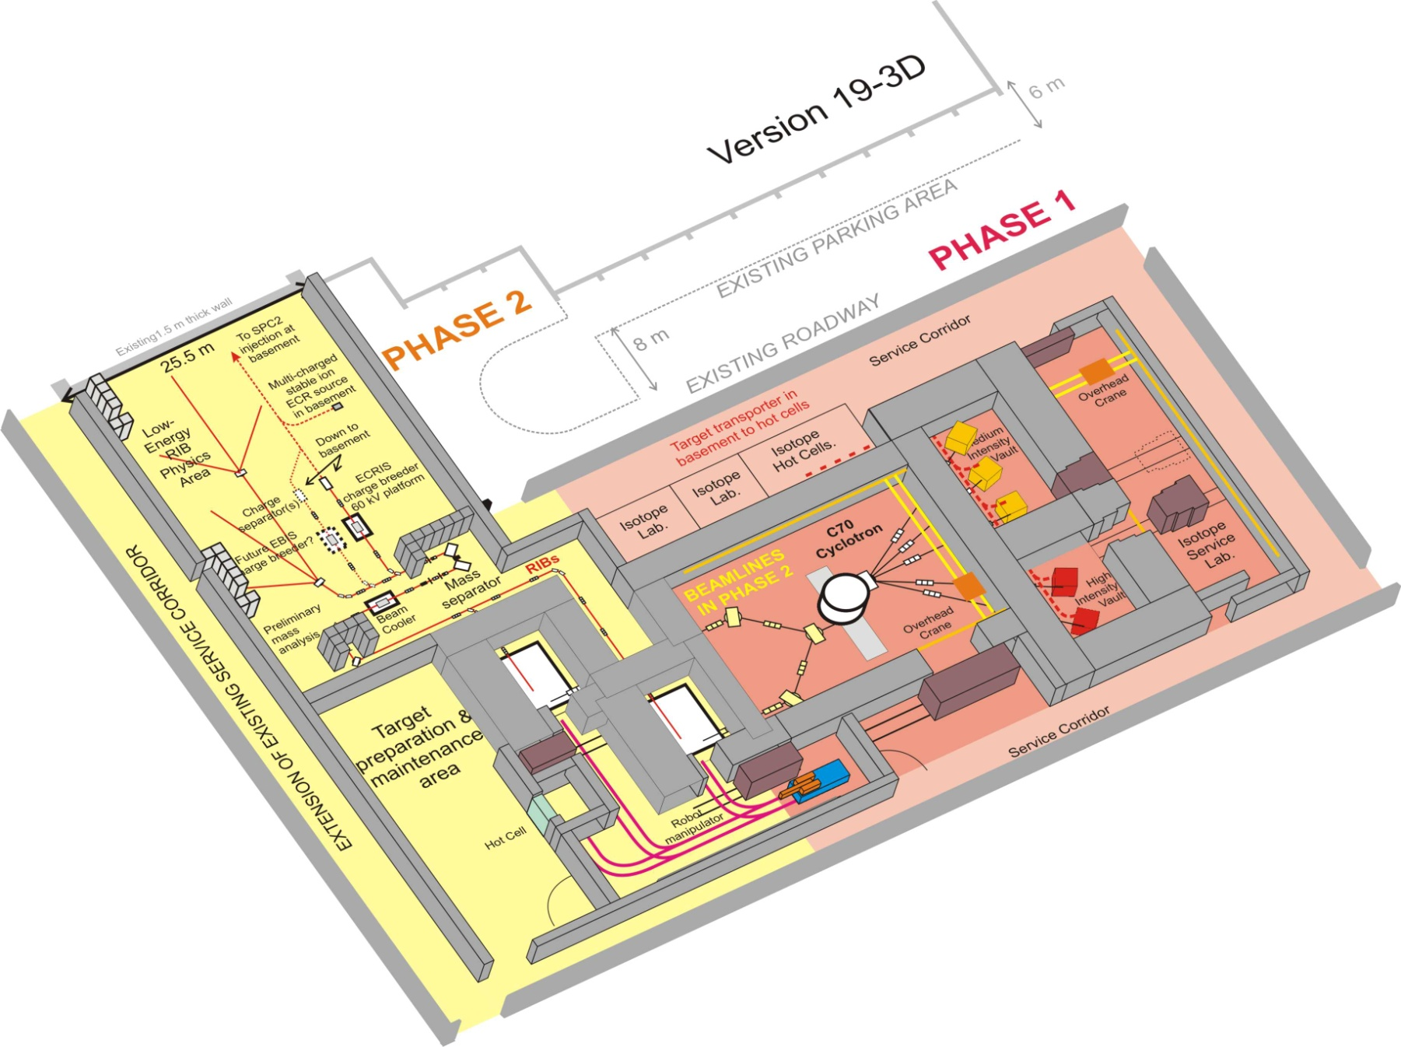
RIB Production
To injector/SSC
Low-energy
beamlines
Charge breeder
Mass analyser
Beam cooler
RIB production
stations
Target / ion-
source
maintenance
Robot
Target storage

Slide 29
RIB Target/Ion-SourceTest Facility & Technical Design Study
Technical Design Study R7M
Test Facility R25M
Funded by NRF
Later to be used for
β-decay studies
Materials sciences
Testing fundamental symmetries

Slide 30
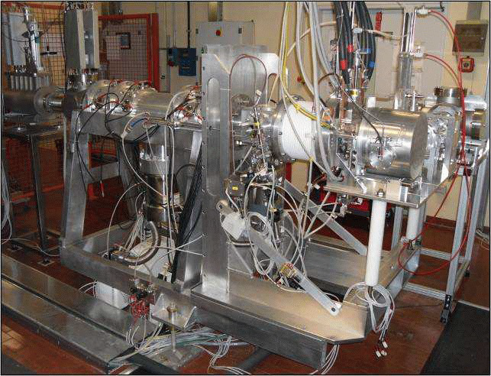
SPES Target/Ion-source
Collaboration with INFN Legnaro, Italy
High-power tests of SPES targets.

Slide 31
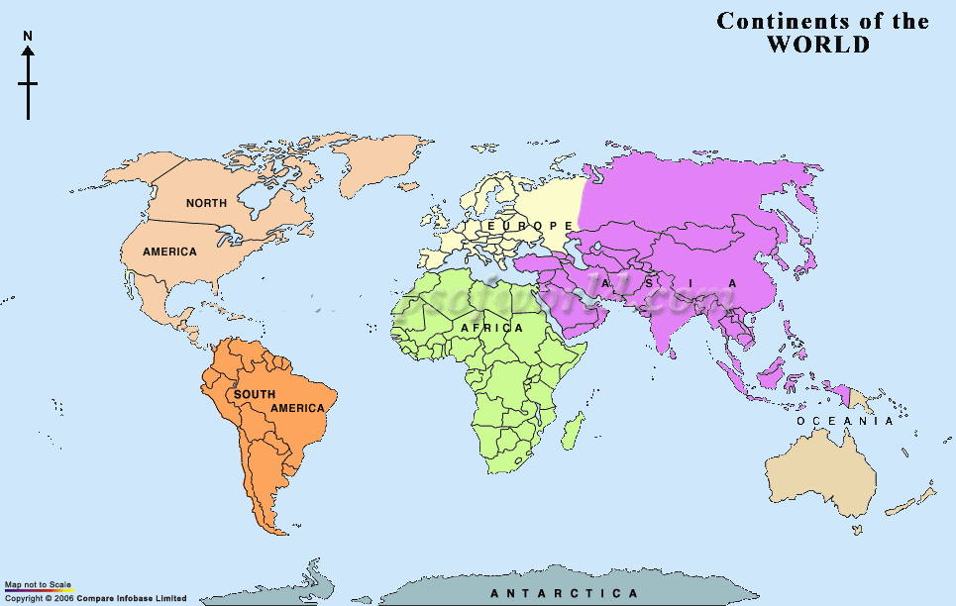

iThemba LABS Radionuclide Distribution Network
Africa 3
Australia 2
Asia 19
Canada 2
Europe 31
USA 12

Slide 32
cGMP Radiopharmaceuticals
Supply over 25 local Nuclear Medicine Hospitals and Private Clinics

Slide 33
Long-Lived Radionuclides
Supply over 60 clients worldwide

