Slide 1
INFIERI
(Intelligent, Fast, Interconnected and Efficient devices for frontier exploitation in Research and Industry)
Fabrizio Palla
INFN – Sezione di Pisa
http://infieri-network.eu/

Slide 2
INFIERI at a glance
EU funded within FP7
  FP7-People-2012-ITN 317446
    Started Feb. 2013
    End Jan. 2017
  2 Early Stage Researchers (ESR)
    E. Kostara and S. Poulios (hired Jan. 2014)
  1 Experienced Researcher (ER)
    G. Fedi (hired Sept. 2014)
    Total INFIERI budget ~4 M Euro
      @ INFN ~500KEuro (of which ~30% on research, 10% overheads)

Slide 3
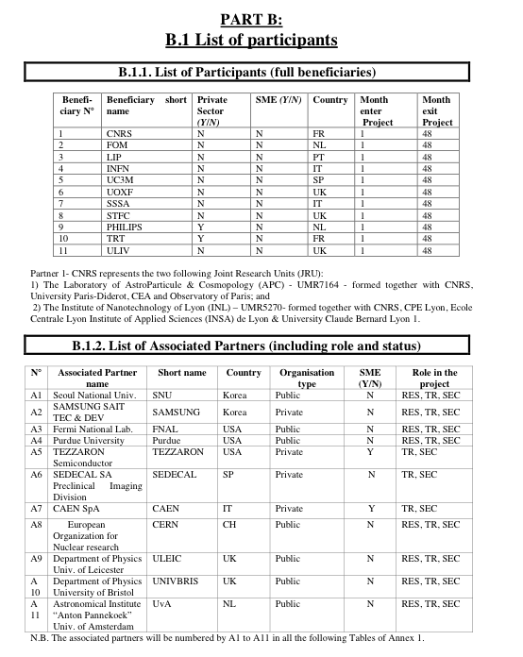
Thales exited
To be replaced soon

Slide 4
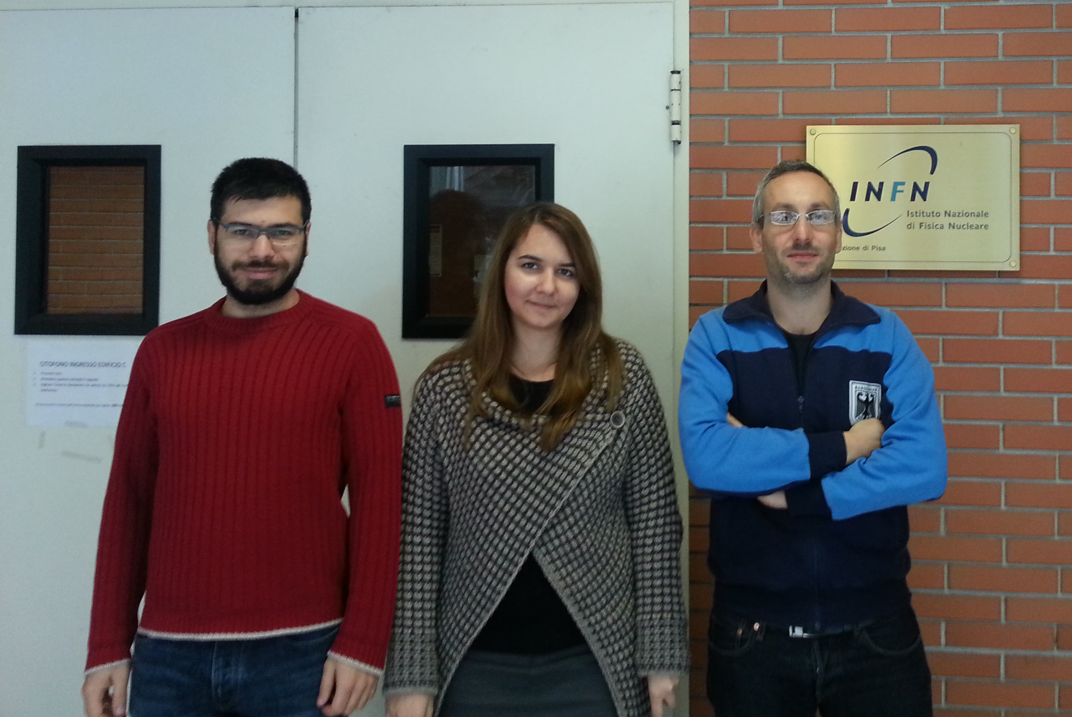
The fellows
Giacomo Fedi
Stamatis Poulios
Eleftheria Kostara

Slide 5
INFN for INFIERI
Three research groups
  High Energy Physics – CMS experiment
    WP1, WP4 & WP6: Level 1 Track Trigger for the HL-LHC
      Outer Tracker: G. Fedi (ER1), L. Martini, G. Magazzù, F. Palla
      Inner pixels: K. Androsov, G. Bagliesi, M. A. Ciocci, M. T. Grippo, M. Minuti, F. Palla
    WP3, WP6: optical wireless communications for Silicon detectors readout – in conjunction with WP1 for Track Trigger applications
      R. Dell’Orso, A. Messineo, F. Palla, P. G. Verdini
  Medical Physics (WP1, WP4, WP6) – Positron Emission Tomography
    WP1, WP4 & WP6: Fast data readout and pattern reconstruction
      E. Kostara (ESR7), M. G. Bisogni, A. Del Guerra, M. Morrocchi , G. Sportelli
  Astro-particle Physics (WP1, WP6) – Cherenkov Telescope Array
    WP1, WP6: Data acquisition and Trigger
      S. Poulios (ESR6), R. Paoletti
WP coordination
  WP8 (Outreach): F. Ligabue, M. A. Ciocci – nel passato F. Palla (WP1) e R. Paoletti (WP6)
  Young Researchers Panel: M. T. Grippo

Slide 6
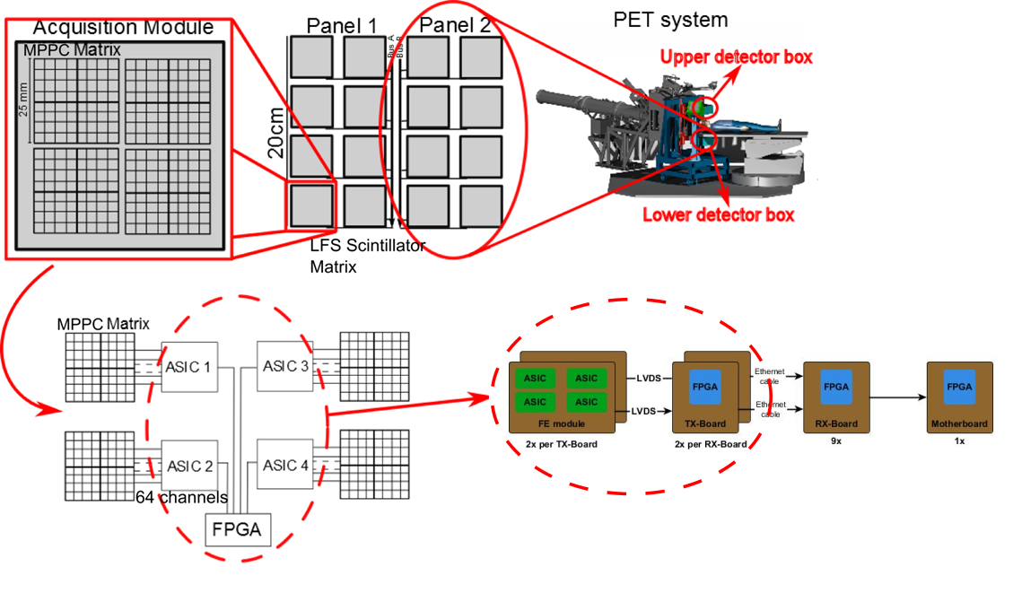
PET prototype - INSIDE
E. Kostara, G. Sportelli, G. Bisogni
2 planar panels
2x4 pixelated LFS scintillator matrices
4 matrices of 8x8 MPPC from Hamamatsu
4x64-channel ASICs
FE-Modules
TX-Boards
RX-Boards
Motherboard
Notes:
The PET prototype designed by the INSIDE project, is made of two planar panels 10cm x 20cm wide. Each panel consists of 2 x 4 pixelated LFS (Lutetium Fine Silicate) scintillator matrices measure 5cm x 5cm (16 x 16 pixels, 3mm x 3mm x 20mm crystals). Each scintillator matrix is coupled to four matrices of 8 x 8 MPPC (Multi Pixel Photon Counter) from Hamamatsu with one-to-one crystal-detector coupling to form a detection module. Each module uses four 64-channel front-end (FE) ASICs, with on-chip multiplexing and time-to-digital (TDC) conversion resources based on the same 0.18um CMOS technology.
A small low-cost FPGA board, the TX-board (transmitter), is mounted along with each FE-board in a separate enclosure to the PET block enclosure. The DAQ motherboard has nine slots. In each slot, the RX-board (receiver) is connected and acts as a data concentrator for the fiber-optic transceivers of the TX-boards and for communication between the DAQ system and the FE-boards. In each RX-board, two TX-boards are connected, while each TX-board is connected to the FE-boards (4 ASICs). The motherboard can manage up to nine RX-boards

Slide 7
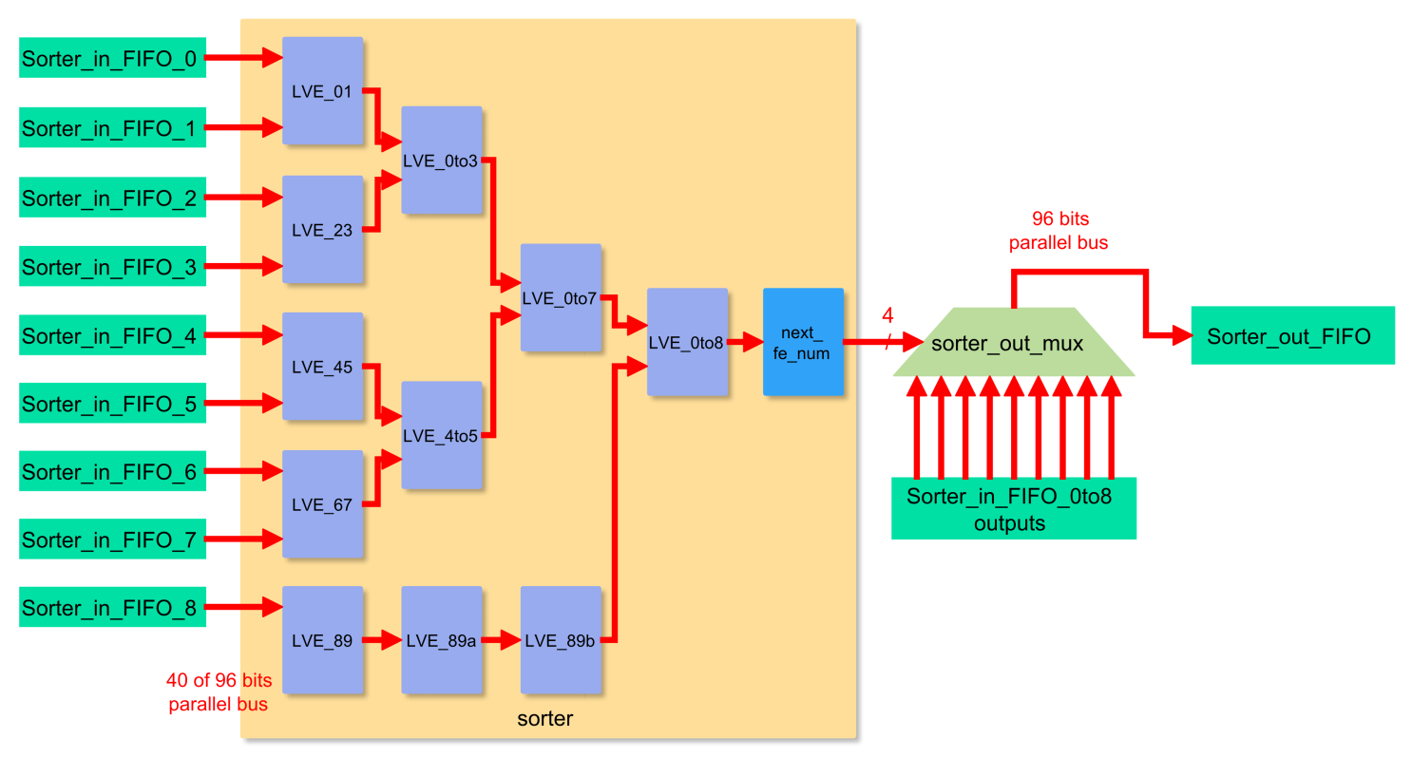
Coincidence sorter architecture
Data packet with earliest timestamp storage
Merged data
Restart the process
1 bit | 4 bits | 40 bits
Valid data | FE number | Timestamp
Timestamp
comparator
5 additional bits to the timestamp
Notes:
Each LVE (Lowest Value Extractor) compares the timestamps of two events coming from two FIFOs or two previous LVEs and outputs the earliest one. If the LVE has only one input or one of the FIFOs is empty, then it outputs the only available event. If all the FIFOs are empty, then the process never starts. Four stages are needed for nine FEs.
In the final stage, the “next_fe_num” component checks the four bits (FE number), that indicate the corresponding input FIFO which presents the earliest timestamp. Then, it outputs the next timestamp from that FIFO and the process starts again. Also, these four bits are used for reading the corresponding data packet, which is stored to the output FIFO through the multiplexer.

Slide 8
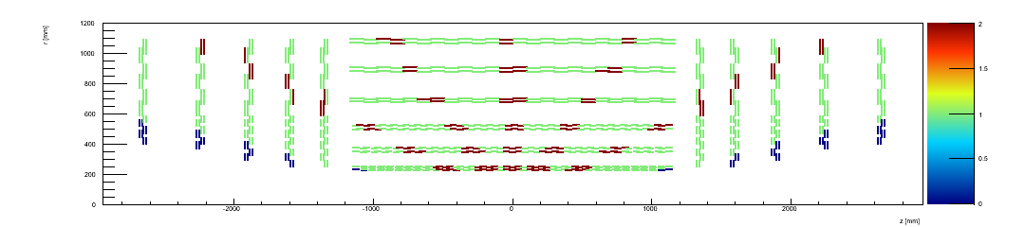
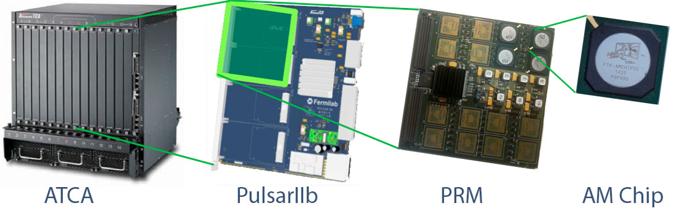
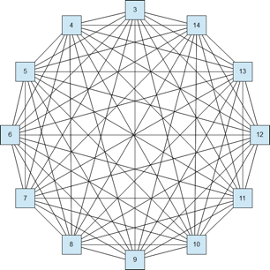
L1 Track Trigger in CMS
G. Fedi et al
few hundred stubs/tower
Send data to Pattern Recognition Mezzanine in each ATCA blade
  Data distributed to Pulsar boards in time multiplexed mode in round robin
  Perform pattern recognition using several AM chips (120k Patterns/AM chip)
  Track fit with FPGA inside the Mezzanine (~1 ns/fit)

Slide 9
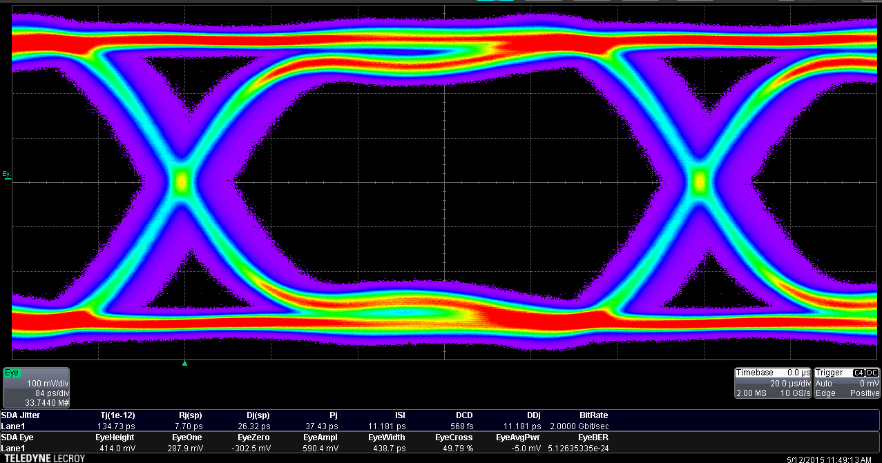
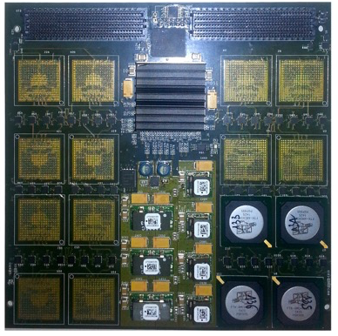
Risultati 2015
Testati ~100 chips AM05 a Pisa (G. Fedi)
  in collaborazione con FTK
Test e caratterizzazione della mezzanina di test prodotta a Perugia (G. Fedi, G. Magazzu)
Sviluppo Firmware di test (G. Magazzu)
Sviluppo Track fit e Data Organizer
  C++ (L. Martini) + Perugia
  FW (G. Gentsos – IAPP / FTK)
Studio configurazione banche (L. Martini)
Test links @2 Gbps (verso i chip) e @8 Gbps (verso Pulsar)
Nessun errore in 8 ore: BER<10 ⁻¹⁴

Slide 10
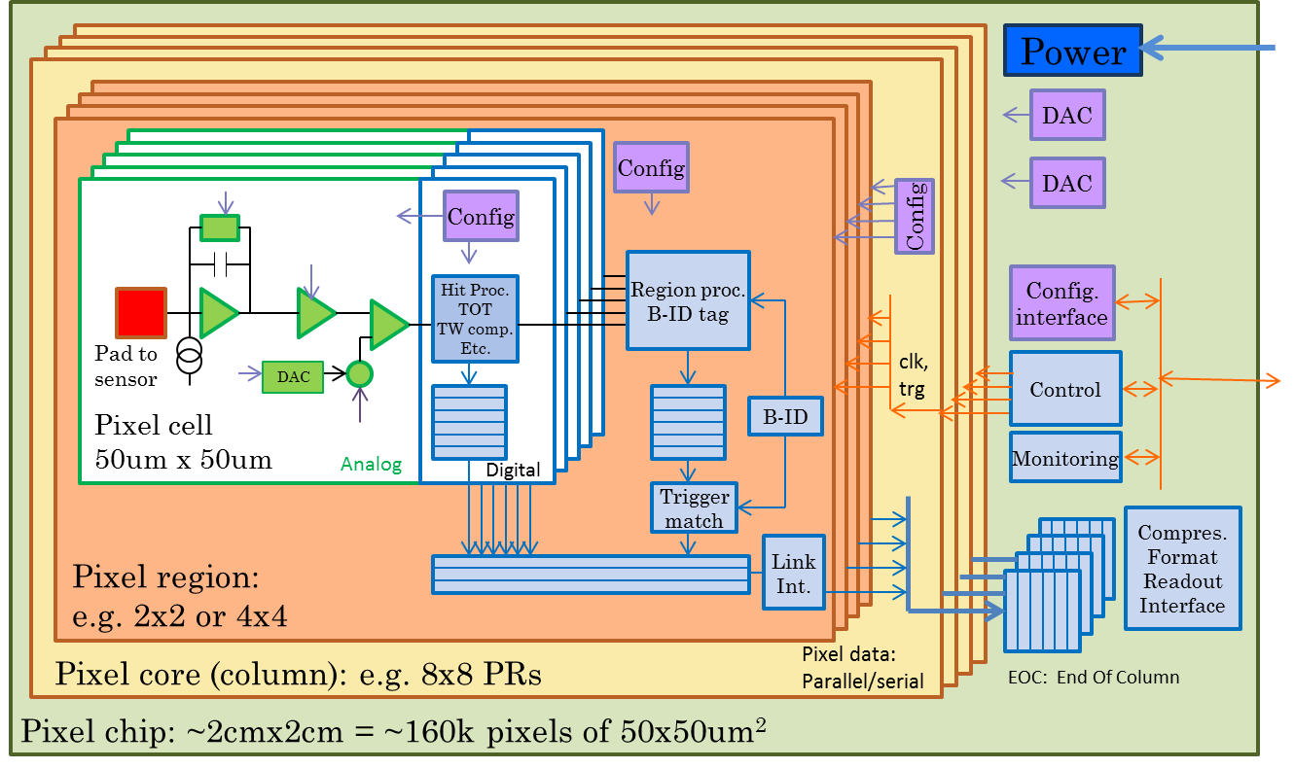
3rd generation pixel architecture
S. Poulios + CERN
95% digital (FEI4 like)
Charge digitization
160k pixel channels per chip
Pixel regions with buffering
Data compression in End Of Column

Slide 11
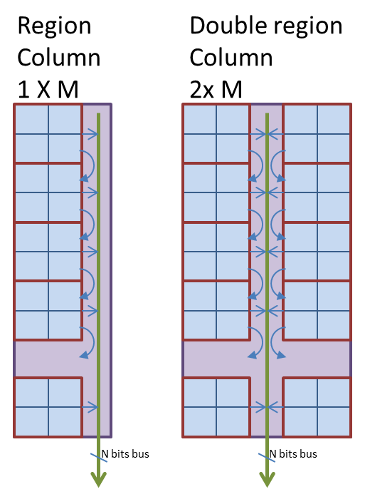
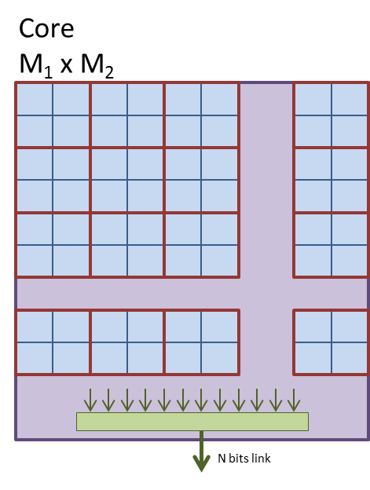
Wired on
top of PR
Pixel chip divided in pixel cores containing pixel regions (2x2 px)
Current work
Studying the “pixel chip” architecture (described in SystemVerilog)
  Goal: porting the “data compression” module to the simulation framework
Investigating preliminary compression within the chip
  Address encoding(e.g. relative address to previous hit data)
11

Slide 12
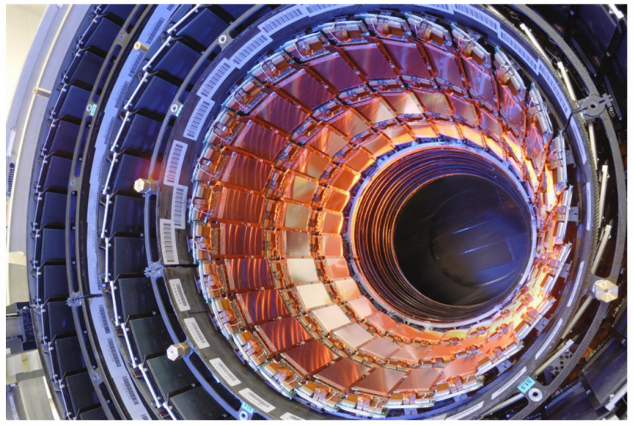
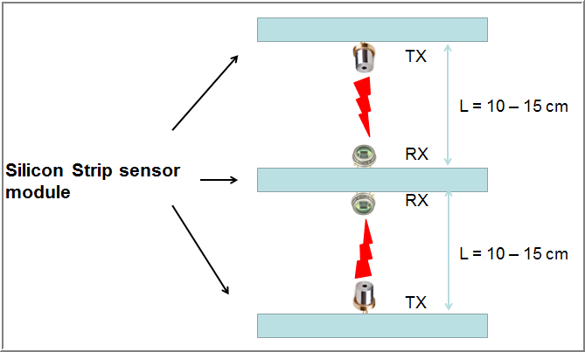
Optical wireless transmission in HEP
R. Dell’Orso, A. Messineo, F. Palla, P. G. Verdini + S. Anna

Slide 13
Secondments
Stamatis is seconded at CERN until end of July
  Works under the supervision of J. Christiansen on pixel data compression
Eleftheria and Stamatis will both go to CAEN for 4 months secondments in 2015
  To work on Power supply and on SiPM, respectively
Giacomo will be seconded to FNAL for 2 weeks in July/August and in September/October (TBD)
  To learn the ATCA technology

Slide 14
6th INFIERI workshop
INFIERI workshop in Pisa
  27-29 October
  ~50 people
  Public seminar on Oct. 27th in SNS
  Visit to Virgo on Oct. 28th

Slide 15
Nomi | FTE (%)
K. Androsov | 5
G. Bisogni | 5
M. A. Ciocci | 10
R. Dell’Orso | 5
G. Fedi | 100
M. T. Grippo | 5
E. Kostara | 100
F. Ligabue | 10
A. Messineo | 5
F. Palla | 10
R. Paoletti | 5
S. Poulios | 100
P. G. Verdini | 5

