Slide 1
The INFN COSA project
Tommaso Boccali
(alcune slides riadattate da Daniele Cesini)

Slide 2
INFN-CSN5 COSA project
COSA: Computing On SOC Architecture
Duration: 2 years from January 2015
Departments: 7 INFN
CNAF, PI, PD, ROMA1, FE, PR, LNL
BUDGET :51.5 kEuro Year I

Slide 3
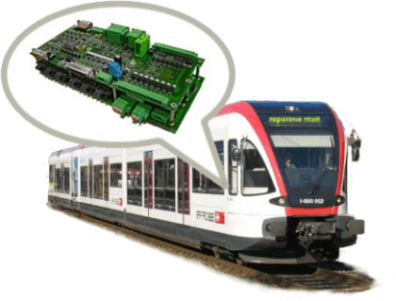
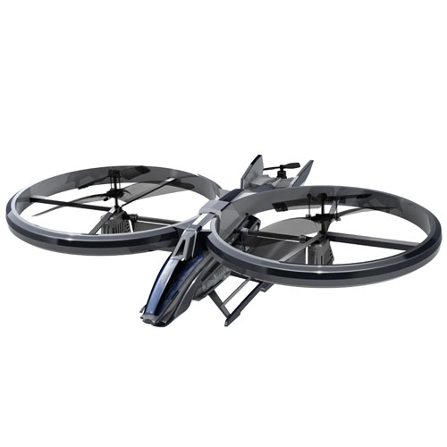
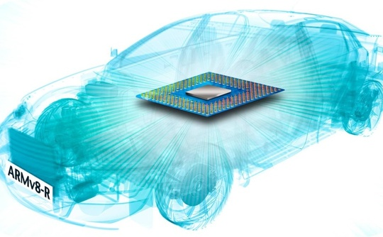
Where do I find a SoC?
Mobile
Embedded

Slide 4
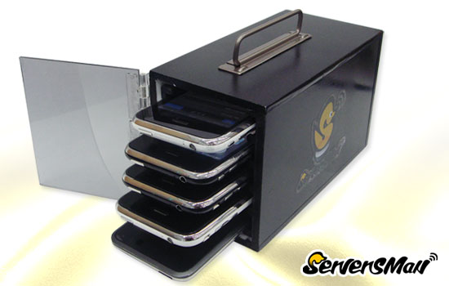
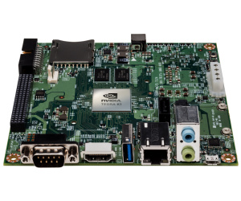
Ok, but then....an iPhone cluster?
NO, we are not thinking to build an iPhone cluster
We want to use these processors in a standard computing center configuration
Rack mounted
Linux powered
Running scientific application mostly in a batch environment
..... Use development board...

Slide 5
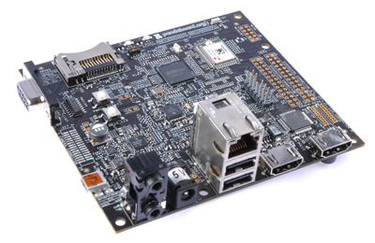
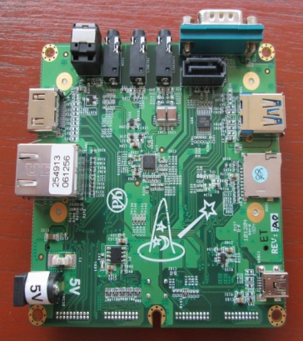
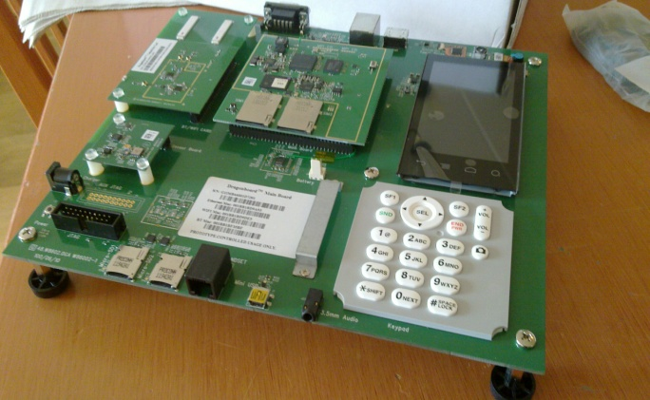
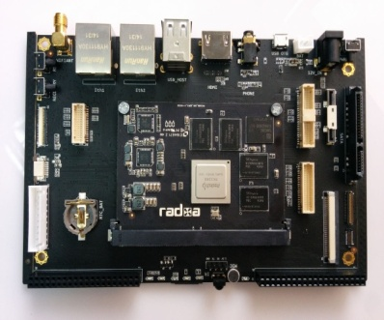
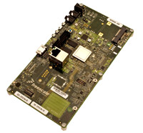
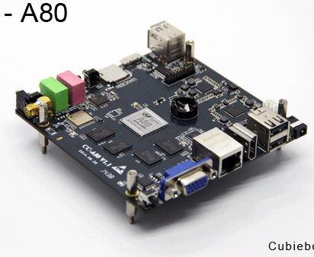
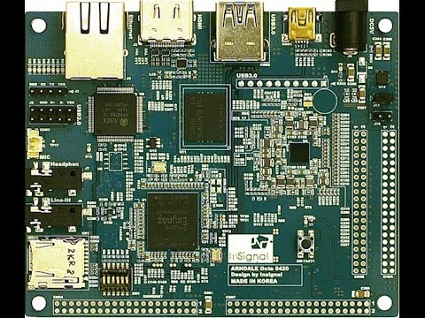
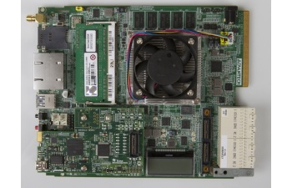
Some nice boards
PandaBoard
WandBoard
Rock2Board
DragonBoard
SabreBoard
CubieBoard
Arndale OCTA Board
Texas Instruments EVMK2H
http://elinux.org/Development_Platforms
...and counting...

Slide 6
NVIDIA JETSON TK1
First ARM+CUDA programmable SoC based Linux development board
4 cores ARM A15 CPU
192 cores NVIDIA GPU ➔ 300 GFLOPS (peak sp)
~ 21 GFLOPS/W (sp
... for less than 200 Euros
32bit
64bit version announced

Slide 7
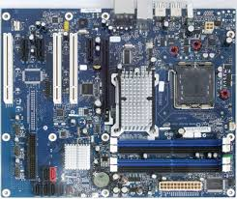
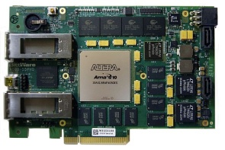
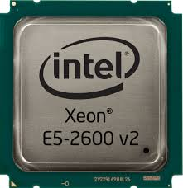
COSA Clusters
CNAF
ROMA1
~25 board SoC Based
(GFLOPS nominali di 2 server
tradizionali con GPU)
Anno I
4 board ARM+FPGA based
+ 1 server
16 board ARM+FPGA based
+ 4 server
Anno I
+ ~10 nuove board
Anno II
ex cluster COKA (2 server)
+ nuove acquisizioni (1 server)
+ nuove acquisizioni (1 server)
(server = cpu + acceleratori)
Anno II
Anno I
Anno II
PD
Ex cluster HEPMARK
+ nuove acquisizioni (~ 3 server)
+ nuove acquisizione (~ 3 server)
Anno I
Anno II

Slide 8
Activities & WPs
WP1: Management
WP2: Technology Tracking and Benchmarking
WP3: Implementation of the CNAF prototype
WP4: Development of dedicated network connections
WP5: Application Porting
PISA/Boccali WP leader
WP6: Technology Transfer and Dissemination

Slide 9
Project Timeline
Jan 2015
Benchmarking
Tests of new boards
Cluster implementation
Cluster setup at CNAF (25 boards)
Application Porting
Tests under real life condition
Clusters upgrade (+10boards @CNAF, +12 boards @ ROME)
Benchmarks with real life applications and synthetic tests
Tests of first FPGAs for dedicated low latency network
Selection of the final architecture for the clusters
Cluster Setup in ROME (4 FPGA boards)
Application Porting
Dissemination and H2020 Preparation
Sept 2015
Jan 2016
Dec 2016

Slide 10
Applications
Theoretical Physics (PR, FE)
Parallel applications usually run in HPC environments
Lattice Boltzmann fluid dynamics
Monte Carlo simulations of Spin-Glass systems
Lattice Quantum ChromoDynamics simulations
Experimental Physics (PI, PD, CNAF)
HEP experiments High Level Trigger applications
Montecarlo and analysis of LHC experiments
Applications needing portable systems
Computer tomography
Neural Networks (RM1)
DPSNN-STDP code

Slide 11
Some applications examples / benchmarks

Slide 12
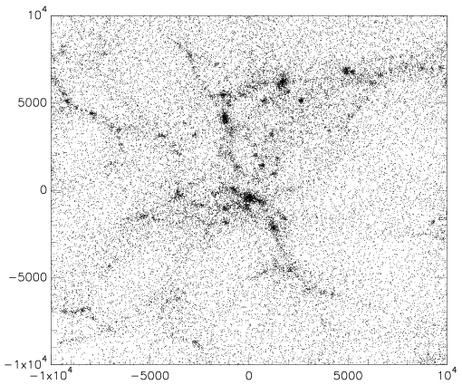
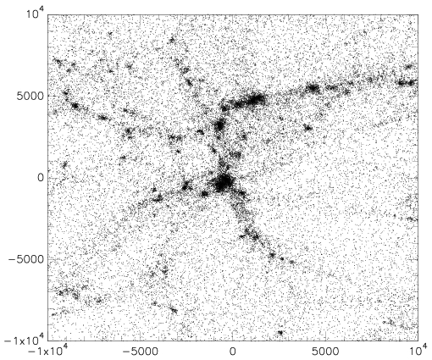
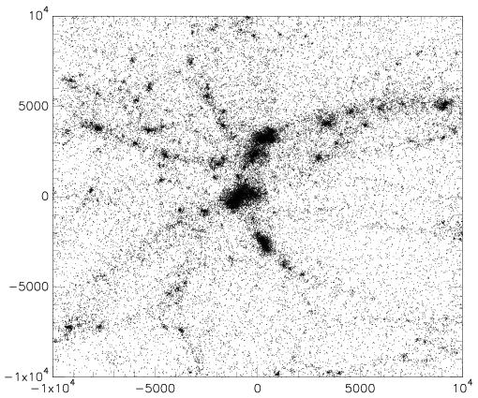
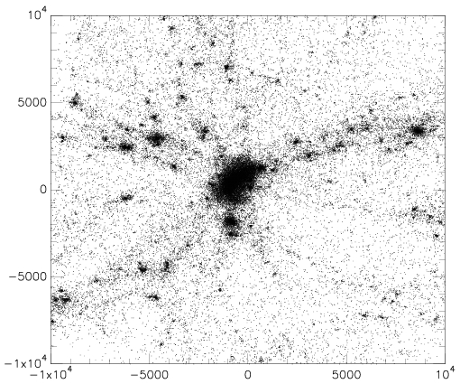
Formation of a galaxy cluster with Gadget2
MULTI BOARD
CPU ONLY
276498 particles, formation of a cluster
of galaxies in an expanding Universe

Slide 13
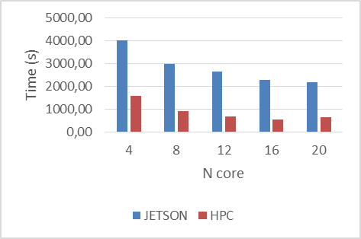
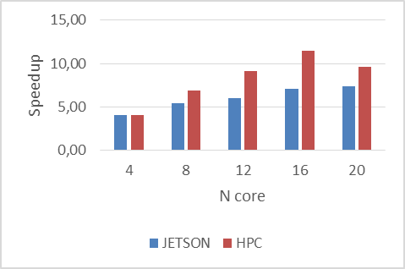
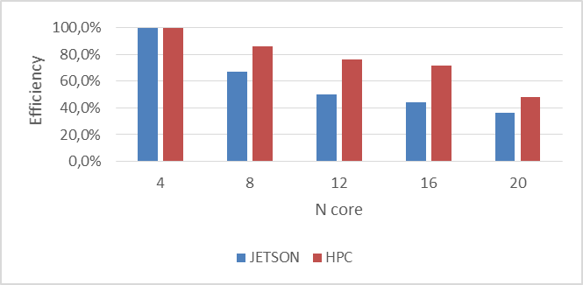
Formation of a galaxy cluster

Slide 14
Neural Networks: DPSNN-STDP

Slide 15
See Enrico Calore talk

Slide 16
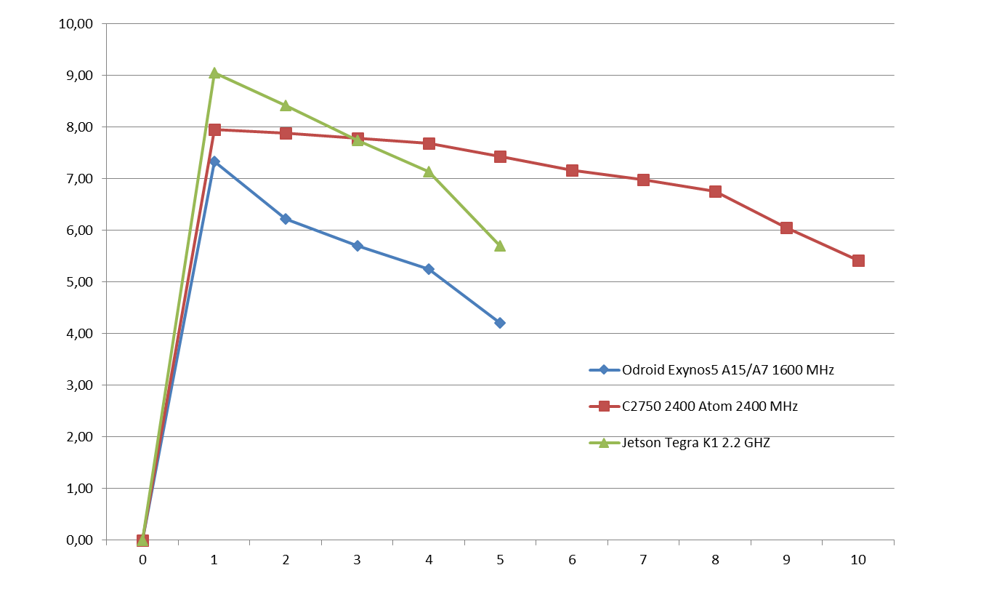
HS06
HS06 on Exynos5, TegraK1 and Atom C2750 –
Per core loaded
(data from M.Michelotto@HEPIX 2014 https://indico.cern.ch/event/320819/session/3/contribution/30/material/slides/0.pptx )

Slide 17
Tests from CMS
Pisa

Slide 18
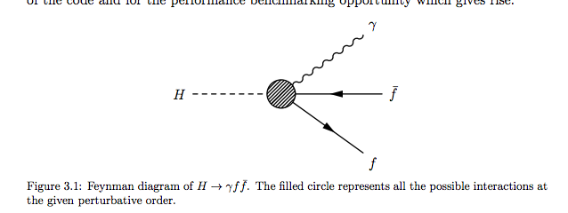
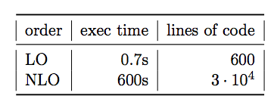
Test di codice teorico (Torino - Pisa)
Case Study: Higgs Dalitz Decay
Tesi di laurea di P. Viviani (UniTo): parallelizzazione codice NLO di Passarino
Integrazione su spazio delle fasi, tempo scalare per integrazione:
O(10⁶) punti da integrare: mesi su CPU scalare single thread
Codice fortran, non immediatamente riscrivibile in C++

Slide 19
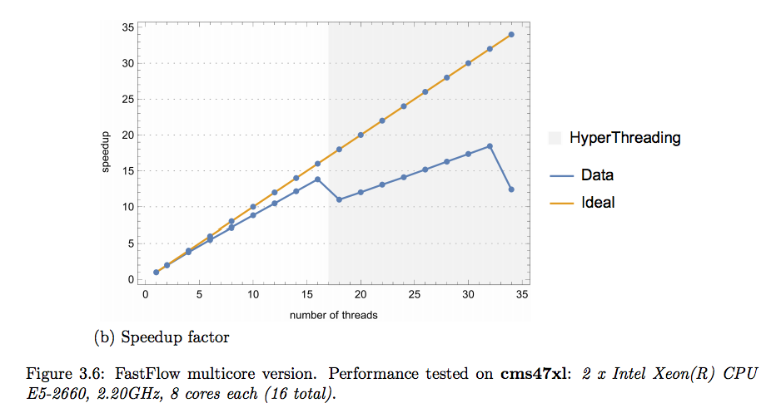
Performance
Utilizzati:
2x Intel Xeon E5-2660 2.2 GHz (16 cores total)
4x Intel Xeon E7-4820 2 GHz (32 cores total)
Intel Atom SoC C2750 2.4 GHz (8 cores, cluster di 4 nodi = 32 cores)
Una prima nota: il codice scala in modo quasi perfetto, non ci sono lock e/o inter thread communication a parte il reduce finale

Slide 20
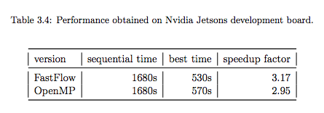
Add Nvidia K1 (OpenMP + FastFlow)
CPU | Seq time | Best parallel time | Multi thread scaling | Single core wrt i5
I5 2.2 GHz | 670 sec | 35.3 sec | 19 | 1
I7 2.0 Ghz | 1060 sec | 30.5 sec | 35 | 1.6
Atom 2.4 GHz | 1960 sec | 285 sec | 6.9 | 2.9
Nvidia K1 | 1680 sec | 530 sec | 3.2 | 2.5
Un po’ sorprendente …

Slide 21
Pisa

Slide 22
Pisa

Slide 23
Richieste 2016
Manpower: andiamo ancora a soglia di 1 FTE
Boccali 20%
Ciampa 20%
Arezzini 20%
Bonati 10%
(nuovo assegno calcolo 30%)

Slide 24
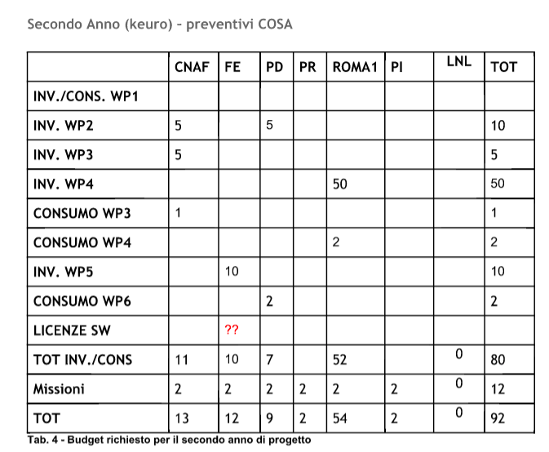
richieste

