Slide 1
CHIPIX65
Sviluppo di un pixel chip innovativo in tecnologia CMOS 65nm per altissimi flussi di particelle e radiazione agli esperimenti di HL_LHC e futuri collider di nuova generazione
Progetto CALL 2013 CSN5
Web-site: http://chipix65.to.infn.it
Fabrizio Palla – Consiglio di Sezione Pisa
9 luglio 2015

Slide 2
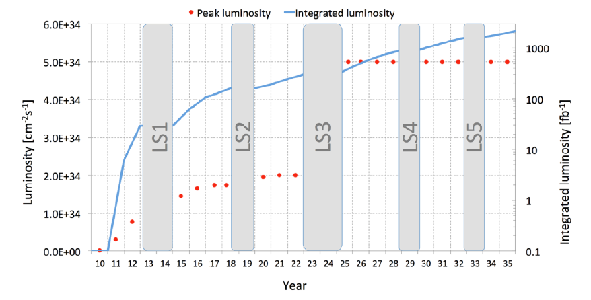
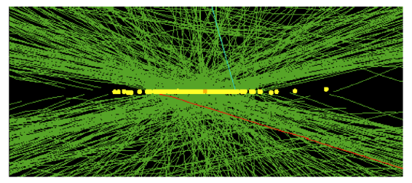
The HL_LHC challenge
HL-LHC accelerator: new frontier for particle physics after year 2024
200 pp collisions at the same time !
Experiments: taking data at higher L1-Trigger rate
Read-out data: x5 particles, x10 trigger
ALL THIS to get:
3000 fb-1
study rare-phenomena in Higgs sectors or other exotic decays
Events with pile-up=66; (HL-HLC will be 200 !)

Slide 3
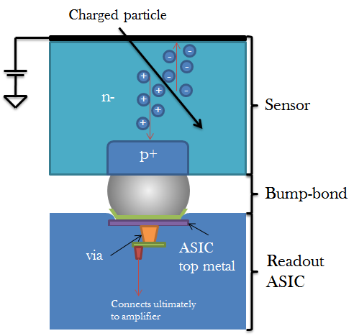
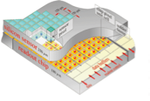
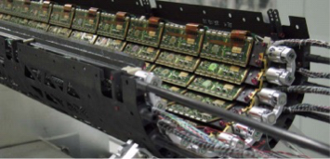
Pixel Detector at HL-LHC
Requirements from HL-LHC (ATLAS & CMS)
Small pixels: 50x50µm²
Large chips: 2cm x 2cm ( ~1 billion transistors)
Hit rates: 3 GHz/cm²
Radiation: 1Grad, 10¹⁶ n/cm² (unprecedented)
Trigger: up to 1MHz with 12.5us latency
(~100x buffering and readout)
Low power - Low mass systems
Data readout : up to 4-5 Gbs/s
TRIGGER Latency up to 12.5µs (x3) ==> deeper storage buffer

Slide 4
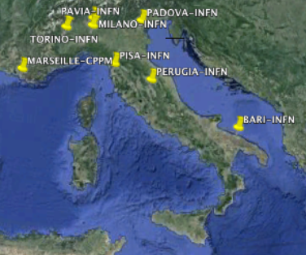
CHIPIX65 Project
chipix65.to.infn.it.ch
Proposal approved and funded by INFN in fall 2013, started 2014
Participant Research Units: Bari, Milano, Padova, Pavia, Perugia, Pisa, Torino
Project Outline :
One goal of this project is the development of an innovative CHIP for a PIXel detector, using a CMOS 65nm technology for the first time in HEP community, for experiments with extreme particle rates and radiation at future High Energy Physics colliders. For this is part of RD53 Collaboration
Another goal is the efficiently propagation across INFN of CMOS 65nm technology providing close collaboration and coordination of experts across different INFN sites in Italy
new-2016: LECCE
About 40 members of which more than 50% are ASIC designers

Slide 5
The CHIPIX65 Project : (about 11 FTE)
N.Demaria, G.Dellacasa, G.Mazza, A.Rivetti, M.D.Da Rocha Rolo, E.Monteil, L.Pacher, F.Ciciriello, F.Corsi, C.Marzocca, G.De Robertis, F.Loddo, C.Tamma, M.Bagatin, D.Bisello, S.Gerardin, S.Mattiazzo, L.Ding, P.Giubilato, A.Paccagnella, F.De Canio, L.Gaioni, M.Manghisoni, V.Re, G.Traversi, E.Riceputi, L.Ratti, C.Vacchi,
R.Beccherle, G.Magazzu, M.Minuti, F.Morsani, F.Palla, V.Liberali , S.Shojaii , A.Stabile , G.M.Bilei , M.Menichelli , E.Conti , S.Marconi, D.Passeri , P.Placidi
new-2016: S.D’Amico, C.Veri, A.Donno

Slide 6
RD53 collaboration
20 Institutes (Seville has joined)
Bari, Bergamo-Pavia, Bonn, CERN, CPPM, Fermilab, LBNL, LPNHE Paris, Milano, NIKHEF, New Mexico, Padova, Perugia, Pisa, Prague IP/FNSPE-CTU, PSI, RAL, Seville, Torino, UC Santa Cruz.
140 on collaboration Email list
~70 actively contributing
2015 FTE: ~23
Spokes persons: Maurice Garcia-Sciveres, LBNL (ATLAS), Jorgen Christiansen, CERN (CMS)
IB chair: Lino Demaria
WG conveners: Marlon Barbero, Roberto Beccherle, Jorgen Christiansen, Maurice Garcia-Sciveres, Tomasz Hemperek, Valerio Re
2 year terms coming up to renewal within 3 months
Next Collaboration meeting: Pisa October 14-16, 2015
Activity | FTE 2015
Radiation | 4
Analog | 3
IP | 7
Simulation | 3
Top | 3
I/O | 1
Organization | 2
Total | ~23

Slide 7
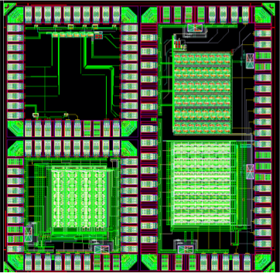
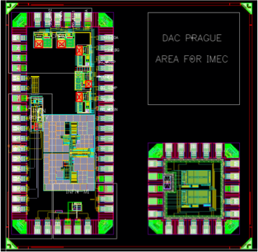
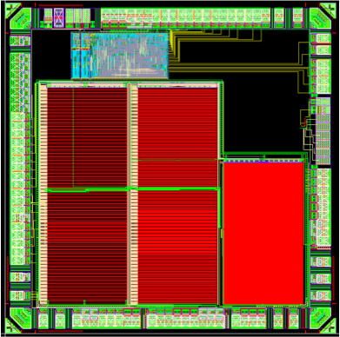
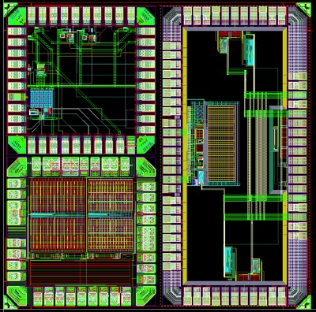
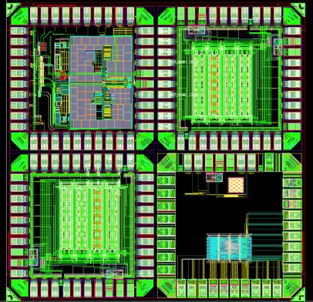
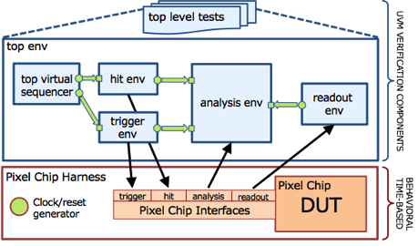
CHIPIX65 activities
…at a glance
Radiation characterisation
x-ray machine at LNL / Pd-INFN
Total Ionising Dose (TID)
1 GRad in ~ 2 weeks
Low-p at CN accelerator LNL
TID and Total Displacement damage
TANDEM / SIRAD
Single Event Effects - with Heavy Ion
Studies on n-MOS, p-MOS
Irradiation of IP-block, Noise-measurements vs Irradiation
Design in 65nm
5 silicon dyes 2x2mm2 submitted
CHIPIX65 IP-blocks
DAC-curr, ADC, SRAM,
SER/DES, sLVDS(TX/RX)
BandGap, D2RA digital cells
JTAG
CHIPIX65 Analog Very Front End
Synchronous chain
Asynchronous chain
Integration of other RD53 IPs
DAC-volt (Prague)
SER (Bonn), BandGap (CPPM, CERN)
CHIPIX_BIAS CHIPIX_VFE_1
Digital Electronics:
Simulation Framework
System-Verilog-UVM (VEPIX53)
Digital Architecture Studies
Input protocols definition
fast/efficient/continuos (while readout)
SEE robust
CHIPIX_SRAM, CHIPIX_IP_3, CHIPIX_VFE_2

Slide 8
Radiation WG
Radiation test and qualification of 65nm technology: 1Grad and 2 10¹⁶ neu/cm²
Radiation tests with X-rays, Cobalt source and 3Mev protons
Significant radiation damage above ~100Mrad
New radiation effects has made it difficult/slow to reach final conclusions
Strong dependence on temperature during radiation: Cold is better
Strong dependence on both length and width of transistors: Large is better
Strong dependence on biasing during high temperature (100ºC) annealing: High temperature anneal bad
Realistic to reach ½ Grad with conservative design approach
Radiation cold: -20ºC
No high temperature (100ºC) annealing (needs careful verification as this limits our ability to do accelerated aging test)
NMOS: Small degradation: 10% – 20%
PMOS: Significant degradation: 25% (Large transistors) – 50% (very small transistors)
Analog: Design recommendations (“large” transistors normally used in analog)
Digital: PMOS might need to be larger than minimum size (e.g. W > 300nm, possibly too conservative) and digital cells to be characterized for speed degradation.
Inner barrel layer to be replaced after 5 years
Further tests of devices, circuits and full chips will determine if 1Grad can be accomplished

Slide 9
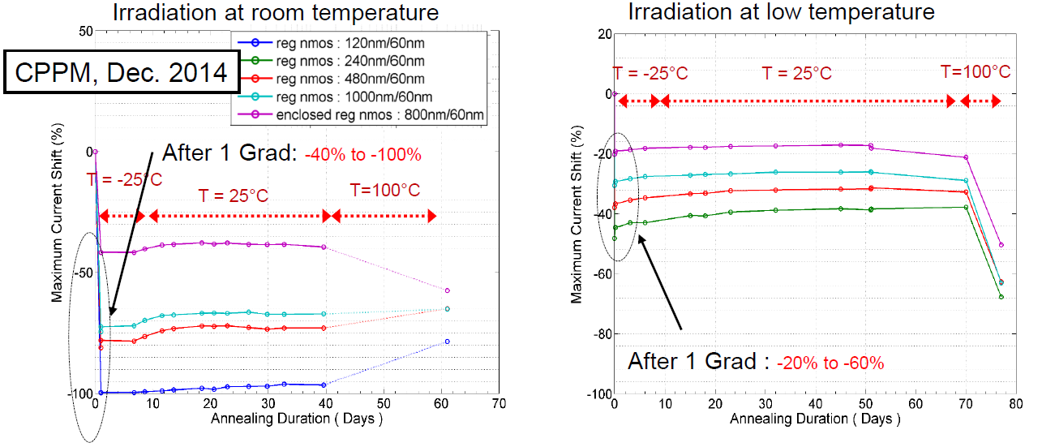
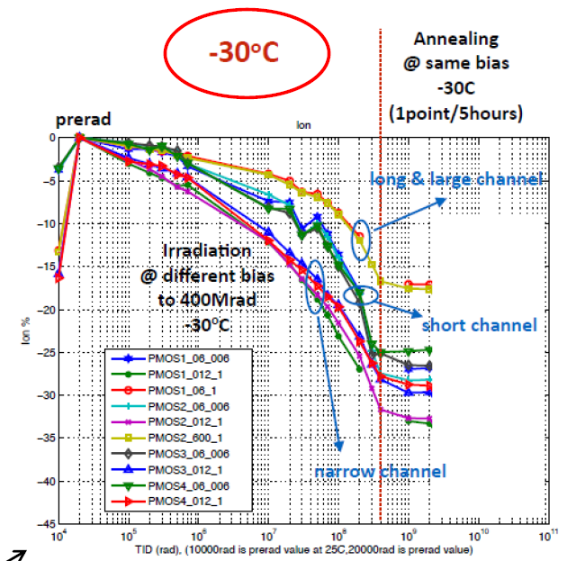
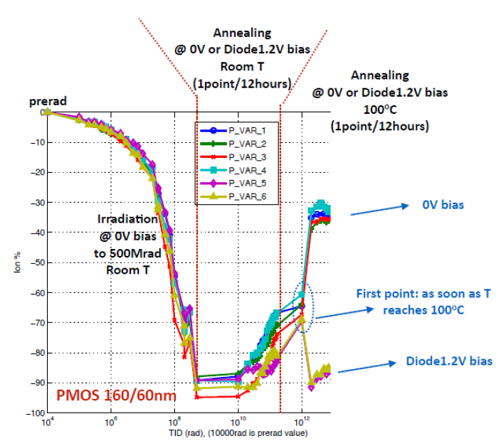
Radiation effects (PMOS)
Requires an extended
seminar to explain
all this

Slide 10
IO WG (R. Beccherle)
Readout and control interfaces
Proposed control protocol @160Mbits/s
Clock, trigger, resets, commands, configuration
Single line (differential)
DC balanced
Appropriate for system synchronization
Error correction
Compatible with LPGBT optical link chip
Simulated and verified
Plans
Define readout protocol
Rate: 1.28 – 2.56 – (5.12) Gbits/s Inner layer pixel chip: ~4Gbits/s raw data (can be reduced with intelligent formatting/compression)
Data merging across chips Outer layer pixel chip: ~400Mbits/s
Appropriate for electrical links: 2 – 5m (cable driver)
Formatting, Encoding
Compatible with LPGBT or direct optical modulation
Implement/verify IO blocks for pixel chip
Standardize and implement pixel test systems

Slide 11
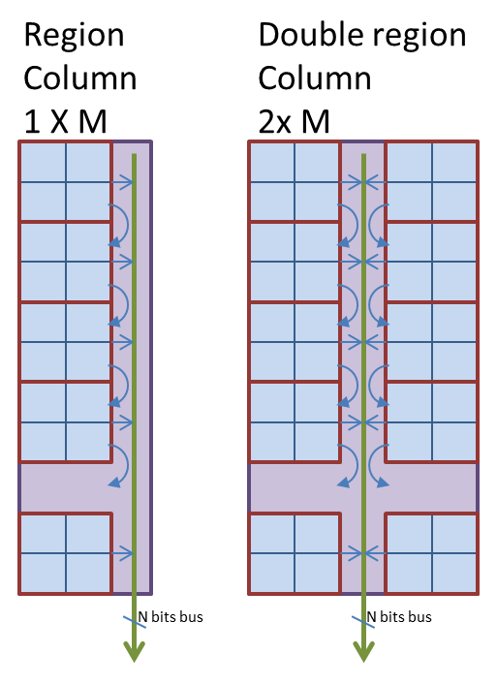
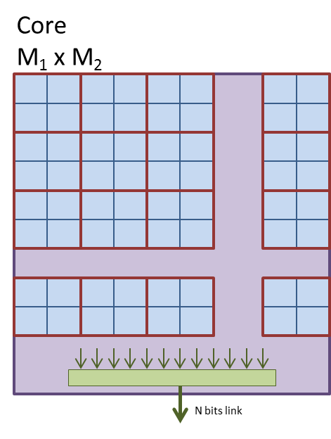
Lossless data compression
K. Androsov, M. Minuti, S. Poulios
Hit rate estimation for inner barrel layer at 140 Pile-Up is about 2 GHz/cm²
Expected high readout rate (~ 4.8 Gbits/s per chip for 1MHz trigger rate)
2.4 Gbits/s max bandwidth per chip (2 E-links)
First studies on arithmetic data compression shown
Indications on power consumption and timing
Synthetized in 130 nm. Scaled to 65 nm, estimated area and power
0.095 mm²
20 mW
Currently starting integrating the data compression on pixel cores
In collaboration with the Simulation group and J. Christiansen at CERN

Slide 12
IP cores
DESIGN | CHIPIX65 team | RD53 - other
SER | PISA | Bonn
DES | PISA | n.c
SLVS | PISA
SLVS | Pavia
Clock Dist | Pavia | n.c.
BandGap | Pavia | CERN, CPPM
BandGap | Milano | CERN, CPPM
DualRail Digital cells | Milano
DICE RAM | Milano | CPPM
DAC-curr | Bari | Prague (Volt)
ADC | Bari
PLL | Torino | Bonn
PLL | Padova | Bonn
JTAG | Torino | nc
DC-DC | Lecce
VFE-synch | Torino | LBNL-asynch
VFE-asynch | Pavia | LBNL-asynch

Slide 13
IPcores Pisa (G. Magazzù)
sLVDS TX/RX
SER / DES
Differential transceiver complaint with Scalable Low-Voltage Signaling (SLVS) standard
Specs: 1.2 Gbps, with 200mV common mode voltage and 200mV swing.
Dimensions and Power :
TX : 160 x 160 µm² ; ~2 mW (estim)
RX: 70 x 80 µm² ; ~ 0.2 mW (estim)
small with 2 RX and 1 TX submitted in May 2015
Data parallel port at 20 bit
Standard cells with TMR
SER / DES: speed 2 Gbps
SER: 100x56 µm²; 2.3 mW, Data strobe Output as read clock for input data buffers
DES: 180x 56 µm²; 17,8mW; Data Valid Output as write clock for output data buffers

Slide 14
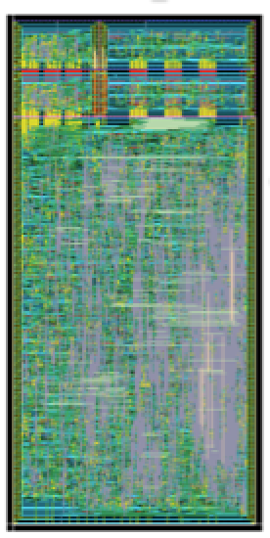
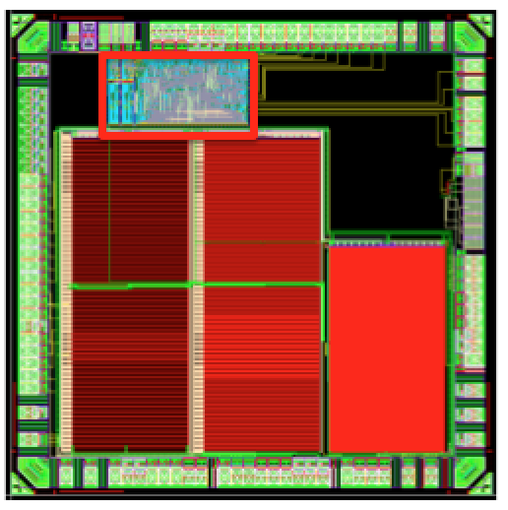
SERDES65_V1
CML-RX
High-Speed Clock
SER (PISA)
DES (PISA)
Embedded Test Bench
Low-Speed Clock
SER (PISA)
DES (PISA)
SERDES65_V1 Architecture
SERDES65_V1 Layout

Slide 15
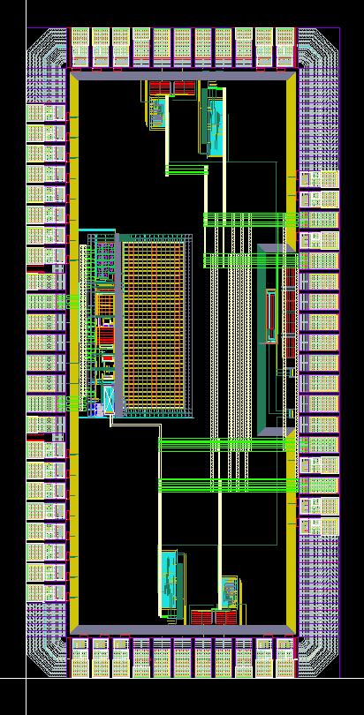
SERDES65_V2
SLVS-RX
Clock
SER (BONN)
SLVS-TX
SER (PISA)
SLVS-TX
High-Speed Digital I/O
Data Port & Controls
DES (PISA)
SLVS-RX
I/O LOGIC
ADC (BARI)
SLVS-TX
SLVS-RX
Analog I/O Voltages
SERDES65_V2 Architecture
SERDES65_V2 Layout

Slide 16
IP Cores Pisa - planning
Test and characterization of SERDES_V1 prototypes (including TID test at CERN and SEE test at LNL in July 5)
September 2015
Development of a test bench for the Test and characterization of SERDES_V2 prototypes
November 2015
Development of an IP-Core library including SERDES and SLVS Driver and Receiver modules
November 2015
Design of SERDES_V3 (possible improvements w.r.t. power management and radiation tolerance in SERDES and SLVS driver and Receiver modules)
December 2015 – February 2016
Test and Characterization of SERDES_V3
April 2014 – June 2016
Design of SERDES_V4 (final SERDES and Driver and Receiver integrated with ESD protection in differential pads)
May 2016 – July 2016

Slide 17
Attivita’ a Pisa per la sottomissione Ottobre 2014 e successivo test Fabio Morsani
progetto logica di controllo del TimeOverThreshold
readout e configurazione del pixel
layout e check pixel/matrice “1x2”, ½ BG e ½ TO
progetto testboard compatibile PIXFEL-CHIPIX65 per tutti i 3 tipi di chip e carrier per ognuno di essi
montaggio, test e distribuzione TB+CARRIER a TO e BG
test preliminari sulla configurazione di “1x2”, modifiche al layout per correzione problemi riscontrati

Slide 18
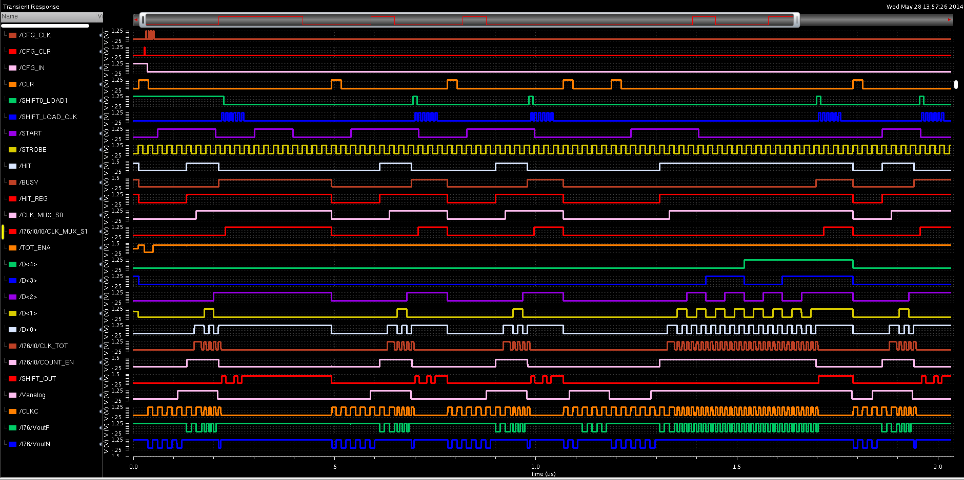
Simulazione, 5 eventi singolo pixel in vari casi, si vede bene il clock del ToT e il caso di timeout nel conteggio del ToT

Slide 19
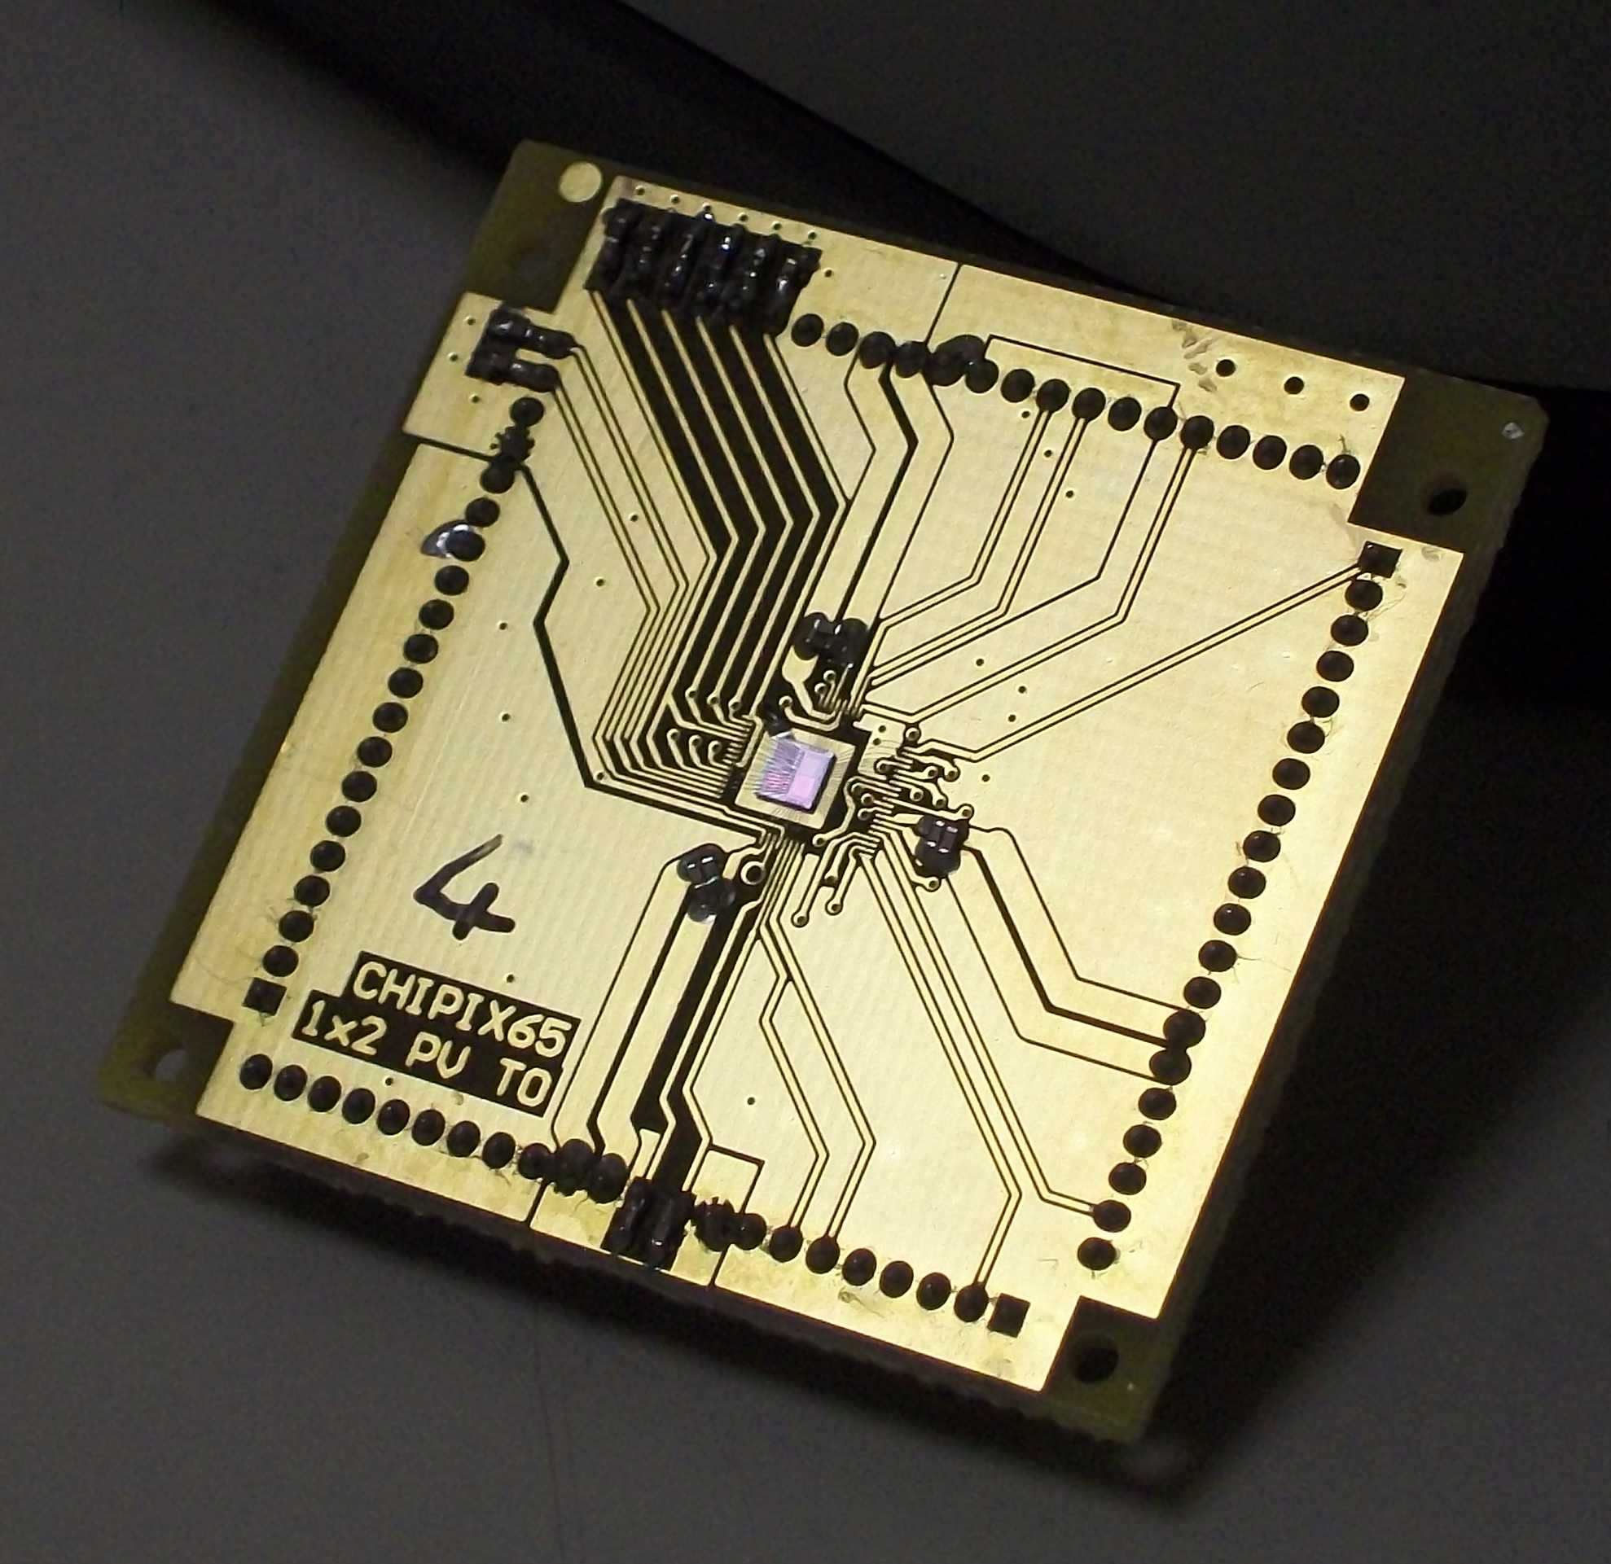
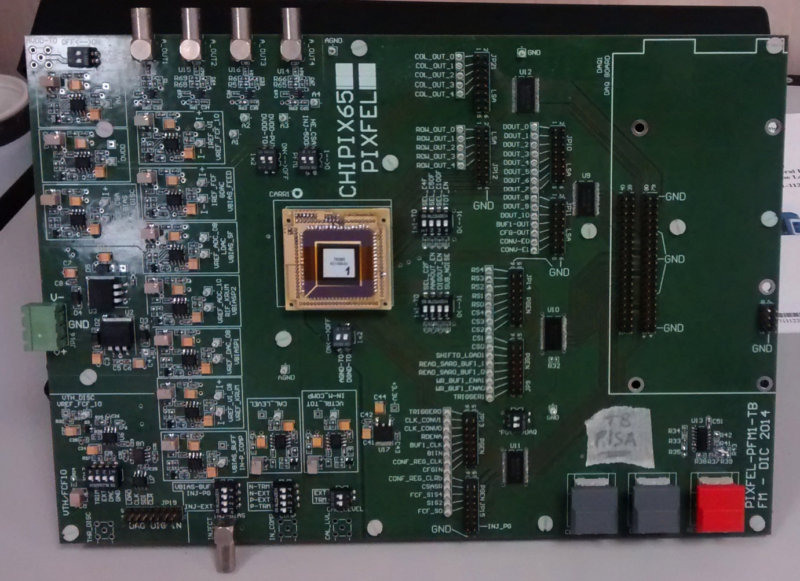
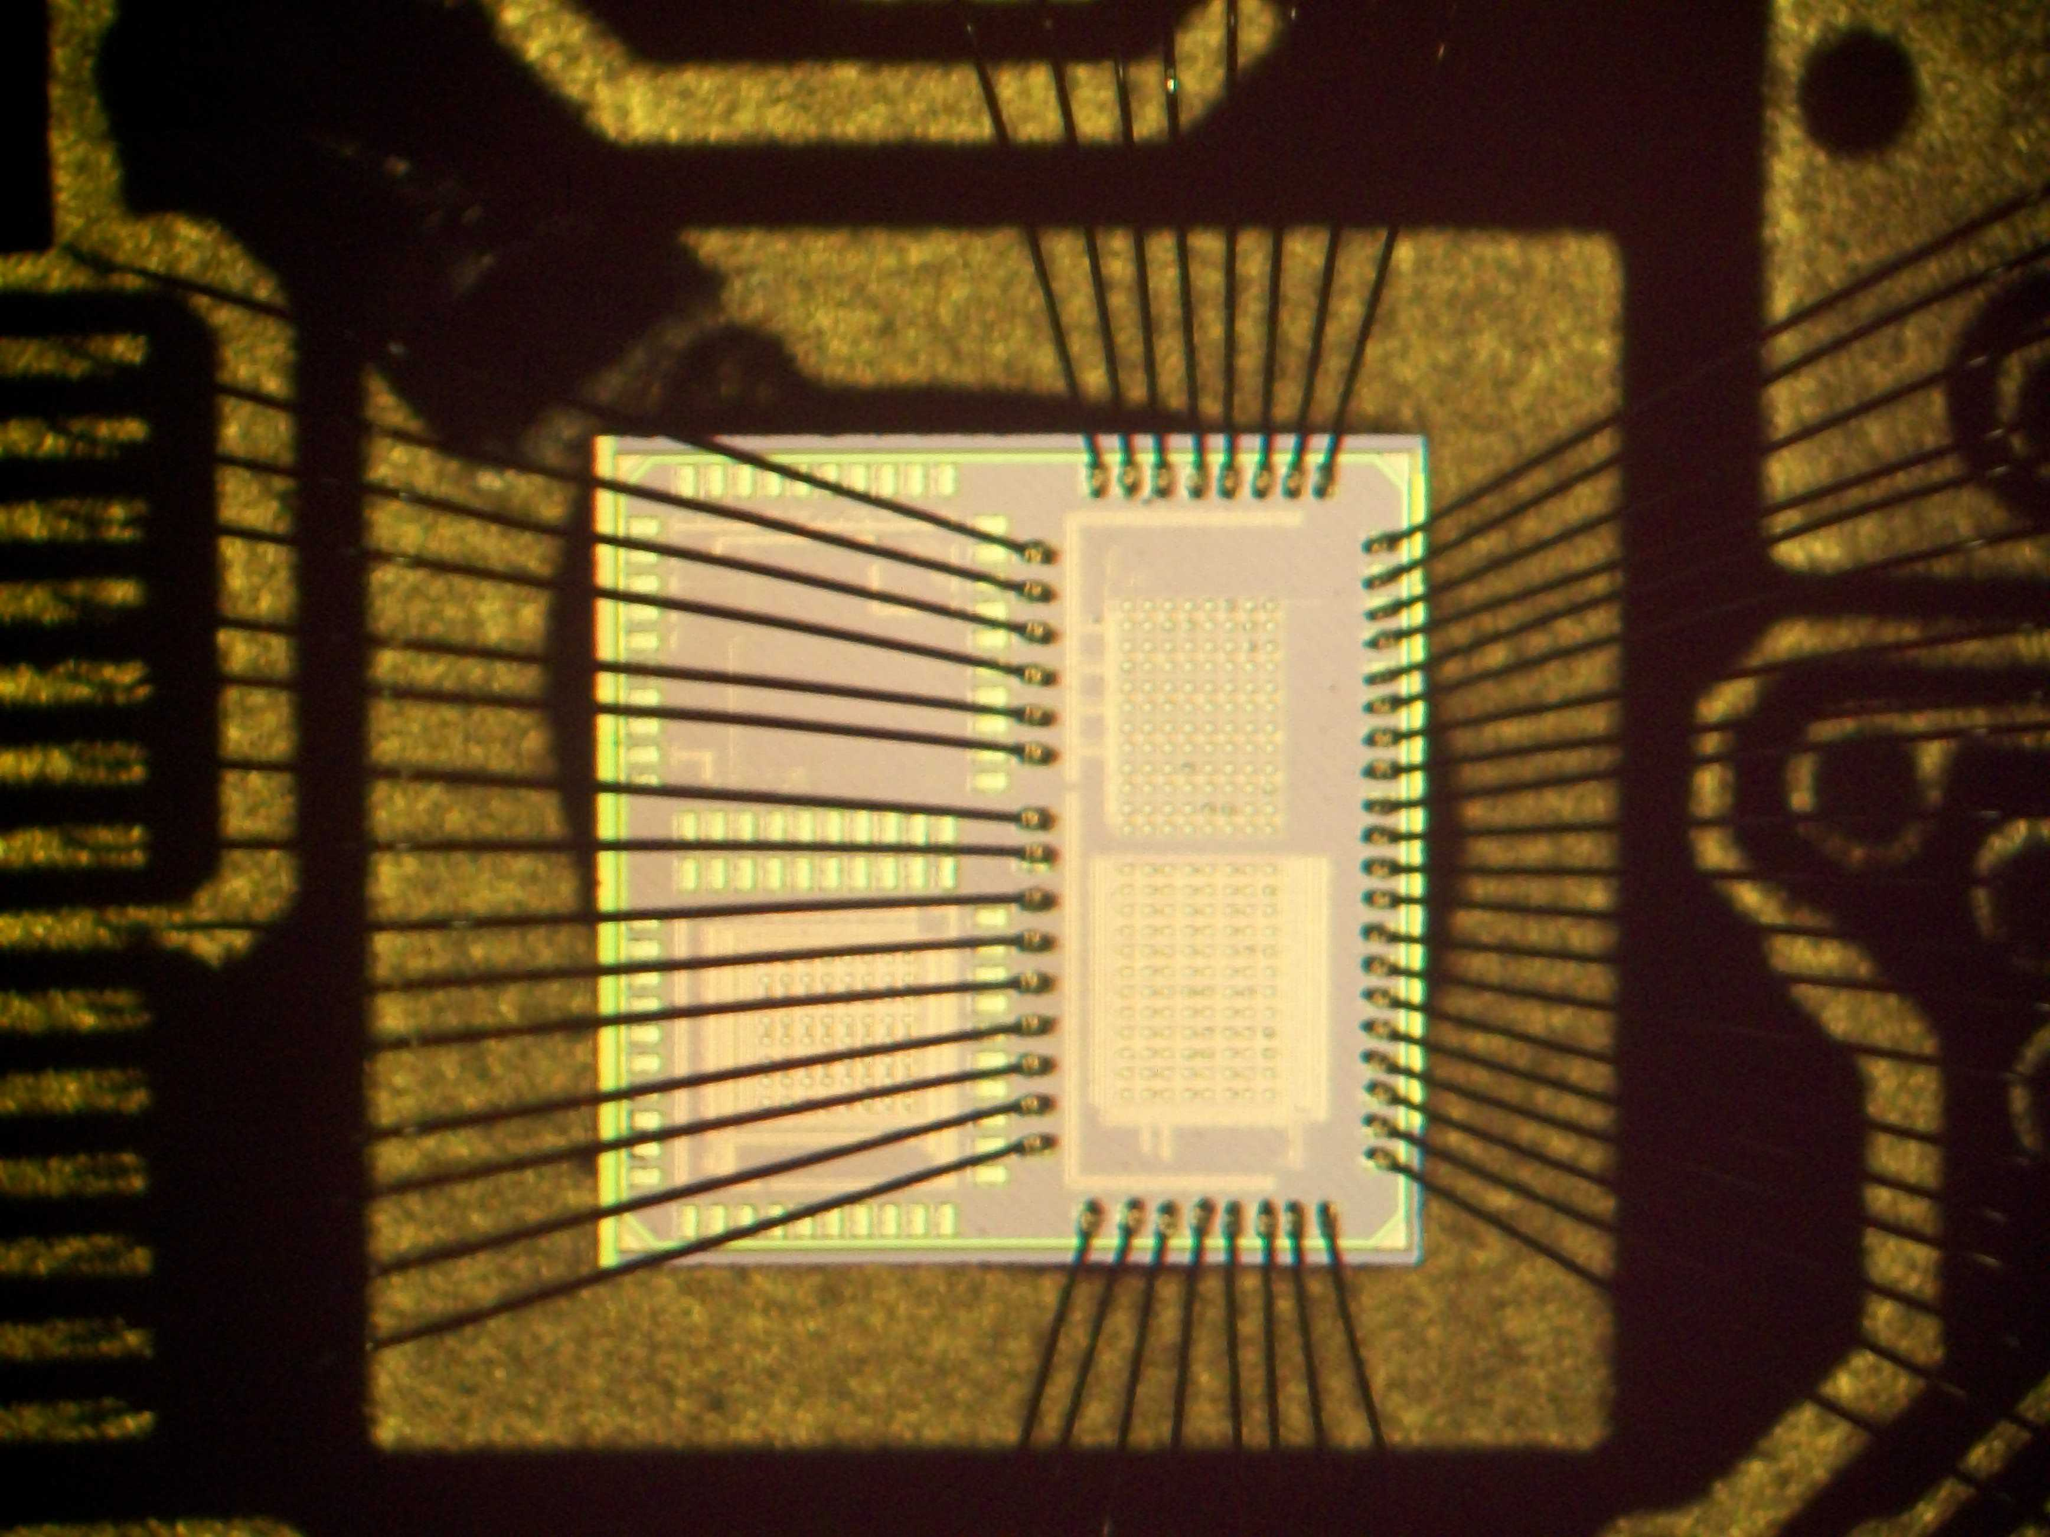
Test board (F. Morsani)
Testboard developed to be compatible between PIXFEL and CHIPIX65

Slide 20
Main RD53 milestone: RD53A
2016 : RD53 Design of RD53A prototype
2-3 cm² prototype
Joined effort of the whole RD53 collaboration
Now definition / discussions o:
Technical Specs, Funding,
Milestone, Design team organization
submission end-2016
THIS WILL BE THE OUTPUT of RD53 Collaboration, closing the major part of R&D, communities will concentrate more into the chip for the experiments then.
Expect big contribution from R. Beccherle
CHIPIX65 contributions
Provide Analog Front End(s)
Provide IP-blocks
Digital architectures (shared work)
CHIP integration (shared work)
IP-block whould be in a stable ‘final’ version by middle/end of 2016
Finance contribution:
about 1/5 of cost
cost from 600ke to 1ME

Slide 21
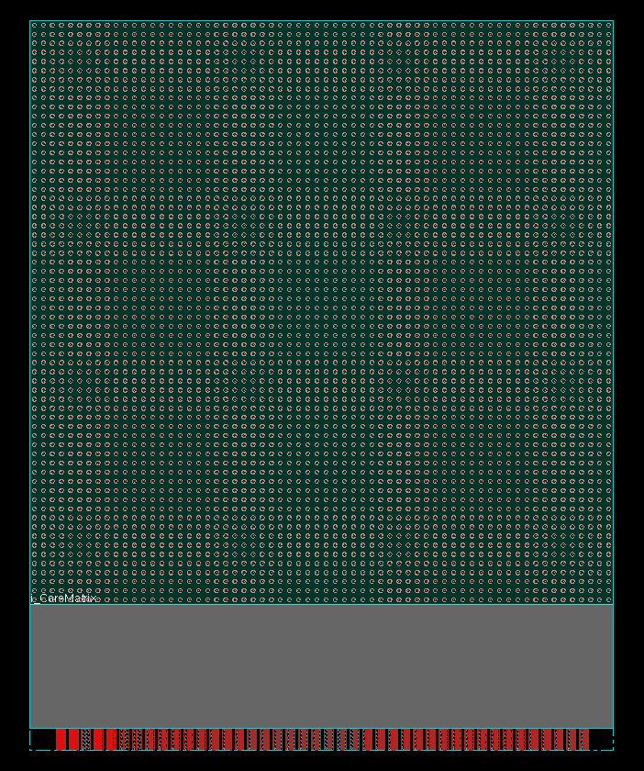
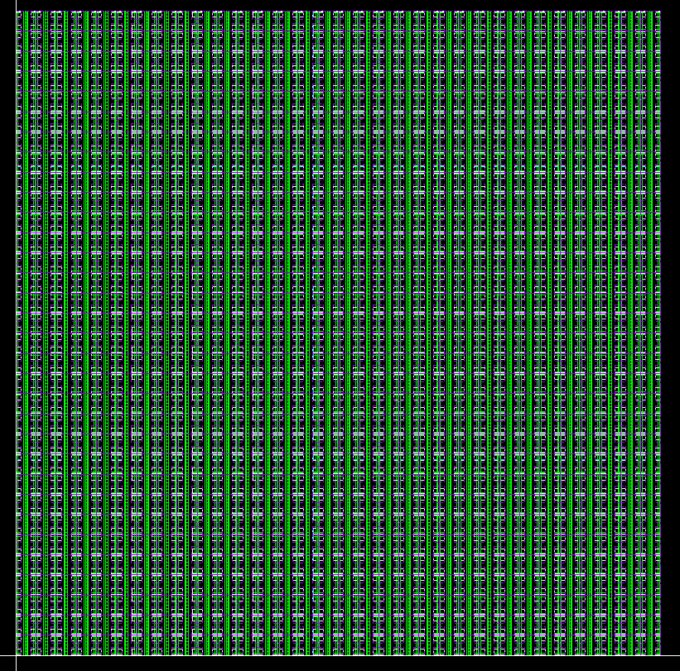
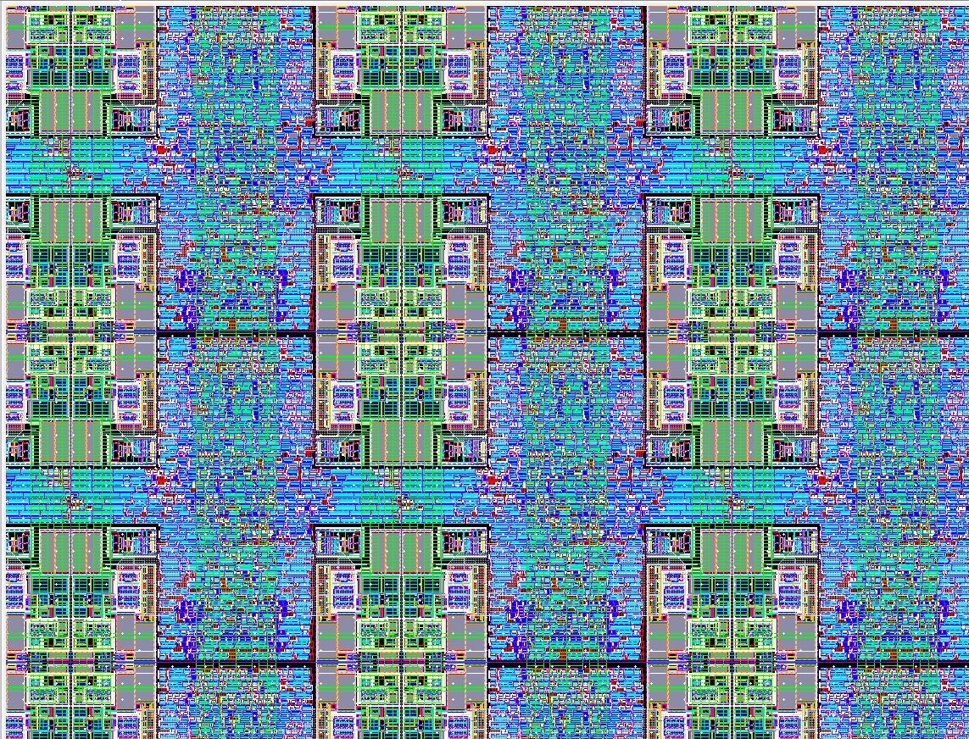
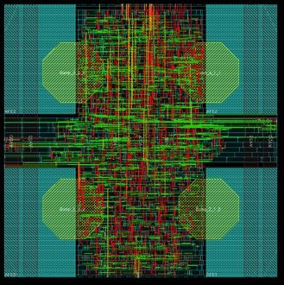
CHIPIX65 demonstrator 2015
Design of a small pixel array – in view of definition
64x64 pixels, 50µm x 50 µm; chip size ~ 4x4 mm²
Exercising a digital-architecture (CHIPIX65/Pg + CERN)
Implementing IP-blocks available
G. Magazzù involved
Integration in Digital-on-Top methodology
BUMP bondable to a sensors from next RD-phase 2
full integration using Digital-on-Top approach

Slide 22
RD53 Meeting in Pisa
Collaboration meeting in Pisa
14-16 October
~50 people
Hot topic is the definition of the RD53A chip
Good occasion to listen on progresses on R&D

Slide 23
Anagrafica e richieste 2016
Fisici | FTE (%)
K. Androsov | 10
M. T. Grippo | 10
F. Palla | 15
Tecnologi
R. Beccherle | 50
G. Magazzù | 30
F. Morsani | 10
M. Minuti
Consumi: 3 (5?)KE per test boards

Slide 24
BACKUP

Slide 25
RD53 Collaboration
www.cern.ch/RD53
Collaboration born in 2013 after a workshop among experts in CMS and ATLAS interested to develop a new generation pixel chip
Base technology chosen is CMOS 65nm
~125 members, 20 Institutes (from CMS , ATLAS or BOTH): 40-50% are ASIC designer
Bari, Bergamo-Pavia, Bonn, CERN, CPPM, Fermilab, LBNL, LPNHE Paris, Milano, NIKHEF, New Mexico, Padova, Perugia, Pisa, Prague IP/FNSPE-CTU, PSI, RAL, Sevillia, Torino, UC Santa Cruz

Slide 26
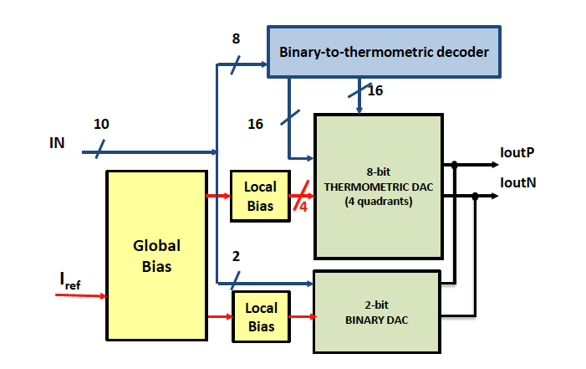
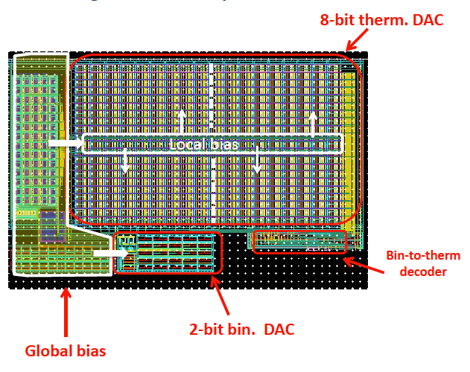
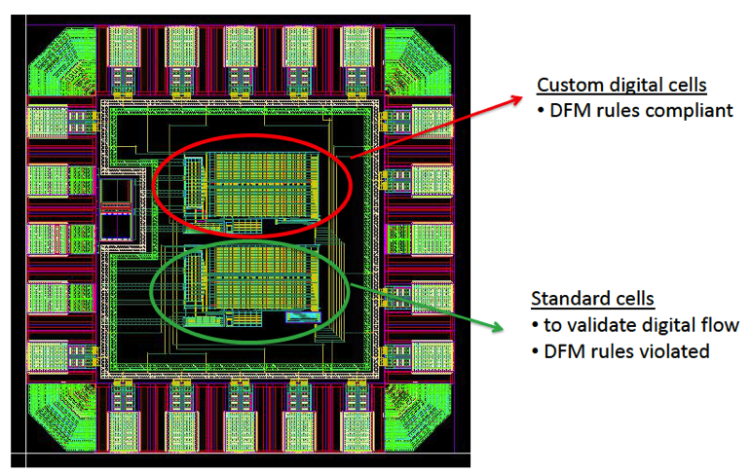
DAC
10-bit current-steering Digital-to-Analog converter; LSB = 100nA (nominal) -Architecture: 8+2 segmented DAC (2 binary weighted + 8 unitary decoded cells)
No-minimum size transistors used (radiation)
TESTED: MonteCarlo simulation agree with data
dimensions: 140 x 240 um²

Slide 27
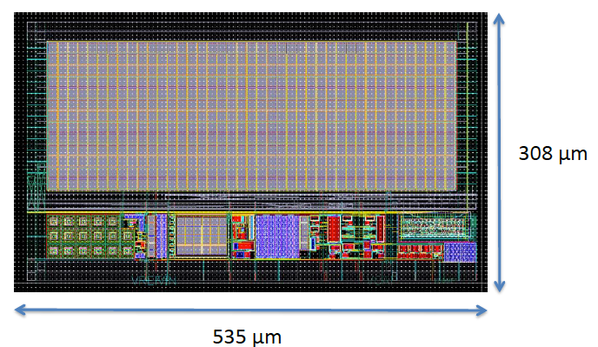
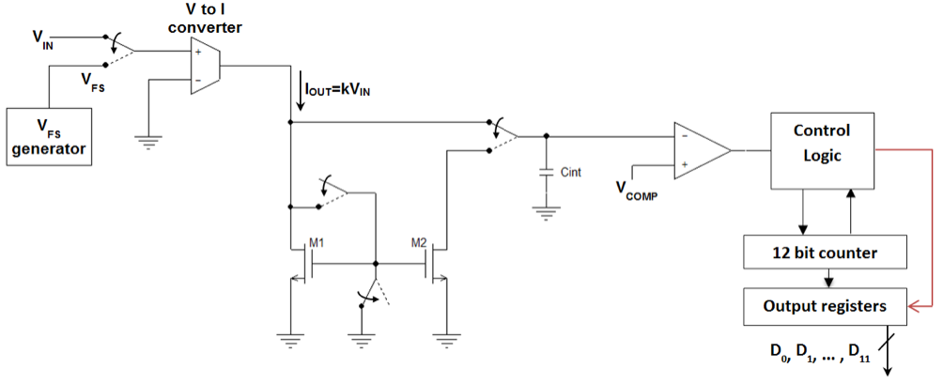
ADC
12-bit ADC for monitoring of slowly varying signals;
range of 1V; serving 16-muxed inputs.Conversion rate of 5kSample/s
Architecture: Voltage-to-current , charging an integration capacitance for 212 clocks. Measurements of clock cycles needed to discharge the capacitance using a fixed current.
Large capacitance for better precision (see layout)
Design finished and submitted in May 2015.

Slide 28
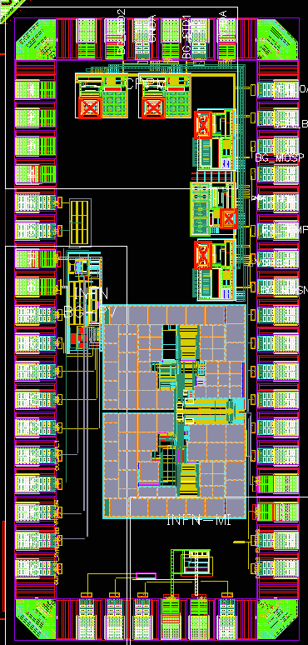
Band Gap
Normally a Band Gap should provide a DC voltage independent of Process, supply Voltage and Temperature.
for HEP: independent of radiation damage; critical for HL_LHC
To achieve this an all-MOSFET designs have been chosen
CHIPIX65 IP-blocks submitted together with others labs
INFN, CERN, CPPM structures

Slide 29
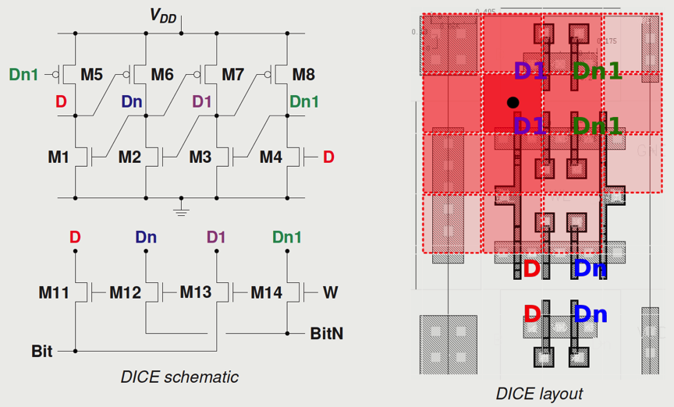
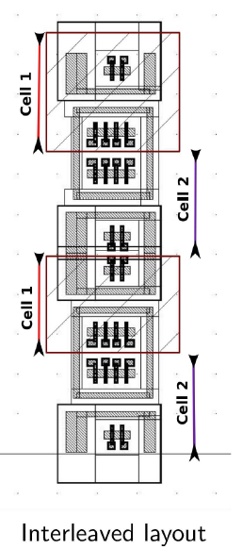
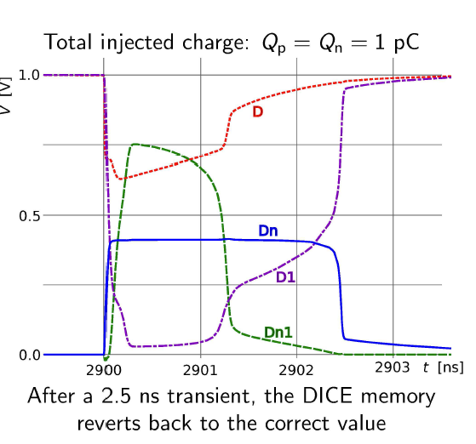
Dice S-RAM
DICE memory design to prevent SEU.
Duplicated data in nodes D e D1. If Transient happens cell does not show SEU.
Simulation with RC parasitic, injecting fault charge release ==> DICE recovers in 2.5ns, well enough for LHC
Array of 256x256 cells in three different layout:
simple
with guard rings (better SEL)
as (2) but interleaved (better resistance to Multi-Bit SEU)
Area affected by charge release
is larger than single diode
Dim: 1,8x3,3um²

Slide 30
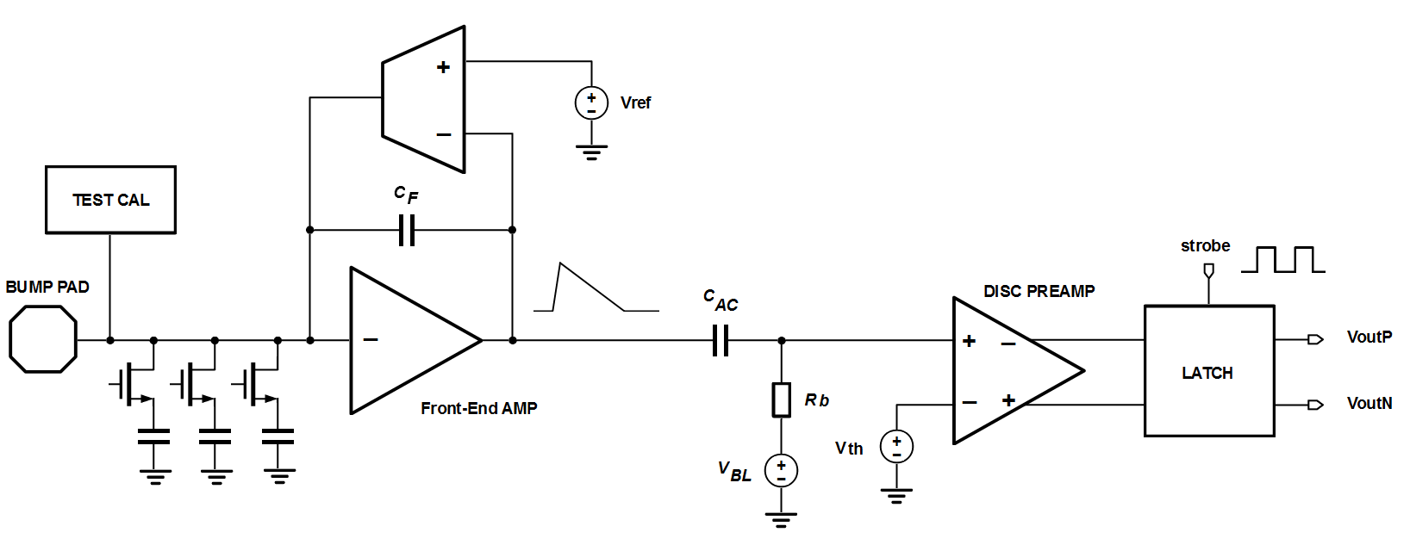
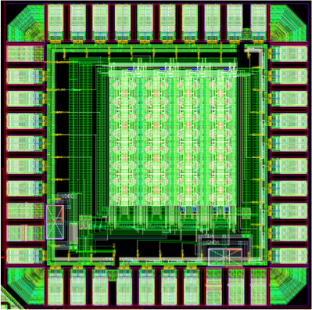
TORINO :
Synchronous Analog Chain
8x8 pixel matrix submitted and tested
Analog readout of CSA and Discriminator (via buffers)
PREAMPLIFIER
One stage CSA with Krummenacher feedback
Synchronous DISCRIMINATOR
(AC coupled to CSA)
off-set compensated diff.amplif. + latch;
FAST Time-over-Threshold
Local oscillator strobing Latch (to 800MHz
Calibration circuit
digital signal + DC calibration leve
Performance SUMMARY
Compact: ~25um x 40 um
Low power: < 5.5 uW (with ToT logic)
Low noise: ENC=100e⁻ @Cdet=100 fF
Leakage compensation: up to 50nA/pixel
Fast Charge measurement:
30 ke⁻ in <300ns (or 800ns)
up to 7-8bit (125-250e⁻/ADC) - no ext clock
NO Threshold-Trimming:
autozeroing made by hardware

Slide 31
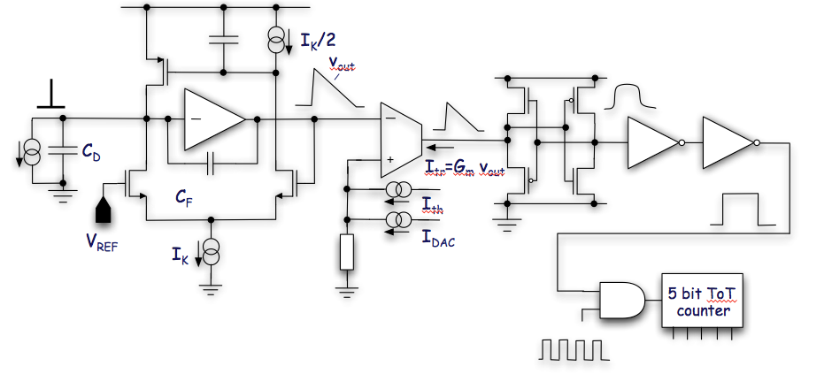
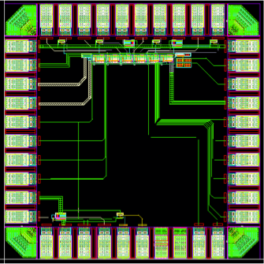
Asynchronous Analog Chain
Test Structures produced and tested
PREAMPLIFIER
Single amplification stage for minimum power dissipation
Krummenacher feedback to comply with the expected large increase in the detector leakage current
DISCRIMINATOR
High speed, low power current comparator
Local Threshold correction via 4-bit current DAC
5 bit counter – 400 ns maximum time over threshold
Performance SUMMARY
Compact: <25um x 50 um
Low power: ~ 5 uW
Low noise: ENC~110e⁻ @Cdet=100 fF
Leakage compensation: up to 50nA/pixel
ToT Charge measurement:
30 ke⁻ in 400ns
5-bits for 80 MHz external clock
NO Threshold-Trimming:
autozeroing made by hardware

Slide 32
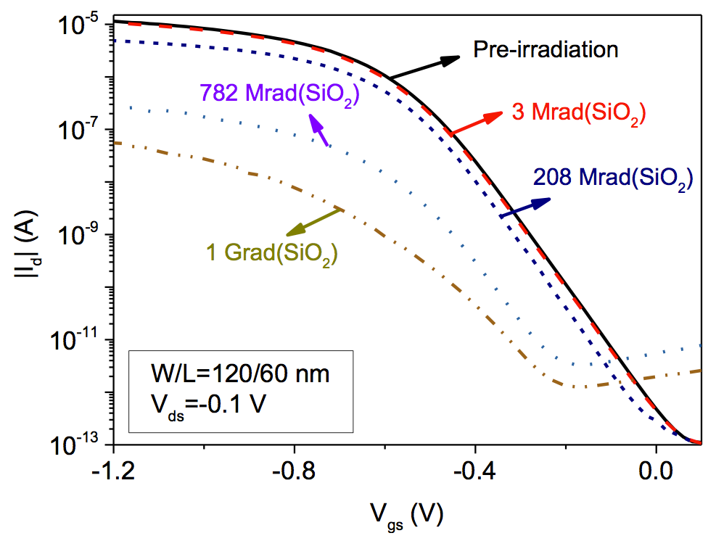
Radiation Characterization
No full review here, for that see RD53-talks at recent conference (no time to cover all today…)
Here just some hints and measurements done by CHIPIX65 (contribution to RD53)
for minimum-size p-MOS degradation significant above 100 MRad and very significant at 1 Grad (see plot). Mitigation actions:
larger sizes (W>300-500nm)
operation at low temperature
High T annealing is bad
Total Displacement Damage does not take a role also for 65nm
Impact on digital circuitry, analog is fine since low-mismatch and performance require already larger size than minimum
Ids-Vgs characteristics of a core small size
p-MOS for diffrent dose up to 1 Grad

Slide 33
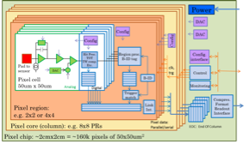
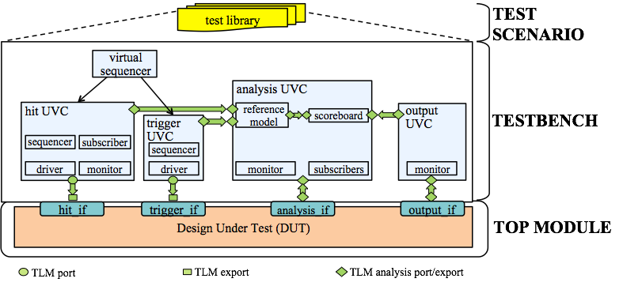
Digital Architecture and Simulation FrameWork
Architecture Main concept:
Pixel organized in Regions
local storage
trigger matching at L1
shared resources
Emphasis on Analog isolation from Digital (low threshold should be reached)
Digital-on-Top approach to design large area pixel chip (~2x2 cm²)
Development of a System Verilog-UVM Simulation Framework (VEPIX53) - CHIPIX65 / CERN
IO protocols, protection from SEU, balancing and possible continuous configuration of pixel chip / cells

Slide 34
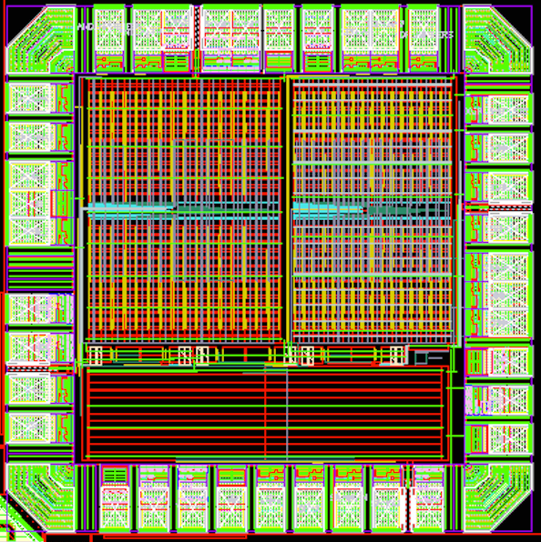
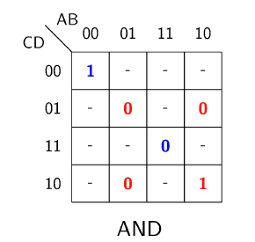
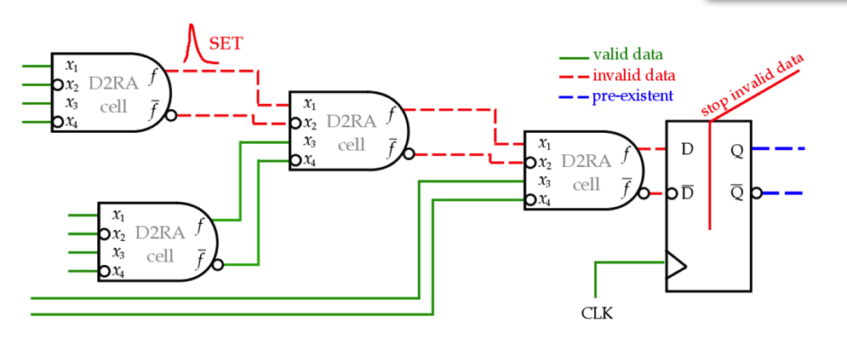
Dual-Rail digital cells
Redundant logic which processes both the bit and the inverse bit (D2RA)
(01) and (10) : valid data
(00) and (11) : invalid data
Combinatorial logic gate realised:
AND / NAND; OR / NOR; XOR / XNOR, NOT ; MUX
Sequencial logic gates:
Edge-Triggered delay flip-flop (D-FF)
Clock edge detector
NB: two parts of N2RA must be distant 5um
Test structure with AND/NAND tree, D-FF in series;

Slide 35
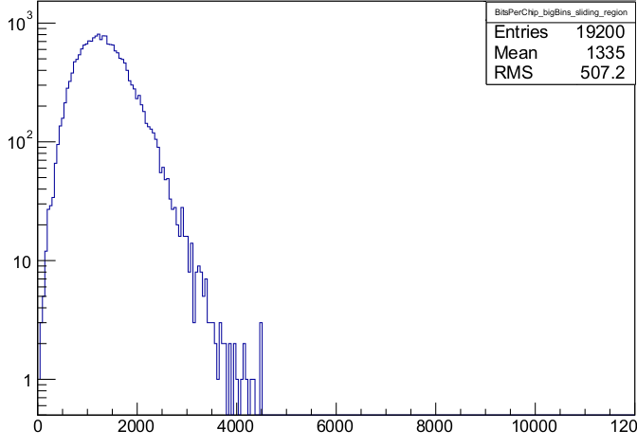
Delta representation
Pixel ordering | H Δx | H Δy | H pixel position
By rows | 2.25 | 3.70 | 5.95
Bits per chip per event (ordering by rows)

