Slide 1
Preventivi CSN5 - Pisa
IMPART
Young Researchers CSN5
Calliope-Louisa Sotiropoulou on behalf of the IMPART Project

Slide 2
Project Goals
To develop a pattern recognition device for fast image and DNA analysis and future trigger processors for High Energy Physics (HEP)
This project will achieve an innovative multi-chip package (System in Package, SiP) with the final aim of enhancing performance and power saving in electronic devices devoted to pattern recognition tasks for several interdisciplinary applications
The IMPART project consist of design, fabrication and characterization of a device made of a Field Programmable Gate Array (FPGA) die and an ad-hoc Application-Specific Integrated Circuit (ASIC) assembled in the same pagkage

Slide 3
Research Units Description and Duties
1 Post-Doc, 2 PhD Students, 1 Engineer Staff
Notes:
Describe only pisa… and talk about stabile

Slide 4
WP3. Smart Cameras and DNA Sequencing
Deliverable done and already submitted in collaboration with IAPP Project

Slide 5
Timetable Overview

Slide 6
Costs
Notes:
The money is allocated in Milano they will be moved in the future

Slide 7
System In Package (SiP): ASIC + FPGA
Data between FPGA and AM chip:
  Single-ended bondwires (200MHz)
Data between FPGA and external world:
  Serial-link at high frequency
Target: Bring the pattern matching function of the AM chip and the Track Fitting function of the FPGA close together to achieve much higher performance*
*(see “Future Evolution of the FTK Processing Unit”, C. Gentos et. al, TIPP 2014 )

Slide 8
Computer Vision for Smart Cameras and Medical Imaging Applications

Slide 9
IMPART + Del Viva’s Algorithm
Currently in development: The majority of the modules are designed and currently in the process of behavioural simulation. Integration in progess.
The know how already exists from the FTK project.
C.-L. Sotiropoulou et. al, “A Multi-Core FPGA-based 2D-Clustering Implementation for Real-Time Image Processing”, IEEE TNS, vol. 61, no. 6, pp. 3599 - 3606, December 2014

Slide 10

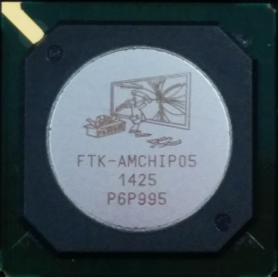
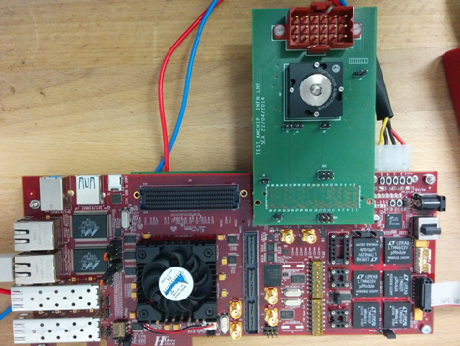
Hardware configuration:
Use of AMchip 05 Test system
Pattern
Filtering:
performed by
AM
Chip
Traning:
performed by
FPGA
+
Ex. Memory

Slide 11
Hardware configuration:
Use of AMchip 05 Test system
Adapt the existing system to load images and execute the training phase
  Identify all existing patterns, generate Probability Density Histograms
  Identify useful patterns
Adapt the existing system to execute pattern matching
  Load the useful patterns to the AMchip
  Execute pattern matching for various input images
  Extract contours or/and execute a post processing step (e.g. clustering)
More details on the algorithm in the backup slides

Slide 12
Current Project Status
Parts of the Training Phase hardware are already designed and successfully tested in behavioral simulation
The integration of the Training Phase firmware is in progress
Actively seeking for possible collaborations for future applications (HiPEAC CSW Thematic Session, collaborations with INFN researchers etc.)
First deliverable from Pisa group (WP3.1):
https://agenda.infn.it/getFile.py/access?resId=0&materialId=0&confId=9777
HiPEAC Computing Sestems Week Milano, 21-23 September PoliMi (Edificio 11)
https://www.hipeac.net/csw/2015/milano/
Thematic Session on: “Advanced Image Processing Implementations: A multidisciplinary approach”
Monday 21 of September, 14:00

Slide 13
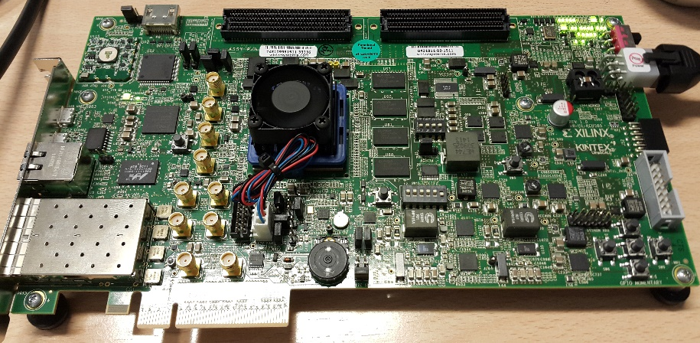
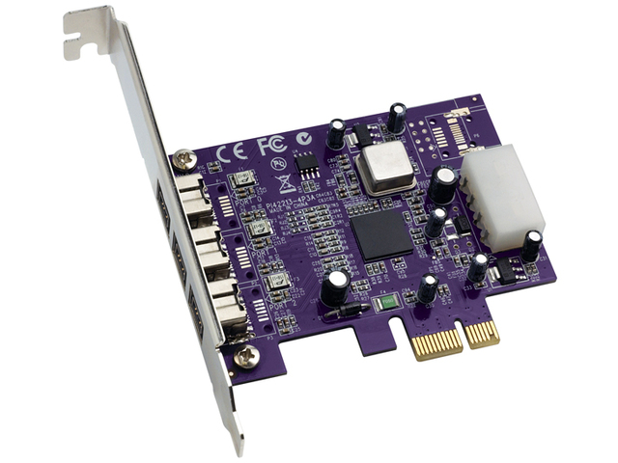
Next Steps
Use of Ultrascale FPGAs:
We currentrly have available two (2) Xilinx Kintex Ultrascale Development boards (latest FPGA technology available from Xilinx)
Merge the devices on a single chip (SiP)
Targeting the development of a portable and flexible hardware accelerator (possibly with a PCI type interface) to be easily interconnected with a PC

Slide 14
Project Impact

Slide 15
Back Up

Slide 16
A New Multi-Purpose Idea

Slide 17
FPGA Tasks

Slide 18
Hardware configuration:
Use of AMchip 05 Test system
A Virtex-6 LX240T Development board with a system implemented to test the AMchip
Functions that exist:
  Pattern loading
  Pattern comparison
  Ethernet connection
  IPbus controls
  GTX transceivers etc.

Slide 19
FTK for Image Filtering
Image Filtering → Finding Contours is the way human brain operates: New approach for image processing hardware
Major difference between HEP and Human Brain:
  For HEP we are aware a-priori of the relevant patterns
  The Human Brain is trained in real time
  (we are not aware of the patterns beforehand and we always adjust to new environments)
Target:
Design and prototype a pattern matching machine that executes both training and filtering in real time using high performance embedded systems (FPGAs, ASICs and combination of the two - SiP / System In Package)

Slide 20


FTK for Image Filtering
Build small arrays of pixels (3x3 for static images or 3x3x3 for movies – 3rd dimension for time) that are AM patterns (M. Del. Viva, G. Punzi)
B/W 2⁹=512 patterns: 101-010-100, ……. , 111-011-001
4 gray level 2¹⁸= 256 Kpatterns: 00,00,01-00,01,00-11,00,10 …..
B/W + time 2²⁷= 128 Mpatterns: 111,000,000 - 000,111,000 - 000,000,000
Training: Calculate the frequency of each pattern in the sample images/frames
Compute Probability Density Histograms (PDHs) for different training image sets
Select the relevant patterns to be put in the AM bank

Slide 21
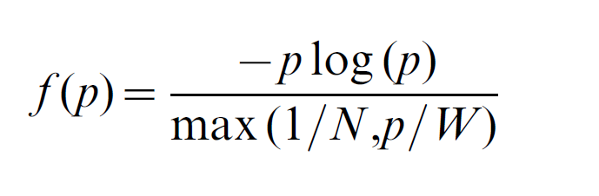
FTK for Image Filtering
Choice of relative patterns: Choose the pattern set that maximizes entropy H under real constraints
Unbounded entropy
Entropy yield per unit cost and for each pattern:
Where p is the probability that a given portion of the input data matches a specific pattern, N is the maximum number of storable patterns and W is the maximum allowed total rate of pattern acceptance.

Slide 22
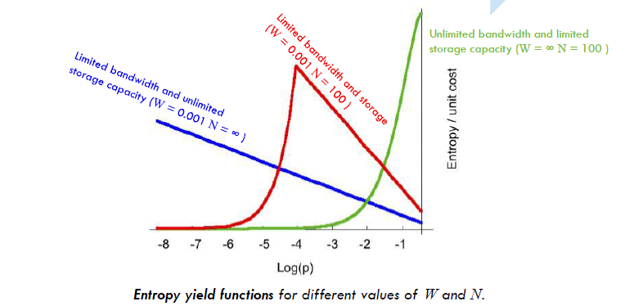
FTK for Image Filtering

Slide 23
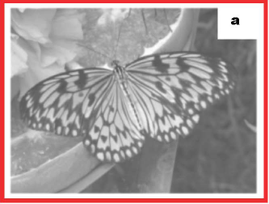
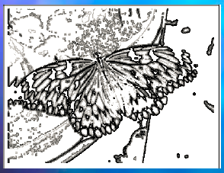
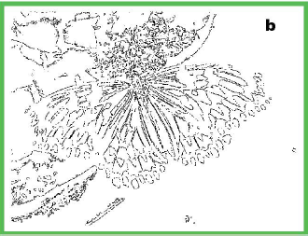
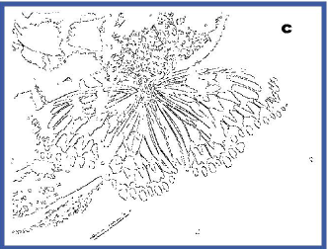
FTK for Image Filtering
4 grey level:
2¹⁸ patterns
Stored N=2000
= 1/64 of 1 chip
= 50 mW
Accepting only
these 50 patterns
Accepting only
these 16 patterns
9.8%
5.5%

Slide 24
Hardware Implementation:
Training Phase – Calculate the frequency of each possible pattern
4 Gray levels 2¹⁸= 256 Kpatterns (B/W movement: 2²⁷= 128 Mpatterns)
i. e. pattern = 11,11,11-11,11,11, 01,11,11
Each pattern = its own address
32 b × 256 k
= 500 kB
Pattern = ADDRESS
NumOfAppearances = NoA(pattern)
(movement
32 b ×128 M
= 500MB)
Ext Memory
2 GB
16 bits
18 (or 27) bits
Each Location contains the updated number of appearances of each pattern. When a pattern is identified the specific pattern address is read, contents are increased by one (+1), and written back in the same location - ACCUMULATION

Slide 25
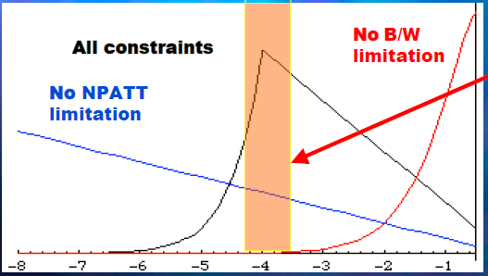
Hardware Implementation:
Training Phase – Updating Frequencies
Patterns that are efficient carriers of information
given the bandwidth (W) & memory limits (N)
Log(p)
W/N>p
W/N<p
f(p) = -pNlog (p)
f(p) = -Wlog (p)
N of
appearances
(per pattern)
DSP
pi
RAM
-log(pi)
-Wlog (p) if p>W/N
-pNlog(p) if p<W/N
Compare
To THR
Yes
Or
No

Slide 26
Hardware Implementation:
Training Phase – Calculate the frequency of each possible pattern
Optimized Accumulator design to execute the probability calculation function

Slide 27
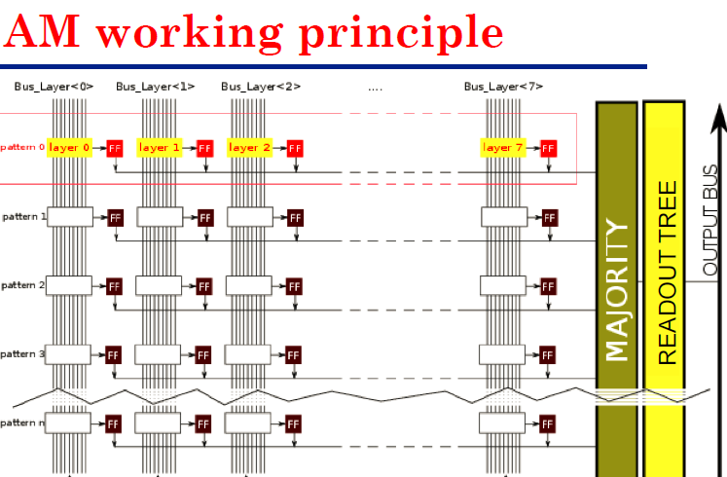
Hardware Implementation:
Running Phase – Filtering Patterns
4 grey levels $→256 kpatterns→\sim 1\% good kpatterns=2 kpatterns$
GOOD for AM05 used with threshold 1 – same pattern written 8 times in the 8 columns
Each comparison we (1) compare 8 patterns (2) read for each match the bitmap (3) give INIT
………
Patt0 Patt1 Patt2 Patt7
Running Phase
Bus_layer0 Bus_layer1 Bus_layer2 …….. Bus_layer7
layer0
layer1
layer2
pattern0
layer7
layer0
layer1
layer2
pattern1
layer7
pattern2
pattern3

Slide 28
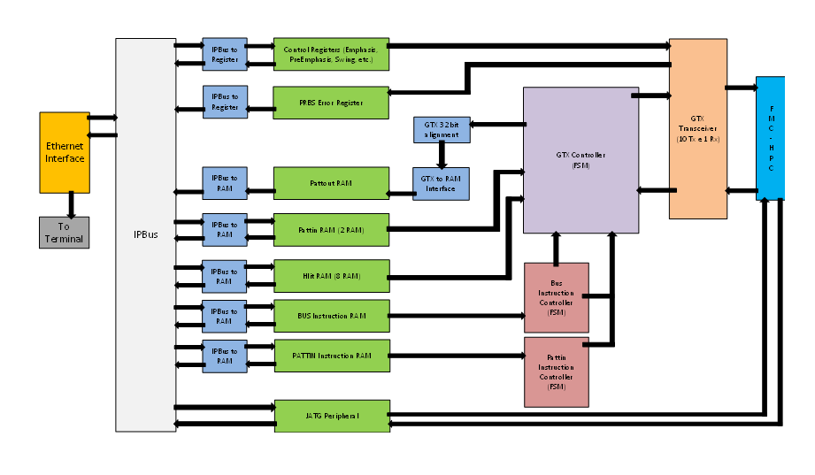
Hardware configuration:
Use of AMchip 05 Test system

Slide 29
Multi Package and Power Considerations

