Slide 1
CMS – RPC GIF++
G. Pugliese on behalf of the RPC Collaboration

Slide 2
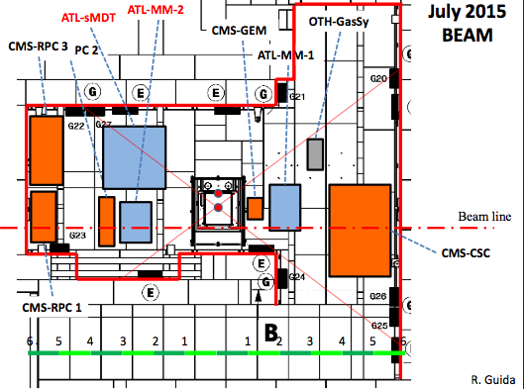
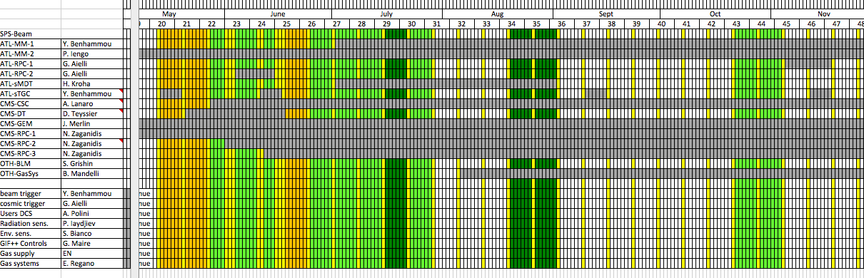
CMS RPC plan@ GIF++
3 RPC trolleys will be installed in the upstream region:
Consolidation for longevity study
Upgrade
GRPC
BEAM Periods
MAIN USER: 1 week in July and 2 weeks in August
Parasitic user: 1 week in June – 2 in July – 2 in Oct
Trolley 3: upgrade
Trolley 2: GRPC
Trolley consolidation

Slide 3
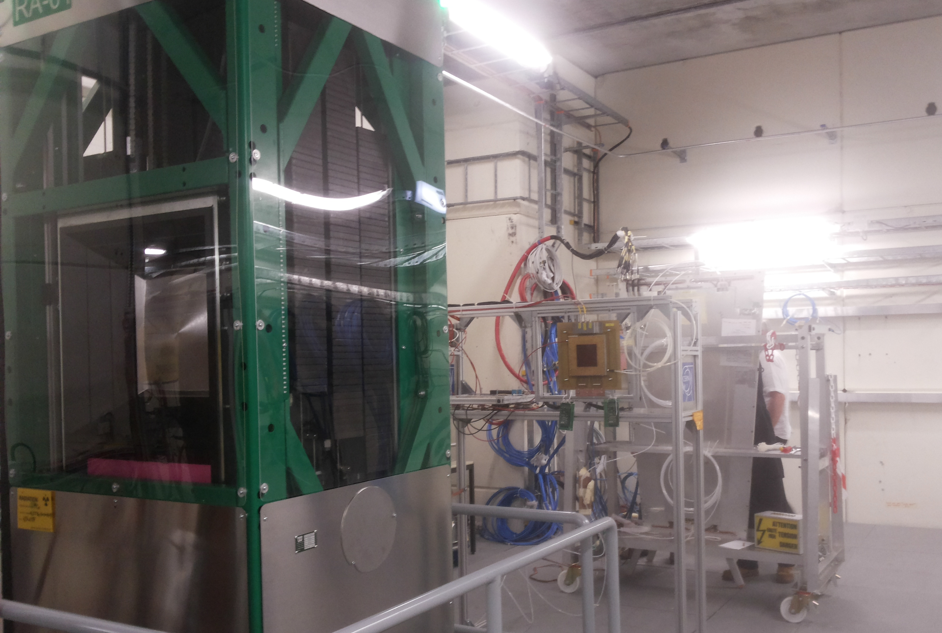
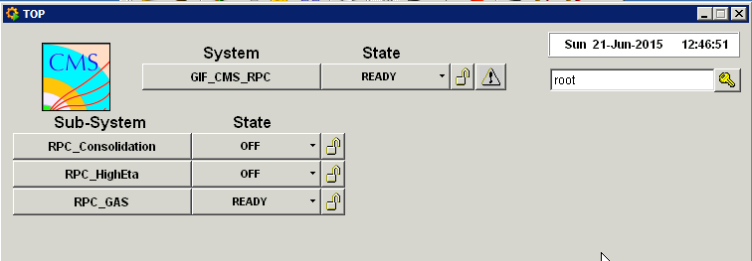
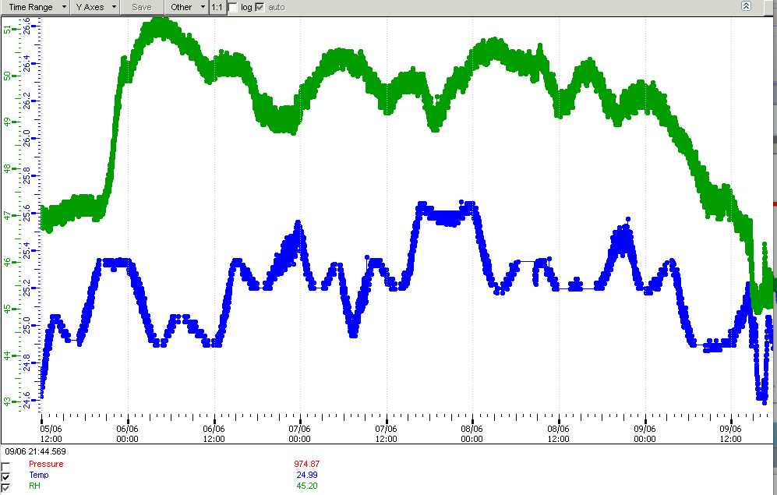
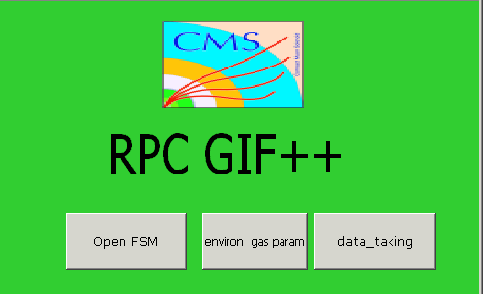
GIF++ Readiness
One old RPC chamber installed since 1 week. Preliminary measurements on gamma rate with several filters and chamber position on-going.
RPC DAQ and monitoring tools under commissioning
On-line and offline software in preparation
25.6
Some concerns:
High temperature inside the bunker. NO conditioning system planned by GIF++ infrastructure: RPC tent & local cooling under studying.
Beam trigger not ready yet.
24.4
Humidity
Temperature

Slide 4

GAS system
RPC Gas system operational
4 lines in the bunker upstream zone :
1 line in the preparation area
But NOT YET AVALABLE
NOW We are using a temporary line
→ gas mixer open loop:
Shared with ATLAS to use a common system, able to go up to 30 l/h:.
-20 l/hours for RPC
- 3 l/hour for the analyzer
Gas mixer Close loop: not yet ready
(up to 100 l/h )
→ GAS KILL NOT yet installed

Slide 5
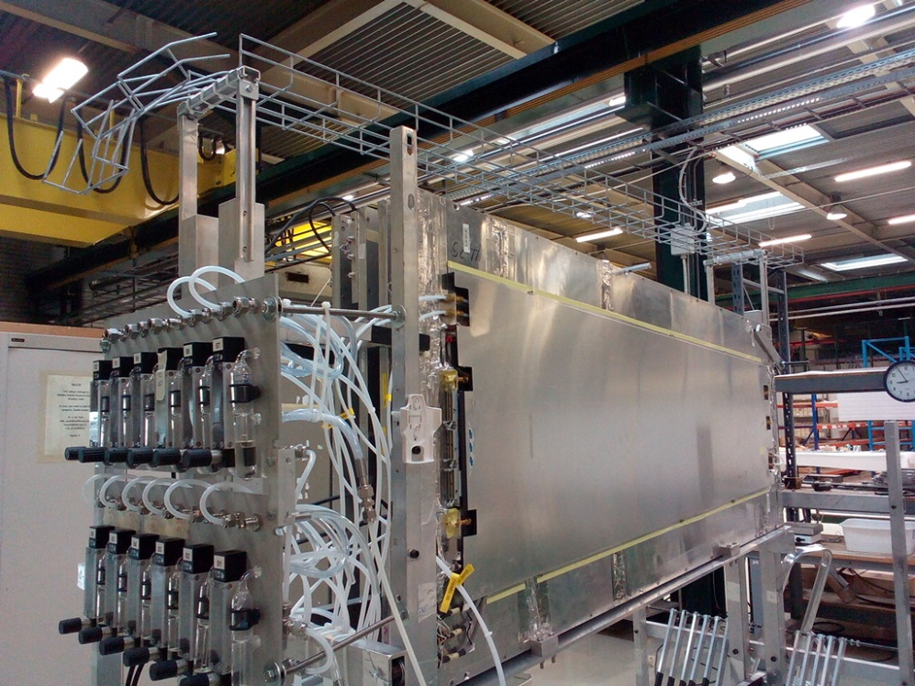
CMS Longevity Study Status
Four spare chambers (2 RE4 and 2 RE3) have been qualified in Ghent using the CMS telescope used during the last RE4 production.
Consolidation trolley in GIF++ preparation area: preliminary test done.
Plan to start the test by middle of July as soon as Beam trigger and all tools for monitoring and analysis will be validated.
Milestones:
Detector performance study vs HV with muon beam with different ABS and without source in the first test beams (in July and August).
Integrate an equivalent charge and dose for 10 years of HL-LHC about 1 year of irradiations).

Slide 6
R&D on Bakelite RPC
New Bakelite panels ready.
20 panels of Bakelite produced in Puricelli firm in April with thicknesses of 2mm, 1.8mm and 1.6 mm and with a resistivity range 1-6 10¹⁰ Ωcm higher than expected (0.9-210¹⁰ Ωcm). We will make a second production in July.
Panels cutted in Riva firm this week.
Four prototypes will build in General Technica under INFN supervision. Small rectangular prototypes with 2.0, 1.8 and 1.6 mm gap thickness. Plan to send them at CERN by the end-July. Cosmic telescope needed to certify the chambers.
Two Trapezoidal chambers RE4-1 geometry will be build in Korea with 2mm and 1.6 mm thick. Plan to send them at CERN in October.

Slide 7
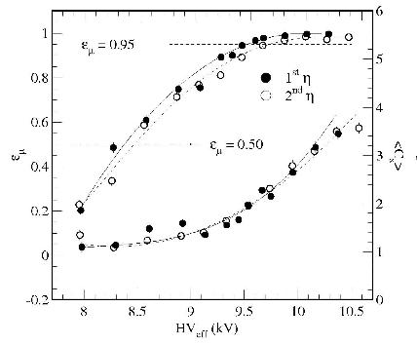
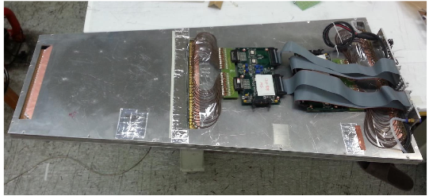
Upgrade R&D (Others)
Two prototypes built and tested in Korea (half size of the RE4/1):
CMS double gap: 1.6 mm gap thickness with Italian old HPL panels.
Multi-gap Gap: 0.8 mm gap thickness with Italian old HPL panels.
Plan: send them at CERN by July for the TestBeam in GIF++ in August.

Slide 8
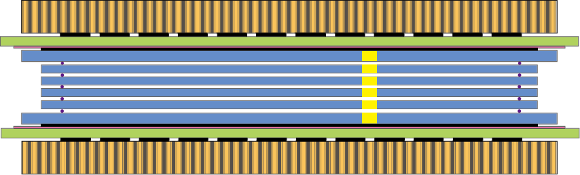
Upgrade R&D (Others)
Multi-gap Gap: the size of low resistivity glass is a limitation to build large MRPC (maximum size: 32×30 cm²). A mosaic of MRPC (40 x 50 cm²) have been build and tested by gluing two glasses together in Tsinghua University. Plan: send it at CERN by July for the TB at GIF++ in August.

Slide 9
SPARE

Slide 10
Conclusions
RUN2 operation started. CMS RPC system fully operational.
R&D for Phase 2 upgrade activity is on going on longevity study, iRPC, GRPC, Eco-Gas.
GIF++ activity is proceeding well.
Plan to have the first Test Beam by middle of July with 4 RPC spare chambers, several GRPC gap and 2 prototypes of improved RPC.

Slide 11
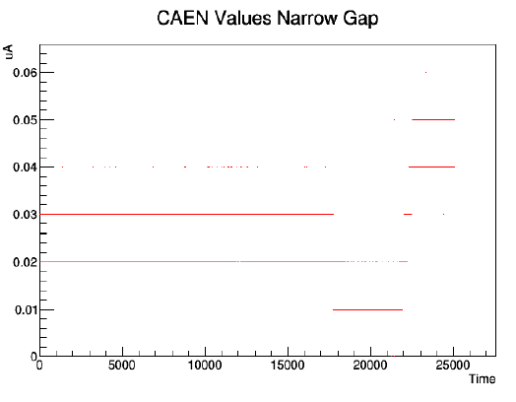
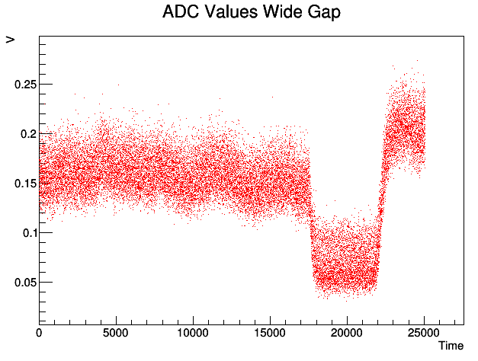
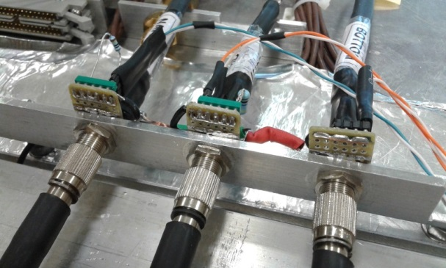
Current monitoring
Cabling done, installation of the circuits on the return line of the gaps done ,Thanks to colleagues from Georgia
In order to monitor the ageing of RPCs installed in GIF++, it is crucial to have a good measurement of the gap dark current.
R= 10 kOhm | I(uA)= 100* V ( Volts)
Range | 1000 uA
ADC | 0.001μA
CAEN main frame | 0.01μA
The next step will be to measure the current with high background.

Slide 12
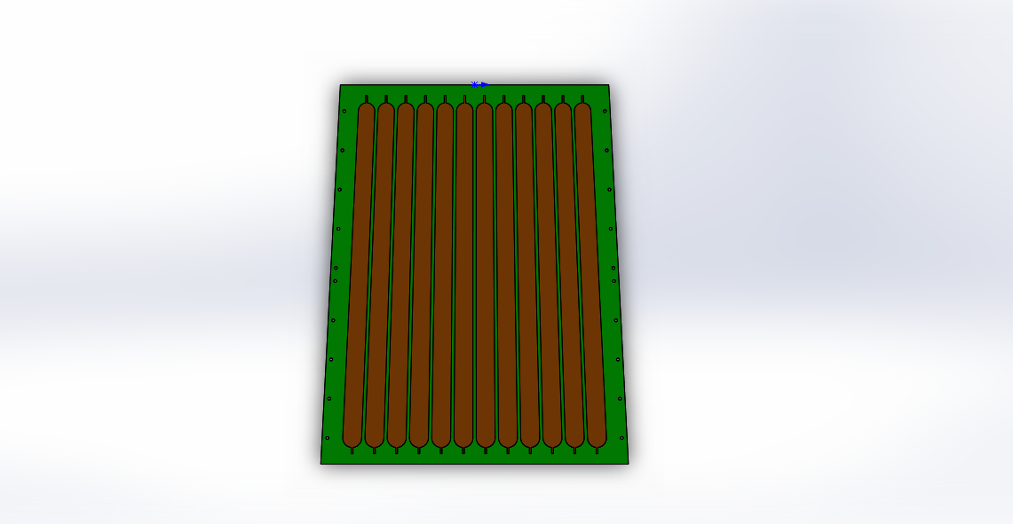
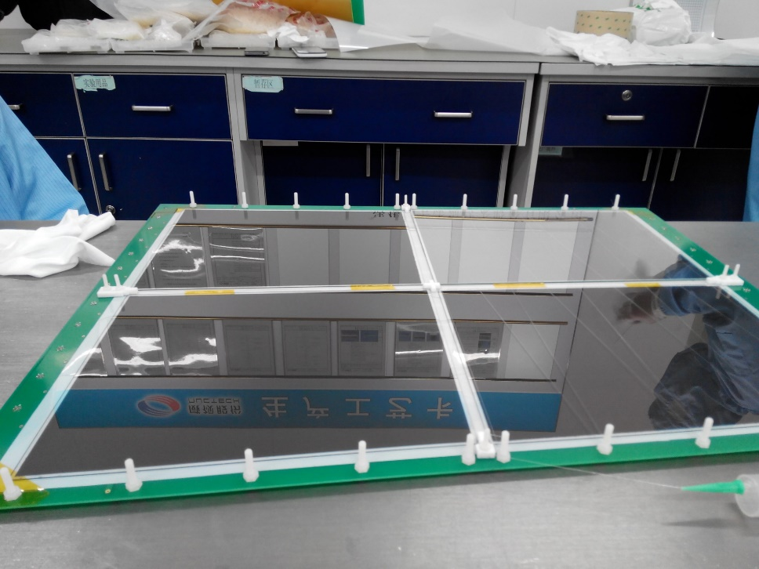
Trapezoid MRPC
The trapezoid MRPC consists of four parts and it is readout with single big PCB
Dead area is larger
Gas gap:
5×0.25mm
41 cm
58 cm
12 strips
Strip width: 25~29 mm
Nearly 5 mm width
Normal glass

Slide 13
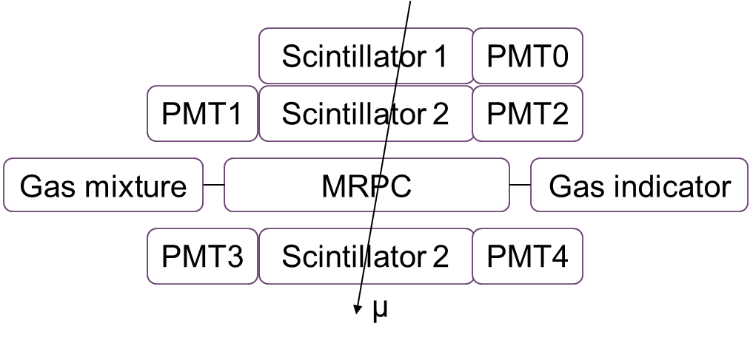
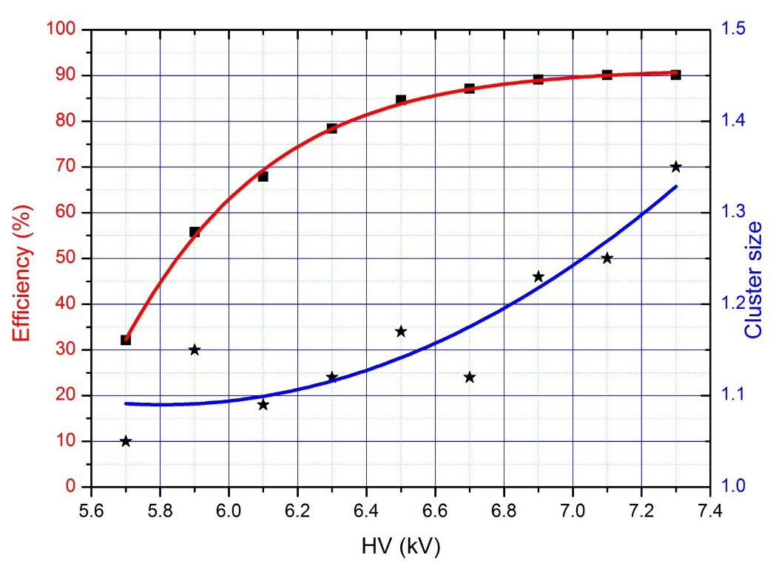
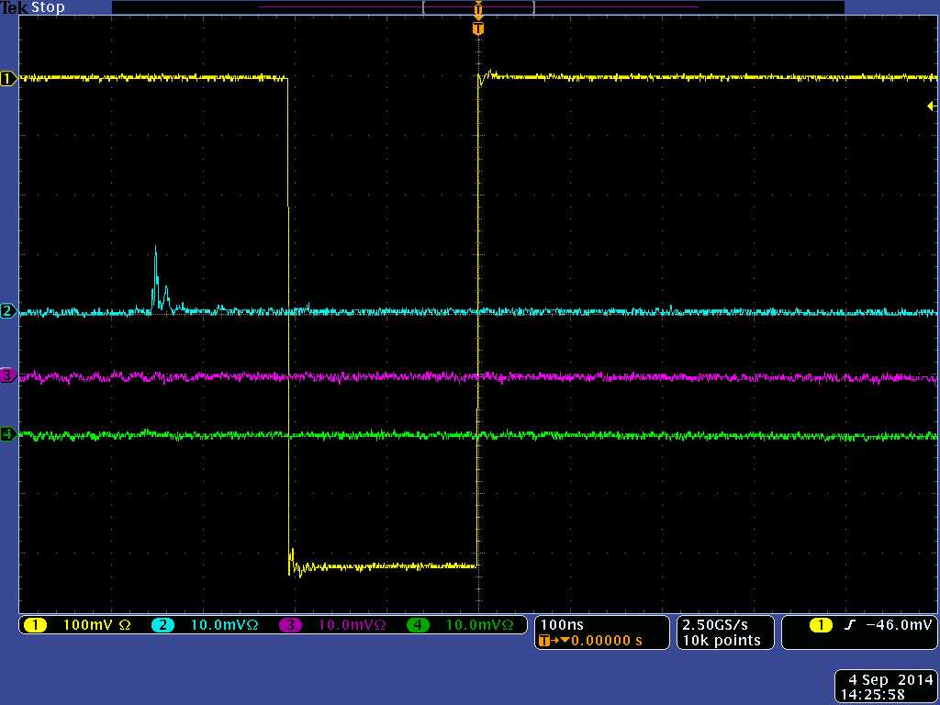
Trapezoid MRPC
Results
Trigger：yellow line
MRPC signal of 3 neighboring strips: blue; purple; green line
When voltage is 7.1 kV, efficiency reaches 90.1%
Notes:
We put this trapezoid MRPC into the same testing system as the gluing one, like this, and here is some of the results. This is from oscilloscope, the yellow one is trigger and the other 3 lines are 3 neighboring strips of the MRPC, here we can see a signal from MRPC, it is very clean. This is efficiency curve and cluster size curve. When voltage is 7kV, the efficiency reaches 90%.

Slide 14
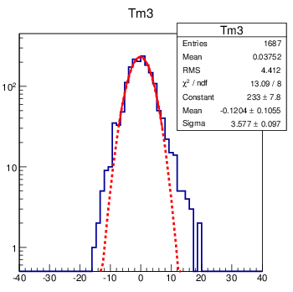
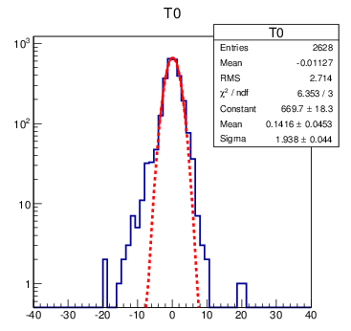
Trapezoid MRPC
Working gas：90% Freon， 5% iso-butane，5% Sf6
Time resolution
Notes:
This slide is about the time resolution performance. Here Tm3 means time of channel 3. Here after Gauss fitting, sigma is 3.58, and Tm0 is time of PMTs, as we choose a common stop time related to all the PMTs, here when calculating the final time resolution, we should eliminate the influence of PMT. So the final time resolution is 105ps

Slide 15
R&D on iRPC: Plan
Many groups (KODEL, INFN, Lyon, Beijing…) working on develop and test of improved RPCs chamber and electronics.
We have decided to move in these directions:
New materials (low resistivity Bakelite, low resistivity glass)
New detector configurations (reduced electrode and gap thickness, multigap configuration)
New electronics (ATLAS-like, IPNL-OMEGA-Tsninghua)
Important effort will be done at GIF++ this and the next years.

Slide 16
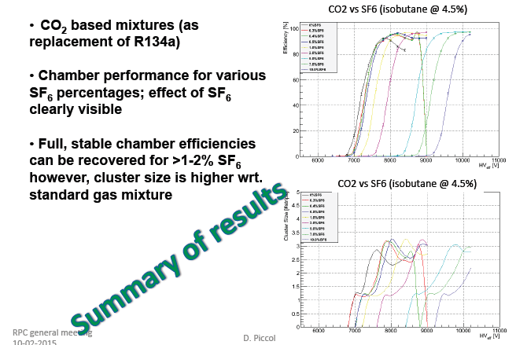
Ghent tests

Slide 17
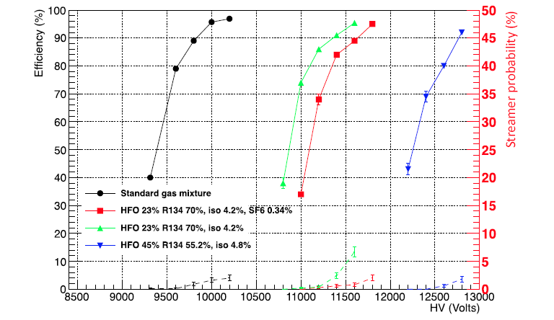
Frascati tests
Preliminary results from Frascati: good efficiency but reduced effective plateau
LFN internal note: “a study of HFO-1234ze(1,3,3,3-Tetrafluoropropene as an eco-friendly replacement of RPC detector” INFN 14/14-LNF

Slide 18
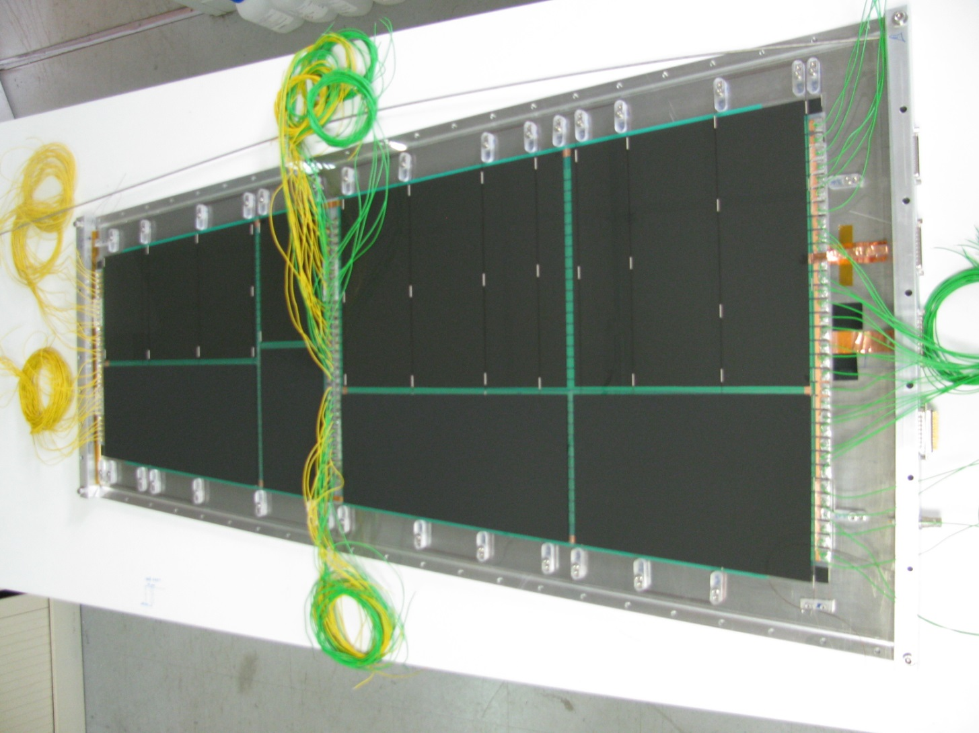
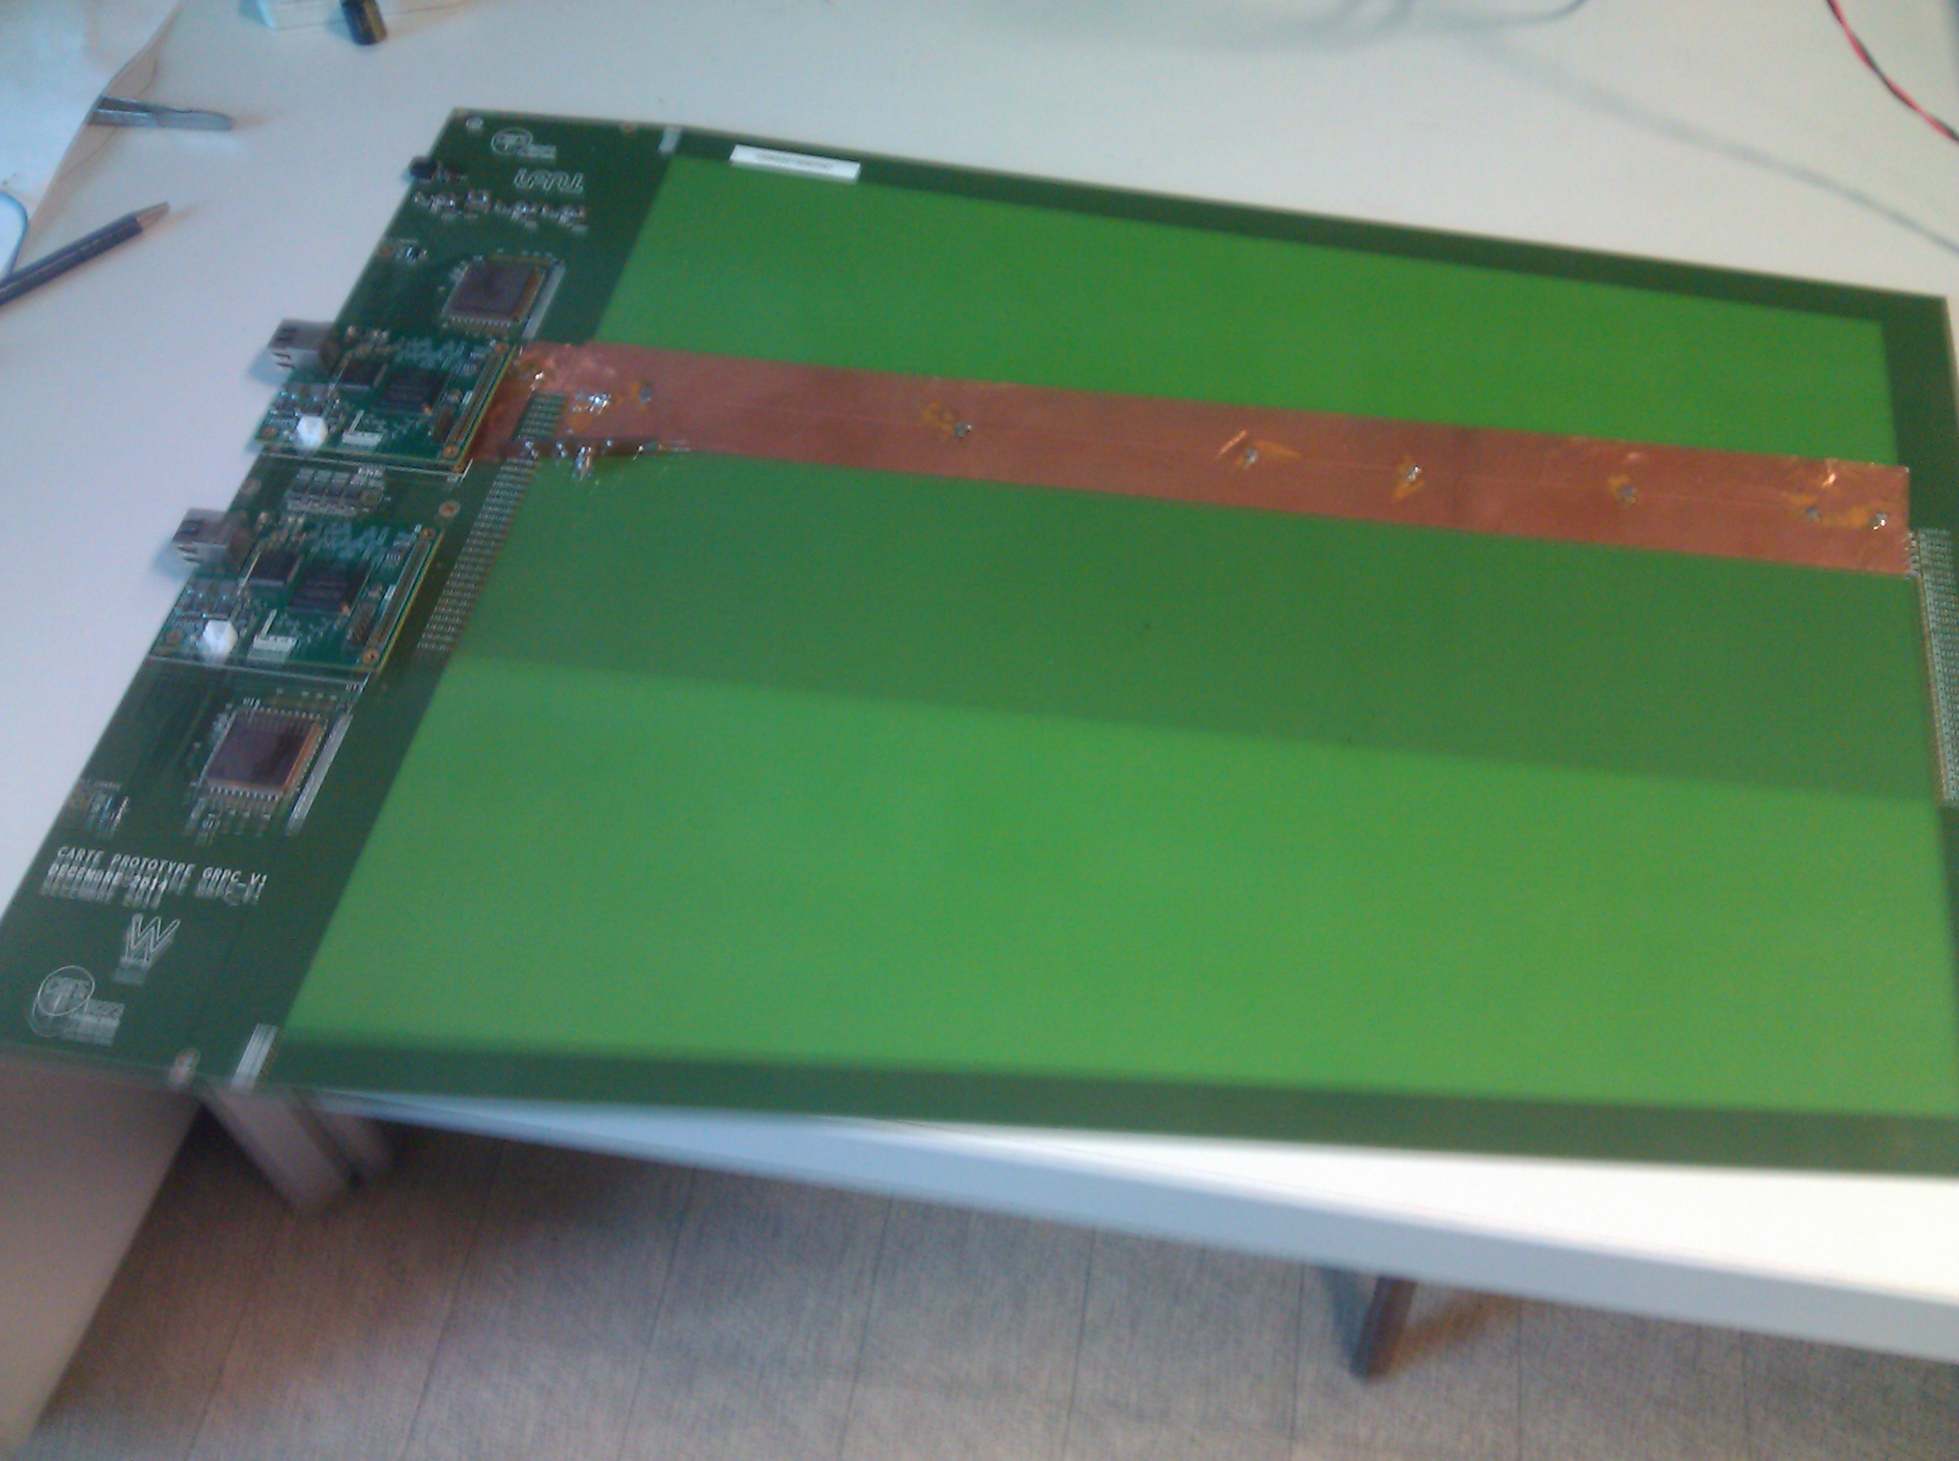
R&D on glass RPC: status
A new solution to build large GRPC using small pieces of Chinese glass by mechanical fixation with gas-tight cassette.
Then glued and assembled GRPC performance will be compared.
Two-gap GRPC, gas-tight cassette
DAQ system to exploit the timing and position is being developed.
GIF++ test after final selection of the construction method and validated electronics test planned for the end of the year.
New readout electronics ( < 50 ps)

Slide 19
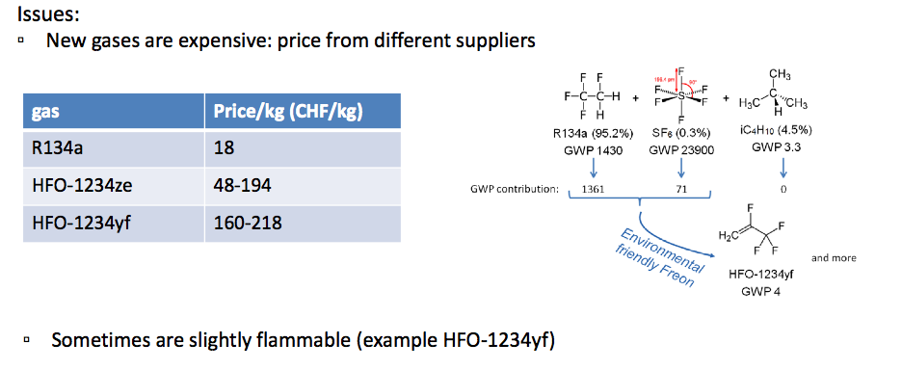
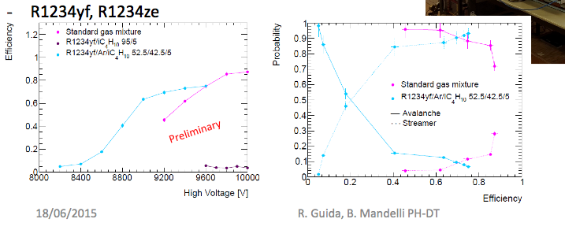
PH - DT gas service activity

Slide 20
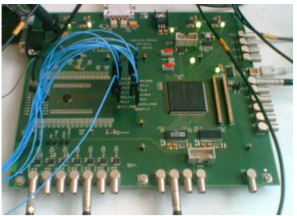
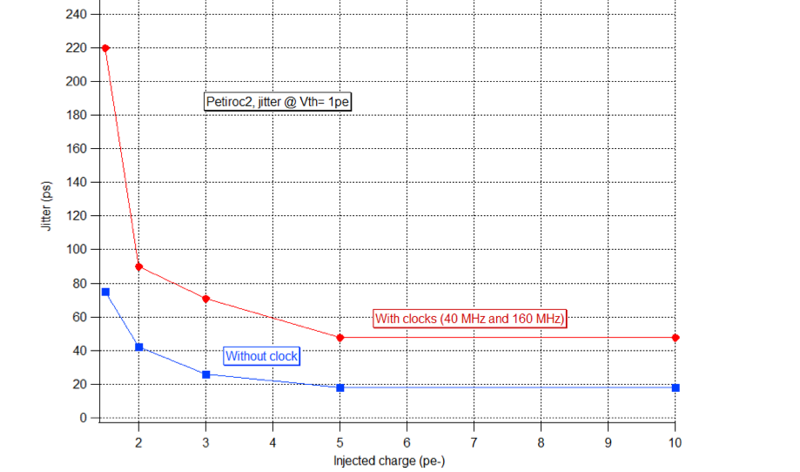
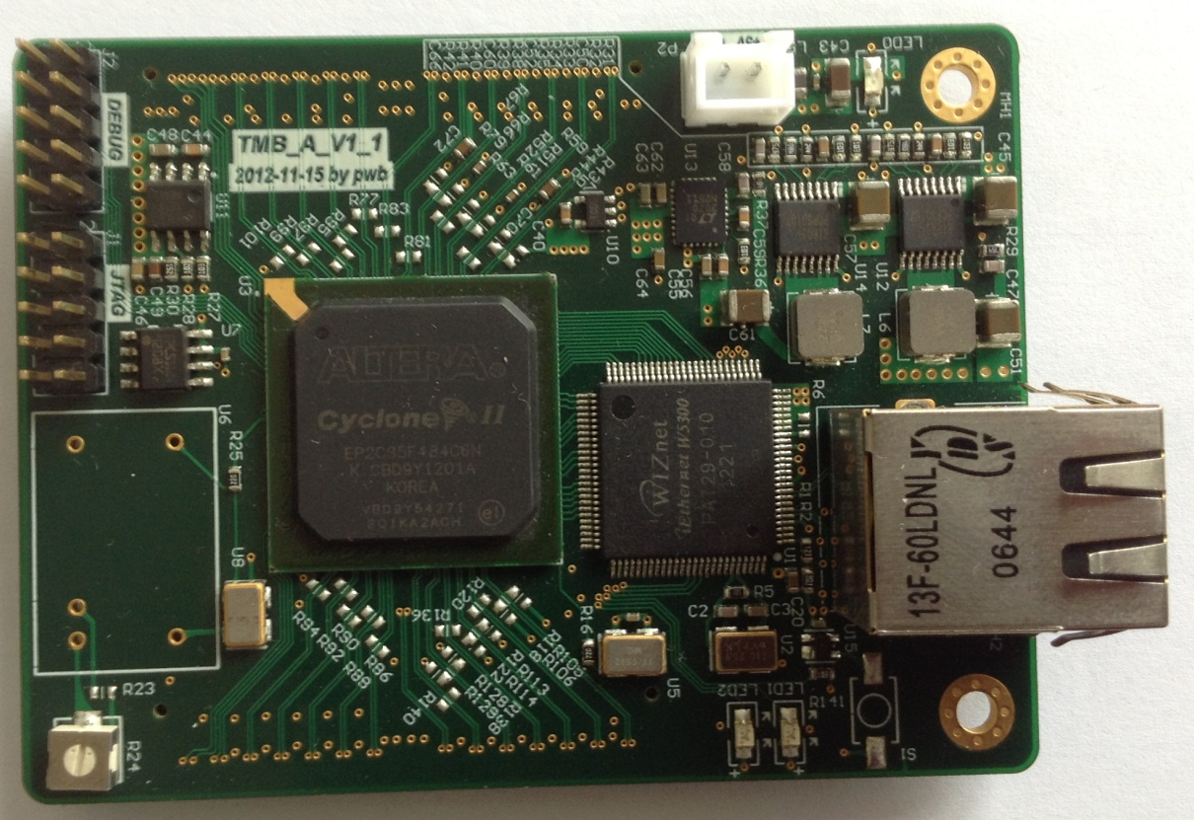
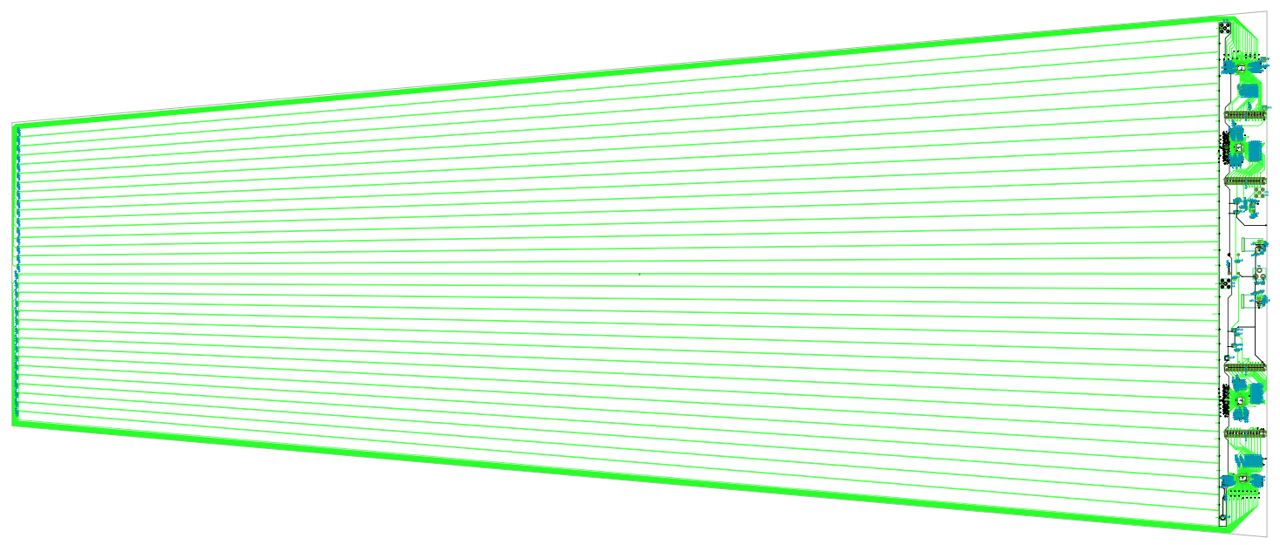
To achieve excellent timing
-OPTIROC ASIC : 32-channel,
high bandwidth preamp (GBWP>
10 GHz), <3 mW/ch, dual time and
charge measurement (160 fC-400 pC)
jitter < 20 ps rms
OMEGA group
- 24-ch, TDC of 25 ps time resolution developed by the Tsinghua university will be used
Tsinghua
Y
.New PCB with pick-up strips read from
both sides is being designed information
with the aim to achieve Y-position
determination Y= L/2-v*(t₂-t₁)/2.
Time resolution can be measured:
(t₁+t₂)- L/v
On-detector Strip
IPNL
Off-detector Strip

