Slide 1
Pathway towards An Integrated Research Facility: G. Dattoli, E. Di Palma, F. Nguyen, E. Sabia and I. Spassovsky

Slide 2
A) Is it possible to conceive a research structure in this area in which
CNR-ENEA-INFN And Roman Universities
Find a profittable way of cooperation?

Slide 3
The Question is less naive than it might appear
A) Find Topics of Common interest
B) Find common financial sources
C) Find a common «Administrative Framework»
D) Open an effective communication channel between top management…

Slide 4
SPARC (X) Could be a useful test bench
Either for what worked and for what did not.
What did we learn?
Scientists agree on a common program
Bottom up mechanisms are reliable
Merging of competence is feasible, but needs political skills
The dialogue between top managements is difficult
…May become even worst for tria-logue…polia-logue…

Slide 5
An integrated facility like
LAW
Could satisfy common interests
Covering research domains from
Technology to Cosmology
(This is like a Blasphemy….)

Slide 6
Let us explain the meaning of the achronim
Light-Axion-Wave
Light Sources (Lasers, Free Electron Lasers…)
Wave Sources (Klystrons, Gyrotrons, CARM…)
Axion ???????

Slide 7
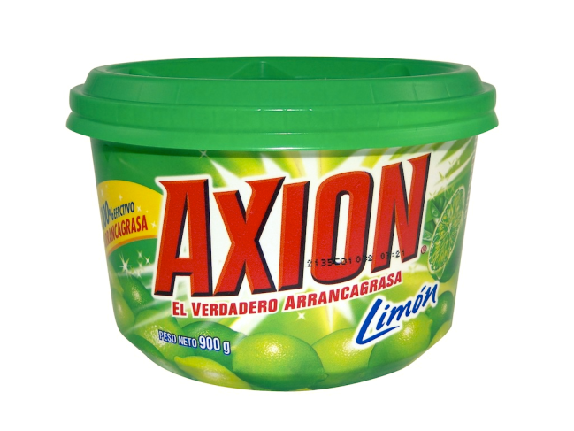
What are Axions?
Axions have been introduced to eliminate the strong CP violations due to QCD non-trivial vacuum. large CP violating interactions originating from QCD would induce a large electric dipole moment (EDM) for the neutron (unobserved) .The introduction of the AXION allows the elimination of strong CP effects.

Slide 8
Furthermore
Axion Strong CP Problem (Peccei-Quinn)
Constituent of Dark matter (mass<10^-3 Ev )
Photons interacting with a strong magnetic field are converted into Axions (Sikivie 1993)
See A. Polosa (STAX)
https://mail.enea.it/SRedirect/agenda.infn.it/getFile.py/access?resId=0&materialId=slides&contribId=8&sessionId=1&subContId=2&confId=10045

Slide 9
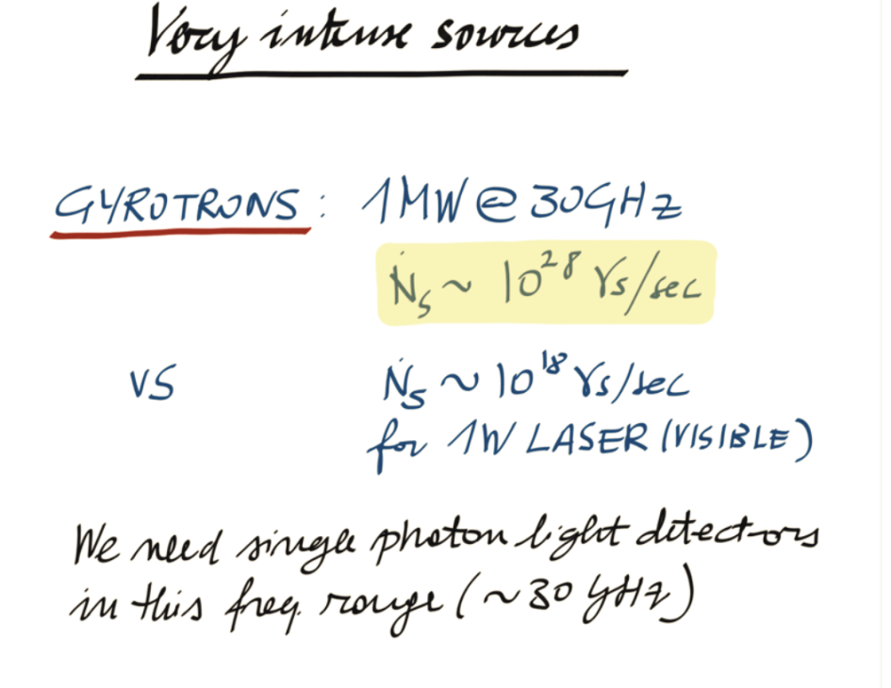

Slide 10
Gyrotrons are well known work-horse In fusion Technology
High field magnets (15 T) are within the ENEA activity
1MW@30 GHz (CW) 1y cost 10^7 Euros!!!
Problem: how reduce the power costs???
Increase the efficiency or the external magnetic field
(CARM!!!)

Slide 11
Micro-Wave Undulators: S. Tantawi (Ivan’s Pupil) lu=1.4 cm (Pathway to Compact FEL devices: NIM (2015) ENEA-INFN –CNR)

Slide 12
I R I D E
IRIDE: Una Grande Macchina
Per
Le «Larghe I N T E S E»

Slide 13
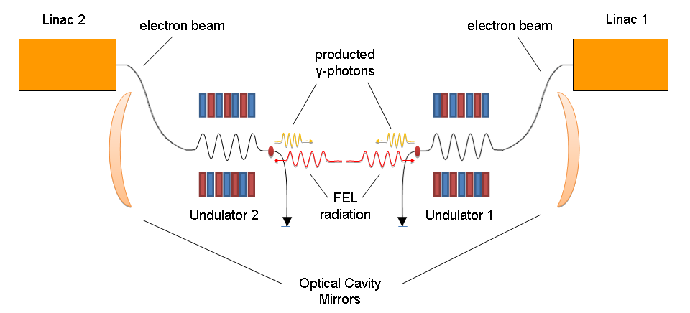
Low Energy Gamma-Gamma collider (Torre, Dattoli, Spassovsky, Surrenti, Ferrario,Milotti(JOSA-B-2015))

Slide 14
…What Next??? MEDIC: A Facility for Cancer Imaging, Diagnostics and Therapy
Undulator
K (Undulator Strength Parameter) | 1.5
Undulator Period | 2.0 cm
Matched Beta (equal focusing both planes) | 44 cm
Number of Periods | 40
Length | 80 cm
Electron Beam
Beam Energy | 53 MeV
Normalized Emittance | 5 mm-mrad
Peak Current | 10 A
Energy Spread | 0.5%
Useful Bunch Length | 5 ps
FEL
Output wavelength | 2 mm
Output Coupling | 10%

Slide 15
ALICE (Daresbury-2010)
 | Jlab IR-Demo | ALICE
Frequency | 74.85MHz | 16.25MHz
Bunch charge | ~70pC | ~60-80pC
Mode | CW | 10Hz; 100us
Beam energy | 48MeV | 27.6MeV
Wavelength | 3.1um | 8um
IR power | 1720W | 32/0.7=45mW (~700W if scaled )

Slide 16
CNR-ENEA-INFN-Universities…
The research is a major project between four leading UK Universities and three NHS hospital trusts, and will be carried out at the Science and Technology Facilities Council’s (STFC) pioneering ALICE accelerator facility. The goal is to develop new techniques to accurately diagnose the three cancer types much earlier than any current conventional tests. It will also aim to develop a new generation of portable and highly accurate cancer diagnostics instruments.

Slide 17
Intracavity Compton Backscattering
MEDIC Photons & Backscattering
10^2/micropulse, 2 *10^5/macropulse and *10^7/sec. emitted within an angle of 2 mrad.

Slide 18
To do what?
Enhancement of radiosensitization by metal-based nanoparticles in cancer radiation therapy: X Ray photons + Nano particles

Slide 19
Cancer Killer A nanoparticle designed for photodynamic cancer therapy consists of a core of europium-doped strontium aluminate (SAO) surrounded by layers of solid silica (blue) and mesoporous silica (dark gray). The SAO absorbs X-rays and then emits visible light (green), which activates merocyanine dye (tan spheres) inside the silica pores. The dye then triggers the production of reactive oxygen species that can kill cancer cells.

