Slide 1
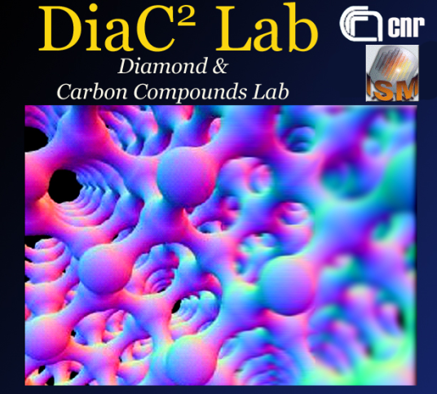
CVD Diamond for
Ionising Radiation Detection and Concentrated Solar Radiation Conversion
DiaC²Lab
Diamond and Carbon Compounds Laboratory
Daniele M. Trucchi
    A. Bellucci – Optical Characterization
    P. Calvani – Diamond Surface Processing & Characterization
    M. Girolami – Photo-electrical Characterization
    V. Valentini – Chemical Characterization
    +
    S. Orlando – Fs-laser Surface Texturing
    A. Santagata + his group
    +
    R. Flammini – Surface Analysis + low dimensional materials
Institute for Structure of Matter (ISM)
of the Italian National Research Council (CNR)
Montelibretti Section
Institute for Structure of Matter (ISM)
Tito Scalo Section
Institute for Structure of Matter (ISM)
TorVergata Section

Slide 2
Outline
Detection & Monitoring of Radiation:
Diamond Dosimeters for X-Ray and Radiation Therapy
Diamond Detectors for Fast Neutrons
Exploitation of Solar Radiation & Use of Advanced Radiation for Technology:
High-Temperature Solar Cells
    Advanced Surface Texturing
    Turning Diamond into Graphite!

Slide 3

CVD Diamond Dosimeters – Fabrication of Photoconductor Structure
Me, 100 nm
Au, 100 nm
DLC, 1-3 nm
Dosimeter
CVD Diamond
DLC, 1-3 nm
Me, 100 nm
Au, 100 nm
Radiation damage resistant
Tissue-equivalent
Primingless
Linear with radiation dose-rate at high bias
Fast with high bias voltages
Highly sensitive
D.M. Trucchi, P. Allegrini, P. Calvani, A. Galbiati, K. Oliver, G. Conte, IEEE Electron Device Letters 33 (2012) 615-617

Slide 4
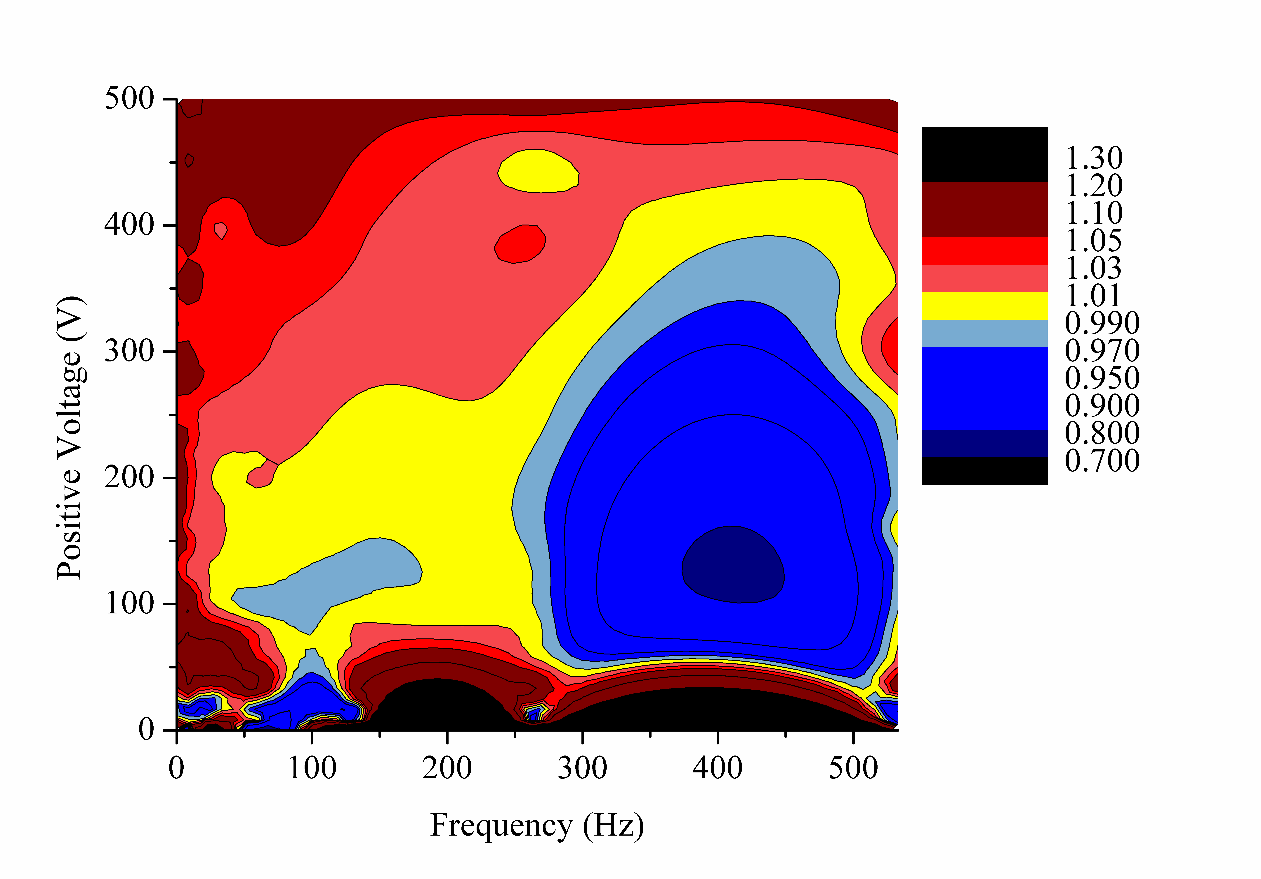
CVD Diamond Dosimeters – Schottky Photodiode
Me, 100 nm
Au, 100 nm
DLC, 1-3 nm
CVD Diamond
Annealing @ 450 °C
Fast response under low bias voltage and even under photovoltaic regime (@ 0V)!!!
WC by PLD, 200 nm
WC Schottky/Diamond/Ohmic Structure
Schottky Photodiode
Photoconductor
Linearity to dose-rate at low voltages and high frequency
Linearity to dose-rate at high frequency needs a continuous increase of bias voltage
A. Bellucci, S. Orlando, D. Caputo, E. Cappelli, and D.M. Trucchi, IEEE Electron Device Letters 35 (2013) 695-697

Slide 5
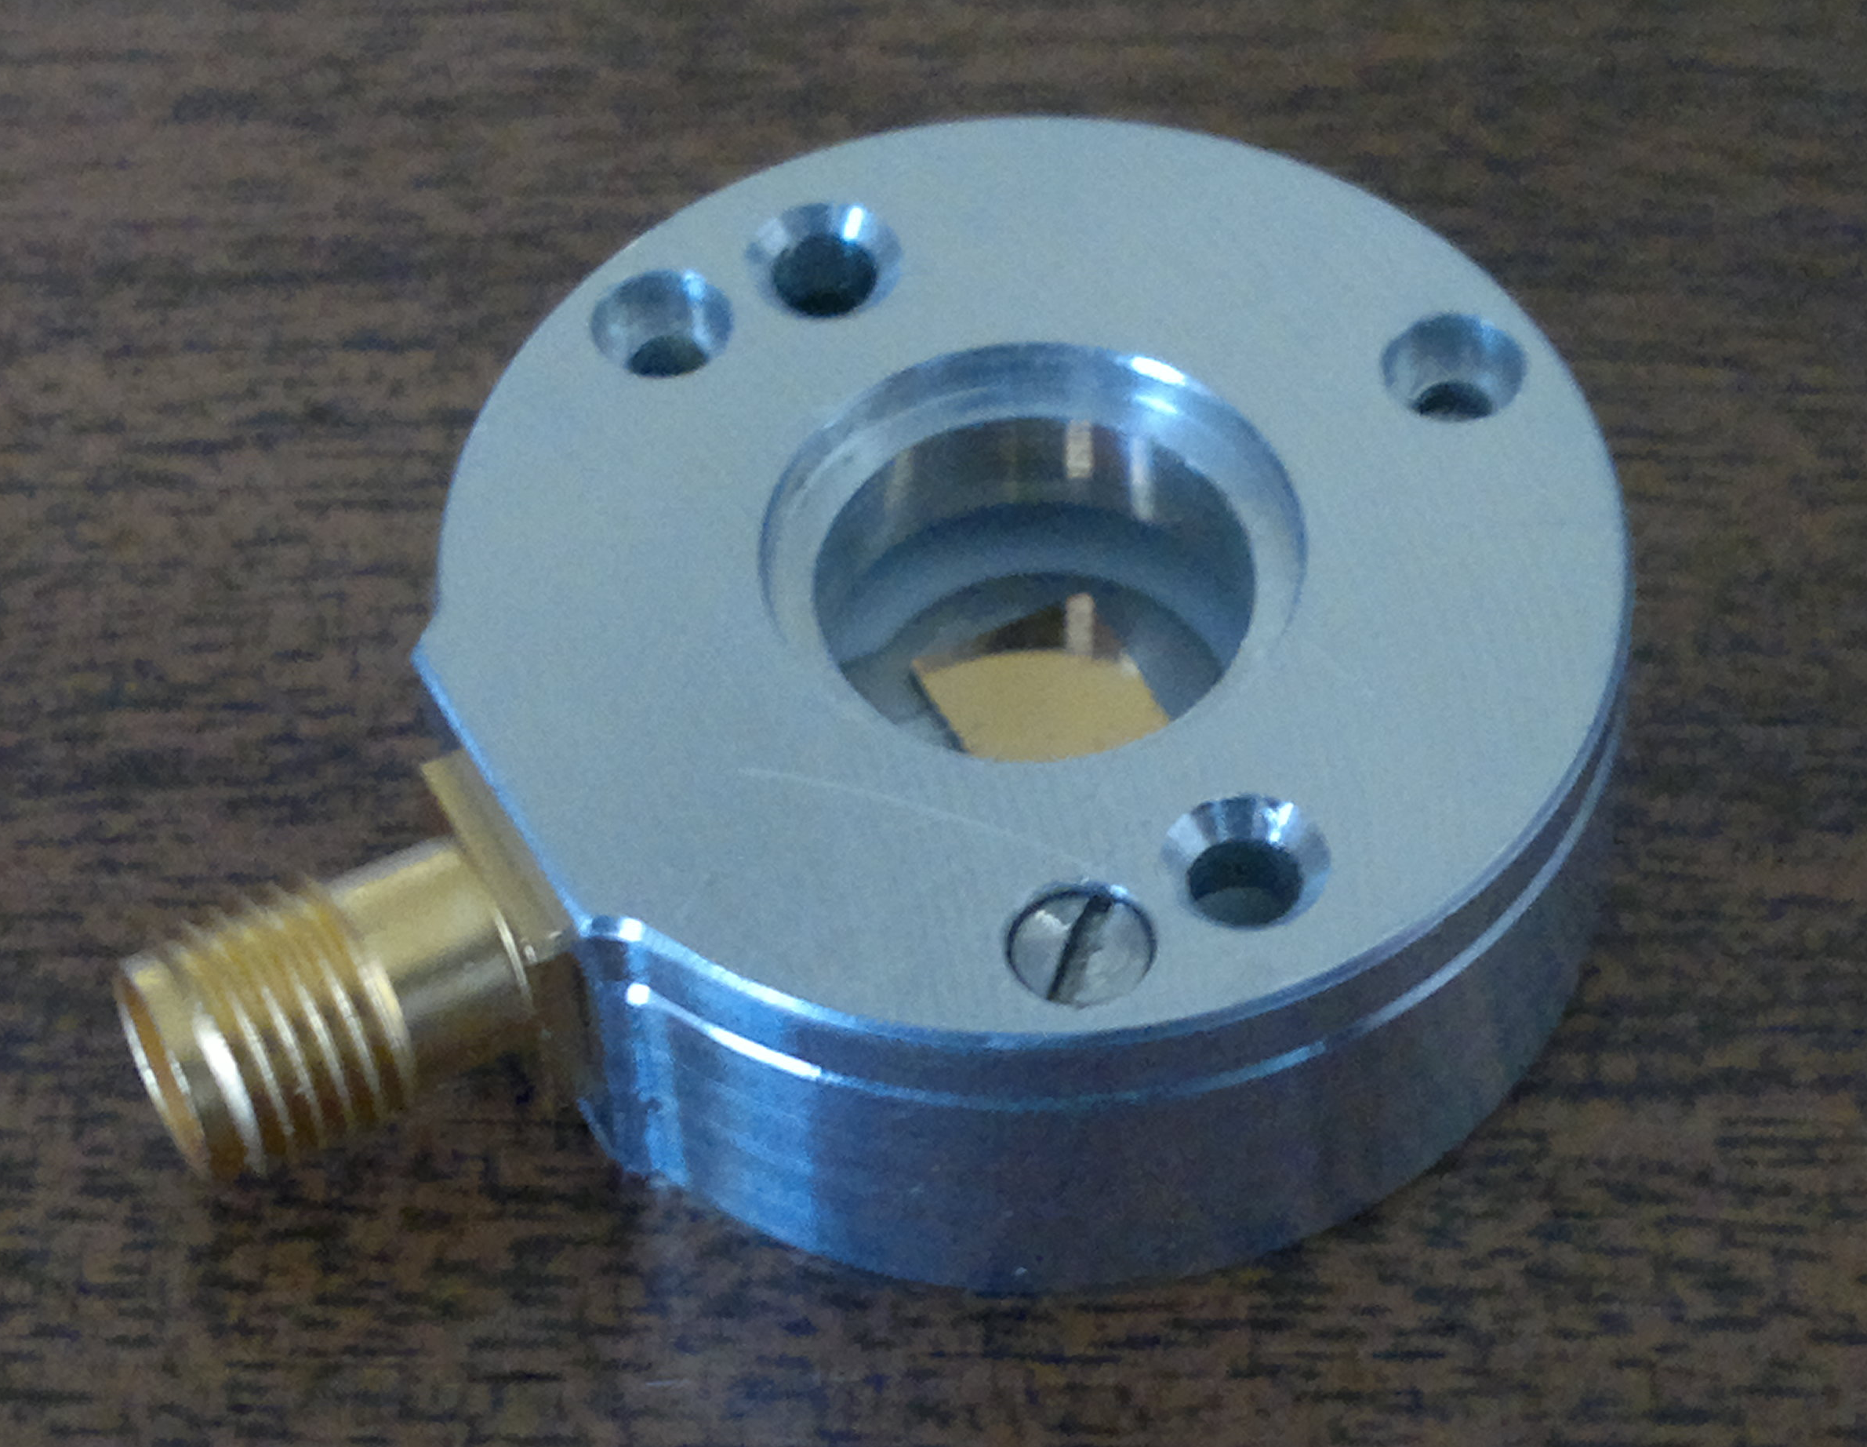
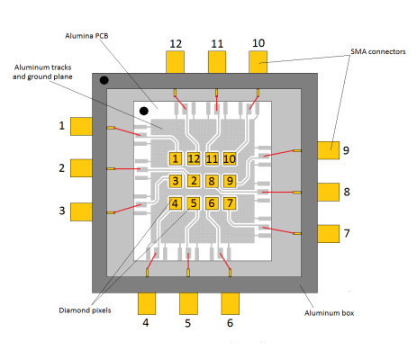
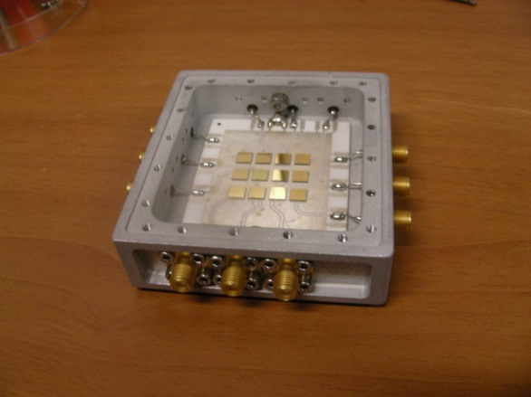
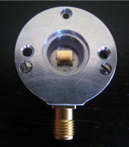
Fast Neutron Spectrometry
CVD Diamond detector is a compact and versatile solution for fast neutrons, alpha and beta particles spectroscopy and time-of-flight.
Diamond radiation hardness, high radiation sensitivity, low dark current and high thermal conductivity allow room temperature spectroscopy as well as time of flight accurate measurements.
Charge collection efficiency close to 100%
Minimized space charge effects owing to a proprietary diamond/metal junction technology
Single-pixel diamond spectrometer is operating at ISIS
Diamond Spectrometer Array (12 pixels) will operate at JET
The development of the diamond technology was performed by the DiaC² Lab of CNR-ISM (Rome),
in collaboration with CNR-IFP (Milan)
M. Rebai et al., Journal of Instrumentation 10 (2015) C03016.
M. Girolamiet al., Phys. Status Solidi A (2015) in press, DOI 10.1002/pssa.201532191.

Slide 6
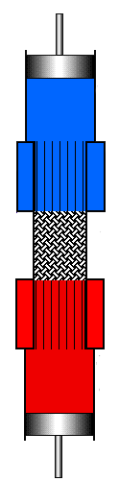
Photon-Enhanced Thermionic Emission (PETE) Devices
Absorber: thin-film semiconductor with bandgap of 1.8 eV and a thickness of hundreds of nm
Ideally, a number n semiconductor layers with scaling bandgap
Optimized d to allow photoelectrons to be injected in the following layer
Optically transparent substrate for mechanically supporting the cathode (quartz, sapphire, etc.)
Emitting layer, able to drastically reduce the work function and allow electron escape
PETE* devices can be defined as high-temperature cells for solar concentrating systems, since they avoid the limitations of junction cells and even benefit from high operating temperatures
*J. Schwede,et al., Nature Materials 9 (2010) 762
Z_{LOAD}
Transparent window
CONCENTRATED SOLAR RADIATION
Secondary conversion system
A (%)
100
Vacuum enclosure
(pressure as low as possible)
CATHODE
ANODE
0
λ
λ
IR selective absorber
Back surface contact
Function: exploiting IR for heating the cathode
Photo-generation increases electron population at conduction band above the equilibrium level, and the emission energy barrier is reduced:
more electrons are emitted from the cathode at lower cathode temperatures compared to conventional thermionic emitters
Thermalization processes within the cathode increase its temperature, further increasing the emission current density (thermionic emission)
PETE devices utilize both photonic and thermal processes for energy conversion, and are not subject to either the Shockley-Queisser limit or the thermal limit (Carnot)**
**G. Segev, Y. Rosenwaks, A. Kribus, Solar Energy Materials & Solar Cells 140 (2015) 464

Slide 7

Photo-Thermionic Cathode
Advantage: no p-n junction is needed
Capability to operate at high temperature
Exploitation of additional thermionic emission
III-V Semiconductors
Advanced IV Semiconductors (CVD Diamond)
CATHODE
May 2013 - Apr 2016
Total Project Cost: 4.2 M€
Total EU Funding: 3.0 M€
www.prometheus-energy.eu
Advantages:
Proper bandgap for absorption and photocarrier generation (about 1.8 eV)
Advantages:
Low “native” work function caused by NEA conditions (surface hydrogen termination)
Wide range of operating temperature (<780 °C)
High thermal stability
High robustness
High electron diffusion lengths
Disadvantages:
High work function -> Necessity of coatings for “work-function-engineering”
Instability at high-temperature
Disadvantages:
Wide bandgap (5.47 eV @ RT)
Bandgap Engineering
Defect Engineering

Slide 8
Diamond Photo-Thermionic Defect-Engineered Cathode
Diamond plate
d < L_{d} (diffusion length)
Graphitic distributed electric contact
Surface Texturing
H
H
H
H
H
H
H
H
H
H
H
H
H
H
H
H
H
H
H
H
H
H
H
H
H
H
H
H
H
H
n-doped diamond thin layer (100-500 nm)
Technological steps:
Implantation of B ions on front surface for a buried p-type layer a) acting as a back electric contact; b) increasing the photogeneration contribution; c) separating e-h for reducing recombination
Fs laser-induced distributed contacts for reducing device series resistance
Fs laser front surface nanoscale texturing for increasing optical absorption and photogeneration
CVD deposition of n-doped thin diamond layer (100-500 nm)
Emitting surface hydrogenation for NEA
Deposition of electric contacts
Electric
contacts
P-type layer
A. Bellucci, P. Calvani, M. Girolami, and D.M. Trucchi, 2015 IEEE 15th International Conference on Environment and Electrical Engineering Proc., (2015) 1616

Slide 9
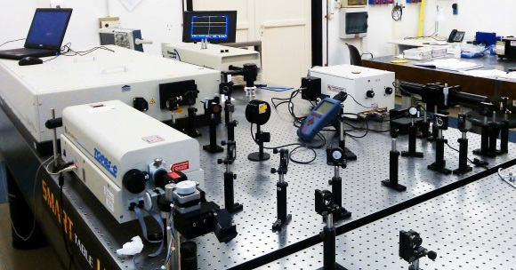
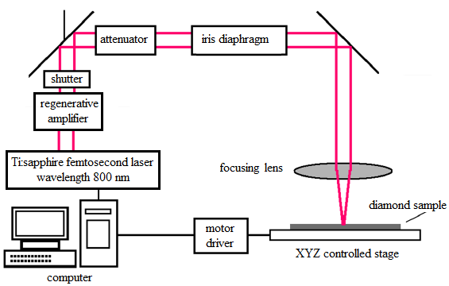
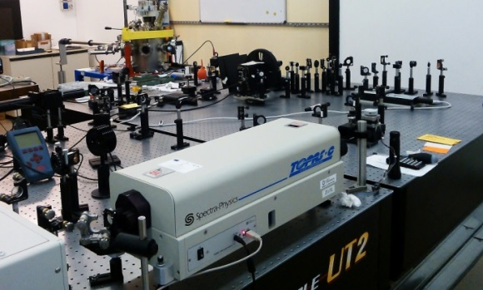
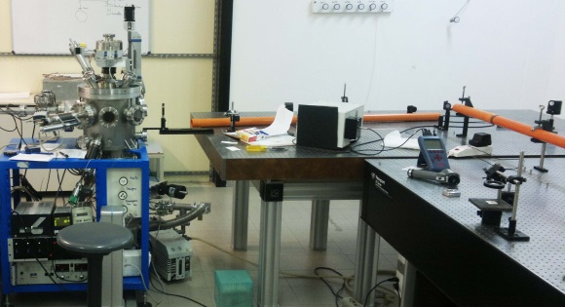
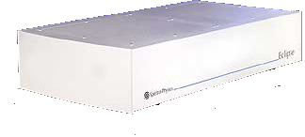
Surface Texturing – Ultrashort Laser Pulses
Femtosecond laser pulses are able to texture the surface of materials and dielectrics with periodic nanoscale structures without use of photolithographic steps
The laser system employed is based on a Spectra Physics Tsunami S - fs oscillator (pulse duration about 100 fs, repetition rate 80 MHz, wavelength 800 nm, peak power > 0.7 W) pumped by a Spectra-Physics Millennia Pro 5sJS (CW, wavelength 532 nm, power 5W). The output of the oscillator is the seed for the Spectra-Physics Spitfire Pro 100 F 1K XP 4W amplifier (pulse duration < 120 fs, repetition rate up to 1000 Hz, wavelength 800 nm, pulse energy up to 4 mJ/pulse) pumped by a Spectra-Physics Empower 30 Q-switched DPSS (Diode Pumped Solid State) Nd:YLF (repetition rate 1000 Hz, wavelength 527 nm, pulse energy up to 20 mJ/pulse, pulse duration 100 ns).
Femtosecond Laser installed in the
CNR-ISM of Tito Scalo (PZ)
Vacuum or Reactive gas atmosphere
Femtosecond Laser

Slide 10
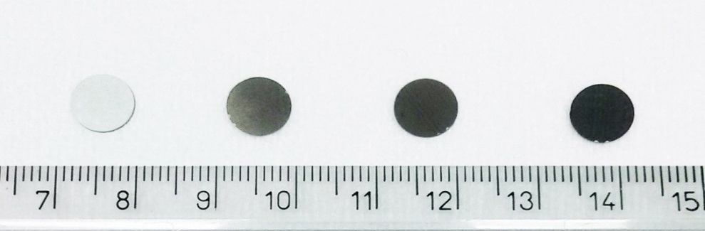
Surface Texturing – Process Parameters
Samples used are freestanding CVD polycrystalline Optical Grade (OG) diamond plates purchased from Element Six Ltd: 8 mm Ø × 0.5 mm thickness, K>1900 W/mK, R_{a} < 30 nm, ρ_{bulk} > 10¹² Ω∙cm
DOSE
Laser parameters:
λ = 800 nm
Pulse duration = 100 fs
Repetition rate = 1000 Hz
Pulse energy = 3.6 mJ
Spot size = 100 um (diameter)
Diamond target is moved by an automated X-Y translational stage perpendicular to the laser axis with selectable speed under vacuum (P < 10⁻⁷ mbar)
It is possible to vary the number of laser pulses impingining on the sample and so the radiation dose per surface unit D
Sample | Number of fs-pulses | Dose, D
OG-1 | - | -
OG-2 | 7×10⁵ | 2.5 kJ/cm²
OG-3 | 1.4×10⁶ | 5.0 kJ/cm²
OG-4 | 3.5×10⁶ | 12.5 kJ/cm²
Energy of Single Pulse
Number of Pulses
D =
Sample Area
D is varied from 2.5 to 12.5 kJ/cm²

Slide 11
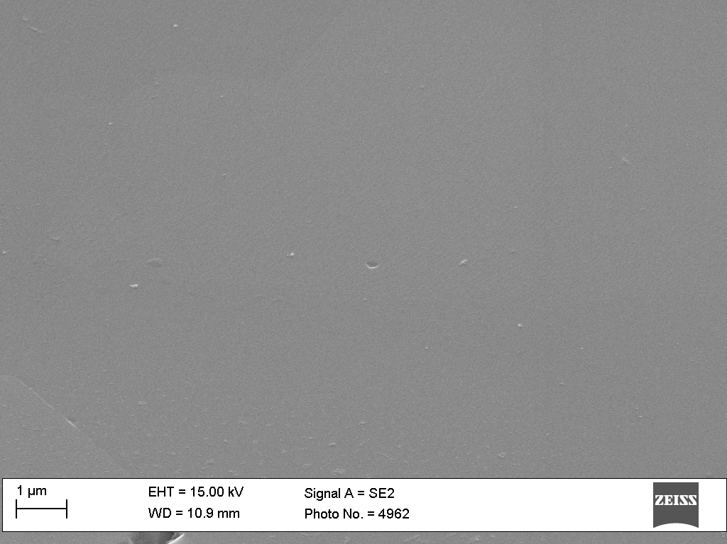
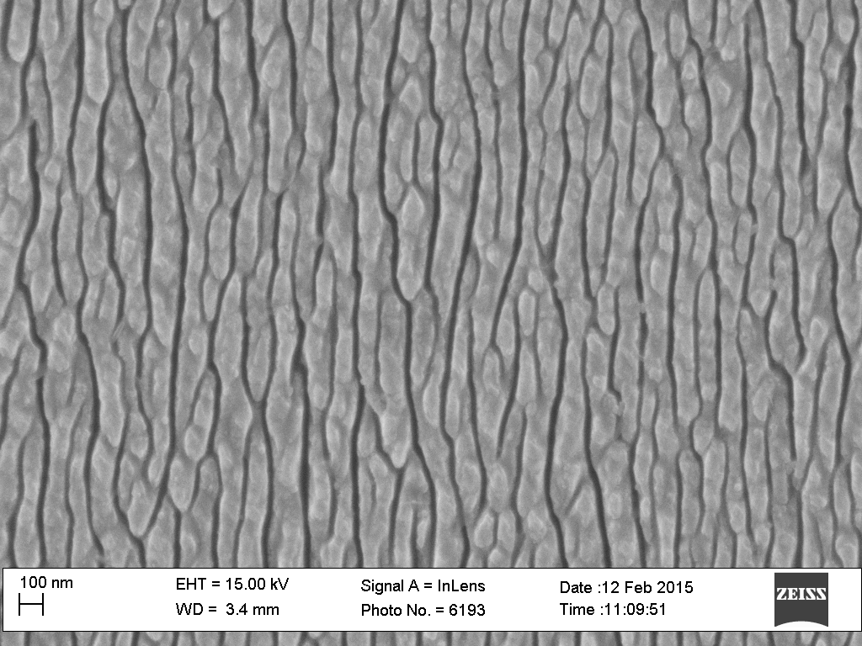
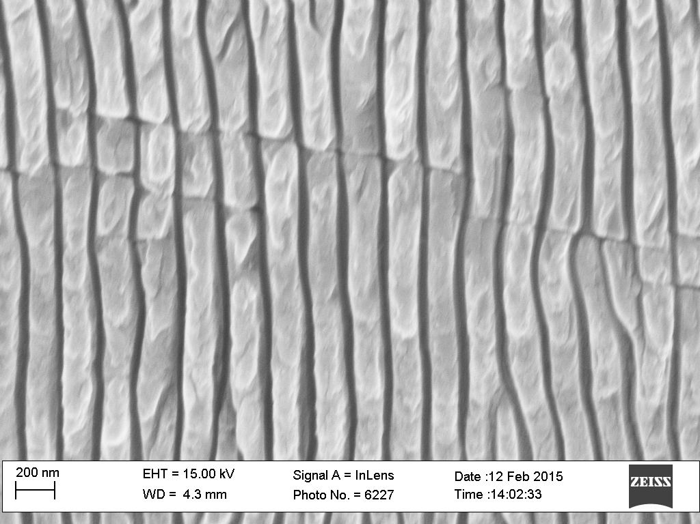
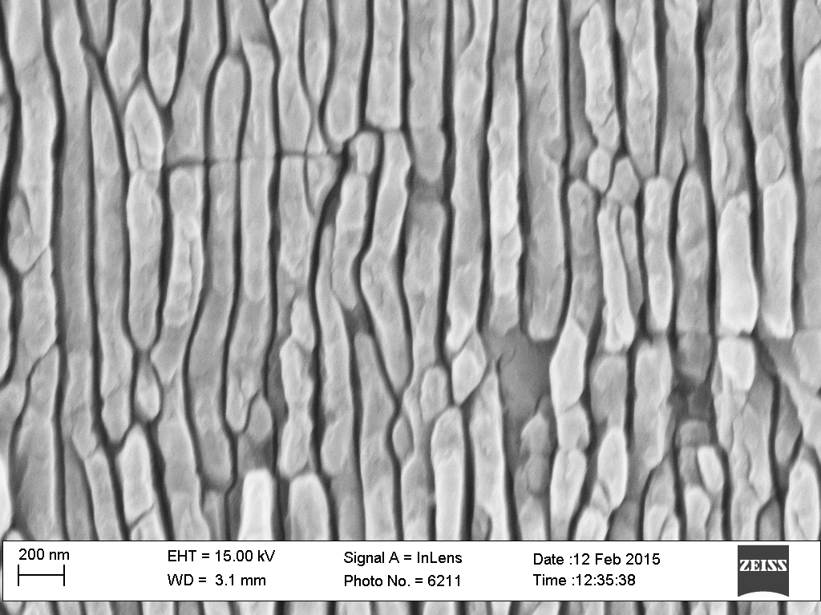
Surface Texturing - BLACK DIAMOND - Microstructure
OG-1 (untreated)
DOSE
OG-2 (treated@2.5kJ/cm²)
OG-3 (treated @ 5kJ/cm²)
OG-4 (treated @ 12.5kJ/cm²)
Low doses (2.5 kJ/ cm² ): the structures are not well defined
Medium doses (5 kJ/ cm² ): defined linear structures with periodicity of 170 nm and length of several μm
High doses (12.5 kJ/ cm² ): degraded structures (post-ablation)

Slide 12
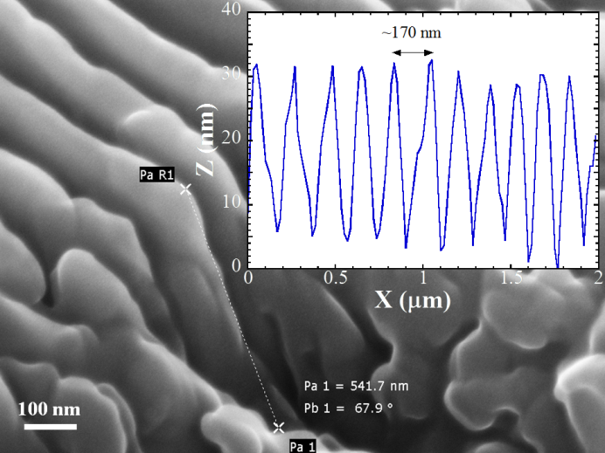
Surface Texturing - BLACK DIAMOND
The ripples formation mechanism is debated in literature and typically attributed to the interaction of the laser pulse with the laser-induced plasma* that gives rise a periodicity close to
λ_{r} = λ/2n
λ is the wavelength of the incident laser radiation = 800 nm
n is the refractive index of diamond, n ≅ 2.41 at 800 nm.
The resulting λ_{r} = 167 nm is confirmed by SEM and AFM
Q. Wu, et al., Appl. Phys. Lett. 82, 1703 (2003);
P. P. Rajeev, et al., J. Phys. B: At. Mol. Opt. Phys. 40, S273 (2007);
B. Stuart, et al., Phys. Rev. Lett. 74, 2248 (1995);
T.J.-Y. Derrien, et al., J. Appl. Phys. 114, 083104 (2013).
Surface structures characterized by:
Periodicity = λ / 2n = 170 nm
Depth of 400 nm
Length of several μm
Raman spectroscopy, after debris removal produced by the treatment, points out:
No presence of graphitic domains
A negligible variation of the diamond peak, consistent with structural properties comparable to the untreated sample
It means that bulk physical properties do not change
P. Calvani, A. Bellucci, M. Girolami, S. Orlando, V. Valentini, A. Lettino, and D.M. Trucchi, Applied Physics A 117 (2014) 25-29

Slide 13

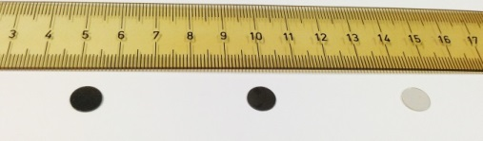
BLACK DIAMOND – Optical Characterization
D
Absorptance, reflectance, and transmittance spectra in the 200-2000 nm range highlighted:
A significant increase in absorbance for the treated samples
Absorbance is an increasing function of treatment dose D
Thermal Grade samples (TM)
Optical Grade samples (OG)
The solar absorptance values are similar at a same treatment doses independently from the values of the untreated samples
Solar absorptance α, defined as the normalized integral product between absorbance A and solar irradiance spectrum W_{solar}
An efficient optical absorption is ONLY a NECESSARY but NOT SUFFICIENT condition for an efficient solar energy converter
ABSORBED PHOTONS have to generate CHARGE CARRIERS
P. Calvani, A. Bellucci, M. Girolami, S. Orlando, V. Valentini, R. Polini, and D.M. Trucchi , Physica Status Solidi A (2015) in press, DOI 10.1002/pssa.201532189

Slide 14
BLACK DIAMOND – Photo-Electrical Characterization
Spectral photoconductivity measurements have been performed to quantify the photogeneration capability of useful charge carriers
D
The external QE of the most performing sample is maximum at bandgap energy. QE ranges from 2% to 6% from about 3 eV (≅420 nm) to 5.1 eV (≅ 250 nm)
This is an excellent result, but needs to be further improved for competitive performance with solar radiation
A. Bellucci, P. Calvani, M. Girolami, S. Orlando, V. Valentini, R. Polini, and D.M. Trucchi , in preparation

Slide 15
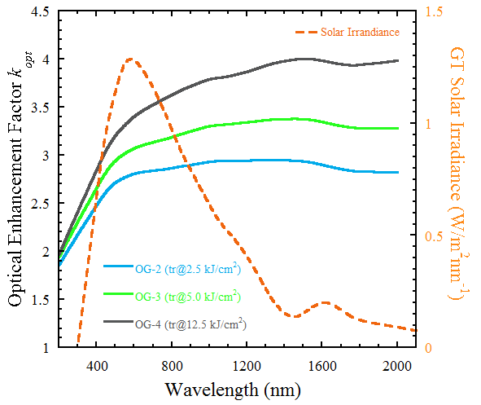
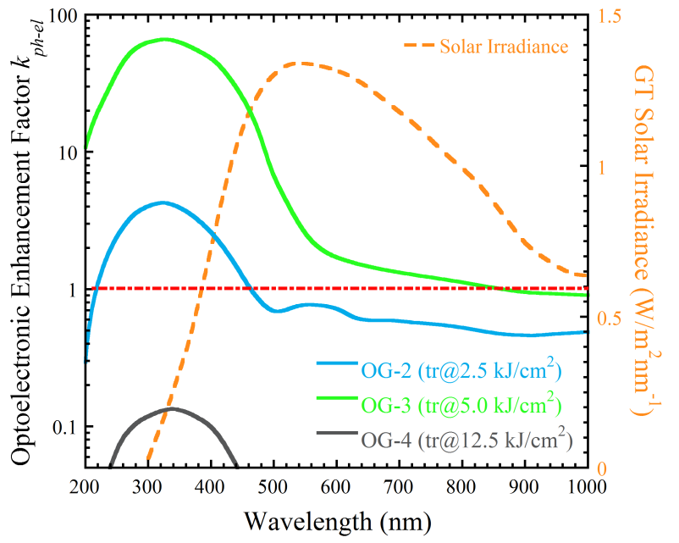
BLACK DIAMOND – Origin of the effect
In order to disentangle the effect of:
absorption centers and
electronically defect states
natively present in the crystal from the ones induced by the periodic surface texturing, we define
Optical
D
Photoelectric
D
We suppose that the subwavelength surface texturing acts
Optically as a diffraction grating smoothing the refractive index of the material
Electronically by introducing an intermediate band favoring the photogeneration

Slide 16


Slide 17
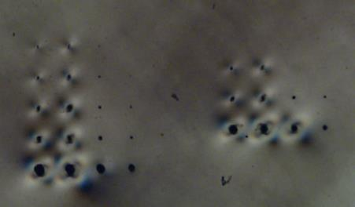
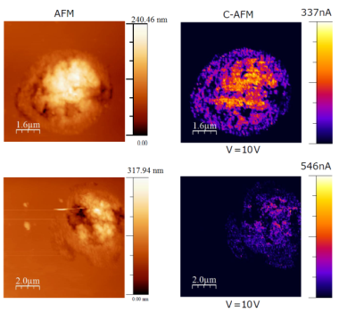
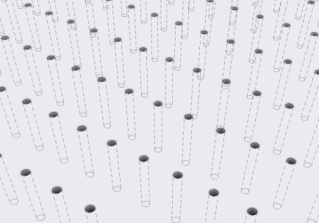
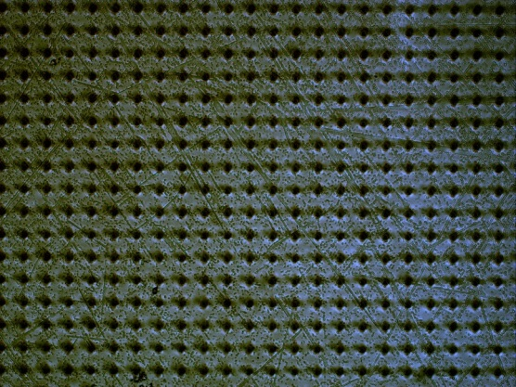
Graphitic Columns for 3D Diamond Structures
Femtosecond laser is able to transform diamond into graphite according to 3D arbitrary paths and minimizing thermal effects (i.e. sharp transitions between the two carbon phases)
speed
Laser wavelength
Green
IR
power
High electric conductivity graphitic columns with diameters down to 1 μm along all the thickness can be fabricated within the diamond plate acting as distributed electrodes for thermal electrons
Collaboration with IIT Milan & CNR-IFN
45 μm
45 μm
φ = 10 μm
From design (target: series resistance <<1 Ω with 10k columns)…
…to fabrication (presently under characterization)

Slide 18


The activity was funded by the European Community within the framework of the ProME³ThE²US² project – GA 308975
May 2013 - Apr 2016
www.prometheus-energy.eu
…AND THANKS TO
Thank you for the Attention!
TorVergata University
Dep.t of Chemical Technologies
Riccardo POLINI – SEM characterization
Center for Nanotechnology of the Italian Technology Institute (IIT)
Luigino CRIANTE – Microcolumns fabrication
Sara LO TURCO - Microcolumns fabrication
Institute for Photonics & Nanotechnologies (IFN-CNR)
Andrea NOTARGIACOMO – Conductive AFM
Marialilia PEA - Conductive AFM
TECHNION Israeli Institute of Technology
Shaul MICHAELSON – Ion implantation
Alon HOFFMAN - Ion implantation

Slide 19
Band Diagram
H
H
H
H
H
H
H
H
H
H
H
H
H
Hot electrons
Thermal electrons
hν

