Slide 1






RAIN15 -- RAdiazione per l'INnovazione 2015
Frascati, 12-13 October 2015
Looking with Terahertz Eyes
Mauro Missori, Istituto dei Sistemi Complessi – CNR
and
C. Conti, R. Fastampa, Università di Roma "Sapienza"
A. Mosca Conte, O. Pulci, Università di Roma Tor Vergata
M. Peccianti, University of Sussex (UK)

Slide 2

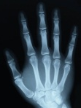

Terahertz (THz) radiation = electro-magnetic waves in a frequency range 0.1 - 10 THz
Terahertz Technology:
optoelectronic devices
Wavelength 3 – 0.03 mm
Wavenumber: 3.3 – 333 cm⁻¹
Energy: 0.41 – 41meV
Temperature: 1 – 100K
Electronics
Photonics
Microwave
mm wave
Sub mm wave
Infrared
Visible
Ultraviolet
X-ray
0.001
0.01
0.1
1
10
100
1000
10000
Frequency [THz]
?
This is the so-called ‘terahertz gap’. It has historically been defined by the relative lack of convenient and inexpensive sources.
Application in science and industry, offering complementary or even
alternative methods of material characterization.

Slide 3
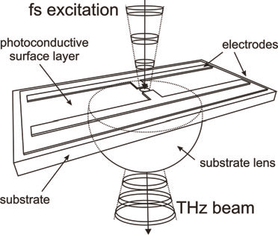
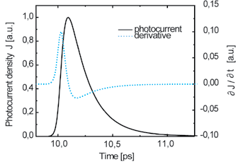
THz-Generation and Detection
Broadband THz radiation can be efficiently generated and detected using femtosecond lasers and photoconductive antennas based on semiconductor materials.

Slide 4
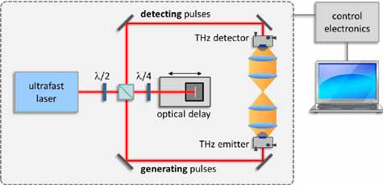
THz Time-Domain Spectroscopy
Phase sensitive
coherent detection scheme
THz waveform
1.2
0
1
-10
π
0.8
Fourier Transform
-20
0.6
Power Spectral Density [dB]
Optical Delay (rad)
Amplitude [n.u.]
-30
0
0.4
0.2
-40
-50
-π
0
-0.2
50
60
70
80
90
100
-60
0
0.5
1
1.5
2
2.5
3
3.5
Time [ps]
Frequency [THz]

Slide 5
THz Emerging Markets
Morphological and compositional diagnoses,(e.g. Tumors)
Medical diagnostics
in-Vivo imaging (Dental Imaging)
Life Science
Forensic medicine
Cellular chemistry
New therapies? (High-Energy THz)
Cellular Microscopy
Material science
Ultrafast dynamics (High-Energy THz)
Interaction with charges and magnetic dipoles
Paleontology
Quantum computing
Fossil Imaging
Materials,Sensing
and Environment
Security
(Horizon 2020)
Morphological identification of Illicit items (e.g. weapons).
Morphological and compositional identification of illicit substances (drugs, explosives, bio-harzard)
Degradation analysis
Cultural heritage conservation
Drug analysis
Process control
Material structural analysis
Food analysis

Slide 6
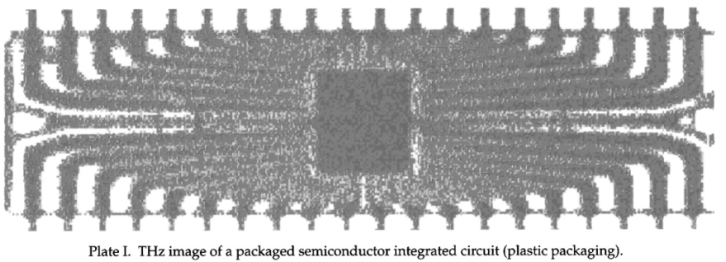


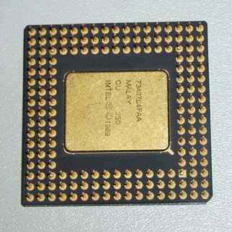
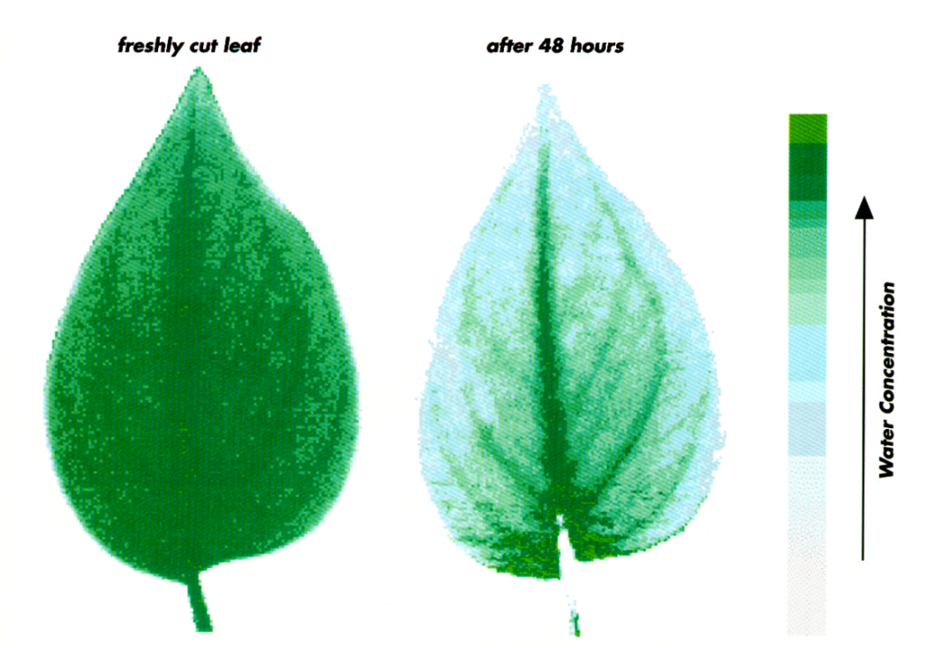
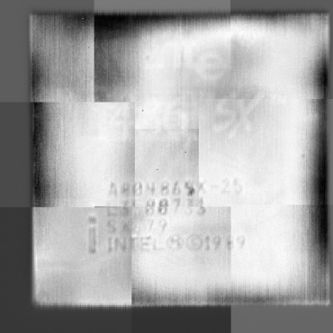
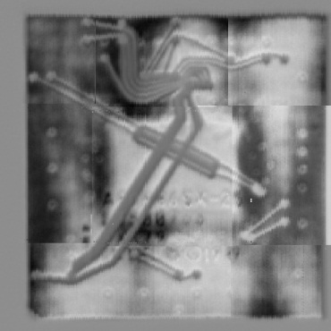
THz waves penetrate a wide variety of non-conducting materials such as polymers, paper, textiles, ceramics, composite materials, chemical powders…
B. B. Hu and M. C. Nuss, "Imaging with terahertz waves," Opt. Lett. 20, 1716-1718 (1995)
Freshly cut Leaf
After 48 hours
Water concentration

Slide 7
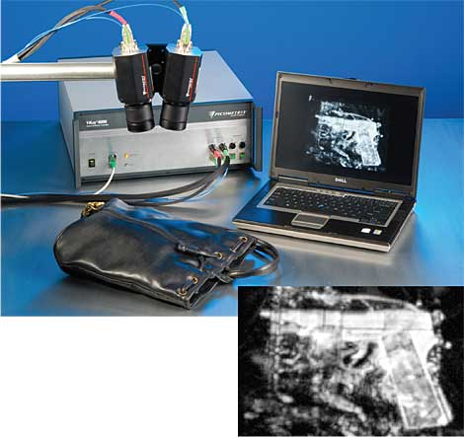
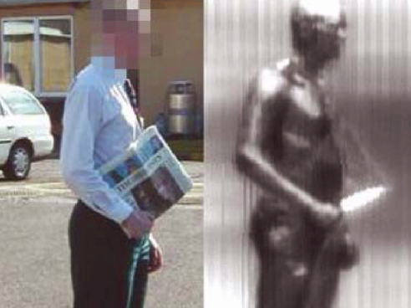
…and are being reflected by metals
TeraView Ltd (UK)
Clery, Science 297, 763 (2002)
2 million people will fly today only in US

Slide 8
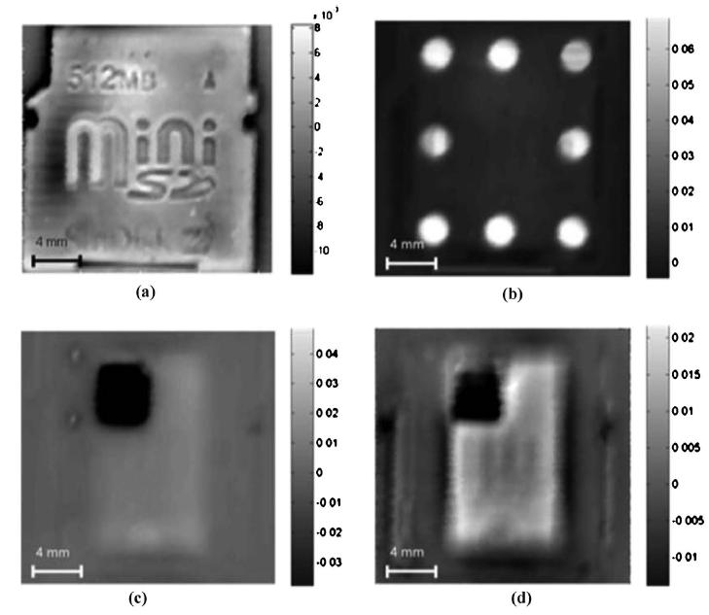
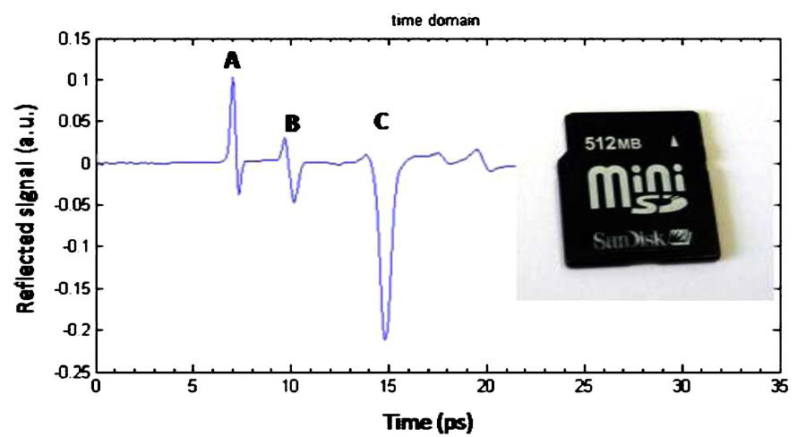
Coherent Imaging
(a)
(a)
(b)
V. P. Wallace et al.,
J. Opt. Sec. Am. A 25, 3120 (2008)
(c)
(d)
Raster-Scan (the image is reconstructed by moving the sample). Pixel size=300μm
Image at different delays (a): t = 10.0 ps, surface of SD card, (b) t = 11.5 ps, bonding plastic, (c) t = 15.0 ps, control chip, (d) t = 16.7ps, main memory chip

Slide 9
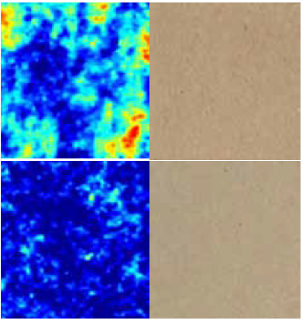
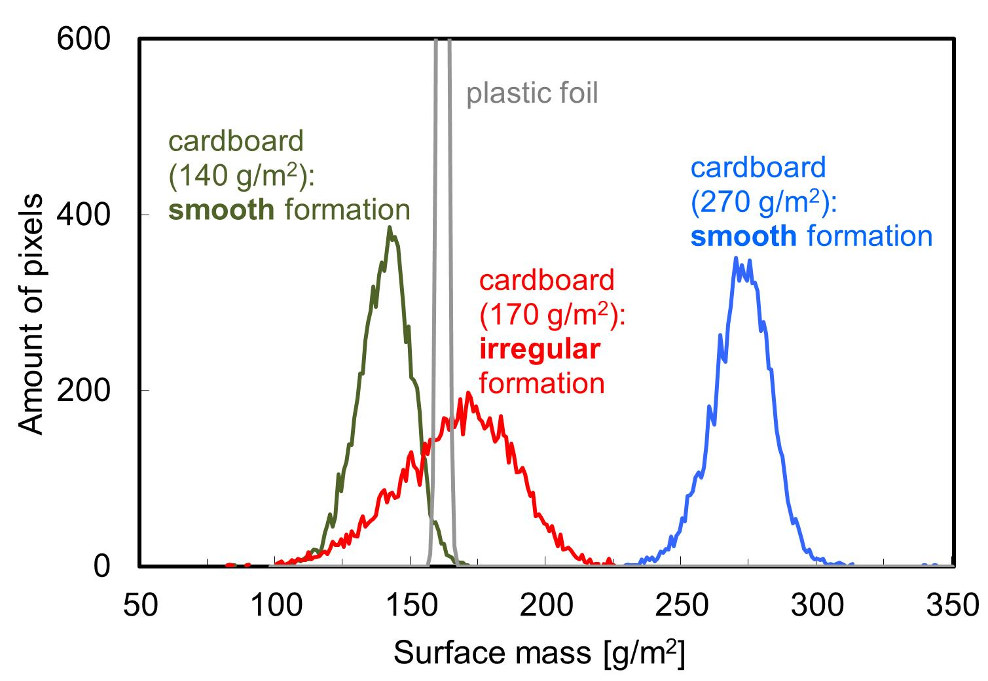
Mapping the Formation of Paper Products
THz images and photographs of raw cardboard with irregular and smooth formation.
Paper thickness 200 µm, sample size 45 mm x 70 mm.
Distribution of the grammage for the two cardboard samples compared to a plastic foil with a similar grammage.
Papiertechnische Stiftung (PTS) & Menlo Systems

Slide 10
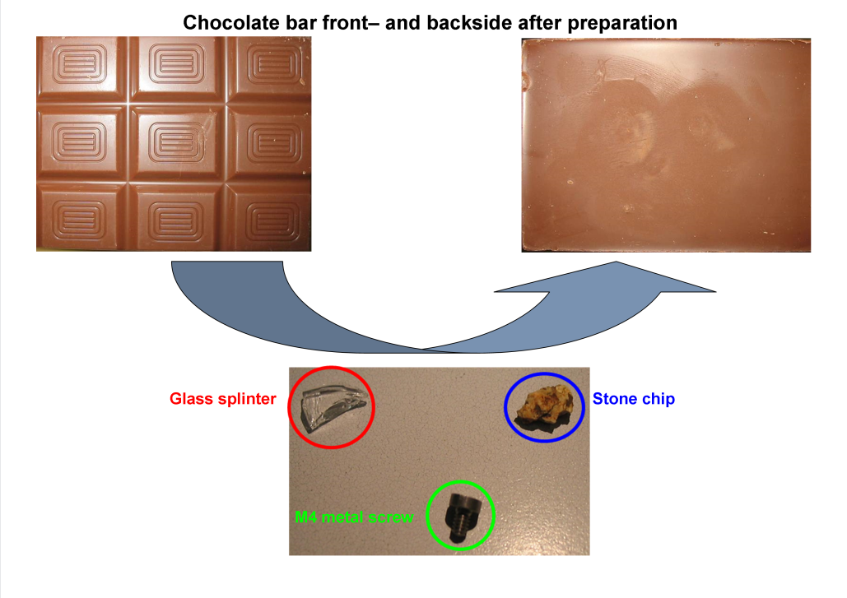
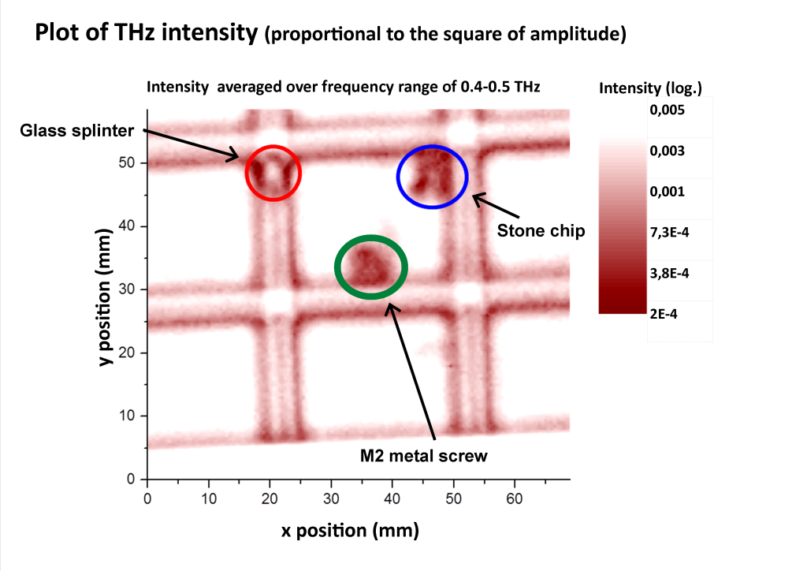
Quality Control of Chocolate Products with THz Imaging
Front and back side of chocolate bar after preparation with a glass splinter, a stone, and a metal screw.
THz intensity image of a chocolate bar with different contaminating particles
C. Jördens et al., European Conference on Non-Destructive Testing, 2006

Slide 11
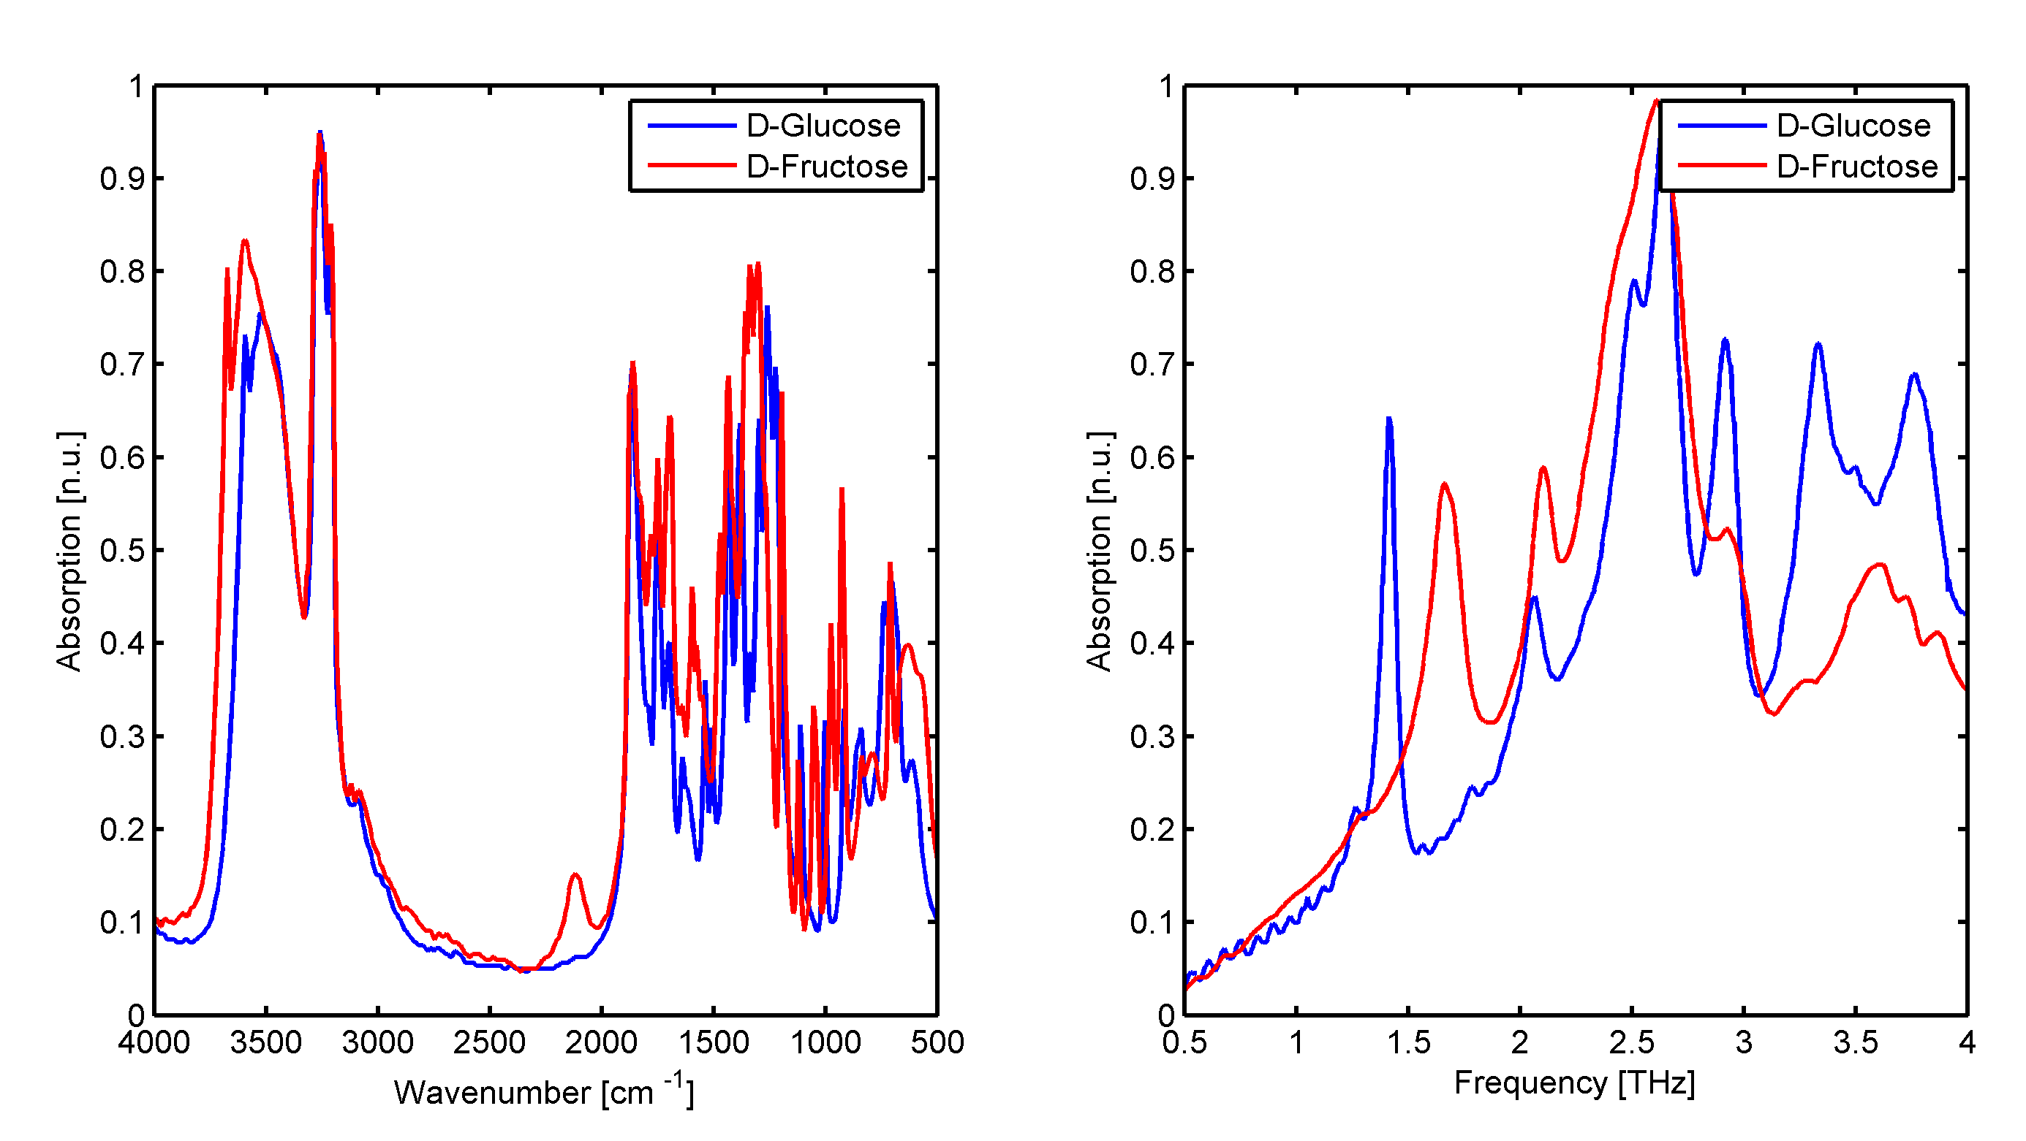
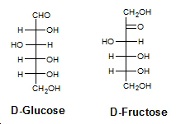
THz enable agile organic compound discrimination through selective absorption and dispersion due to rotational and vibrational transitions
Spectral Data Base (SDBS) AIST (Japan)
Optics Communications 285, 1868 (2012)

Slide 12


PROGETTO PREMIALE THEIA
Terahertz imaging advances: looking with teraherts eyes
“The THz core system will be assembled focusing on the establishment of a highly sensitive THz imaging test bed, i.e. a time-domain spectroscopy imaging system, oriented to industry deployment.”
Work-package WP5: Route Toward Super-High Resolution THz Imaging.
Theoretical and experimental investigation of sub-wavelength resolved THz images.
Work-package WP6: Implementation of THz Time-Domain Reflective Spectroscopy.
Theoretical and experimental investigation of material spectroscopic fingerprints from the data retrieved by reflective TDS.
Work-package WP7: THz spectroscopy for non-destructive characterization of cultural heritage artefacts.
Deploy the technology developed in the framework of this project in a real application scenario.
Methods and applications
Other institutions involved

Slide 13


Early monitoring of the mechanical degradation of ancient paper

Slide 14
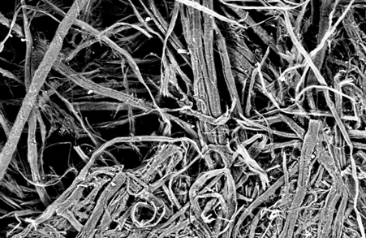
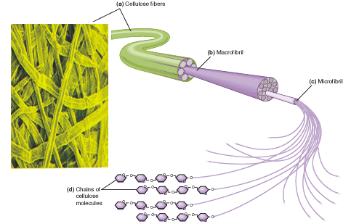
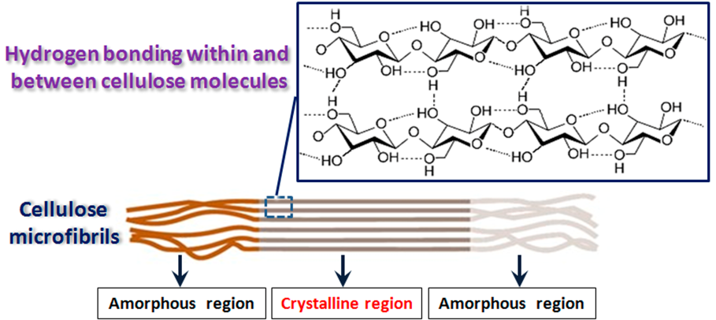
Paper: morphology and molecular structure
cellulose fibre
macrofibrils
microfibrils
chains of
cellulose
molecules
100 μm
M. Missori, et al., Phys. Rev. Lett. 97, 238001 (2006).
Notes:
Isolated cellulose possesses a stable thermodynamical configuration, which allows an excellent durability over time.
14

Slide 15

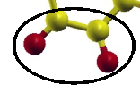
Degradation at the molecular scale
thermal energy
O
H
radiative energy
humidity
C
micro-organisms
hydrolysis
oxidation
O
H
O
H
C
C
Variations of mechanical and morphological properties
UV-Vis active oxidized groups (chromophores)
M. Bicchieri, et al., J. of Raman Spectr. 37, 1186 (2006).
T. Lojewski, et al., Carbohydrate Polymers 82, 370 (2010).

Slide 16
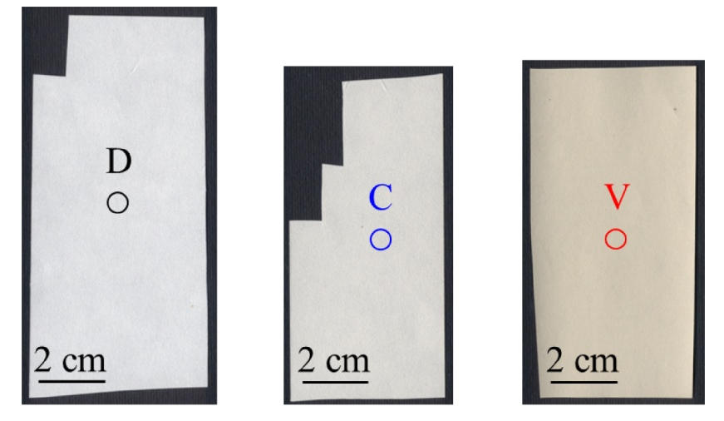
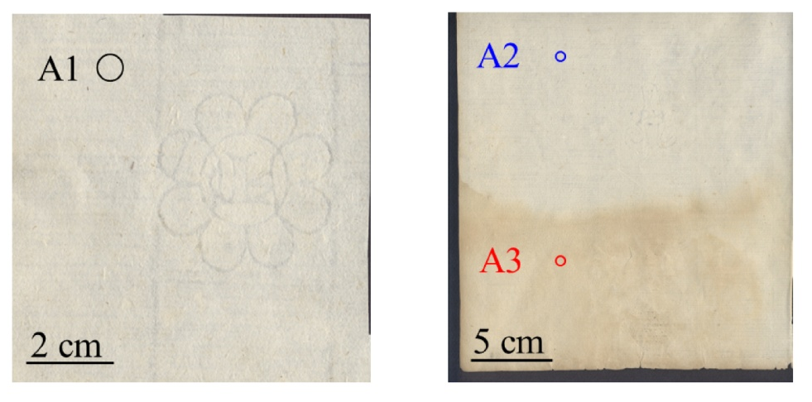
Materials
Modern paper samples made of pristine cotton cellulose were artificially aged at 90°C up to 48 days in different environmental settings
Ancient samples produced in 15th century in Italy and France exhibiting different state of conservation and damages

Slide 17
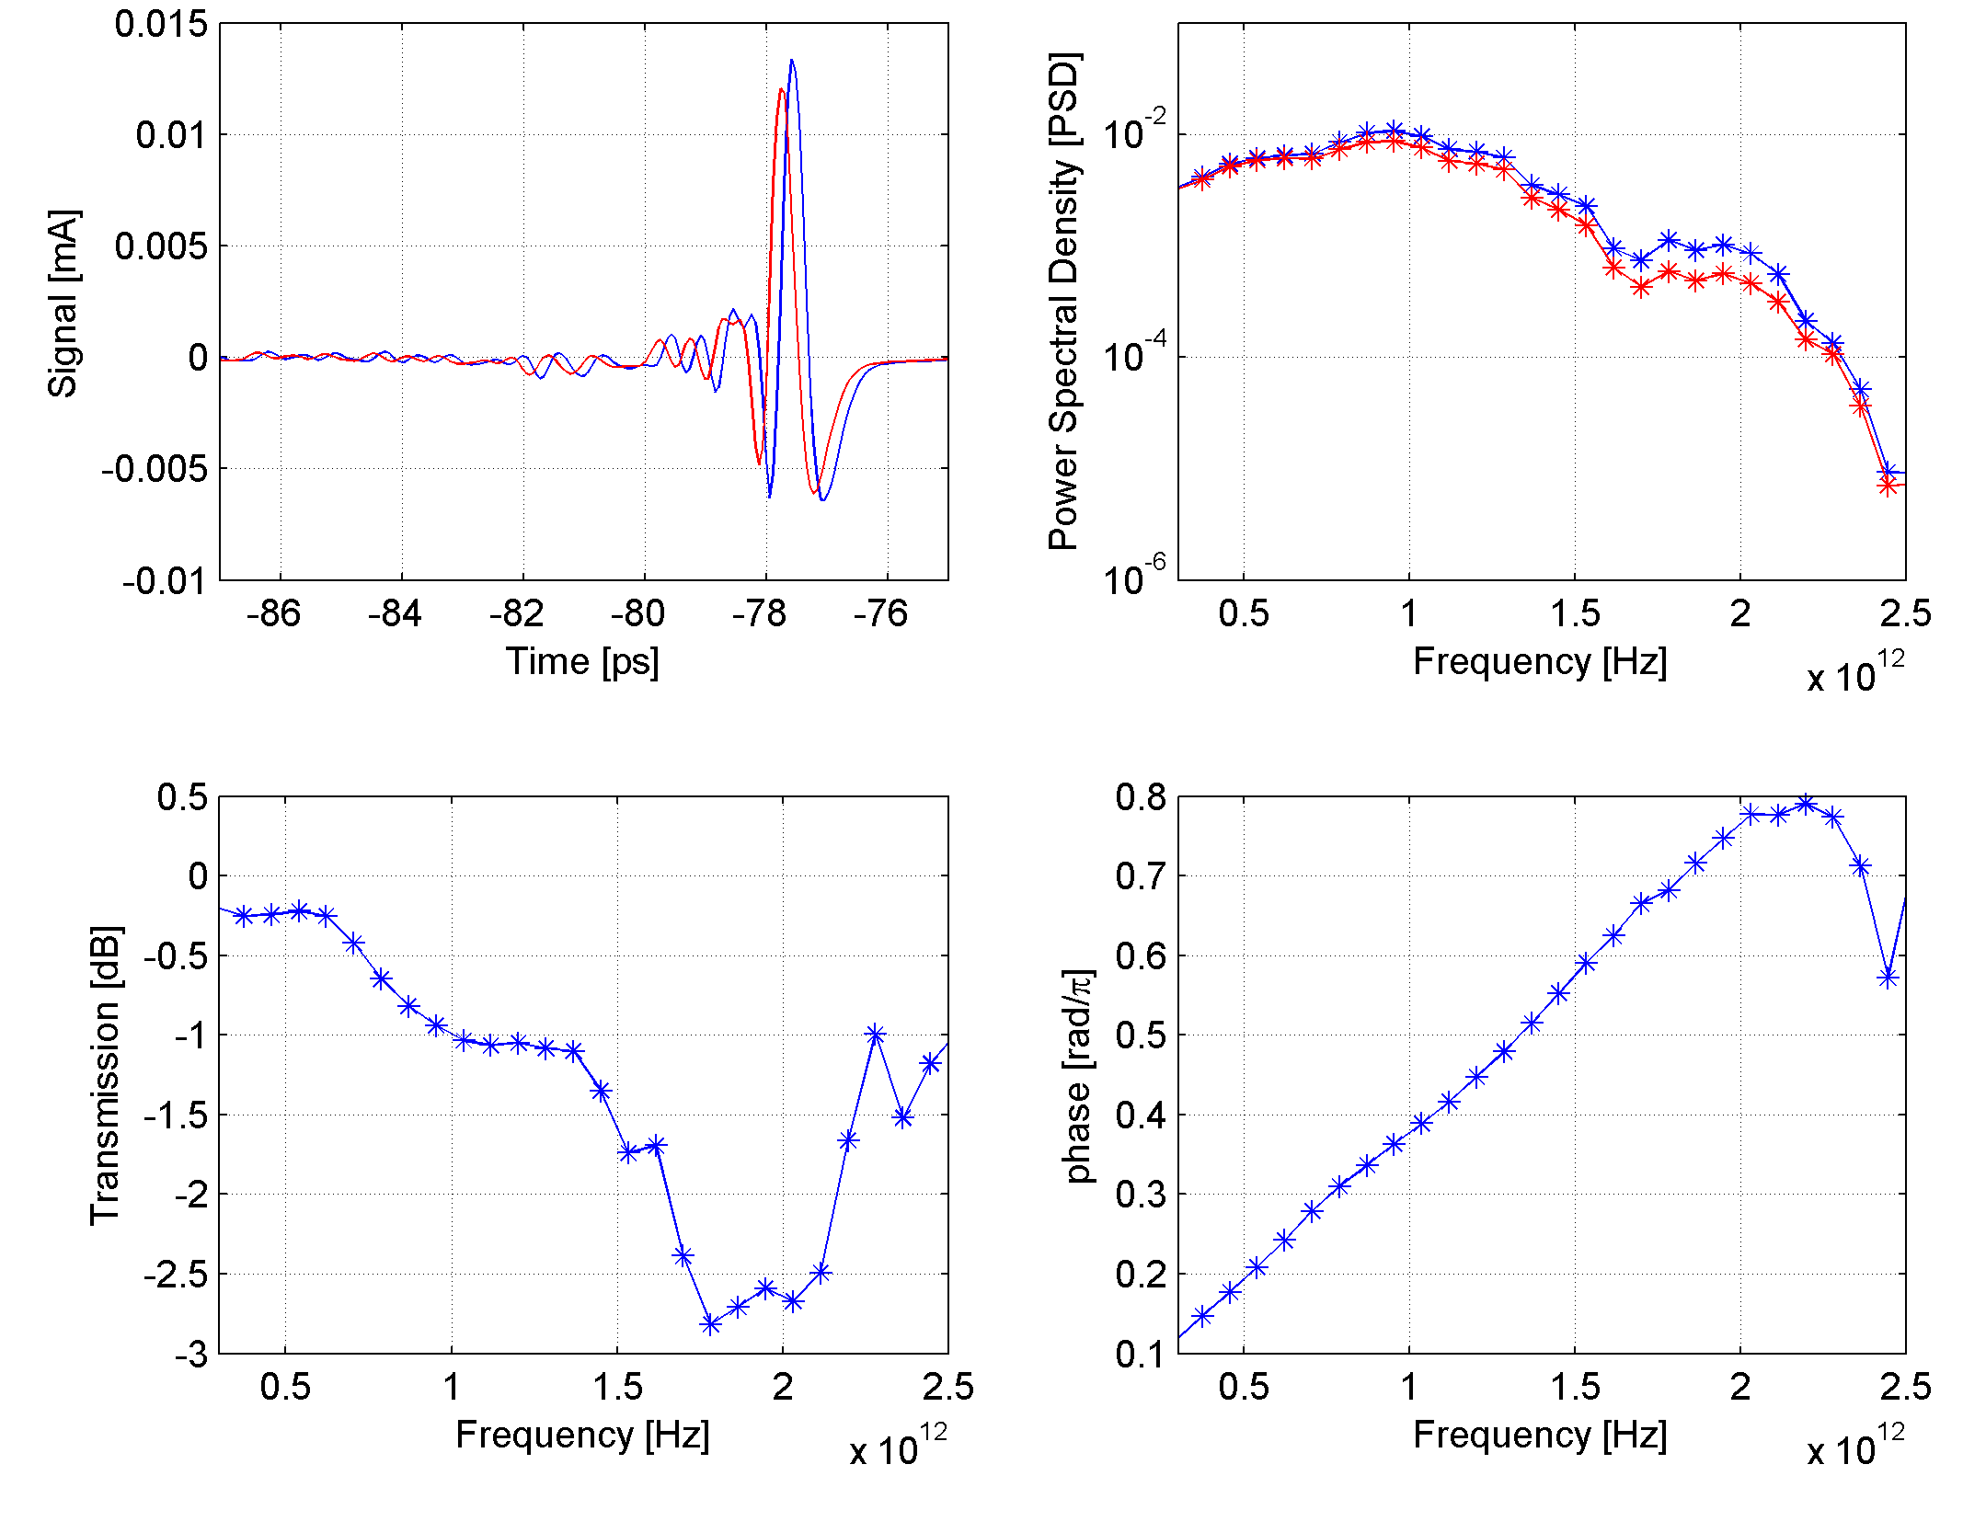
THz Time-Domain Spectroscopy: paper sheets
Sample
Reference
Delay (refractive index)

Slide 18
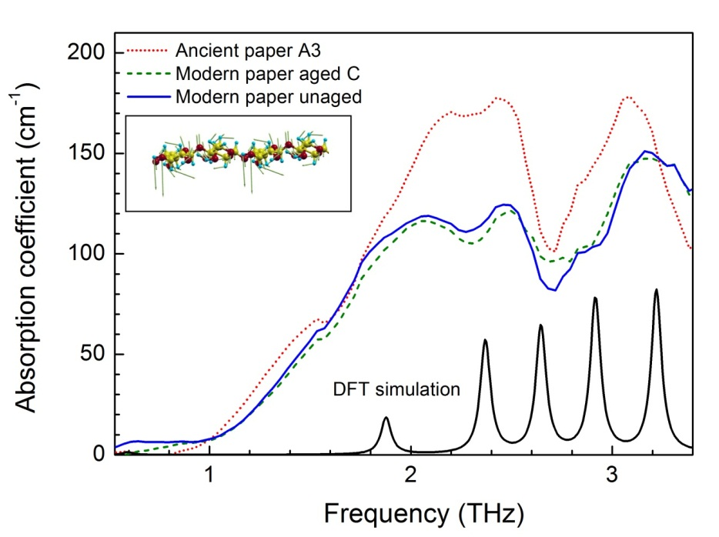
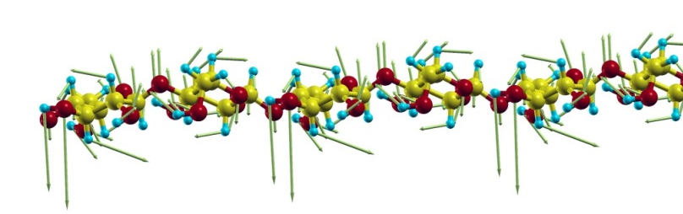
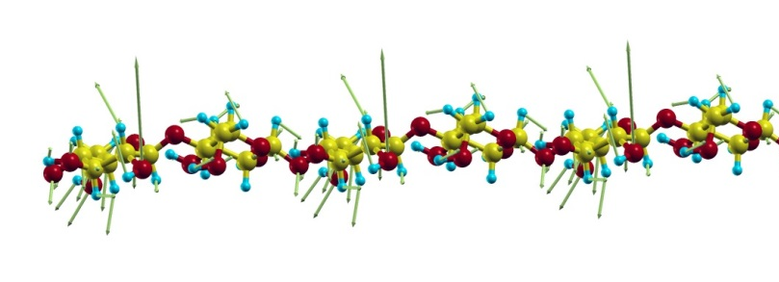
THz Time-Domain Spectroscopy: results
1.9THz
2.4THz
Main spectral features at 1.47 THz, 1.90 THz, 2.13 THz, 2.4 THz and 3.1THz.
Set up a method to evaluate the degree of crystallinity of ancient paper from THz spectra.

Slide 19
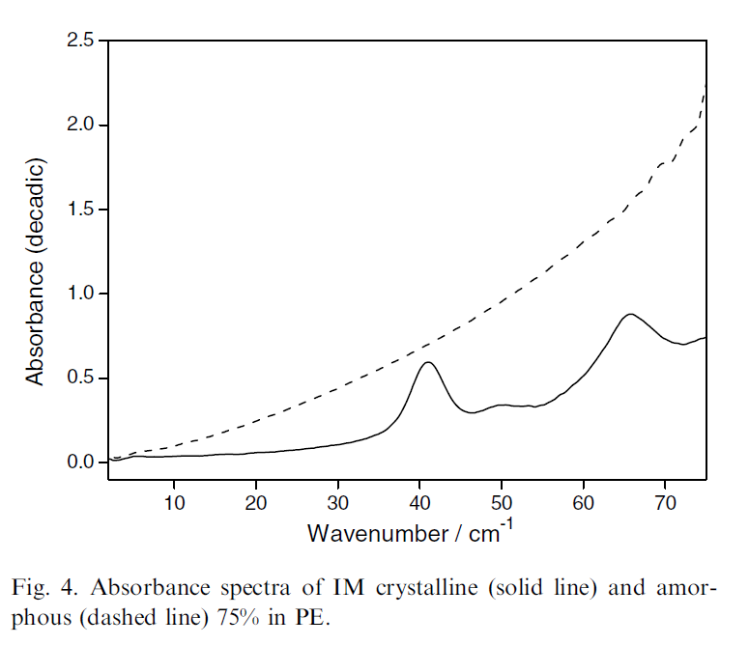

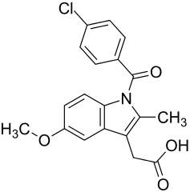
Effect of sample crystallinity on THz spectra
amorphous
crystalline
IM=indomethacin
(anti-inflammatory drug)
Clare J. Strachan et al., Using terahertz pulsed spectroscopy to study crystallinity of pharmaceutical materials, Chemical Physics Letters 390, 20–24 (2004)

Slide 20
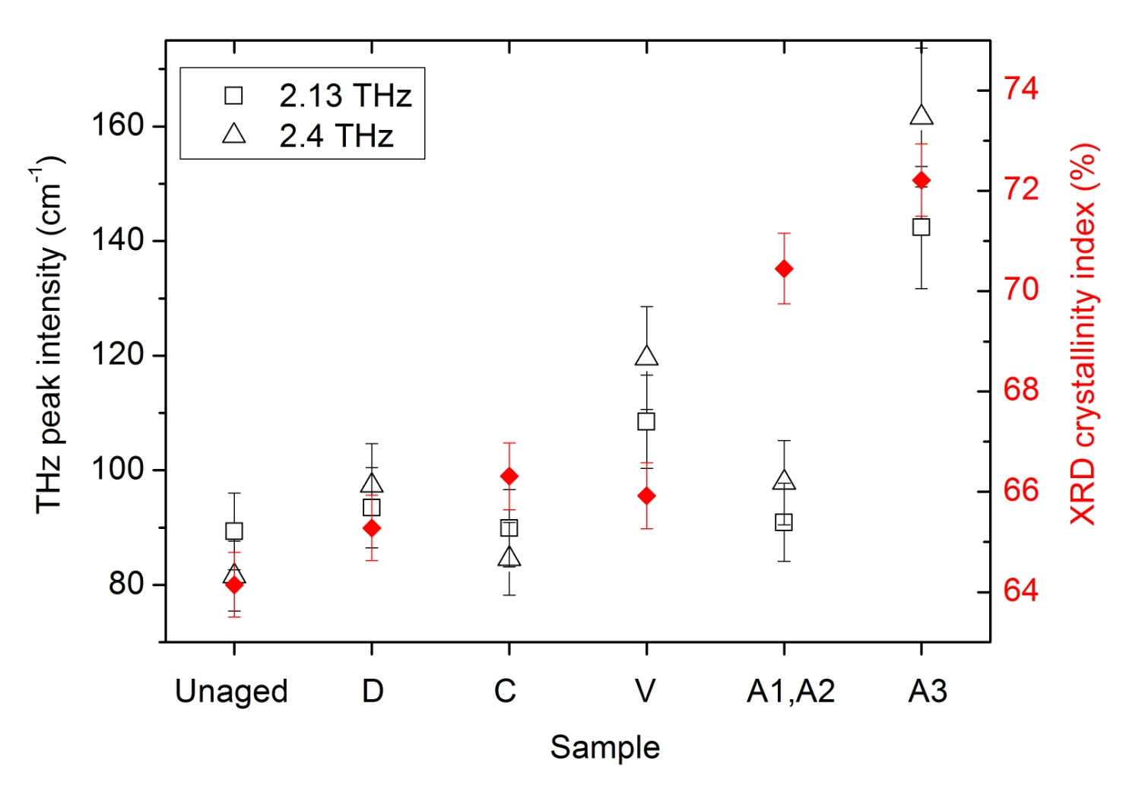
THz data were compared with X-ray diffraction spectra used to calculate crystallinity indexes of samples
THz peak absorption intensity vs
XRD deconvolution crystallinity index
M. Missori et al., Conference on Lasers and Electro-Optics/Europe (CLEO 2015)

Slide 21
Thanks for
your attention
And a special thank to other scientists involved: Jacek Bagniuk, Matteo Clerici, Joanna Łojewska, Roberto Morandotti, Lorenzo Teodonio, Claudia Violante

