Slide 1
Frascati Beam-Test Facility
Paolo Valente*, Bruno Buonomo, Luca Foggetta, Claudio Di Giulio
con lo staff del linac di DAFNE
Maurizio Belli, Riccardo Ceccarelli, Alberto Cecchinelli, Renato Clementi, Moreno Martinelli, Graziano Piermarini, Serena Strabioli, Luis Antonio Rossi, Raffaele Zarlenga
e con lo staff di supporto BTF
Francesca Casarin, Maria Rita Ferrazza, Manuela Giabbai
INFN Laboratori Nazionali di Frascati
*INFN Sezione di Roma

Slide 2
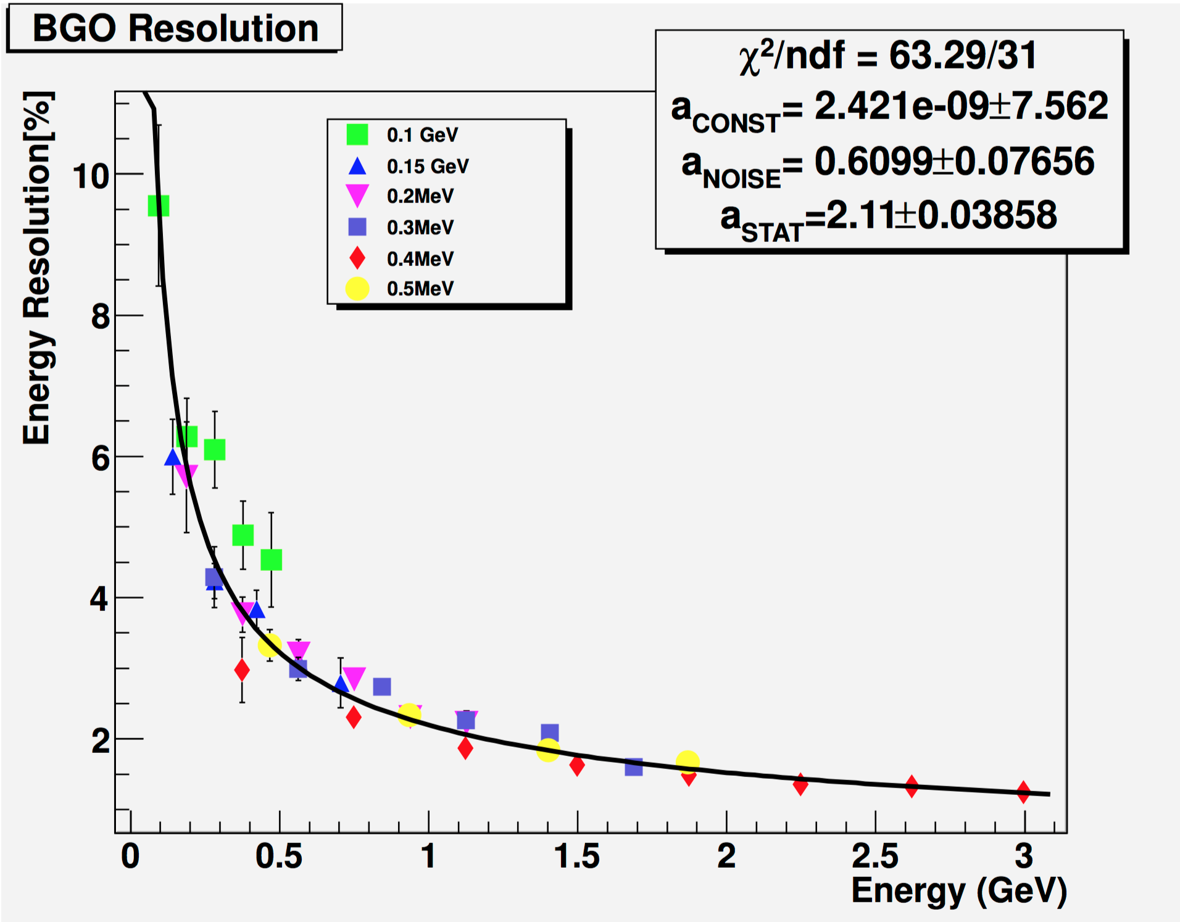
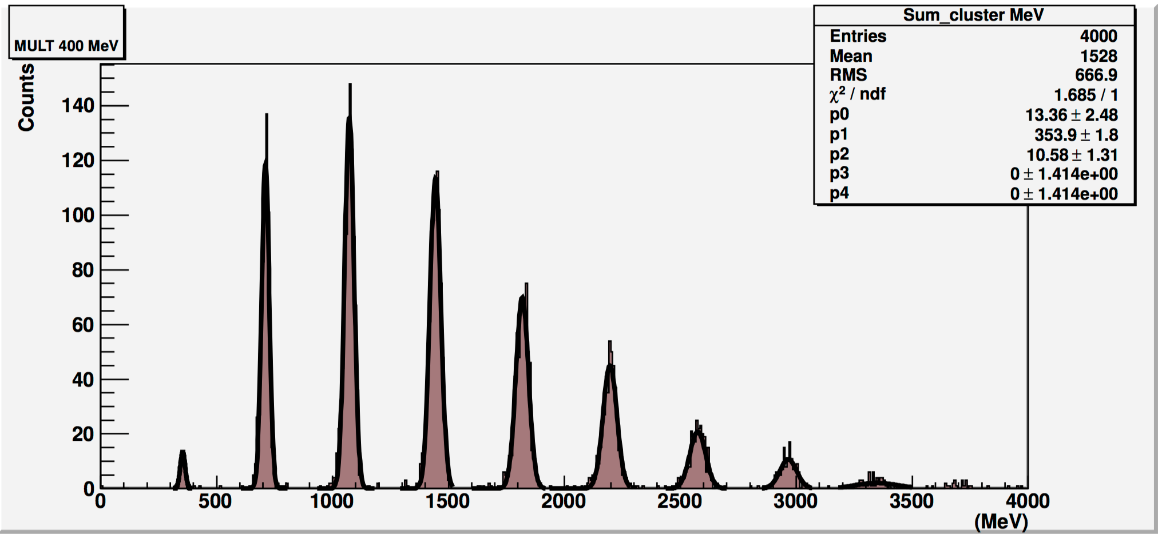
What is BTF
A facility part of the DAFNE accelerator complex, that allows to:
Extract, attenuate, energy select, focus and collimate electrons and positrons accelerated by the linac
Measure in real-time and tune the beam parameters (particle species, energy, intensity, beam spot size and position)
Provide a series of services: power supply, networking, gas, DAQ, vacuum and cryogenics, alignment, magnetic fields
It generally works in “parasitic” mode to the operations of the DAFNE collider
Commissioning performed in 2002, users routinely since 2004
Mainly used by the high-energy physics and astro-particle communities
Parameter | Parasitic mode |  | Dedicated mode
 | With target | Without target | With target | Without target
Particle species | e⁺ or e⁻ Selectable by user | e⁺ or e⁻ Depending on DAFNE mode | e⁺ or e⁻ Selectable by user
Energy (MeV) | 25–500 | 510 | 25–700 (e⁻/e⁺) | 250–730 (e⁻) 250–530 (e⁺)
Energy spread | 1% at 500 MeV | 0.5% | 0.5%
Rep. rate (Hz) | Variable between 10 and 49 Depending on DAFNE mode |  | 1–49 Selectable by user
Pulse duration (ns) | 10 |  | 1.5–40 Selectable by user
Intensity (particles/bunch) | 1–10⁵ Depending on the energy | 10⁷–1.5 10¹⁰ | 1–10⁵ Depending on the energy | 10³–3 10¹⁰
Max. average flux | 3.125 10¹⁰ particles/s
Spot size (mm) | 0.5–25 (y) × 0.6–55 (x)
Divergence (mrad) | 1–1.5

Slide 3
BTF Users

Slide 4
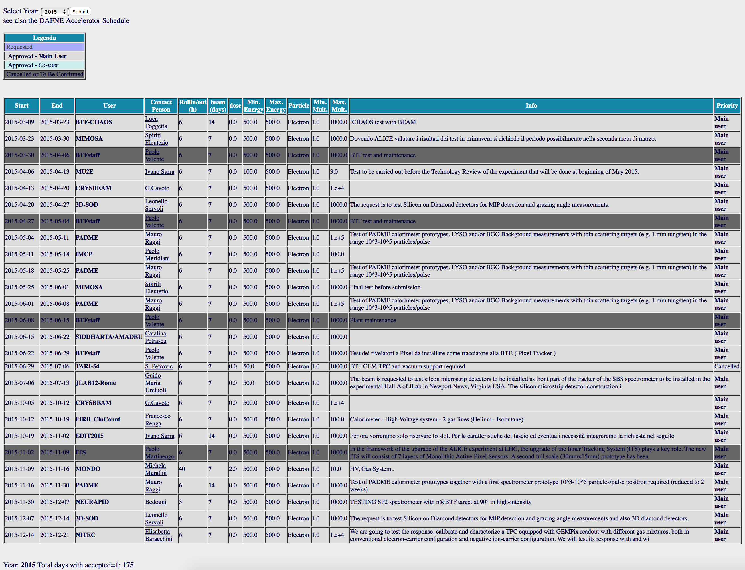
Call and Schedule
Two calls/year, typically ending in November and May
Scheduled shifts from January to July and from September to December
1 week shifts from Monday to Monday
Beam request web form:
http://www.lnf.infn.it/acceleratori/btf/request.html
BTF running subject to regular linac operations
BTF planning strongly linked to the DAFNE one
BTF Users Committee helps for the assignment of beam shifts
1 in 5 or 6 shifts dedicated to maintenance, facility improvements
High intensity runs to be agreed with RP

Slide 5
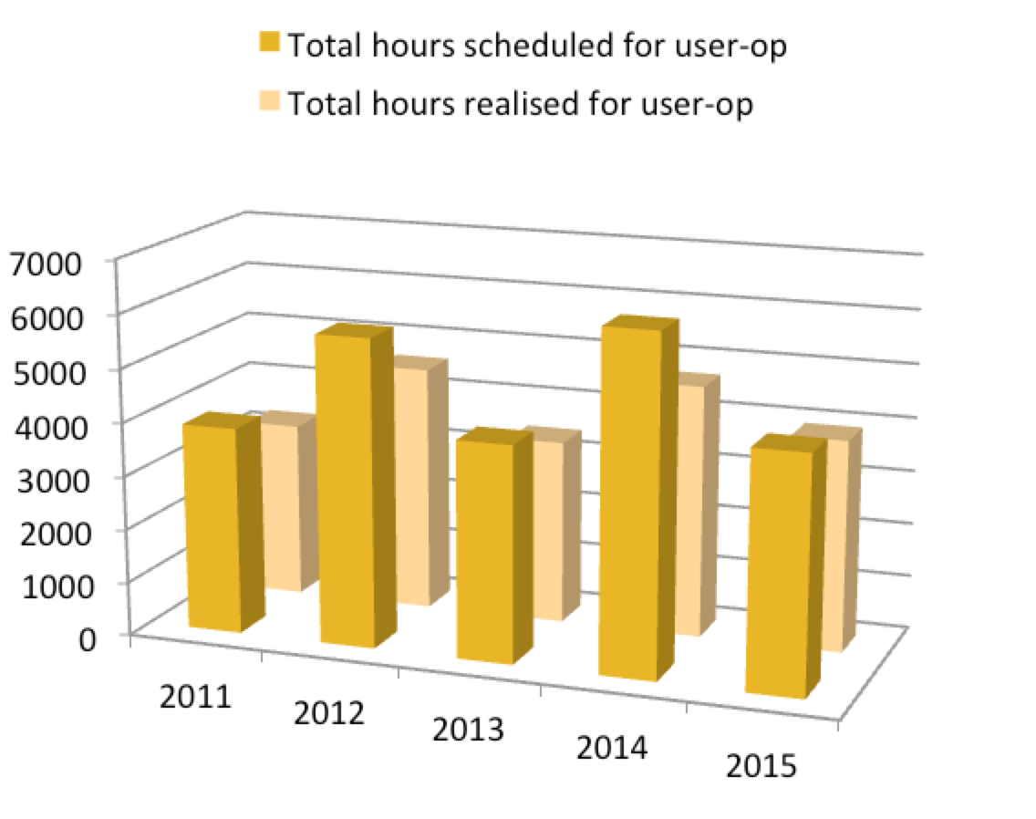
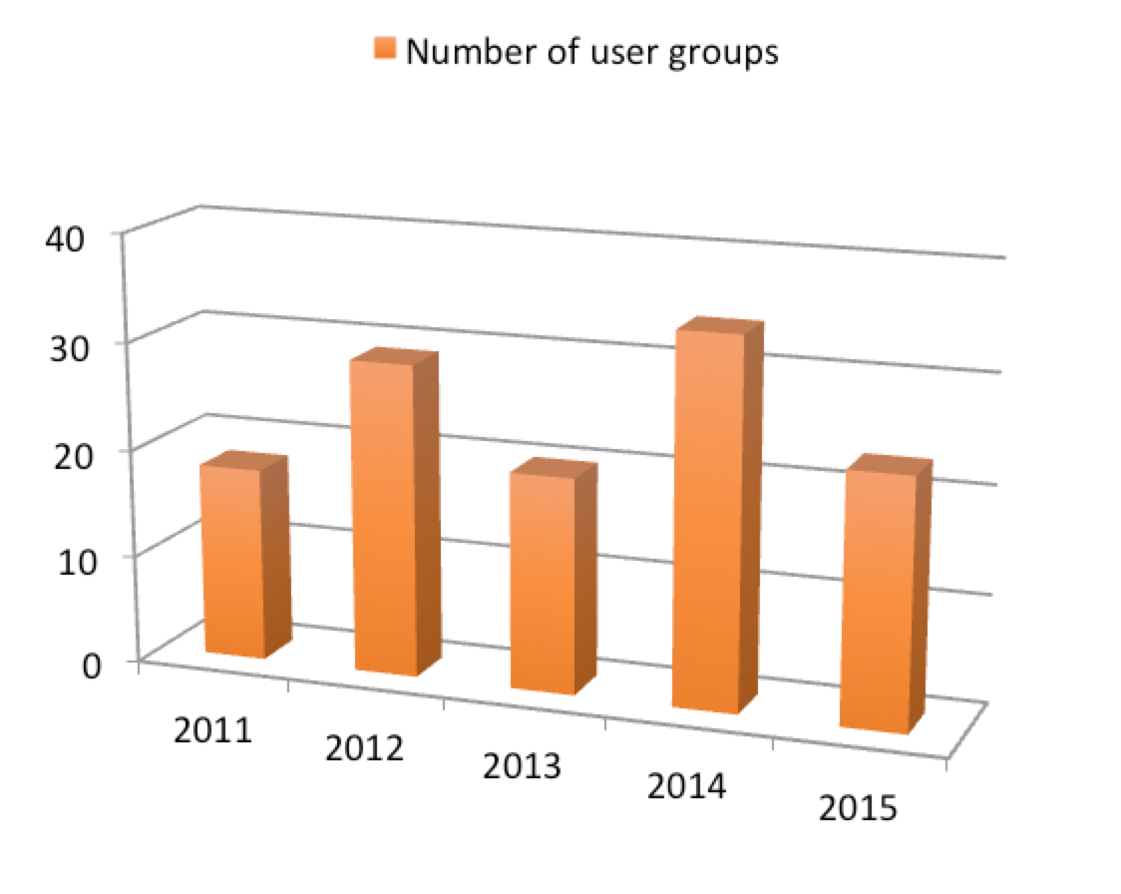
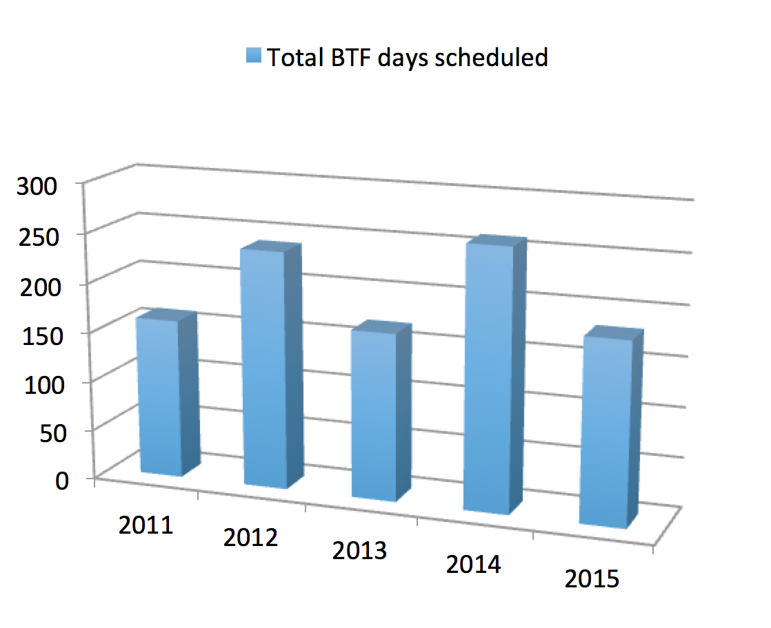
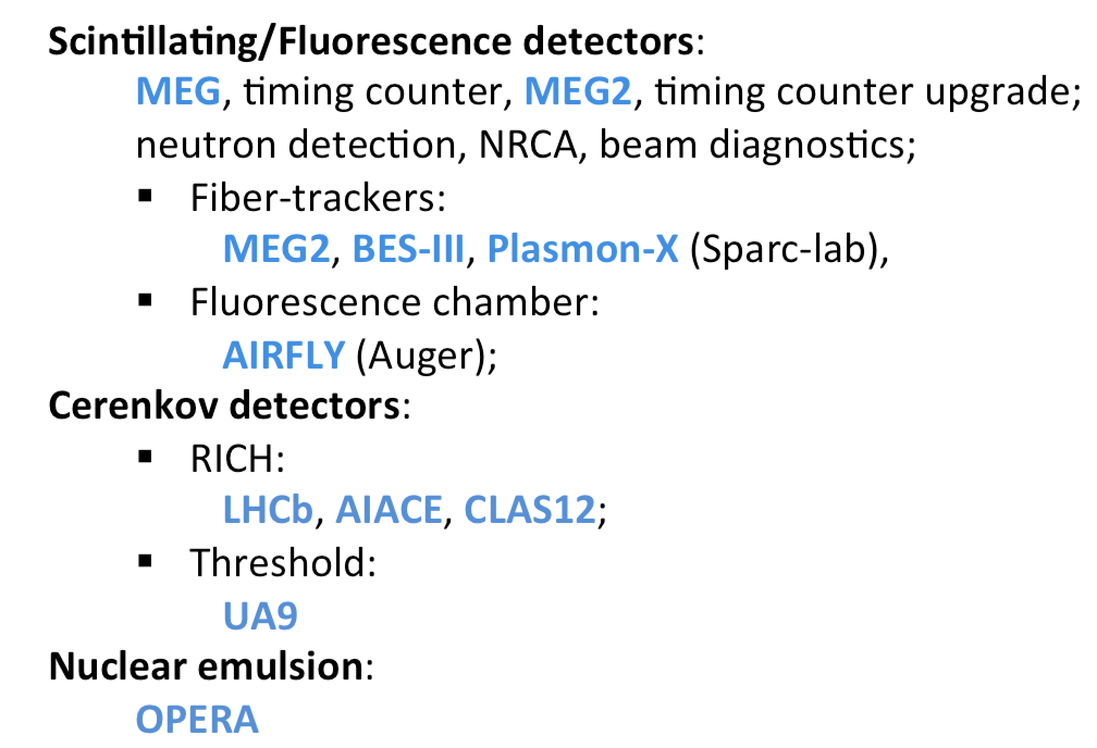
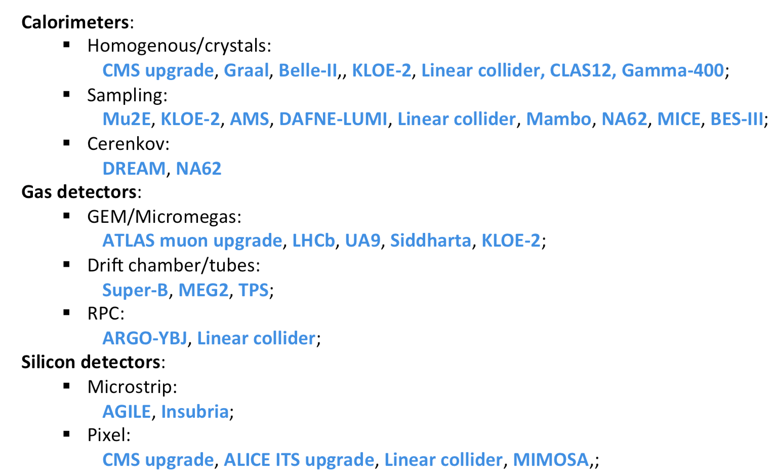
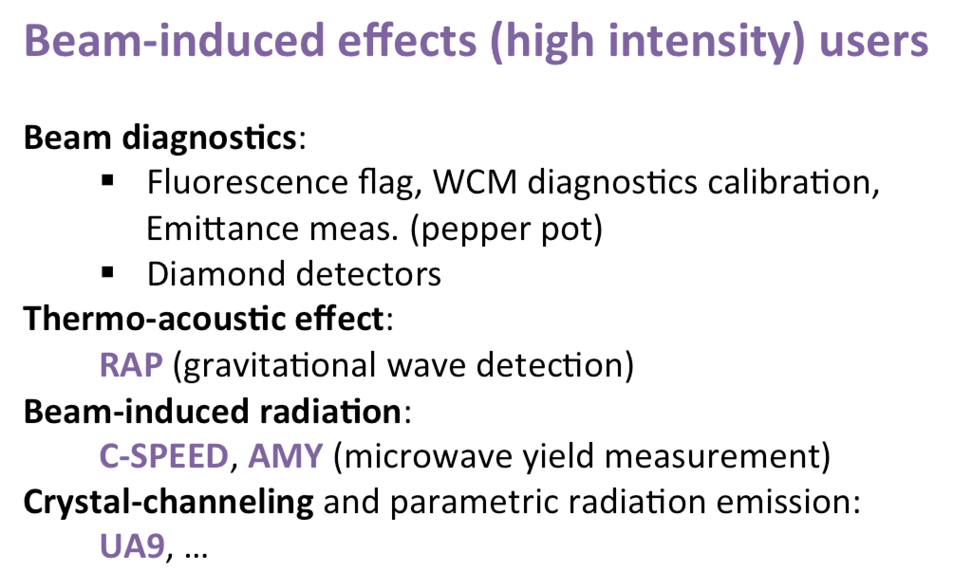
Access to the facility
90% of shifts for detector testing and calibration
To date, almost exclusively research groups

Slide 6
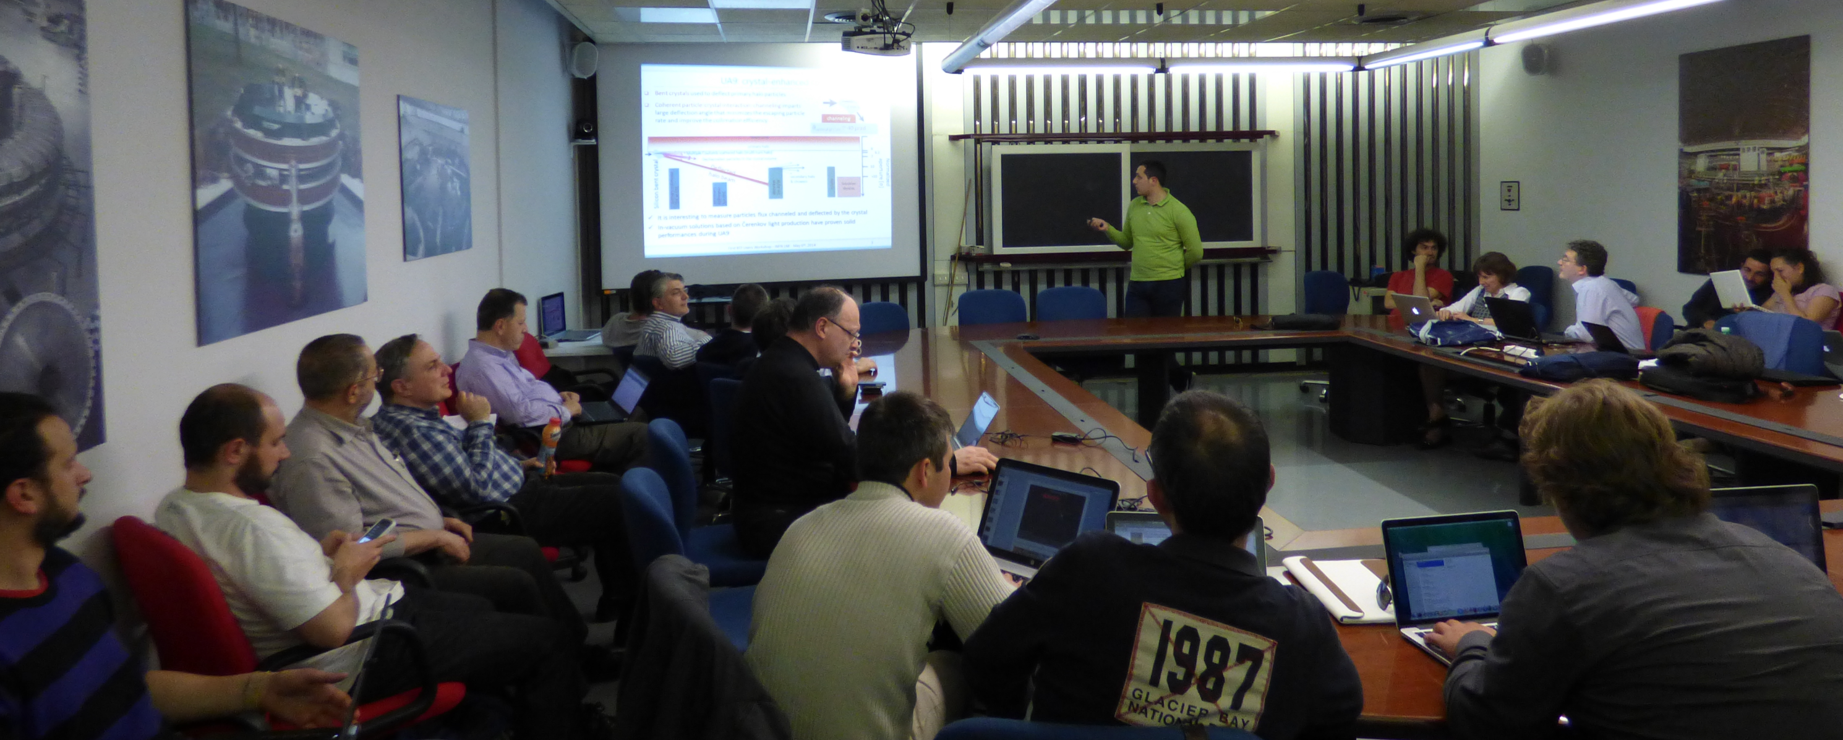
1st BTF Users Workshop
A panorama of the applications, results and users requirements
Mainly from tests perfomed in a three years period (2011-2014)
May 6th-7th, 2014; 35 registered partecipants, 20 talks:
https://agenda.infn.it/event/btf2014
A very useful opportunity of discussing future prospects and users desiderata
The possibility of performing high-energy physics “full” experiments has been proposed in the context of “What Next” long-term strategy of INFN
Discussion on the BTF prospects during the LNF long-term strategy workshop:
https://agenda.infn.it/getFile.py/access?contribId=26&resId=0&materialId=slides&confId=8563

Slide 7
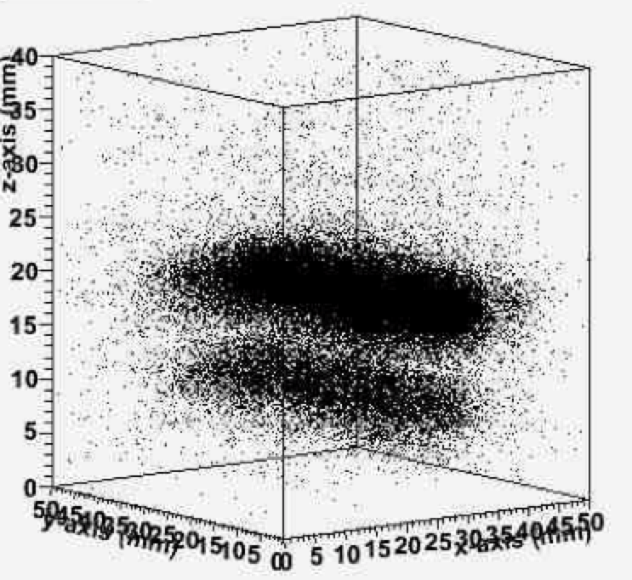
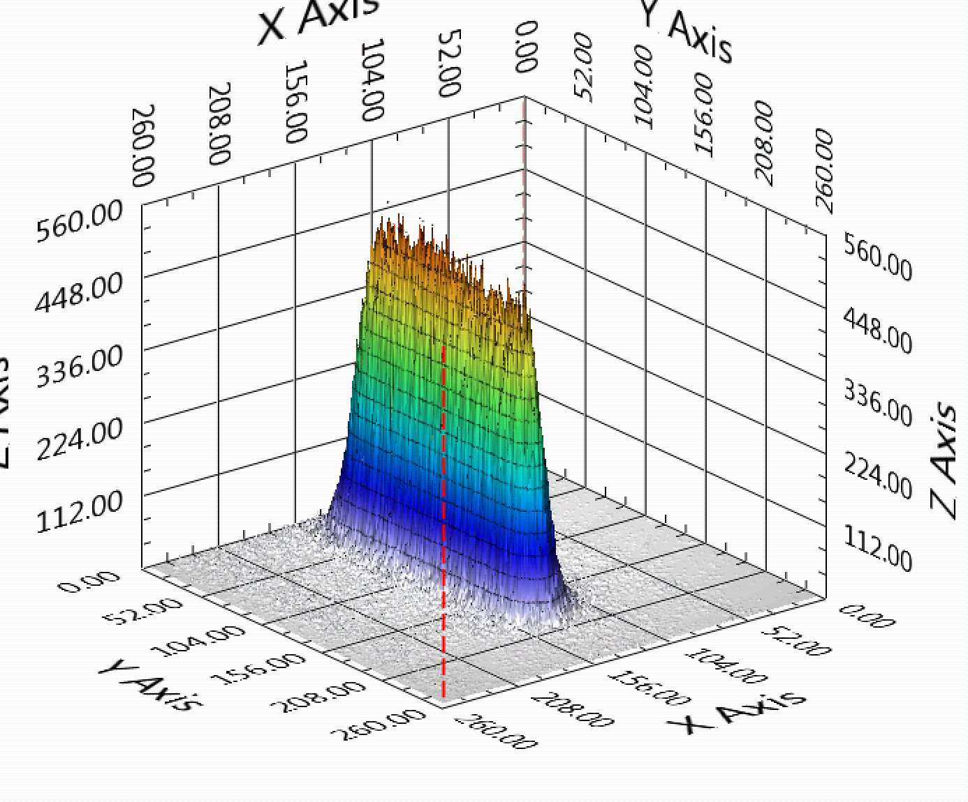
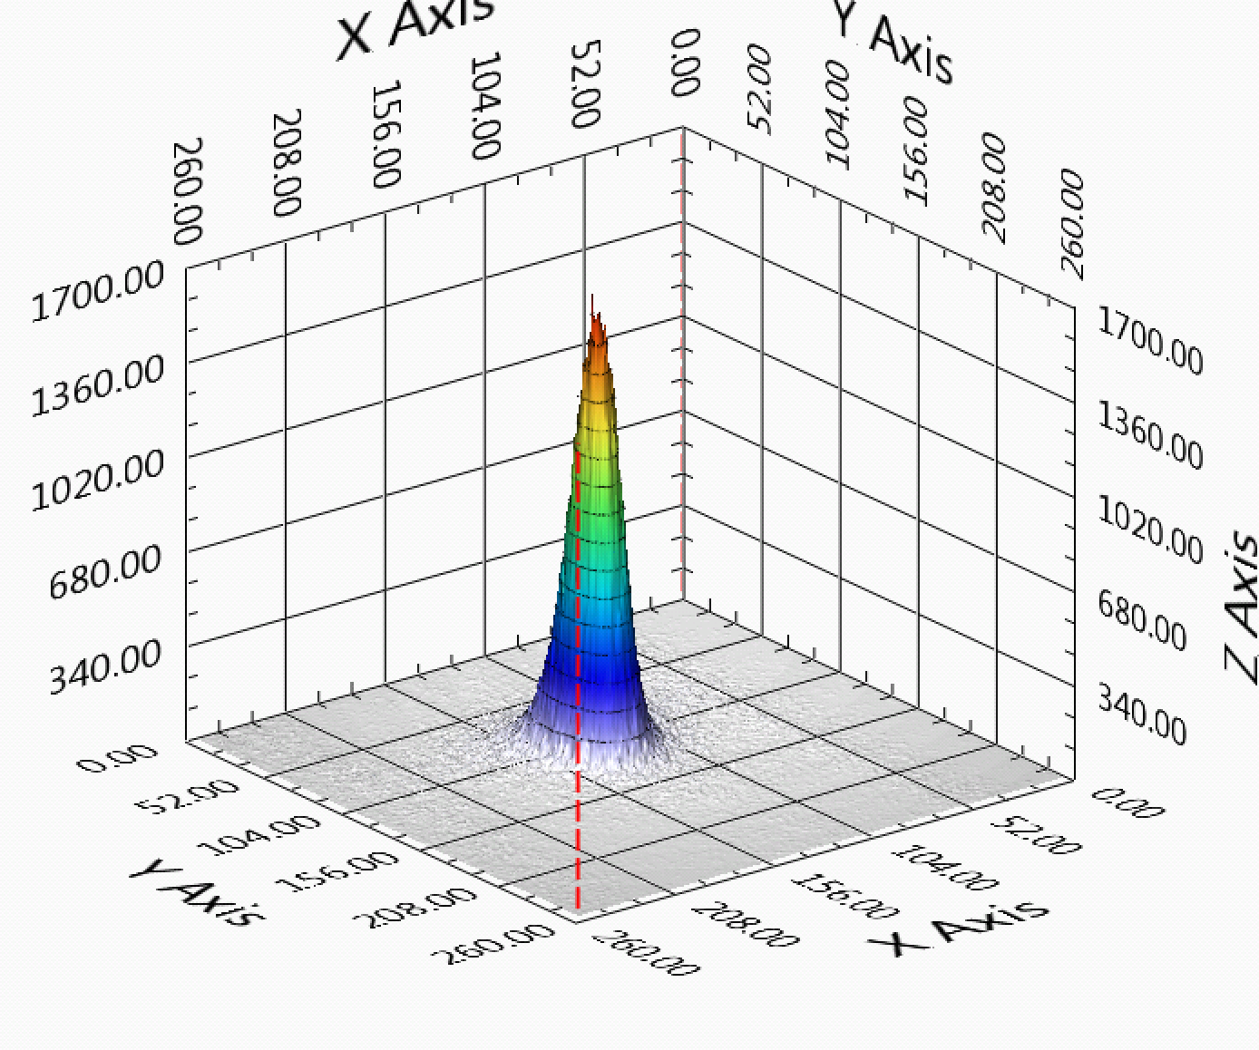
BTF strong points …
Efficiency
Taking out the linac down-time and the dead-time during the switch of the linac and the transfer lines from electron to positron mode, the fraction of time with beam available to BTF is >90%
However during injections for DAFNE the number of bunches available to BTF goes down from 49 to 2 per second
Flexibility
Beam parameters can be adjusted in fairly wide ranges, quickly and with a good reproducibility
User-friendly diagnostics
Diagnostics has been continuously improved during the years, both from the point of view of performance and ease of use
In particular GEM TPC and MediPix/FitPix detectors allows real-time adjustment and monitoring of the beam spot size and position
Calorimeter particle counting and WCM intensity measurement
Wide range of services
Network, DAQ, gas distribution
Magnetic fields
Remotely controlled x-y trolley, linear and rotation stages
Vacuum and (with some limitation) cryogenics setups

Slide 8
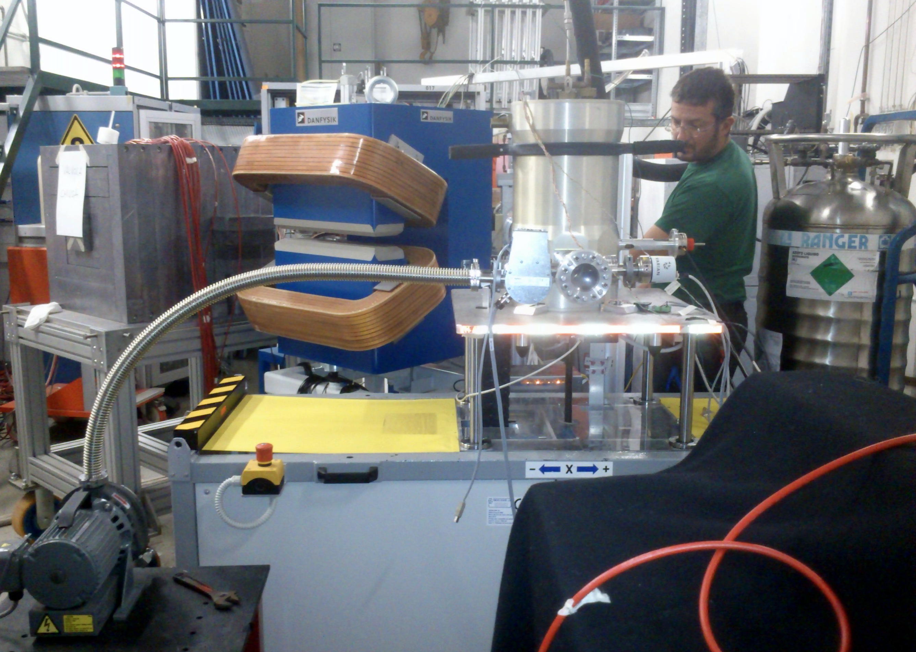
Setup with vacuum and cryogenics, in addition to “standard” movement and alignment services, diagnostics, etc.

Slide 9
… and limitations
In parasitic operations
The duty cycle is limited, mainly by the switch between electrons and positrons, but more importantly the intensity of the beam on the BTF target (and thus downstream in the BTF line) changes by almost an order of magnitude in the two modes
The maximum energy is limited to 500 MeV (in “single particle”)
The bunch length is fixed at 10 ns
Working with the BTF target
The maximum intensity is limited to 10³-10⁴ particles/bunch only lowering the selected energy and opening the collimators, thus worsening the momentum resolution (up to 1-2%)
The beam spot
Is practically Gaussian, it’s not easy to have an uniform intensity over a large area even defocussing and working with the collimators
The angular divergence
It’s of the order of 1-2 mrad, essentially dominated by the Coulomb scattering on the exit window (500 μm thick Beryllium)
The last dipole adds a significant dispersion when increasing the intensity: opening of the collimators the entrance angle in the energy selection dipole increases, thus spoiling the momentum resolution
The diagnostics
Intensity is measured well in the low multiplicity range (by calorimeters) and above 10⁷ particles/bunch (without target, by Integrating Charge Toroid), but with less accuracy in the intermediate range
MediPix/FitPix are imaging detectors, not really a tracking system
The GEM TPC has a sub-mm resolution only in the drift coordinate
Tagged photons
Are available, but with a low rate and not uniform energy resolution
Neutrons
Can be produced, but with RP limitations on the repetition rate and run duration,
Diagnostics has to be improved

Slide 10
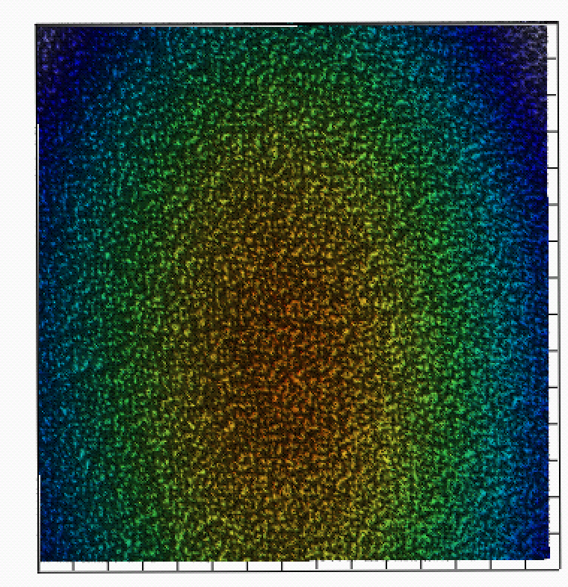
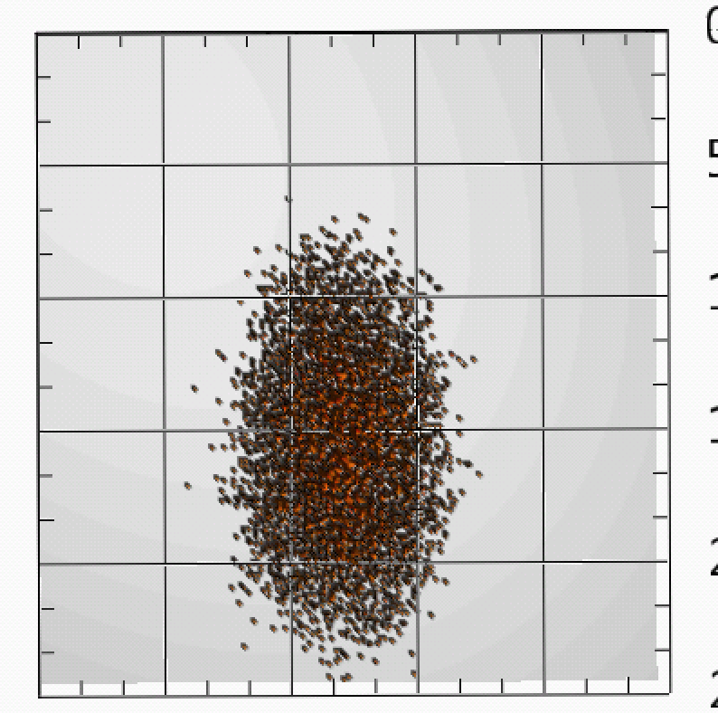
Beam spot (low energy, large)
Optimized beam for electron irradiation run
50 MeV, 3.5×10³ electrons/pulse
Beam spot
>90% of maximum intensity ≈1.5 cm²

Slide 11
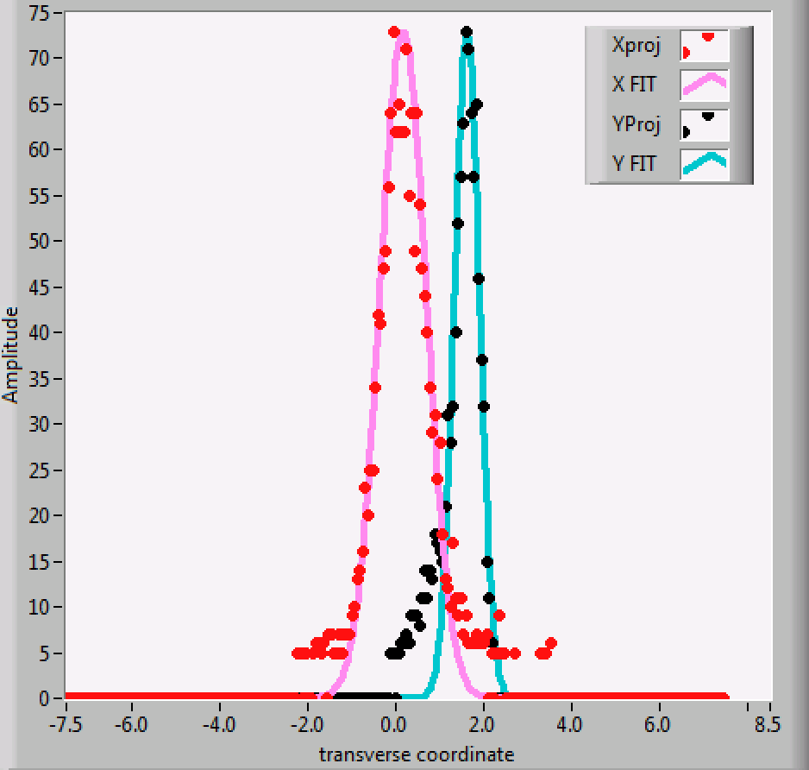
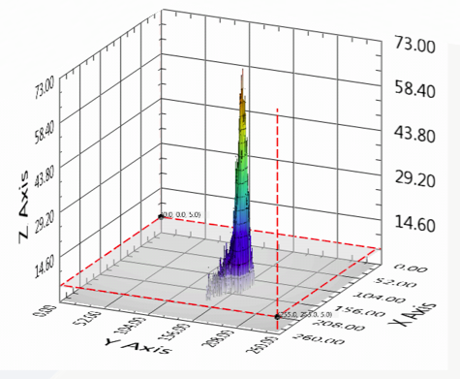
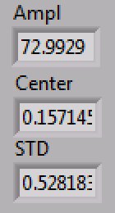
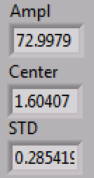
Beam spot (high energy, small)
Optimized beam for small spot
450 MeV, 100 electrons/pulse after additional W collimator

Slide 12
BTF improvements
In questi ultimi anni abbiamo lavorato allo scopo di migliorare:
l’efficienza della facility (in termini di disponibilità del fascio e stabilità di operazione)
la flessibilità dei parametri di fascio, e la qualità della diagnostica (che sono due aspetti fortemente correlati)
Inoltre abbiamo messo in campo una serie di idee e progetti per ampliare il range di parametri di fascio disponibili agli utenti:
2003-2004: Photon tagging
2008-2010: n@BTF, per studiare un target ottimizzato per la foto-produzione di neutroni
Upgrade shielding per operazione a alta intensità
Impulso >40 ns
Nuovo target
Sistema di collimazione (per raggiungere le centinaia di μrad)
Seconda linea di fascio
Nuova photon tagging
Dosimetria per irraggiamento (con elettroni)
Facility integrata per la caratterizzazione di payload per lo spazio
Upgrade in energia
…

Slide 13
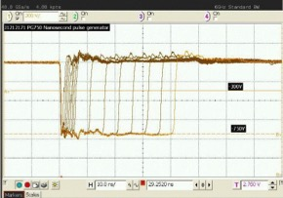
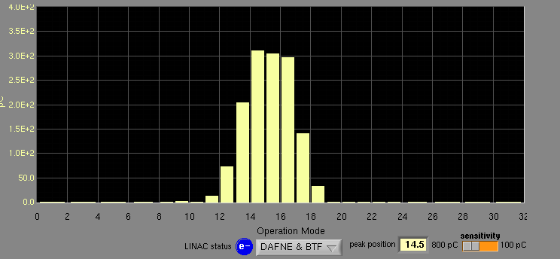
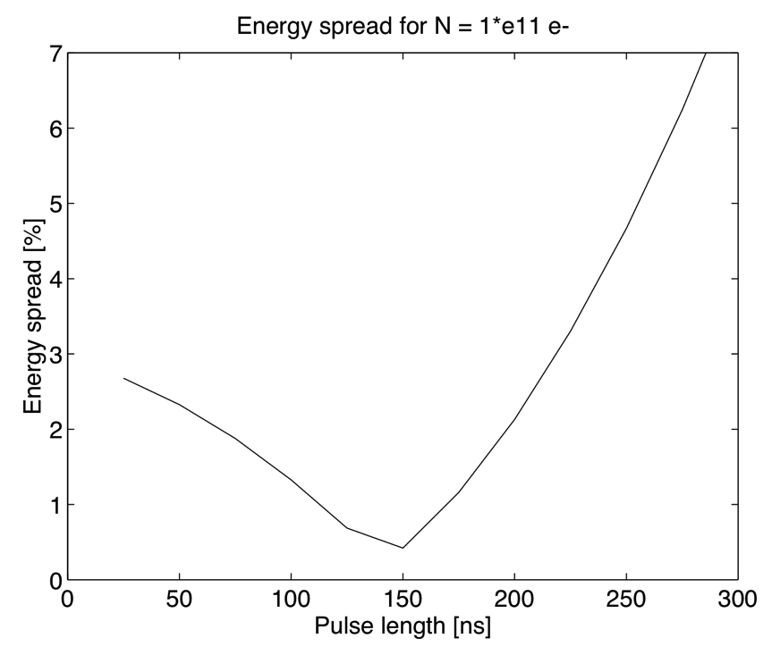
Bunch length
Diluting in time electrons/positrons in one linac bunch can be very useful for a number of applications (e.g. decreasing pile-up)
Assuming constant current from the gun cathode, a longer pulse will correspond to a larger beam charge
The main limitation comes from the RF pulse compression, needed to reach higher energy: SLac Energy Doubling system (SLED)
Outside flat top the accelerating field decreases rapidly, thus increasing the energy spread
We aim at extending from 40 to 200 ns in the first phase
10 ns
40 ns

Slide 14
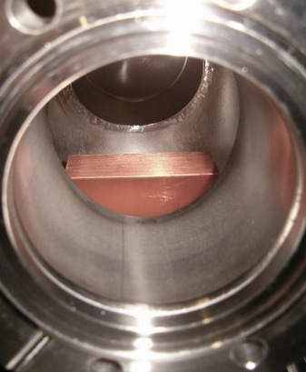
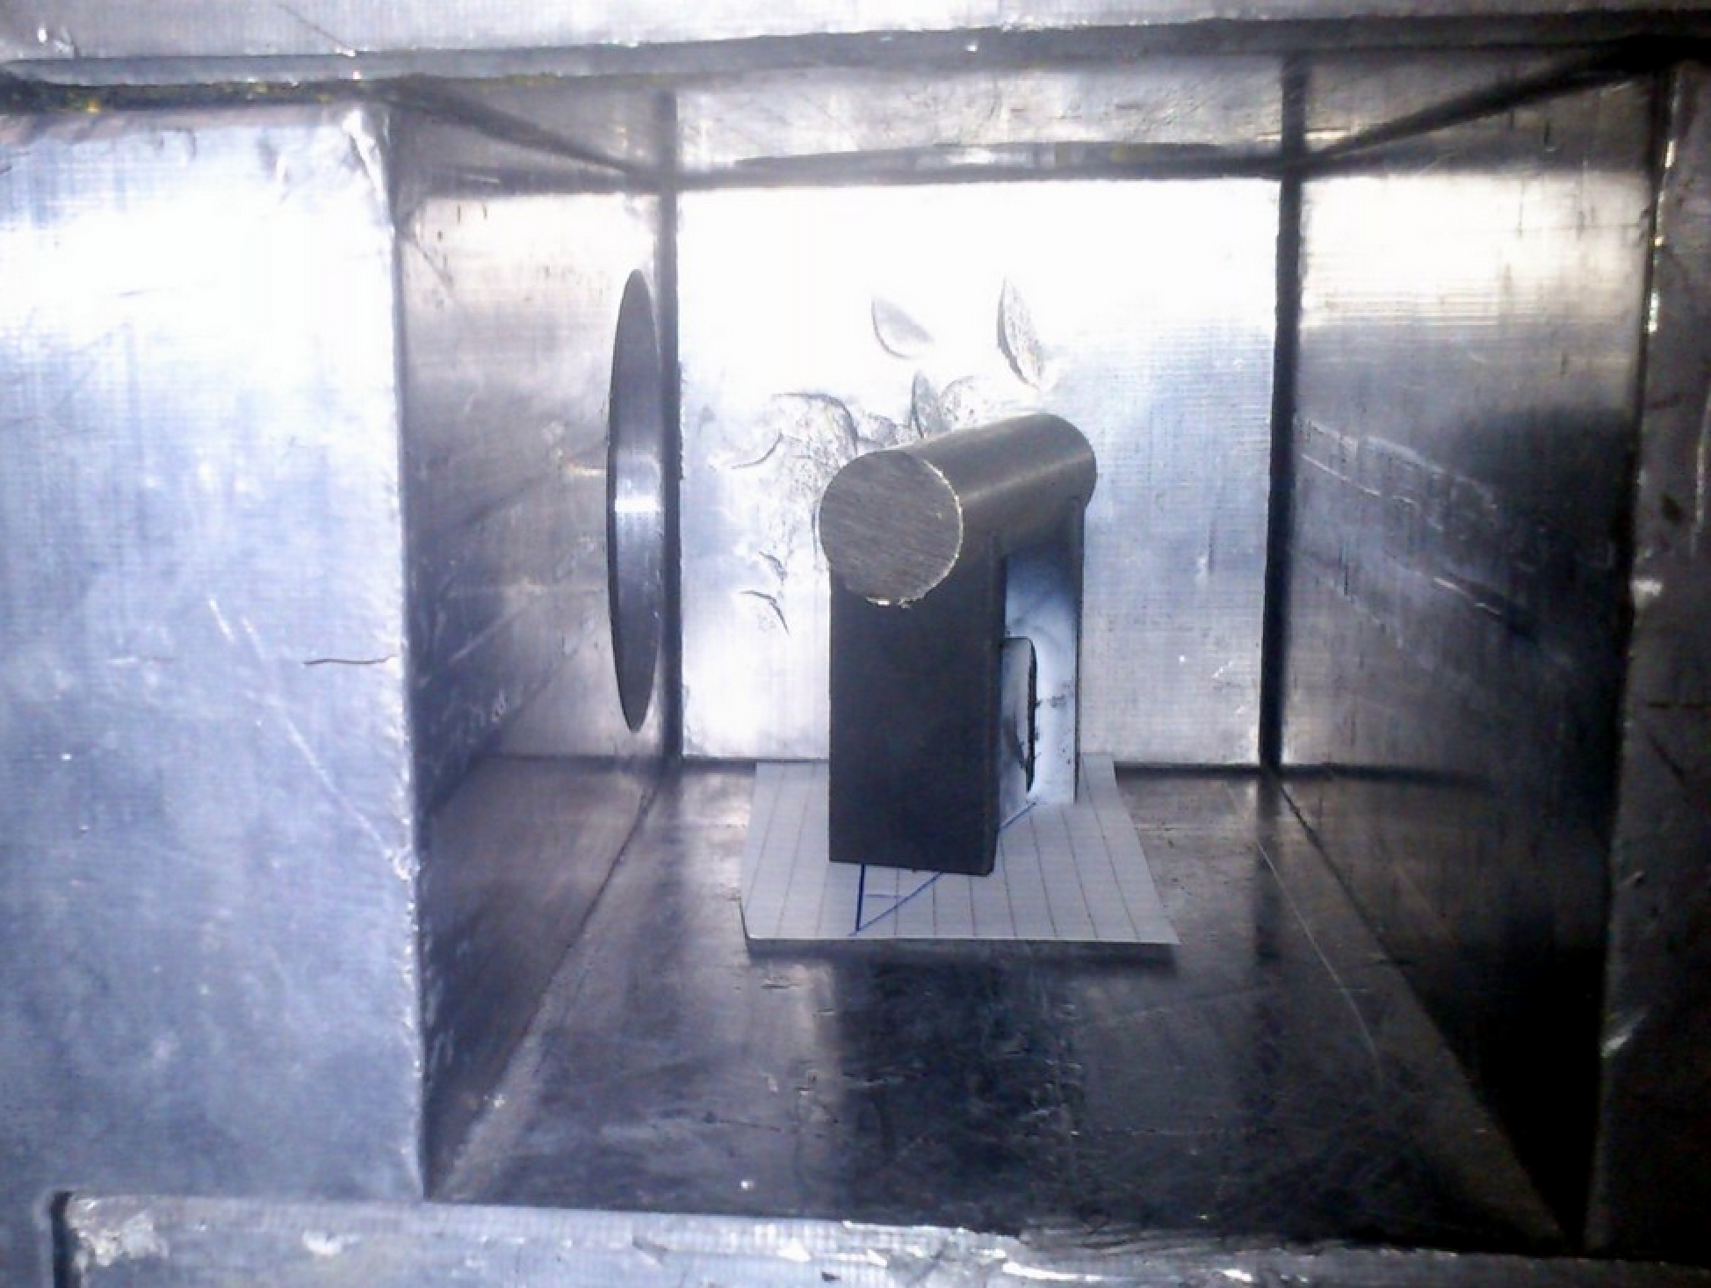
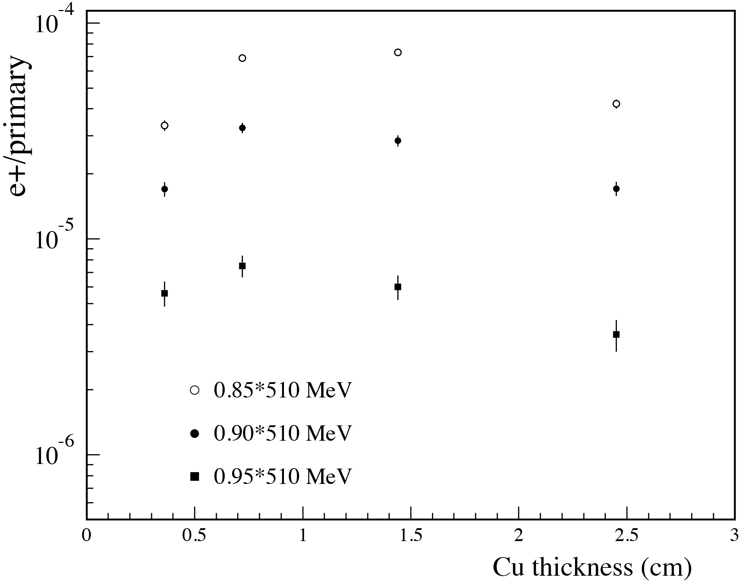
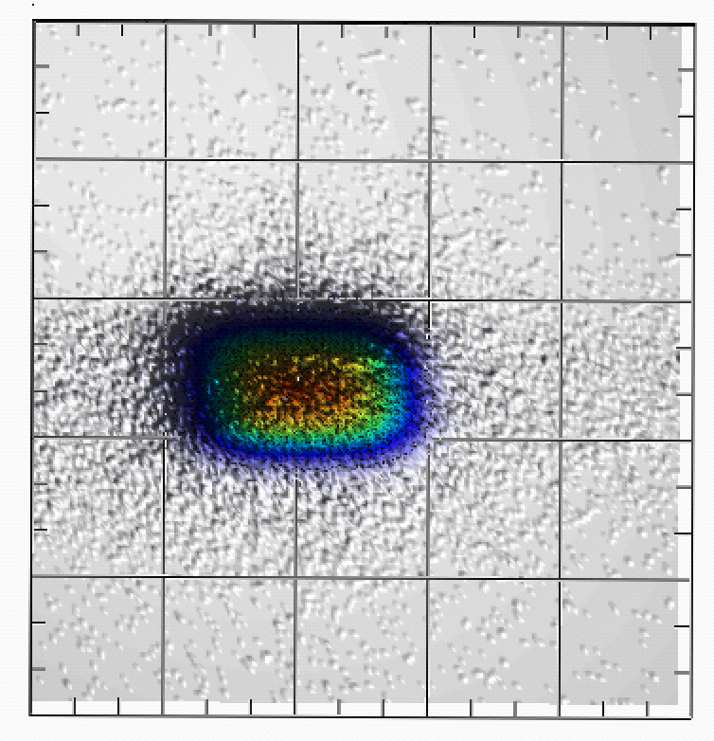
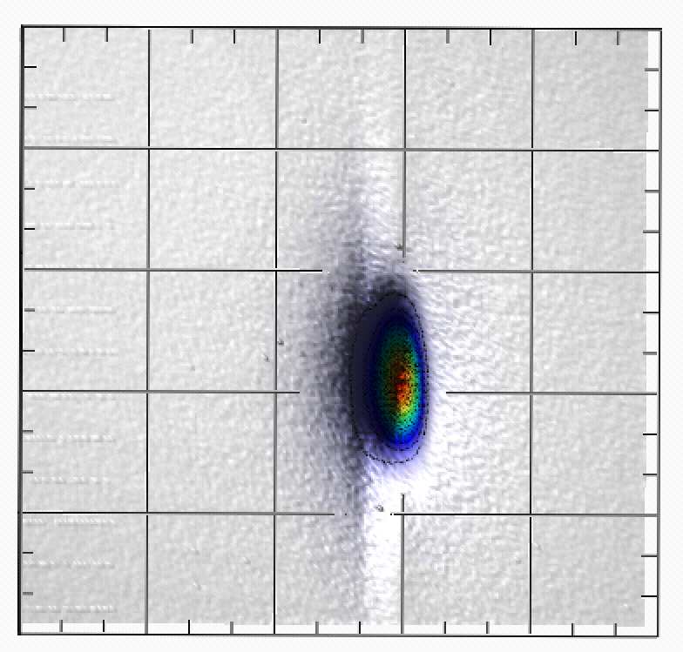
New target and improved collimation
Present Copper target optimized for the production of maximum number of secondaries
Three steps: 1.7, 2.0 e 2.3 x₀
Not always the optimal solution
e.g. for the production of positrons of high energy (E ≈ E₀)
Or to get an intermediate range of intensity reduction
Preliminary tests of proton and pion production on a Nichel target
Positron yield vs. thickness
(no fit)
60 mm of Tungsten additional collimator, ≈ 0.15 mm gap
0.5 x₀
1.0 x₀
1.7 x₀

Slide 15
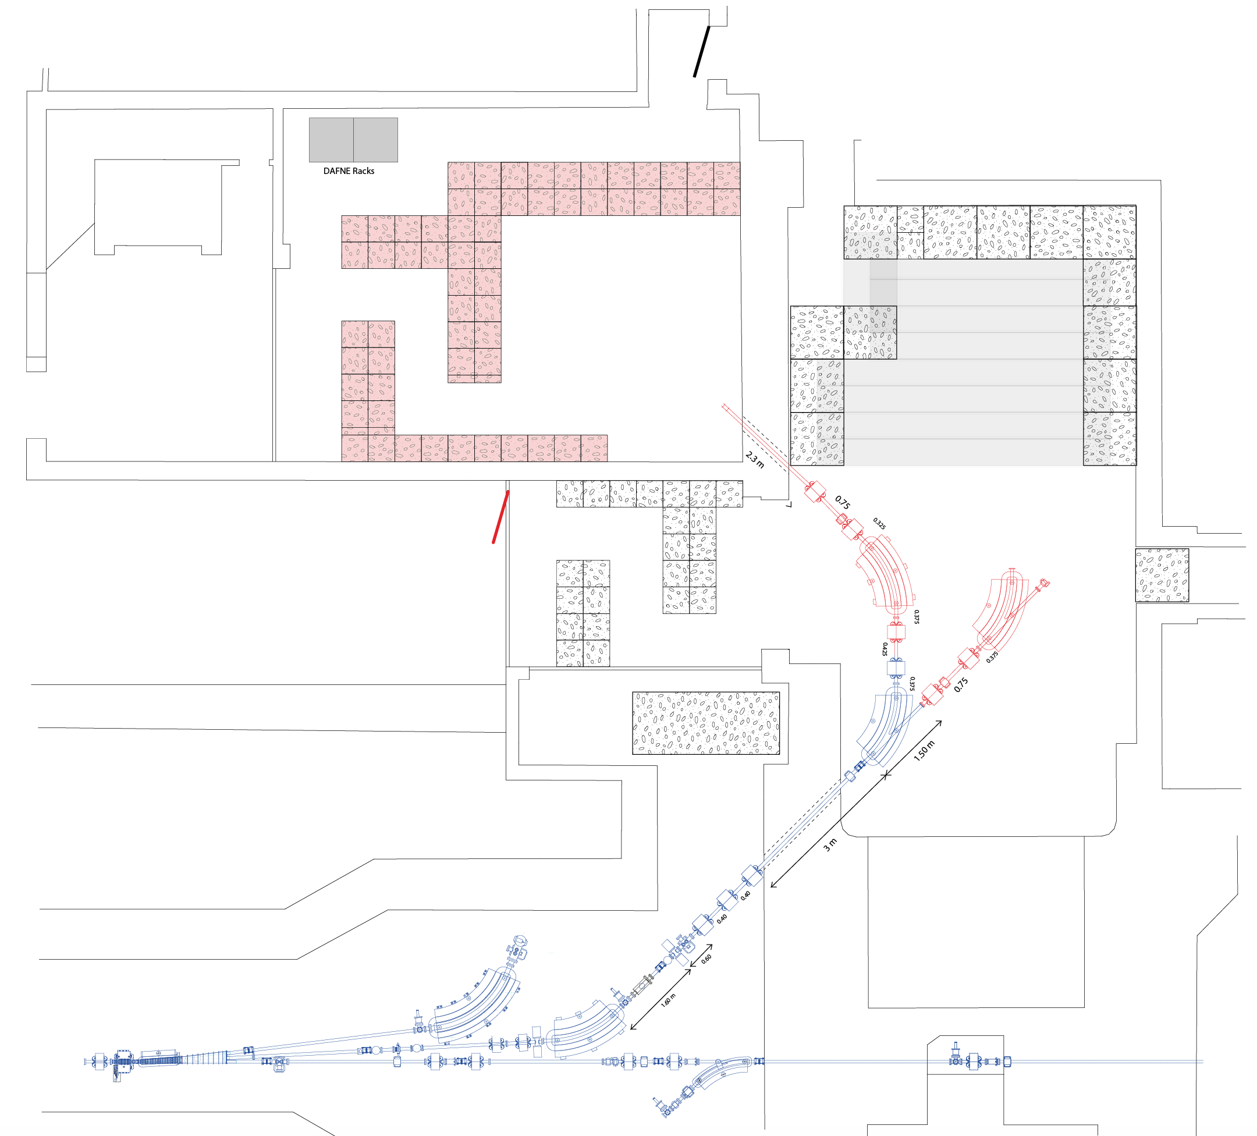
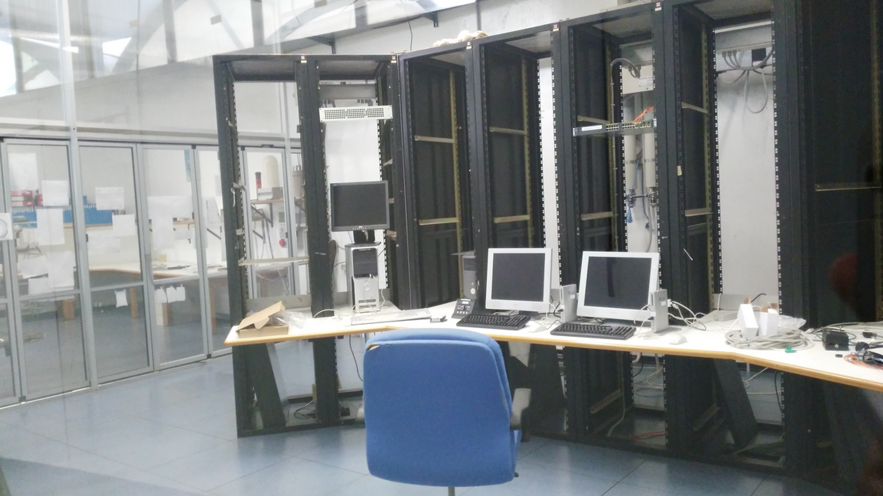
Doubling of beam-line
Constant requests level for detector calibration and testing
Increasing requests for “dedicated” high intensity beam for:
Real experiments with extracted beam (dark photon, dump experiments)
Electron irradiation (TID)
Possible integration with space qualification facilities
High intensity electron beam for photon or neutron production
Basic idea: extend the present experimental area using the present control room
AIDA 2020 WP 15.4.1
New control room ready
New elements in red
On-going design of the new lines
Build new magnets and vacuum pipes
Installation and commissioning

Slide 16
Improved diagnostics
High resolution tracker
To exploit and optimize collimation and focussing:
Preliminary project:
Coulomb scattering in air: short base(≈30 cm)
MAPS detectors (EUDET-like)
Few μm point resolution
2 cm² sensitivite area
Up to 10⁶ hits/cm²/s
DUT
AIDA 2020 WP 15.4.1
BTF remote trolley
Dosimetry
TID electron irradiation requires high spatial uniformity (better than 10%) over O(cm²) area
Energy few MeV – hundreds of MeV
Stable beam intensity, from 10⁵ particles/s
Faraday cup, ionization chamber

Slide 17
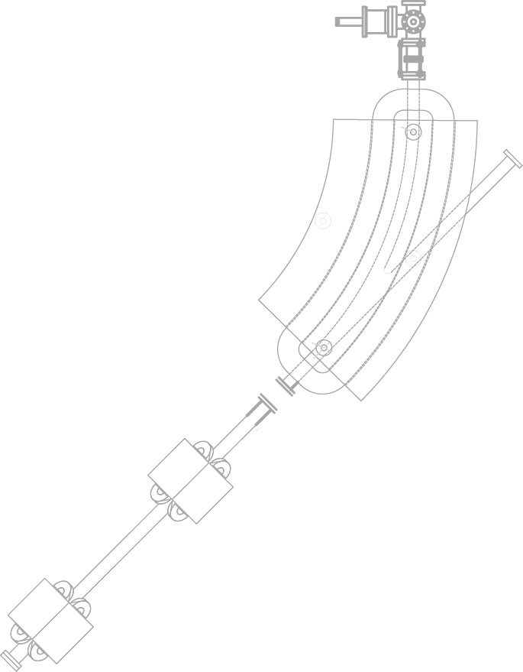
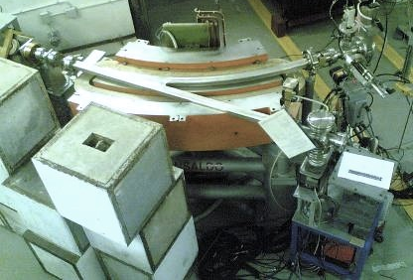
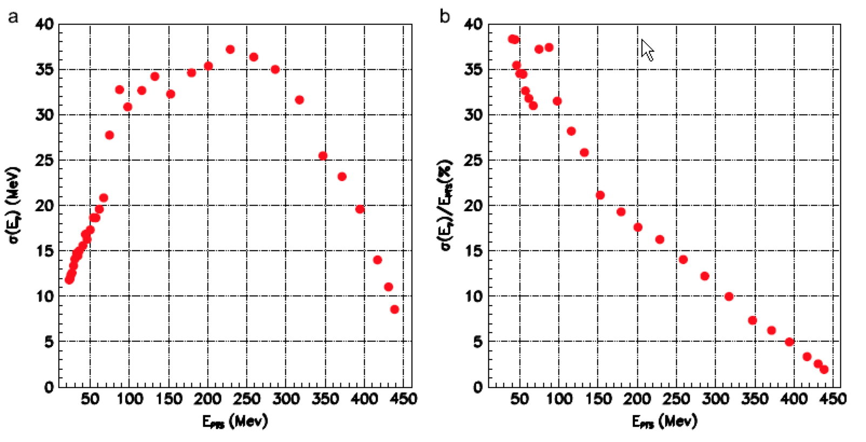
Improved photon tagging
Bremsstrahlung
photon
silicon detectors
dipole magnet
silicon tagging
target
Incoming electron
Be window
System realized and successfully used for on-ground calibration of the AGILE satellite scientific payload
Some limitation of performance (energy resolution and range) and rate
New design:
Tagging detector in vacuum and in the focal plane
AIDA 2020 WP 15.4.2

Slide 18
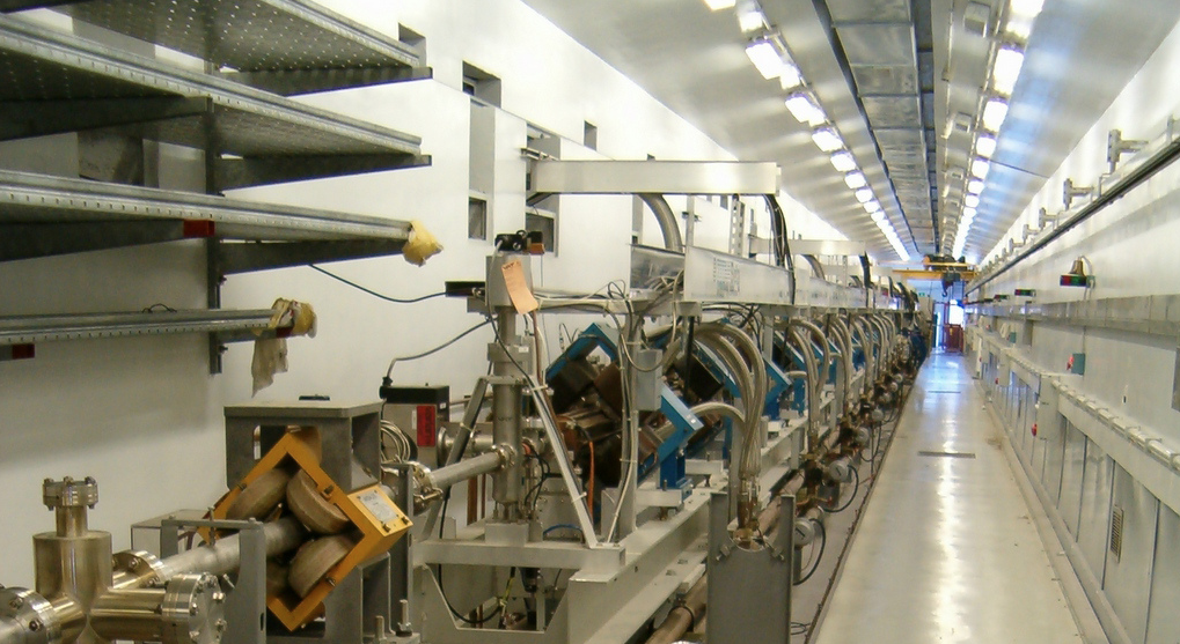
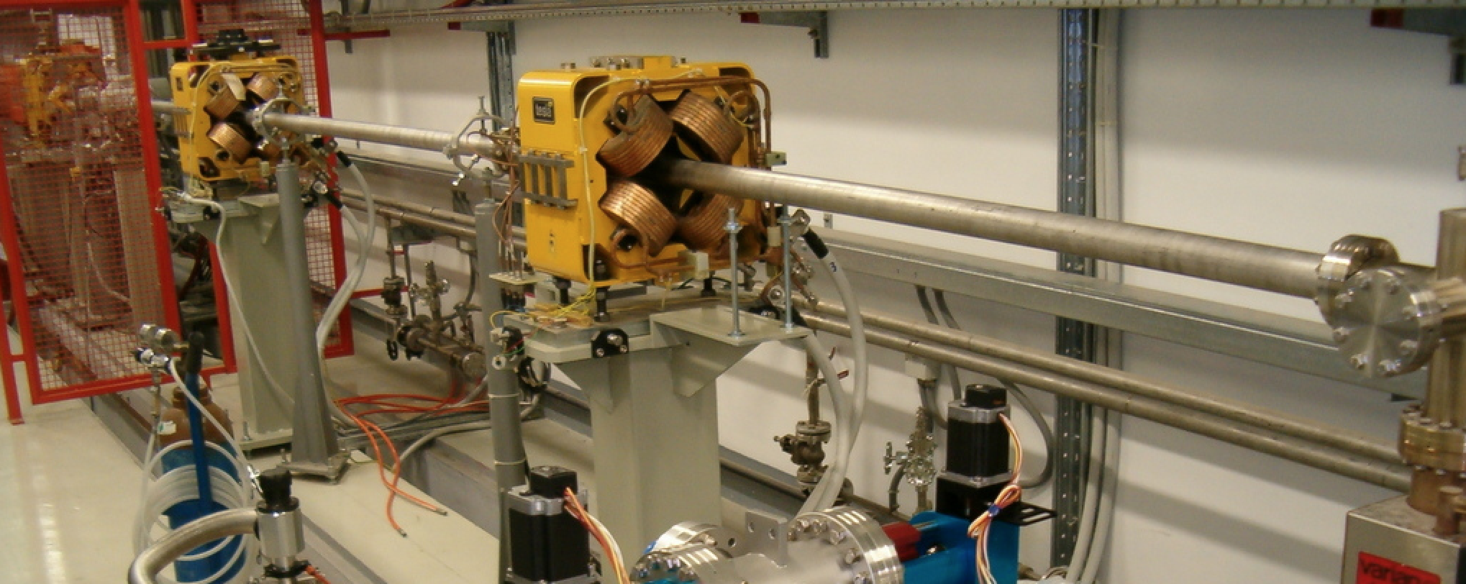
Energy upgrade
Approximately 15 m drift at the end of the linac: add 4 accelerating sections, fed by one or two RF stations (reaching 1 GeV for e⁻). It is also possible to double the RF power in the other 8 sections after the positron converter (now fed by modulators C and D, to reach 1.2 GeV for e⁻)
(Similar to what proposed in: R. Boni, arXiv:0402081 [physics])
BTF/spectrometer/injection three-way switchyard
Last accelerating section
E
E
F
+200 MeV
+310 MeV

Slide 19
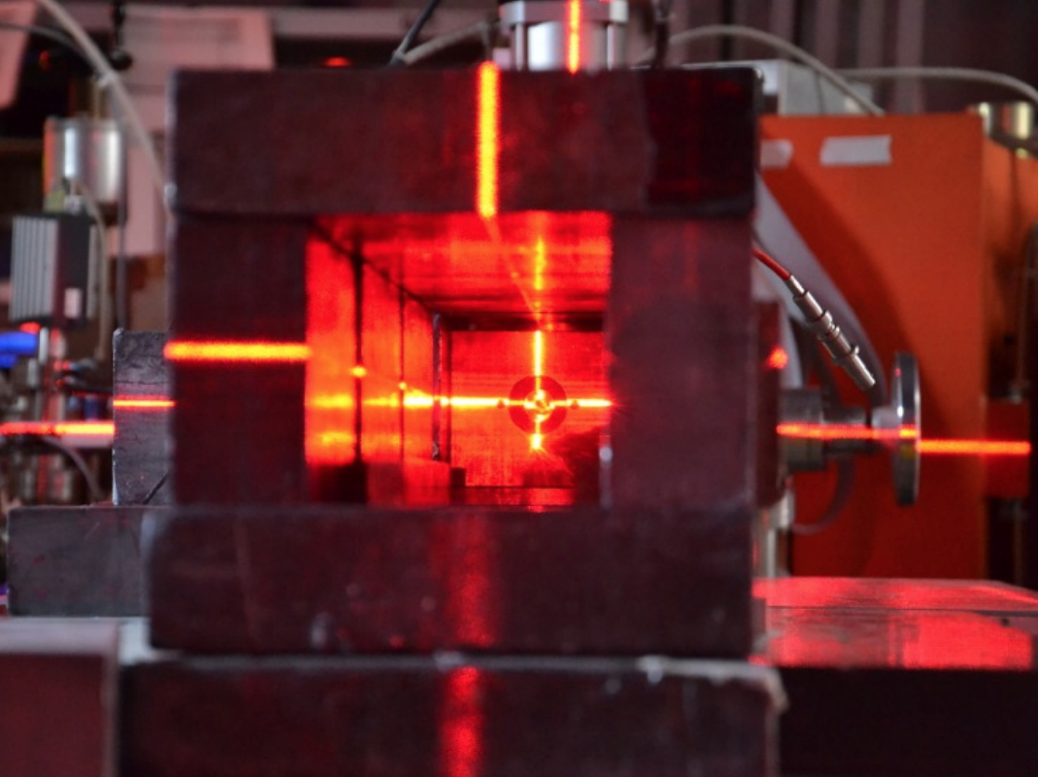

Slide 20
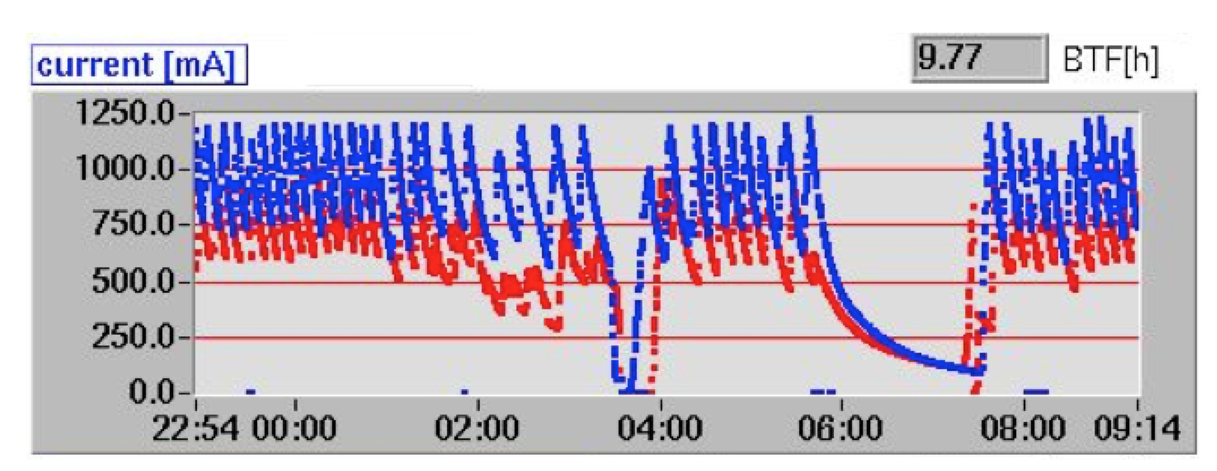
DAΦNE timing
25 or 50 Hz repetition rate
Last bunch every second always to spectrometer line
Accumulator
BTF line
Spectrometer
Main rings
LINAC = LINAC shots are delivered at 25(50) pulses/s and dumped at the end of TL
LINAC+BTF = LINAC shots are delivered with a selectable duty cycle to BTF: 1 to 24(49) pulses/s. Remaining pulses are dumped at the end of the TL
GLOBAL = LINAC shots are delivered with a variable duty cycle to BTF according to injection parameter in ACCUMULATOR
NO INJECTION = SELECTABLE from 1 to 24(49) pulse per second
INJECTION = the injection needs are DAΦNE Control Room controlled. Typically injection pulses are at 2Hz, taking from 1 up to 7 LINAC bunches per sequence. BTF delivers 22 down to 10 bunches per second

Slide 21
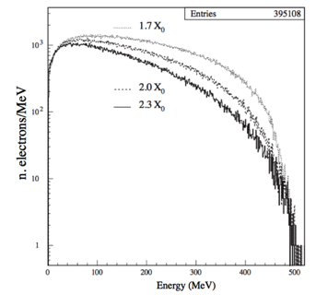
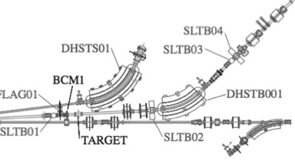
Beam intensity fine tuning
Adjustment of the number of particles can be achieved:
Without changing the momentum resolution:
Modulating the LINAC current [not possible in ‘parasitic mode’, rough] (transport optics or modulators power/phase, etc.)
Collimating the beam before the target, using the up-stream vertical slits [large range]
Choosing one of the three target depths [step change, very reproducible]
Collimating the beam after the dipole, using the down-stream vertical slits [fine, small range]
Also changing the momentum resolution:
Closing/Opening the horizontal collimators [both upstream and downstream]

Slide 22
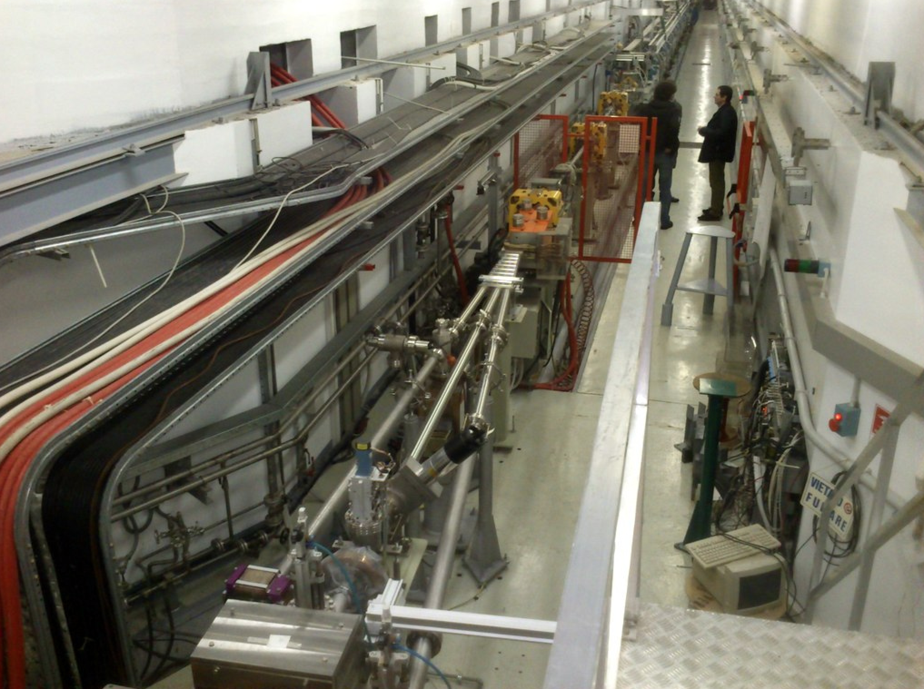
Sezioni acceleranti
Pulsati 3°/6°
Target BTF

Slide 23
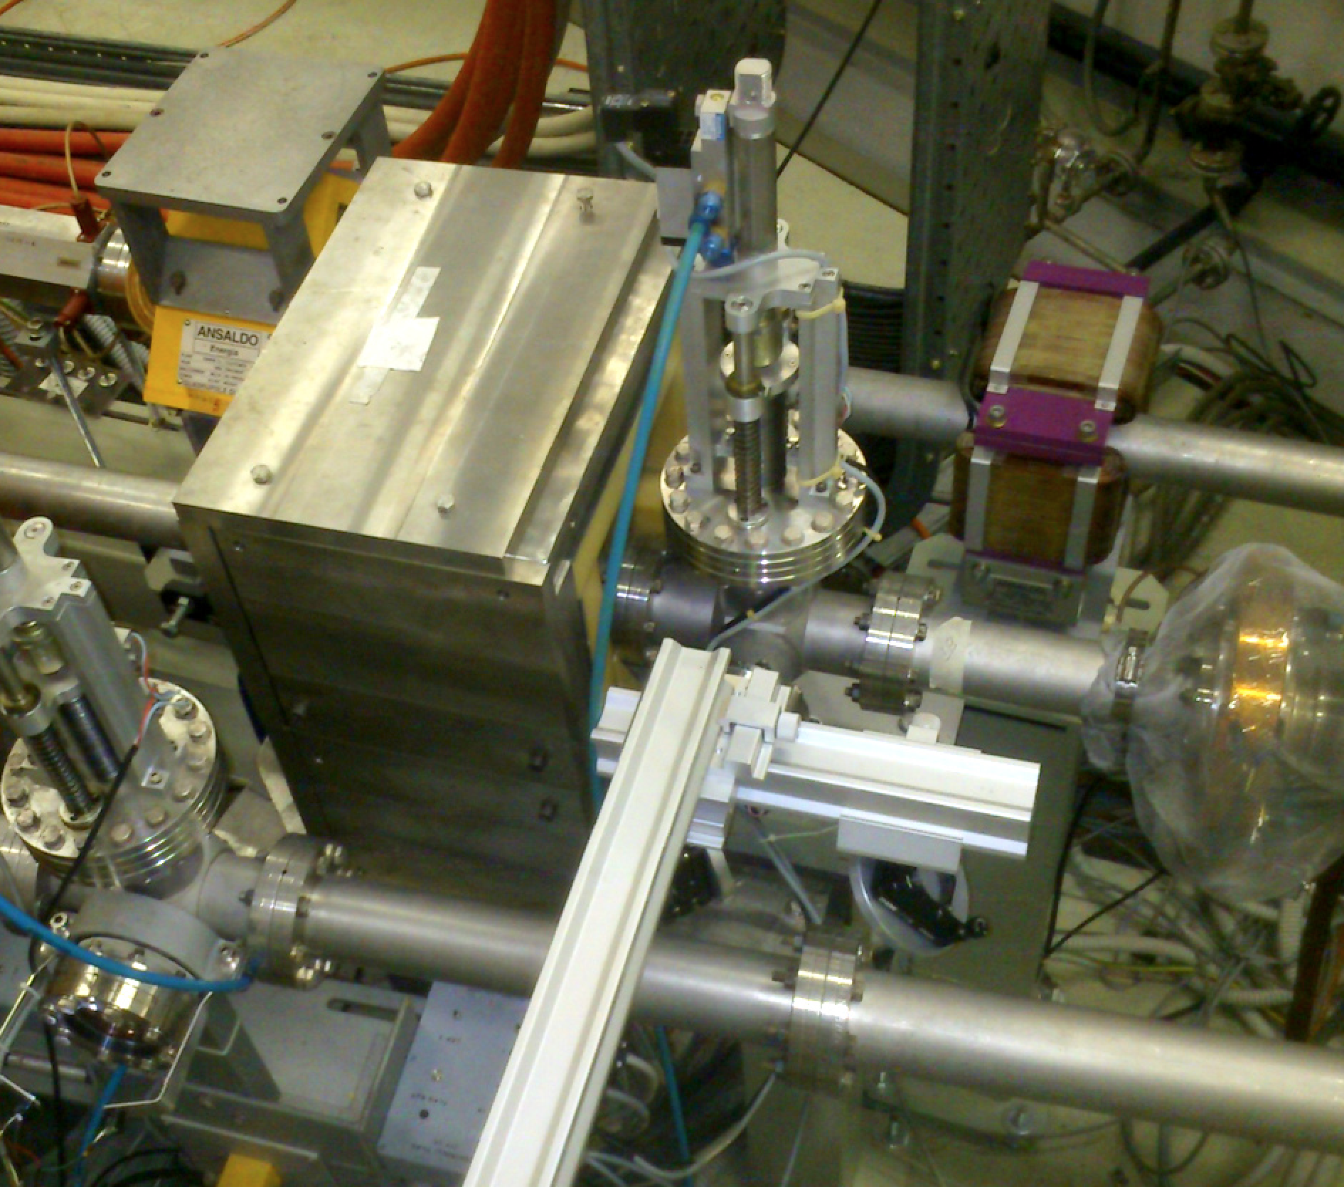
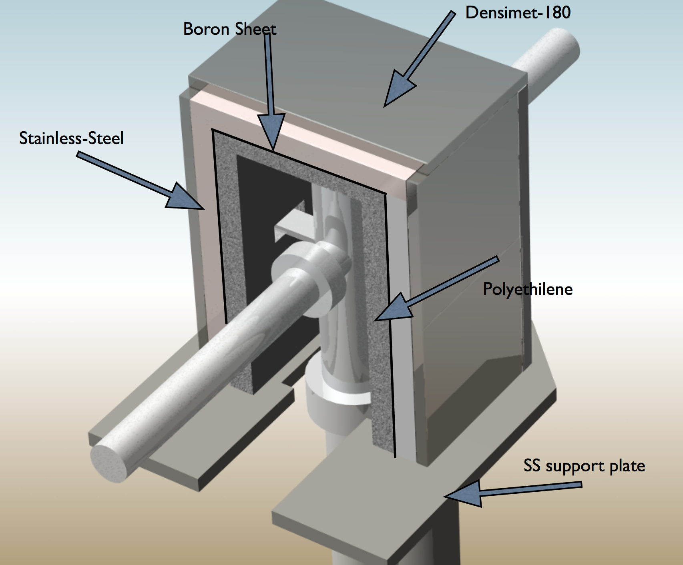
BTF target assembly and shielding

