Slide 1


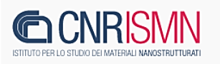


RAIN15 -- RAdiazione per l'INnovazione 2015
Frascati, 12-13 October 2015
Interaction between cellulose materials and bleach products:
an example of joint academic-industrial research
Mauro Missori, Istituto dei Sistemi Complessi – CNR
Francesco Valle, Istituto per lo Studio dei Materiali Nanostrutturati – CNR
Stefano Resta, Matteo Lega, Fater SpA
Lorenzo Teodonio, ICRPAL – MIBACT

Slide 2
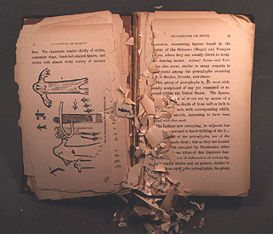
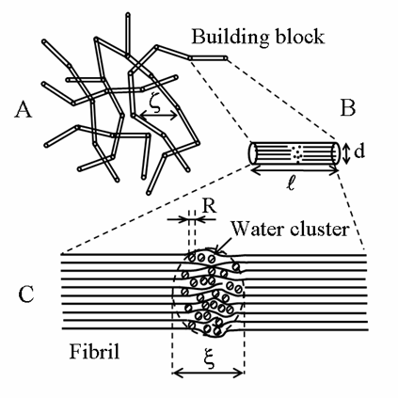
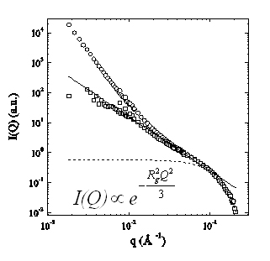
ISC activities on cellulose based materials
Structural degradation of paper and textiles on aging
Model of the supramolecular structure of cellulose
ESEM image
Loss of mechanical properties
Neutron scattering
Porod law: I(q)=Aq^{-α}
α = 3.8 ± 0.2.
Fibers surface fractal dimension = 6-α =2.2
Porod power
law decay
Mass fractal power
law decay
roll-off
Power law I=α q^{-Dm}
D_{m}=1.8 ± 0.1
mass fractal dimension of scatteres
Sizes of nanoscale pores
in cellulose microfibrils
R_{g} = (1.64 ± 0.02) nm
M. Missori et al. PRL, 97, 238001 (2006).

Slide 3
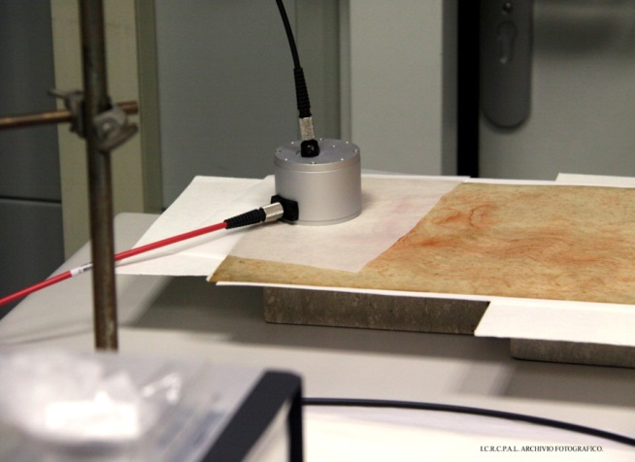
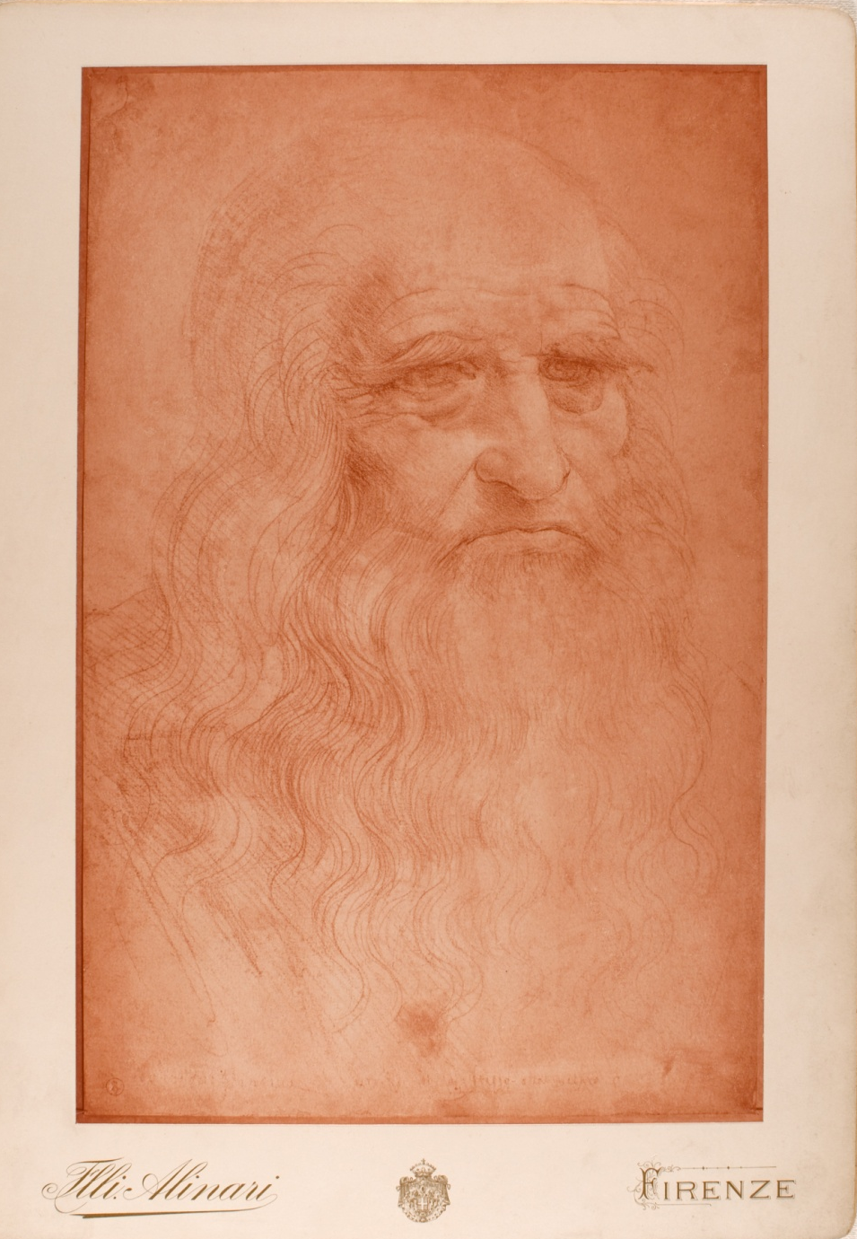
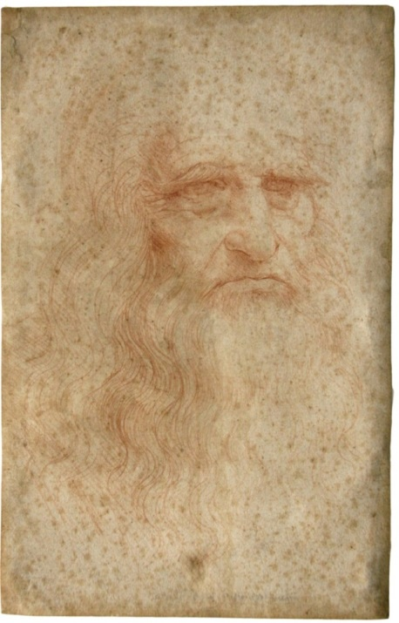
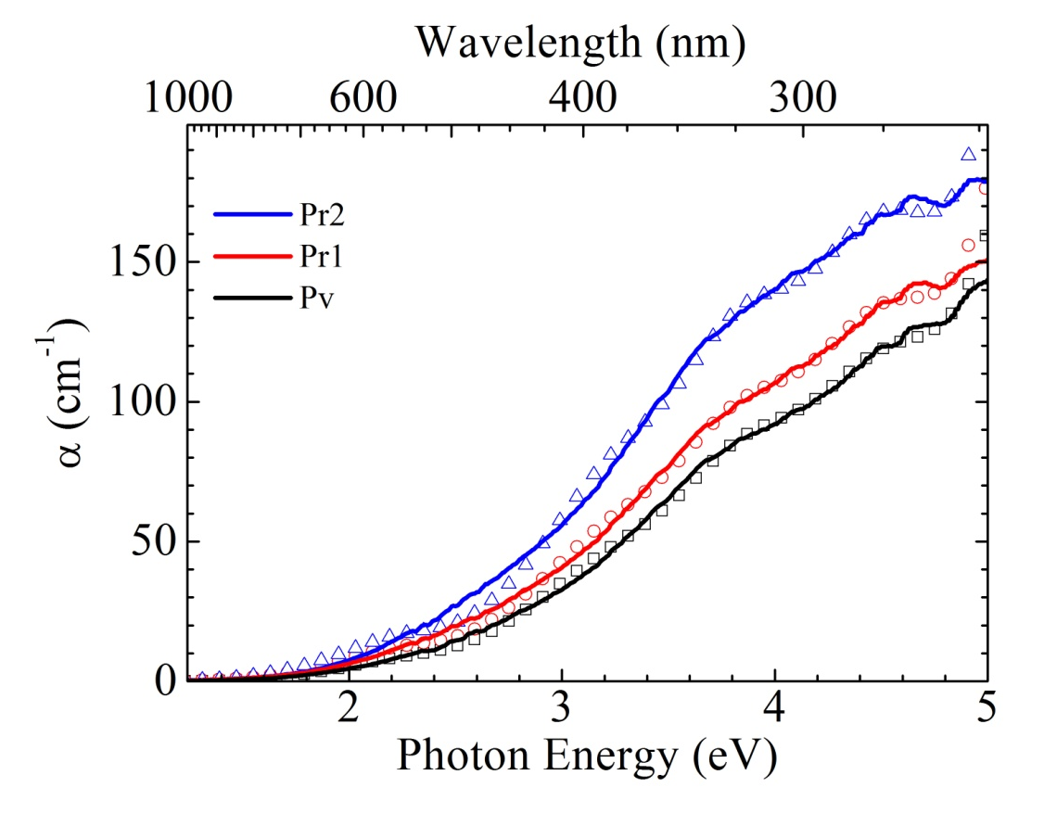
Optical degradation on aging
1898
2012
Leonardo da Vinci self-portrait
Time-Dependent
DFT simulations
M. Missori et al., PRB 89, 054201 (2014)
A. Mosca Conte et al., APL 104, 224101 (2014)
→ 6 mmol/100g of cellulose

Slide 4
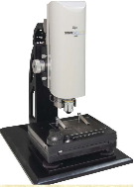

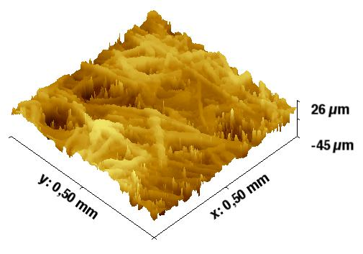
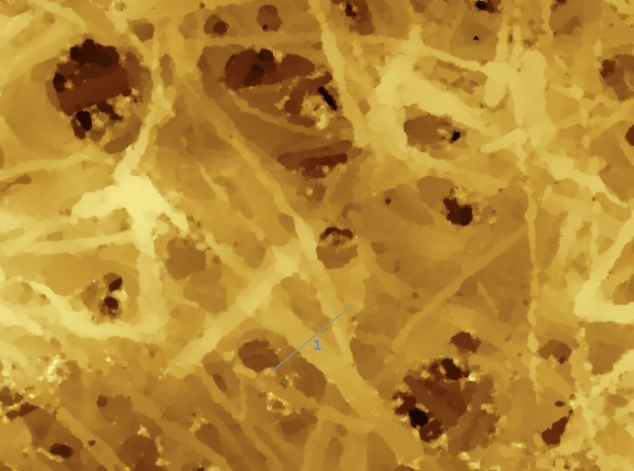
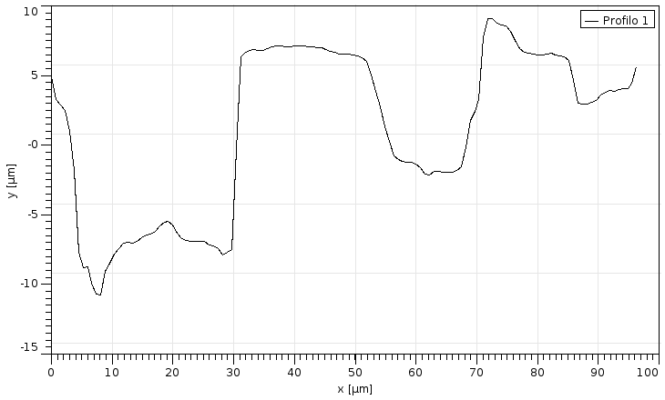
ISMN activity on fiber network materials
z_{i}²
Real 3D topography
x,y : optical resolution
z : nm scale
Non-invasive measurement of the roughness of the sheets
Paper sheets belonging to the
Italian Minister of Cultural Heritage MiBACT
Notes:
Esiste una signature di questa frammentazione nella morfologia? (e poi nella nanomeccanica) The experimental setup is very simple
Il network di fibre viene visto the roughness is the RMS of the Z-coordinate

Slide 5
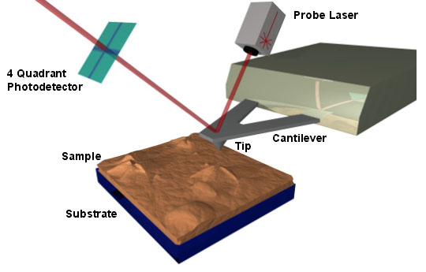
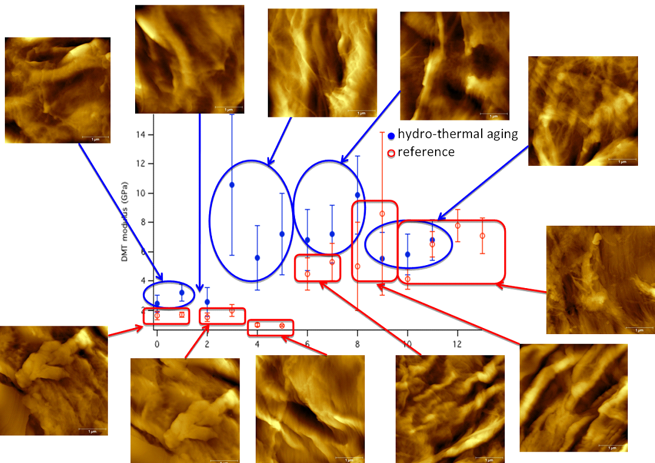
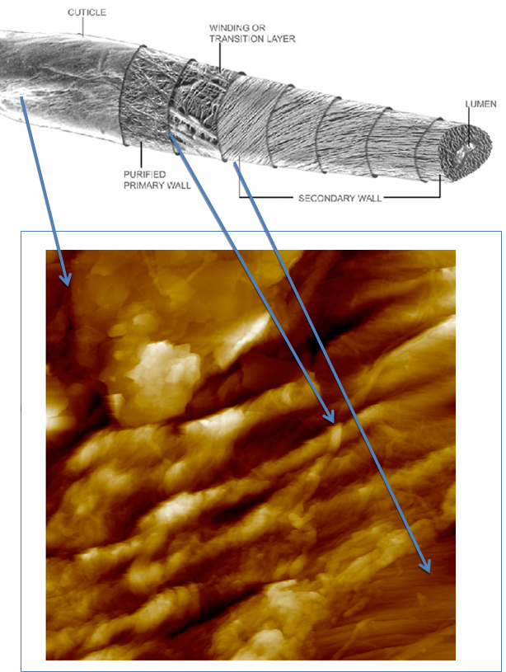
ISMN activities on cellulose fibers
AFM
F. Valle, Italian Soft Days Workshop, Rome, 2014

Slide 6
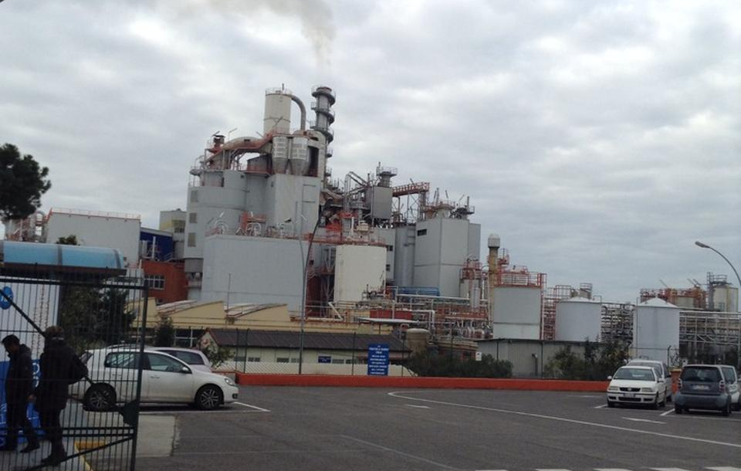









(Joint venture of Procter&Gamble and Angelini)
Procter & Gamble - Pomezia plant
LEADER NEL MERCATO ITALIANO DEI PRODOTTI ASSORBENTI PER LA PERSONA E NEL MERCATO EUROPEO DELLE CANDEGGINE
1.200 PERSONE
4% del fatturato IN RICERCA E SVILUPPO
911 mln DI EURO DI FATTURATO

Slide 7
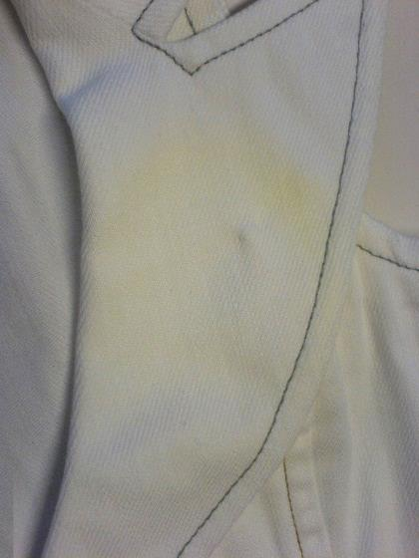
Topics for collaboration with CNR
Title: Interaction between Cellulose and Bleach
Objective
Study the effect of oxidizing species in bleach products (e.g. hypochlorite, hydrogen peroxide, peroxyacids) when used in cleaning cellulose-based materials.
Topics to be covered in the study:
Reactions involved in fabric bleaching:
  Definition of species formed during bleaching of garments
  Effect on cellulose structure and mechanical properties – i.e. tensile strength
  Effect on surface structure and color – i.e. yellowing
Scope of the work
Development of analytical methods to study oxidation at:
  Textile level
  Fiber level
  Polymer level
Experimental studies on fabric bleaching using different Fater formulations:
  Effect on mechanical properties
  Effect on optical properties
Modeling of oxidation kinetics.

Slide 8
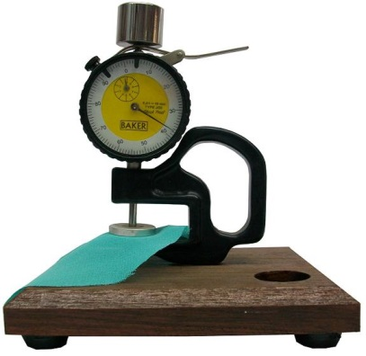
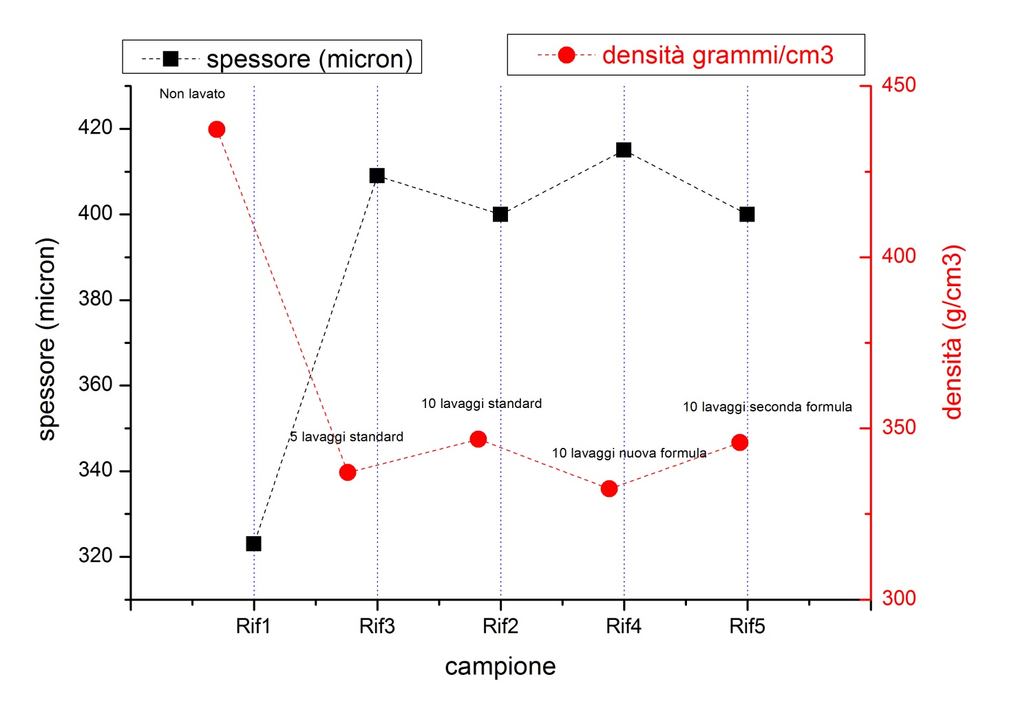
Modification of physical properties of textiles after washing

Slide 9
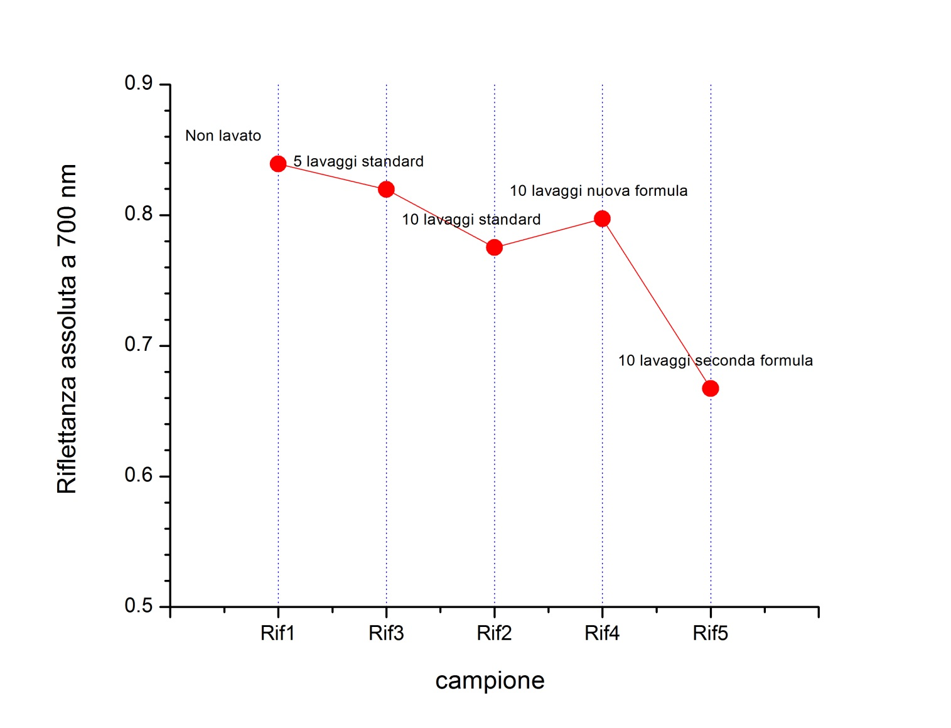
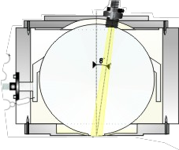
Modification of optical properties (absolute reflectance) of textiles after washing
optical
fiber
input radiation
output to spectrometer
integrating sphere
optical
fiber
textile
white or black backing
Reflectance spectra measured with white (R_{w}) and then black (R_{b}) backings.
R_{w} and R_{b} → R∞ the reflectance that would have an infinite layer of the same sample

Slide 10
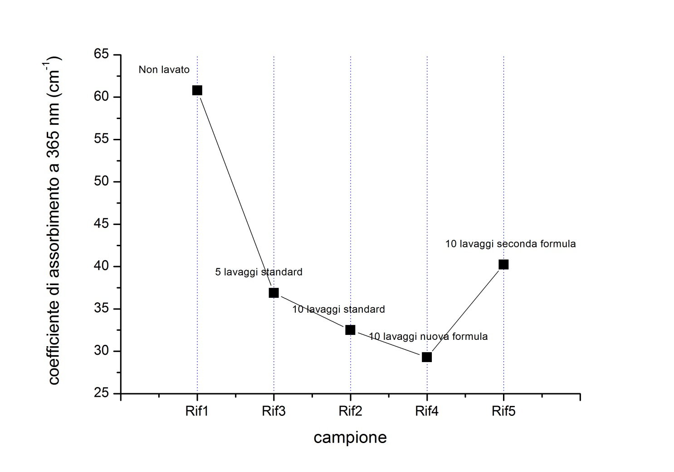
Modification of optical properties (absorption coefficient) of textiles after washing
Effect of optical brighteners
Extention of the original Kubelka-Munk theory to optically thick samples
M. Missori et al., Physical Review B 89, 054201 (2014).

Slide 11
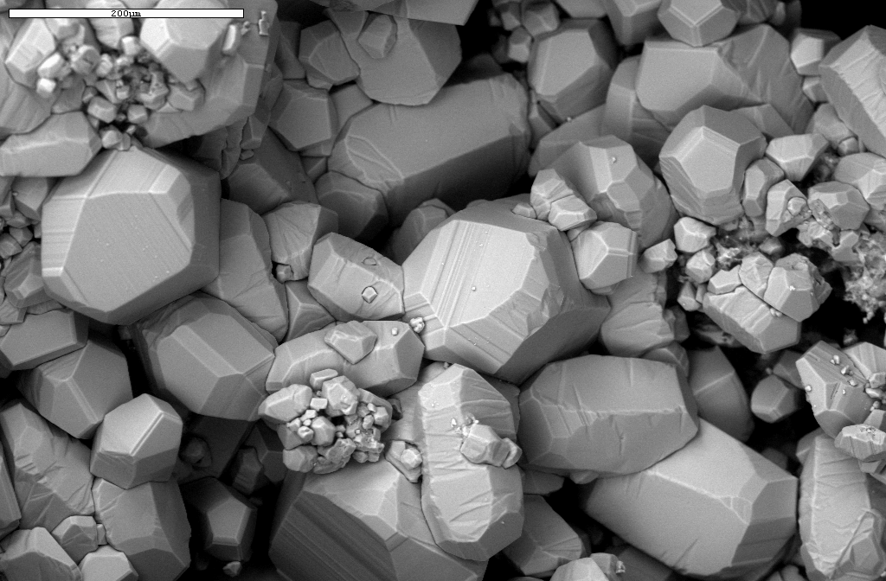
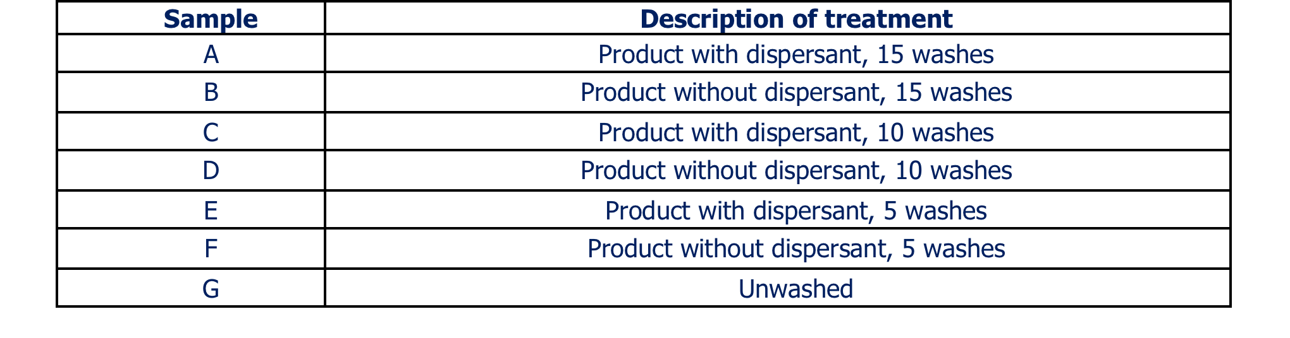
Effect of dispersants
Samples of fabrics washed with formulations containing or not dispersant:
characterization of the possible presence of Ca based crystals

Slide 12
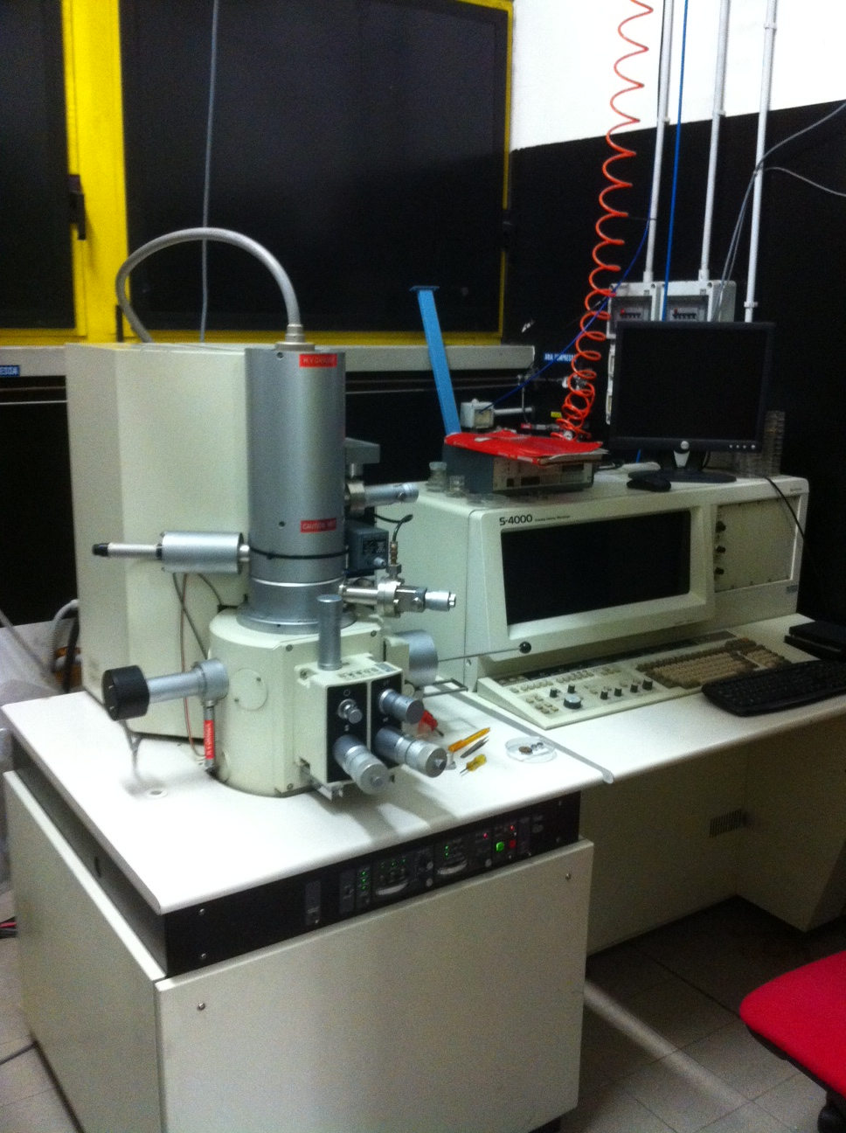
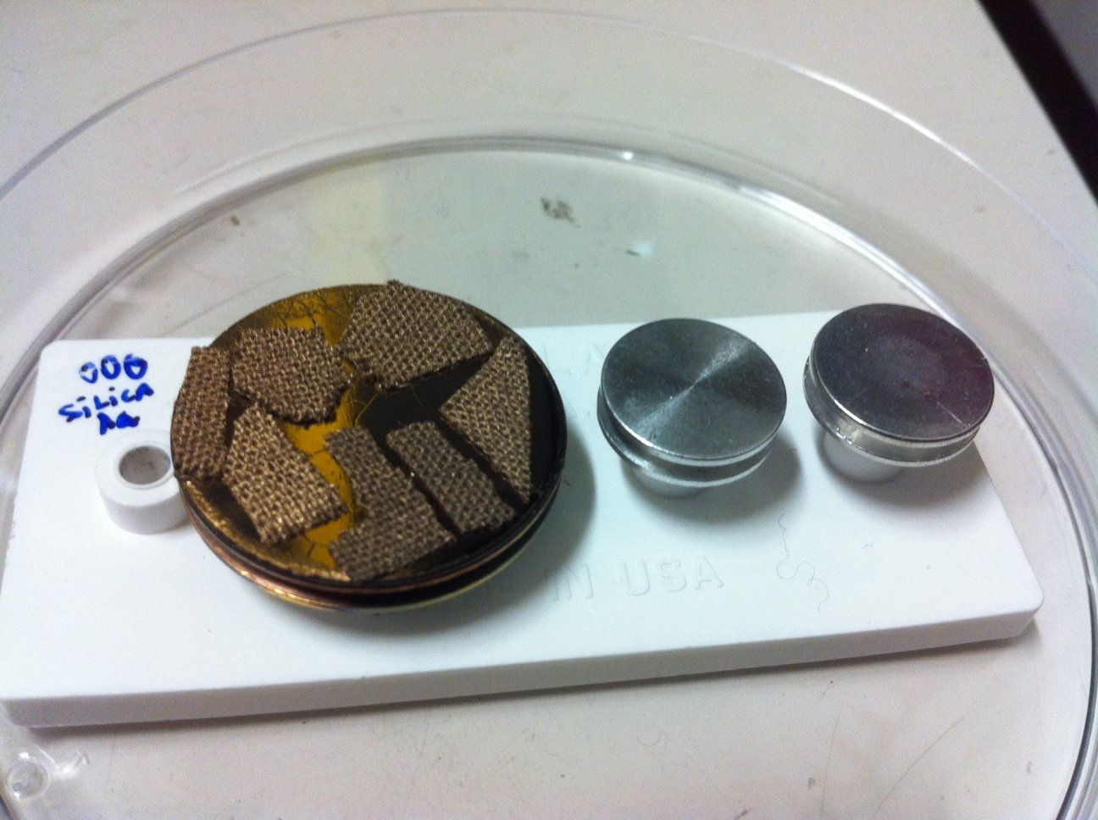
SEM characterization
The Scanning Electron Microscope is a Hitachi SEM-Feg S-4000 and it has been operated at 20KV.
Small squares of the different fabrics have been cut and glued by carbon tape on a Scanning Electron Microscope stub.
The samples have then been coated with 20 nm of gold using a metal sputter and mounted in the Scanning Electron Microscope.
Samples have been imaged under blind conditions (except from the unwashed one that was easily identified)

Slide 13
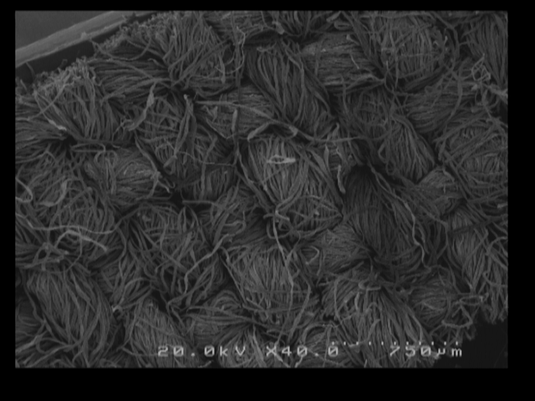
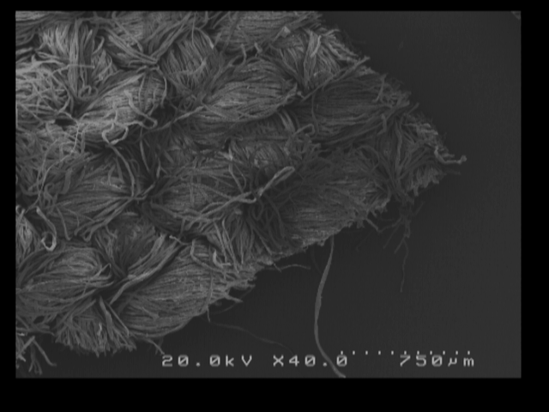
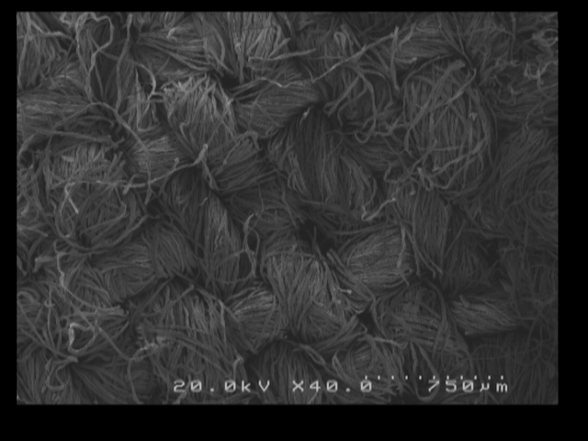
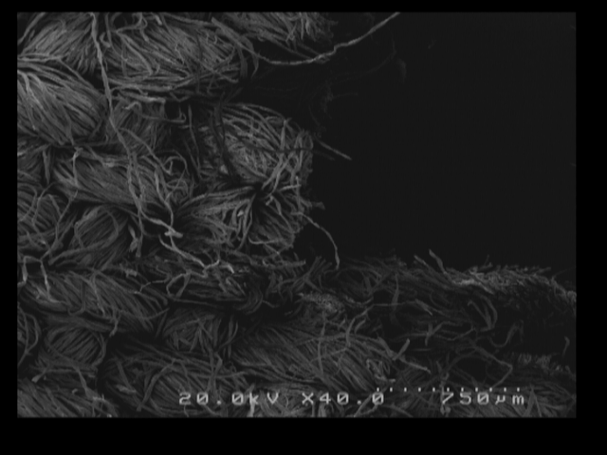
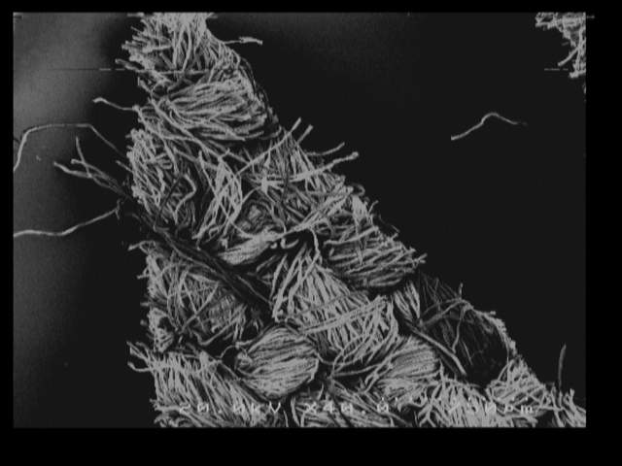
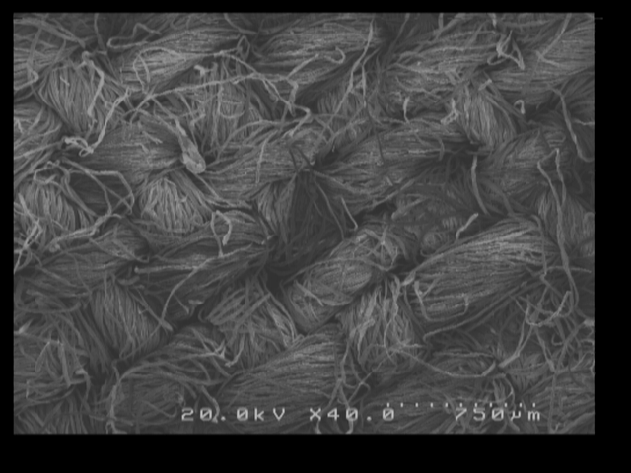
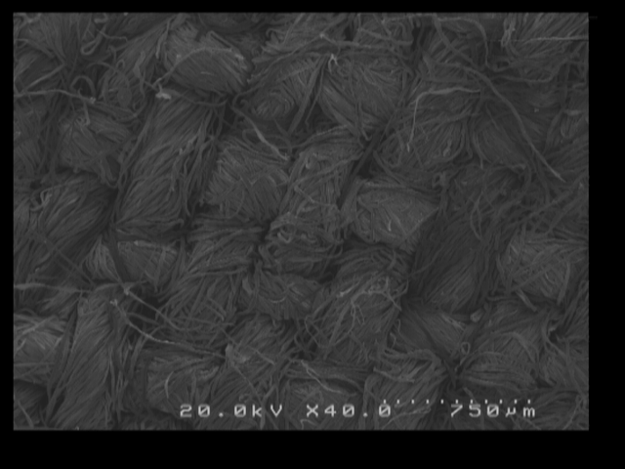
Low magnification images show the large scale modification induced
by the washing process
A
B
C
D
E
F
G

Slide 14
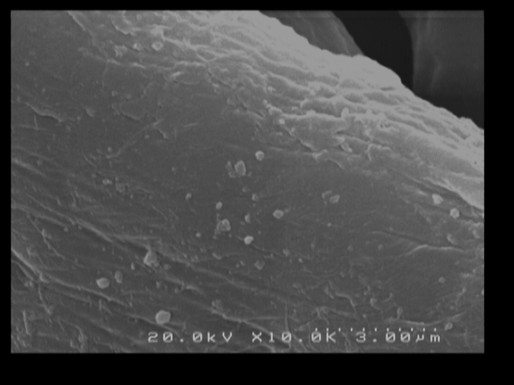
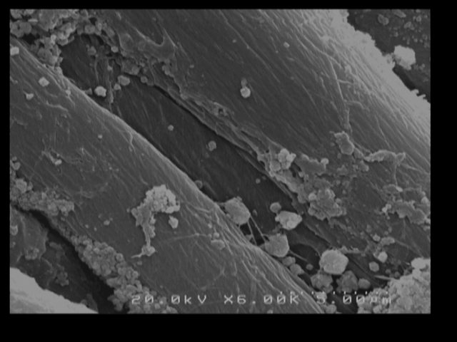
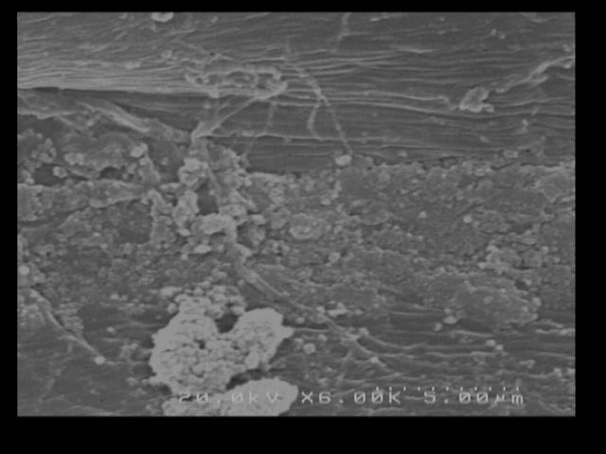
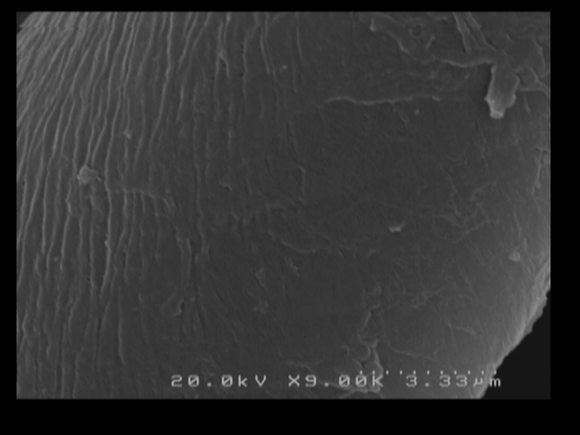
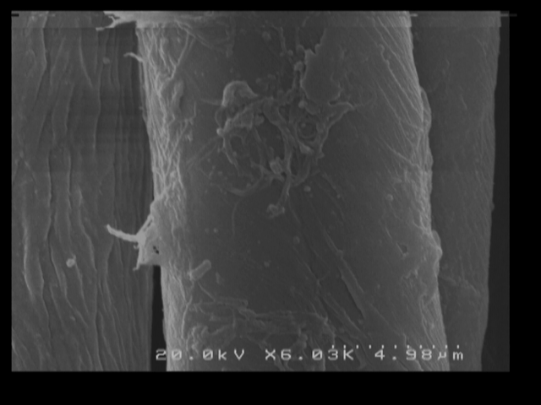
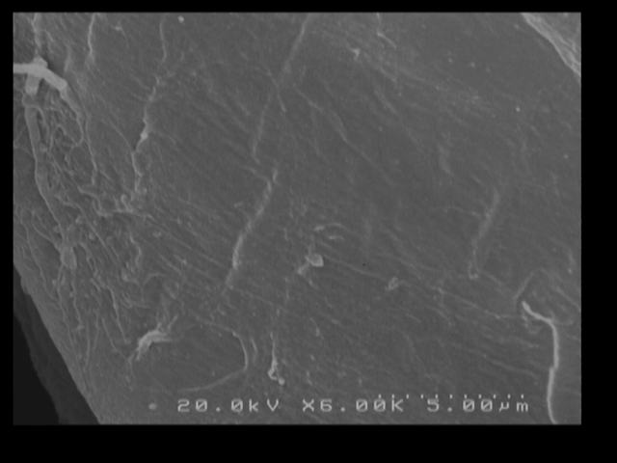
Dispersant vs no dispersant – dispersant avoid the formation of calcite/vaterite crystals
5 washes
10 washes
15 washes
no dispersant
with dispersant

Slide 15
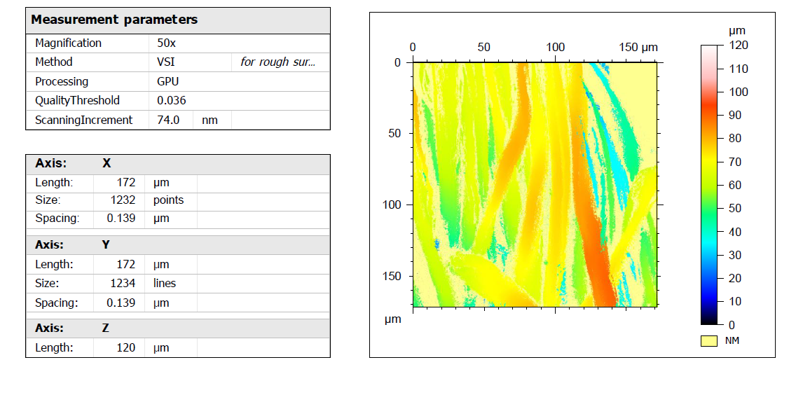
New approach: morphological properties of textiles after washing by optical profilometry

Slide 16

Thanks for
your attention

