Slide 1
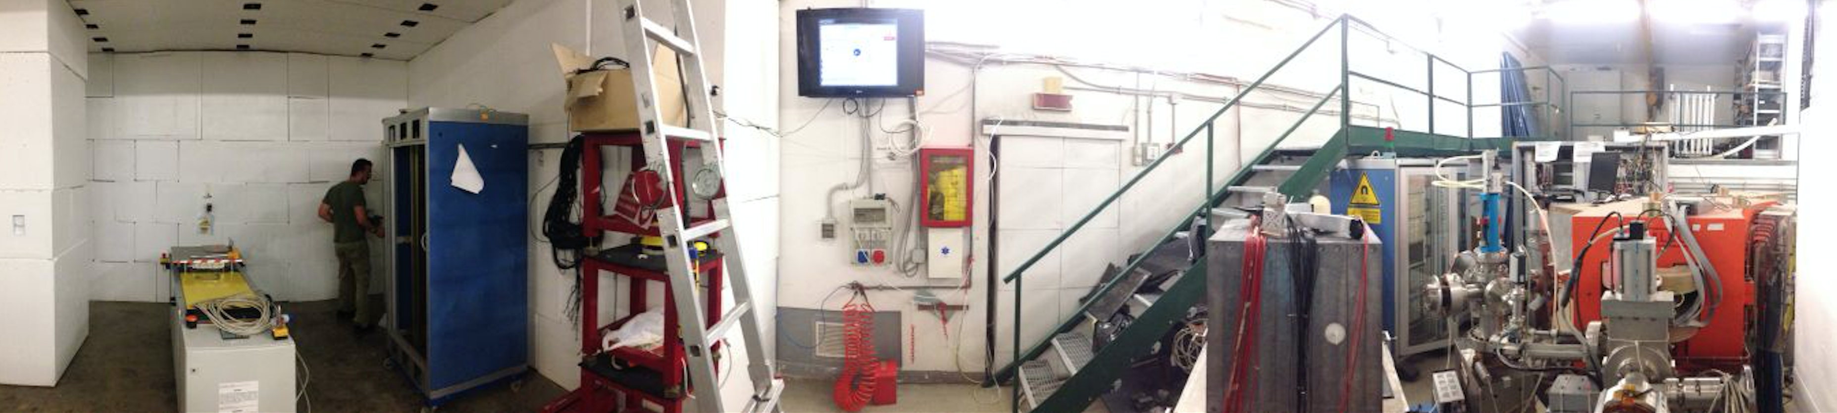
Neutrons@BTF
Paolo Valente*, Roberto Bedogni, Bruno Buonomo, Luca Foggetta, Claudio Di Giulio, Lina Quintieri§
con lo staff del linac di DAFNE
Maurizio Belli, Riccardo Ceccarelli, Alberto Cecchinelli, Renato Clementi, Moreno Martinelli, Graziano Piermarini, Serena Strabioli, Luis Antonio Rossi, Raffaele Zarlenga
e con lo staff di supporto BTF
Francesca Casarin, Maria Rita Ferrazza, Manuela Giabbai
INFN Laboratori Nazionali di Frascati
*INFN Sezione di Roma
§ENEA INMRI, Casaccia (Roma)

Slide 2
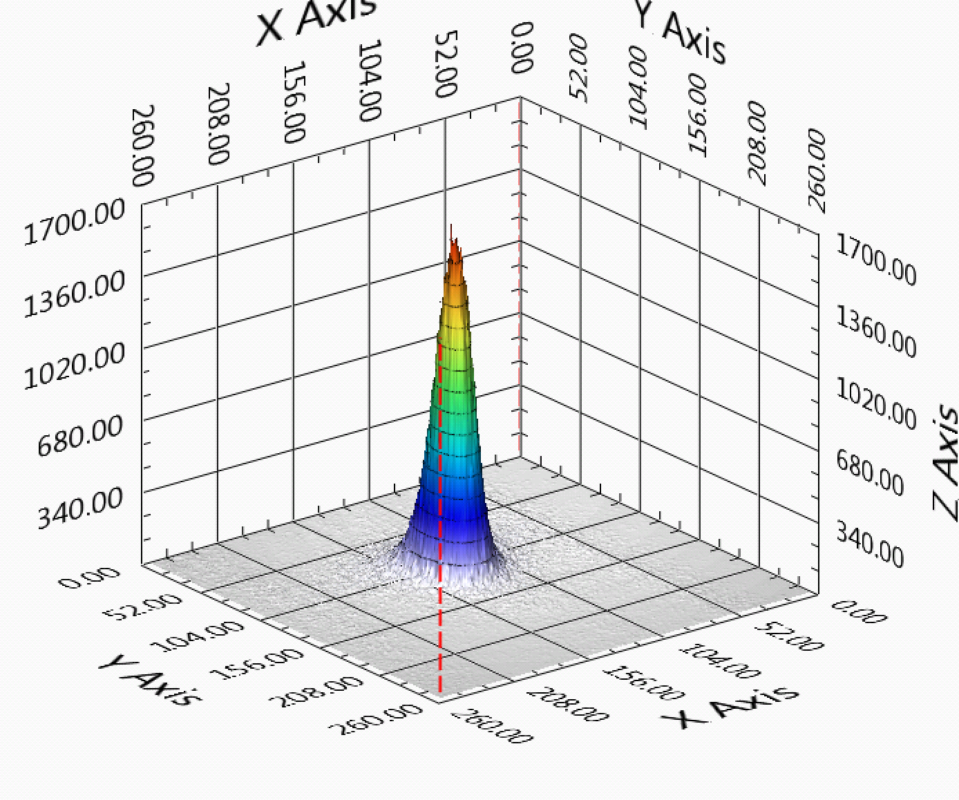
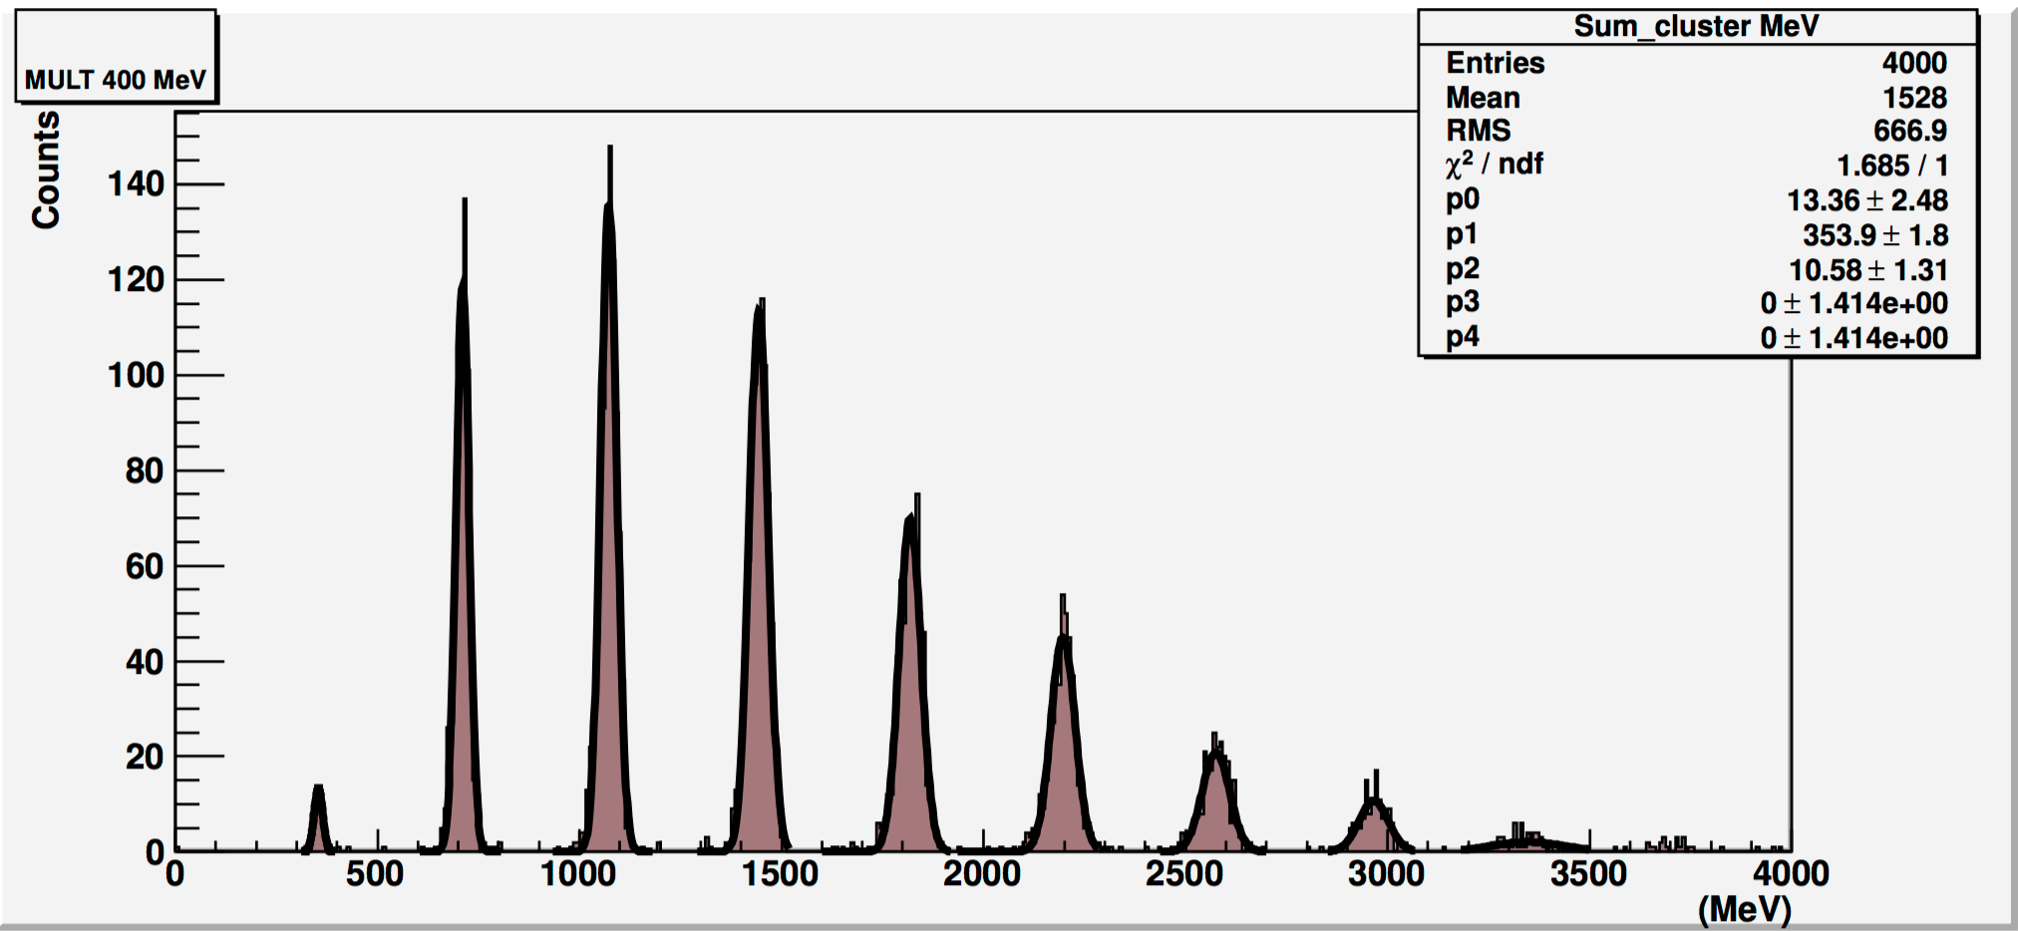
What is BTF
A facility part of the DAFNE accelerator complex, that allows to:
  Extract, attenuate, energy select, focus and collimate electrons and positrons accelerated by the linac
  Measure in real-time and tune the beam parameters (particle species, energy, intensity, beam spot size and position)
  Provide a series of services: power supply, networking, gas, DAQ, vacuum and cryogenics, alignment, magnetic fields
It generally works in “parasitic” mode to the operations of the DAFNE collider
Commissioning performed in 2002, users routinely since 2004
Mainly used by the high-energy physics and astro-particle communities
Parameter | Parasitic mode |  | Dedicated mode
 | With target | Without target | With target | Without target
Particle species | e⁺ or e⁻ Selectable by user | e⁺ or e⁻ Depending on DAFNE mode | e⁺ or e⁻ Selectable by user
Energy (MeV) | 25–500 | 510 | 25–700 (e⁻/e⁺) | 250–730 (e⁻) 250–530 (e⁺)
Energy spread | 1% at 500 MeV | 0.5% | 0.5%
Rep. rate (Hz) | Variable between 10 and 49 Depending on DAFNE mode |  | 1–49 Selectable by user
Pulse duration (ns) | 10 |  | 1.5–40 Selectable by user
Intensity (particles/bunch) | 1–10⁵ Depending on the energy | 10⁷–1.5 10¹⁰ | 1–10⁵ Depending on the energy | 10³–3 10¹⁰
Max. average flux | 3.125 10¹⁰ particles/s
Spot size (mm) | 0.5–25 (y) × 0.6–55 (x)
Divergence (mrad) | 1–1.5

Slide 3
Neutron electro-production
Tungsten target
At full linac power: 10¹³ e/s
  to be compared e.g. with nELBE, N=6·10¹⁵ e/s
Swanson estimate
  9.3·10¹⁰ Z^{(0.73±0.05)} n/s kW⁻¹
  2.15 ·10¹² n/s kW⁻¹ for Tungsten
Optimizing the target configuration can (slightly) improve the yield:
  n@BTF optimized target: 2.75 ·10¹² n/s kW⁻¹
  0.218 n/pr (over 4π and all spectrum)
In our case the main limitation will always be the intensity delivered onto the target
Evaporation peak + fast neutrons shoulder

Slide 4
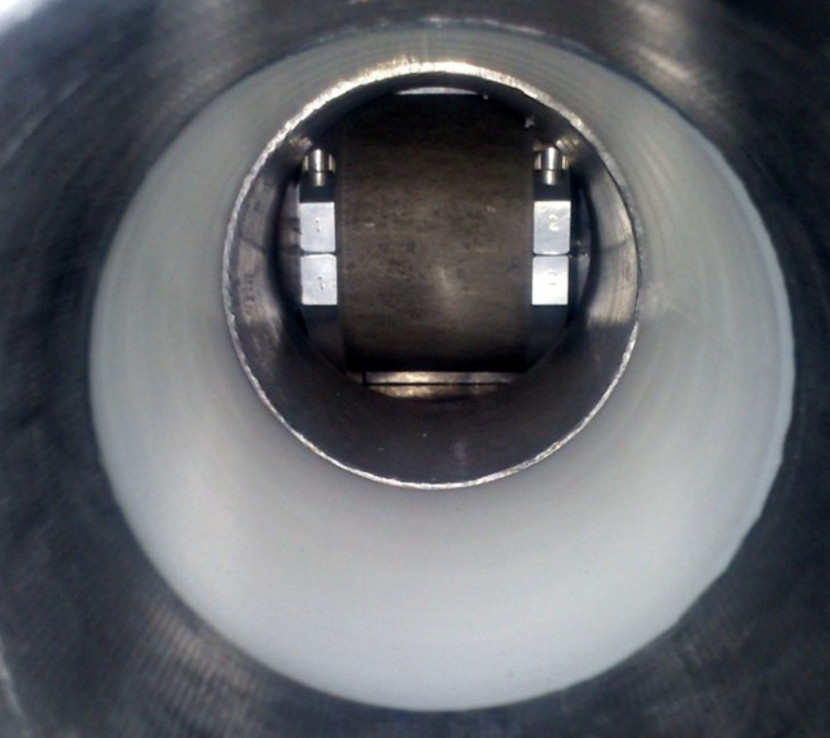
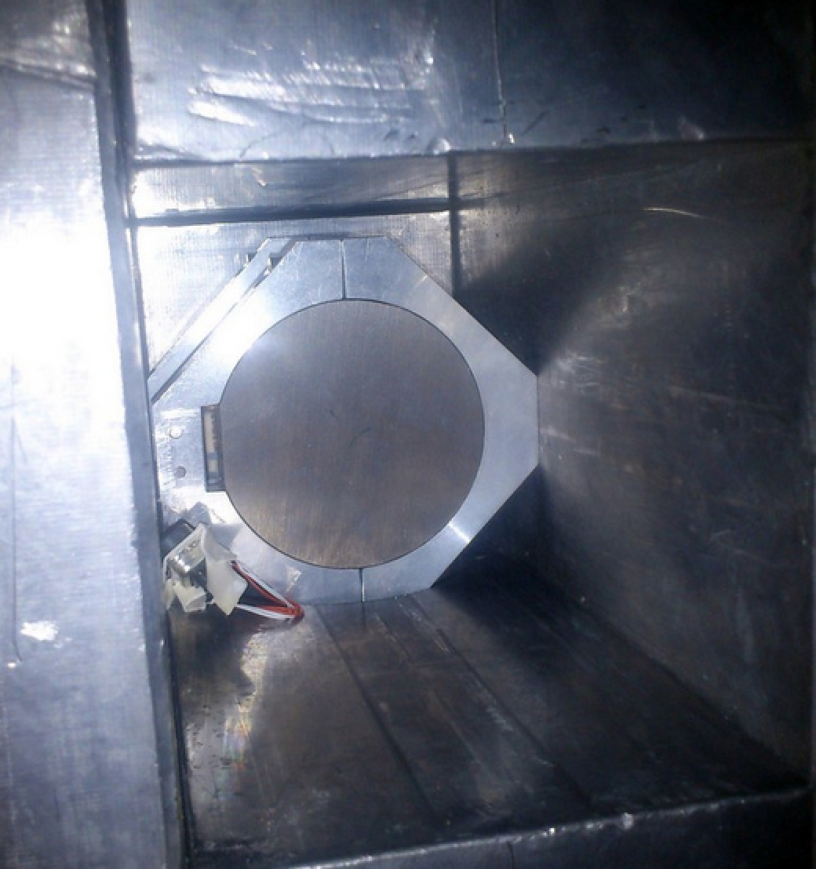
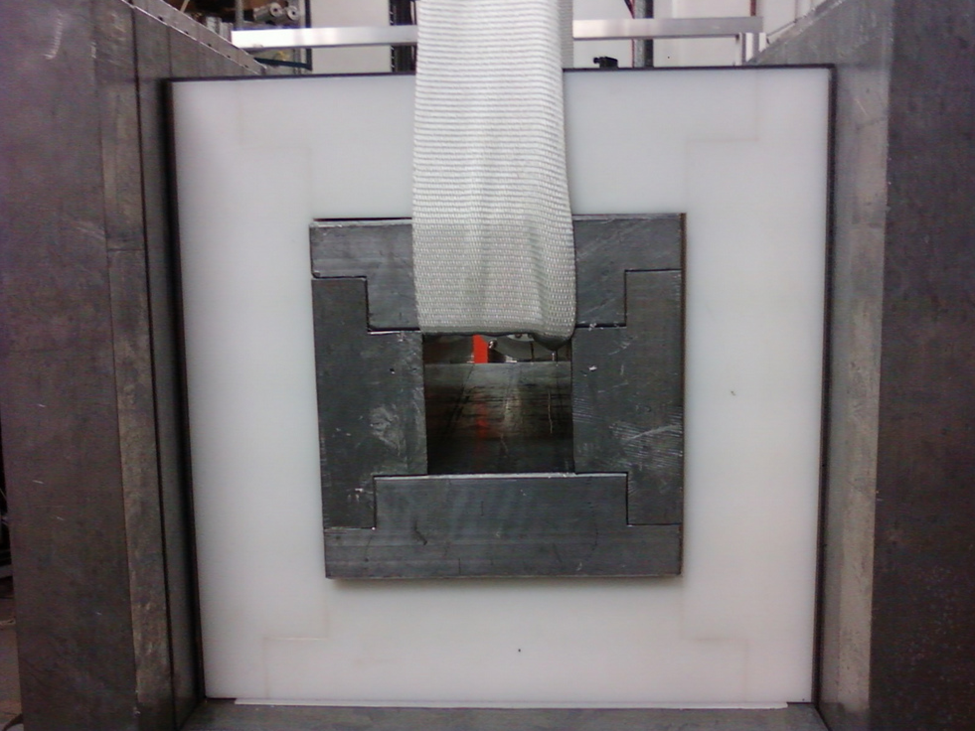
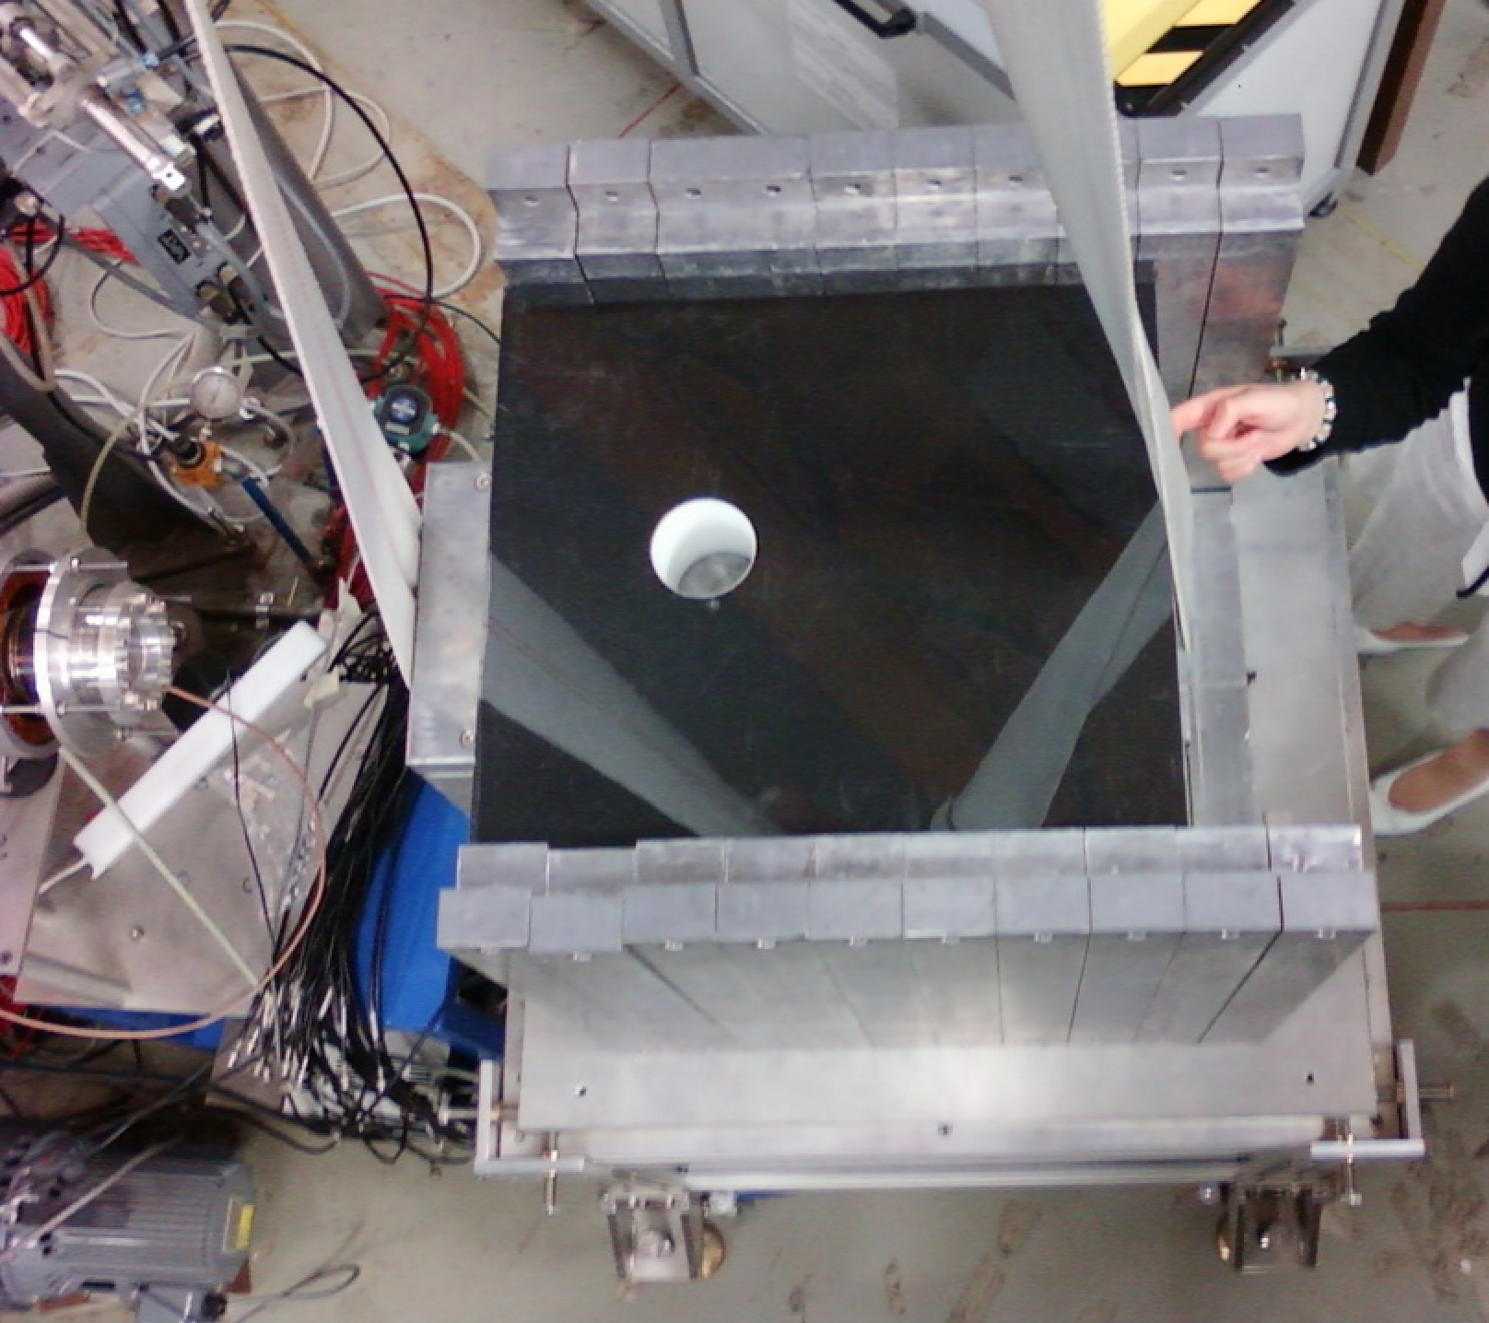
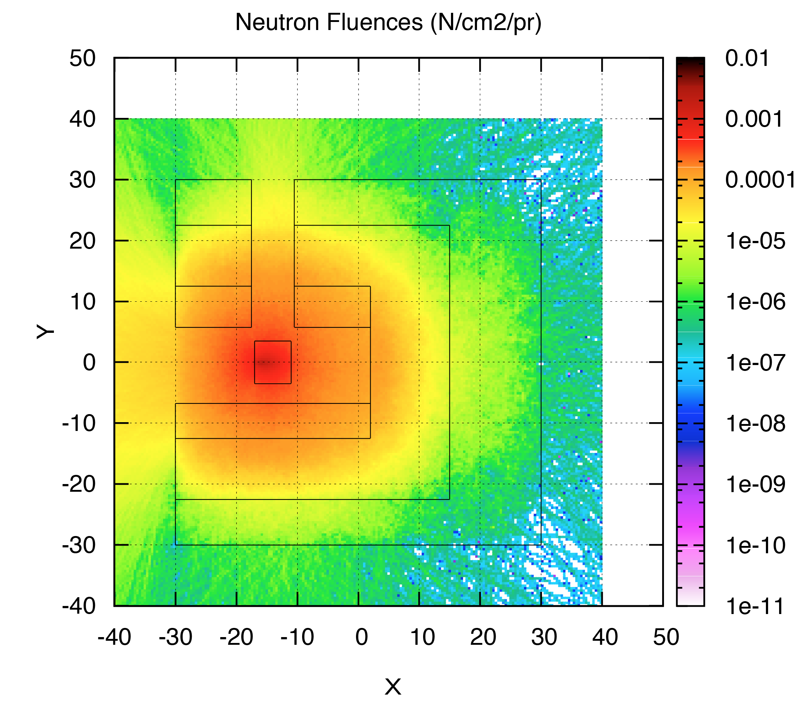
N@BTF target
Optimized Tungsten target: 70 mm diameter cylinder, 60 cm long
Optimized shielding, lead + polyethylene

Slide 5
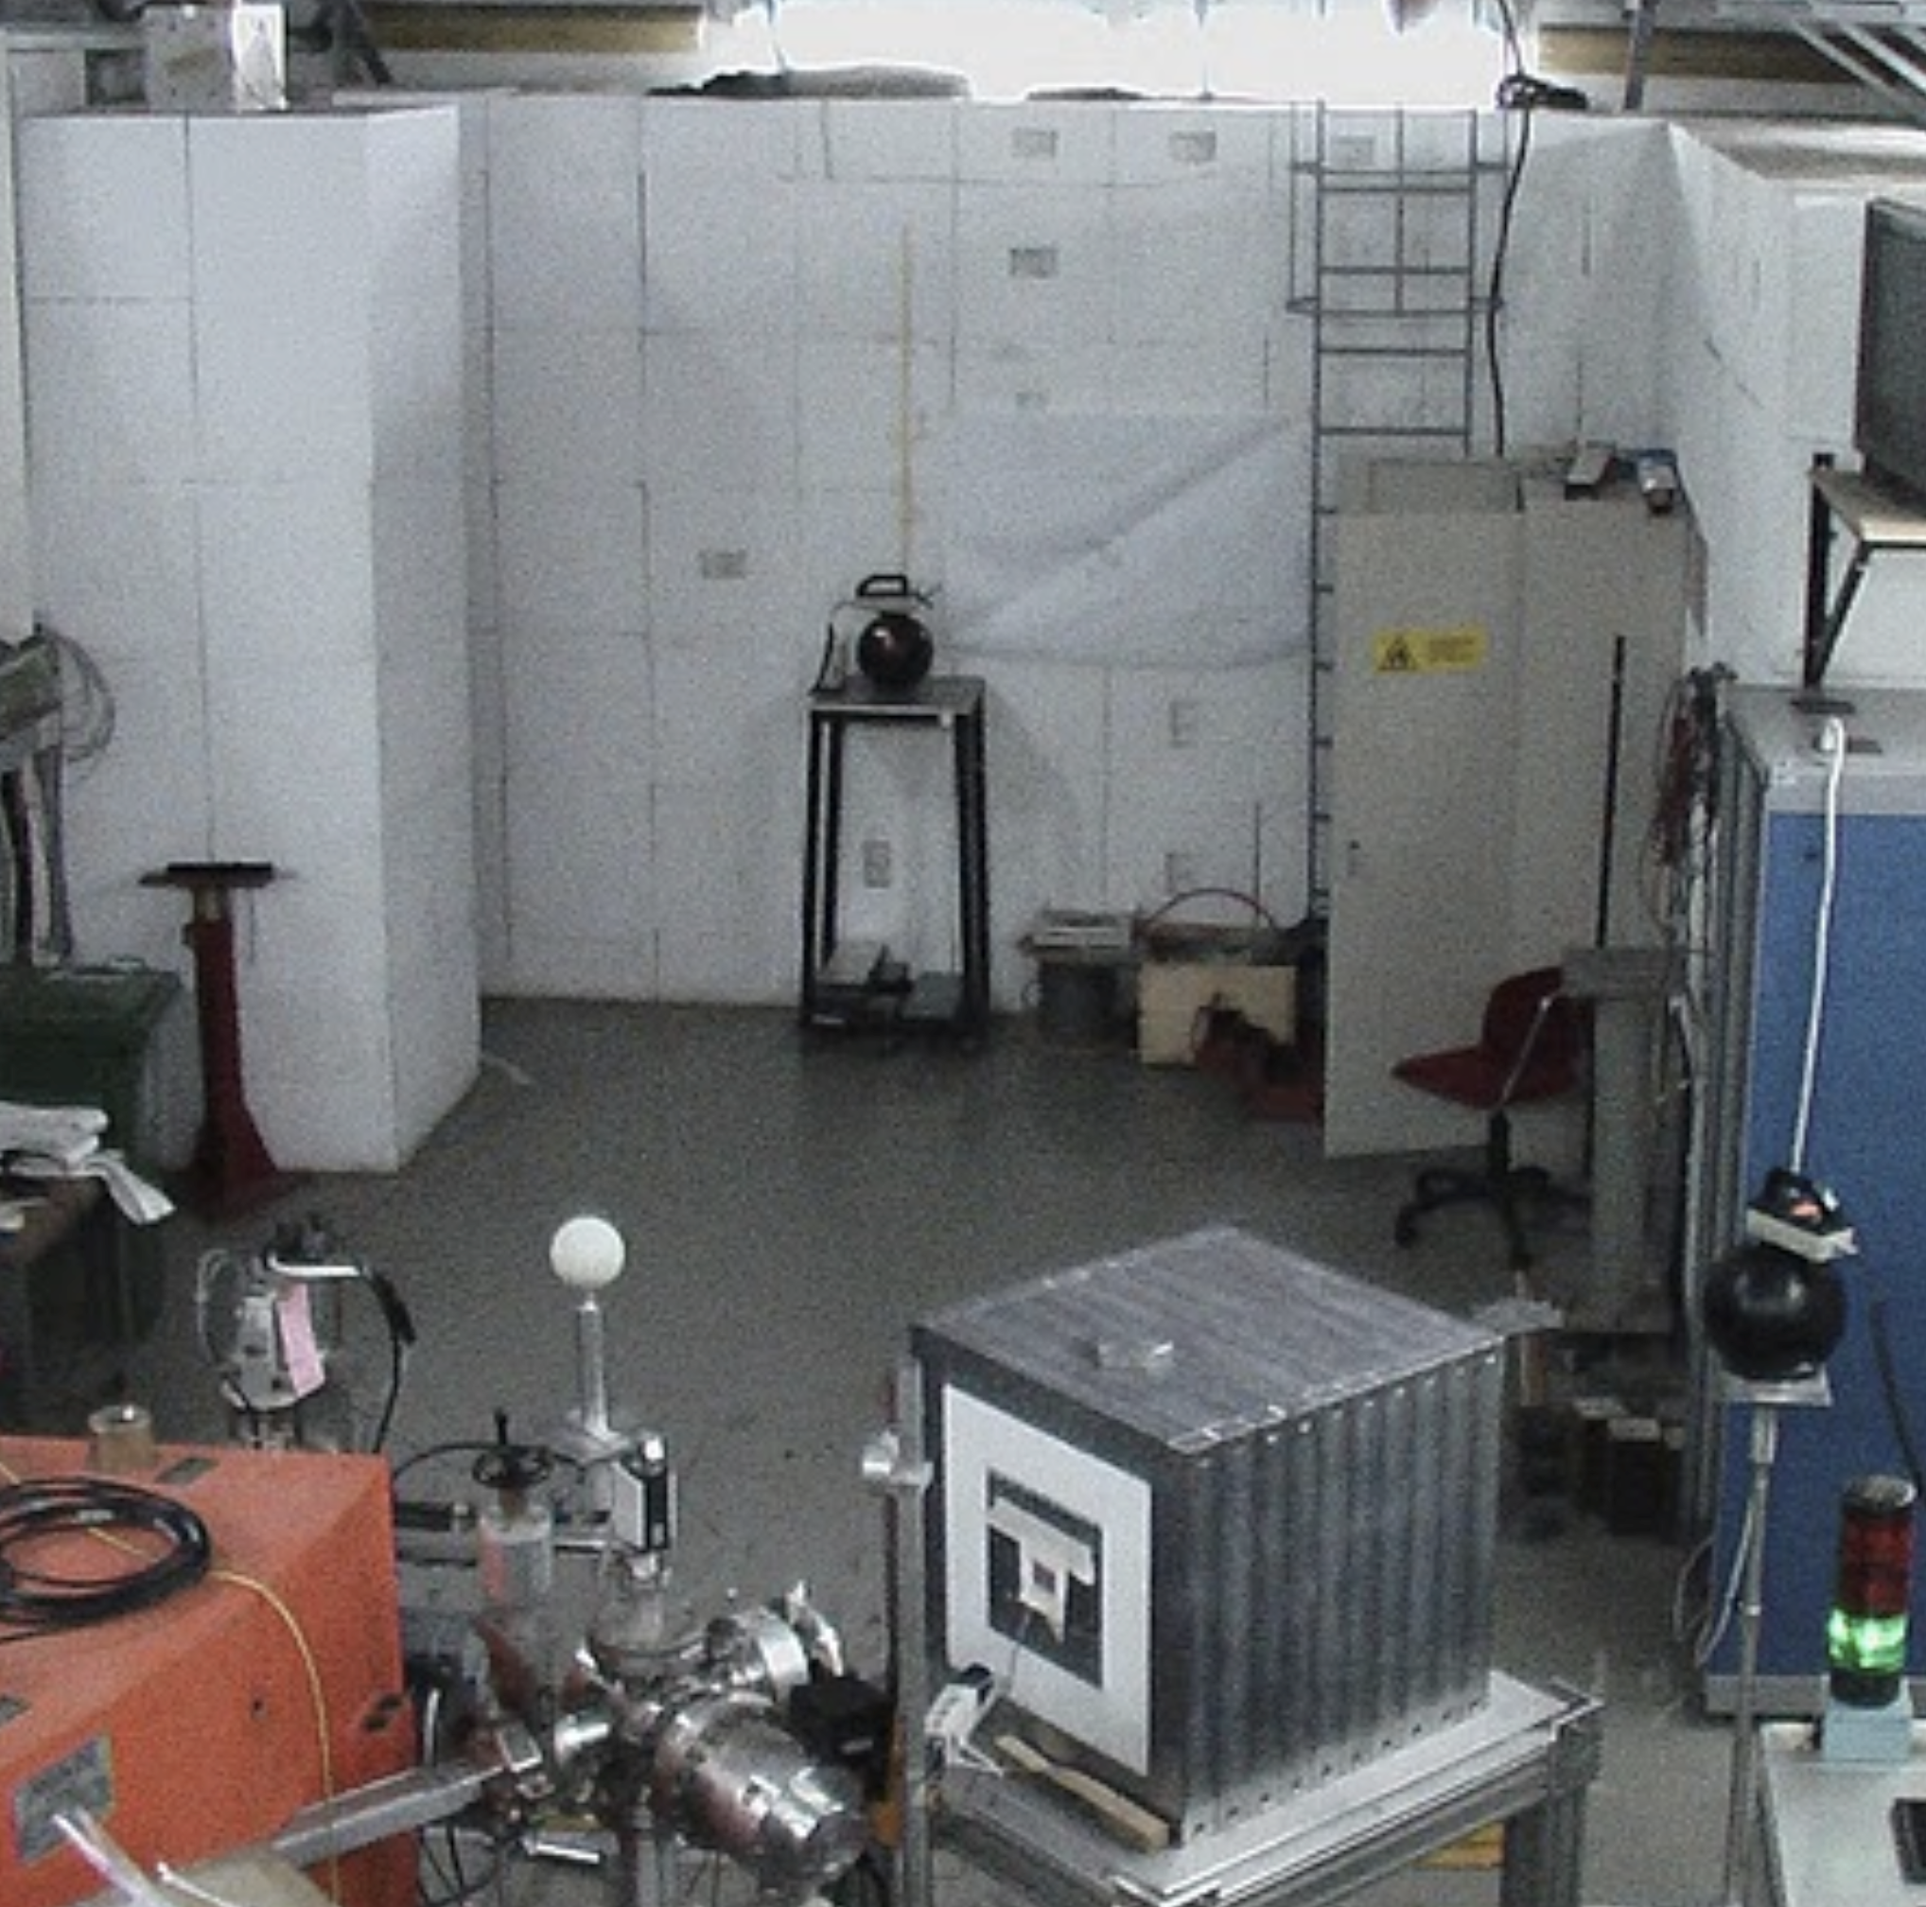
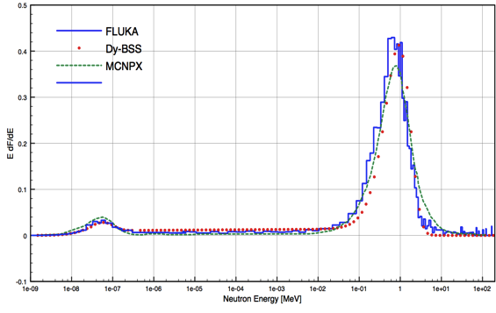
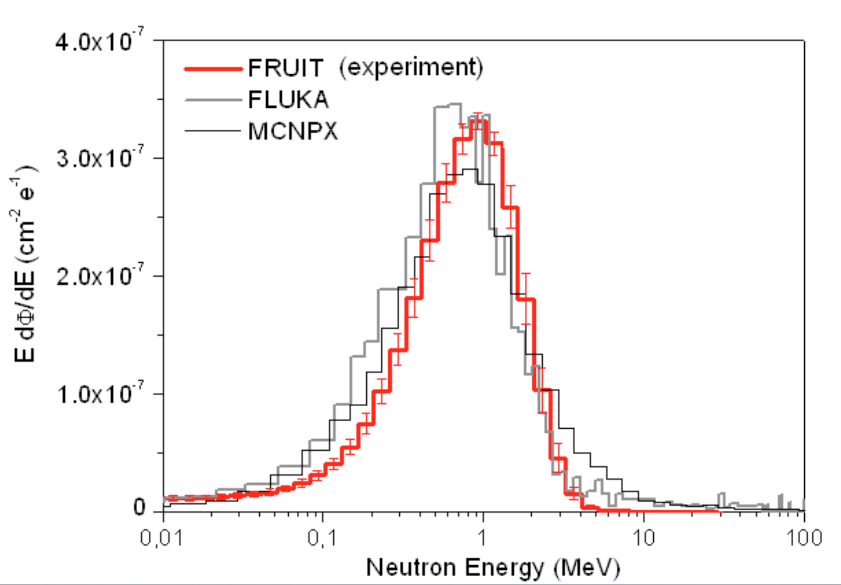
Neutron spectrum
Bonner Sphere Spectrometer based on Dysprosium activation foils
1.5 m distance from optimized target
Good agreement with simulations

Slide 6
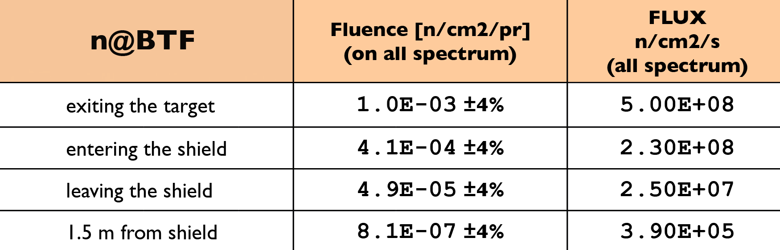
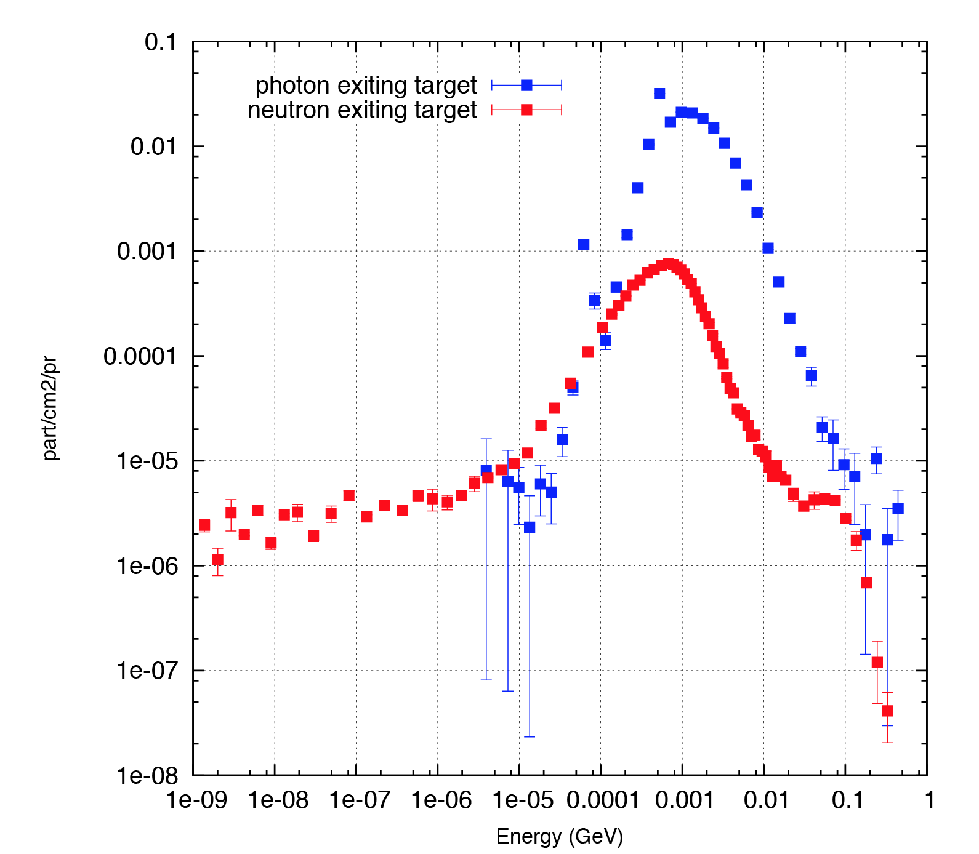
Neutron flux
With full rate at high intensity = 4×10⁵ n/cm²/s on a 10 cm sphere at 1.5 m distance
  BTF beam bunch rate = 49 bunches/s
  N_{pr} = 10¹⁰ e⁻/bunch
  Power_{target} = 40 W (absorbed by target)
With the present setup (1 Hz) = 8×10³ n/cm²/s
20× photon flux

Slide 7
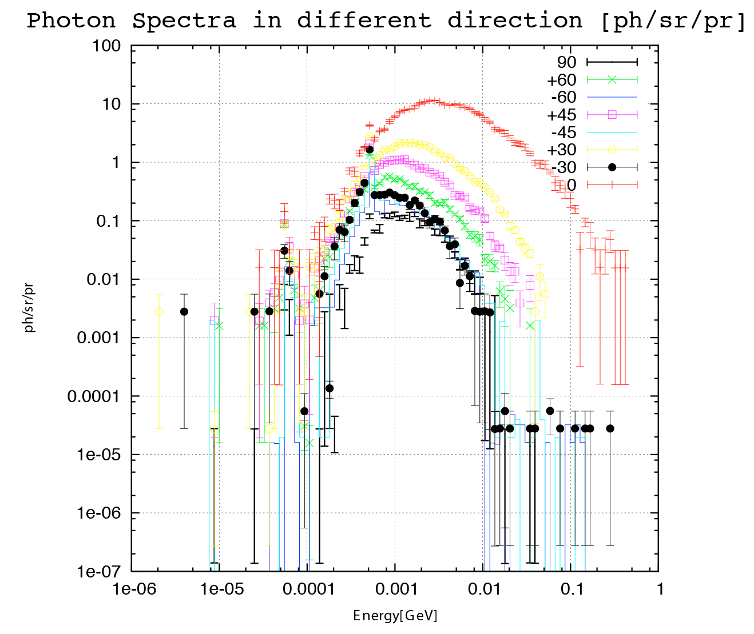
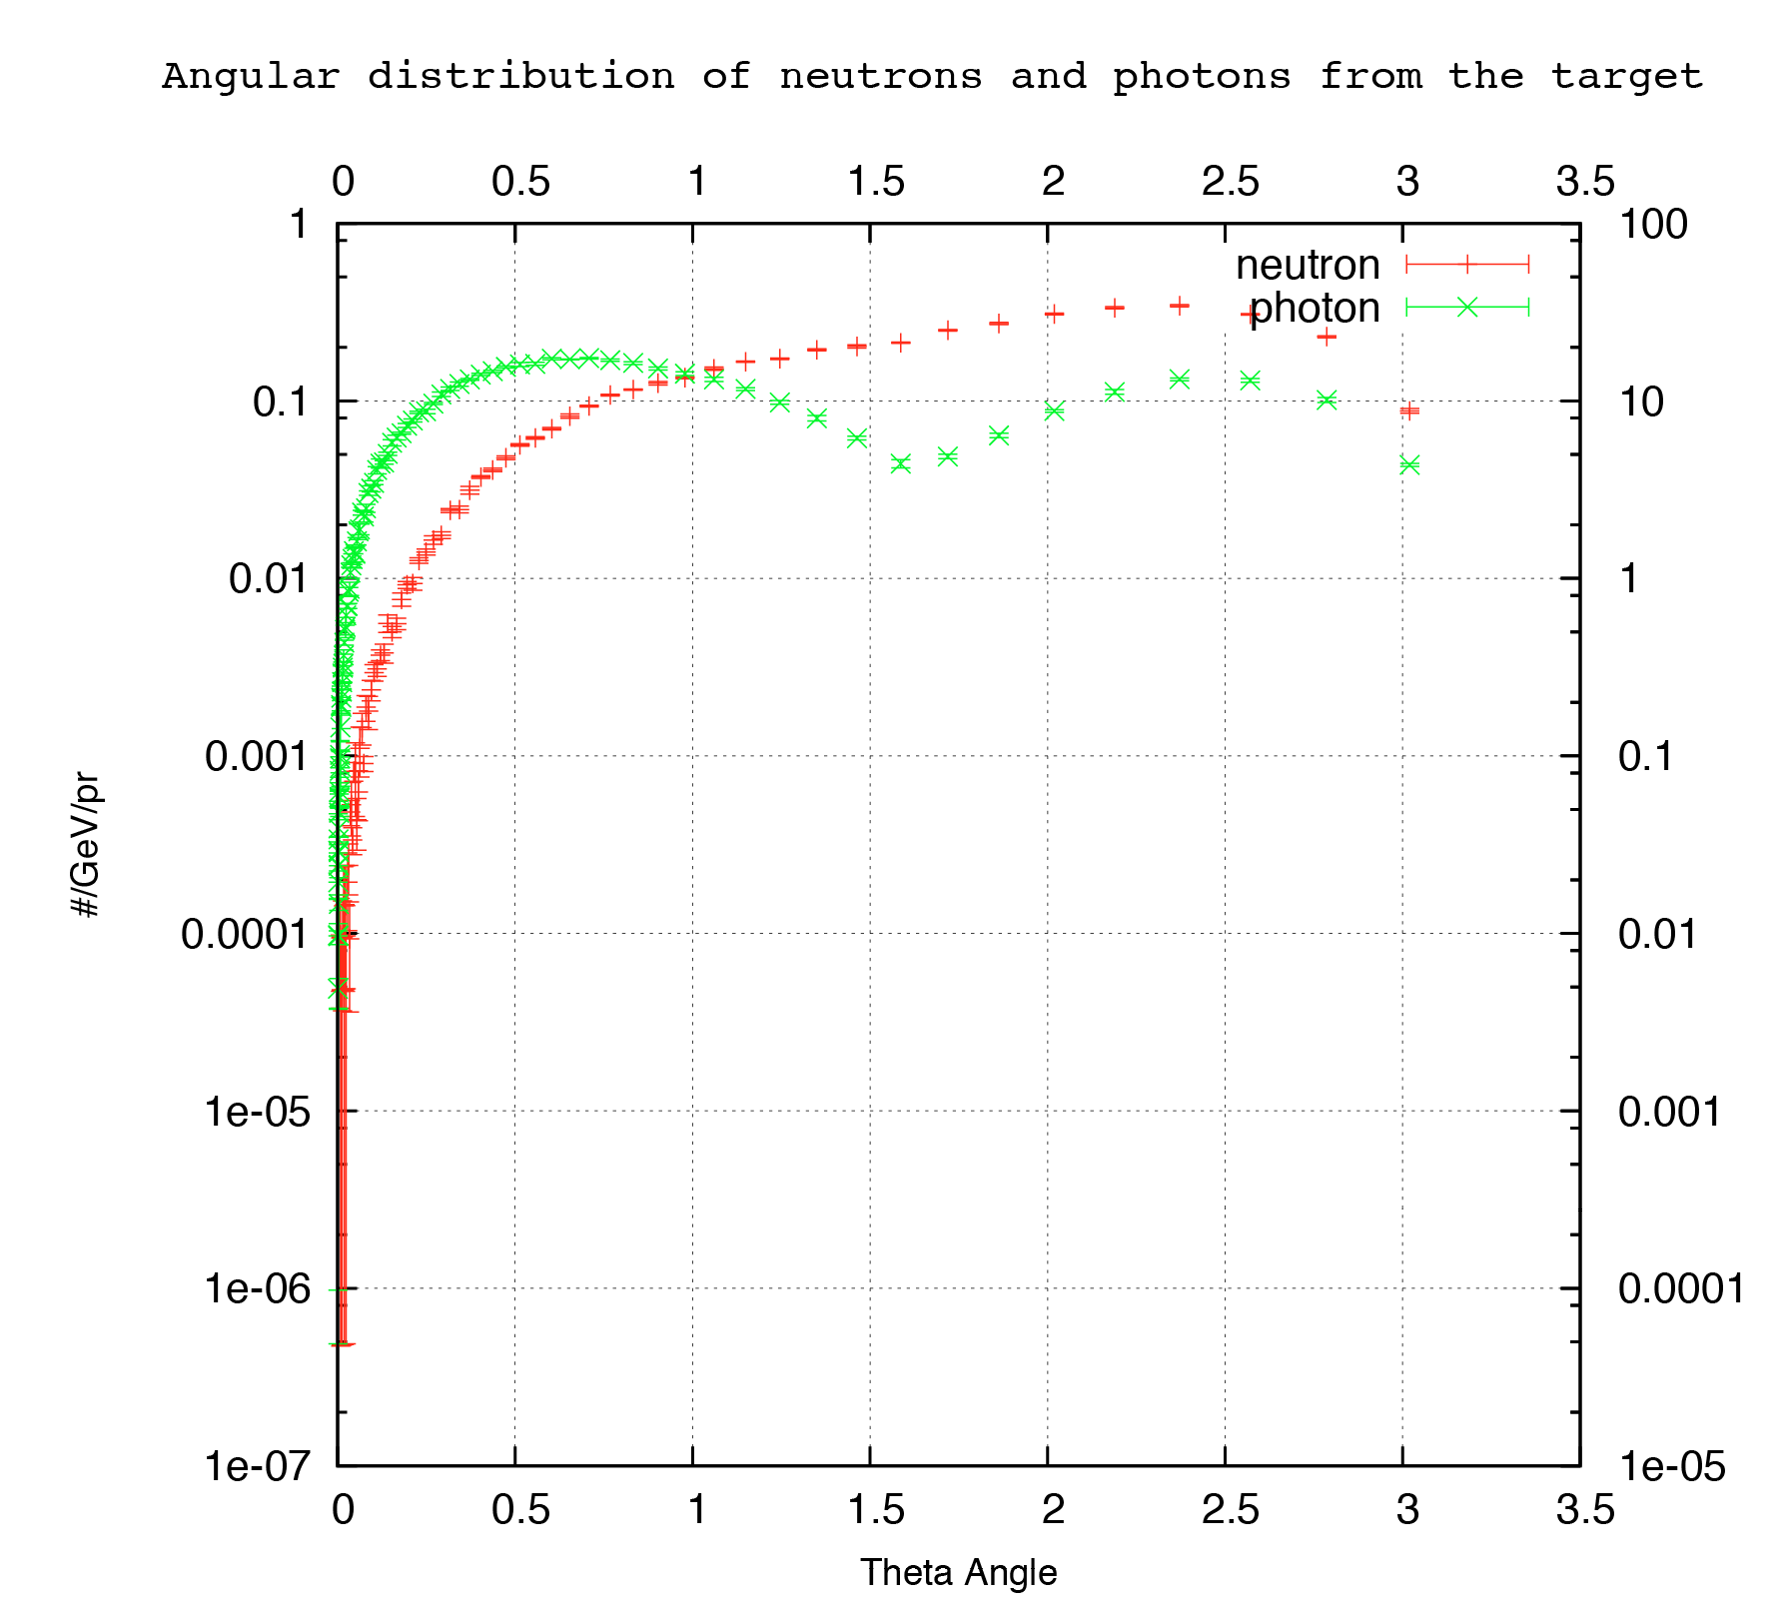
Photon spectrum

Slide 8
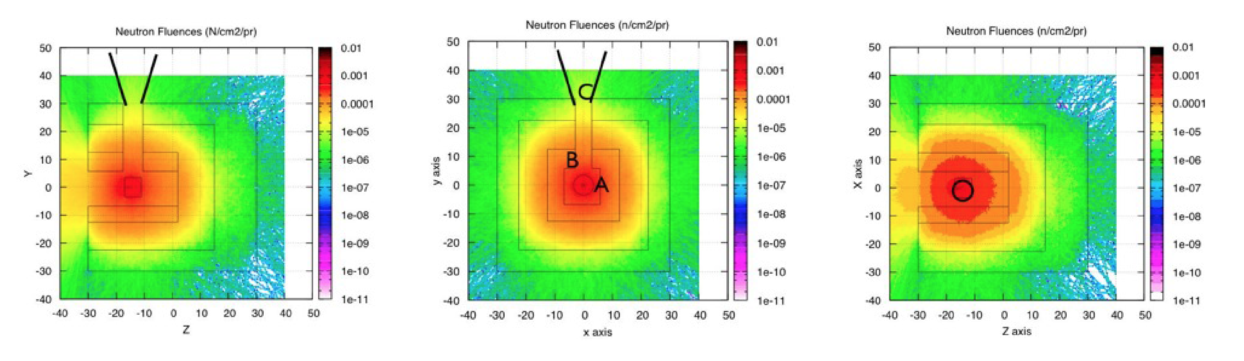
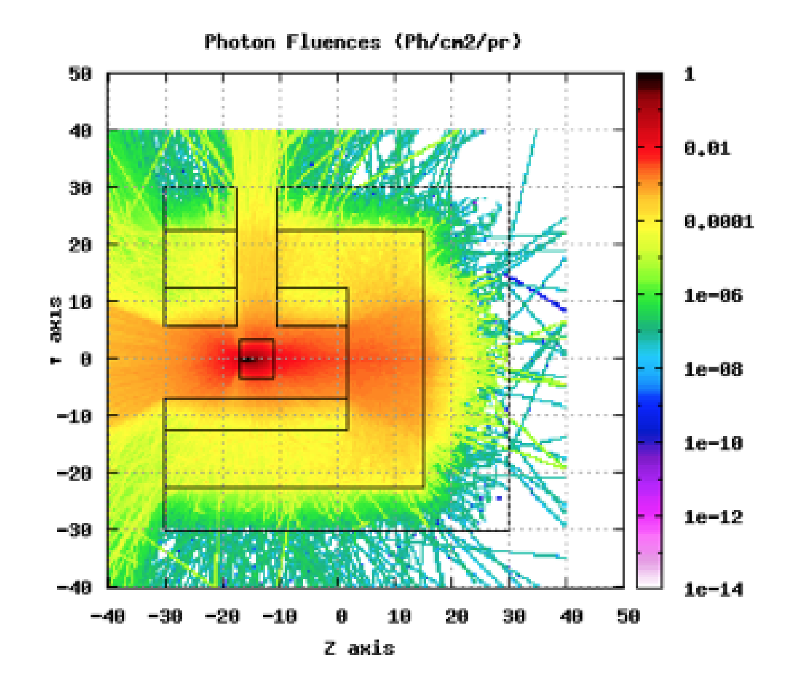
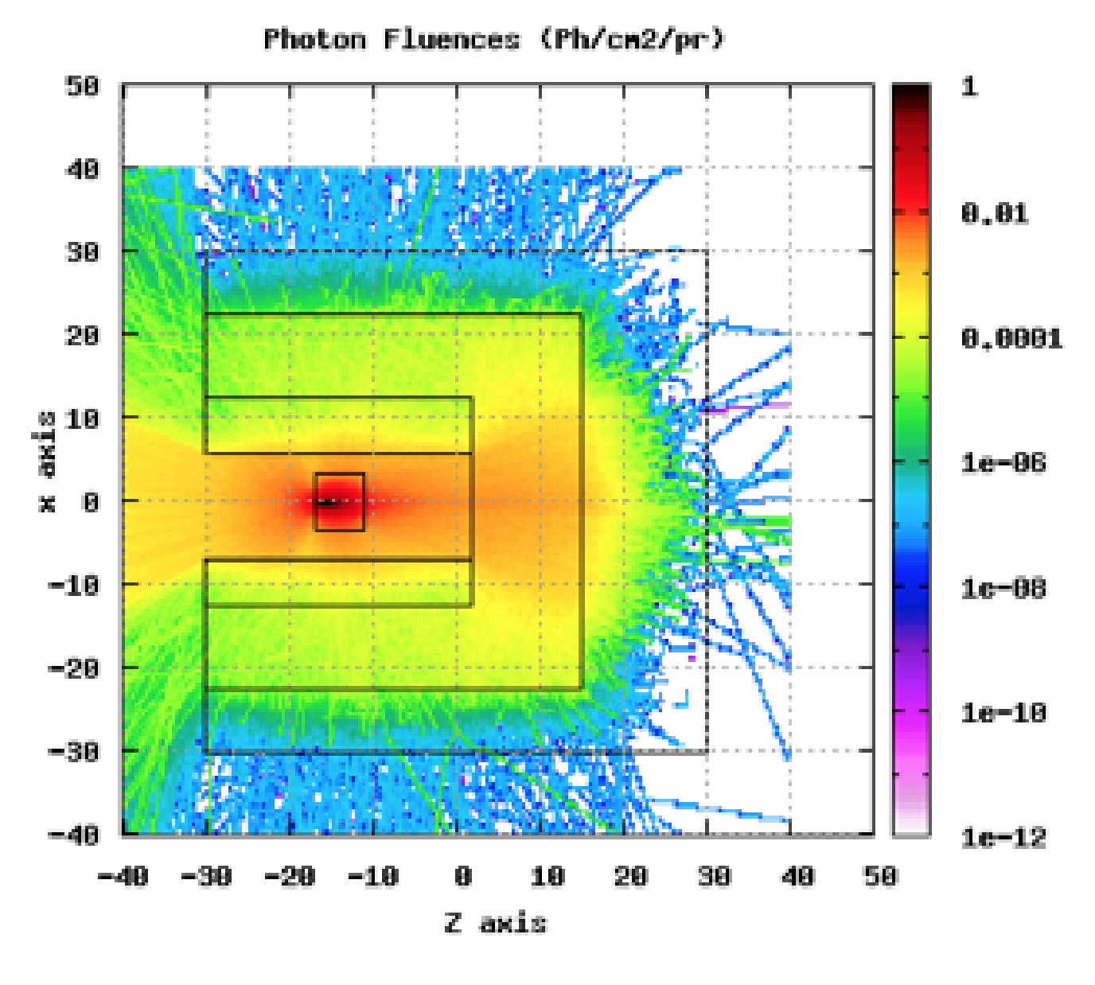
Neutrons vs. Photons

Slide 9
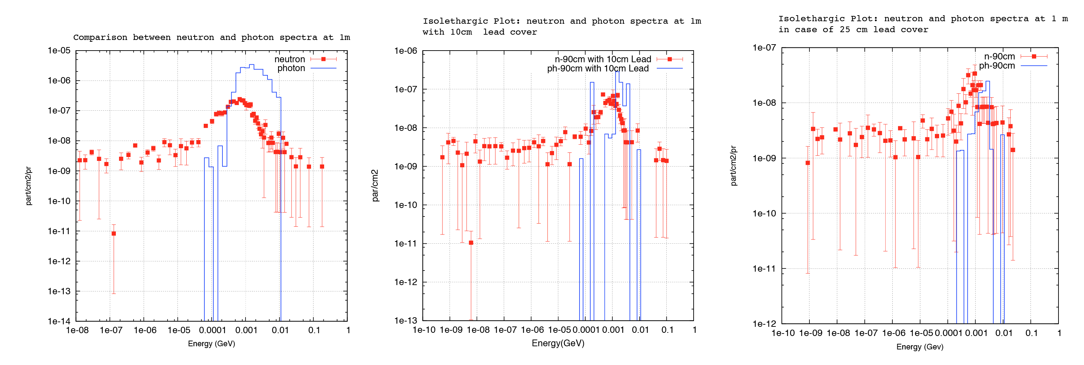
Lead cover effect

Slide 10
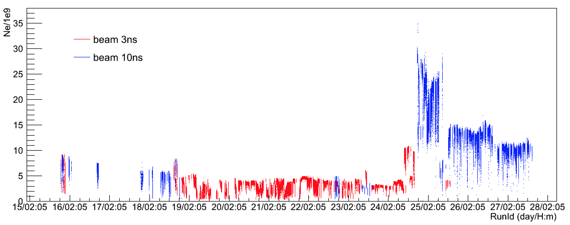
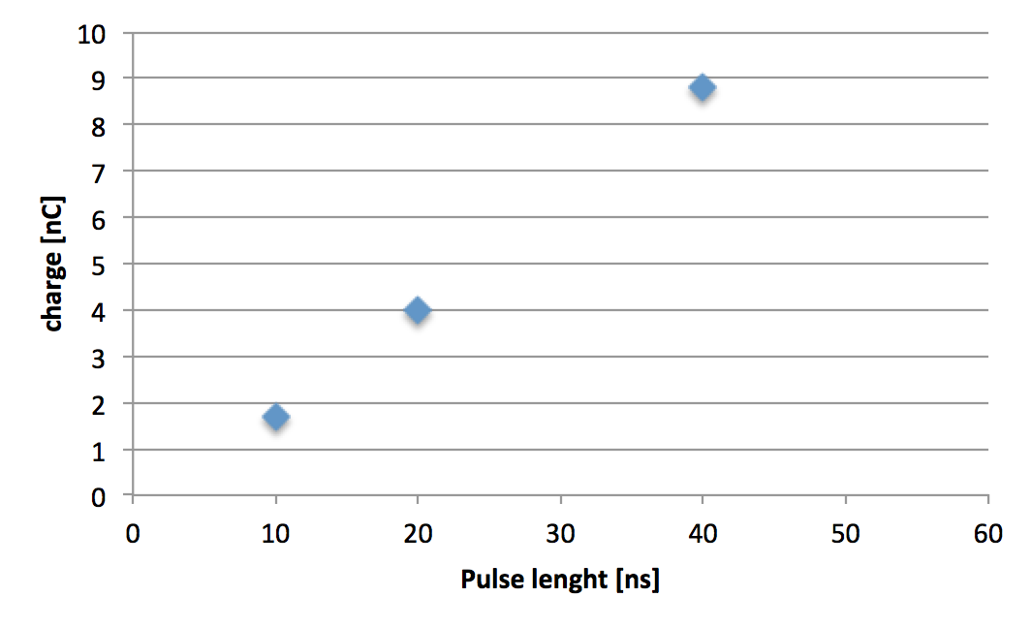
High intensity operation
Up to 2×10¹⁰ at 1 Hz
A mix of authorization (3.125×10¹⁰ average maximum) and operation problems
    Running parasitic to DAFNE collider operations, not optimized optics
    Beam losses triggering the linac interlock
Beam pulse length extended to 40 ns
  Linearly increasing beam charge (constant current from gun cathode)
  10¹³ electrons/s
  Plans to further increase to 160-200 ns

Slide 11
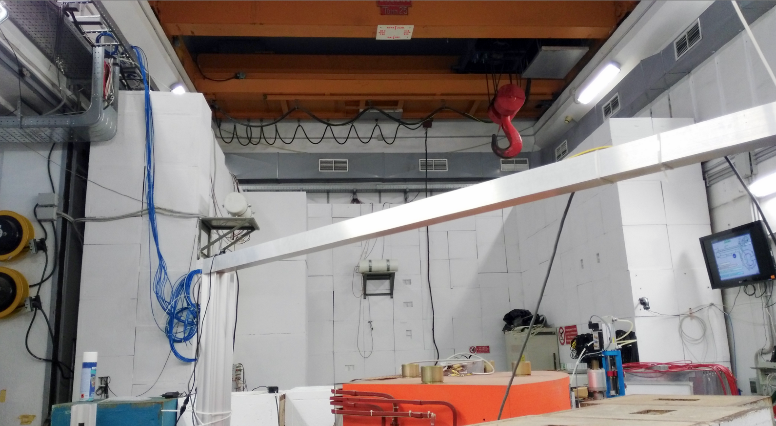

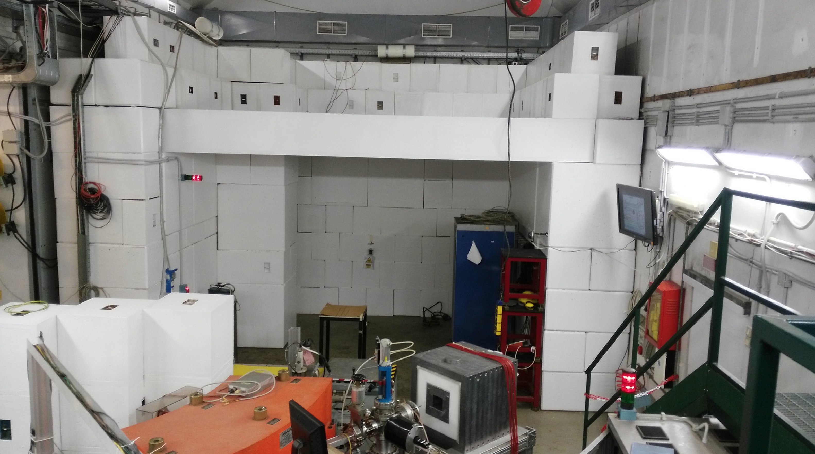

Upgrade shielding
Added 50 cm concrete roof to the BTF bunker
Started authorization procedure to exceed 3.125×10¹⁰ particle/s

Slide 12
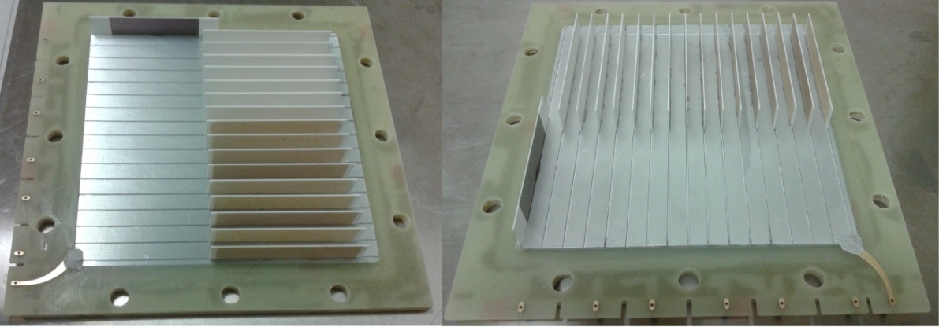
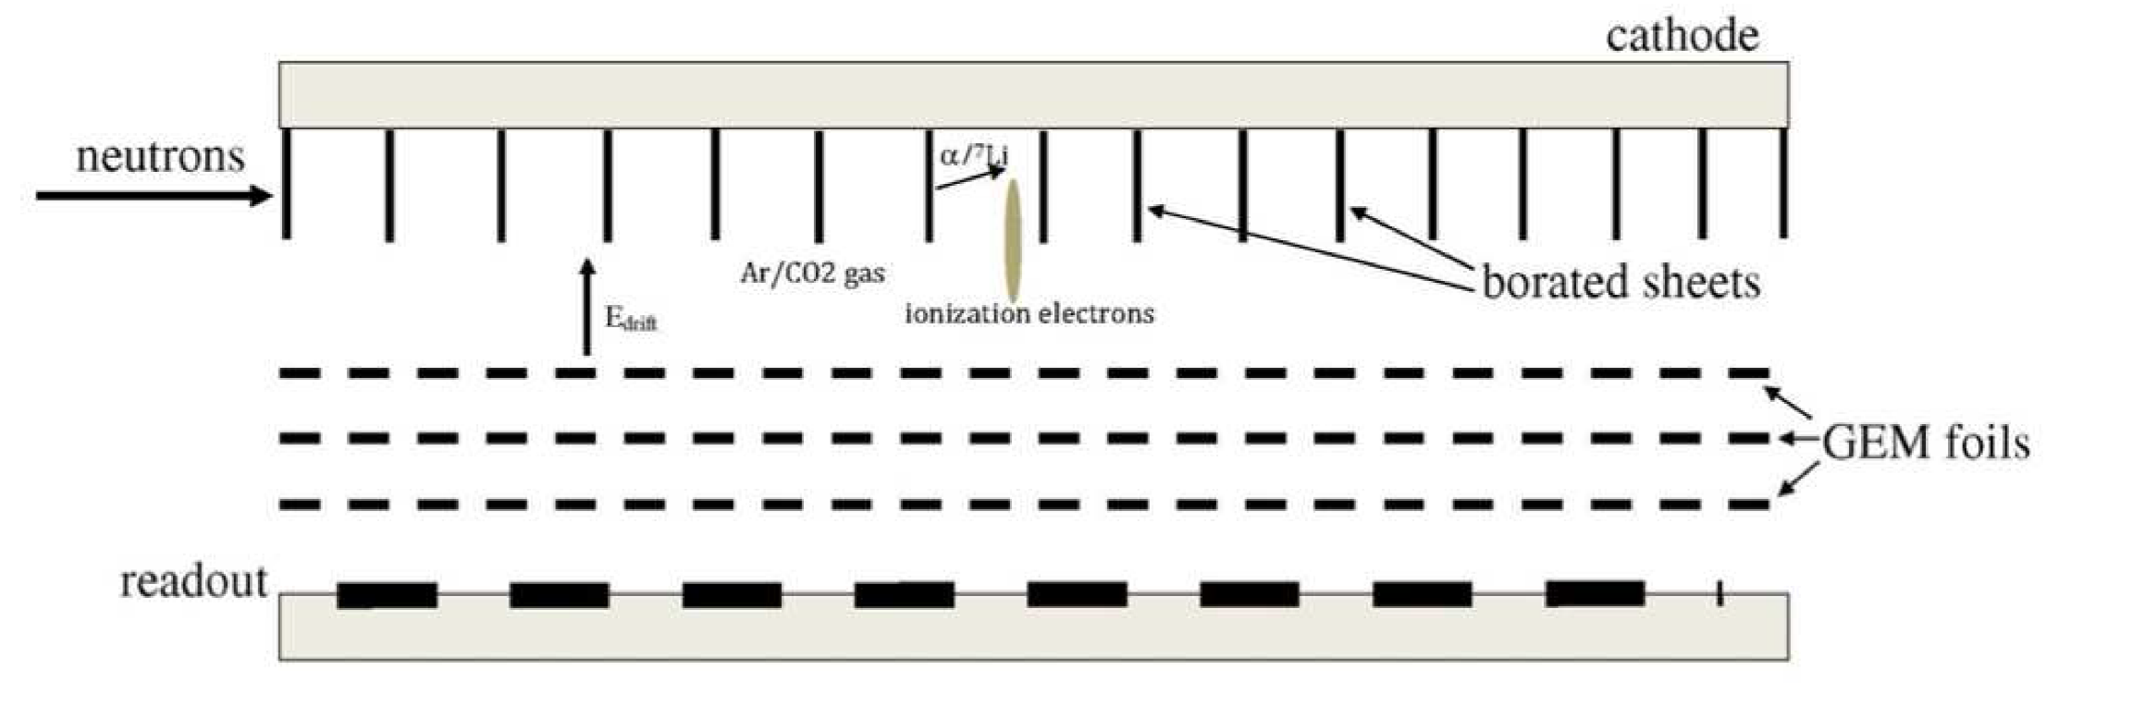
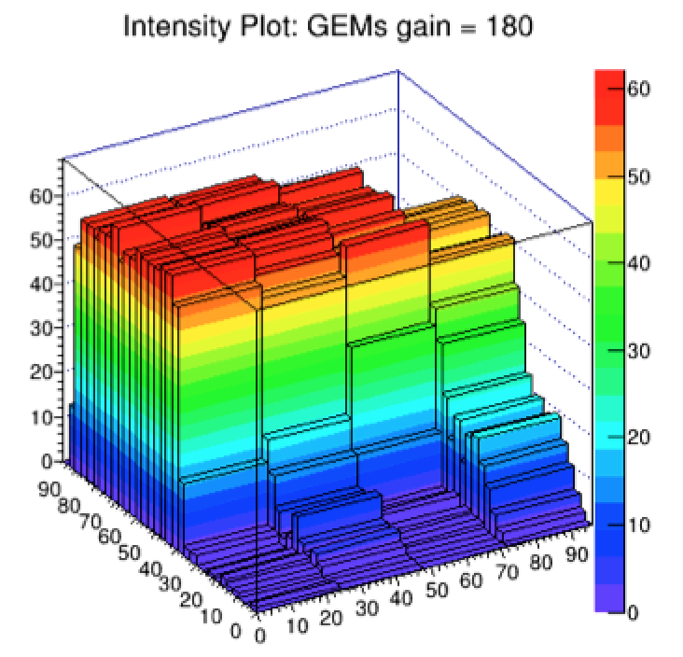
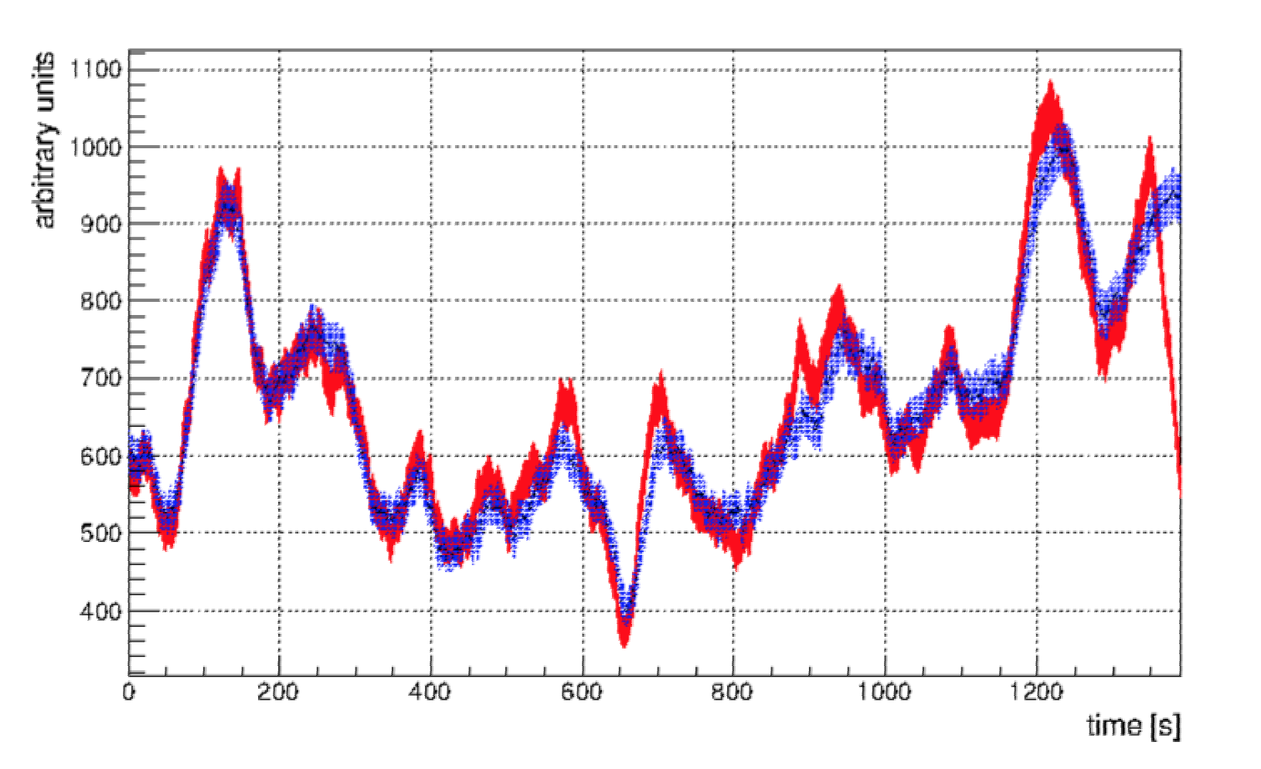
Neutron diagnostics
Fast neutron Borated GEM monitor at 50 cm from target
Electron current
GEM counts
Problems: calibration, integration

Slide 13
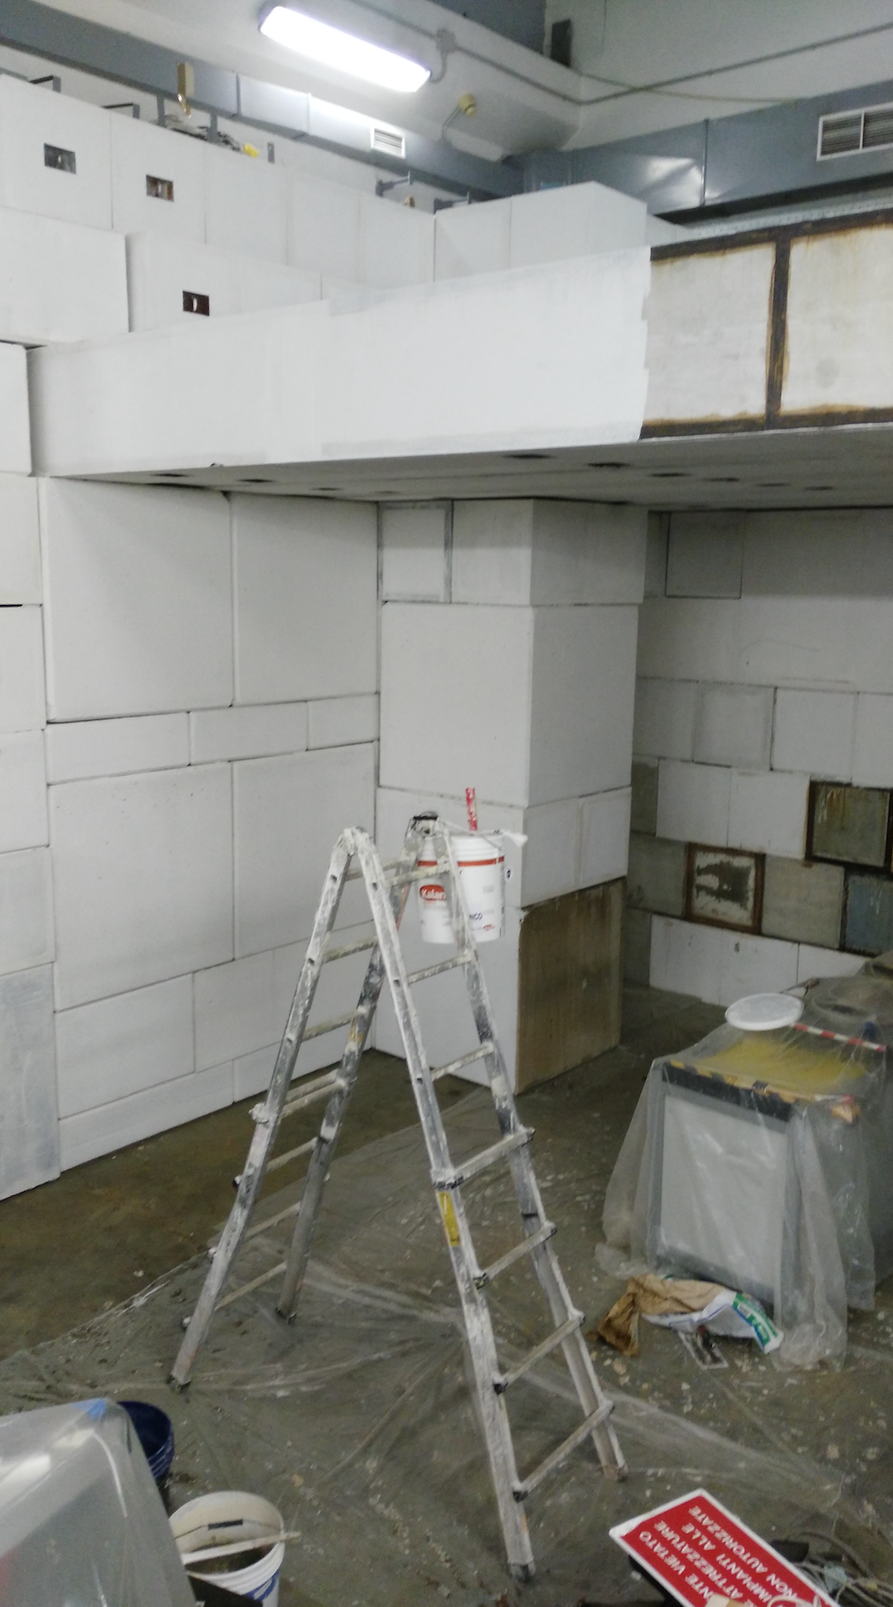
Work in progress
On maximum electron beam intensity
On neutron diagnostics
Waiting for users to improve experience

Slide 14
Spares

Slide 15
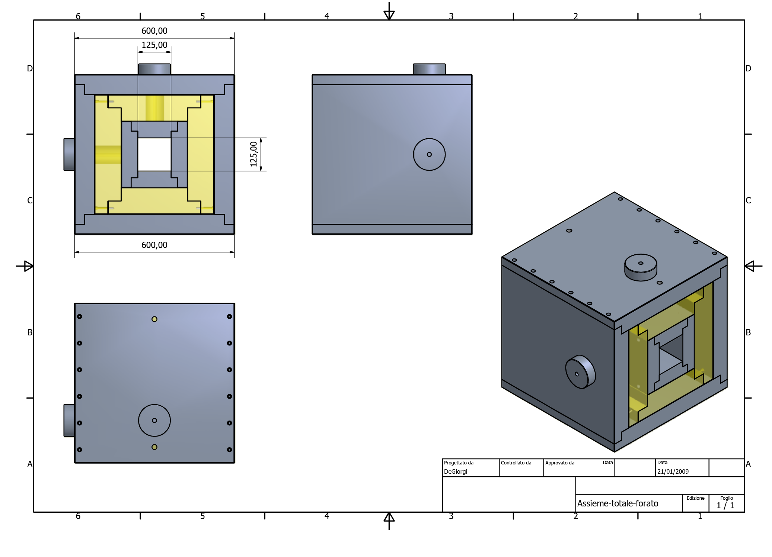

Slide 16
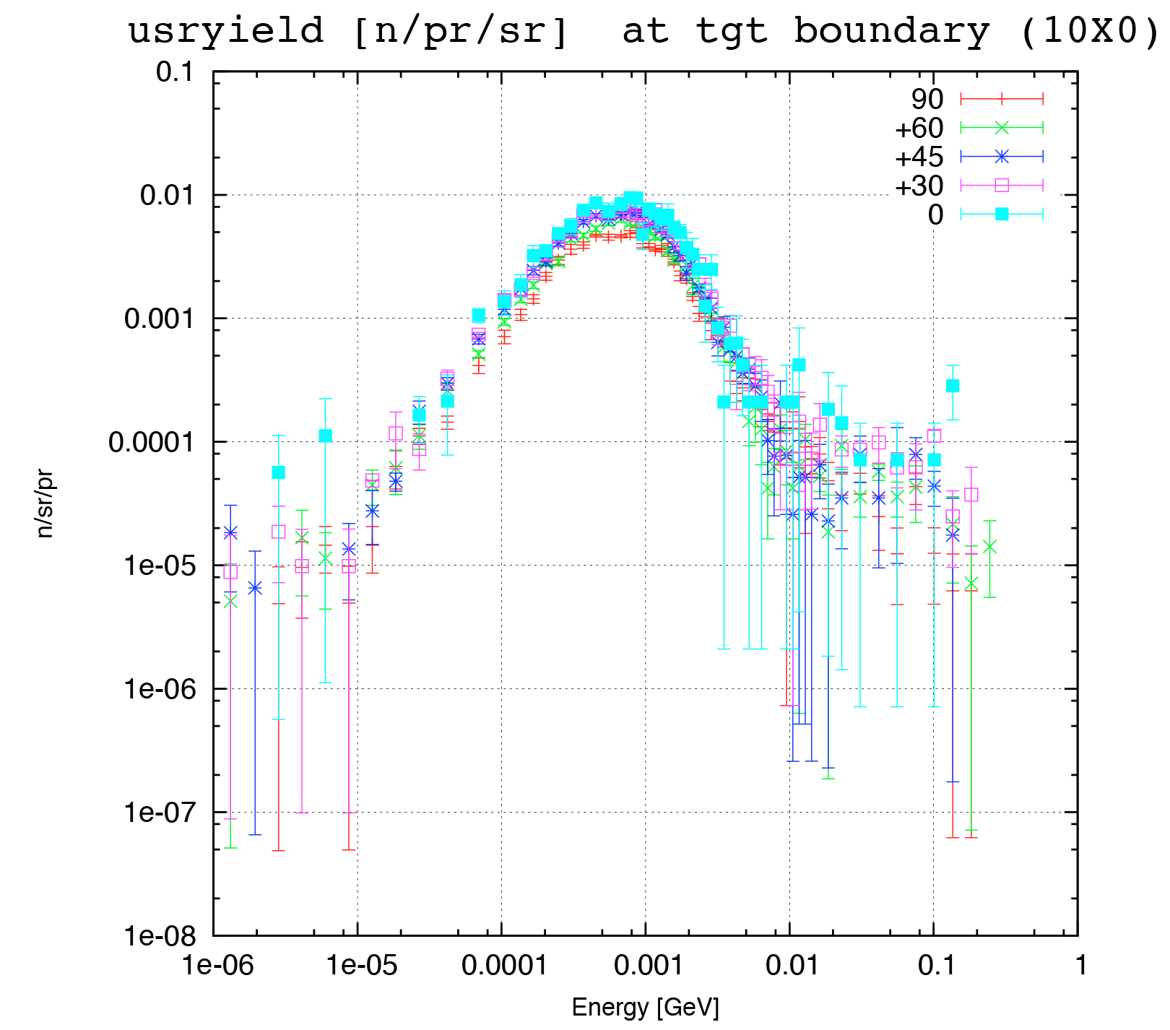
Isotropic production

Slide 17
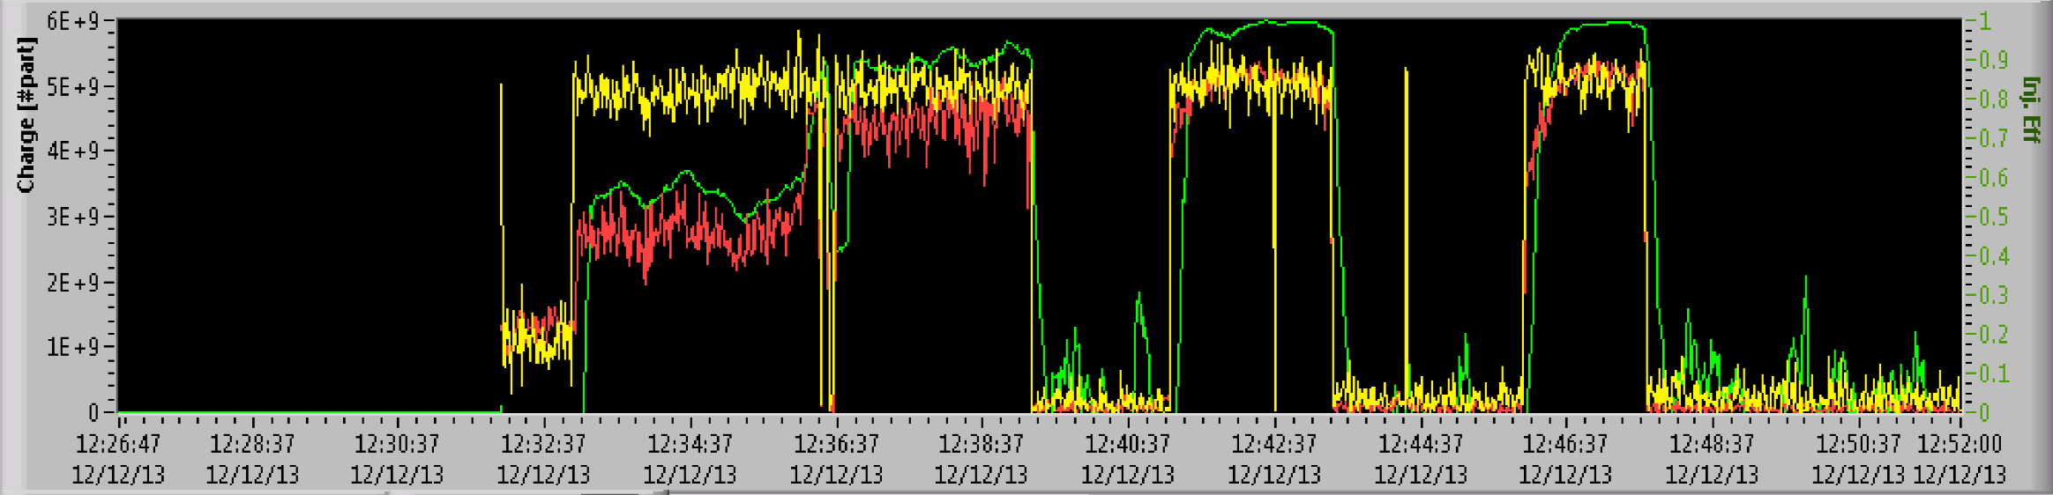
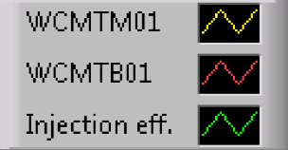
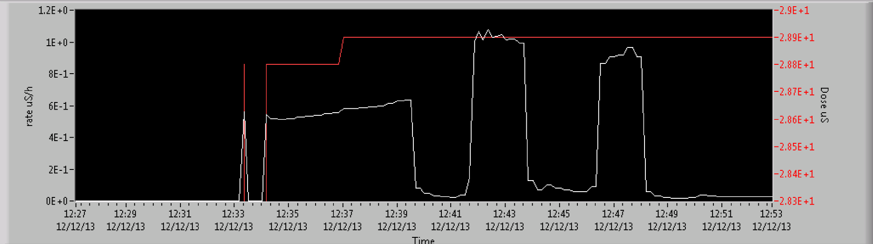

rem counter at ≈5 m distance from target

