Slide 1
TDC and Status Report on the nSYNC project for the LHCB muon upgrade
S. Cadeddu, A. Cardini, L. Casu, A. Lai, A. Loi – INFN Cagliari
P. Ciambrone – INFN LNF

Slide 2
Outline
Introduction to TDC
TDC test results
nSYNC status and future plans
Conclusion

Slide 3
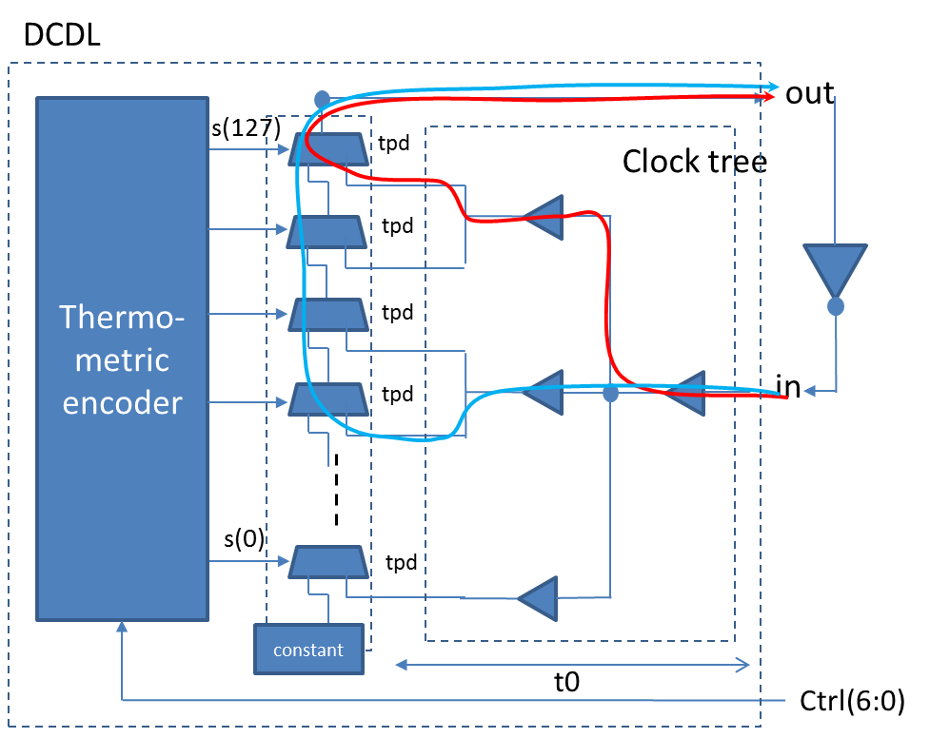

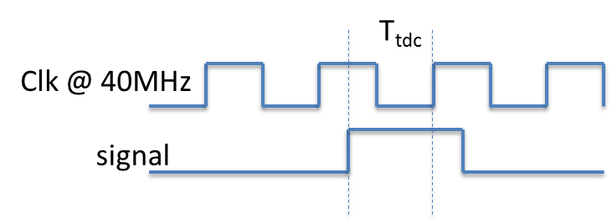
Introduction TDC
This TDC have to measure the phase of incoming signal w.r.t. the 40MHz master clock, according to the picture below
The resolution is the number of slices the master clock is divided
The TDC have the possibility to set the resolution in a range from 8 to 32 slices
The TDC uses the Giordano-DCO developed for ALLDIGITALL and for which we have a patent request pending
TDC must have an automatic calibration tool that can be activated on request
TDC-DCO has a dithering system to minimize the systematic errors due to discrete delay unit
TDC measurement is done with a fast counter running with the clock DCO generated.
TDC is active only when a signal arrives, to minimize the switching power consumption.
DCDL Based on a high-fan-out network (HFN) feeding a multi-input delay chain
Clock tree guarantees uniform delay between in and the input of each delay (t0)
tpd is the propagation delay of each mux
Thermometric encoder determines the number of muxes crossed from in to out => the total delay Δt=n⋅tpd+t0
Clock tree is a standard element of any digital ASIC
Full automatic implementation with standard CAD tools

Slide 4
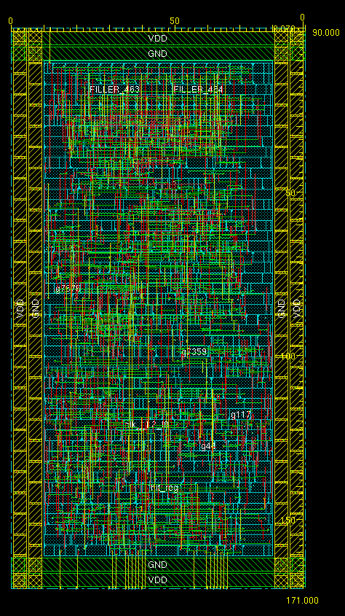
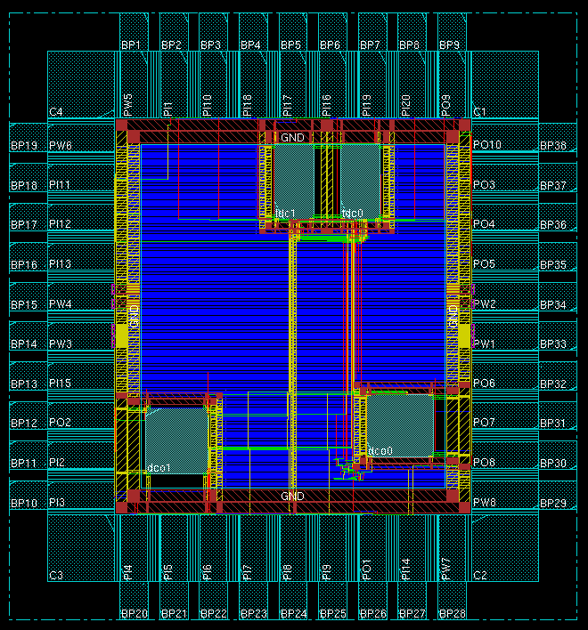
TDC Layout
Size: (90 x 171) μm²
Working Power consumption: <100μW
UMC130 nm Technology
It was submitted in February 2015 in the new ADV2 chip, with two identical TDC integrated.

Slide 5
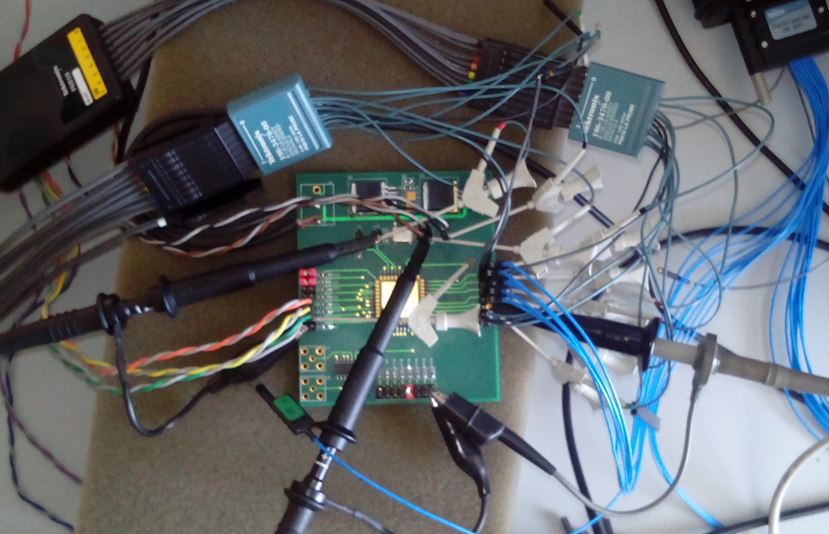
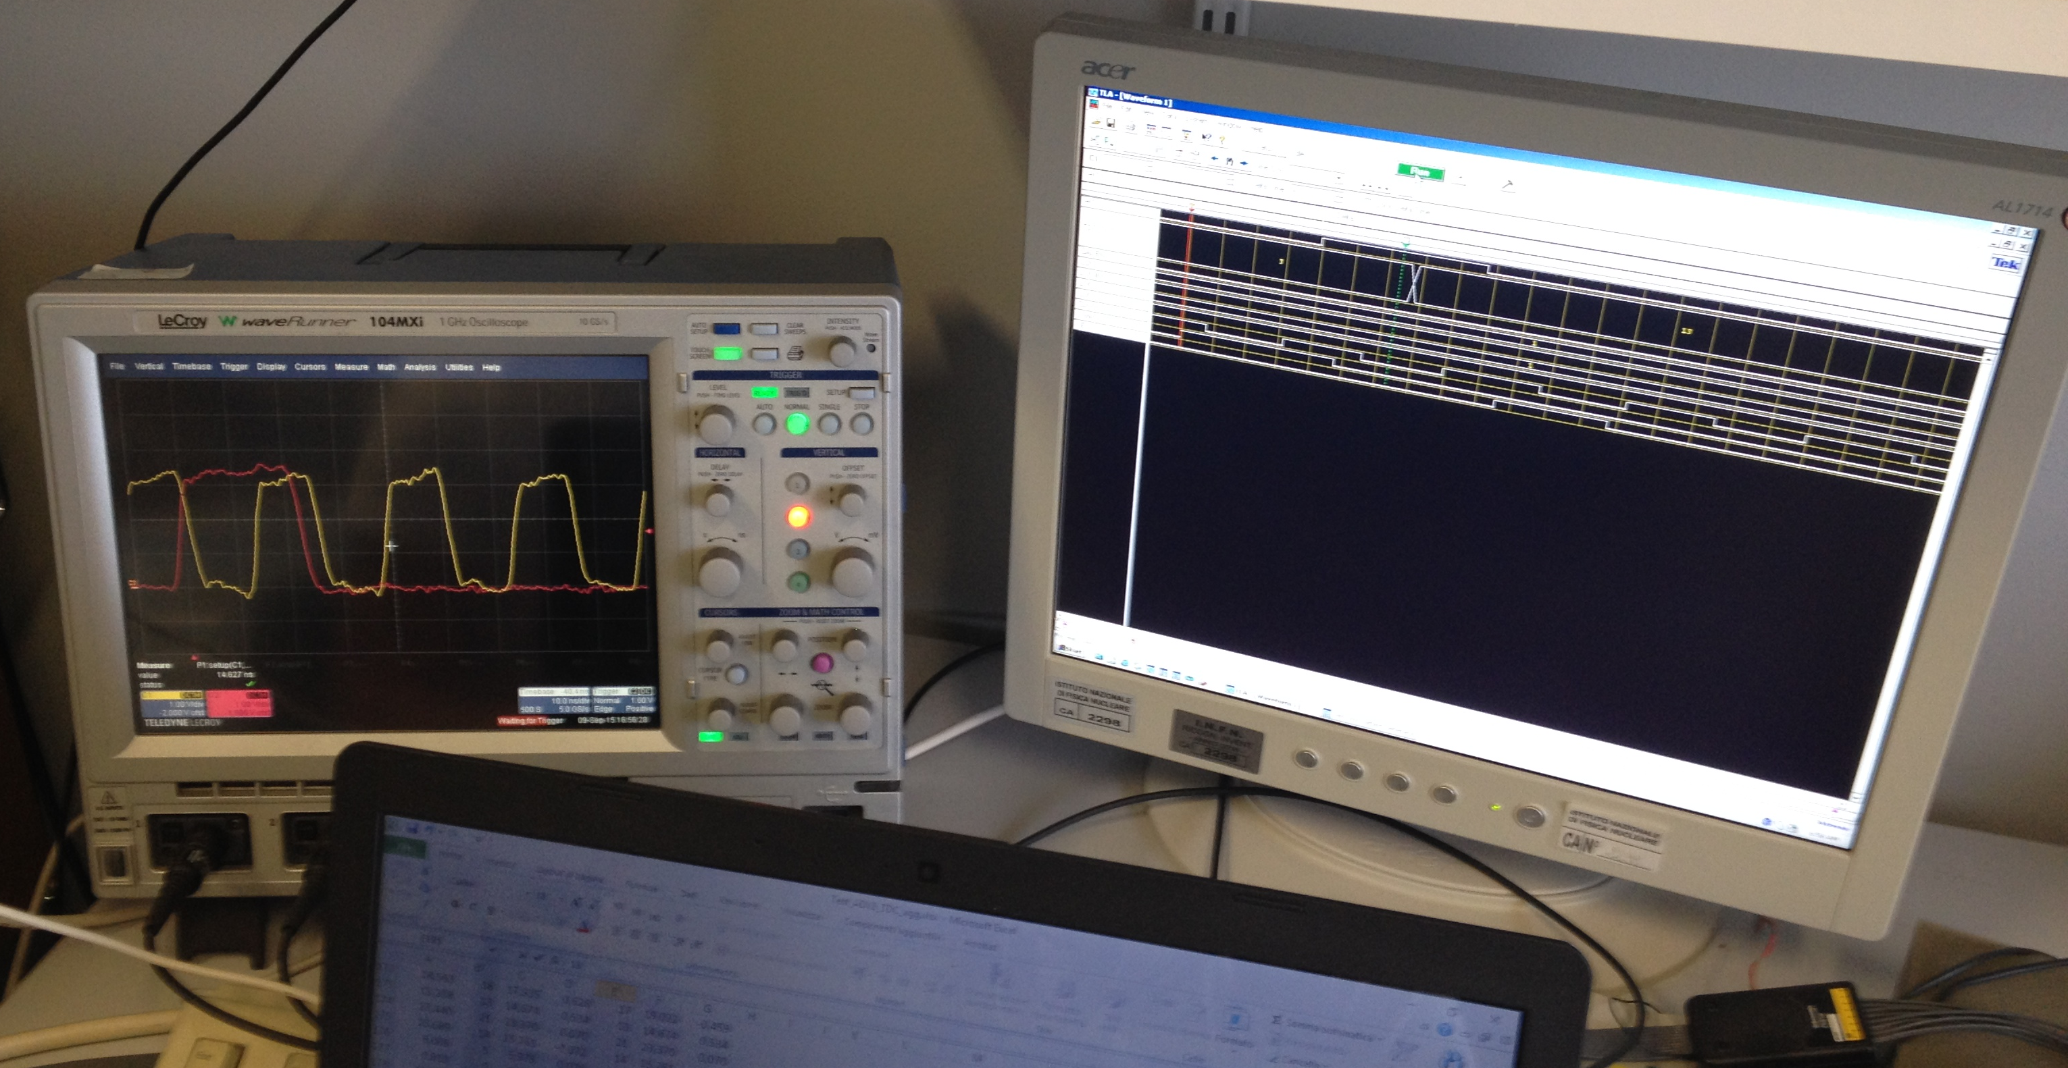
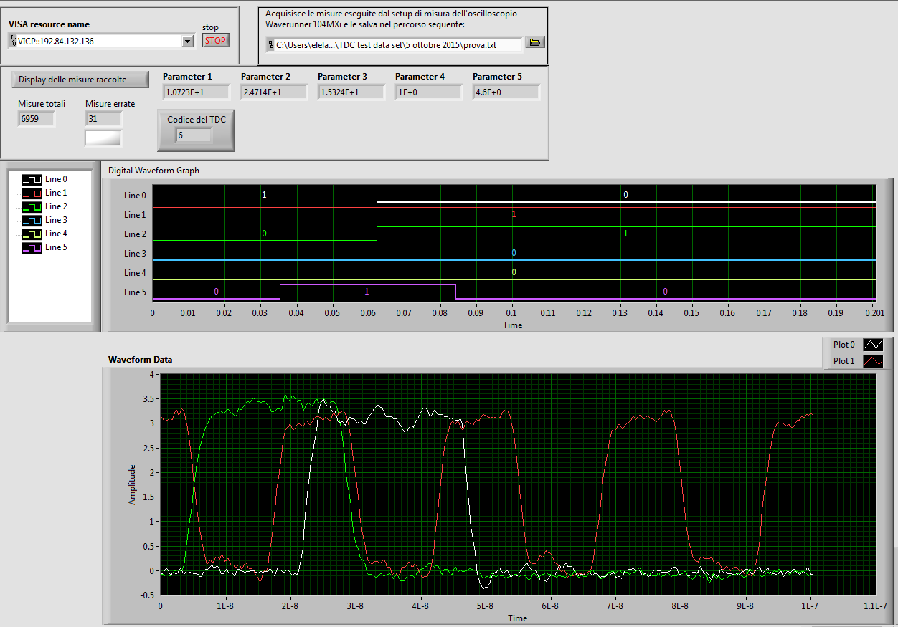
TDC Test Setup
A LeCroy Mixed Signal Oscilloscope 10Gs/s measures the phase of the input signal w.r.t. to the 40MHz master clock and reads the digital outputs
A Tektronix TLA 712 Pattern Generator/Logic Analyzer is used to send inputs/read back data to/from the chip
Data acquisition is fully automated and performed using LabView.

Slide 6
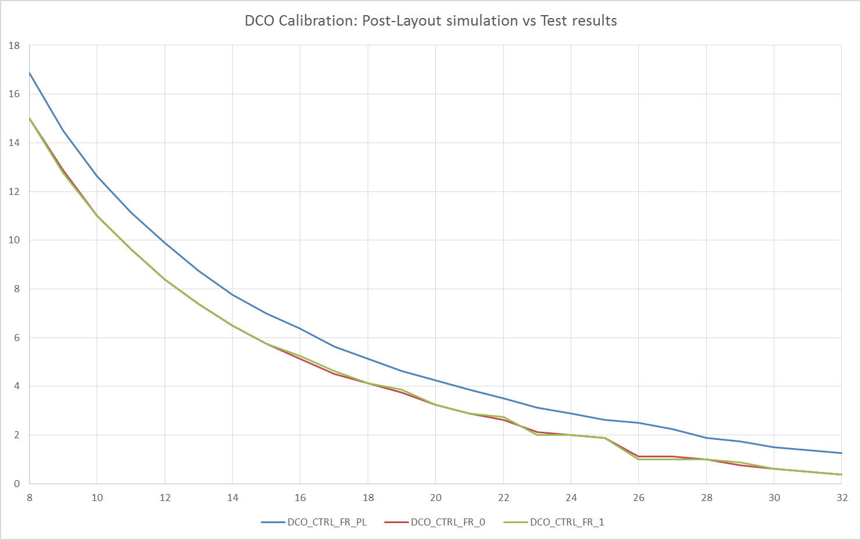
TDC Calibration: Test Results
Digital words controlling the DCO and Dithering are output from the TDC and can be used to verify the TDC Calibration results.
The plot below shows the comparison between the DCO control word values from Post Layout Simulation vs values from the TDC’s under test
LHCb

Slide 7
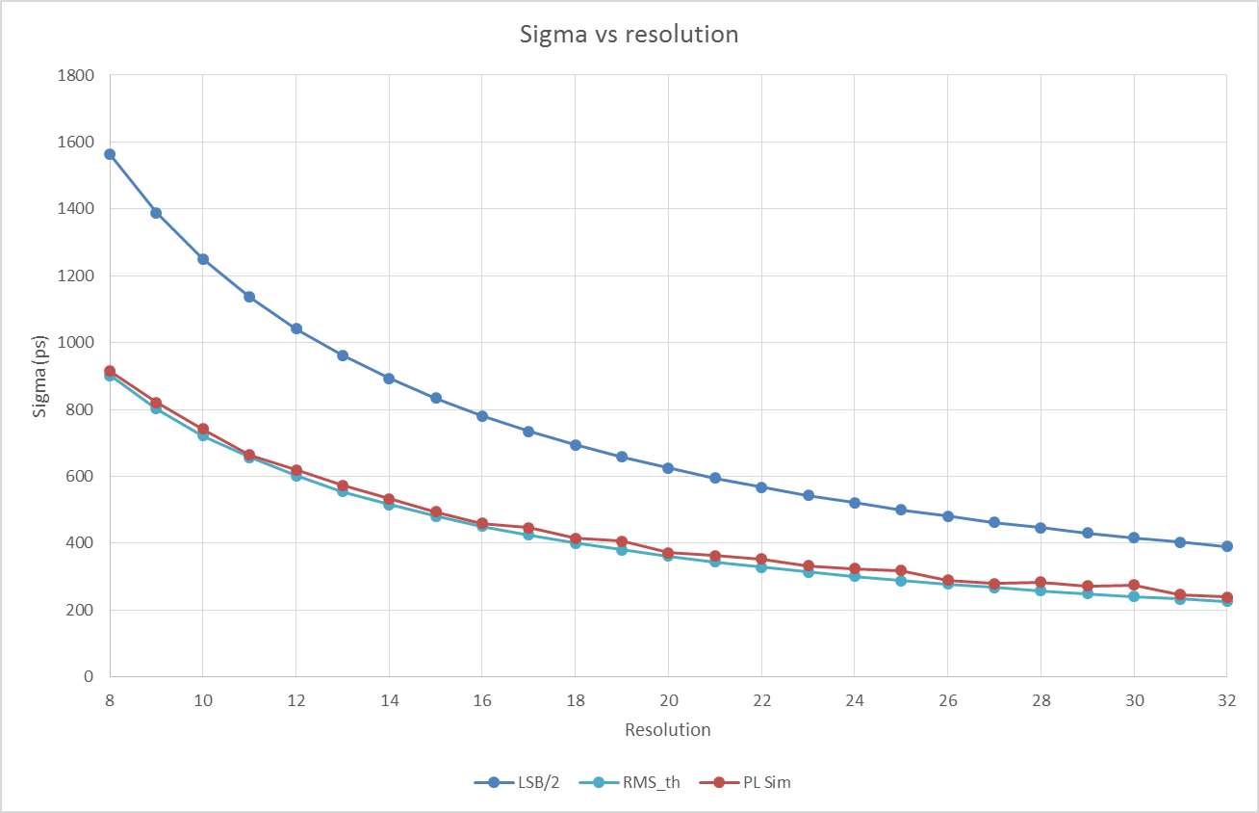
TDC Results: Sigma plots
Below are some plots comparing the error sigma plots vs resolution. The LSB/2 and the Theoric sigma curves are plotted as reference
The Sigma curve obtained from Post-Layout Simulation is shown
LHCb

Slide 8
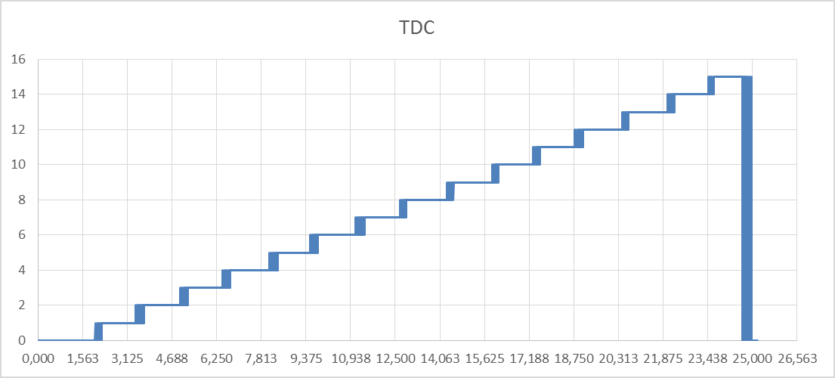
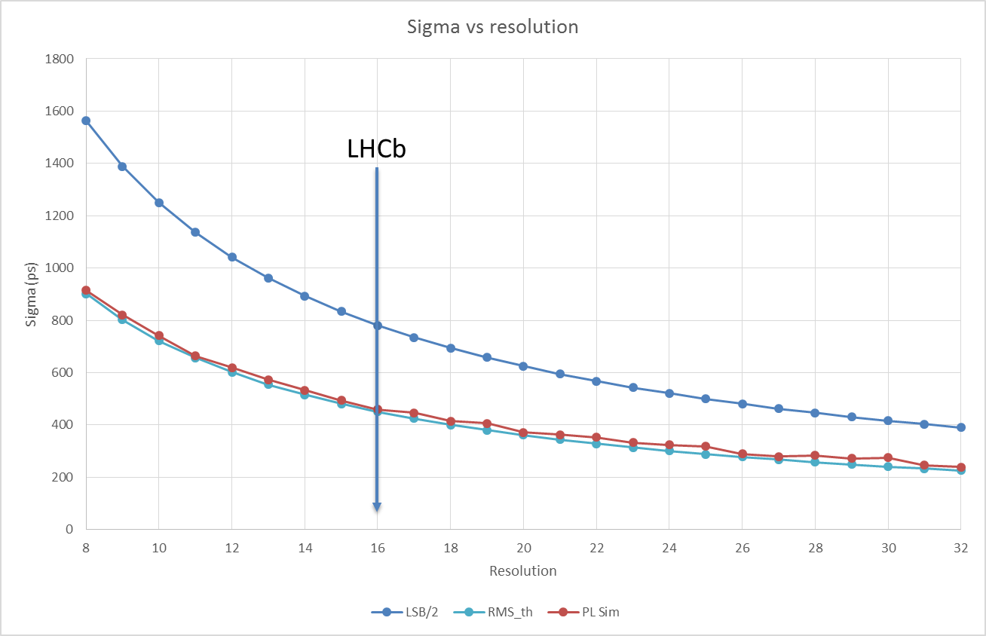
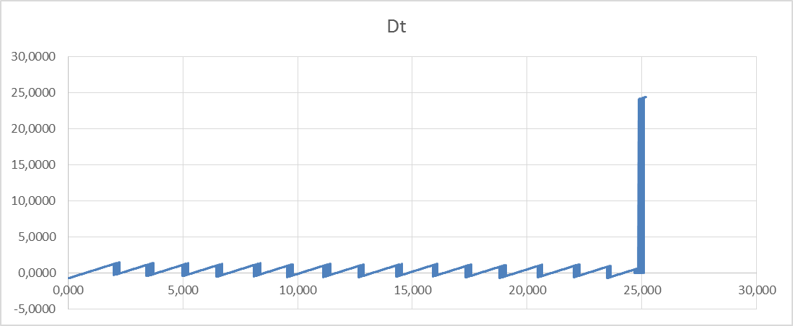
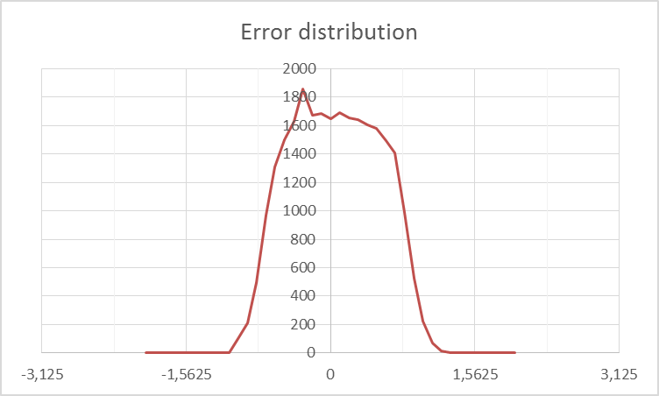
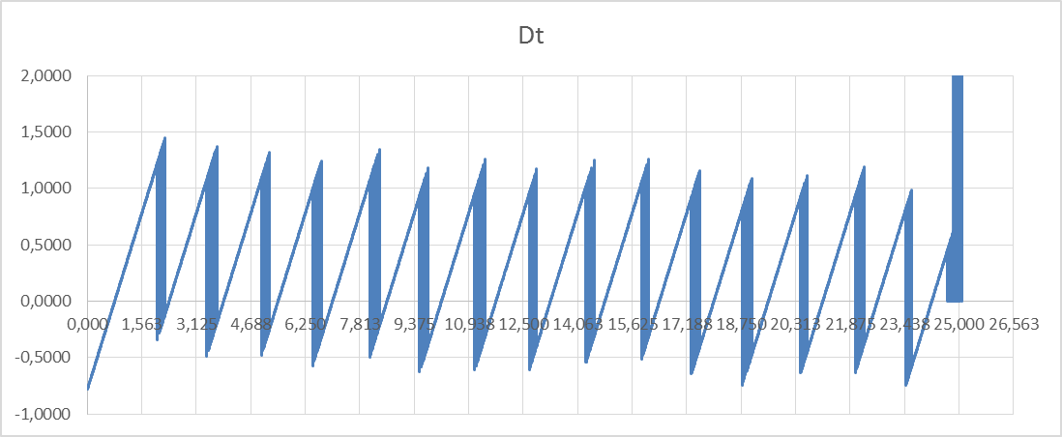
TDC results: >20K samples
This test is performed comparing the phase measured by the Scope and the TDC under test read-back from LabView.
Below are reported results for the resolution of 16 (that will be used @ LHCb)
Sigma is 480ps

Slide 9
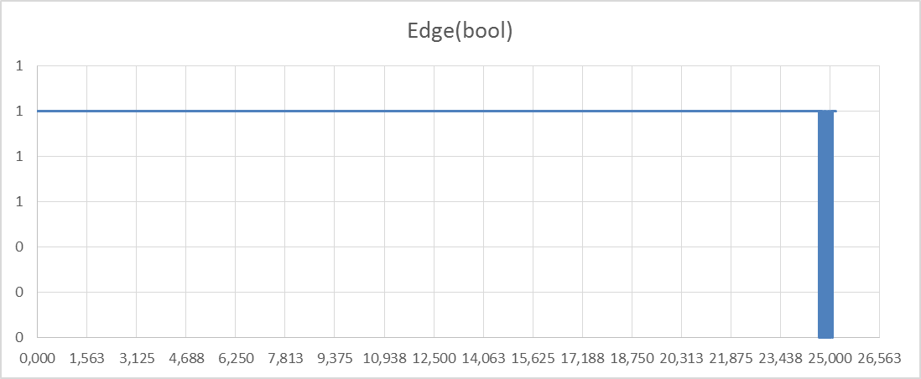
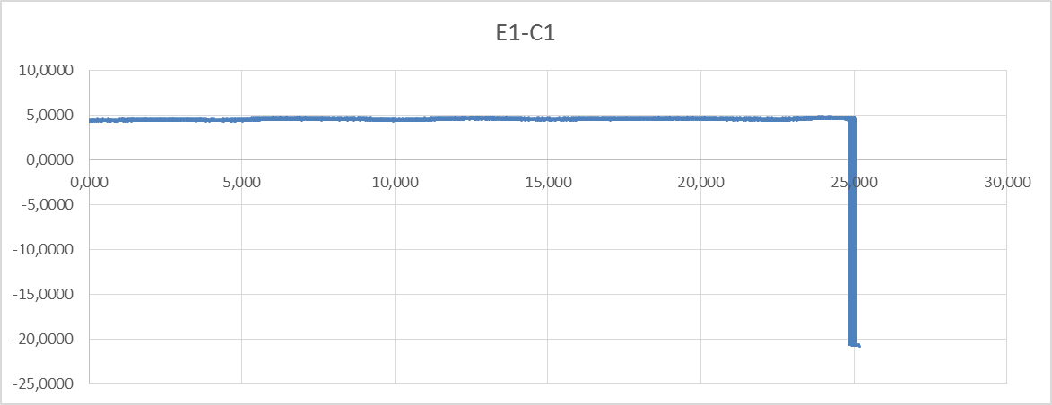
TDC Efficiency: >20K samples
Two kind of Efficiency are tested: Missing Hits and Wrong Clock Cycle
Missing Hits
  This test is done sending an input signal and looking for missing Hit flag.
  Efficiency is around 99,4%
  All the missing hits are around the rising edge of the master clock
Wrong Clock Cycle
  This test is done sending an input signal and verifying the “delay” of the output hit
  Efficiency is around 99,5%
  All the wrong clock cycles events are around the rising edge of the master clock

Slide 10
Nsync: status report

Slide 11
nODE
Hit map
nSYNC
48Input ch
4 nSYNC @ 48 channels
4 GBTx for hit+ TDC data
  Slave GBT
1 GBTx forTFC/ECS
  MasterGBT
1 GBT-SCA
2 VTTx
1 VTRx
GBTx
TDC out
VTTx
Hit map
nSYNC
48Input ch
GBTx
TDC out
Hit map
nSYNC
48Input ch
GBTx
TDC out
VTTx
Hit map
nSYNC
48Input ch
GBTx
TDC out
VTRx
GBTx
ECS
GBT
SCA

Slide 12
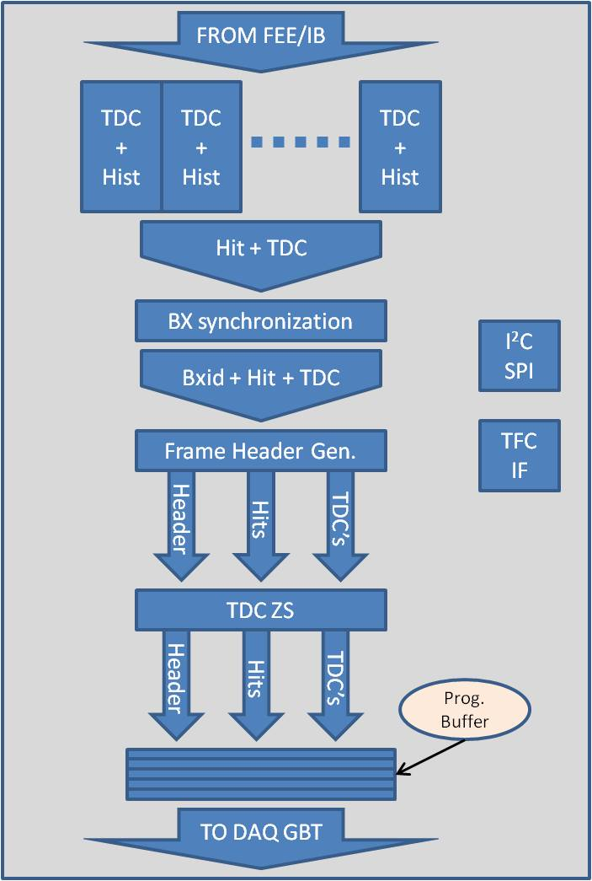
nSYNC block diagram
48 input channels
Each channel equipped with its own TDC + Histogram facility. The Histo’s can be read back through ECS
BX synchronization
  BXid counter is 12 bit wide
Frame header builder
  Frame fixed will be implemented
  Header will be 16 bits wide
  Full Hit Map NZS + TDC data ZS according to the Hit Map (starting from channel number 0)
TDC Zero suppression
  ZS algorithm should take less then 1 clock cycle
  ZS can be bypassed setting the WOI (Window Of Interest) via ECS.
Frame will be protected with Hamming code (programmable via ECS)
TFC interface decoder
ECS interface: I²C, SPI or both
Implement all the status/monitor/error registers

Slide 13
Fixed Frame – Our choice
Data Frame: 112 bits
Header
48 Hit bits
4
4
4
4
4
4
4
4
4
4
8 edac
Header
48 Hit bits
5
5
5
5
5
5
5
5
8 edac
Frame using the 8 bits Hamming/EDAC, hits NZS, two possibility for TDC data (depending on the resolution), 16 bits for the Header
  4 TDC bits: max 10 channels (20,8%), “full frame”
  5 TDC bits: max 8 channels (16,6%), “full frame”
Data Frame: 112 bits
Header
48 Hit bits
4
4
4
4
4
4
4
4
4
4
4
4
Header
48 Hit bits
5
5
5
5
5
5
5
5
5
Frame using no protection, hits NZS, two possibility for TDC data (depending on the resolution), 16 bits for the Header
  4 TDC bits: max 12 channels (25%), “full frame”
  5 TDC bits: max 9 channels (18,7%), three bits “empty”

Slide 14
Fixed Frame and NZS
ZS data transmission:
NZS data transmission (?):
  Our Hit Map (which contains physics information) is always NZS.
  TDC data are used mainly for monitoring purposes.
  We can give the possibility to fix (via ECS) the window of TDC data instead of having the ZS TDC (this can be used for special runs like PDM or calibration runs)
  This means we could ignore the NZS TFC command
Head X
Hit Map X
ZS TDC data X
Head X+1
Hit Map X+1
ZS TDC data X+1
Head X+2
Hit Map X+2
ZS TDC data X+2
Head X
Hit Map X
NZS TDC data-W1 X
Head X+1
Hit Map X+1
NZS TDC data-W1 X
Head X
Hit Map X
NZS TDC data-W2 X
Head X+1
Hit Map X+1
NZS TDC data-W2 X
Head X
Hit Map X
NZS TDC data-W3 X
Head X+1
Hit Map X+1
NZS TDC data-W3 X

Slide 15
Conclusions
TDC:
  First prototype submitted in February 2015
  Test started in September 2015
  Results are in agreement with the post-layout simulations
nSYNC:
  Main data flow blocks are implemented
  TFC interface is now under development
  ECS interface and configuration register designs are on going
Data Format:
  We have defined our format and its implementation is already almost done.

Slide 16
SPARE

Slide 17
TDC Calibration
Calibration is performed launching a TDC measure with a calibration signal at the beginning of the clock cycle. The TDC count is compared with the resolution requested. For better results we integrate the counts for 8 master clock cycles.
Calibration is divided in 4 different phases:
  The best 6 bit control code is searched using a SAR (Successive Approximation Register) approach.
  Refinement of previous found code moving it by +/- 1 and verifying if the result is better.
  Determining the direction of the dithering
  Determining how long, in term of DCO generated clock cycles, the dithering must be applied to minimize the systematic error
Phase 3 and 4 can be skipped if the dithering is disabled or if the previous phases detected the dithering is not needed
Digital words controlling the DCO and Dithering are output from the TDC and can be used to verify the TDC Calibration results.

Slide 18
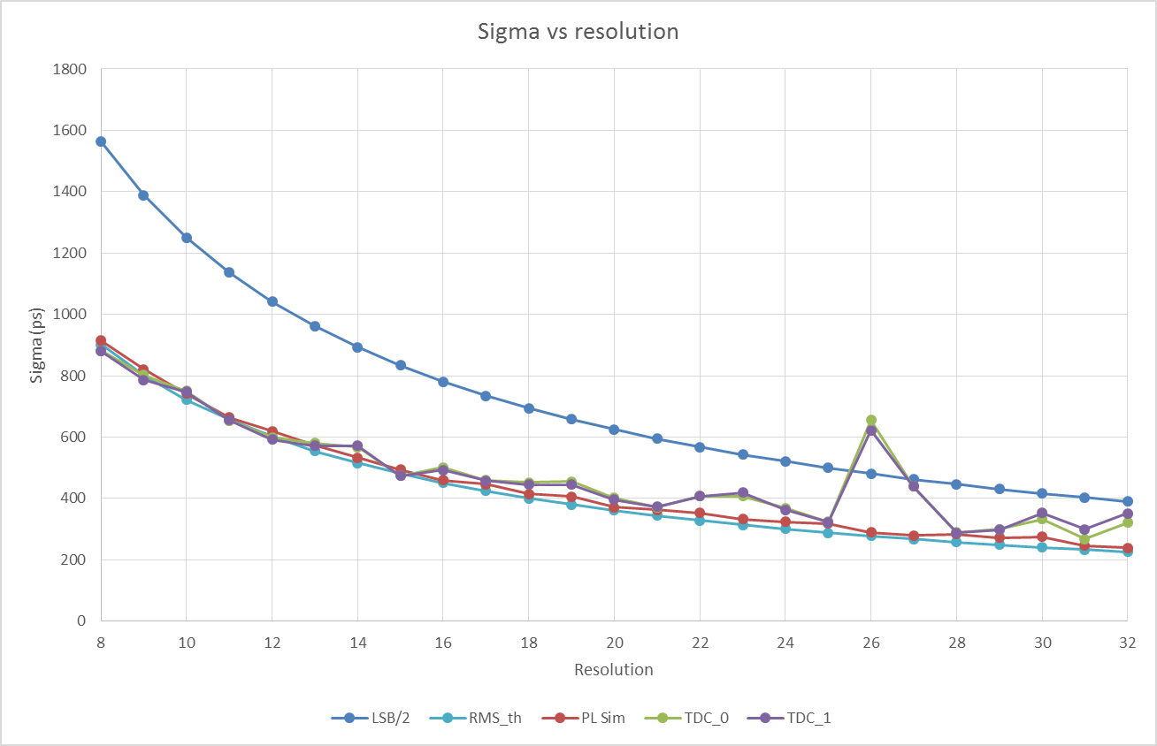
TDC Results: Sigma plots (200 samples)
Below are some plots comparing the error sigma plots vs resolution. The LSB/2 and the Theoric sigma curves are plotted as reference
The Sigma curves obtained from TDC’s under test are shown.
LHCb

Slide 19
Fixed Frame – Reasons of our choice
We choose to use the Fixed Frame with Full Hit Map plus TDC data ZS.
Data Frame (Header + HitMap + TDC) can be protected by an Hamming/EDAC code. This possibility will be programmable.
We have always the Hit Map (i.e. the “physics” information) whatever the occupancy will be. The worst we truncate TDC data.
  The HitMap scheme was approved by trigger people that said (Julien Cogan): ”it is much better to have the hit map separated from the hit times which are not used in the trigger. It would help if the hits are sorted by station and region to speed up the sorting in the software.”
This solution guarantee the maximum occupancy.
The GBT links are always aligned.
Less resources in the nSYNC
Less resources in the TELL40 FPGA.

Slide 20
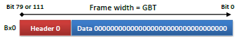
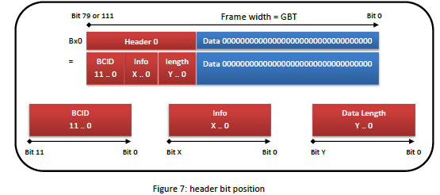
Fixed Frame: Technical details
The Header start at the MSB position of the GBT frame ( bit 111 in our case)
This is also true for the fields inside the Header
Our frame is packed as following:
  Header – Hit Map – TDC data – Hamming bits
In case Sync command is receive, the frame will be:
  Header (12 BXid bits) + sync_pattern (16 bits) + all zero’s
  The Hamming bits will be placed at the same position

