Slide 1
ESPERIMENTO NUCL-EX: Nuovo piano quadriennale
Sede | Ricercatori | Tecnologi | FTE
Legnaro | 7 | 1 | 4.7
Padova | 1 |  | 1
Bologna | 3 | 1 | 2.8
Firenze | 10 |  | 9.3
Napoli | 8 | 1 | 6
Due linee di ricerca principali:
SPES dinamica delle reazioni nucleari in prospettiva di SPES (Clustering, pre-equilibrio, isospin).
FAZIA attività energie intermedie (LNS, GANIL)
Collaborazioni internazionali:
Europa: GANIL, LPC, IPNO, KU Leuven, Nevsehir Univ India: BARC (Mumbai)
30 Ricercatori (24 FTE)
Rappresentanti Nazionali: S. Barlini (FI), L. Morelli (BO)
RICHIESTE 2016
CAPITOLO | PD (2016)
MISSIONI | 6 k€
CONSUMO | 9 k€
INVENTARIO | 0,5 k€
TOTALE | 15,5 k€
TOTALE RICHIESTE Collaborazione
2016 508 k€ | 2017 350 k€ | 2018 250k€ | 2019 250 k€
Notes:
1

Slide 2
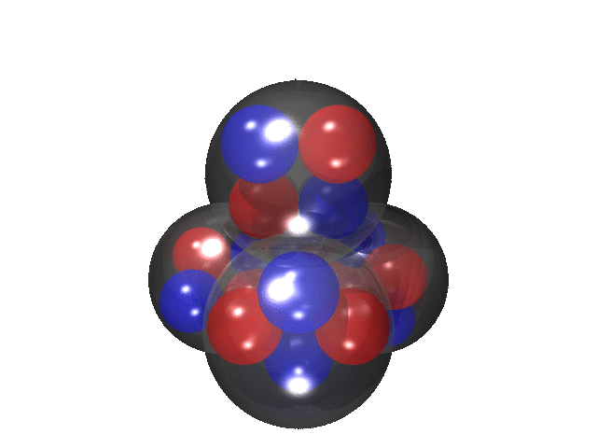
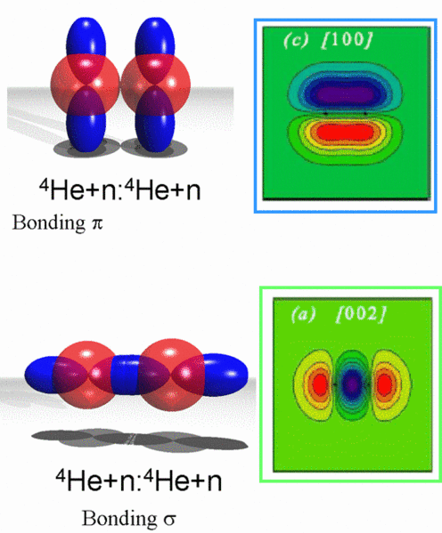
Clustering, Pre-equilibrium, isospin… towards SPES
Clustering in nuclei
Cluster structure appears close to the decay thresholds
The interest in nuclear clustering has been pushed strongly due to the study of neutron-rich and exotic weakly-bound nuclei
WHAT ABOUT HEAVIER SYSTEMS ?
Cluster emission, transfer and capture in nuclear reactions
P.E. Hodgson, E. Betàk, Phys Report 374 (2003) 1
Pre-equilibrium processes
Coalescence vs Preformation
Isospin with FAZIA
¹³²Sn + ²⁷Al @ 11 AMeV
¹³⁰⁻¹³²Sn + ³⁰⁻²⁸Si @ 11 AMeV
Isospin dependence of in-medium effective interaction
plays important role in nuclei and neutron stars.
Proton and neutron exchange
Isospin Drift and Diffusion
¹¹⁴Sn
¹¹⁶Sn
¹²⁴Sn
¹³⁰Sn
1,6 10⁸
¹³²Sn
2,0 10⁷
Proton
¹¹⁴⁻¹¹⁶Sn + ³⁰⁻²⁸Si
⁸⁵Rb
⁸⁷Rb
1,6 10⁸
⁹⁴Rb
2,7 10⁸
⁹⁶Rb
2,0 10⁷
SPES
Day 1 Beams!
(I /40)
ρ/ρ₀
Isospin drift
Ν/Ζ
Proj
Targ
Isospin diffusion
n drift
STABLE targets
⁹⁴⁻⁹⁶Rb + ³⁰⁻²⁸Si
1
²⁸ Si
³⁰ Si
⁸⁵⁻⁸⁷Rb + ³⁰⁻²⁸Si
n/p diffusion
SPES
²⁷Al
TLF
Neck
PLF
TLF
Neck
PLF

Slide 3
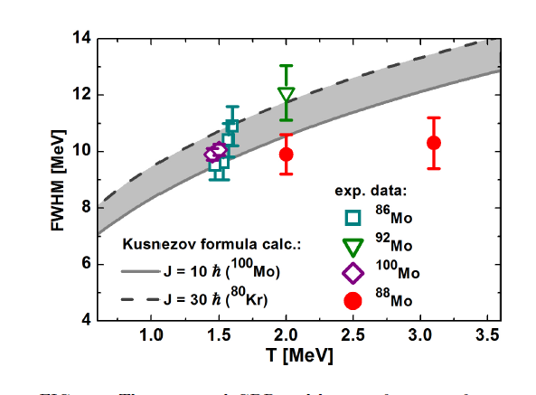
Pubblicazioni 2014-2015
GARFIELD + Phoswich wall + HECTOR (BaF₂ array)
M. Ciemala et al. Phys. Rev. C 91, 054313 (2015)
A.J. Kordyasz et al. Eur. Phys. J. A 51, 15 (2015) (FAZIA)
A. Giaz et al. Phys. Rev. C 90, 014609 (2014) (GARFIELD+HECTOR)
D. Fabris et al. Acta Physica Pol. B 46 (2015) 447
F. Gramegna et al. Acta Phys. Pol. B 46 (2015) 591
F. Gramegna et al. - Journ. of Physics: Conf. Series - 012011 – vol 580 (2015)
T. Marchi et al. – PRL 113 (2014) 182501
E. Wildner et al. – Phys. Rev. Special Topics 17 (2014) 071002
L. Morelli et al. JOP G 41 (2014) 075107
L. Morelli et al . JOP G 41 (2014) 075108
G. Pasquali et al. EPJA 50 (2014) 86
M. Ciemala et al. Giant dipole resonance built on hot rotating nuclei produced during evaporation of light particles from the ⁸⁸Mo compound nucleus
Phys. Rev. C 91, 054313 (2015)
Saturazione della larghezza della GDR con la temperatura nucleare
In fase di invio per pubblicazione:
S. Appannababu et al. (dati RIPEN) - Study of Mass, Total Kinetic energy and Neutron Multiplicity Correlations in the binary fragmentation of ⁵⁰Ti + ²⁰⁸Pb at 294 MeV bombarding energy
S. Valdrè et al (dati GARFIELD + Phoswich wall + HECTOR ) Phys. Rev. C - Decay of excited ⁸⁸Mo nucleus in fusion-evaporation and fusion-fission reactions

Slide 4
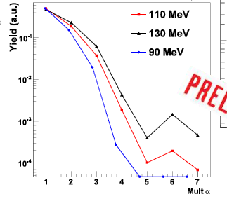
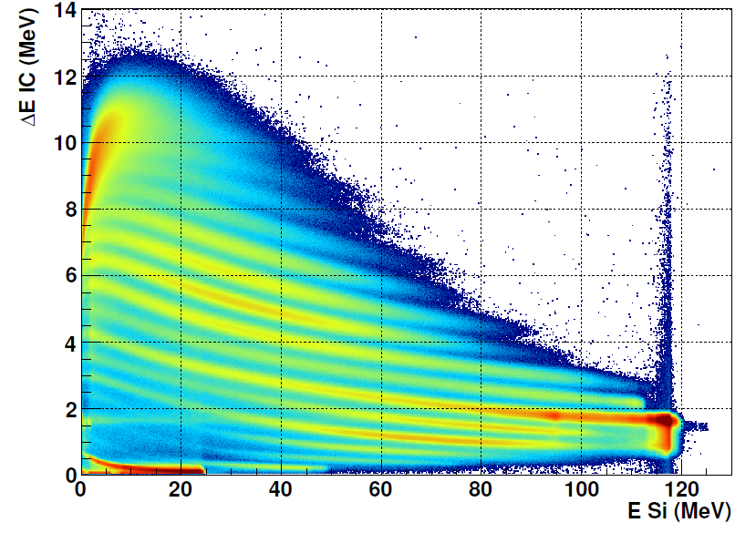
GARFIELD +RCo: Attività sperimentale 2014-2015
Campagna DELIGHT: Studio del clustering nei nuclei leggeri N=Z tramite reazioni di fusione-evaporazione (10 giorni di beam time marzo 2015)
90, 110, 130 MeV ¹⁶O + ¹²C→ ²⁸Si*
1 new proposal approved by LNL PAC (June 2015)
²⁴Mg + ¹²C, ¹³C @ 133, 115 MeV
Preliminary
Possibilità dell’esistenza di uno stato a 7 α nel ²⁸Si
M_{α}
Campagna ACLUST: Studio del clustering nei nuclei attraverso lo studio dell’emissione di pre-equilibrio di particelle cariche (14 giorni di beam time maggio – giugno 2015)
Projectile | Target | Energy (MeV/A)
¹⁶0 | ³⁰Si | 7
¹⁶0 | ³⁰Si | 8
¹⁸O | ²⁸Si | 7
¹⁹F | ²⁷Al | 7
ER
ΔE-E RCo IC-SiE
7 MeV/A ¹⁸O + ²⁸Si
²⁸Si

Slide 5
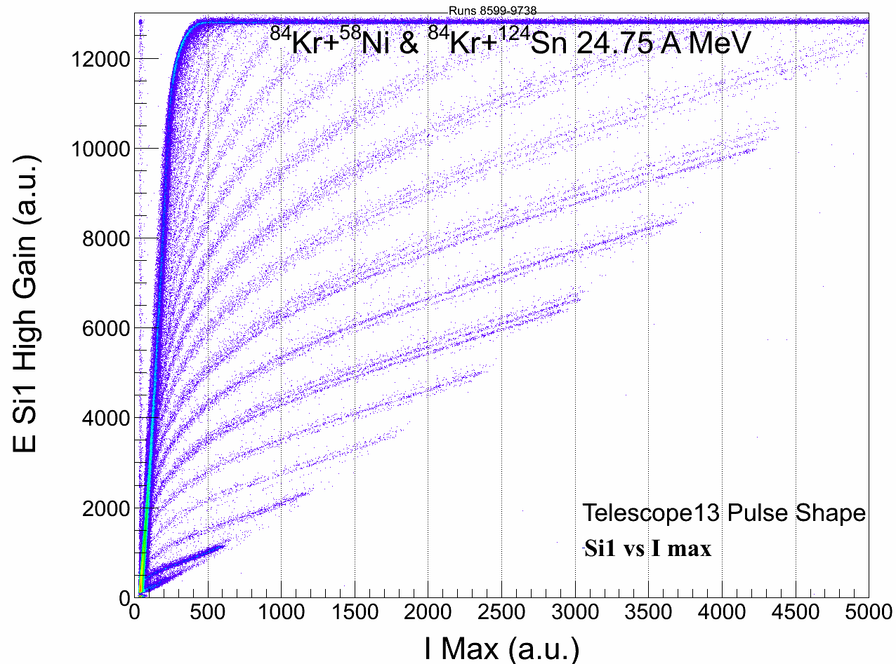
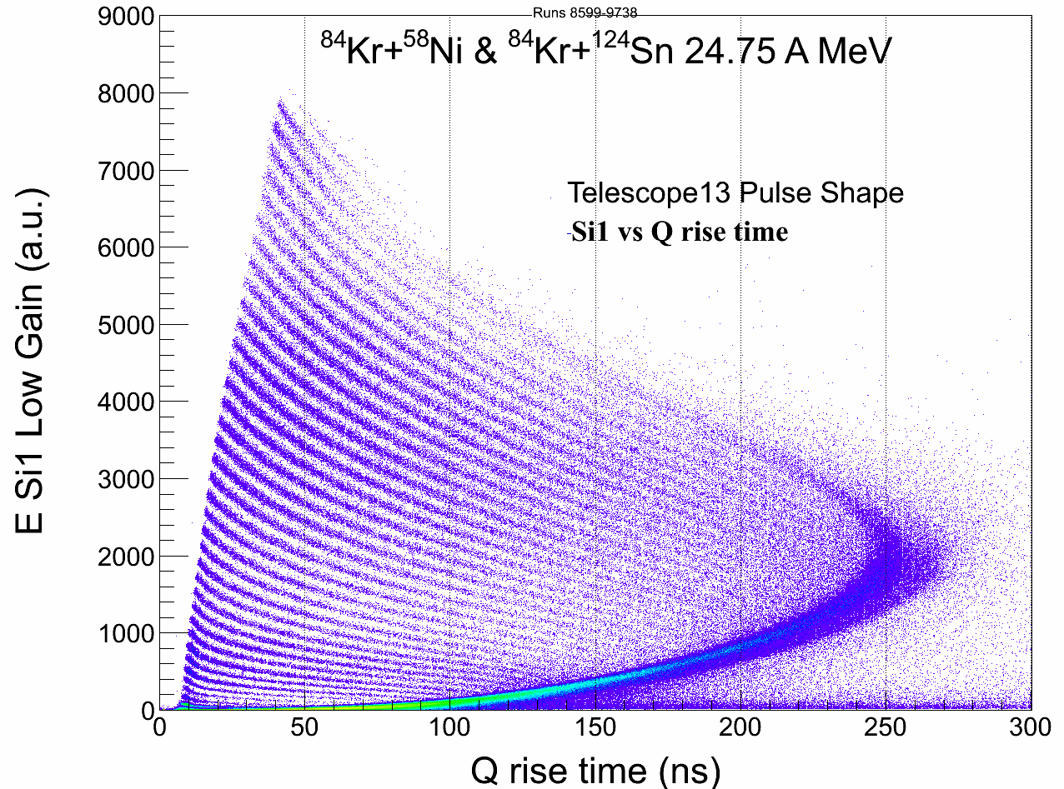
FAZIA: Attività sperimentale 2014-2015
FAZIA Commissioning @ LNS (December 2014): Masses on particles stopped in the first Silicon!
PSA on current signal
PSA on charge signal
Beam time @ LNS (June 2015): Role of isospin diffusion on Quasi-Projectile sequential fission
⁸⁴Kr+^{40,48}Ca@35 AMeV
Copertura angolare maggiore rispetto al precedente turno → 4 blocks (64 telescopi)
QP fission: rivelazione dei due frammenti di fission da QP in coincidenza (identificazione isotopica fino a Z=20)
Beam time @ LNS (FALL 2015): Precise measurement of fragment cross section ⁴⁰Ca+^{48,40}Ca @ 35 AMeV

Slide 6
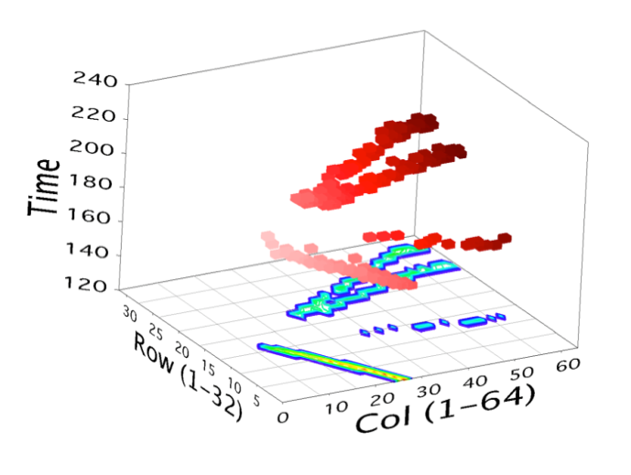
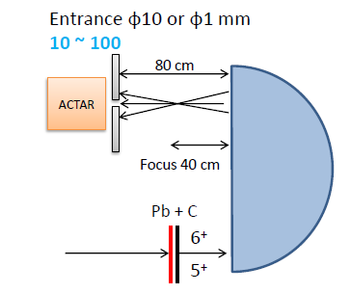
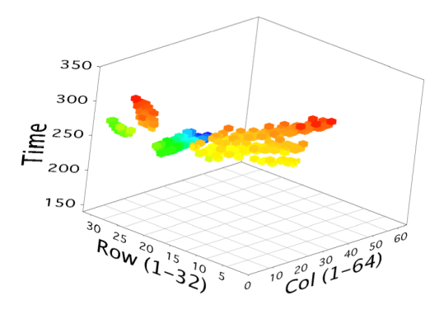
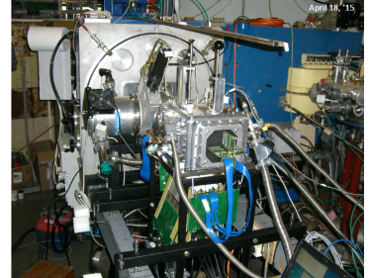
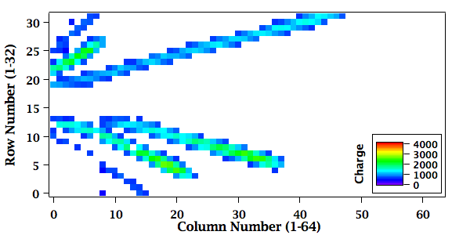
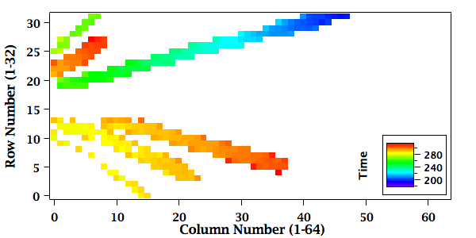
ACTAR_TPC, SPECMat MagicTin
Feb 2015: MagicTin Project approved by UE (MSC Action) T. Marchi → ¹³⁴Sn(d,p)¹³⁵Sn @ SPES
→ preliminary test: ¹²⁰Sn(d,p)¹²¹Sn @ LNL
April 2015: Experimental Area Request sent to LNL director.
8-12 June 2015 [N-SI-37b @ IPNO]:Hoyle State via ¹²C(α,α’)
Charge Projection
He:C₄H₁₀ 90:10
Time Projection
Bacchus
¹²C beam
Run 30 Event 265:
6 particles
29 June – 3 July 2015 [N-SI-78 @ IPNO]: Search for cluster states in ¹⁰B.
FALL 2015: ACTAR collaboration meeting; 2016: ACTAR demonstrator test @ GANIL

