Slide 1
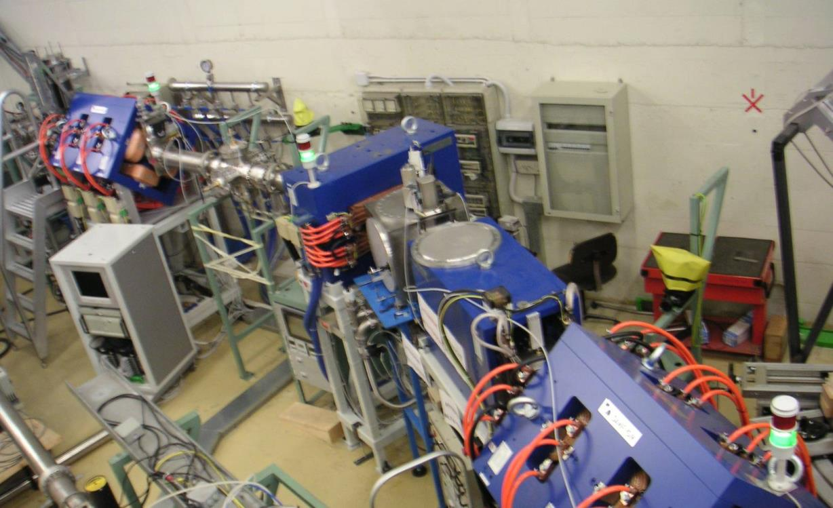
EXOTIC (7 ricercatori, 5.4 FTE)
NA (3.1 FTE) M. La Commara (0.8), G. La Rana (0.3), C. Parascandolo (1.0), D. Pierroutsakou (1.0)
PD (2.3 FTE): M. Mazzocco (1.0), F. Soramel (0.5), E. Strano (0.8)
1) Reaction mechanisms and the structure of weakly bound stable and exotic nuclei and measurements of astrophysical interest with RIBs (PD)
2) Collective modes: Study of the pre-equilibrium dipole γ ray emission in dissipative heavy-ion reactions (NA)
Gas Target
1st Quadrupole Triplet
PRIMARY
BEAM
30°-Dipole Magnet
Wien Filter
⁷Be, ⁸Li, ⁸B, ¹⁵O, ¹⁷F
SECONDARY BEAM
2nd Quadrupole Triplet

Slide 2
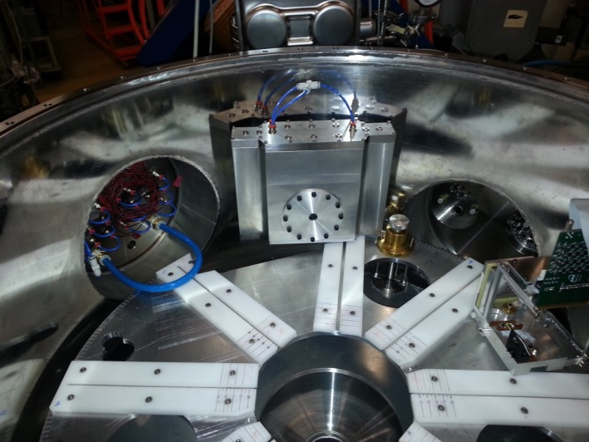
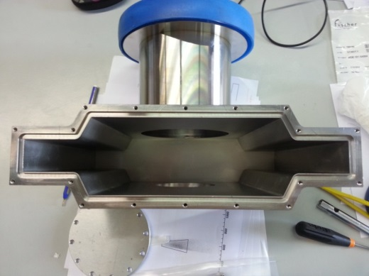
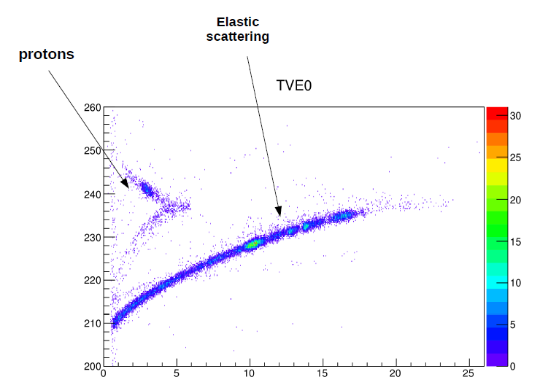
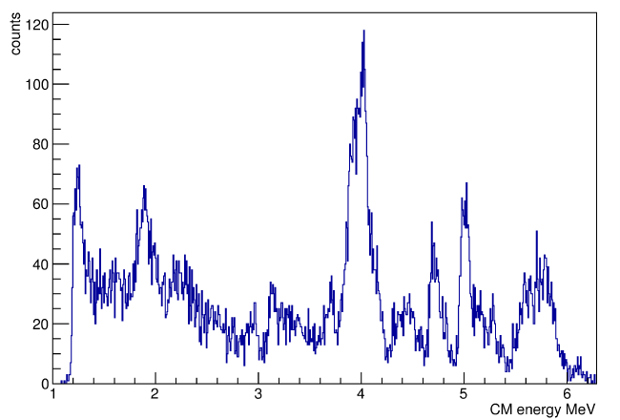
Experiments: July 2014 – June 2015
⁷Be+²⁸Si @ 17.2 MeV
(Oct. 2014)
¹⁵O+⁴He @ 27.2 MeV
(Feb. 2015)
PPAC B
Havar
window
Quasi-Elastic Scattering
Rearrangement of the EXOTIC final scattering chamber
Threshold Anomaly
Cluster configurations in ¹⁹Ne via resonant scattering

Slide 3
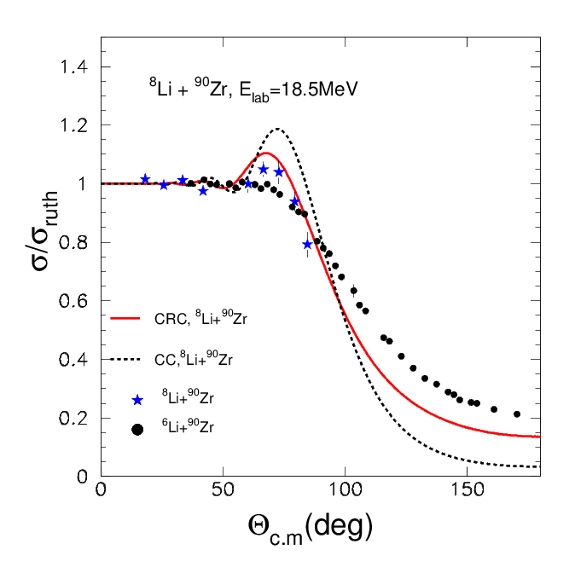
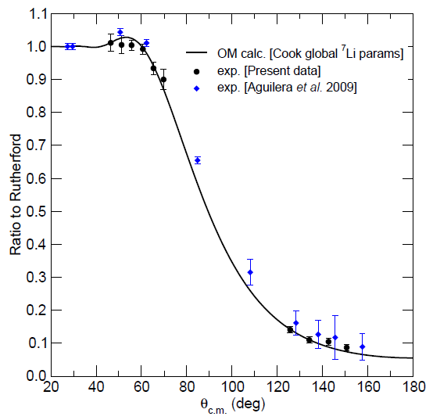
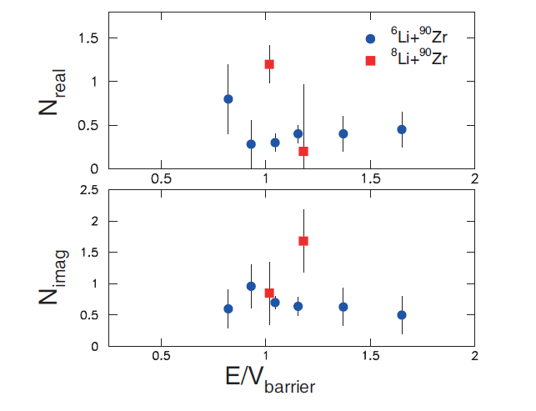
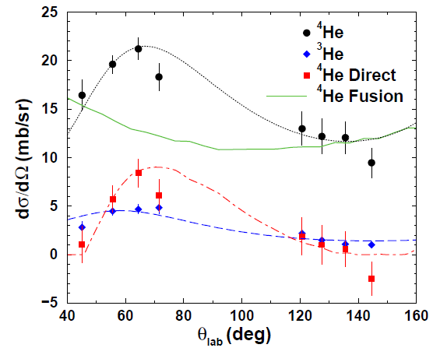
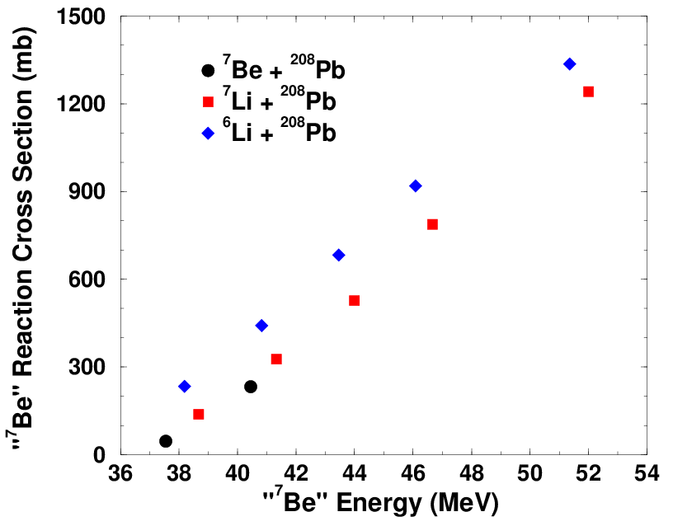
Data Analysis: July 2014 – June 2015
⁸Li+⁹⁰Zr @ 20 MeV
(Published)
⁷Be+⁵⁸Ni @ 22 MeV
(to be submitted)
⁷Be+²⁰⁸Pb @ 40 MeV
(Master Thesis)
Quasi-Elastic Scattering
Quasi-Elastic Scattering
A. Pakou et al., PLB (submitted )
A.Pakou et al., EPJA 51, 55 (2015)
^{3,4}He production
Reaction Cross Section

Slide 4
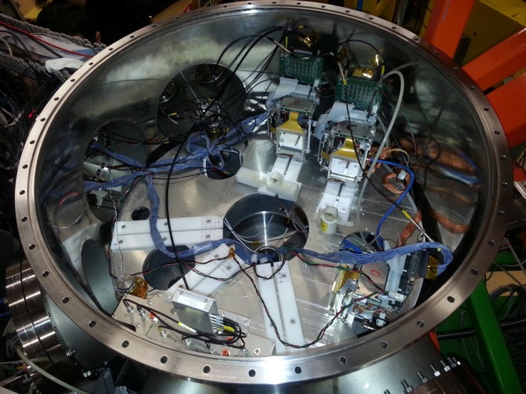
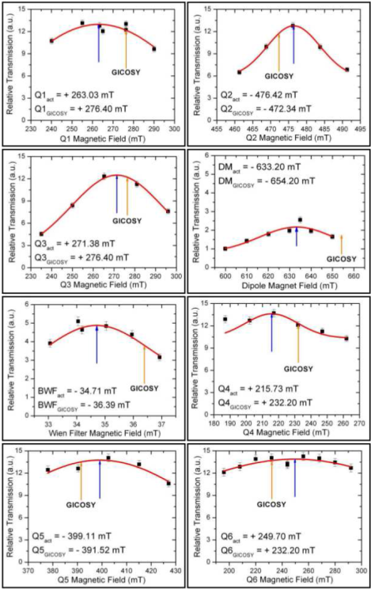
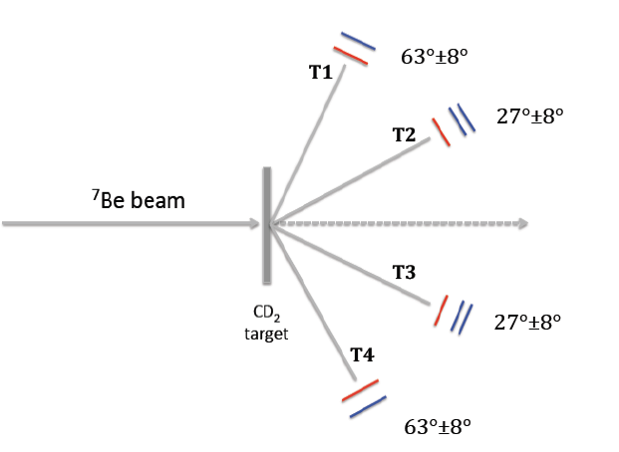
Activity: July 2015 – June 2016
EXOTIC as Recoil Separator (PRISMA)
July, 18-20
⁷Be+n → ⁴He+⁴He
(ASFIN+LUNA)
13 days, Oct. – Nov.
¹⁰C Development
(LNS-STREAM)
2 days, Oct. – Nov.
d
p
n
α
⁷Be
Laser-assisted Alignment
α
¹⁰C secondary beam development for future cluster configuration studies in ¹⁴O (via resonant scattering ¹⁰C+⁴He)
Reaction relevant for the BBN nucleosynthesis and the cosmological ⁷Li problem

Slide 5
Richieste finanziarie 2016: CA, Cons, T, M
(preliminare)
Le richieste si riferiscono a EXOTIC Sez. Napoli e Sez. Padova
Richieste totali Missioni: 20 k€ Interno - 13 k€ Estero
Costruzione Apparati
10 k€ : Criogenia Linea EXOTIC
5 k€: Manutenzione Linea
12 k€: 4 MEGAMP for i QQQ2 (12 k€ anche nel 2017)
Consumo
7.5 k€ : 1 DSSD di 1.5 mm (lo stesso nel 2017)
6 k€: (elettronica per 8 schede di elettronica di basso rumore per i QQQ2 e materiale di laboratorio)
2 k€: isotopi
Manutenzione
2 k€
Trasporti
3 k€ (trasporto di materiale fragile)
Totale: 80.5 k€
Richieste ai Servizi della Sezione INFN di Padova
Laboratorio di Elettronica: 2 mesi/uomo (assistenza/manutenzione)
Officina Meccanica: 3 mesi/uomo (realizzazione e messa in opera piccole componenti)
Progettazione: 1 mese/uomo (ev. progettazione piccole componenti)

