Slide 1
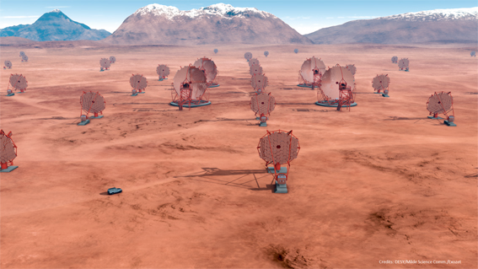
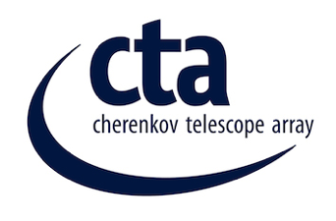
ATMOSPHERIC MONITORING AND CALIBRATIONS PLANS WITH CTA
Michele Doro (michele.doro@pd.infn.it)
University and INFN Padova
GAG Meeting, 2015/03/27

Slide 2
Why IACTs need atmospheric calibration

Slide 3
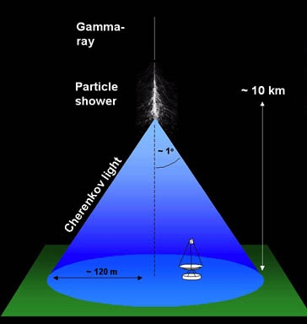
What’s with the atmosphere
The atmosphere is the place where
  The gamma-ray has the first interaction with atmospheric molecules
  The electromagnetic and hadronic showers take place
  The Cherenkov light is transmitted to the ground
Goal is <8% uncertainty in the energy reconstruction

Slide 4
What’s with the IACT
All three aspects are influenced by atmospheric conditions and this is reflected in the data
  On the energy threshold
  On the energy bias and resolution
  On the effective area
  On the spectral reconstruction
  On the reconstruction of the gamma-ray direction
And on the observatory handling
  Reduce to a minimum data taken under non-optimal conditions and later thrown away during the analysis
  Smart scheduling? E.g. a) move to a source better visible under current observation conditions, b) move to a source that does not require so low energy threshold c) move to a source that does not require precision pointing

Slide 5
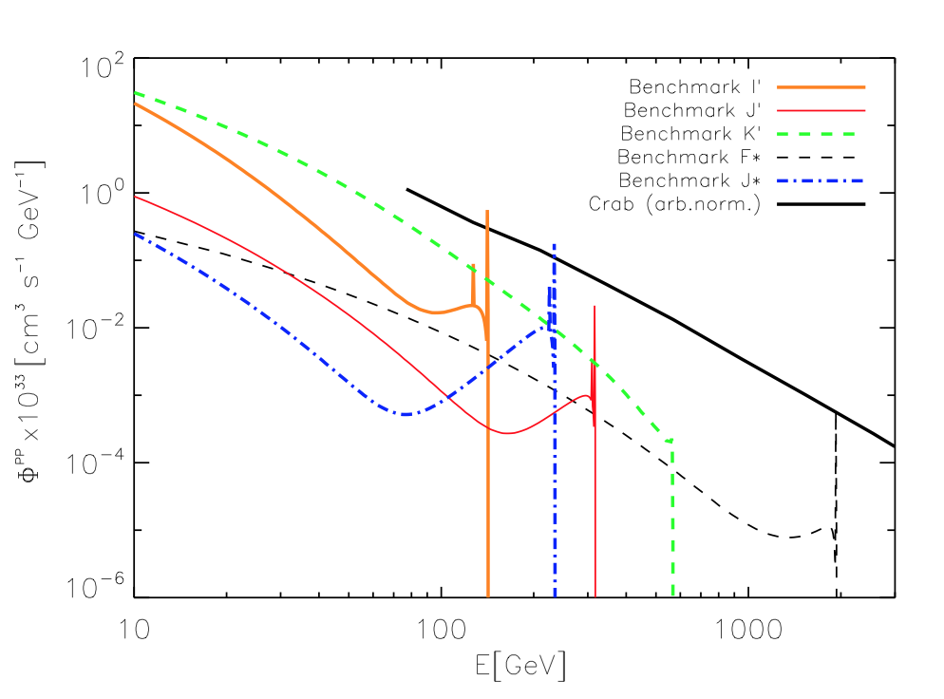
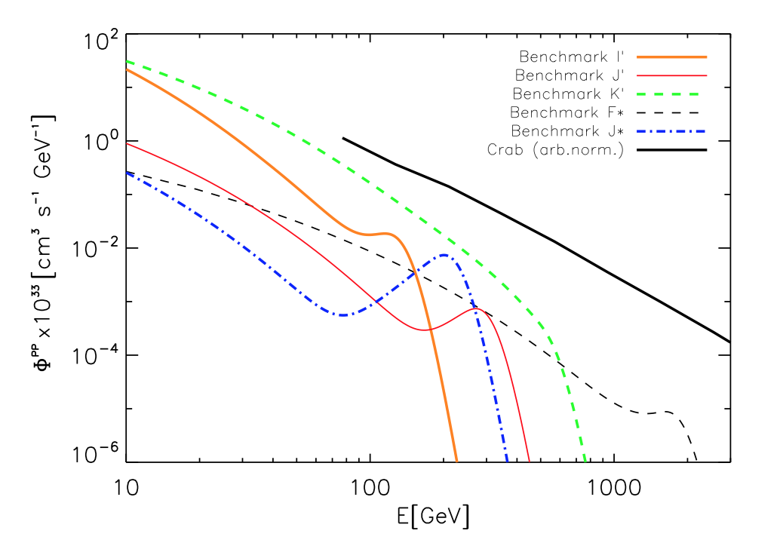
Energy resolution

Slide 6
How do aerosol layers influence IACT data?
Does the height of the aerosol overdensity matter? A MC study was made (Garrido+ 2012) now ongoing for CTA (INFN PD, NA, TO)
3 models
  Changing global density
  Changing “cloud” altitude
  Changing “cloud” density
Comparison between
  Wrong MC
  Good MC
  Correction method

Slide 7

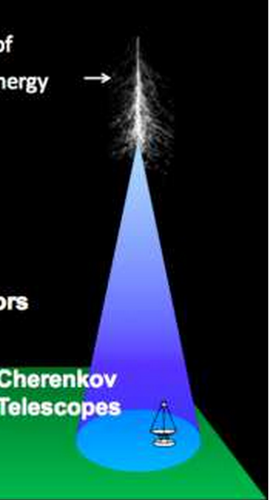
Main outcomes of the study
By using the correct MC (including hazy atmosphere) one get back the correct energy and flux information
Location of the aerosol or cloud overdensity:
  Below the electromagnetic shower (~10km above the ground),
  ➔A simple total transmission parameter is sufficient for data reconstruction
  At the level of the e.m. shower
  ➔effect on data is not linear anymore
  Above the e.m. shower, no effect on data

Slide 8
Energy threshold
Using correct MC, energy and flux reconstruction is correct, at the only expense of a larger energy threshold
Higher global density
Variable “cloud” position
Garrido et al., Proc. 33rd ICRC, Nr. 465, arXiv: arXiv:1308.0473

Slide 9
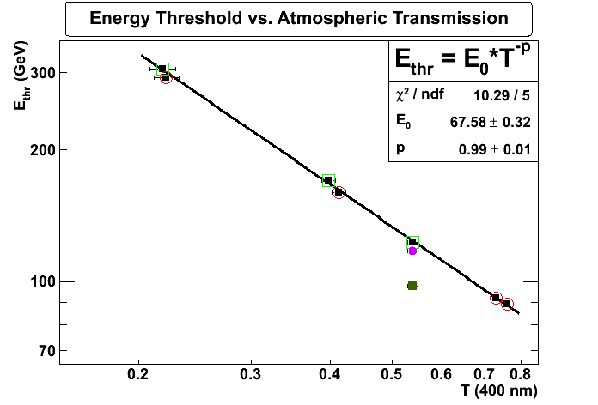
e.g. Energy Threshold
ground
6 km
10 km
14 km
Up to >6 km a.s.l.: E_{thr} = E₀ / T (400 nm)
Garrido et al., Proc. 33rd ICRC, Nr. 465, arXiv: arXiv:1308.0473

Slide 10
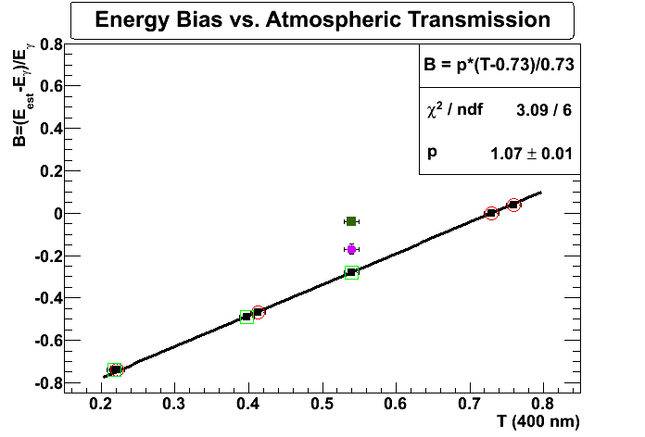
e.g. energy Bias
14 km
6 km
10 km
ground
Up to >6 km a.s.l. (until 5 TeV): (E_{rec}-E_{γ})/E_{γ} = (T-0.73)/0.73
(can be corrected using only total atmospheric transmission)
Garrido et al., Proc. 33rd ICRC, Nr. 465, arXiv: arXiv:1308.0473

Slide 11
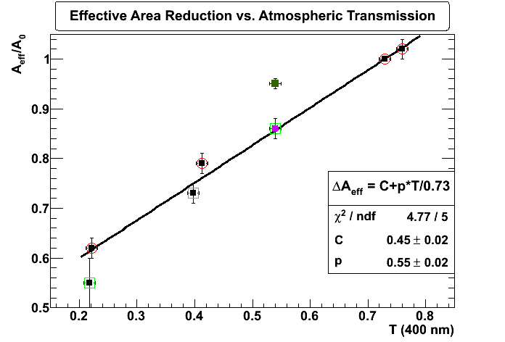
e.g. effective area
14 km
6 km
10 km
ground
Up to >6 km a.s.l. (until 5 TeV): A_{aerosols}/A_{ref} = 0.45+0.75*T
Garrido et al., Proc. 33rd ICRC, Nr. 465, arXiv: arXiv:1308.0473

Slide 12
Result 2
In case the aerosol overdensity or cloud is below the electromagnetic shower, simple correction methods can be used to restore correct energy and flux reconstruction
Garrido et al., Proc. 33rd ICRC, Nr. 465, arXiv: arXiv:1308.0473

Slide 13
Conclusion
When the clouds or aerosol layer is at the shower development region or above, the total extinction is no longer a useful parameter
It is therefore important to know the differential atmospheric tranmission. We need instruments with height resolution!

Slide 14
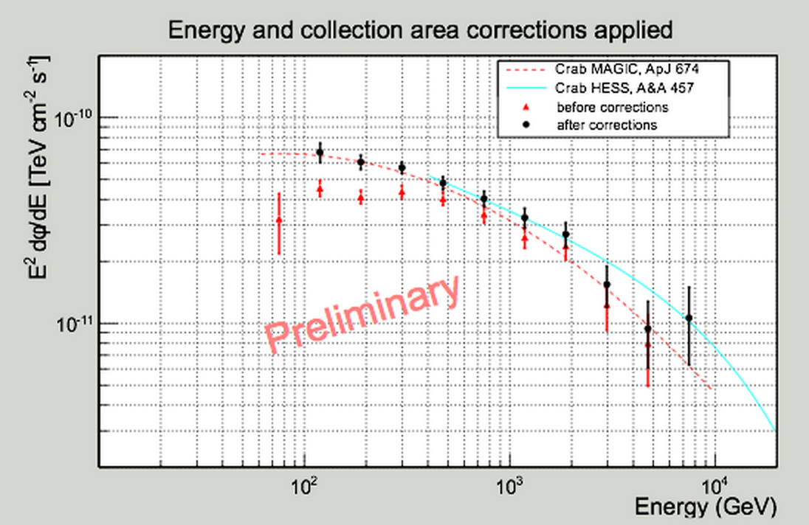
On the right way…
When taking full Lidar information into account, spectral retrieval is possible (Gaug,Fruck←MAGIC)
INFN-TO + INFN-PD repeating exercise for CTA

Slide 15
CTA WP

Slide 16
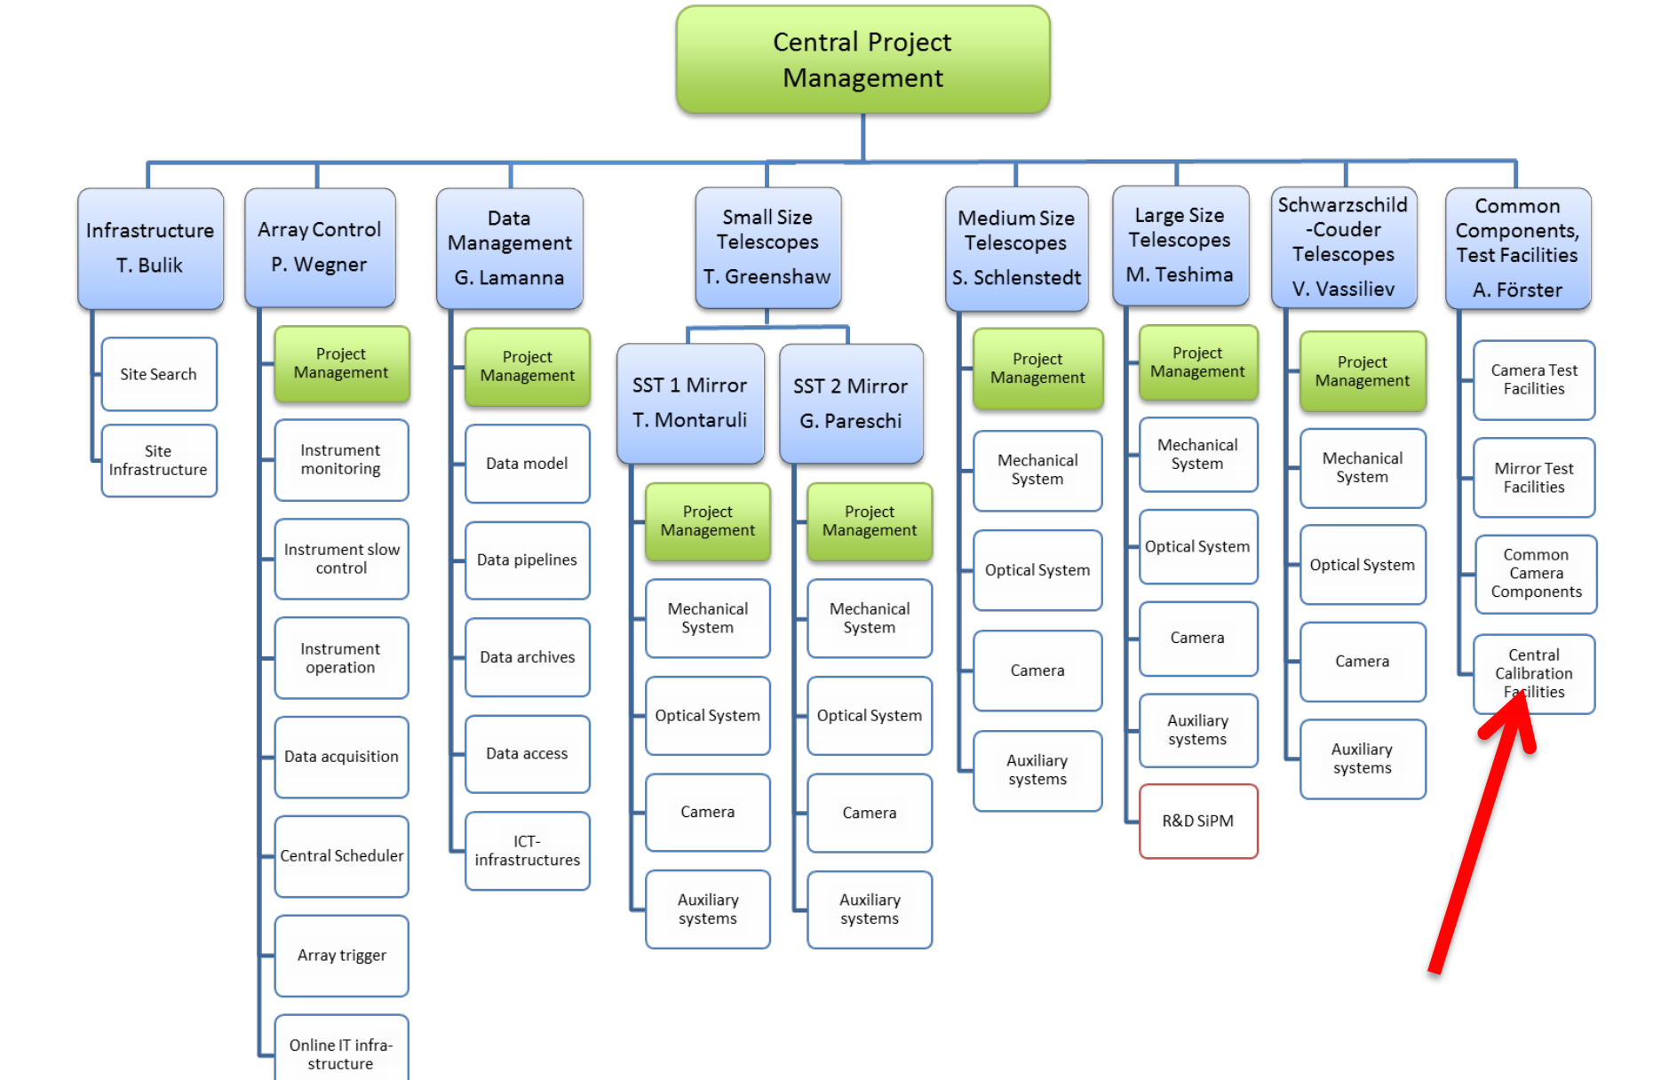
COM-CCF-ATMO

Slide 17
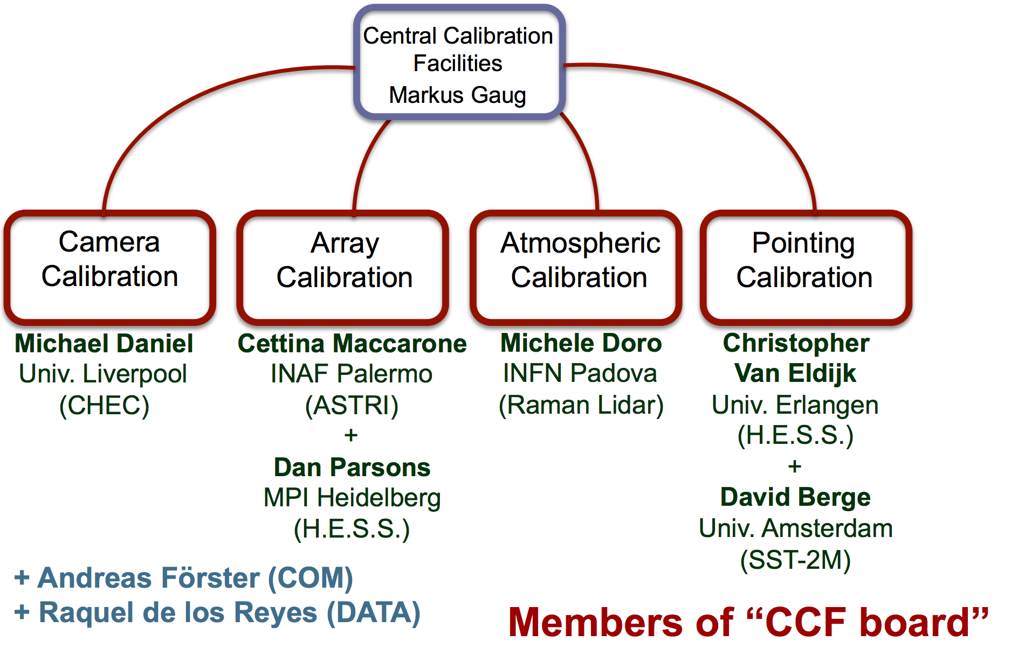
CCF-Board
Carla A
Vincenzo R
Claudio DG

Slide 18

Activities
Group formed in Dec 2013
First review in March 2014 www.cta-observatory.org/indico/conferenceDisplay.py?confId=623 (several documents produced)
Letter of intent for the LIDAR: COM-CCF:130509
TDR submitted: most complete document on our activities
Sharepoint page: portal.cta-observatory.org/wg/com/ccf/

Slide 19
CTA Strategy

Slide 20

Tasks envisaged by atmospheric devices
TASK 1 Site Climatology: Characterization of the site and instruments and method validation
TASK 2 Off-line data selection: certify quality of data and control of background systematics
TASK 3 Off-line data correction: reduce the amount of data loss by correction of hazy-atmosphere data
TASK 4 On-line smart scheduling: online monitoring of energy threshold, selection of best targets in the sky
TASK 5 Weather forecast, alerts and protection: rain sensors, forecasts, alerts for lightning, etc.

Slide 21
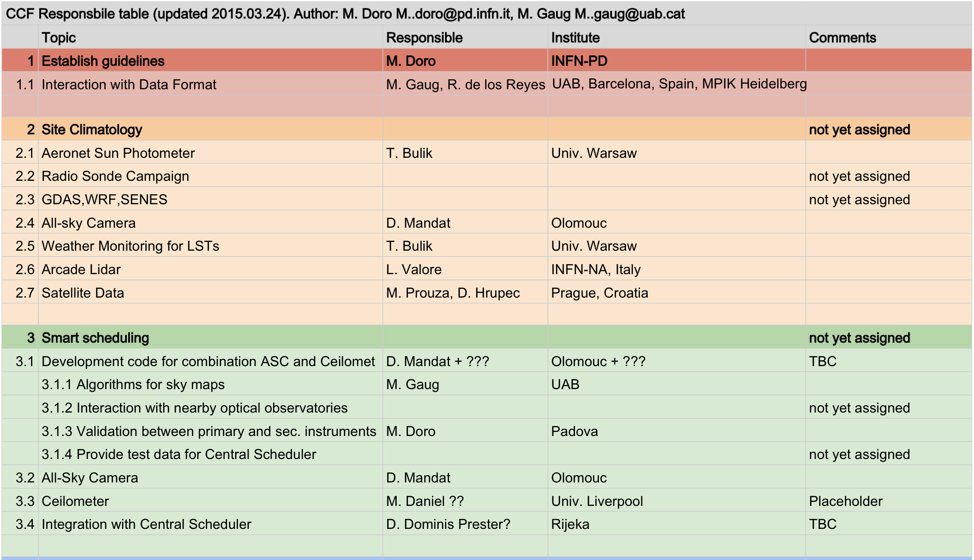
Responsible table #1

Slide 22
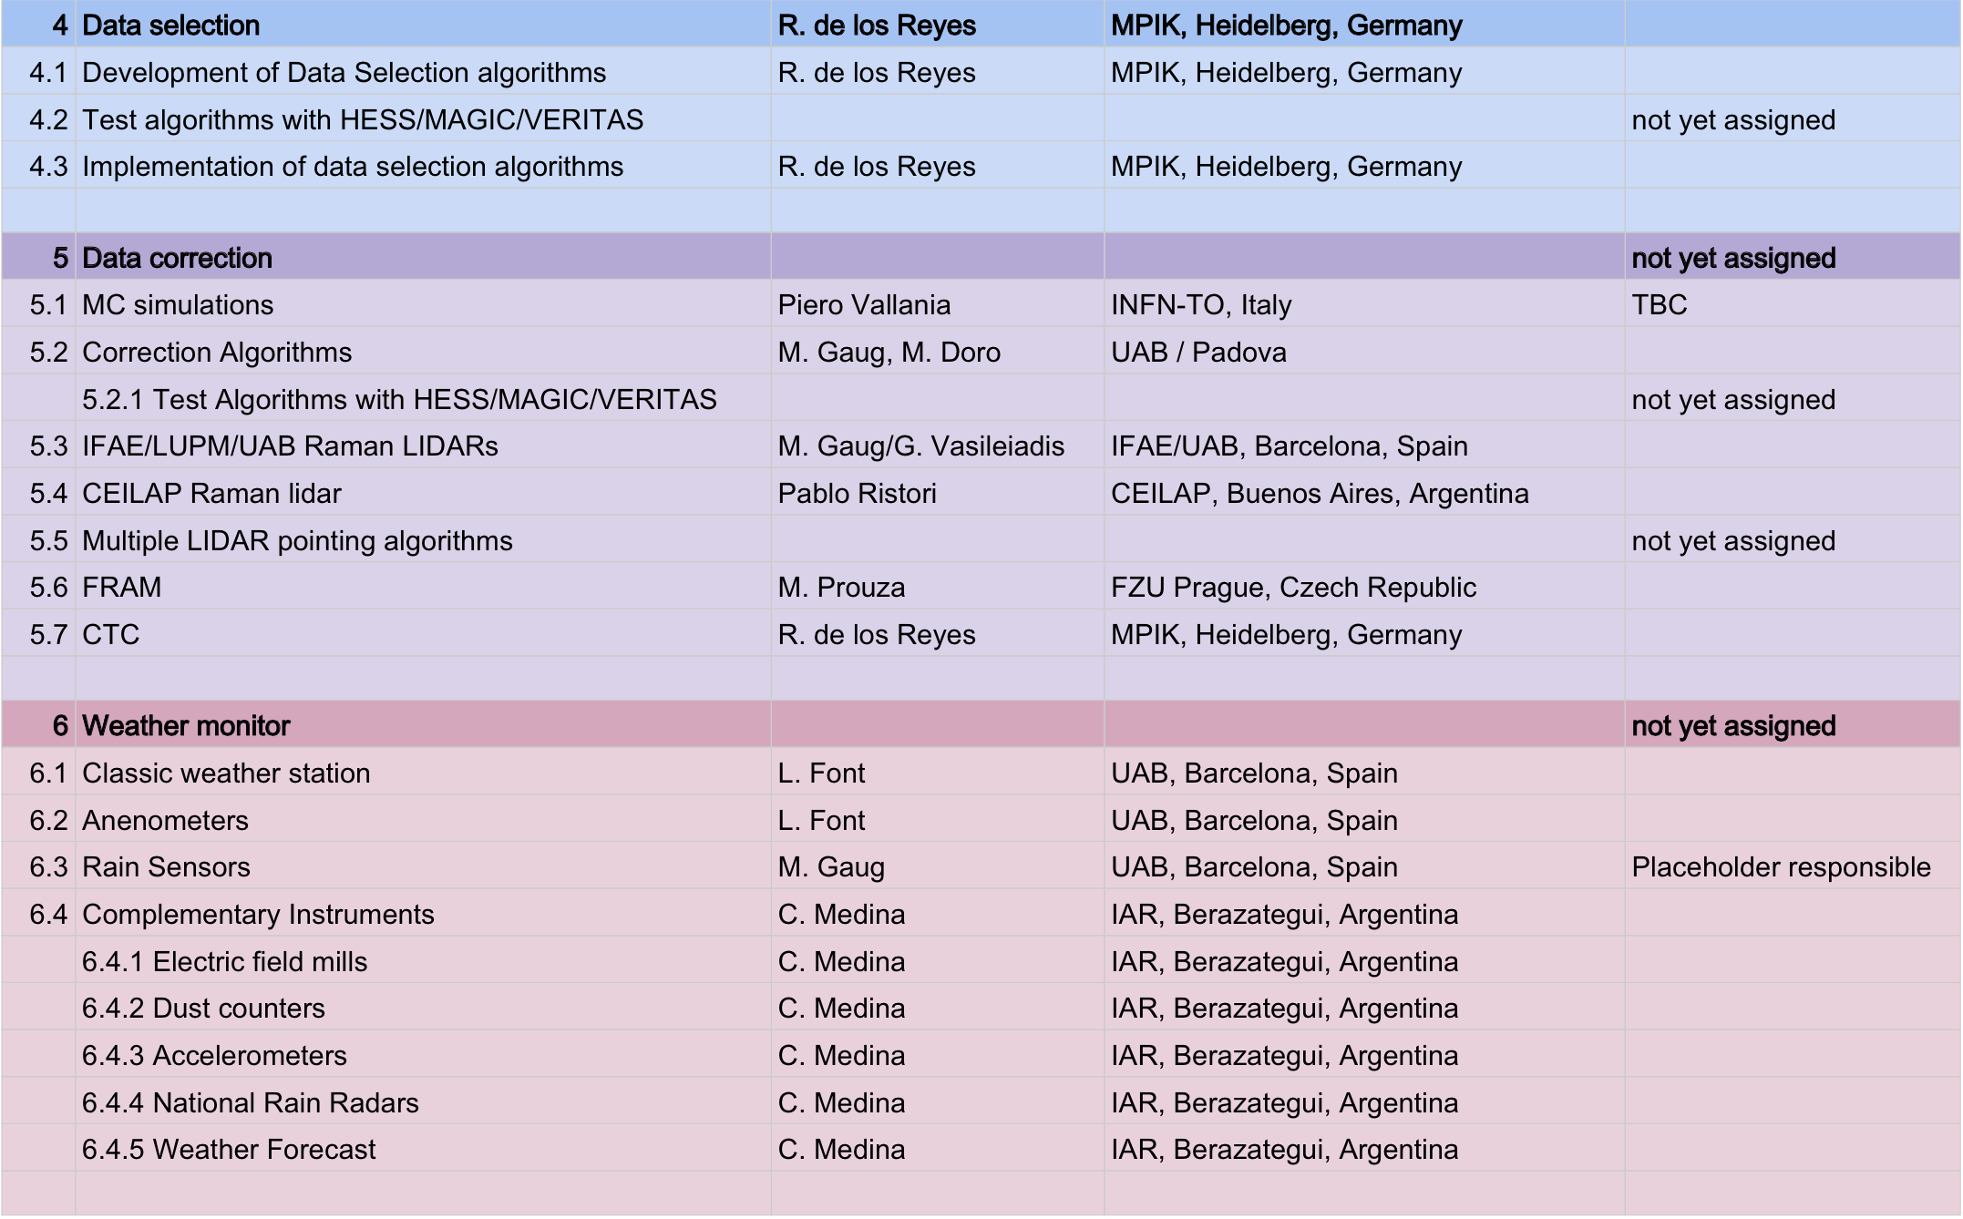
Responsible table #1

Slide 23
CTA-INFN CONTRIBUTION

Slide 24
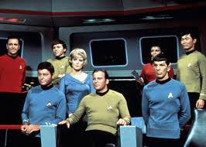
Goal and team
The questions we care
  How performances depend on the atmospheric condi/on?
  Which is the accetable limit to have a running detector in physics mode?
  Similar exercise as done in MAGIC
Team:
  Torino: Piero, Ciro, Federico, Carlo Vigorito
  Padova: Michele
  ISAC: Bianca Maria Dinelli (BO), E. Palazzi (TO) M. Premuda (BO)
Time-schedule:
  Went very slow due specially to my fault and Markus’s delay in providing input data
  Could be reasonably made in few months once all inputs are available

Slide 25
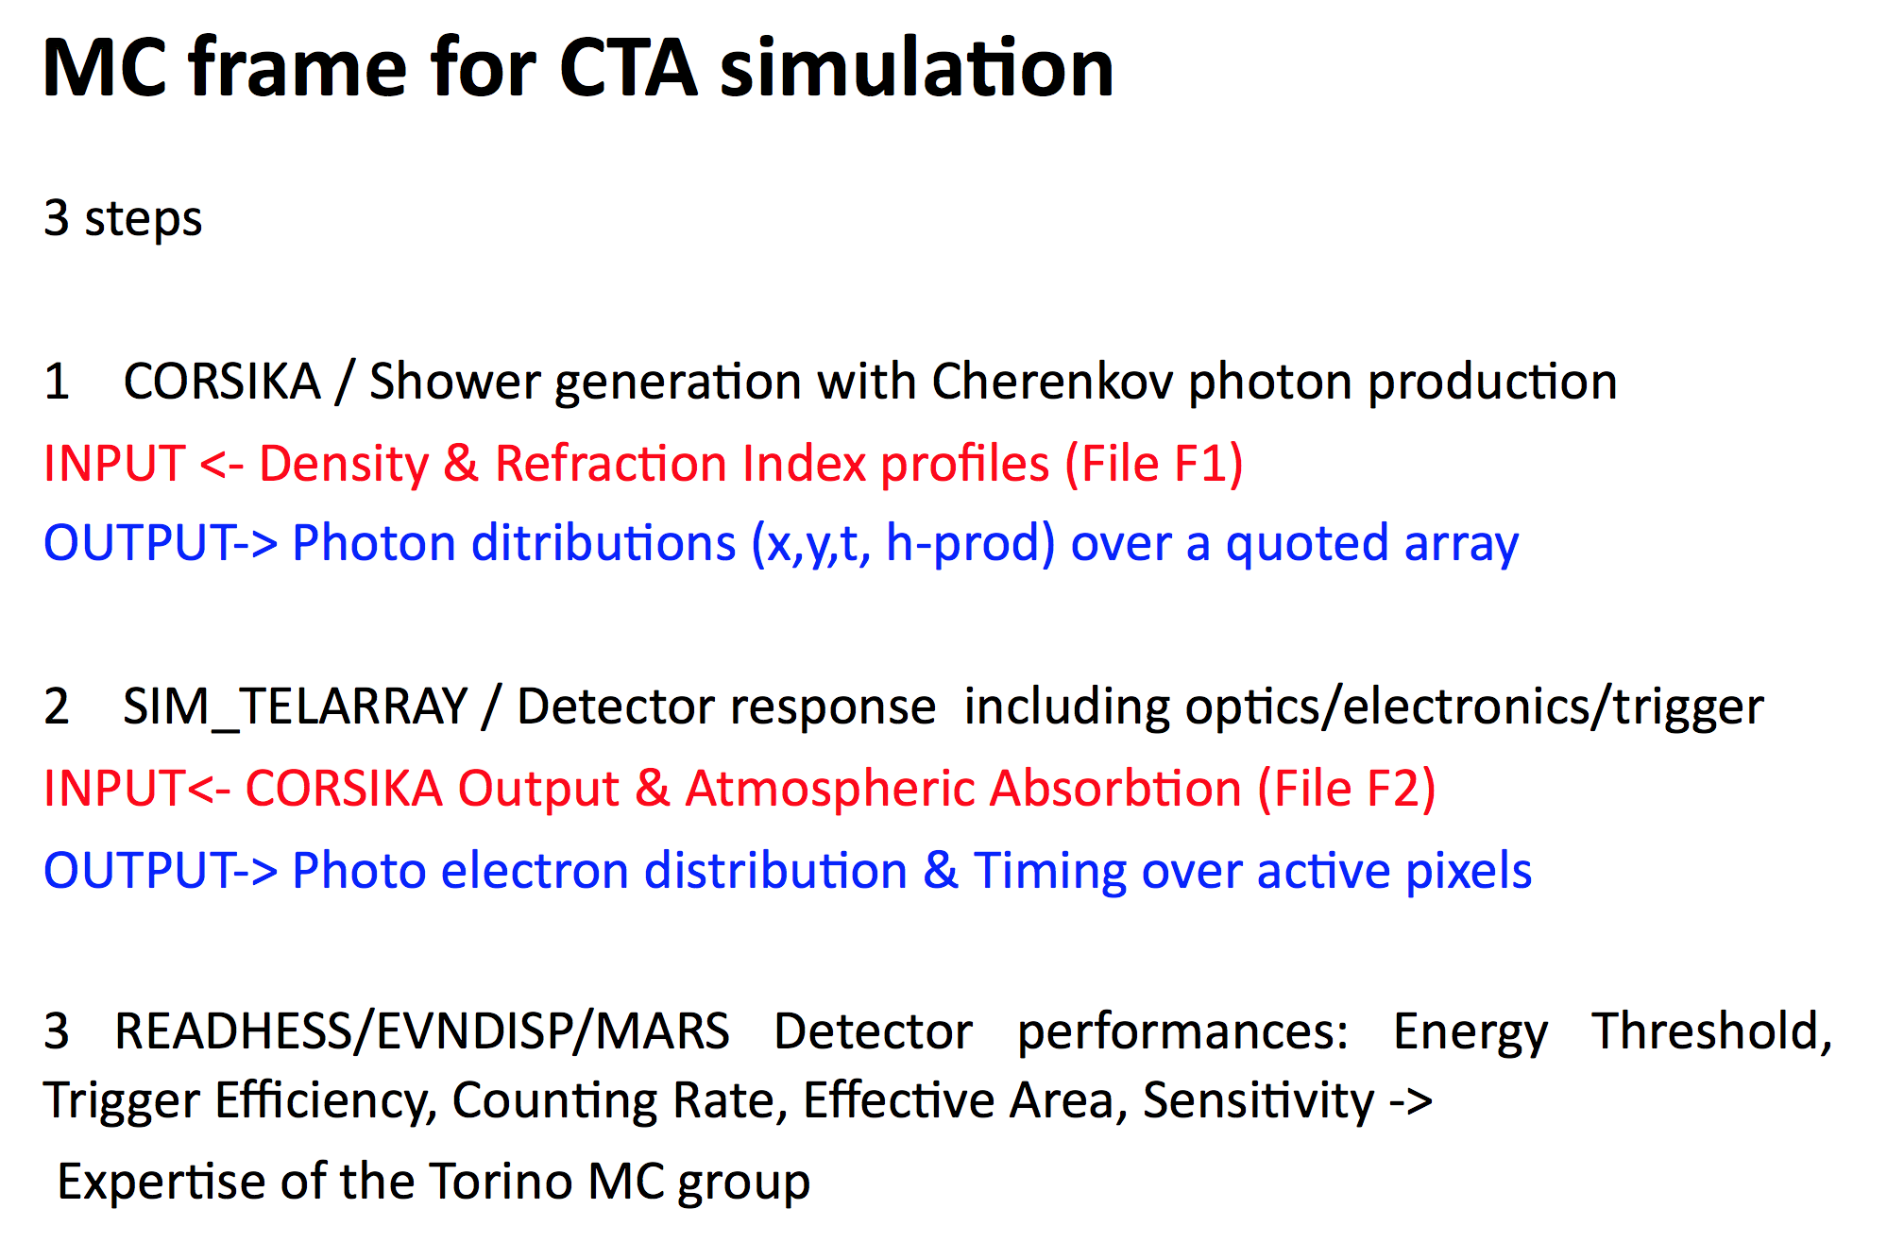
CF Vigorito

Slide 26
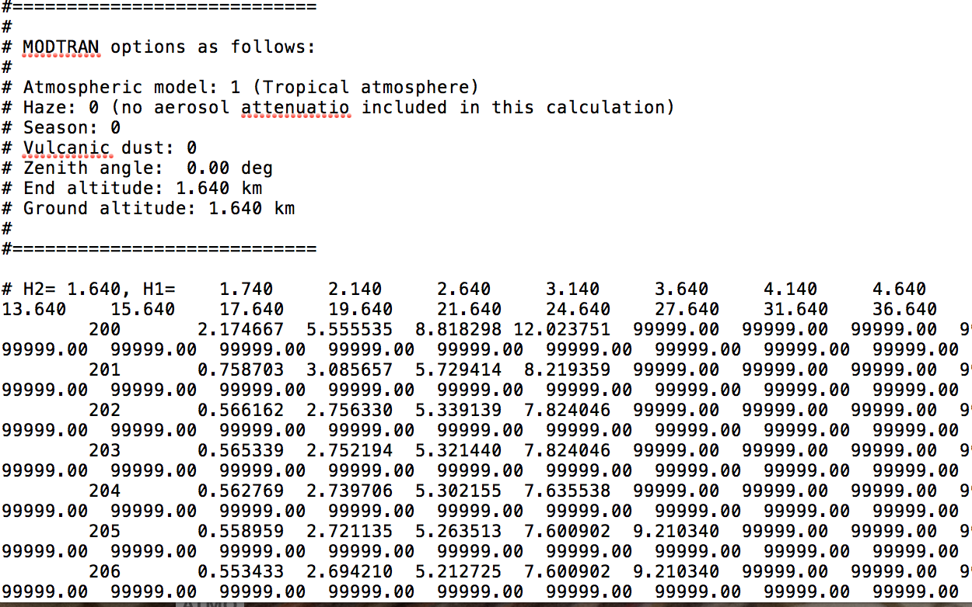
Our plan
1. We learnt how to input atmosphere in sim_telarray: it uses as input file an output file from Modtran* written in some specific format
* Commercial code to simulate atmospheres

Slide 27
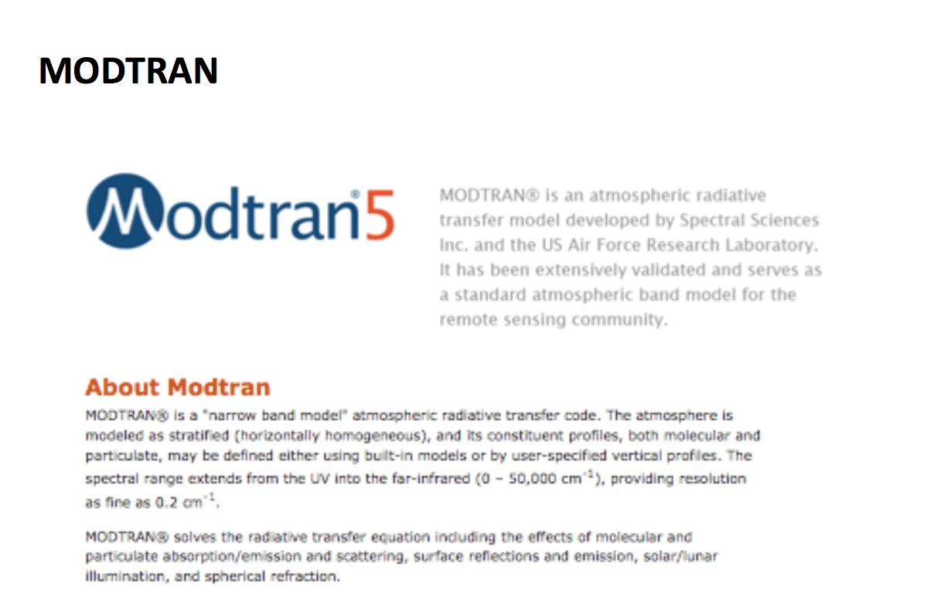
CF Vigorito

Slide 28
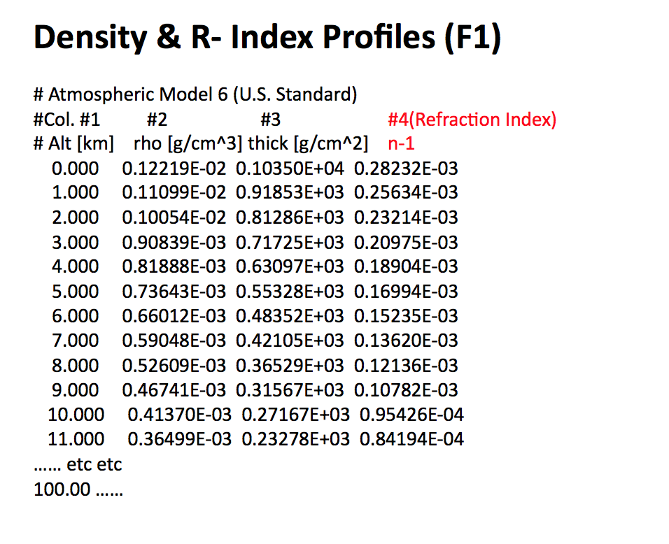
CF Vigorito

Slide 29
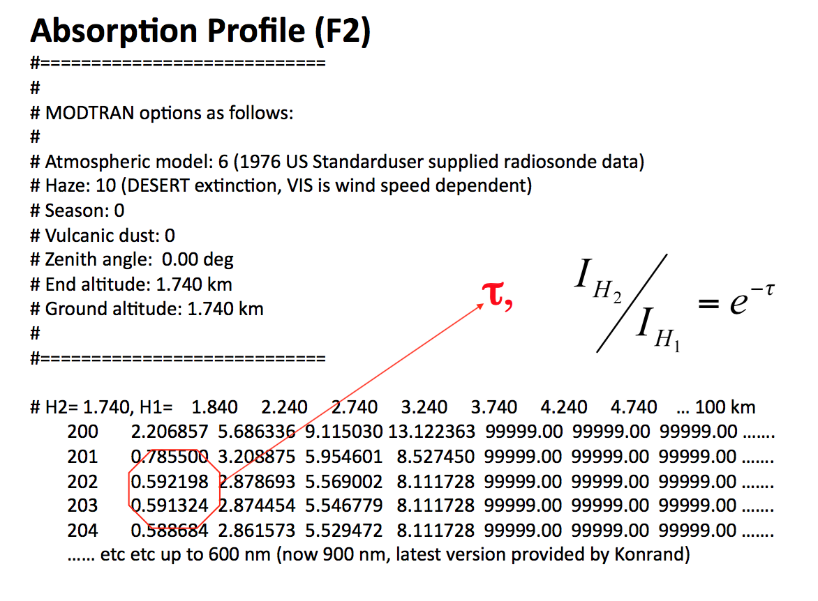
CF Vigorito

Slide 30
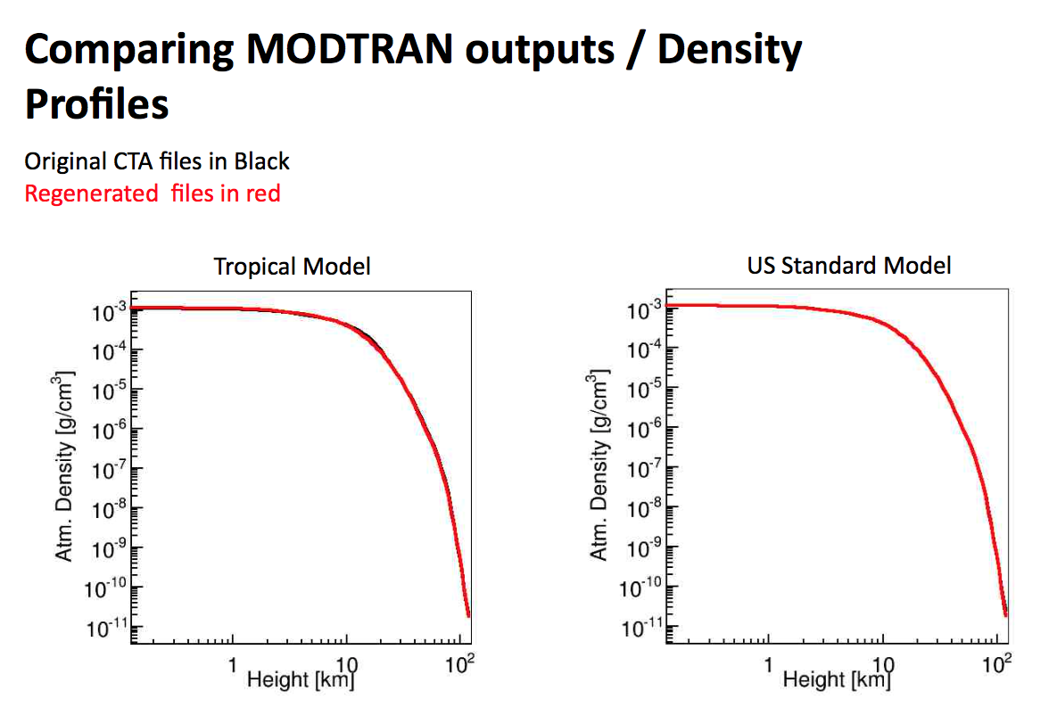
CF Vigorito

Slide 31
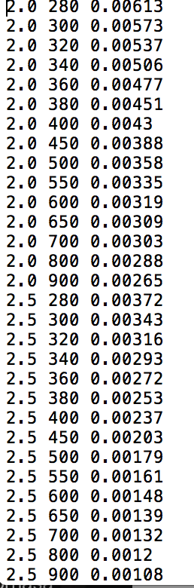
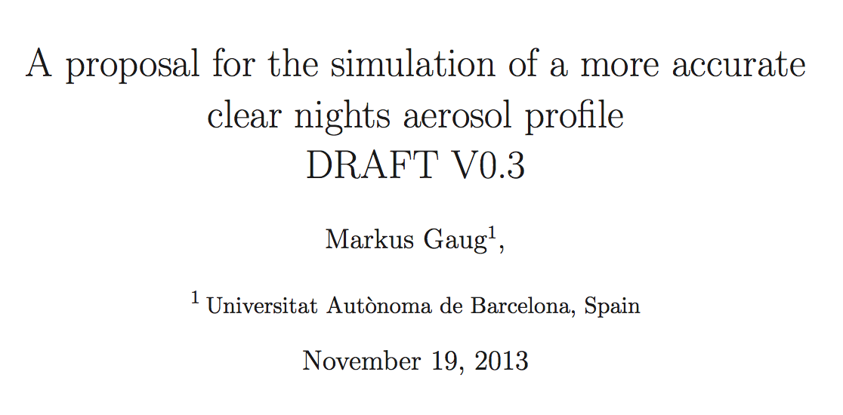
Our plan
2. We simulate
  Benchmark atmosphere at LP as those used in MAGIC sims: Markus Gaug provided input files in the same sim_telarray format (needs validation)
  Realistic atmospheres at LP: Markus Gaug made the most extensive studies
Molecular profile: GDAS well fits our LIDAR data
Aerosol profile: mostly taken by LP literature

Slide 32
The future
Custom profiles for choosen sites:
  e.g. variable aerosol contents, clouds , dust, pollution according to historical data and/or on site measurements via our MODTRAN generator
Automatize generation of atmospheres for CTA codes
Gather atmospheric data on a site as input for Modtran
Activity from Carla, Vincenzo, Claudio are much intertwined with this task

Slide 33
BACKUP

Slide 34
Instruments and methods

Slide 35
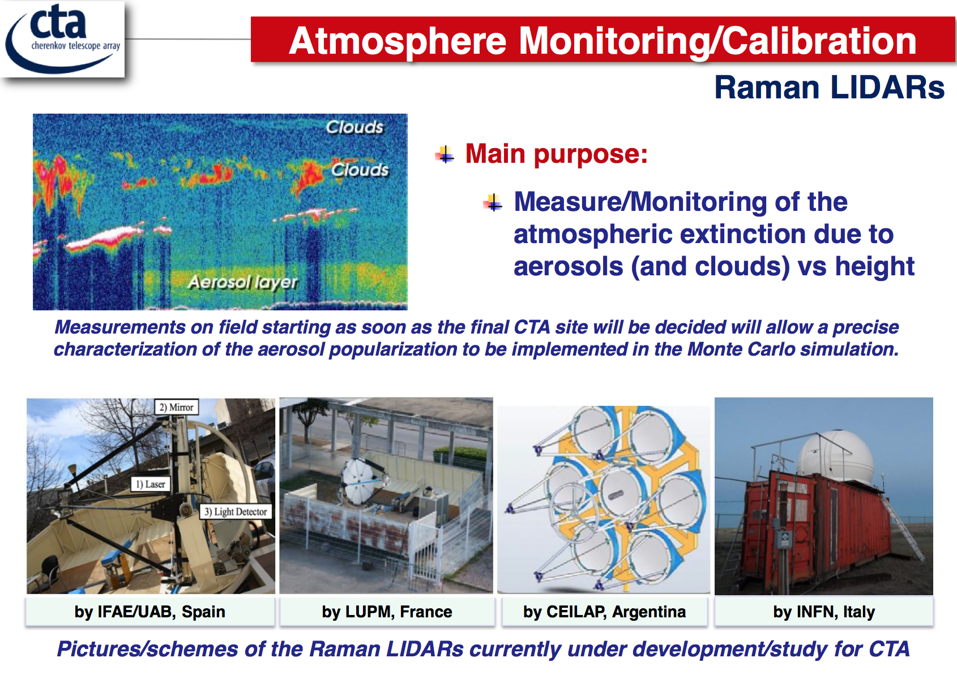
Cettina Maccarone SPIE

Slide 36
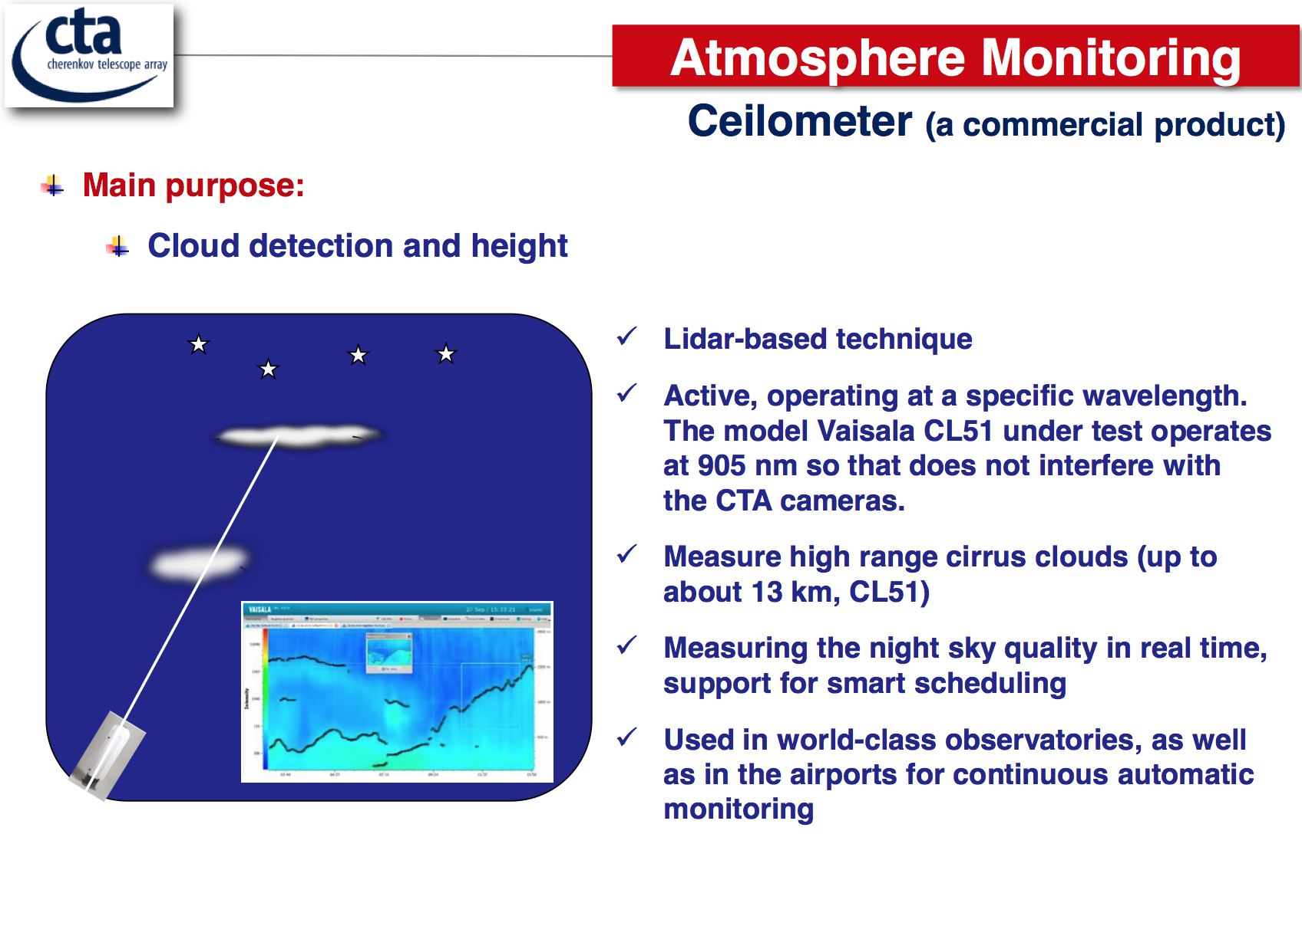
Cettina Maccarone SPIE

Slide 37
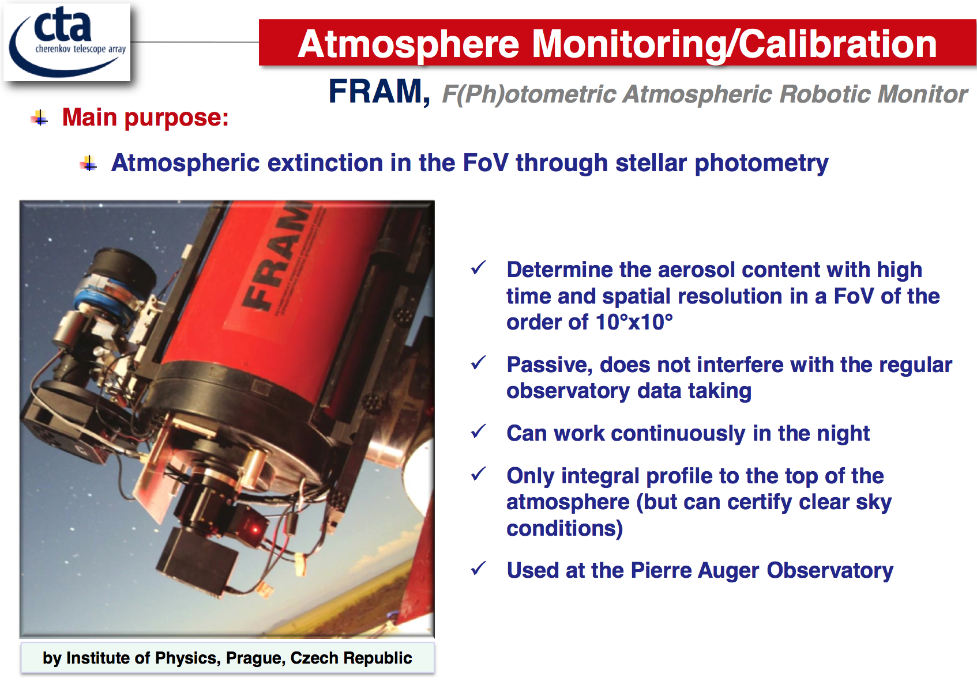
Cettina Maccarone SPIE

Slide 38
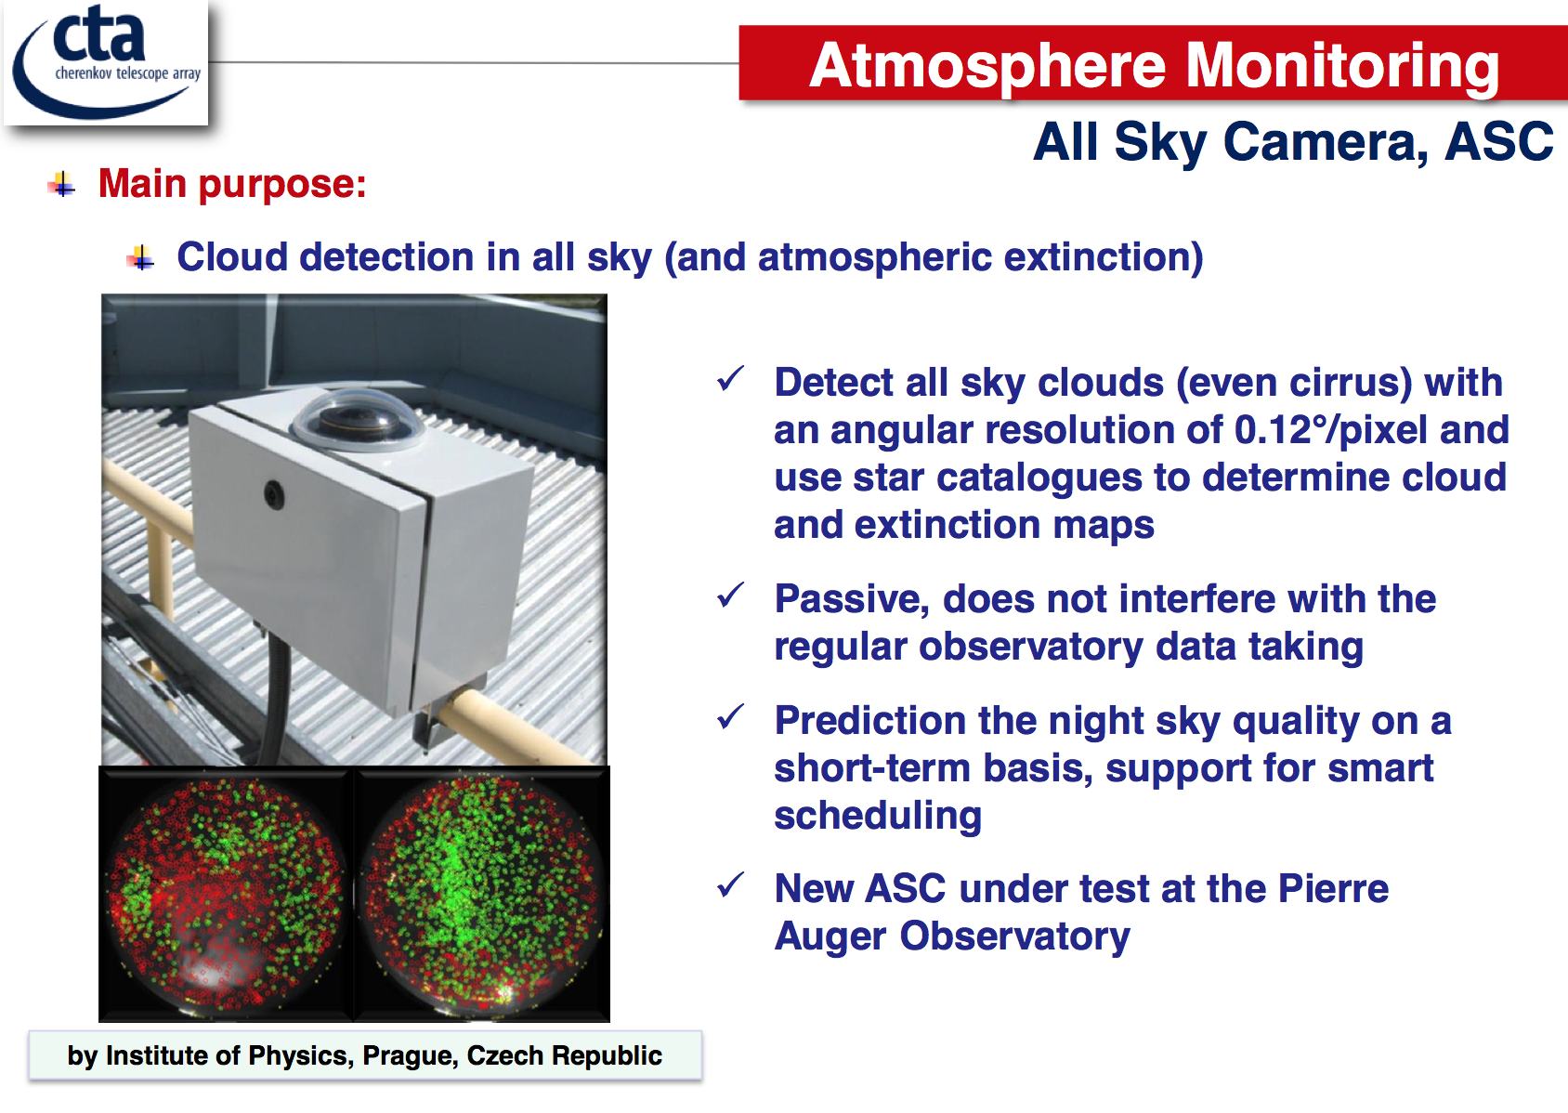
Cettina Maccarone SPIE

Slide 39
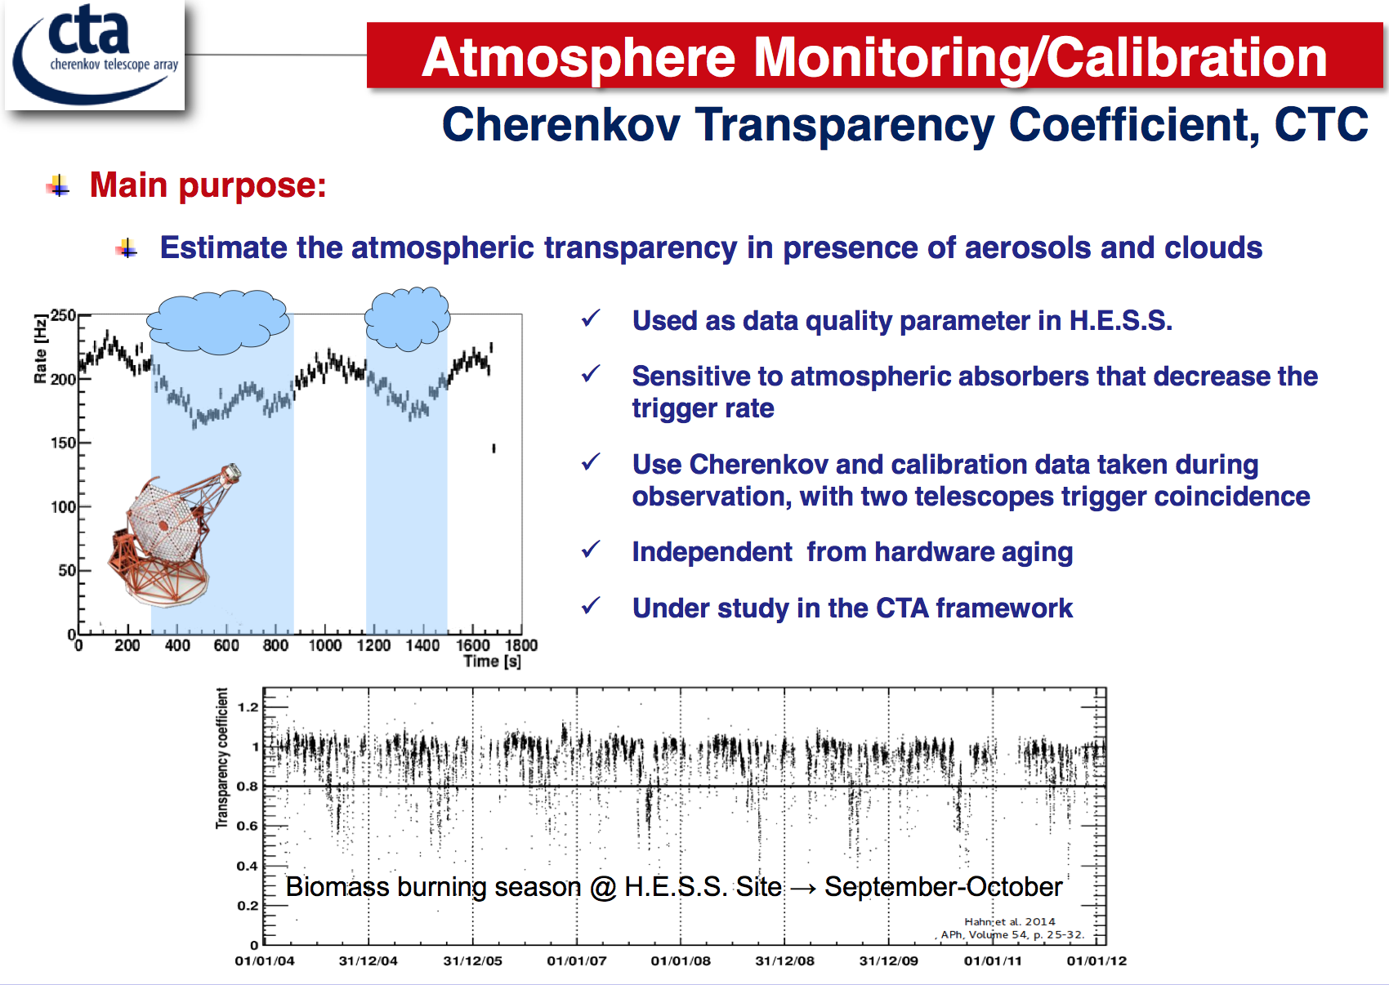
Cettina Maccarone SPIE

Slide 40
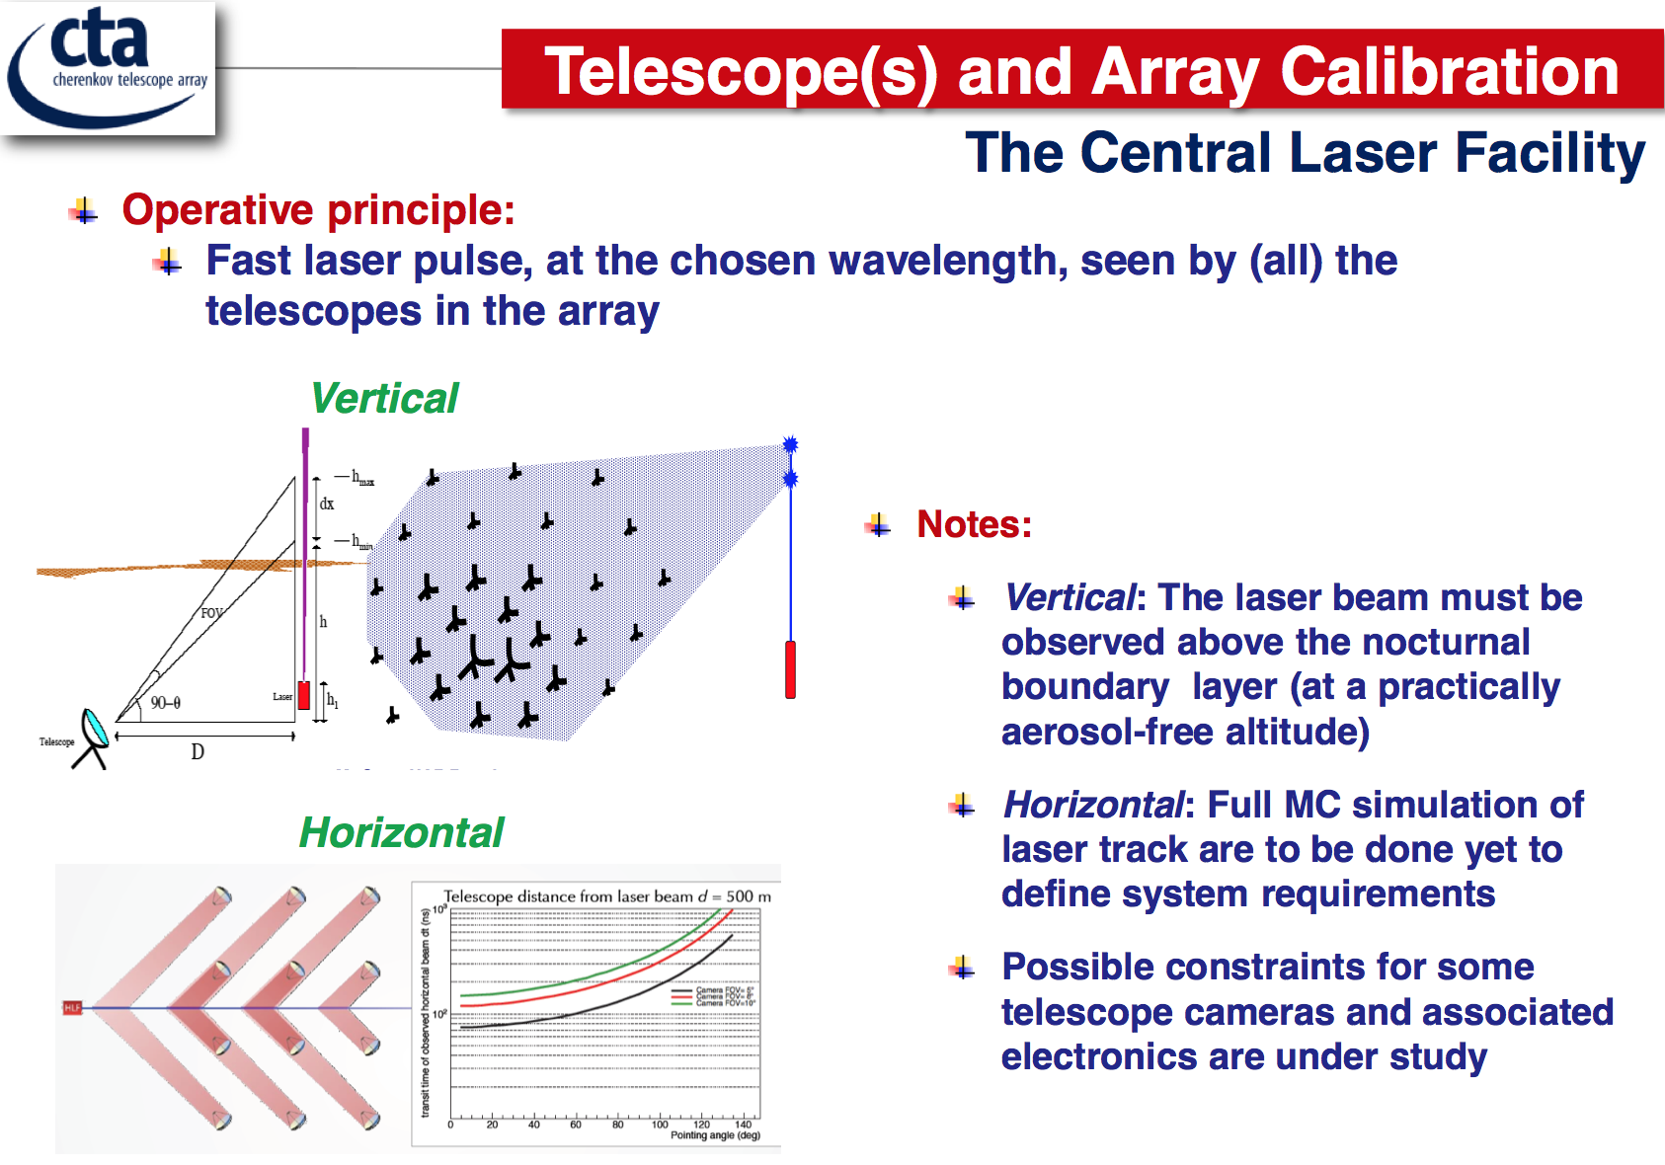
Cettina Maccarone SPIE

Slide 41
Implementation of the strategy
MD+ 2015 http://arxiv.org/abs/1503.05481

Slide 42
Conclusion
Atmospheric calibration along with instrumental construction care can guarantee energy resolution < 8%
Atmospheric monitoring and calibration plans are very articulate and include several instruments and methods
Activities will start at the site well before the first telescope are installed
  All-Sky Camera
  ARCADE Lidar
  Ceilometer?
Main problem is manpower, we are missing people involved and responsibles. In case you are interested don’t hesitate to contact us

Slide 43
BACKUP

Slide 44
Networks
CTA instruments
Global Network
Coverage in remote sites
Non-commercial instruments
Data validation
Feedback
We may want to make contact (Aeronet, ACTRIS, etc)

