Slide 1
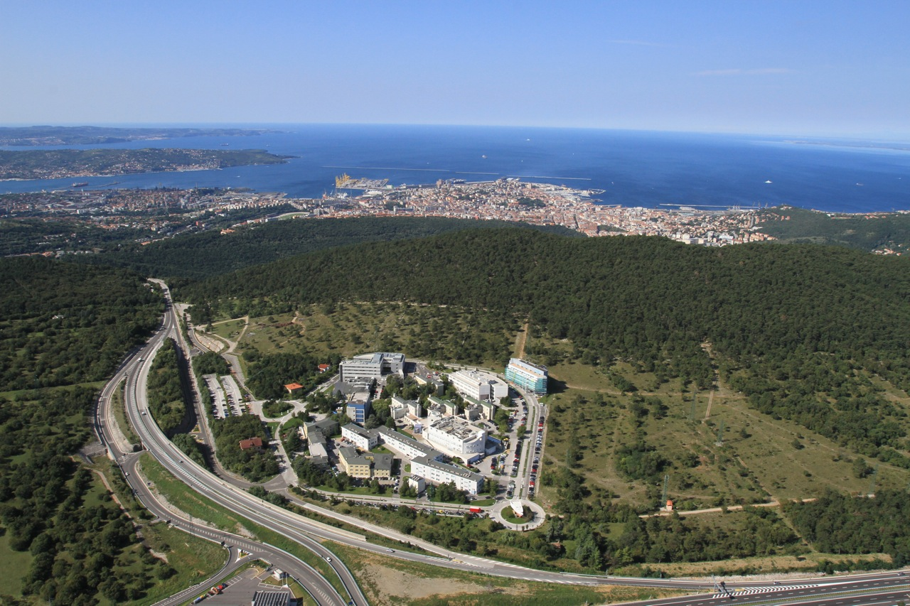



Environmental and Radiation Monitoring for the BELLE-II Vertex Detector
L.Vitale
INFN and Univ. Trieste

Slide 2
Outline
General overview: SuperKEKB and Belle-II
List of Trieste activities
Radiation monitor & beam abort
Environmental sensors
Temperature monitoring: NTC + FOS
Humidity: sniffing pipes & external sensors + FOS
Interlock

Slide 3
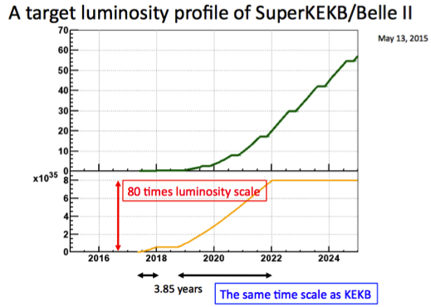
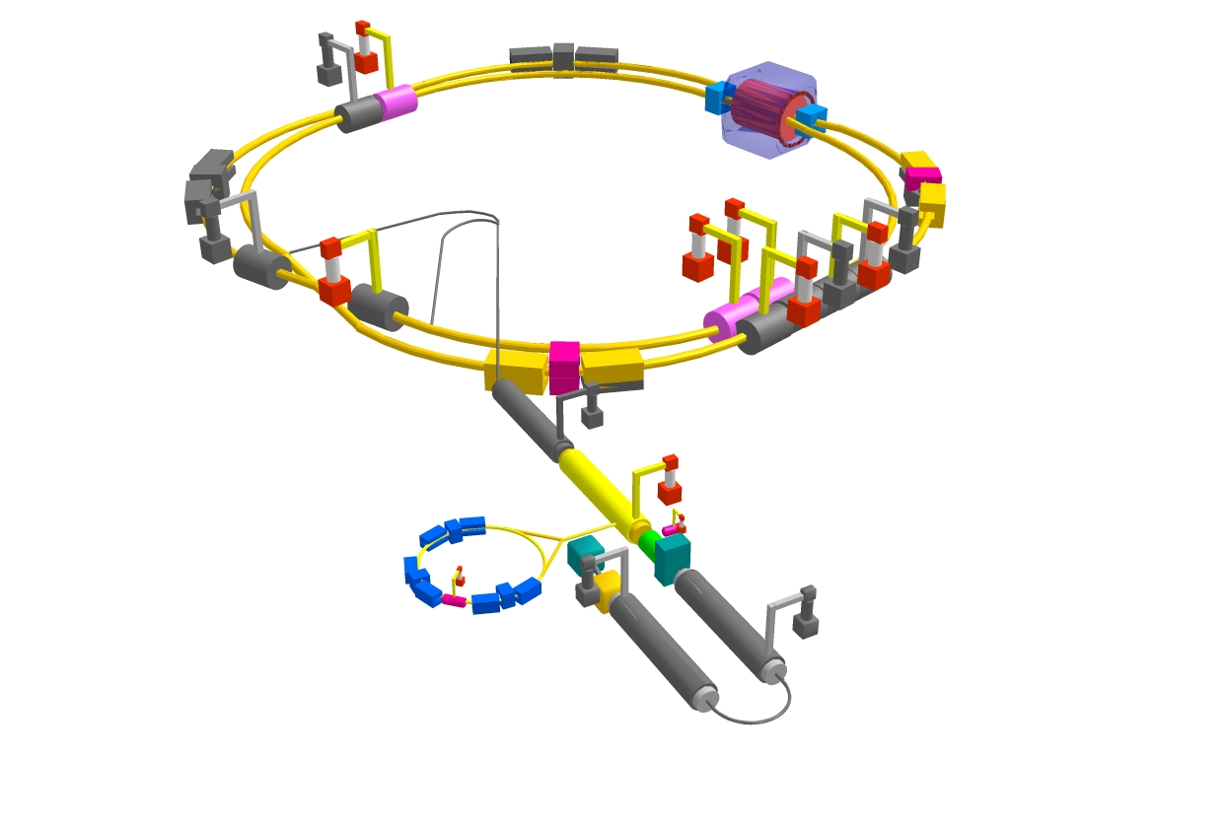
SuperKEKB/Belle II
Belle II detector
e⁻ 7GeV 2.6 A
e⁺ 4GeV 3.6 A
SuperKEKB @ KEK
Belle II experiment @ SuperKEKB:
Asymm. e⁺e⁻ collider √s≈Υ(4s)≈11 GeV
Designed luminosity: 8×10³⁵ cm⁻²s⁻¹
Precise measurements in b and c
Search for the physics beyond the SM
Detectors and accelerator are being constructed:
2016 accelerator commissioning
2017 physics with partial VXD
2018 physics with full detector

Slide 4
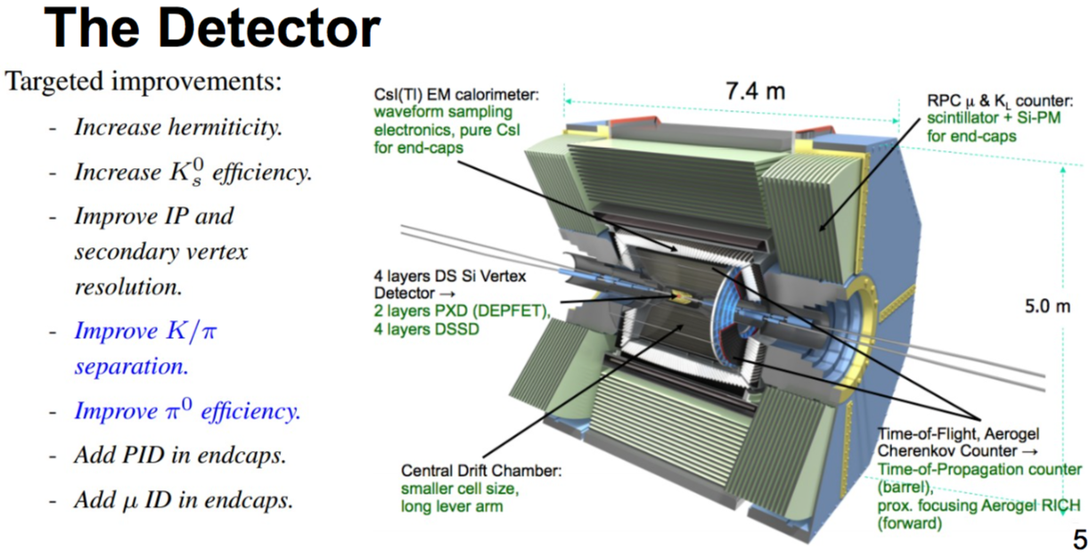
Belle-II

Slide 5
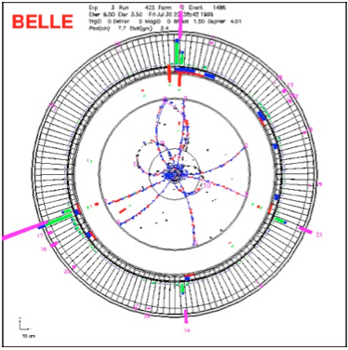
Belle II VerteX Detector
Asymmetric B factory
Typical Υ(4s) Event
from Belle
Average multiplicities
~ 11 charged tracks
~5 neutral pions
~1 neutral kaon
Like in Belle the detector must be optimized precision vertex reconstruction of the two short-lived B-mesons decays
But compared to KEK/BELLE
REDUCED BOOST BY 2/3
HIGHER BACKGROUND
Design driven by following requirements:
Soft particles from tens MeV to GeV – multiple scattering
Needs very low mass detector
High luminosity – occupancy/pile-up
Need small sensitive area and/or fast readout
Radiation – ≤ 100 kGy
Magnetic field – 1.5 T

Slide 6
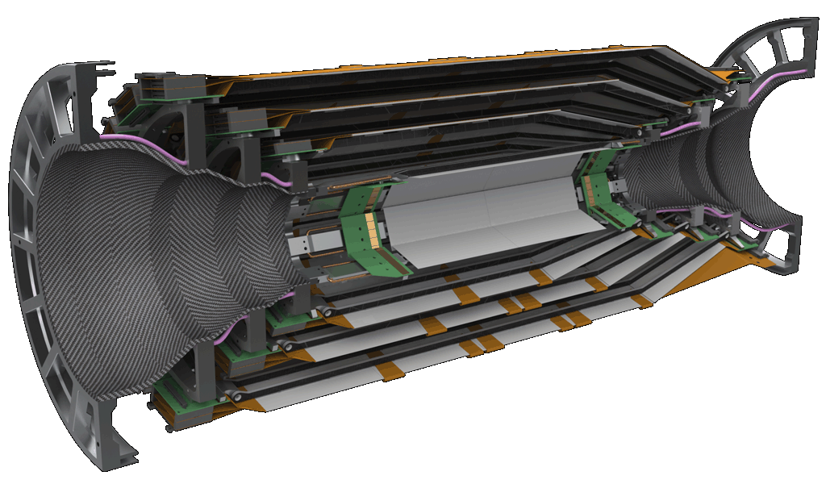
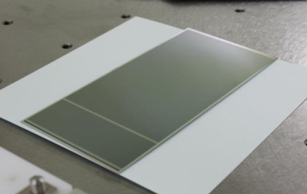
VerteX Detector VXD
VerteX Detector (SVD+PXD)
charged particle
Silicon vertex detector
2-layer pixels sensors (DEPFET ) 75 µm thin 0.2% X₀/layer
4-layer DSSD sensors 0.58% X₀/layer
Radiation Monitoring and Beam Abort System based on single crystal diamonds will be integrated in the system
e⁺ 4GeV
e⁻ 7GeV
DSSD

Slide 7
Origami – Chip-on-Sensor Concept
To read out each sensor individually. Used for inner DSSDs of layers 4,5 and 6
Chip-on-sensor concept for double-sided readout
Short fan-out pieces for n-side (z)
Flex fan-out pieces wrapped to opposite side (hence “Origami“)
All chips aligned on one side → single cooling pipe
Side View (below)

Slide 8
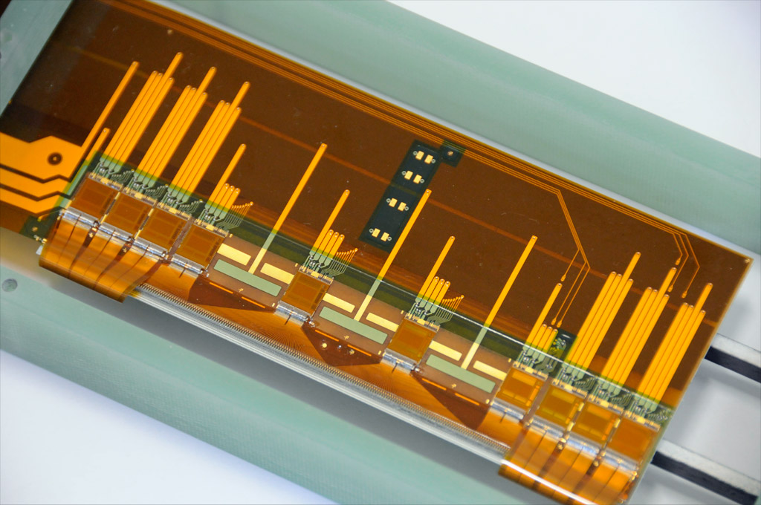
Origami Prototype Module with 6” HPK DSSD
Flex hybrid
APV25 readout chip
Silicon sensor
Pitch adapter for top side of sensor
Pitch adapter for bottom side of sensor

Slide 9
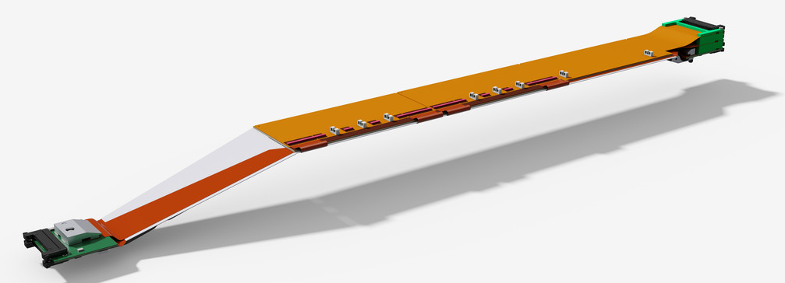
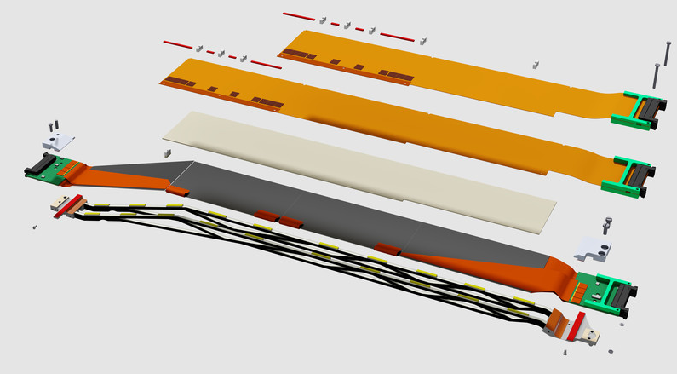
Sketch of the Layer 5 Ladder
Two central sensors have Origami structure, edge sensors are read out from sides
Averaged material budget over the full module: 0.58% X₀

Slide 10
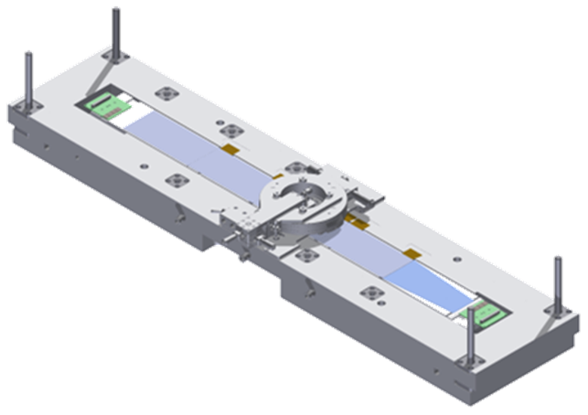
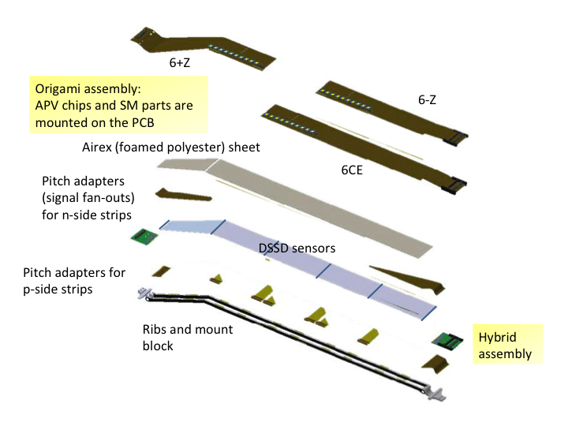
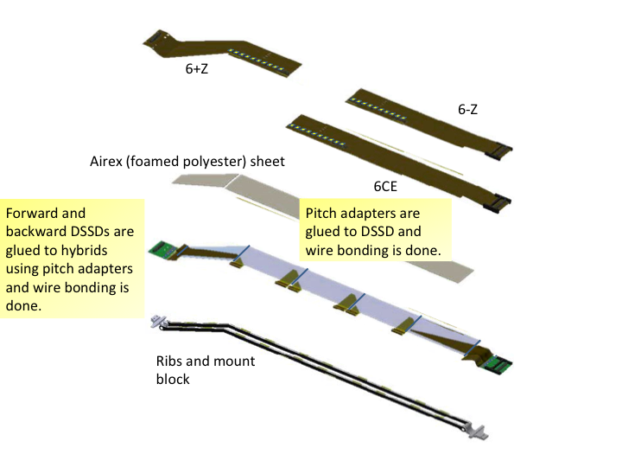
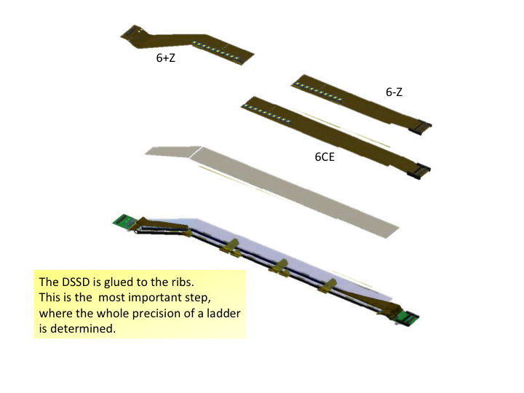
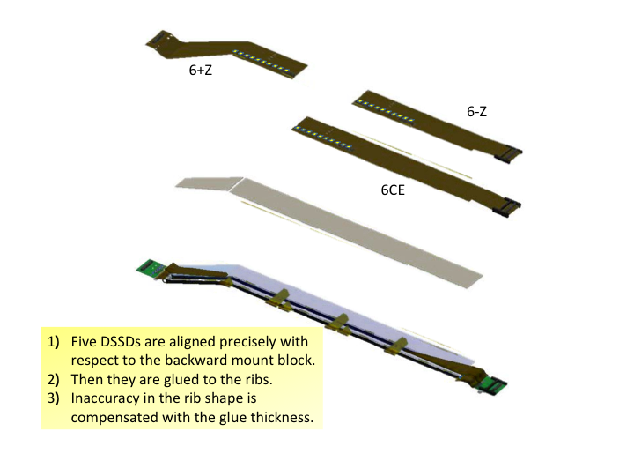
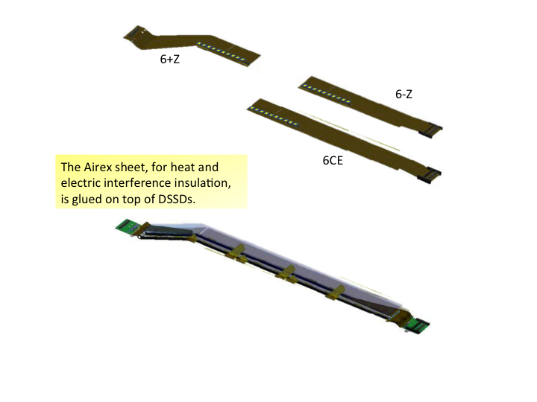
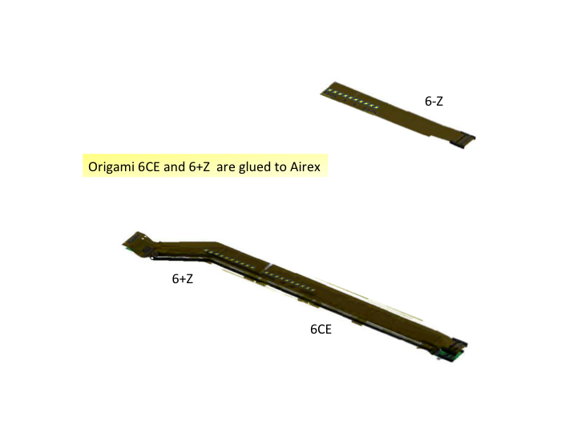
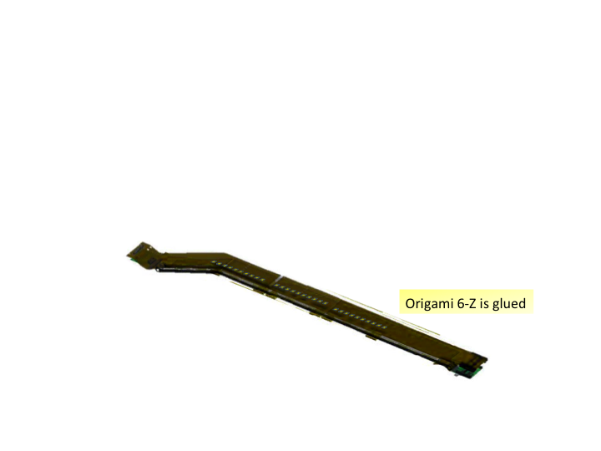
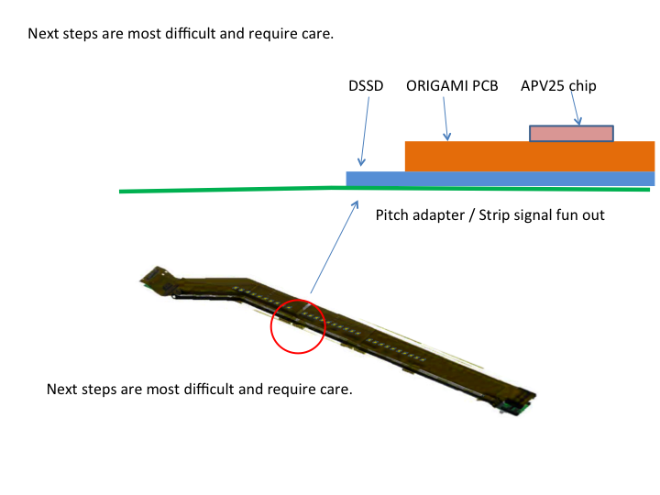
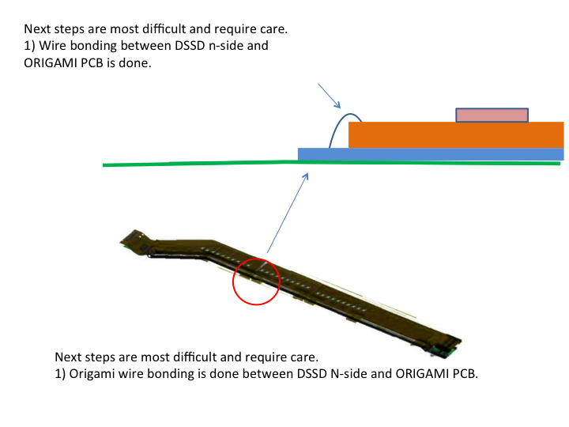
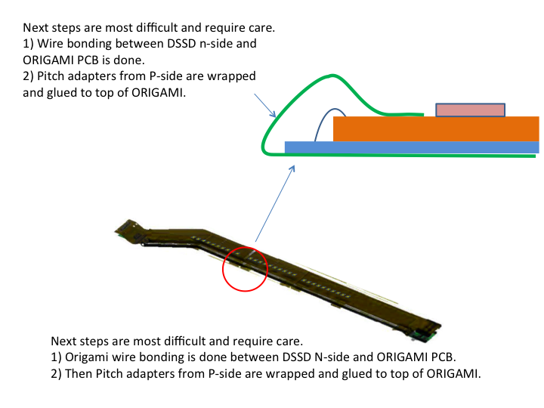
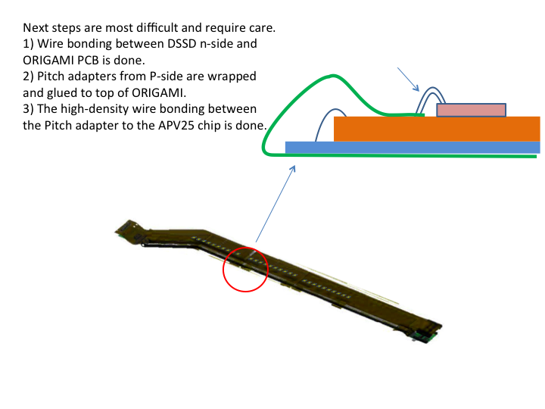
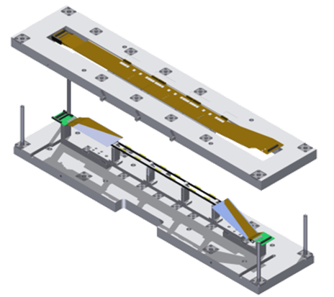
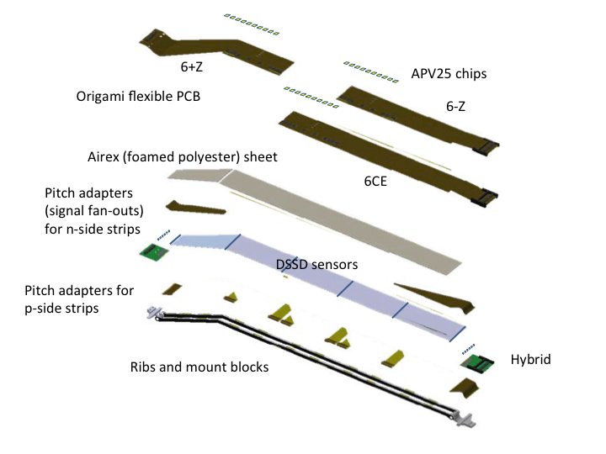
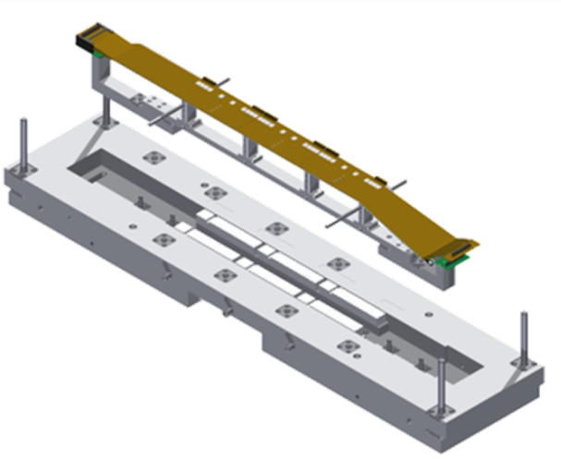
Ladder assembly procedure (from Vertex2013 T.Bergauer)
alignment
w/ XYZθ-stage
Two weeks per ladder expected
Bonding/glue-curing interlaced
DSSD
Assembly-jig
…
Finish

Slide 11
Belle II – Trieste in sintesi (2015)
Partecipanti
L. Bosisio 60%
L.Lanceri 90%
L.Vitale (*) 90%
I.Rashevskaya (TIFPA)
G.Cautero (Elettra) 10%
D.Giuressi (Elettra) 10%
H.Menk (Elettra) 10%
+ Assegno ricerca biennale!
(*) coord. Monitor SVD
Servizi di Sezione
P. Cristaudo (NTC)
G. Orzan (test sensori)
M. Bari (FOS)
A. Zanetti (umidità, PLC)
G. Venier (commissioning…)
Officina meccanica
Responsabilità hardware
Test sensori microstrip DSSD, da Micron e HPK
Per VXD = PXD + SVD monitor radiazione e trigger per beam abort
Per SVD Monitor temperatura (NTC, FOS) e umidità (con “sniffing pipes”), interlock (PLC)

Slide 12
Micron and HPK microstrip sensors tests

Slide 13
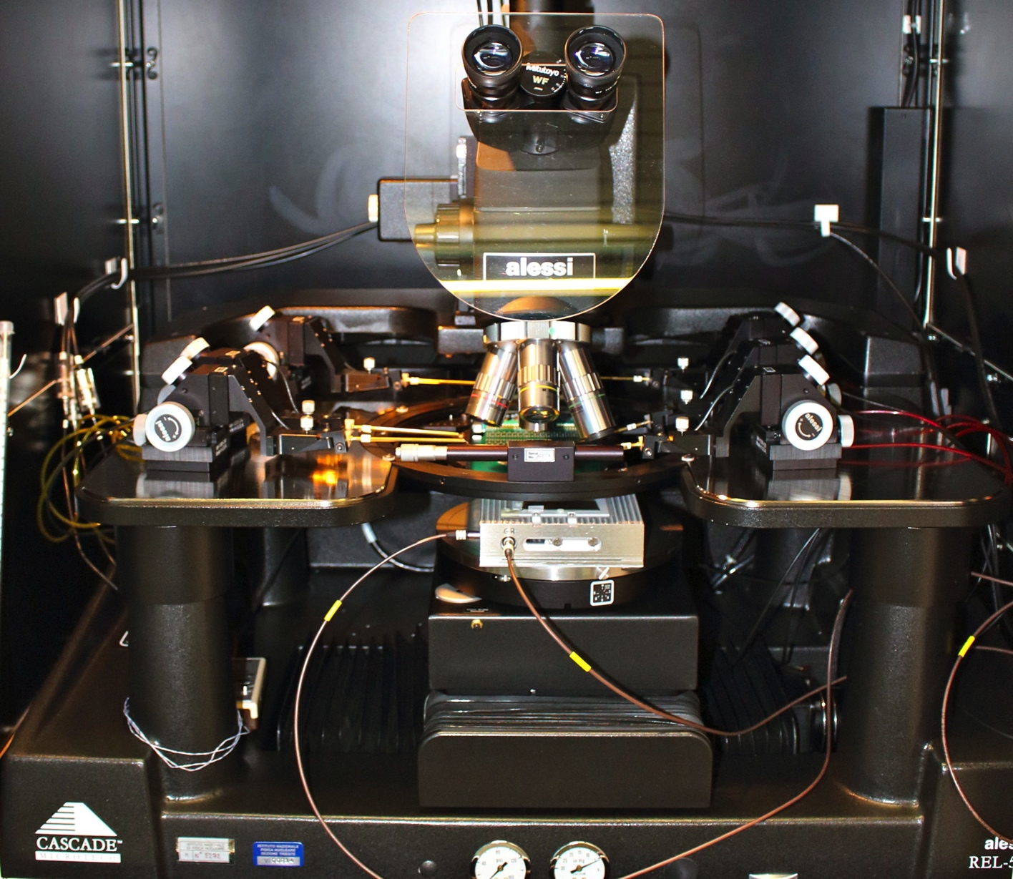
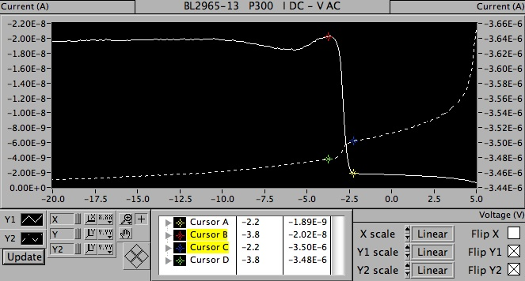
Test di sensori DSSD HPK e Micron
Caratterizzazione dettagliata di sensori Micron e HPK
Several inconsistencies in Hamamatsu tests have been found (later acknowledged by HPK).
Test di qualifica di 46 sensori Micron (su 70)
Test di sensori HPK ‘meccanici’ (parziale recupero?)
Studio dell'effetto di una tensione applicata alle strip metalliche (tramite l'elettronica di lettura) sull’isolamento delle strip.
Disponibilità a eseguire in futuro:
test di verifica sui sensori Micron graffiati durante il test a Vienna.
test di altri sensori HPK, se richiesto.

Slide 14
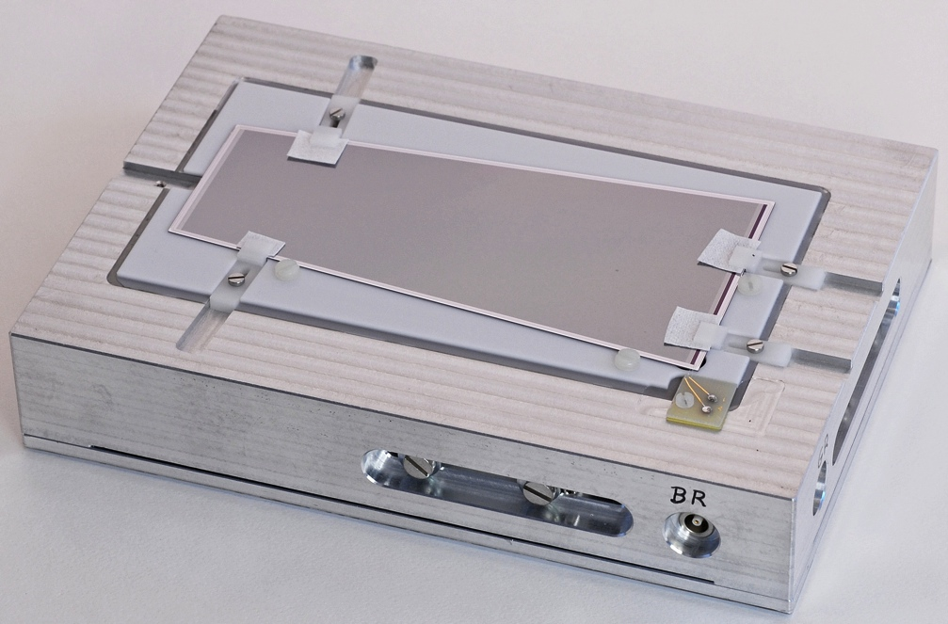
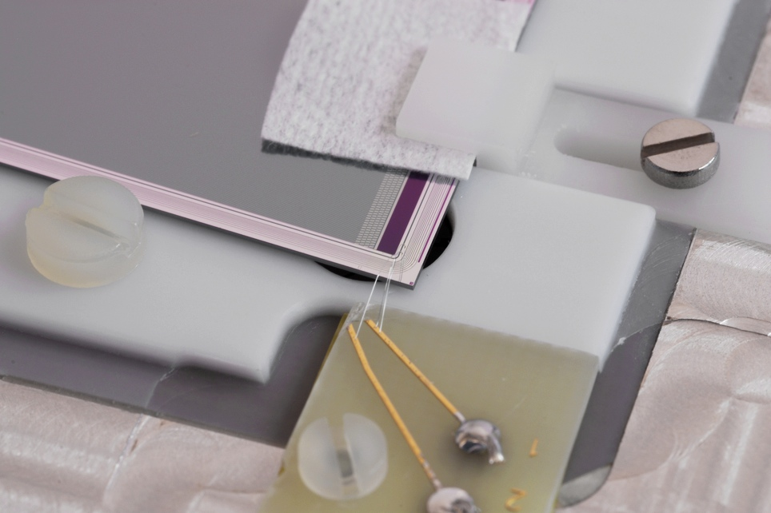
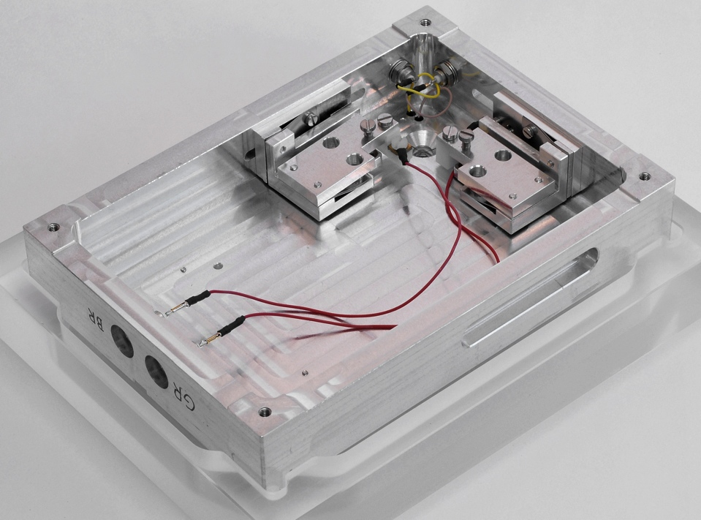
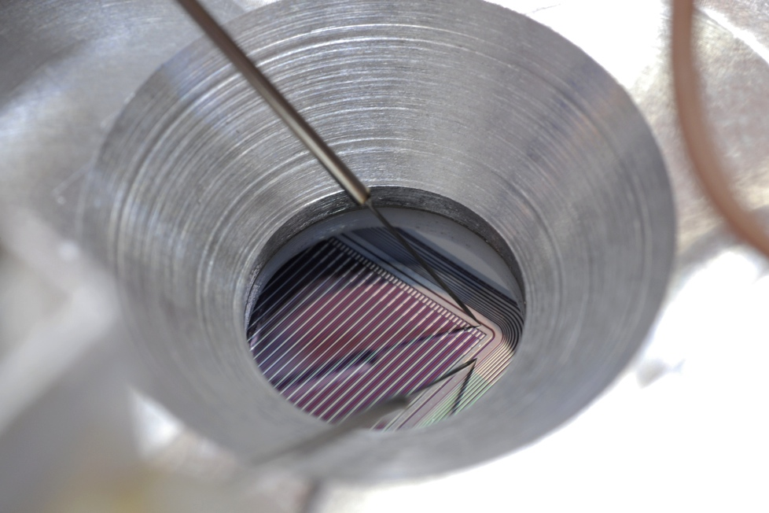
Testing Jig for Micron (trapezoidal) Sensors
wire bonding of
top-side bias & guard rings
Top view
contacting back-side
bias & guard rings
Bottom view

Slide 15
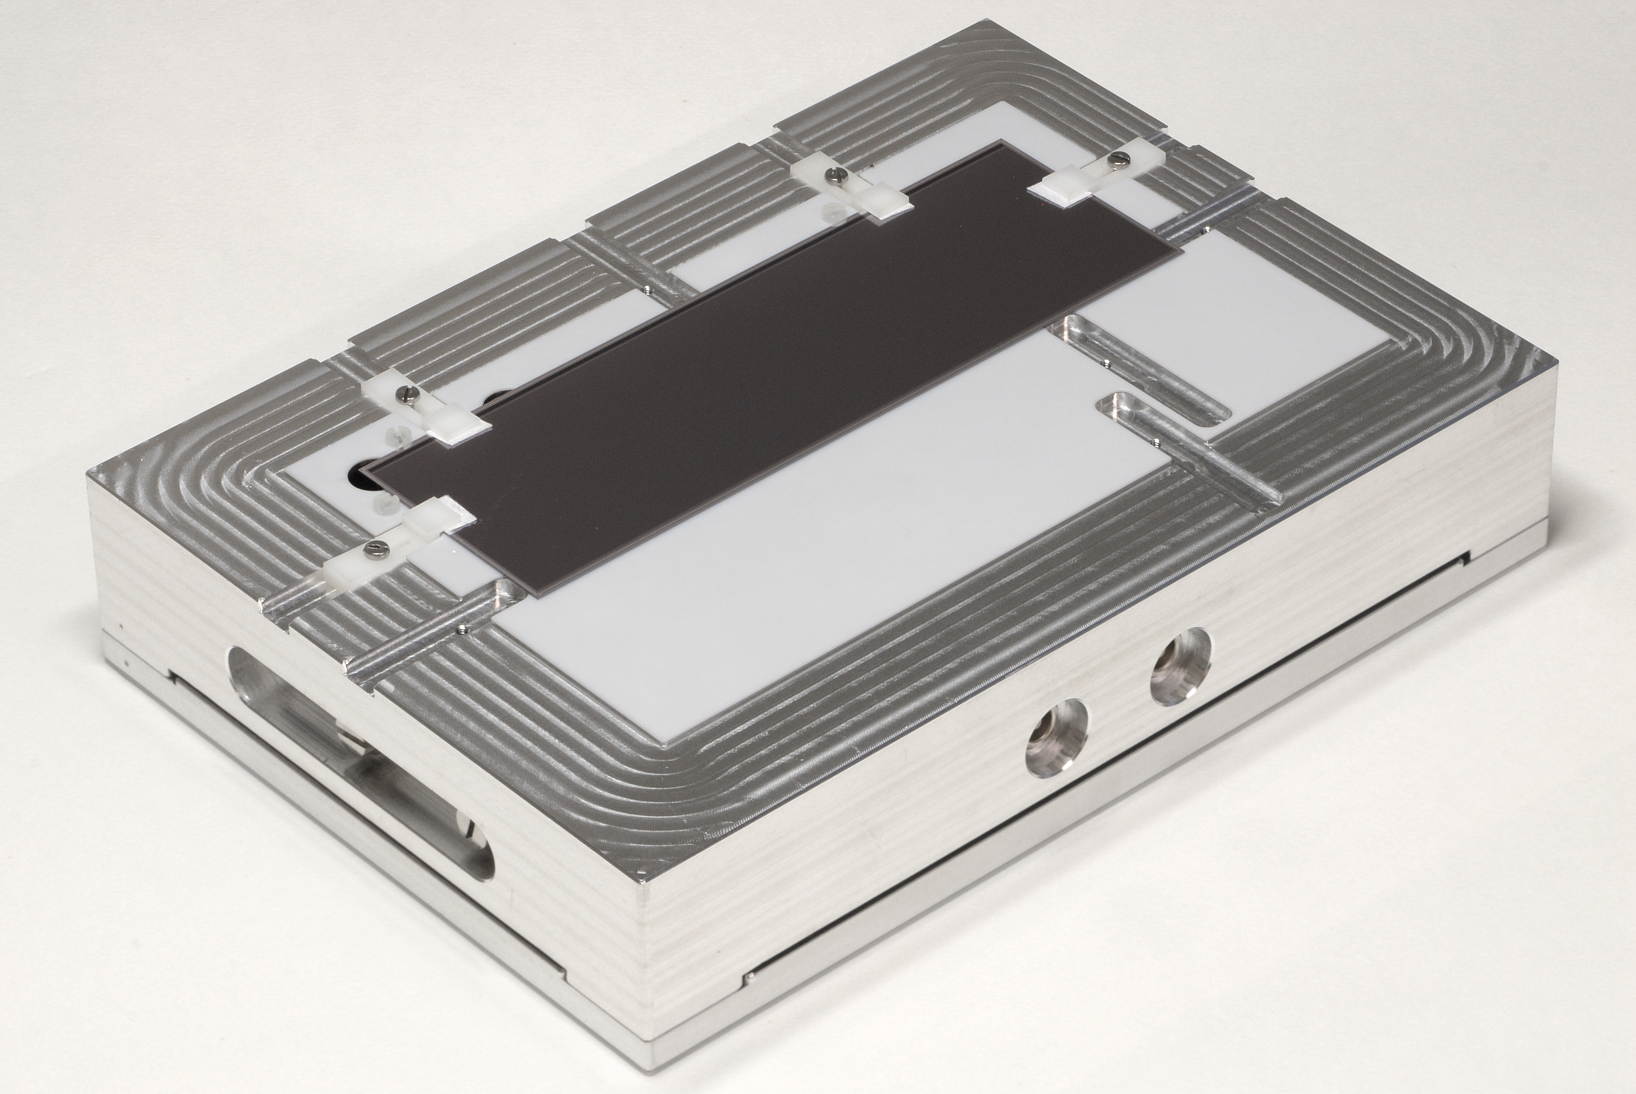
Testing Jig for Hamamatsu (HPK) Sensors
n-side pads tested along this edge
Showing sensor mounted n-side UP

Slide 16
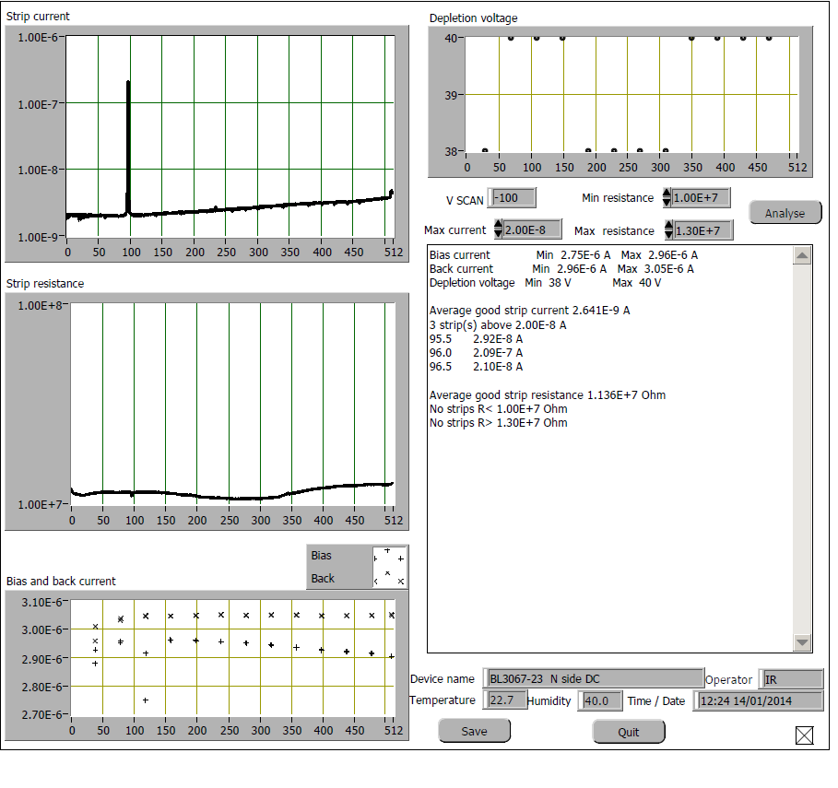
An example: DC Strip Scan on n-side
N-side strip insulation voltage
(measured on 12 strips across the sensor)
Strip leakage current
Summary report of the analysis program.
Lists:
Defective strips
high current
low resistance
Average current of ‘good’ strips
Average total resistance of ‘good’ strips
Strip resistance
Sensor ID: 3067-23
GR & BR currents

Slide 17
Radiation monitor & beam abort

Slide 18
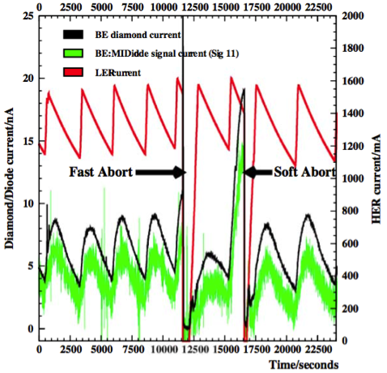
Belle II-VXD Radiation Monitoring and Beam Abort
Main requirements
Measurement of instantaneous dose rates & integrated doses
Sensitivity ≈ 1 mrad/s = 10 μGy/s, sampling rate ≈ 100 KHz
Beam Abort for excessive beam losses affecting PXD, SVD
Programmable thresholds, depending on accelerator conditions (filling injection, stable beams, machine development, …)
“Fast” (10 μs = 1 accelerator revolution) Beam Abort trigger
“slower” Beam Abort triggers, based on digitally filtered signals (averages over programmable numbers of samplings)
Conceptual design
Based on experience from Belle, BaBar, CDF, LHC
scCVD diamond sensors, measurement of currents:
Reference: typical pCVD sensor (10 × 10 × 0.5) mm³ 1 nA = 7 mrad/s = 70 μGy/s
Noise should be limited to a few pA
4 + 4 sensors located near PXD (very limited space)
6 + 6 sensors located near SVD
Background dominated by electrons

Slide 19
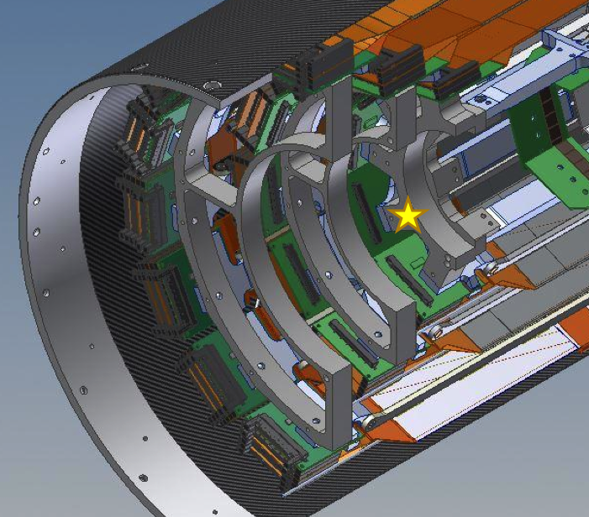
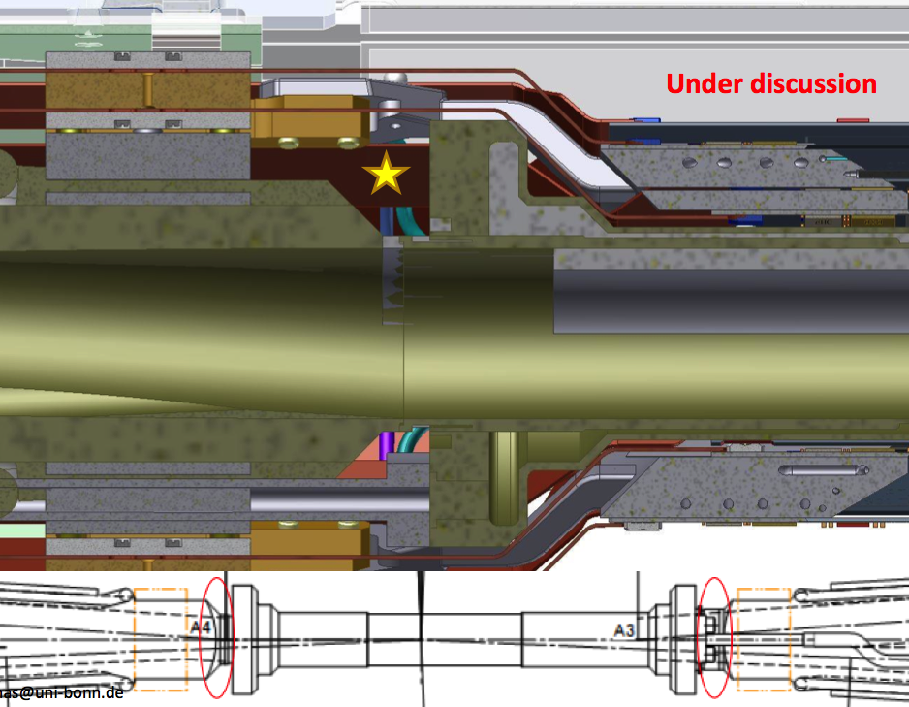
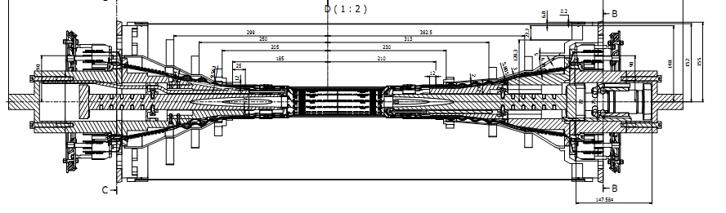
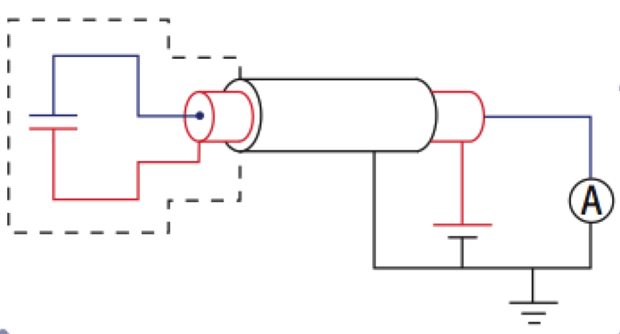
scCVD radiation sensors
4 + 4 sensors
PXD-beam pipe
6 + 6 sensors
close to SVD L3
support rings
Shielded
diamond
sensors
3+15 m (3+40 m) cables
Voltage sources (150÷500 V)
picoAmmeters

Slide 20
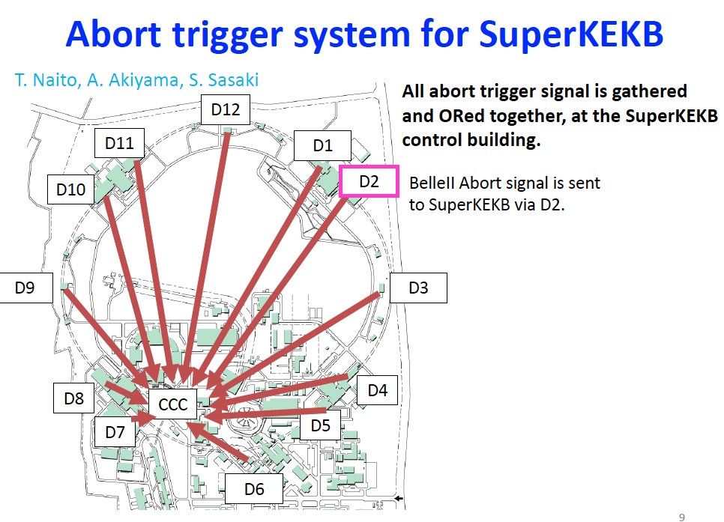

Slide 21
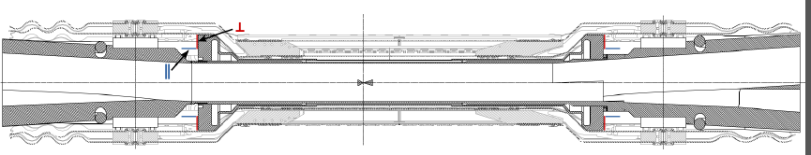
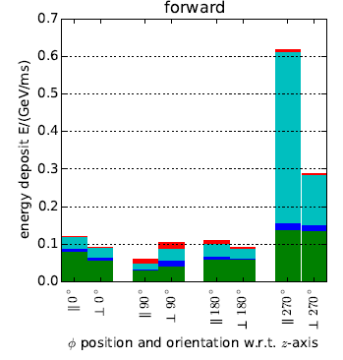
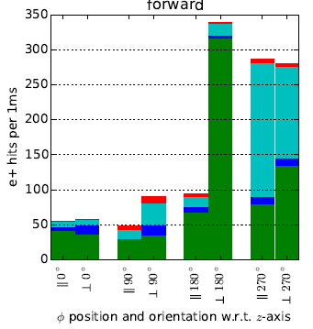
Expected radiation from simulations
VXD radiation/abort sensors now included in simulation geometry
Energy deposit
Particle fluence (e-)
Preliminary
Preliminary

Slide 22
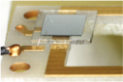
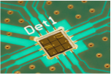
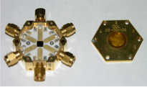
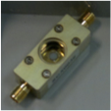
Diamond sensors
DM1
DC1
PD
DM4

Slide 23
Diamond sensor characterization
Label | Provider | sc/p CVD | Geometry mm^3 | pads | Validation ⁹⁰Sr beta | Validation IV radiation
PD | DDL | sc | 4.7x4.7x0.15 | 2x2 | OK
DC1 | Cividec | sc | 4.7x4.7x0.50 | 3x3 | OK
DC2 | Cividec | p | 5.0x5.0x0.50 | 3x3 | TBD
DC4 | Cividec | sc | 4.7x4.7x0.50 | 1 | OK
DM1* | Micron | p | 5.0x5.0x0.50 | 1 | OK
DM2* | Micron | sc | 4.7x4.7x0.50 | 1 round | OK
DM3 | Micron | p | 5.0x5.0x0.50 | 1 | Rejected
DM4 | Micron | sc | 4.7x4.7x0.50 | 1 | OK
DM5 | Micron | sc | 4.7x4.7x0.50 | 1 | OK
DM6 | Micron | p | 5.0x5.0x0.50 | 1 | TBD

Slide 24
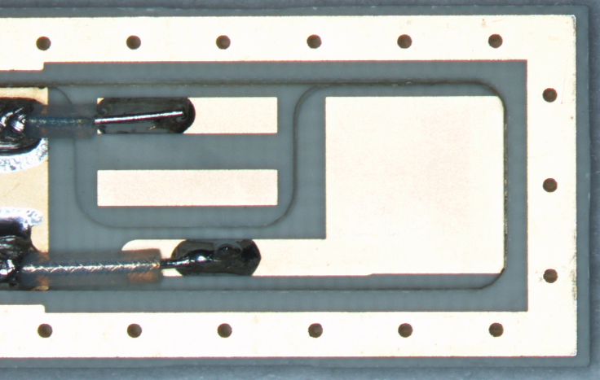
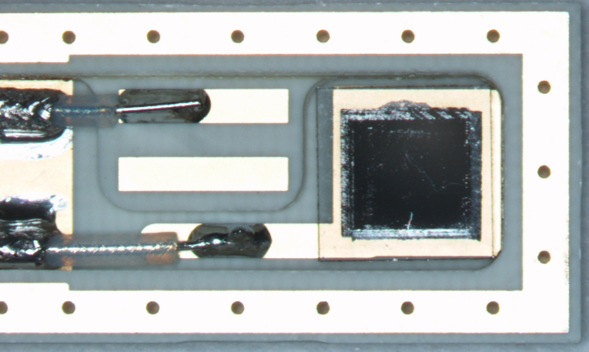
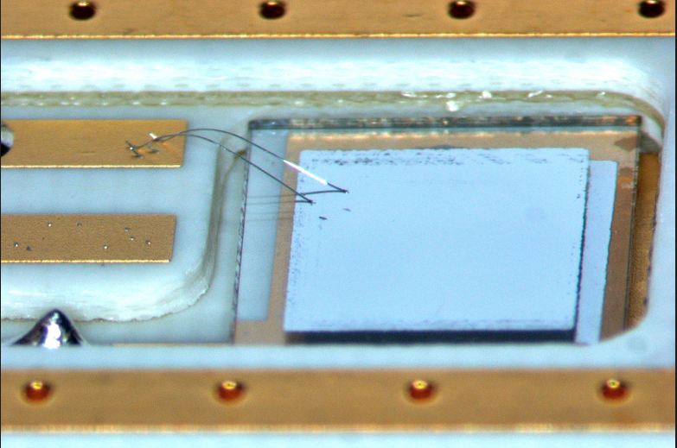
First tests with compact package

Slide 25
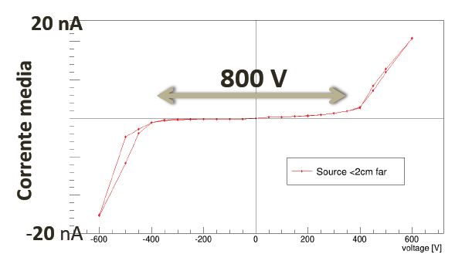




Characterisation of scCVD sensors - 1
I-V with ⁹⁰Sr β source at fixed d
pointlike
⁹⁰Sr β source
*
d
I
V
FLUKA simulation, ⁹⁰Sr β source
Current I vs distance d of ⁹⁰Sr β source
measurement
simulation

Slide 26




Characterisation of scCVD sensors - 2
Charge Collection Efficiency from MIPs
Carrier mobility, α source (TCT)

Slide 27
Readout Electronics: specs
For each of the 4 input channels (diamond sensors)
Individual HV supply
Effective bandwidth: 100 kHz (matched to 1 revolution = 10 μs)
Selectable current range: 0-50 μA or 0-2 mA
16 (24) - bit ADC; over-sampling possible with freq > 100 kHz
4 circular data buffers, updated every 10 μs:
“Raw data” and 3 levels of "sliding sums” over programmable numbers of cycles
digital filtering levels and time responses, from "immediate" (10 us) to "very slow" (typically 1 s)
4 levels of abort signals
from the comparison of raw data and sliding sums with the programmable thresholds, selected according to a “SuperKEKB Status Register”
Approach similar to FermiLab Beam Loss Monitor (BLM) and CERN LHC BLM systems
Specifications discussed within Belle II and with SuperKEKB
In collaboration with G.Cautero, D.Giuressi, and R.H.Menk from Elettra - Sincrotrone Trieste S.C.p.A.

Slide 28


Readout & Beam Abort: electronics prototype
F.Vulpone, thesis with G.Cautero et al. (Elettra): prototype ready of:
Analog front end: picoammeter (transimpedence amplifier, ADC 16 bit 130 MHz)
Digital section: FPGA (running averages, abort thresholds, timing&control)
External RAM and Ethernet interfaces; Labview control & readout test program
Ready for first field tests at KEK in October!
Ethernet
RAM
DAC
ADC

Slide 29
Attività di monitoring ambientale
VXD sistema molto complesso dal punto di vista termico:
Varie fonti di calore: elettronica APV25, Pixel, ambientale
Raffreddamento CO2 e flussaggio azoto
Quando siamo entrati in SVD non c’era ancora un piano preciso di monitoraggio ambientale

Slide 30
Temperature and humidity
Requirements
PXD+SVD Front End power dissipation: 360+700 W
CO₂ cooling pipes (-20ºC), cold dry air flow (0ºC ?)
Temperature monitoring:
near heat sources and at the inlets/outlets of cooling pipes
about 1ºC (0.1ºC) absolute (relative) accuracy
Interlocks on temperature and humidity (stand-alone, VXD)
Temperature above threshold, or dew point approaching -20ºC
Conceptual design
Fiber Optical Sensors (FOS) and laser interrogators (commercial)
Based on Bragg grating reflection of specific wavelengts
Can monitor stress, temperature, humidity (different coating) at several points
Conventional NTC thermistors for cross-calibration and interlocks
Humidity interlock: “sniffers” plus chilled mirror hygrometer outside

Slide 31


Slide 32


Slide 33


Slide 34



CO₂ Cooling
The total SVD (Origami) power dissipation 688(328) W
Edge hybrids: APV25 chips cooled by end rings
A pre-bent cooling pipe (OD=1.6mm) will be clipped onto the ladders on top of the Origami APVs

Slide 35


Thermal mock-up (DESY)
Belle II strips and pixels share the same volume
PXD+SVD power dissipation: 360+700 W
CO₂ cooling pipes (-20ºC); dry air / nitrogen flow (20ºC)
A PXD+SVD thermal mock-up is available at DESY for realistic tests.
It will be crucial for understanding several aspects and setting the exact location for the ambient sensors

Slide 36
Temperature monitoring: NTC thermistors FBG fiber sensors

Slide 37


Temperature 1: NTC Thermistors
System now foresees up to 96 NTC thermistors (Betatherm 100kΩ)
24=12 pairs: 12 half-rings supporting the SVD ladders
32=16 pairs: inlets and outlets of the CO₂ cooling pipes
6: near FOS fibers for cross-calibration
34 still available
Readout based on ELMB (Embedded Local Monitor Board) CMS-ATLAS
1 power supply board, 3 motherboards with ELMB and CANbus adapter, 3 x 2 current source boards, 3 x 2 x 16-channel connectors

Slide 38

NTC current sources and interlock signals
6 small boards, each:
Current sources for 16 NTCs
16 comparators with hardwired thresholds
2 interlock signal outputs (each: OR of 8 channels)
Built-in redundancy
2 NTCs per measurement point
Each contributes to a separate interlock OR
Design completed, prototype channel tested

Slide 39

NTC final locations
12 sensor pairs attached to the 12 half-rings supporting the SVD ladders:
4mm alignment holes in half rings L5 and L6, drill a specific 3mm hole L3-4
16 sensor pairs on the inlets and outlets of the CO₂ cooling pipes:
on the “streuli connectors” of CO2 inlets-outlets
A few (~8) positioned near fibers for cross-calibration

Slide 40
NTC final readout (ELMB) system design
sensors
docks
Box in Electronics Hut
twisted
pairs (32)
≈ 3÷4 m
4 interlock signals
3 x 4 signals
to VXD
Interlock PLC
Current
sources
+ interlocks
ELMB
4 x 8 twisted pairs
(no shield)
3 Small
connect.
boards
Current
sources
+ interlocks
CANbus
ELMB
Current
sources
+ interlocks
Temperature:
up to
3 x 32 = 96
NTC thermistors
ELMB
PC
connectors
+ jumpers
Power supply
EPICS
Slow Control

Slide 41


Now the system is ready

Slide 42


Temperature 2 and Humidity 1 – FOS
FOS R&D completed by the IFIC group for PXD,
successfully tested at the DESY beam test Jan 2014
We adopt a similar approach for SVD:
one fiber per ladder, inserted in the Airex foam,
with several temperature sensing points per fiber
(one per DSSD in layers 4, 5, 6)
Total: 38 fibers and 158-240 temp. sensing points
Read-out of up to 40 fibers:
One rack-type sm225-800 interrogation unit (16 ch), 0.5Hz
10 (4 x 1) passive couplers.
=> Read-out available for 8-18 additional fibers (with humidity-sensitive coating?)
Model | description | cost | quantity | total
sm225-800 | FBG interrogator | 26,000€+VAT | 1 | 31,720€
CP-W-P-1X4-1550-250 | 1x4 passive coupler | 180/45€+VAT | 10 | ~800€
Moreover, humidity (to avoid condensation issues, from CO₂ cooling at -30ºC): interlock (Dew point < - 40 ºC): sniffing pipes e Chilled Mirror Hygrometers

Slide 43

Where and how many temperature sensors on the fibers?
Our proposal:
1/2 FBGs per DSSD in the origami,
1 in the BW DSSD (both inside Airex channel)
1 sensor close to the clamp (outside Airex channel)
Airex channel
500 μm ⌀
Yellow: buffer tube 900 μm ⌀
Orange: coating 250 μm ⌀
Blue: core 9 μm ⌀
Coating: acrylate (almost insensitive to humidity)
FBG Sensor dimension ~10mm
location not very precise (~±10mm)

Slide 44
SVD FOS fibers system -2 FBGs/origami
(4x1)couplers
DOCKs
Layer 6: 16 ladders
16 fibers x 7 (+1) FBGs
Layer 6
4 couplers
…
…
Interrogator
…
Layer 5
3 couplers
Layer 5: 12 ladders
12 fibers x 5 (+1) FBGs
(16 inputs)
…
…
Layer 4: 10 ladders
10 fibers x 3 (+1) FBGs
Layer 4
3 couplers
…
…

Slide 45

FBG (FOS): tests and calibrations
Multiplexed fibers with 5 or 8 FBG sensors
attenuations OK, well separated peaks
Calibrations in environmental chamber,
-20 to +40 ºC: polynomial fits OK

Slide 46

8/5 FBGs with/without splitters
5 sensors fiber direct to interrogator
8 sensors fiber with 1x2 splitter
2 fibers (8 sensors +5 sensors), 1x4 splitter, 30m fiber and all PC/APC connectors is OK, the attenuation is ~ as expected: OK!

Slide 47



FBG calibrations (-20 to +40ºC)
4-parameter polynomial fits: stable and reproducible results,
residuals and stability within about ± 0.15ºC (less than ± 0.5ºC)
T [ºC]
λ [nm]
ΔT [ºC]
T [ºC]

Slide 48



Dew Point Sensors (interlock @ -40°C)
Sniffing pipes
Vaisala DMT242B
Dew Point Transmitters
[-60, +60]ºC dew point range
Edgetech Dewmaster
Chilled Mirror Hygrometer
(for calibrations)
Rotameter
flux meters
Pump

Slide 49

Dew Point Sensors (interlock @ -30°C)
Main components received
Detailed mechanical design almost completed.
Prototype system in preparation for tests on the VXD thermal mock-up (DESY)

Slide 50
SVD + PXD Interlocks
INPUTS
INTERLOCK
LOGICS
OUTPUTS
?
?
?

Slide 51

SVD + PXD Interlocks
INPUTS
INTERLOCK
LOGICS
OUTPUTS
Temperature (NTCs)
Dew point (Vaisala)
Sniffer Pump(s)
Cooling plant failure
Beam Abort
Fire alarm?
…etc
?
?
?
PXD power supplies
VXD power supplies
(not segmented)
…etc
Programmable Logic Controller (PLC)
Schneider M340 – cpu BMX P34 2030
Modbus/EPICS drivers exist! expandable
kit (p.s. + cpu + I/O + software) purchased
Local expertise: INFN technician

Slide 52
Conclusioni
SuperKEKB e Belle-II hanno un programma molto ambizioso
Il rivelatore di vertice ora in fase avanzata di costruzione sarà cruciale per l’esperimento
Prima fase di commissioning dell’acceleratore primo semestre 2016 con già 4 diamanti
Tutto 2016 assemblaggio SVD
2017 seconda fase commissioning con parte VXD e tutto il sistema di monitor di radiazione
2018 installazione finale VXD e fisica

Slide 53
Back-up

Slide 54
Trapezoidal Sensor Testing
41 wedge-shaped sensors to be installed in SVT (forward region of layers 4, 5, 6).
60 sensors ordered (by HEPHY) to Micron Semiconductor.
Trieste is sharing with Vienna the test of these sensors, using a semi-automatic prober and probe cards.
A dedicated jig for interfacing the double-sided sensors with our prober has been designed and fabricated.
Two 40-needle probe cards have been procured:
100 µm pitch card for p-side
240 µm pitch card for n-side

Slide 55
Sensor testing set-up
Sensor testing Jig
Front and Back-side Rings are connected through cables
Strips are contacted by a 40-needle Probe Card

Slide 56
Sensor Testing Procedure
Mount the sensor n-side up on the jig, bond the n-side Rings
I-V measure of the whole sensor and of one n-side strip
AC (metal) strip Scan on n-side, using the 240 µm probe card
DC (implanted) STRIP SCAN on n-side, using the 240 µm probe card to contact (in two steps) the readout strips and the non-readout ones (120 µm pitch)
Remove the bonds on n-side, turn the sensor and bond the p-side Rings
AC strip Scan on p-side (along short edge), using the 100 µm probe card to contact (in two steps) all 50 µm pitch metal strips
DC STRIP SCAN on p-side, using the 100 µm probe card to contact (in four steps) all 25 µm pitch implanted strips

Slide 57
Wedge Sensor Summary
43 production sensors delivered in Trieste (37 to Vienna).
31 sensors (plus 3 pre-series units) fully tested in Trieste.
General quality is quite good. 27 out of 31 accepted.
Besides standard tests, detailed investigations have been made of a contact resistance problem found on p-side.

Slide 58
Test of Hamamatsu Sensors
Two rectangular sensors for Layer 3 of SVD, previously tested by HPK and by Vienna have been thoroughly tested in Trieste for cross-checking the test results.
This required fabricating a new, dedicated support jig.
Several inconsistencies in Hamamatsu tests have been found (later acknowledged by HPK).
A strip insulation problem on p-side has been found and extensively investigated.

Slide 59
General overview
Radiation monitoring:
20 single crystal diamonds sensors (4+4PXD, 6+6SVD)
Temperature monitoring:
64 NTC sensors for SVD (readout up to 96)
38 FOS Fibers for SVD (few spare channels)
Plan for humidity in VXD:
2(?) Sniffing pipes to outside: Vaisala DMT242B Dew Point Transmitters plus chilled mirror hygrometer for reference
2 more FOS Fibers from Santander?
Other sacrificial ones?

Slide 60
List of Trieste activities in Belle-II
L.Bosisio, G.Orzan,
I.Rashevskaia
Micron and HPK microstrip sensors tests
Radiation monitor & beam abort
scCVD diamond sensors (Cividec): characterization & specs, tender
prototype electronics ready (digitizer, FPGA, beam abort)
Temperature monitoring
NTC thermistors: mechanics, readout electronics, EPICS
FBG fiber sensors: tests, calibrations (EPICS already done)
Humidity monitoring, interlocks, PLC
Preparations for tests at the DESY VXD thermal mock-up
L.B., P.Cristaudo, L.Vitale,
L.L., M.Zuppichin, …
F.Vulpone, G.Cautero,
D.Giuressi, L.L., …
P.Cristaudo,
L.L., L.V.
M.Bari,
L.Vitale
A.Tomasin
A.Zanetti,
L.L., L.V.

Slide 61

Design of shorter diamond package

