Slide 1
LABORATORI NAZIONALI DI FRASCATI
www.lnf.infn.it
Advances on the
µ-RWELL gas detector
M. Poli Lener ^{(a)}
G. Bencivenni ^{(a)} , R. de Oliveira ^{(b)}, G. Felici ^{(a)} , M. Gatta ^{(a)}, G. Morello ^{(a)}
    ^{(a)} LNF-INFN, Italy, ^{(b)} CERN, Meyrin, Switzerland

Slide 2
Outline
Introduction
The µ-RWELL technology & features
Detector performances
Large size device for future project
Cylindrical shape detector
Summary

Slide 3
Introduction
MicroPattern Gas Detectors (MPGD) due to their performance (high rate capability and fine space resolution) are ideal tools for :
  fundamental research (Compass, LHCb, Totem, KLOE, Jlab, LHC experiments upgrades)
  applications beyond science (medical, industrial, neutron ...)
In spite of the recent relevant progress in the field, still a long way to go by dedicated R&D studies towards:
  stability under heavy irradiation (discharge containment)
  simplified construction technologies, a MUST for
      very large scale applications in fundamental research
      technology dissemination beyond HEP

Slide 4
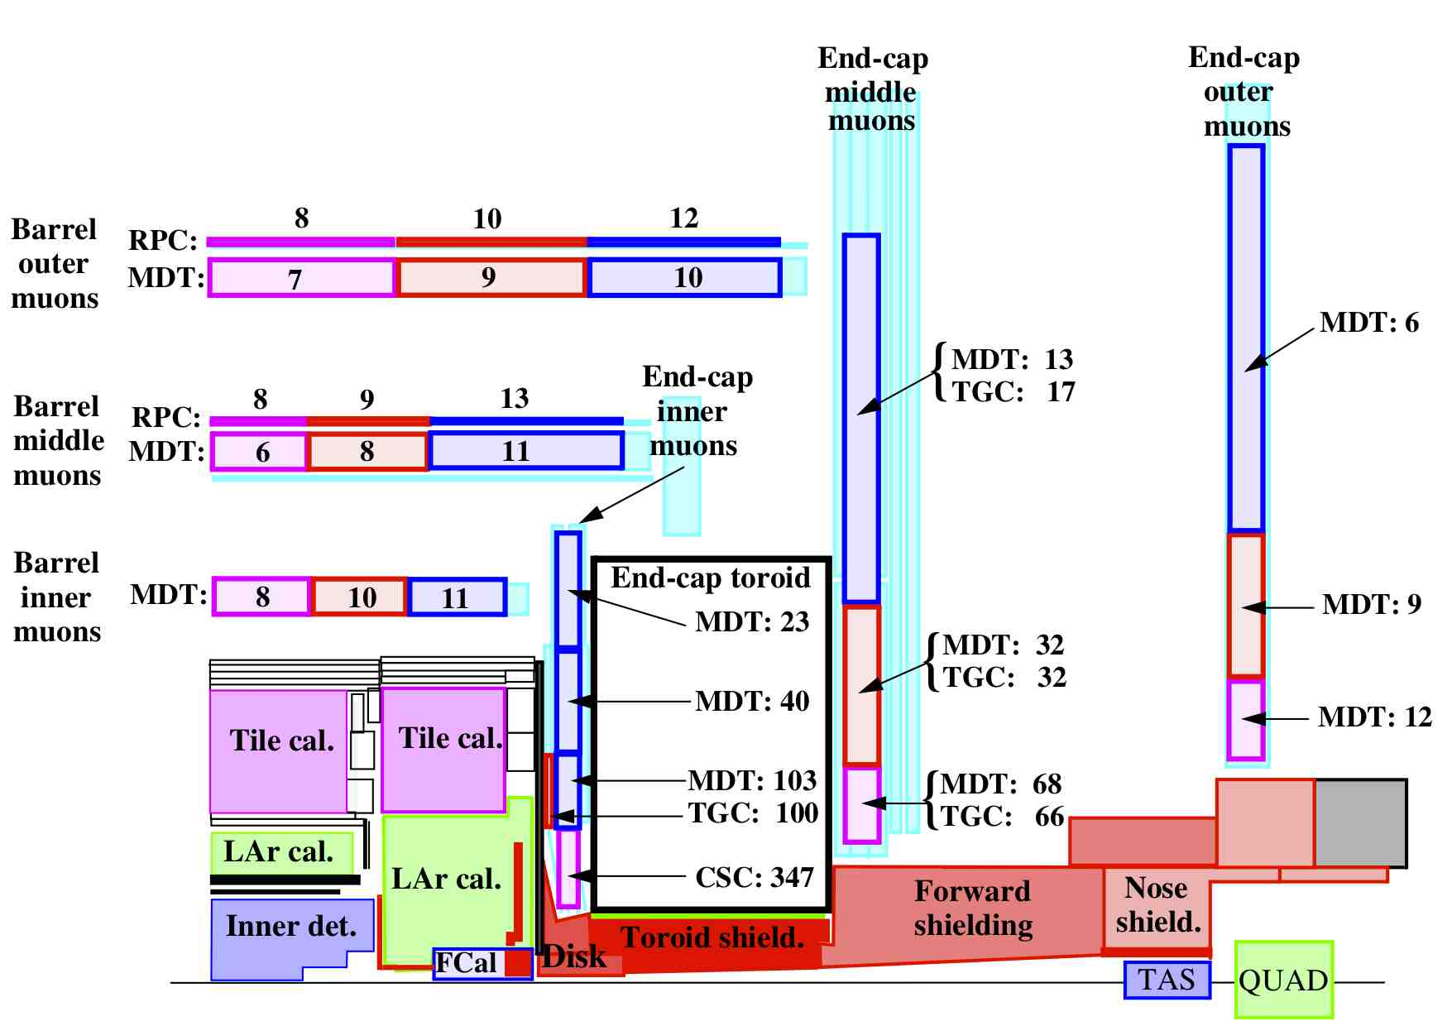



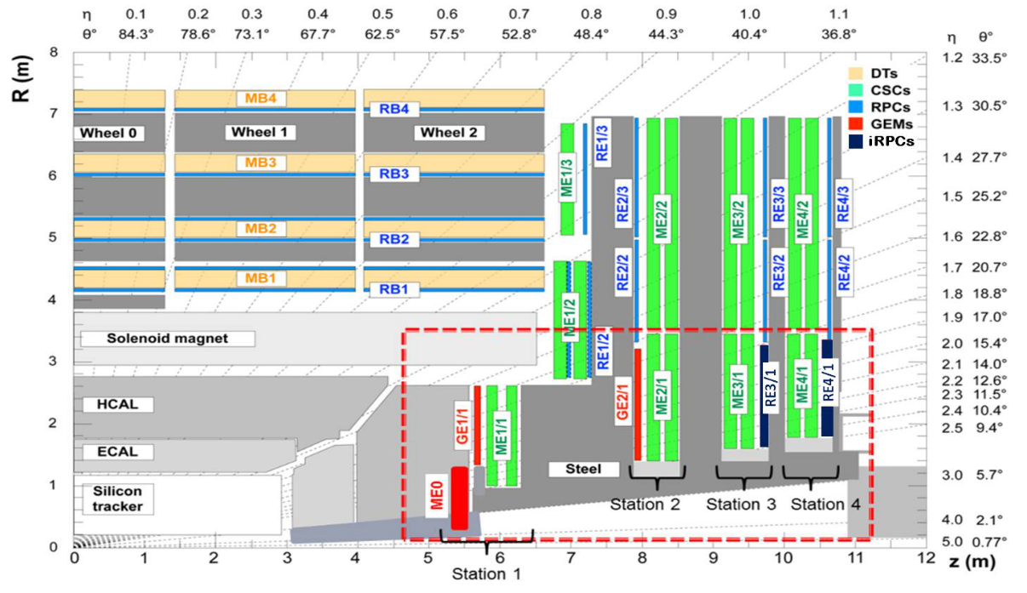
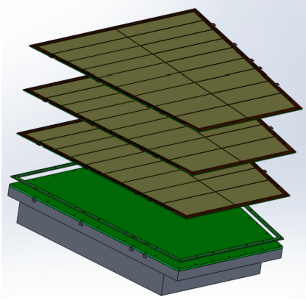

MPGDs @ LHC (Upgrades)
Small Wheel
Rates in Hz/cm²
LHCb upgrade
 | # chambers / size (w/out spares) | Total GEM foil area
M2R1 M3R1 | n.48 –> ~ 30x25 cm² n.48 –> ~32.x27 cm² | ~12 m² ~13 m²
Rates at inner rim
1–2 kHz/cm²
GE2/1
GE1/1
ME0
Alice-TPC

Slide 5
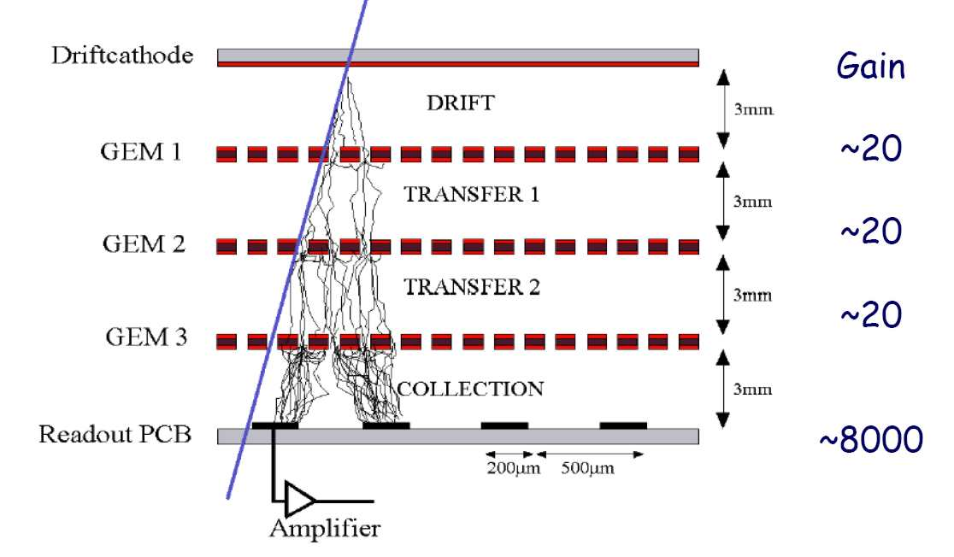
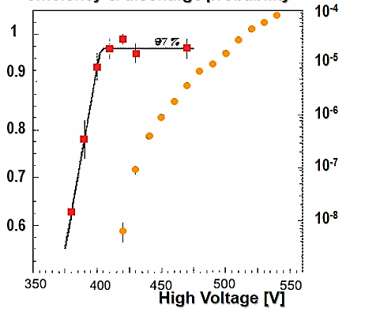
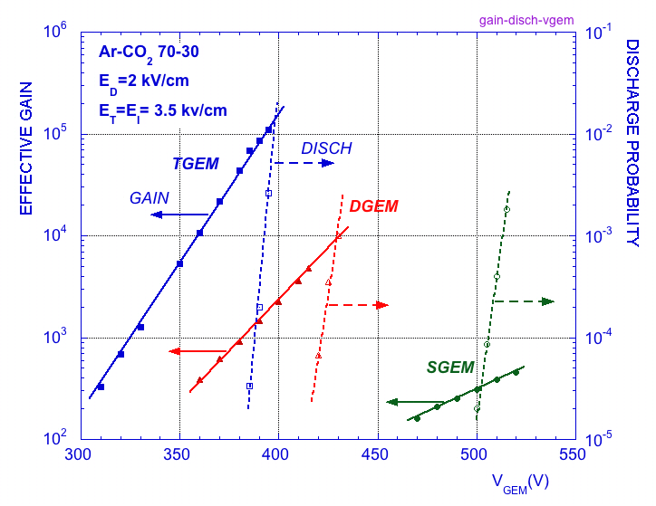
MPGDs: stability
The biggest “enemy” of MPGDs are the discharges.
Due to the fine structure and the typical micrometric distance of their electrodes, MPGDs generally suffer from spark occurrence that can eventually damage the detector and the related FEE.
GEM
MM
Efficiency & discharge probability
Efficiency
discharge probability
Strongly reduced but not completely suppressed
²⁴¹ Am α souce
10 GeV/c proton
A. Bay et al.,
NIMA 488 (2002) 162
S. Bachmann et al.,
NIMA A479(2002) 294

Slide 6
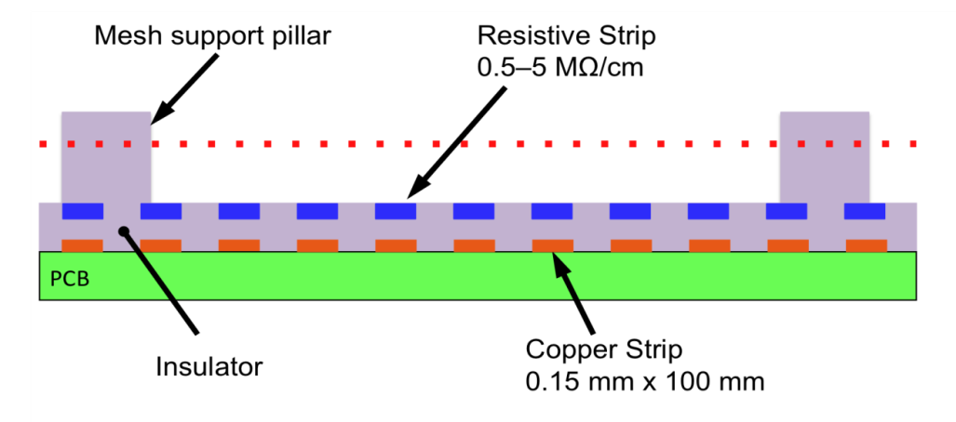
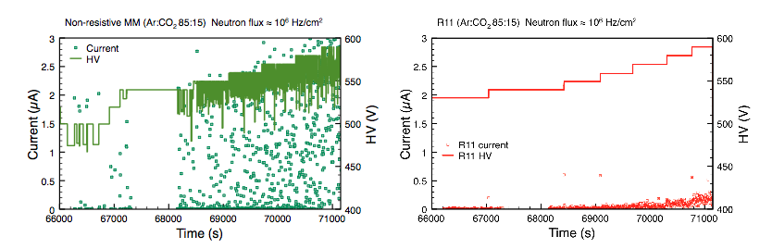
Technology improvements: resistive Micromegas
For MM, the spark occurrence between the metallic mesh and the readout PCB has been overcome with the implementation of a “resistive layer” on top of the readout itself . The principle is the same as the resistive electrode used in the RPCs: the transition from streamer to spark is strongly suppressed by a local voltage drop.
by R.de Oliveira TE MPE CERN Workshop
The resistive layer is realized as resistive strips capacitive coupled with the copper readout strips.
voltage drop due to sparking

Slide 7
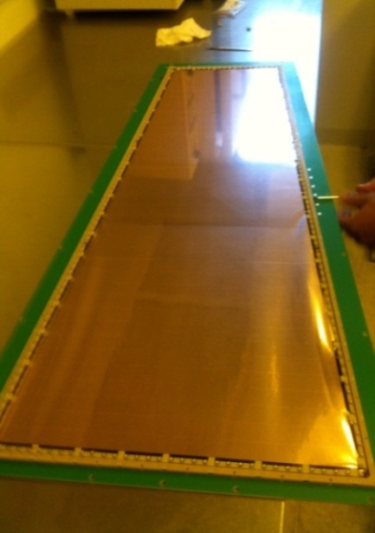
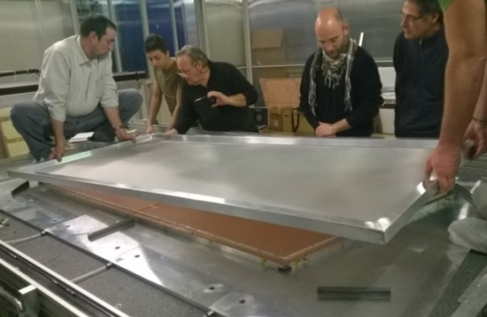
MPGDs: the challenge of large area
A further challenge for such MPGDs is the complexity of their assembly procedure, in case of large area devices.
NS2(CERN): no gluing but still stretching …
The construction of a GEM requires some time-consuming (complex) assembly steps such as the stretching (with quite large mechanical tension to cope with, ∼1 kg/cm) of GEM foils. The splicing/joining of smaller detectors to realize large surfaces is difficult unless introducing not negligible dead zones (2÷3 mm). The width of the raw material is limited to 60 cm.
Similar considerations hold for MM: the splicing /joining of smaller PCBs is possible, opening the way towards the large area covering (dead zone of the order 0.2÷0.3 mm).
The fine metallic mesh, defining the amplification gap, is a
“floating component”, because it is stretched on the cathode
(∼1 kg/cm) and electrostatically attracted toward the PCB
→ Possible source of gain non-uniformity.
Handling of a stretched
mesh

Slide 8
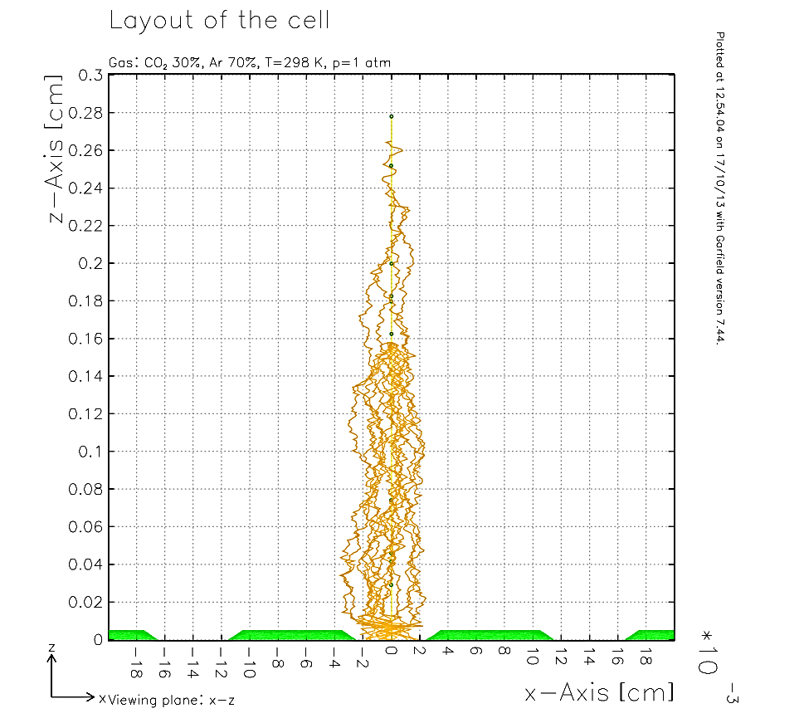
The µ-RWELL: a novel architecture (I)
The goal of this study is the development of a novel MPGD by combining in a unique approach the solutions and improvements proposed in the last years in the MPGD field (RD51).
Cathode
Muon Track
50 µm
RWELL_PCB

Slide 9
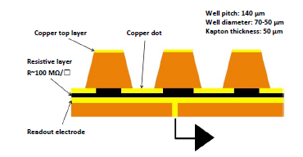
The µ-RWELL: a novel architecture (I)
The goal of this study is the development of a novel MPGD by combining in a unique approach the solutions and improvements proposed in the last years in the MPGD field (RD51).
The µ-RWELL is realized by coupling:
a “suitable patterned GEM foil” for the “amplification stage” → OK;
a “resistive stage” for the discharge suppression & current evacuation
a simple readout PCB board (rigid or flexible)→ OK
1
2
3
The simplest scheme of µ-RWELL detector
The detector is compact, simple to build & cost effective :
only two mechanical components: µ-RWELL_PCB + cathode
no critical & time consuming assembly steps: no gluing, no stretching, easy handling
no stiff & large frames
large area with PCB splicing technique
The µ-RWELL is easy to operate:
very simple HV supply: 2 independent channels or a trivial passive divider

Slide 10
The µ-RWELL: a GEM-MM mixed solution
µ-RWELL
GEM detector sketch
MM detector sketch

Slide 11
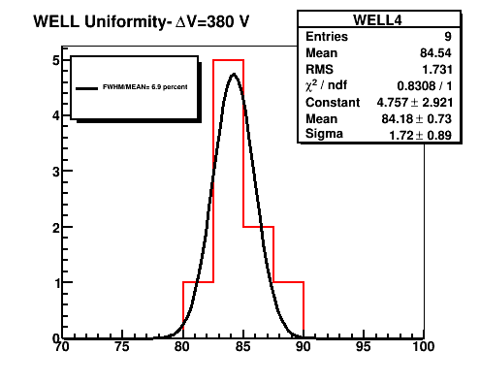
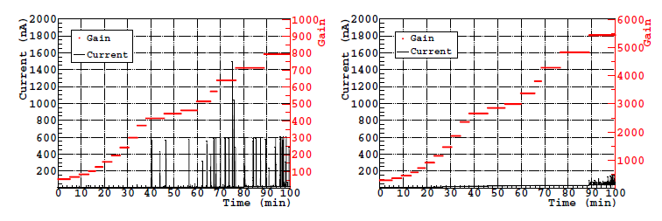
The µ-RWELL: a GEM-MM mixed solution
5.9 keV X-ray & Φ∼3MHz/cm²
The µ-RWELL has operational features in common either with GEMs or Micromegas:
from GEM it takes the amplifying scheme with the peculiarity of a “well defined amplifying gap”, thus ensuring very high gain uniformity (even better because of the absence of transfer/induction gaps)
from Micromegas it takes the resistive readout scheme that allows a strong suppression of the amplitude of the discharges
10x10 cm² proto with double resistive layers
FWHM/MEAN= 6.9 %
Gain (a.u)
5.9 keV X-ray & Φ∼1MHz/cm²
5x5 cm² proto with single resistive layer
Discharge Amplitude (nA)
Discharges for µ-RWELL of the order of few tens of nA (<100 nA @ max gain)
Ref. 2015_JINST_10_P02008

Slide 12
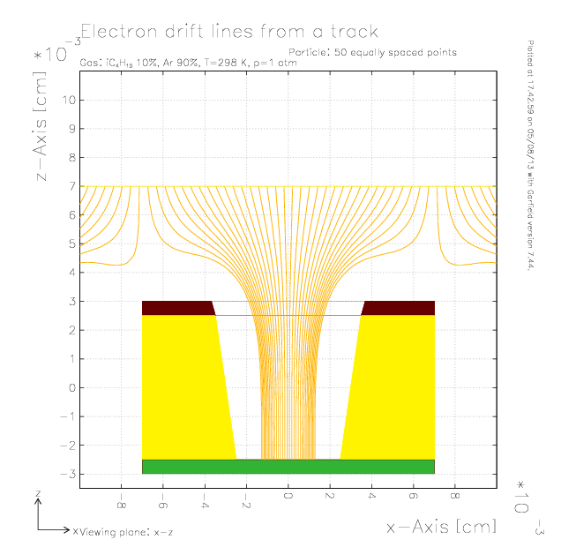
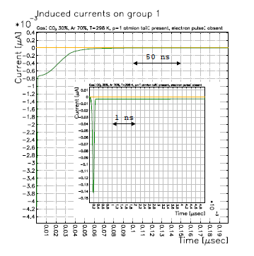
The µ-RWELL (Garfield simulation)
µ-RWELL – Ar:CO2 70:30 gas mixture
Signal from a single ionization electron in a µ-RWELL:
The absence of the induction gap is responsible for the fast initial spike, about 200 ps, induced by the motion and fast collection of the electrons then followed by a ~50 ns ion tail.
The µ-RWELL signal is similar to the MM one.

Slide 13
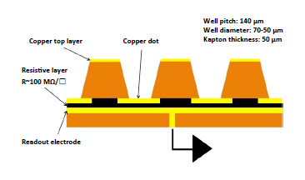
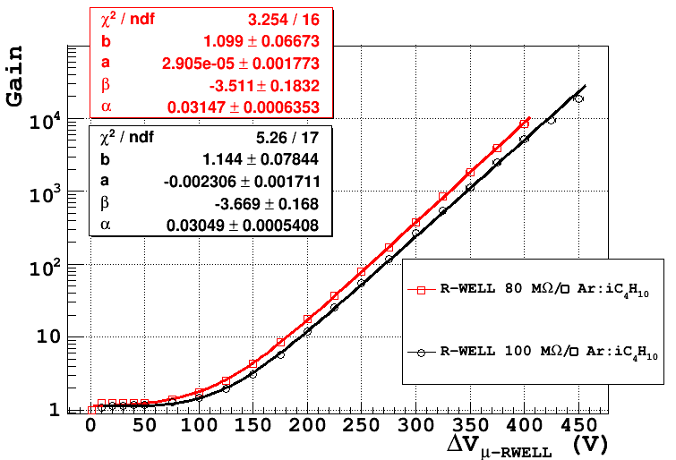
The µ-RWELL performance (I)
The prototypes have been tested with Ar/CO₂ =70/30 & Ar/i-C₄H₁₀ =90/10 gas mixtures and characterized by measuring the gas gain, rate capability and discharge in current mode.
The devices has been irradiated with a collimated flux of 5.9 keV X-rays generated by a PW2217/20 Philips Tube.
The gain has been measured vs potential applied between the top of the electrode of the amplification stage and the resistive layer.
Ar/i-C₄H₁₀ =90/10
GAIN UP TO 10⁴

Slide 14
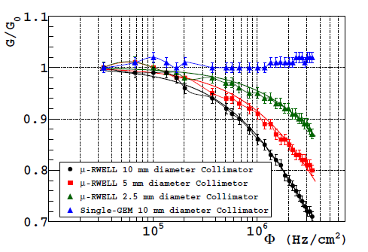
The µ-RWELL performance (III)
A drawback correlated with the implementation of a resistive layer is the reduced capability to stand high particle fluxes: larger the radiation rate, higher is the current drawn through the resistive layer and, as a consequence, larger the drop of the amplifying voltage.
Taking into account that ionization of a m.i.p. is a factor 7 smaller than X-rays, the rate capability of the detector can be tuned with a suitable current evacuation scheme:
“Low particle rate” (LR) << 100 kHz/cm² (mip): single resistive layer → surface resistivity (≈100 MΩ/)
“High particle rate” (HR) >> 100 kHz/cm² (mip): more sophisticated resistive scheme must be implemented (performed by MPDG_NEXT- LNF financed by GR51-INFN)
X-ray Ar/CO₂ – G_{RWELL} = 3000
100 MΩ/
equivalent mip
Normalized gain vs X-ray flux for GEM and µ-RWELL for irradiation at the center of the active area, with three different collimator diameters: 10 mm, 5 mm and 2.5 mm.

Slide 15
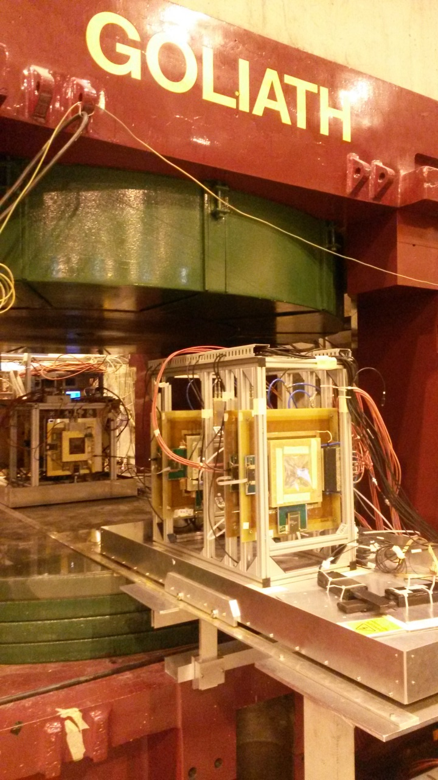
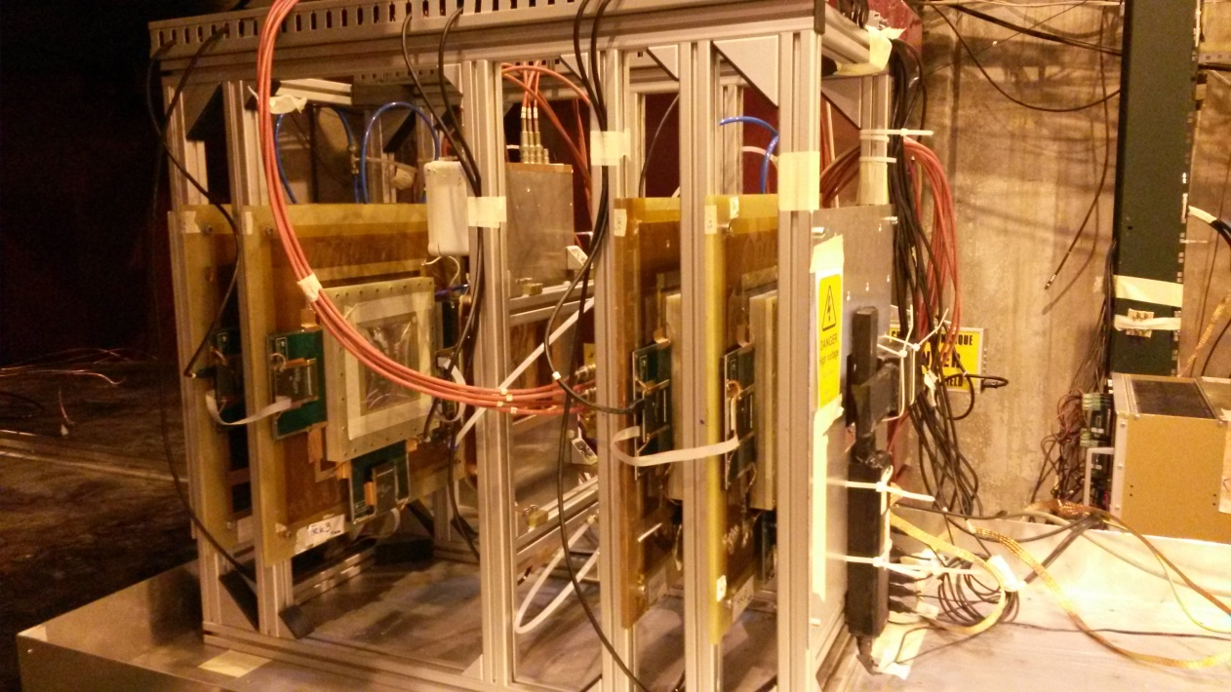
H4 beam test
Muon beam momentum: 150 GeV/c
Goliath: B up to 1.4 T
μ-RWELL prototype 80 MΩ /□
400 µm pitch strips
APV25 (CoG analysis)
Ar/iC₄H₁₀ = 90/10
BES III-GEM chambers
GEMs Trackers
15

Slide 16
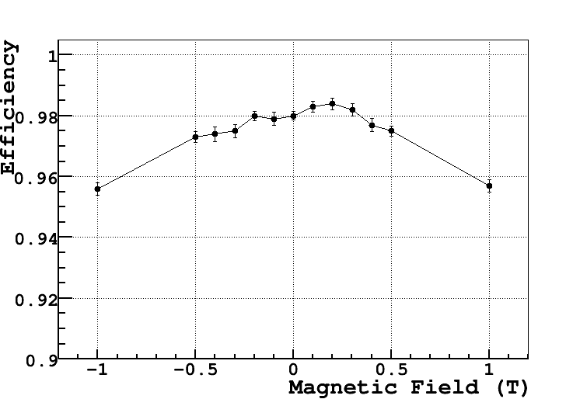
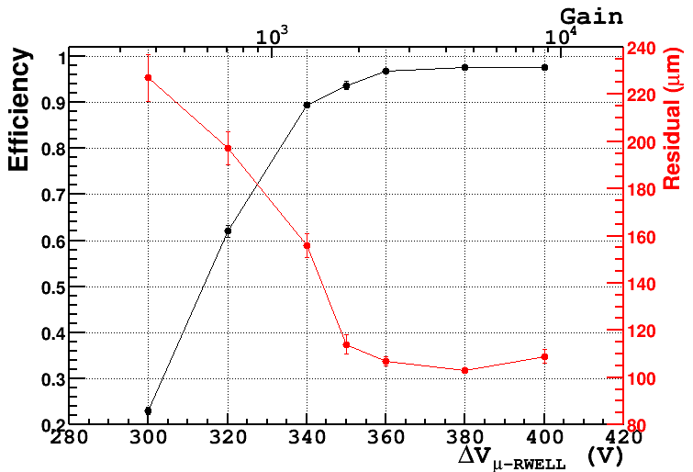
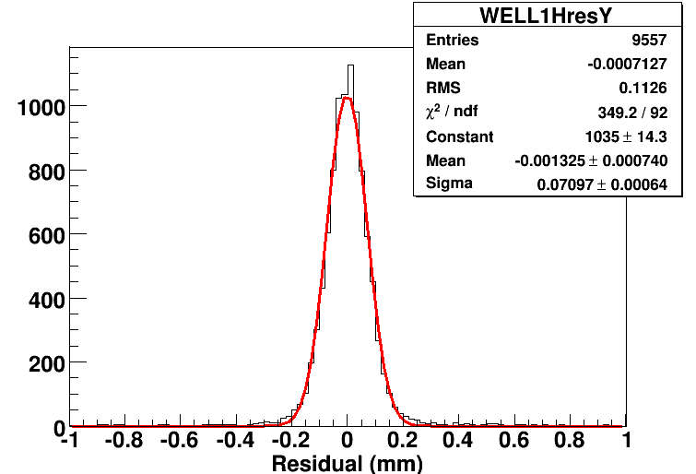
H4 beam test: orthogonal tracks
μ-RWELL vs B (G = 4000)
μ-RWELL vs HV (B = 0.5 T)
G∼2k with APV
∼98 %
σ_{RWELL} = (52+-6) µm
@ B= 0T after TRKs contribution substruction
Ref. To be published in NIM A, contrib ELBA conf 2015

Slide 17
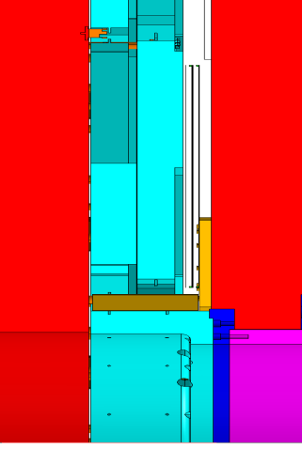

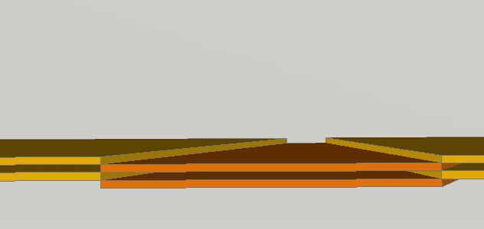
µ-RWELL for CMS-Muon system (I)
88 mm
Stiff structure with honeycomb sandwiched r/o & cathode PCBs to prevent possible deformation due to gas over-pressure
YE2
YE1
600
Detector cross section
600
Readout & µ-RWELL
1
Honey-comb
3
5
15
1
Detector gas gap
1
5
Honey-comb
3
5
Splicing zone
< 0.5 mm wide
Cathode
1
600
Possible detectors arrangement in GE2/1 region
Three PCB RWELL spliced with the same technique used for large ATLAS MM + only one cathode closing the detector
60

Slide 18
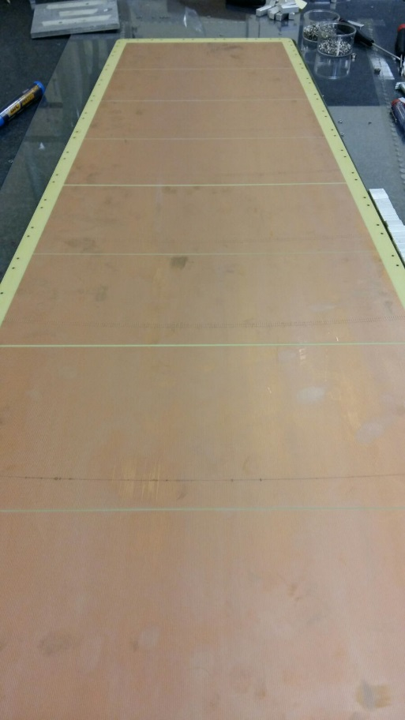
µ-RWELL for CMS-Muon system (II)
As a first step, the prototype will be based on the GE1/1 PCB readout:
PCB r/o ∼1.2x0.5 m divided in 8 r/o sectors
One single resistive layer with DLC technique with edge current evacuation scheme (expected part. rate≈10 kHz/cm² )
One amplification stage (50 µm or 125 µm thick)
1200 mm
8 r/o sectors
A very simplified
detector scheme

Slide 19

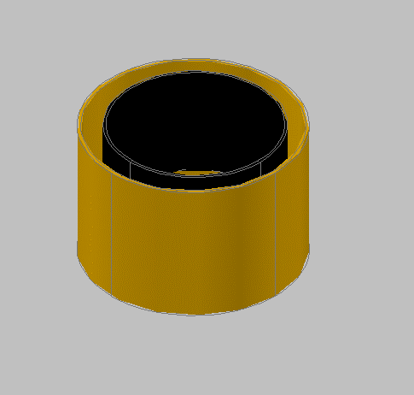
A Cylindrical µ-RWELL scheme
Flexible r/o should be implemented in the RWELL scheme & the same technique used by cylindrical GEM (mould, vacuum bag, ect) are employed in the RWELL detector assembly
Gas gap
Flexible Readout
Gas gap
Copper top layer
Copper dot
Resistive layer
Cathode
Flexible RWELL+r/o
Flexible Cathode
The simplest scheme of cylindrical µ-RWELL detector
A more easier
production assembly & greater gain uniformity

Slide 20
SUMMARY
The µ-RWELL seems to be a very promising MPGD technology:
very compact device
very simple assembly
effective spark quenching (quantitative test tbd)
gas gain ∼10⁴
high gain uniformity
rate capability ∼1 MHz/cm² for m.i.p
good space resolution
R&D required to become a reliable solution for applications such as
large area tracking & compact digital calorimetry

Slide 22
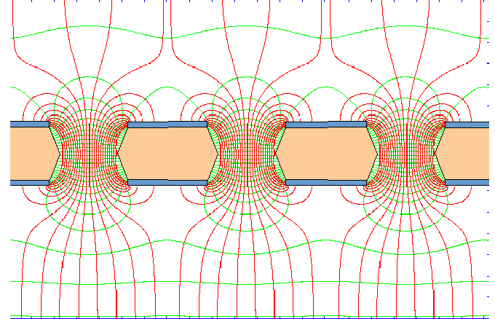
Principle of operation: single-GEM
Cathode
Electrons:
Drift
Field
Ions
Diffusion Losses
Ion trap
~50%
Induction
Field
signal only due to electron motion
~50%
Anode
Ion Feedback =
I⁺_{drift} / I⁻_{out}
I⁻_{out} = I⁻_{in} . G . T
(gain x transparency)

Slide 23
Resistive-MicroMegas with floating mesh
(positioning rely only on the electrostics of the cell)
not to scale detector opened
not to scale detector opened
Stiffening panel
Drift electrode
Pillars (128 µm)
PCB1
PCB2
PCB₁
PCB₂
Aluminum support plate
Rohacell

Slide 24
Resistive MicroMegas with floating mesh
(positioning rely only on the electrostics of the cell)
not to scale detector closed
Stiffening panel
5.00
PCB1
PCB2
PCB₁
PCB₂
Aluminum support plate
Rohacell

Slide 25
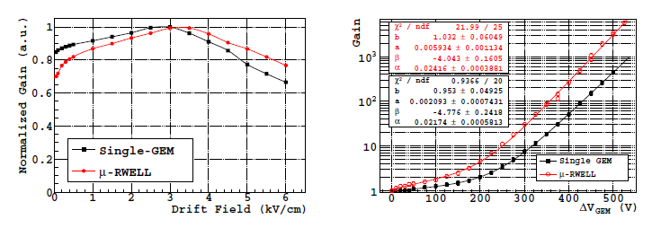
The µ-RWELL performance (I)
The prototype has been tested with Ar:CO₂ (70:30) gas mixture and characterized by measuring the gas gain, rate capability and discharge behavior in current mode.
ΔV (V)

Slide 26
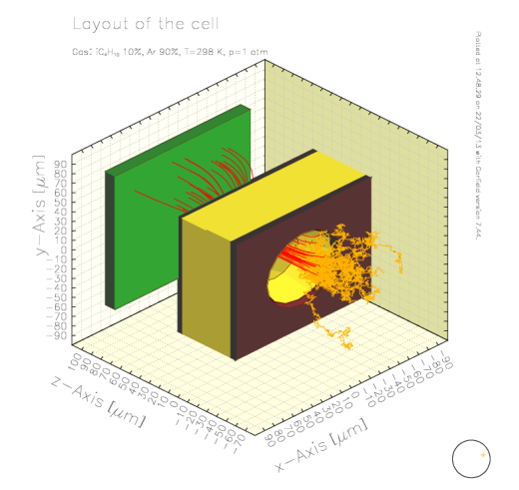
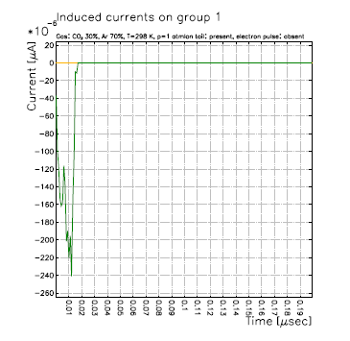
The µ-RWELL vs GEM (Garfield simulation)
GEM – Ar:CO2 70:30 gas mixture
Signal from a single ionization electron in a GEM:
The duration of the signal (purely electronic), about 20 ns, depends on the induction gap thickness, drift velocity and electric field in the gap.
Signal from a single ionization electron in a µ-RWELL:
The absence of the induction gap is responsible for the fast initial spike, about 200 ps, induced by the motion and fast collection of the electrons then followed by a ~50 ns ion tail.
The µ-RWELL signal is similar to the MM one.
µ-RWELL – Ar:CO2 70:30 gas mixture

Slide 27
The µ-RWELL performance (III)
Qualitative discharge study: µ-RWELL vs single-GEM
Single-GEM
µ-RWELL
The max. ΔV achieved for the gain measurement is correlated with the onset of the discharge activity, that, comes out to be substantially different for the two devices:
discharges for µ-RWELL of the order of few tens of nA (<100 nA @ max gain)
for GEM discharges the order of 1µA are observed at high gas gain
Systematic and more quantitative studies must be clearly performed

Slide 28










The Ohmic model for the Gain of a µ-RWELL
The gain variation of a µ-RWELL depends on the radiation flux and the observed drop is supposed to be due to the resistive layer. The gain of a µ-RWELL can be written as follows:
A gain drop corresponds to a decrease of the voltage V₀:
Following the Ohm first law:
where “i” is the current measured on the resistive layer and Ω is the average resistance faced by the charges to reach the ground frame. The current “i” can be written as follows:
expanding the exponential using the Maclaurin serie up to the first order we obtain:
and thus:
which admits the following solution:

Slide 29

The µ-RWELL performance (III)
Normalized gain vs X-ray flux for GEM and µ-RWELL for irradiation at the center of the active area, with three different collimator diameters: 10 mm, 5 mm and 2.5 mm.
Ar/CO₂ – G_{R-WELL} = 3000, G_{DROP} <1000
100 MΩ/
The curves are fitted with the function (purely Ohmic model):
The function allows the evaluation of the radiation flux for a given gain drop of 3%, 5% and 10% for all the collimators.
X-Ray

Slide 30
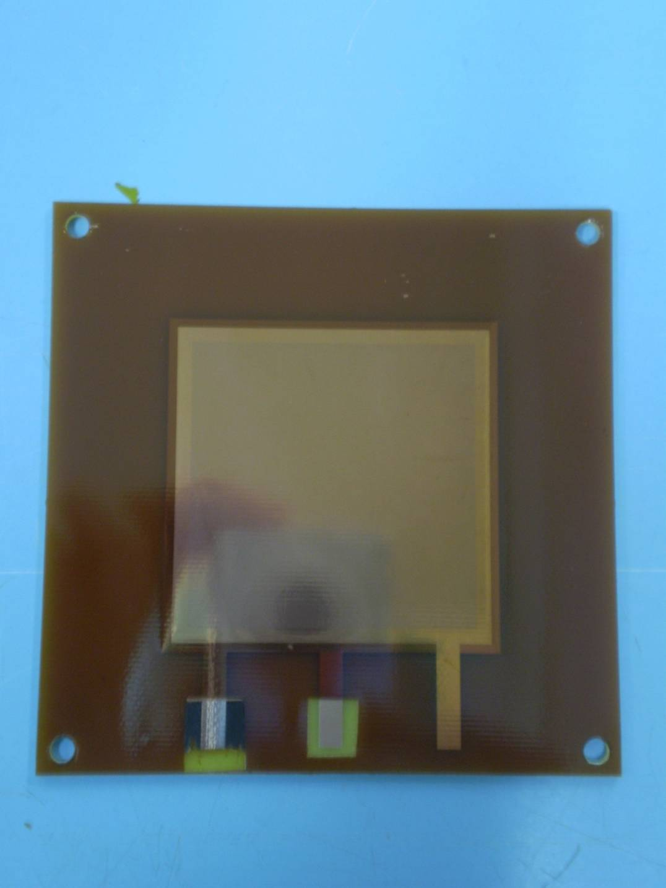
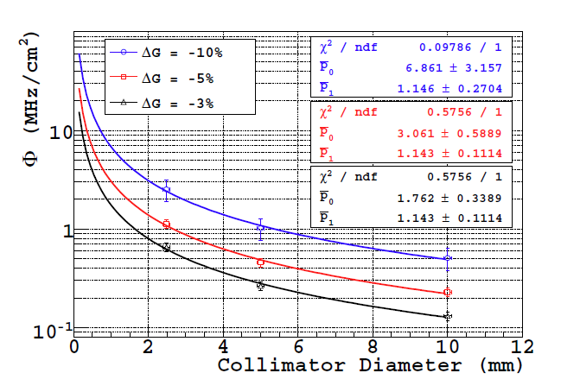
The µ-RWELL performance (IV)
The particle flux that the µ-RWELL is able to stand, in agreement with an Ohmic behavior of the detector, decreases with the increase of the diameter of the X-ray spot on the detector.
matrix of resistive pads
for m.i.p. × 7
“HR scheme”
150-200 kHz/cm2 with X-Rays & 10 mm of “equivalent“ segmentation
Taking into account that ionization of a m.i.p. is a factor 7 smaller than X-rays, the rate capability of the detector, for a fixed surface resistivity, can be tuned with a suitable evacuation scheme of the current: a sort of a“matrix of vias” connected to ground through the readout every 1x1 cm².
With this scheme a ∼1 MHz/cm² for m.i.p. should be achievable

Slide 31
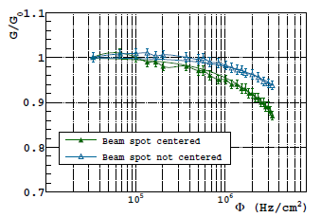
The µ-RWELL performance (II)
A drawback correlated with the implementation of a resistive layer is the reduced capability to stand high particle fluxes: larger the radiation rate, higher is the current drawn through the resistive layer and, as a consequence, larger the drop of the amplifying voltage.
Gain vs beam position
“LR scheme”
The gain (vs particle flux) depends on the beam position: the larger is the distance covered by electrons in the resistive layer (green curve) to reach the ground, the greater is the average resistance and the lower is the rate capability.

Slide 32
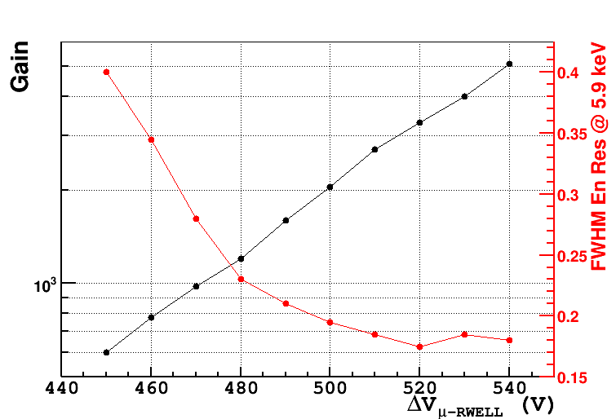
µ-RWELL: Energy Resolution
The prototype of µ-RWELL (100 MΩ/□) has been tested with X-rays tube (6keV) (Ar/CO2=70/30) & the signal has been readout with an ORTEC amplifier

Slide 33
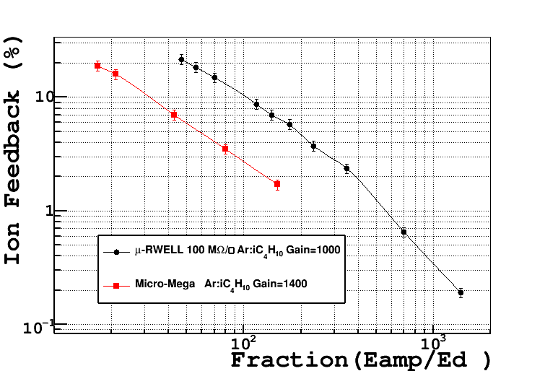
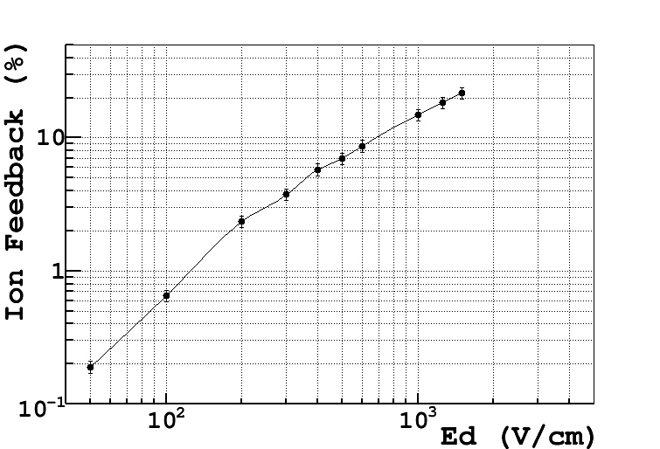
µ-RWELL: Ion Feed-Back measurement
MM IBF Measurement NIMA 535 (2004) 2006

Slide 34
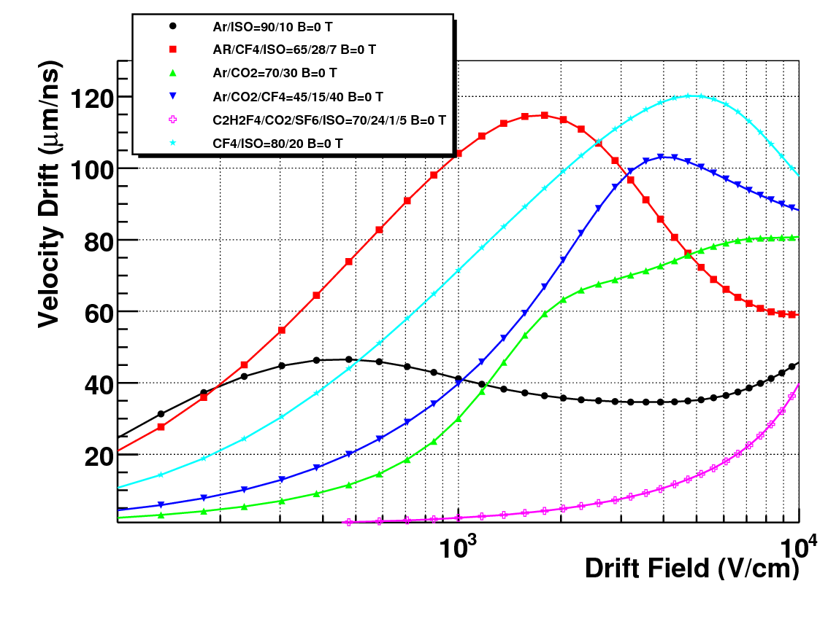
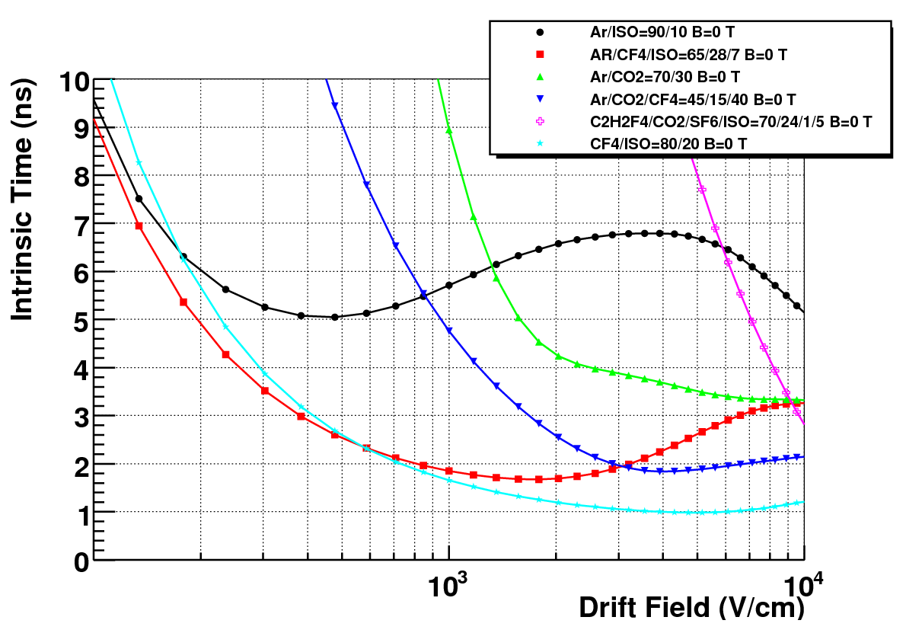
Gas mixtures properties for
triggering & tracker detectors
σ_{T} ∼ 1 /n_{clu} * vel_{drift}
Gas Mixture | Cluster/cm (µ 10 GeV) | Vd @ 2 kV (µm/ns)
Ar/ISO = 90/10 | 42.52±0.06 | 36 (flat)
AR/CF4/ISO = 65/28/7 | 52.00±0.07 | 113 (max)
Ar/CO2 = 70/30 | 37.22±0.06 | 64 (max)
Ar/CO2/CF4 = 45/15/40 | 52.85±0.07 | 74 (rise)
C2H2F4/CO2/SF6/ISO = 70/24/1/5 | 89.49±0.09 | 4.9 (rise)
CF4/ISO = 80/20 | 84.66±0.09 | 99 (rise)

Slide 35
Gas mixtures properties for
triggering & tracker detectors
Gas Mixture | Cluster/cm (µ 10 GeV) | Vd @ 2 kV (µm/ns) | σt = 1/nv (ns) @ 2 kV | σlong @ 2 kV (µm/√cm) | σtra @ 2 kV (µm/√cm) | Lorentz Angle (degree) @ 2 kV | Town@ 80 kV (1/cm) | Att @ 80 kV (1/cm) | e-/clu
 |  |  | MAGNETIC FIELD = 0. T
Ar/ISO = 90/10 | 42.52±0.06 | 36 (flat) | 6.57 | 163 (flat) | 376 (flat) |  | 1695 | 0.0716 | 2.073±0.001
AR/CF4/ISO = 65/28/7 | 52.00±0.07 | 113 (max) | 1.69 | 73.6 (drop) | 133.8 (flat) |  | 1565 | 13.9 | 1.815±0.001
Ar/CO2 = 70/30 | 37.22±0.06 | 64 (max) | 4.24 | 150 (flat) | 228 (rise) |  | 1229 | 2.17 | 1.966±0.001
Ar/CO2/CF4 = 45/15/40 | 52.85±0.07 | 74 (rise) | 2.55 | 90.6 (drop) | 91.3 min |  | 1207 | 18.9 | 1.884±0.003
C2H2F4/CO2/SF6/ISO = 70/24/1/5 | 89.49±0.09 | 4.9 (rise) | 22.9 | 60.4 (drop) | 55.9 (drop) |  | 797 | 23.1 | 2.361±0.006
CF4/ISO = 80/20 | 84.66±0.09 | 99 (rise) | 1.2 | 58.0 (drop) | 76.0 (flat) |  | 1300 | 47.45 | 2.400±0.005

