Slide 1
New MPGDs at CERN PCB Workshop
Rui De Oliveira
17-11-2015

Slide 2
outline
Introduction to sparks protection
Embedded resistors in Micromegas
Embedded resistors with well detectors
MSGC development status
Future
Conclusion

Slide 3
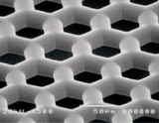
Spark protection
After looking in bibliography we found that the Voltage V during a spark is in the range of 15 to 30 V
It can change a little bit depending on the metals and the available energy
Since this value is low compared to the 600V needed we usually consider a spark as a short
The protection test on a read out structure becomes simple : apply the mesh voltage directly to the pads
V

Slide 4
First idea for spark protection
-Cover the pads with resistive material
-We have easily found resistive paste and produced samples
-After applying directly the voltage to the pads , we have clearly seen a problem of breakdown voltage through the resistive layer ,
-up to now we never found any resistive material able to do a long term protection with this configuration

Slide 5
Second idea
-the resistive material is not in contact with the read-out pads, a high breakdown voltage material is inserted in between.
-The signal is correctly transmitted by capacitive coupling
-in this configuration the protection is optimum. We have not seen up to now any damages
-The current flowing in the resistive layer can at one point be a problem in High rate applications

Slide 6
Introducing an embedded resistor for High rate applications
Surface resistor
2 layers with one embedded
-The thickness above the pad is similar in both structures
-Around 50 to 75um to minimize the signal loss

Slide 7
Rate limitation due to surface evacuation of charges with single resistive layer protection
V1
V2
V3
V4
I1
I2
I3
I4
-If the layer resistivity is too large the voltage drops will affect the amplification field
- Resistivity should be chosen taking in account the current flow : (rate) x (charges )
-This mode of evacuation spreads the signal if low resistivity is used.
-A local measurement of the max rate can’t be extrapolated to large sizes.

Slide 8
Embedded resistor
-One resistive pad will not see any current coming from neighbors
-For a given resistive value the maximum rate is increased
-A local measurement can be extrapolated to the full size detector
-The length of the embedded resistor should be designed taking in
account the max mesh voltage to avoid any voltage breakdown

Slide 9
outline
Introduction to sparks protection
Embedded resistors in Micromegas
Embedded resistors with well detectors
MSGC development status
Future
Conclusion

Slide 10
Pad PCB for LAPP tests

Slide 11
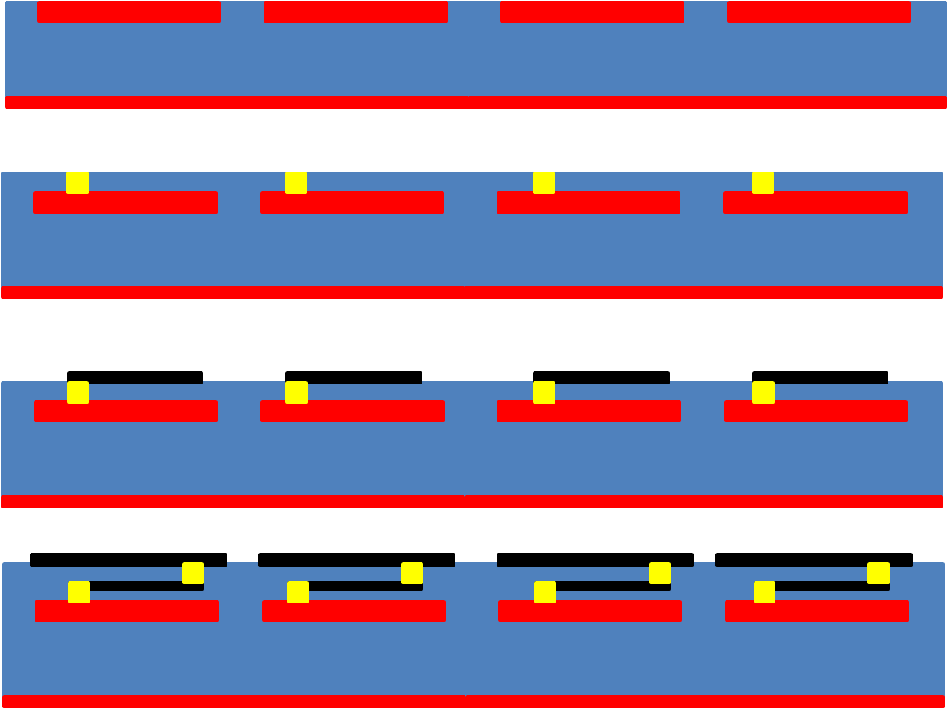
Production steps
Bare PCB
Coverlay gluing + via fill
Inner resistor printing
Coverlay gluing + via fill
+top resistive layer print

Slide 12
Production steps
Bare PCB
Coverlay gluing + via fill
Inner resistor printing
Coverlay gluing + via fill
+top resistive layer print

Slide 13
Production steps
Bare PCB
Coverlay gluing + via fill
Inner resistor printing
Coverlay gluing + via fill
+top resistive layer print

Slide 14
Production steps
Bare PCB
Coverlay gluing + via fill
Inner resistor printing
Coverlay gluing + via fill
+top resistive layer print

Slide 15
Shapes and values for embedded resistor R1 Detectors for the LAPP
Real values:
40 to 60 KOhms with 10KΩ/Sq
400 to 750 KOhms With 100KΩ/Sq
Real values:
400 KOhms with 10KΩ/Sq
4 MOhms With 100KΩ/Sq
Real values:
4 MOhms with 10KΩ/Sq
40 MOhms With 100KΩ/Sq

Slide 16
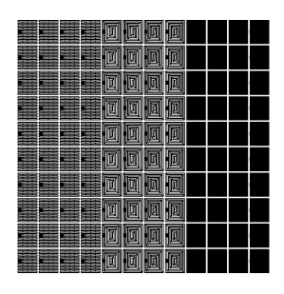
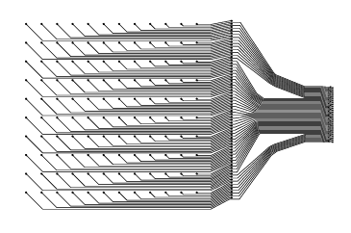
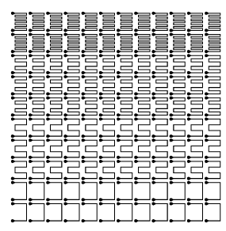
1 2 3
Surface resistors
1
2
3
4
Best region
Embedded resistors
Region 3 in buried and 1 in surface
(we call it 31) gives the best linearity
in response

Slide 17
Results with embedded resistors in Micromegas
Results are corresponding to expectations
Up to 11 mega events per cm2 with good linearity (rate VS current) have been measured
For deeper details please contact Maxime Chefdeville at LAPP.

Slide 18
outline
Introduction to sparks protection
Embedded resistors in Micromegas
Embedded resistors with Well detectors
MSGC development status
Future
conclusion

Slide 19
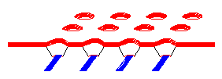
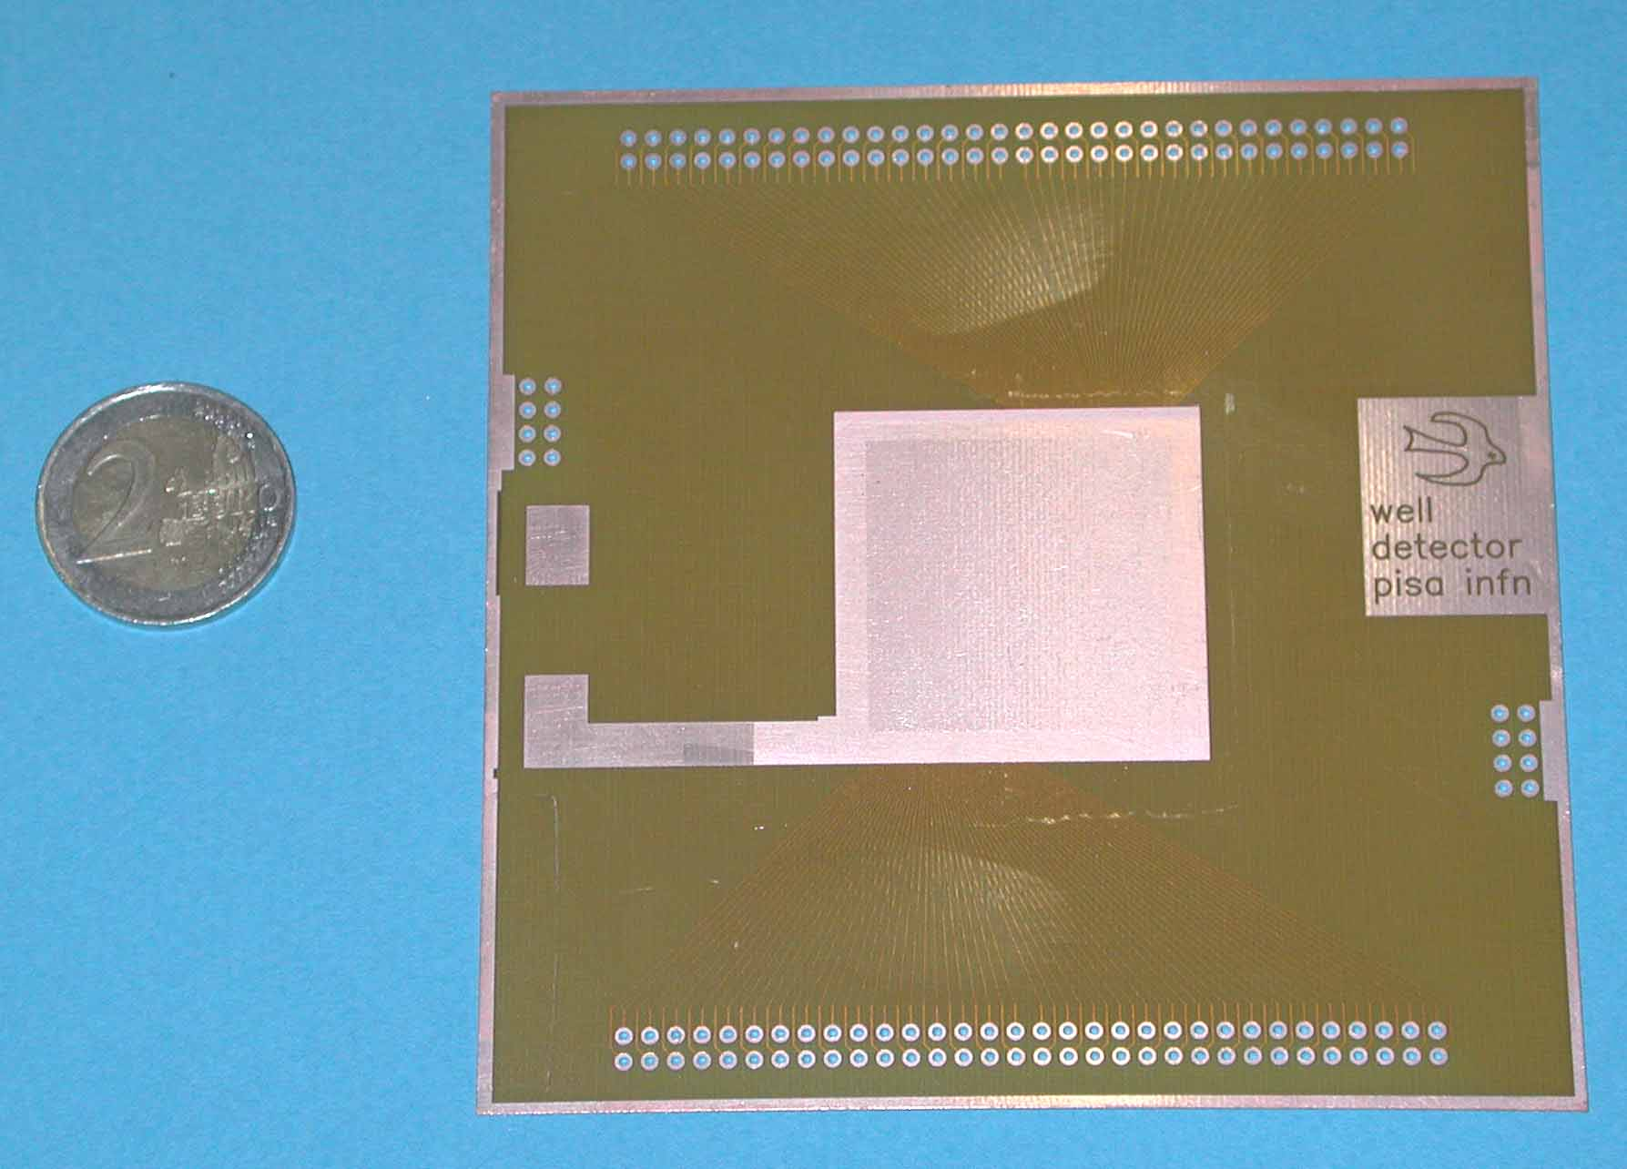
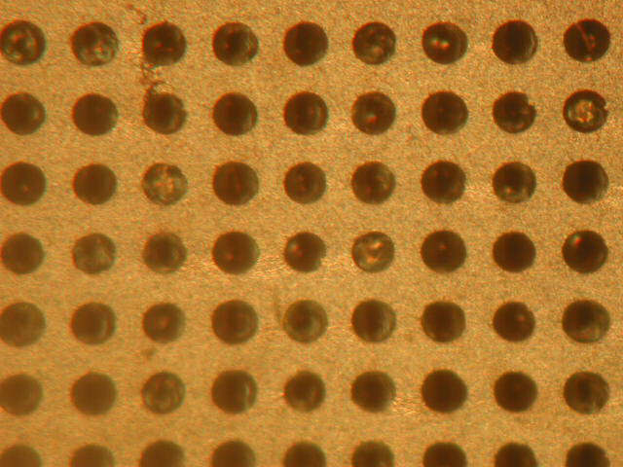
Well detectors
Introduced by Ronaldo Bellazini in 1997
Simple and accurate structure
Single stage amplification
More robust than MSGC
But suffering anyway from spark
Bottom lines
Top electrode

Slide 20
Embedded resistors in well structure
Medium rate
High rate

Slide 21
Process medium rate
Bottom resistive DLC deposition on 50um Kapton

Slide 22
Process medium rate
Glue to read-out board

Slide 23
Process medium rate
Top layer patterning + kapton etching

Slide 24
Process high rate
Bottom resistive deposition

Slide 25
Process high rate
Bottom coverlay + via fill + second resistive layer print

Slide 26
Process high rate
Strip or pad flex gluing + via fill

Slide 27
Process high rate
Rigidizer gluing if needed

Slide 28
Process high rate
Top layer patterning + kapton etching

Slide 29
Problems in first high rate production
Layer 1
Layer 2
-due to the multiple gluing steps and the high value targeted
(80Mohm/square) the first resistive layer value increased in
a non controllable way
-after many test we have discover that the 1MOHMS/square paste
is polluted by the glue
-new samples are planned , we will use DLC resistor for the fist layer. The
Second one will be screen printed with 100Kohms paste
-For preliminary results please contact Giovanni Bencivenni

Slide 30
outline
Introduction to sparks protection
Embedded resistors in Micromegas
Embedded resistors with well detectors
MSGC development status
Future
Conclusion

Slide 31
MSGC
No introduction needed
We are still investigating this device
because it is still the simplest existing MPGD

Slide 32
MSGC production with PCB technologies
We have produced many samples with PCB technologies and materials
They work as expected:
Good gain
Good energy resolution
They suffer from spark damages
They charge up
They show polarizing effects

Slide 33
First improvement
-We have change the material of the cathode electrode.
From metal we went to 100Kohms/square paste
-This modification solved the spark problem
-But we were still suffering from charging up and polarization
Looking in literature we have found a lot of papers dealing with
this problem and giving solutions ,one of them was to deposit a
thin resistive high value layer over the full structure

Slide 34
After resistive deposition
-We have subcontracted resistive Vacuum deposition in 2 institutes .
-We have discovered that one of them already did in the past the deposition on Glass
MSCG mentioned in literature
-We have asked for 4 different resistive value depositions on 20 small pieces from
10^12 to 10^15 ohms/square
-After this coating 2 situations appeared : high values do not improve the behavior
low values are showing the expected effect
but totally degrading the device at the same time
-None of the suppliers were ready to guaranty their resistive value
-Due to the last statement this direction is abandoned (still ALD deposition could be investigated but
completely out of our budget)

Slide 35
New direction: remove material between electrodes where charges are attaching
Type 1
etching the substrate
Type 2
etching the substrate
Adding an electrode
Type 3
Removing top electrode

Slide 36
New direction: remove material between electrodes where charges are attaching
Type 1
etching the substrate
Type 2
etching the substrate
Adding an electrode
Type 3
Removing top electrode

Slide 37
New direction: remove material between electrodes where charges are attaching
Type 1
etching the substrate
Type 2
etching the substrate
Adding an electrode
Type 3
Removing top electrode

Slide 38
Micro gap
Even more simple than MSGC
We are now producing a few micro-gap structures
This time we will study first that the charging up and polarization effects are as expected negligible by construction .
We will then introduce the resistive layer for spark protection

Slide 39
Micro gap pad prototype layout
1cm x 1cm pad structure
4 pads structure

Slide 40
Micro gap production
We expect some samples in the coming weeks
STD qualification test will be then performed
Gain
Energy resolution
Rate
Stability in time and rate
If OK we will produce a resistive version

Slide 41
outline
Introduction to sparks protection
Embedded resistors in Micromegas
Embedded resistors with well detectors
MSGC development status
Future
Conclusion

Slide 42
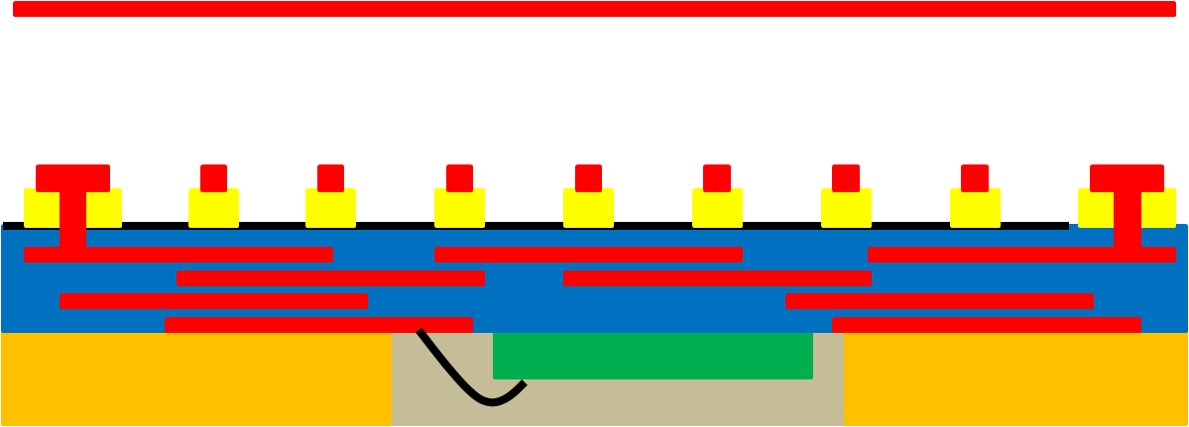
2016 R&D: Embedded FE electronics
Drift volume 3mm
Detecting skin 0.2mm
Multilayer PCB 0.8mm
FE Chip in glob top 0.8mm
Full detector Thickness : 4.8mm
Single board structure

Slide 43
2016 R&D: Embedded FE electronics
Drift volume 3mm
Detecting skin 0.2mm
Multilayer PCB 0.8mm
FE Chip in glob top 0.8mm
Full detector Thickness : 4.8mm
Single board structure

Slide 44
2016 R&D: Embedded FE electronics
Drift volume 3mm
Detecting skin 0.2mm
Multilayer PCB 0.8mm
FE Chip in glob top 0.8mm
Full detector Thickness : 4.8mm
Single board structure

Slide 45
2016 R&D: Embedded FE electronics
Drift volume 3mm
Detecting skin 0.2mm
Multilayer PCB 0.8mm
FE Chip in glob top 0.8mm
Full detector Thickness : 4.8mm
Single board structure

Slide 46
2016 R&D: Embedded FE electronics
Drift volume 3mm
Detecting skin 0.2mm
Multilayer PCB 0.8mm
FE Chip in glob top 0.8mm
Full detector Thickness : 4.8mm
Single board structure

Slide 47
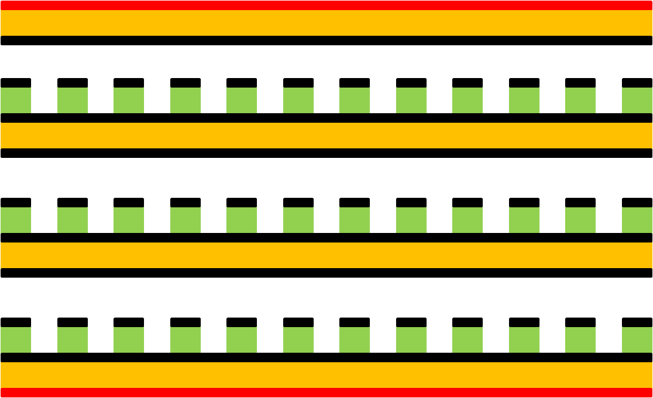
2016 R&D Future sub ns proportional high rate MPGD
Top read-out electrode
Thin drift gap 250um
First resistive well
Thin drift gap 250um
Second resistive well
Thin drift gap 250um
Third resistive well
Bottom electrode

Slide 48
2016 R&D Future sub ns proportional high rate MPGD
Top read-out electrode
Thin drift gap 250um
First resistive well
Thin drift gap 250um
Second resistive well
Thin drift gap 250um
Third resistive well
Bottom electrode

Slide 49
2016 R&D Future sub ns proportional high rate MPGD
Top read-out electrode
Thin drift gap 250um
First resistive well
Thin drift gap 250um
Second resistive well
Thin drift gap 250um
Third resistive well
Bottom electrode

Slide 50
2016 R&D Future sub ns proportional high rate MPGD
Top read-out electrode
Thin drift gap 250um
First resistive well
Thin drift gap 250um
Second resistive well
Thin drift gap 250um
Third resistive well
Bottom electrode

Slide 51
Sub ns detector
Time resolution well below 500ps are expected
No high voltage, each cell is independent
First test beams are confirming the principle with 2 stacked well structures .
Differential read-out possible
Resistivity in the range of 10Mohms/square. High rate compatible and spark protected.
We are going to build a 4 gap soon.

Slide 52
Conclusion
We are working on 3 single board detectors principles: Micromegas , Well , Micro gap
2 of them are already showing good results . Micro gap still to be proven
Embedding the FE electronic will make an extra thin structure for calorimeter applications
Large areas can be easily covered by patching small size modules without dead zones.

