Slide 1
KLOE-2 performance at dafne
Danilo Domenici
on behalf of the KLOE-2 Collaboration
4th LNF Workshop on Cylindrical GEM Detectors

Slide 2
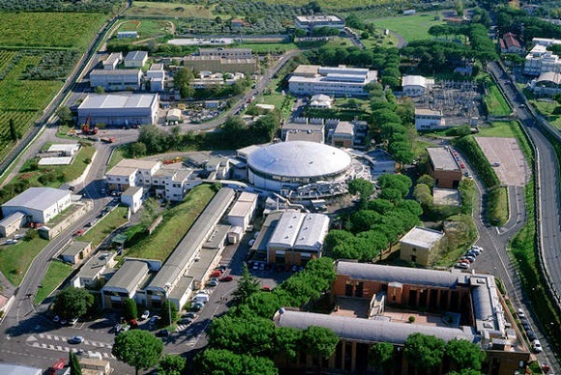
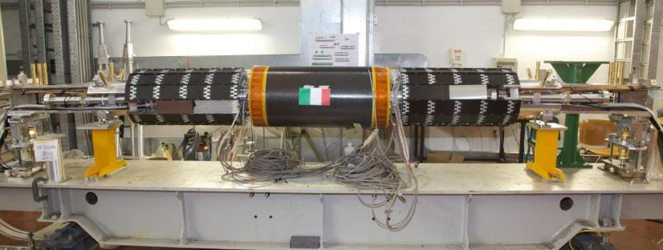
Introduction of KLOE-2 at DAFNE
DAFNE φ-factory
e⁺ e– at 1020 MeV
First time of crab-waist IP with
detector solenoid
Run I: November 2014 – July 2015
Run II: started at September 2015
Physics program (EPJ C68, 619)
γγ physics
Ks, η, η_{S} rare decays
CPT test
Dark photon search
Gamma Taggers
LET – LYSO Crystal / SiPM at 1m from IP
HET – Scintillator hodoscope at 11m from IP
Notes:
That is the upgraded continuation of the KLOE experiment at the Dafne phi factory, wich has been recently upgraded itself as well.
The apparatus is composed of 2 main subsystems: a Calo system, with a main structure of barrel and endcaps (one is seen here), 2 QCAL instrumenting the focusing quadrupoles of Dafne and a 2 small angle LYSO crystal calorimeters.
The tracking system is made of the central helium drift chamber, very large, with more than 52k wires is seen here, and a new gaseous IT realized with 4 layers of cylindrical GEM which is the subject of this talk.
Everything is immersed in a 0.5 T solenoidal field, while dafne is planed to deliver 5-10 fb-1 in 3 years of data taking.

Slide 3
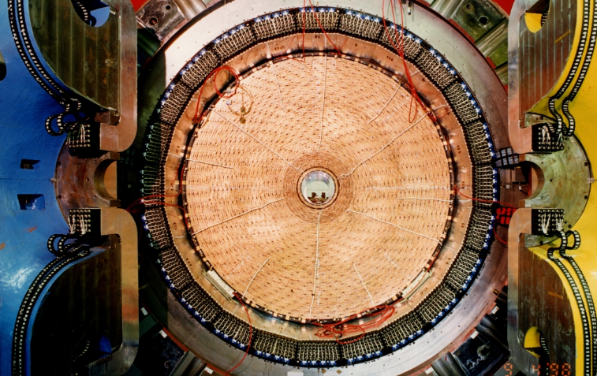
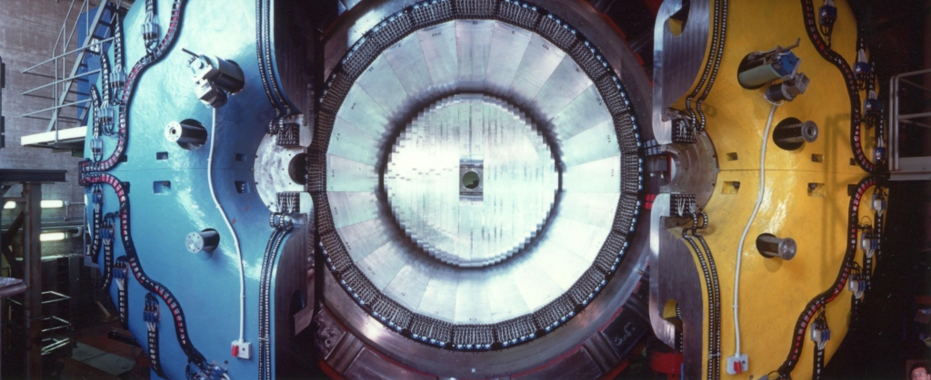
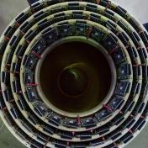
Introduction of KLOE-2 at DAFNE
Superconductive Magnet
0.52 T solenoidal field
Calorimeter System
EMC – Lead / Scintillating Fibers / PMT Barrel and Endcaps
QCAL – Tungsten / Scintillating Tiles / SiPM Quadrupole Instrumentation
CCAL – LYSO Crystal / SiPM Low angle
Tracking System
DC – Helium 3.7m x 4m Drift Chamber
IT – 4 Layers Cylindrical GEM Inner Tracker
Notes:
That is the upgraded continuation of the KLOE experiment at the Dafne phi factory, wich has been recently upgraded itself as well.
The apparatus is composed of 2 main subsystems: a Calo system, with a main structure of barrel and endcaps (one is seen here), 2 QCAL instrumenting the focusing quadrupoles of Dafne and a 2 small angle LYSO crystal calorimeters.
The tracking system is made of the central helium drift chamber, very large, with more than 52k wires is seen here, and a new gaseous IT realized with 4 layers of cylindrical GEM which is the subject of this talk.
Everything is immersed in a 0.5 T solenoidal field, while dafne is planed to deliver 5-10 fb-1 in 3 years of data taking.

Slide 4
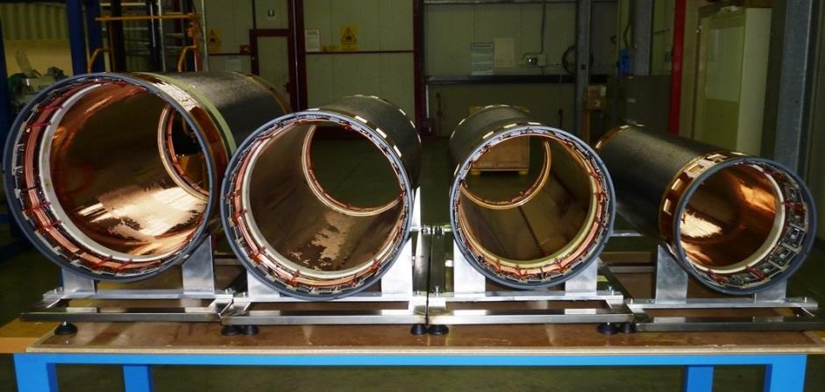
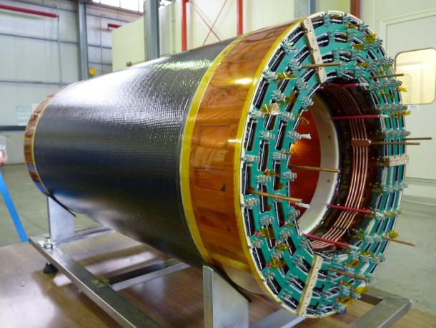
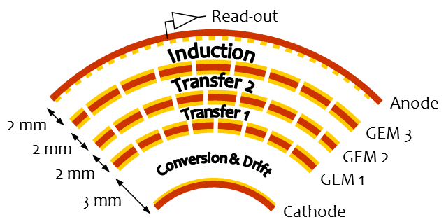
The Cylindrical-GEM Inner Tracker
4 cylindrical-GEM detectors
41 cm
36 cm
31 cm
26 cm
70 cm active length
650 μm pitch strip readout
20k GASTONE FEE channels
1300 HV channels
Ar/Iso:90/10 gas mixture
12000 gas gain
3/2/2/2 mm triple-GEM layout
2% X₀ material budget
Notes:
The IT is composed of 4 cylindrical detecting layers, photographed here before thay have been inserted one into other. These are their diameters, chosen to fit the available space between the baeampipe and the dc.
Usually GEMs and in general MPGD are used in harsh environments beacouse of their outstanding rate capability. Here we rather exploited the intrinsic flexibility of the GEM to obtain a cylindrical geometry and its lightness to achieve a material budget of only 2% a radiation length, a mandatory requirement for KLOE, where all the tracks have a low momentum.

Slide 5
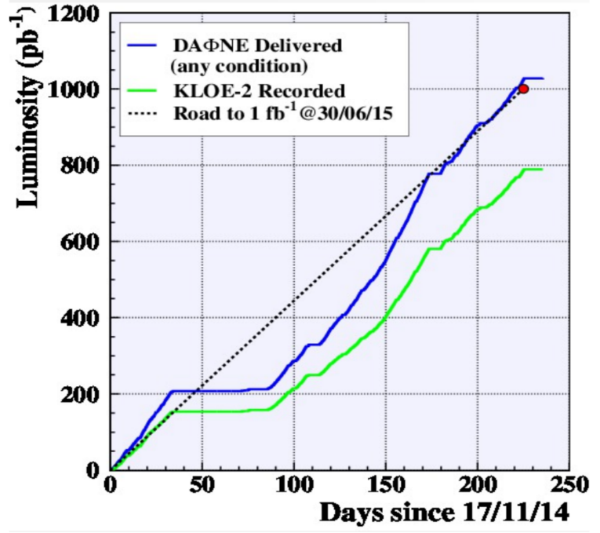
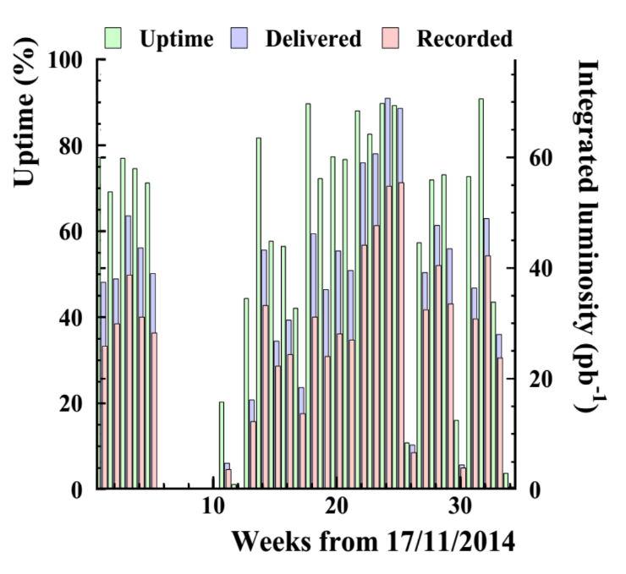
Run I Luminosity Summary
DAFNE delivered: 1030 pb⁻¹ KLOE recorded: 790 pb⁻¹
77% data-taking efficiency
DAFNE best performance achieved in April May
Uptime reduced by few planned or unforeseen stops

Slide 6
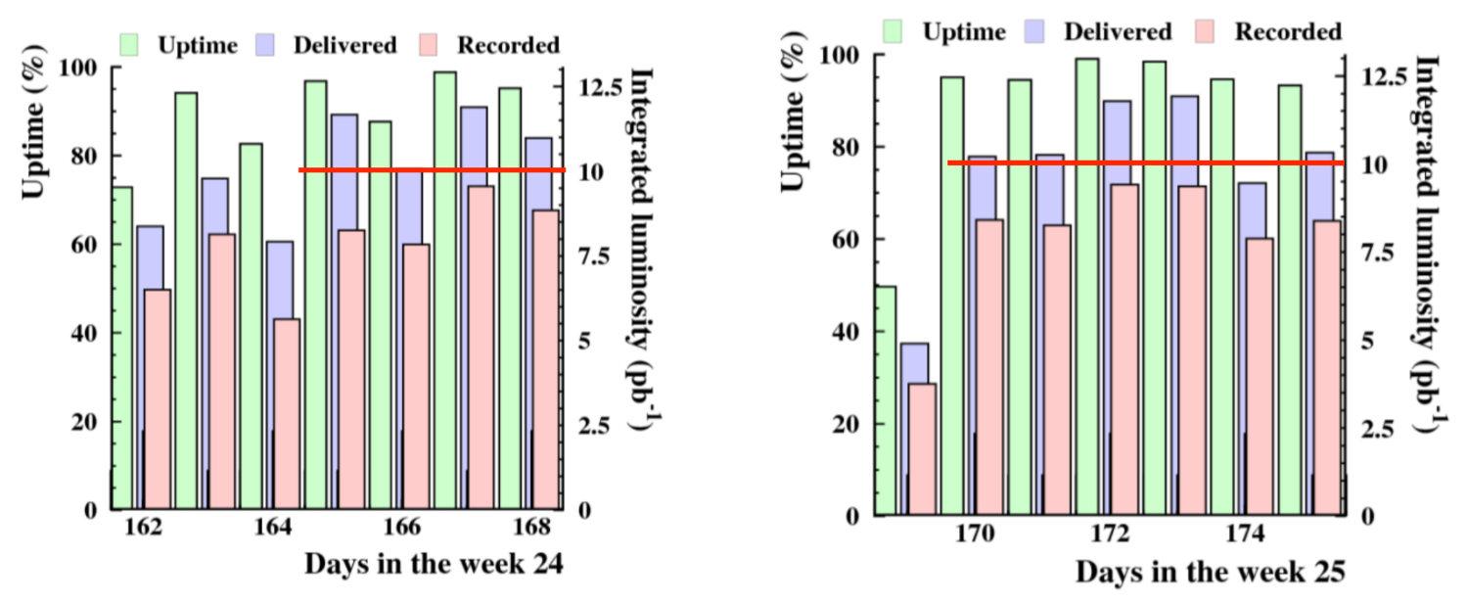
Run I Luminosity Summary
week 24: 27 April – 3 May
71 pb⁻¹ delivered
55 pb⁻¹ recordered
week 25: 4 May – 10 May
69 pb⁻¹ delivered
56 pb⁻¹ recordered
DAFNE luminosity records
2 x 10³² peak - 12 pb⁻¹ daily integrated

Slide 7
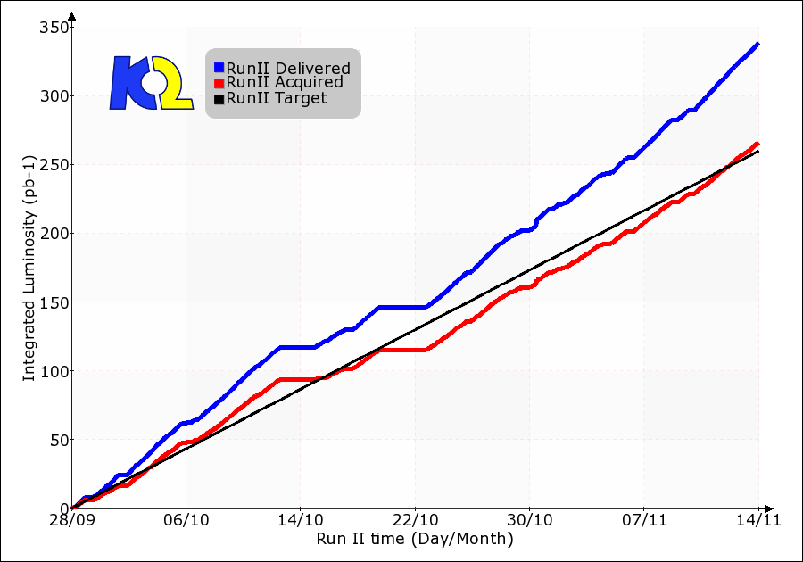
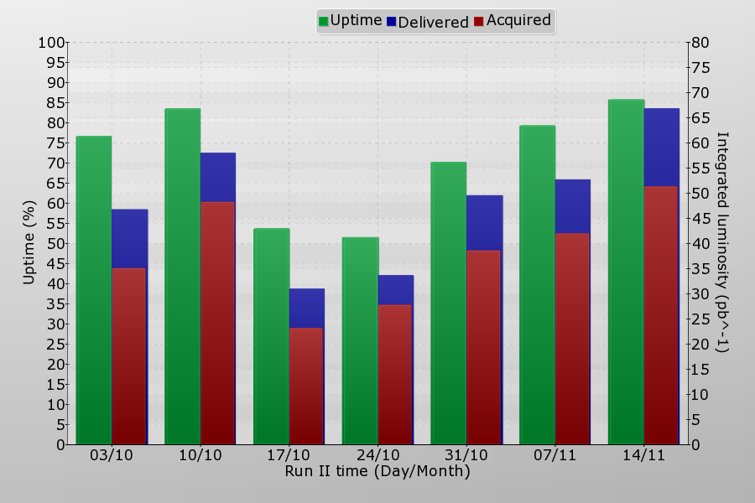
Run II Luminosity Summary
DAFNE delivered: 340 pb⁻¹ KLOE recorded: 260 pb⁻¹
77% data-taking efficiency
Best week
86% DAFNE uptime
66 pb⁻¹ delivered
51 pb⁻¹ recorded

Slide 8
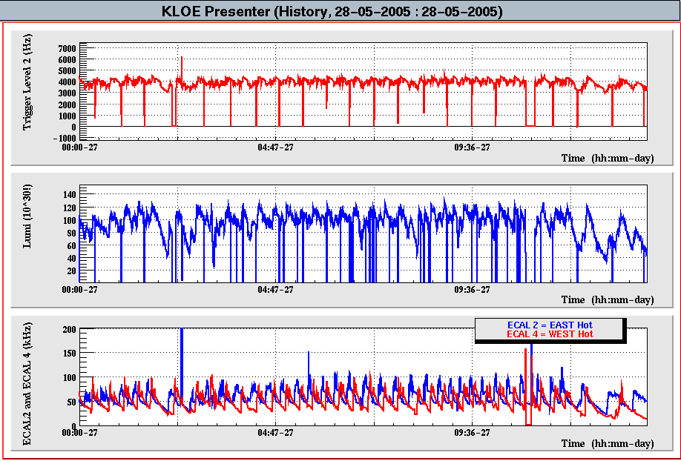
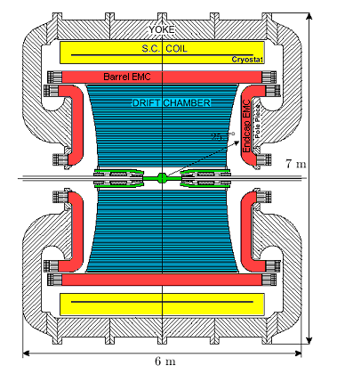
KLOE 2005 Data Taking Conditions
Typical conditions
Level2 Trigger ~ 4 kHz
Avg Lumi ~ 10³²
EndCap rates < 100 kHz
Calorimeter EndCap rates used as standard measurement of machine induced background

Slide 9
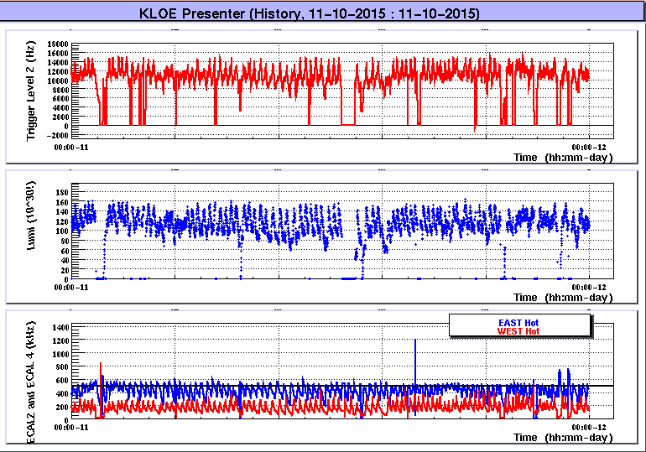
KLOE 2015 Data Taking Conditions
Typical conditions
Level2 Trigger ~ 12 kHz
Avg Lumi ~ 1.2 x 10³²
EndCap rates < 600 kHz
Factor of 5 increase of background due to higher Touschek effect typical of Crab Waist scheme

Slide 10
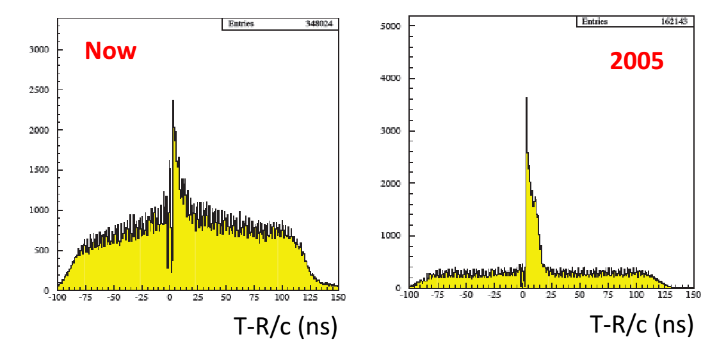
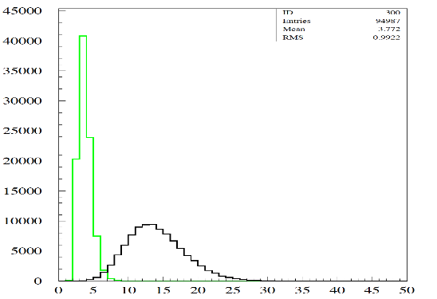
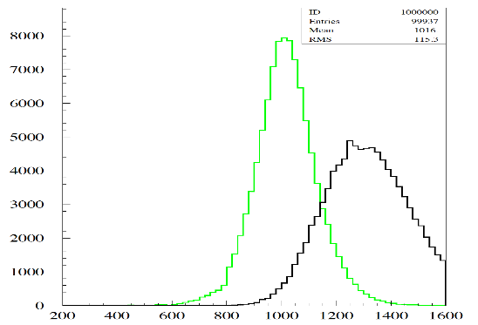
Background and Data Quality
Trigger Rate: 4kHz → 12kHz
Event Size: 4kB → 8kB
Factor of 6 increase data throughput
Touschek background is mostly out of time wrt the bunch with physics
can be reduced offline associating energy to bunch crossing
exploiting 53ps/√E(GeV) EMC time resolution
2015
2005
EMC cluster multiplicity
Total EMC Bhabha energy (MeV)
event
bunch
event
bunch

Slide 11
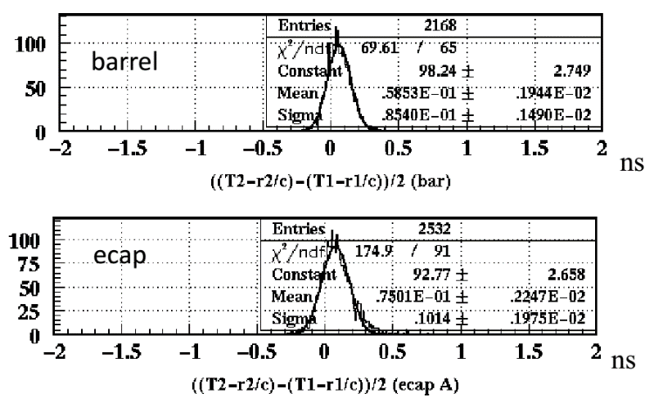
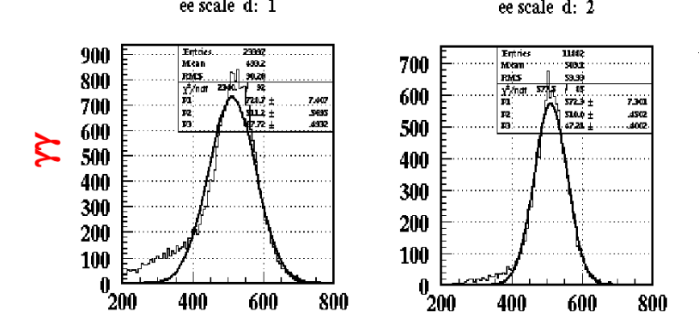
Calorimeter Performance
Time Calibration
Evaluated every run by fixing T–R/c=0 for γγ events
Time Resolutions
Barrel: 85 ps
Endcaps: 100 ps
Energy Calibration
Evaluated every run by fixing the γγ peak to 510 MeV
Endcap Barrell
γγ peak-finding influenced by
low-energy tail due to background
Energy Resolutions
~5%/√E
MeV
MeV

Slide 12
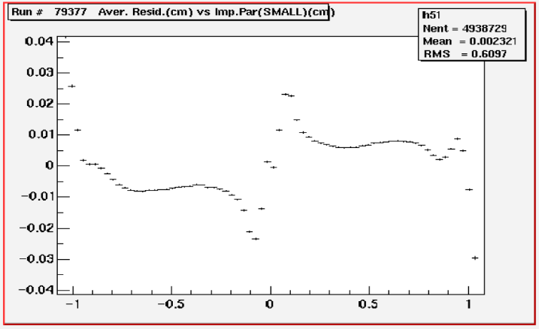
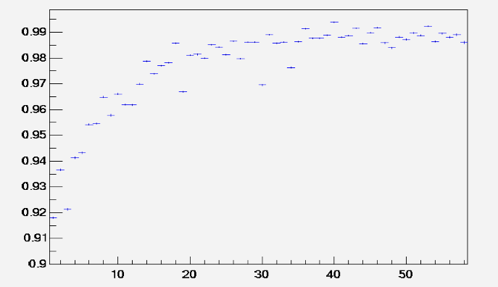
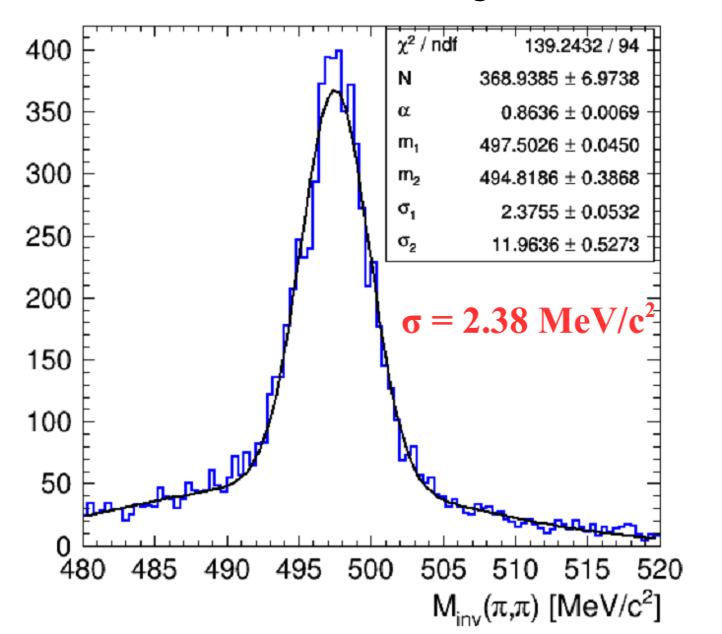
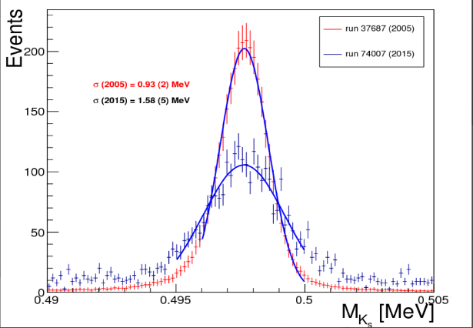
Drift Chamber Performance
DC Efficiency vs Layer
DC Residuals vs Impact Parameter
Inner cells at a lower voltage to cope with machine background
Ks mass affected by IT material
Expected to improve with IT tracking
Only decays inside DC
2015: σ = 1.58 MeV
2005: σ = 0.93 MeV
DC tracking only
2015: σ = 2.38 MeV/c²
2005: σ = 2.49 MeV/c²

Slide 13
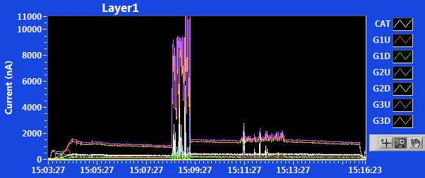
Beam Injections
Both beams are injected with a period of ~10 minutes
Injection time is 40% of total time
Beam Current (mA)
High radiation produced in injection is an issue for gaseous detectors (DC+IT)
DC current is 2÷6 times higher during injections
IT currents (GEM3) are 8÷10 times higher during electrons injections
DC Current (μA)
electron injection
positron injection

Slide 14
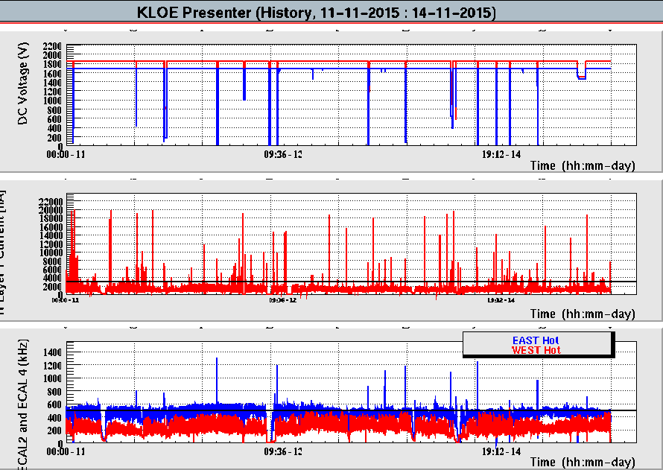
Beam Losses
DAFNE has no beam dump system
Occasionally beams can be partially (blow-up) or completely lost in the detector
DC Voltage (V)
L1 Current (μA)
ECap Rate (kHz)
15 beam losses giving a DC global Trip in 4 days
Few less spikes seen by EMC EndCaps
Tens of spikes in IT Layer1 current (most sensitive detector)

Slide 15
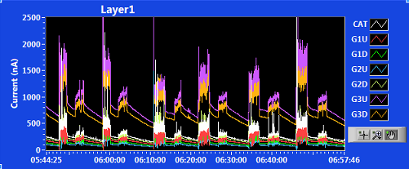
Inner Tracker Performance
Given the harsh environment we realized that the design gain (12000) was too high to guarantee the safety operation of the C-GEM
It has been decreased to 10000 that is still compatible with the GASTONE amplifier without dramatic efficiency loss
A lot of work done by DAFNE crew to optimize injections
Anyway an unexpected rate of HV sectors with leakeage current occurred

Slide 16
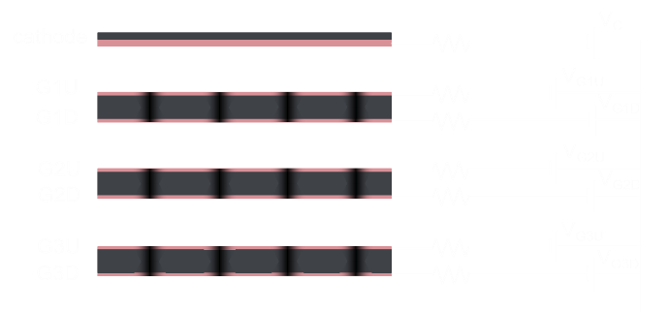
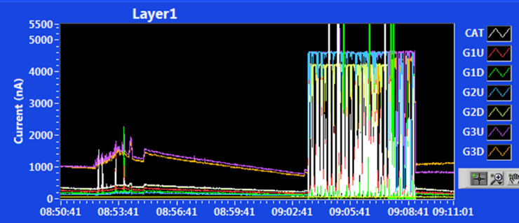
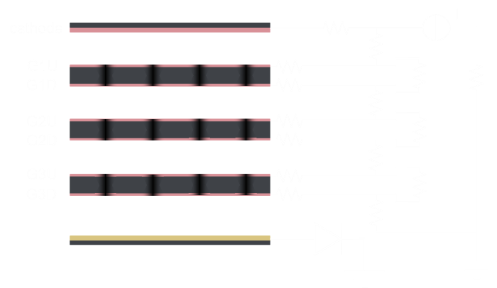
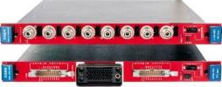
Inner Tracker HV System
Run I HV scheme
7 independent channels referred to ground
Current limit only to top GEM faces
Software common trip
bad
electron injection
positron injection
current saturation during e- injection
decrese of Vup and increase of fields
possible propagation of discharge between GEM stages
Run II HV scheme
single current generator channel
passive voltage divider
Future planned HV scheme
dedicated CAEN board with common floating return channels
advantages of both schemes

Slide 17
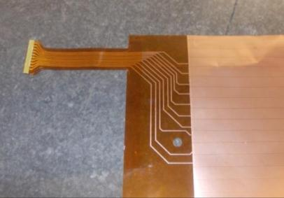
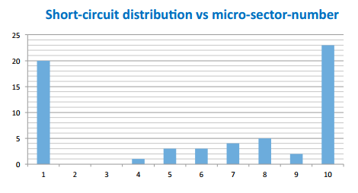
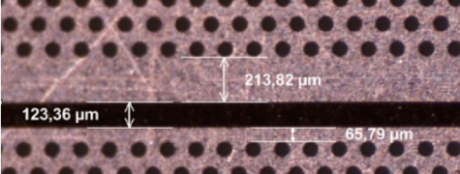
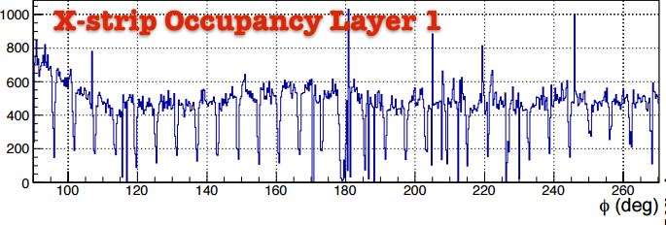
Inner Tracker Current Leaks
Current leaks are mainly (but not only) triggered by heavy irradiation during anomalous injections or beam losses
Effect enhanced by relatively high gain of operation (discharge probability is exponential with gain)
61 leaks uniquely concentrated on edge GEM sectors
8 GEM1
28 GEM2
25 GEM3
X-strips occupancy
Sectorization creates distortion of electric field resulting in higher effective gain
Sectors can be seen in
X-strips occupancy

Slide 18
Conclusions
KLOE-2 data-taking is ongoing (Run I + Run II) with ~ 1.4 fb⁻¹ of integrated luminosity delivered by DAFNE up to now
A lot of efforts have been focused to cope with a high background environment given by the new Crab-waist interaction scheme
Besides the increase of data throughput and the polluting of the data, a serious concern is the safety operation of the gaseous central detectors
The major issue for the Inner Tracker is the occurrence of current leaks mostly due to bad injections or beam losses and enhanced by the relatively high operating gain
Changing the HV supply scheme and decreasing the gain have been the adopted countermoves so far, in addition to the optimization of the beam injections with proper online feedback information (IT and DC currents)

Slide 19
SPARES

Slide 20
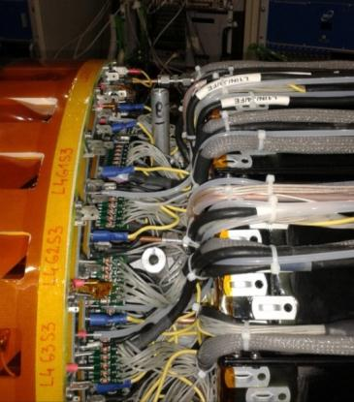
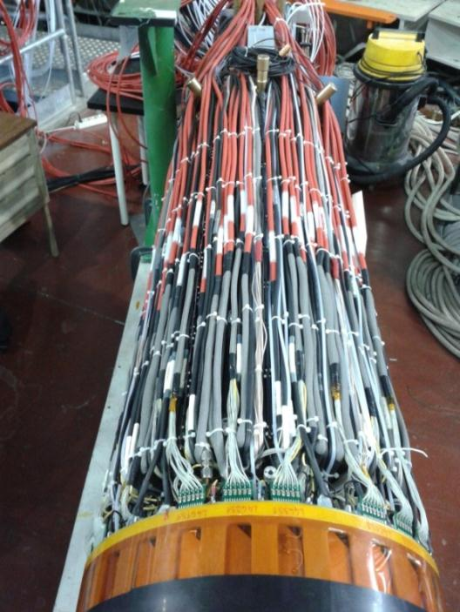
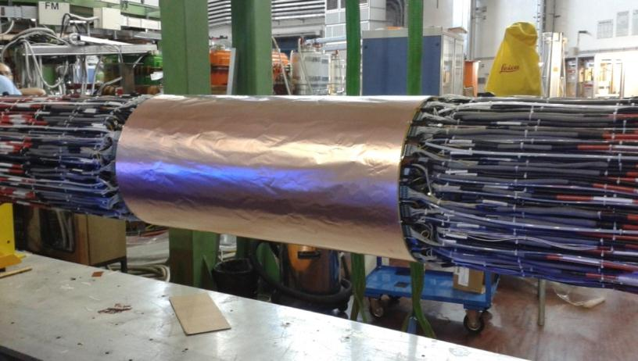
IT cabling
Each IT side has:
90 readout cables
69 HV cables
36 gas tubes
8 cooling tubes
6 temp. probes cables
Detail of connectors zone
One side fully cabled
IT cabled and shielded

Slide 21
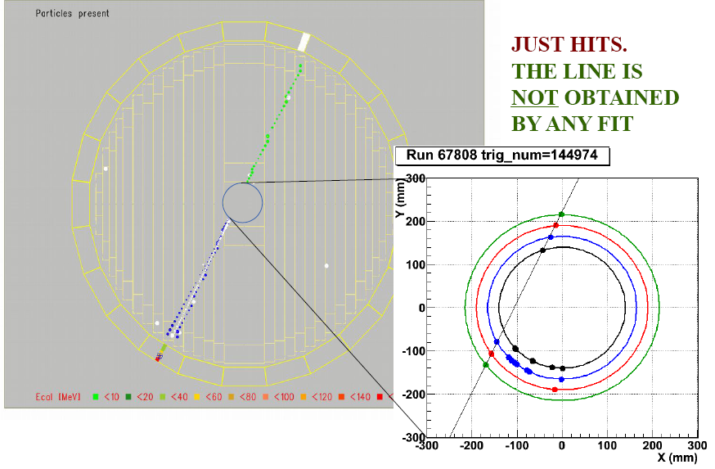
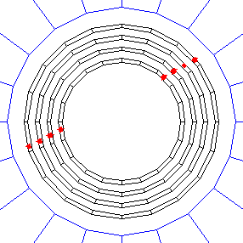
Cosmic rays events
EMC + DC
IT
Notes:
This how a cosmic muon passing through KLOE appears, triggered by the calorimeter, and reconstructed both by th dc and the IT

