Slide 1
Front End Amplifier for the BES CGEM detector
Chongyang Leng
INFN-Torino, Italy
IHEP, China
Politecnico di Torino, Italy

Slide 2
Designers:
C.Y. Leng (INFN,IHEP, Politecnico di Torino)
H.S. Li (IHEP)
J.Y. Chai (INFN,IHEP, Politecnico di Torino)
Technical Advisors:
Rivetti (INFN)
M. Rolo (INFN)

Slide 3
Design constraints
Channel Per Chip: 64
Data Rate Per Channel: 60kHz
Detector Capacitance: 100pF ~ 150pF
Time Resolution: 3ns
Charge Measurement Range: 1fC ~ 60fC
Power Consumption Per Channel(FE part): 5mW
Layout Size: 5mm x 5mm
Process: UMC 110nm 1P8M CMOS

Slide 4
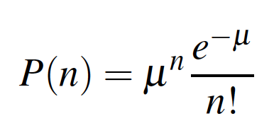
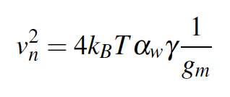
Brief theoretical calculation
Poisson distribution
=>data rate 60kHz (time interval 16us)
=> full pulse width less than 1.6us (assuming the piled up<10%)
=> 1us pulse width for FE part.
Minimum input signal 1fC with a good SNR about 5~6
=> Equivalent Noise Charge about 0.2 fC
Approximate equation of MOS transistors
=>considering a normal gain 10mV/fC, g_{m}=50mS required
=>current about 4mA
=>power consumption about 5mV per channel (FE part)

Slide 5
Channel Structure
High bandwidth comparator
CR-RC⁴ shapers with conjugated poles
Other functional blocks
BANDGAP
DAC
LDO
…

Slide 6
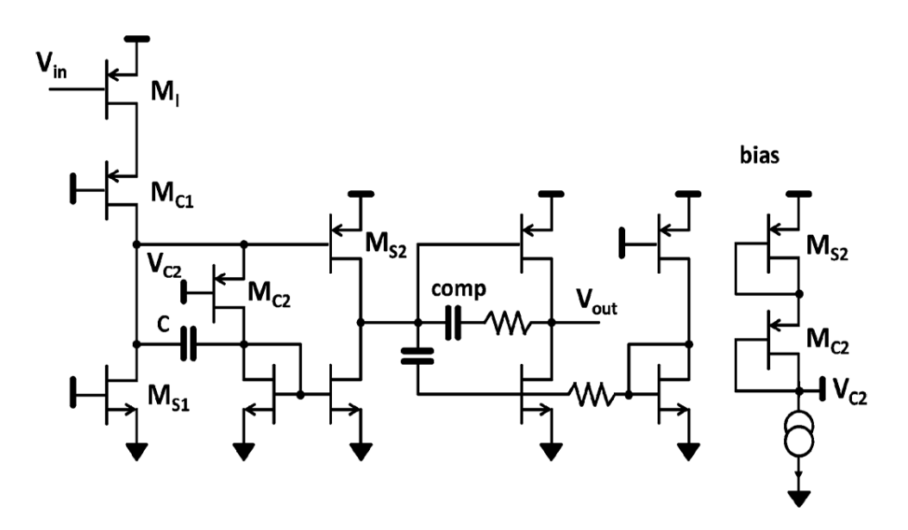
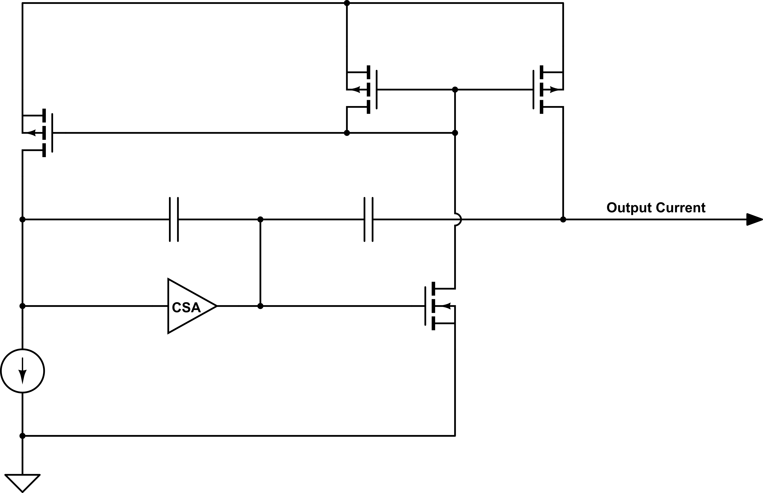
Preamplifier implement
A low noise charge sensitive amplifier strategy
Current mode feedback structure,
to get precise duplicated input signals
for both branches
Charge Sensitive Amplifier, originally proposed by Gianluigi De Geronimo

Slide 7
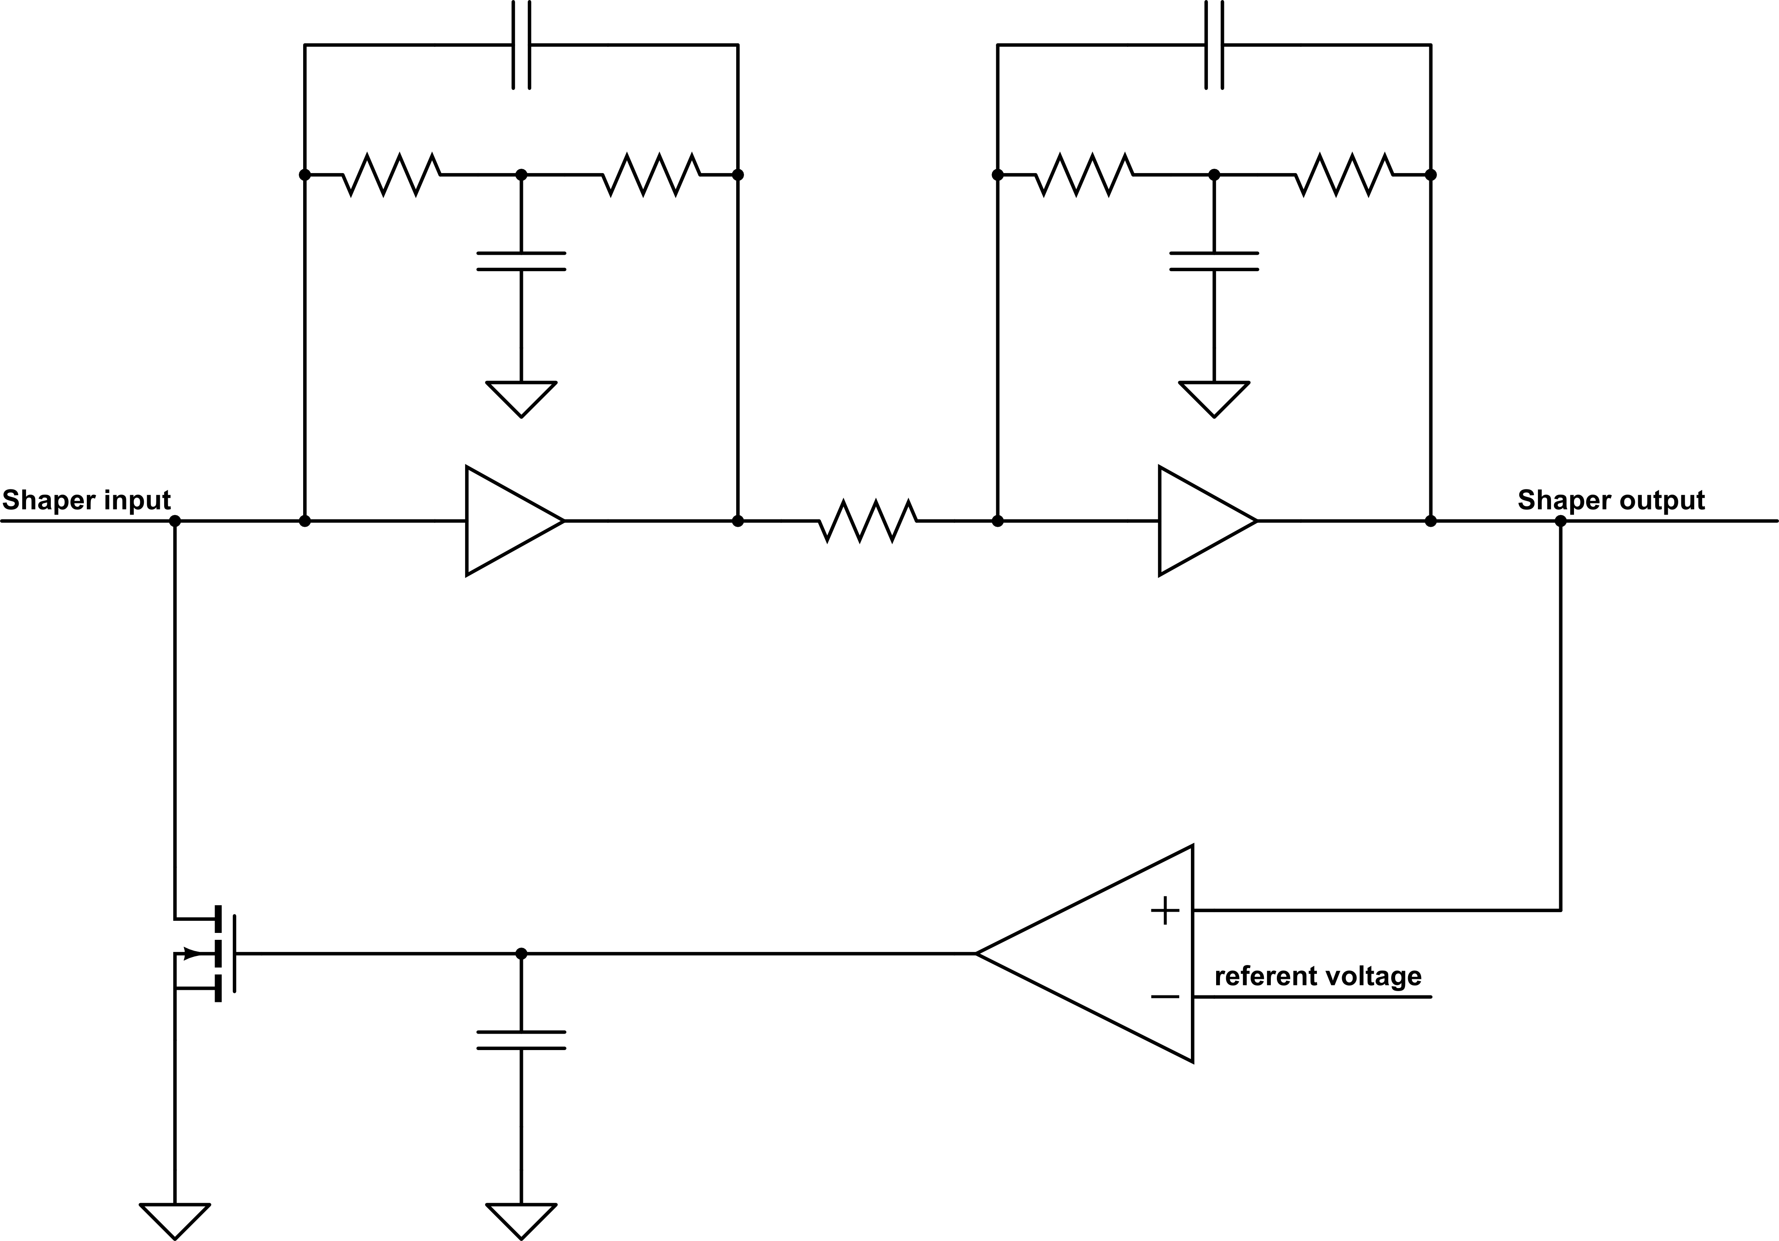
Shaper Structure
T-bridge network to get semi Gaussian waveform and set the peaking time to ~ 300ns
Shapers with two stages
Baseline holder: setting the quiescent point

Slide 8
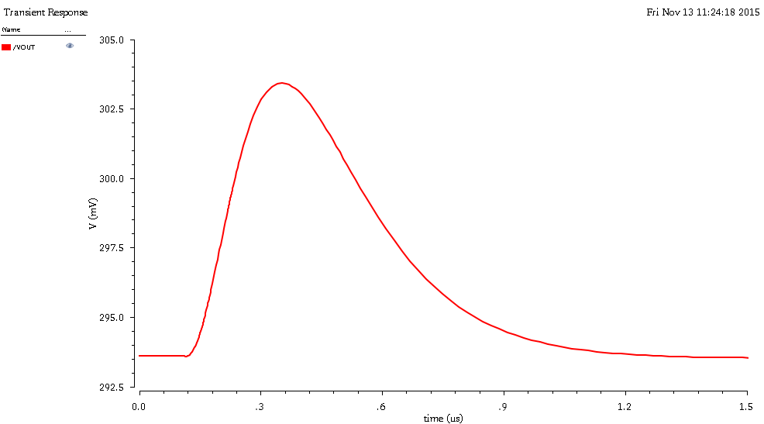
Performance and result
Peaking time 250ns
pulse width 900ns~1us

Slide 9
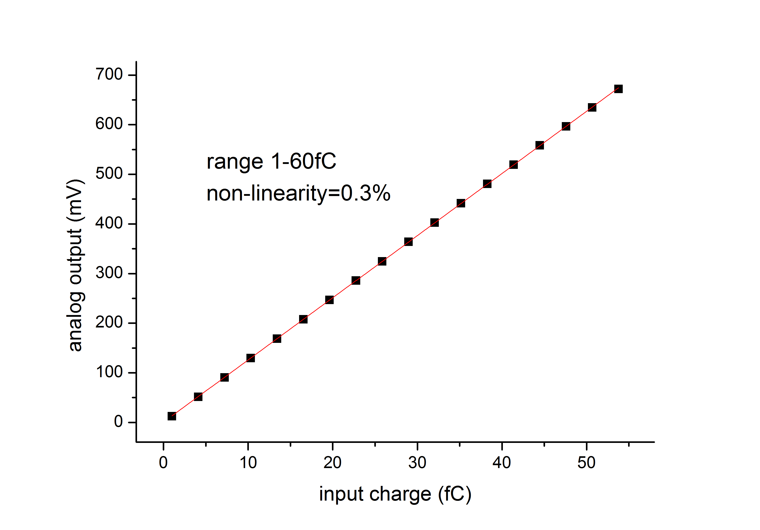
Performance and result

Slide 10
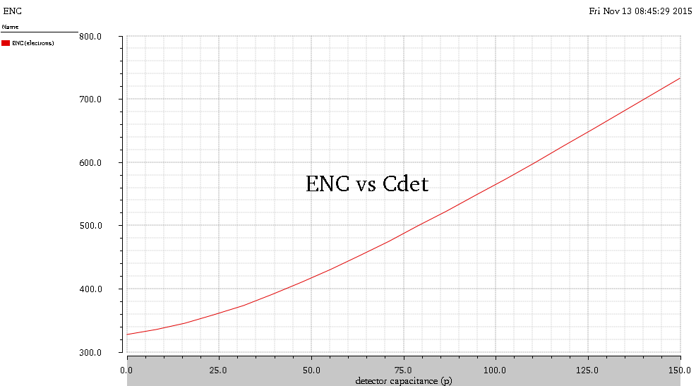
Performance and result
720 electrons @150 pF
560 electrons @100 pF

Slide 11
Performance and result
Detector capacitance 150pF
ENC: <800 e @peaking time =250ns,
Power consumption ≈ 5mW
Full signal pulse width < 1us
Non-linearity = 0.3% (1fC to 60fC)
Noise ratio ≈ 3.2 e/pF
Gain ≈ 10mV/fC

Slide 12
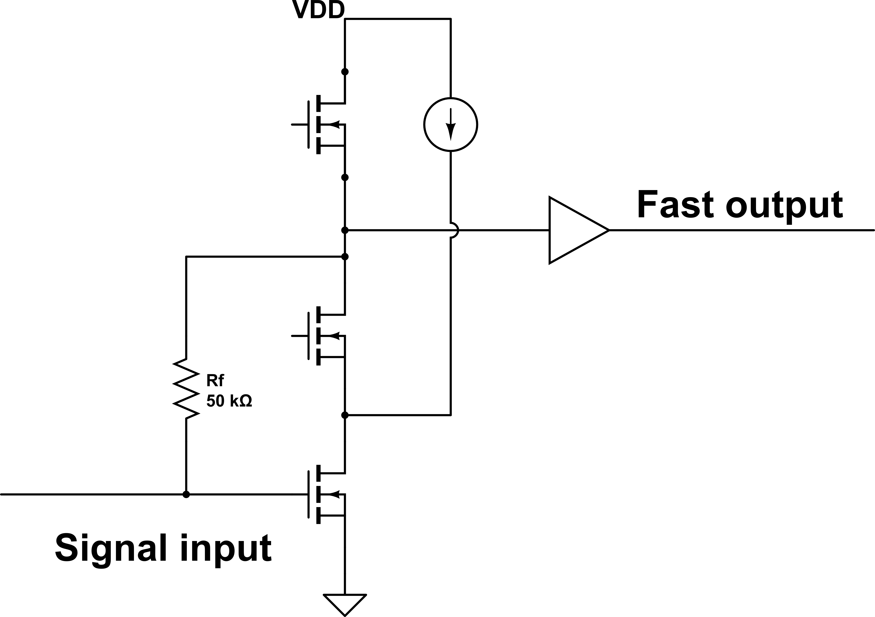
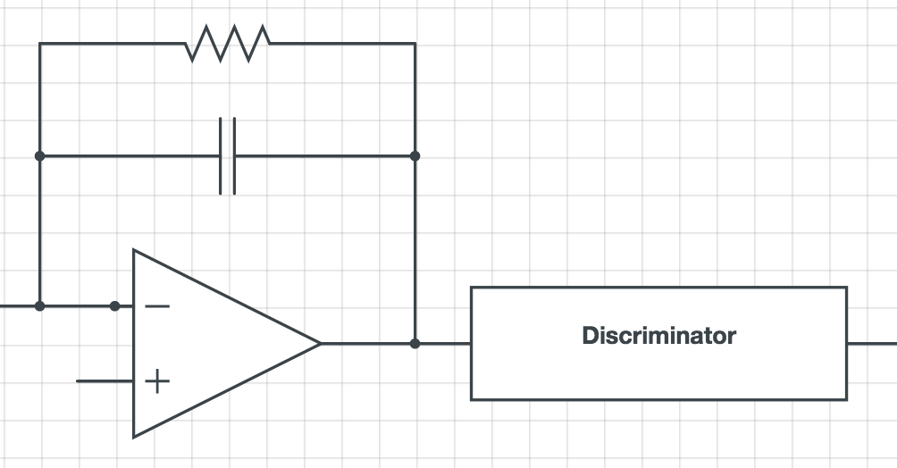
Effort on improving the time resolution
Another structure of preamplifier studied to further enhance the time resolution , by speeding up the response and take the very fast preamplifier signal for measurement
Feedback resistor
Same discriminator and backend structure
Transimpedance amplifier with split current and a buffer

Slide 13
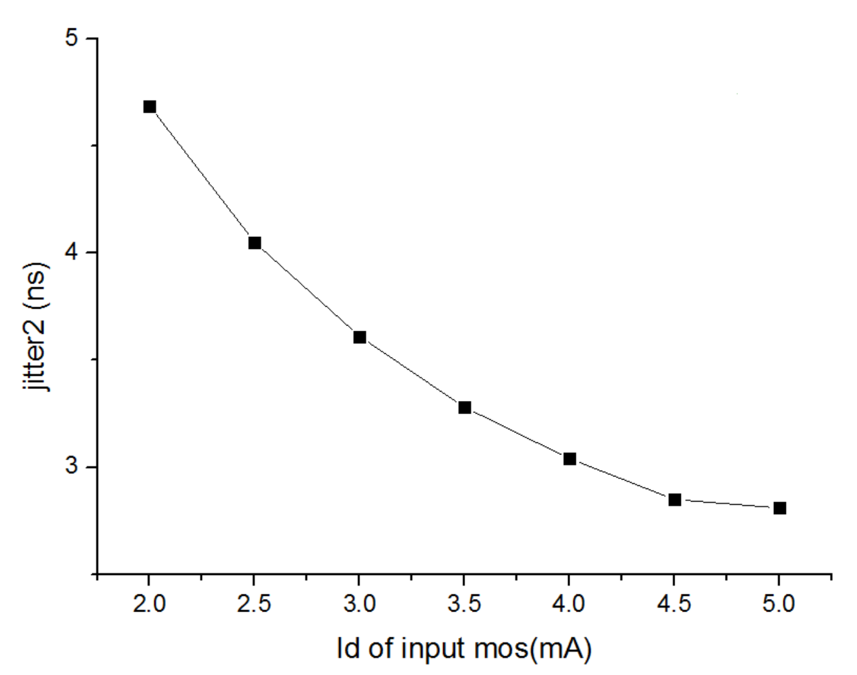
Quick timing results
Faster rising edge: ~6ns
Time jitter: ~3ns
Minimum signal detected: 1fC (with target SNR=2)
Compromise must be made between: ENC noise in charge measurement, time resolution and power consumption

Slide 14
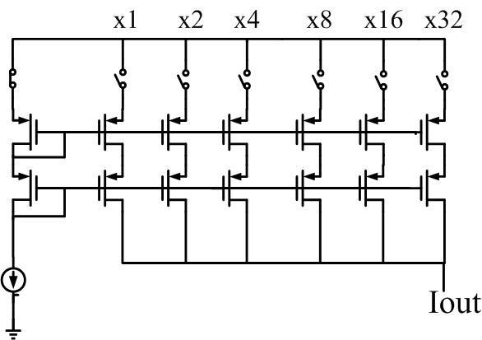
Design blocks
Structure of the 6-bits DAC
Used for bias cell of the frontend and the threshold of the discriminator

Slide 15
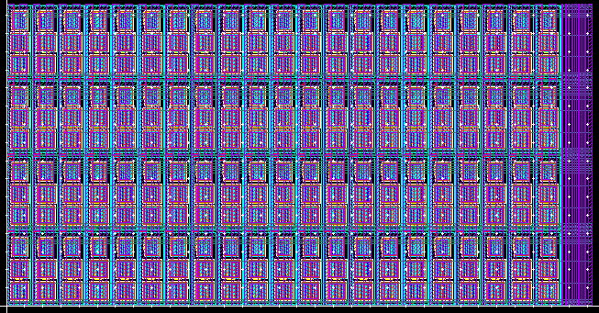
DAC implementation
LSB=3.6uA
Output: 0V→0.7V（64LSB@3kΩ）
Area: 140um x 70um
INL (all corner simulated) is less than 0.2%
Layout arrangement of the DAC

Slide 16
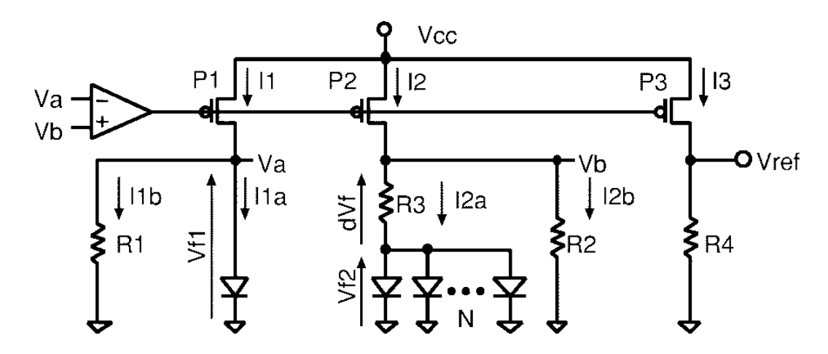
Bandgap implementation
Hironori Banba, IEEE JOURNAL OF SOLID-STATE CIRCUITS, VOL. 34, NO. 5, MAY 1999
The bandgap reference is a temperature independent voltage reference circuit.
It will produces a fixed voltage regardless of power supply variations, temperature changes and circuit loading from a device to generate precise references for the chip.

Slide 17
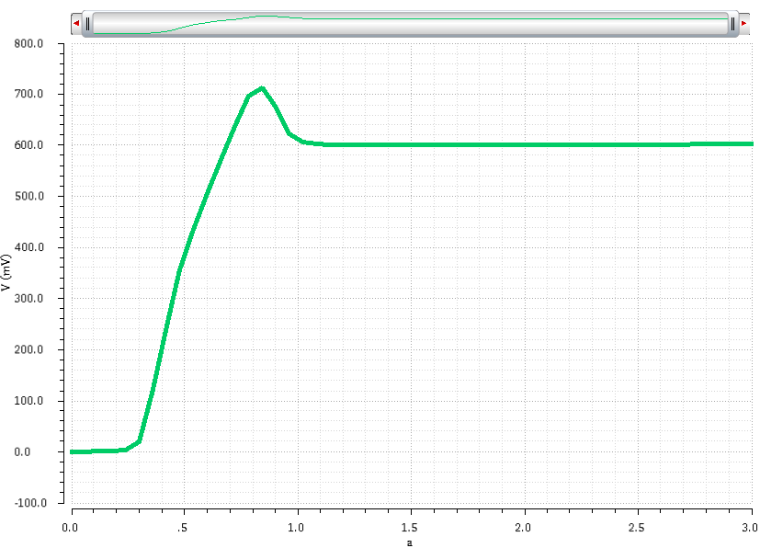
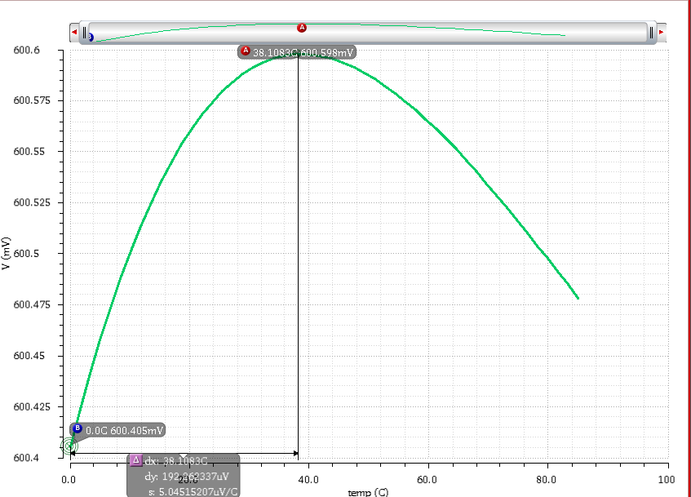
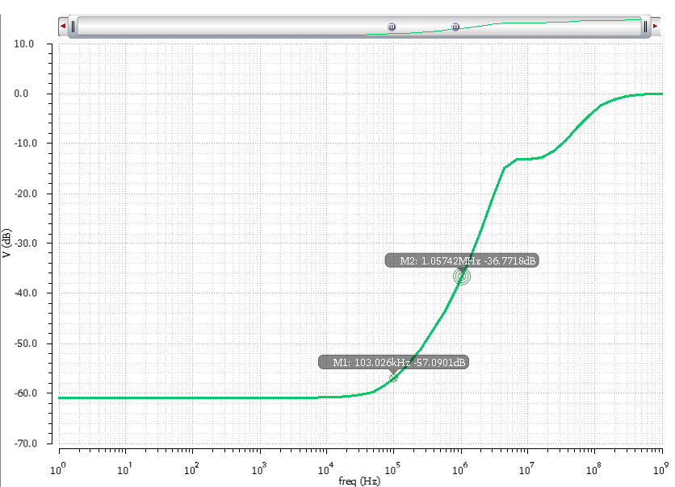
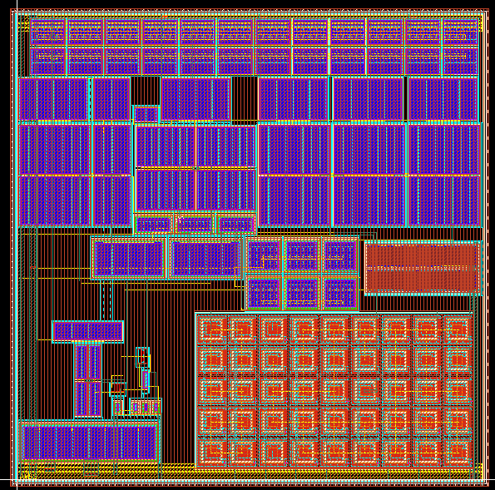
Bandgap implementation
Vref VS Vdd
Vsupply-min=1.0V
Vref VS temp
ΔV=192.3uV@typical, 0~85℃
The best corner is: 3.7ppm
Area: 300um*300um,
Power: 250uA
PSR=60.1dB@100Hz
PSR=57.1dB@100KHz
PSR=36.8dB@1MHz
17

Slide 18
Conclusions
Satisfactory charge and time resolution separately, but compromise needed between them.
Limited power consumption
Good invariance among processes,design parameters and other conditions
Simulation of the schematic almost finished and remaining layout work will start soon
Supposed to be submitted at the beginning of March, 2016
18

