Slide 1
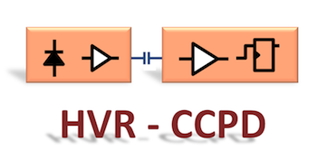
HVR_CCPD: Hybridization
Pixel R&D Projects Meeting
Milano, 8 June 2015
G. Darbo / INFN – Genova
On behalf of HVR_CCPD Genova:
M. Biasotti, V. Ceriale, G. Darbo, G. Gariano, F. Gatti, C. Gemme, P. Morettini, L. Rossi, A. Rovani, E. Ruscino, M. Sannino.
Indico:
https://agenda.infn.it/conferenceDisplay.py?confId=9770

Slide 2
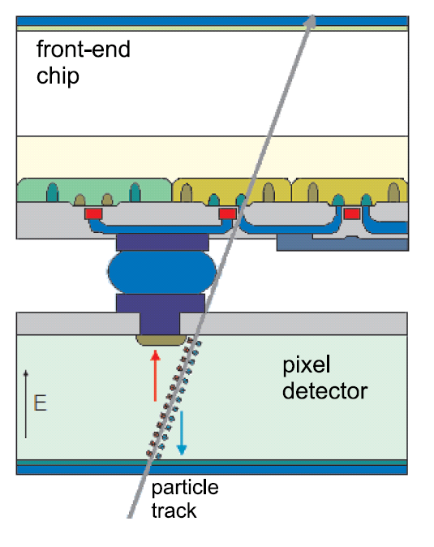
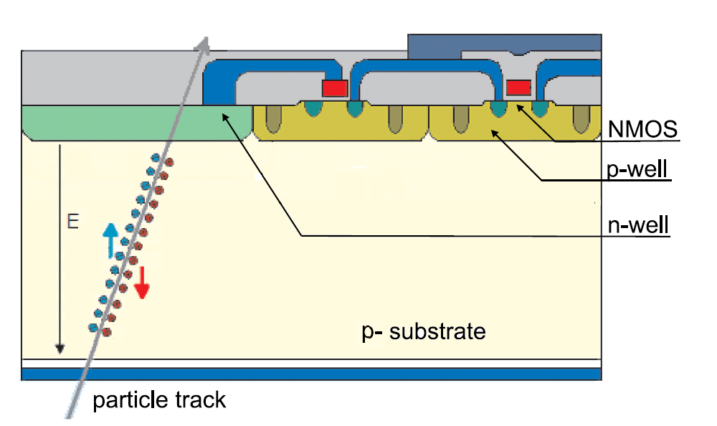
CCPD – Capacitively Coupled Pixel Detectors
New generation of Pixel detectors under development for the ATLAS Pixel detector at the HL-LHC
Passive hybrid detectors use “resistive” coupling between sensor and R/O chip
HV-CMOS detector use a High Voltage chip technology to make sensor and amplifier which is then coupled to the “usual” front-end chip…
through a dielectric…
Why capacitive?
Passive sensors need diode biasing from amplifier other than for collecting charge: AC coupling is (almost) not an option.
Capacitive coupling it might be cheaper: glue and alignment looks easier.
Thin FE chip
R/O Architecture
Thin FE chip
Electrical Interconnection
Bump-bond
Dielectric (glue)
Amp/Disc layer
Amp/Disc layer
HV/HR-CMOS
HV/HR-CMOS
Drift layer
Drift layer
© T. Hemperek, Bonn, DE

Slide 3
(Some) Requirements
Capacitance uniformity
Between pixels, from an assembly to another: ~10 % → thickness uniformity
Most critical for analog coupling (no discriminator in the HV/HR-CMOS)
RD-53 chips will have 50µm pitch, but also versions for very small pixels: 25µm pitches are considered
X-Y alignment: better than few µm (cross talk / signal loss)
Glue requirements
Low viscosity: 0.1 ÷ 0.5 Pas
Radiation hard: epoxy
Not degassing
Low temperature curing, investigating UV/Temp curing glues
Minimum thickness of glue to give for full adhesion (usual specs are 1-2 mil, but we want less!)
For chip-to-wafer and wafer to wafer TVS are needed on one or both facing chips
For the moment we are looking at chip-to-chip processes

Slide 4
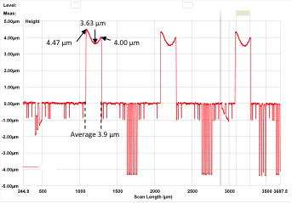
Controlled Glue Thickness
Procedure for Controlled Glue Thickness
Deposit uniform layer of SU8 photoresist on R/O chip wafer (or single chip) by spinning – tune for 5 µm layer by controlling RPM speed
Pattern pillars using lithographic process .
Spin SU-8 photoresist
Pattern pillars by mask
R/O CHIP
Glue deposition
Profile of pillars on top of a FE-I4 chip
R/O CHIP
Align & pressure
DETECTOR CHIP
R/O CHIP
Pillars
Deposition of SU8 photoresist by spinning
FE-I4 topography
© V. Ceriale, A. Rovani, Genova, IT

Slide 5
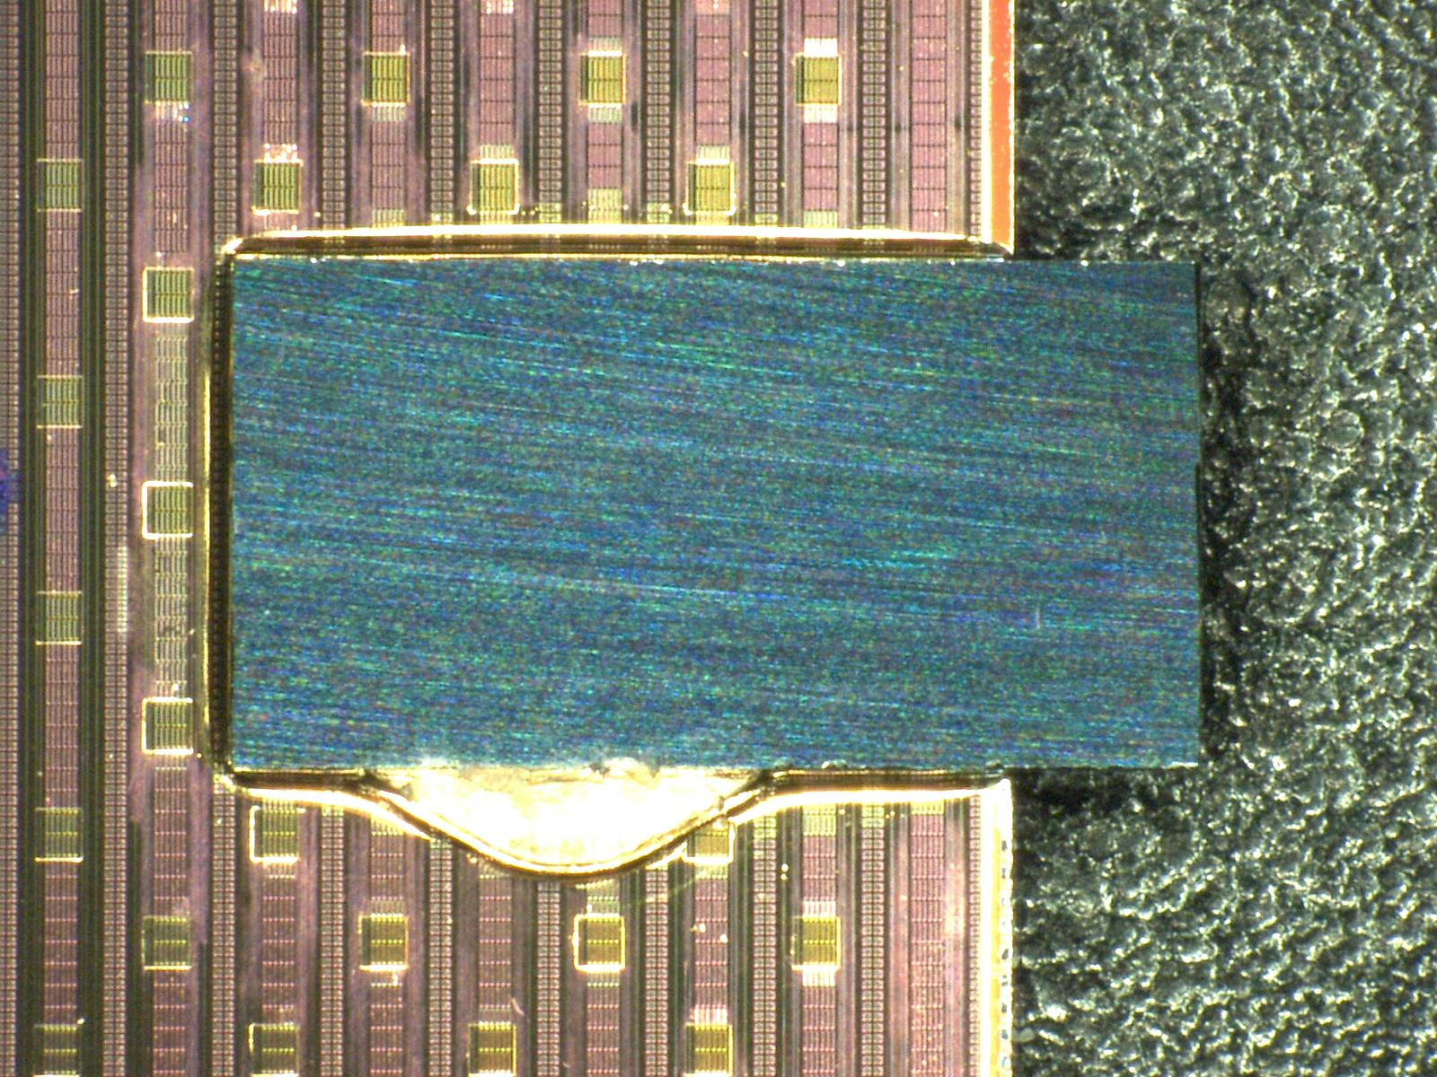
sd
 | Side A [µm] | Side B [µm]
Scan 1 | 254.40 | 257.04
Scan 2 | 257.31 | 257.91
Scan 3 | 256.77 | 257.83
Scan 4 | 256.55 | 257.55
Scan 5 | 255.97 | 257.23
Side A
Scan 5
Scan 4
Scan 3
Scan 2
Scan 1
Side B
FE-I4 chip
SU8 pillar
© A. Rovani & V. Ceriale - Genova

Slide 6
Basic CCPD Process under Study
Pillars can be produced by standard lithographic processes:
SU8 photoresist deposition (3 – 5 µm thickness) by spinning on 8 – 12-inch wafers (for testing we could use 6-inch wafers)
Pillars are made by mask as for bump-bonding openings in the photoresist
Chips need alignment after a glue is deposited (flip-chip machine)
SU8 deposition by spinning

Slide 7
Plan for Hybridization - Glues
Look for UV/Temp curing glues
Reason: tacking of glued chips and the final cure in the oven – this reduces the flip-chip machine time from several hours to few minutes!
Fineplace modified by Alessando R. by adding UV LEDs. – tested on glasses with bump pads and available glue samples (wirebond potting glue) – looks promising!
Valentina C. has searched for glue candidates – Individuated suitable candidate we are going to order.

Slide 8
Plan for Hybridization – Dummy wafers
Test pillar and glue process on dummy wafers/chips
Design a 6-inch wafer with FE-I4 size dummies
Place 48 capacitors of 1 mm² each on every dummy chip.
Capacitance gives information of glue thickness uniformity
FLIP
PROBING PADS
Equivalent circuit
after flip C_{tot} = ½ C

Slide 9
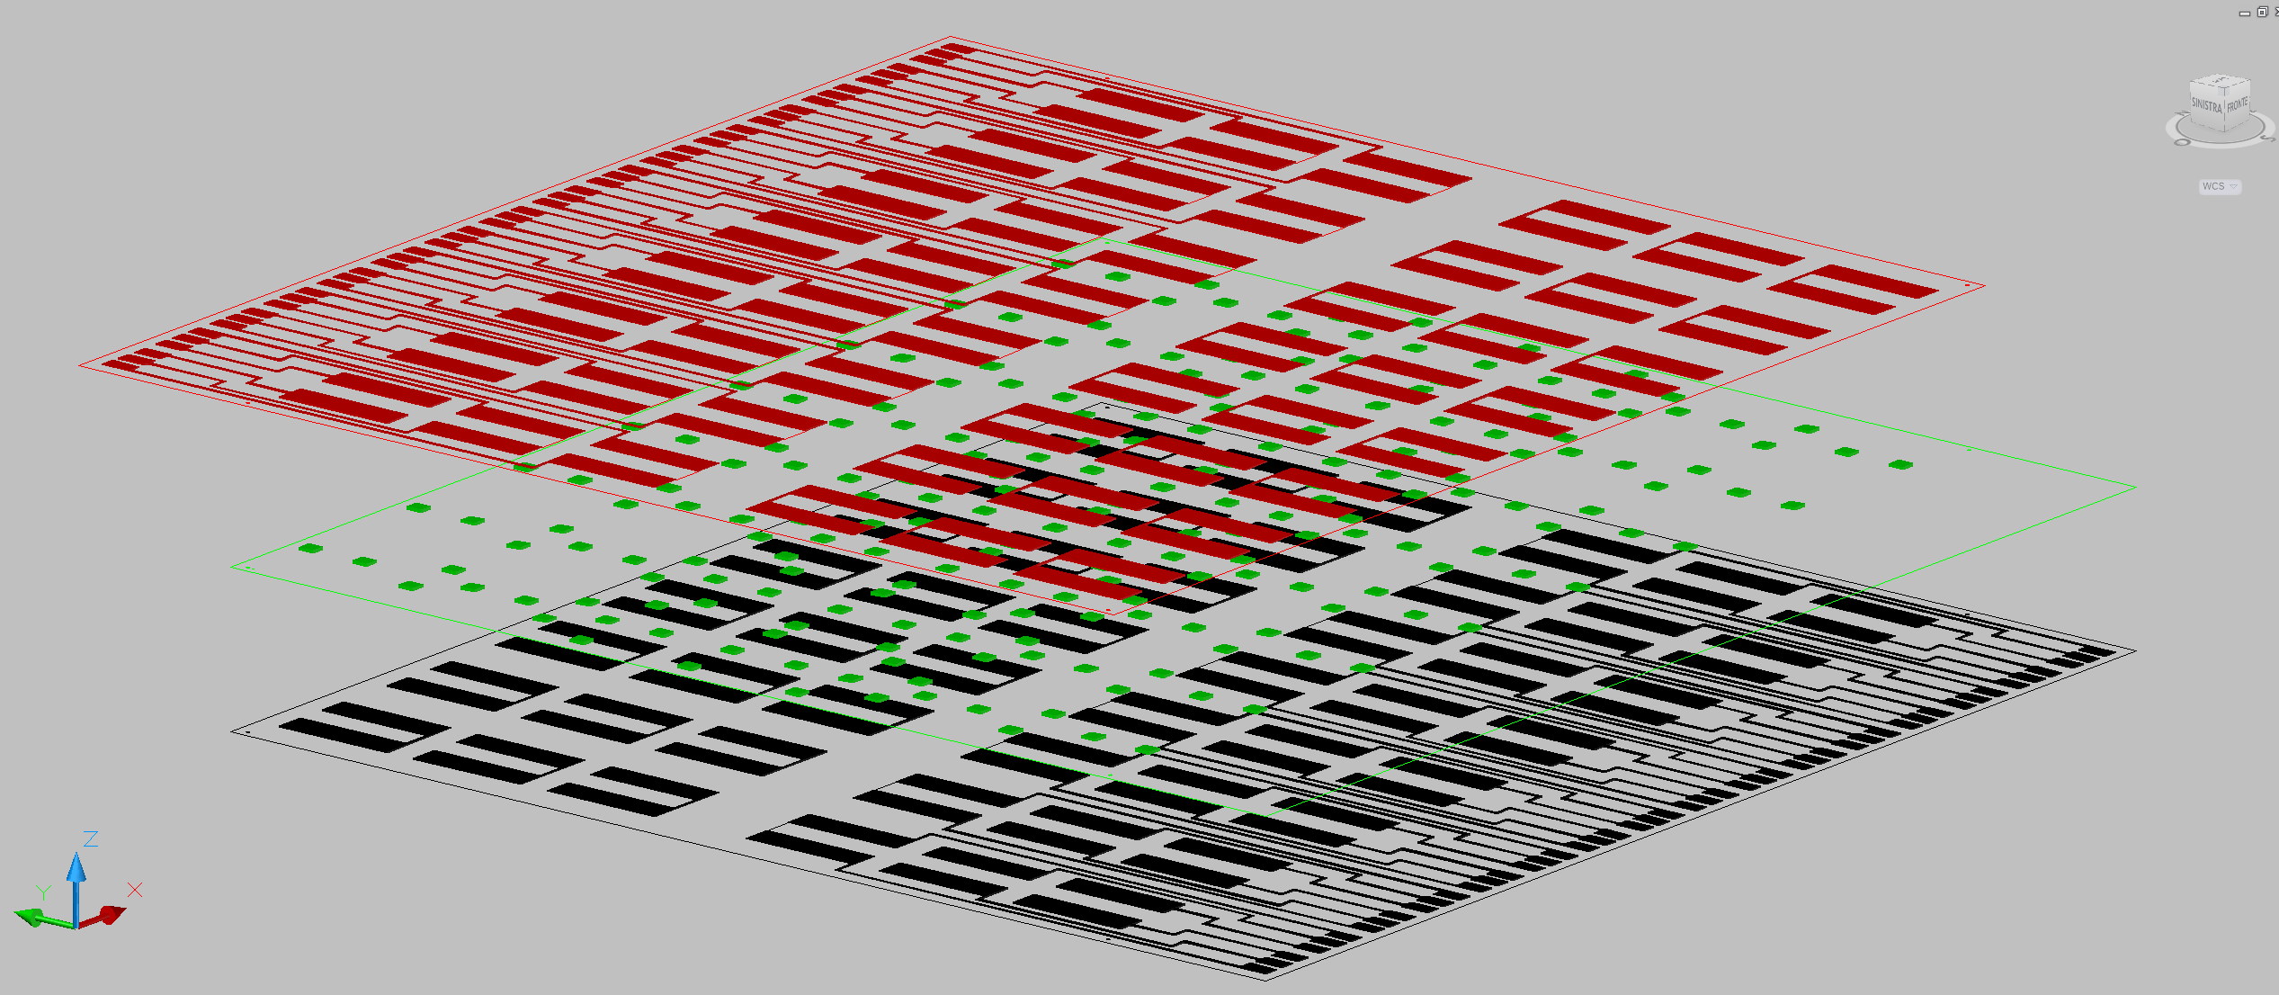
Dummy Assembly
Credits: Alessandro Rovani – INFN / Genova

Slide 10
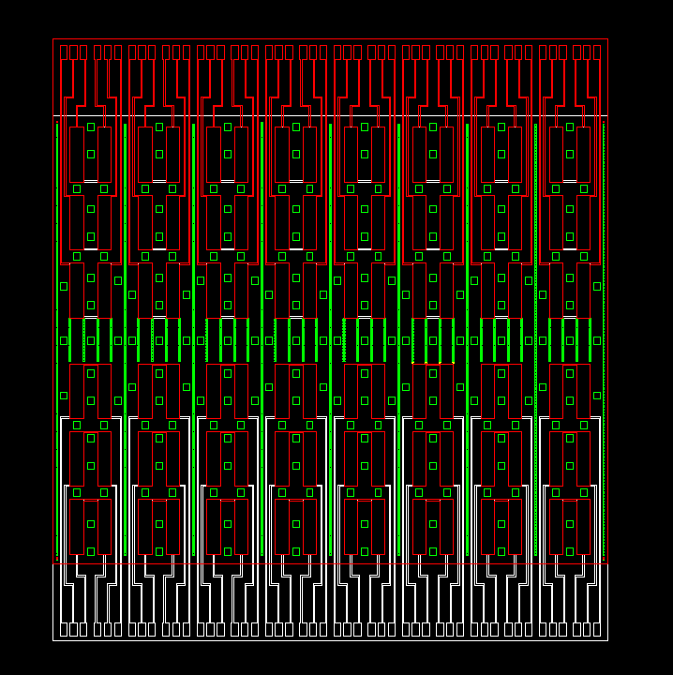
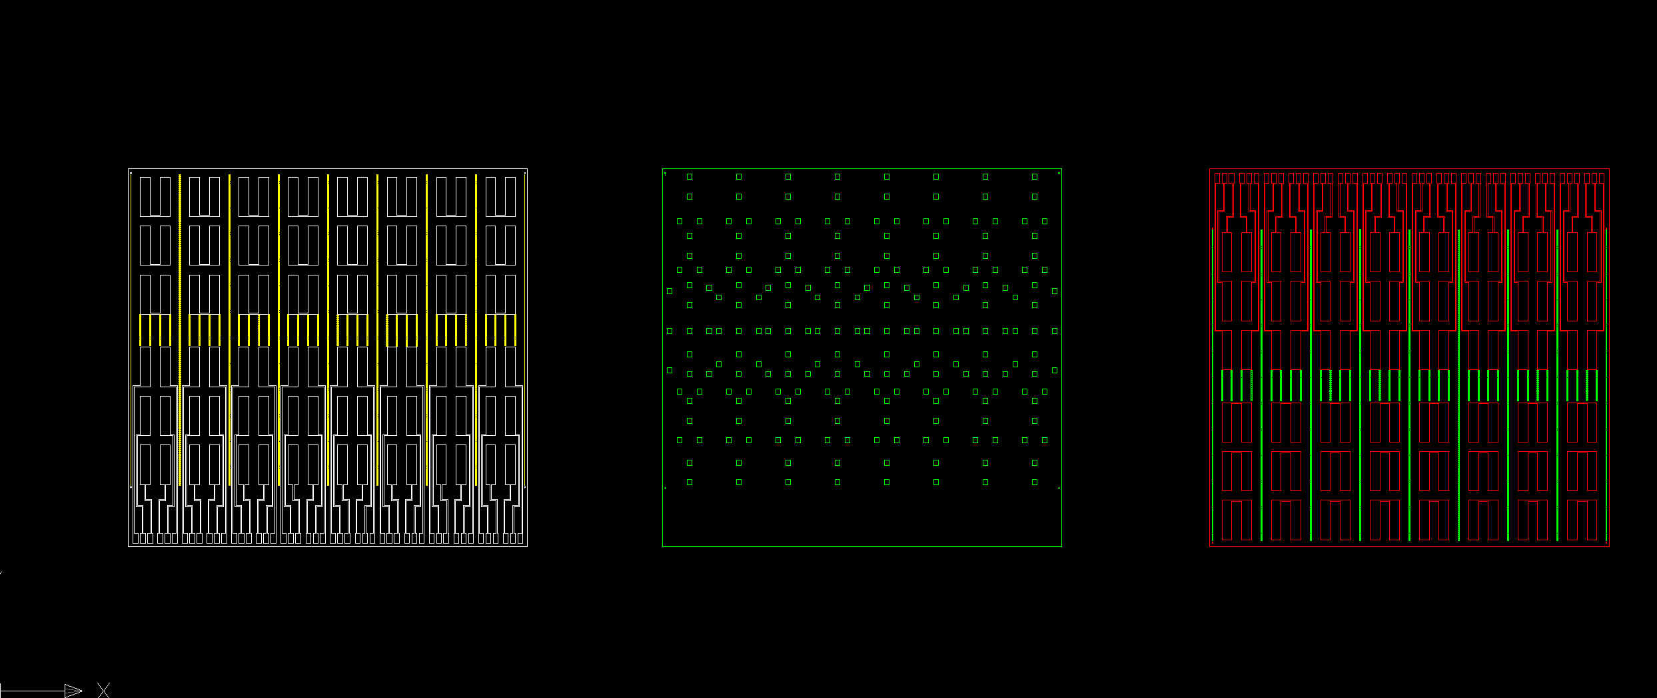
Overlaid – Bottom metal + SU8 pillard + Top metal
Credits: Alessandro Rovani – INFN / Genova

Slide 11

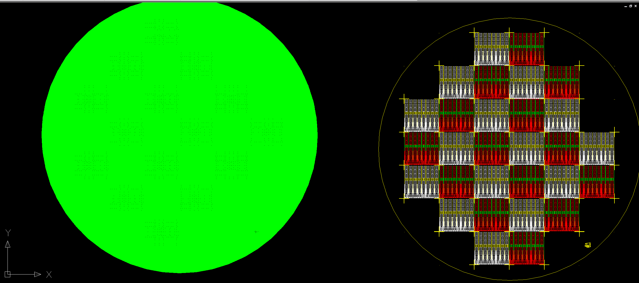
Mask Layout (draft)
pillars
metal
Ref.: Alessandro R.

Slide 12
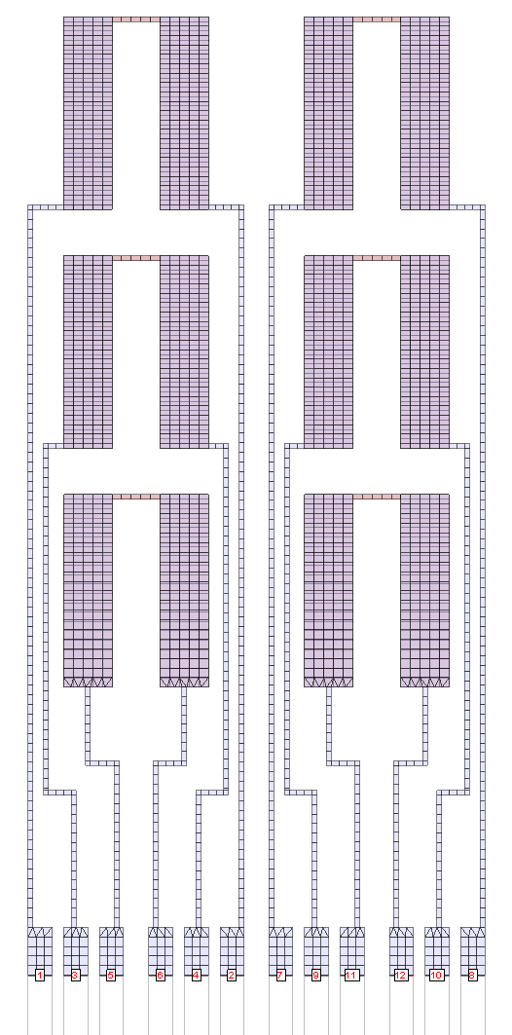
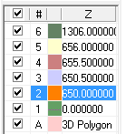
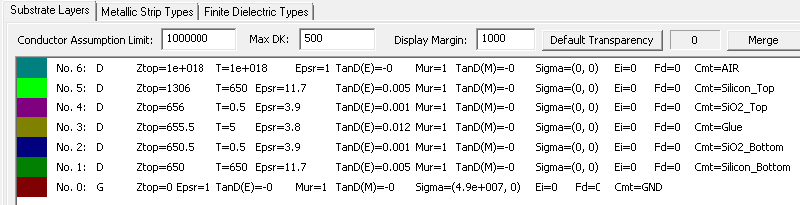
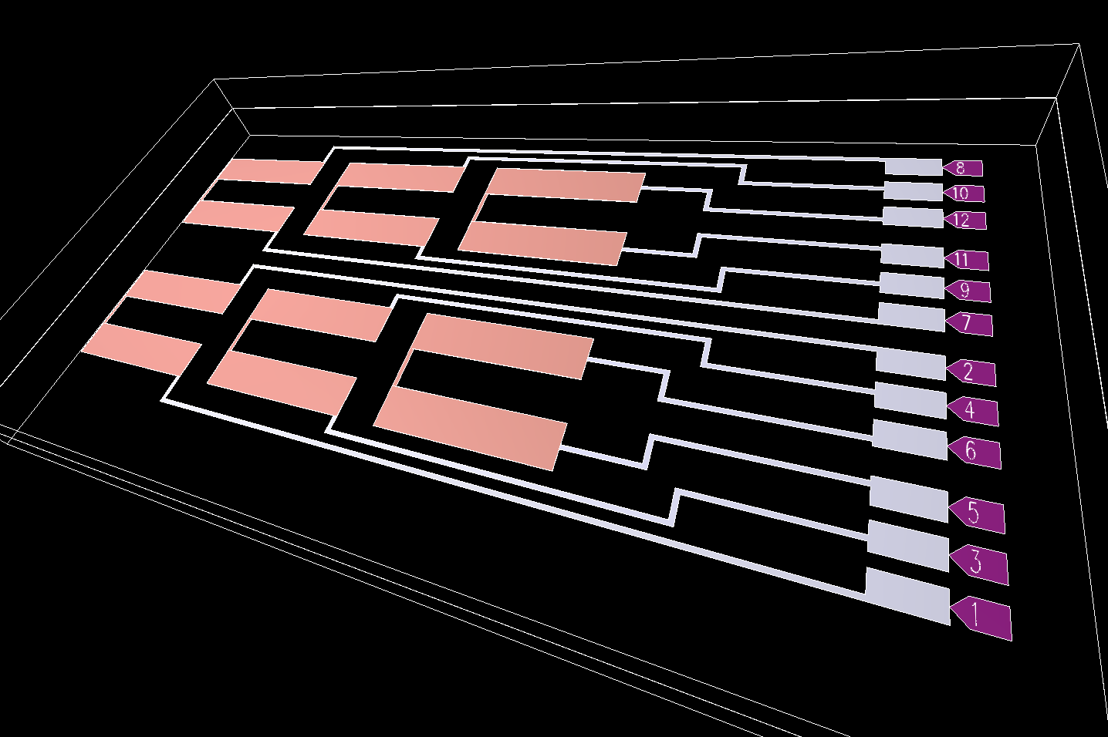
3D Simulation - HyperLynx® 3D EM
5µm dielectric thickness
Stack-up:
Credits: Ettore Ruscino – INFN / Genova

Slide 13
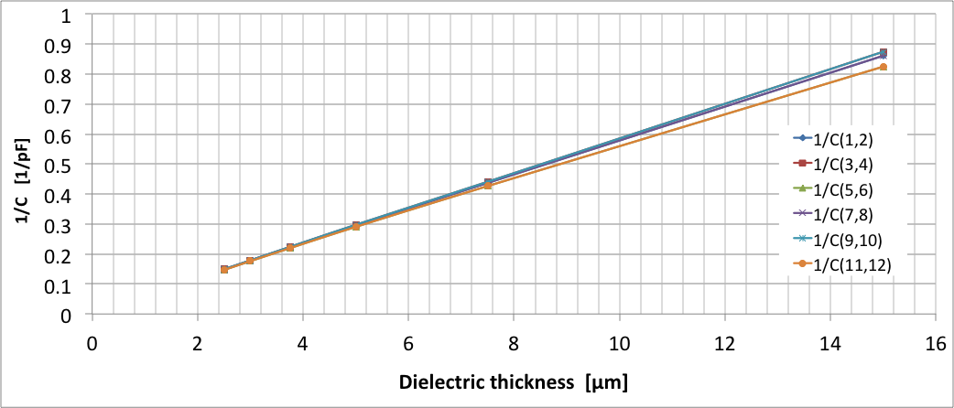
Dielectric thickness (µm) → Capacitance (pF)
10 MHz
Credits: Ettore Ruscino – INFN / Genova
Dielectric | 2.5um | 3um | 3.75um | 5um | 7.5um | 15um
C(1,2) | 6,7485 | 5,6125 | 4,4937 | 3,3829 | 2,2878 | 1,1613
C(3,4) | 6,7267 | 5,5912 | 4,4731 | 3,363 | 2,268 | 1,1436
C(5,6) | 6,8096 | 5,6761 | 4,5565 | 3,4424 | 2,3444 | 1,2124
C(7,8) | 6,7485 | 5,6125 | 4,4937 | 3,3829 | 2,2878 | 1,1613
C(9,10) | 6,7267 | 5,5912 | 4,4731 | 3,363 | 2,268 | 1,1436
C(11,12) | 6,8096 | 5,6761 | 4,5565 | 3,4424 | 2,3444 | 1,2124
C5,6
C11,12
C3,4
C9,10
C1,2
C7,8
1/X
Capacitance (pF)
Dielectric thickness (um)

Slide 14
Dummy Wafers & Process Plan…
Dummy wafer layout completed
6-inch wafer will be produced by FBK – standard thickness, one metal layer on top of passivation (oxide)
Spinning of SU8 – two options:
Selex – they have experience with SU8 and they can do – we do not have a quote of the cost.
PTA - http://www.pta-grenoble.com/ - near Grenoble – Clean room and equipment available at hour cost to users (after training).
Flip chip at Genova or at other sites (Barcelona and Geneva)
Modified the flip-chip machine for UV curing
After qualification, process a full FE-I4 wafer.
We are also looking at full simulation of HV/HR-CMOS – FE chip coupling for optimal signal transfer
Configuration data from R/O chip to HV/HR-CMOS can be transmitted capacitively… only power/ground need DC connection (laser soldering to flex hybrid as in ALICE proposal?)

Slide 15
AIDA-2020 – WP6
Task 6.4 Hybridisation
Perform basic R&D on capacitive interconnection
Setup production facilities for full-prototype assemblies (chips on test boards)
Deliver full assemblies to all participating projects
Investigate options for future industrialisation of the interconnection process
Task 6.4 Beneficiaries and (INFN) interested groups:
INFN-GE, IFAE, UNILIV → HVR_CCPD will be carried on in collaboration with AIDA-2020
Additional INFN groups involved: Milano.
Activities on HV/HR-CMOS hybridization funded by 3 year INFN project:
AIDA 2020: 1/5/2015 – 30/4/2019
HVR_CCPD: 2015 – 2017
Matching funds to AIDA-2020 WP6 Task 4 comes from INFN – HVR_CCPD will cover it partially.
More INFO on AIDA-2020:
WEB Site: http://aida2020.web.cern.ch
AIDA-2020 kick-off meeting (3-5/6/2015): https://indico.cern.ch/event/382133/

Slide 16
Conclusions
Hybridization activities started with funds from CSN1 in 2014 and followed by CSN5 (HVR_CCPD)
Most of the work done at home using ATLAS and LTD (Low Temperature Detector) laboratories at INFN – Genova
Start to involve Industries for more systematic studies on dummies:
FBK and Selex (contracts in preparations)
The AIDA-2020 approval shall provide an international collaboration framework:
Collaboration with the other beneficiaries: Liverpool and Barcelona

Slide 17
Backup slides

Slide 18
UV/Thermal Curing Glue 1/2
Valentina contacted Master Bond. They propose two epoxy glues.
UV15DC80LV -> looks interesting, do we have questions to Master Bond?
UV15-7DC -> viscosity too high!
The price to purchase the products in the ½ pint size is $ 800/each
Similar to EpoTEK 301-2 and Araldite 2020.
1000 cps = 1 Pas

Slide 19
PTA Quote
Regarding the use of MA8:
- Mask dimension 7x7” for 6” wafers (available)
- Mask dimension 9x9” for 8” wafers (available)
- Photoresist available : SU8-2005 (negative, 5 microns thick); SU8-2025 (negative, 25 microns thick) ; AZ4562 (positive, 5 to 10 microns thick)
Regarding the PTA access:
Project submission in line
Process flow definition
If work done by the team of the project
Safety training for cleanroom access (thanks to a badge)
Equipment training
Use the equipment to do the work
Billing based on the using machine time (210 euros/hours)
If work done by the PTA technical team
Work definition by both technical team and project team
Work done by the technical team
Billing based on the attendance time (120euros/hours) and the using machine time (210 euros/hours)

Slide 20
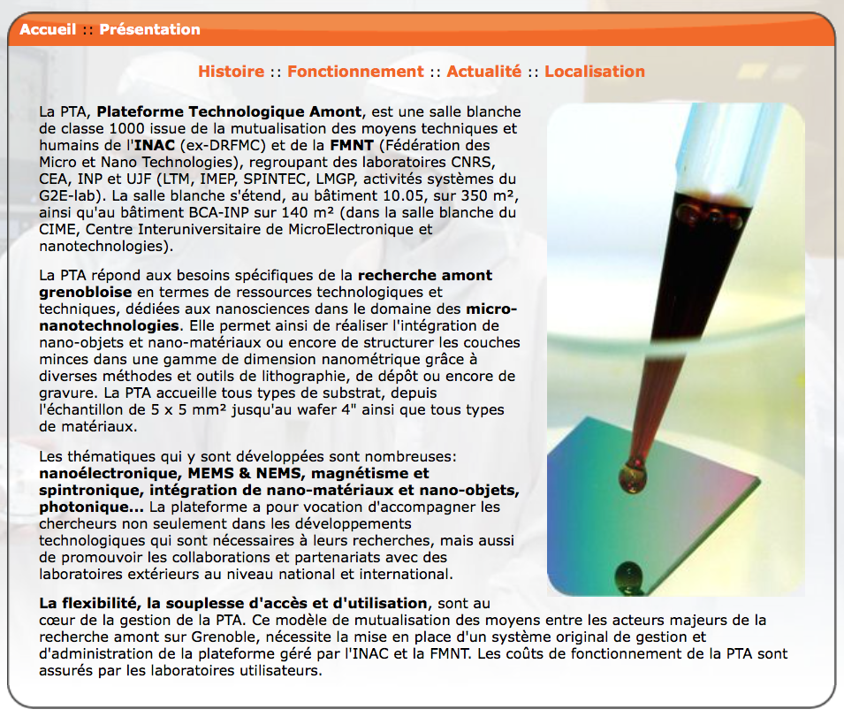
Plateforme Technologique Amont

Slide 21
Summary of Mask/Wafers
Description | Use | Mask / Wafer | Qty
Resistive chain | BB | Mask | 2 (metal, bump opening)
Dummy chip with chains | BB | Wafer @ FBK | 8
Bump deposition | BB | Mask | 1
12” wafers for deposition | BB | wafers | 9 (few used by Selex)
12” wafer bumps | BB | Mask | 1
Dummy chip for glue | HV | Mask | 1 (metal)
Dummy chip for glue | HV | Mask | 1
Dummy chip for glue | HV | Wafer @ FBK | 6
This activity will be supported by AIDA-2020 (1/5/2015 – 30/4/2019)
2 x 2 years “assegno di ricerca”
And funded by INFN (2015 – 2017)
RD_FASE2 (BB)
HVR_CCPD (HV-CMOS)

Slide 22
2µm metal thickness
Units in pF
(@ 10MHZ)
3.61
3.61
0.43
3.61
0.39
3.61
0.25
0.24
0.32
0.24
0.39
0.25
3.47
3.47
0.43
3.49
3.49
Credits: Ettore Ruscino – INFN / Genova

