Slide 1
UPDATES on INSIDE MECHANICS
All design of mechanical parts of Inside are defined and frozen.
Construction of mechanical parts started (Torino INFN workshop)
Cooling panel → ready
Chariot and shoulder → need external workshop (welded parts). Waiting for quotation.
Heads → in progress
Delivery of some commercial parts delayed due to the new invoicing method.
Purchase of other commercial parts needs new market recognition. Regular suppliers reject the new invoicing method.
B. Giraudo
INFN torino

Slide 2
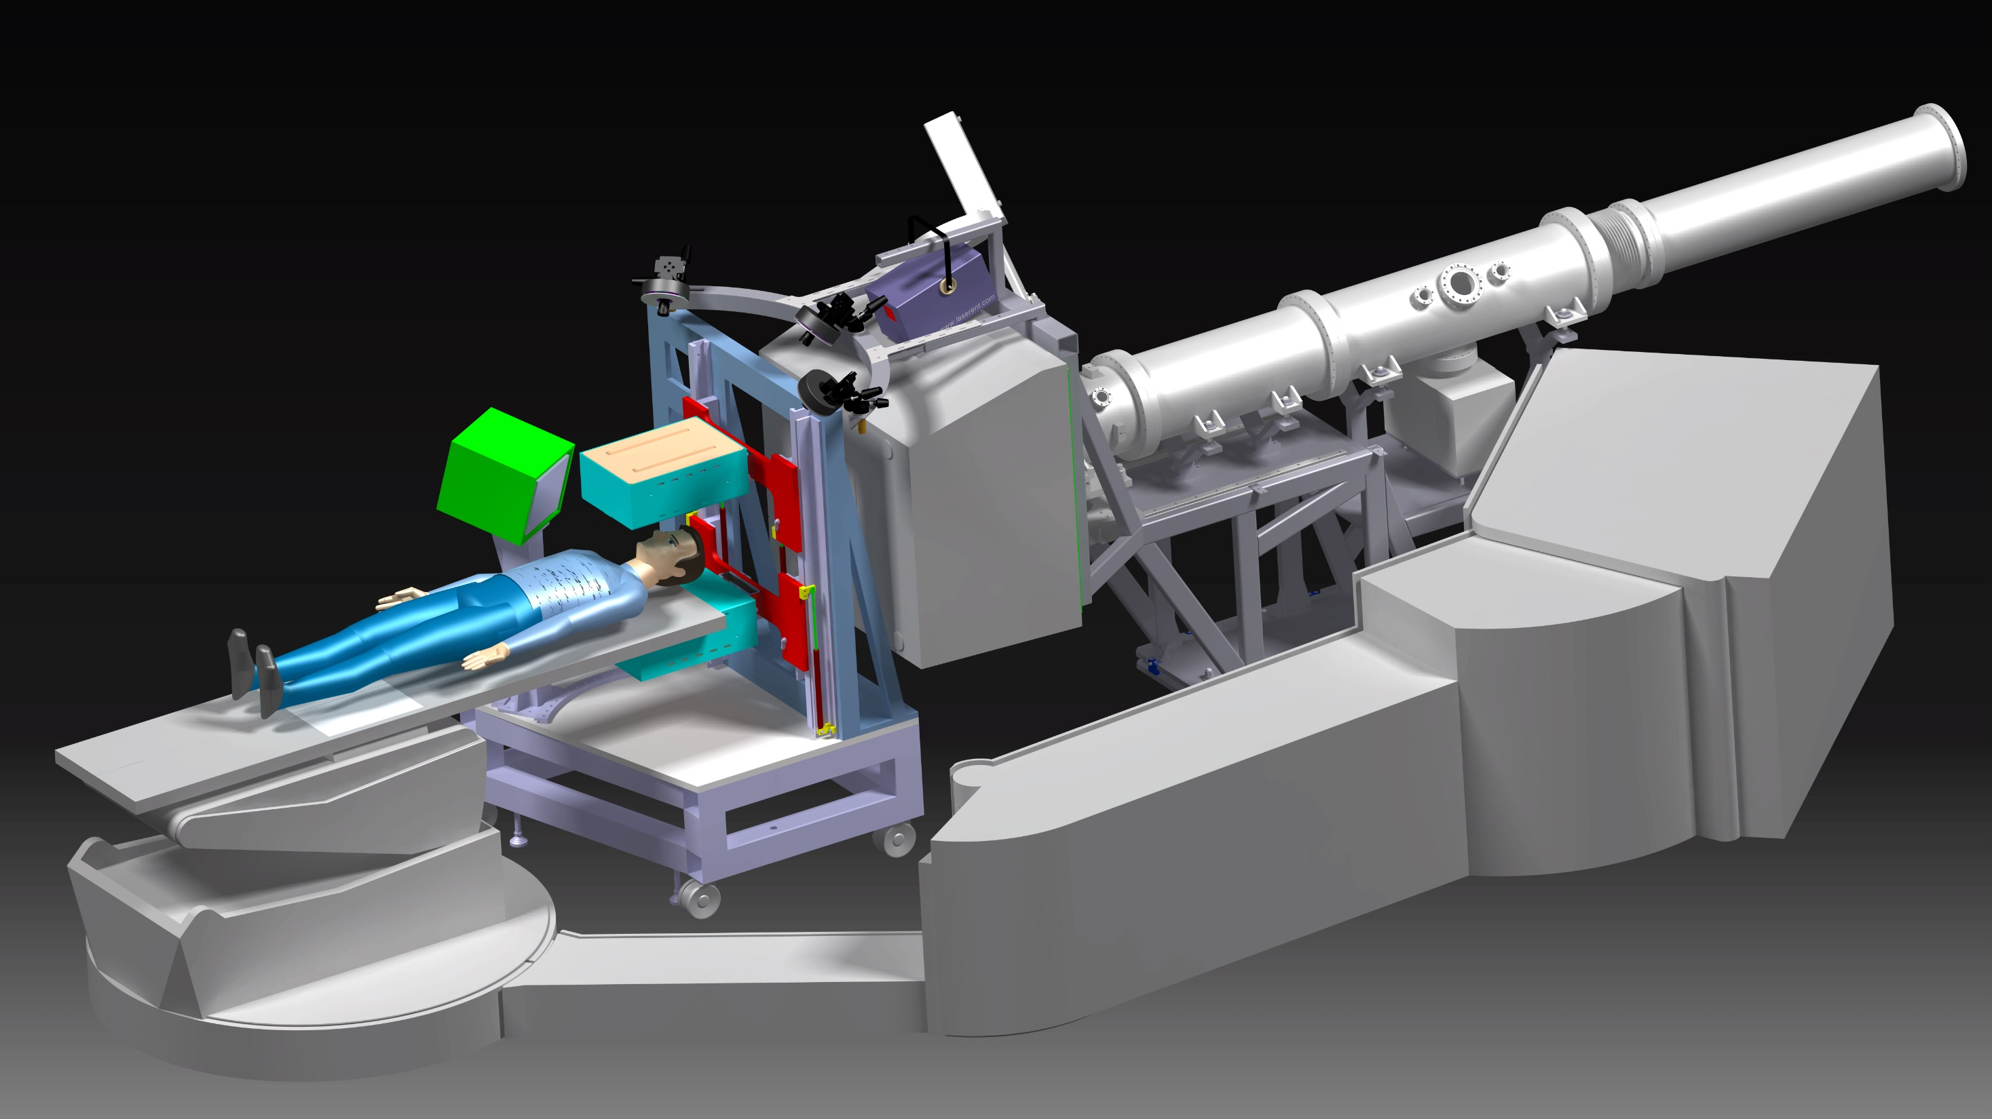
Disegno Globale
Estensione corsa max ±400 mm
Dimensione longitudinale Testa +5 mm
Taglio sulla base
G. Giraudo
Roma 18/12/2014

Slide 3
Disegno Globale
Posizionamento Profiler
Minima Distanza tra le Teste
G. Giraudo
Roma 18/12/2014

Slide 4
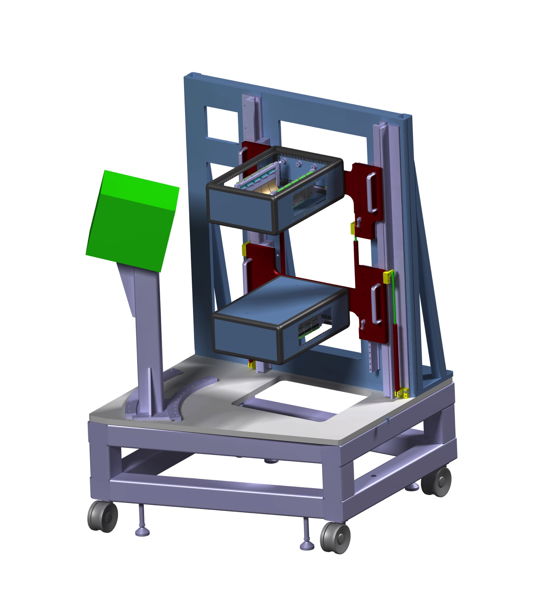

Slide 5
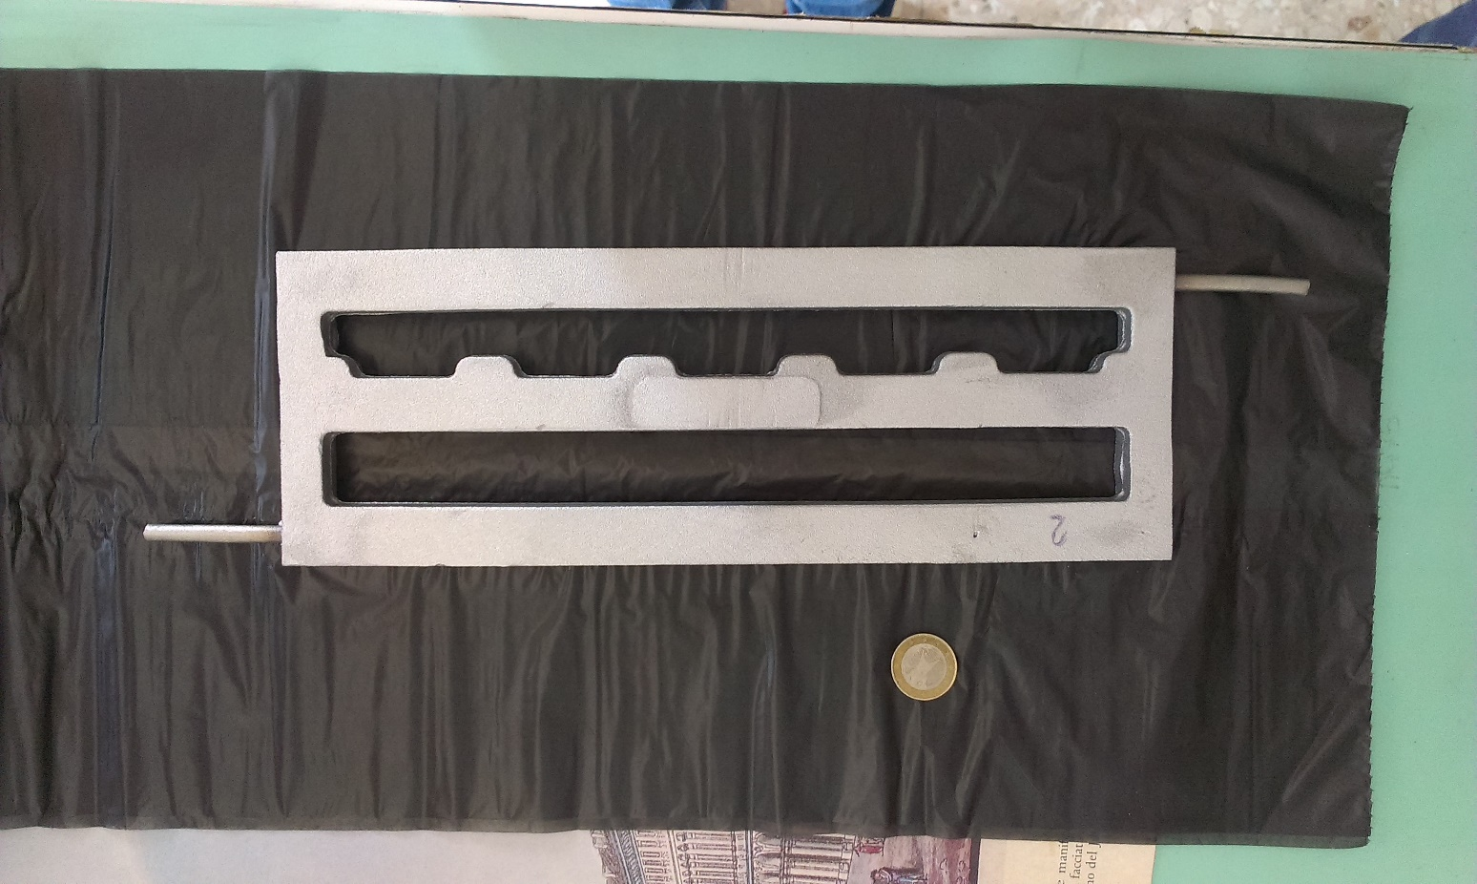
Thermal heat exchanger
Aluminium casting with stainless steel tube embedded.
Pre-machining view.
RX of the thermal heat exchanger. Survey of tube position.

Slide 6
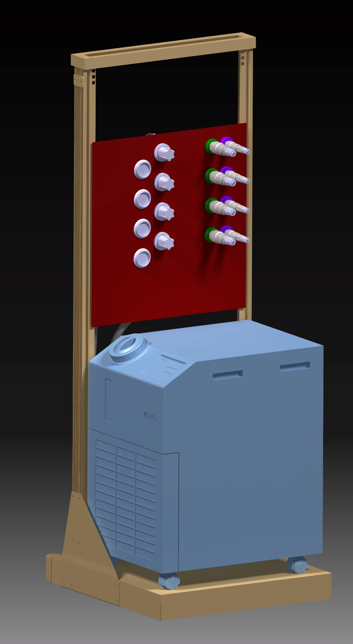
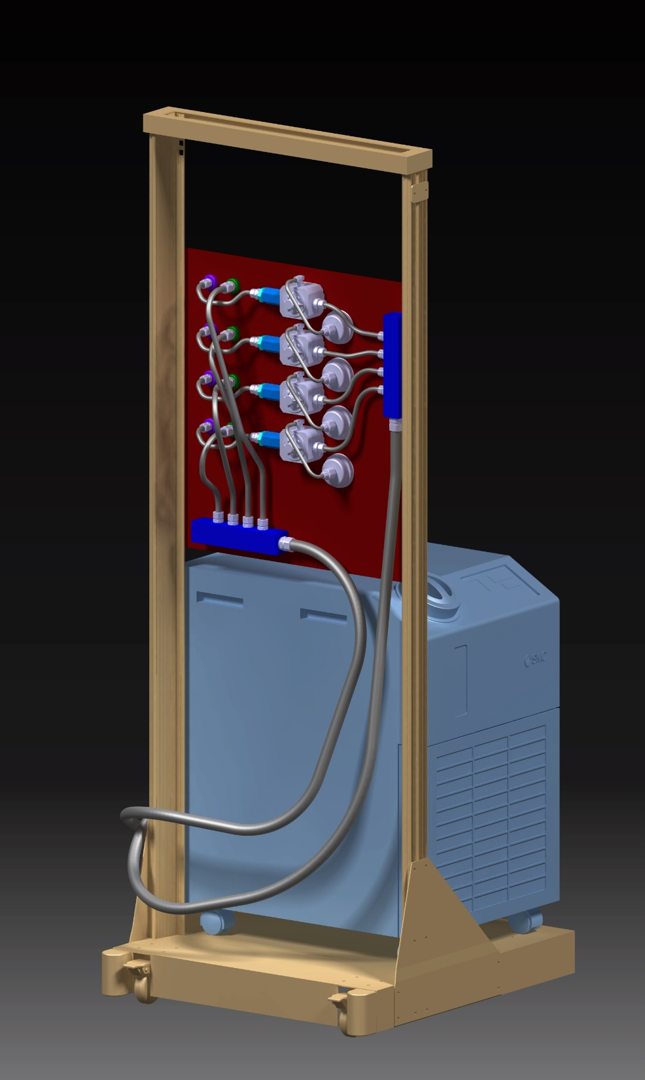
Disegno Impianto di Raffreddamento
G. Giraudo
Roma 18/12/2014

Slide 7
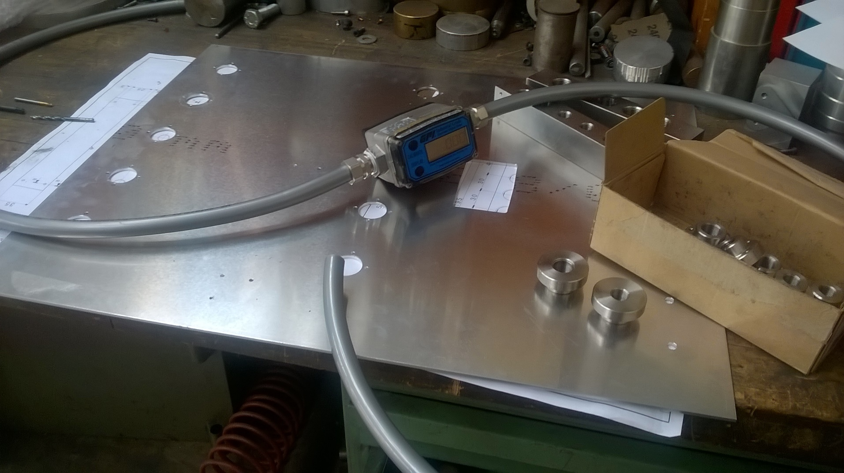
In/Out manifolds
Cooling panel parts ready
Flowmeter
Support panel
Fittings and chiller delivery → end of June
Polyurethane tubes delivery delayed (?)
Ring-nut for tube transition

Slide 8
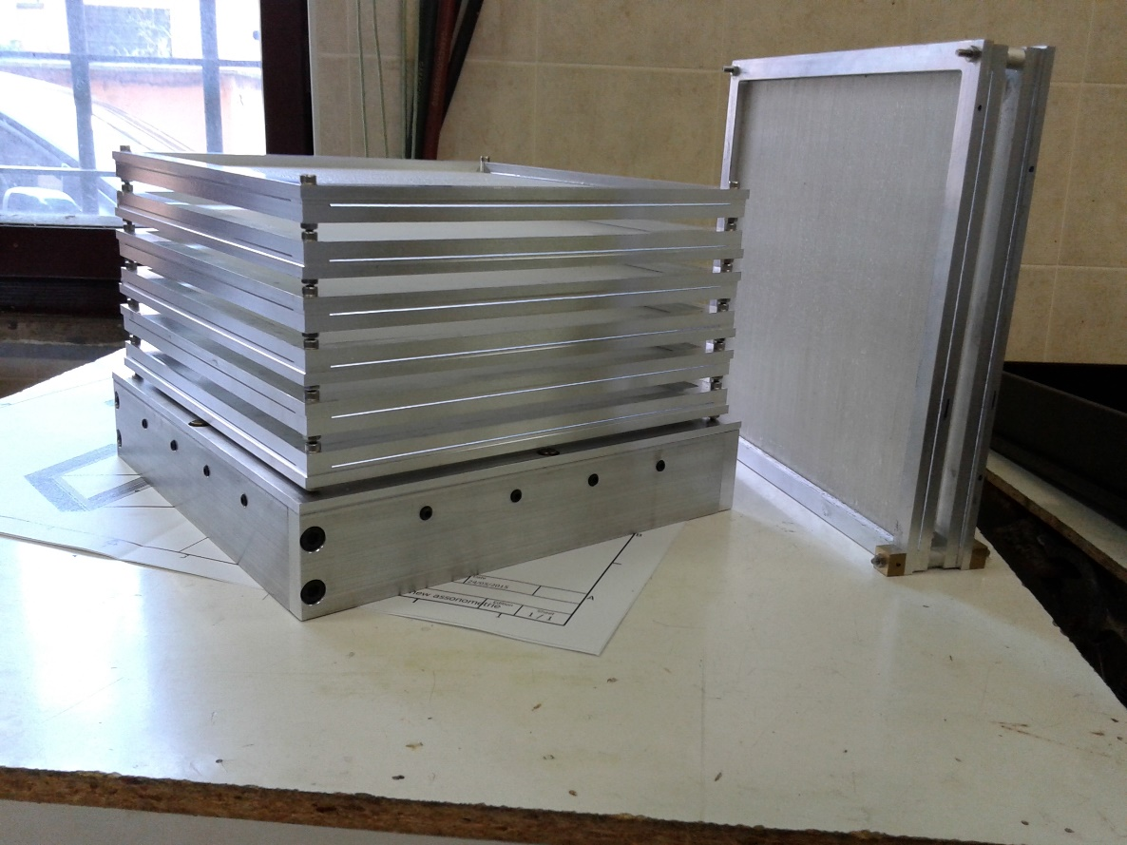
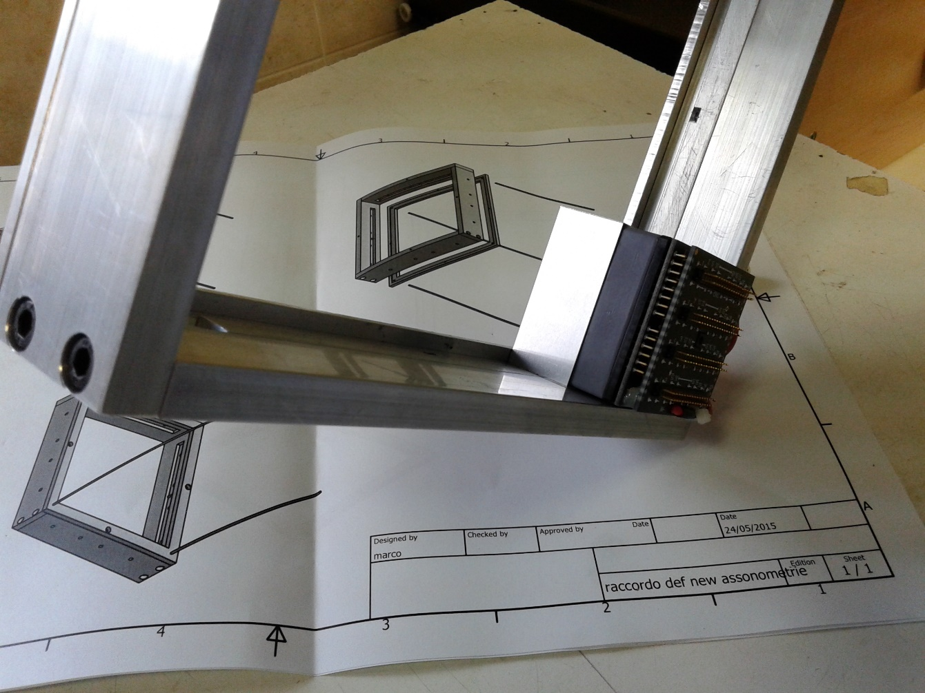
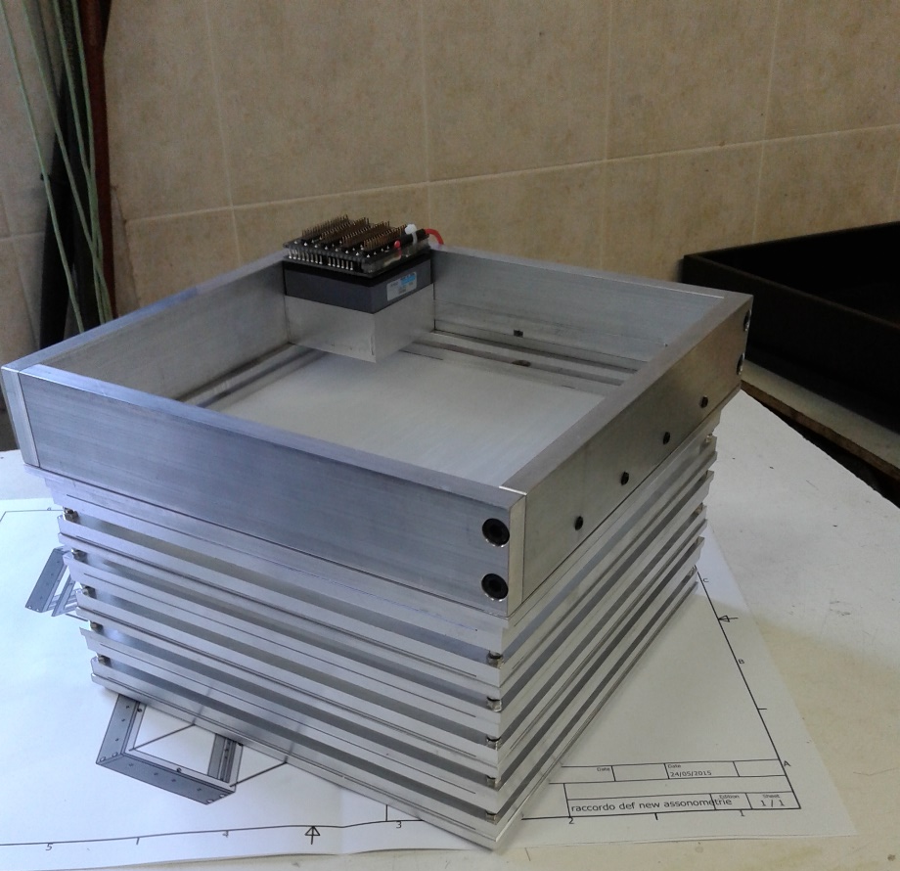
Profiler
6 X-Y fiber planes + 2 spares ready
calorimeter structure almost ready
waiting for electronics to finalize cooling
system design (beginning July)
210x210x0,3 mm³ foil to be inserted here
crystal fixation system
thanks to MARCO MAGI

Slide 9
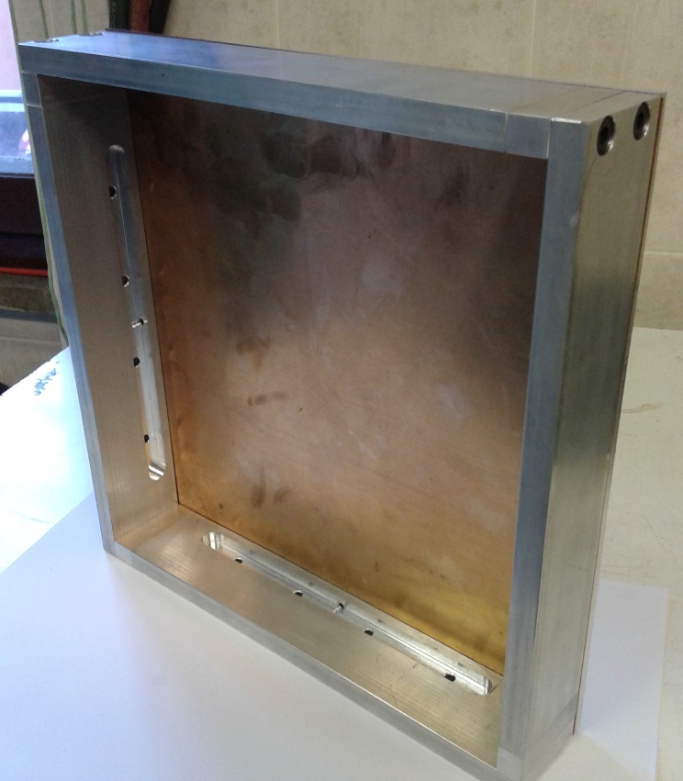
Profiler
0,25 mm phosphor bronze foil inserted
calorimeter matrix assembly; multianode PMT will be pressed against it

