Slide 1
INSIDE HW REPORT
M. Giuseppina Bisogni
PISA, INSIDE Meeting 10/6/2015

Slide 2
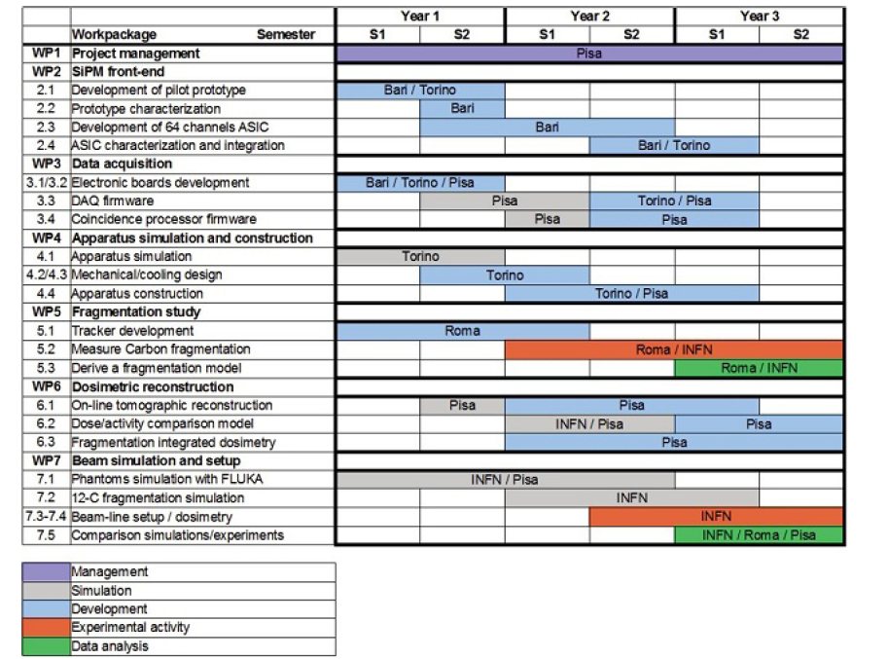
1/2/2013
31/1/2016

Slide 3
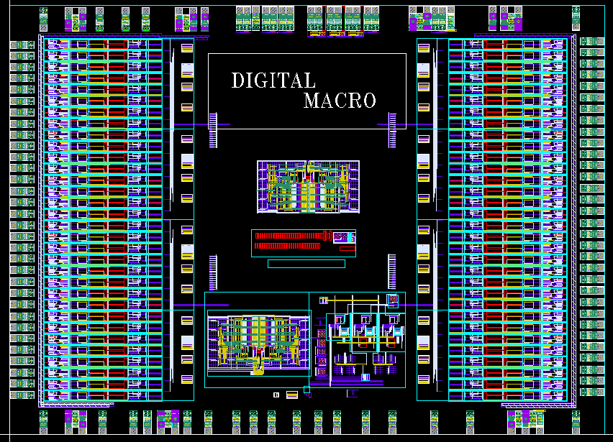
Design of the layout: TOP layout of the BASIC64 chip
C. MARZOCCA
POLIBARI
ASIC top hierarchy
Meeting INSIDE, June 9, 2015, Pisa

Slide 4
Schedule and submission
All the layouts of the analog blocks have been designed in their final version
To be done:
- Generation of the final layout of the digital part
Generation of the pad ring
Top routing, verification and analog top simulation
Realistic estimation: one month and a half of work needed to finish
Next available MPW run deadline: July 27th
GDS database expected to be submitted on that date
VERRANNO PRODOTTI 40 ASIC → RELEASE META’ SETTEMBRE 2015
IN PARALLELO DISEGNO BOARD PER TEST COMPATIBILI CON RIVELATORI INSIDE
COSTO PER PRODURRE NUOVI RUN → 7 KEU
Meeting INSIDE, June 9, 2015, Pisa
Notes:
This is the outline of the presentation.
Fist of all, we needed an accurat model of the detector in order to perform reliable simulations at circuit level. So, the classical model of the SiPM has been modified by adding some relevant features which gives remarkable contributions to the electrical behaviour of the detector itself and, moreover we set up a suitable extraction procedure to evaluate the paramenters involved in the model.
After that, different front-end circuit solutions have been compared to find out the most suitable one, considering the SiPM characteristics. Some prototypes of the very first front-end have been realized and some results fromt their characterization will be shown.
The very first version of the f.e. has been equipped with more building blocks and a first version of the complete analog channel has been designed, realized and characterized. Also in this case some measurements results wil be provided.
Next, the design of an 8 channel test chip has been carried out, togheter with the architecture of the digital read-out section. The chip has been submitted to a MPW for fabrication at the end of July and we expect the delivery of the prototypes by the first part of October.
Eventually some possible future work will be described

Slide 5
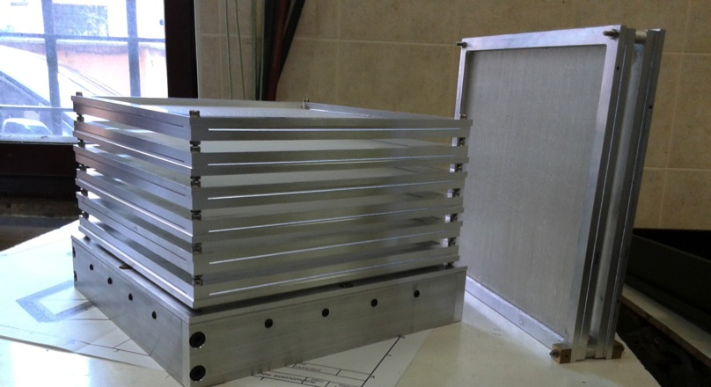
Dose Profiler General status
Tracker mechanics almost finished ( frame & fibers)
Waiting for electronics PCB (beginning July) to finalize cooling system design
Calorimeter mechanics started
Dose Profiler complete tracking system with the calorimeter support plus 2 spare tracking planes
V. Patera UniRoma and INFN Roma1

Slide 6
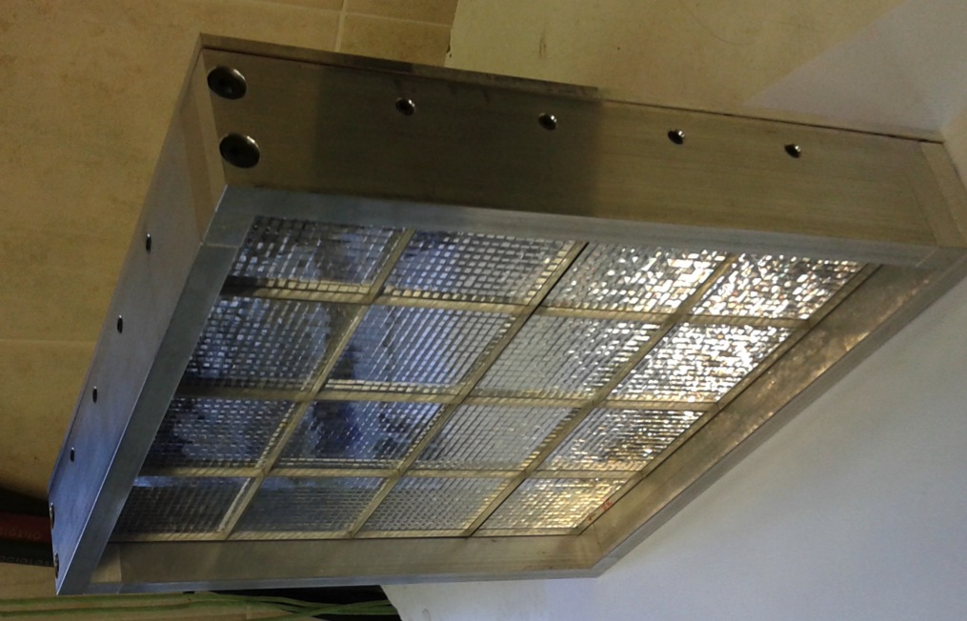
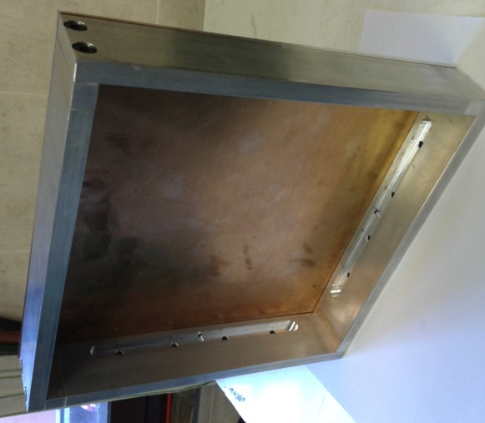
Calorimeter Mechanics Status
External frame, to be fixed to the tracker, finalized
Developed a fixing system of the crystals+MAPMT elements
Integration with electronics ( and cooling) on going

Slide 7
DOSE Profiler electronics tests
G. Traini, UNI Roma and INFN

Slide 8
DOSE Profiler electronics tests
Front-End board test
Writing reading configuration correctly
DAQ ext and int trigger performed
2 out of 192 chn not working→ further investigation
AFTER this check→ production of 18 board will start
BASIC32 testing (O150 ASIC’s)
Set-up based on CAEN V1495 and interface board for basic32 (M. Cecchetti Milano)
First results →write config, generate ext trigger, read charge and address and store in a fifo, read the fifo via VME
G. Traini, UNI Roma and INFN

Slide 9
To be done
Implement int-trigger mode for basic testing
Perform ADC, threshold, offset test for mass production
Write FW from Dose Profiler read-out FPGA (ready end of this month)
Write FW for Dose Profiler concentrator FPGA (September) in collaboration wINFN LNF

Slide 10
Calo electronic update
LNF electronic service is taking care of calorimeter electronics
Preliminary layout ready -> building phase
HV PCB modules for H8500 ordered (->Centro Fermi)
front-end for calorimeter order is being prepared (12k€+IVA->INSIDE)
Concentrator FPGA board design ok-> order will follow

Slide 11
Update on INSIDE Mechanics
All design of mechanical parts of Inside are defined and frozen.
Construction of mechanical parts started (Torino INFN workshop)
Cooling panel → ready
Chariot and shoulder → need external workshop (welded parts). Waiting for quotation.
Heads → in progress
Delivery of some commercial parts delayed due to the new invoicing method.
Purchase of other commercial parts needs new market recognition. Regular suppliers reject the new invoicing method.
B. Giraudo
INFN torino

Slide 12
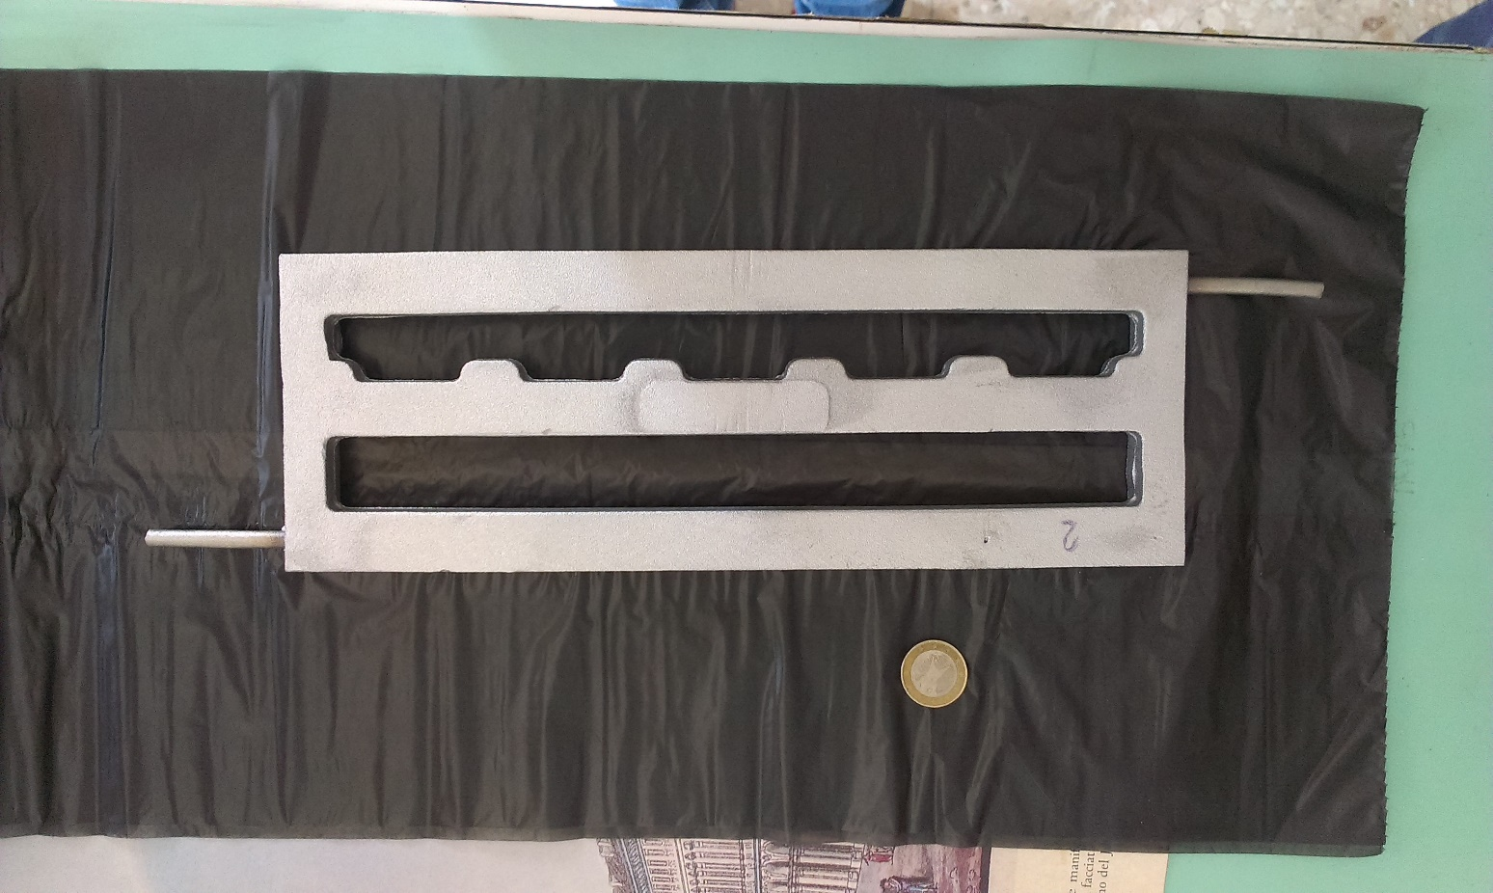
Thermal heat exchanger
Aluminium casting with stainless steel tube embedded.
Pre-machining view.
RX of the thermal heat exchanger. Survey of tube position.

Slide 13
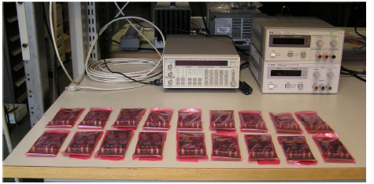
PET ELECTRONICS STATUS
TX HW (22 boards) available and FW almost completed, not fully tested
TOFPET ASICS testing: yield 75 % (1 bad channel/ASIC)
286(To)+40(Pi) tested
84 ASIC tested in Torino
20new FE delivered (26 in total); mounting on going to be finished by end of july
25 FMC adapter delivered
Remaining work:
HV and LV power supply procurement (quotation on going)
Last 5 Detector modules procurements (17 available in pisa+5 delivered on 6/7)
Cable and connector procurements
Clock and reset board procurement
PET box assemply and test (end of september)
R. WHEADON INFN AND UNITO

Slide 14
PET Motherboard update
Coincidence sorter simulated on ModelSIM and tested at 28 MHz
Cluster filter simulated
USB implemented read-write data from/to PC
SPI simulated and tested ->results by end of the week
LVDS communication simulated and tested on Sockit → works at 160 MHz , goal 840 MHz
NEXT STEP test SPI –LVDS communication
MB – Sockit board connection using THDB-HTG board
E. Kostara UNIPI and INFN Pisa

Slide 15
NEWS
Collaborazione INSIDE-CNAO
Pronti documenti tecnici (schema elettrico e progetto meccanico) per fissare i requisiti minimi di sicurezza per il personale che opera nelle sale trattamento dove verranno eseguite le prove con i fantocci → approvato CNAO
Contatti con industria
Damien Bertrand-IBA
Proposta exclusive option to negotiate a royalty-bearing, limited-term, worldwide exclusive license to the Technology for PET detector→ contatti per negoziazione

Slide 16
Conferenze
F. Pennazio - XIII Turku PET Symposium, Turku, 24-27 May 2014. Monte carlo simulations for in-beam PET monitoring in Hadron-Therapy
M. G. Bisogni - HADRONTERAPY: a new frontier for cancer treatment, CNAO foundation, 19-20 September 2014. INSIDE: an integrated monitoring system for the assessment of particle therapy treatment accuracy
F. Pennazio - II Symposium on Positron Emission tomography, Jagiellonian University of Krakov, 21-24 September 2014. A study of monitoring performances with the INSIDE system
M. Marafini - II Symposium on Positron Emission tomography, Jagiellonian University of Krakov, 21-24 September 2014. Innovative Solutions for In­‐beam Dosimetry in Hadrontherapy
2015
E. Fiorina - Frontier Detectors for Frontier Physics, XIII Pisa Meeting, Isola d'Elba, 24-30 May 2015. An integrated system for the on-line monitoring of particle therapy treatment accuracy (pdf) (pptx)
SUBMITTED IEEE NSS –MIC San Diego, USA, 31 oct-7 nov 2015
F. Pennazio et al. “The INSIDE in-beam PET: test beam results with in-spill and inter-spill acquisition
M. G. Bisogni et al.” A bi-modal system for the on-line verification of particle therapy treatments”
SUMBITTE SIF 2015 ROMA 21-25 september 2015
G. Pirrone et al.”
NEXT ICTR-PHE 2016 Geneve 15-19 feb 2016
Abstract submission closes: October 16, 2015

Slide 17
Papers
F. Pennazio et al.- II Symposium on Positron Emission tomography, Jagiellonian University of Krakov, 21-24 September 2014. A study of monitoring performances with the INSIDE system
M. Marafini et al. - II Symposium on Positron Emission tomography, Jagiellonian University of Krakov, 21-24 September 2014. Innovative Solutions for In­‐beam Dosimetry in Hadrontherapy published on Acta Physica Polonica 2015
G. Battistoni et al.” Measurement of charged particle yields from therapeutic beams in view of the design of an innovative hadrontherapy dose monitor” JINST proceeding IWORID 2014
IN PREPARATION
V. Patera et al. “Design of a dual-mode tracking device for on-line dose
monitor in hadron therapy”, in prep.
E. Fiorina Pisa meeting in prep.
A. Piliero in prep.

Slide 18
Aknowledgment
This project has been supported by Ministero dell’Istruzione, dell’Università e della Ricerca of the Italian government under the program PRIN 2010-2011 project nr. 2010P98A75
European Union’s Seventh Framework Program for research, technological development and demonstration under grant agreement no 317446 (INFIERI)

Slide 19
News dalla CSN5
1. per il 2016 il bilancio della csn5 rimane invariato (5.3 M) (su cui pende tuttora una possibile riduzione di 9 M)
2. c'e' stata la conferma dello sblocco del 10% congelato.
Ad oggi, e questo e' un limite inferiore perche' non tutti gli
esperimenti hanno presentato il piano di spesa triennale, abbiamo
impegni per circa 3.4 M; a questi dobbiamo aggiungere gli impegni per i
grant giovani in corso e nuovi (by the way, e' confermato che le
commissioni 1,2 e 3 continuino a finanziare un grant ciascuna), quindi
arriviamo a circa 3.8 M.

