Slide 1

Preliminary results on the detection of Prompt Photons from He, C and O ions (HIT test beam of 2014)
G. Battistoni
G. Battistoni (INFN Milano), F. Collamati (Univ. Roma 1 and INFN-RM1), E. De Lucia (INFN-LNF), R. Faccini (Univ. Roma 1 and INFN-RM1), F. Ferroni (Univ. Roma 1 and INFN-RM1), M. P. Frallicciardi (Centro Fermi), M. Marafini (centro Fermi), I. Mattei (Univ. Roma 3 and INFN-LNF), S. Morganti (INFN-RM1), S. Muraro (INFN-MI), L. Piersanti (INFN-LNF), A. Rucinski (INFN-RM1), A. Russomando (Univ. Roma 1), A. Sarti (Univ. Roma 1 and INFN-LNF), A. Sciubba (Univ. Roma 1 and INFN-RM1), E. Solfaroli-Camillocci (IIT,INFN-RM1), M. Toppi (Univ. Roma 1 and INFN-LNF), G. Traini (Univ. Roma 1), C. Voena (INFN-RM1) and V. Patera (Univ. Roma 1, Centro Fermi and INFN-RM1

Slide 2
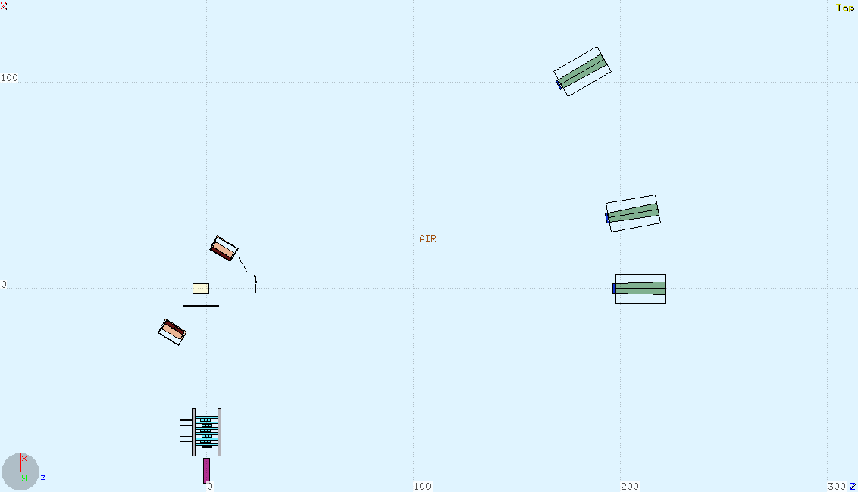
Experimental Setup
SC = plastic scintillator; trigger for the DAQ
PMMA = phantom
Rn = 2 pixelated LYSO,side by side,1.6x5x5 cm³ each
Rs = 2 pixelated LYSO,side by side,1.6x5x5 cm³ each
(PET photons detectors)
LTS = plastic scintillator (charged particles TOF)
DCH = Drift Chamber (charged particles tracking)
LYSO = matrix of four LYSO crystals
(prompt photons and charged particles detector)
STS1a,b,c = plastic scintillators
STS2a,b,c = plastic scintillators
(charged fragments TOF)
BGOa,b,c = BGO crystals (charged fragments detectors)
θ = 30º
BGOc
STS2c
θ = 10º
Rn
STS2b
BGOb
STS1c
SC
PMMA
STS1b
θ = 0º
BEAM
STS1a
LTS
STS2a
BGOa
Rs
φ = 60º
φ = 90º
DCH
DCH
LYSO
LYSO

Slide 3

LYSO crystal(s)
Made of 4 different crystals
Calibrated with different radioactive sources and with hadron beams at HIT
An individual calibration curve obtained
for each crystal
Calibration curves inserted in simulation analysis together with energy resolution parameters

Slide 4
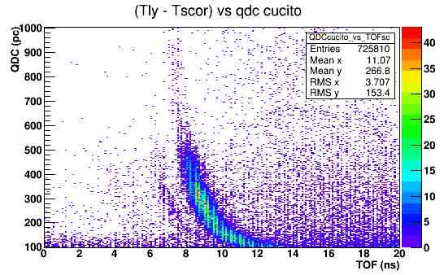
Essential of Data Selection 1
Charged particles
1) raw Charge vs TOF
¹²C
Photons (+ some electrons)

Slide 5
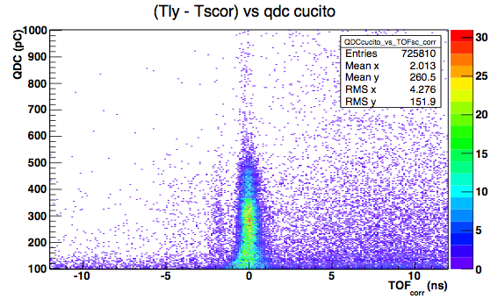

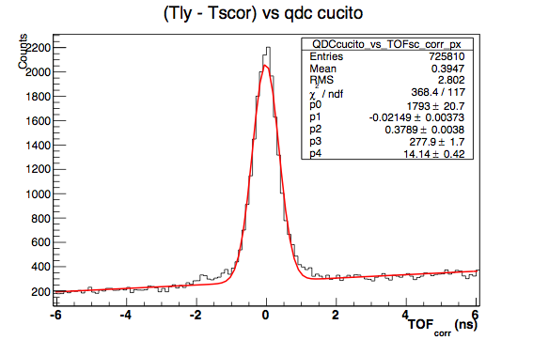
Essential of Data Selection 2
2) Slew time correction to Charge vs TOF
3) Background fitted and subtracted
4) N_{photon} evaluated for each charge bin

Slide 6
HELIUM BEAM

Slide 7

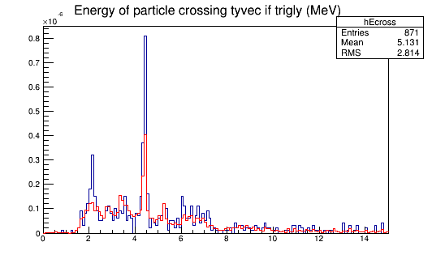
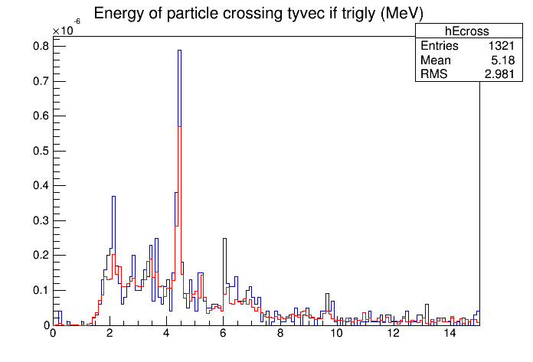
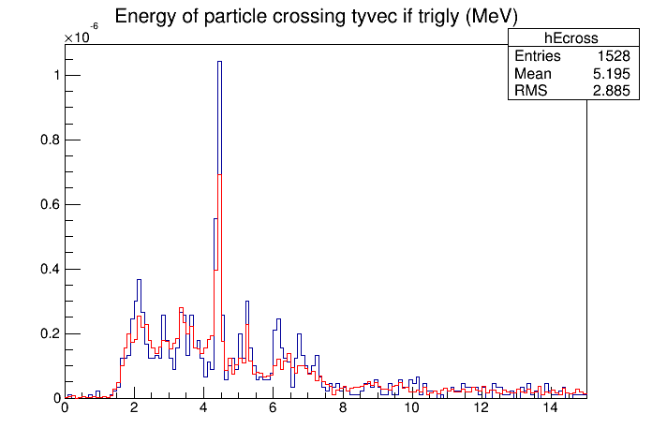
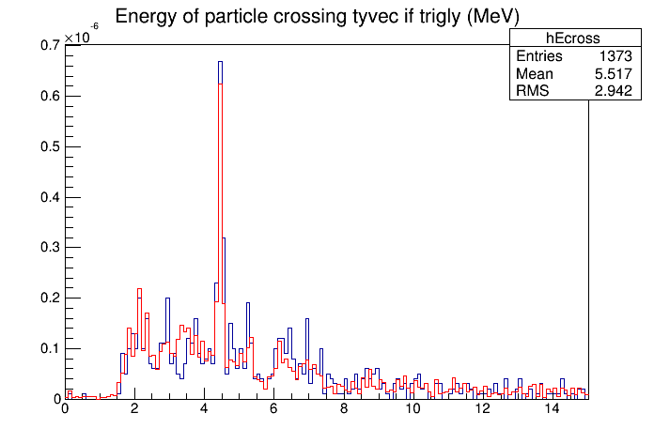
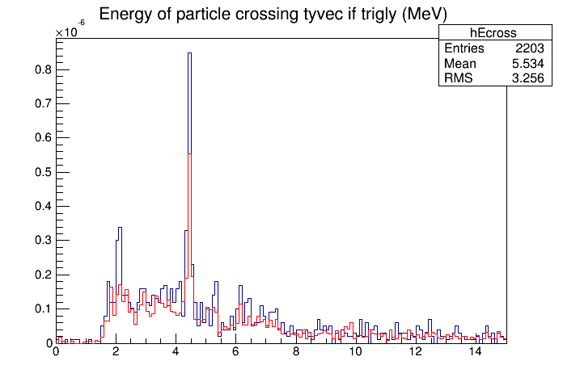
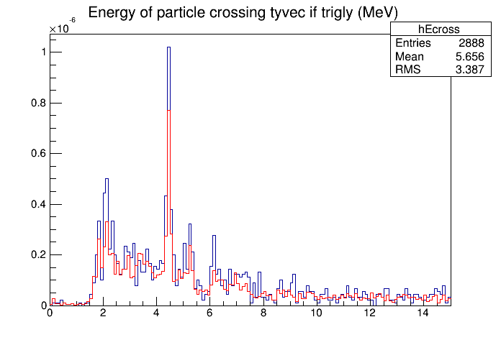
FLUKA: v2013 vs v2015
photon energy at production
FLUKA2015
FLUKA2013
HE102
HE125
HE145
HE102_60
HE125_60
HE145_60

Slide 8
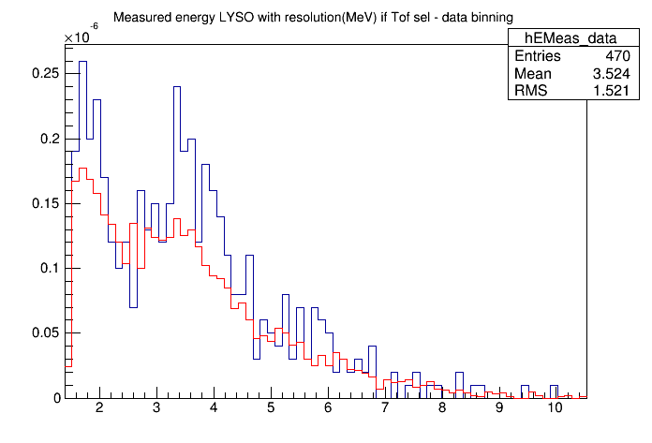
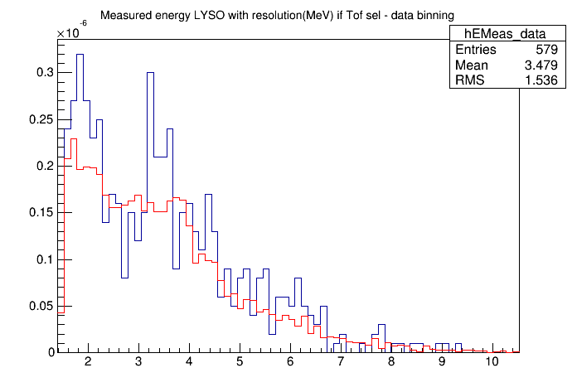
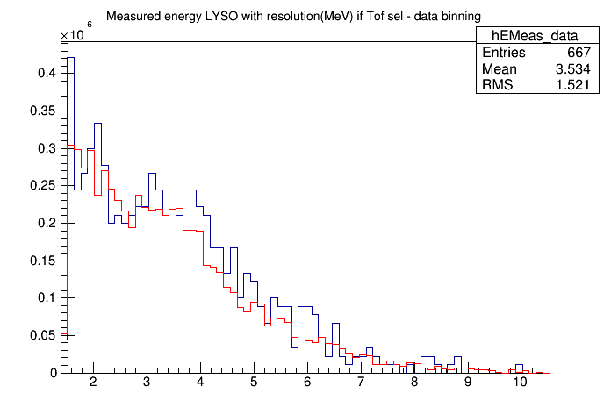
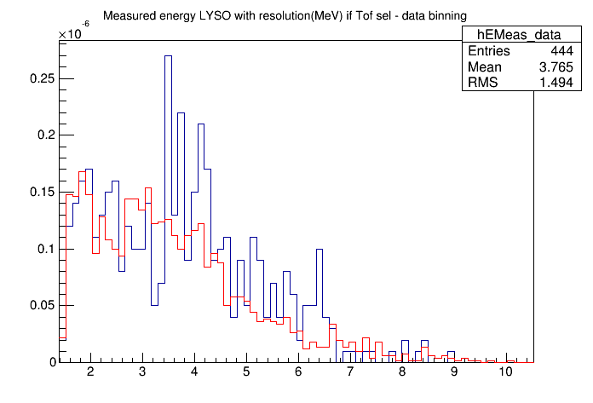
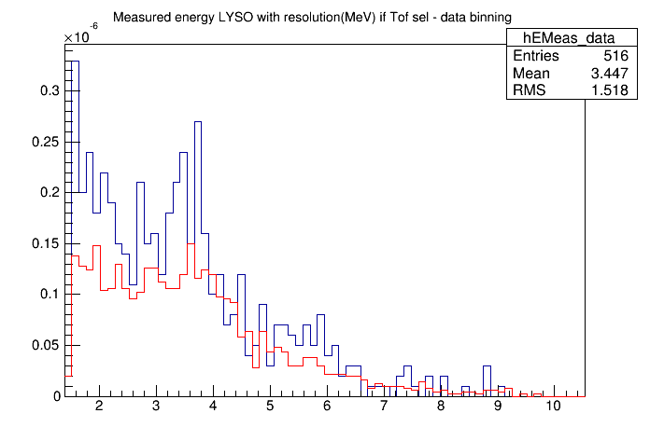
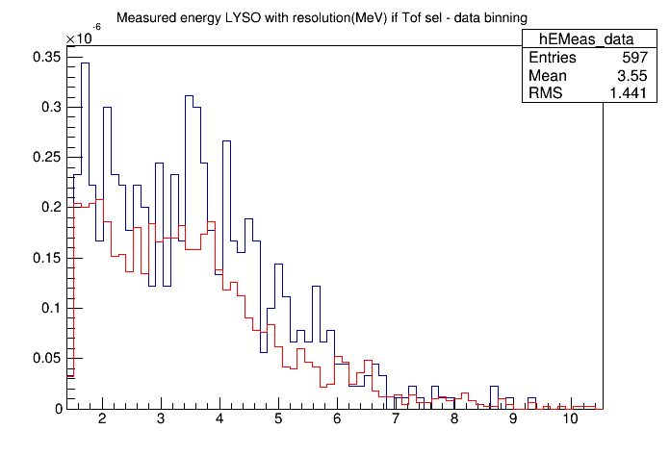
FLUKA: v2013 & v2015
Measured Energy
FLUKA2015
FLUKA2013
He102
He125
He145
He102_60
He125_60
He145_60

Slide 9
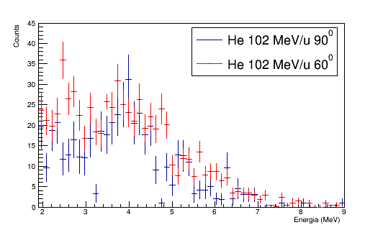
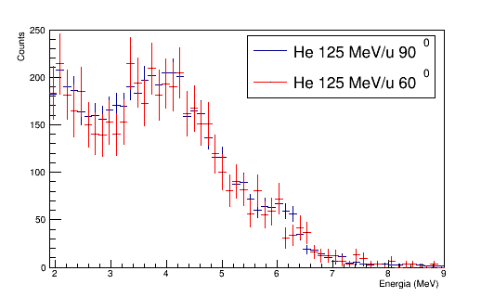
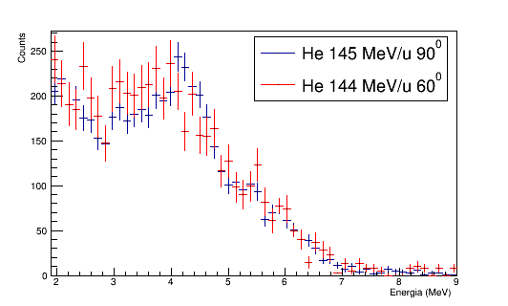
Measured Energy Spectra
Photon spectra from He beams at the same energy and different angles are compatible in shape within the errors.
Here normalized to peak at ~ 4 MeV

Slide 10
RAW Yields
(Raw Yield)DATA = Ngamma(2-9MeV) / (Nprimarycorr*epsDT)
(Raw Yield)FLUKA = Ngamma(2-9MeV) / Nprimary
 | DATA (10⁻⁶ Gamma(2-9MeV)/(Hecorr*epsDT) | FLUKA 2015 (10⁻⁶ Gamma(2-9MeV)/primary) | FLUKA 2013 (10⁻⁶ Gamma(2-9MeV)/primary)
He 90º 125 MeV/u | 4.70 ± 0.07 - 8.58 ± 0.14 | 4.8 ± 0.2 | 4.1 ± 0.1
He 90º 145 MeV/u | 5.92 ± 0.09 - 6.52 ± 0.10 | 6.4 ± 0.3 | 5.6 ± 0.1
He 60º 102 MeV/u | 1.44 ± 0.03 - 2.88 ± 0.04 | 4.0 ± 0.2 | 3.2 ± 0.1
He 60º 125 MeV/u | 3.36 ± 0.05 - 3.79 ± 0.05 | 4.3 ± 0.2 | 3.0 ± 0.1
He 60º 145 MeV/u | 5.00 ± 0.06 - 5.32 ± 0.07 | 5.8 ± 0.3 | 4.2 ± 0.1
*in the 60º config, the PMMA-LYSO distance is larger wrt the 90º config

Slide 11
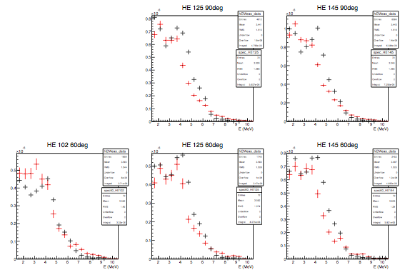
RAW Yields
Absolute Comparison:
N𝛾/primary
DATA
Ngamma/Nprimary
Ngamma/Nprimary
MC FLUKA
Ngamma/Nprimary
Ngamma/Nprimary
Ngamma/Nprimary

Slide 12


Yields
(after correction for Acceptance⨂Detection Efficiency)
(Yield)DATA = Ngamma(2-9MeV) / (Nprimarycorr*epsDT*epsTOT)
(Yield)FLUKA = Ngamma(2-9MeV) / (Nprimary*epsTOT)
 | DATA (10⁻² Gamma(2-9MeV)/(Hecorr*epsDT*epsTOT) | FLUKA (10⁻² Gamma(2-9MeV)/(primary*epsTOT))
He 90º 125 MeV/u | 5.7 ± 0.3 - 10.3 ± 0.5 | 5.7 ± 0.4
He 90º 145 MeV/u | 7.2 ± 0.3 - 7.9 ± 0.4 | 7.7 ± 0.5
He 60º 102 MeV/u | 1.68 ± 0.09 - 3.4 ± 0.2 | 4.7 ± 0.3
He 60º 125 MeV/u | 4.5 ± 0.2 - 5.0 ± 0.3 | 5.7 ± 0.4
He 60º 144 MeV/u | 6.7 ± 0.3 - 7.1 ± 0.3 | 7.7 ± 0.5

Slide 13
CARBON BEAM

Slide 14
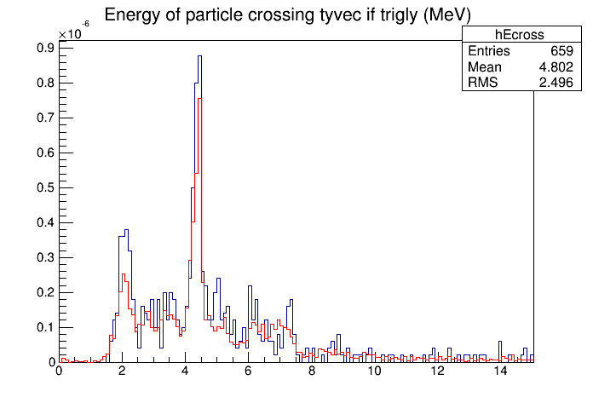
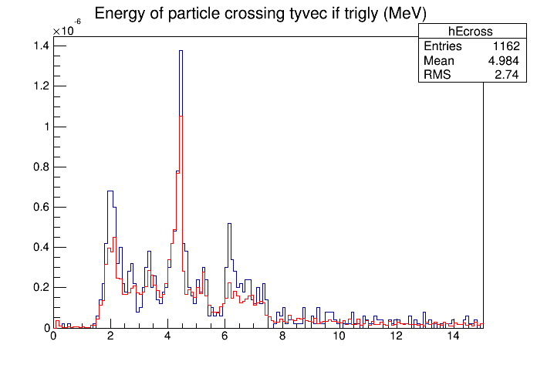
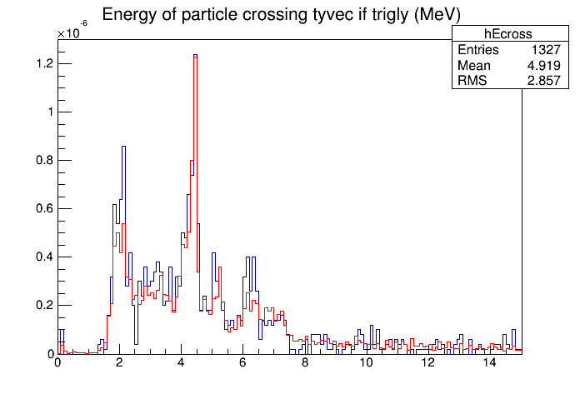
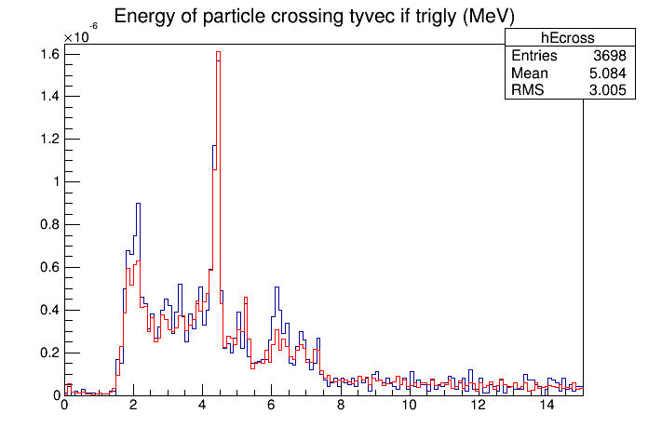
FLUKA: v2013 & v2015
photon energy at production
FLUKA2015
FLUKA2013
C120
C160
C180
C220

Slide 15
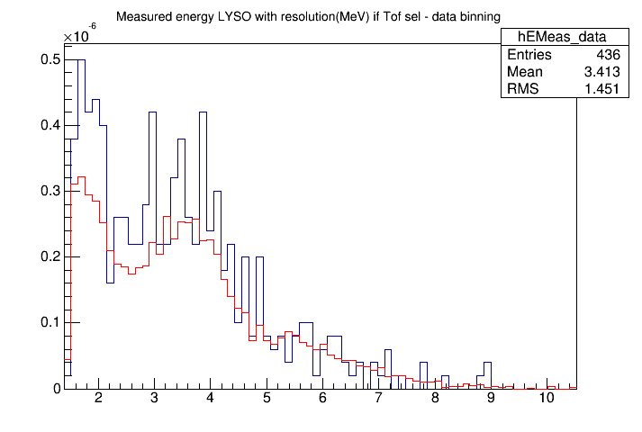
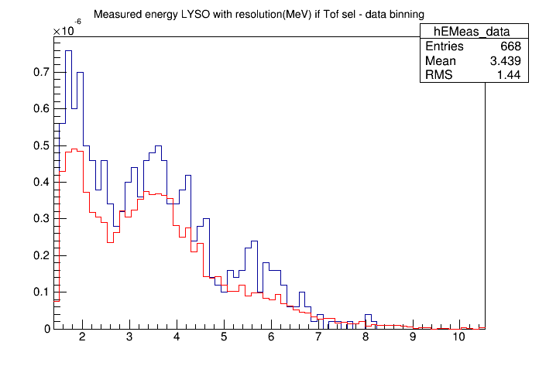
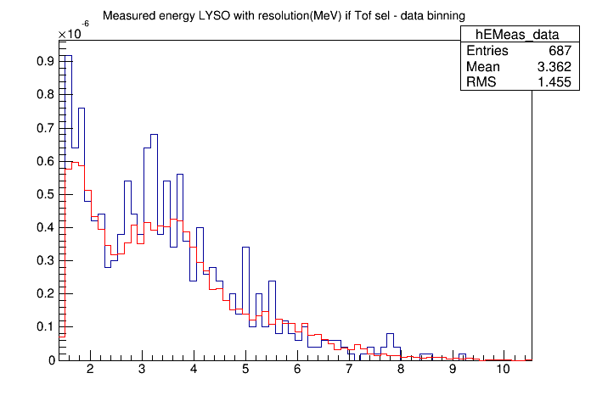
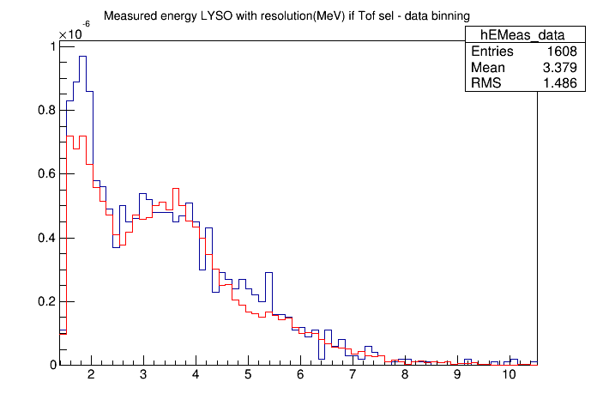
FLUKA: v2013 & v2015
Measured Energy
FLUKA2015
FLUKA2013
C120
C160
C180
C220

Slide 16
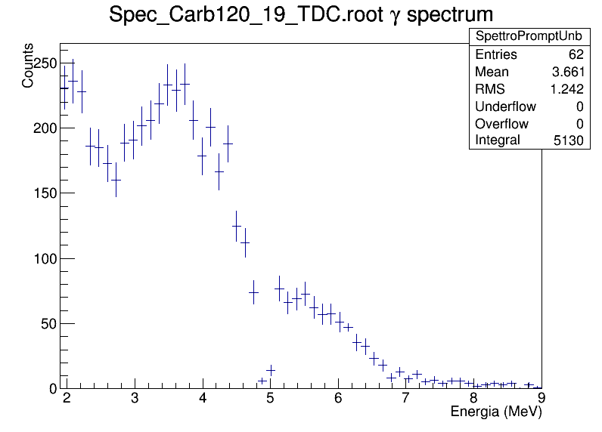
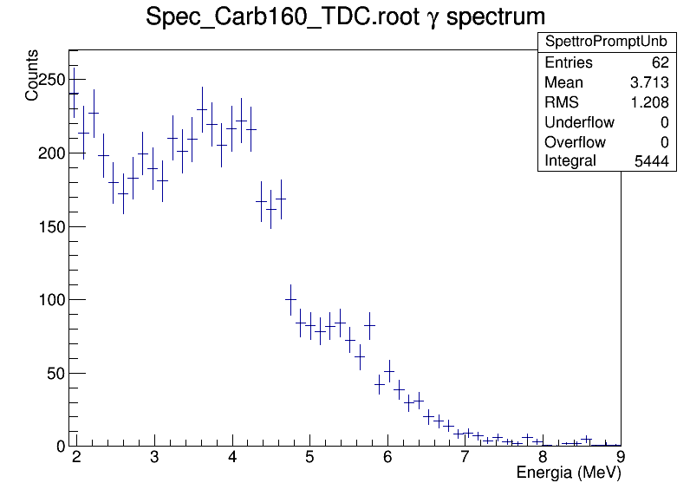
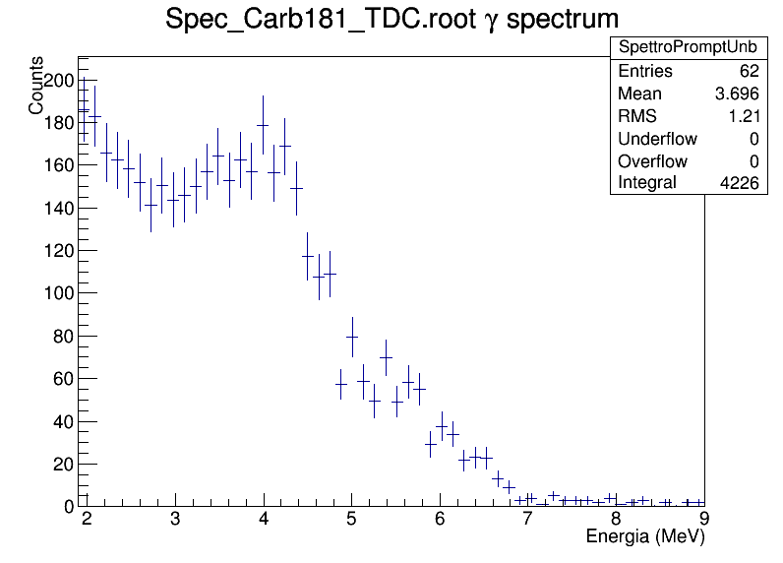
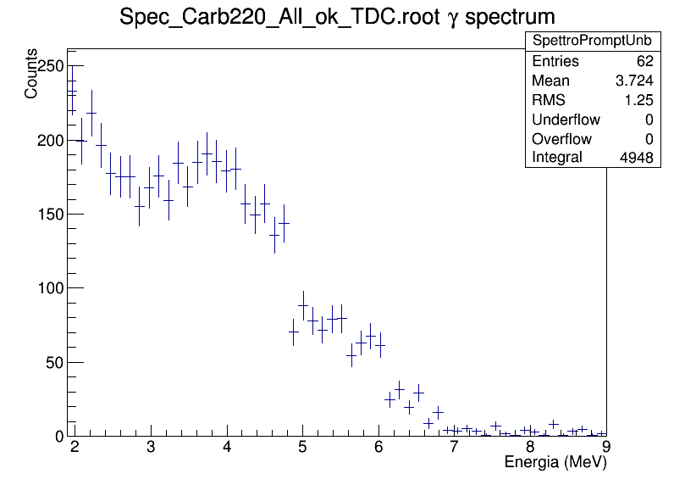
Measured Energy Spectra

Slide 17
RAW Yields
(Raw Yield)DATA = Ngamma(2-9MeV) / (Nprimarycorr*epsDT)
(Raw Yield)FLUKA = Ngamma(2-9MeV) / Nprimary
 | DATA (10⁻⁶ Gamma(2-9MeV)/(¹²Ccorr*epsDT) | FLUKA (10⁻⁶ Gamma(2-9MeV)/ primary)
¹²C 160 MeV/u | 6.3 ± 0.1 - 6.5 ± 0.1 | 8.6 ± 0.1
¹²C 181 MeV/u | 7.9 ± 0.1 - 8.2 ± 0.2 | 9.9 ± 0.1
¹²C 220 MeV/u | 6.7 ± 0.2 - 10.2 ± 0.2 | 10.8 ± 0.1
In carbon runs (just 90º) the PMMA was always 10 cm long.

Slide 18
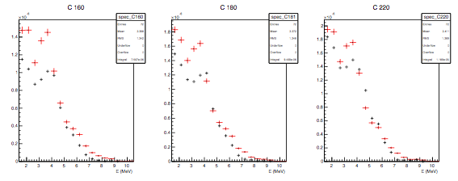
RAW Yields
DATA
MC FLUKA
Absolute Comparison: N𝛾/primary
Ngamma/Nprimary
Ngamma/Nprimary
Ngamma/Nprimary
The gammas contribution at low energy is always larger in the simulation (v2013,v2015) with respect to data.
We asked ourselves if we were actually subtracting from signal an higher amount of background, counting less gammas in that energy range, so we tried to change bkg model and so on.
The bkg subtraction cannot explain such large signal/MC difference.

Slide 19
Yields
(after correction for Acceptance⨂Detection Efficiency)
(Yield)DATA = Ngamma(2-9MeV) / (Nprimarycorr*epsDT*epsTOT)
(Yield)FLUKA = Ngamma(2-9MeV) / (Nprimary*epsTOT)
 | DATA (10⁻² Gamma(2-9MeV)/(¹²Ccorr*epsDT*epsTOT) | FLUKA (10⁻² Gamma(2-9MeV)/(primary*epsTOT))
¹²C 160 MeV/u | 6.5 ± 0.3 - 6.8 ± 0.3 | 11.8 ± 0.7
¹²C 181 MeV/u | 9.7 ± 0.4 - 10.0 ± 0.5 | 13.6 ± 0.8
¹²C 220 MeV/u | 8.0 ± 0.3 - 12.1 ± 0.4 | 15.6 ± 0.6
In carbon runs (just 90º) the PMMA was always 10 cm long.

Slide 20
OXYGEN BEAM

Slide 21
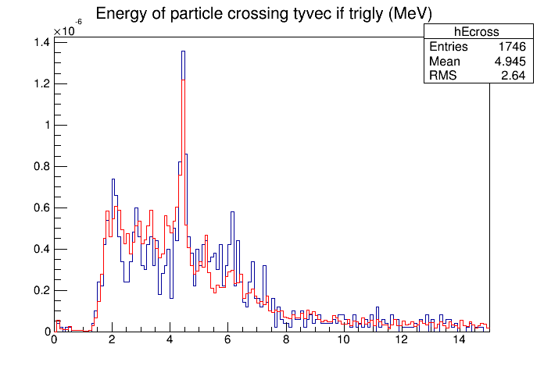
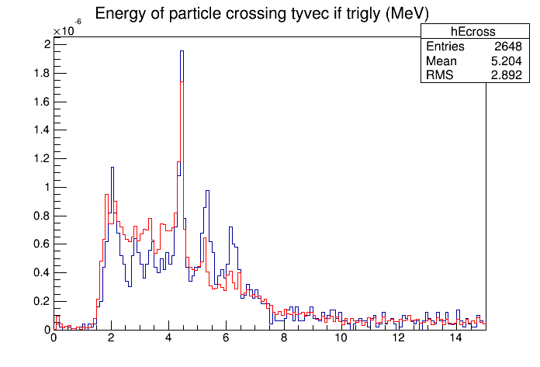
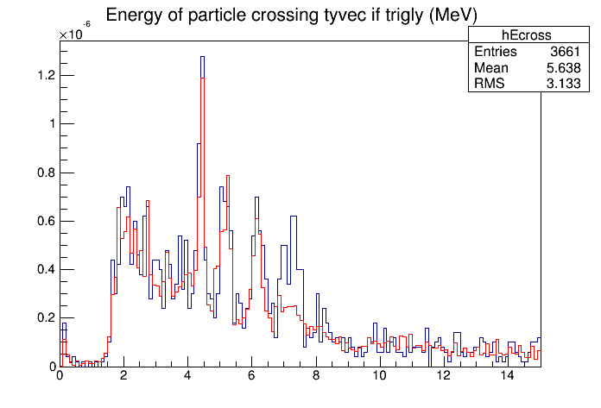
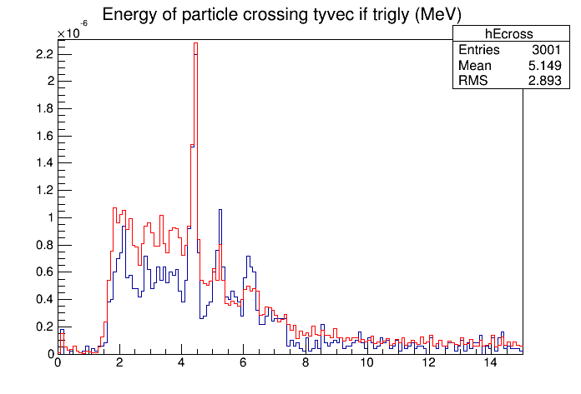
FLUKA: v2013 & v2015
photon energy at production
FLUKA2015
FLUKA2013
O210
O260
O210_60
O300

Slide 22
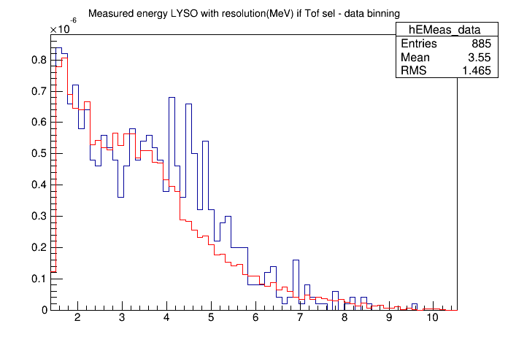
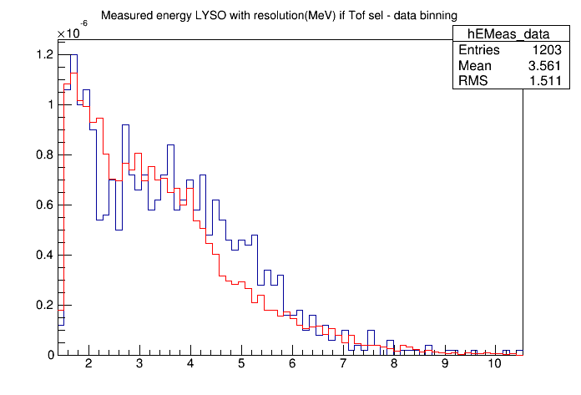
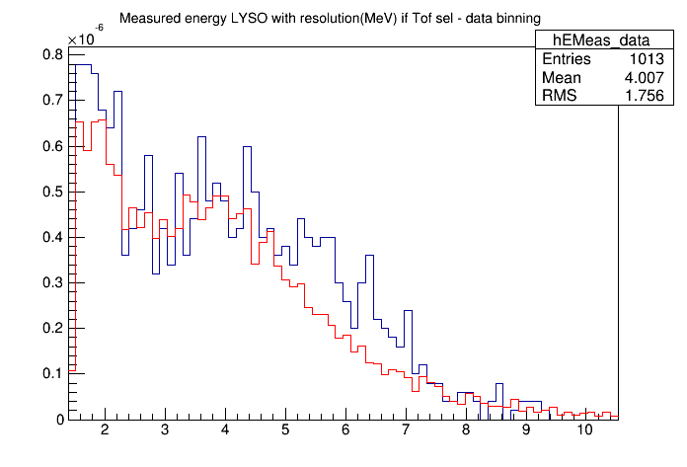
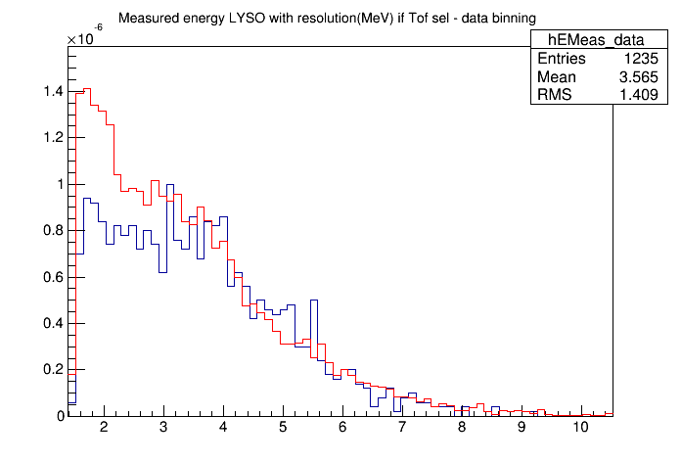
FLUKA: v2013 & v2015
Measured Energy
FLUKA2015
FLUKA2013
O210
O260
O210_60
O300

Slide 23
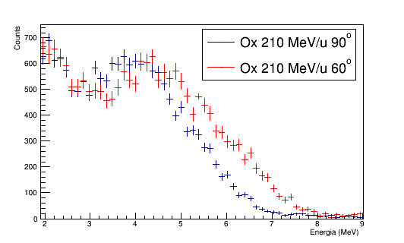
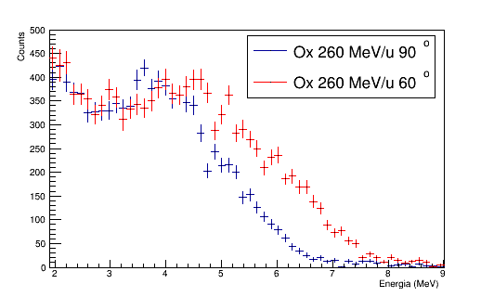
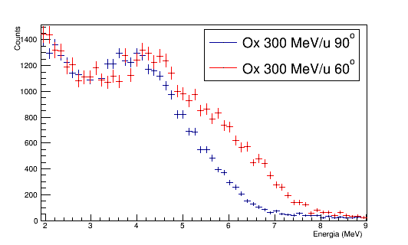
Measured Energy Spectra
Photon spectra from ¹⁶O at the same energy beams and different angles have different shapes.
normalized to peak at ~ 4 MeV

Slide 24
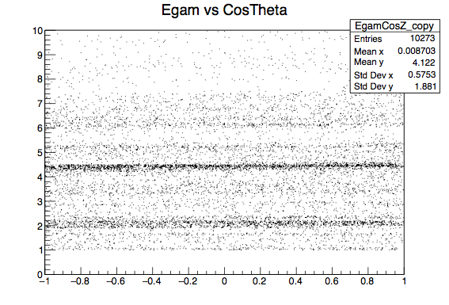
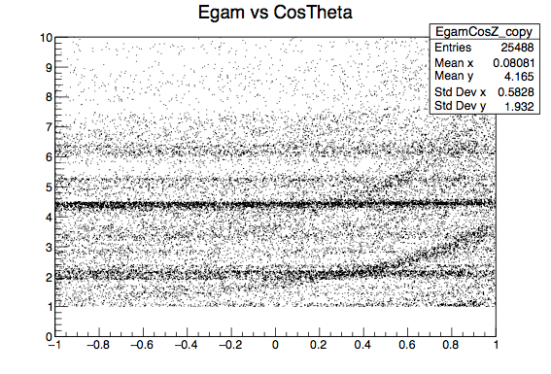
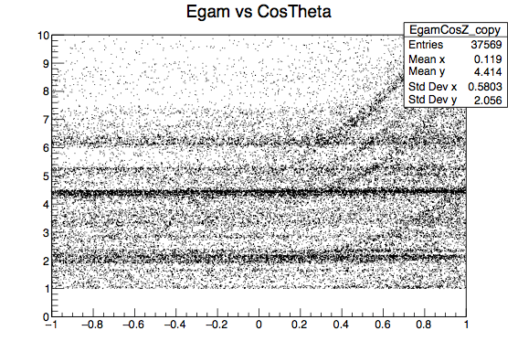
Explanation of change of shape at 60º
There is a correlation of the energy of photons exiting the PMMA, produced by projectiles (and their fast fragments) de-excitations, with the emission angle for CosTheta ≳ 0.2/0.4 (Theta ≲ 78º) => energy boost
(from a dedicated simulation: ⁴He/¹²C/¹⁶O beam impinging on a PMMA target)
The boost effect on prompt photons energy for the ¹²C appears around 2-4 MeV; less evident than the effect due to the ¹⁶O
The more intense gamma lines are due to target nuclei de-excitations (¹¹C~2 MeV;¹²C~4.4 MeV; ¹¹C,¹⁵O:~5 MeV; ¹⁶O:~6.13 MeV ) which are instead not affected by boost (a part a minor effect due to nucleus recoil)
60º
60º
⁴He 145 MeV/u
¹²C 220 MeV/u
¹⁶O 300 MeV/u
Egam
Egam
no projectile fragments
=> no effect
Egam
CosTheta
CosTheta
CosTheta

Slide 25
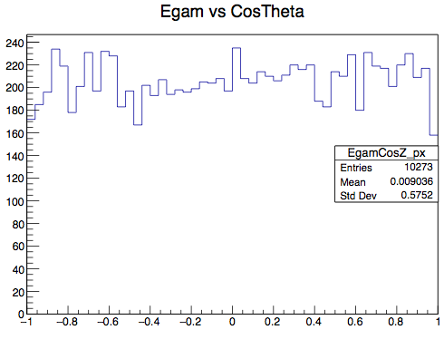
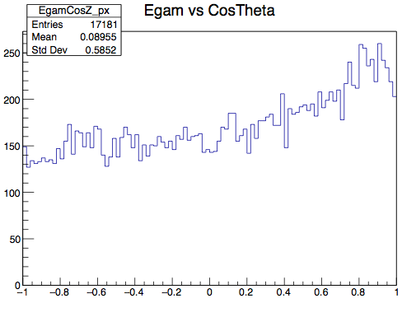
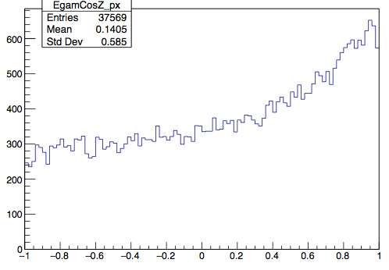
Explanation of change of shape at 60º
As a result, the theory predicts an uniform angular distribution for the ⁴He beam (which has no gamma de-excitation lines), but not for the ¹²C and ¹⁶O beams
⁴He 145 MeV/u
CosTheta
¹²C 220 MeV/u
CosTheta
¹⁶O 300 MeV/u
CosTheta

Slide 26
Explanation of change of shape at 60º
Is the shift of the peak around ~4 MeV in the Ox spectra at 60º due to the energy boost of photons emitted by *C fragments (gamma peak ~ 4.3/4.4MeV->~5MeV) and ¹⁵O nuclei (gamma peak ~ 5.2MeV->~6MeV) coming from the ¹⁶O beam and mixing with the ~4 MeV peak coming from photons emitted by *C target fragments?
¹⁶O 300 MeV/u
¹⁵O
*C

Slide 27

Photon spectrum ¹⁶O
Etrue of gammas produced in PMMA

Slide 28
RAW Yields
(Raw Yield)DATA = Ngamma(2-9MeV) / (Nprimarycorr*epsDT)
(Raw Yield)FLUKA = Ngamma(2-9MeV) / Nprimary
 | DATA (10⁻⁶ Gamma(2-9MeV)/(Oxcorr*epsDT) | FLUKA (10⁻⁶Gamma(2-9MeV)/primary)
Ox 90º 210 MeV/u | 8.8 ± 0.1 - 9.9 ± 0.3 | 15.2 ± 0.6
Ox 90º 260 MeV/u | 12.0 ± 0.2 - 12.7 ± 0.2 | 19.9 ± 0.6
Ox 90º 300 MeV/u | 16.5 ± 0.3 - 19.7 ± 1.1 | 21.0 ± 0.7
Ox 60º 210 MeV/u | 10.7 ± 0.2 - 11.5 ± 0.2 | 17.4 ± 0.6
Ox 60º 260 MeV/u | 14.4 ± 0.2 - 15.4 ± 0.3 | 24.2 ± 0.8
Ox 60º 300 MeV/u | 17.9 ± 0.3 - 20.3 ± 0.3 | 30.5 ± 0.8
*in the 60º config, the PMMA-LYSO distance is larger wrt the 90º config

Slide 29

RAW Yields
DATA
FLUKA2015
Absolute Comparison: N𝛾/primary
Ngamma/Nprimary
Ngamma/Nprimary
Ngamma/Nprimary
Ngamma/Nprimary
Ngamma/Nprimary
Ngamma/Nprimary

Slide 30
RAW Yields
DATA
MC FLUKA
Absolute Comparison: N𝛾/primary
Ngamma/Nprimary
Ngamma/Nprimary
Ngamma/Nprimary
As for the C ions case, the bkg subtraction cannot explain such large signal/MC difference.
Ngamma/Nprimary
Ngamma/Nprimary
Strange: are we really sure?

Slide 31
Yields
(after correction for Acceptance⨂Detection Efficiency)
Yields
(Yield)DATA = Ngamma(2-9MeV) / (Nprimarycorr*epsDT*epsTOT)
(Yield)FLUKA = Ngamma(2-9MeV) / (Nprimary*epsTOT)
 | DATA (10⁻² Gamma(2-9MeV)/(Oxcorr*epsDT*epsTOT) | FLUKA 2015 (10⁻² Gamma(2-9MeV)/(primary*epsTOT))
Ox 90º 210 MeV/u | 10.5 ± 0.4 - 11.85 ± 0.56 | 18.12 ± 0.93
Ox 90º 260 MeV/u | 13.95 ± 0.51 - 14.78 ± 0.53 | 23.19 ± 1.04
Ox 90º 300 MeV/u | 23.74 ± 0.83 - 26.89 ± 0.96 | 30.26 ± 1.32
Ox 60º 210 MeV/u | 11.16 ± 0.42 - 11.97 ± 0.44 | 18.12 ± 0.87
Ox 60º 260 MeV/u | 13.77 ± 0.45 - 14.77 ± 0.49 | 23.19 ± 0.94
Ox 60º 300 MeV/u | 17.72 ± 0.53 - 20.14 ± 0.60 | 30.26 ± 1.10

Slide 32
Some conclusions
We are close to analysis completion
Importance for INSIDE: these results, if confirmed,
demonstrate the capability of predicting prompt photon
fluxes in the irradiation performed with ion therapeutic
beams
There remains a suspicious mismatch in the range of
detected energy 2-4 MeV in part of Carbon cases and for
Oxygen. There could be different explanations
(the MC model, effects due to data selection,…) under
investigation

