Slide 1
Design of the 64-channel ASIC: status
DEI - Politecnico di Bari and INFN - Sezione di Bari
Outline
Status of the design (basically layout developments)
Floorplan & packaging
Schedule and submission
Meeting INSIDE, June 9, 2015, Pisa
Notes:
i just would like to present you the work that has been done in Bari, aimed to the develompment of integrated front-end electronics suitable for Silicon Photomultiplier detectors.
The entire activity has been carried out whitin the framework of a project called DASIPM2, financed by the italian National Institute of Nuclear Phisics (INFN)

Slide 2
Design of the layout: status
ISSUES
Manpower shortage (first three months of 2015)
Currently, only one skilled designer involved in the development of the layout
40k€ available budget for prototyping, roughly corresponding to 50mm² of silicon area (cost of the technology: 580€/mm²)
Floorplan constraints to be considered for fitting as many as 64 channels along with ADCs (both 8bit and 10bit on chip), digital macro and bias blocks.
Backward resizing of the single channel design necessary for fitting into the available area and floorplan.
Meeting INSIDE, June 9, 2015, Pisa

Slide 3
Design of the layout: floorplan of the 64-channels ASIC
Initially, we were thinking to an arrangement based on all the 64 channels placed on one side of the chip, but the resulting aspect ratio of the ASIC was not suitable
In order to keep the aspect ratio close to unity, without wasting silicon area, and to preserve symmetry, the 64-channels have been grouped in two banks of 32 channels, placed side by side.
The preliminary estimation of the single channel area was roughly 580x580 μm²
Considering the total area available (a little more than 50mm²), with a 200μm pitch for the abutted channels, 6.4mm in the vertical direction are covered and no more than 8mm room is left in the horizontal direction
The last version of the layout of the single channel has dimensions 1700x200 μm².
≅ 8mm
single channel
32-channels
32-channels
≅ 6.4mm
Meeting INSIDE, June 9, 2015, Pisa

Slide 4
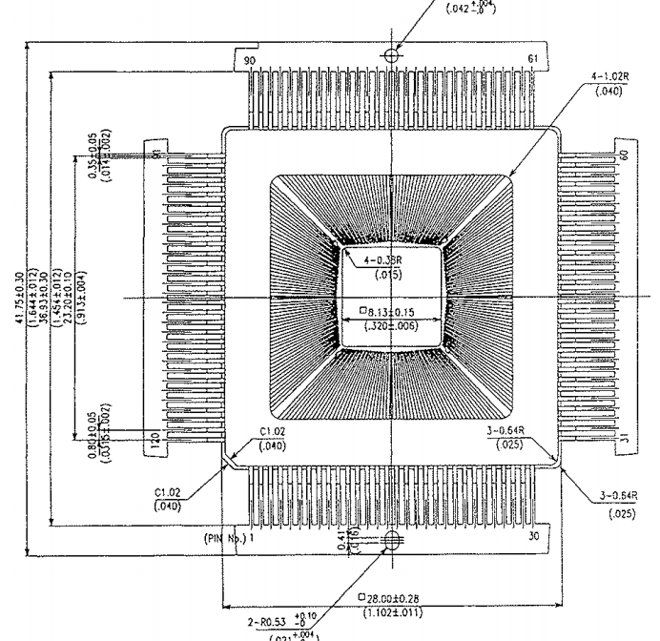
Design of the layout: choice of the package
A 28x28 mm² QFP 120LD package has been chosen. With 30 pins per side, the four corner channels pads are bonded each to the corresponding four edge leads of upper and lower horizontal lines of the frame.
upper line edge lead
upper line edge lead
lower line edge lead
lower line edge lead
Meeting INSIDE, June 9, 2015, Pisa

Slide 5
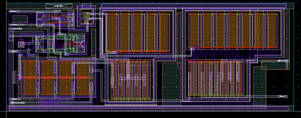
Design of the layout: the single channel 1/2
The main blocks of the single channel are shaped in order to meet the target x-y dimensions of the “finger”.
The single channel is built to accept both SiPM polarity on setting a dedicated digital signal high or low.
P channel
P timing comp
Channel Currents
charge comp
N channel
N timing comp
Meeting INSIDE, June 9, 2015, Pisa

Slide 6
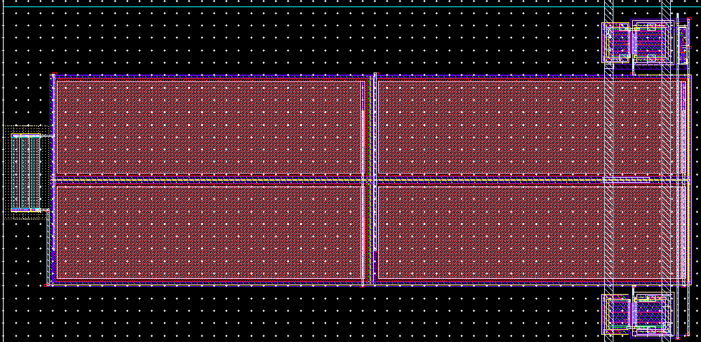
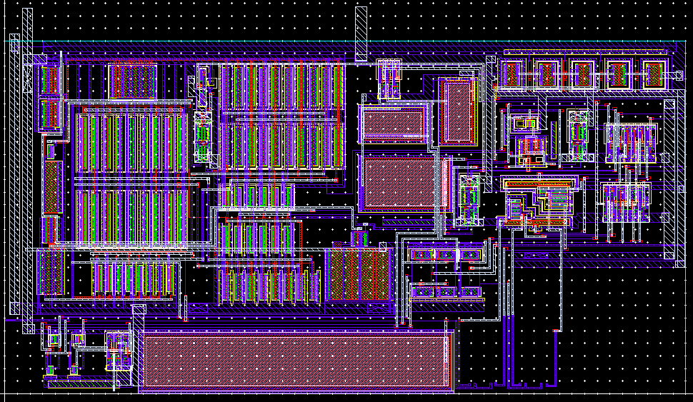
Design of the layout: the single channel 2/2
The integrator-shaper and the Dual Peak Detector are the remaining blocks
P timing comp
P channel
Channel Currents
N channel
Integrator-shaper
Dual PD
N timing comp
P timing comp
(p Event trigger Comparator)
Channel currents
(Current references for channel blocks)
P channel
(p type input stage)
Charge comp
(Charge signal amplitude Comparator)
Buffers
Buffers
Buffers
N channel
(n type input stage)
N timing comp
(n Event trigger Comparator)
Single channel top hierarchy
Meeting INSIDE, June 9, 2015, Pisa

Slide 7
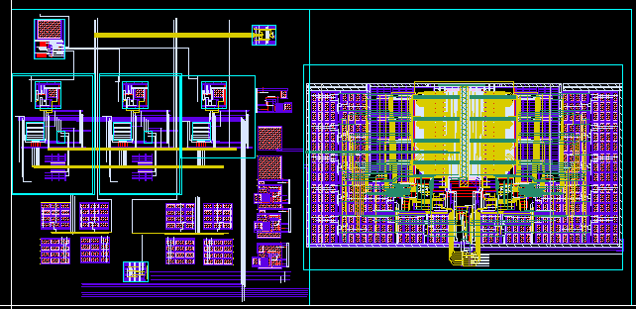
Design of the layout: 10b ADC
Also the layout of the 10bit ADC has been rearranged to fit the floorplan. It has to be routed on top
and post-layout simulated, in order to accommodate for clock issues coming from merging operations
of the 8bit ADC and the pipeline of two 1.5bit ADC stages.
10b ADC top hierarchy
Meeting INSIDE, June 9, 2015, Pisa

Slide 8
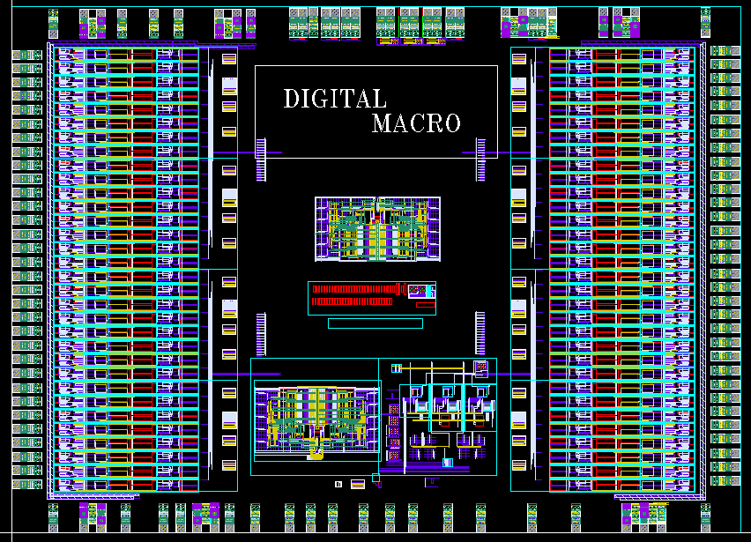
Design of the layout: TOP layout of the 64-channels chip
ASIC top hierarchy
Meeting INSIDE, June 9, 2015, Pisa

Slide 9
Schedule and submission
All the layouts of the analog blocks have been designed in their final version
To be done:
- Generation of the final layout of the digital part
Generation of the pad ring
Top routing, verification and analog top simulation
Realistic estimation: one month and a half of work needed to finish
Next available MPW run deadline: July 27th
GDS database expected to be submitted on that date
Meeting INSIDE, June 9, 2015, Pisa
Notes:
This is the outline of the presentation.
Fist of all, we needed an accurat model of the detector in order to perform reliable simulations at circuit level. So, the classical model of the SiPM has been modified by adding some relevant features which gives remarkable contributions to the electrical behaviour of the detector itself and, moreover we set up a suitable extraction procedure to evaluate the paramenters involved in the model.
After that, different front-end circuit solutions have been compared to find out the most suitable one, considering the SiPM characteristics. Some prototypes of the very first front-end have been realized and some results fromt their characterization will be shown.
The very first version of the f.e. has been equipped with more building blocks and a first version of the complete analog channel has been designed, realized and characterized. Also in this case some measurements results wil be provided.
Next, the design of an 8 channel test chip has been carried out, togheter with the architecture of the digital read-out section. The chip has been submitted to a MPW for fabrication at the end of July and we expect the delivery of the prototypes by the first part of October.
Eventually some possible future work will be described

