Slide 1
INSIDE Motherboard Update
INtelligent Signal Processing for
FrontIEr Research and Industry
E. Kostara^{1,2}, G. Sportelli^{1,3}, E. Zaccaro³, M.G. Bisogni^{1,3}, F. Palla¹
¹ INFN Pisa, ² University of Siena, ³ University of Pisa
Pisa 09-10/06/2015

Slide 2
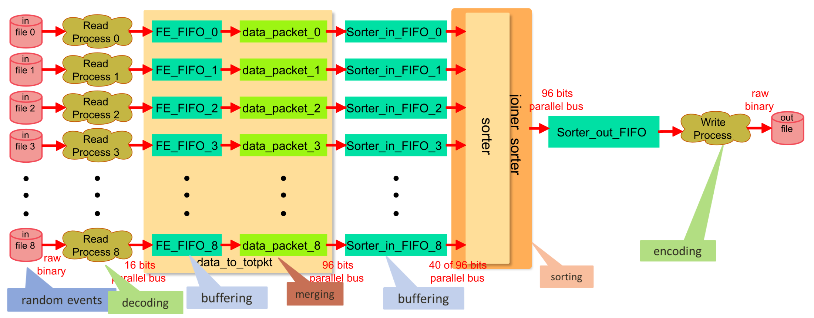
Coincidence Sorter
Simulation on ModelSim
Goal: Minimum throughput rate → 20MHz
Achievement → 28MHz

Slide 3
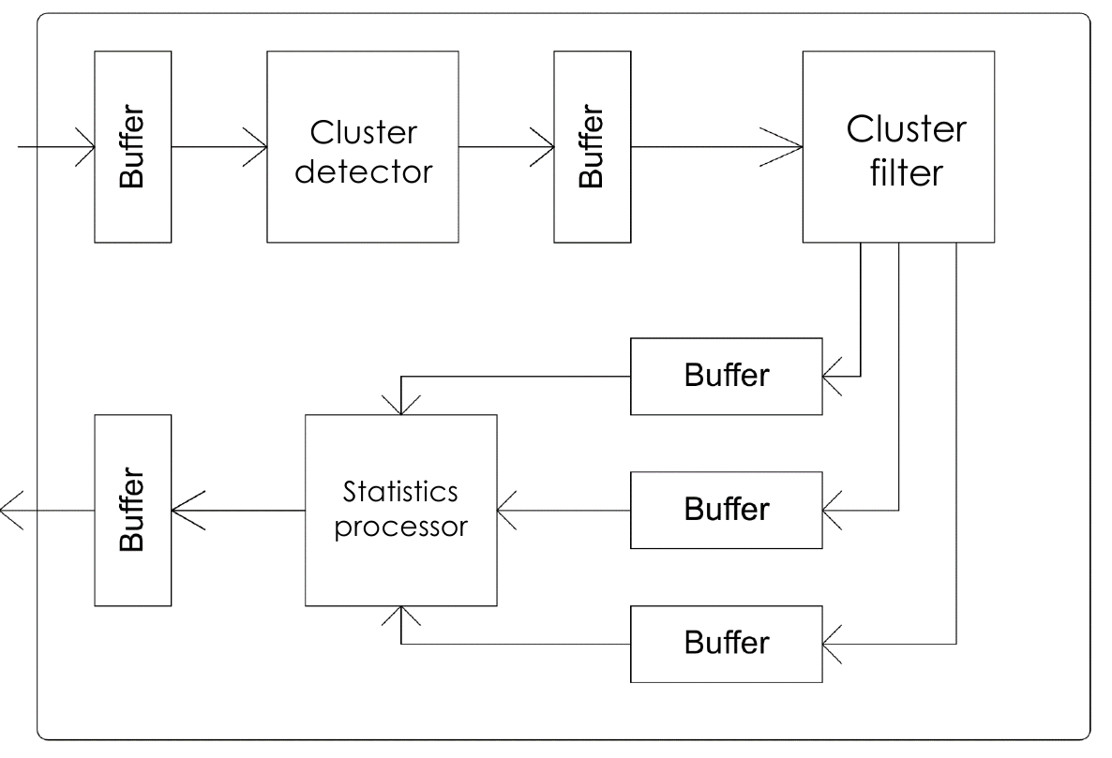
Cluster Filter
Simulated on ModelSim
Run on 100MHz
Write and Read continuously

Slide 4
USB Implementation
Cypress EZ-USB FX2LP device (CY7C68013A)
Adaptation of the firmware used in previous project (QPEM )
Internal 30MHz synchronous clock
Write data from host PC to FPGA
Read data from FPGA to host PC

Slide 5
SPI communication
Simulation on ModelSim
Currently testing on motherboard and debugging

Slide 6
LVDS communication
Simulation on ModelSim
Tested on Sockit board
Works on 160MHz mtbf: >2 days
Next step: on 320MHz
Goal: on 840MHz

Slide 7
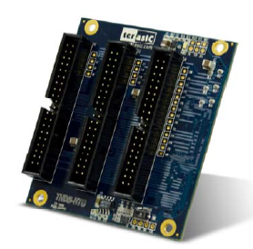
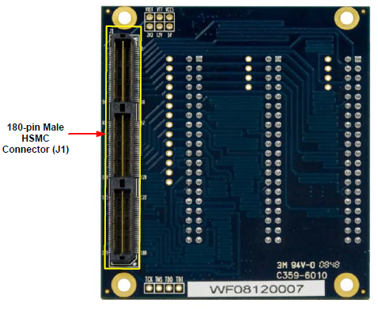
Next steps on SPI - LVDS
Test SPI – LVDS communication:
MB – Sockit board connection using THDB-HTG board
THDB-HTG board
Back side - HSMC version

