Slide 1
INSIDE – Update meeting
PET DAQ
9 June 2015
G. Sportelli on behalf of the INSIDE DAQ workgroup

Slide 2
RX HW development status in the last meeting (04/2015)
Functional design ✔
Schematic design ✔
Mechanical design ✔
PCB design
  Functional design ✔
  IC and connectors placement ✔
  Negotiation ✔
  External company kick-start ✔
Construction and assembly ✖
Expected delivery 7/2015 -> 9/2015
Most recent results are marked in blue

Slide 3
Current work
SoCKit board
  Finish time constraining of ethernet connection ✔
  Develop a HW/SW test framework
Motherboard
  Finish hardware tests (mainly LVDS channels)
  Develop clock management boot-strap ✔
  Re-implement control firmware from DoPET ✔
  Test coincidence sorting ✔
  Develop coincidence filtering ✔
RX board
  Develop complete firmware
Most recent results are marked in blue

Slide 4
ASICs calibration framework
The TX boards need calibration data from the user through the Ethernet interface
Now this is done by a preliminary LabView script developed by Richard
In the final version, the motherboard will perform the same operations as the script
However this is a high-level feature that requires a detailed plan before starting development
Agreed strategy: develop an alternate calibration software at Pisa and use it to test and document in detail the calibration procedure

Slide 5
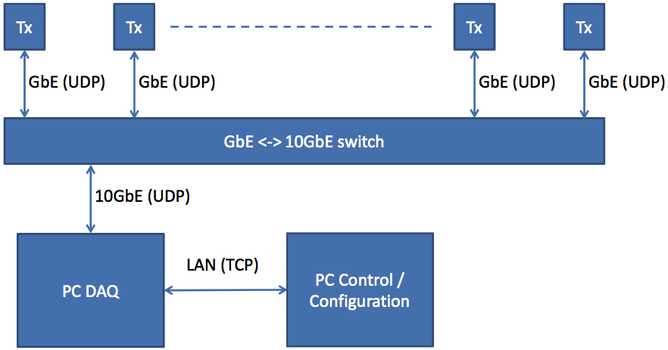
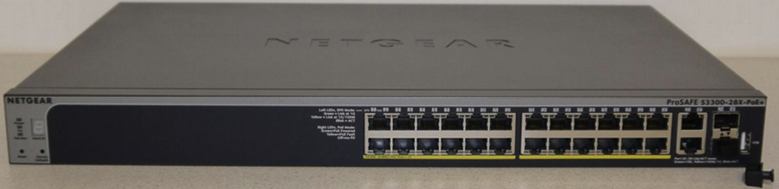
System configuration for
SW-calibration: alternative 1

Slide 6
System configuration for
SW-calibration: alternative 1
Advantages
  no custom FW development
  full-SW based system
  relatively cheap
  part of the development is done already
Disadvantages
  the DAQ workstation might not be fast enough to process events at the expected count rates
  SW development might not take less than the MB-based solution

Slide 7
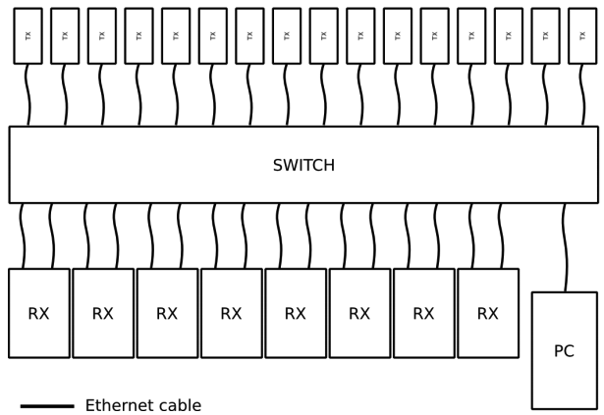
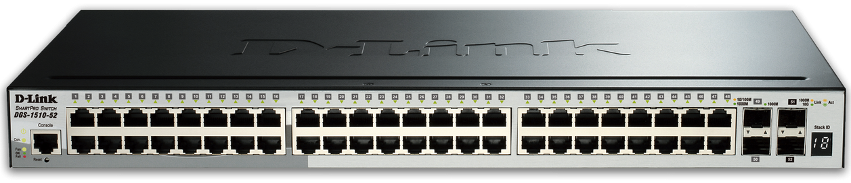
System configuration for
SW-calibration: alternative 2

Slide 8
System configuration for
SW-calibration: alternative 2
Advantages
  FW development reuse
  highest performance
Disadvantages
  relies on contractors deadlines
  relies on prompt and successful HW/FW development

Slide 9
System configuration: final considerations
The two proposed solutions are fully compatible
The strategy will be:
  buy a switch model with 52x1GbE ports plus 1x10GbE port
  develop in parallel at Pisa and Torino the SW-based and MB-based DAQ
  develop the system calibration SW at Pisa

